Slide 1
Summary , schedule, cost and resources (and DAQ not covered elsewhere)
Flemming Videbæk
BNL

Slide 2
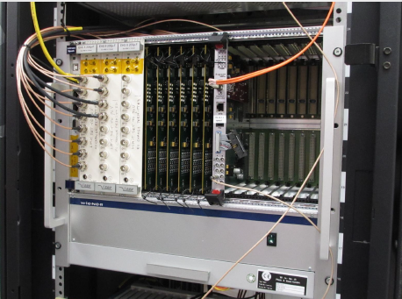
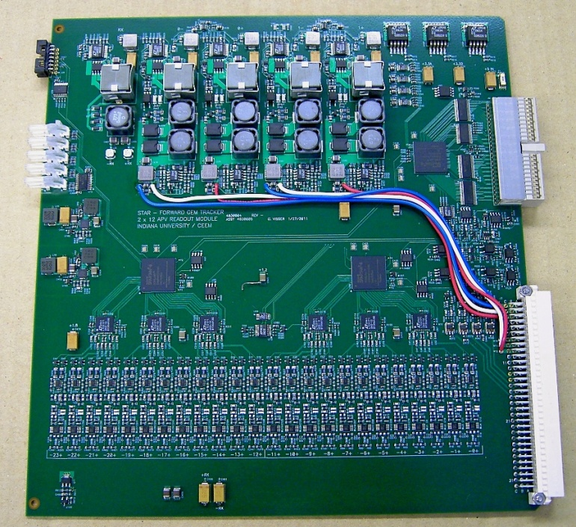
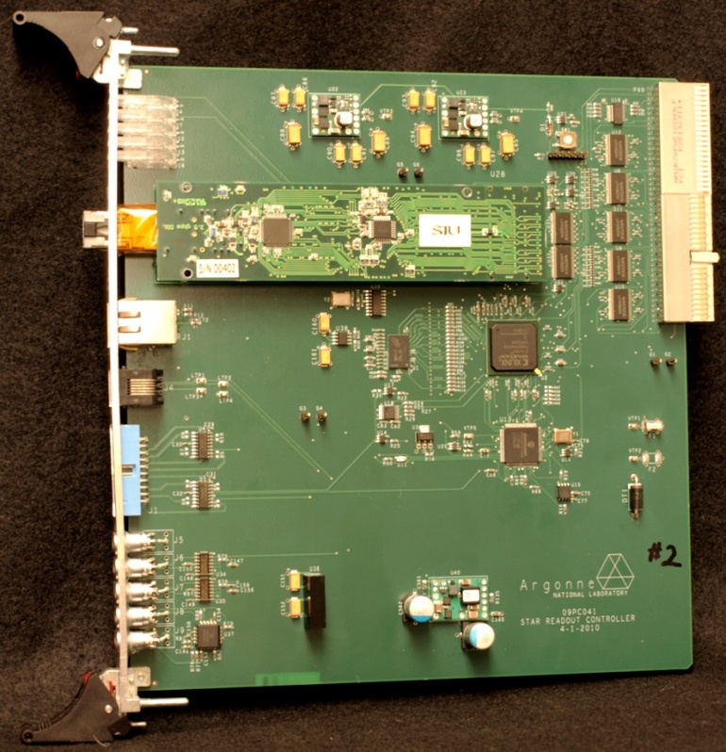
STAR Forward Silicon Tracker – Crates, ARC, ARM
Custom-designed DAQ system in a WIENER MPOD HV-cPCI mainframe
3 crates, 6 ARCII, 36 ARM for IST sitting on STAR platform ready to use for FST
72 outer signal cables and patch-panel boards for IST reserved as well. (36 needed)
36 patch panels. 36 available.
Need to make new inner signal cables for FST
HV
ARM
ARC

Slide 3
Status & plans for DAQ system
The Full system of crates and ARM,ARC boards was exercised in mid September 2019. No issues found
Smaller system are used routinely at test stand at UIC for readout of prototypes
Slow control for FST; primarily HV still need to be integrated back into STAR; small changes relative to IST operation
Long signal cables must be re-installed in STAR

Slide 4
FST construction workforce
NCKU
Mechanical Structure and Assembly, QC
Han-Sheng Li, Pu-Kai Wang, Yi Yang
SDU
Hybrid and T-boards
Maowu Nie, Jianing Dong
UIC
Si-sensors, Assembly with FNAL, Module testing and QC
Zhenyu Ye, Xu Sun, Andres Aguilar, Gavin Wilks, Shenghui Zhang
BNL
Support Structure, integration, testing
Rahul Sharma + STSG+electronics group, Pritwish Trebety, Yu Hu, Flemming Videbaek

Slide 5
Schedule
Procedure – reevaluation after prototypes assembly
Input from Zhenyu, Yi, Maowu, Rahul
Procurement of Si delayed particular since the inner sensors could not be tested until now. Longest lead time
As was noted by mini-PAC report FST has substantial delays compared to original plan.
Difficulties to get required flatness and accuracy on module sedges
Covid-19 (less of impact, but none the less)

Slide 6
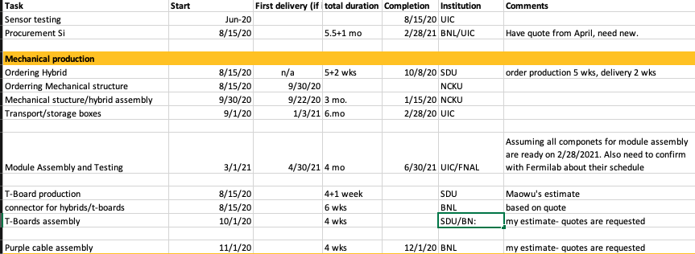
Schedule input I

Slide 7
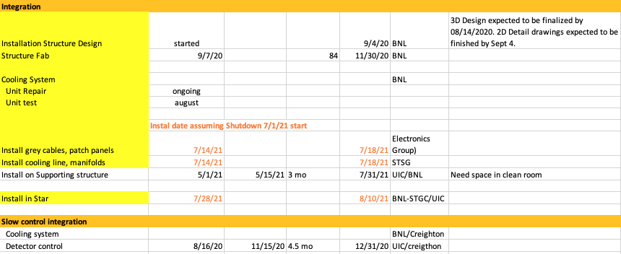
Schedule input II

Slide 8
Time lines

Slide 9
Milestones
 | As shown in Feb -- Now
Prototype assembly | 2/28/20 -> 7/25/20
Module testing | 4/30/20 -> 8/15/20
Production (ordering) | 5/31/20 -> 8/15/20
1st batch of Hybrids | 7/31/20 -> 10/8/20
1st batch of mechanical structure | 9/31/20 -> 9/30/20
1st batch of sensors | 12/31/20 -> 2/28/20
Assembly complete | 4/30/21 -> 6/30/20
Supporting structure
Design and Fab | (9/31/20) -> 11/30/20
Installation on support (start) | 5/1/21
FST in clean room complete | 6/15/21 -> 7/31/21
Install in STAR | 7/15/21 -> 8/20/21
The table is Zhenyu’s table
Based on info gathered recently as provious two slides
Assumes that production can proceed mid August
Assume run-21 ends July 1, 2021

Slide 10
Costs
Item | Inst | Estimate | note
Si-Sensors | BNL | 280k$ | Quote from April
T-board connectors | BNL | 5.7k$ | Quote
T-Board assembly | SDU/BNL |  | Quote requested
Cable assembly | BNL |  | Quote requested
Hybrids | SDU | In-kind
Mechanical + assy. | NCKU | In-kind
Transport boxes | UIC
Si mounting and wire bonding | FNAL ( UIC) |  | SOW with BNL; Not enough funds; Requested estimate
Support structure | BNL | 50k$ | First estimate from Rahul
Cooling Lines | BNL | ??

Slide 11
Readiness review for production
Need to procure Si sensors asap; only just being tested inner sectors
Large purchase – need to ensure the are no open ends
Will have a ½ day review on 8/3 Monday
Committee, all non-STAR BNL people
Jim Stewart
Jim Mills
Gerrit van Nieuwenhuizen
Paul o’Connor
Grezgor Deptuch

Slide 12
Agenda
Introduction -> Zhenyu Ye (15’) Detector requirements Design concepts Module Mechanical production -> Yi Yang (25’) Hybrids Mechanical sector production Assembly Tests and QA
Hybrid production and QC – Maowu (15’) Prototype module assembly and performance - Xu Sun (25’) Module assembly at FNAL Tests and QA at UIC (procedures) Performance from the tests Performance in simulation based on the measured response (?) Mechanical integration -> Rahul Sharma (25’) Requirements, Design Support structures Detector support interface Cooling system Summary and Outlook - Flemming Videbaek (25’) Electronics, DAQ and Slow Control Schedule, Milestones, Resources

Slide 13
Summary
The FST schedule is tight; feasibility do depend on the run/shutdown schedule for run-21 that is yet not determined.
The prototyping has revealed several issues that are almost all solved.
The Si-design is frozen at this point!
Awaiting review for major procurements to go ahead

