Slide 1
FTT Module design, production and test
Qian Yang/ Yingying Shi
Shandong University

Slide 2
Outline
Full Size Prototype
Full size prototype design and production procedure
Full size prototype performance test
Pentagon Prototype
Pentagon prototype design and production status
Summary

Slide 3
Full size prototype design, production and performance test

Slide 4
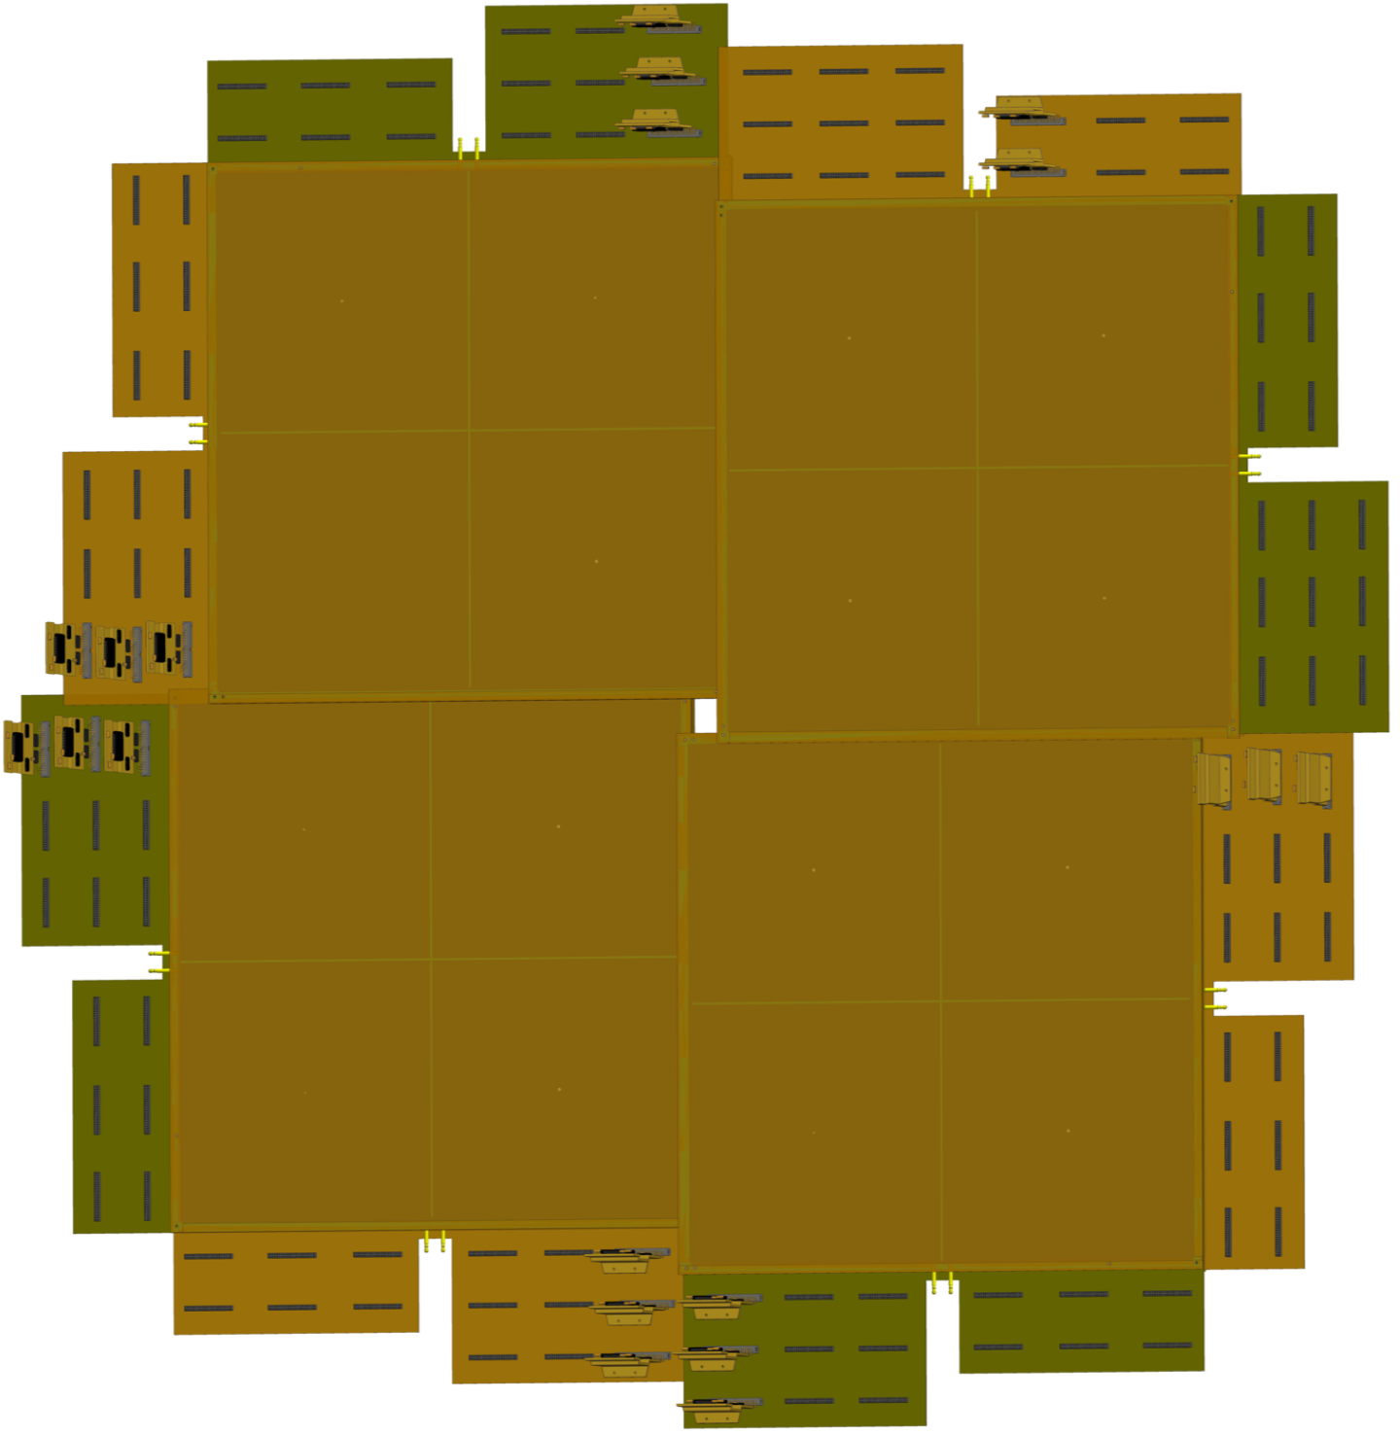
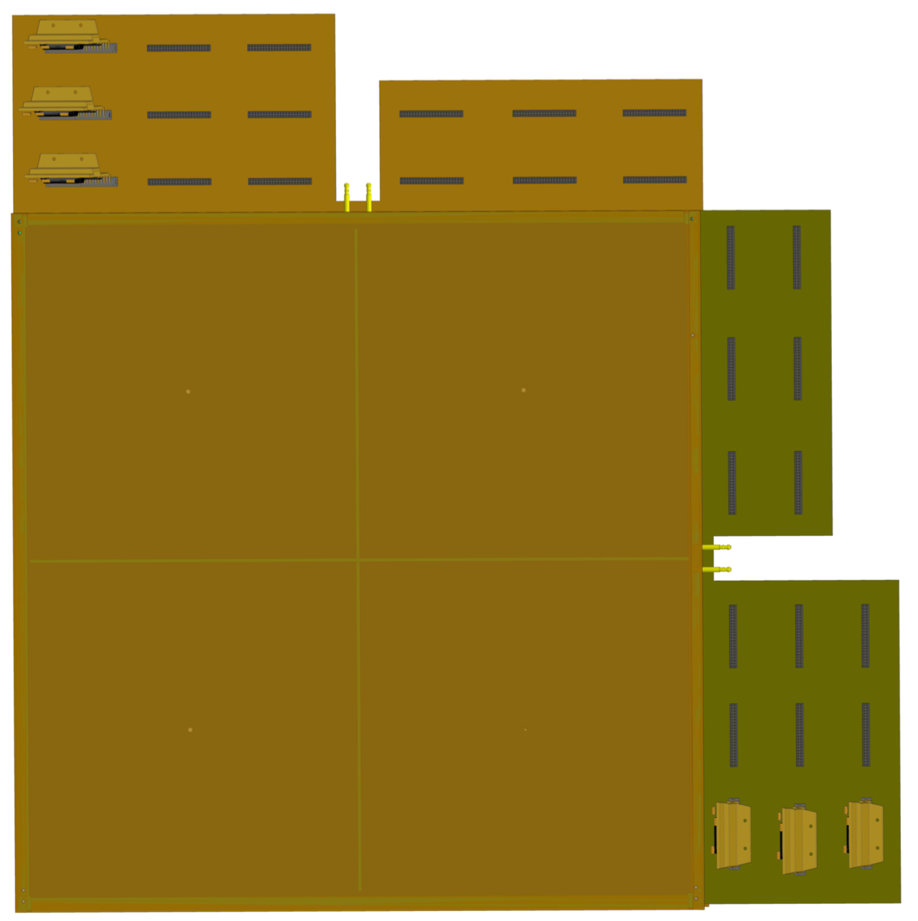
Full size prototype design
FEE
Station
60cm*60cm active area
Endcap view for the whole layer

Slide 5
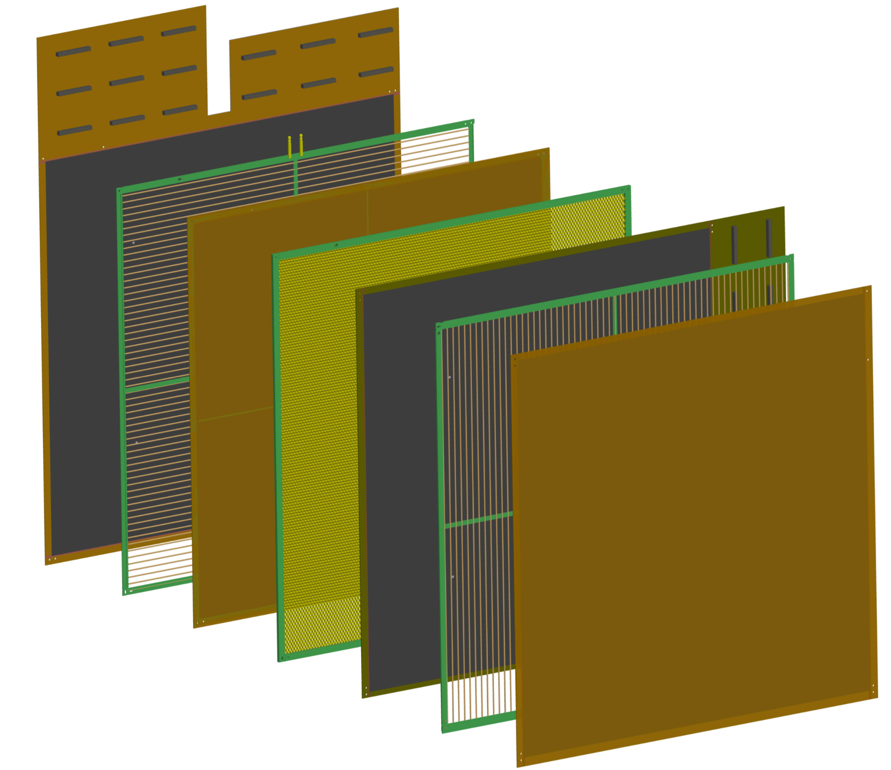
Full size prototype design : station structure
Strip plate ( FR4 + Copper strip + Graphite)
Anode wire plate ( 50$μm$ gold-plated tungsten wire)
Cathode (copper pad )
Honeycomb plate (60cm*60cm)
FEE slot
Chamber1
Chamber2

Slide 6
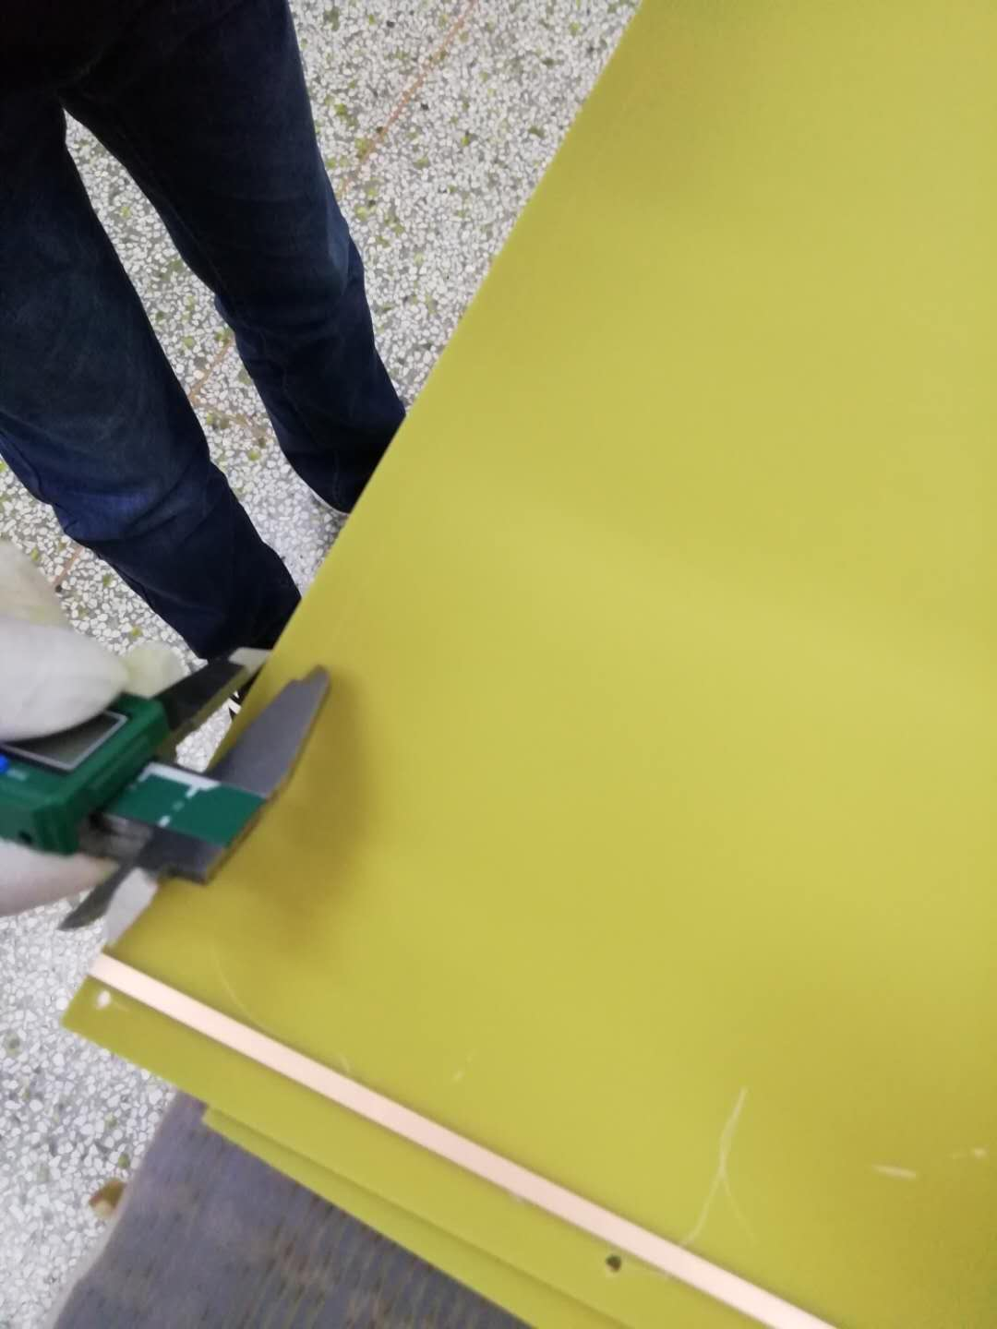
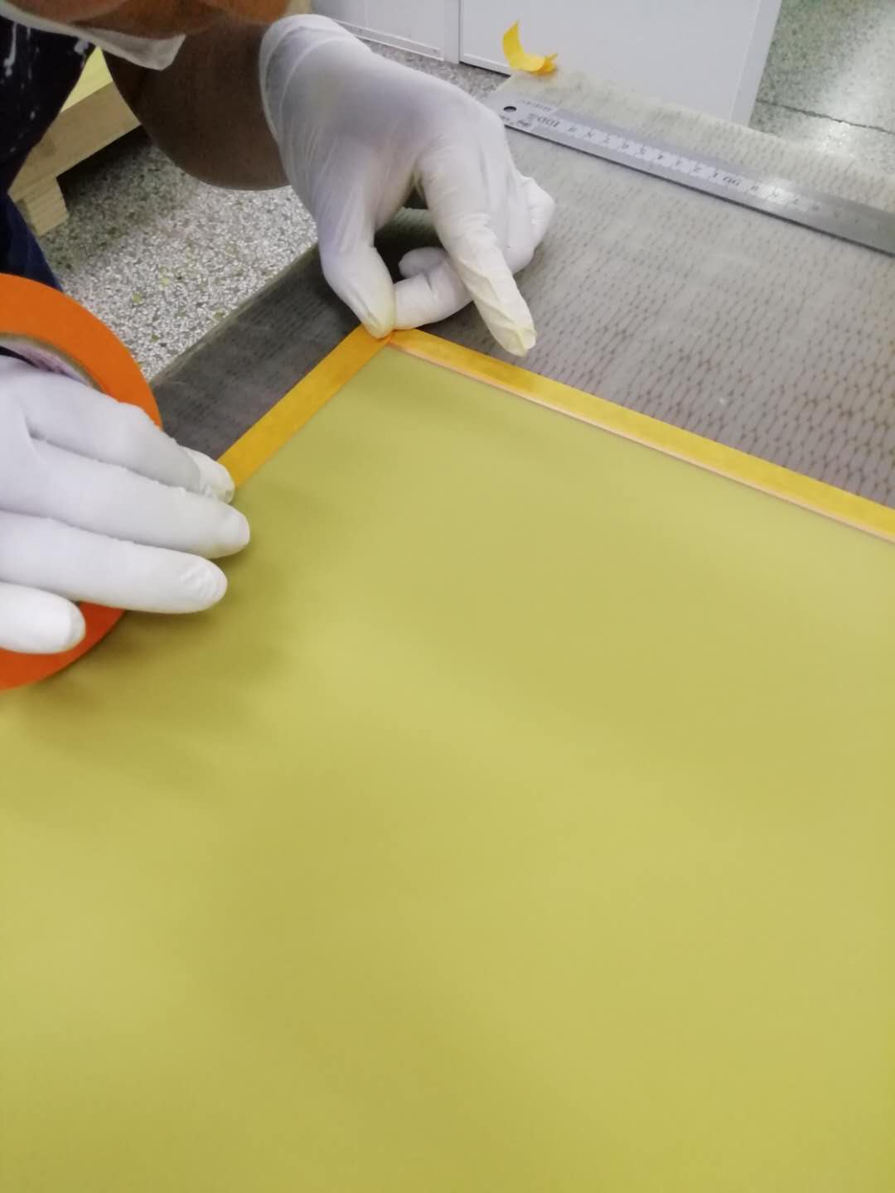
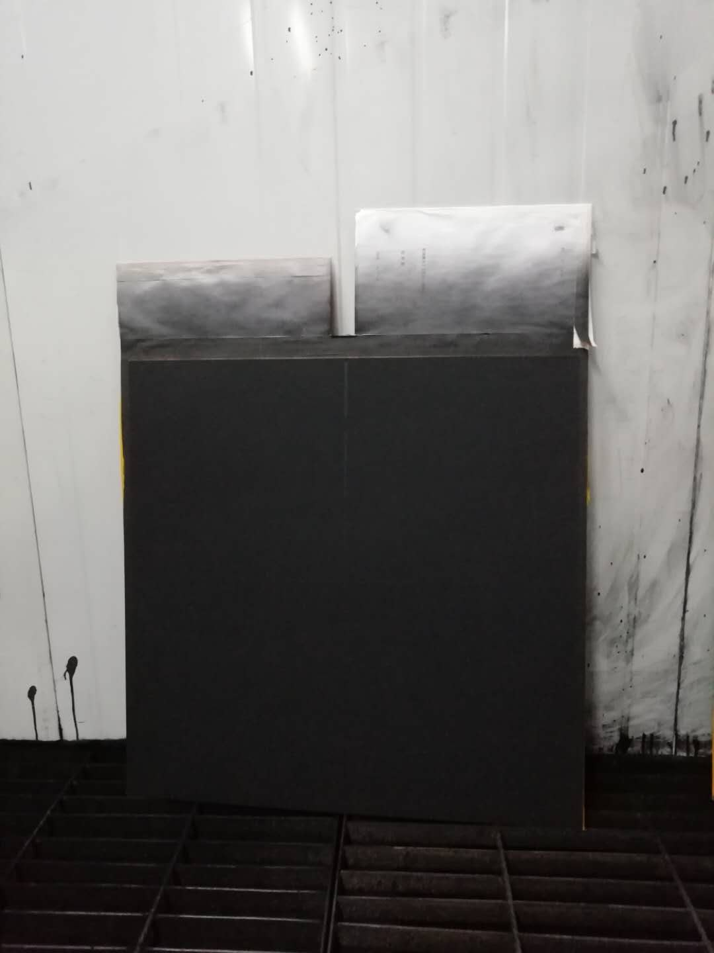
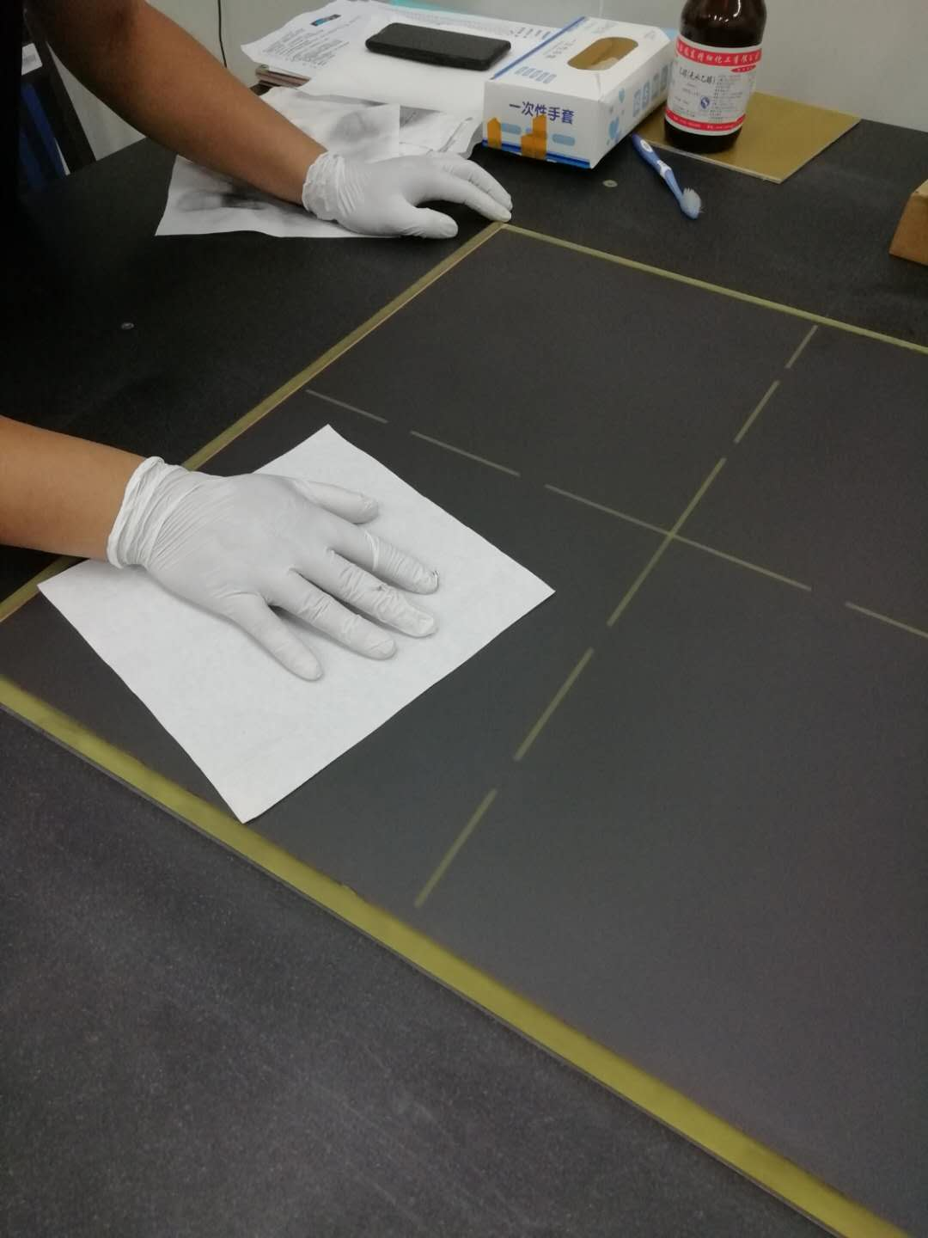
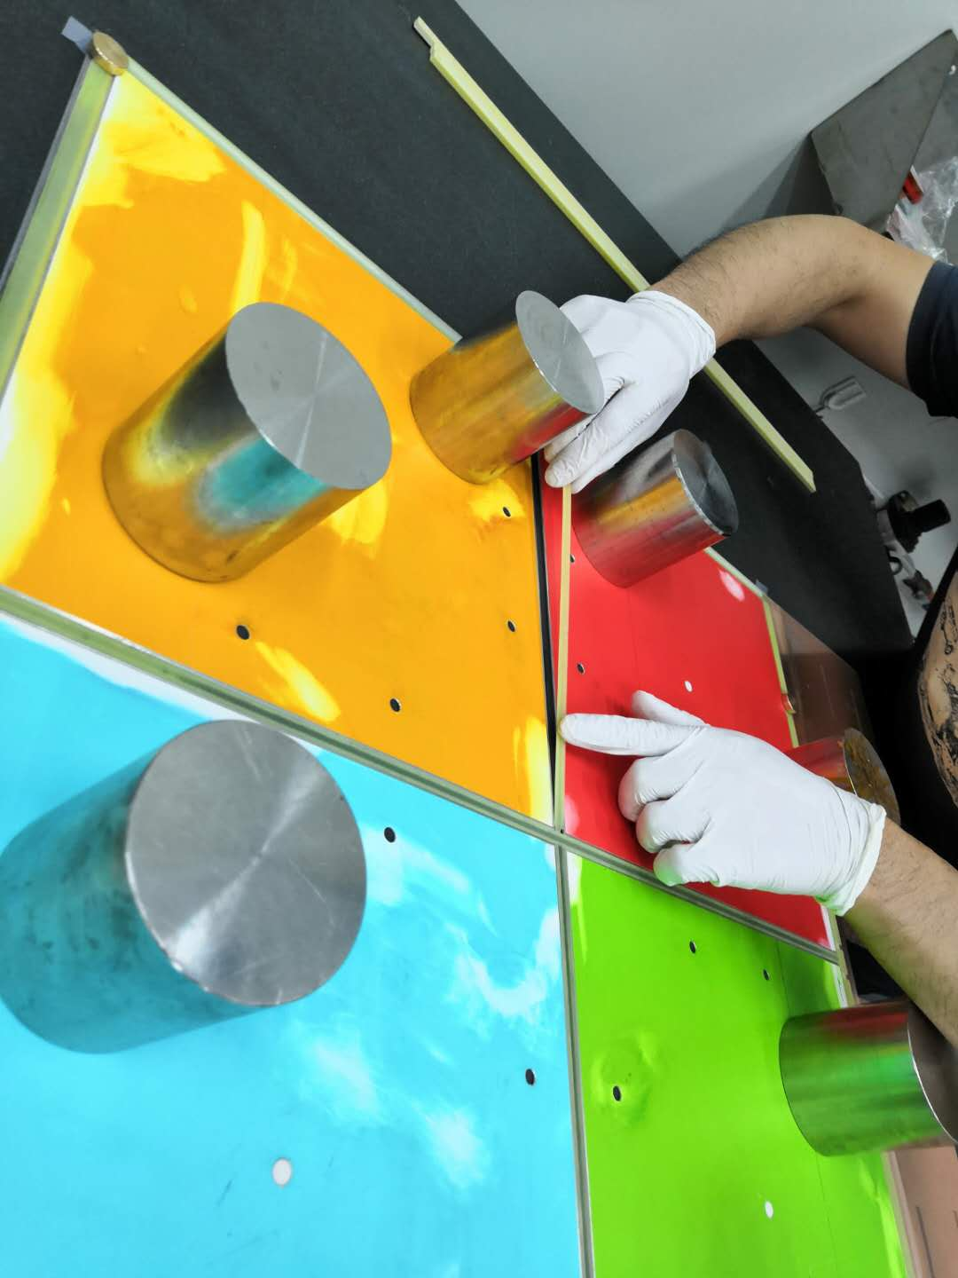
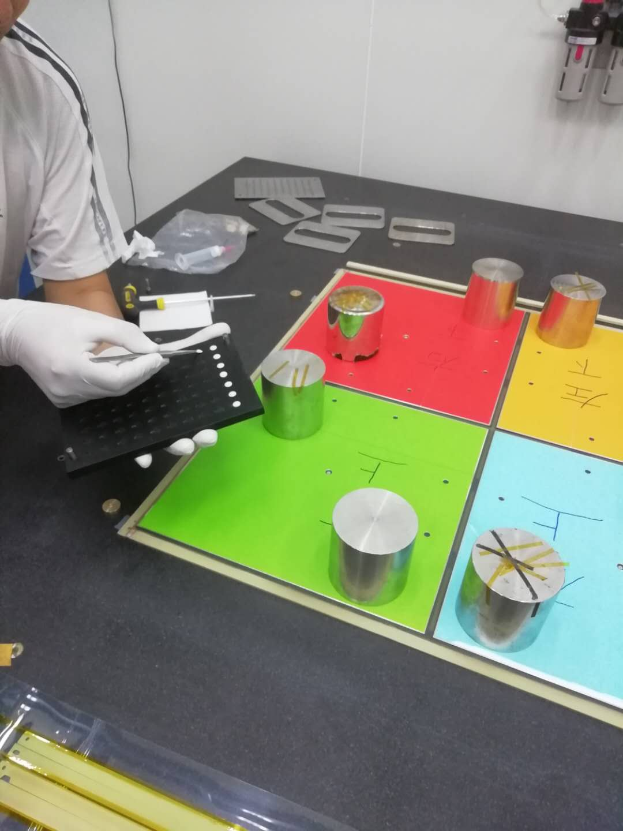
Full size prototype production : chamber production
1⃣️
2⃣️
3⃣️
PCB inspection
Tape support strip area
Spray graphite: Graphite : Plastik-70 = 3:1
4⃣️
5⃣️
6⃣️
Polish graphite to $1{60−240k/2.5cm}^{2}$
Support strip installation
Buckle installation

Slide 7
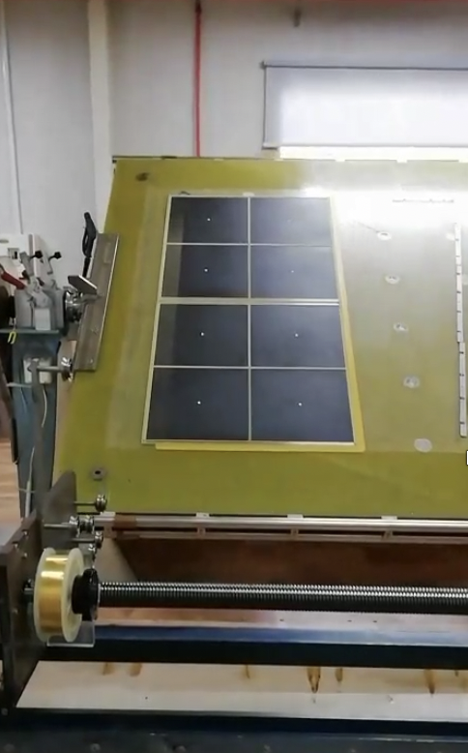
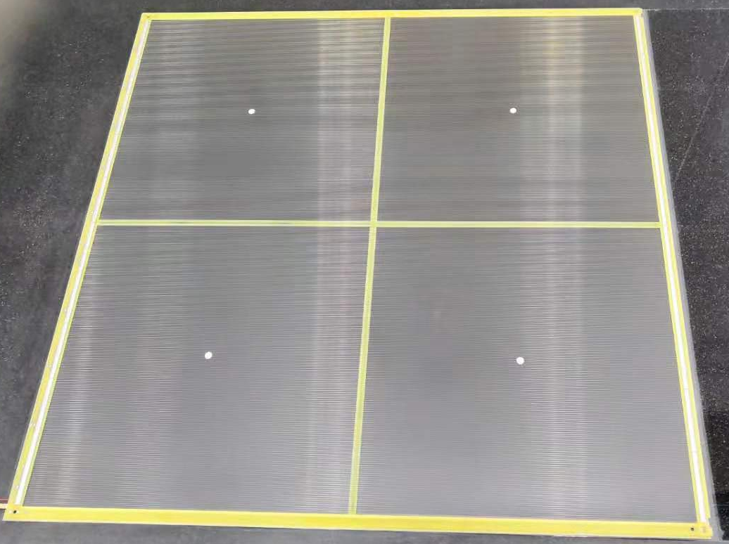
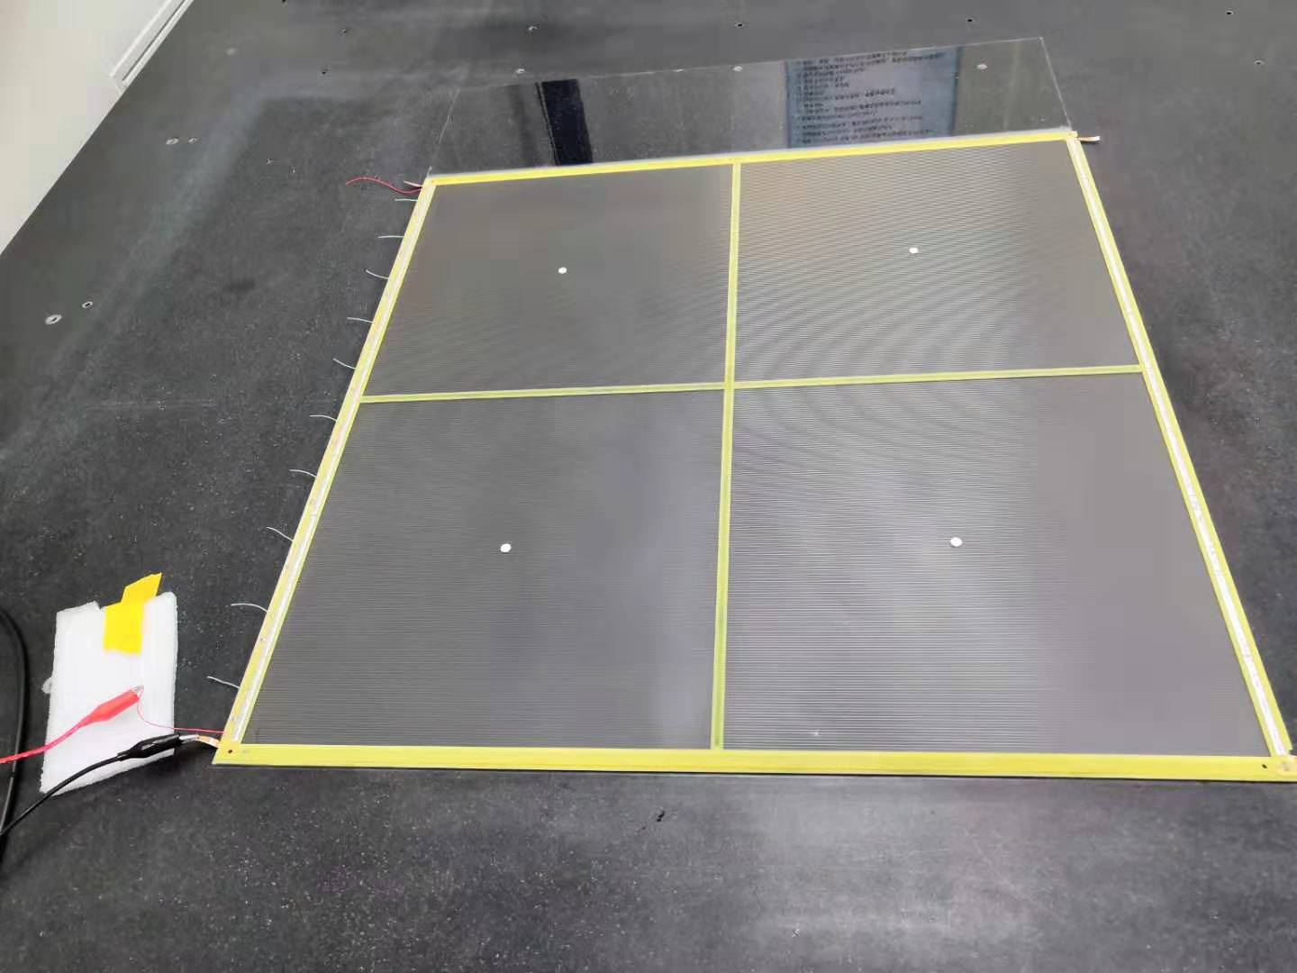
Full size prototype production : chamber production
7⃣️ Wire winding
8⃣️ HV scan
Anode:
50μm gold-plated tungsten wire
340 wires with a pitch of 1.8mm and a tension of 350g
The resistance is 10MΩ
high-voltage 3100v
Monitoring anode wire current <100nA is qualified

Slide 8
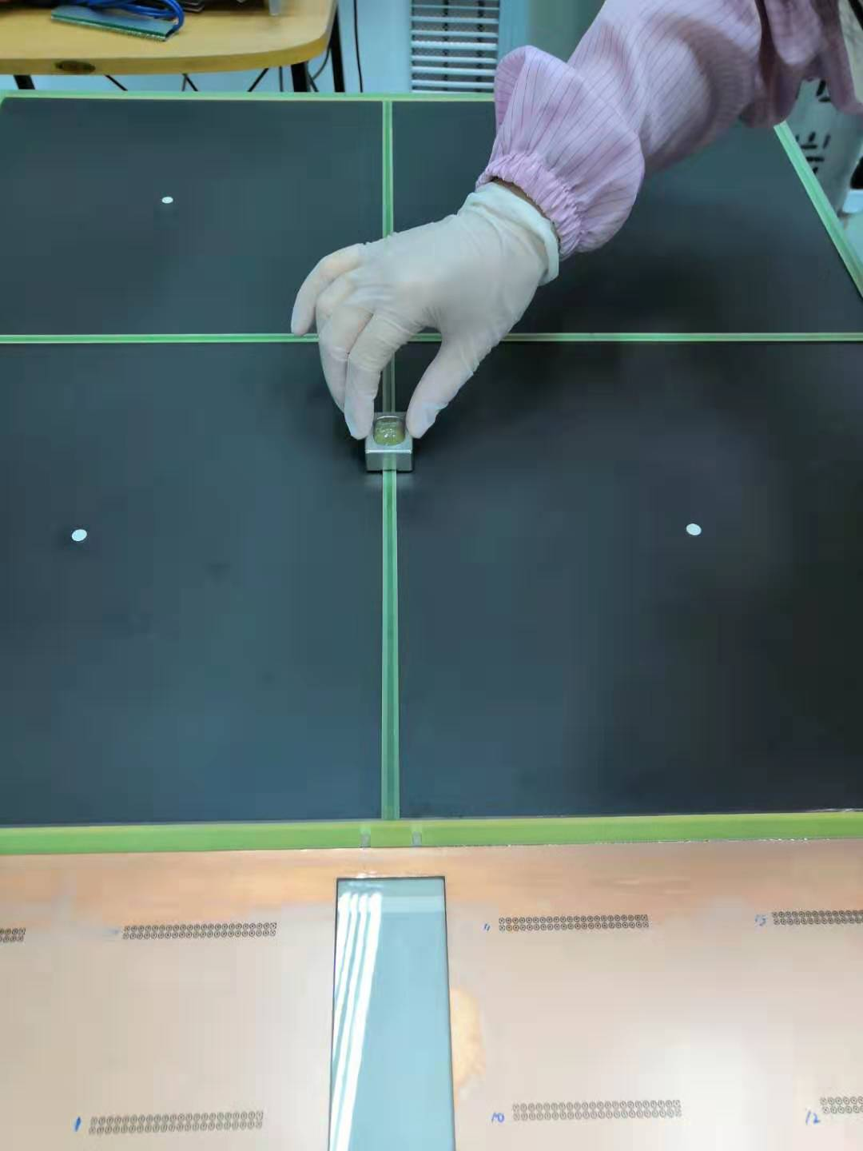
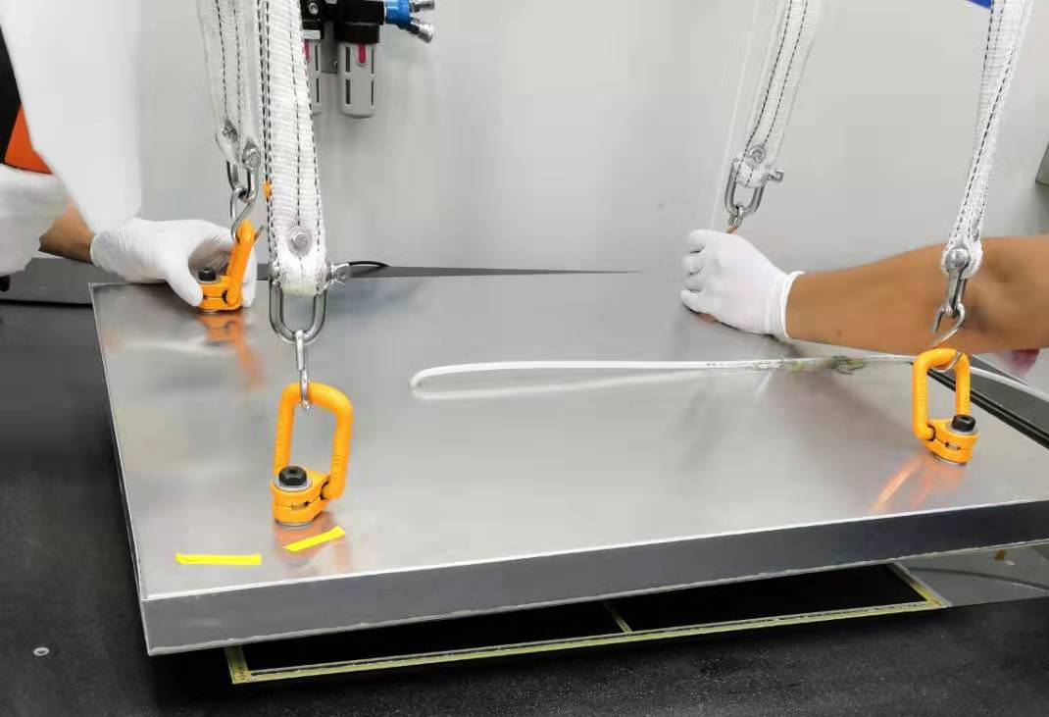
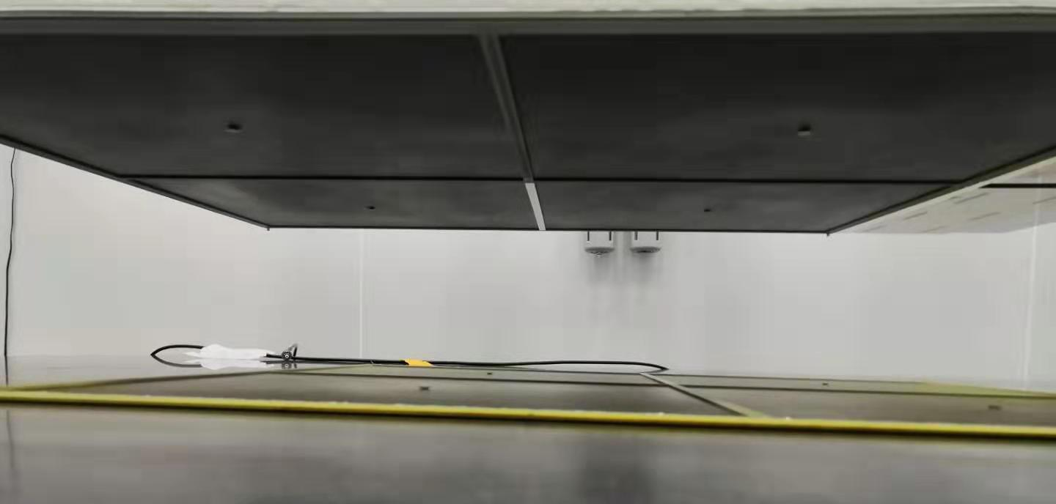
Full size prototype production : chamber production
9⃣️ Gluing
🔟 Synthesize
The chamber is under a force of 40 kilograms, which is about 11g/cm2
Follow with CO2 for about six hours

Slide 9
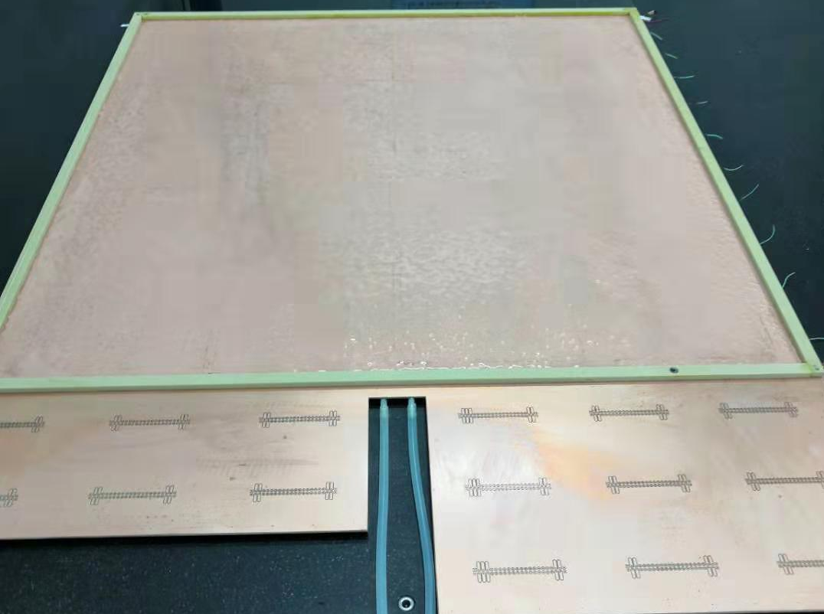
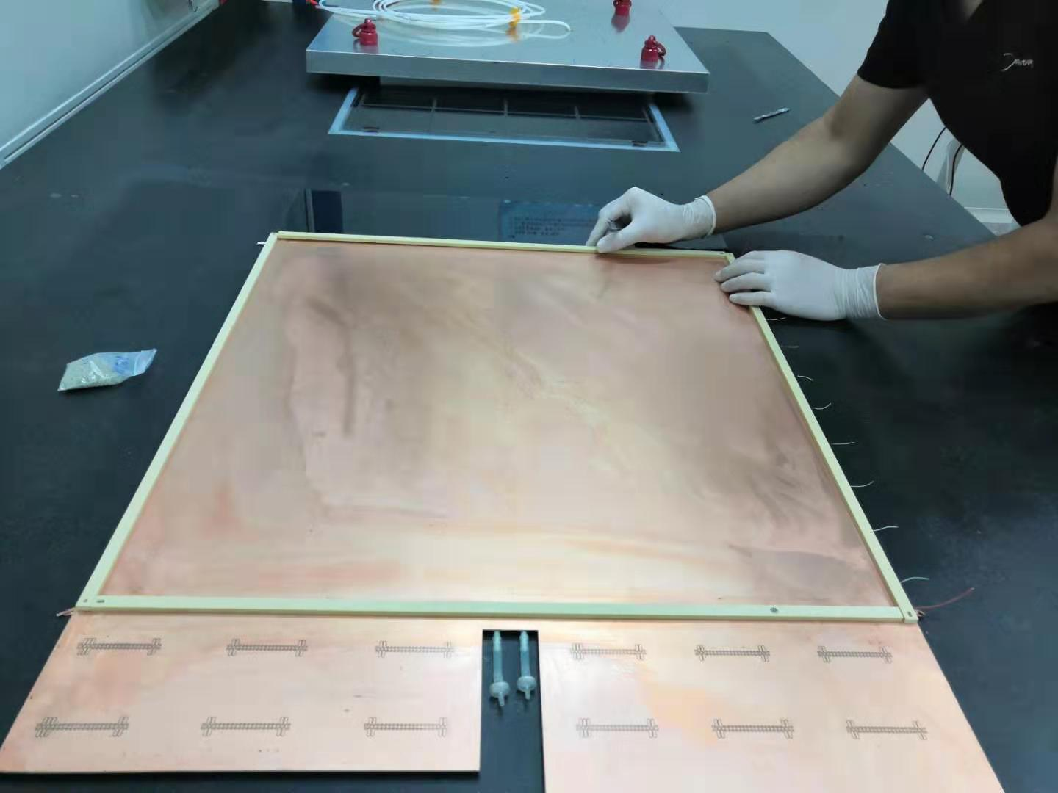
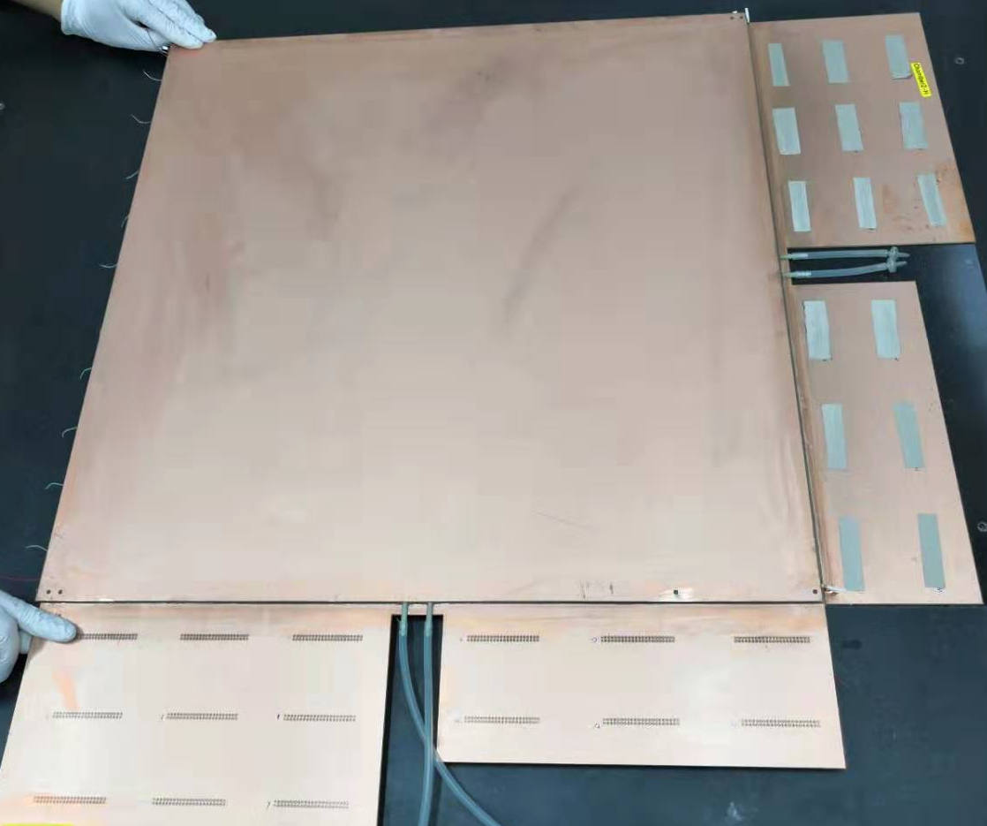
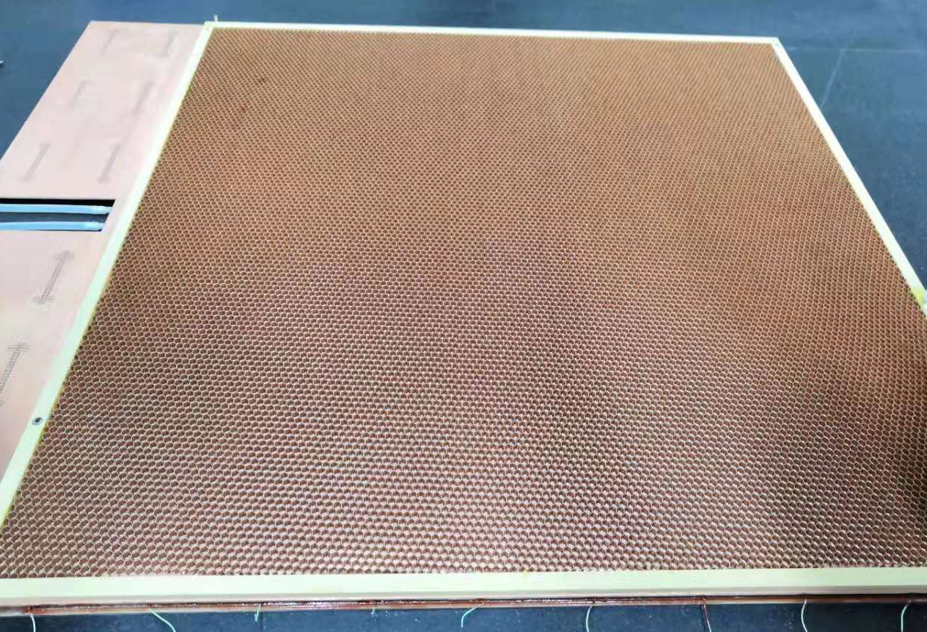
Station production
1⃣️
Install support strip
2⃣️
Gluing
3⃣️
Add honeycomb board
4⃣️ Synthesize

Slide 10
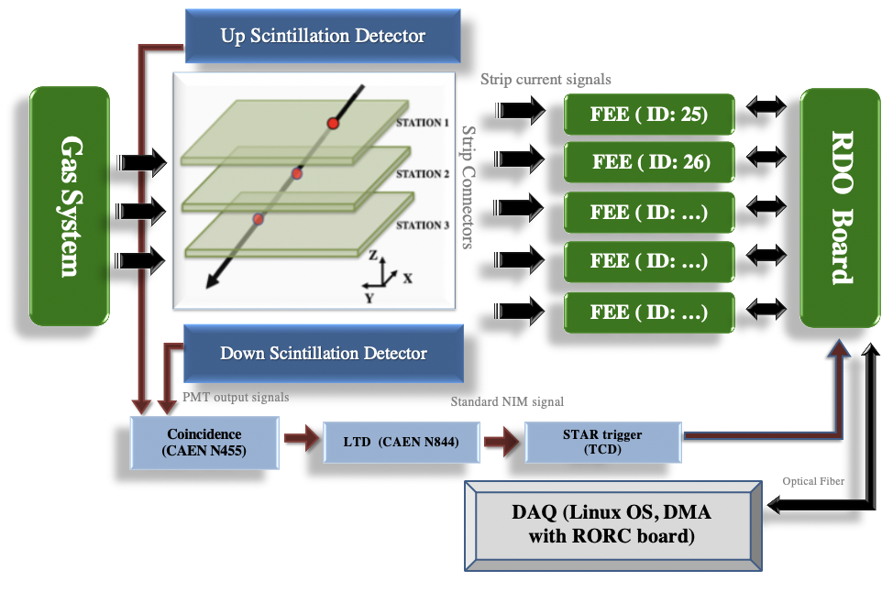
Test System
Readout area: 22*10cm²
Gas: 45%n-Pentane + 55%CO₂
HV: 2700V

Slide 11
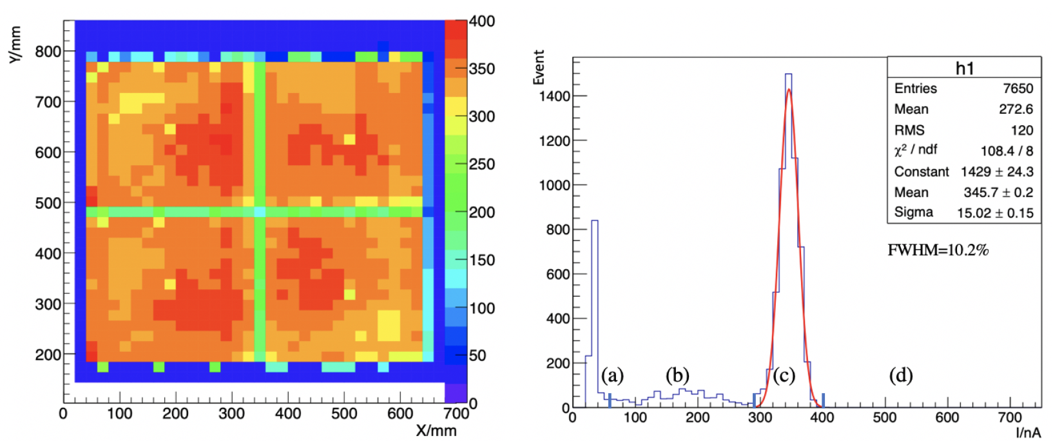
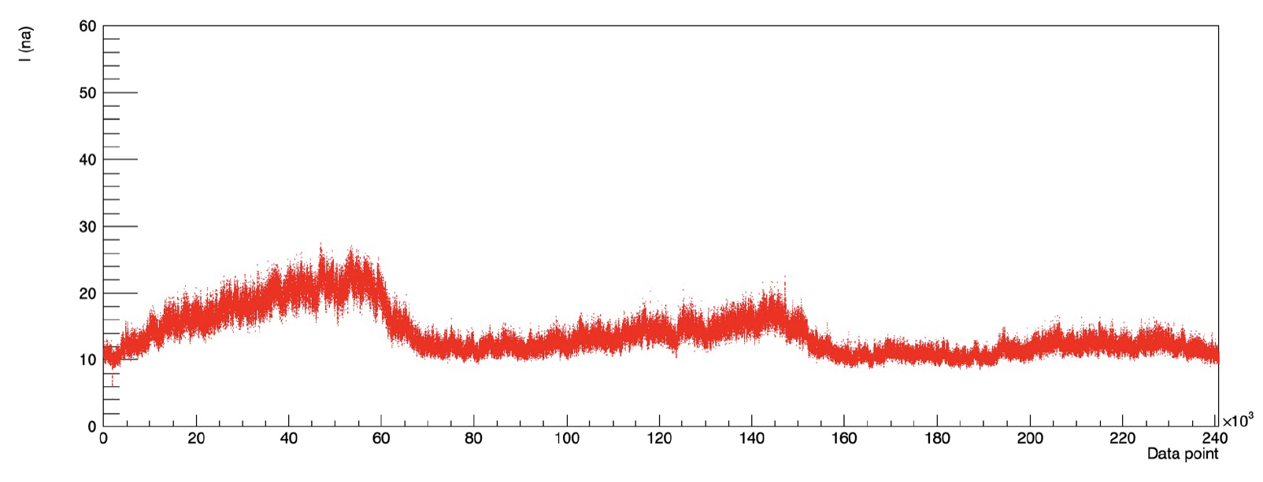
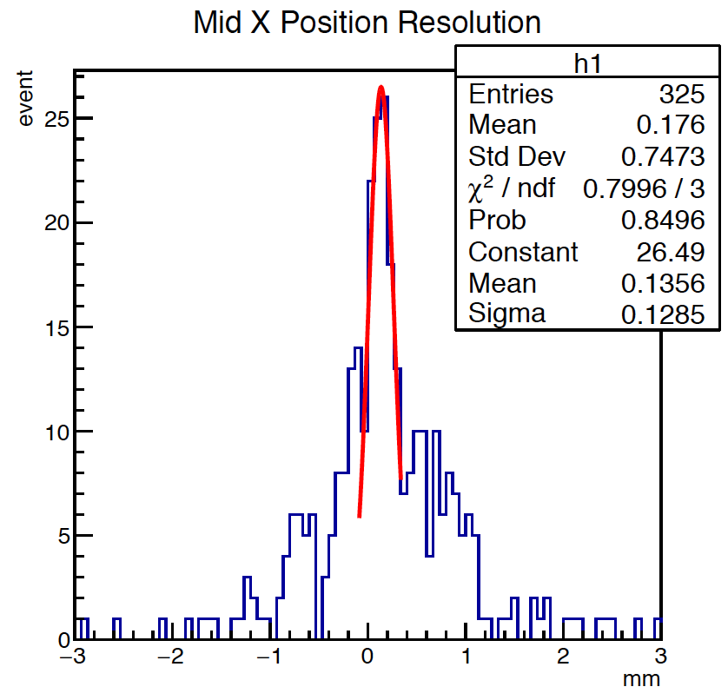
Detector performance
X-ray scan
Long time leakage current tracking
Position distribution w/o alignment
Detector efficiencies at the level of 98%

Slide 12
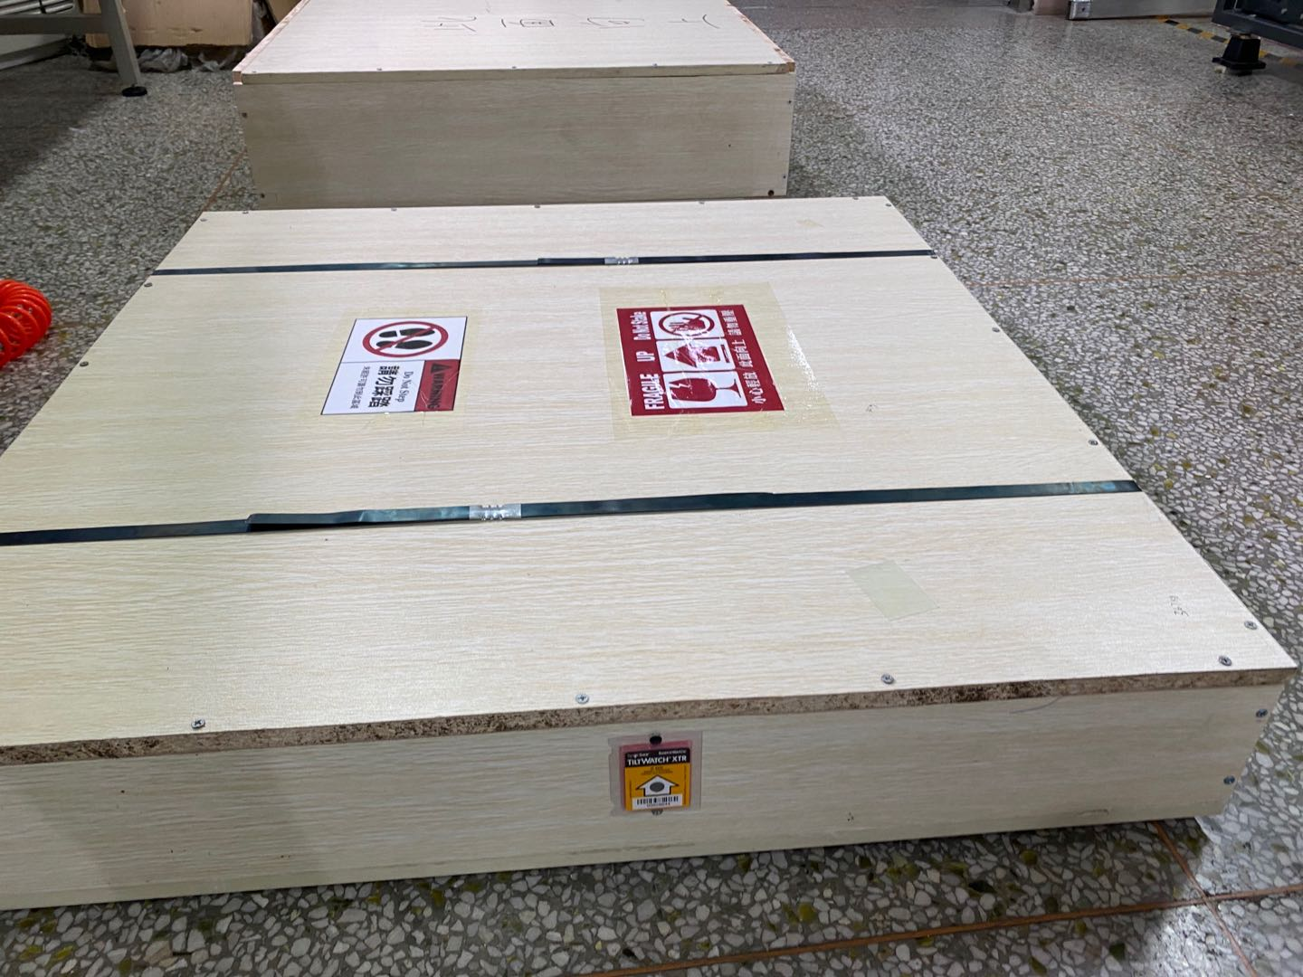
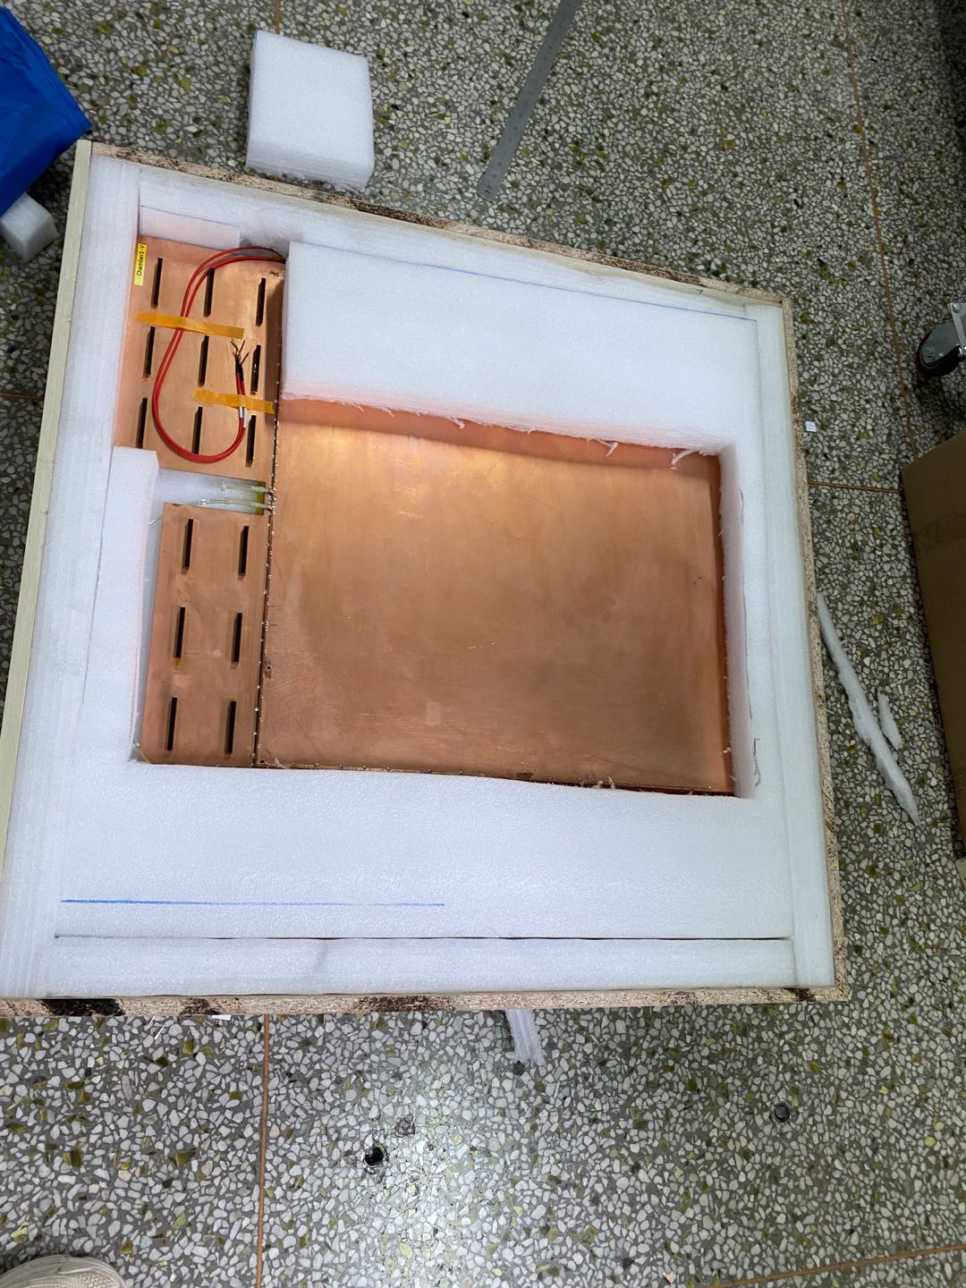
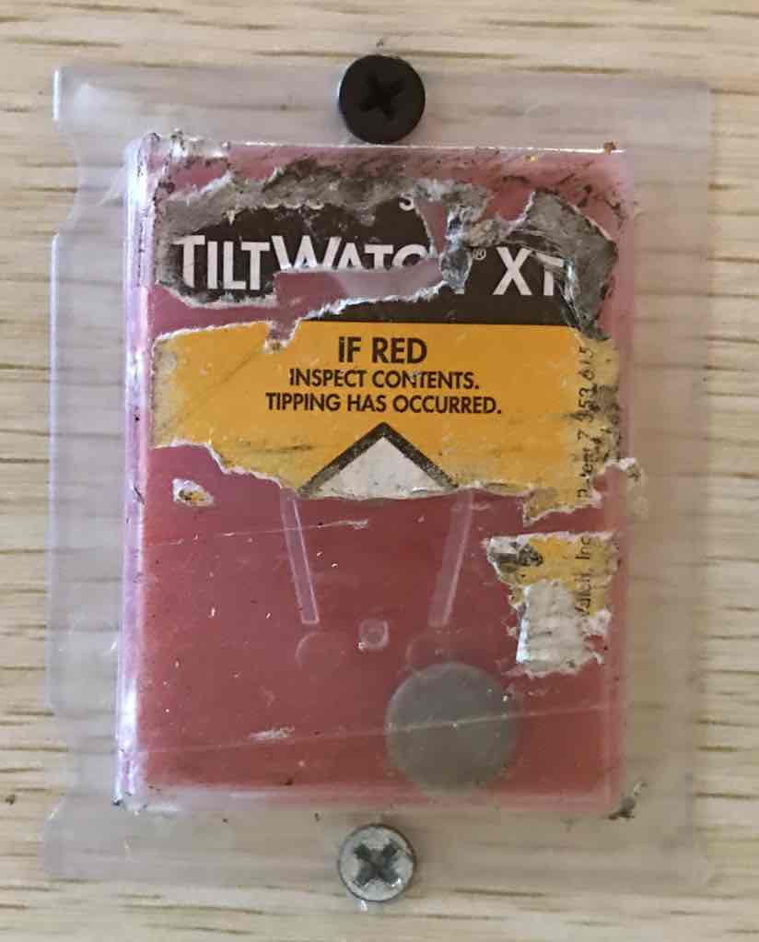
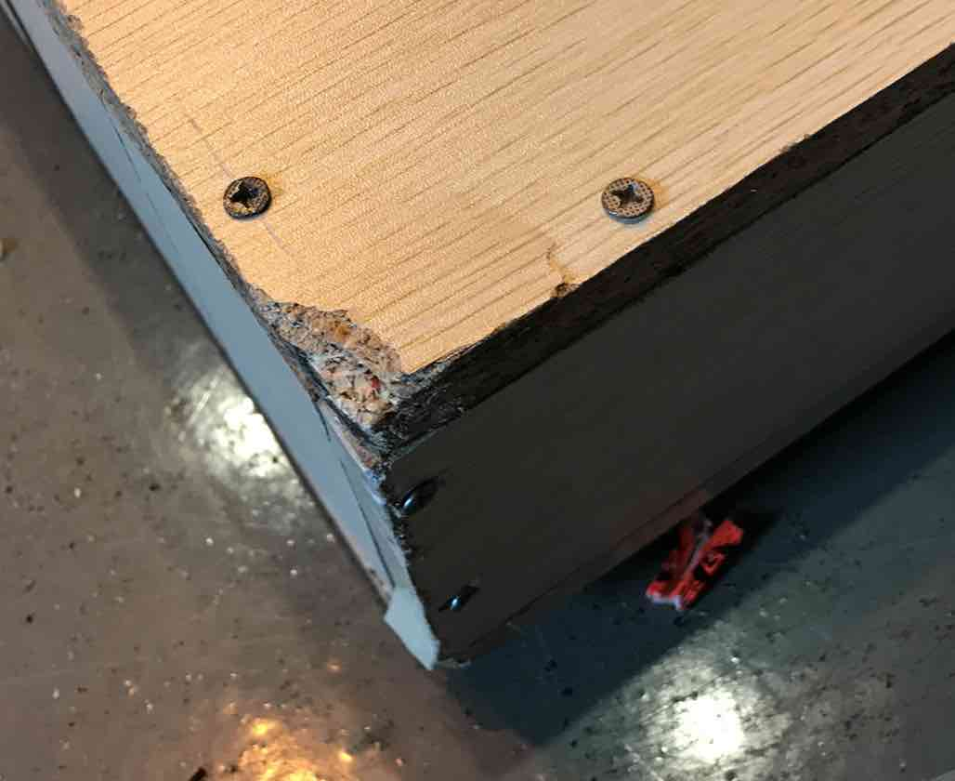
Detector shipping
Full size prototype has been shipped to BNL in June

Slide 13
Pentagon prototype design and production status

Slide 14
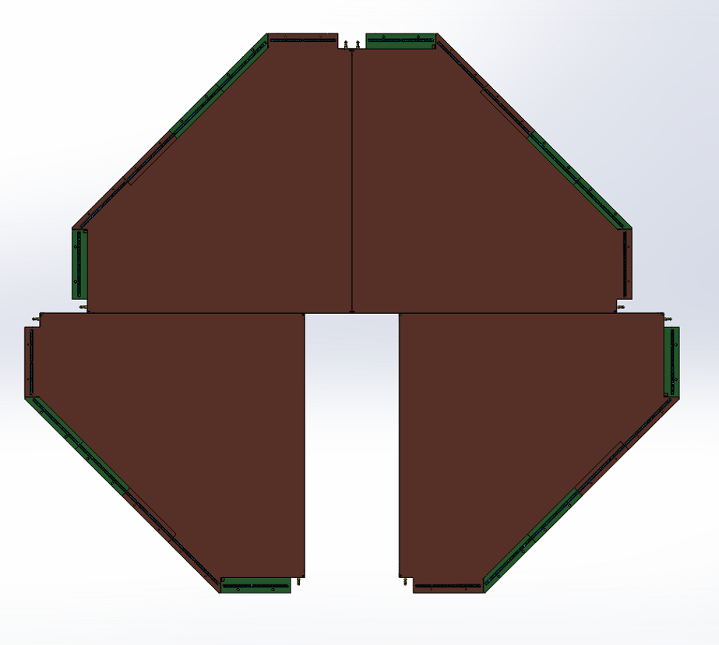
Pentagon prototype design
x
Station
Endcap view for the whole layer

Slide 15
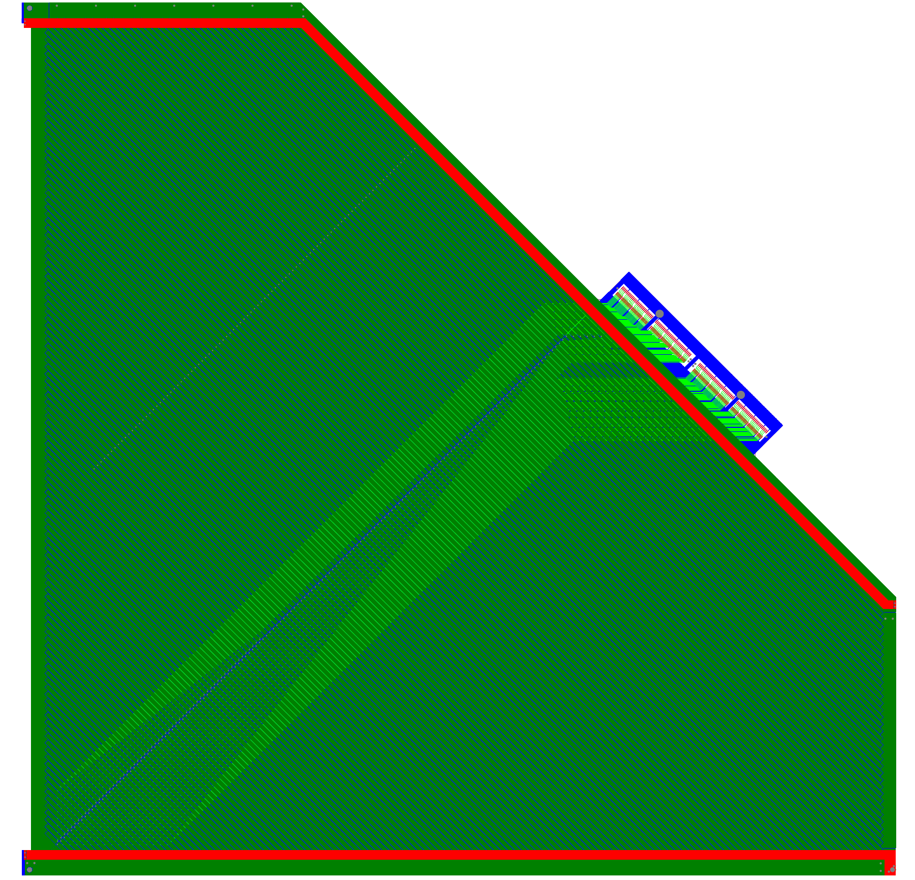
sTGC geometry
sTGC layout-side-view
Cathode
1.4mm
Anode wire
1.4mm
Cathode
x
Anode: 50$μm$ gold-plated tungsten wire, wire pitch 1.8mm, the wire tension 350g;
Cathode: graphite epoxy mixture
Readout: copper strips (0$°$ and 45$°$ ); 0$°$ strips are perpendicular to anode wires; 45$°$ strips for ghost hits rejection

Slide 16
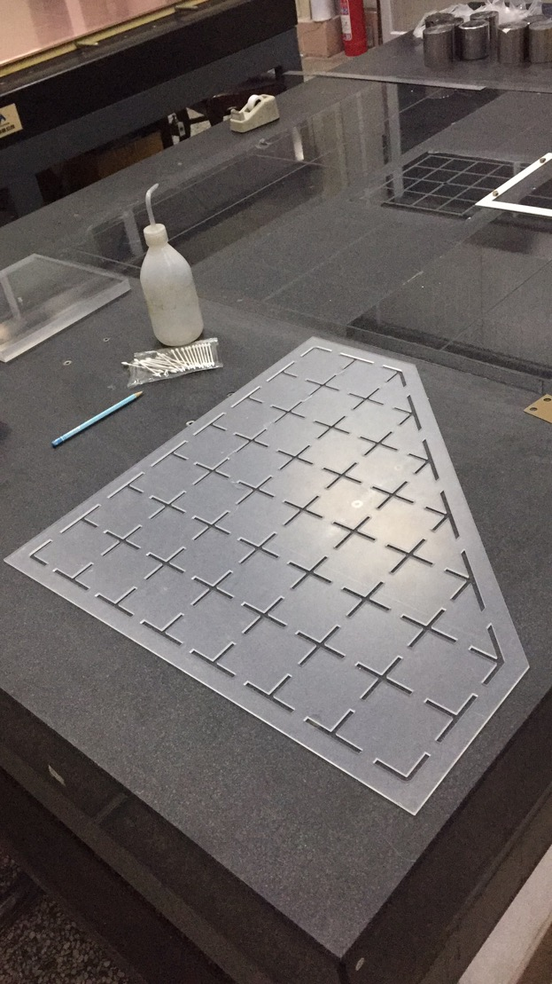
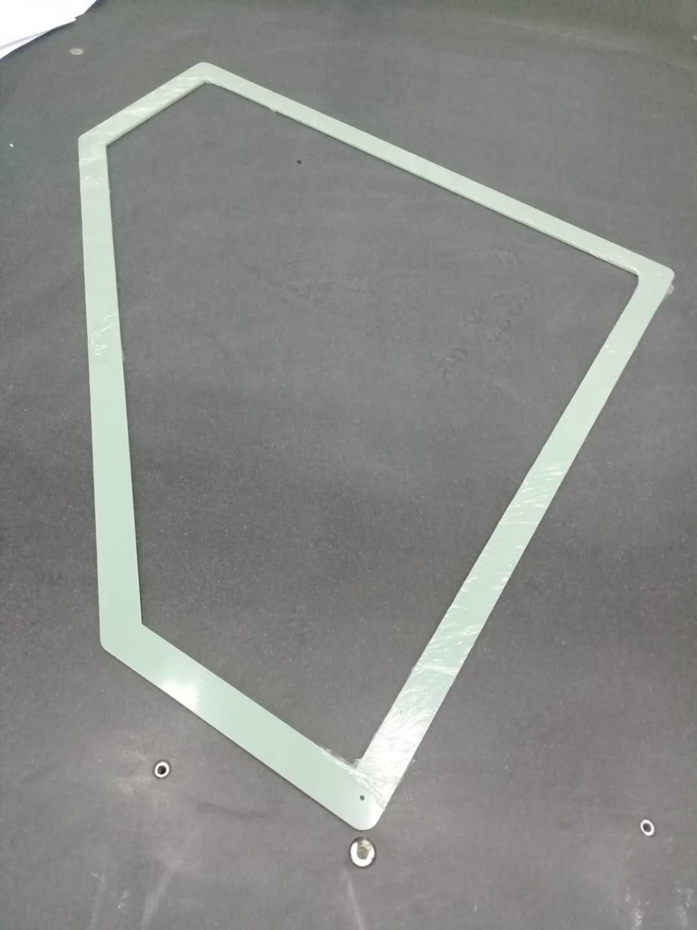
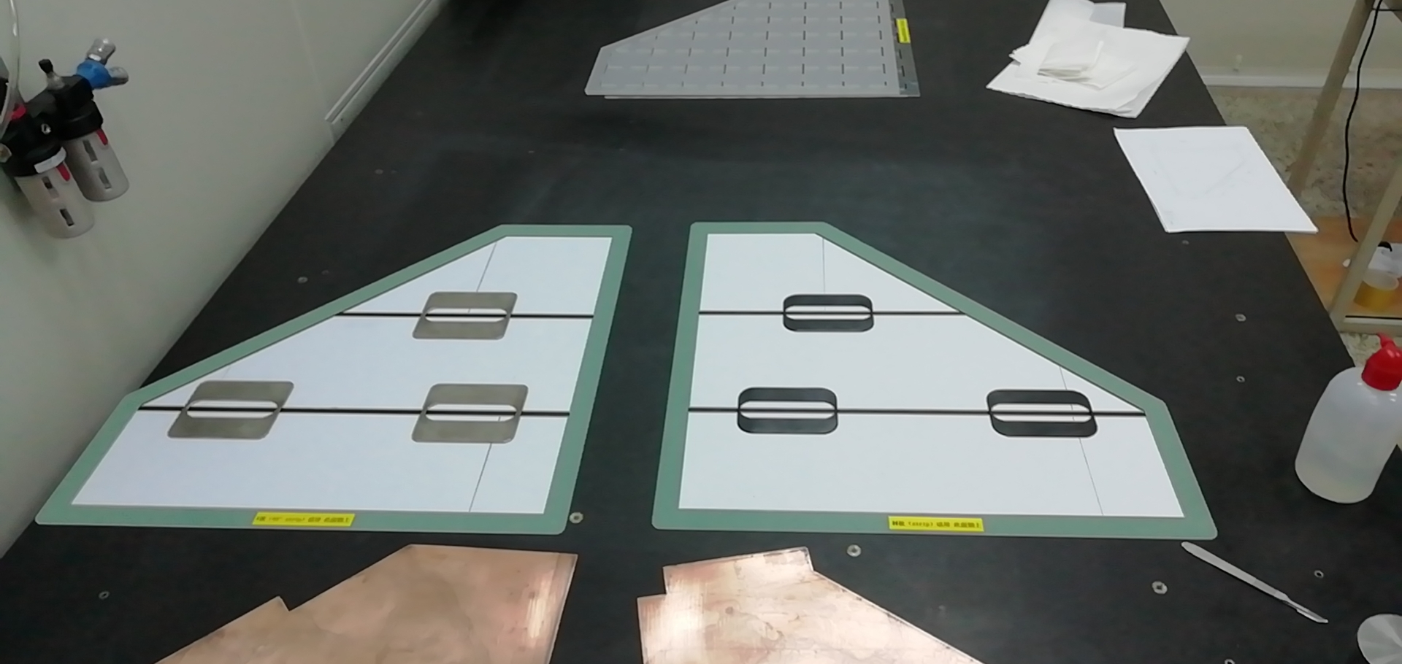
Tooling for pentagon sTGC production
Location-frame for graphite edge
Location-frame for graphite edge
Vacuum tool on marble table

Slide 17
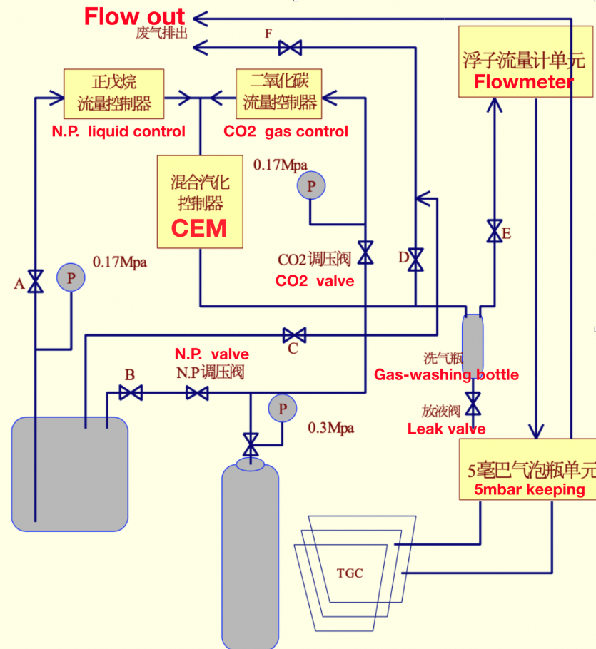
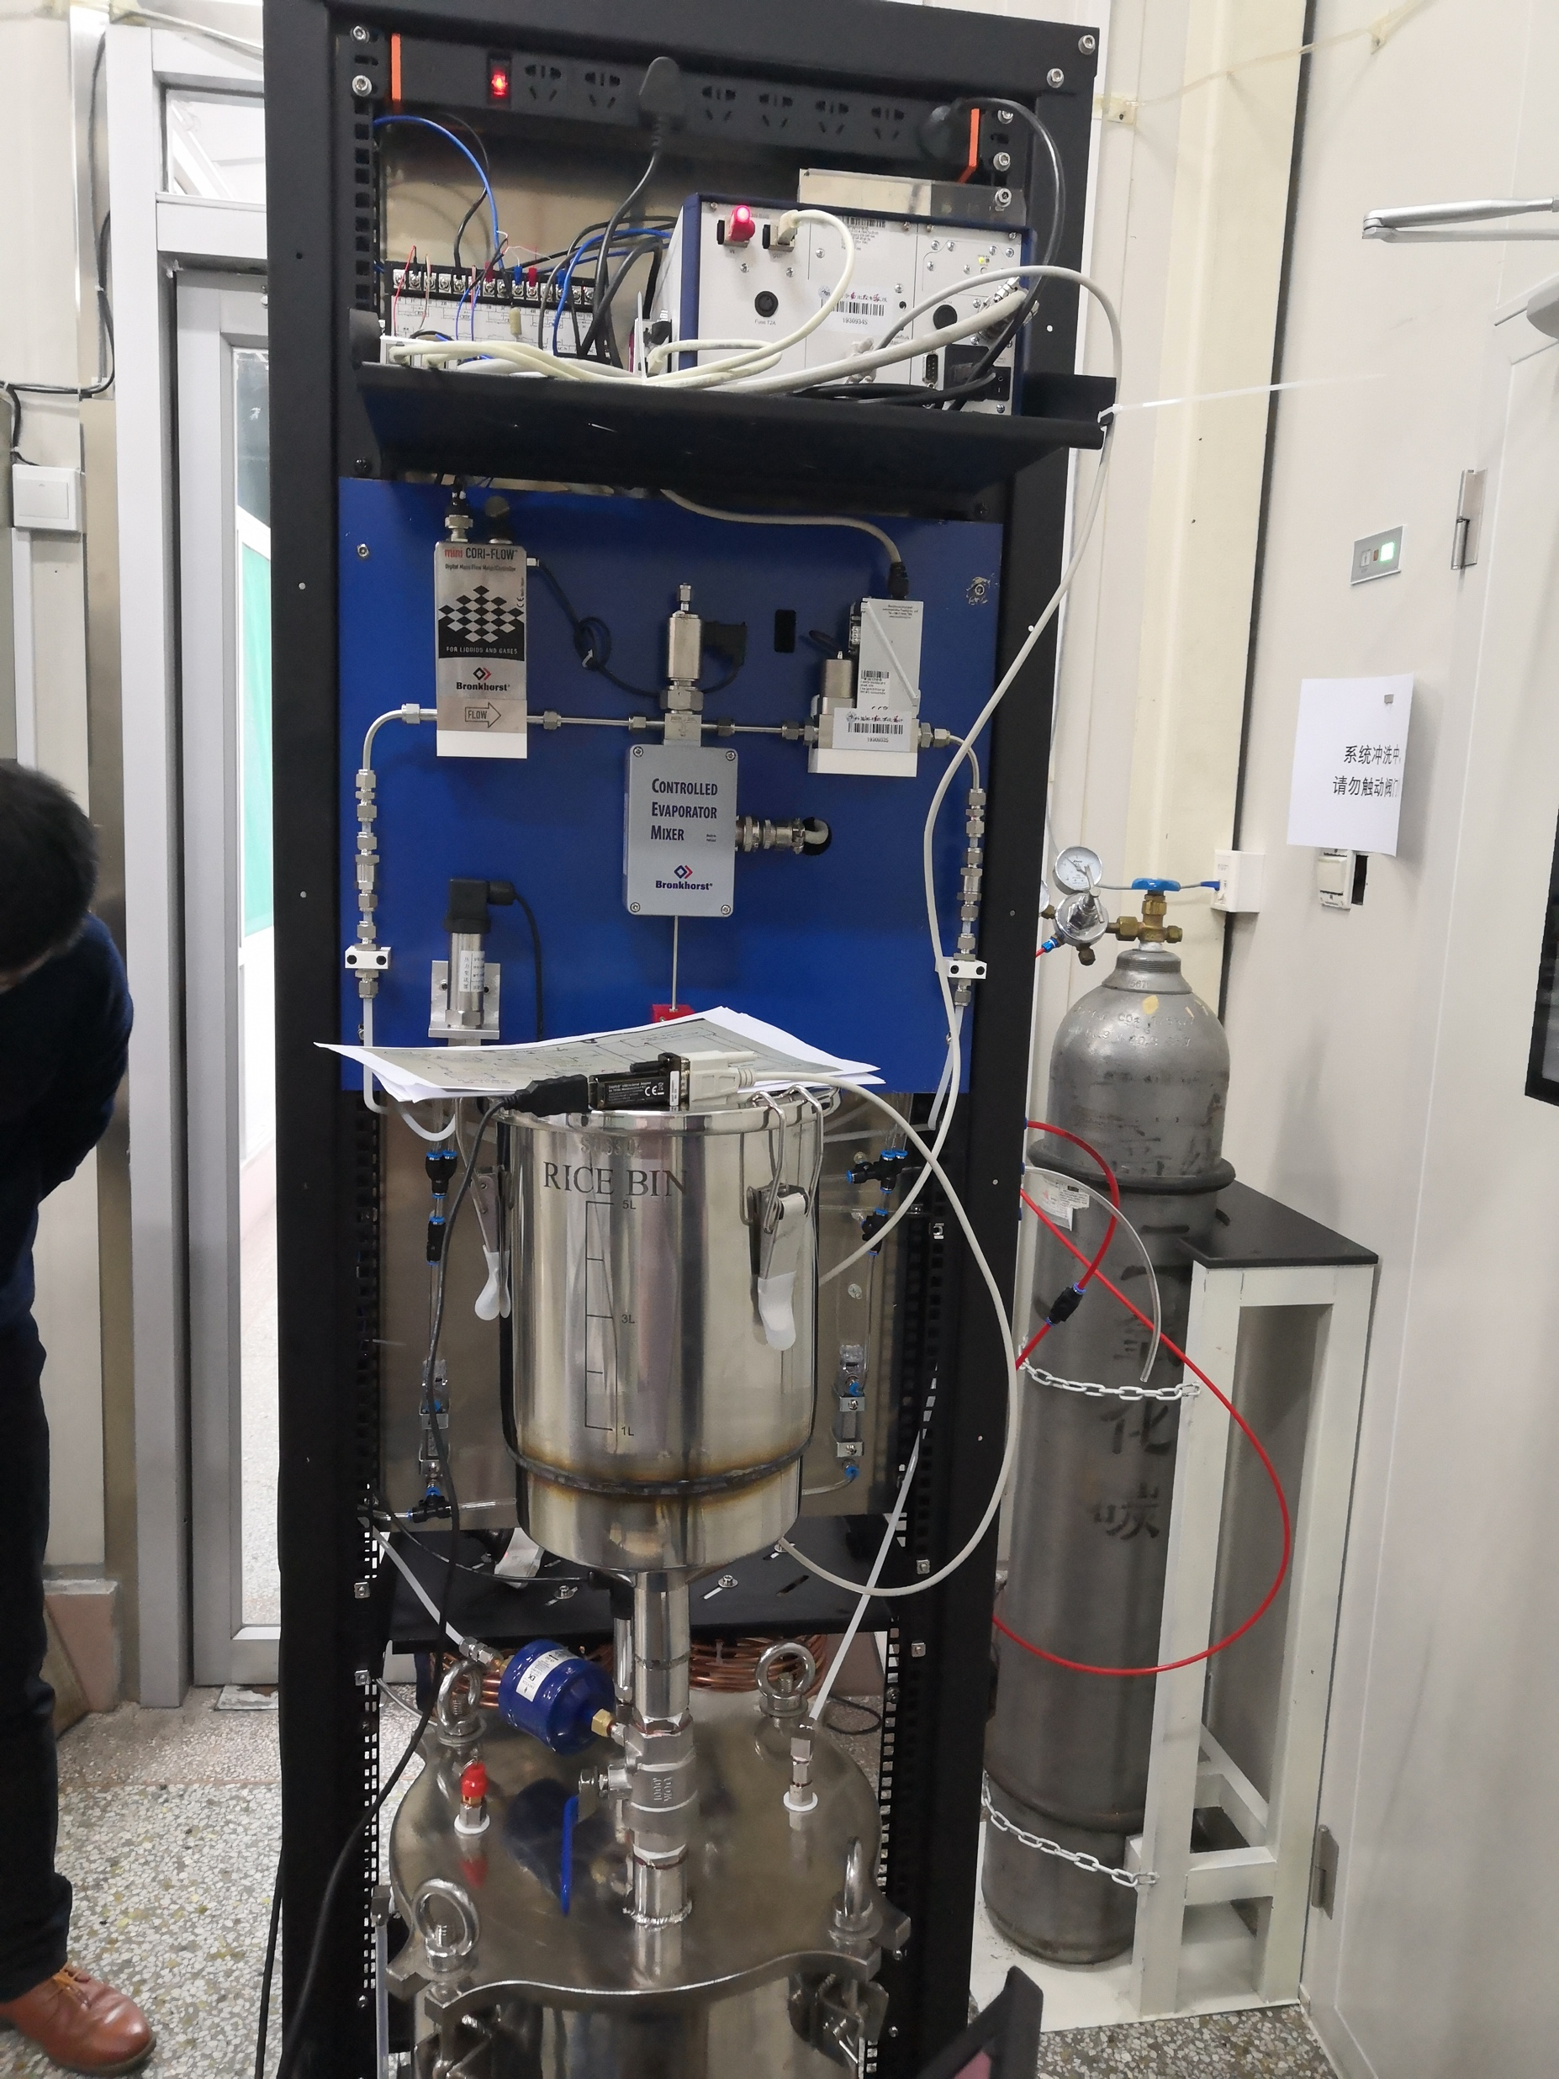
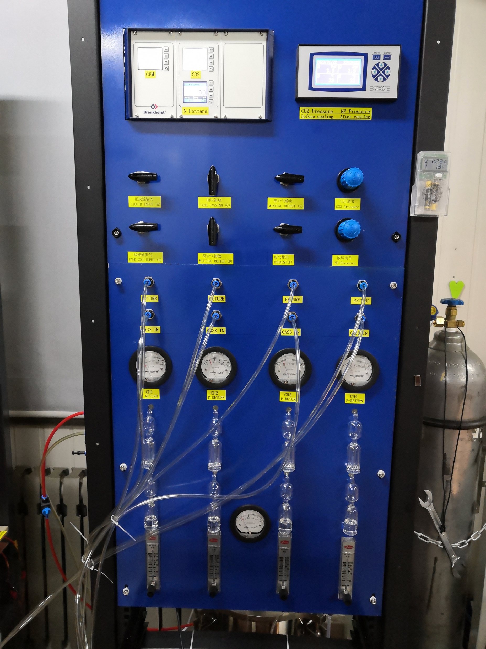
New gas system
Control Evaporation Mixing

Slide 18
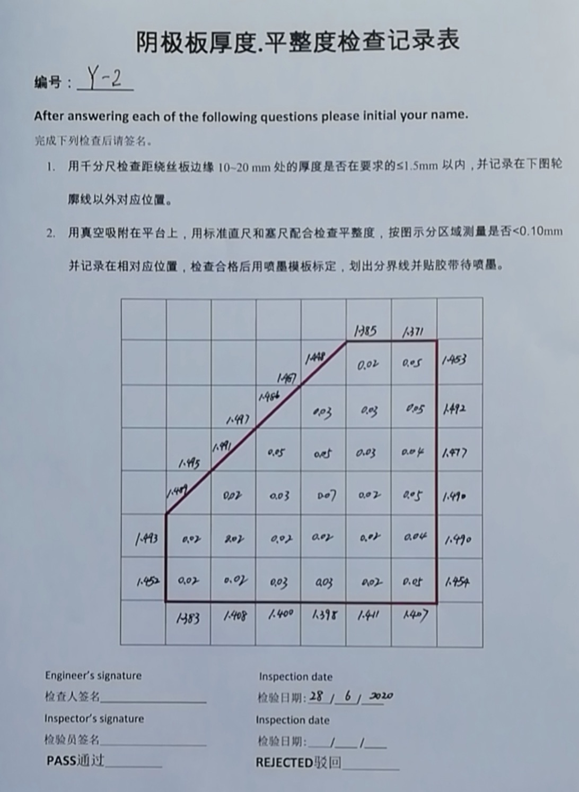
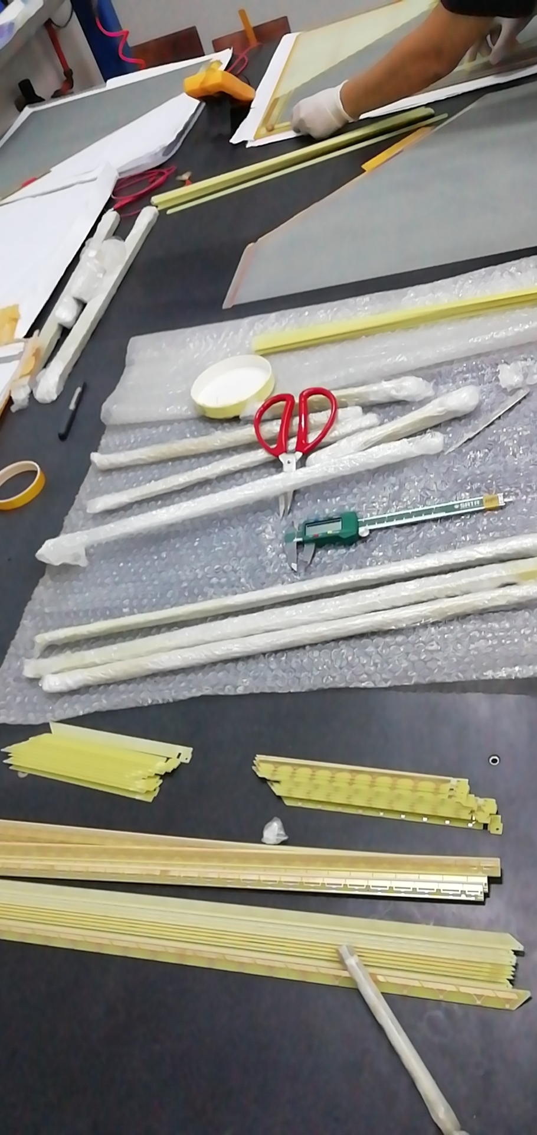
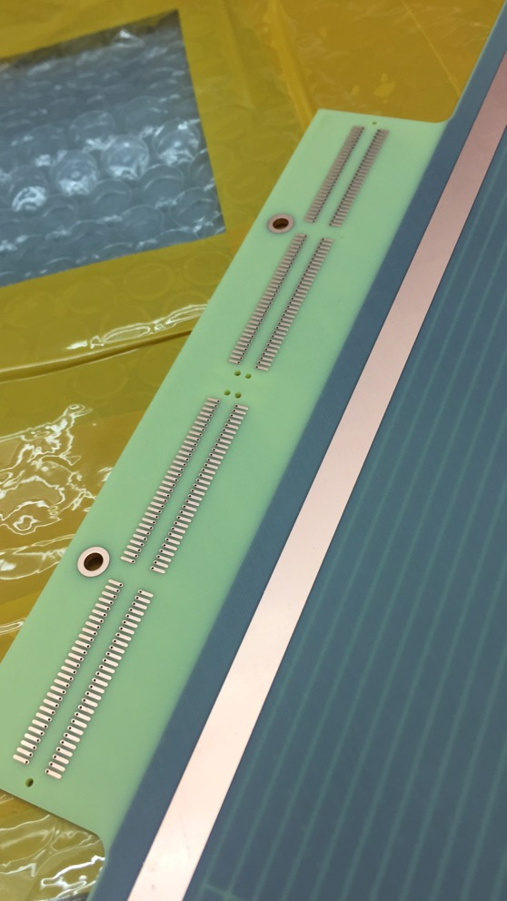
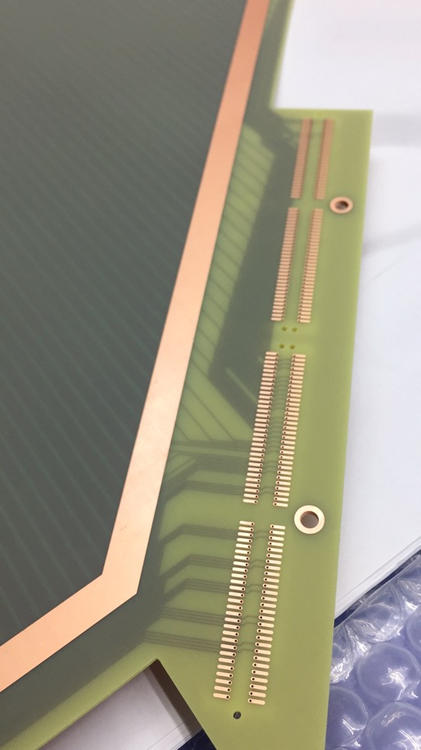
PCB inspection
10 sets of PCBs
PCB thickness and flatness inspection
All qualified
Connectivity check
One PCB needs replacement
Cleaning support frame and painting Luka on it

Slide 19
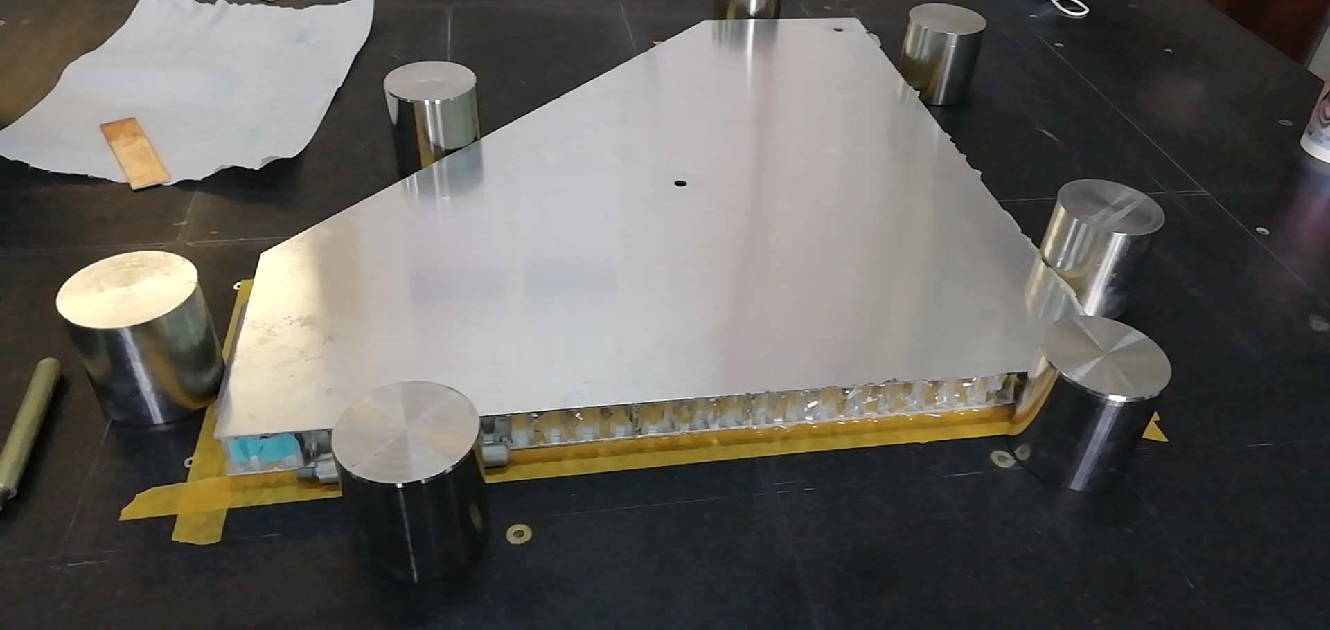
Pentagon production readiness
PCB thickness and flatness check √
Connectivity check √
Painting Luka on support frame √
Graphite spraying (this week ☺)
Wire winding machine √
Gas system √

Slide 20
sTGC production schedule
Final design
Vender production
Mass production
Aug. to Oct.
Oct. to Jul. 2021
Jul. to Sep.
Sep. to Nov.
design
Prototype production
Vender production

Slide 21
Summary
Full Size Prototype
The full size prototype has been produced and detector shows good performance
Prototype has been shipped to BNL
Pentagon Prototype
The pentagon prototype design has set down.
Tools and new gas system has been developed
PCB inspection has done
sTGC production is on going

