Slide 1
Electronics Status at USTC
Feng Li, Shuang Zhou, Peng Miao, Ge Jin
July 21st, 2020
University of Science and Technology of China

Slide 2
Outline
System Architecture
FEB Status
VMM3 Usage on FEB
ROD Status
Adapter Board design

Slide 3
System Architecture

Slide 4
Complete sTGC layer
The strips of each sTGC layer can be handled by 24 Front-End Boards.
In total, there will need 96 FEBs for 4 sTGC layers.
The innermost sTGC layer locate in the cone at the place with diameter of 152cm
About 10cm gap between the sTGC border and the cone
FEB boards are vertically inserted in the sTGC chamber.

Slide 5
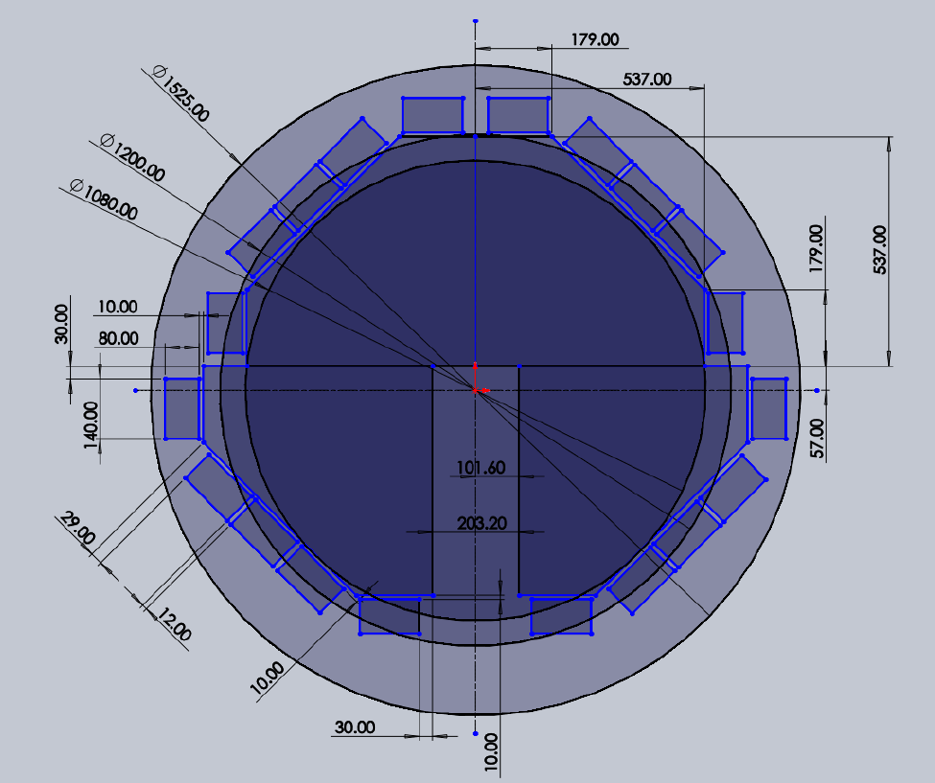

Slide 6
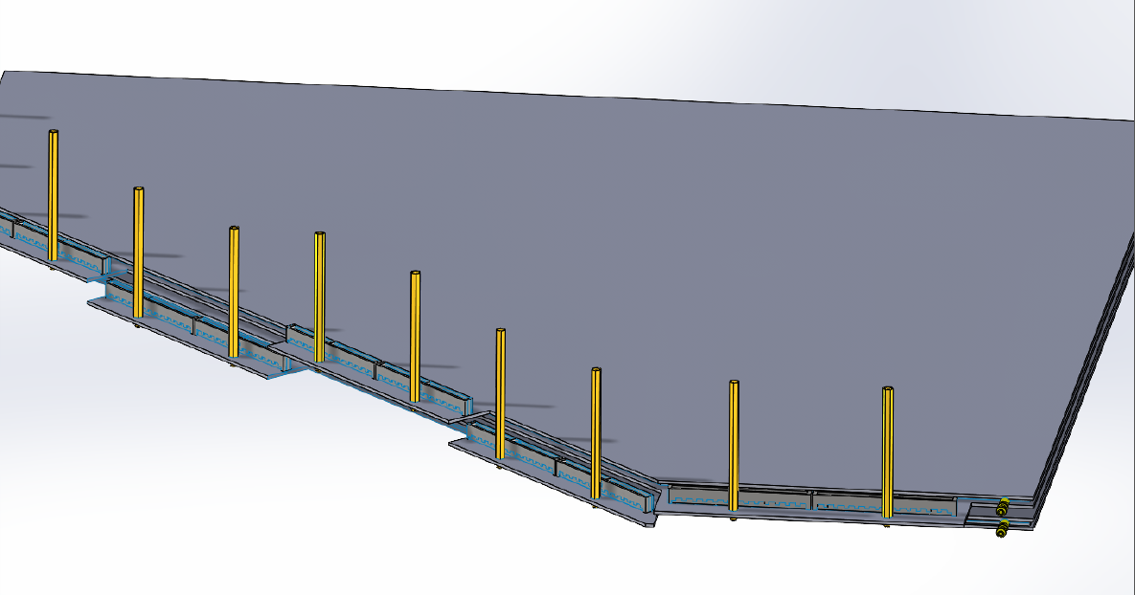

Slide 7
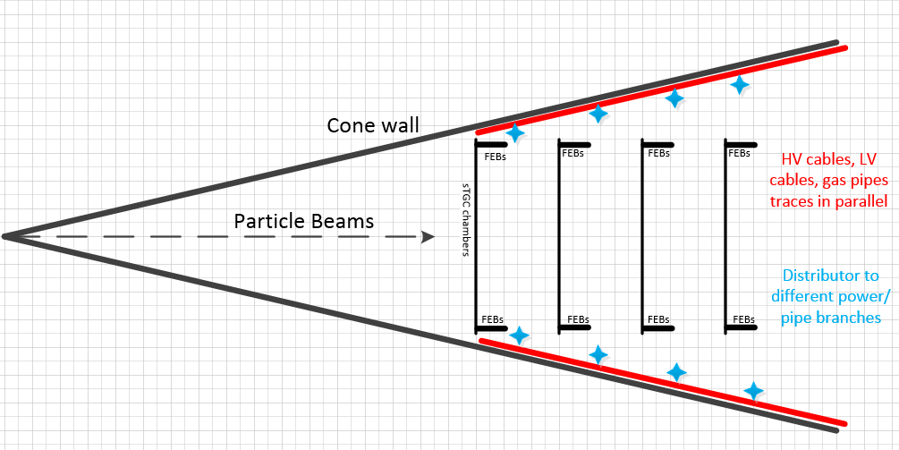
Layout in the cone
7-inch distance between adjacent sTGC chambers.
FEBs are vertically inserted into the connector slots on chamber.
FEBs are almost parallel to the particle beams.
3-6 power cables can be grouped together and then distributed to each FEB near the chamber.
Notes:
FEB is almost parallel to the particle beams, which can help reduce the radiation on electronic chips.

Slide 8
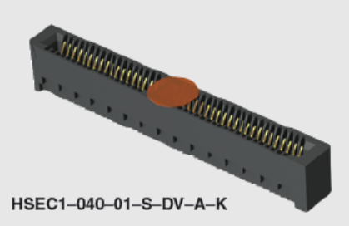
Connector between chamber and FEB
Connector P/N on chamber: SAMTEC HSEC1-060-01-S-DV-A-K, used as board slot connector
Connector size on chamber: 69.5 * 5.6 * 7.8mm (L*W*H)
1.0mm pitch, dual rows, 60 positions/row
120 strip signals can be connected to the connector
Surface-mounted, can be soldered manually.
No connectors needed on FEB: Golden fingers on both layers of FEB
Each FEB contains two connectors, capable of up 240 strip channels (sTGC chamber can supply ~210 strips for each FEB).

Slide 9
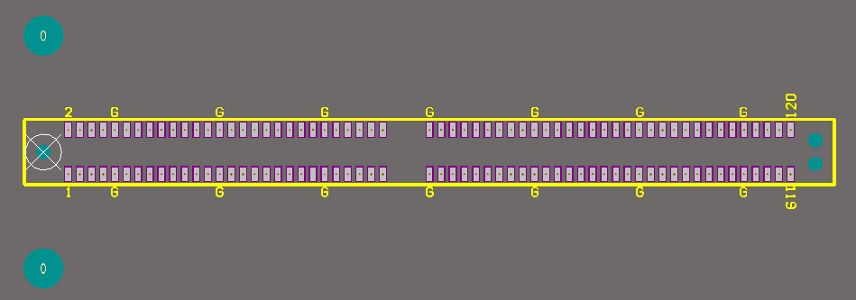
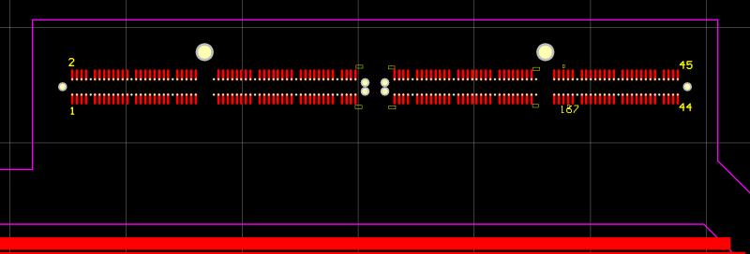
Connector Pin Map
120 positions:14 for signal Ground(marked with ‘G’), 106 for strips.
Footprint on chamber
Golden fingers on FEB

Slide 10
Read-out Electronics Architecture
96 Front-End Boards
16 Read Out Driver Module
ROD modules are designed based on Standard VME 6U Crate(with DC power supply)

Slide 11
FEB Status

Slide 12
3D show of FEB

Slide 13
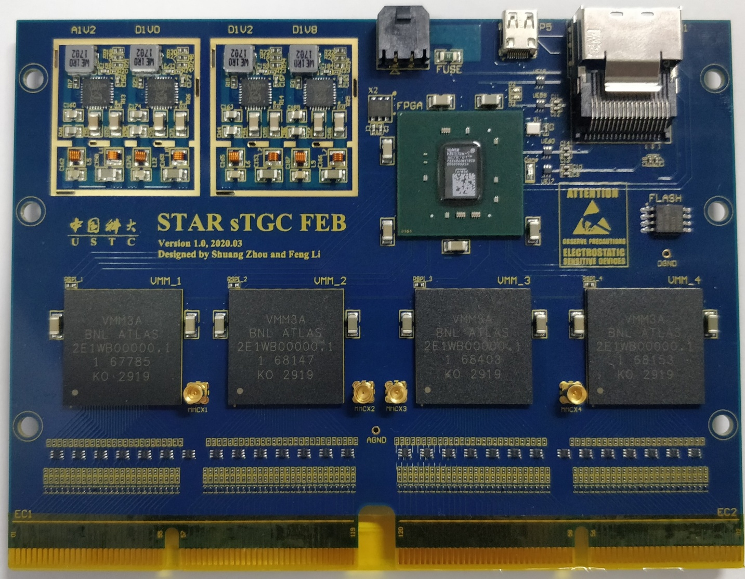
FEB is shown on the right.
Test the performance of the GTX link .
The VMM configuration and readout.
Check the power supply of the FEB.
FEB weight:
shown<70g
cooling pad and cages（power） < 20g
data cable and power cable < 15g
……
FEB weight < 110g

Slide 14
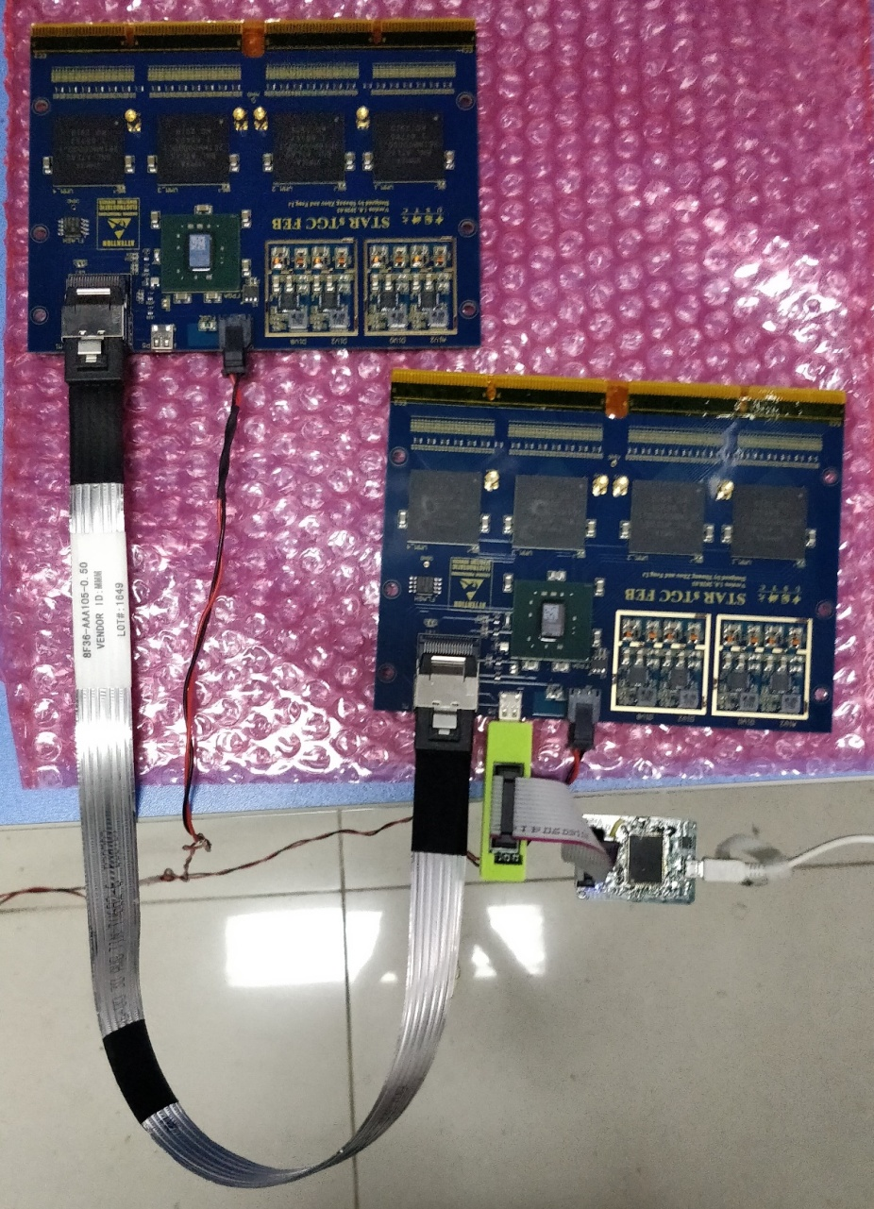
Test the performance of the GTX link at 4 Gbps by Xilinx IBERT core.
The left picture shows the test platform, and the results are shown below.
Test the GTX link with different length of the mini-SAS cable (0.5m, 1m, 2m, 3m), and the GTX link works steadily at all length.
Power: 10V, 0.8A (4 VMMs configured and readout, GTX activated).

Slide 15
Completed work:
VMM configuration and readout. We can configure VMM in right mode, and readout the events data of test pulses from VMM.
Reformat events data. Add Cyclic Redundancy Check in each data packet, and scramble the data stream before transmitting.
Transmit data packets at 4 Gbps by GTX.
Slow data links(40Mbps) tests. Slow data links between FEB and ROD, include the clock signal, the trigger signal, and the commands.

Slide 16
Next to do:
Test VMM readout with the external test pulse.
Monitor the temperature sensor of VMM.
Power connector and Data connector will be replaced by vertical types in the next version of FEB.

Slide 17
VMM3 usage on FEB
configuration and readout

Slide 18
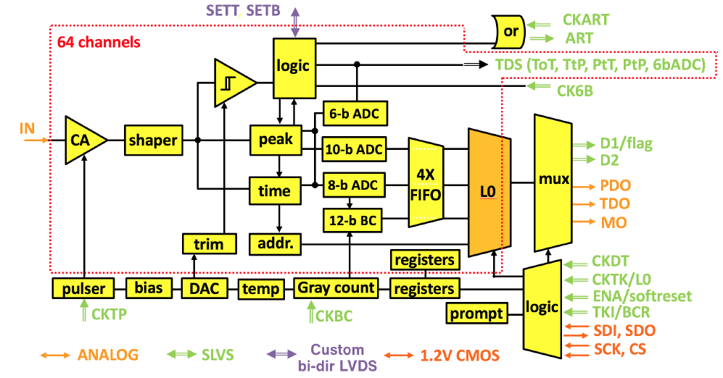
Architecture of VMM3

Slide 19
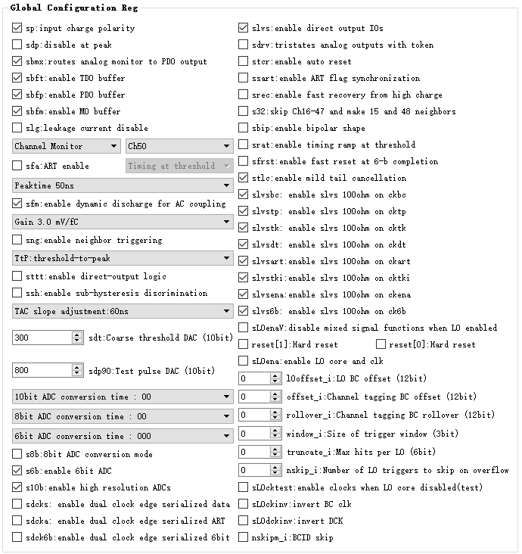
VMM3 configuration
Global register: 192 bits
Charge polarity
Gain(0.5,1,3,4.5,6,9,12,16mV/fC)
Peaking Time(200,100,50,25ns)
Coarse threshold DAC
Test Pulse DAC
……

Slide 20
VMM3 configuration
Channel register: 24 bits/CH
Threshold trimming
Internal test pulse
……
VMM Configuration Process:
192 + 24 * 64 = 1728 bits
configure VMM through SPI.
Each VMM can be configured individually.
18*96-bits: 2*96-bits for global registers, 16*96-bits for channel registers.

Slide 21
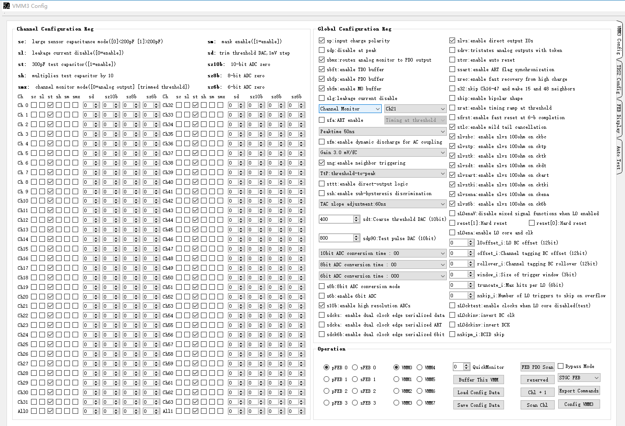
VMM3 configuration GUI
Used for ATLAS FEB mass inspection
Can be transplanted to be used for STAR FEB test before shipment.

Slide 22
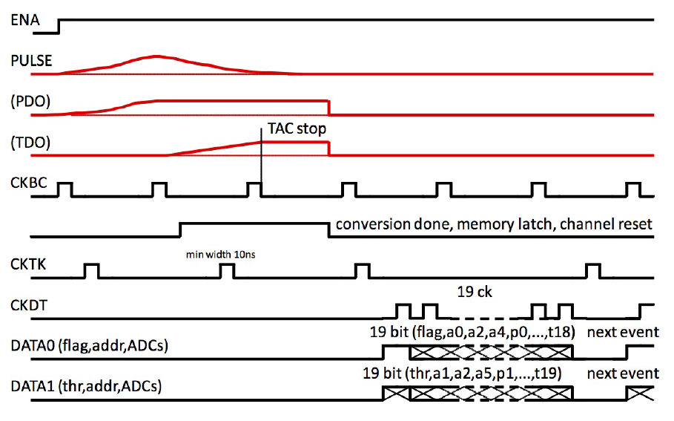
VMM Mode: Non-ATLAS Continuous Mode.
VMM Data Format:
Each event data is 38 bits, contains 1 bit flag, 1 bit threshold, 6 bits channel ID, 10 bits PDO, 8 bits TDO, and 12 bits BCID.

Slide 23
ROD Status

Slide 24
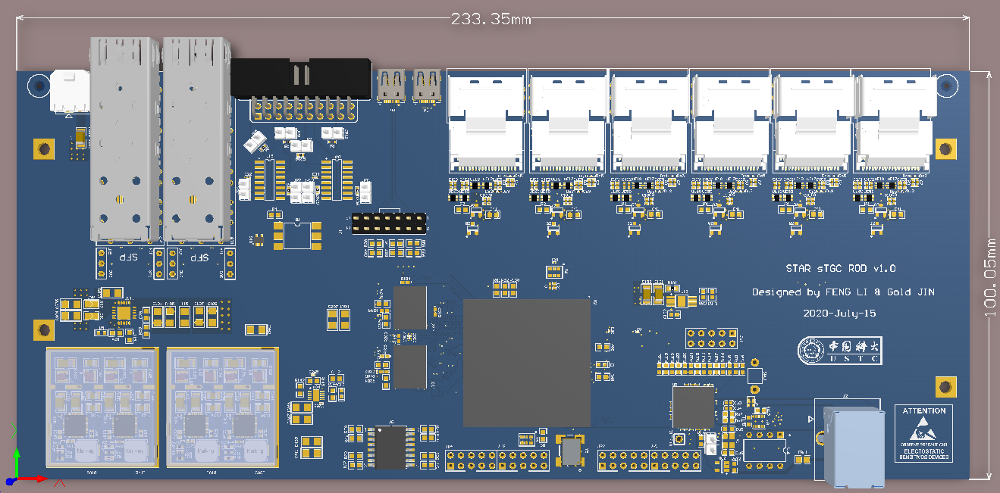
ROD Architecture
6 DATA connectors compatible with 6 FEBs
Xilinx Kintex-7 FPGA: XC7K325T-2FFG900I
FEAST power modules
2 optical fiber SFP+ to communicate with STAR DAQ (1 for spare)
ROD size:233*100mm
TCD circuit for STAR DAQ connection.
USB3.0 connector added for communication with PC(not necessary for STAR).

Slide 26
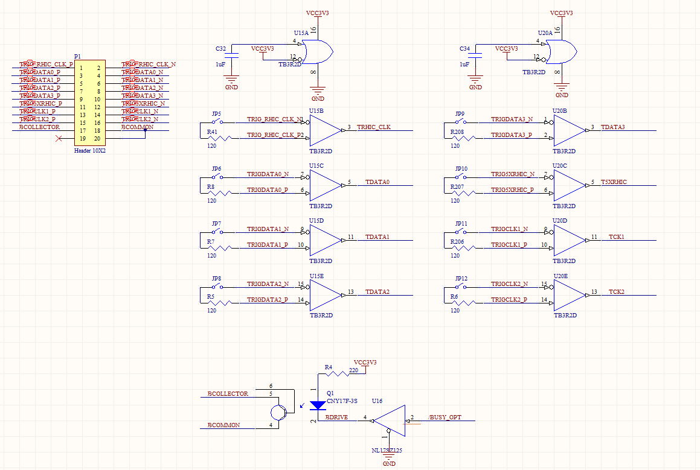
TCD circuit
LVPECL(from cable) → LVTTL → FPGA
120-ohm resistors kept but only one board needs to solder them
Busy signal from FPGA will return to TCD board.

Slide 27
POWER
4 FEAST ASICs used:
Digital 3.3V: SFP+ Powering, SPI Flash, TCD, GPIO
DDR_1.5V(LDO): DDR powering
0.75V(LDO):DDR reference voltage
Digital 1.0V: FPGA core voltage and MGT_AVCC
Digital 1.2V: MGT_AVTT
Digital 1.8V: FEB links

Slide 28
Board Status
ROD boards will be back early August. Then 1-2 weeks for soldering.
Firmware development ongoing:
Decode data packet; Descramble; CRC
10G SFP+ code transplanting;
DDR3 code development

Slide 29
Adapter between FEB and Simulator Board

Slide 30
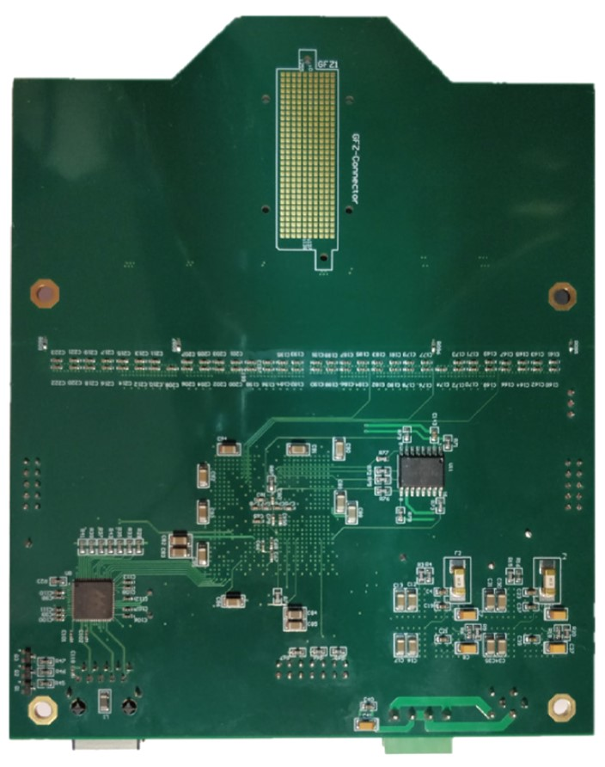
STGC Signal Simulator board
256 channels charge output, ~0.4pC
Used as external test pulse source for FEB

Slide 31
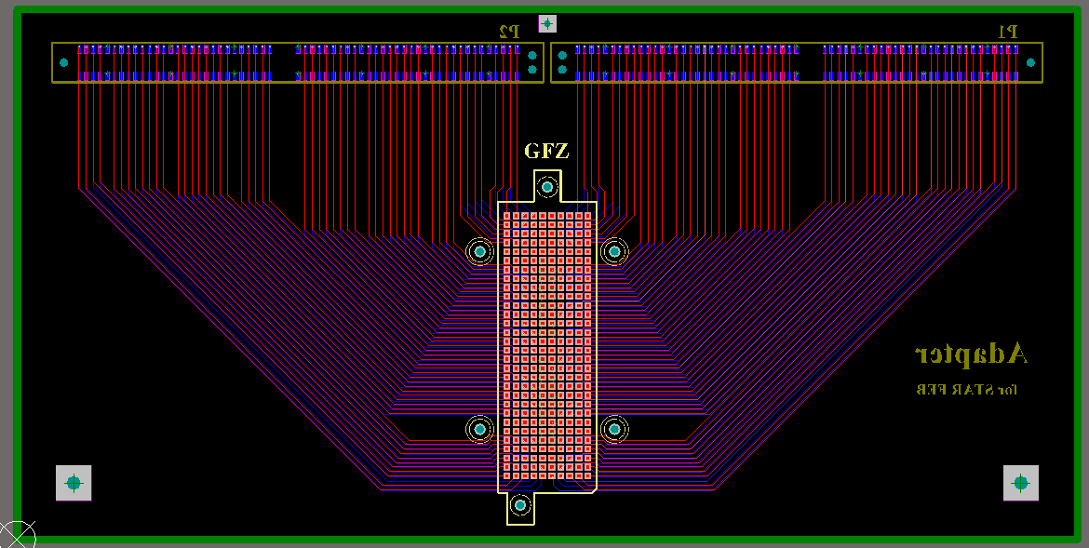
Adapter board design

Slide 32
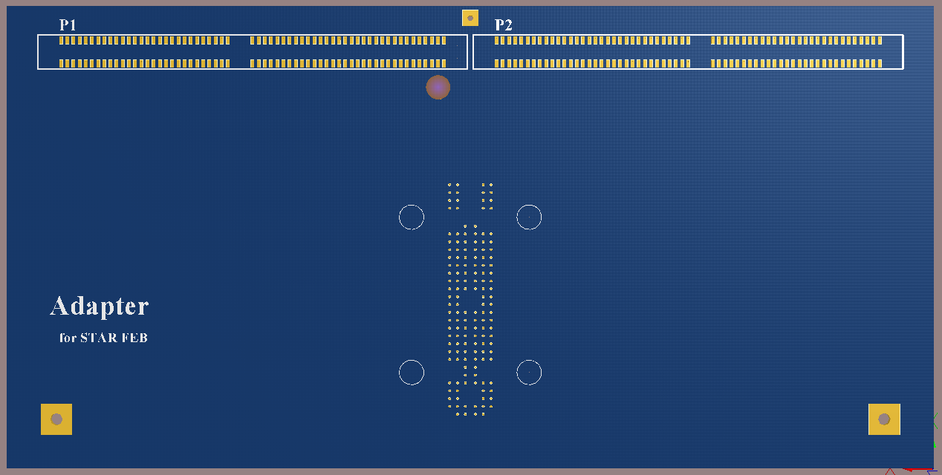
Connection

Slide 33
Thanks!

