Slide 1
STGC integration and Gas System
- Rahul Sharma

Slide 2
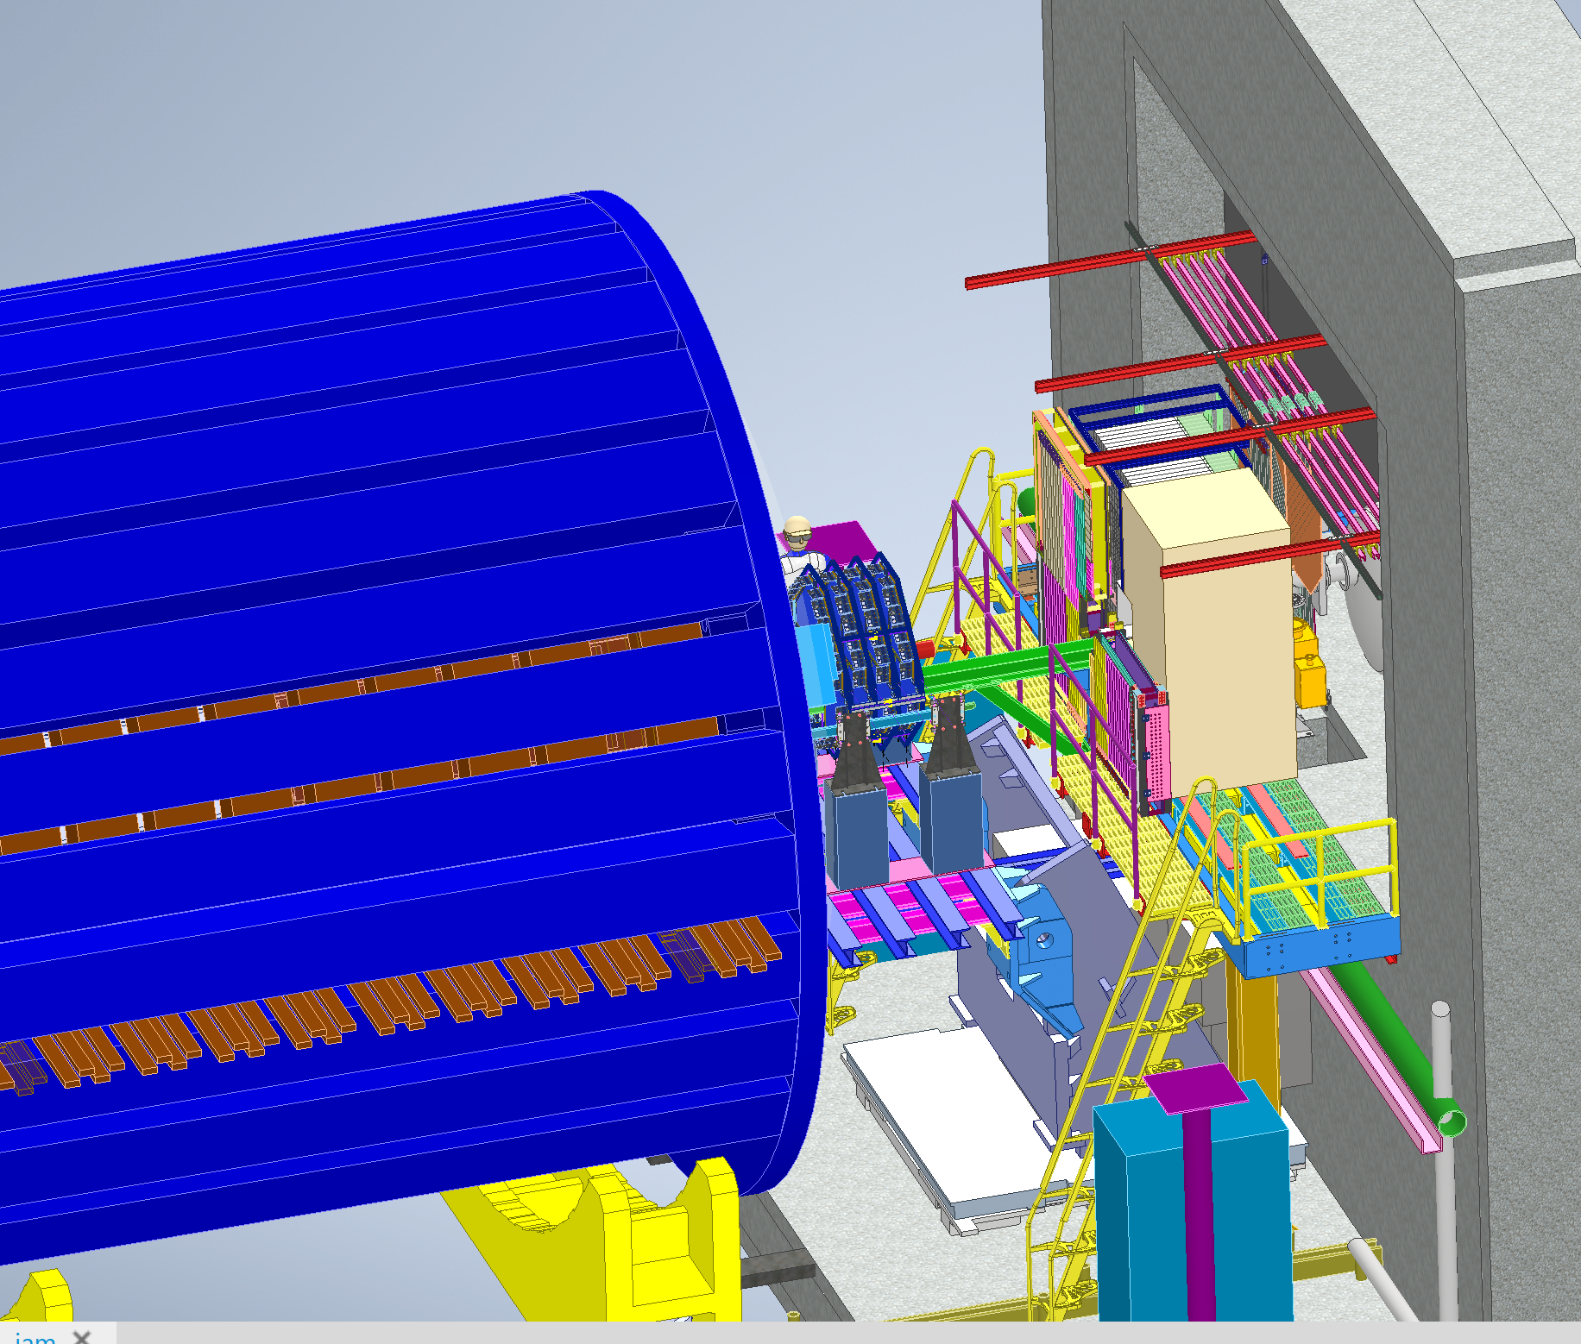
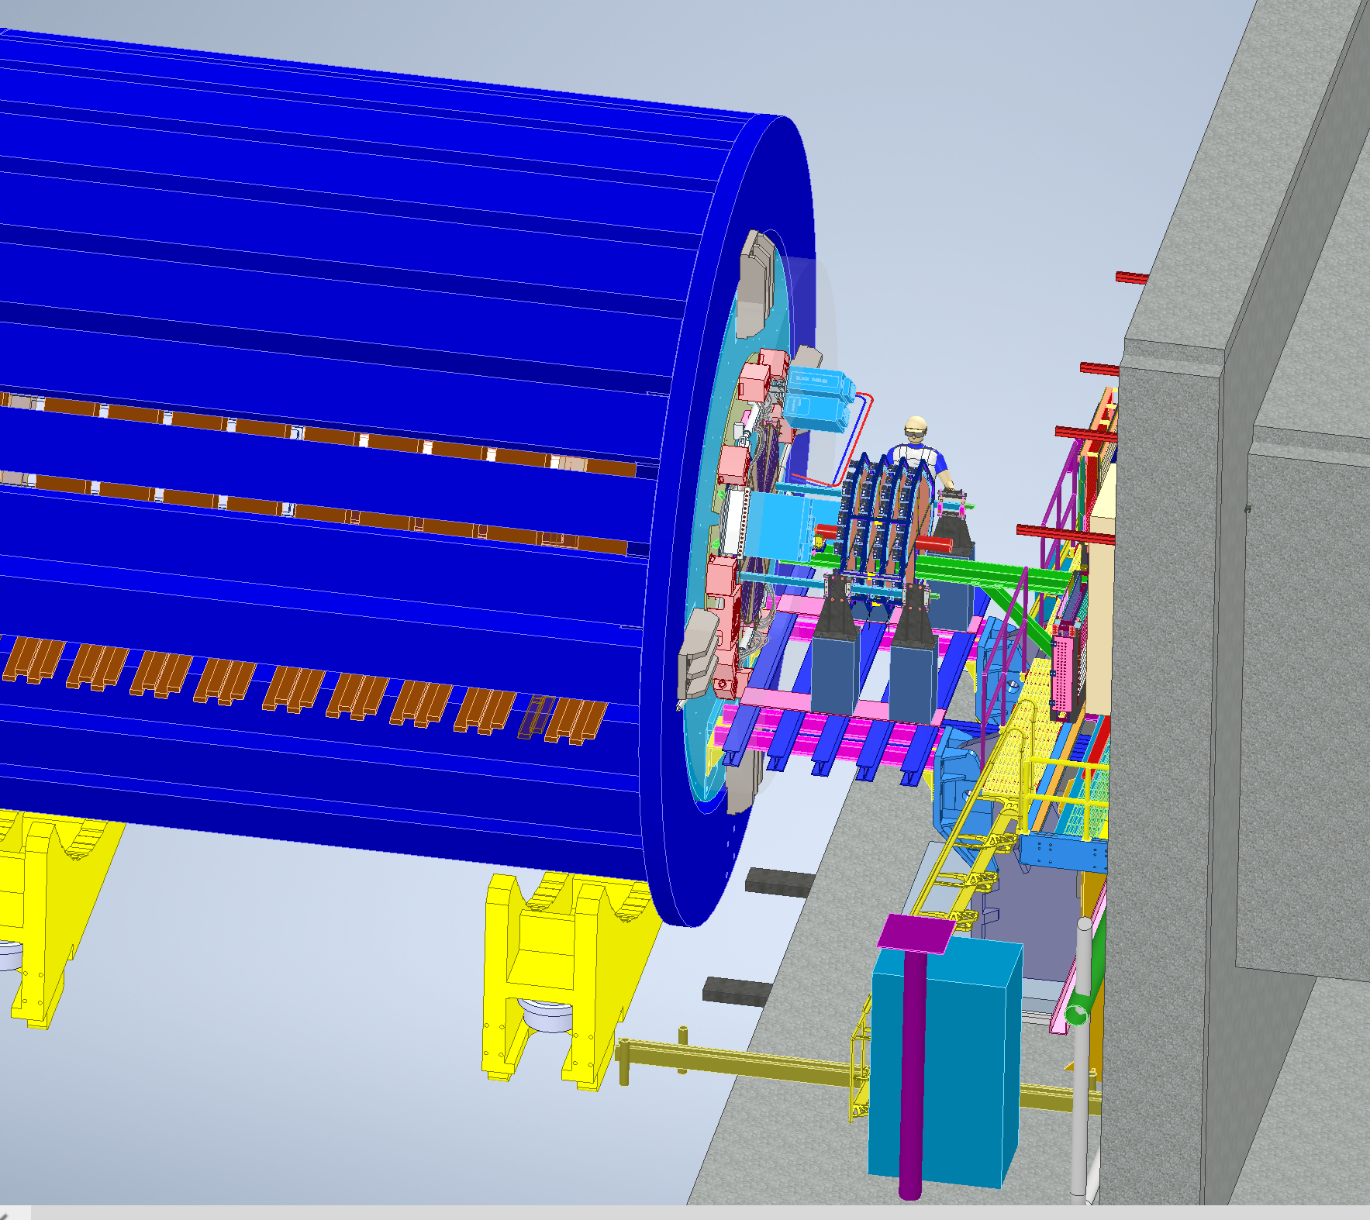
Integration in STAR

Slide 3
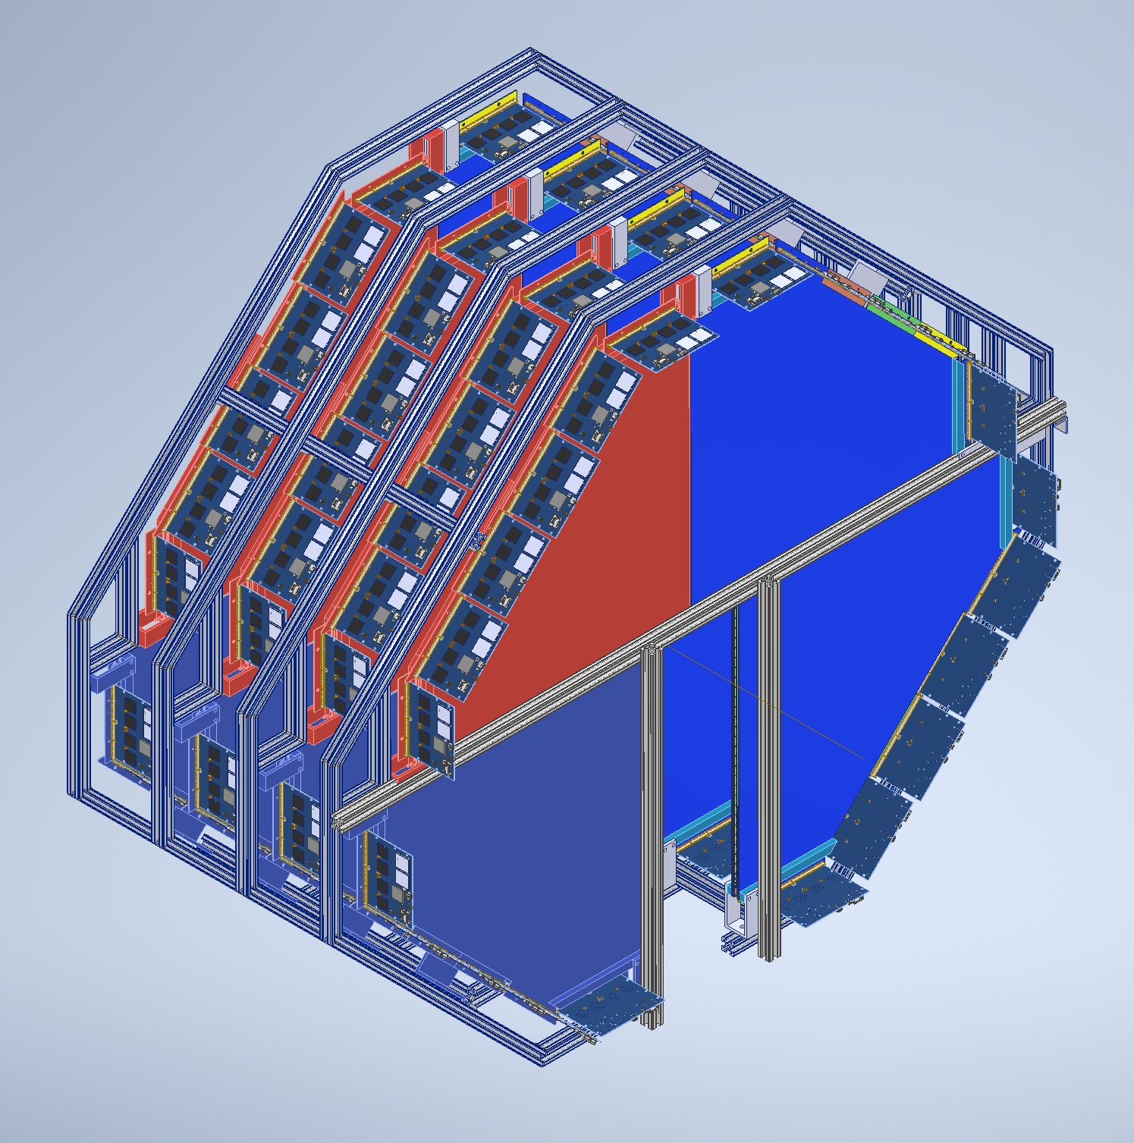
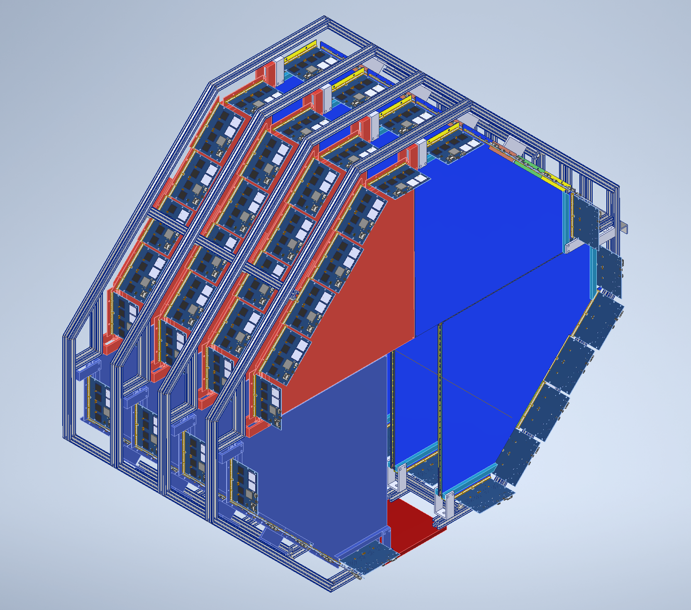
Frame Design (Still Work in progress)
During Lift
After Lowering on Rails

Slide 4
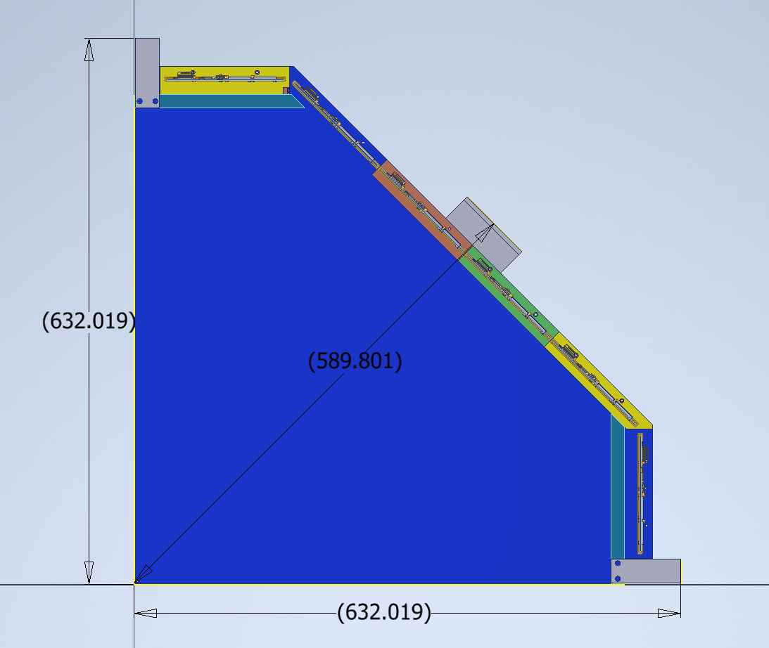
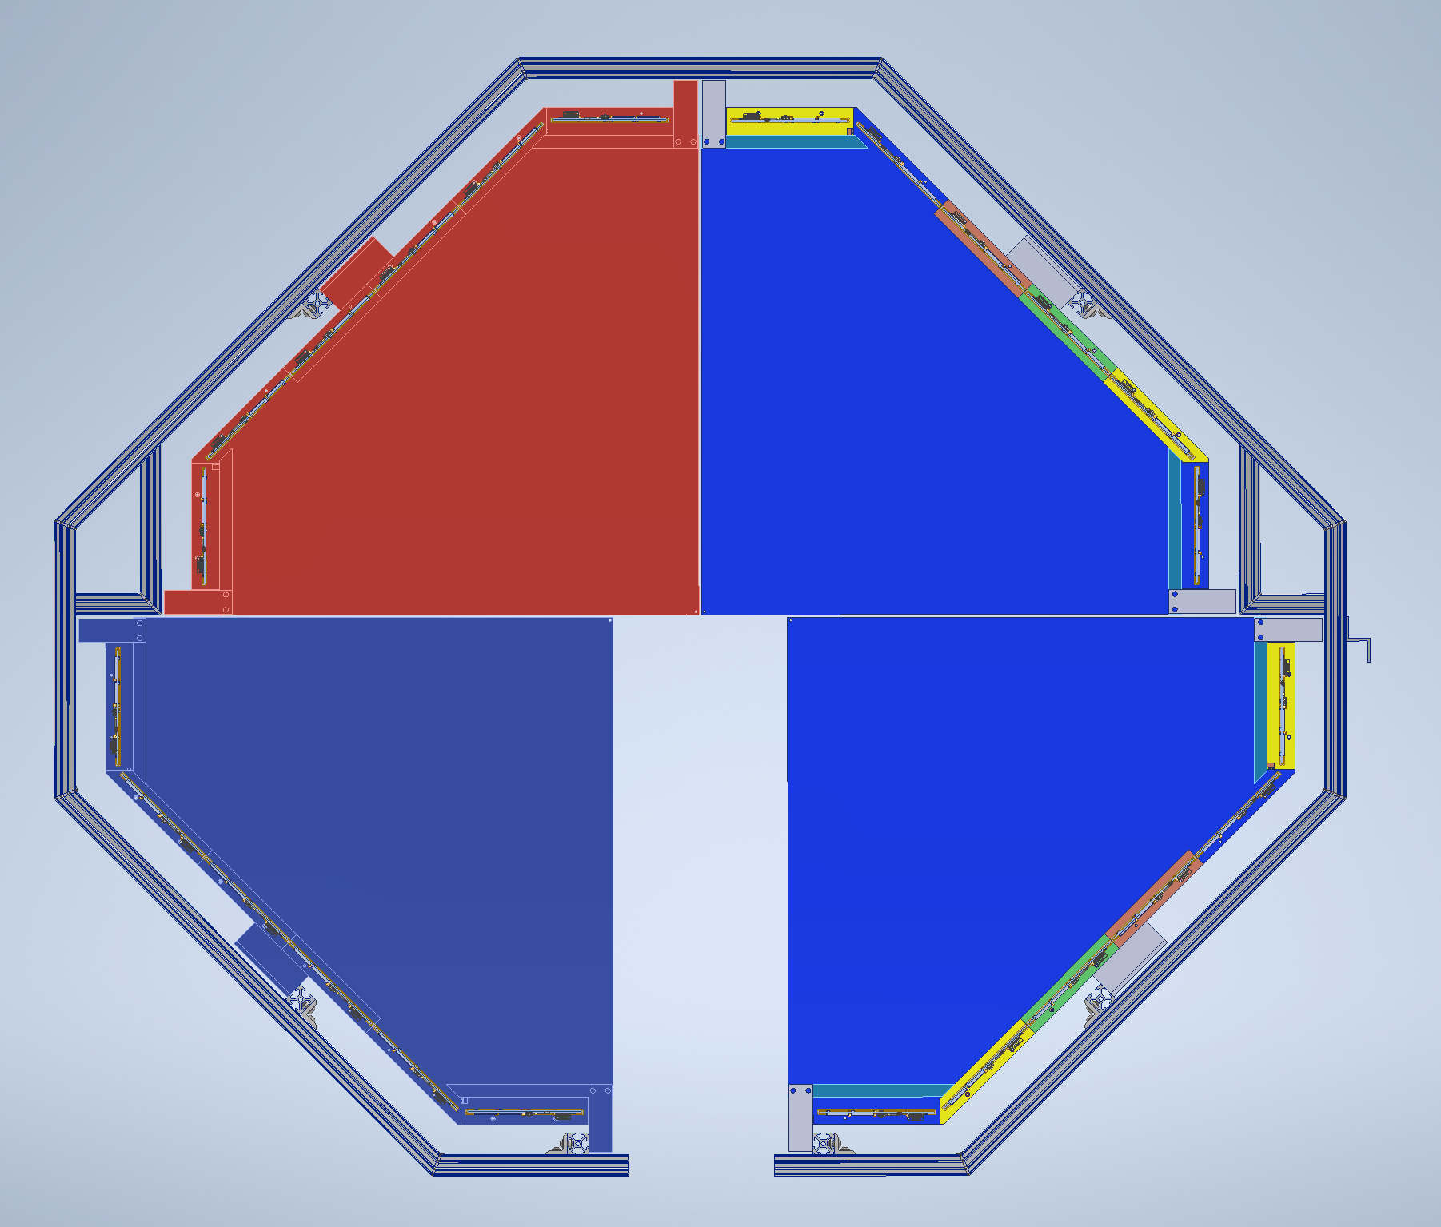
Issues/Open questions?
Spacing between the modules is kept as 1/8”. This may change when frame is lifted due to deflections in frame. What nominal spacing is needed?
How accurately are the aluminum straps fabricated and assembled
Maintaining a straight 1/8th inch gap will be very difficult due to manufacturing and assembly toleraces. May need to define a tolerance range for the gap
Survey requirements?

Slide 5
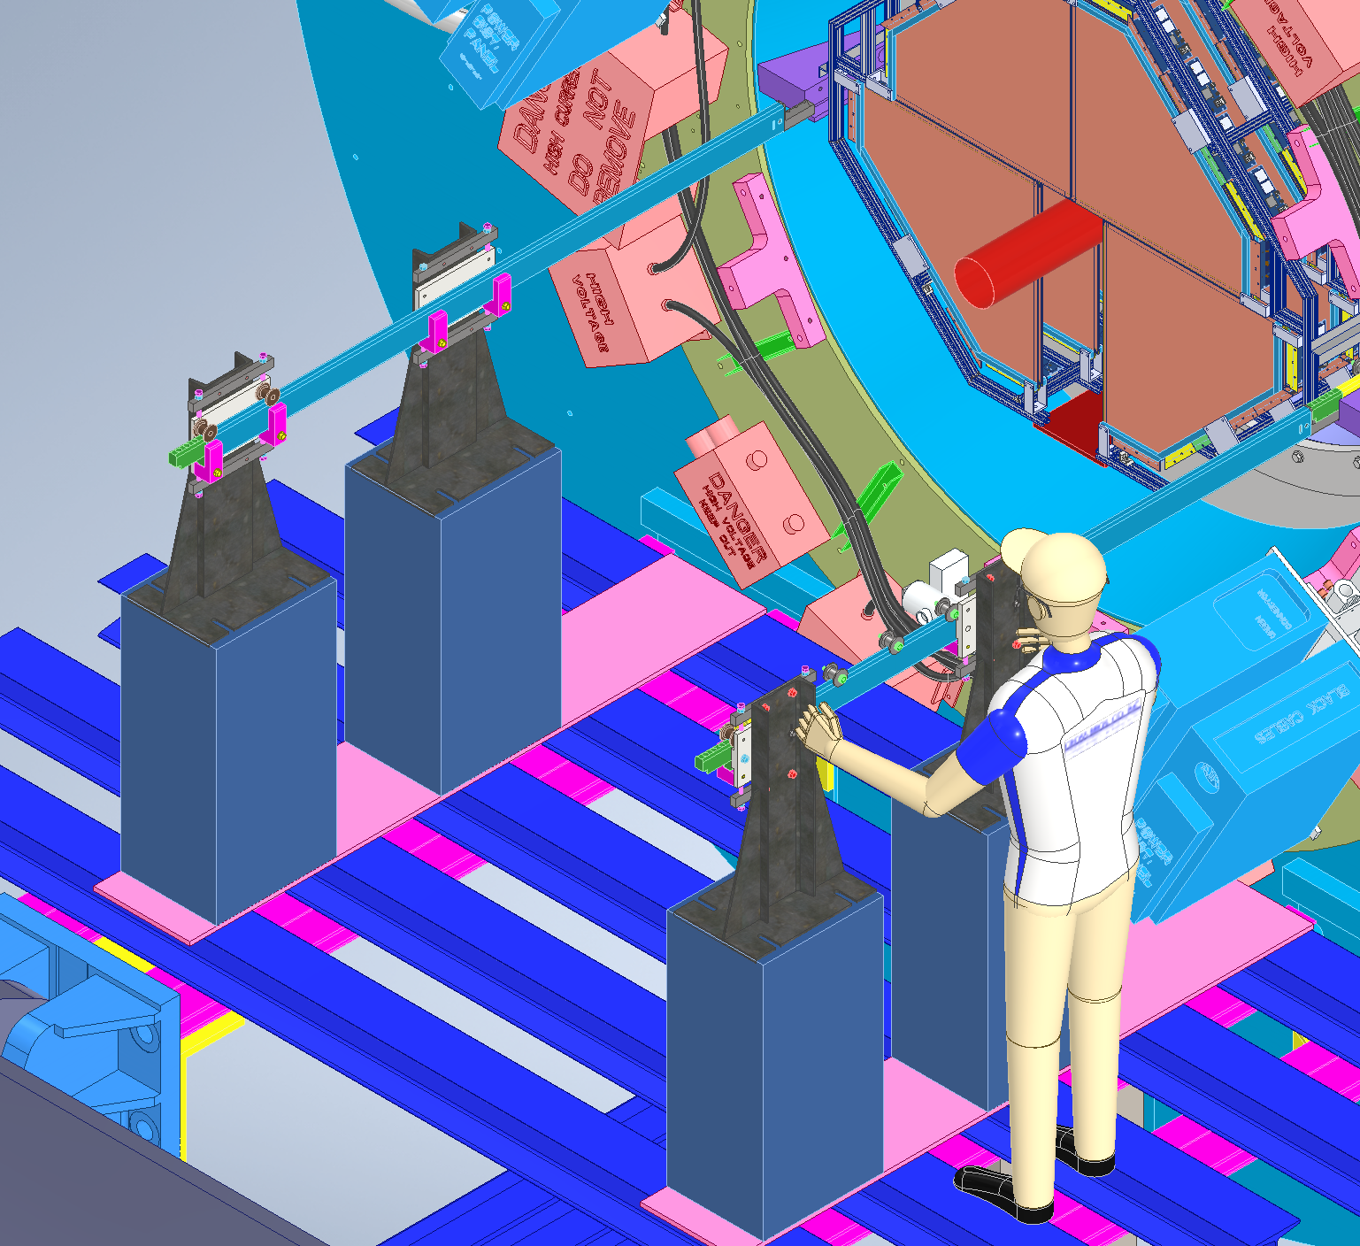
Rail system
Exiting IDS Rails and Stantions can be used
The detector will be lowered onto the rails using crane and will be pushed in to place
It will be deemed a critical lift and all the procedures will have to be approved by safety
Some new brackets and rails are needed.

Slide 6
Tasks to be completed
Frame design and analysis/Calculations
Transportation cart design
Heat load analysis
Cooling duct system design
Cabling design
Rail system design
Platform design

Slide 7
Gas System Requirements
Gas Mixture Requirements:
Gas Mixture : 45% n-Pentane + 55% CO2
Moisture Content: As low as achievable.
Flow rate/Layer (4 chambers) 75cc/min
Flow Rate (Full System): 300cc/min
Pressure: Pressure inside the detector must not exceed 5 mbars.
Temperature of gas delivered to the detector: 24C +/- 2C
System Safety Requirements:
Keeping quantity of pentane inside assembly hall minimal (approximately 8 gallons)
Liquid pentane storage outside the building needs secondary containment in event of leakage.
Liquid tanks outside the building should also be protected (from unintentional accidents with forklifts and snowplows) using concrete barriers
All Components should be grounded.
System should be able to detect leaks and any other fire/smoke event.
Pressure relief valves in all circuits where overpressure can occur.
For supply line from mixing source to experiment joints should be minimized and if joints are needed they should be brazed.
All lines should be tested to 50 psi pressure using dry nitrogen.
System must vent to the outside the building.

Slide 8
Gas System Requirements
Distribution and Operation Requirements:
Monitor Level of n- Pentane and CO2 to avoid scenario of running out product.
Temperature in the lines with gas mixture should not drop below 17C.
System should not allow gas mixture to liquify.
Interlock and monitoring system requirements:
Monitor system should monitor the essential parameters using GUI that includes a logic diagram:
Gas mixing system parameters: Mass flow meter readings, Output gas flow rate.
Gas Safety system parameters: Gas concentration, Temperature from heat Sensors to detect fire.
Power Supplies status monitoring.
Pressure sensors in the system.
Temperature monitoring throughout gas distribution system
Interlock system Requirements:
In case of gas leak or fire, purge the system with CO2 and drop High Voltage.
As temperature drop can cause pentane to liquify, so in case of temperature drop below 22C system should sound an alarm for 30 mins (enough time if a simple corrective action is needed). If no corrective action is taken in 30 mins then purge the system with CO2 and drop power.
If pressure is out of range (too high or too low) then drop HV power and shut down the system. No purging needed.

Slide 9
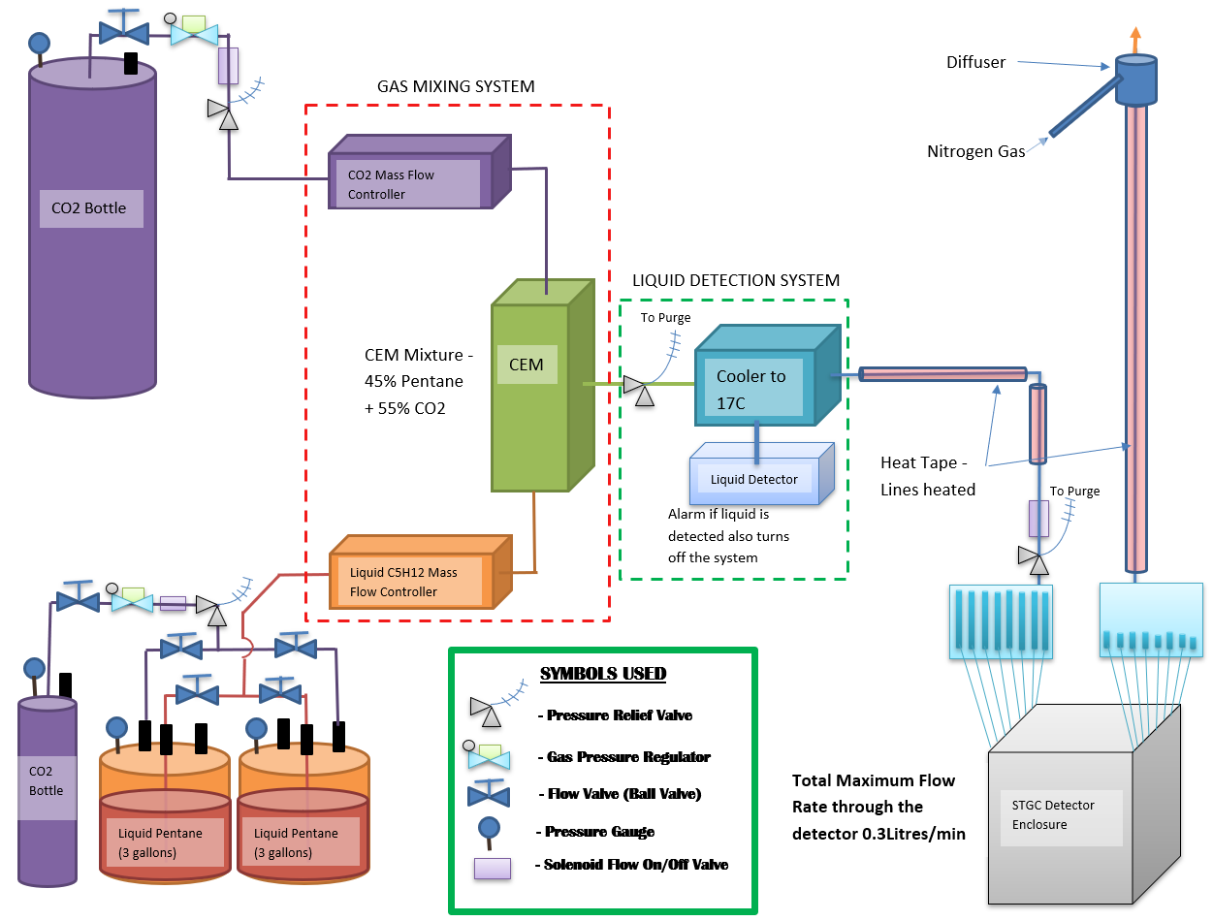
Gas System Overview
Small Strip Thin Gas Chamber (sTGC) detector needs a gas mixture (45% Pentane +55% CO2) for optimal performance.
Gas System will comprise of the following:
Gas and liquid Storage - CO2 and n-C5H12 bottles and containers.
Gas Mixing System
Liquid Detection System
Gas Delivery to the detector
Purging System
As shown the CO2 and Liquid Pentane will be pressurized to flow into their respective mass flow controllers
Mass flow controllers will allow the exact flow rate of CO2 and pentane respectively through them leading it to Controlled Evaporator Mixer (CEM) System. Here the pentane would be heated and gas mixture would be produced.

Slide 10
Gas System Overview
The mixture will go into the cooling and liquid detection system where it will be cooled using water at 17C. In case of any excess pentane in the mixture (due to error in pentane mass flow meter) it will liquify. Liquid detector will then trigger an alarm and shut down the system.
Gas will be delivered to the gas panel (with flowmeters) using 1/2”OD & 3/8” ID Copper tubing. Copper tubing will be heated and insulated.
As we will like gas to be delivered between 22C and 25C to the detector, we will install a thermocouples in the system to monitor gas line and gas temperatures. Temperature of heat tape will be varied based on temperature readings on thermocouples.

Slide 11
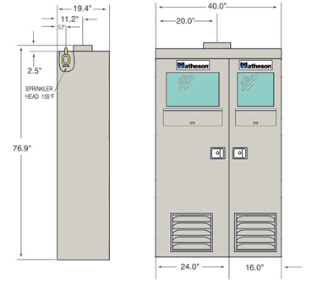
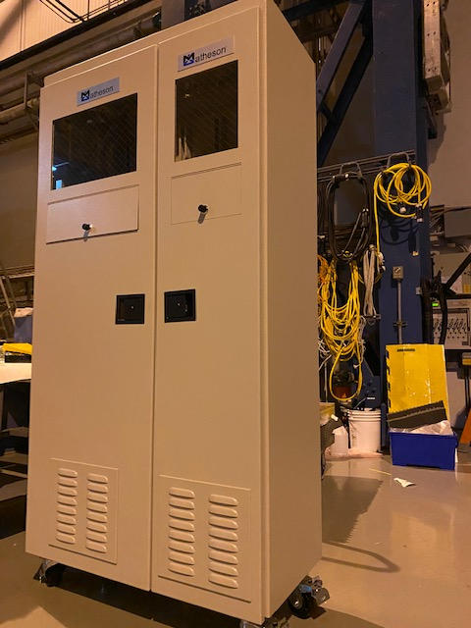
Storage in assembly building
N-pentane appears as a clear colorless liquid with a petroleum-like odor. It is highly flammable. Some of its physical and chemical properties are:
Flash point: 57°F (13.9°C).
Boiling point: 97°F (36°C).
Less dense than water and insoluble in water. Hence floats on water.
Vapors are heavier than air.
Lower Explosive Limit (LEL): 1.5%
Upper Explosive Limit (UEL): 7.8%
Autoignition Temperature: 500°F (260°C)
Matheson Cabinet will be used to store liquid pentane tanks as well as to house gas panel (that mounts mass flow meters, CEM, heat exchanger, liquid detector, valves etc. )
Copper/Flex Lines will be entering through the top opening in the cabinet.
Sniffers and Heat Sensors will be placed in the matheson cabinet.
Status: At BNL

Slide 12
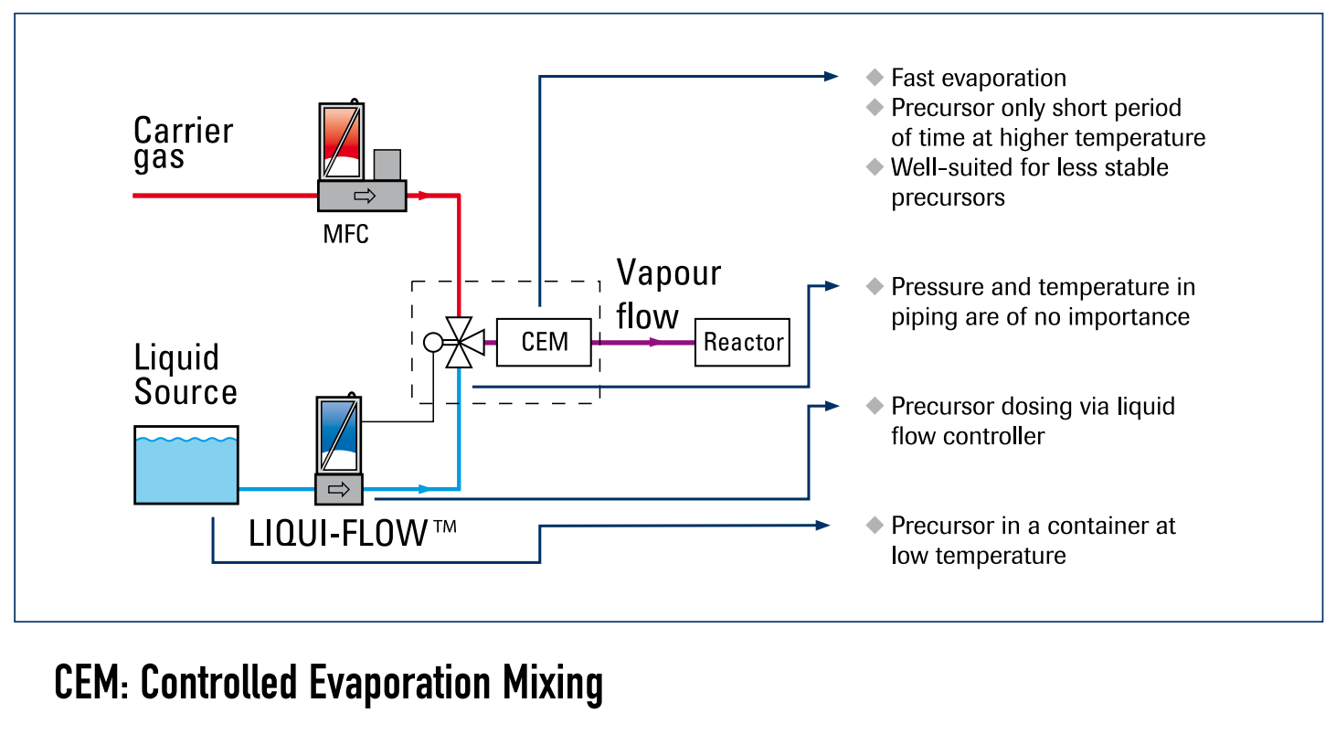
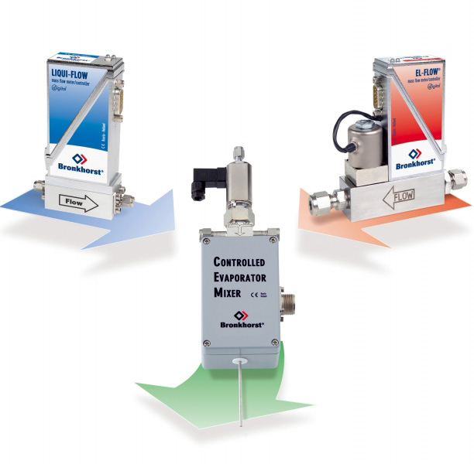
Gas Mixing System
Gas Mixing System is on order from Bronkhorst USA.
The instruments have a CE rating. We can get the instruments with IP-65, ATEX, and the gas instrument can be FM Class 1 Div 2 if needed.
Instruments are NOT NRTL or UL Listed.
We will have to certify these at BNL.
Status: in hand

Slide 13
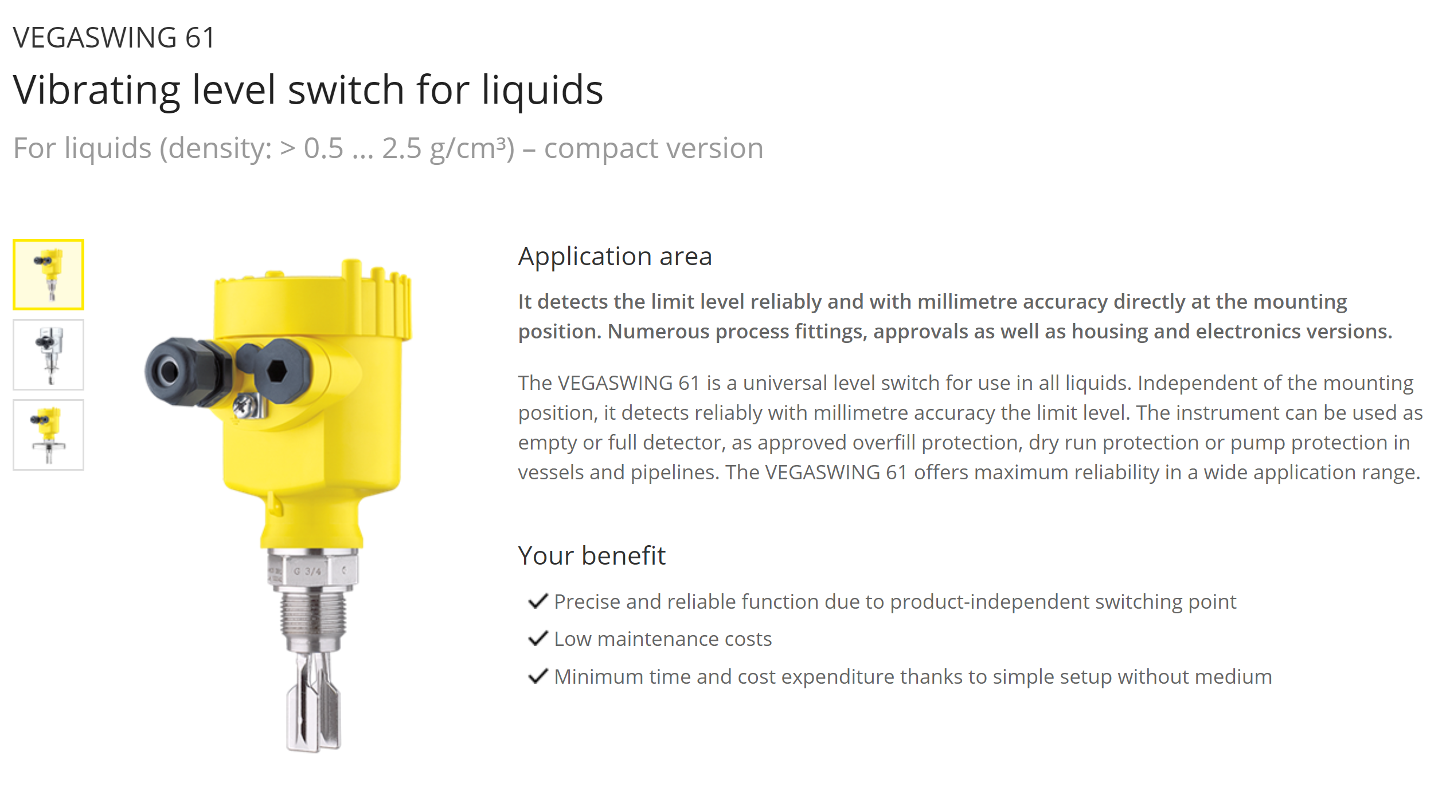
Liquid Detection System
Shell and Tube type Heat Exchanger from Exergy Inc.
Status: At BNL
In case of excess pentane in mixture it will liquify and will be collected in a container. This will be sensed using Vega Swing 61.
Status: at BNL.

Slide 14
Delivery system (heated copper lines)
As mentioned earlier, we will like gas to be delivered between 24°C +/- 2°C to the detector.
Long copper lines carrying gas from assembly hall to the IR have increased risk of temperature falling below 17°C and accumulating liquid pentane in lines specially during winters.
Lines will have to be heated. Current proposal is Si Heat Tape.
We will install a thermocouples in the system to monitor gas line and gas temperatures.
Temperature of heat tape will be varied based on temperature readings on thermocouples.
Optimum temperature will be set on the controller that will self regulate the temperature of the Heat Tape.
Temperature range of Si Tape will be 21°C to 40°C.
Please note that Heat Tape is UL Recognized and Controller is UL Listed.
Heat Tapes and Contoller are on order expected to arrive in 3rd week of march

Slide 15
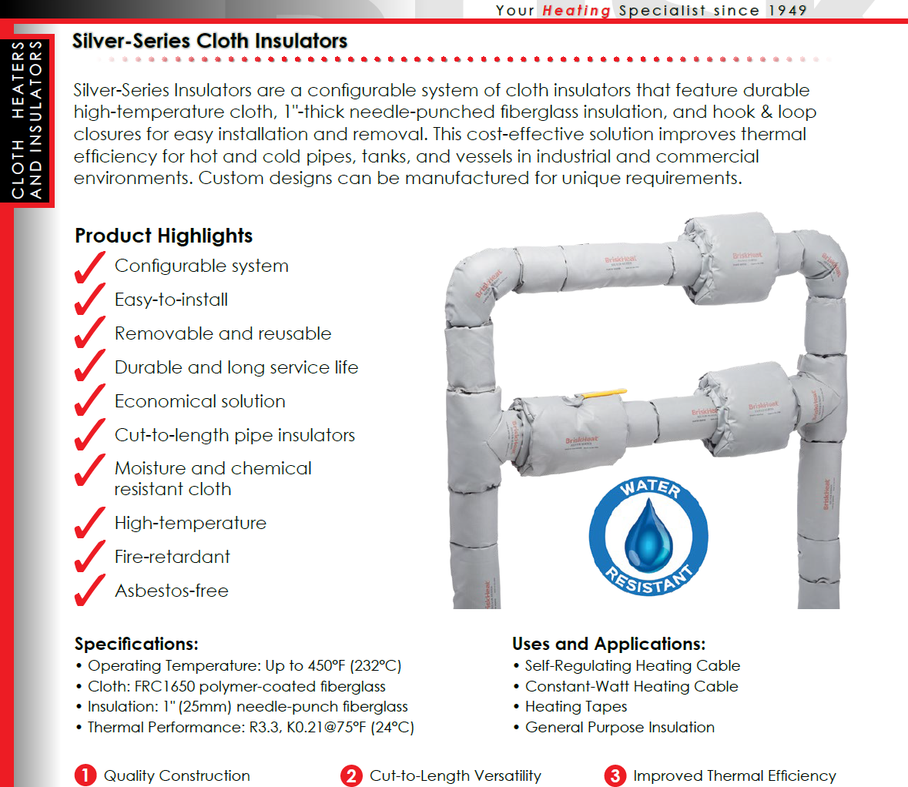
Heated and Insulated Lines (Using Si Heat Tape)

Slide 16
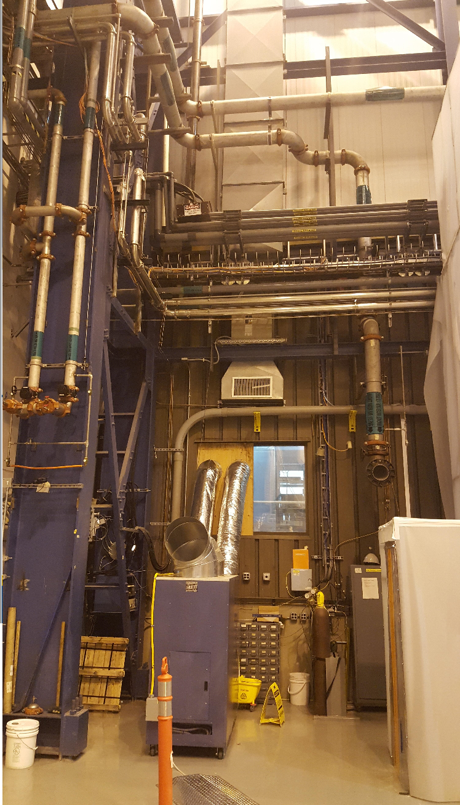
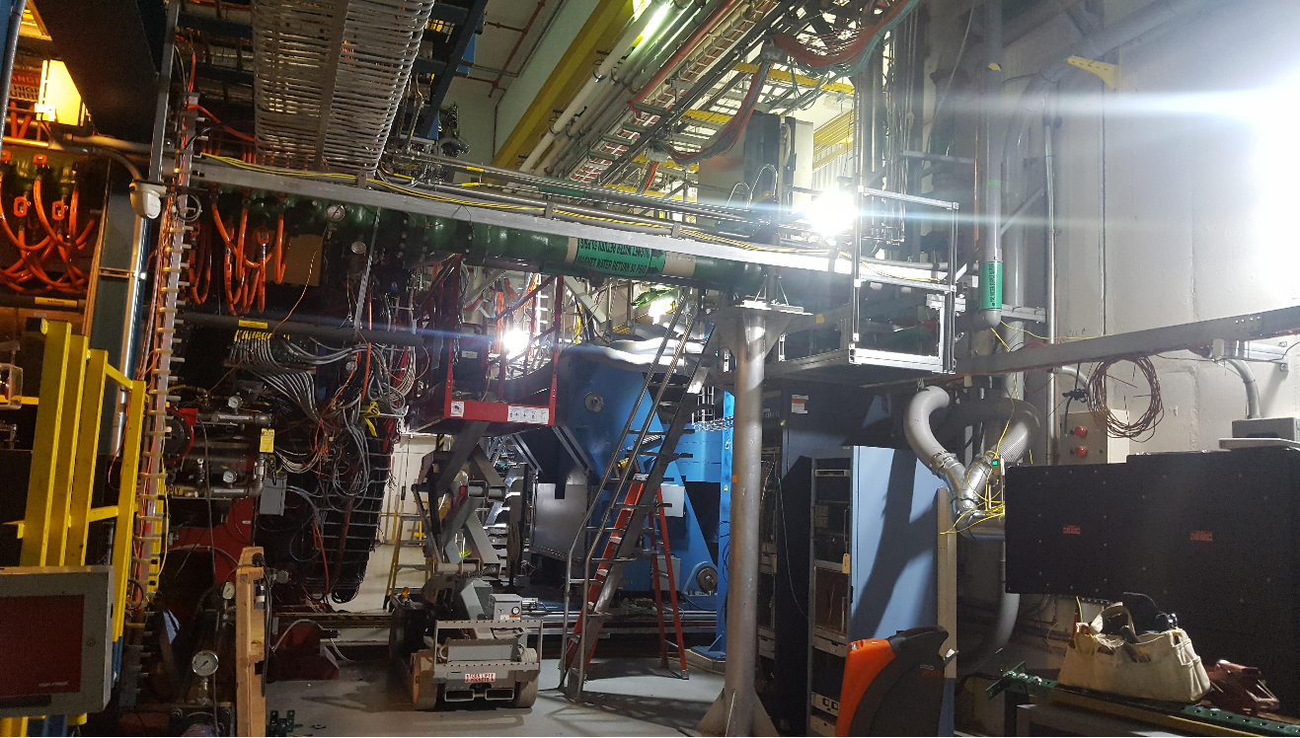
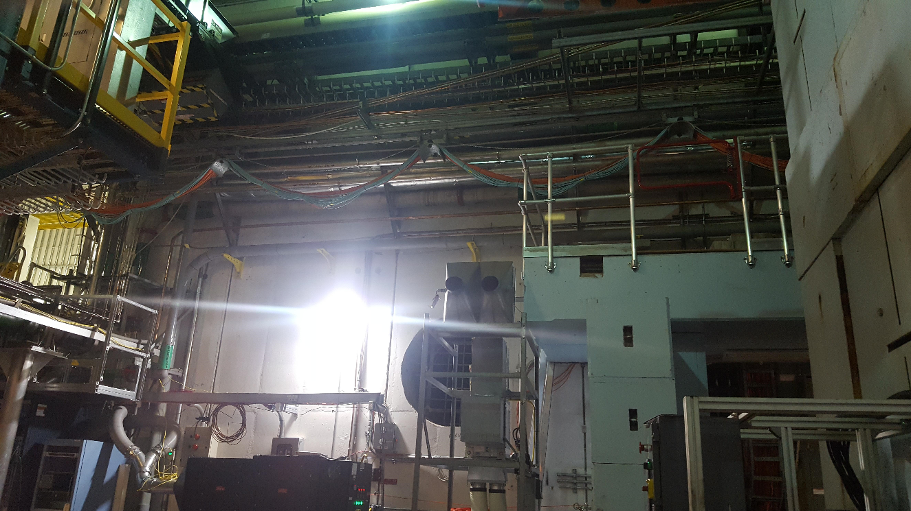
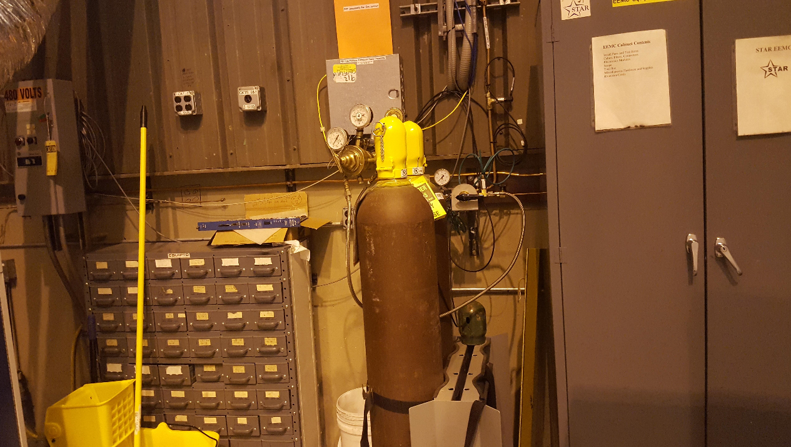
Location of Gas System

Slide 17
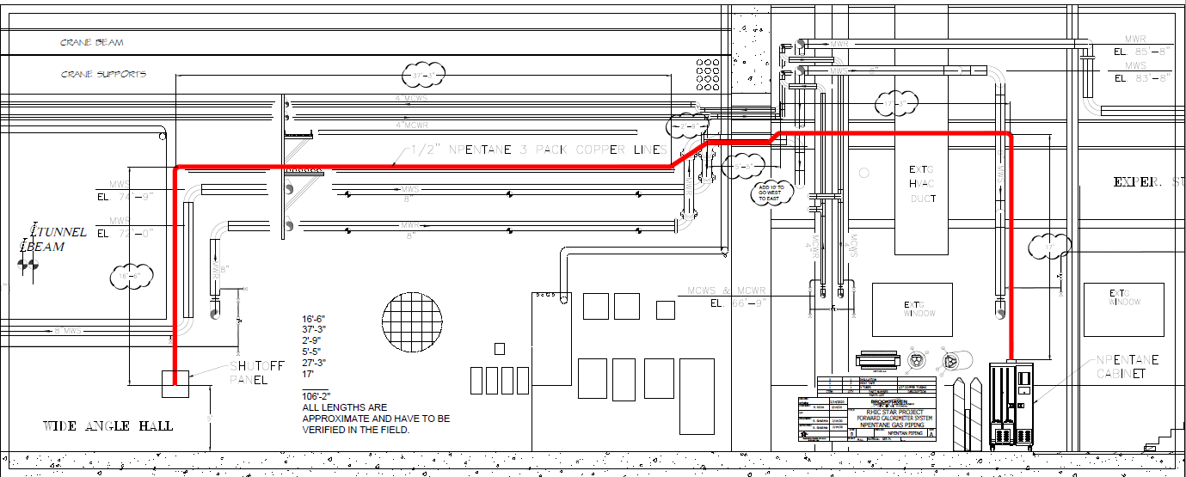
Line/Piping Diagram
Job of Laying copper lines and wrapping with heat tape is assigned to CAD. Work will start during shutdown.

Slide 18
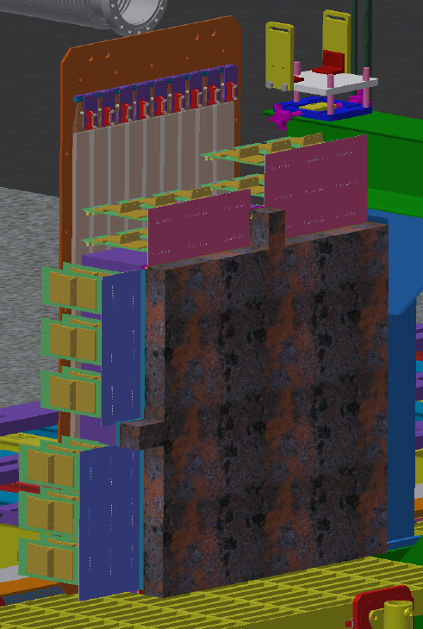
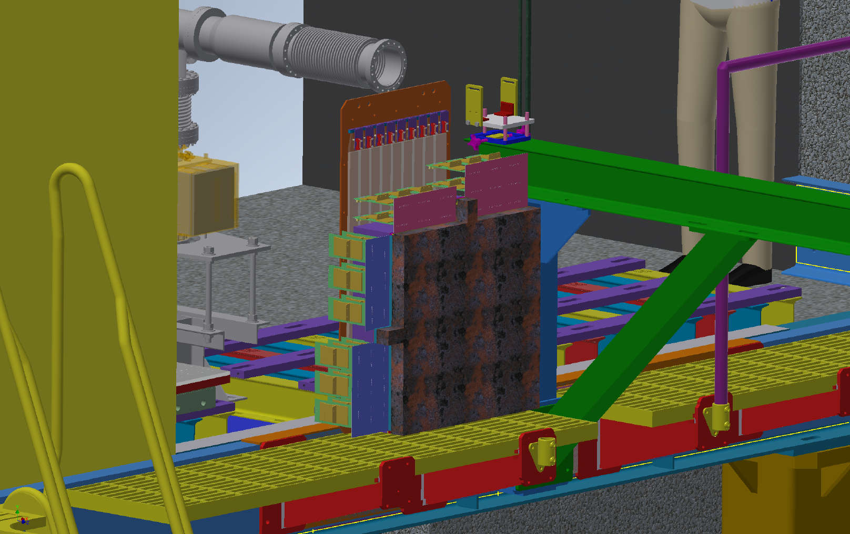
Detector for Run 2021
Heat Sensor
sTGC Detector Metal Enclosure
Sniffer
Detector module for run 2021 will be enclosed inside a metal box equipped with gas sniffer and smoke detector. In case of a smoke signal or sniffer signal solenoid valves will shutdown the flow of gas mixture into the detector.

Slide 19
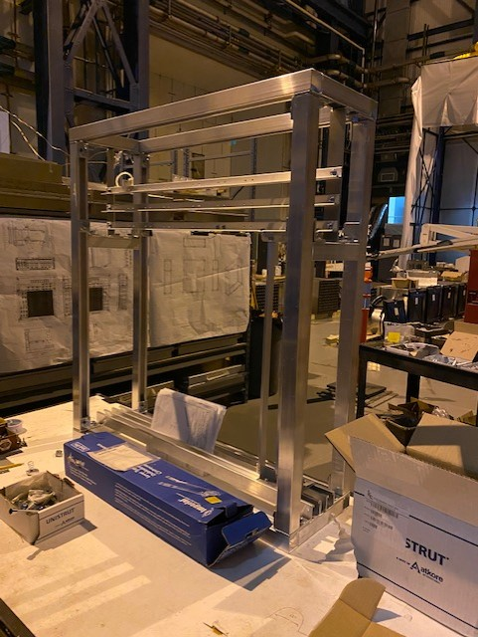
Frame and sheet metal box
Metal Frame to hold STGC Detector is built and Sheet Metal Box is almost done.
IT includes all necessary features for:
Mounting fee cards
Mounting rdos
Mounting pre-shower detector
It was going to be placed on the HCAL plate but now??.

Slide 20
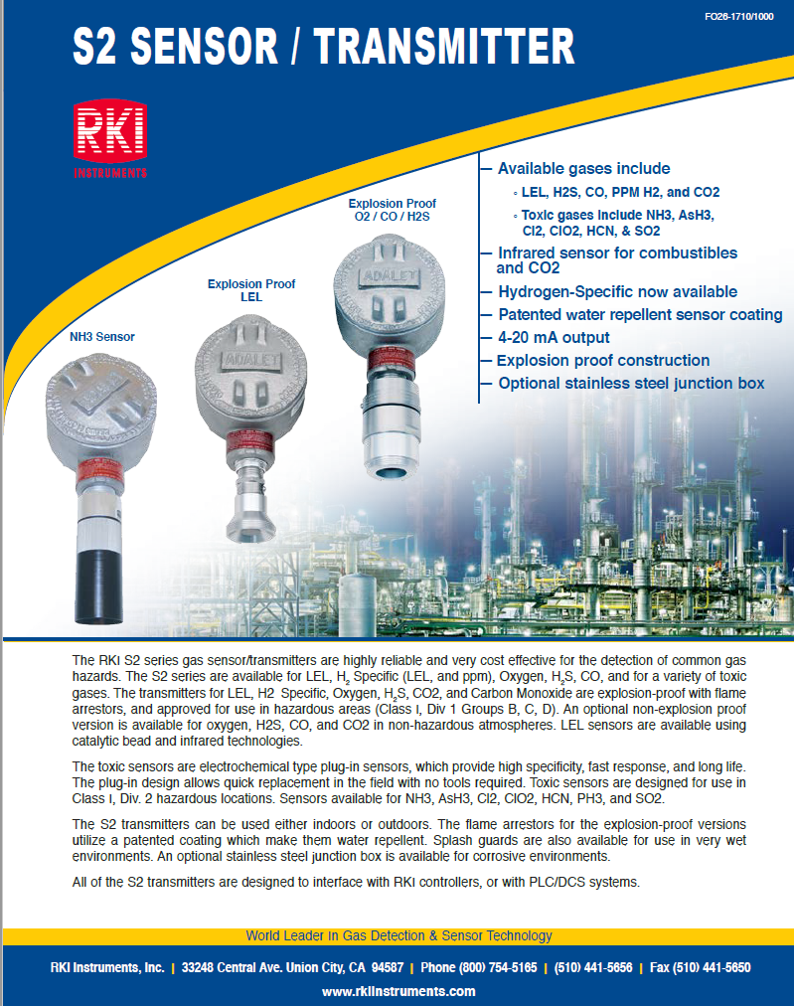
Gas Sniffing and smoke detection
We will strategically place 3 pentane sniffers and 3 smoke detectors in the whole system:
Inside flammable gas cabinet that includes gas mixing system and liquid detection system
Inside flowmeter box (for full system)
Inside the detector box for the prototype and in the poletip opening for full system.
In case of any alarm, interlock system will take measures as described in requirements document and deliverables for interlocks.

Slide 21
Tested and approved Materials
System | Gas | Elastomeres |  | Metals |  | Plastics |  | Thread Thightness |  | Bubbler Oils |  | Lubricants
 |  | accepted | forbidden | accepted | forbidden | accepted | forbidden | accepted | forbidden | accepted | forbidden | accepted | forbidden
sTGC | CO₂-n-pentane | Neoprene, Nitrile, NBR, Buna N, Viton | NR, Nordel EPM, EPDM | Stainless Steel Aluminium Cupper Brass | - | BR4 Rilsan Polyurethane Teflon |  | Teflon band Loctite ? | Si-joint | Briox oil | Si Oils | Apiezon Kryotox | any Si based

Slide 22
Safety
Metal Flammable liquid cabinet for storage of Pentane.
Pressure relief valves in circuits where overpressure may occur.
Solenoid valves and pressure transducers in the system to stop the flow in case of alarm.
All lines carrying liquid and gas will be grounded.
Si Heat Tape will be grounded.
Controllers for all modules/instruments will be plugged into GFCIs.
Gas sniffers and smoke detectors.
Pressure testing:
All the gas lines (copper lines) will be tested to a pressure (50psi)
Detector will be tested in the clean room for 5 times the operating pressure (5 millibar)
Full system pressure test will be done before commissioning.

Slide 23
Testing
Gas mixing system equipment would be tested in clean room prior to installation.
Heat tapes and thermocouples will be tested prior to installation
All copper gas lines from the cabinet to the detector will be tested at 50psi (requirement by BNL safety)
Vega Liquid detector will be tested for functionality in cleanroom
Sniffers, heat detectors, pressure transducers and solenoid valves will be tested for verifying i/O signals to monitoring and interlock system.

Slide 24
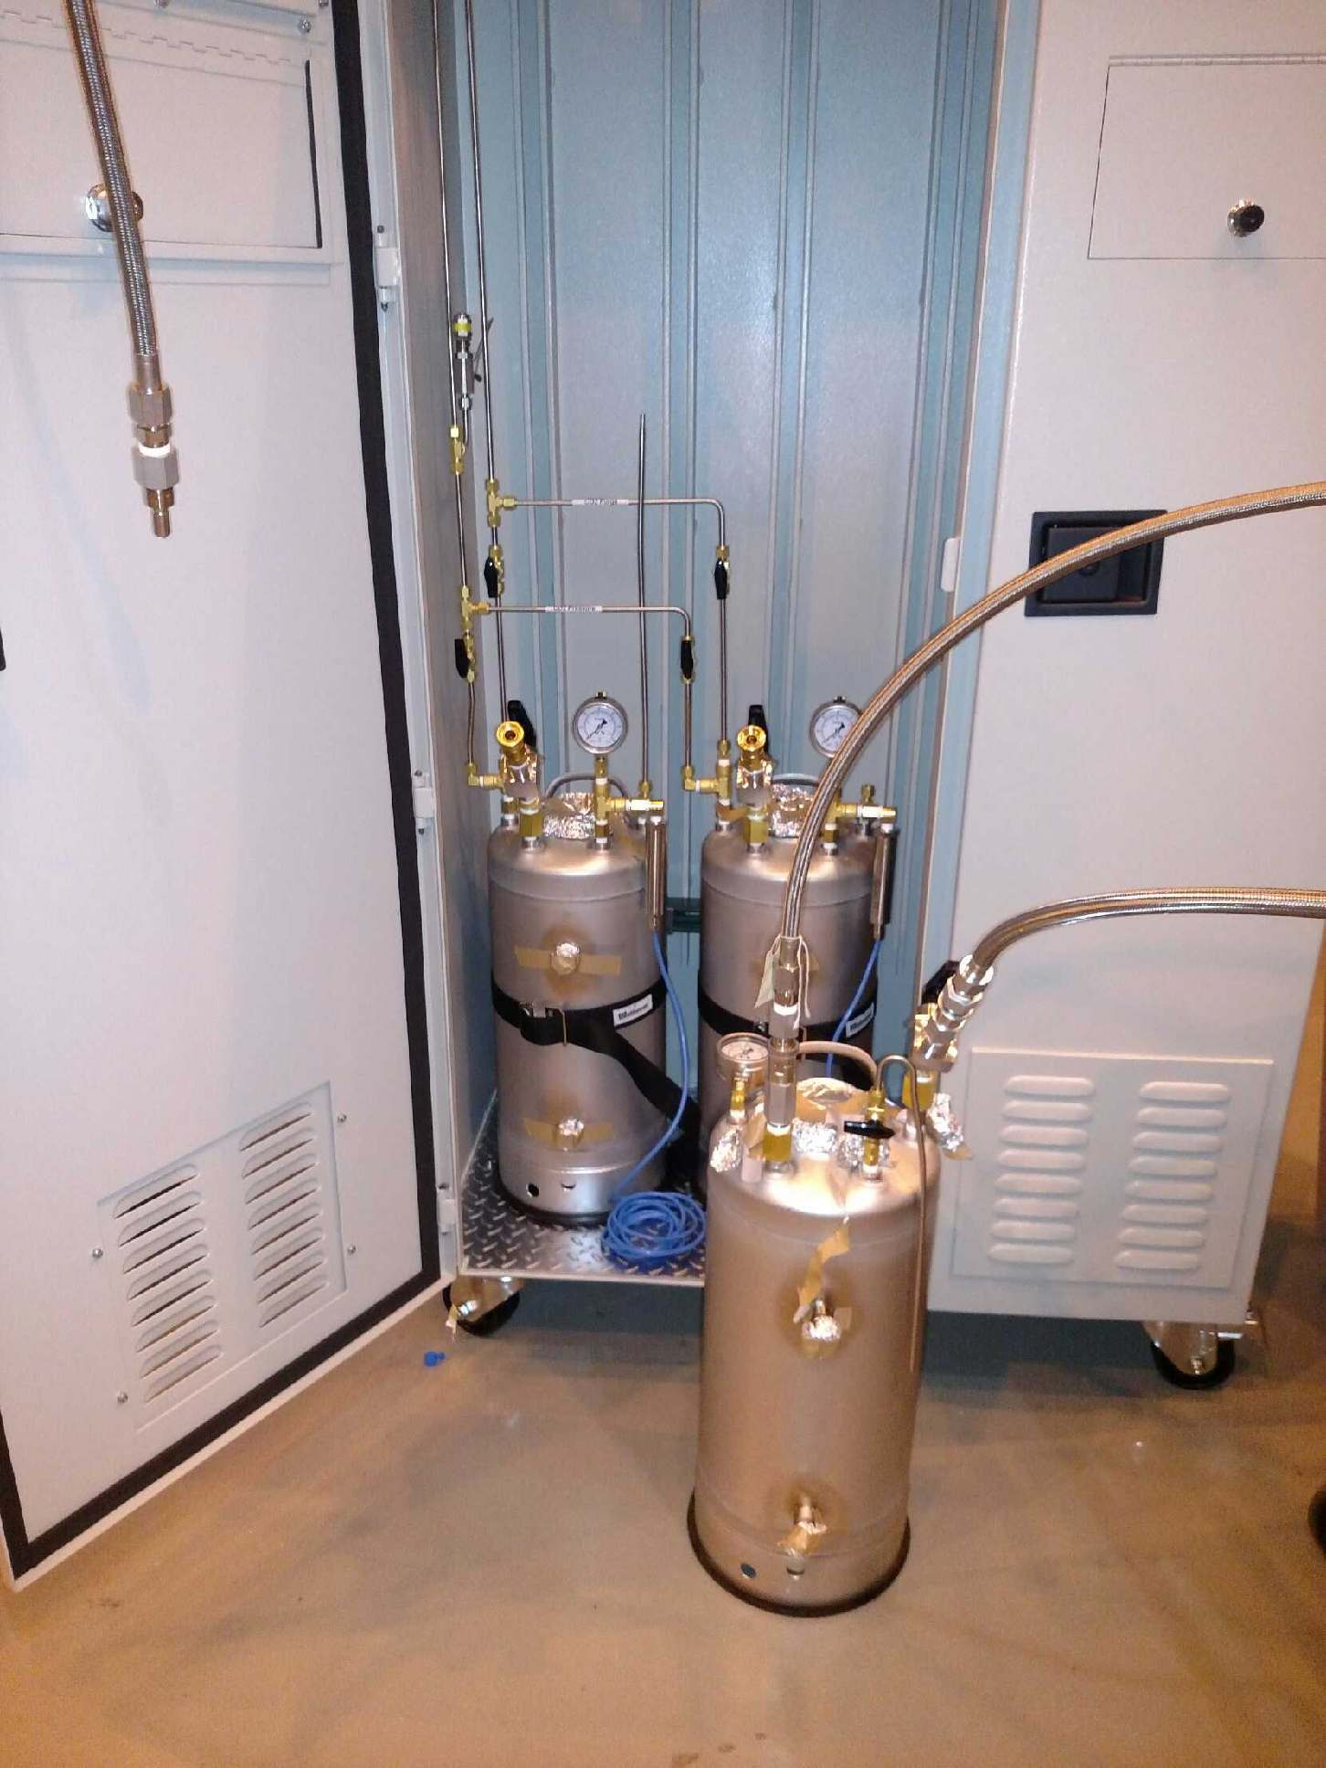
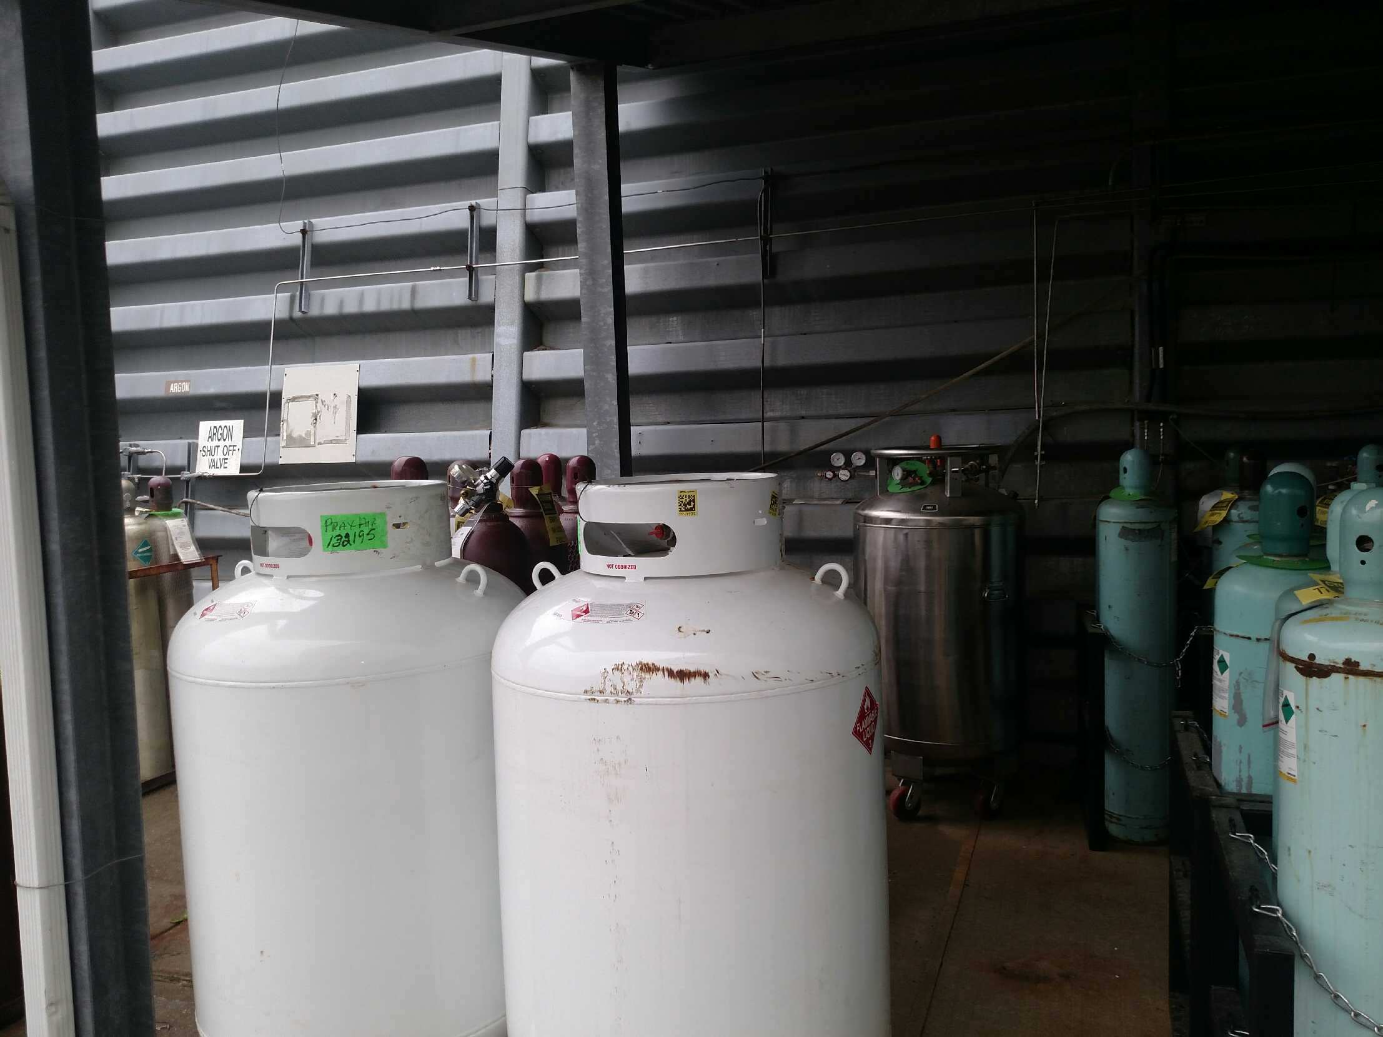
Status
Requirements fully established.
Regular communication with safety and within the group to ensure work progress is being made.
Matheson cabinet received at bnl.
Liquid CO2 dewar received at BNL.
Pentane tanks received at BNL: Plumbing work started
work request submitted for barriers to protect liquid pentane tanks (Req by safety)
Gas mixing system components received.
Vega unit and liquid container in hand.
Heat tapes and controller received.
Interlock system hardware requirements established and hardware received at bnl
Special wiring to be ordered – details by prashanth
solenoid valves received
Pressure regulators received

Slide 25
Schedule
All heat tape Components tested and ready for installation : August 21st, 2020
All mass flowmeters and CEM Tested and ready to be installed : august 21st , 2020
Gas panel construction: Sept 4, 2020
Heat tape installation : beginning of shutdown
Installation complete: Oct 31st
Interlock system complete and installed : Oct 31st
Final tuning, testing and commissioning: Nov 13th

Slide 26
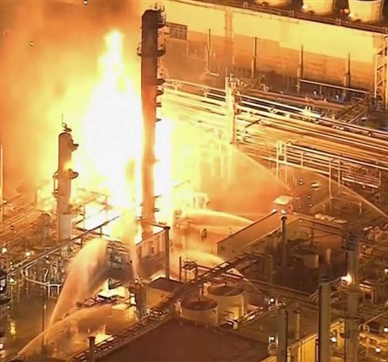
Safety risks
Risk: Any malfunction in any of the sub-systems can cause gas leak which can cause fire/explosion.
All components in flammable gas environment are class-1 div-1 or class-1 div-2 approved as required.
Interlock and monitoring system: the logic is designed to prevent any such accidents.
As we are dealing with flammable gas, we are taking safety very seriously. We are making sure All relevant mechanical, electrical and fire safety engineers are engaged in project.

Slide 27
End of Presentation
Questions/Comments??

