Slide 1
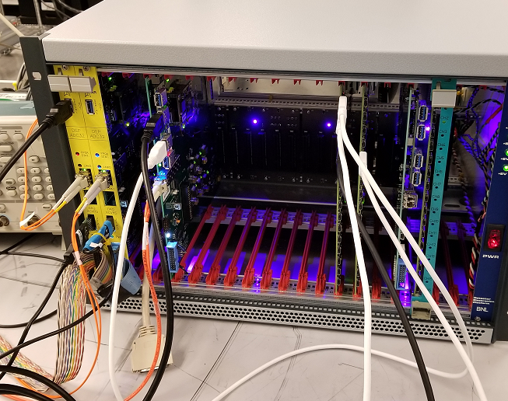
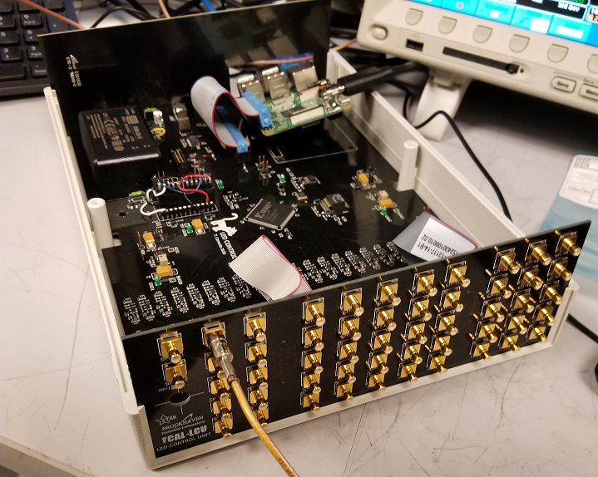
Electronics Installation
ECAL & HCAL Forward Calorimeters
sTGC
Tim Camarda for the STAR Electronics Group
FALL 2020

Slide 2
Rackmount Electronics Equipment
P2 BREAKER PANEL
P2 BREAKER PANEL
Old FMS SOUTH
Old FMS NORTH
4U Duplex Fiber Panel
1U 208V 20A PDU
FMS South
FMS North has adequate power feed and rack configuration for 120/ 208V 20A
FMS North
Same config as FMS N. But will need to be relocated on the south side next to FMS S.
The power feed cable will need to be disconnected from the knife-switch box mounted on the cabinet and re-routed to the South.
FMS North need to remove:
2x 9U empty VME crates
NIM power bin
Schedule: Can start once shutdown begins in September
1U 208V 20A PDU
1U 208V 20A PDU
1U 115V 20A PDU
1U 115V 20A PDU
8 U MPOD
LV FCAL POWER
6.5 U DEP CRATE
1U Air Intake
6.5 U DEP CRATE
ECAL
LED CNTRL
HCAL
LED CNTRL
42 UNITS
6.5 U sTGC LV Power
6.5 U DEP CRATE
6.5 U sTGC LV Power
1U TCD FAN OUT
6.5 U DEP CRATE
1U TCD FAN OUT
1U Air Intake
6.5 U DEP CRATE
8 U CAEN
SY4527
sTGC HV
2U Air Intake
2U Air Intake

Slide 3
Support Components & Cables
1. Patch panels (Power & Signal Boards):
Board Fabrication and assembly is out for quote for turnkey assembly
3 - 4 week turn-time (27 cards)
2. Color Coded Signal cables from FEE to patch panel
7 of the 8 colors are in house for ECAL (350 cables)
White cable will be available in August (50 cables)
HCAL signal cables: Submitted PO (160 cables)
3. Power/control ribbon cables from FEE to patch panel (LV, HV & I2C Comm.)
Drawing complete, need to re-check cable length going into the detector enclosure.
4. Power cables from MPD rack power to patch panels
Cable drawing complete
Waiting for quote from vendor
5-6 week turn-time (12 cables, 10 for system plus 2 spares)
6. LED on detector boards
ECAL LED board assemblies are completed (55 cards)
HCAL LED boards: Submitted PO for turnkey assembly (35 cards) 15 day
7.LED SMB driver cables (HCAL & ECAL)
- Still needs to be ordered. (need 80 cables plus spares)
8. ‘plugin converter board’ to check signals with a scope on the platform
Need to design board
9. Patch panel mounting plate
Mounting plate drawing complete, need to submit for fabrication
Rack Components Install
DEP Crates
2 Complete crates
3 Crates in progress
1 Spare crate
Network PDU’s
120V 20A -> 2 in house
208V 20A -> 2 in house
Duplex Fiber Panel -> in house
1u TCD FAN OUT -> 2 in stock
LED Control Unit
2 boxes built & Tested SAT
3u Blowers for rack cooling -> Need to order
sTGC DEP Power Crate
LV Power Module -> Prototype Tested SAT
Backplane design complete -> need to order boards
Control Board for crate -> in development
Crates need to be ordered from vendor

Slide 4
Electronics Install Summary
Most of the Rackmount Equipment is available in house
Need to order 3u Fans/ Blowers for Cabinet Cooling
FMS North Rack: Needs to be relocated to South side of beam pipe
LED Control Box: 2 units assembled & tested
Ready to start installing equipment in September 2020
LV Module for sTGC
Prototype in development
Crates & Backplanes: Need to be ordered
Schedule: Need to test in lab with FEE & RBO
Production boards targeted for November 2020
Support Components & Cables
Patch Panel (signal & Power Board): Waiting on quote from vendor: 3-4 week turn-time for 27 cards
Mounting plate: Drawing complete, need to submit for fabrication
Color coded signal cables: 350 of 400 ECAL in house, HCAL PO submitted for 160 cables
Schedule: Should have all cables in by September 7, 2020
Power/ control ribbon cables: Drawing complete, need to get quote from vendor
LV Power Cables: Still waiting on quote from vendor (5 – 6 week turn)
LED Detector Boards: ECAL 55 boards ready to install: HCAL PO for 35 boards submitted
LED SMB driver cables: Drawing Complete: Need to get quoted from vendor
Differential to Single-ended test board: Needs to be designed and built.

