Slide 1
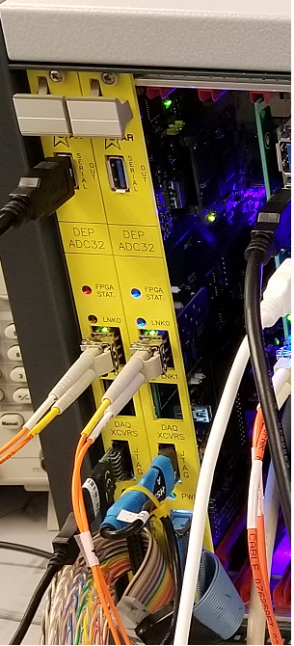
Electronics & DAQ Status
T. Camarda
(with T. Ljubicic)

Slide 2
DEP/ADC Boards
Boards are in assembly
expected early Aug
2 early articles received and tested OK
some minor issues -- list sent to vendor
5 DEP crates getting assembled in the lab
enclosure, power supplies, backplanes, etc.
expected by Aug 1
quick Q&A plan available once the boards arrive
with final testing assumed to be done after installation in STAR

Slide 3
DEP/IO (Trigger) Boards
we still need to complete the full setup and verification
lost 3-4 months so far due to COVID
need Bob Scheetz and TL to continue…
on hold until BS & TL available (Sep? Oct?)
Trigger algorithms stalled
expected to pick this up later in fall/winter

Slide 4
FCS DAQ
All 11 DAQ PCs installed and working
All 22 DAQ Receiver Boards installed in the PCs
firmware flashed
devices drivers ported
all pass preliminary tests
full tests need active fibers → Sep
2 MIC boxes (aka fiber patch panels) installed
fiber patch cables purchased
long fiber bundles purchased and waiting for installation
this also includes STGC fibers, NB

Slide 5
STGC DAQ
4+1 spare DAQ PCs ordered
expected mid-Aug
space in the same DAQ FCS rack available
power, network ready
4+1 DAQ Receiver Boards ordered and received
need firmware programming and assembly → will wait for DAQ PCs (Aug)

Slide 6
FCS Electronics Installation in ~Sep
FCS rack available and in-place (see Tim’s talk)
Major components:
5 DEP crates
TCD fanout unit (with cable to the FCS TCD already in place)
Network power switches for remote power control (already purchased)
MIC fiber patchpanel boxes (purchased)
ethernet
Installation expected to be quick
also need to install fiber bundles and pull them to the DAQ Room PCs
Verification and further development (firmware, software) will continue in fall/winter 2020

Slide 7
Summary
generally doing well
managed to “salvage” significant chunks of time lost due to COVID
Bob & TL remotely
Mike and Tim also but in the lab/DAQ Room as well!
major part still left are the DEP/ADC boards Q&A once they arrive
DEP/Trigger board system verification and final setup still on “COVID”-hold

