Slide 1
Integration Schedule
- Rahul Sharma

Slide 2
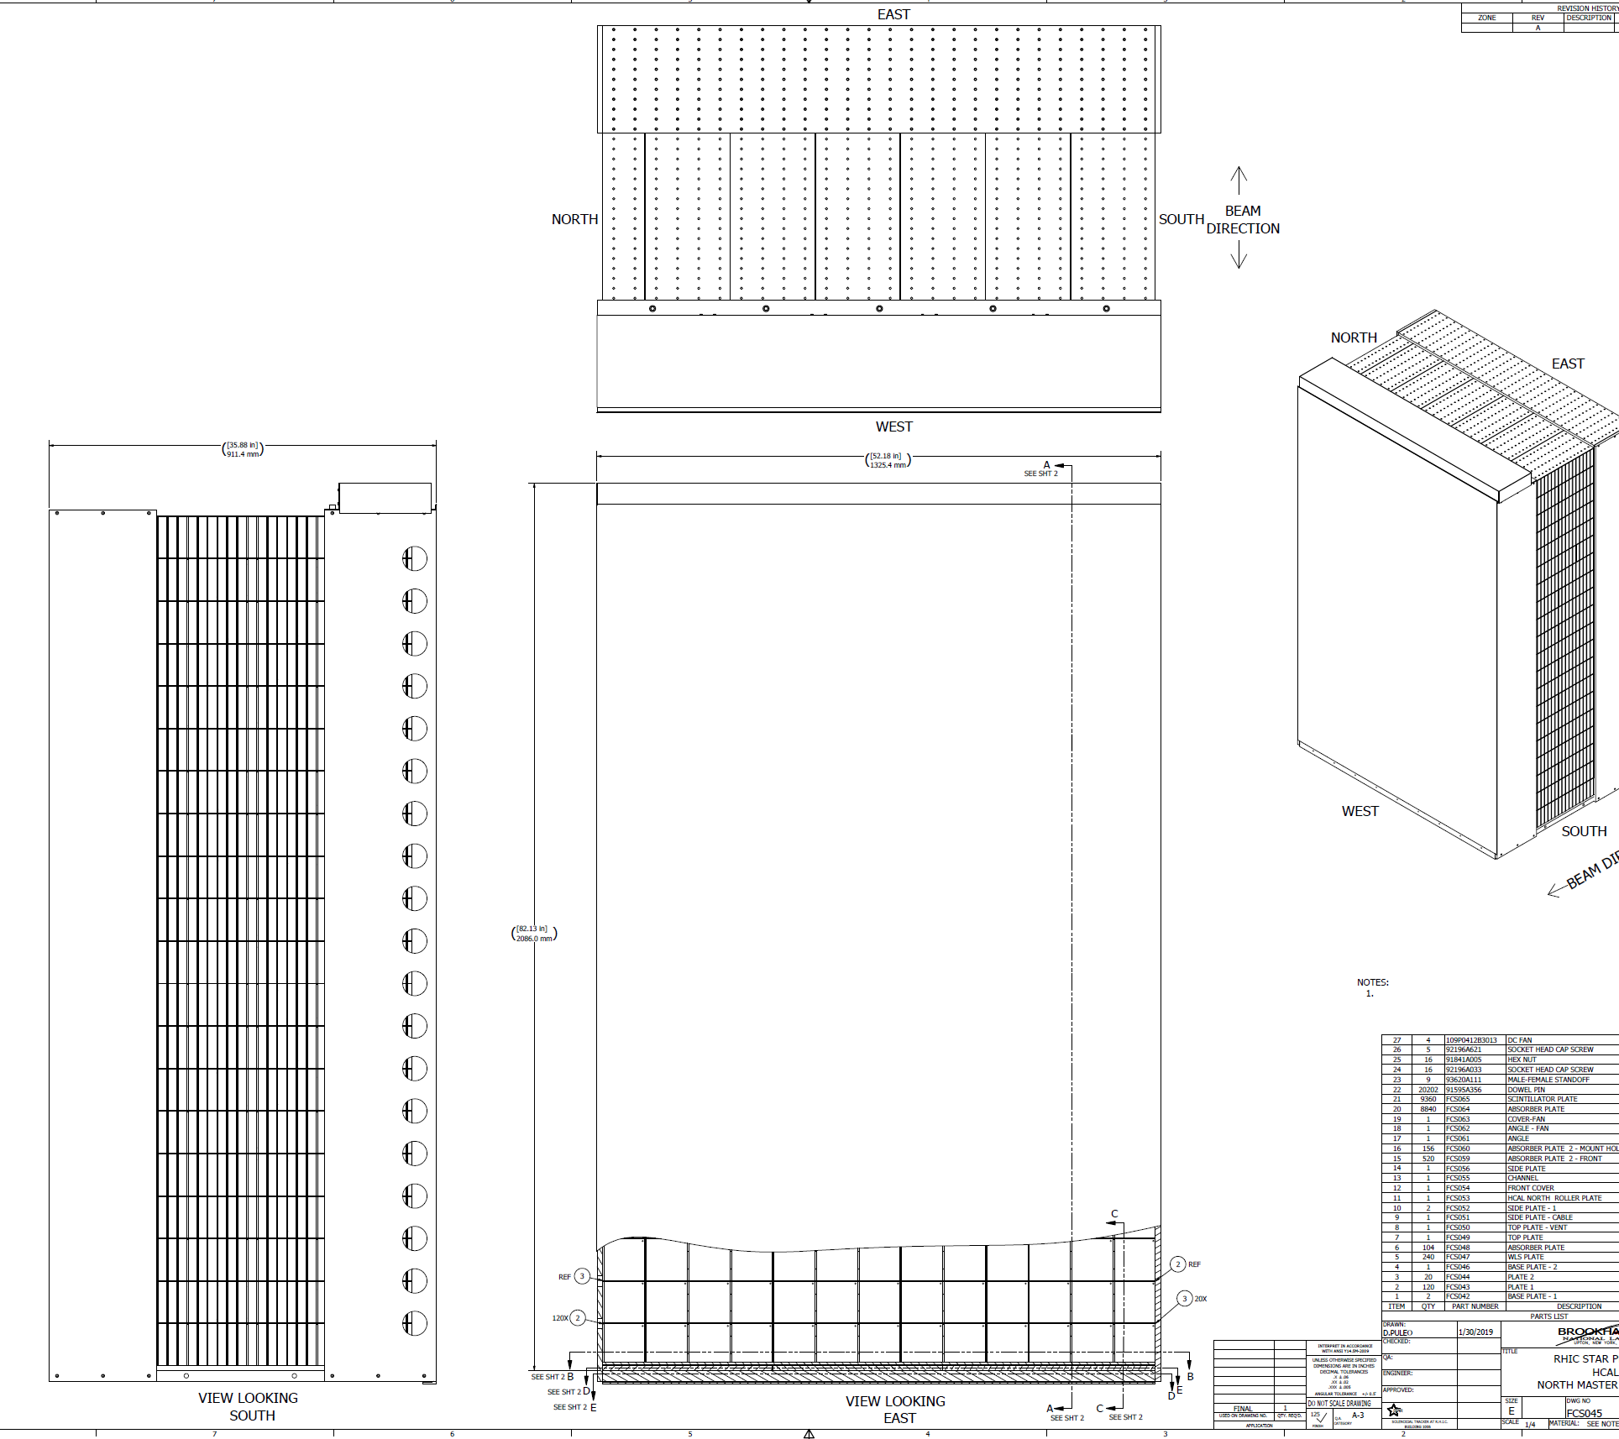
HCAL/EMCAL
Detail Design Complete
Parts Fabrication: September 30, 2020
Detector installation: Sept 2020-January 2021
EMCAL mechanical installation complete
EMCAL Electronics installation and commissioning: October to November 2020

Slide 3
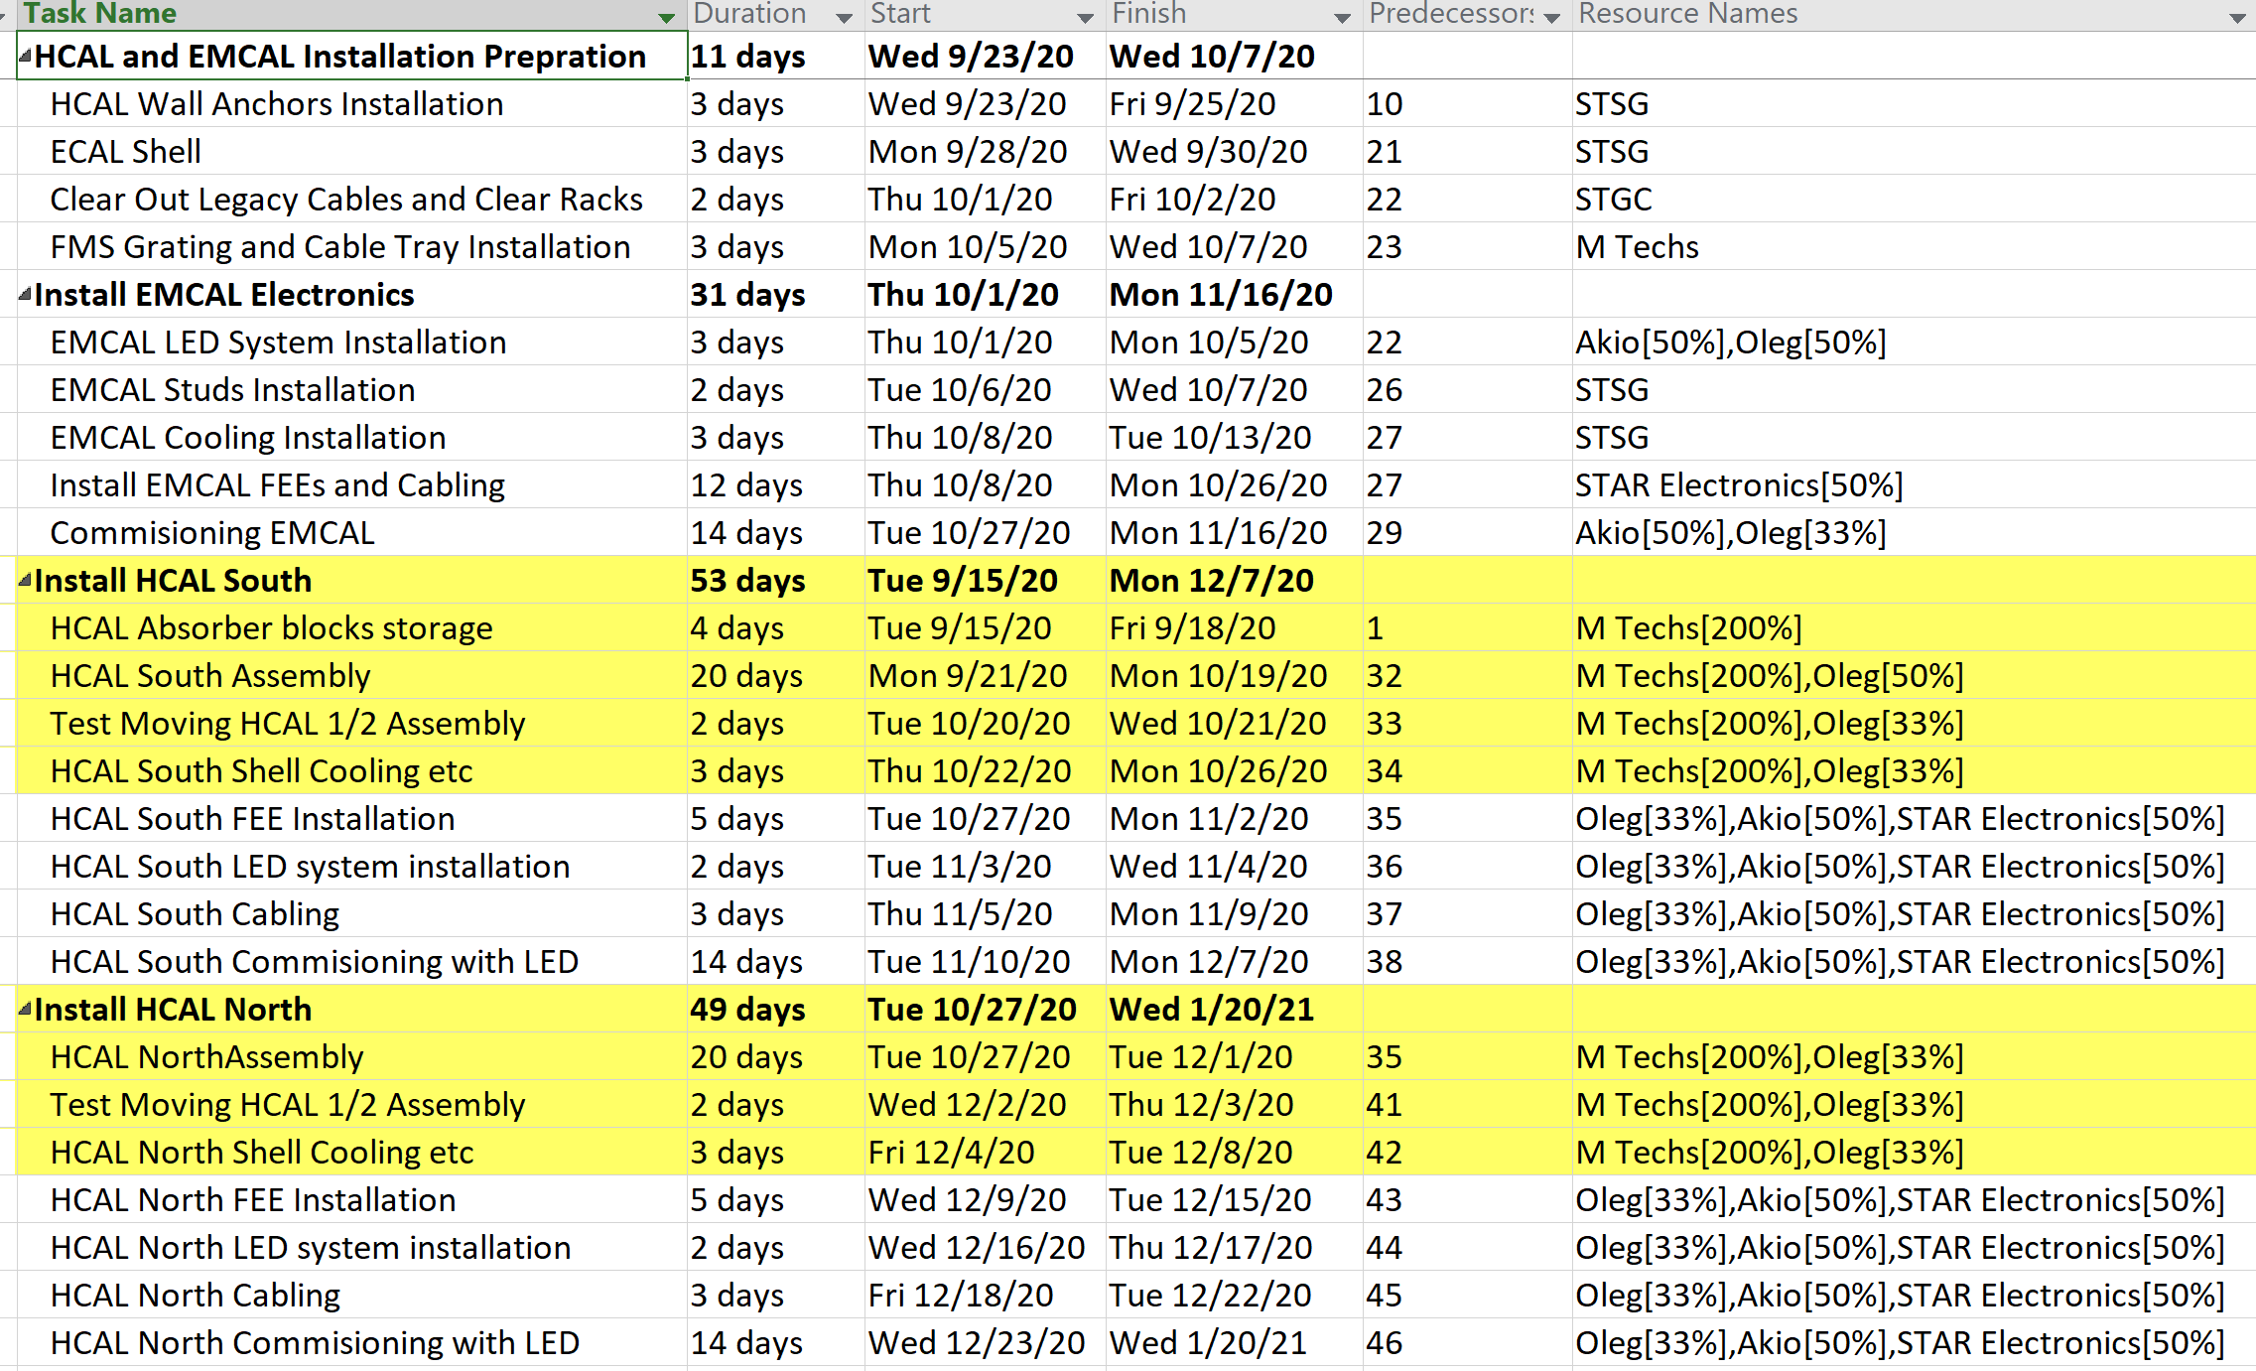
HCAL EMCAL Schedule 2020

Slide 4
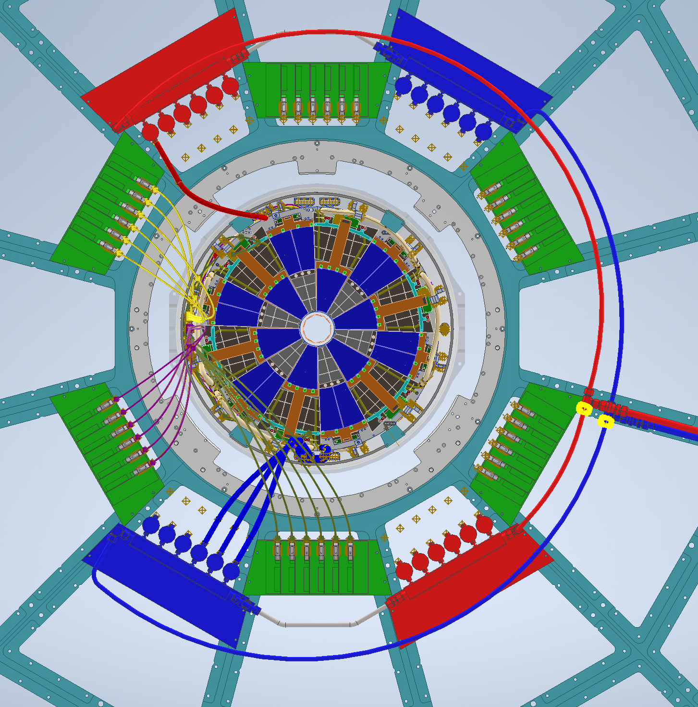
FST
Detail Design in Progress
Expected Completion Date: August 31, 2020
Parts Fabrication: October 31st, 2020
Mockup testing inside cone: Dec, 2020
Novec Cooling System Installation – Oct 2020
Detector installation: 7/28/2021 to 8/10/2021

Slide 5
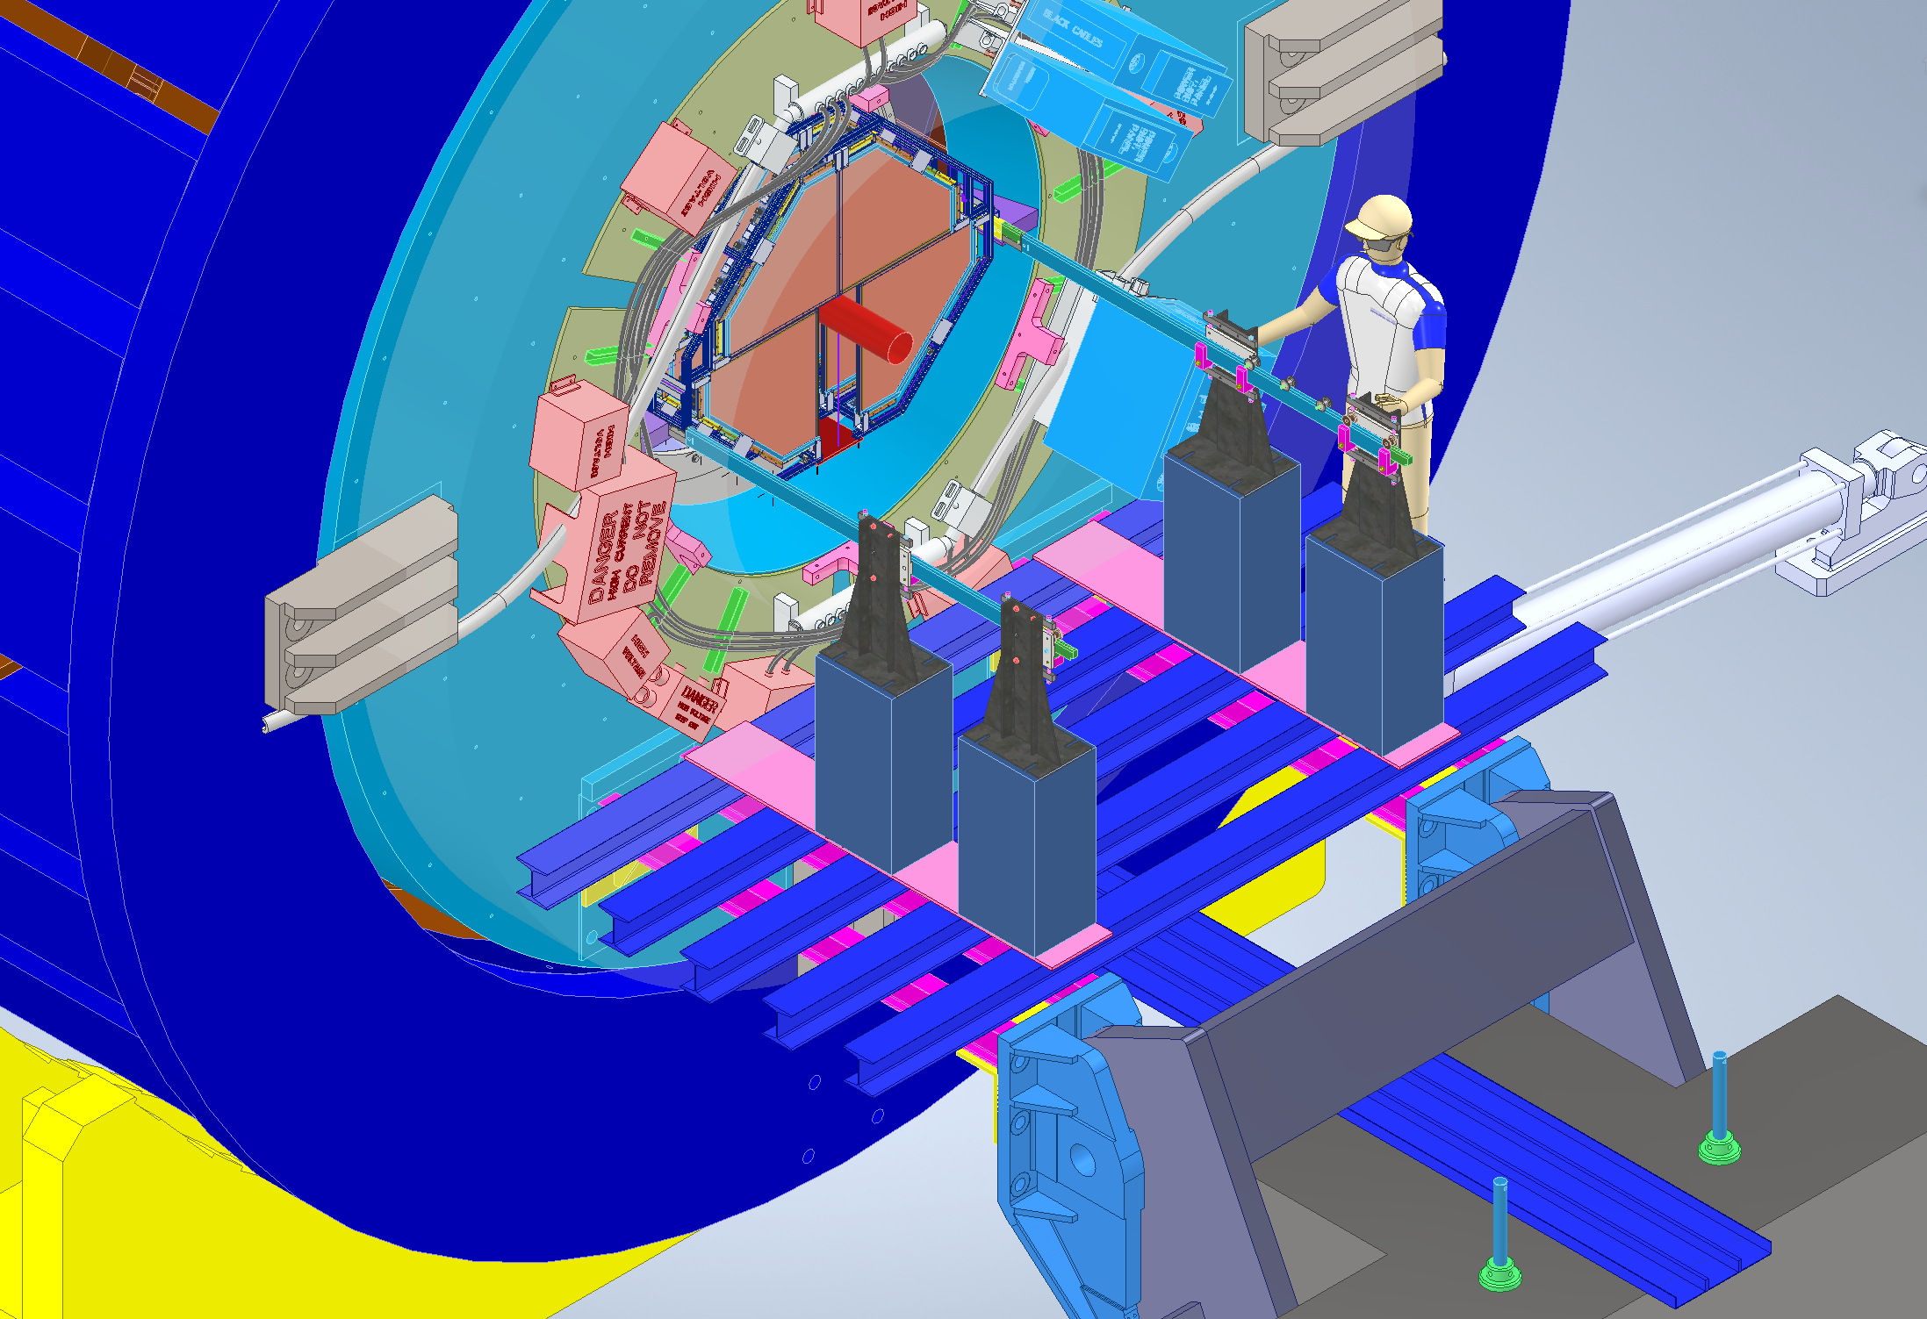
STGC Schedule
3D Design Completed – Sept 30, 2020
Detail Drawings Complete – Oct 31st 2020
STGC Gas System Ready – Nov 13 2020
STGC Parts Fabrication – January 31st 2021
STSG Module Assembly – July 7, 2021 to July 20, 2021
STSG Installation and Commissioning – 9/9/2021 to 9/29/2021

Slide 6
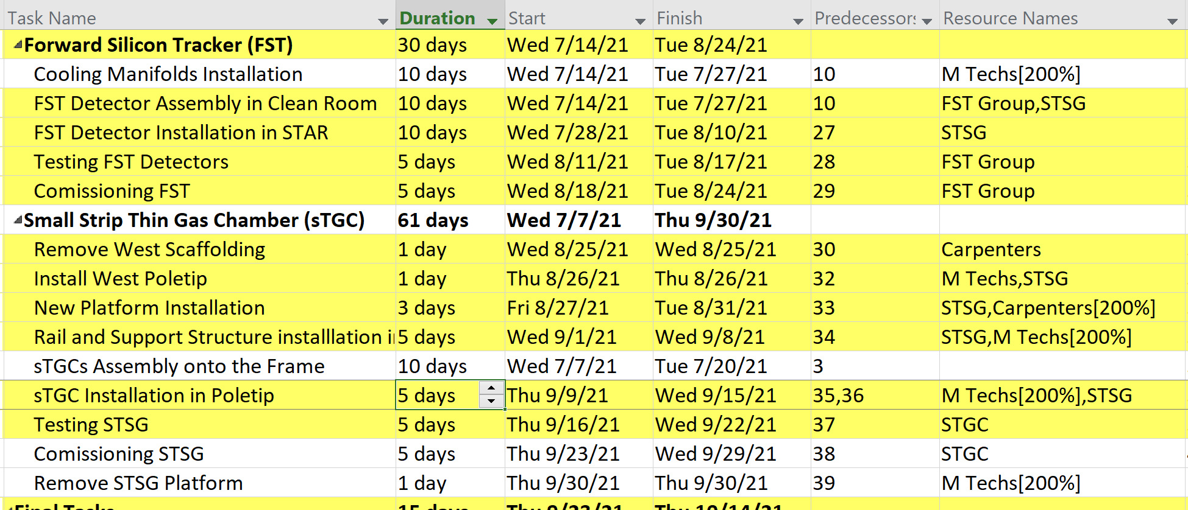
FST and STGC Installation Schedule 2021

