Slide 1
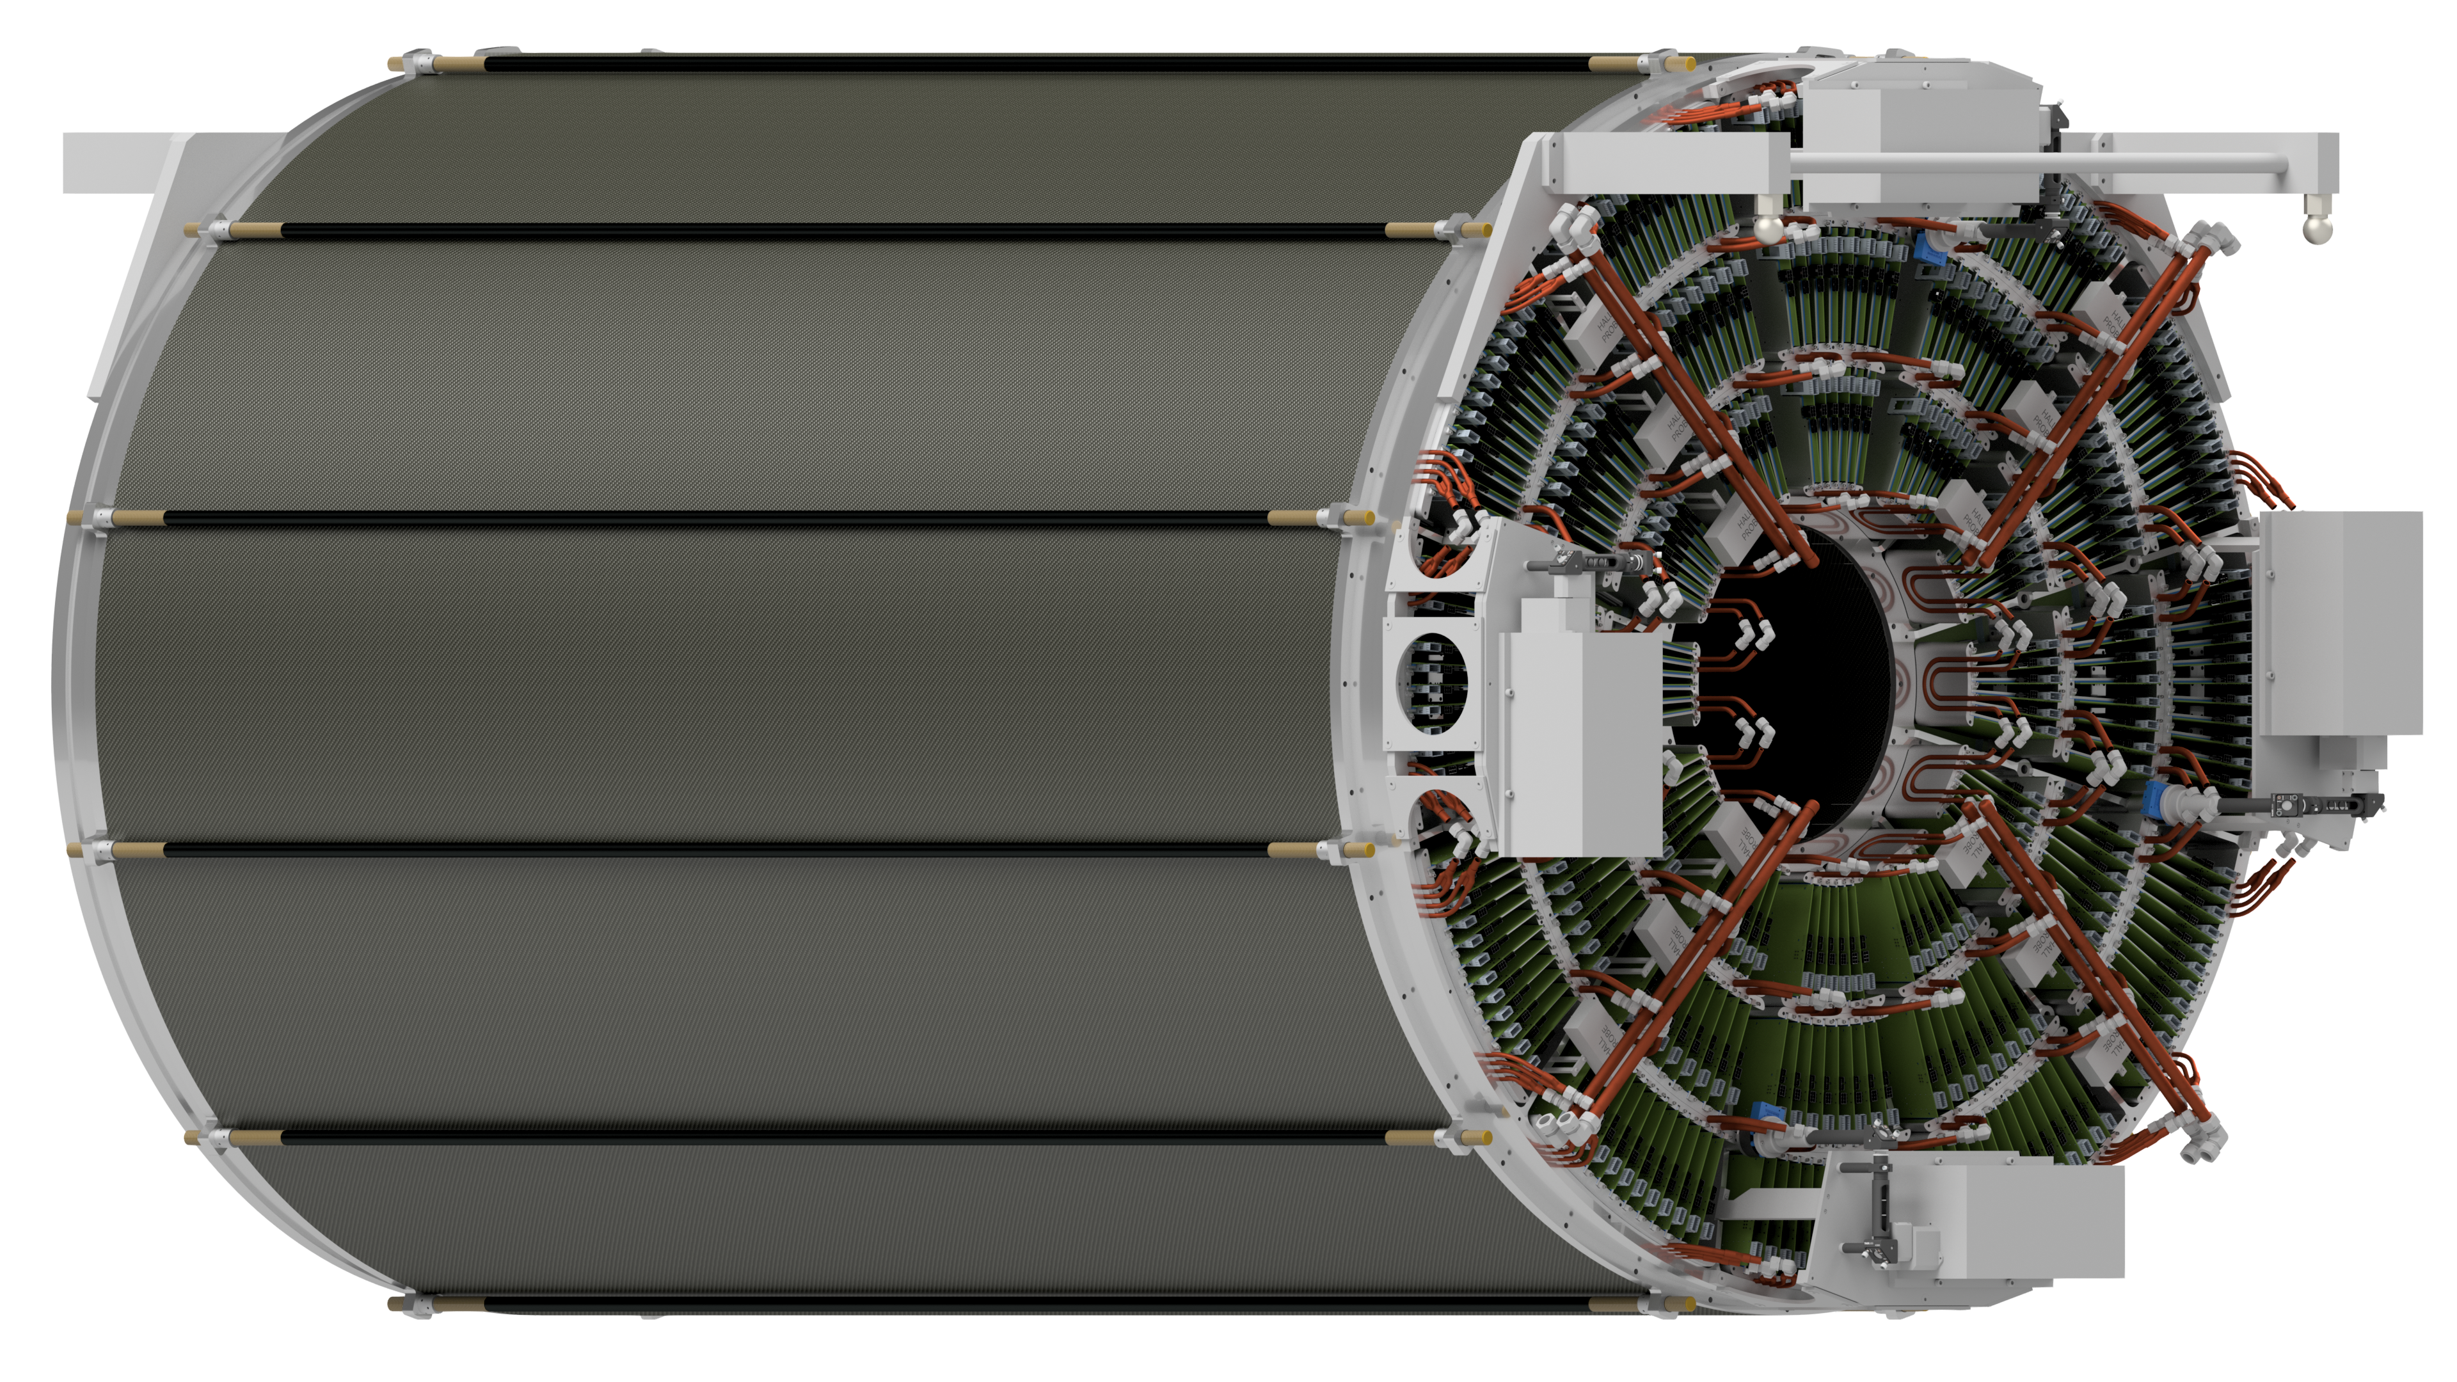
Planning for the sPHENIX TPC GEM Assembly & QA
Aiwu, Henry , Klaus, Prakhar, Tom
8/3/2020, Group Meeting

Slide 2
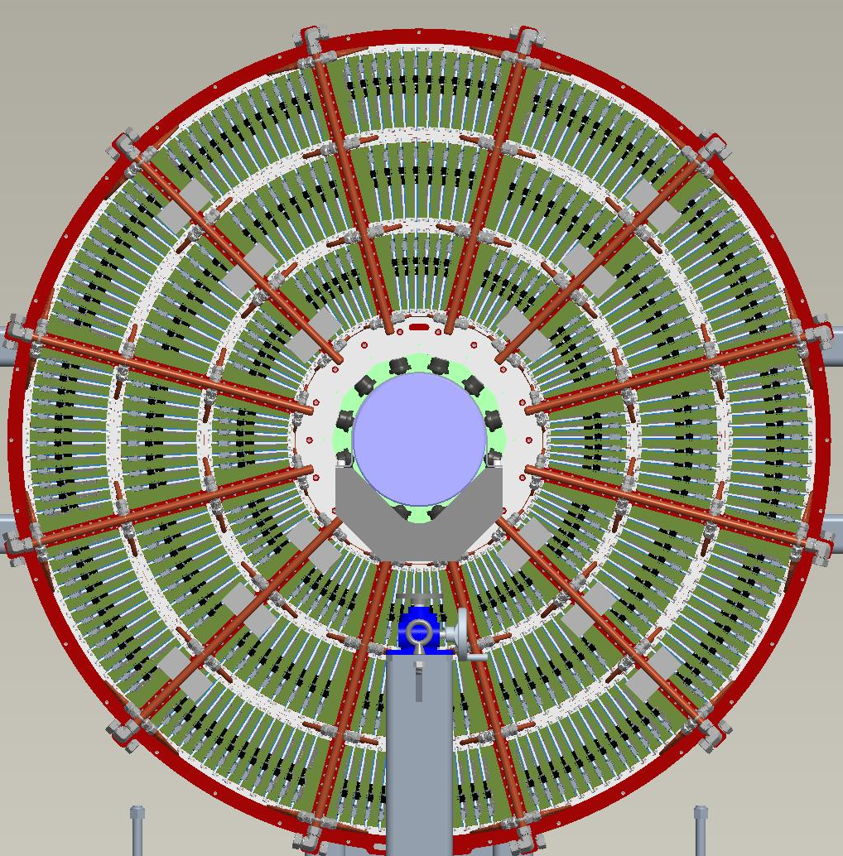
Introduction
The TPC will be integrated into the sPHENIX detector in two years
GEM foil production to be started at CERN very soon (Oct 2020)
Followed by framing GEM foils at the four production factories:
Weizmann Institute, for R1 GEM
Wayne State U., for R2
Temple U. and Vanderbilt U., for R3
It is huge amount of work ahead of us:
Assemble the GEM modules
Make sure they are OK
Integration
It is important that we plan ahead …
R3
R2
R1

Slide 3
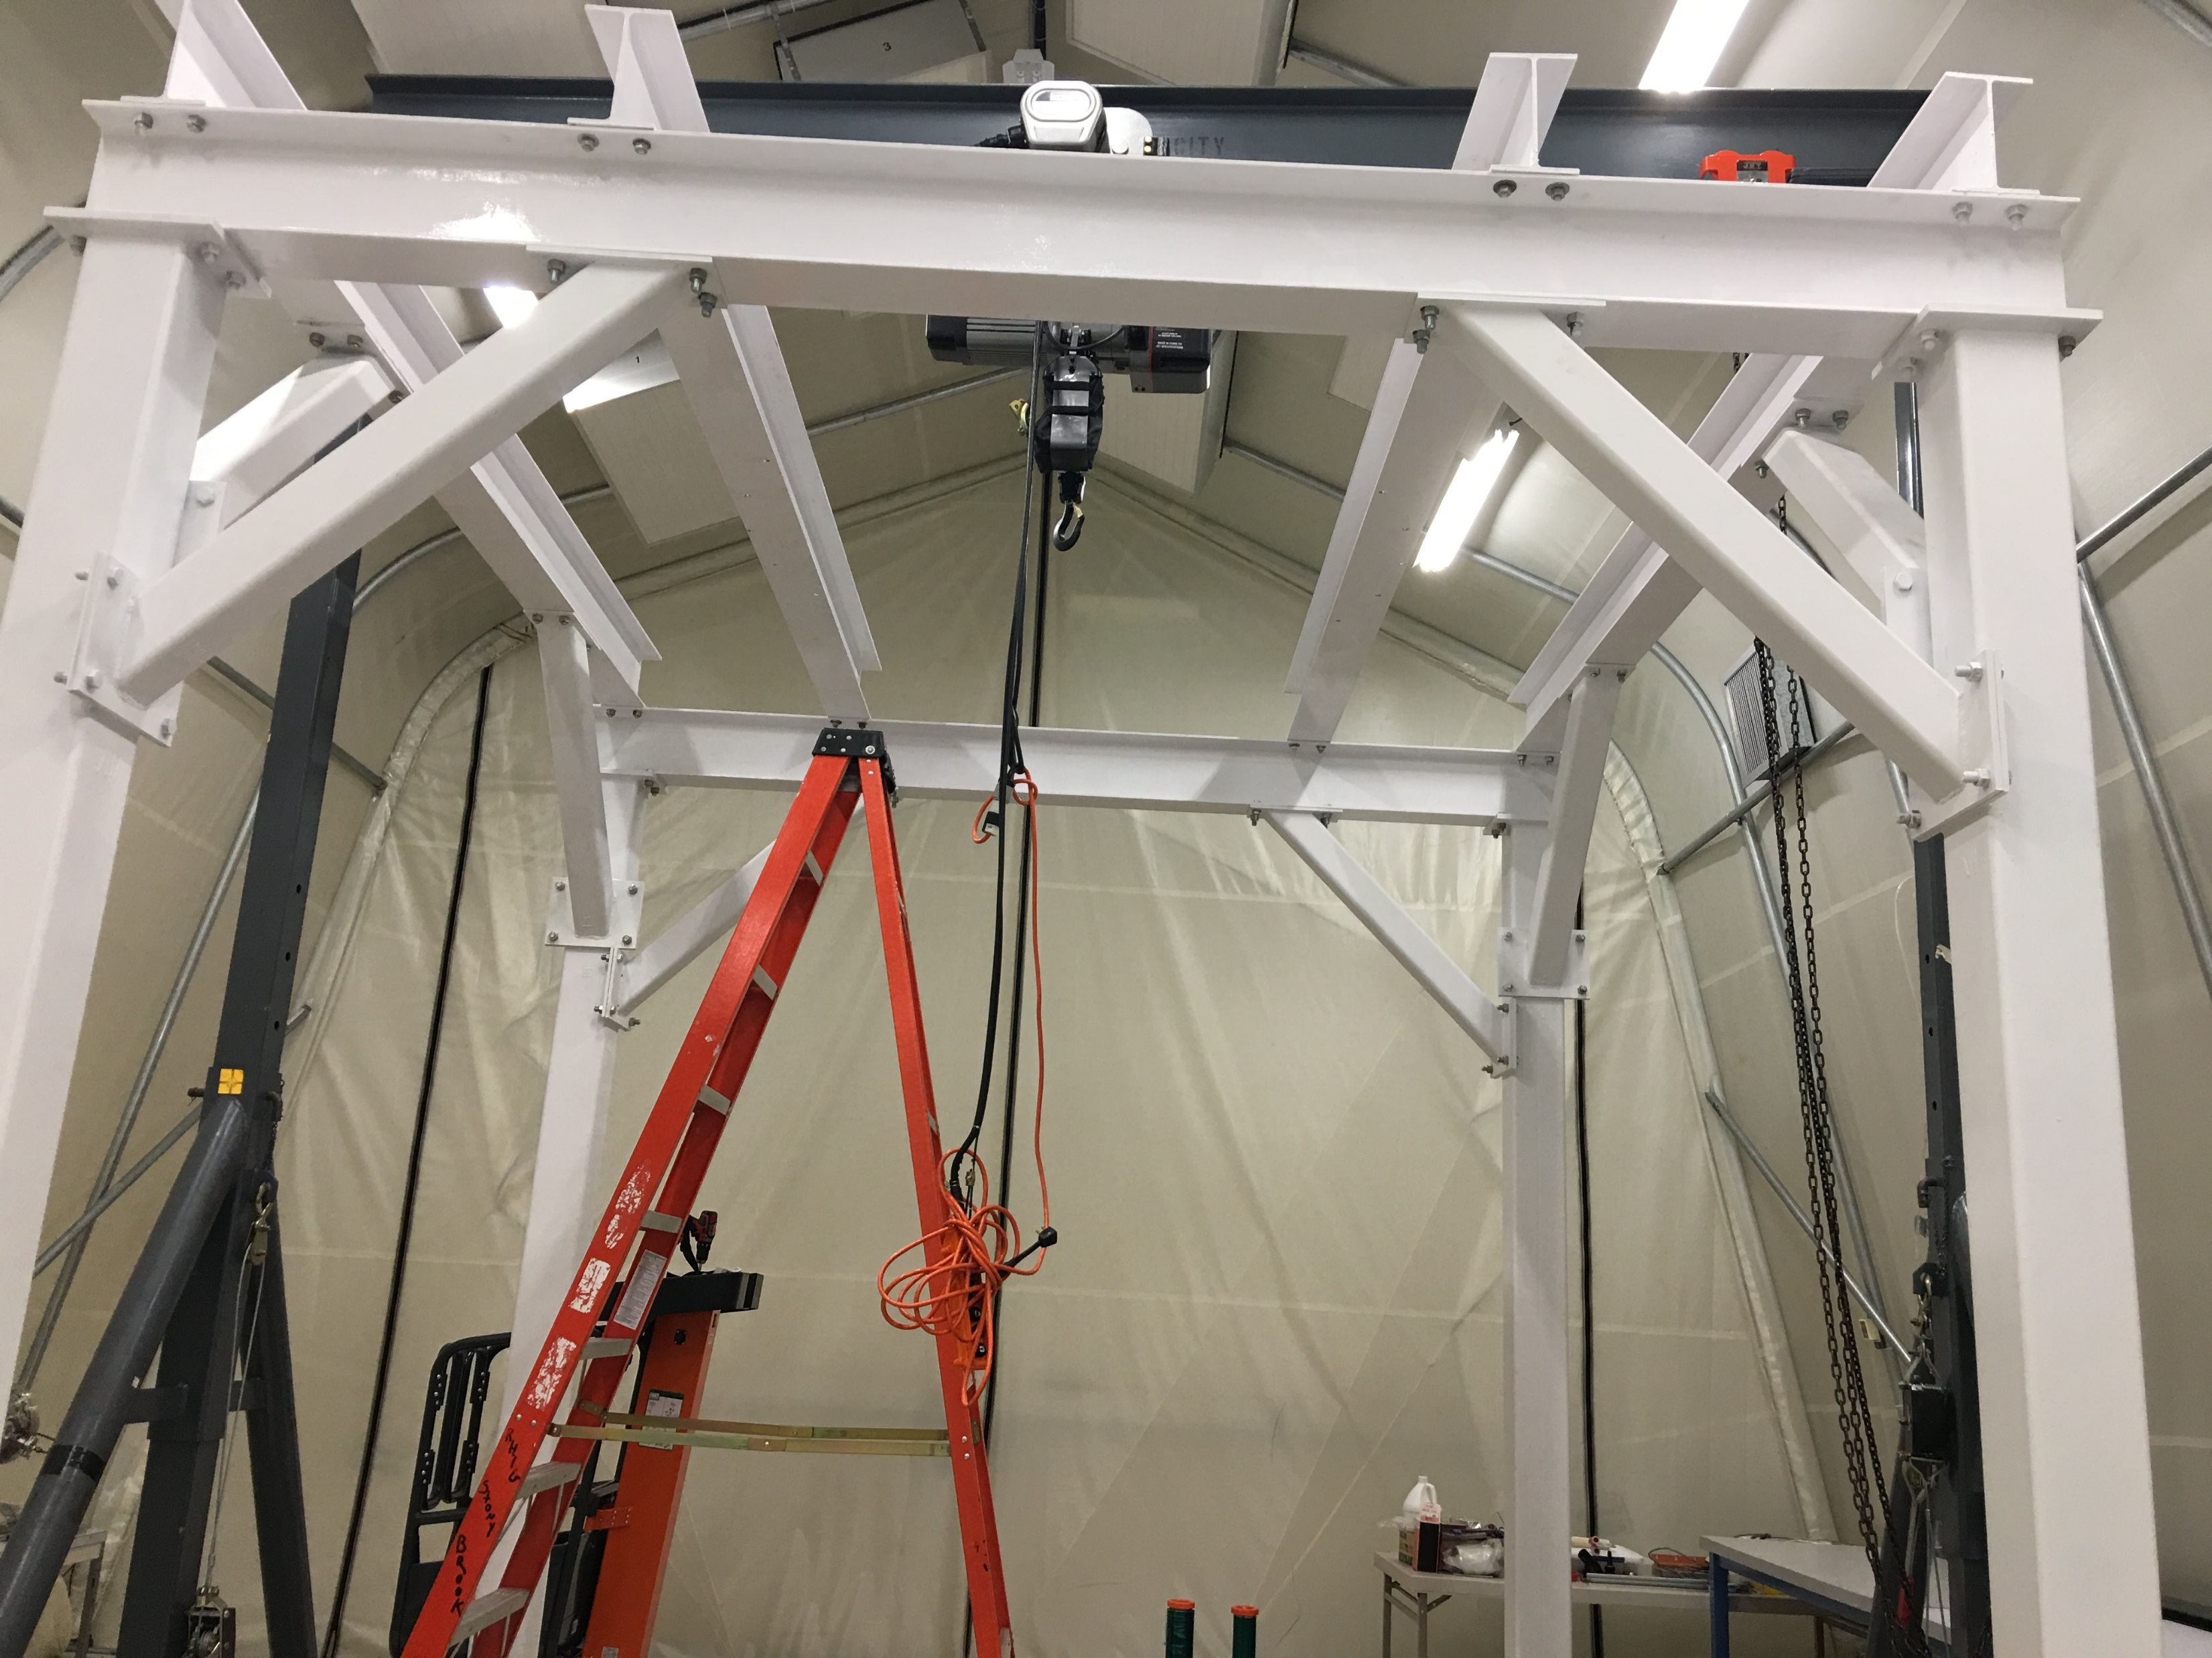
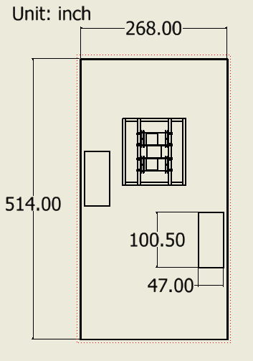
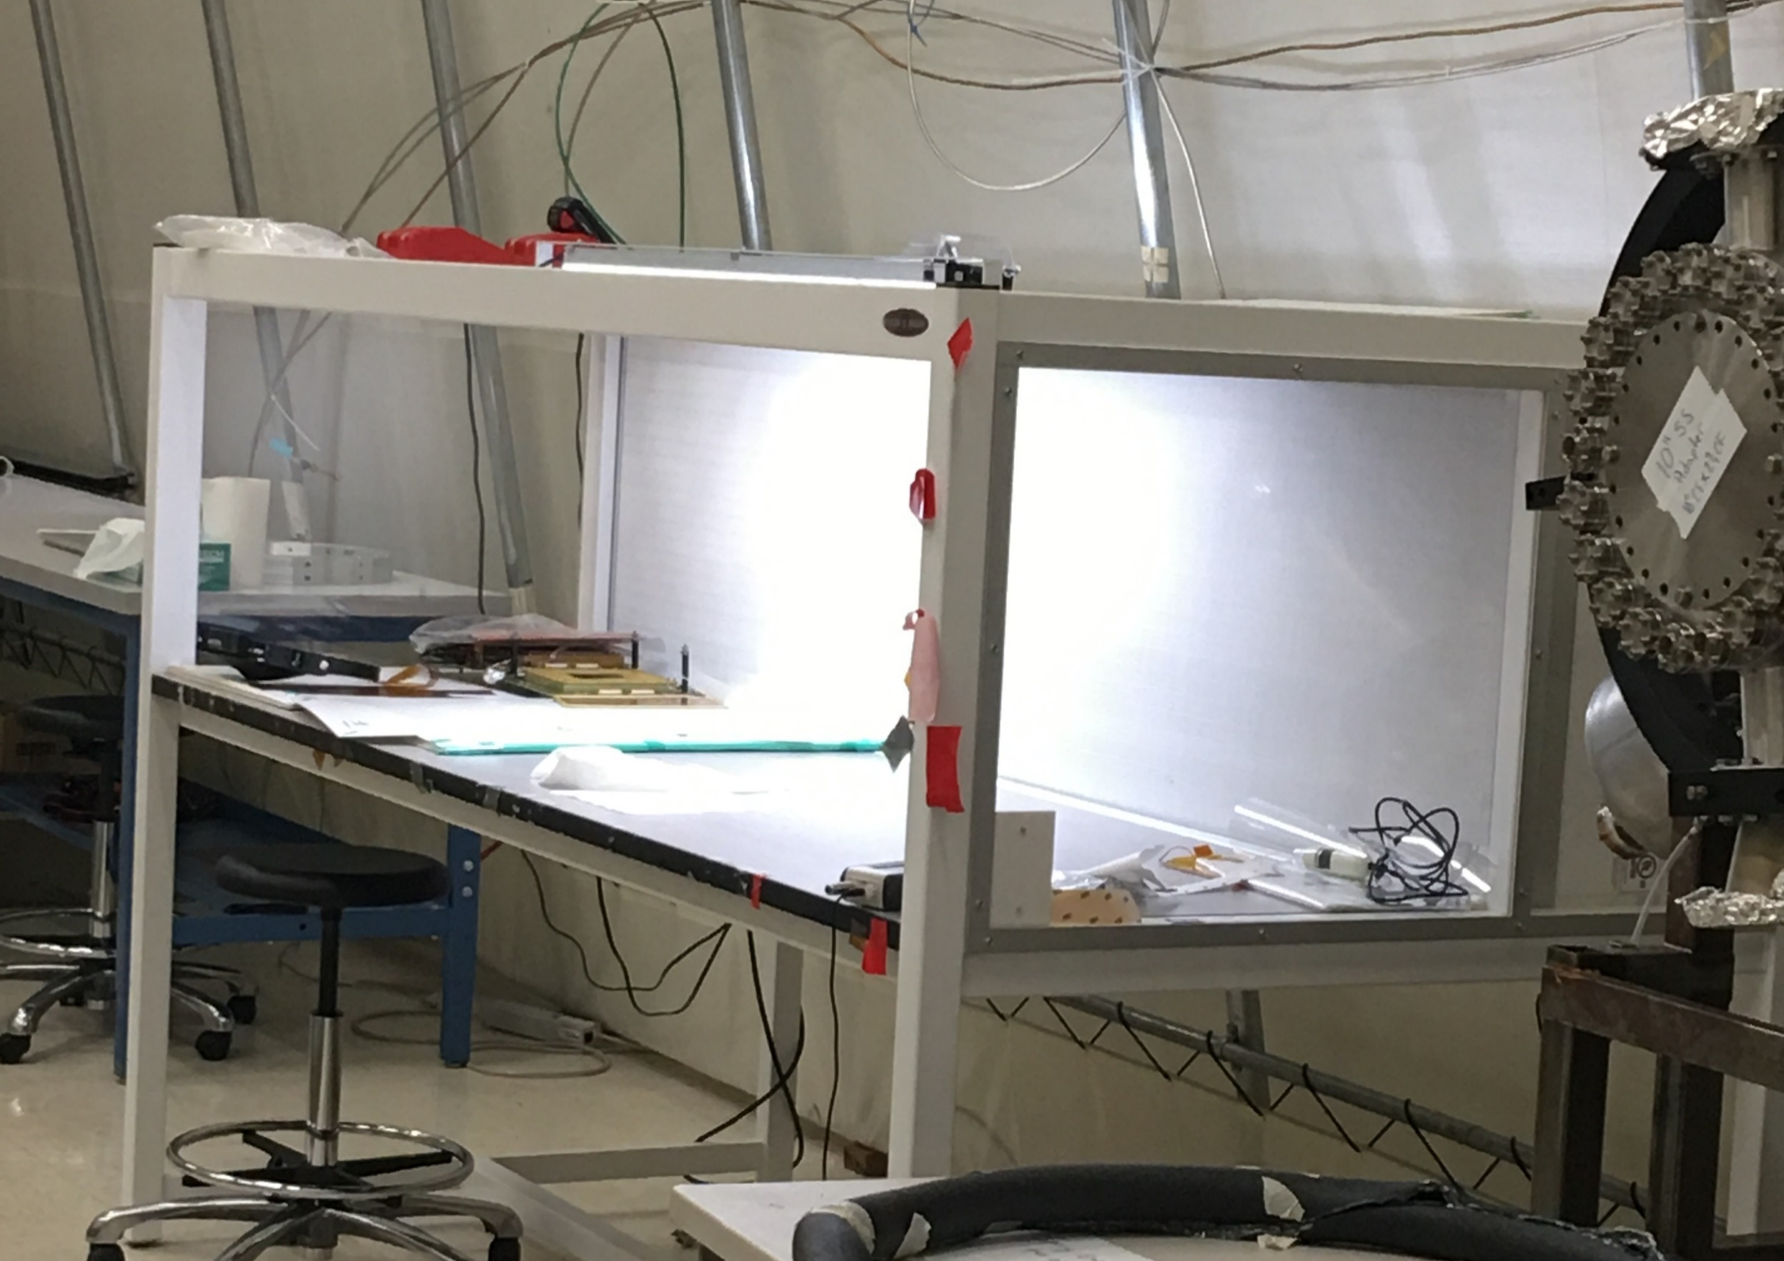
Lab space arrangement (1)
All the assembly work should be in cleanroom
Suspension for TPC integration (field cages, GEM modules, etc.)
Clean bench
Workable volume 96”(L)*25”(W)*22”(H)
“double” clean environment
Clean room sketch
Currently have two clean benches, may need one more
Dimensions maybe slightly off

Slide 4
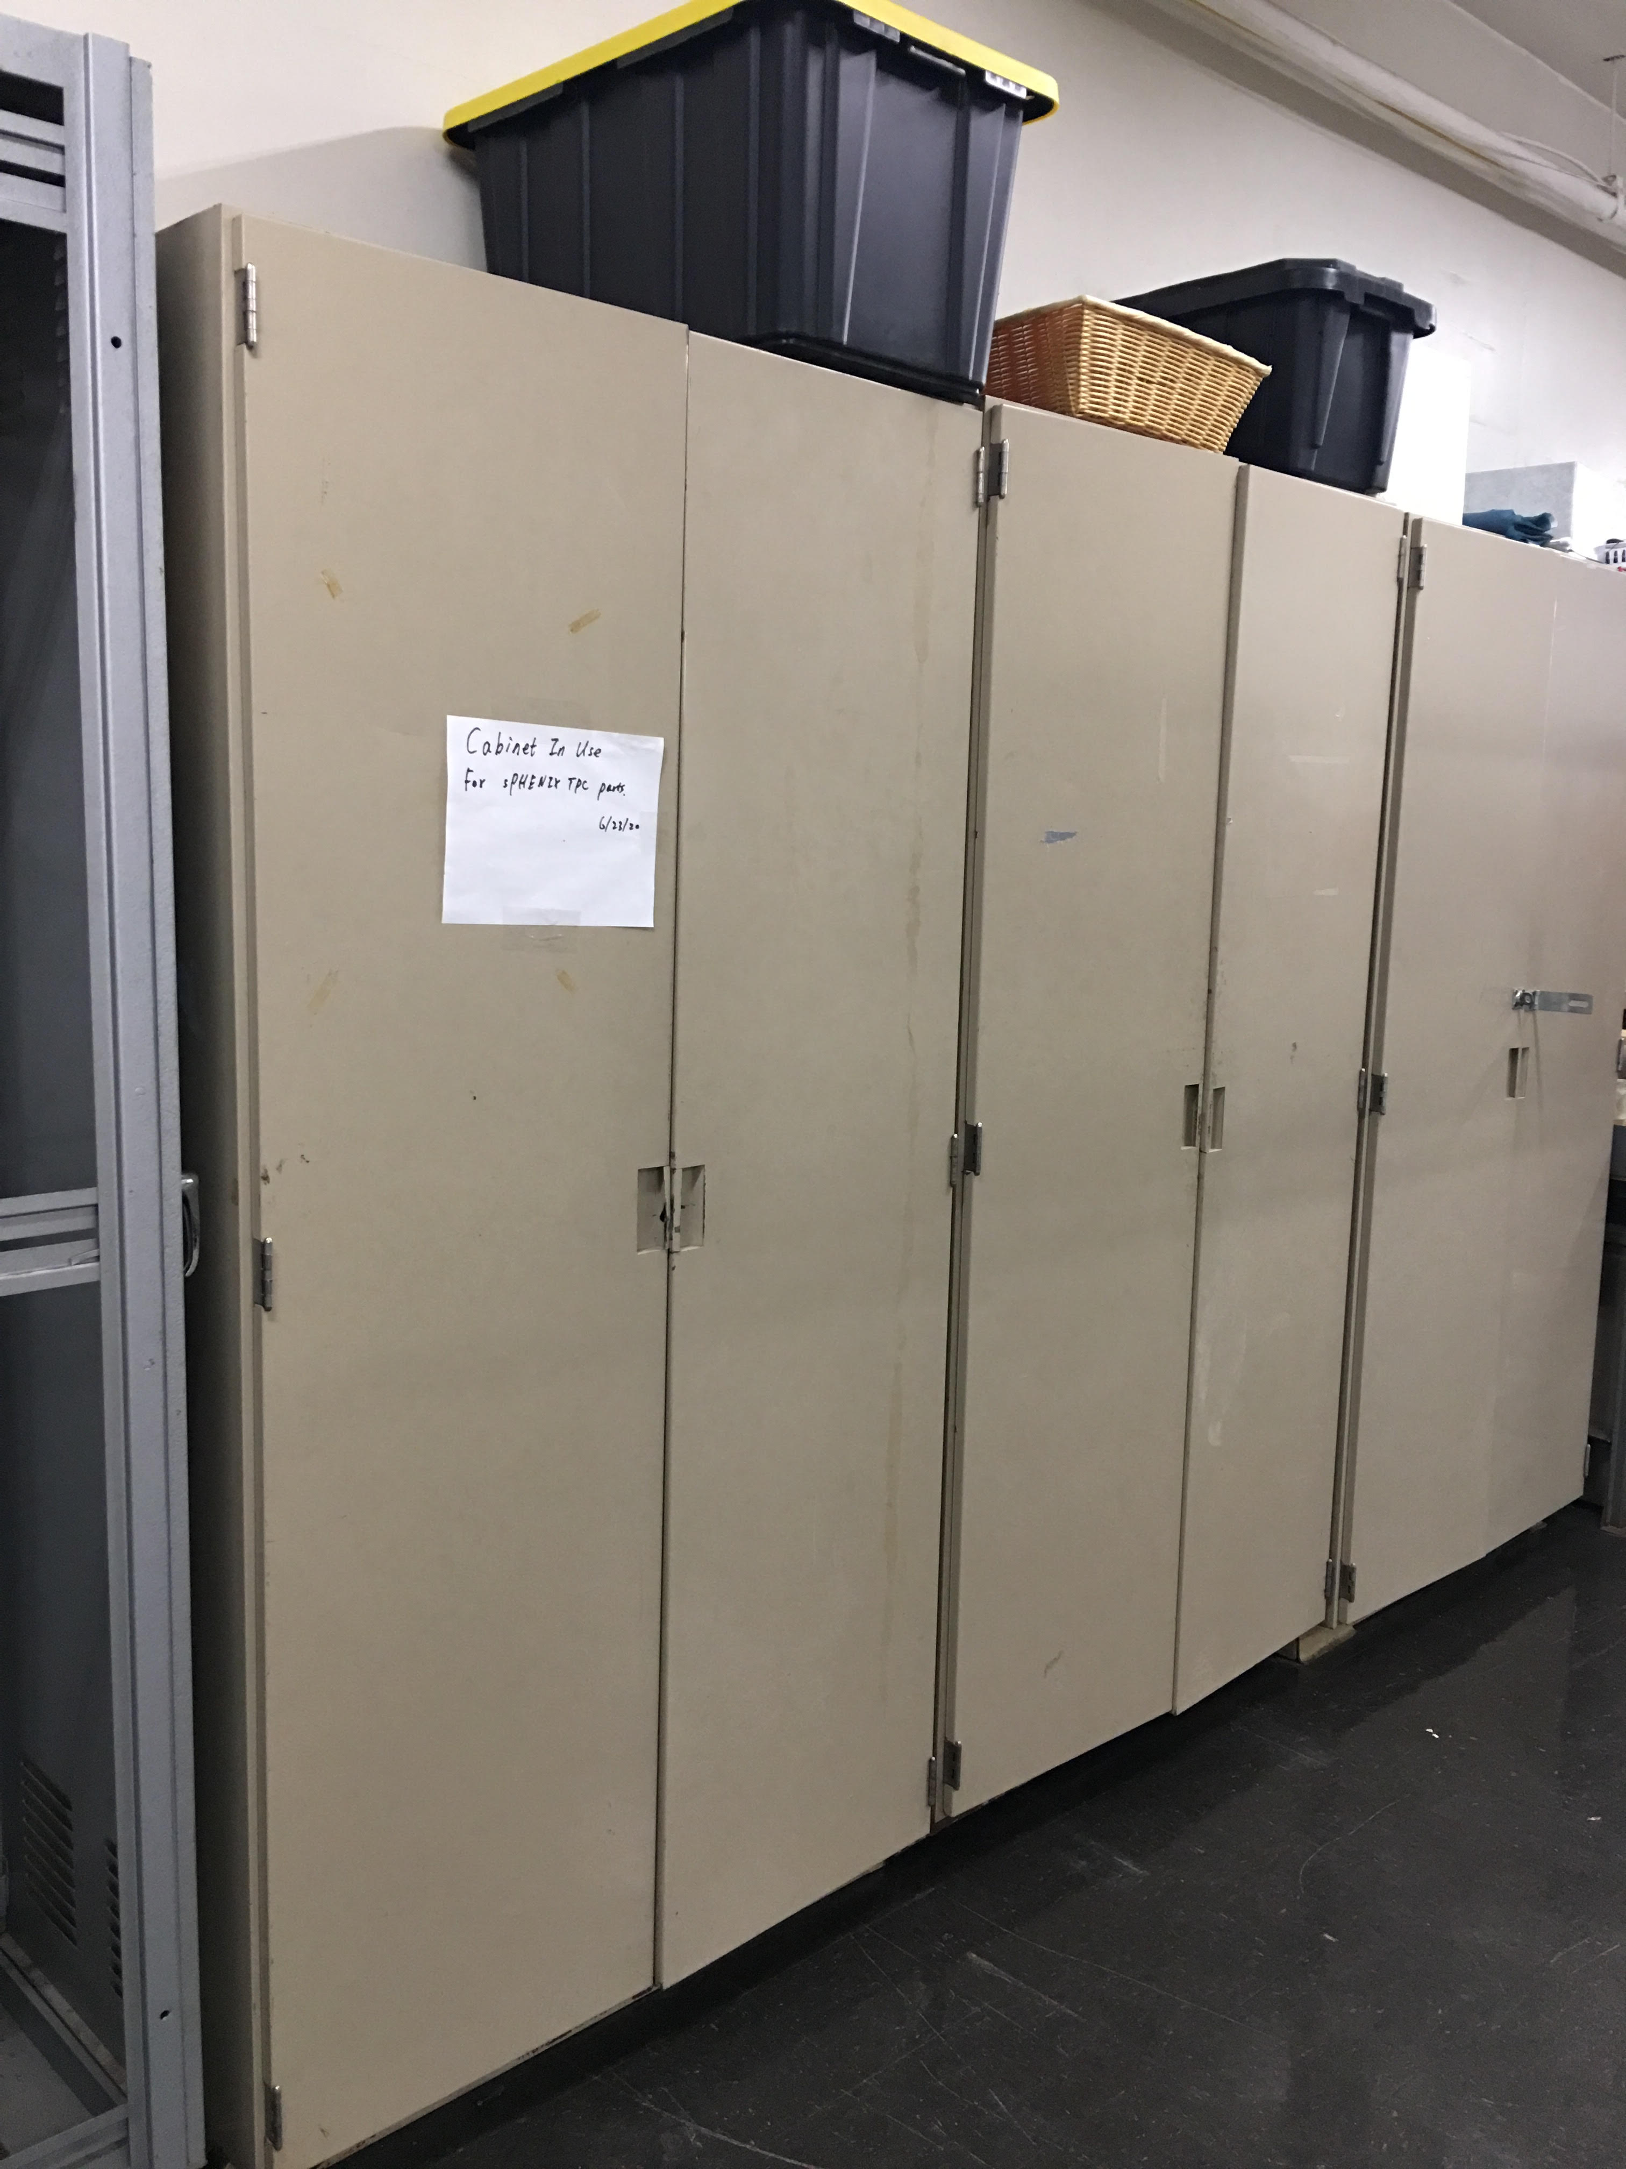
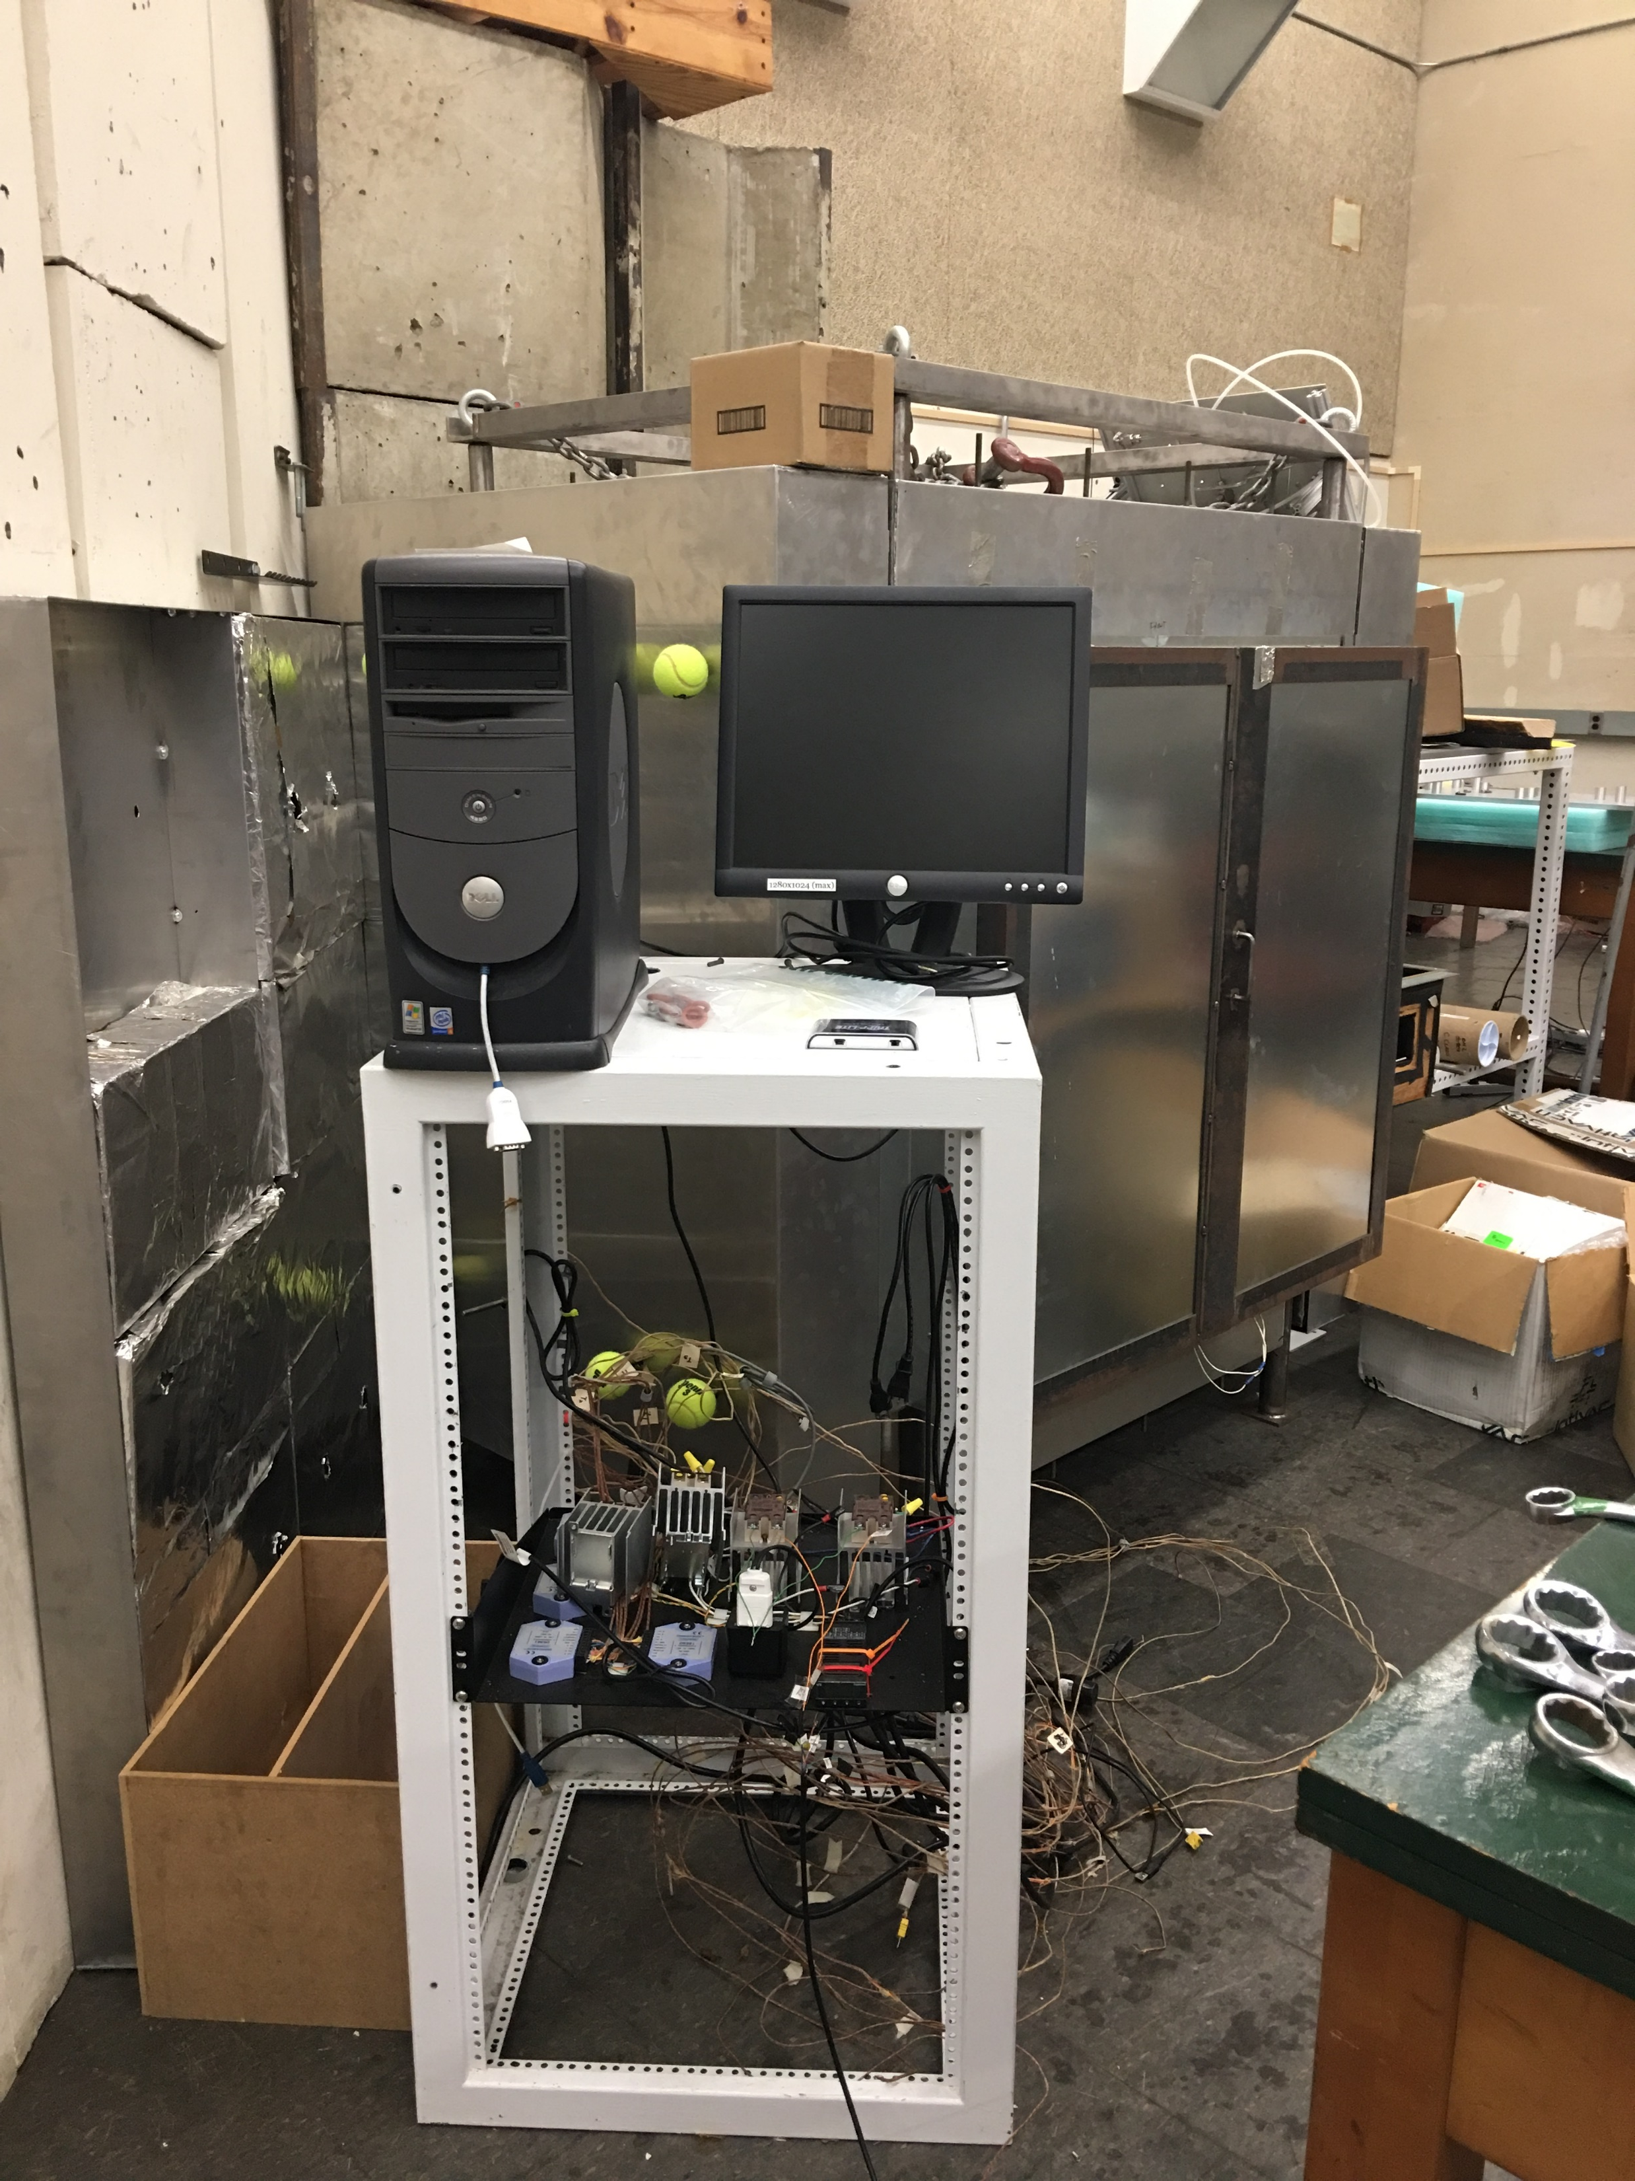
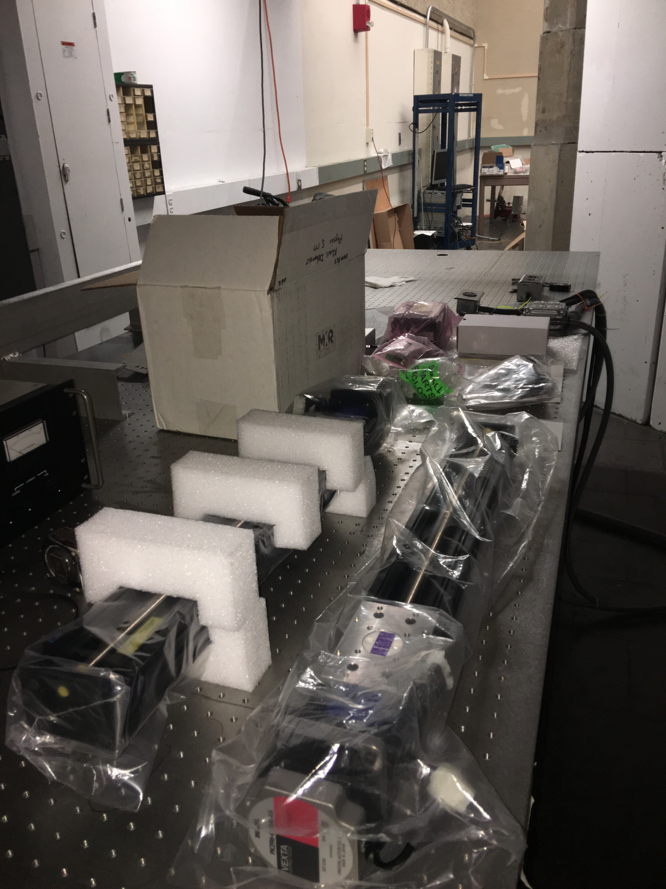
Lab space arrangement (2)
X-ray test space (S-103)
Other storage space (hallway)

Slide 5






Workflow 0 – Receiving & Distribution of GEM foils
Action: need storage place for framed GEM foils received from factories
(recommended humidity < 30%)

Slide 6
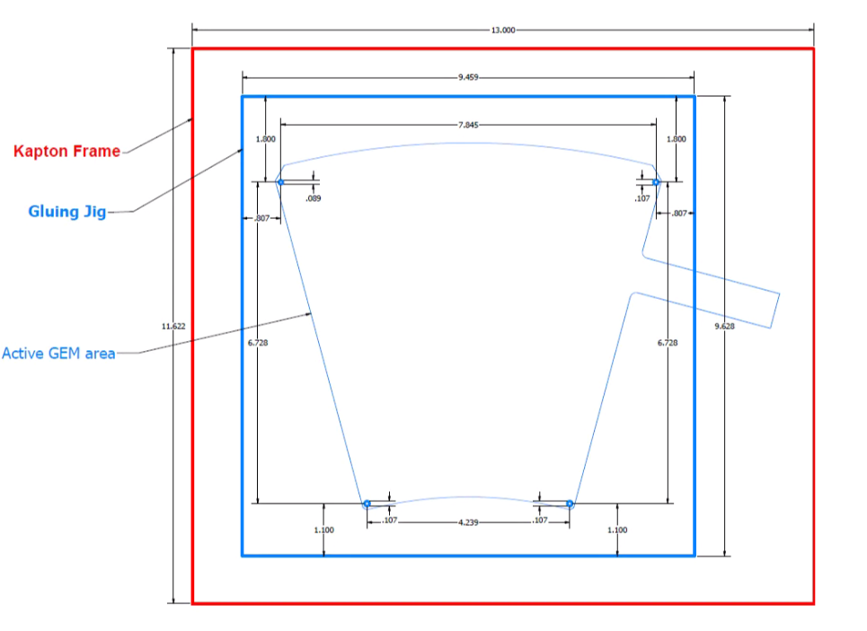
Workflow 1 - Framed GEM foils
Cutting the edges – may need to design some stainless-steel
support substrate (the electrodes tails are fridge regions)
Potting the resistors – this can reduce discharge near the resistors;
DP-460 no-sag glue
Need to design tools for foil protection / convenient
Saves time by potting multiple GEM foils
Quick check of GEM foil quality again
We admit the foils are QA-checked at the factories, so our check do not need sector by sector (note: each foil is sectorized on one side to limit discharge energy)
Dry air gun (or ionizing blow-off gun)
Apply some voltage (eg., 500 V at factories) to the foil in open air, and measure the current with a picoameter (measurement time TBD, eg., ~ 1 hr)
Since our picoameter has multiple (12) channels, we may be able to process multiple GEM foils
Action Item: HV supply, picoameter and ion gun to be located
Caution: all these work should be done in “double” clean environment (the clean benches)

Slide 7
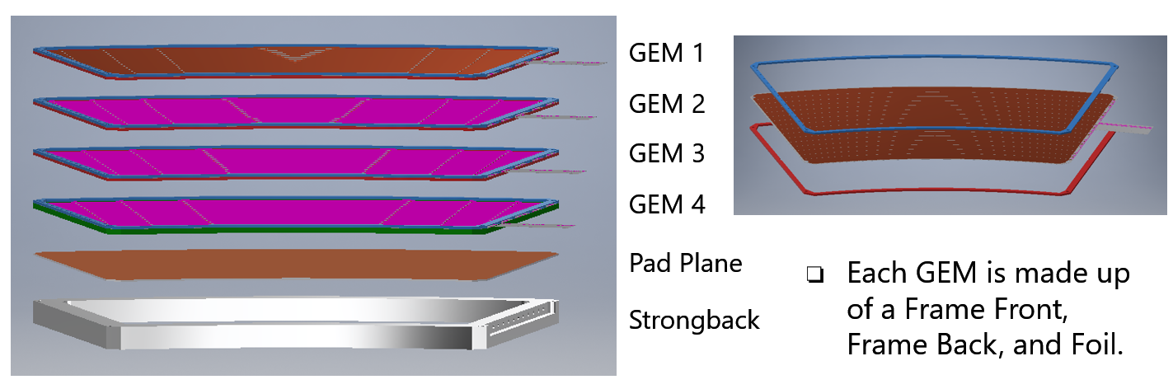
Workflow 2 - GEM modules
Readout boards
Visual inspection on zigzag strips – microscope?
Soldering connectors – outsource this work?
Connectivity check, make sure no short, no open (need pulser, electronics, etc.)
Module Assembly
Stacking – looks easy but care must be given
Gluing r/o boards to strongbacks (for gas seal) – need to design some support structure
r/o board
Strongback
Caution: Assemble in clean bench
Gaps between layers: 3/3/3/1.5 mm ?

Slide 8
Workflow 3 –GEM modules testing
Workflow 4 – software
Characterize each module with X-ray for
Gain uniformity
IBF
Provide HV configuration ref. for final operation
Need to design an enclosure, with
Gas inlet/outlet
HV: single ch. Vs. divider
Need a drift mesh: 1 cm above GEM1 ?
Hardware to be located/prepared
HV supply, picoameter, gas system
Post-testing storage
Store in clean bench vs. individual boxes?
Others
There is discussion about adding Kapton layer between modules to protect GEM tails from discharge
Necessary tools:
For X-ray test: motor controller
Daq: mainly picoameter
Database - for production
Elog – for daily activity logging
Mylar window
Drift mesh
1 cm

Slide 9
Schedule (less clear at this moment)
GEM foils from CERN
First article (13 foils) in Aug~Sep, for us to check the design (size, hole location, etc.)
Launch production if all OK
~60 Foils each, comes in 6 batches by Mar 2021.
Framed GEM foils from factories
~4 weeks after we distribute the foils
In-lab workflow
2 GEM modules per week,
Total ~90 GEM modules, 45 weeks
Finish by Sep. 2021 (if start in Nov. 2020)

Slide 10
Summary
A baseline plan is presented
Work should begin as soon as we can
Details will be figured with exercises
Many areas need more hands …
Challenged but prepared!
https://www.overleaf.com/read/wctddgrcqmqh
will keep documenting the procedures as they develop
Near term actions
Prepare for first article GEM foil checks (frames at hand)
Set up X-ray test system (w/ Luke Legnosky)
Start collecting tools (HV, picoameter, etc.), especially, one more clean bench and additional storage?
Design work
Thank you!

