Slide 1
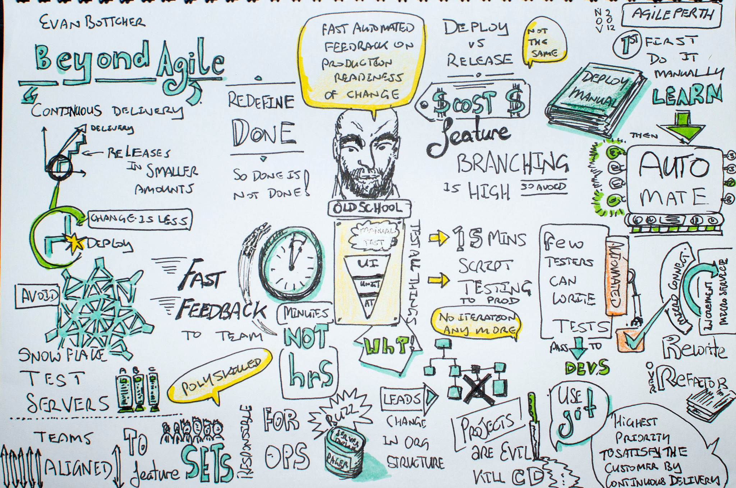
Continuous Integration I
Beyond Agile to Continuous Delivery
Dmitry Romanov
July 2020

Slide 2
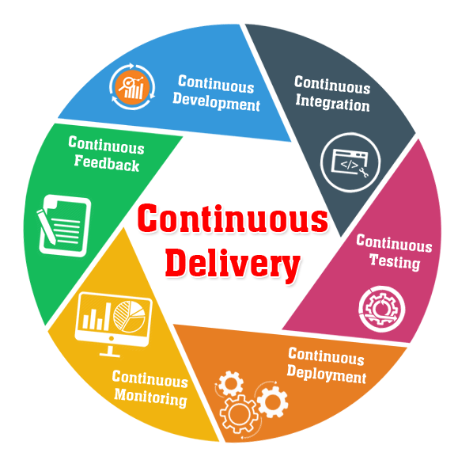
DevOPS?
Continuous Integration
Continuous Delivery
Continuous Deployment

Slide 3
What development of software development tries to develop?
What is software development about?

Slide 4
Only two problems to fight with
Humans are not designed to write code
Interactions between humans writing software collectively
Cognitive issues in the process of software development: review and reappraisal 1986
Human cognition in programming 1990
CognitiveBiasesinSoftwareEngineering:ASystematicMappingStudy 2018

Slide 5
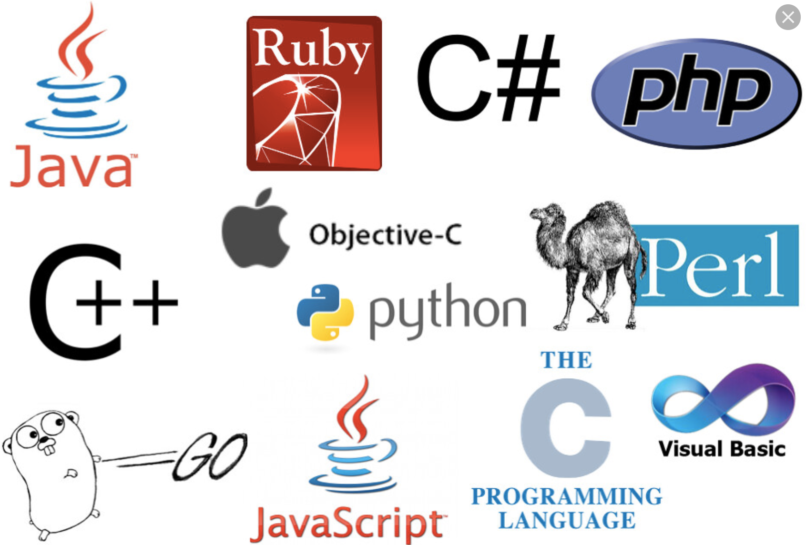
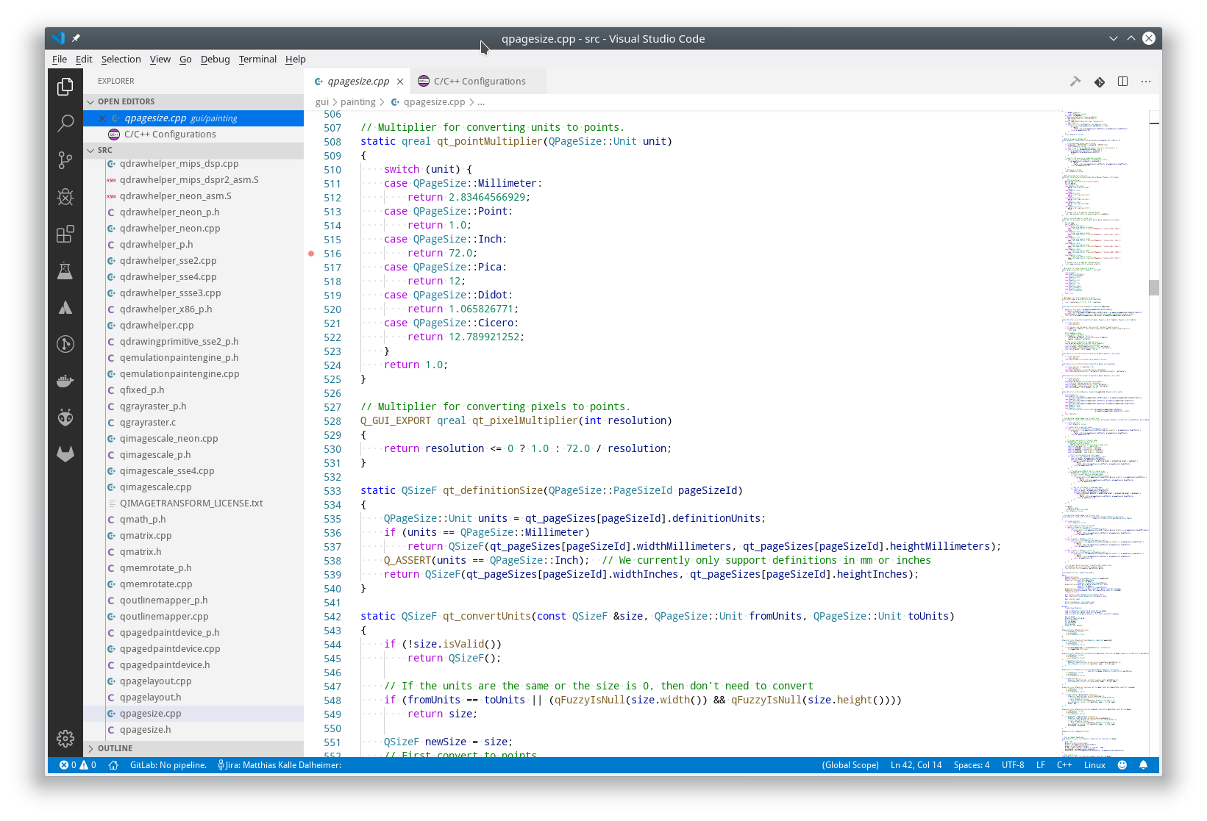
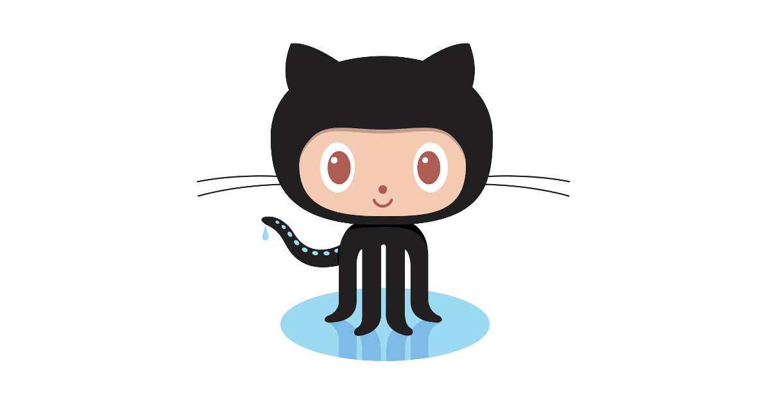
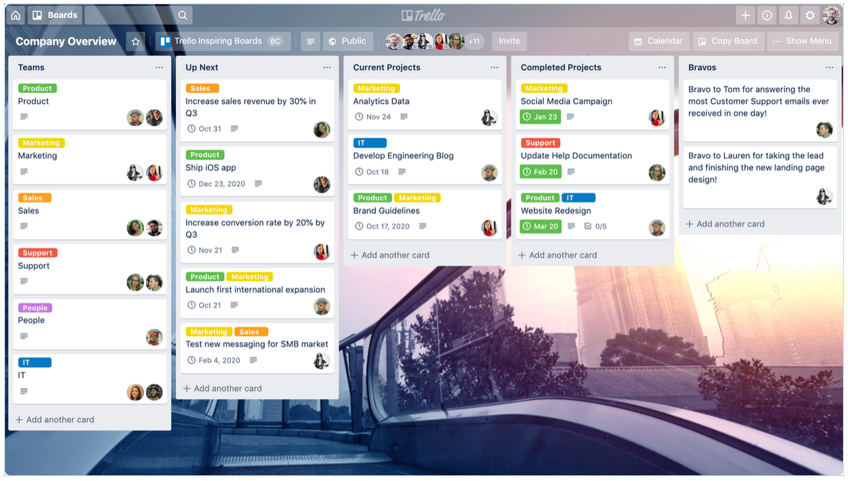
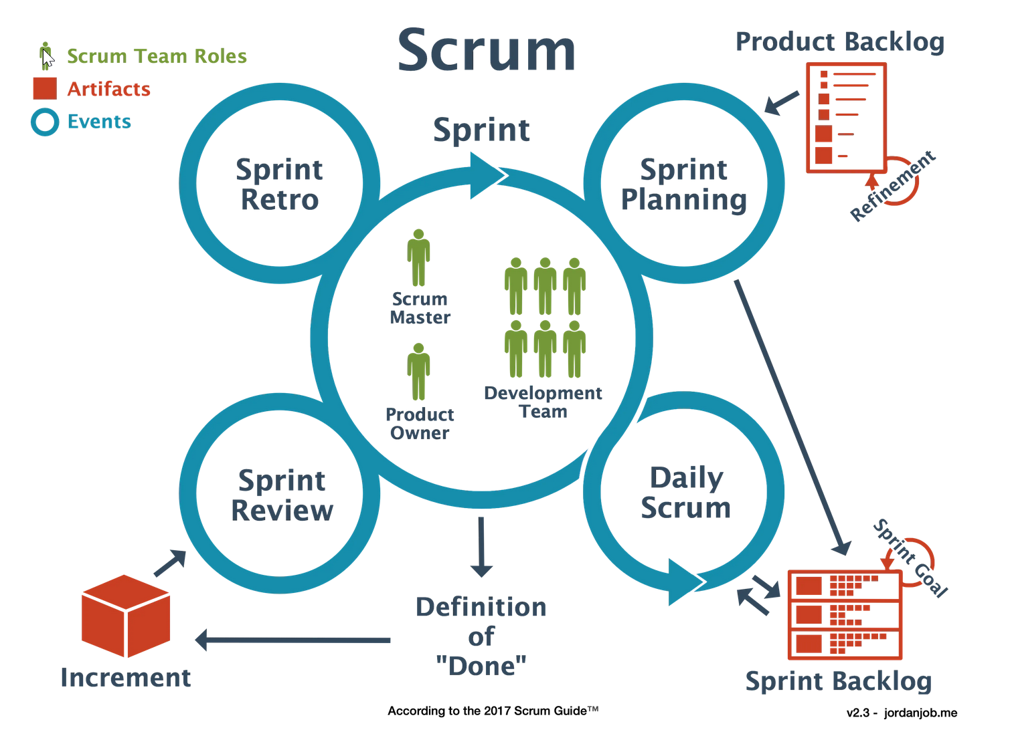
Two things to optimize
The performance of a single developer
The performance of a team
METHODS
TOOLS

Slide 6
History
Iterative and incremental development methods can be traced back as early as 1957, with evolutionary project management and adaptive software development emerging in the early 1970s.
During the 1990s, a number of lightweight software development methods evolved in reaction to the prevailing heavyweight methods (such as waterfall) that critics described as overly regulated, planned, and micro-managed.
rapid application development (RAD), from 1991;
the unified process (UP) 1994
dynamic systems development method (DSDM) 1994;
scrum, from 1995;
extreme programming (XP) 1996;
feature-driven development, from 1997. Later - The Manifesto for Agile Software Development

Slide 7
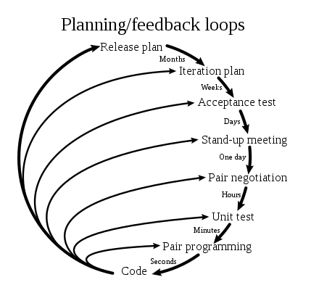
Extreme programming

Slide 8
The Manifesto for Agile Software Development
Customer satisfaction by early and continuous delivery of valuable software.
Welcome changing requirements, even in late development.
Deliver working software frequently (weeks rather than months)
Close, daily cooperation between business people and developers
Projects are built around motivated individuals, who should be trusted
Face-to-face conversation is the best form of communication (co-location)
Working software is the primary measure of progress
Sustainable development, able to maintain a constant pace
Continuous attention to technical excellence and good design
Simplicity—the art of maximizing the amount of work not done—is essential
Best architectures, requirements, and designs emerge from self-organizing teams
Regularly, the team reflects on how to become more effective, and adjusts accordingly
Source from Wikipedia

Slide 9
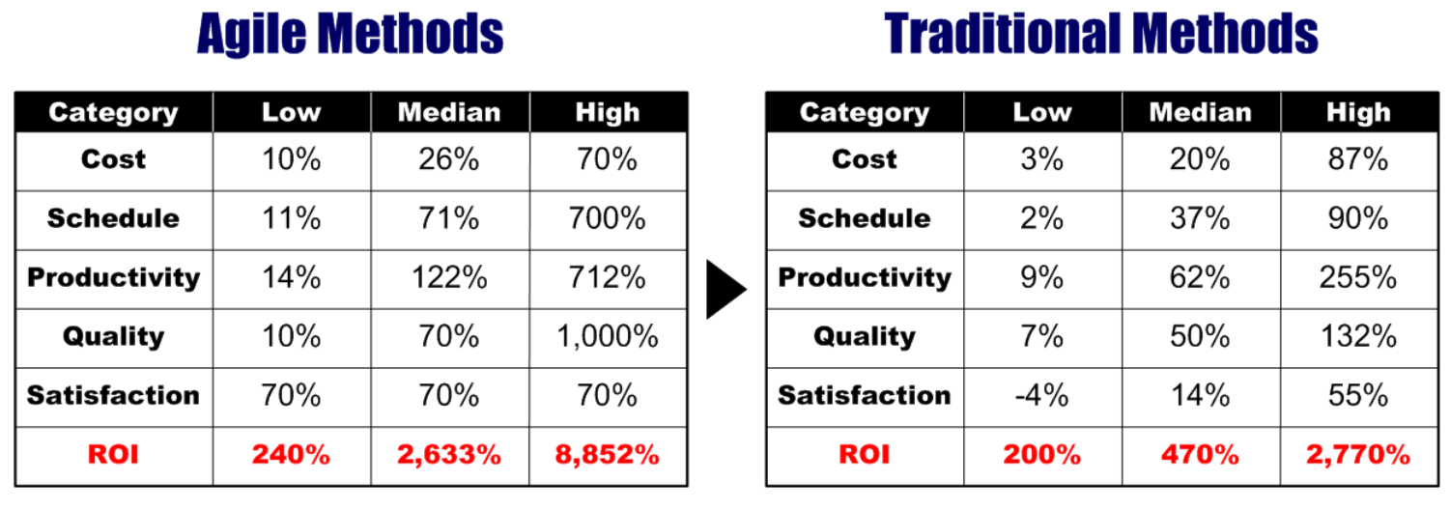
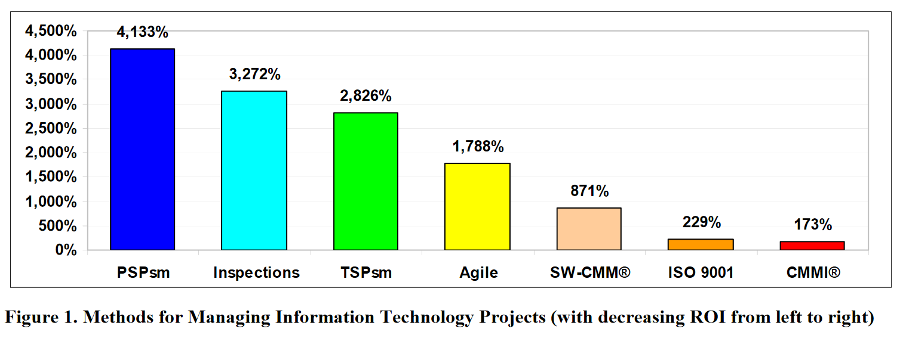
Scientific studies of agile vs traditional software development
Optimistic Pessimistic
This and many other tables with sources
Overview of analyses of ROI of Agile vs Traditional methods

Slide 10
DevOPS?
Continuous Integration
Continuous Delivery
Continuous Deployment

Slide 11
Definitions of Continuous Integration
Wikipedia: continuous integration (CI) is the practice of merging all developers' working copies to a shared mainline several times a day
Amazon: CI is a DevOps software development practice where developers regularly merge their code changes into a central repository, after which automated builds and tests are run. Continuous integration most often refers to the build or integration stage of the software release process and entails both an automation component (e.g. a CI or build service) and a cultural component (e.g. learning to integrate frequently).
Tech target: CI is a software engineering practice in which frequent, isolated changes are immediately tested and reported on when they are added to a larger code base
Atlassian: CI is the practice of automating the integration of code changes from multiple contributors into a single software project. The CI process is comprised of automatic tools that assert the new code’s correctness before integration.
Microsoft: CI is the process of automating the build and testing of code every time a team member commits changes to version control.

Slide 12
Definitions of Continuous Delivery and Deployment
Continuous delivery is an extension of continuous integration to make sure that you can release new changes quickly in a sustainable way. This means that on top of having automated your testing, you also have automated your release process and you can deploy your application at any point of time by clicking on a button.
Continuous deployment goes one step further than continuous delivery. With this practice, every change that passes all stages of your production pipeline is released to your customers. There's no human intervention, and only a failed test will prevent a new change to be deployed to production.

Slide 13
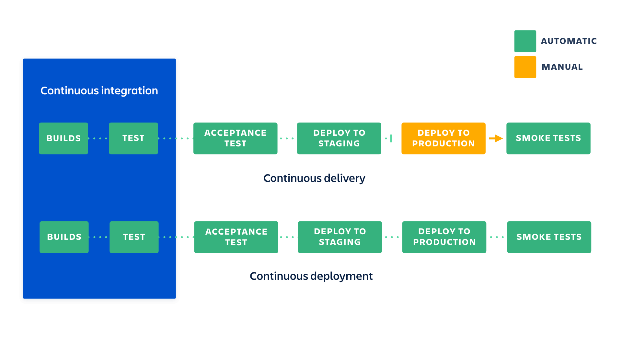
Integration vs Delivery vs Deployment
https://www.atlassian.com/continuous-delivery/principles/continuous-integration-vs-delivery-vs-deployment

Slide 14
Benefits of CI
What you need (cost)
Your team will need to write automated tests for each new feature, improvement or bug fix.
You need a continuous integration server that can monitor the main repository and run the tests automatically for every new commits pushed.
Developers need to merge their changes as often as possible, at least once a day.
What you gain
Less bugs get shipped to production as regressions are captured early by the automated tests.
Building the release is easy as all integration issues have been solved early.
Less context switching as developers are alerted as soon as they break the build and can work on fixing it before they move to another task.
Testing costs are reduced drastically – your CI server can run hundreds of tests in the matter of seconds.
Your QA team spend less time testing and can focus on significant improvements to the quality culture.

Slide 15
Benefits of Continuous Delivery
What you need (cost)
You need a strong foundation in continuous integration and your test suite needs to cover enough of your codebase.
Deployments need to be automated. The trigger is still manual but once a deployment is started there shouldn't be a need for human intervention.
Your team will most likely need to embrace feature flags so that incomplete features do not affect users in production.
What you gain
The complexity of deploying software has been taken away. Your team doesn't have to spend days preparing for a release anymore.
You can release more often, thus accelerating the feedback loop with your customers.
There is much less pressure on decisions for small changes, hence encouraging iterating faster.

Slide 16
Benefits of Continuous Deployment
What you need (cost)
Your testing culture needs to be at its best. The quality of your test suite will determine the quality of your releases.
Your documentation process will need to keep up with the pace of deployments.
Feature flags become an inherent part of the process of releasing significant changes to make sure you can coordinate with requests.
What you gain
You can develop faster as there's no need to pause development for releases. Deployments pipelines are triggered automatically for every change.
Releases are less risky and easier to fix in case of problem as you deploy small batches of changes.
Users see a continuous stream of improvements, and quality increases every day, instead of every month, quarter or year.

Slide 17
What is unit testing
UNIT TESTING is a level of software testing where individual units/ components of a software are tested. – C++ => Methods of classes
INTEGRATION TESTING is a level of software testing where individual units are combined and tested as a group. – C++ => Classes work together, API works, detector reco works
SMOKE TESTING, also known as “Build Verification Testing”, is a type of software testing that comprises of a non-exhaustive set of tests that aim at ensuring that the most important functions work. - HENP – Software compiles, runs, and some plots are built

Slide 18
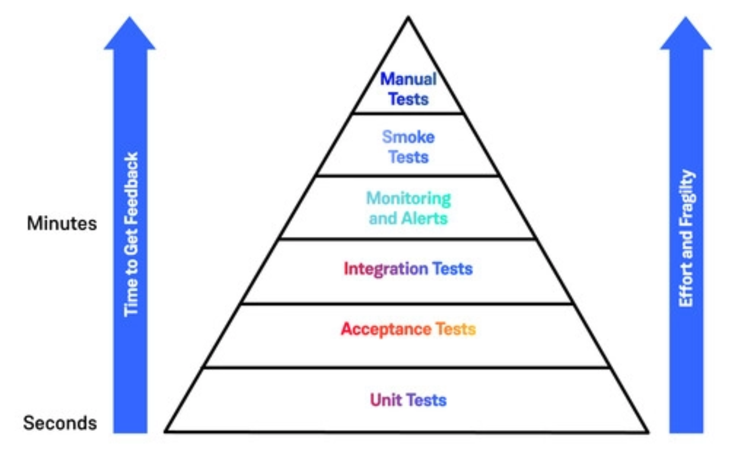
Unit tests pyramid
E2E 3-5%
Integration – 15%
Unit – 80%
There are many forms of such pyramid
Deterministic vs non-deterministic
Regression Testing – always add to tests for fixed bugs
Acceptance/Alpha/Betta testing
System Testing – works on different OS
Stress Testing – unfavorable conditions to the system and check how they perform
Performance Testing
Test-driven development – write tests before or with the code

Slide 19
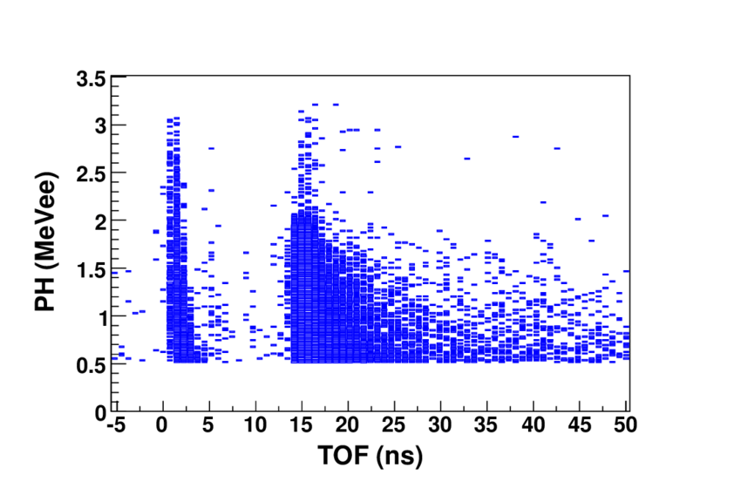
Tests determinism
Main sources of non-determinism: multithreading, complex scientific processing
E2E 3-5%
Integration – 15%
Unit – 80%
Black box
Non-deterministic
White box
Deterministic

Slide 20
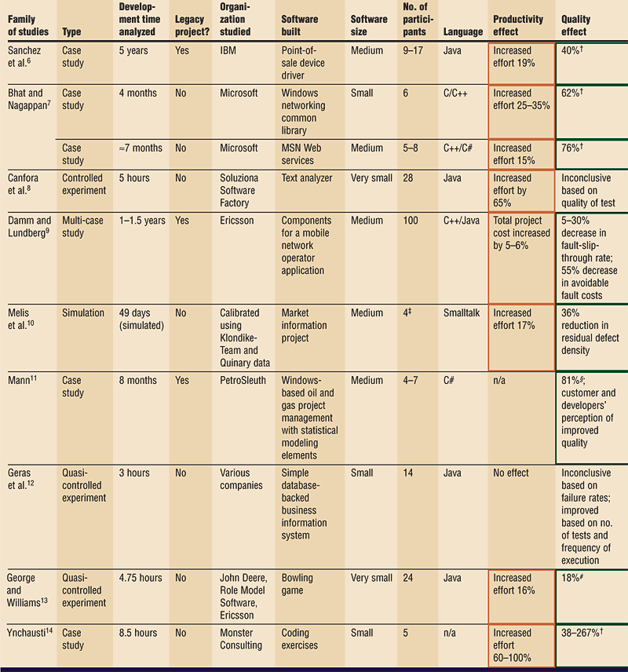
Proven benefits
TDD and show 15-35% increase in initial development time after adopting TDD, but a 40-90% decrease in pre-release defects [link, link]

Slide 21
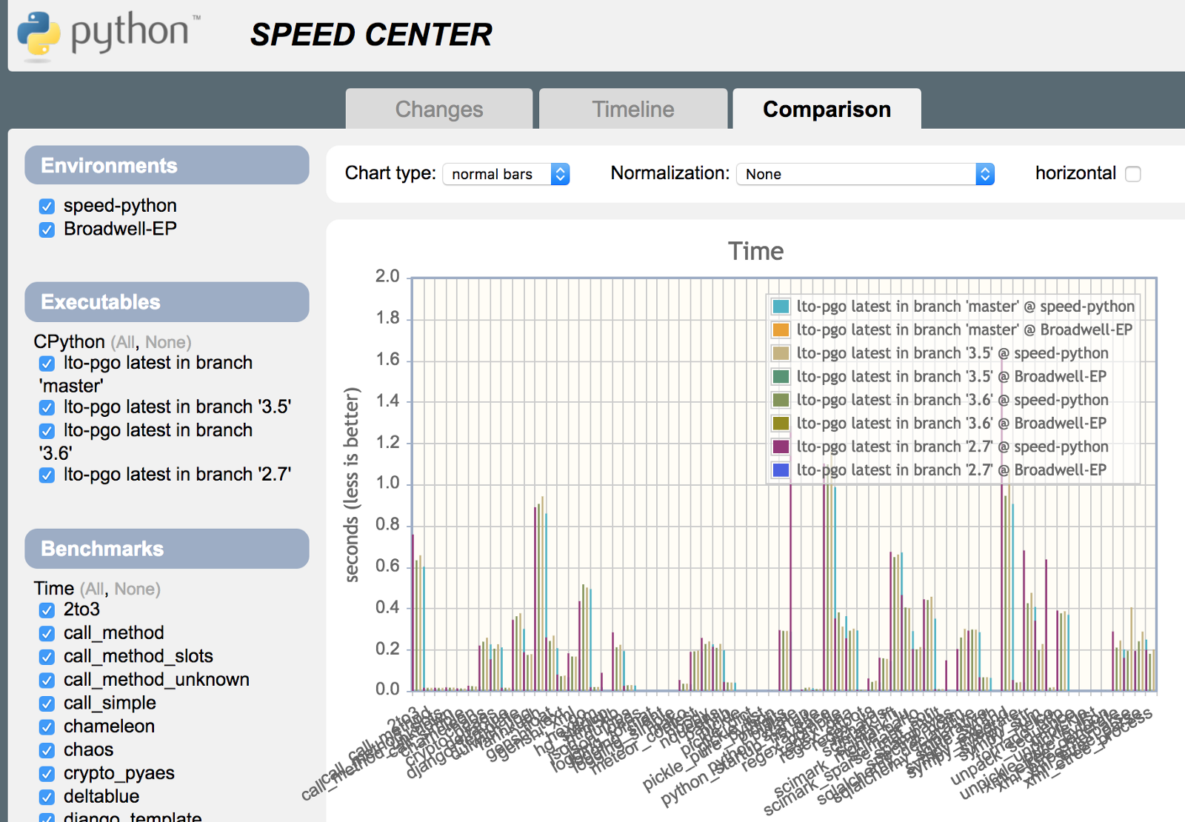
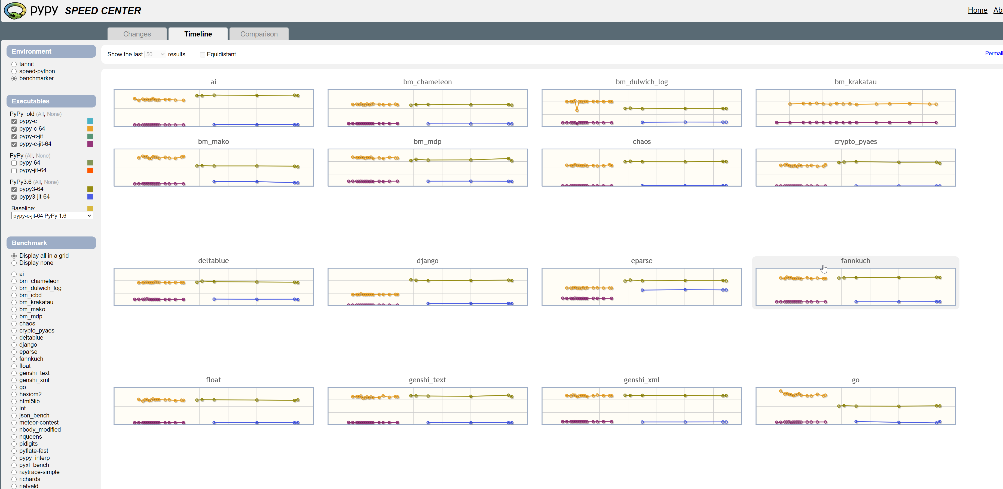
Performance tests
As performance matters in our field!
https://speed.pypy.org/

Slide 22
Our field
Repo
Compiles
Start with end-to-end tests and system tests
More end to end tests than others
Start with non deterministic tests
Sometimes manual performance tests
No Unit Tests at all!
Repo
Compiles here
Compiles there
Repo
Compiles
Produces plots

Slide 23
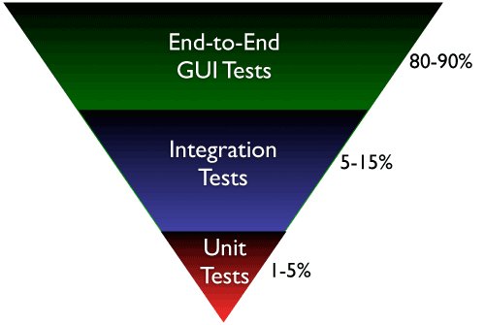
Inversed tests pyramid

Slide 24
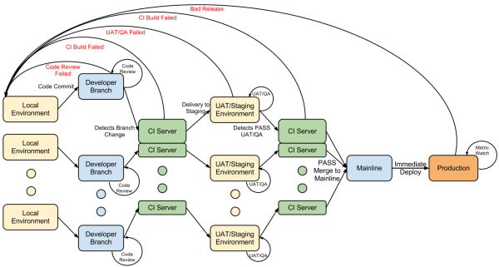
CI & CD with code review

Slide 25
Different CI strategies

Slide 26
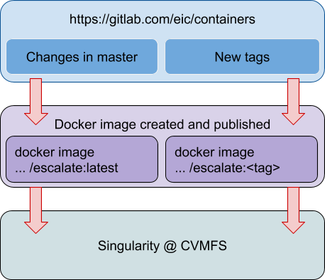
ESCalate CI/CD
GitLab CI Build Uint tests
push to master
ejana
Update container
push to tag
Change in eic-spack
Delivery to CVMFS
Automated
Manual
Automated

Slide 27
Thank you

