Slide 1

Challenges and Opportunities in Understanding Neutrino Properties with Accelerator-based Experiments
Xin Qian
BNL
Notes:
Good evening every one. First, I would like to thank the organizer for the invitation. I am very glad to come to this workshop to discuss the challenges and opportunities in understanding neutrino properties with accelerator-based experiments.

Slide 2
Outline
Motivation
Opportunities of future generations of experiments
Challenges and Solutions
  Neutrino Flux
  Neutrino Detection
Summary
Notes:
Here is my outline. I will start with the motivation, and then talk about the current and future generation accelerator experiments. In particular, I would like to focus on the opportunities of the next-generation experiments. After that, I will describe the challenges that we are facing and the proposed solutions. In the end, I will conclude my talk.

Slide 3
Neutrino Mass and Mixing: the only
well-established new physics
included the Standard Model
0νββ
θ₂₃ ~ 45°
θ₁₃ ~ 9°δ = ???
θ₁₂ ~ 34°
Accelerator experiments provide crucial inputs:
  Discovery of muon and tau neutrinos
  Confirm atmospheric neutrino oscillation
  The most precise Δm²_{atm}~Δm²₃₂
  Confirm “large” non-zero θ₁₃
  Initial hints of leptonic CP violation
Notes:
With about two decades of experimental efforts, neutrino mass and mixing has been unambiguously established through studying the phenomenon of neutrino flavor oscillation. This is the only new physics that has been included into the Standard Model since its birth about 40 years ago. Now, we have a nice 3-neutrino model, also known as the PMNS model. This model can nicely describe almost all observed oscillation phenomenon. In this model, there are three mixing angle and one phase relevant for the oscillations. The first angle theta23, also referred to as the atmospheric mixing angle, was measured to be about 45 degrees, and the oscillation frequency is measured to be about 2.4e-3 eV^2. The second angle theta12, also known as the solar mixing angle, was measured to be about 34 degrees, and the oscillation frequency is measured to be about 7.5e-5 eV^2. The last angle theta13 is recently measured to be about 9 degrees, which opened the door to access the unknown CP phase.
During this process, accelerator neutrino experiments have been providing crucial inputs …

Slide 4
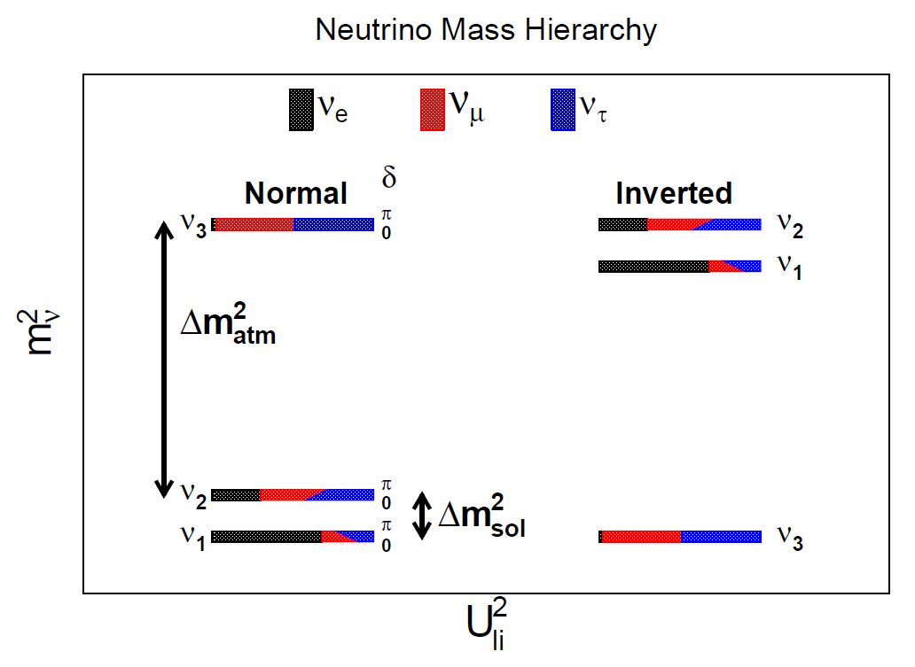
Some Remaining Questions
CP violation in the neutrino sector?
Normal or Inverted Mass Hierarchy?
Octant:
ν_{μ} >? | =? | <? ν_{τ} in ν₃
Dirac or Majorana Neutrinos?
What is the absolute neutrino mass?
Is PMNS matrix unitary?
Any pattern in PMNS matrix?
Notes:
Despite the very successful progress in the neutrino field, there are still many remaining questions. Here, I try to list some of them …
These questions present new opportunities for accelerator neutrino experiments.

Slide 5
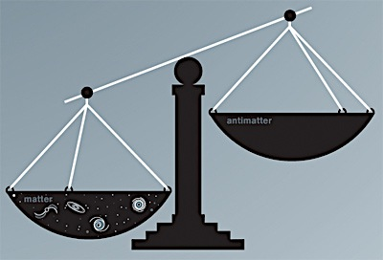
Search for new CP violation
Charge-Parity (CP) Violation in neutrino sector
  Crucial for leptongenesis models to explain the large matter-anti-matter asymmetry in the universe
  δ_{CP} is expected to be sizable, as it naturally links to the CP phase of very heavy “see-saw” partner
Model calculation
(See-saw type I)
Pascoli, Petcov, Riotto
PRD75, NPB774
Observation
O(10¹⁰) matter galaxies
Notes:
The first, and in particular very unique opportunity, is to search for CP violation in the neutrino or leptonic sector.
The establishment of CP violation in the neutrino sector will be revolutionary, and is crucial for leptogenesis models to explain the apparent large matter-anti-matter asymmetry in our universe.
If leptogenesis is really responsible for the matter dominance in the universe, we would expect …
This simple argument was quantified in some of the model calculations. For example, in the see-saw type-I model, we have …
This would mean that the establishment of CPV is within reach with next-generation experiment …

Slide 6
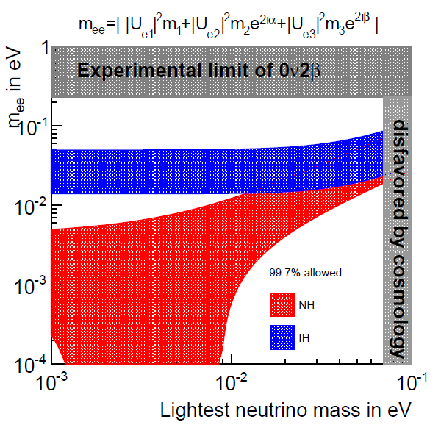
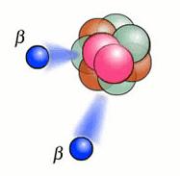
Mass Hierarchy
If inverted hierarchy,
planning next-generation discovery-level neutrino-less double beta decay (0νDBD) becomes clear
Important input for model building to explain neutrino mass and mixing (also precision measurements of neutrino mixing)
Notes:
The second opportunity is unambiguous determination of the neutrino mass hierarchy. Basically determine whether the third generation of neutrino mass eigenstate is heavier or lighter than the first two generations. This parameter is a crucial input for model building to explain the neutrino mass and mixing patterns.
Together with precision measurements of neutrino mixing, the determination of MH might guide us to a theory explaining the flavor structure of elementary particles. For example, this table summarizes some predicted relations among mixing parameters.
Furthermore, the determination of MH is crucial for the neutrinoless double beta decay experiments. This plot shows …
For example, if we have inverted hierarchy, the planning of next generation discovery-level experiments in terms of scale becomes clear.

Slide 7
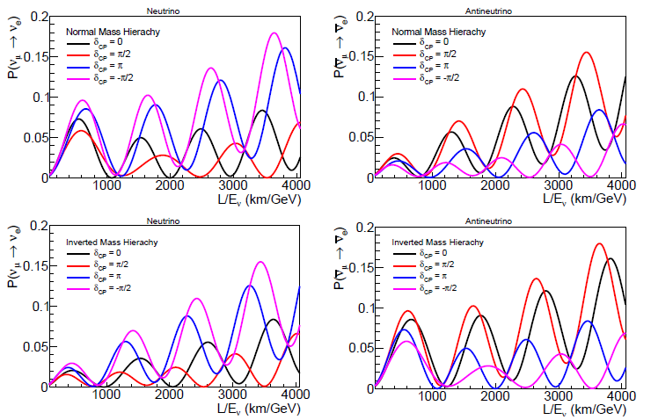
Accelerator ν_{e} Appearance
Oscillation pattern are very sensitive to the value of δ_{CP}, the mass hierarchy, θ₁₃, θ₂₃ (Octant), and Δm²₃₂ (5/7)
Unique opportunity to search for CPV
Notes:
In accelerator neutrino experiments, the primary method to address these two questions is the nu_mu to nu_e appearance measurement. What I am showing here is … 1st 2nd … Left panels are neutrino, right panels are antineutrinos. Top panels are normal mass hierarchy, bottom panels are inverted …
As you see, the oscillation pattern …
In particular, this is the currently the only known reliable way to measure CP phase delta.

Slide 8
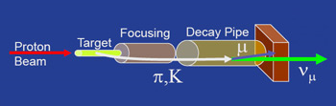
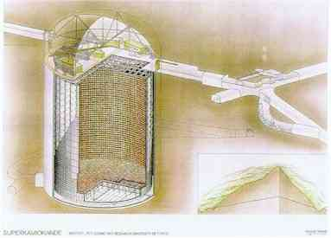
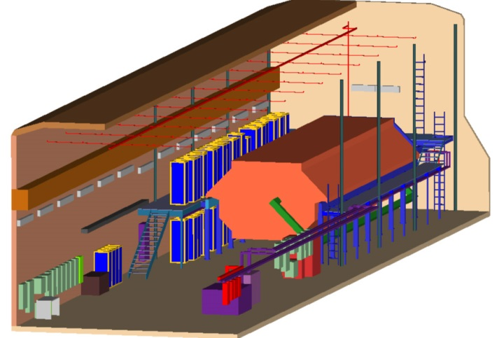
Accelerator Neutrino Experiment
Accelerator Neutrino Beam
Far Detector to measure Neutrino Oscillation
Near Detector to categorize Neutrino beam
Notes:
Accelerator Neutrino experiments normally consist of three parts.
The first one is the neutrino beam. Basically, we have a energetic proton beam hitting a target such as Graphite. It would produce charged pion and kaons. And they will get focused by the focusing magnet. The decay of these pions/kaons would generate a neutrino beam with primary component being muon neutrino. For this kind of beam, there will also be a small component of electron neutrino coming from muon, kaon, and kaon-long decays.
The second one is a large far detector to measure the neutrino events after the oscillation.
The third one is a near detector to categorize neutrino beam in terms of spectrum, backgrounds, and cross section measurements

Slide 9
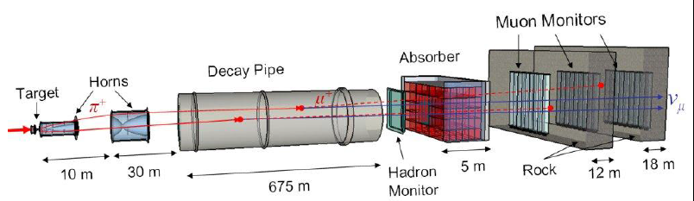
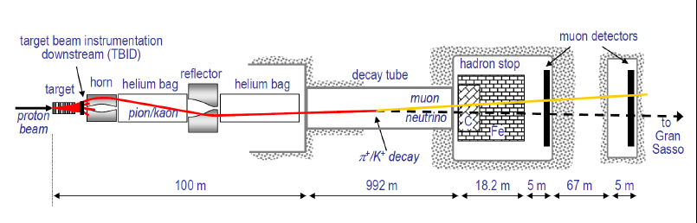
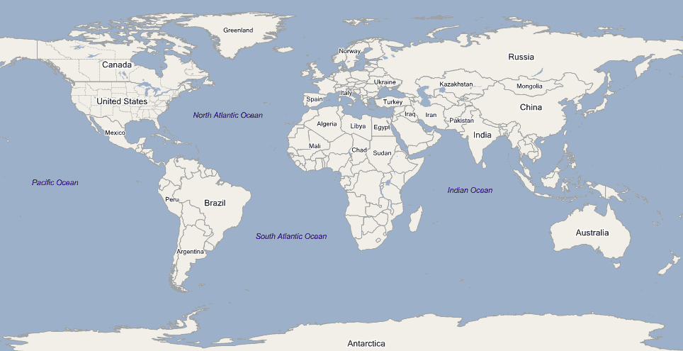
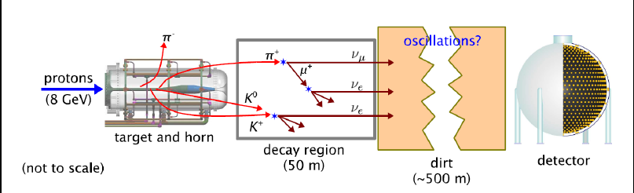
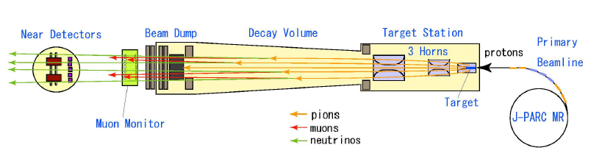
Recent Accelerator Neutrino Beams
CNGS
NUMI @ FNAL
BNB @ FNAL
J-PARC
Notes:
Let’s me introduce the recent running accelerator neutrino beams.
At FNAL lab in Chicago, there are two beamlines.
The first one is the NUMI (neutrino from the main injector) which served as beam line for MINOS experiment, and is currently used for the Nova experiment.
The second one is the Booster beam line, which served as the beam line for the MiniBooNE experiment, and is going to be used for the MicroBooNE experiment.
The third one is the CNGS beam from CERN. It was used for OPERA and ICARUS experiments.
The fourth one is the JPARC beam from Japan. It is currently used for the T2K experiment who first ever observe a neutrino appearance oscillation above 5-sigma significance.
First challenge is the scale
Not only organization and money, but also engineer challenges
Main conclusion of the talk (could be a factor of 10 bigger, amazingly lucky that we can building such a thing
Factor of 10 of what we have done, but still within the grasp, absolutely doable.
Understand the scale, well aware the,
How to building something?
Systematics
MiniBooNE,
K2K, MINOS, ICARUS, OPERA,
T2K, Nova,
What’s we learned???
How to building this beamline, How to build this kind of detector?
Reconstructed events in a WC? Becoming a high precision instrument
LBNE, LBNO (MicroBooNE + ND … ), Hyper-K

Slide 10
Recent Experiments
Exp. | Beam | Energy (GeV) | Power (MW) | Detector Technology | Detector Weight (kt) | Baseline (km)
K2K | KEK-PS | 0.3-2.7 | 0.01-0.02 | Water | 50 | 250
MINOS | NUMI | 1.0-12 | 0.4 | Steel Scintillator | 5.4 | 735
OPERA | CNGS | 5-30 | 0.5 | Lead Emulsion | 1.8 | 732
ICARUS | CNGS | 5-30 | 0.5 | Lar-TPC | 0.6 | 732
MiniBooNE | BNB | < 2 | 0.04 | Mineral Oil | 0.8 | 0.54
T2K | J-PARC | 0.3-1.5 | 0.75 | Water | 50 | 295
NOVA | NUMI | 1.0-3.0 | 0.7 | Liquid Scintillator | 15 | 810
MicroBooNE | BNB | < 2 | 0.04 | Lar-TPC | 0.08 | 0.47
First and Second Generation Oscillation Experiments
Long-Baseline Experiments
Notes:
This table summarizes the first and second generation oscillation experiments. Here, I only include experiments that are focusing on the oscillation physics. There are additional experiments focusing the measurement of the neutrino-nuclei cross section.
I tried to list the location, energy range, and power of the beam. I also listed the technology and mass of the detector and the baseline.
Basically, the first generation of experiments includes K2K from Japan, MINOS from US, OPERA/ICARUS from Europe, and MiniBooNE from the US.
The second generation of experiments includes T2K from Japan, and Nova from US which are currently taking data, and MicroBooNE experiment from the US which about to take data soon.
In the following, I am going to introduce the next-generation long baseline oscillation experiments
Update MINOS, Minerva, Nomad .. Sciboone …
Current and recent …

Slide 11
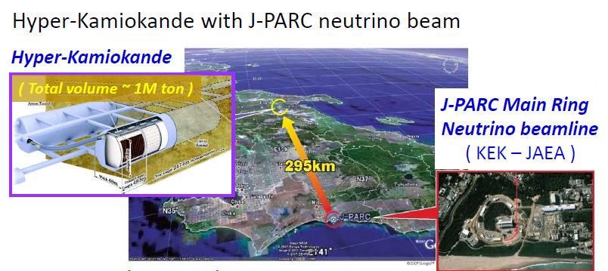
Future Experiments
Exp. | Beam | Energy (GeV) | Power (MW) | Detector Technology | Detector Weight (kt) | Baseline (km)
Hyper-K | J-PARC | 0.3-1.5 | >0.75 | Water | 1000 | 295
Y. Hayato Neutrino 2014
Notes:
In Japan, a new experiment, the Hyper Kamiokande is proposed to search for CP violation and to precisely measure the CP phase delta. It will also use the JPARC neutrino beam from the main ring. The goal is to have a higher than 0.75 MW beam power.
The far detector will be two huge water Cerenkov detector with a total mass of 1 M ton. This corresponds to about 560 kt fiducial mass.
The baseline is about 295 km. The Hyper Kamiokande experiment will focus on the first oscillation maxima which peaks about 0.6 GeV to measure the oscillation differences between the neutrino and antineutrino.

Slide 12
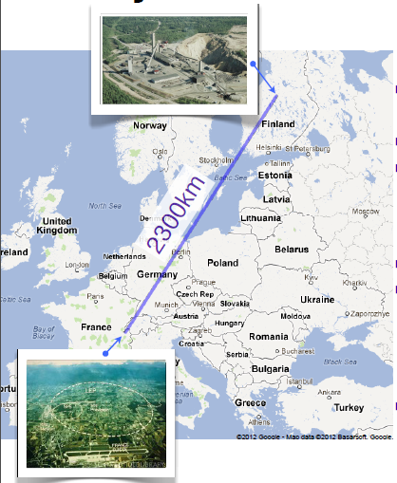
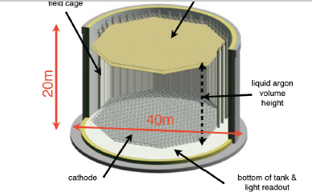
Future Experiments
Exp. | Beam | Energy (GeV) | Power (MW) | Detector Technology | Detector Weight (kt) | Baseline (km)
LBNO | CERN | 0.5-8.0 | 0.75 | Double-Phase LAr-TPC + MIND | 24-70 | 2300
Notes:
In Europe, a new experiment, LBNO is proposed. This experiment proposes a new powerfully neutrino beam from CERN to Norway. With the 2300 km baseline, the targeted neutrino energy is between 0.5 and 8 GeV. The far detector assumes a double-phased liquid argon time projection chamber with a target mass between 24 and 70 kton. This detector will be placed together with a magnetized iron neutrino detector for the charge seperation.
At 2300 km, one can measure the CP phase with rate as well as spectral shape information. One can also determine the MH using the matter effect.

Slide 13
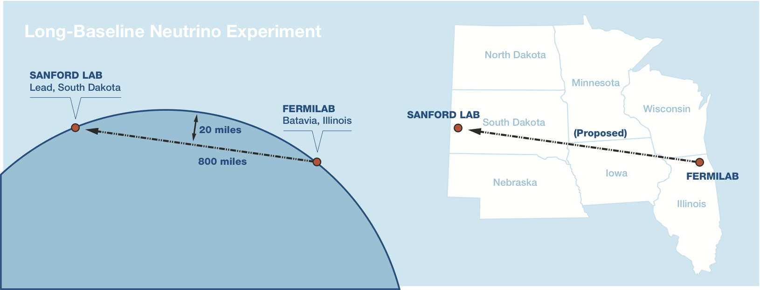
Future Experiments
Exp. | Beam | Energy (GeV) | Power (MW) | Detector Technology | Detector Weight (kt) | Baseline (km)
LBNE | FNAL | 0.5-5.0 | 1.2-2.3 | Single Phase LAr-TPC | 35-70 | 1300
Aim for MH, CPV,
precision measurements of Δm²₃₂, sin²2θ₁₃, sin²θ₂₃, and δ_{CP}
Notes:
In the US, we are working on the LBNE experiment (also recently known as LBNF). It consists a new and powerful neutrino beam from FNAL. The initial beam power will be 1.2 MW. The current plan is that the muon neutrinos would travel 1300 km to South Dakoda, the Sanford underground research facility. There, there will be a large 35 kt liquid argon time projection chamber placed deep underground to measure neutrino interaction. There will be near detectors (such as fine grain tracker) at FNAL to categorize the beam. The goal of this experiment is to determine the MH and search for CPV. It will also provide precision measurements of …

Slide 14
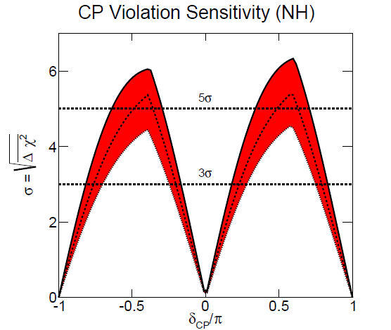
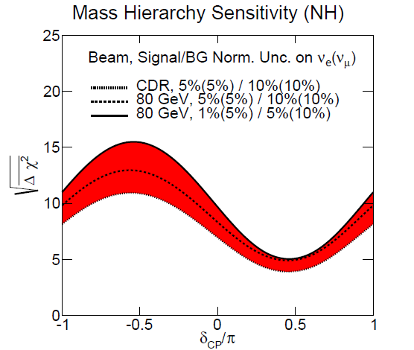
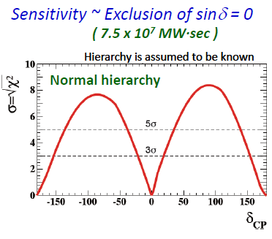
CPV and MH
LBNE
LBNE sensitivity: 1.2 MW x 6 years
1 year ~ 1.65e7 sec
Unique opportunity to
search for CPV
Unambiguous determination
of MH at high significance
Hyper-K
Hayato Neutrino 2014

Slide 15
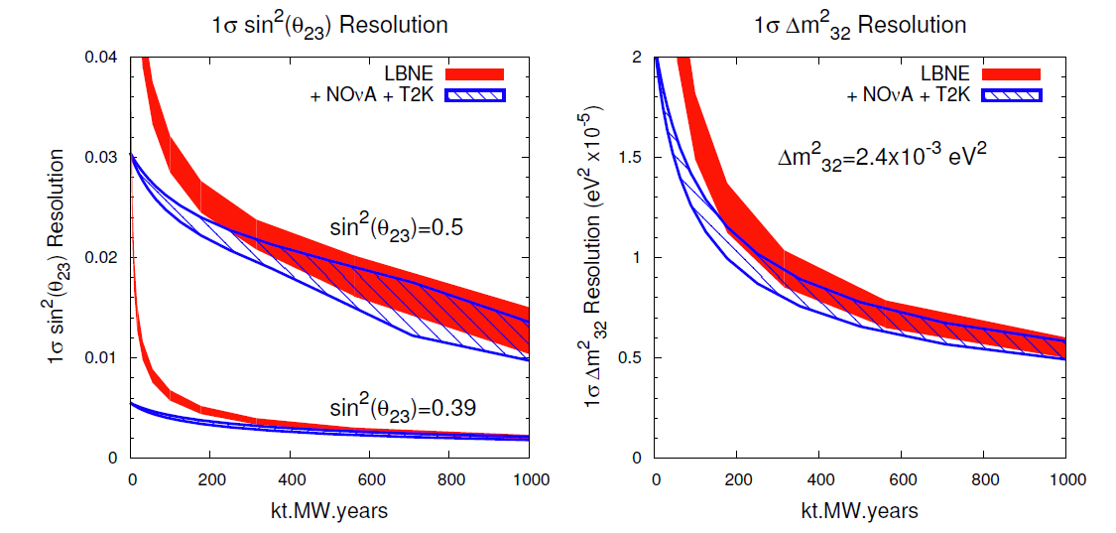
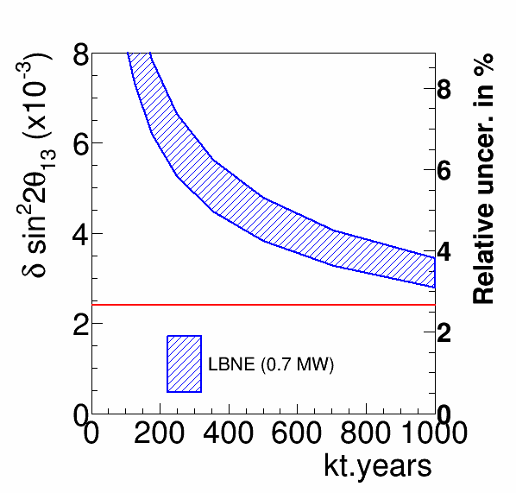
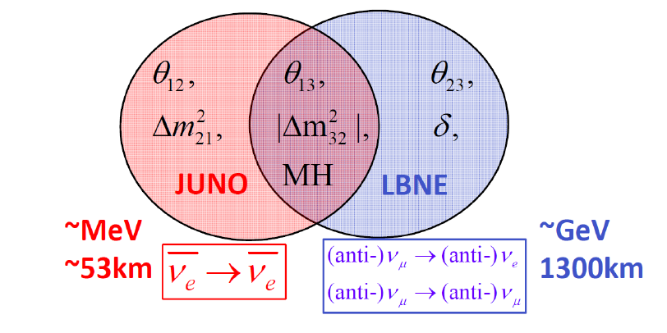
Sensitivity of Precision Measurements
Daya Bay exp.
Also Hyper-K
/LBNO

Slide 16
Outline
Motivation for Accelerator Experiments
Current and future generations of experiments
Challenges and Solutions
  Neutrino Flux
  Neutrino Detection
    LAr TPC
    Water Cerenkov Detector
    ν-A Cross section
Summary

Slide 17
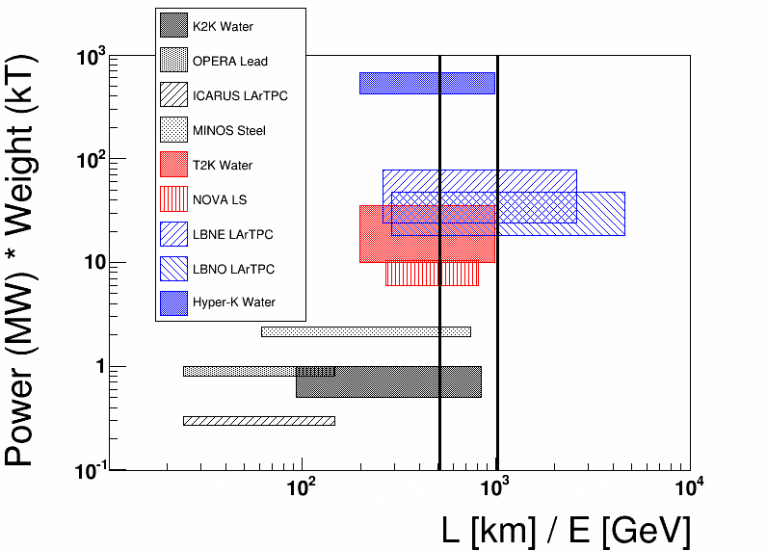
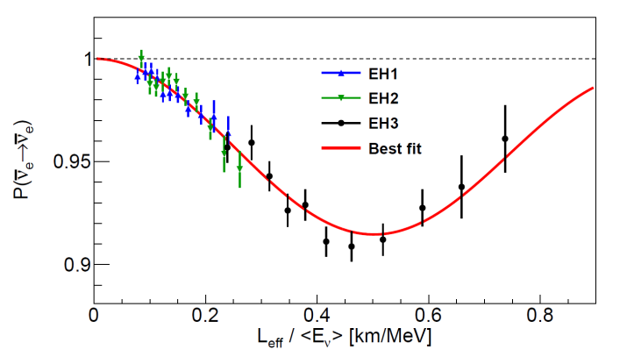
Challenge I: Experiment Scale
Next generation accelerator-based experiments aim at 1-2 order increase in the overall exposure underground (Water + LArTPC)
500-1000 people
~ 1 B$ scale
1st osc.
2nd osc.
We are lucky that the MH/Octant CPV (if maximal) are within reach given the large θ₁₃!
Daya Bay
Notes:
The first challenge that we are facing is the scale of the experiment. This plot shows the product of beam power and detector mass vs. the ratio of travel distance and neutrino energy.
You can see that the next-generation experiments aims for 1-2 order of increase in the overall exposure.
In particular for water Cerenkov detector, From K2K → T2K, it is about 1 order of increase, and from T2K to Hyper-K, it is another order of increase.
For LAr TPC, we are looking at about two order of increase.
The scale of the experiment corresponds to about 500-1000 collaborations with about a billion dollar scale, approaching the scale of the LHC experiments.
Nevertheless, I have to say that we are quite lucky that the MH and Octant determination as well as the CP violation hunt are within reach given the large theta13 discovered in the reactor experiment.
This is a challenge, but also a huge huge oppurtunity for us.

Slide 18
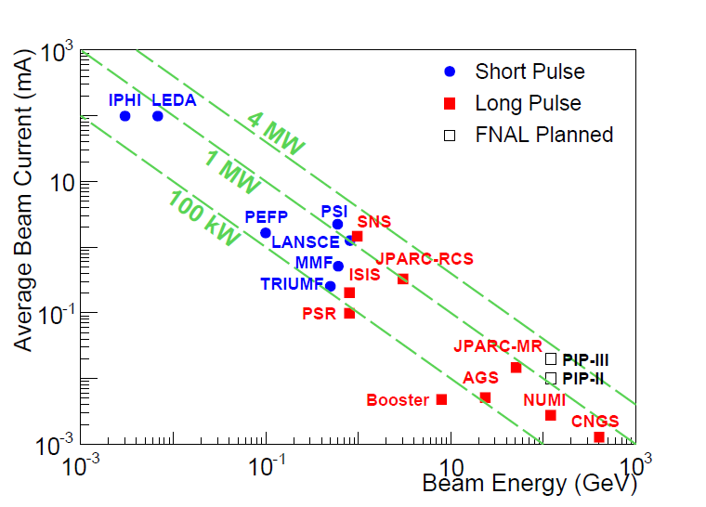
Challenge II: MW-power Beam
High-quality beam to injector
Accelerating high current beam to high energy
Low beam loss during transportation
MW-power is crucial to reach required statistics for long-baseline accelerator experiments
Notes:
Central challenge at intensity frontier for accelerators is controlling beam loss to minimize activation of the accelerator components
2) 1 nA of protons at 1 GeV (1 watt) activates stainless steel to 80 mrem/hr at 1 ft after 4 hrs
Add PIP-II
4MeV

Slide 19
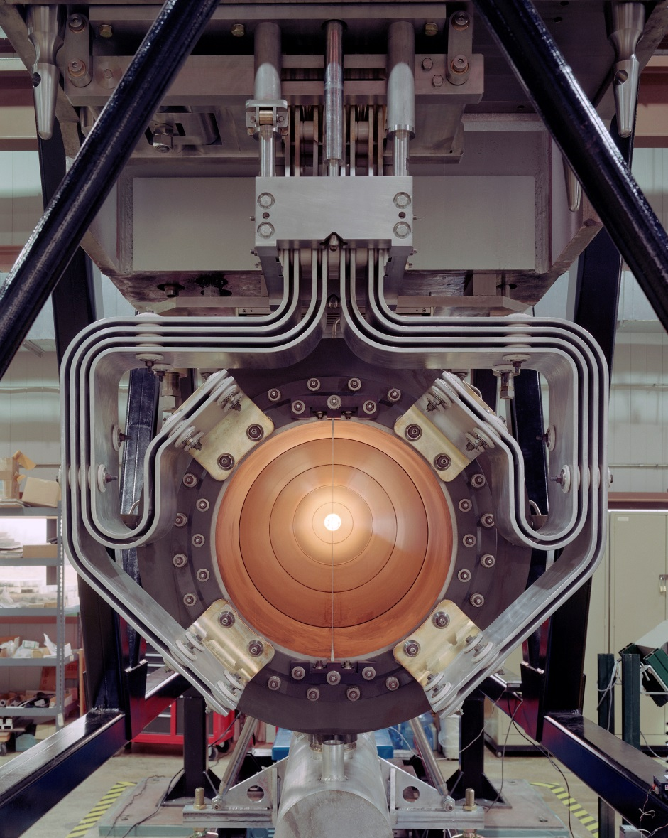
Challenge II: MW-power Beam
Challenges:
  Thermal Shock
  Remote Handling
  Cooling for High Heat
  Radiation Protection
  Design of Beam Window, target, horn
  Radiation Damage
Robust target and horn system for extreme power densities and extreme radiation
Notes:
Liquid target 4-8 MW … Bob Palmer

Slide 20
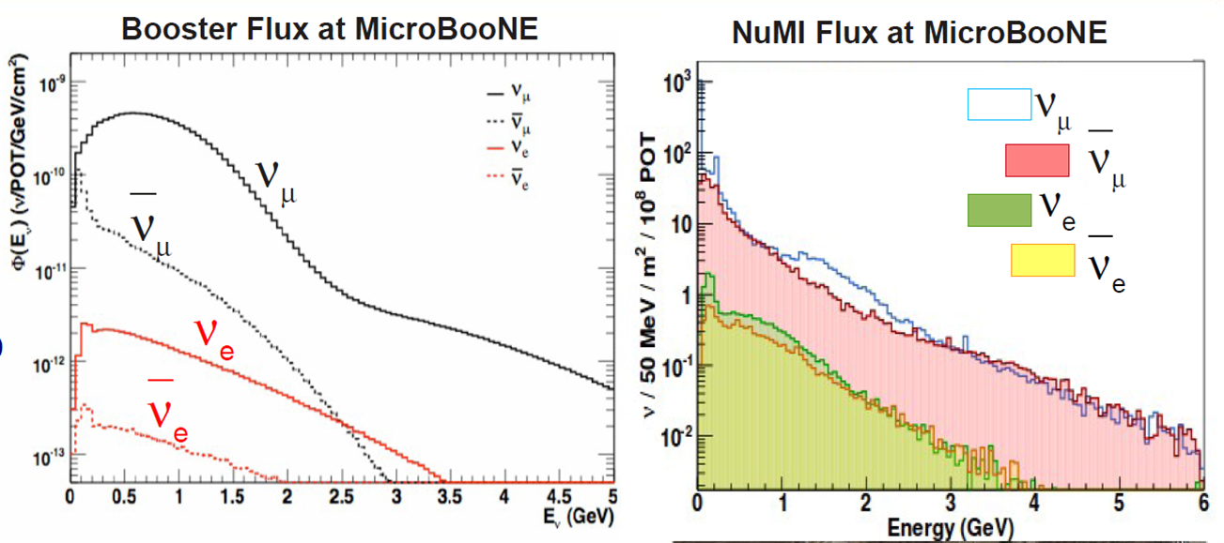
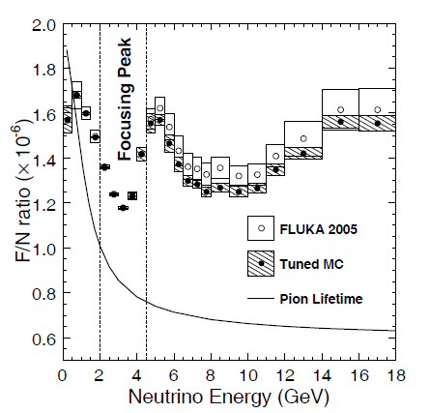
Challenge III: Categorization of Neutrino Beam
MINOS
Z. Pavlovic
ν_{μ} flux is crucial to signal, ν_{e} flux is irreducible background
It is crucial to categorize neutrino fluxes with near detector(s)
Notes:
T2K near detector fit …

Slide 21
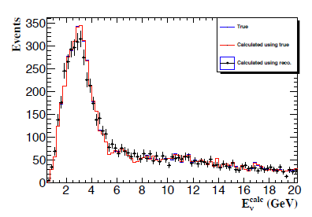
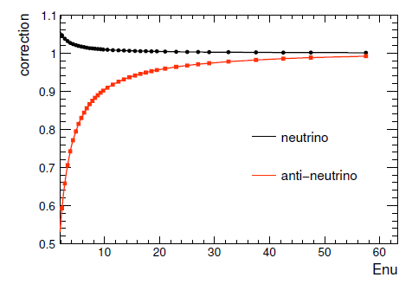
Absolute and Relative Flux Determination
ν-e NC elastic scattering
Also
Low-ν₀ method
Xinchun Tian
Aim ~2% determination of absolute flux
S. R. Mishra Proceeding.
A. Bodek et al., EPJC 72, 1973 (2012)
S. R. Mishra
Aim ~1-2% determination of relative flux

Slide 22
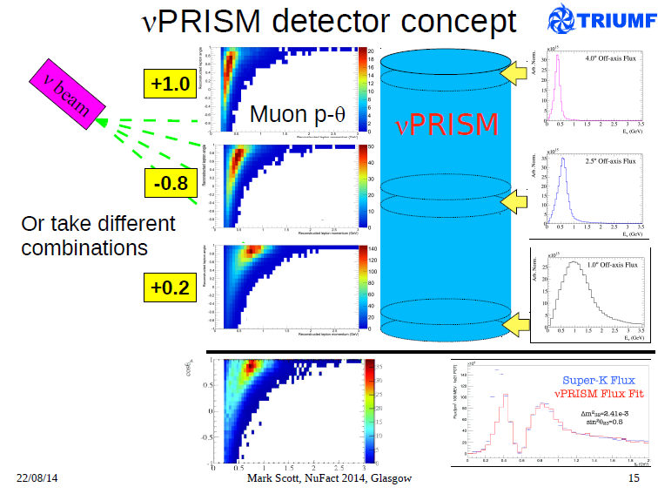
Also intrinsic νe flux
Cross section measurements
Mono-energetic neutrino beam …

Slide 23
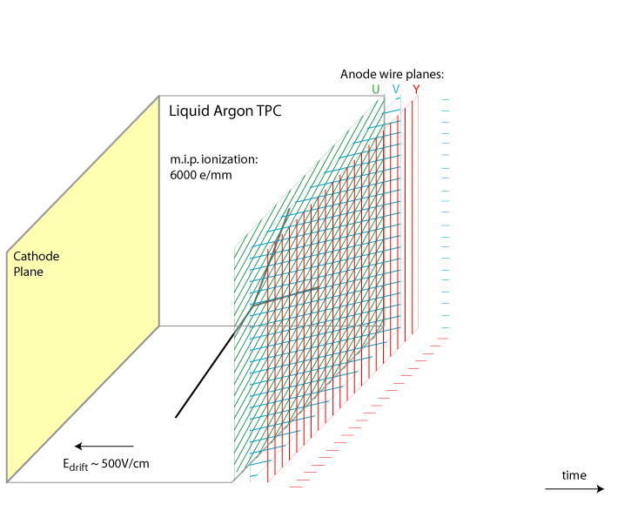
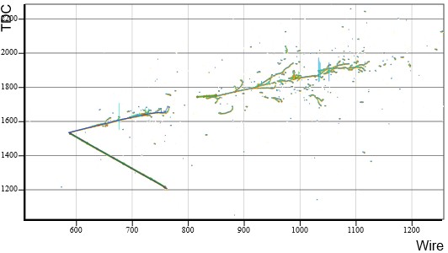
Excellent new opportunity
with high res. LArTPC
Argon: most abundant noble gas (1.3% by weight)
LAr: 1.4 g/mL @ 87 K
Electron drift velocity:
1.6 km/s → 1.6 ms
[ 2.5 m drift ]
Position resolution ~ mm
Good scintillation yield (emission peak @ ~128 nm) → trigger
PID: dE/dx through charge collection + event topology
dE/dx of 1 MIP: 2.1MeV/cm
8000 γ/mm
Electron shower
First proposed by C. Rubbia, 1977 → ICARUS;
Recoil proton
time
Notes:
8000 photons per mm

Slide 24
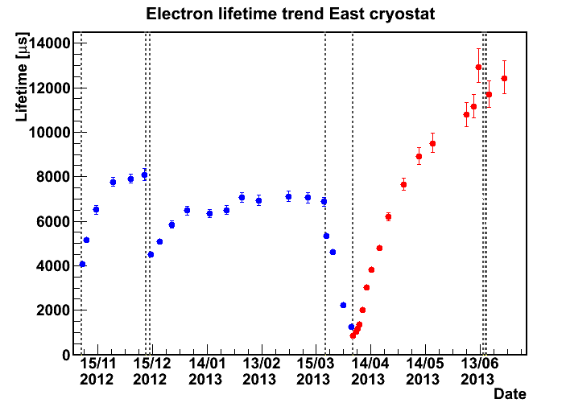
Challenge: LAr Purity
iii) Electron lifetime: collected charge
Ionized electron collide 10¹² times every second
Within the ~ ms drift time, if electron collides with an impurity and get attached, we lose it
Preliminary
ICARUS
Neutrino 2014
ICARUS reached 12 ms electron lifetime
Expect longer electron lifetime in MicroBooNE

Slide 25
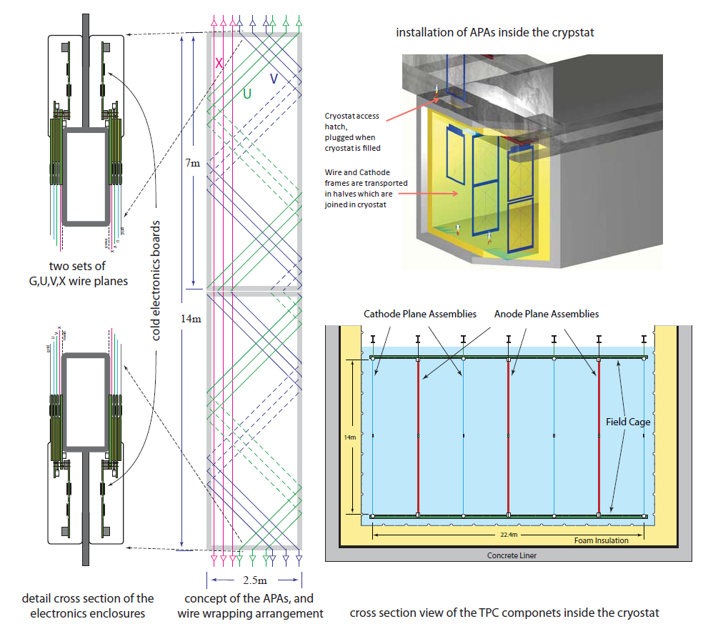
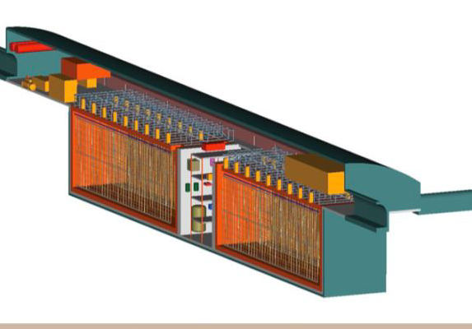
Challenge: Detector Size
Volume: 15m x 24m x 49m x 2
Total Liquid Argon Mass:
~50,000 tonnes
Fiducial Mass for ν Physics:
~35,000 tonnes
LBNE
Modular design is the key!
Notes:
Modular construction
Standardize technology cryogenic vessel (feasible)
Does it need to be special need for the experiment … No need vacuum insulation …
Make it into two slides …

Slide 26
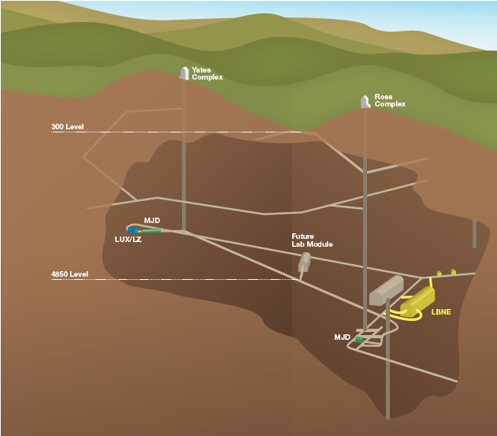
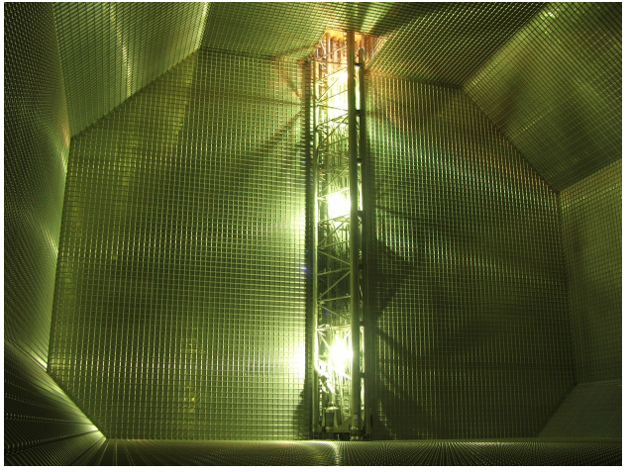
Underground and Insulation
No vacuum insulation needed
Industry tech. tanker with membrane from GTT
Successful LBNE 35 ton
prototype detector test
LAPD
LAPD/LBNE LAr purification/filtration vessels/system
0.7-2.4 vol change/day
LAr/GAr transfer lines

Slide 27
Cold Electronics
Cavern
to
DAQ
ADC
3000 x12 bit
16 channel mixed signal
LAr Cryostat
s
per channel
Front End ASIC (x8)
s
e
r
r
e
. . .
p
f
?
Charge amplifier + filter
. . .
p
. . .
f
. . .
u
16:1
8 Mb/s
. . .
u
?
Charge calibration
. . .
S
. . .
. . .
B
. . .
. . .
o
?
ADC
. . .
r
Nx Redundancy
. . .
. . .
e
. . .
. . .
Z
?
Zero-suppression
?
Buffering
?
Token passing bus
30:1
N:N
?
Register programmable
s
3840 (2304) wires/APA
h
240 Mb/s
g
u
8:1
o
r
h
t
Nx Redundancy
d
e
e
F
CM or LV differential
30:1
N:N
digital signaling
1 Mb/s
240 Mb/s
Optical
or
128 ch FE MB
Copper
. . .
Driver
128 ch FE MB
One APA

Slide 28

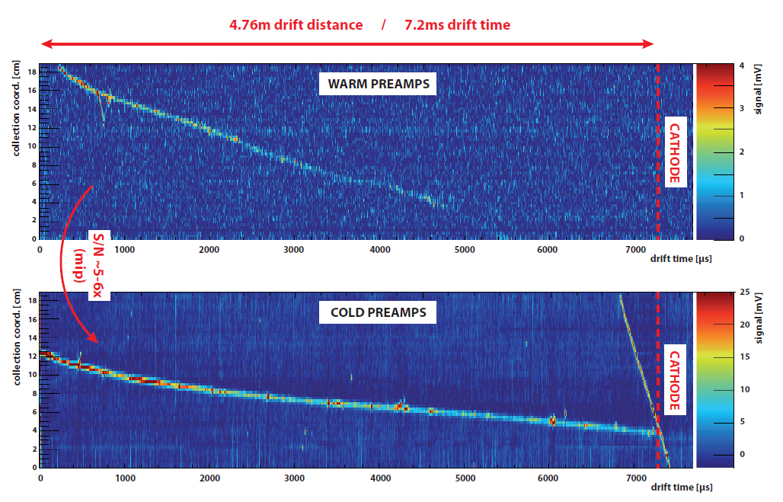
Cold vs. Warm Electronics
BNL low-noise
CMOS ASIC
Performance is constant from RT to 77K, except for noise
ARGONTUBE results by M. Schenk, Uni Bern
Noise is ~550e⁻ with C_{D} = 150pF in LN₂ (1us, 14mV/fC)
Noise level is about half with cold electronics
RMS Noise (e⁻)
Channel

Slide 29
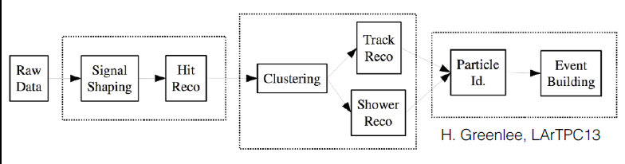
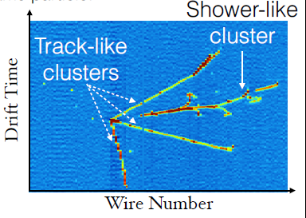
Challenge: Event Reconstruction
T. Yang LArTPC14
High-quality automated event reconstruction in LAr is crucial and in developing

Slide 30
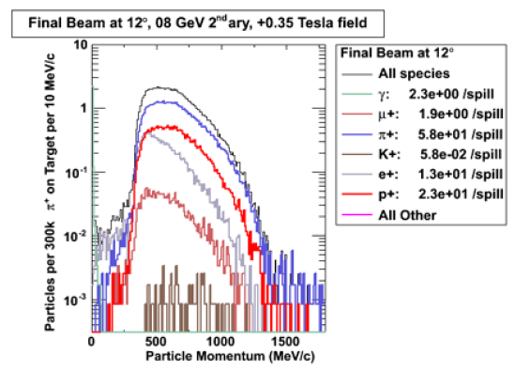
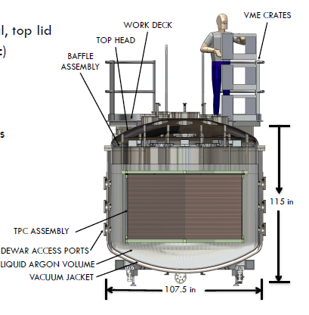
Test Beam Experiments
Use a well-defined charged particle beam to study LAr TPC
  Single particle tracks
  E&M Shower
  Hadronic Shower
FNAL test beam from arXiv:1406.5560
LAriat, WA105
Captain
  Energy response to neutrons

Slide 31
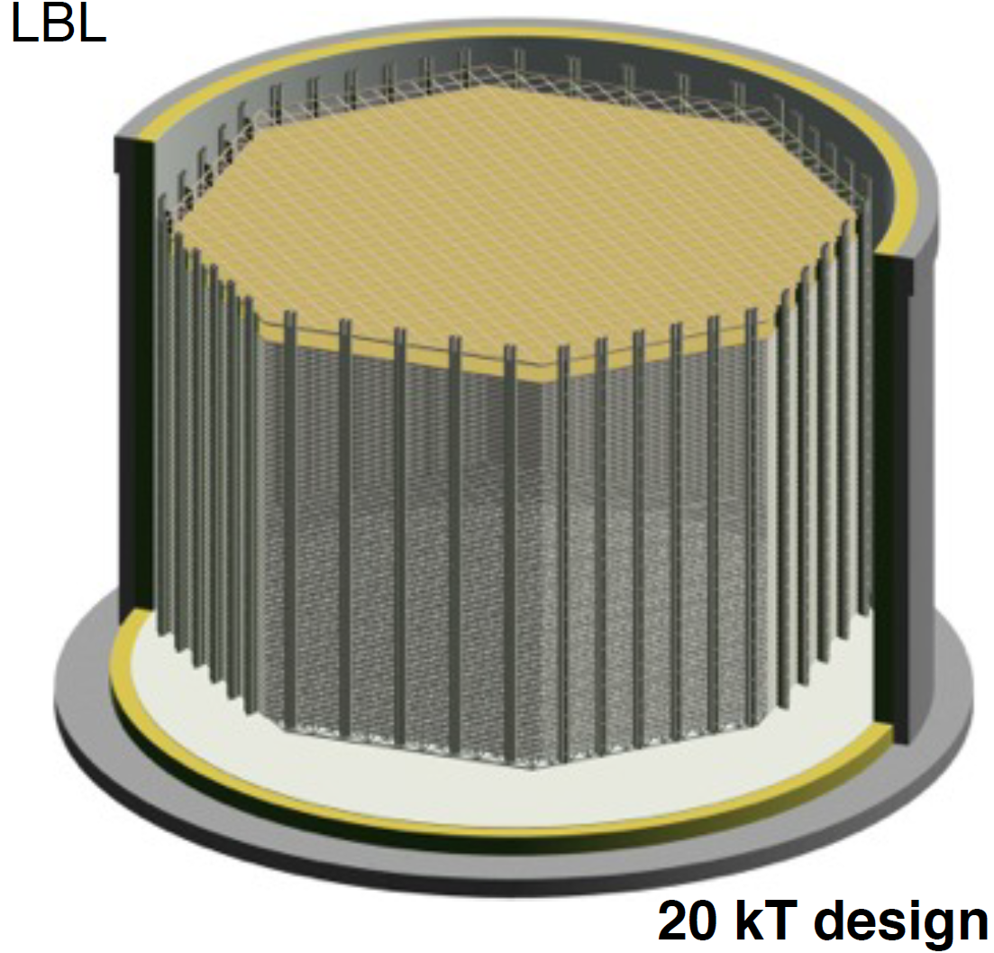
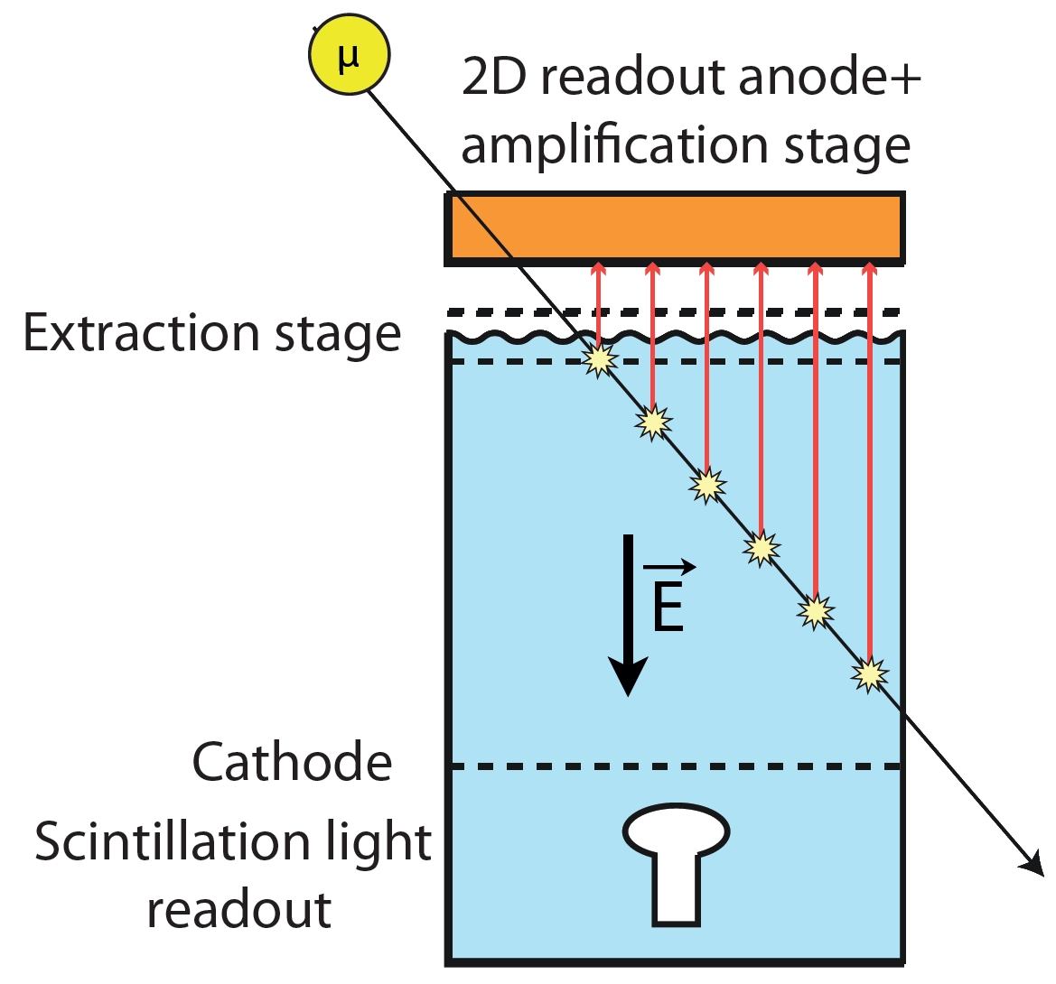
Challenges in Double-Phases LArTPC
40 m
20 m
HV (~10⁶ V) and ultra LAr purity is required for 20 m drift distance
Number of signals reaching 5x10⁵ for 20 kt
Light collection: Raleigh Scattering and light detector placement
Engineering issue, gain uniformity …
Notes:
Double phases …
Power related to the signal
PMT at the bottom
Talk to LBNO people …

Slide 32
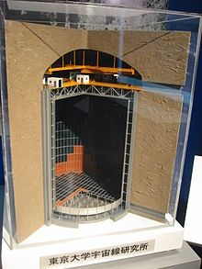
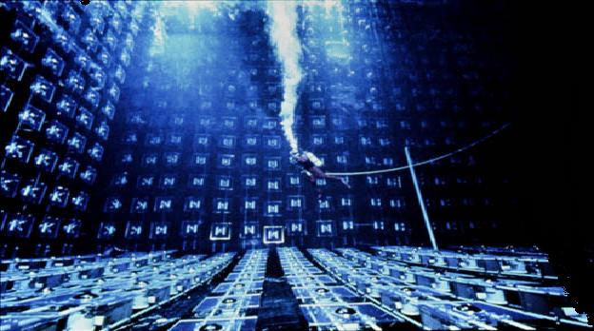
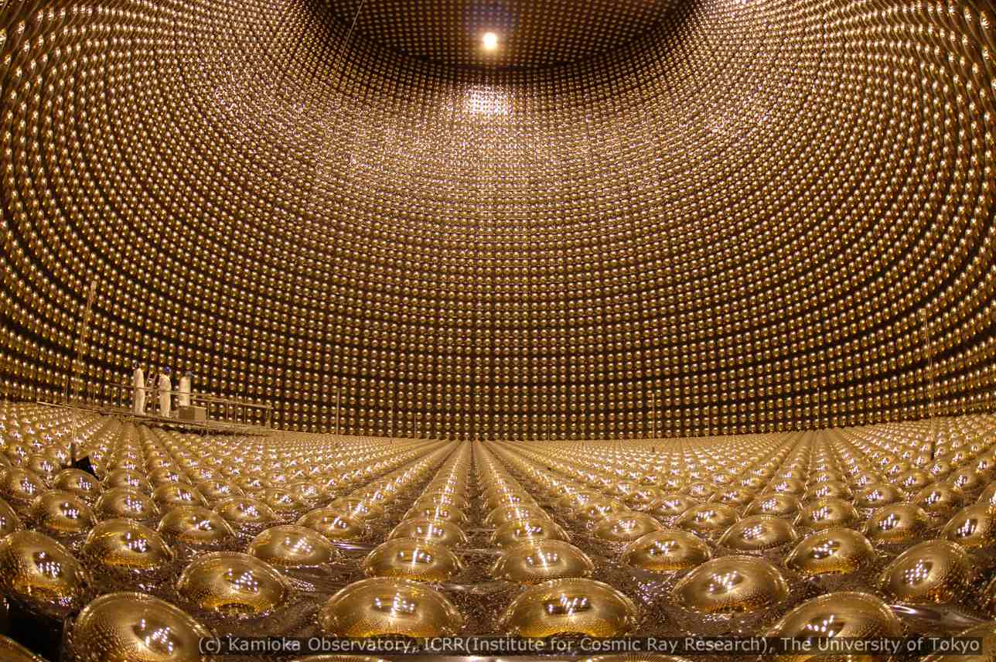
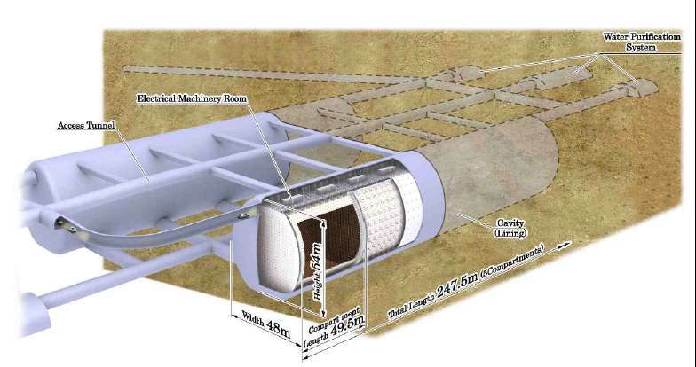
Water Cerenkov Detector
IMB 6.8 kton
Kamiokande
3 kton
Super-K 50 (22.5) kton
Hyper-K 1.0 (0.56) Mton

Slide 33

π⁰ background
M. Wilking (T2K 2013)
1.26 NC π⁰ backgrounds
70% removed with new alg.
Observed 28 events
Good role model for the LArTPC reconstruction development

Slide 34


ν-A Cross Section
LBNE
LBNO
Hyper-K
Understanding Neutrino Interaction is crucial for the oscillation experiments
  Neutrino energy reconstruction + normalization
Notes:
Add bars for Hyper-K, LBNE, LBNO …

Slide 35

Rapid Progresses
Experiments:
  MiniBooNE, Minerva, Argoneut, T2K, MicroBooNE …
Event Generator:
  GENIE, NEUT, GIBUU, NuWro …
  Validation with electron
  scattering data from
  (SLAC, MIT-Bates, JLab …)
Future measurements:
  Low-nu method +
  Fine Grain Tracker (LBNE)
  nuPRISM Concept
M. Scott
NuFact 14
Notes:
LBNE (1/3 QE, 1/3 RES, 1/3 DIS),
Hyper-K (QE mainly), Gibuu, …

Slide 36
Summary
Accelerator-based neutrino experiments will deliver high-quality physics results
  Determination of the MH will aid planning neutrinoless double beta decay experiments
  Establishment of lepton CPV will be revolutionary: explaining the matter dominance in our universe
  Excellent opportunities in FNAL, JPARC …
Scale of next-generation experiment is well-known, broad acceptance in the world, and within reach
  There are various technical issues relating to the scale, but no show stopper
  Issues on how to analyze data: increase signal efficiency, reduce backgrounds, keep systematics low is working out by the entire community

Slide 38
Principle of Water Cerenkov Detector
Muon: (sharp edge, group or rings)
Electron (fuzzy ring).
Sharp edge
Fuzzy ring
Also Michel electrons for muon identification

Slide 39


Signal Extraction
Ionization energy loss → deposited energy
LAr atom spacing 0.4 nm
MIP: 2.1 MeV/cm ~100 nm spacing
HIP: 25 MeV/cm ~10 nm spacing
Average energy loss
A. Szelc
Measurement of ionized electrons is crucial for tracking, PID, and energy reconstruction

Slide 40

ν_{e} vs. ν_{μ} Cross Section
J. Wolcott U. of Rochester @ NuFACT14, MINERVA
Also M. Day & K. S. McFarland PRD86 (2012)

Slide 41

G. Garvey

Slide 42
Summary
Know a lot
Flow chart …
  We have good reason that this is the answer to the matter dominance
Scale of the experiment is within reach, and well known, and has broad acceptance throughout the world
There are technique issues: scale of detector and intensity beam line
  R&D … US 100 millions → (2008)
Notes:
Missing here is the performances of this detector
Need overburden,
Need to put these detector underground …
No matter how this experiment is done, we are going to deal with neutrino cross section, efficiencies, corrections to a precision higher than before …

Slide 43




LAr TPC Signal Formation
v) TPC signal: induction and collection
Time scale of signals determined by wire plane spacing (geometry) and electron drift velocity
(Electric field)
Veljko Radeka
[µs]
3 mm
Notes:
Cold electronic ….

Slide 44


More Basics about LAr TPC
Assume wire pitch 3 mm
Particle | Energy Threshold
Proton | 22 MeV
Pion | 10 MeV
Kaon | 17 MeV
Muon | 10 MeV
Liquid Argon are dense
High probability of re-interaction
Lots of energies would be lost during collision due to energy threshold, neutral particles
Additional resolutions due to recombination correction
Energy reconstruction can be achieved by range for single track or by calorimetry through charge
Notes:
Remove this slide

Slide 45


e/single-γ separation in LAr
LAr radiation length ~ 14 cm
dE/dx @ shower vertex distinguishes
e (1 MIP) from γ→e⁺e⁻ (2 MIPs)
Electron
Gamma
Energy reconstruction can only be achieved with calorimetry
Recombination Correction

Slide 46
Information
Neutrino fluxes (Power + Spectrum + Categorization)
Detector (Size + Response + Identicalness between near and far)
Neutrino Interactions (Nuclear effect, nue and numu cross section differences)
Previous generation: MINOS + K2K
Current generation: T2K + Nova
Future Experiments: LBNE + LBNO + Hyper-K
SBL: MicroBooNE + Minerva (MiniBooNE)

Slide 47

Future Accelerator Experiments
Exp. | Beam | Energy (GeV) | Power (MW) | Detector Technology | Detector Weight (kt) | Baseline (km)
FNAL-SBN | BNB | < 2 | 0.04 | LAr-TPC | 0.08/0.6 | 0.6
Stage-I: MicroBooNE
~170 t + 470 m
close to data taking
Stage-II: SBN-ND
~ 150 t + 100 m
possibly larger in 2-3 years
Stage-III: ICARUS-T600
~ 600 t + 600 m
in 5-7 years
Search for Sterile Neutrino
Neutrino-Argon Cross Section Measurements
Development of LAr TPC technology

Slide 48

Mass Hierarchy
Important input for model building to explain neutrino mass and mixing
If inverted hierarchy,
the planning for next-generation discovery neutrino-less double beta decay (0νDBD) becomes clear
Neutrino MH
Neutrino Mass
0νDBD
Notes:
Chart of senario → Indication of Hierarchy (Motivation of next generation is greatly aided)
If the normal, neutrinoless double beta decay could make incremental progress
If zero neutrino double beta decay is found, cosmology

