Slide 1
COVID-19 Impacts MIE
TPC – expected students not available
Need techs at Stony Brook for field cage and possibly module work, uses $100K MIE contingency
Need tech at CERN for GEM foil work – CERN was closed >4 months thus lost schedule, uses $50K MIE contingency
SAMPA work – managed to adapt at U Sao Paulo (Brazil), Lund (Sweden), TSMC (Taiwan) – chip fab and packaging completed (!) and testing well underway at Lund
FEE and DAM construction – lost schedule on placing current round of orders - can still meet MIE early finish but timely procurements are needed
Support systems – laser and cooling design & prototype work slowed but enough staff back at work that design review finally held – can meet MIE early finish, i.e. absorb the delay here

Slide 2
COVID-19 Impacts MIE
EMCal – Illinois – blocks – 2 months lost
Students available for fiber-filling and stay ahead of schedule
Techs and technical-college students more an issue – supplementing Illinois SOW by $300K from MIE contingency
EMCal – BNL – sectors – 5-6 months lost
Parallel assembly lines now being set up
Need 2-3 more techs to staff these – either borrow internally at BNL or find job-shoppers (use at least $300K of contingency)
Students/postdocs/junior staff for testing of newly built sectors are needed – could this be staffed from sPHENIX group?

Slide 3
COVID-19 Impacts MIE
HCal – students not available over summer
Arrangements have been made for students and staff from “OHCal institutes” to work in 912
Distance in time and space with BNL technicians in 912
Have lost at least 3-4 months but still possible to complete instrumenting OHCal by February 2021 (need to start install in 1008 AH by June 2021)
Scintillating tiles from UNIPLAST are delivering on schedule – one shipment remains – 8% of total
Georgia State U so far has been able to have enough students present to maintain tile testing pace with projected finish in November, 2-3 months ahead of need at BNL
OHCal splice places being fabricated in Pennsylvania – ready by end CY2020 which is 5 months ahead of need in 1008 AH
InnerHCal structure and end rings – still getting contract in place, need Procurement help

Slide 4
COVID-19 Impacts MIE
Calorimeter FEE
Procurements mostly placed – electronics companies largely stayed open during pandemic
Need Procurement attention on EMCal preamp order
Testing slowed by lack of students at Lehigh, Michigan etc however have managed to stay ahead of need for EMCal and OHCal assembly
Digitizer contract prepared but needs final signoff at BNL before placement at Nevis Lab – $1M class procurement

Slide 5
COVID-19 Impacts MIE
DAQ
Testing of prototypes slowed due to BNL partial closure; now completed
PRR held, purchase requests submitted, still have float, no cost impact
Timing and GL1 trigger system
Testing of prototypes slowed due to BNL closure
Have now resumed testing, FDR/PRR planned next month
Can absorb schedule slip, no cost impact
Need to hire replacement computer scientist to be able to deploy
Local LvL-1 trigger – slowed by Nevis, Colorado closure
Board arrived at Nevis mid-March
Have now completed initial tests at Nevis, board sent to Colorado for functional testing
Can absorb schedule slip, very little float left, no cost impact

Slide 6
COVID-19 Impacts I&F
Helium system vendor impacted
Lost fabrication time for the 5 spool pieces needed for link between 1008B and 1008 IR
Install soon after end of Run 2020B
Both the spools and end of Run 2020B were delayed
As chance would have it, spools are appearing just as Run ends
Work on 1008B manifold is different vendor crew, design proceeded, materials procurement underway – so far so good
Need to install this after Run 21
Nitrogen system design lagged to address He system issues
Bids now issued by Procurement to potential vendors

Slide 7
COVID-19 Impacts I&F
Carriage/cradle vendor has stayed open and kept working
Has politely asked us to stay away from their shop
Track refurbishment work in 1008 AH and IR is delayed
AH is more time-critical now
IR work will start during the coming shutdown but must be completed during the 2021 shutdown – must not impede installation of the spool-pieces for the cryogenics system on the West Wall of 1008 IR during the coming shutdown
Schedule is concerning – need AH tracks ready by March 2021, whilst the IR tracks are only needed by March 2022 for sPHENIX roll-in

Slide 8
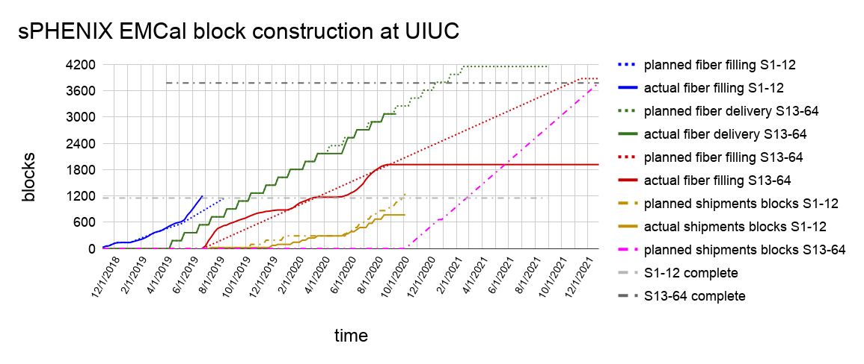
EMCal Schedule - Blocks
Blocks projected to complete late Dec 2021
Change-over from first 12 (preproduction) to production in early October
Feasible, but need added tech labor at Illinois, as noted earlier ($300K contingency)

Slide 9
EMCal Schedule - Sectors
All Module and Sector fabrication work is done at BNL
Sectors 2,3,4,5,6,7 (out of 64) in various stages of completion
Space in 510 lab and 510 high-bay organized now into 7 parallel lines
Dedicated person for light guides – stand-alone task
Attention on cooling loop fabrication – QC/QA
Most tasks are 1-person and have been exercised for >400 blocks, techniques are developed, and dwell-times have been learned
Gluing blocks to the “sawteeth” is a 4-person operation
Need 2-3 more techs – borrow internally or job-shop – 17 month commitment !
Need “junior scientist(s)” to take over post-assembly testing

Slide 10
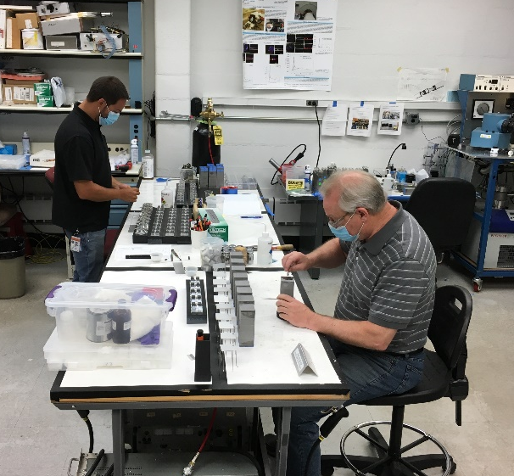
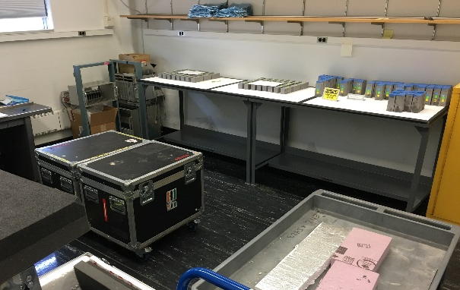
EMCal Module Assembly
Just received shipment (#20) of 96 more blocks from UIUC for sectors 7&8.
Ongoing module assembly, selecting blocks and attaching reflectors and light guides. Finished processing blocks from shipment 19.
Completed modules for Sectors 2-5.
Plan to glue up sector 5 next week.
Currently working on Sectors 6 & 7 modules.
Light guides – Finishing up last shipment of 660. Arranging next shipment.
Preparing light guide assemblies and attaching reflectors.
Unpacked shipment of blocks.

Slide 11
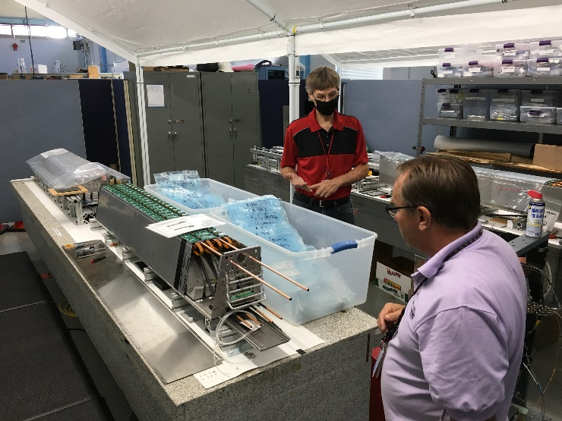
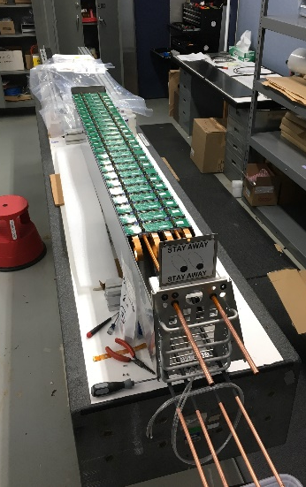
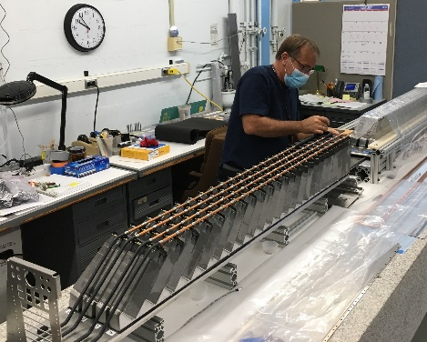
EMCal Sector Assembly
Sector 1 - moved to test tent
Sectors 2&3 – SiPM cooling loops installed, insulation, preamps installed, cables and testing now.
Sector 4 – blocks epoxied August 12, ready for final assembly
Sector 5 – Strongback/sawteeth prepared, blocks ready for epoxying this week.
Sector 6-12 – strongback/sawteeth prepared
Sector 3
Sector 2
Insulating Sector 2
SiPM cooling loops.

