Slide 1
Agenda
Brief sPHENIX Update – EO’B
Current Issues - EO’B
PEMP tied milestones for FY21 – EO’B
Scope contingency (Scope Opportunities) – EO’B
EV report on MIE and I&F Upgrade - EO’B
Cost and schedule impact of COVID even if it does not change the TPC - GY
EMCAL production rate - GY

Slide 2
Status of the sPHENIX Project
The Project is 67.5% Costed and Committed as of 7/31/20
41.2% Budget Contingency with 11.5 months float to PD-4
All FY20 milestones tied to sPHENIX PEMP notable are complete
Annual Review in July went very well. Project team is addressing the 4 recommendations.
All universities with major roles in sPHENIX fab are back at work in a low-density work state.
COVID-19 mitigations plans are being implemented
All sPHENIX commercial vendors are operating. Most are considered “essential industries”.

Slide 3
sPHENIX Technical Status
Long lead procurements received: 100% of SiPMs, 100% of tungsten powder, 70% of scintillating fibers, 94% of scintillator tiles (62% tested at GSU)
All SAMPA v5 chips fabbed and packaged and available for testing . Yield based on initial tests at Lund similar to SAMPA v4 from ALICE experiment(60-80%)
GEM Foils for TPC ordered from CERN. First articles delivered to SBU in August.
Calorimeter Digitizer preproduction electronics has started to arrive at Columbia Univ. Balance of electronics arrives the next few weeks. Testing has started.
>95% of EMCal and OHCal mechanical parts on hand or on order
All MVTX Readout Units at ORNL for testing. (non-MIE)
> 50% of all EMCal SiPM daughter boards at BNL. Testing complete on first 450 boards. Yield > 99%
10/32 OHCal sectors instrumented with scintillating tiles. Sectors 1-10 in various state of cabling and electronics instrumentation. 3 sectors complete and taking cosmic ray data.
EMCal Sectors 3/64 assembled and ready for cosmic ray testing. Sectors 4-6 in various states of assembly.
EMCal blocks for sectors 8-10 at UIUC and being prepared to ship to BNL.
LV distribution system for the sPHENIX subsystems reviewed by the CAD ESRC. No significant issues.

Slide 4
All FY20 Milestones Ties to PEMP Notable Complete
WBS | Milestone Name | Target Milestone Date | Actual Finish | Variance (in work days)
1.01.01 | Approve Project Baseline and Construction PD2/3 | 30-Sep-19 | 20-Sep-19 | 6
1.02.02.02 | Production Readiness Review - TPC Module Factories | 31-Dec-19 | 17-Dec-19 | 8
1.03.02.03.02 | EMCal Preproduction Sector 0 Assembled | 31-Dec-19 | 25-Nov-19 | 23
1.02.06.02 | Production Readiness Review - TPC DAM | 28-Feb-20 | 7-Feb-20 | 14
1.05.02.03 | HCal Preproduction FEE Complete | 30-Apr-20 | 22-Jan -20 | 70
1.05.02.01 | EMCal Electronics Preproduction Complete | 29-May-20 | 28-May-20 | 1
1.03.01.03.01 | EMCal W Powder Acquisition Complete | 30-Jun-20 | 5-Jun-20 | 17
1.03.02.03.03 | EMCal Prod Readiness Review Blocks/Modules/Sectors Complete | 15-Sept-20* | 31-July-20 | 30
1.02.05.03 | SAMPA ASIC Performance Accepted | 30-Sep-20 | 27-May-20 | 88
BHSO/SC: Effectively plan, execute, and successfully deliver SC projects equal to or less than $50 million that have been delegated to the Laboratory Director by SC under DOE O 413.3B [Super Pioneering High Energy Nuclear Interaction (sPHENIX)]. Clearly demonstrate successful accomplishment of work planned for FY 2020 (*adjusted for schedule impacts created by the COVID-19 pandemic) in accordance with SC guidance. (Objective 7.1)

Slide 5
Recommendations from the Annual Review
The sPHENIX annual review was held July 28-29. It had a very positive Close Out. I’ve seen the draft final report and expect it released within the next few days.
4 Recommendations, of which 3 are COVID-related
Due to current COVID restrictions and rules in the work place, project should re-evaluate potential inefficiencies that might need to be included in the P6 forecast plan prior to the end of FY2020. (Due Sept 30)
Conduct a comprehensive EAC update taking into account future COVID impacts due to social distancing inefficiencies by the end of October 2020. (Due Oct 31)
Revisit the Risk Register to review the assigned likelihoods and impacts and to check the consistency of assumptions across the project by the end of FY20. (Due Sept 30)
Prepare a plan by the end of October 2020, with anticipated decision dates, for potential scope opportunities that could be implemented should the project continue to perform well. (Due Oct 31)
Note: There were no technical recommendations

Slide 6
Issues to be Addressed
Personnel
The sPHENIX factories at BNL (EMCal and HCal) have just reached the state were they can use more technicians. In addition the 2020 shutdown will require techs to assist trades and contractors in 1008
CAD (Paul Sampson) has loaned us 2 entry level mech techs (very useful)
PO will look to hire 2 additional mech techs (TW-2) now and 1-2 additional elec techs (TW-2) in October
We’re also interviewing job shoppers for mech and electrical designer positions (we had 1.25 FTEs of designers pulled back to NSLS-II
Looking to bring another ME from IO into sPHENIX part time to work with Russ
PPM
With all the new hires in PPM management and the reorganization we haven’t been successful in getting orders placed for the last 4-6 weeks.
We have ~$2M in contracts pending in PPM right now. We need the logjam to be broken

Slide 7
Proposed PEMP Milestones for FY21
L2 Milestones from 4 major subsystems in FY2021
EMCal SiPM board production complete 31-Mar-2021
1st OHCal Sector w/ Splice plate ready to install 30-Apr-2021
EMCal Scintillating Fiber Acquisition complete 31-May-2021
TPC Fee Production complete 30-Sep-2021

Slide 8
Potential Scope Opportunities
One recommendation from the Annual review was to identify “scope opportunities” if the project continues to have good cost performance.
The approach would be to purchase equipment that either reduces technical risk or increases sPHENIX performance:
Additional FELIX cards
Additional EBDC servers
Additional Calorimeter Digitizers
Additional LV and Bias supplies
Additional Back-End DAQ computing
Additional TPC, EMCal and HCal Fees
Additional calibration equipment for the TPC (?)
Total Cost would be in the $1.5-2M range

Slide 9
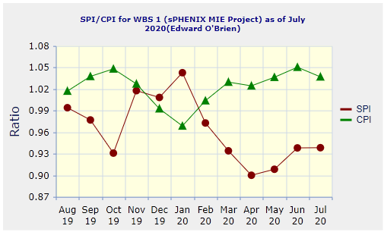
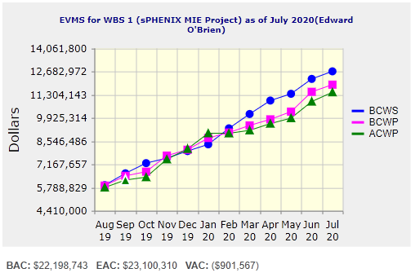
Performance Indices – sPHENIX MIE
Cumulative SPI | Cumulative CPI
0.94 | 1.04
Cumulative BCWS (Scheduled) | $12,688,746
Cumulative BCWP (Performed) | $11,898,007
Cumulative ACWP (Actual) | $11,447,803
DOE SPI or CPI Value Thresholds
0.90 to 1.15
0.85 to 0.89 or 1.16 to 1.25
<0.85 or >1.25

Slide 10
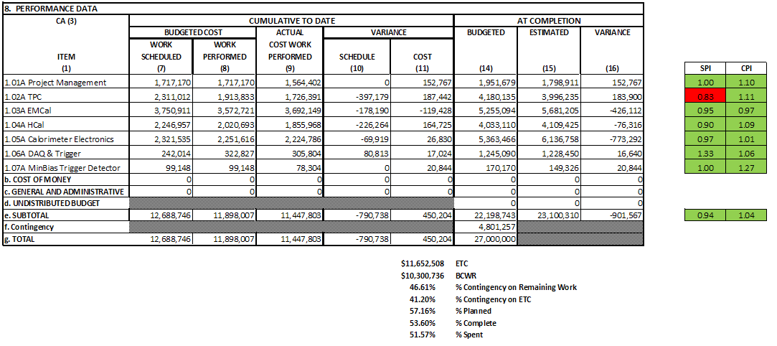
Cost Performance Report (CPR) – sPHENIX MIE
DOE SPI or CPI Value Thresholds
0.90 to 1.15
0.85 to 0.89 or 1.16 to 1.25
<0.85 or >1.25
*Highlights in table above takes variance $ into consideration, not just Indices
53.6% complete
41.2% contingency

Slide 11
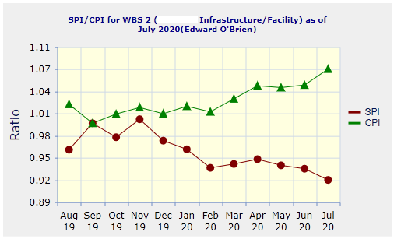
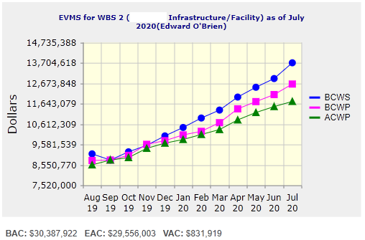
Performance Indices – 1008 Infra and Facility Upgrade
Cumulative SPI | Cumulative CPI
0.92 | 1.07
Cumulative BCWS (Scheduled) | $13,705,223
Cumulative BCWP (Performed) | $12,632,712
Cumulative ACWP (Actual) | $11,754,112
DOE SPI or CPI Value Thresholds
0.90 to 1.15
0.85 to 0.89 or 1.16 to 1.25
<0.85 or >1.25

Slide 12
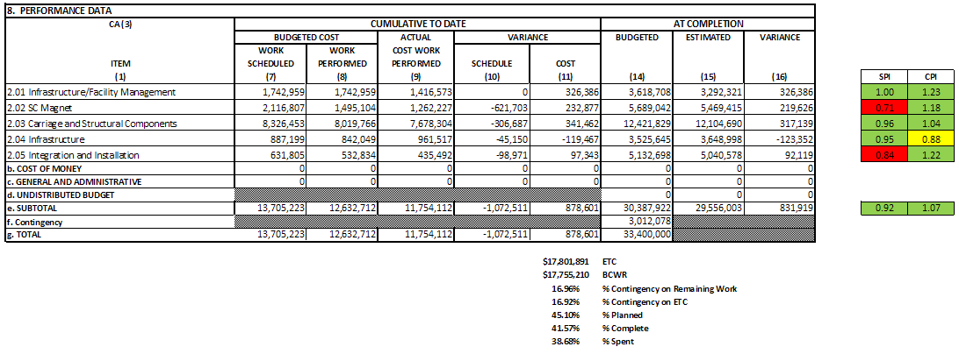
Cost Performance Report (CPR) – 1008 Infra and Facility Upgrade
41.6% complete
17.0% contingency
DOE SPI or CPI Value Thresholds
0.90 to 1.15
0.85 to 0.89 or 1.16 to 1.25
<0.85 or >1.25
*Highlights in table above takes variance $ into consideration, not just Indices

Slide 13
Milestones Status – sPHENIX MIE
# | WBS | Milestone Name | Target Milestone Date | Forecast | Actual Finish | Variance (in work days) | Comments
1 | 1.01.01 | Approve Project Baseline and Construction PD2/3 | 30-Sep-19 | 20-Sep-19 A | 20-Sep-19 | 6
2 | 1.02.02.02 | Production Readiness Review - TPC Module Factories | 31-Dec-19 | 17-Dec-19 A | 17-Dec-19 | 8
3 | 1.03.02.03.02 | EMCal Preproduction Sector 0 Assembled | 31-Dec-19 | 25-Nov-19 A | 25-Nov-19 | 23
4 | 1.02.06.02 | Production Readiness Review - TPC DAM | 28-Feb-20 | 04-Feb-20 A | 4-Feb-20 | 16
5 | 1.05.02.03 | HCal Preproduction FEE Complete | 30-Apr-20 | 22-Jan-20 A | 22-Jan-20 | 70
6 | 1.05.02.01 | EMCal Electronics Preproduction Complete | 29-May-20 | 28-May-20 A | 28-May-20 | 0
7 | 1.03.01.03.01 | EMCal W Powder Acquisition Complete | 30-Jun-20 | 15-Jun-20 A | 15-Jun-20 | 11
8 | 1.03.02.03.03 | EMCal Production Readiness Review Blocks/Modules/Sectors Complete | 31-Jul-20 | 30-Jul-20 A | 30-Jul-20 | 1
9 | 1.02.05.03 | SAMPA ASIC Performance Accepted | 30-Sep-20 | 29-May-20 A | 29-May-20 | 86
10 | 1.05.01 | EMCal/HCal SiPM Sensor Procurement Complete | 30-Oct-20 | 28-Feb-20 A | 28-Feb-20 | 171
11 | 1.05.02.04 | HCal SiPM Boards Assembly Complete | 30-Nov-20 | 15-Jan-21 |  | -33
12 | 1.02.06.03 | TPC DAM Felix 2.0 Production Complete | 29-Jan-21 | 11-Jun-21 |  | -94
13 | 1.06.02.03 | Trigger LL1 Preproduction complete | 26-Feb-21 | 16-Mar-21 |  | -13
14 | 1.05.02.02 | EMCal SiPM Boards Production Complete | 31-Mar-21 | 2-Nov-20 |  | 99
15 | 1.04.04.02 | First Outer HCAL Sector and Splice Plates Ready to Install | 30-Apr-21 | 16-Nov-20 |  | 112
16 | 1.04.01 | Inner HCAL Support Structure Ready for Installation | 30-Apr-21 | 3-May-21 |  | -2
17 | 1.02.01.06 | GEM Production Complete | 31-May-21 | 15-Mar-21 |  | 54
18 | 1.03.01.03.01 | EMCal Scintillating Fiber Acquisition Complete | 31-May-21 | 4-Mar-21 |  | 61
19 | 1.06.01.03 | DAQ Production: DAQ Ready for Operation | 31-May-21 | 15-Dec-21 |  | -136
20 | 1.05.02.04 | HCal Electronics Complete: Production | 30-Jun-21 | 5-Aug-21 |  | -26
21 | 1.02.05.04 | TPC FEE Production Complete | 30-Jul-21 | 15-Jul-21 |  | 10
22 | 1.05.03.02 | Calorimeter Electronics Complete | 30-Jul-21 | 5-Aug-21 |  | -5
23 | 1.05.02.02 | EMCal Electronics Complete | 30-Jul-21 | 15-Apr-21 |  | 73
24 | 1.07 | MinBias Detector Ready to Install | 30-Sep-21 | 16-Nov-21 |  | -32
25 | 1.06.03.03 | GL1 Ready to Operate | 30-Sep-21 | 13-Oct-21 |  | -9
26 | 1.01.01 | Early Project Completion | 29-Oct-21 | 7-Jan-22 |  | -45
27 | 1.02.01.08 | TPC Ready to Install (Assembly Complete) | 29-Oct-21 | 27-Oct-21 |  | 1
28 | 1.02.06.03 | TPC DAM Production Complete | 29-Oct-21 | 20-Oct-21 |  | 6
29 | 1.03.02.03.03 | EMCal Ready to Install | 29-Oct-21 | 6-Jan-22 |  | -45
30 | 1.04.04.02 | Last Outer HCAL Sector Ready to Install | 29-Oct-21 | 17-Sep-21 |  | 28
31 | 1.06.02.04 | LL1 Trigger Production Complete | 29-Oct-21 | 5-Oct-21 |  | 16
32 | 1.06.02.04 | LL1 Ready to Operate | 29-Oct-21 | 5-Oct-21 |  | 16
33 | 1.01.01 | Approve Project Closeout PD-4 | 30-Dec-22 | 29-Dec-22* |  | 0

Slide 14
Milestones Status – 1008 Infra and Facility Upgrade
# | WBS | Milestone Name | Target Milestone Date | Forecast | Actual Finish | Variance (in work days) | Comments
1 | 2.03.03 | Completion of Outer HCAL Sector Mechanical Structure Procurement | 30-Sep-19 | 03-Sep-19 A | 3-Sep-19 | 19
2 | 2.02.03.04.01 | Completed - (Controls Hardware) Power distribution drawings | 31-Oct-20 | 12-Nov-20 |  | -8
3 | 2.03.01 | Completed - Steel Track Modifications | 30-Nov-20 | 13-Jan-21 |  | -31
4 | 2.03.02 | Magnet Supports Released for Production (Milestone) | 31-Jan-21 | 15-Jan-21 |  | 9
5 | 2.04.02.01 | Magnet cryo, electrical and control structural support components Ready for Installation | 31-Mar-21 | 10-May-21 |  | -29
6 | 2.03.02 | Inner HCal Support Tabs Components Ready for Installation | 31-Mar-21 | 28-Jul-21 |  | -84
7 | 2.05.04 | Outer HCal Sectors Ready for Installation | 30-Apr-21 | 16-Nov-20 |  | 112
8 | 2.03.01 | Carriage Cradle - Components Ready for Installation | 31-May-21 | 22-Feb-21 |  | 69
9 | 2.03.05 | CC Bridge, Mid Platforms & Access - Ready for Installation | 31-Oct-21 | 29-Jun-21 |  | 85
10 | 2.02.03.02.04.02 | Completed - Procure LN2 supply transfer line system - Phase 5 - Shipping - Delivery Acceptance | 30-Nov-21 | 28-Jan-22 |  | -41
11 | 2.05.05 | Completed - Install SC Magnet on Cradle | 30-Nov-21 | 15-Sep-21 |  | 49
12 | 2.04.02.06 | Assembly Hall Components Ready for Installation | 30-Nov-21 | 16-Sep-21 |  | 48
13 | 2.04.01.03 | Detector Electronics Racks and Rack generic support systems Components Ready for Installation | 30-Nov-21 | 6-Jan-22 |  | -26
14 | 2.04.01.05 | Detector Safety Subsystems Components Ready for Installation | 31-Dec-21 | 21-Dec-21 |  | 6
15 | 2.02.02 | Completed - Magnet and Solenoid Valvebox - Reinstall | 31-Jan-22 | 4-Nov-21 |  | 55
16 | 2.05.04 | Completed - Install Remainder of Outer HCal Sectors | 31-Jan-22 | 12-Nov-21 |  | 50
17 | 2.05.03 | Completed - Install platforms & access | 28-Feb-22 | 14-Dec-21 |  | 49
18 | 2.05.07 | Completed - Install EMCal Sectors | 31-Mar-22 | 4-Jan-22 |  | 59
19 | 2.05.03 | Completed - Install Pole Tips | 31-May-22 | 28-Mar-22 |  | 44
20 | 2.02.03.01.06 | RHIC Helium Interface - Installation complete | 30-Jun-22 | 2-May-22 |  | 41
21 | 2.02.03.04.03 | (Cryo Controls Hardware) Hardware Installed | 30-Jun-22 | 4-Apr-22 |  | 61
22 | 2.02.01.02 | Magnet is operational | 31-Jul-22 | 13-Jun-22 |  | 33
23 | 2.02.05.03 | Completed - Magnet Field Measurements: Map Magnetic Field of SC Magnet | 31-Aug-22 | 5-Jul-22 |  | 40
24 | 2.05.08 | Completed - Install TPC | 30-Sep-22 | 22-Jul-22 |  | 48
25 | 2.05.11 | Completed - Install Min Bias | 31-Oct-22 | 29-Aug-22 |  | 42
26 | 2.05.10 | Completed - Install MVTX | 30-Nov-22 | 3-Oct-22 |  | 37
27 | 2.05.12 | sPHENIX Ready for Operations | 30-Nov-22 | 12-Oct-22 |  | 31

Slide 15
Summary Schedule – sPHENIX MIE

Slide 16
Summary Schedule – sPHENIX MIE and 1008 Infra and Facility Upgrade

Slide 17
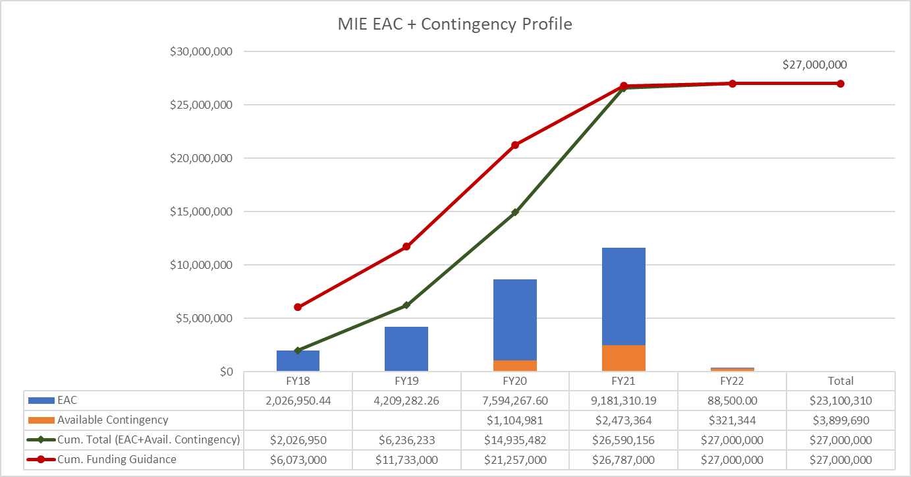
EAC and Contingency Profile – sPHENIX MIE

Slide 18
Baseline/Contingency Log - MIE
Data Date: 31-Jul-20

Slide 19
ETC Log - MIE
Data Date: 31-Jul-20

Slide 20
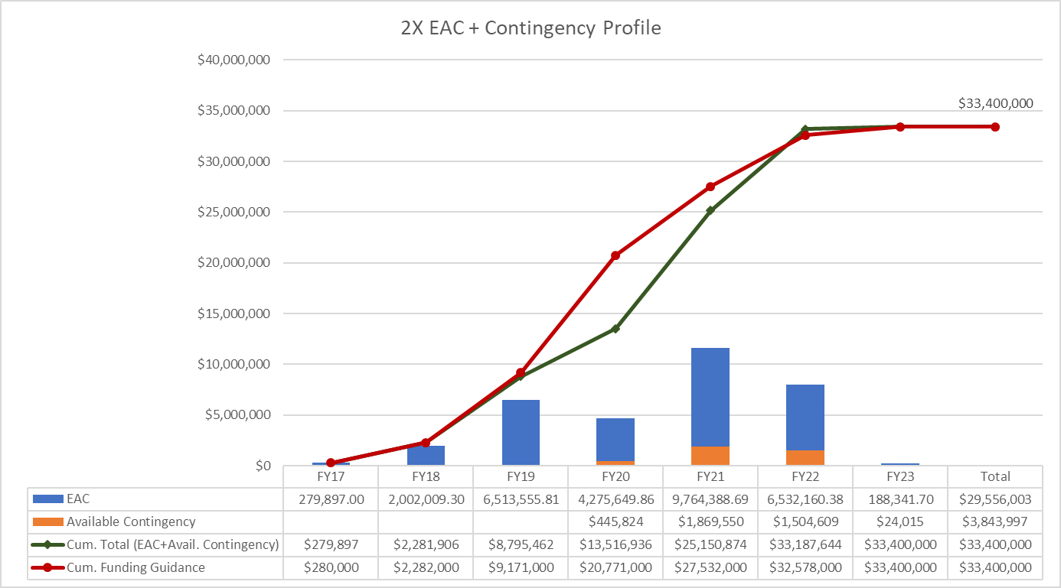
EAC and Contingency Profile – 1008 Infra and Facility Upgrade
Data Date: 31-Jul-20

Slide 21
Baseline/Contingency Log - 1008 Infra and Facility Upgrade
Data Date: 31-Jul-20

Slide 22
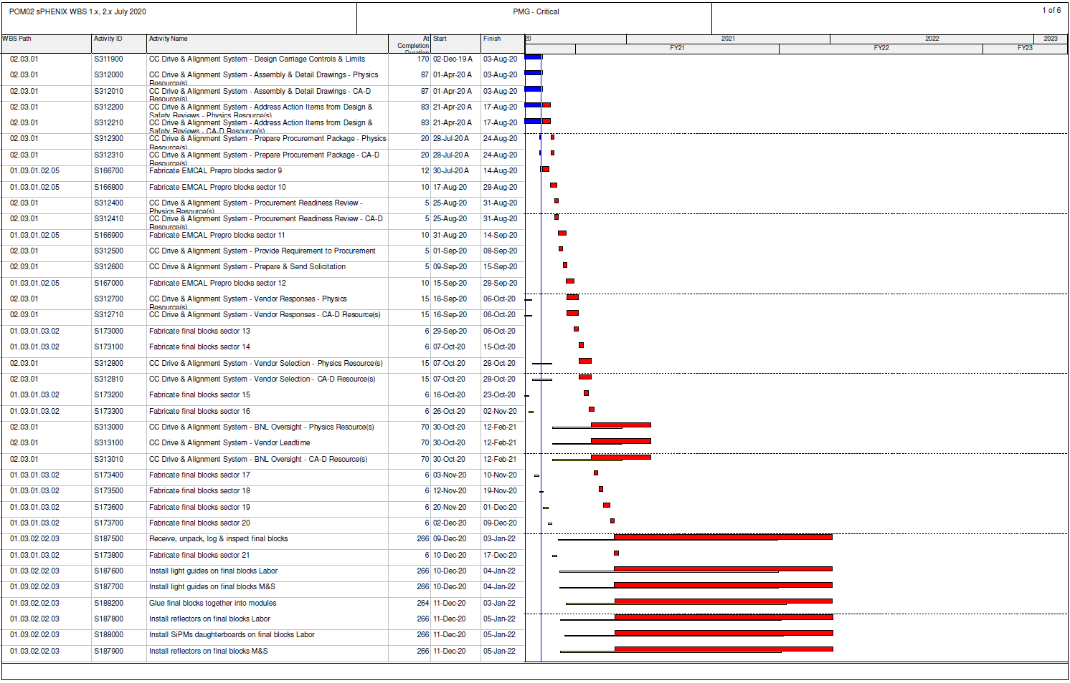
Critical Path (1x, 2x and 3x Combined)
Data Date: 31-Jul-20

Slide 23
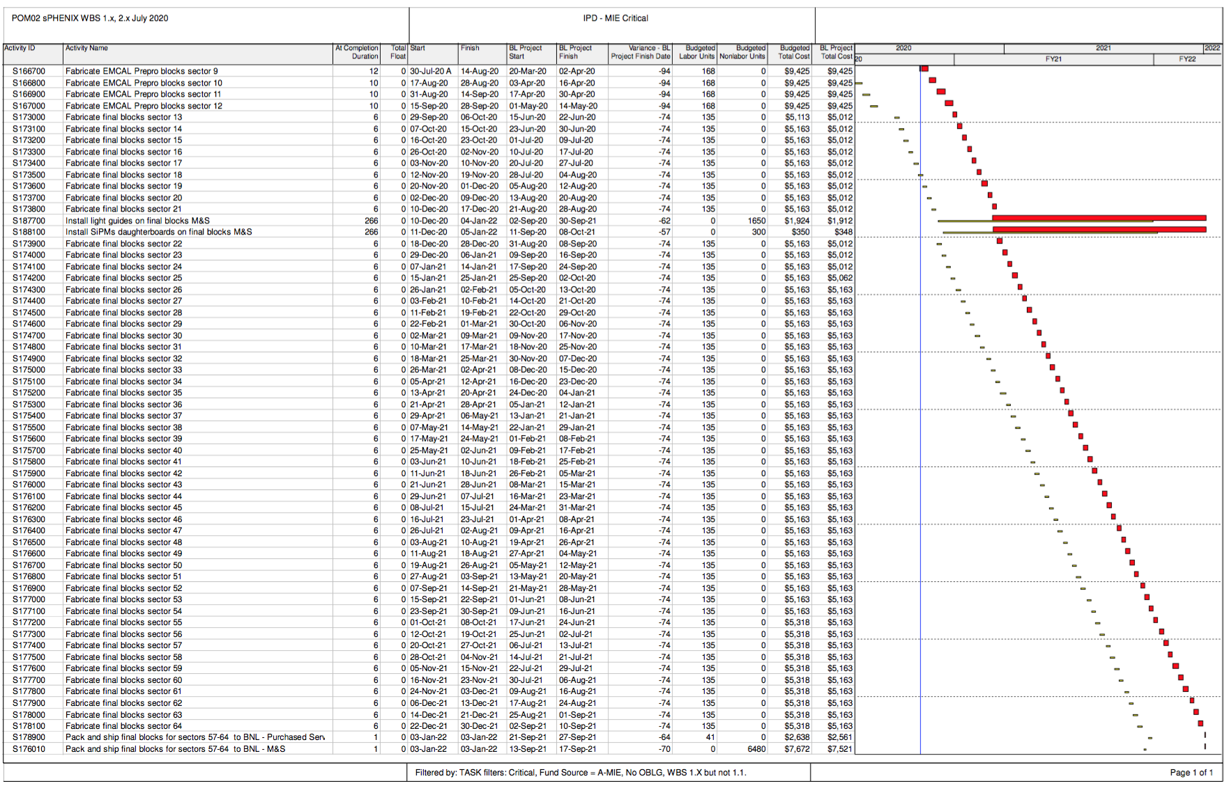
sPHENIX MIE Critical Path
The critical path goes through the EMCal Block/Module/Sector production

Slide 24
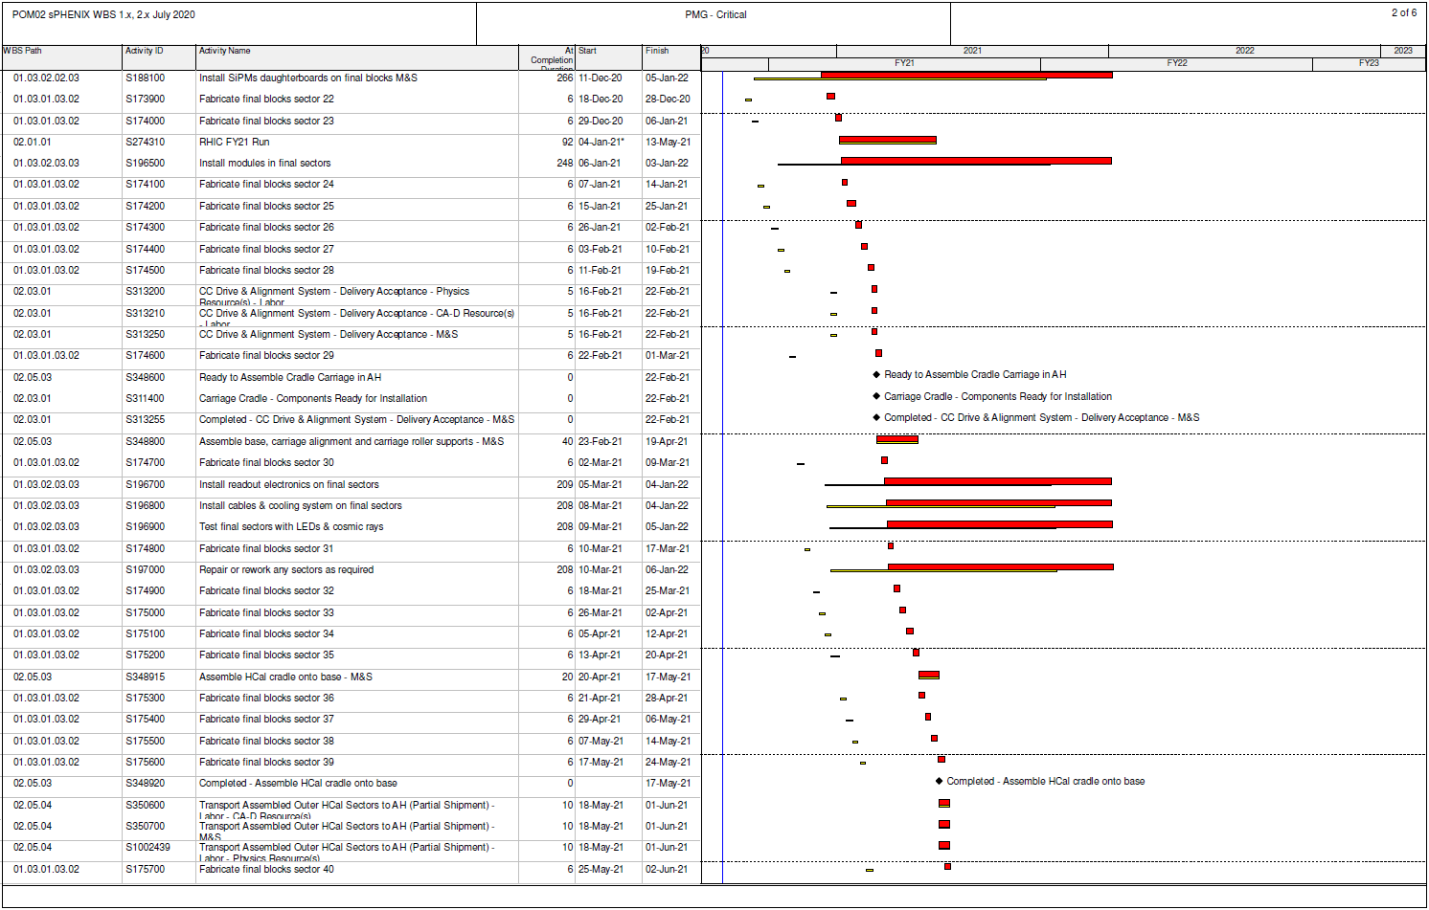
Critical Path (1x, 2x and 3x Combined)
Data Date: 31-Jul-20

Slide 25
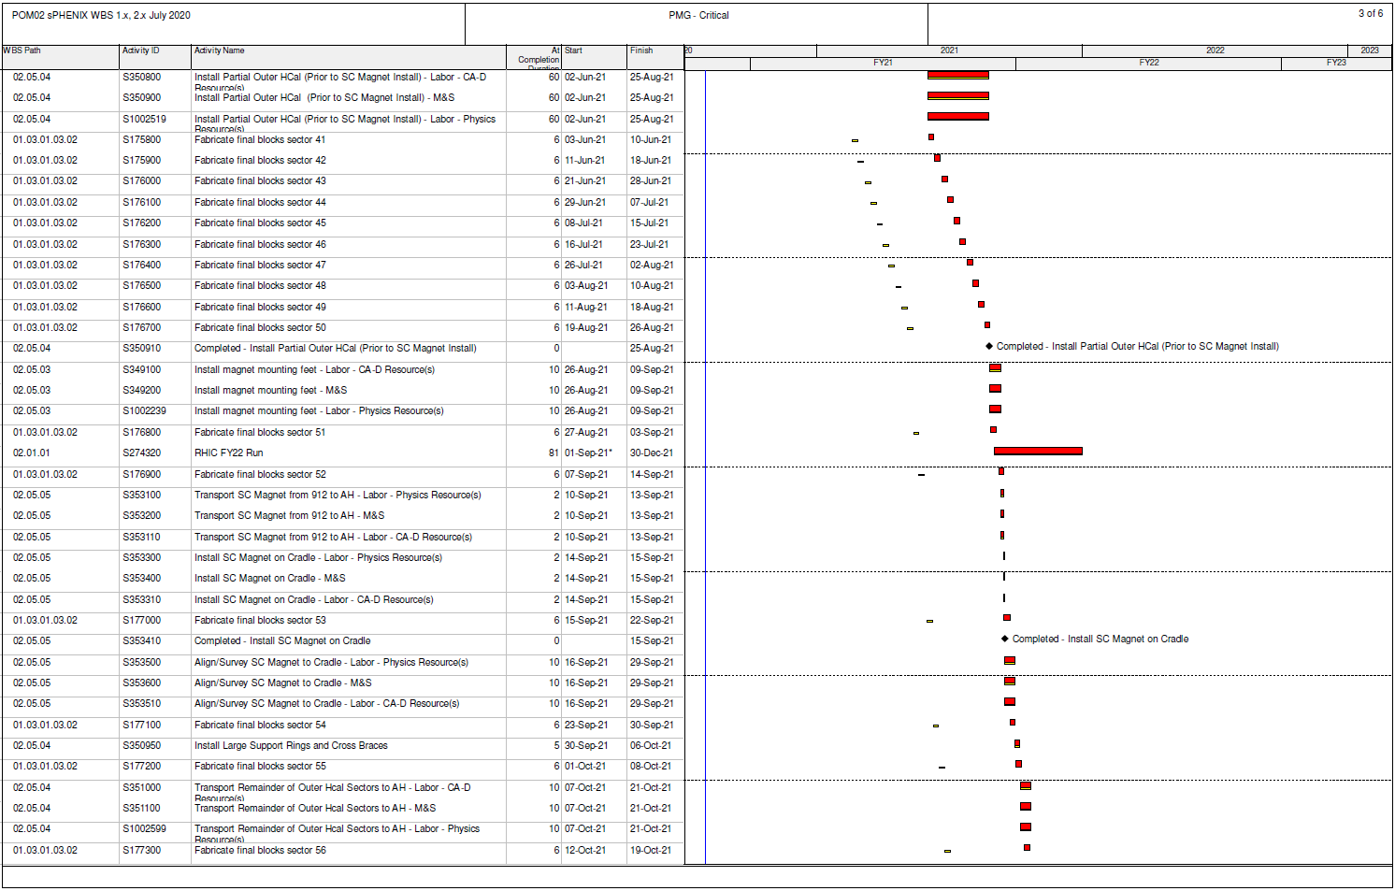
Critical Path (1x, 2x and 3x Combined)
Data Date: 31-Jul-20

Slide 26
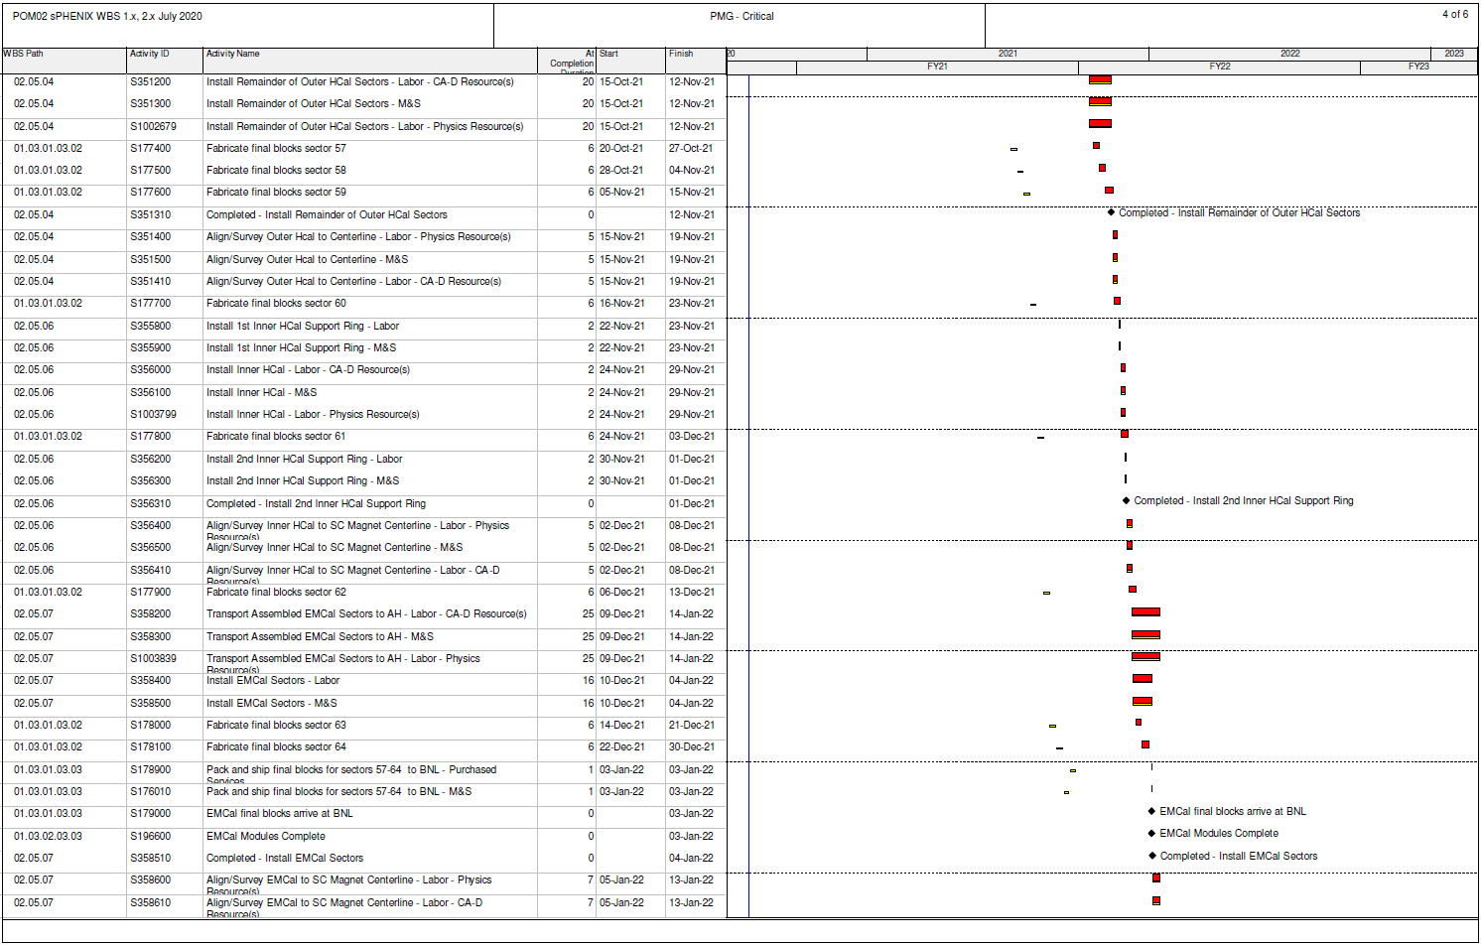
Critical Path (1x, 2x and 3x Combined)
Data Date: 31-Jul-20

Slide 27
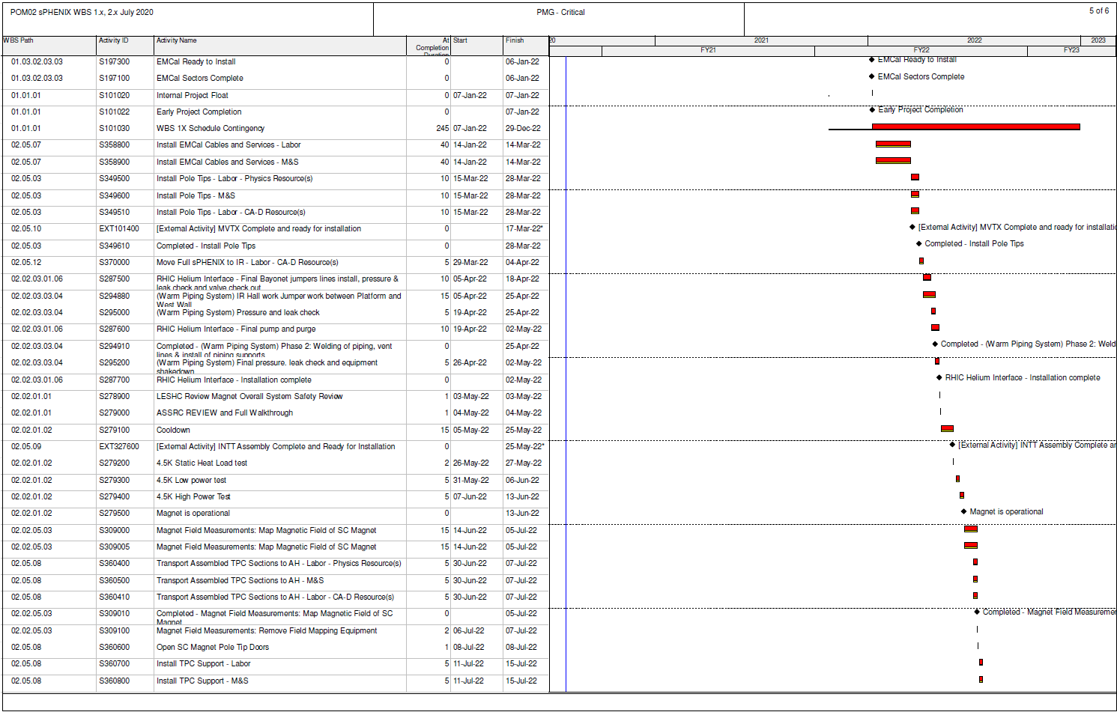
Critical Path (1x, 2x and 3x Combined)
Data Date: 31-Jul-20

Slide 28
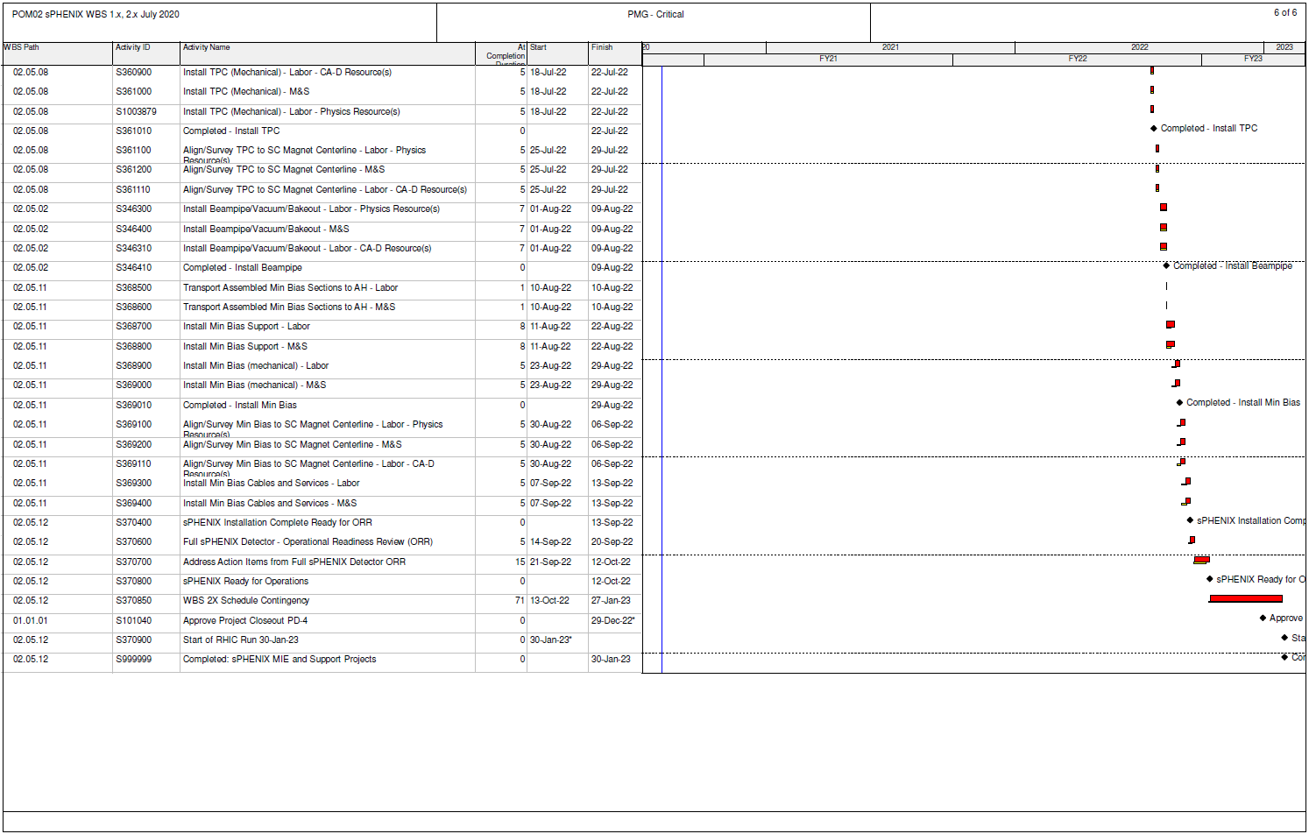
Critical Path (1x, 2x and 3x Combined)
Data Date: 31-Jul-20

Slide 29
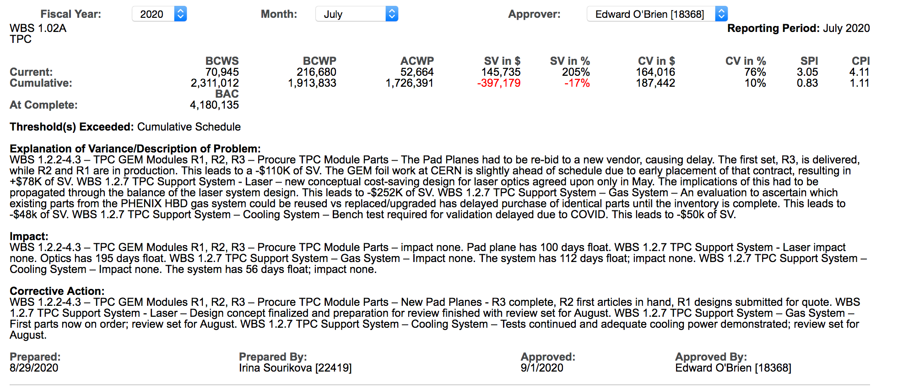
Variance Report - TPC

Slide 30
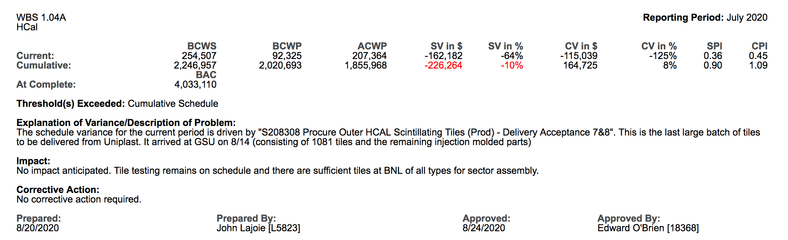
Variance Report - HCal

Slide 31
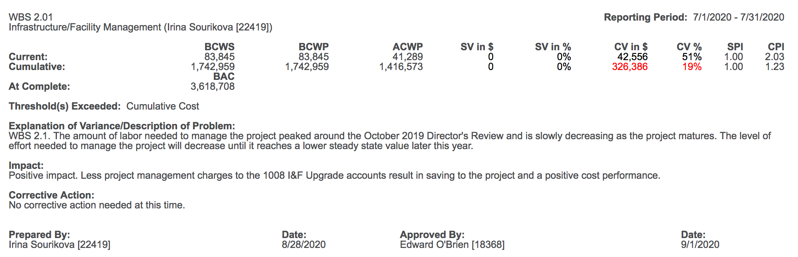
Variance Report – I&F Management

Slide 32
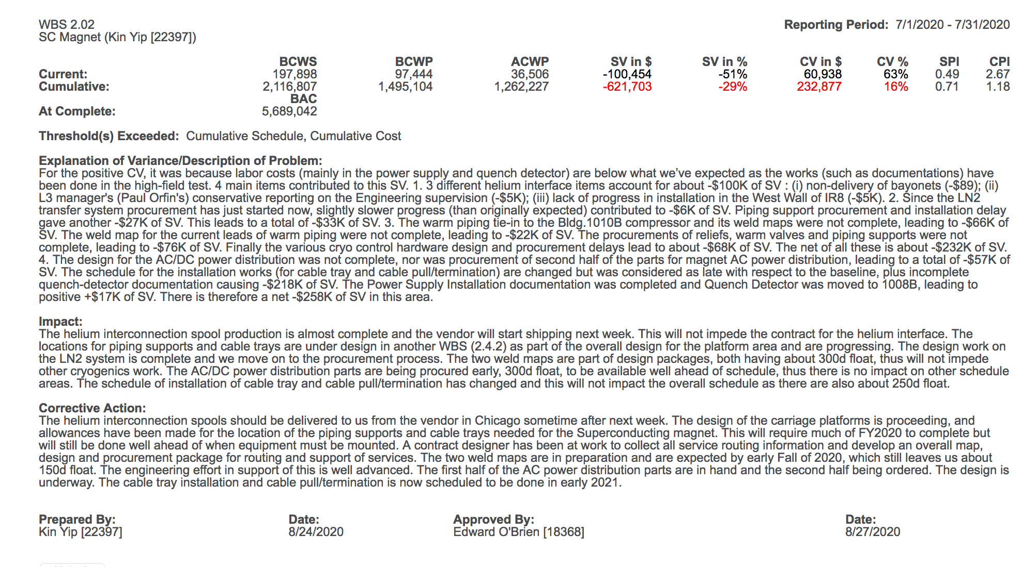
Variance Report - Magnet

Slide 33
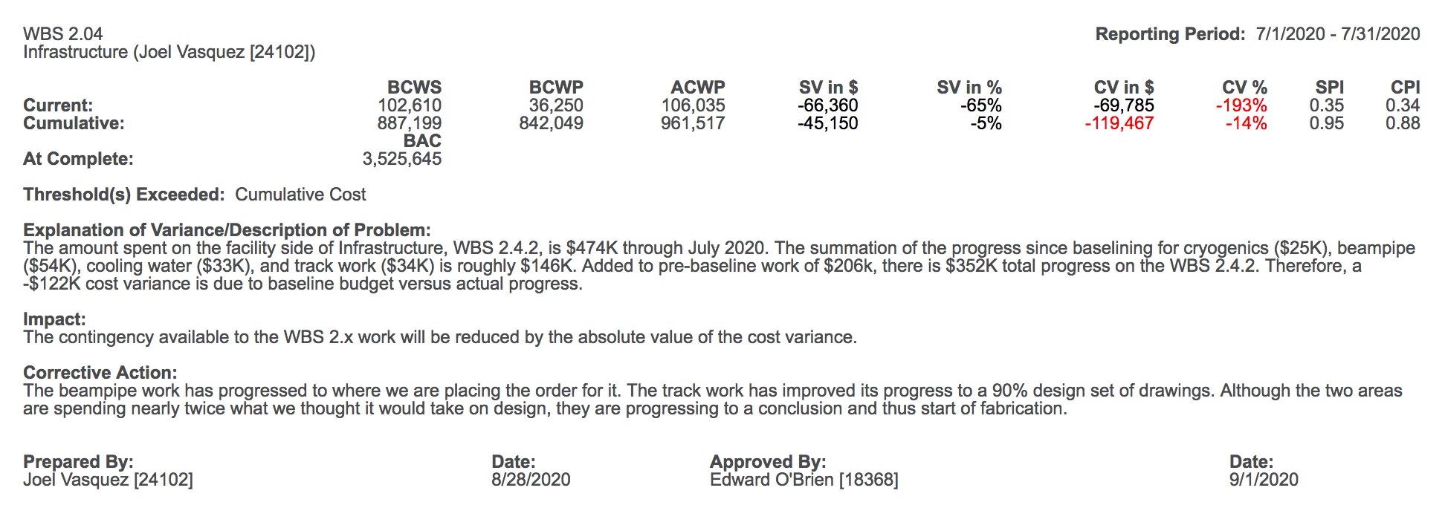
Variance Report - Infrastructure

