Slide 1
sPHENIX PMG Agenda
Project Update
Update on hiring of new personnel
Status of the track reinforcement, cryo orders
Status of EMCAL
Status of procurements
Proposed PEMP notables for FY2021
Earned Value parameters
Oversight of carriage cradle construction – BNL has approved trip for engineer to Strecks in November
Summary and Issues

Slide 2
sPHENIX MIE Overview (1.X)
TPC | Project Director | Last CD Achieved | % Complete | CPI | SPI
$27.0M | Edward O’Brien | PD-2/3 | 56.5% BCWP/BAC @ 8/31/2020 | 1.04 | 0.98
Scope
  Detector systems produced, tested and ready for installation: Time Projection Chamber w/ electronics, Electromagnetic Calorimeter w/ electronics, Hadronic Calorimeter w/ electronics, DAQ/Trigger, Minimum Bias Detector, Project Management
Not in scope
  SC-Magnet, Bldg/Det Infrastructure, Installation and System Commissioning
Schedule
  CD-0 received Sept 2016
  CD-1/3A received Aug 2018
  PD-2/3 received Sept 2019
  Early completion Jan 2021 (11.5 months float to PD-4)
  PD-4 Dec 2022
Cost
  $27.0M AY TPC 43.6% contingency on ETC

Slide 3
1008 Infrastructure & Facility Upgrade (2.X)
TPC | Project Director | % Complete | CPI | SPI
$33.4 M AY | Edward O’Brien | 42.4% BCWP/BAC @ 8/31/2020 | 1.06 | 0.90
Scope
  SC-Magnet support including the Flux Return, Cryogenics into Bldg 1008, Detector Carriage/Cradle, other Bldg 1008 Infrastructure improvements
  sPHENIX Installation, Integration and Commissioning of each Subsystem is part of the scope
Not in Scope
  PreOps prior to RHIC collisions
Schedule
  sPHENIX Ready for Operations Oct 2022
  First RHIC run of sPHENIX Feb 1, 2023
  3.5 months float in schedule between sPHENIX ORR and nominal start of RHIC 2023 run.
Cost
  $33.4 M AY Total Project Cost with 17.2% contingency on BCWR
8/26/2020
POB

Slide 4
sPHENIX Status
sPHENIX MIE and I&F schedule unchanged from July close. 11.5 months of float for MIE, 3.5 months of float for I&F. Run-23 start Feb 1, 2023
  Proposed Run-21, Run-22 schedule has not yet been included in P6 schedule. Expect I&F float to go down
  Additional COVID impact stable for now.
Long lead procurements received: 100% of SiPMs, 100% of tungsten powder, 73% of scintillating fibers, 94% of scintillator tiles
All SAMPA v5 chips fabbed and packaged. At Lund for testing.
All Calorimeter Digitizer preproduction boards (20%) at Columbia U/Nevis for testing.
>95% of EMCal and OHCal mechanical parts on hand or on order
All MVTX Readout Units at ORNL for testing. 30% of staves complete at CERN (non-MIE)
> 50% of all EMCal SiPM daughter boards at BNL. Testing complete on first 900 boards. Yield > 99%
Testing of OHCal tiles at GSU 82% complete. Yield > 98%
EMCal block reached their weekly goal production rate at UIUC of 60 block/wk. Now they must sustain it.
Cryo spools arrived at BNL for 1008 installation during the 2020 shutdown. (non-MIE)
sPHENIX Be beam pipe and LN2 piping system orders to be awarded soon. (non-MIE)

Slide 5
Internal Labor Needs
Two Electrical designers – job shoppers
3 mechanical entry level techs (TW-2, term) 2 EMCal, 1 HCal (Hired through IO)
1 electrical entry level techs (TW-2, term) 1008 racks (Hired through IO)
Entry level electrical engineer (MoU from IO for 1 year)
mid-Career IO mechanical engineer (DeMino – 50%)
1-2 postdocs for hardware testing
Offer for a I-7/9 DAQ/Trigger position (PO)
This is in addition to the entry level techs that we get from CAD (Paul Sampson) for EMCal (1.0 FTE) and HCal/1008 (0.5-1.0 FTE)

Slide 6
2020 Shutdown Tasks
  Tasks to complete during the 2020 shutdown include:
  Installing the cryo deck
  Adding track gussets in IR
  Installing and welding cryo spools in the 1008 IR and 1008 B
  Reinforcing the tracks in the assembly hall
  Beginning track reinforcement in the IR

Slide 7
sPHENIX Fall 1008 Work
CURRENT STATUS
  Cryo Spools and Deck
    Spool pieces 1-5 are completed and at BNL
    Cryo Support Deck to go out for fabrication, sign-offs this week (<$25K)
    Fabrication contract to go directly to vendor (Mid-Island Steel)
    1-2 weeks fabrication of deck
  Track Modification
    Drawings and Specification for Track Modification completed and signed off
    Met with Civil BOA/TO Contractor on 9/14 (G&M)
    10 days for G&M to develop quote (expect quote today)
    Requisition paperwork is generated awaiting quote to be attached
    Will need approval to award directly to BNL Civil BOA/TO Contractor
    Expect if all goes well contractor will start mid to late October.
    Focus on Assembly Hall Modifications then move to IR
    Started some scope with BNL shops in order to gain schedule
    Engineering Consulting Firm estimated modification work will take approximately 6 months.

Slide 8
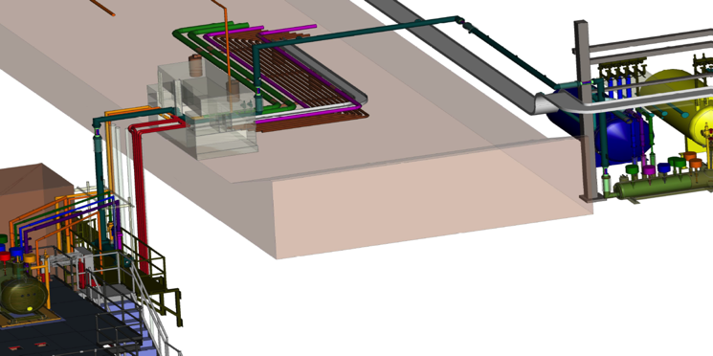
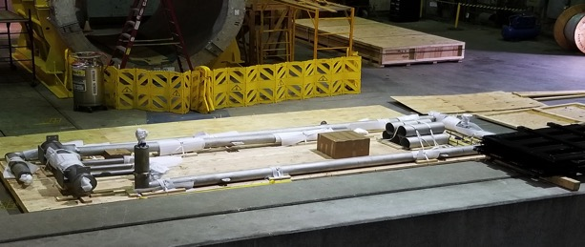
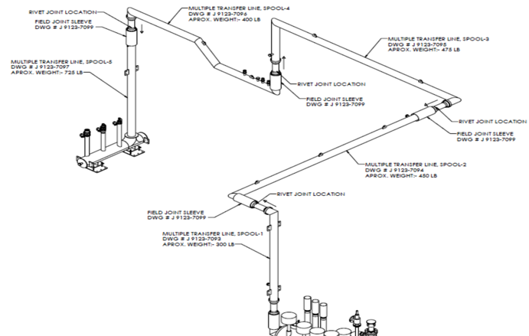
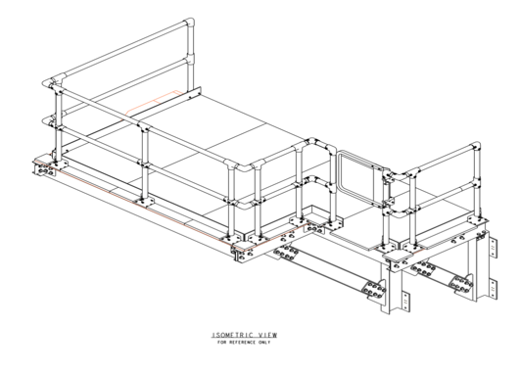
Scope of sPHENIX Fall 1008 Work
Cryo Spools and Deck

Slide 9
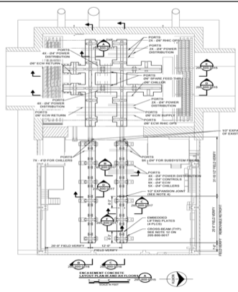
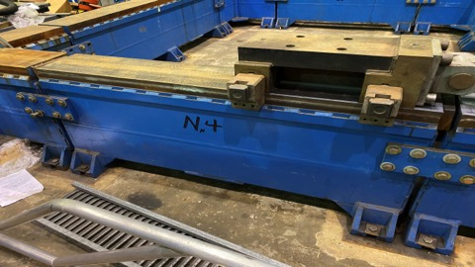
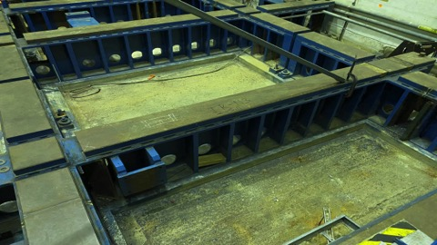
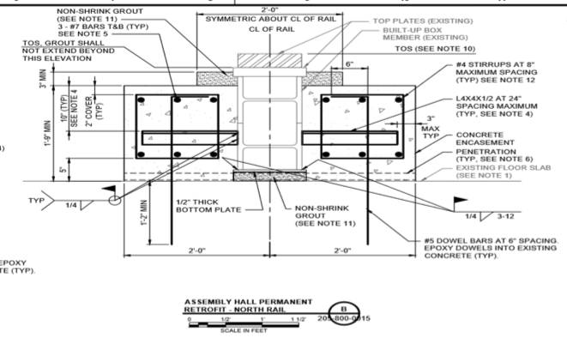
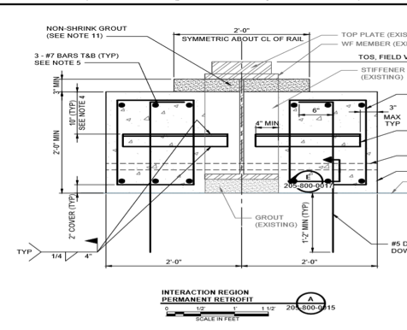
Scope of sPHENIX Fall 1008 Work
Track Modifications

Slide 10
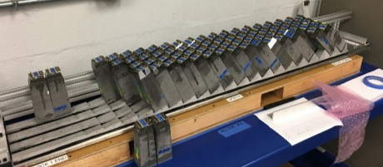
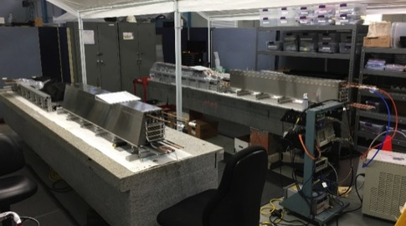
EMCAL Construction Status
Block Production at UIUC
Module Production and Sector Assembly at BNL
All powder delivered
Fiber delivery on schedule
Completed blocks for Sectors 1-12
  91% (11/12) Constructed
  75% (9/12) Shipped to BNL
  Expect delivery of all blocks by mid Oct
Fibers filled for Sectors 13-64 : 52%
Production rate goal achieved (12 blocks/day)
Modules completed for Sectors 1-5
Sectors 1-4 assembled
Sector 1 tested, Sector 2 under test
Sector 5
Sector 3
60/week
Sector 4
Week

Slide 11
Major Procurement To Go (1.X, 2.X)
LN2 piping (submitted)
Track modification
IHCal Frames
IHCal RIngs
TPC Fee (submitted)
FELIX Cards (submitted)
EMCal preamps (submitted)
EMCal Block fab at UIUC 2021 (submitted)
XY tables & drive system
Large Rings
Carriage/cradle assembly fixtures
Magnet supports
EMCal installation fixture
Platform
End Caps/Pole Tips
Calorimeter cables
LV power systems, TPC, EMCal, HCal, MBD (submitted)
TPC Cooling and Laser systems
TPC EBDC’s (submitted)
DAQ LL1 Boards, crates, SEBs (submitted), JSEBs, ATPs, Buffer boxes
IHCal, TPC installation fixtures
Seismic restraints
Many of these reqs are of the scale that they will need many internal approvals in PPM and may require special attention from sPHENIX and BNL Management.
Two near term examples:
IHCal frames $950k
EMCal Block fab at UIUC $460k (amendment to existing $590k contract brings tot to $1.05M)

Slide 12
Proposed PEMP Milestones for FY21
EMCal Preproduction Blocks complete 1-Dec -2020
EMCal SiPM board production complete 30 Apr-2021
1st OHCal Sector ready to install 30-Apr-2021
EMCal Scintillating Fiber Acquisition complete 31-May-2021

Slide 13
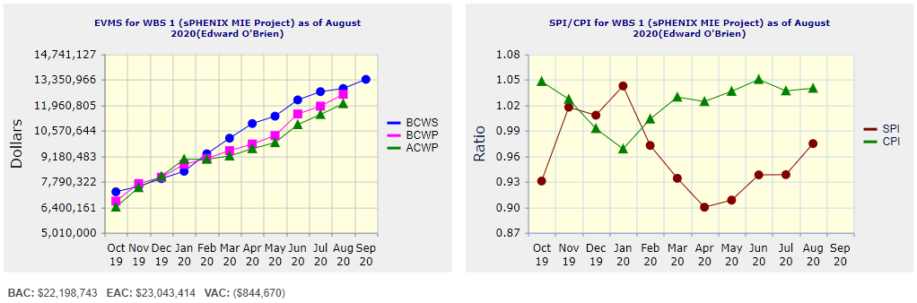
Performance Indices – sPHENIX MIE
Cumulative SPI | Cumulative CPI
0.98 | 1.04
Cumulative BCWS (Scheduled) | $12,860,835
Cumulative BCWP (Performed) | $12,543,729
Cumulative ACWP (Actual) | $12,032,662
DOE SPI or CPI Value Thresholds
0.90 to 1.15
0.85 to 0.89 or 1.16 to 1.25
<0.85 or >1.25

Slide 14
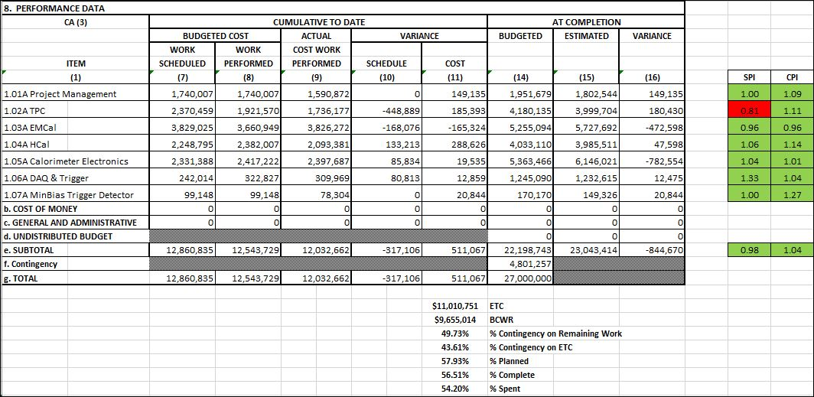
Cost Performance Report (CPR) – sPHENIX MIE
DOE SPI or CPI Value Thresholds
0.90 to 1.15
0.85 to 0.89 or 1.16 to 1.25
<0.85 or >1.25
*Highlights in table above takes variance $ into consideration, not just Indices

Slide 15
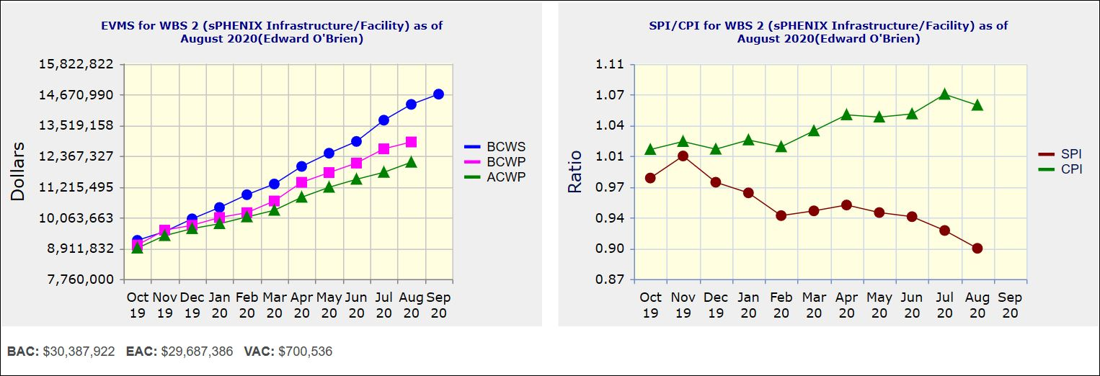
Performance Indices – 1008 Infra and Facility Upgrade
Cumulative SPI | Cumulative CPI
0.90 | 1.06
Cumulative BCWS (Scheduled) | $14,295,664
Cumulative BCWP (Performed) | $12,890,138
Cumulative ACWP (Actual) | $12,131,452
DOE SPI or CPI Value Thresholds
0.90 to 1.15
0.85 to 0.89 or 1.16 to 1.25
<0.85 or >1.25

Slide 16
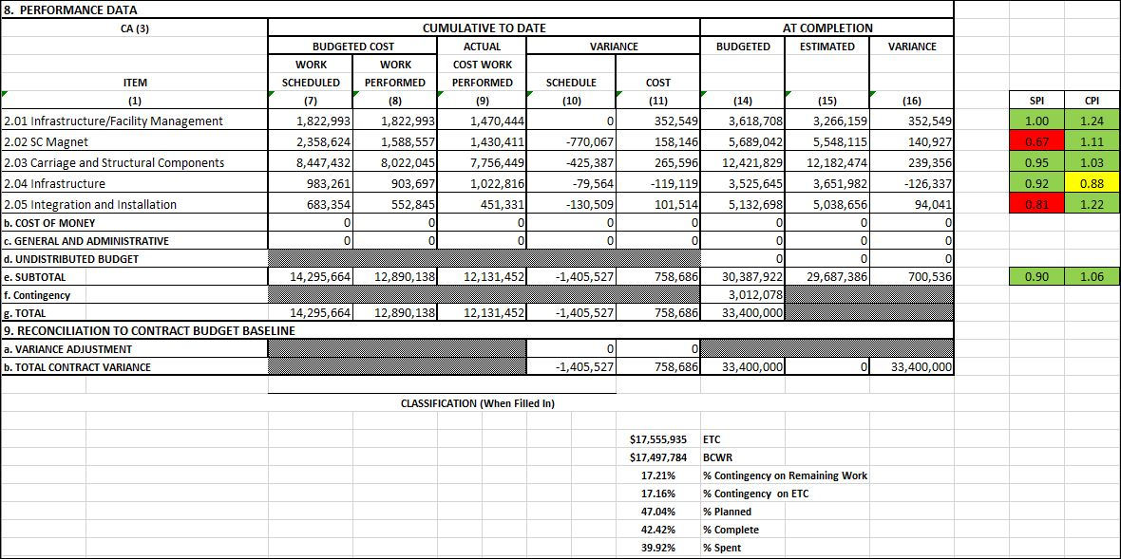
Cost Performance Report (CPR) – 1008 Infra and Facility Upgrade
DOE SPI or CPI Value Thresholds
0.90 to 1.15
0.85 to 0.89 or 1.16 to 1.25
<0.85 or >1.25
*Highlights in table above takes variance $ into consideration, not just Indices

Slide 17
Summary and Issues
sPHENIX continues to make good technical progress.
The MIE early completion date is unchanged in August.
The MIE CPI is very good. The SPI improved from 0.94 to 0.98.
I&F CPI very good, SPI at 0.9. Expect I&F early completion to slip 1-2 months once newly proposed RHIC Run 21, Run 22 schedule is put into P6.
We need to add labor resources to prevent additional slips in the P6 schedule.
We’ve been instructed to do term hires through IO and are working with Bill Wahl to make this happen. May need some BNL Management help expediting with HR.
The 1.5-2 FTEs CAD has given us to work in the EMCal and HCal factories is very beneficial to our effort.
BNL Management/BHSO has assisted us in getting reqs unstuck in PPM. Expect to need more help in the future.

Slide 18
Back Up

Slide 19
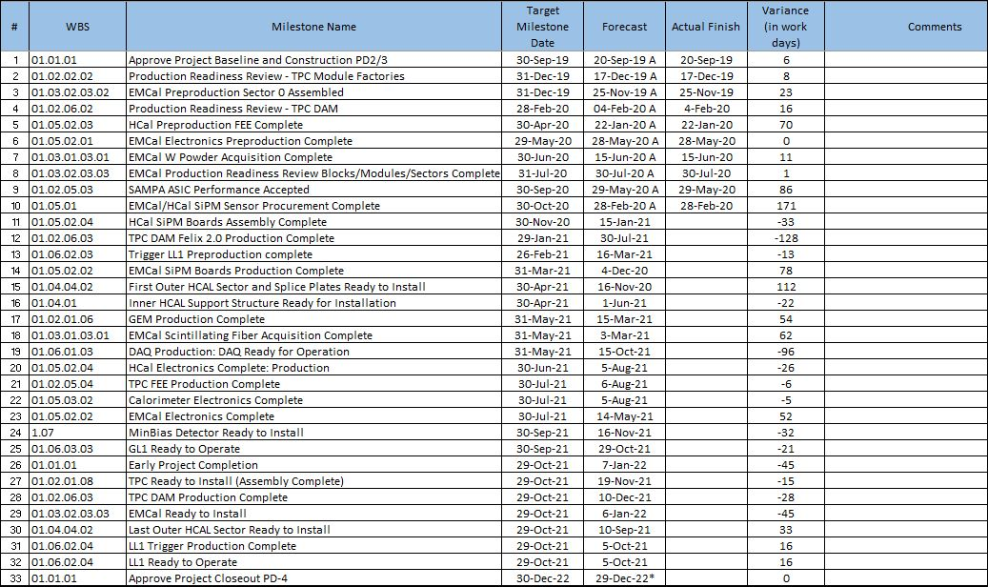
Milestones Status – sPHENIX MIE

Slide 20
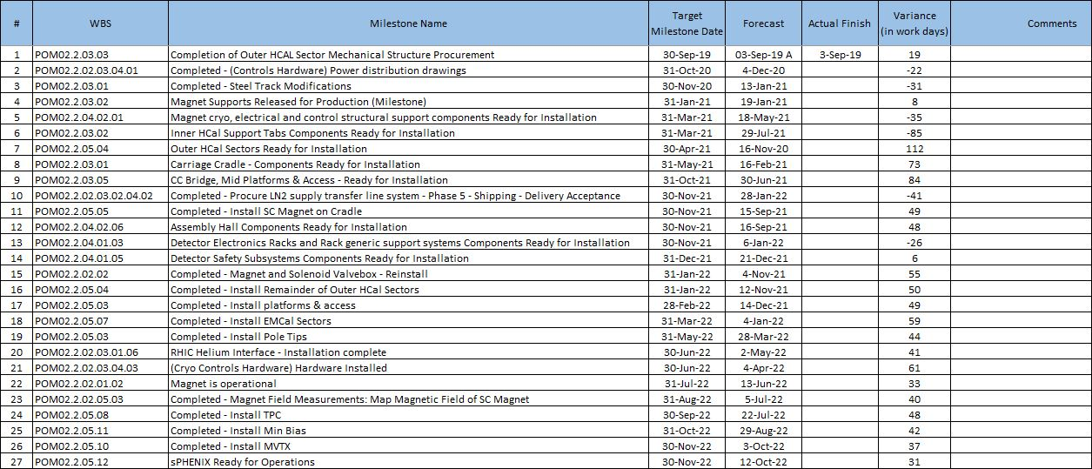
Milestones Status – 1008 Infra and Facility Upgrade

Slide 21
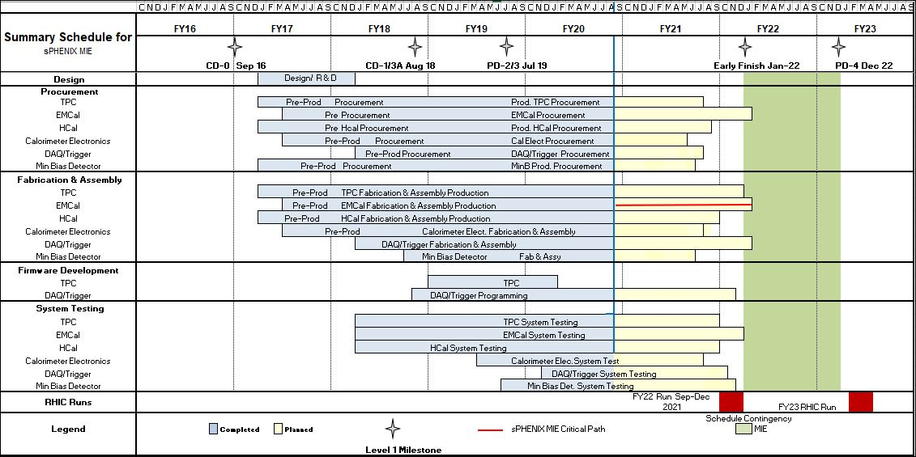
Summary Schedule – sPHENIX MIE

Slide 22
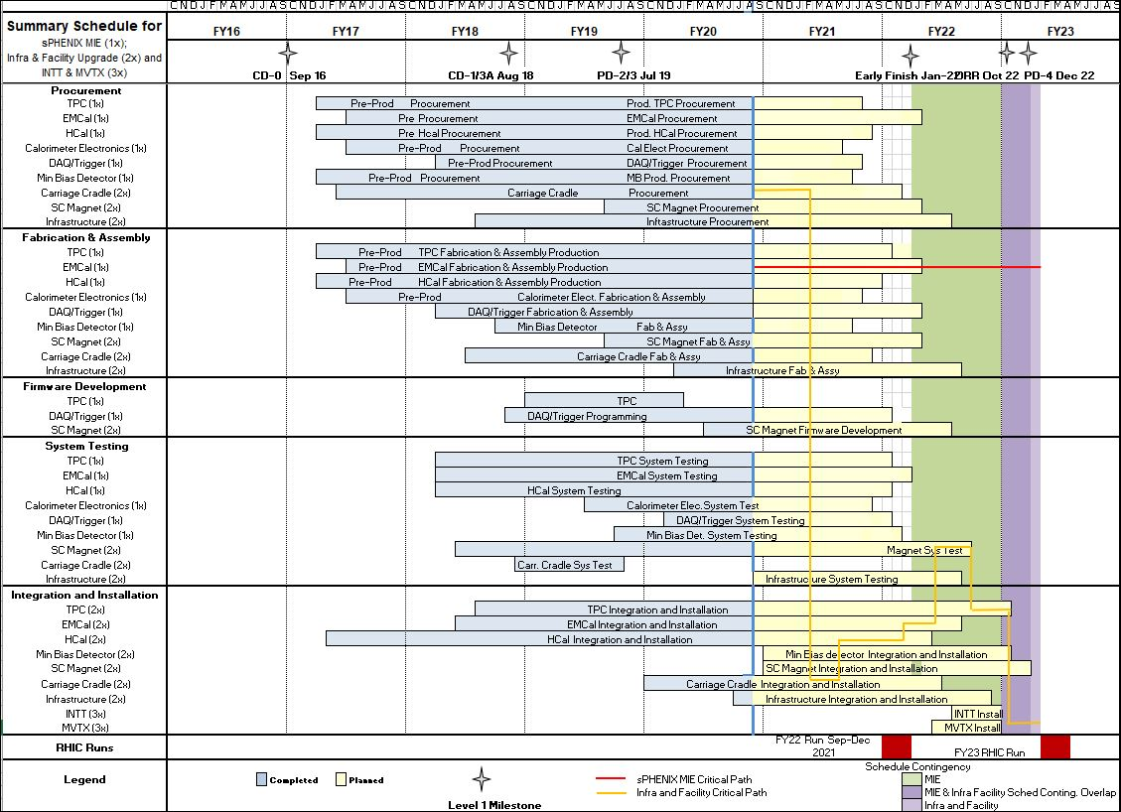
Summary Schedule – sPHENIX MIE and 1008 Infra and Facility Upgrade

Slide 23
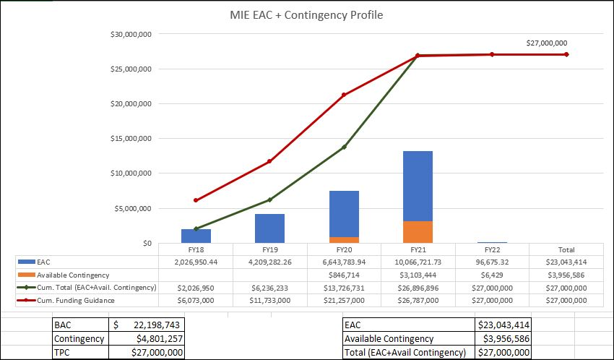
EAC and Contingency Profile – sPHENIX MIE
Data Date: 31-Aug-20

Slide 24
Baseline/Contingency Log - MIE

Slide 25
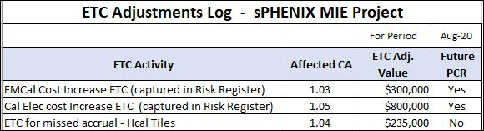
ETC Log - MIE

Slide 26
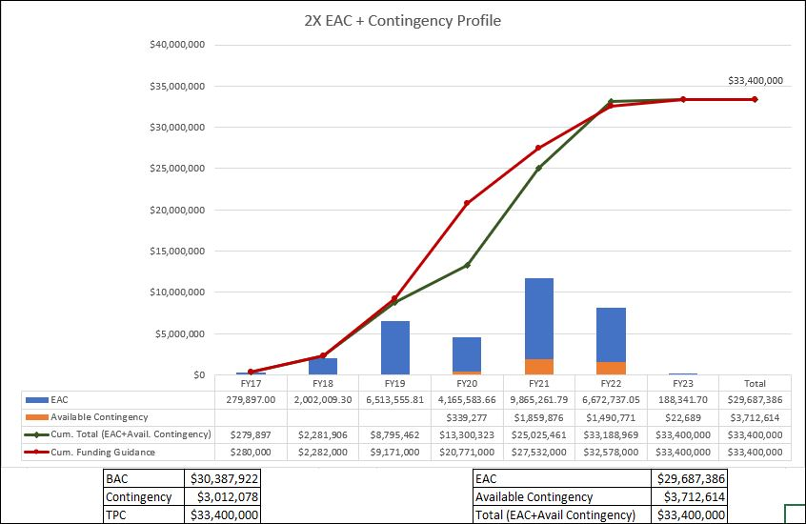
EAC and Contingency Profile – 1008 Infra and Facility Upgrade

Slide 27
Baseline/Contingency Log - 1008 Infra and Facility Upgrade

Slide 28
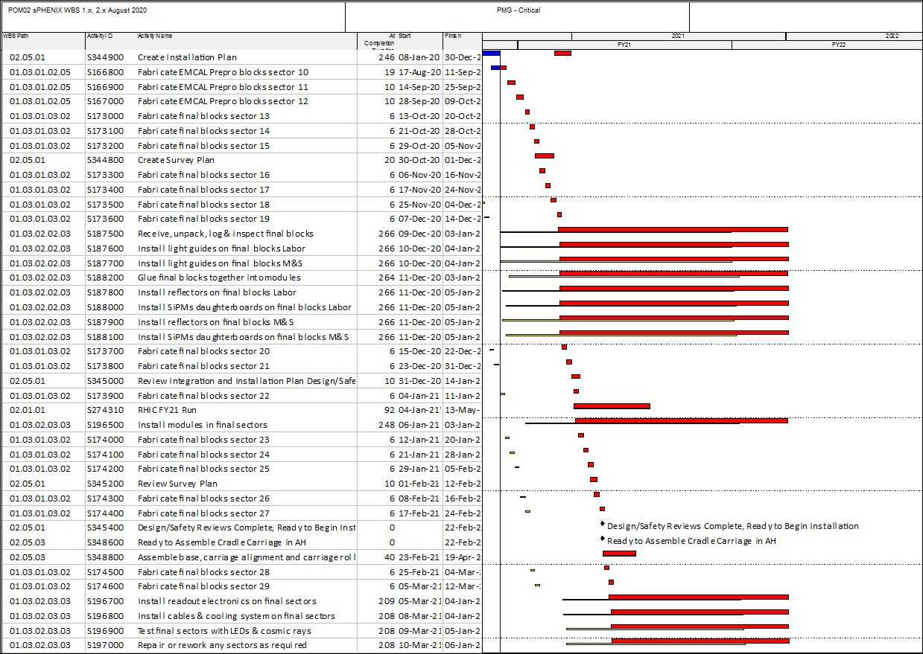
Critical Path (1x, 2x and 3x Combined)

Slide 29
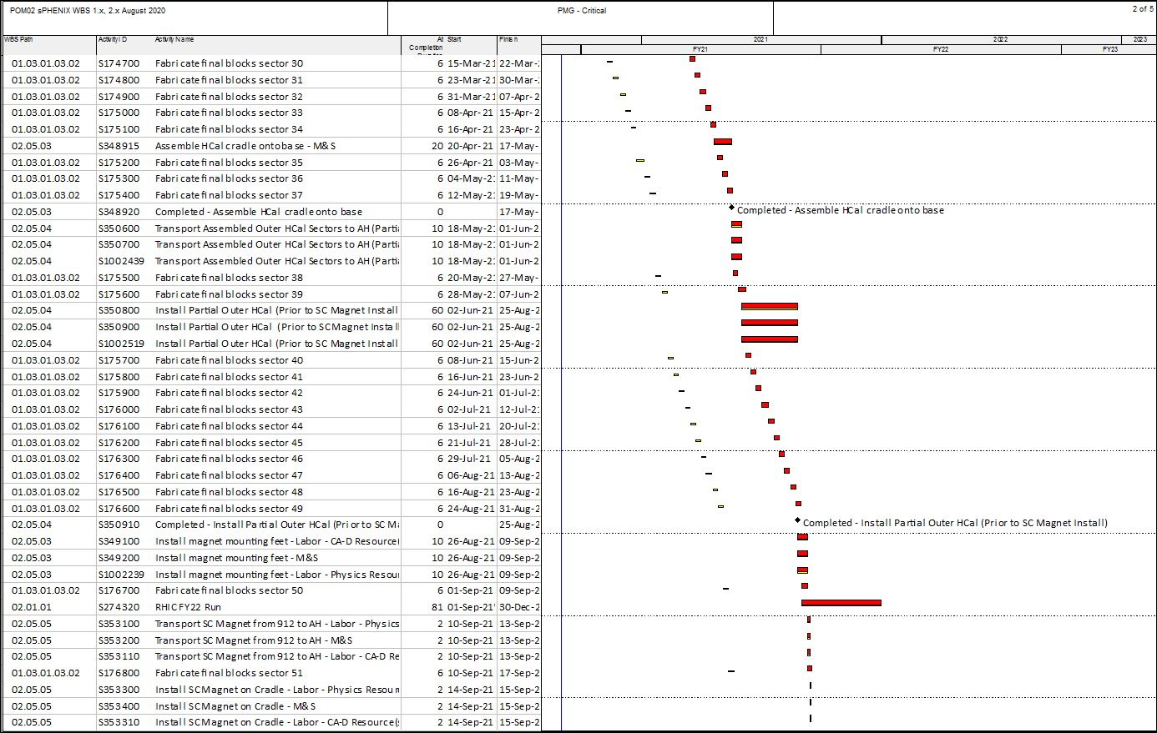
Critical Path (1x, 2x and 3x Combined)

Slide 30
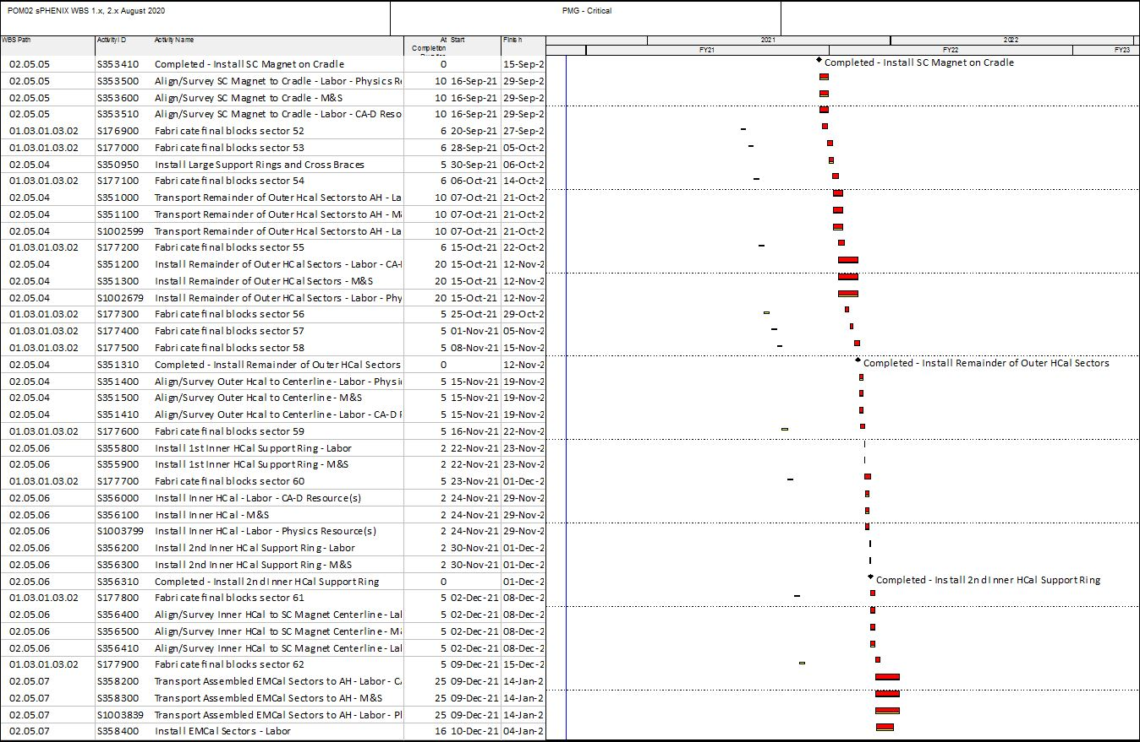
Critical Path (1x, 2x and 3x Combined)

Slide 31
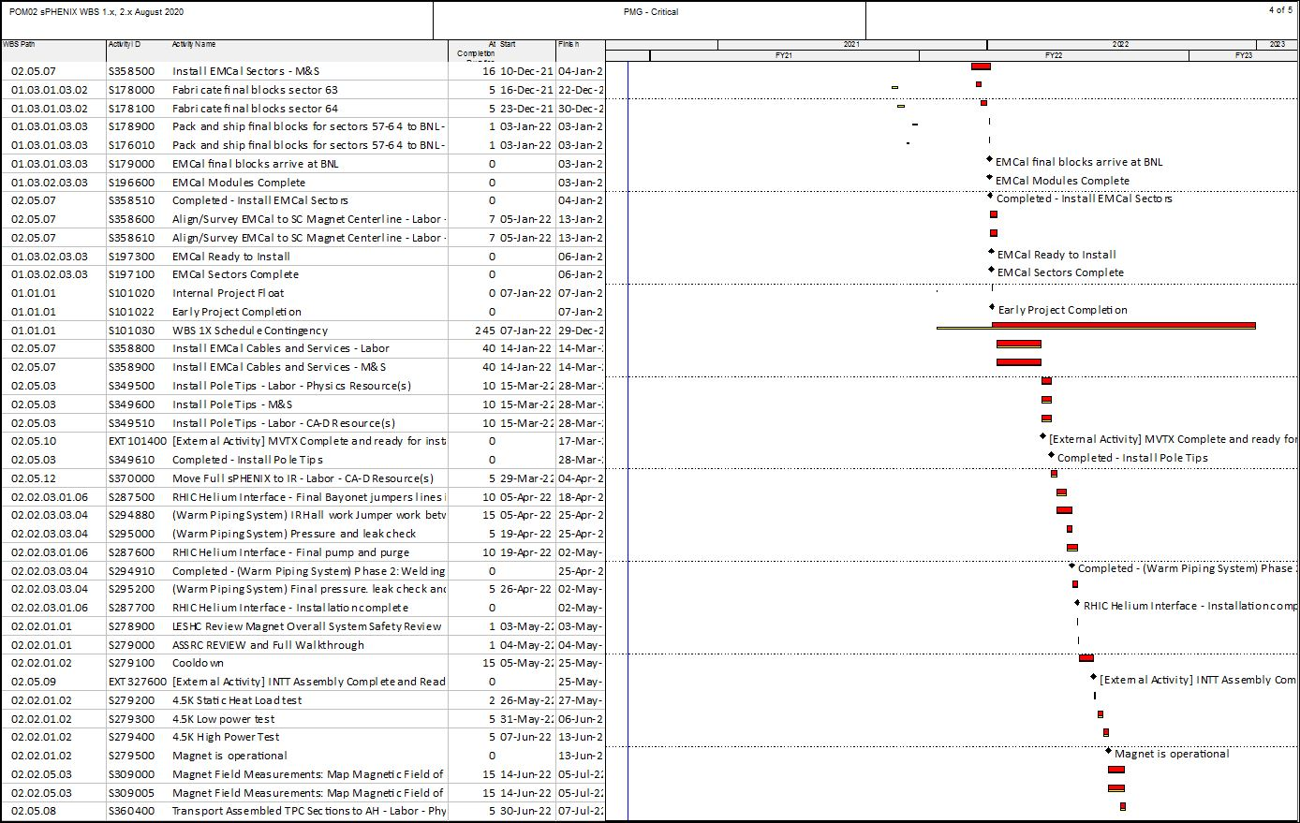
Critical Path (1x, 2x and 3x Combined)

Slide 32
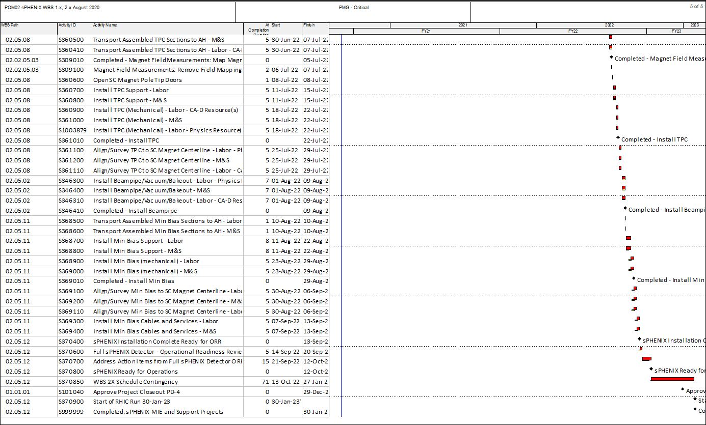
Critical Path (1x, 2x and 3x Combined)

Slide 33
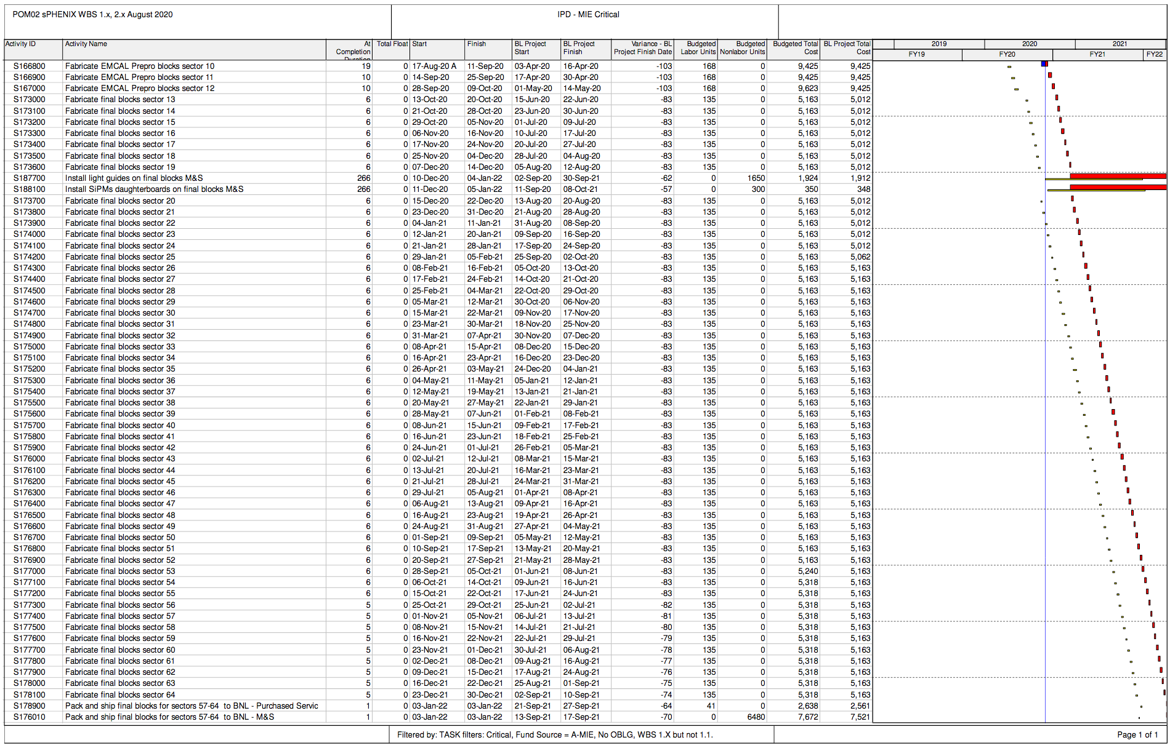
MIE Critical Path

Slide 34
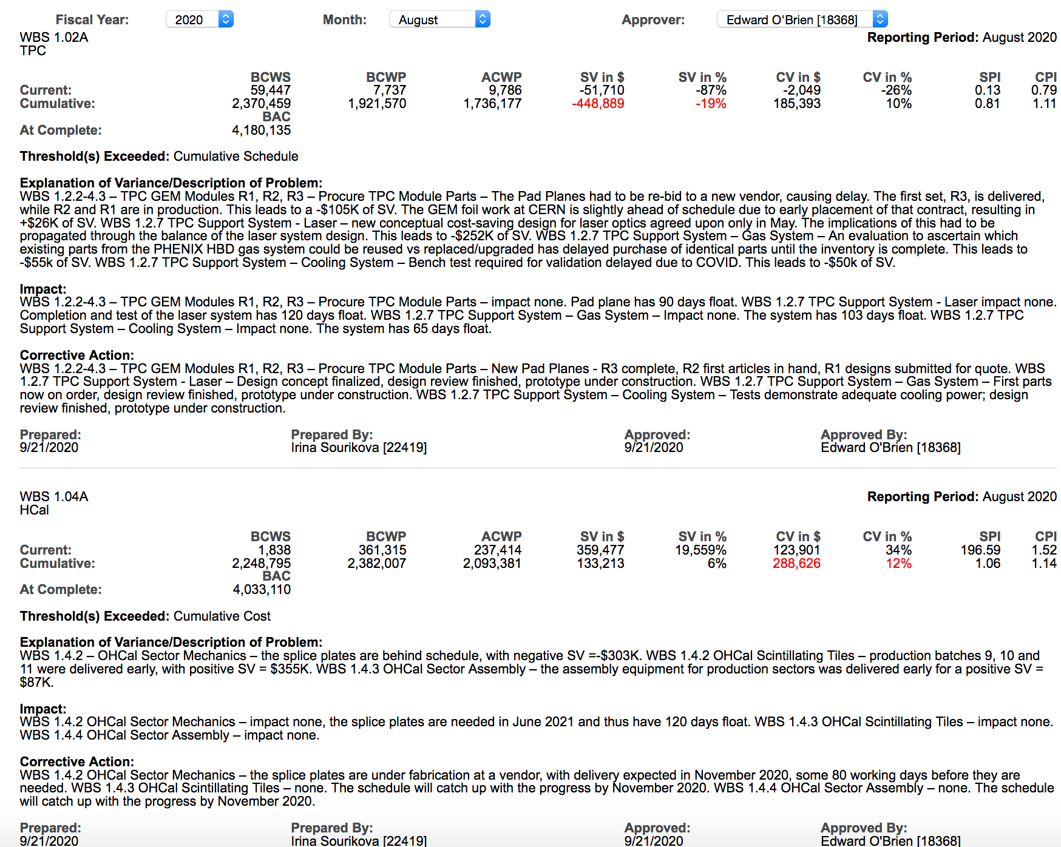
Variance Reports –TPC, HCal

Slide 35
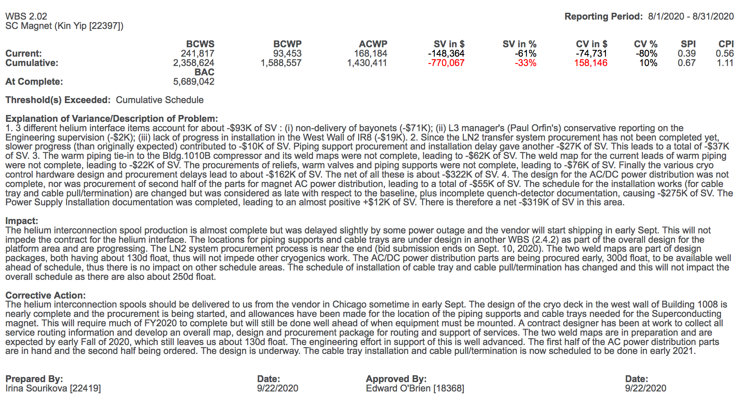
Variance Report - Magnet

Slide 36
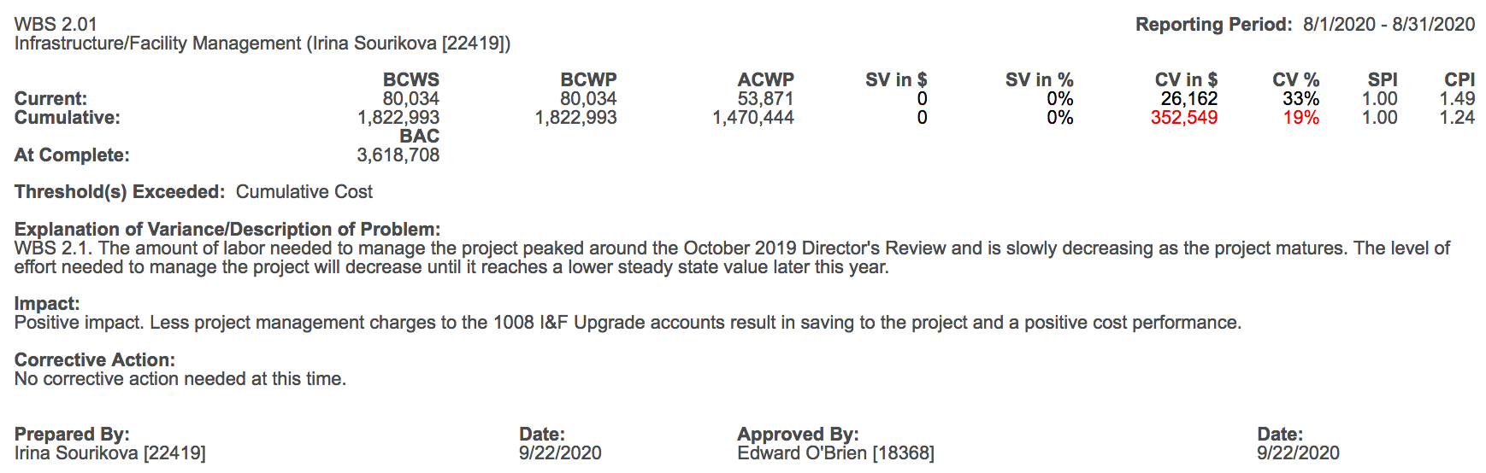
Variance Report – 2.X Management

