Slide 1
PID Class Updates HBD Update
TK Hemmick

Slide 2
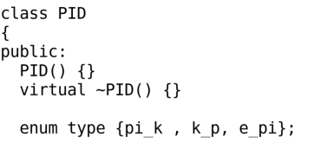
PID Class
Later today I will update the PID Class.
We need to include e-pi separation as a default.
Everyone will be asked to update their code accordingly.

Slide 3
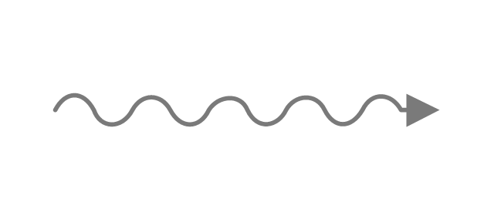
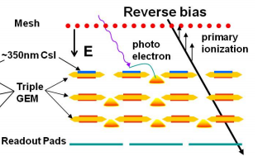
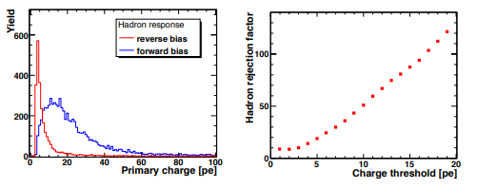
PHENIX(JLEIC) Hadron Blind Detector
Garfield + Fast Monte Carlo
Unfocused Threshold
Cherenkov
electron
Pion Signals Simulated
1st Gap Dominates!
Fractional Contribution to signal
Limited by 1st Gap
PHENIX HBD optimized for 1e-vs-2e separation.
20 photoelectrons vs 40 photelectrons
Non-zero hadron response.
Re-optimize for EIC??

Slide 4
PHENIX/JLEIC Hadron Blind Detector
HBD: Phenix
HBD+: Gem + 1-stage μM gain
HBD++: GEM _ 2-stage μM gain
Conceptual Idea
HBD
HBD
G
10
20
30
pe
μ₁
HBD+
HBD+
μ₂
microMEGAS provide the smallest gas length.
Gain from any or all of three layers:
Gain from GEM
Gain from μ₁
Gain from μ₂
10
20
30
pe
HBD++
HBD++
10
20
30
pe
Fractional Contribution to signal

Slide 5
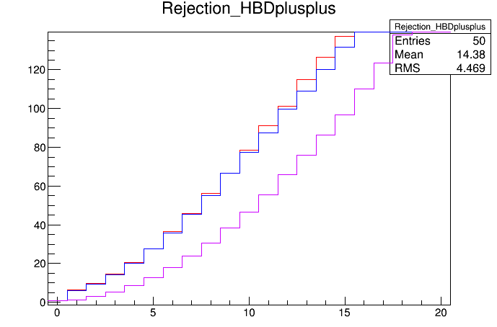
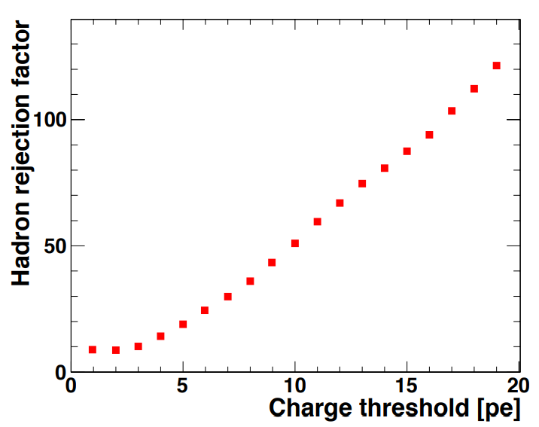
Rejection Simulation
HBD++
HBD+
HBD
Match to measurement is quite good for simple simulation.

Slide 6
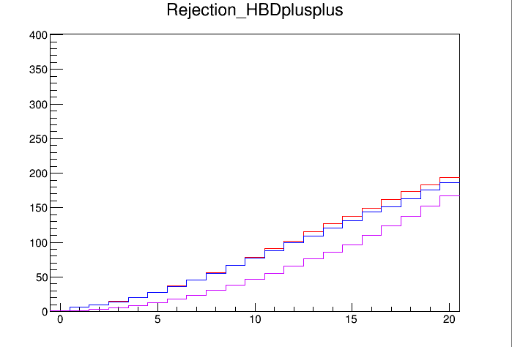
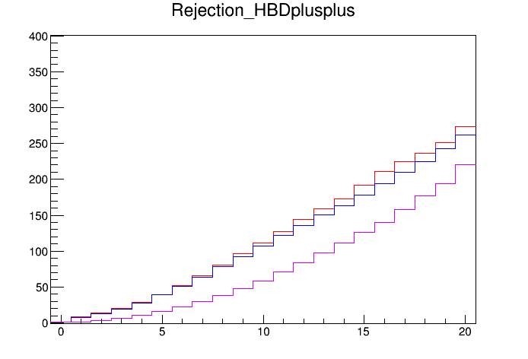
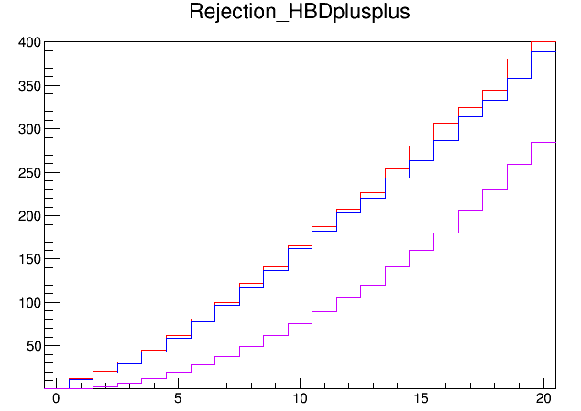
Gem Hole Spacing
150 μm
125 μm
100 μm
Trivial implementation:
Assume scale invariance.
Collection layer thickness linear with spacing.
“Collection Layer” scales with hole spacing
Smaller and Smaller Hole spacing leads to better and better performance

Slide 7
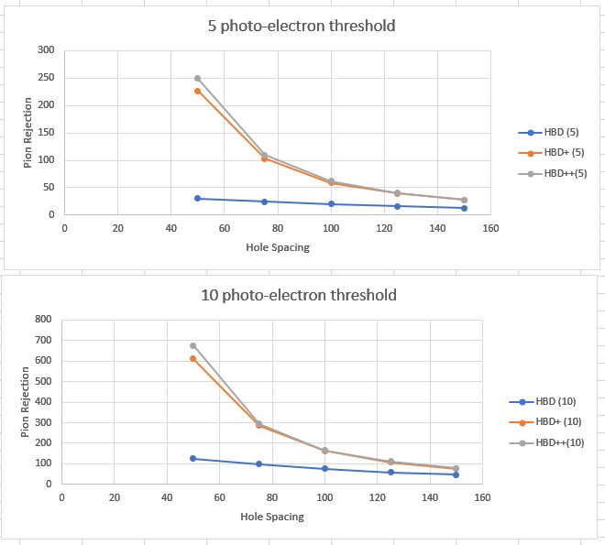
Summary
Reasonable?
HBD can be optimized for e-pi separation.
What rejection is needed requires more debate.
If we minimize hadron response:
Can get better rejection at fixed length.
Can maintain rejection at reduced length.

Slide 8
BACKUPS

Slide 9
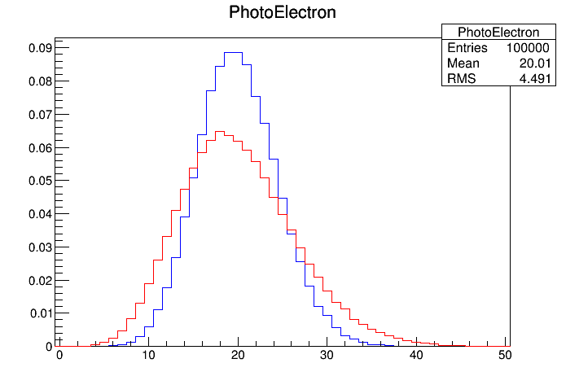
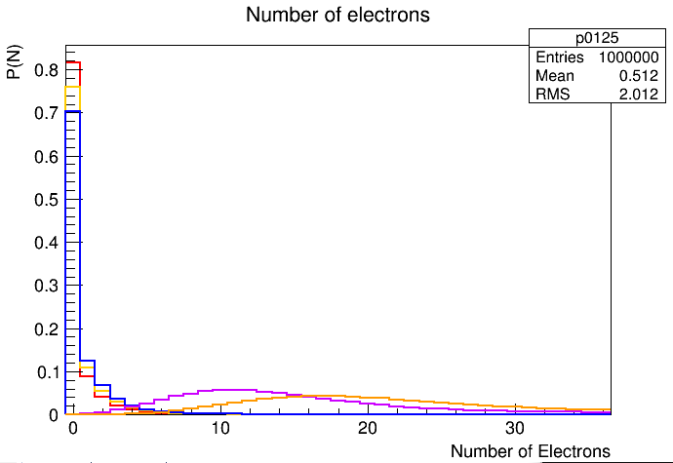
Recent HBD Work
Primary pe
Smeared by gain
125 micron
150 micron
175 micron
1.5 mm
2.12 mm

Slide 10
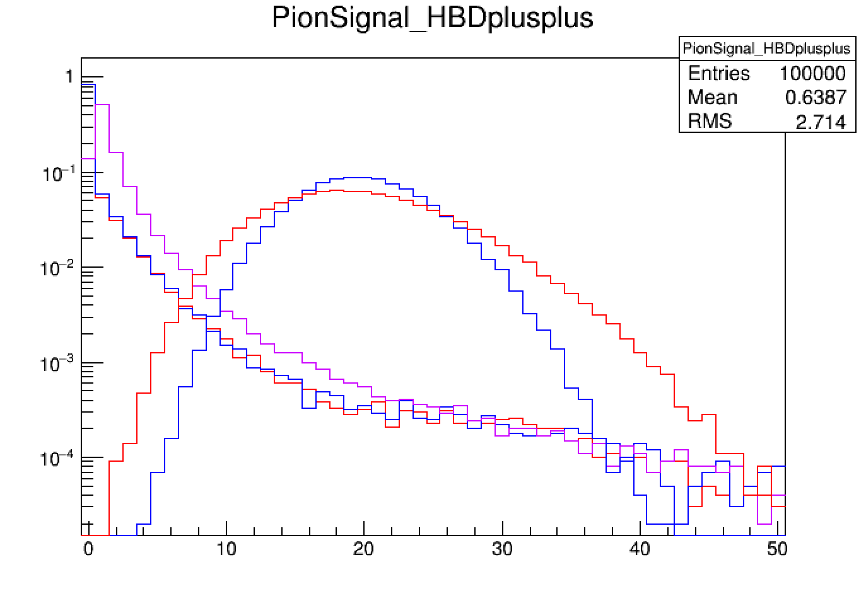

Slide 11
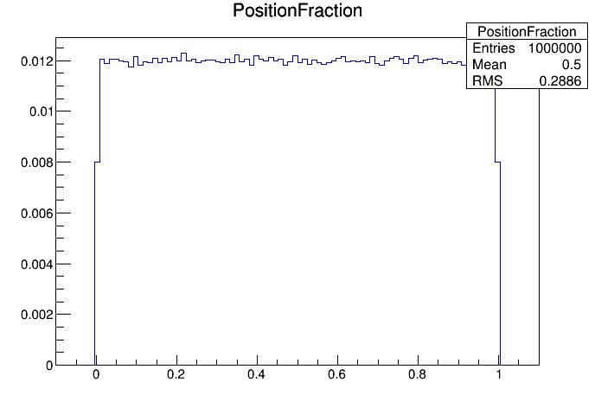
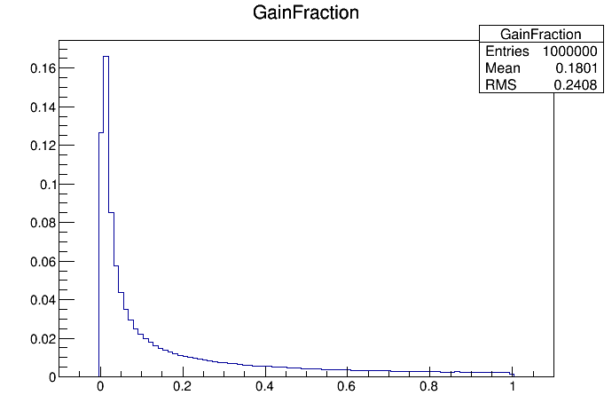
Micro-MEGAS Effective Gain

