Slide 1



Collision dynamics at BES energies and signatures of first-order phase transitions
From theoretical constraints to experimental verification?
Jan Steinheimer
With help of:
A. Motornenko , V. Vovchenko, E. Most, V. Koch, J. Randrup, T. Galatyuk, F. Seck,
And many others

Slide 2
What will be left

Slide 3
Part 1 The direct approach
Calculate the QCD EoS either from first principles
Or, at large densities, by phenomenology guided models

Slide 5
Expansions in imaginary chemical potential

Slide 6
Expansions wont help us even if they diverge

Slide 7
Experiments at T=0

Slide 8
CMF – a phenomenological approach to the QCD EoS
Chiral symmetry in hadronic language
Apects of chiral symmtry

Slide 9
CMF – a phenomenological approach to the QCD EoS
Model also consistent with cold neutron star properties
A. Motornenko, S. Pal, A. Bhattacharyya, JS and H. Stoecker, [arXiv:2009.10848 [hep-ph]].
A. Motornenko, JS, V. Vovchenko, S. Schramm and H. Stoecker, Phys. Rev. C 101 (2020) no.3, 034904

Slide 10
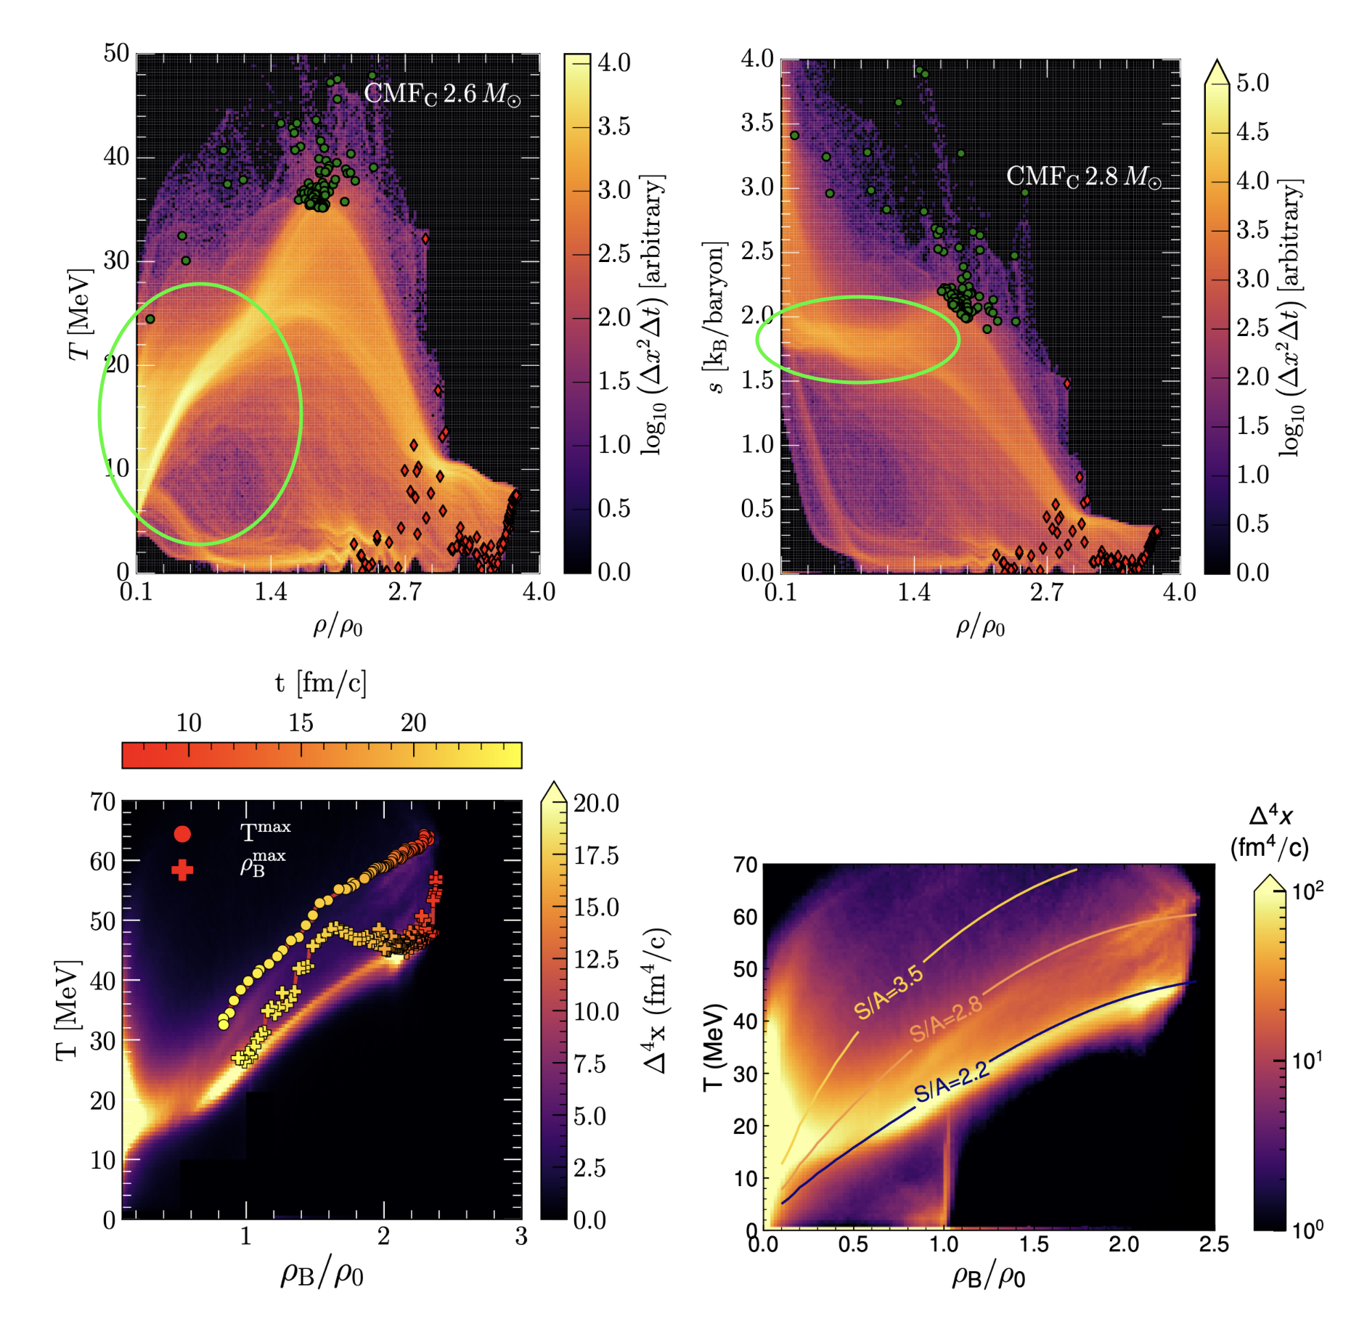
NS merger vs. HIC: range of beam energies
Many thanks for Elias Most.
Magneto-GR-Fluid dynamics for BNSM with 2.8 solar masses.
One EoS for simultaneous description of HIC and BNSM
Entropy per baryon in BNSM ~ 2
Similar to HIC at ~ 500 MeV/nucleon
Densities differ!
Approaches are complementary.
Fluid dynamics for Au+Au collision at 600 MeV/nucleon
In preparation: E. Most, A. Motornenko, V. Dexheimer, JS, L. Rezzolla and H.Stoecker

Slide 11
Part 2: Indications and verifications from HIC Experiments
Which signals do we have for a phase transition?
Even if theory indicates no transition, experimental verification is still necessary.

Slide 12
HIC range of densities

Slide 13
Two features: softening and clustering
There are usually two types of effects discussed for a PT in HIC
The softening
  A result of equal pressure in coexisting phases.
  Work is done to increase volume not accelerate.
  Different scenarios of softening are possible
  Can be easily included via a Maxwell construction
Clustering and Fluctuations
  Can be caused by instabilities at the PT.
  Critical phenomena, interesting but difficult to describe
General rule: There are no easy solutions and many aspects to be considered

Slide 14
The v1 story

Slide 15
Some old results
The old works didn‘t look at v1 explicitly
Yet a strong effect from the softening of the EoS was observed

Slide 16
What about more recent results

Slide 17
The ‘standard’ model of HIC
Could be replaced by hydro initial state for low energies

Slide 18
Remember: Standard hydro means:
Initial state by UrQMD (no EoS)
Overall hydro seems to overestimate the observable
Non-equilibrium effects?

Slide 19
How?: By using also fluid dynamics in the initial state. Effect of different compressibility!

Slide 20
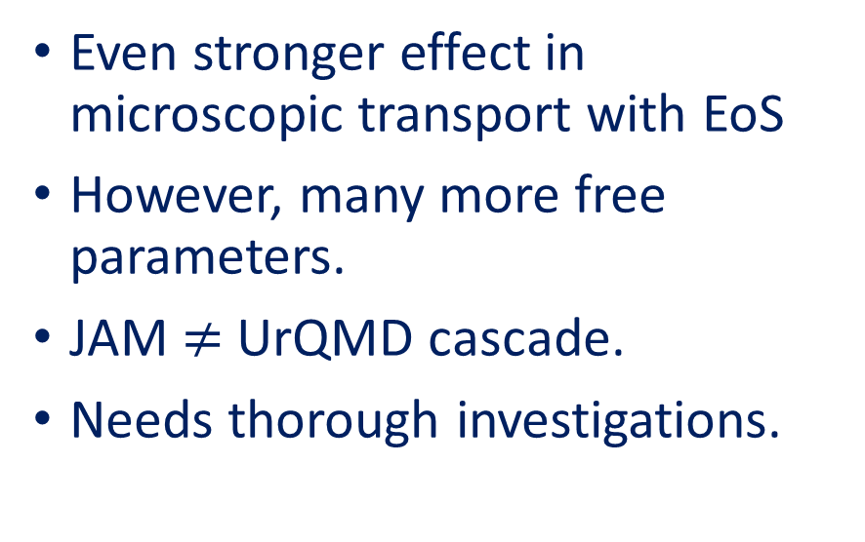
Even stronger effect in microscopic transport with EoS
However, many more free parameters.
JAM $≠$ UrQMD cascade.
Needs thorough investigations.

Slide 21
What about v2?
Approaching the transition from below: UrQMD with Skyrme potential interactions
  Parameters can be chosen to get a ‚hard‘ or ‚soft‘ EoS. Note, terms are relative not absolute.
Nuclear potentials also show an increase of v_2 for a softer EoS.
Proper temperature dependence is necessary.
May be interpreted as indication for softening for beam energy > 5 GeV
JAM results for v_2 show an increase for a softer EoS.
Y. Nara, H. Niemi, A. Ohnishi, JS, X. Luo and H. Stöcker, Eur. Phys. J. A 54 (2018) no.2, 18

Slide 22
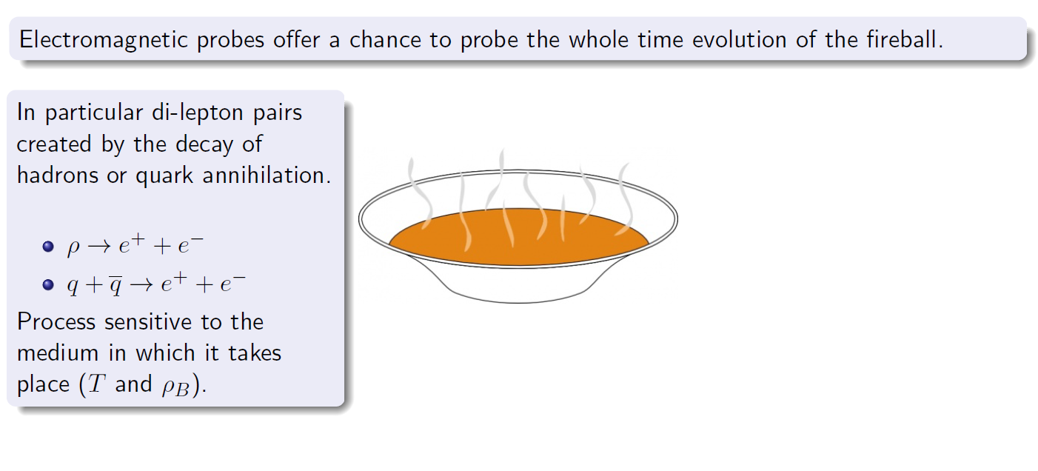
Highly sophisticated picture of HIC
Early it was argued that di-lepton emission will be very sensitive to the occurence of a phase transition.
L. D. McLerran and T. Toimela, Phys. Rev. D (1985), 545

Slide 23
New studies aim at more quantitative predictions
An even more sophisticated picture:
3+1 D fluid dynamics from the beginning to include effect from compression
Using the space-time evolution of the system we can calculate the emission rates.
Already by eye we see significant differences in the evolution.

Slide 27
How to do a phase transition in fluid dynamics
To dynamically describe the process of phase separation, fluid dynamics needs to be augmented
  Most important: a gradient term
  Modifies the dispersion relation.
In the unstable region between the phase boundaries the speed of sound will be imaginary.
Any undulations will grow exponentially with a wave number dependent growth rate
See e.g.:
V. V. Skokov and D. N. Voskresensky, Nucl. Phys. A 828 (2009), 401-438
and
J. Randrup, Phys. Rev. C 79 (2009), 054911
i
Viscosity:
Normal matter mechanically unstable matter

Slide 28
The two scenarios of phase separation
  Equilibrium construction (Maxwell)
  Non-equilibrium separation through instabilities

Slide 30
Effects of the choice of EoS model
Even though some models have the CEP at the same point,
they may yield very different results.
HQ-EoS: what we used
PQM: example for quark mean field approach
Nuclear L-G: well known phenomenology

Slide 31
HQ-EoS vs. PQM model:
Evolution of clusters very different.
Low pressure at coexistence leads to long-lived clusters.
Similar to L-G transition: Clusters are nuclei!
But: Quark clusters are not stable!
As cluster decay and go through hadronic phase, signals wash out.

Slide 32
Time evolution of density moments shows clearly the difference
So whenever a result with a critical point / phase transition is shown:
Check the thermodynamic properties of the transition
Put the results into context of the EoS

Slide 33
CNN results:
Yes in almost every event!

Slide 37
An example for the full evolution using the HQ-EoS
Small enhancement of Skewness observed (relevant is the TP=1 line)
Fluid dynamics is computationally expansive: no Kurtosis yet

Slide 38
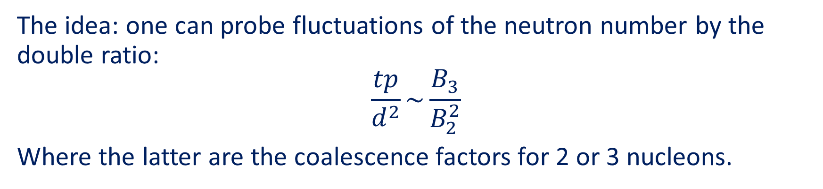
Nuclei ratio idea
K. J. Sun, L. W. Chen, C. M. Ko and Z. Xu, Phys. Lett. B 774, 103-107 (2017)
The idea: one can probe fluctuations of the neutron number by the double ratio:
$$\frac{tp}{d^{2}}\sim \frac{B_{3}}{B_{2}^{2}}$$
Where the latter are the coalescence factors for 2 or 3 nucleons.

Slide 39
What does the dynamical model say?
Result of nuclei ratios from fluid dynamics + thermal production
First calculation did not include effects of phase space coalescence.
Still small effect is observed.
Only during active clumping.
JS, J. Randrup and V. Koch, Phys. Rev. C 89, no.3, 034901 (2014)

Slide 40

Coalescence
Recently an effective phase space coalescence approach was developed for UrQMD.
Coordinate AND momentum space:
$$dr=3.575 fm , dp=0.285 GeV$$
One set of parameters works from SIS18 to LHC.
S. Sombun, K. Tomuang, A. Limphirat, P. Hillmann, C. Herold, JS, Y. Yan and M. Bleicher, Phys. Rev. C 99, no.1, 014901 (2019)

Slide 41
Now also 3-baryon states
Thanks to Paula Hillman
Parameters need to be fixed, for all beam energies: The rest is prediction.

Slide 42
New results
Why?
Multifragmentation?
The LG transition?
Preliminary!
Preliminary!
Flow?
Acceptance?
Why no signal for clustering? Clustering effect is not very large, small volume and global conservation.
Re-scattering removes all previous correlations.
Even for point when clustering is present the smaller coordinate space comes with increased momentum space
P. Hillmann, JS, V. Vovchenko, V. Koch, J. Randrup, Marcus Bleicher)

Slide 43
Employ DL methods
Advantage: No need to explicitly construct observables
  May lead to new surprising features
Disadvantage: Supervised learning requires example data which is as realistic as possible.
Investigations are on the way
Y. L. Du, K. Zhou, JS, L. G. Pang, A. Motornenko, H. S. Zong, X. N. Wang and H. Stöcker, Eur. Phys. J. C 80 (2020) no.6, 516 .
M. Omana Kuttan, JS, K. Zhou, A. Redelbach and H. Stoecker, Phys. Lett. B 811 (2020), 135872
L. G. Pang, K. Zhou, N. Su, H. Petersen, H. Stöcker and X. N. Wang, Nature Commun. 9 (2018) no.1, 210

Slide 44
Summary
Many signals for a phase transition have been proposed over the years.
Almost all of the seem to exhibit some kind of model dependence.
More realistic scenarios generally weaken the signals.
Hydro results dominated by noise from assumed equilibrium
Can transport + Phase transition be an alternative?
Cluster formation still an interesting topic, but with caveats
There is always the super heavy ion collider (neutron star mergers) looming.

