Slide 1

Physics of dileptons in HI Collisions – A Review
Joachim Stroth
RHIC BES seminar series II, Online, PKU, OSU, LBNL
April 27, 2021

Slide 2
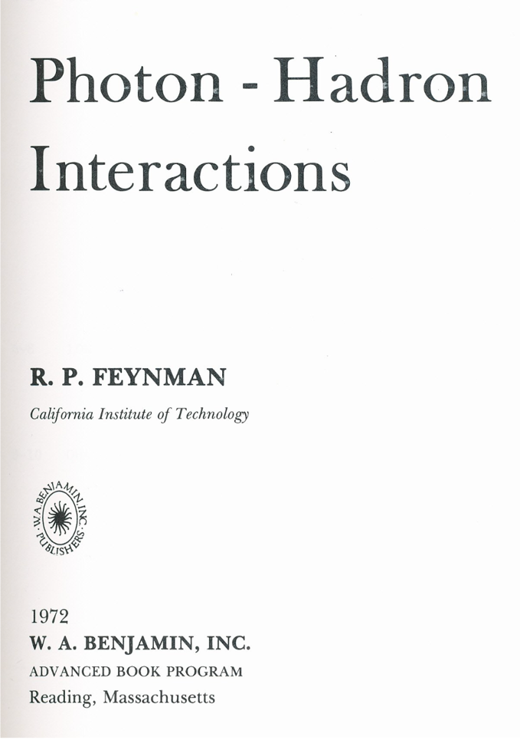
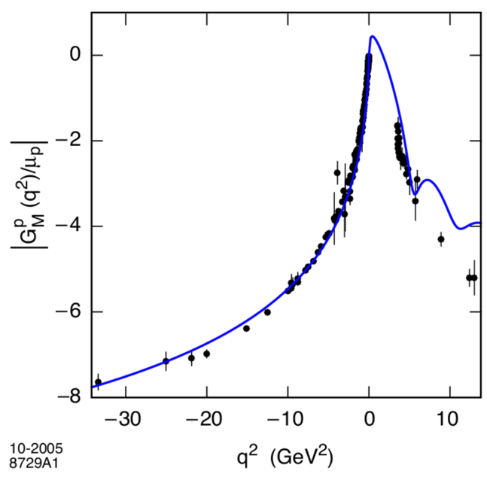
Electromagnetic probes of strong-interaction matter
Space-like
Spacial structure
(momentum)
  Lepton beam on target (scattering)
  cf. Hofstadter, Burton et al.
Resonant structure
(excitation)
  Radiation from object (spectroscopy)
  cf. jet quenching (color)
Proton magnetic
form factor
S. Brodsky, G.F. Téramond,
hep-ph/0510240 [hep-ph]
Time-like

Slide 3
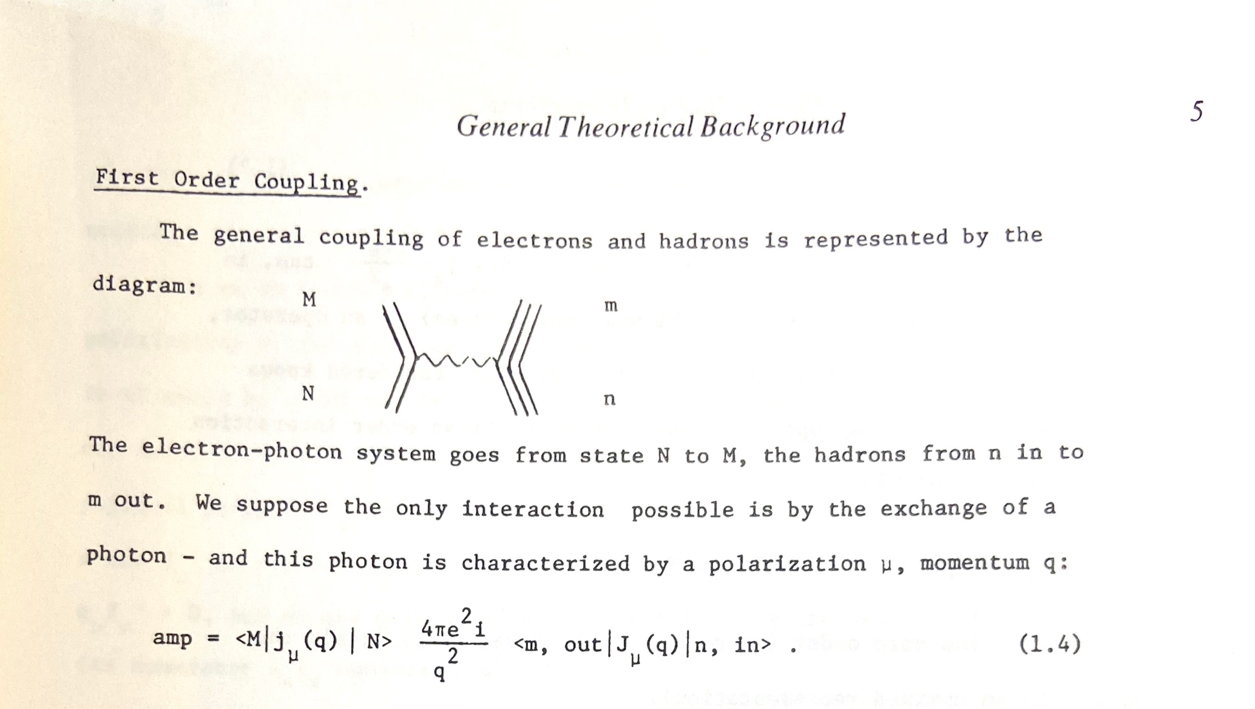
R. P. Feynman, “Photon Hadron Interactions”, Caltech Lectures, Advanced Book Classics

Slide 4

Dilepton spectrometer concepts
Technology has driven the change to multi-purpose detectors
DLS
KEK-235
Muon option
CBM-MUCH
NA60
(LHC)
Two-arm
spectrometers
ALICE
CBM
STAR
sPHENIX
CERES
HADES
PHENIX
Field-free
Cherenkov
$μ$-tracking &
Topological cuts
;)

Slide 5
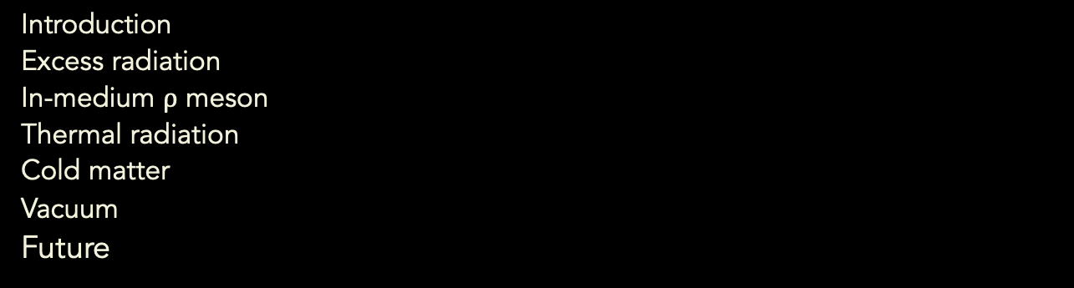
AGENDA
Introduction
Excess radiation
In-medium $ρ$ meson
Thermal radiation
Cold matter
Vacuum
Future
Disclaimer:
Little on hard processes, no real photons (see C. Gale on May 11)
Brief on RHIC (R. Lijuan March 23)

Slide 6
Introduction

Slide 7
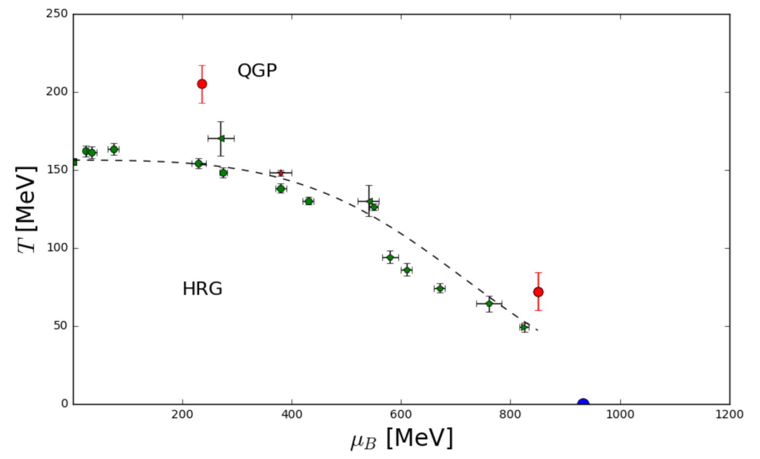


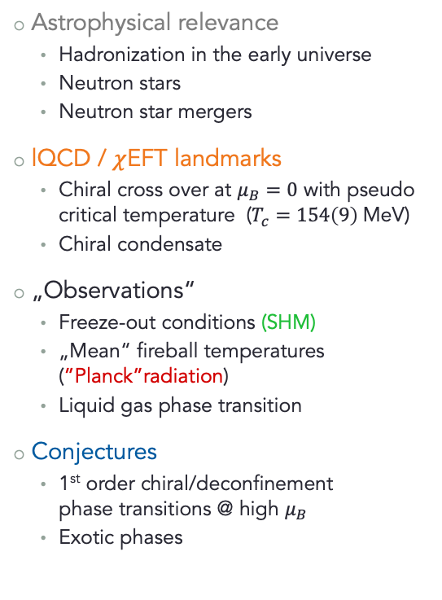






Exploring the QCD phase diagram
Astrophysical relevance
  Hadronization in the early universe
  Neutron stars
  Neutron star mergers
lQCD / $χ$EFT landmarks
  Chiral cross over at $μ_{B}=0$ with pseudo critical temperature ($T_{c}=154\left(9\right) \text{MeV}\text{)}$
  Chiral condensate
„Observations“
  Freeze-out conditions (SHM)
  „Mean“ fireball temperatures (”Planck”radiation)
  Liquid gas phase transition
Conjectures
  1st order chiral/deconfinement
  phase transitions @ high $μ_{B}$
  Exotic phases
arXiv:0711.3444
arXiv:1011.0615
HADES prelim.
arXiv:0511.071
arXiv:9903-063
STAR prelim.
HADES prelim.
arXiv:1005.3508
arXiv:1308.5596
early universe
$$0.2{\left\langle \overline{q}q\right\rangle }_{0}$$
C.P.
$$0.8{\left\langle \overline{q}q\right\rangle }_{0}$$
$$\left\langle q\overline{q}\right\rangle :\text{lQCD}$$
$$0.85$$
$$0.75{\left\langle \overline{q}q\right\rangle }_{0}$$
$$0.8$$
$$0.9$$
NS merger
$$\left\langle \overline{q}q\right\rangle : χ \text{EFT}\text{+}\text{FRG}$$
NS cores

Slide 8
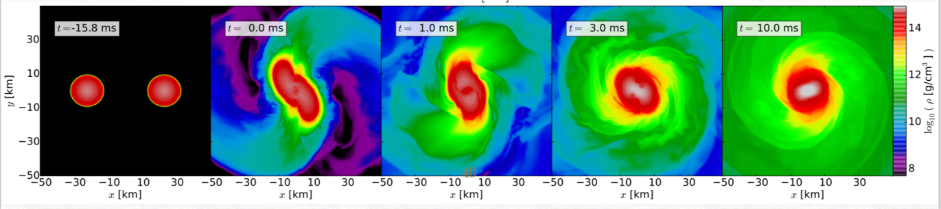
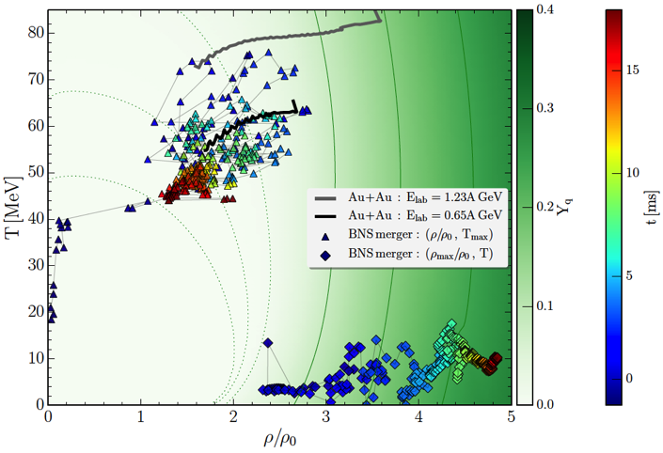

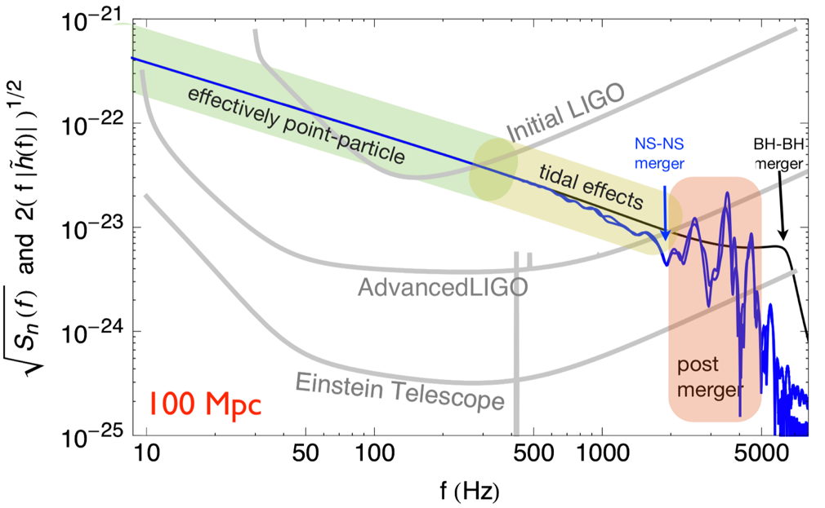

Heavy-ion collisions and neutron star merger
Gravitational wave signal can probe the dense EOS during “ring down“ if frequencies in kHZ range are detected.
Moderately dense but hot medium in the surface region
of the merger.
M. Hanauske, J. Steinheimer (priv. com.)
L. Rezzolla et al. arXiv:1807.03684
H. Stöcker courtesy Jocelyn Read

Slide 9

The (U)RHIC Standard Model
„First chance“
„Pre-equillibrium“
Fireball
Freeze-out
Late stage
Very different a.f.o. $√s_{NN}$
SIS18
SIS100/AGS
SPS
RHIC
LHC
nucleons
Drell/Yan,
correl. semi-leptonic
decay of heavy flavor
partons
“softes” gluons

Slide 10
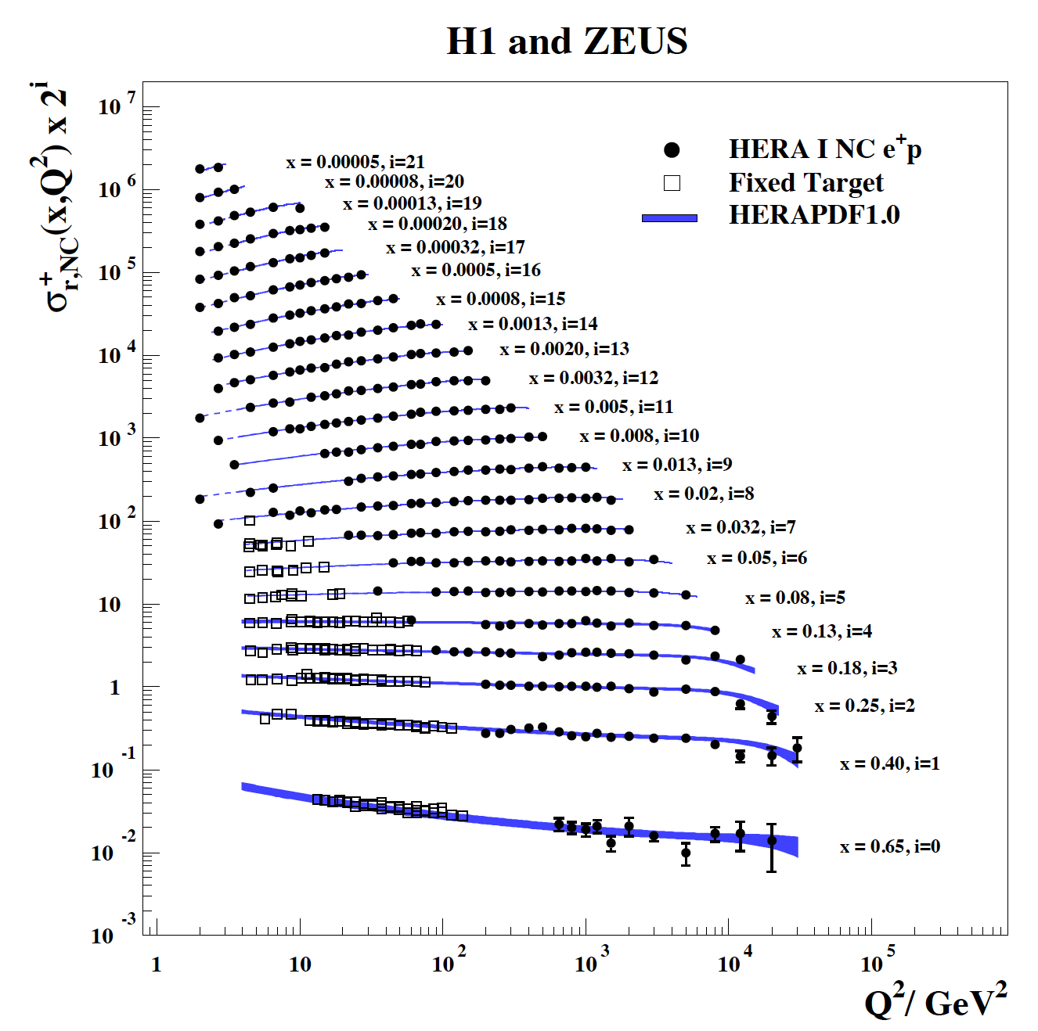
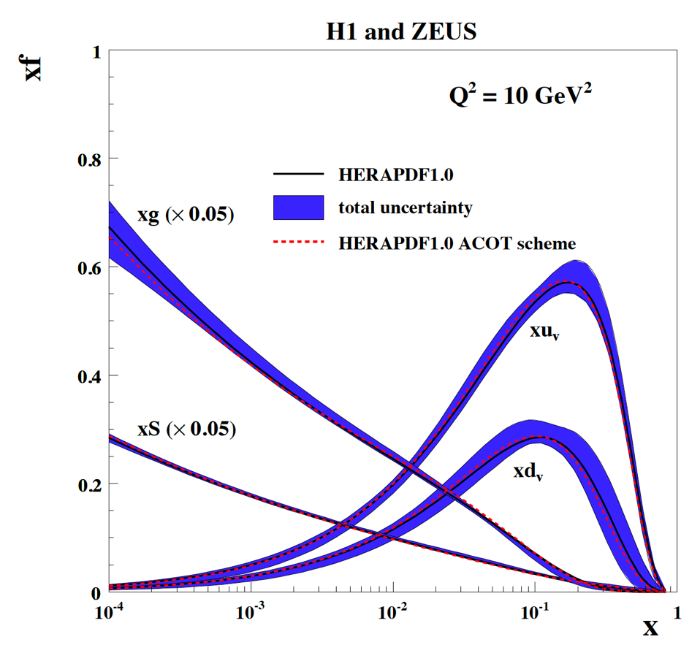
The proton structure functions
The complex nature of baryons are key to understanding the emTFF and the radiation of lepton paris in a baryon-rich medium

Slide 11
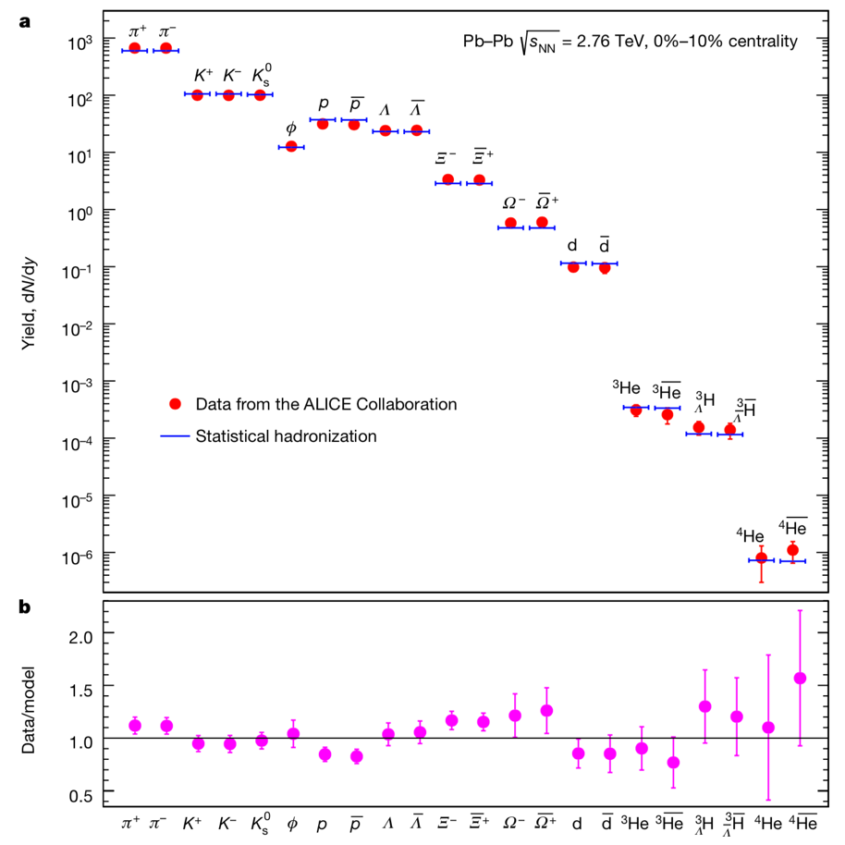
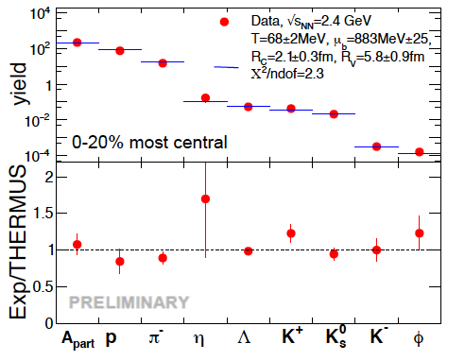

Freeze-out conditions from SIS18 to LHC
ALICE ($\sqrt{s}=2.76 A\text{TeV}$): $T_{ch}=156.5 \left(1.5\right);μ_{B}=0.7 (3.8)$
HADES ($\sqrt{s}=2.4 A\text{GeV}$): $T_{ch}=68.2 \left(1.5\right);μ_{B}=883 (25)$
Factor 1000 in beam energy / factor ~2 in temperature
Strangeness canonical treatment at low beam energies!
Calculation carried out with vacuum masses!
Pb+Pb √s_{NN}= 2.76 TeV
1 ppm
1 ppm
Nature 561, 321–330, 2018
Au+Au √s_{NN}= 2.42 GeV
HADES preliminary

Slide 12
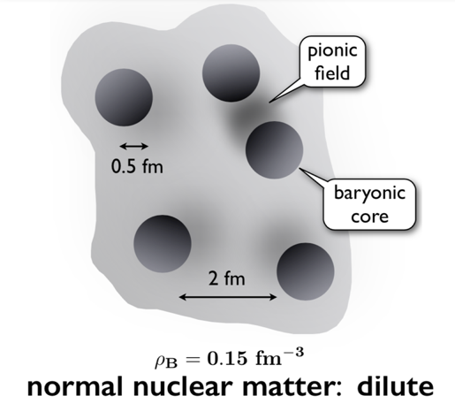
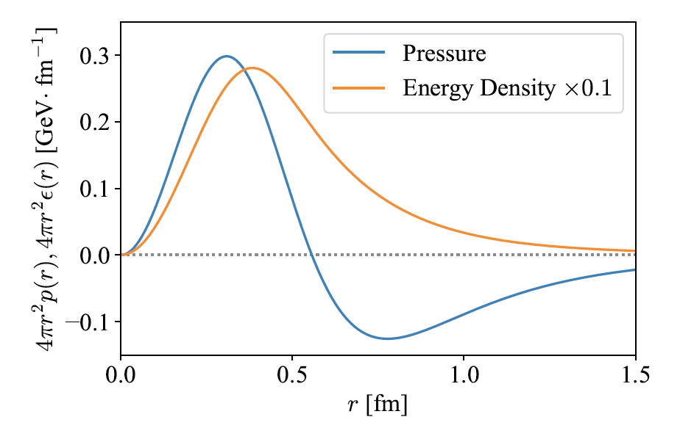
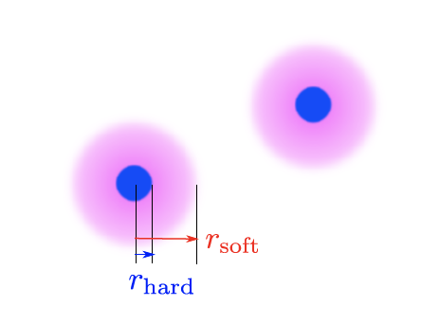
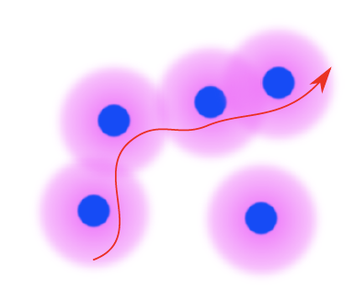
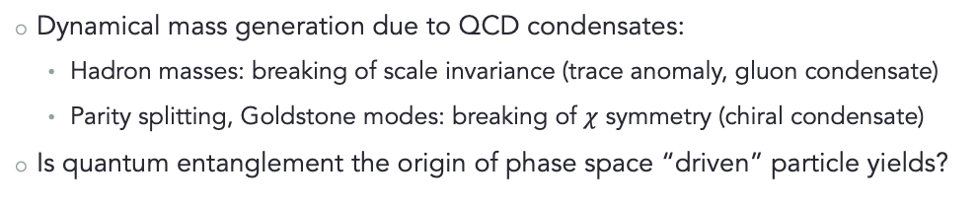

Hadron spectrum and QCD condensates
Dynamical mass generation due to QCD condensates:
  Hadron masses: breaking of scale invariance (trace anomaly, gluon condensate)
  Parity splitting, Goldstone modes: breaking of $χ$ symmetry (chiral condensate)
Is quantum entanglement the origin of phase space “driven” particle yields?
$$ρ,ω,φ$$
W. Weise, QNP2018
K. Fukushima, T. Kojo, W. Weise; arXiv:2008.08436v2 (also G. Baym, QNP2018)

Slide 13
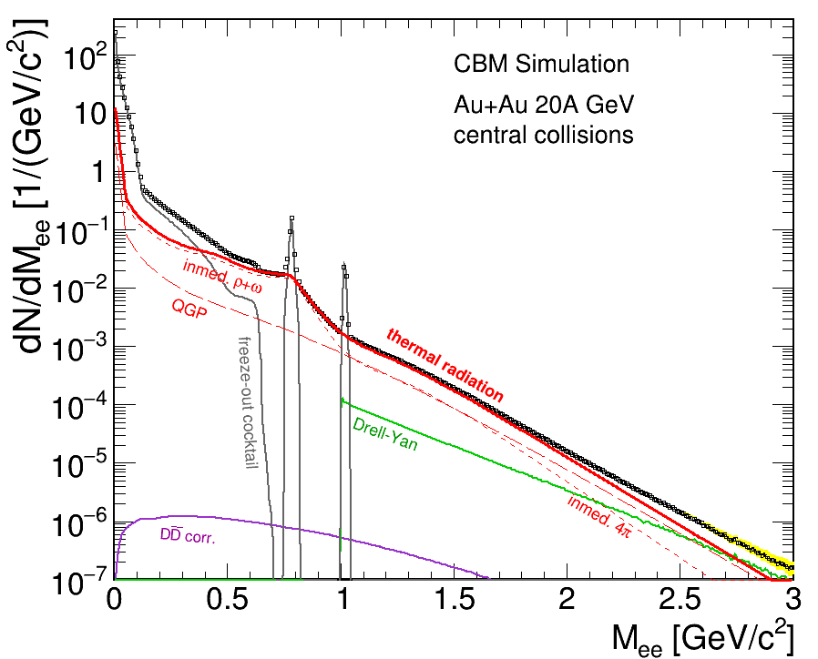
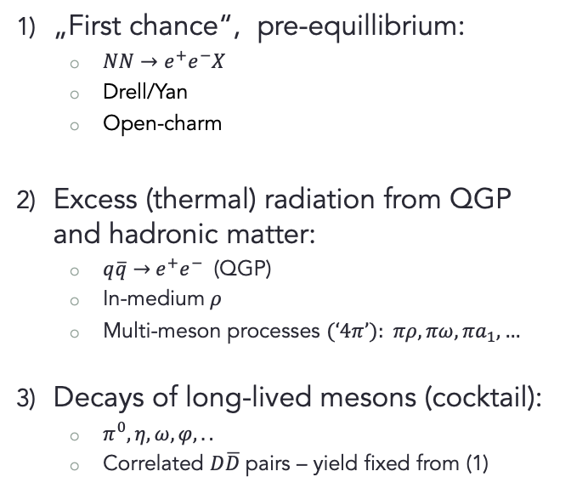
The dilepton invariant mass distribution
13
„First chance“, pre-equillibrium:
  $NN→e^{+}e^{−}X$
  Drell/Yan
  Open-charm
Excess (thermal) radiation from QGP and hadronic matter:
  $q\overline{q}→$ $e^{+}e^{−}$ (QGP)
  In-medium $ρ$
  Multi-meson processes (‘4$π$’): $πρ, πω, πa_{1}, …$
Decays of long-lived mesons (cocktail):
  $π^{0}, η, ω, φ,..$
  Correlated $D\overline{D}$ pairs – yield fixed from (1)
LMR
IMR
F. Seck, MSc 2015
Excess radiation = remainder after subtraction of (1) and (3)

Slide 14
EXcess radiation

Slide 15
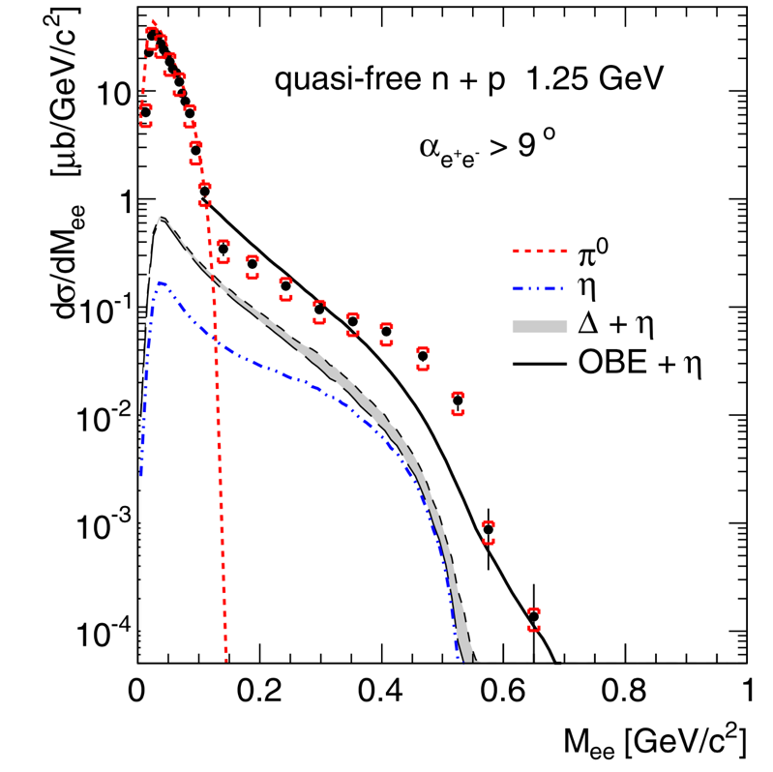
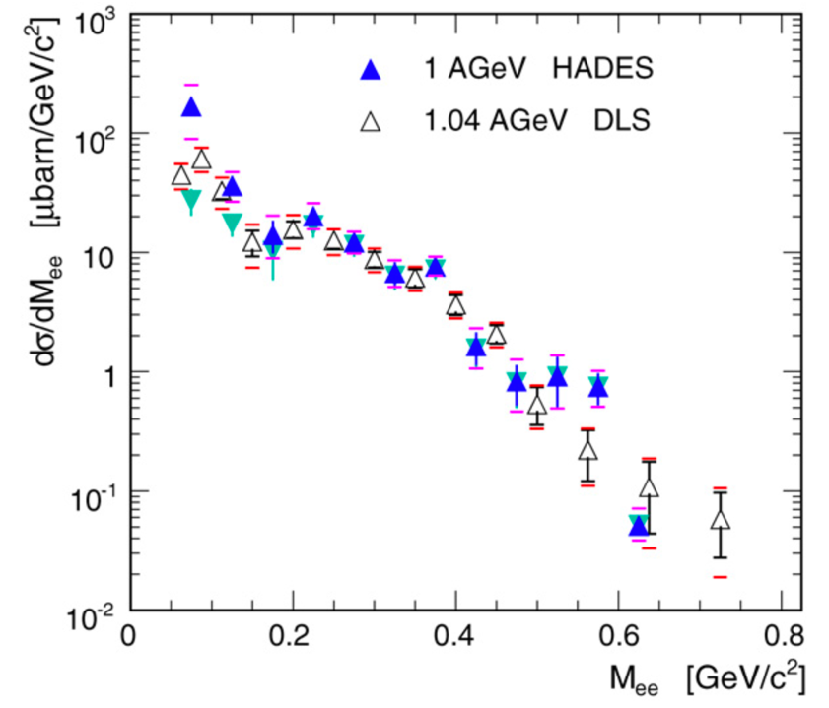

Establishing excess radiation at Bevalac/SIS18 …
… and the solution to the so-called DLS puzzle.
Strong enhancement of dilepton yield from p+n “bremsstrahlung” – first glimpse on the $ρ$ meson!
C+C
HADES, PLB 690 (2010) 118–122
HADES, PLB 663 (2008) 43–48

Slide 16
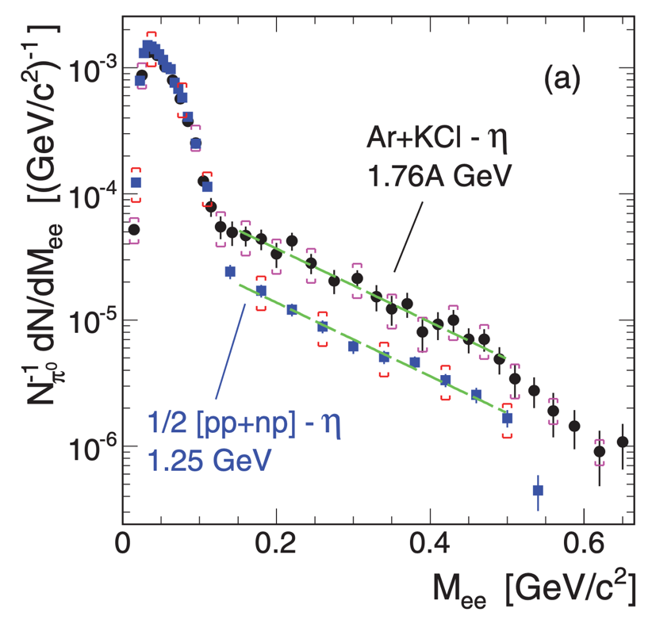
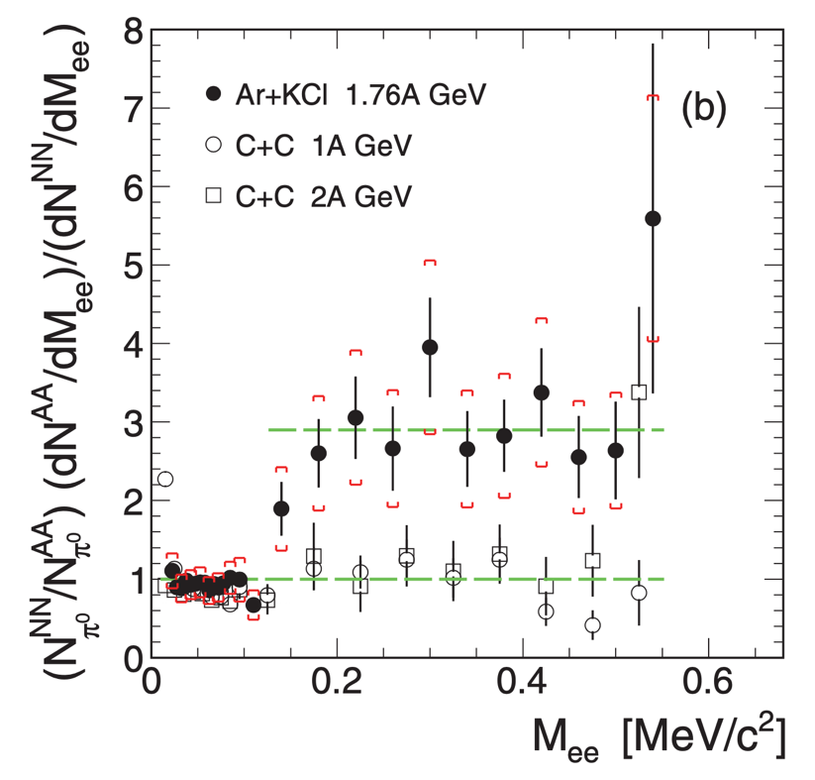

Dileptons from 1.76 A GeV Ar+KCl collisions
The excess radiation is evidenced after subtraction of a proper approximation for the contributions from first-chance NN collisions – the NN reference.
Note the normalization to the $π^{0}$ multiplicity.
HADES, PRC 84, 014902 (2011)
HADES, PRC 84, 014902 (2011)

Slide 17

In-medium $ρ$-meson

Slide 18
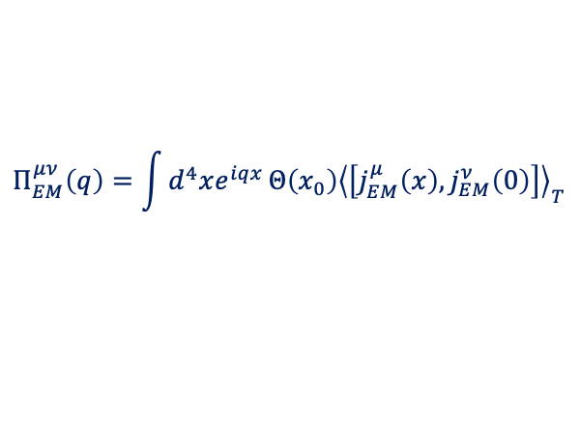

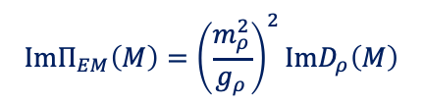

Vector Meson Dominance in hot & dense matter
Generalized „Bremsstrahlung“ – Fourier transform of current-current correlation function $\left\langle j\left(x\right),j(0)\right\rangle :$
Extension of the Gounaris-Sakurai formula to a thermal pion gas:
Hadronic current can be approximated by the imaginary part of the in-medium$ρ$ propagator. Inclusion of meson-baryon coupling, $ρ$ only:
$$Π_{EM}^{μν}\left(q\right)=\int{d^{4}xe^{iqx}}Θ\left(x_{0}\right){\left\langle \left[j_{EM}^{μ}\left(x\right),j_{EM}^{ν}\left(0\right)\right]\right\rangle }_{T}$$
L. McLerran, K. Toimela, Phys. Rev. D31 (1985)
See also: Ralf Rapp arXiv-1110-4345
C. Gale, J. Kapusta: Nucl. Phys. B357 (1991) 65
$j_{EM}^{μ}=\frac{1}{2}\left(\overline{u}γ^{μ}u−\overline{d}γ^{μ}d\right)+\frac{1}{6}\left(\overline{u}γ^{μ}u+\overline{d}γ^{μ}d\right)−\frac{1}{3}\overline{s}γ^{μ}s$ $⟹ ImΠ_{EM}\sim Im{ D}_{ρ}+\frac{1}{9}Im{ D}_{ω}+\frac{2}{9}Im{ D}_{φ}$
$$ImΠ_{EM}\left(M\right)={\left(\frac{m_{ρ}^{2}}{g_{ρ}}\right)}^{2}\text{Im}D_{ρ}\left(M\right)$$
$$D_{ρ}\left(M,q;μ_{B},T\right)=\frac{1}{\left(M^{2}−m_{ρ}^{2}−Σ_{ρππ}−Σ_{ρM}−Σ_{ρB}\right)}$$
R. Rapp, J. Wambach: Adv.Nucl.Phys. 25 (2000) 1
B. Friman, Nucl. Phys. A610 (1996) 358c;
M. Asakawa, C-M. Ko et al., PRC 46 (1992) R1159
B. Friman and H.J. Pirner, Nucl. Phys. A617 (1997) 496
π
π
N*
l⁻
ρ
ρ
Δ
π
l⁺
N⁻¹
N⁻¹

Slide 19
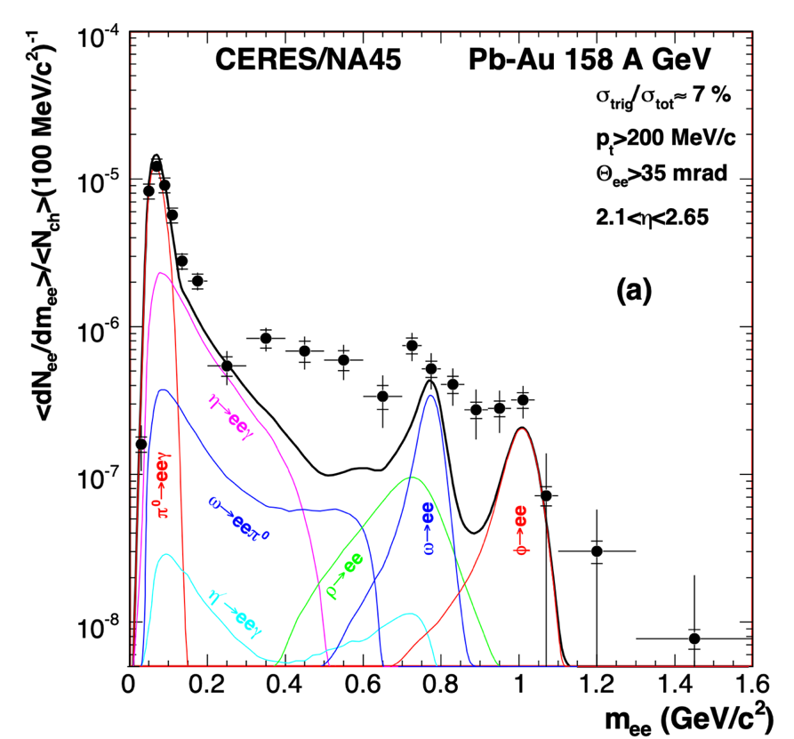
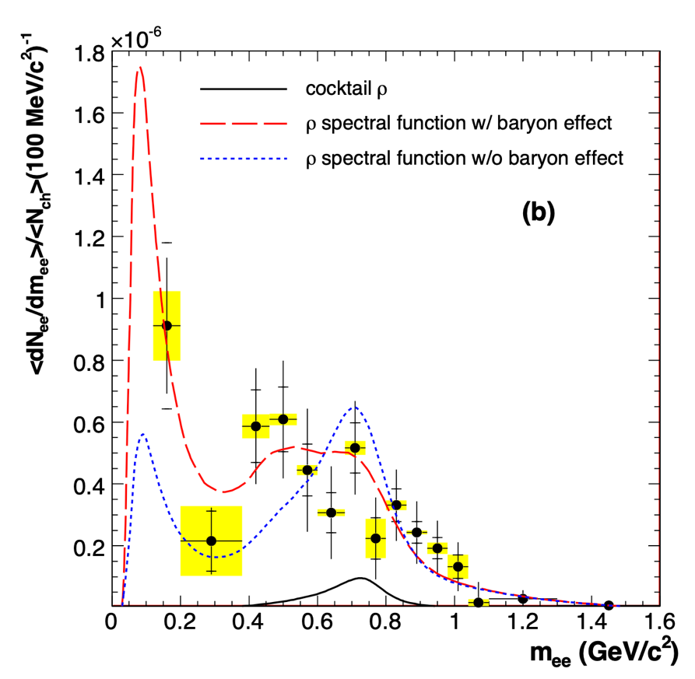
Dileptons from 158 A GeV Pb+Au collisions
First low-mass dilepton spectrum from a heavy collision system.
Indications for strong baryonic effects on the in-medium $ρ$ spectral function.
CERES, PLB 666 (2008) 425-429
CERES, PLB 666 (2008) 425-429

Slide 20
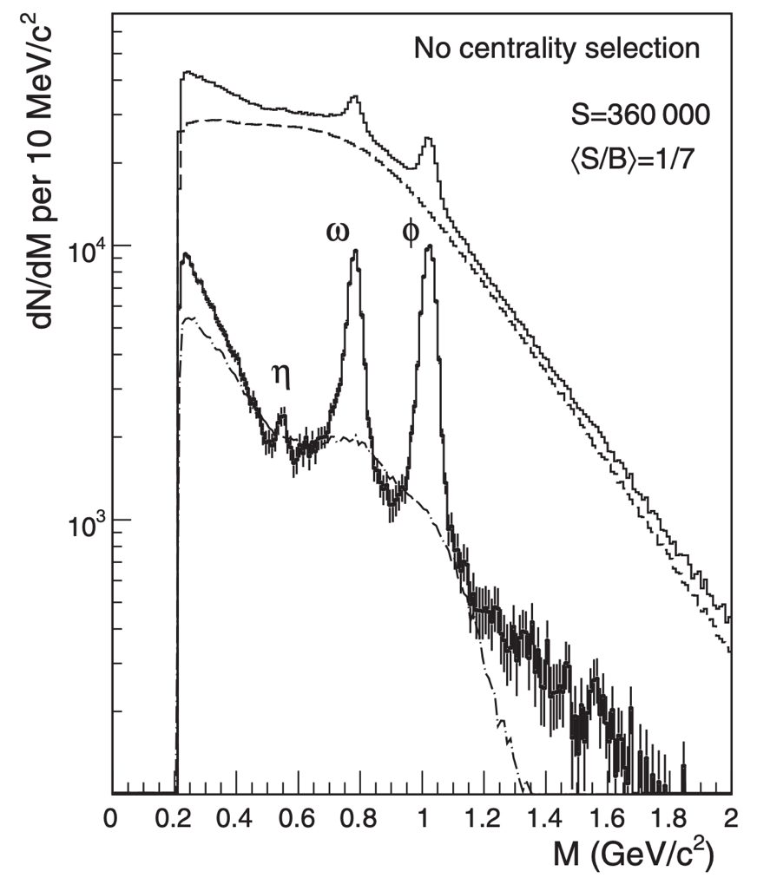
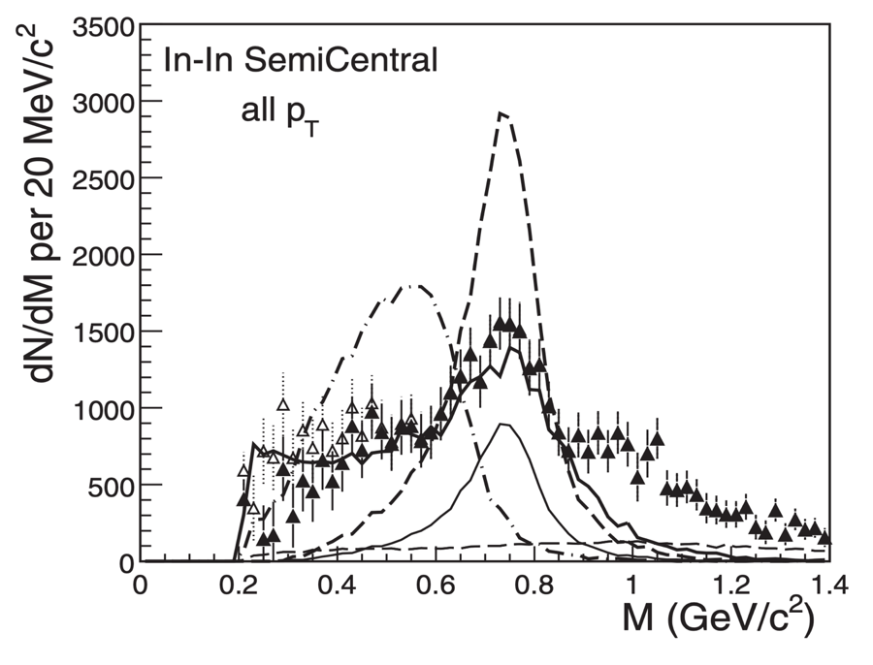

The ground breaking NA60 dimuon measurement
… and the success of the in-medium $ρ$ plus thermal emission.
L. McLerran and T. Toimela, Phys.Rev.D 31 (1985) 545
J. Kapusta and C. Gale, Phys.Rev.C 35 (1987) 2107-2116
G. Chanfray, R. Rapp, and J. Wambach, PRL 76 (1996) 368.
R. Rapp, G. Chanfray, and J. Wambach, Nucl. Phys. A617 ((1997) 472.
R. Rapp and J. Wambach, Adv. Nucl. Phys. 25, (2000) 1.
NA60, PRL 96 (2006) 162302
NA60, PRL 96 (2006) 162302

Slide 21
Thermal radiation

Slide 22
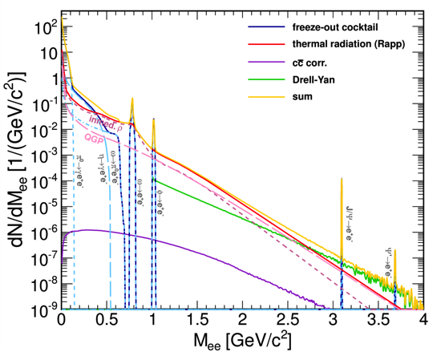
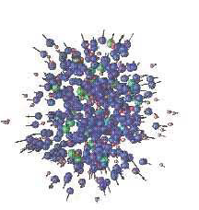
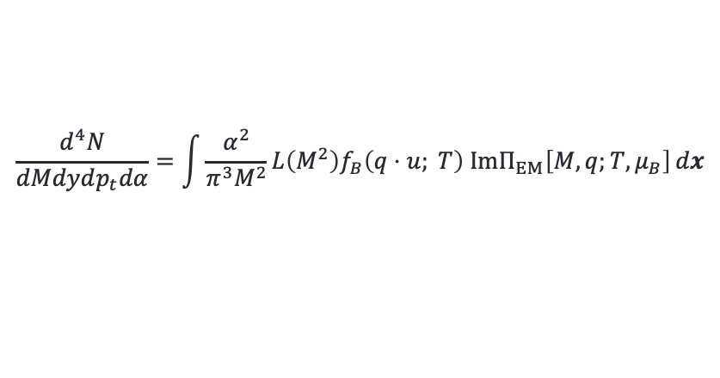
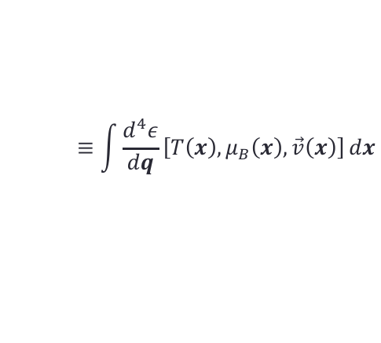
Theoretical approaches to medium radiation
Medium (excess) radiation from Thermal Emission Rates $\left(ε\right)$ (“standard candle”):
$$\frac{d^{4}N}{dMdydp_{t}dα}=\int{\frac{α^{2}}{π^{3}M^{2}}L\left(M^{2}\right)f_{B}\left(q⋅u; T\right) \text{Im}Π_{EM}\left[M,q;T,μ_{B}\right]}dx$$
$$≡\int{\frac{d^{4}ε}{dq}\left[T\left(x\right),μ_{B}\left(x\right),\vec{v}\left(x\right)\right]}dx$$
coarse graining
or
isentropic expansion,
hydro
shining
$$ρ_{0},T_{0},V_{0}$$
UrQMD
Dilepton emission from
Microscopic Transport.
F. Seck, MSc 2015

Slide 23
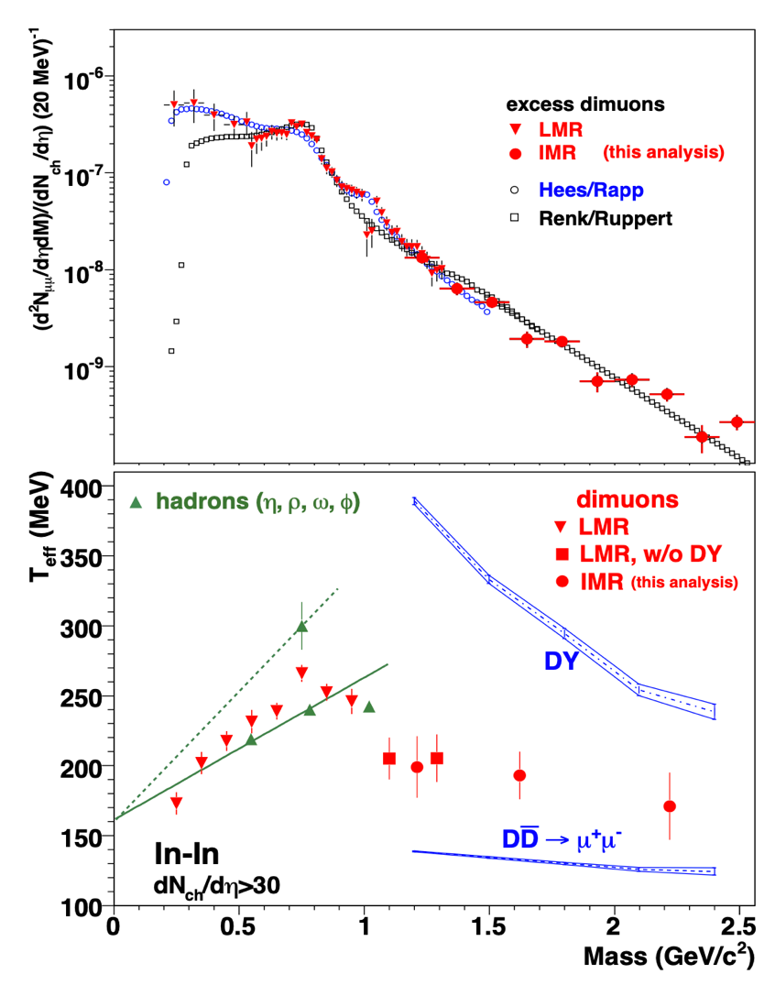
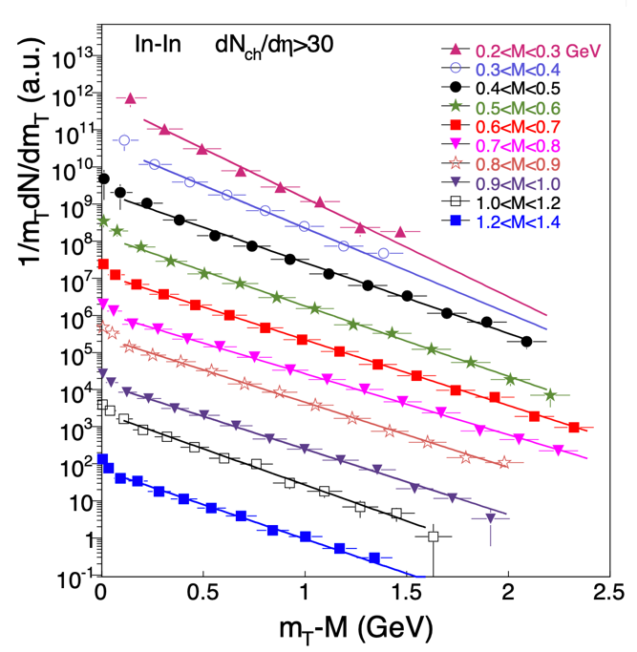
Double-differential analysis of the NA60 data
Temperature, pressure, microscopic structure (and more) – all from one observable
Open-charm subtracted throughout.
T=205±12 MeV
NA60, EPJC 59 (2009) 607-623
NA60, EPJC 59 (2009) 607-623, H. Specht Valencia 2010

Slide 24
Inclusive Dielectron Yields from Au+Au $(\sqrt{s}=2.4 A \text{GeV}$)
HADES
HADES
HADES, Nat. Phys. 15(2019) 1040
HADES, Nat. Phys. 15(2019) 1040

Slide 25
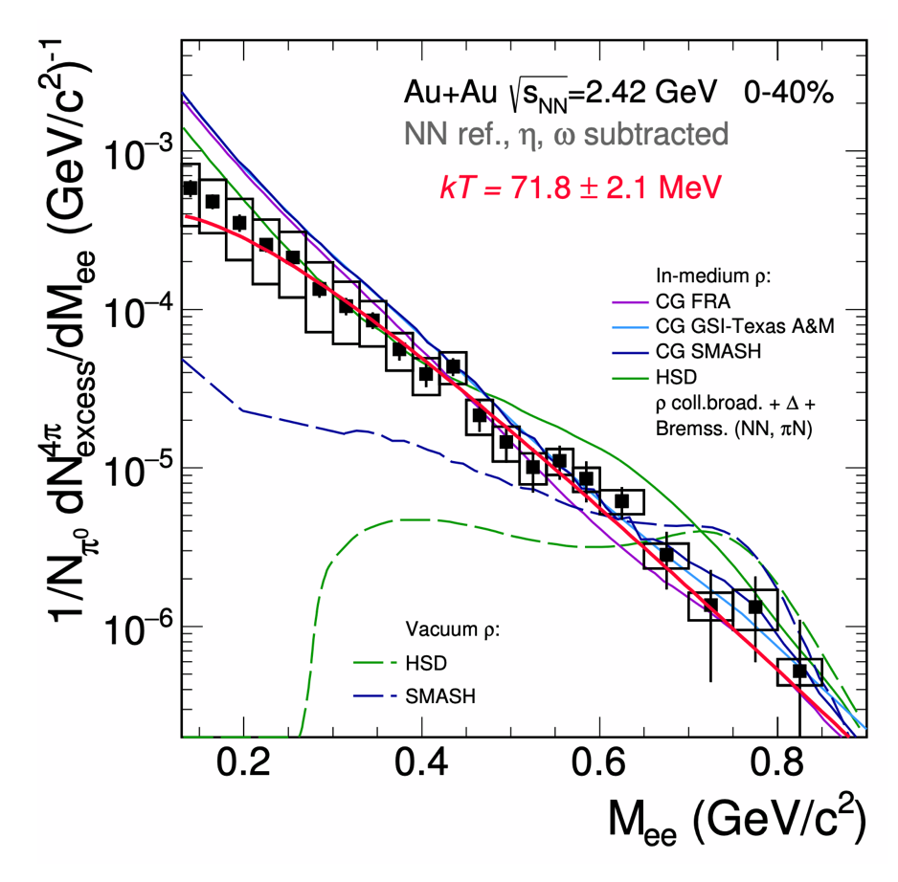

Thermal dileptons Au+Au 1.23A GeV (HADES)
0.3 < M < 0.7 GeV:
In-medium spect. funct.
fireball life-time
fireball temperature⁽¹⁾
M > 1 GeV/c²:
ρ – a1 chiral mixing
dominated by contribution from the hottest and densest region
Microscopic transport⁽²⁾:
  vacuum $ρ$ spectral function and $Δ$ regeneration
  & explicit broadening and density dependent mass shift
Coarse-grained UrQMD⁽³⁾
  thermal emissivity with
  in-medium propagator ⁽⁴⁾
  $ρ−a_{1}$ chiral mixing⁽⁵⁾
  (not measured so far)
(4) Rapp, van Hees; arXiv:1411.4612v
(2) E. Bratkovskaya;
(3) CG FRA Endres, van Hees, Bleicher;
arXiv:1505.06131
CG GSI-TAMU; Galatyuk, Seck, et al.
arXiv:1512.08688
(4) Rapp, Wambach, van Hees; arXiv:0901.3289
(5) Rapp, Hohler; arXiv:1311.2921v
HADES, Nat. Phys. 15(2019) 1040

Slide 26

Thermal dileptons Au+Au 1.23A GeV (HADES)
0.3 < M < 0.7 GeV:
In-medium spect. funct.
fireball life-time
fireball temperature⁽¹⁾
M > 1 GeV/c²:
ρ – a1 chiral mixing
dominated by contribution from the hottest and densest region
Coarse-grained UrQMD⁽³⁾
  thermal emissivity with I
  n-medium propagator ⁽⁴⁾
  $ρ−a_{1}$ chiral mixing⁽⁵⁾
  (not measured so far)
(4) Rapp, van Hees; arXiv:1411.4612v
(2) E. Bratkovskaya;
(3) CG FRA Endres, van Hees, Bleicher;
arXiv:1505.06131
CG GSI-TAMU; Galatyuk, Seck, et al.
arXiv:1512.08688
(4) Rapp, Wambach, van Hees; arXiv:0901.3289
(5) Rapp, Hohler; arXiv:1311.2921v
Full spectrum, “calculated” low-mass, low-momentum emissivities
More statistics in Ag+Ag 1.56 A GeV -> SQM2021

Slide 27
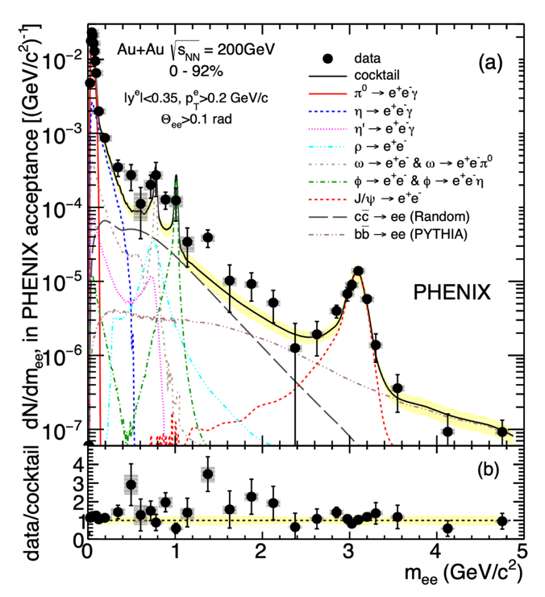
Dilepton spectra from collider
PHENIX STAR ALICE
Excess established at RHIC First excitation function for Most difficult S/B
thermal radiation Excellent opportunities in RUN3
PHENIX, PRC 81 (2010) 034911
PHENIX, PRC 93 (2016) 1
STAR, PRL 113 (2014) 2, 022301
STAR, arXiv:1810.10159
ALICE, PRC 99 (2019) 2, 024002

Slide 28
Cold matter

Slide 29
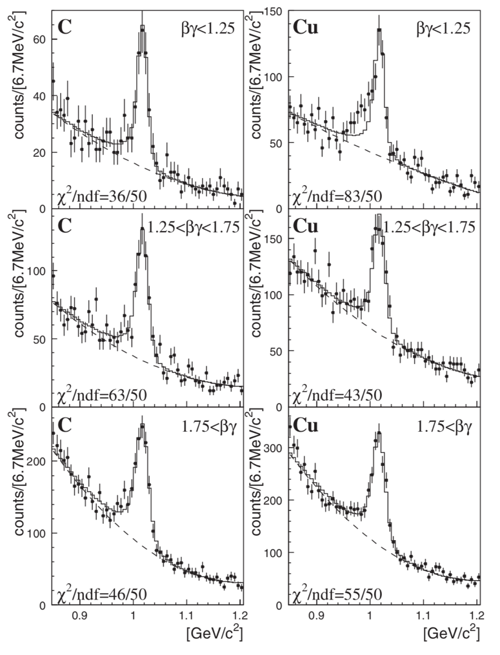
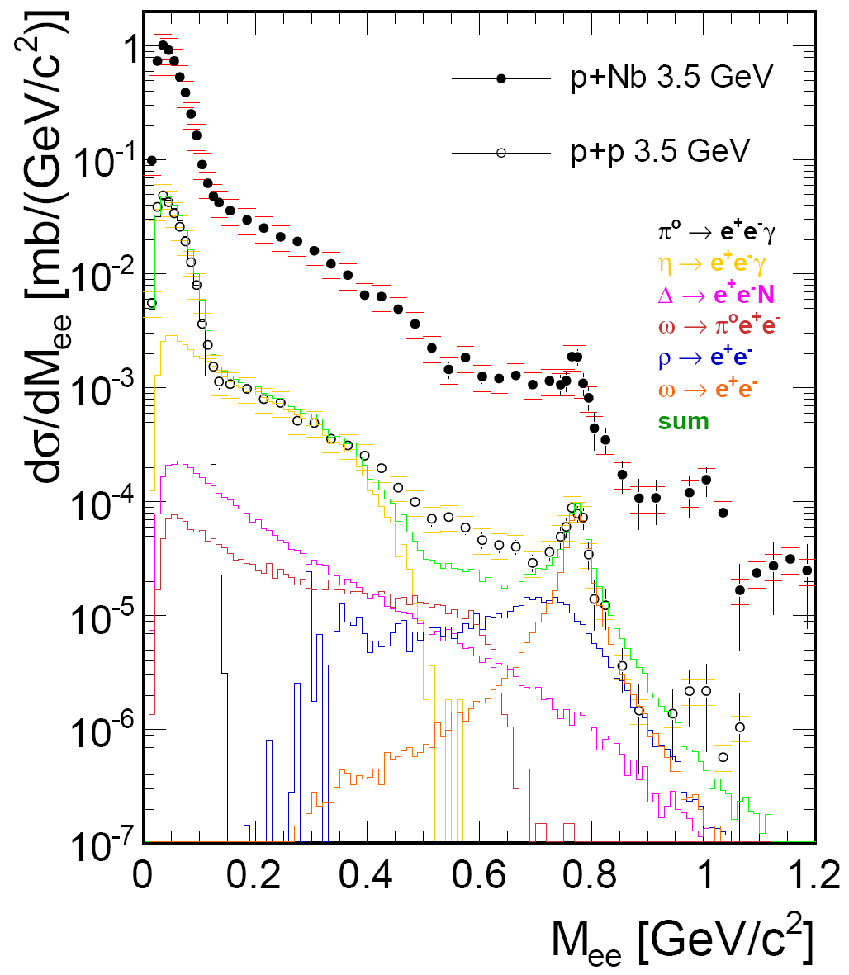
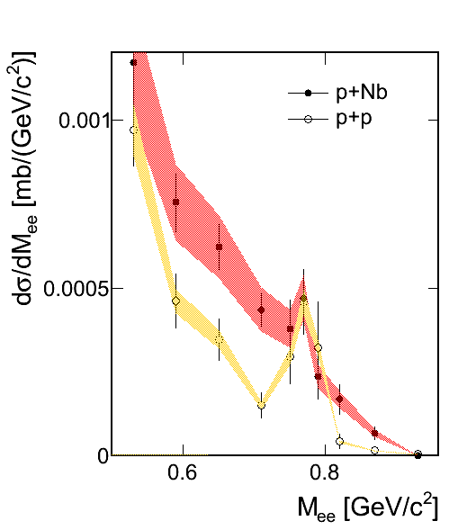


Vector mesons in cold matter
KEK-PS E325 ($φ$)
Ideal probe to monitor possible mass shifts
Low relative momentum to medium needed to increase sensitivity
Broadening and/or mass shift?
New experiment at JPARC starting up!
HADES ($ω$)
HADES, PLB 715 (2012)
KEK-PS E325, PRL 98, 042501 (2007)

Slide 30
“vacuum“

Slide 31
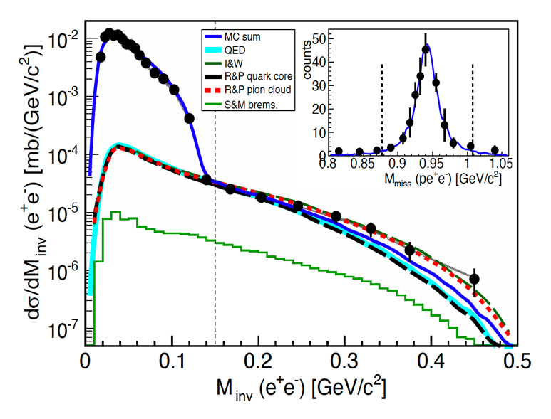
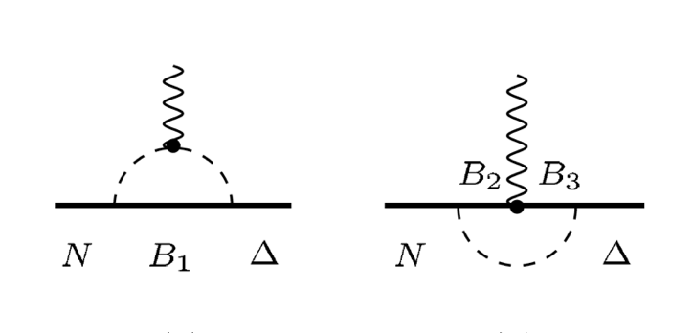
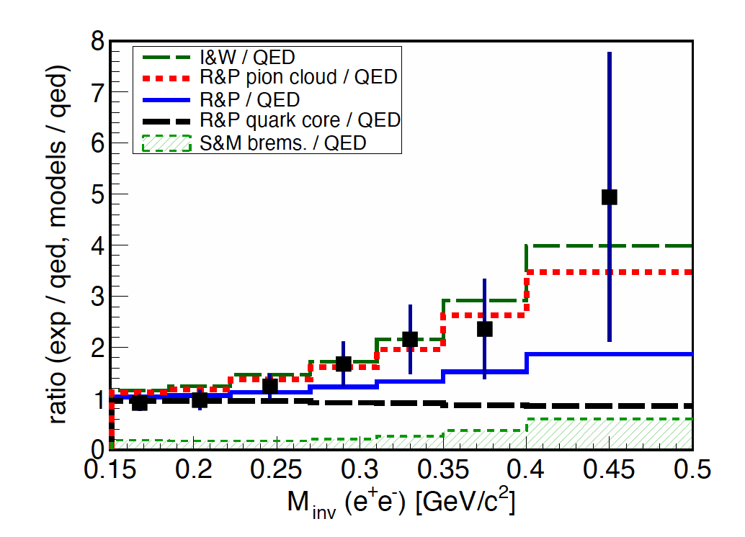


Pion cloud effect in $Δ(1323)$
Exclusive dielectron production in p+p collisions.
Effect of the pion cloud observed in the time-like
electromagnetic transition formafactor
(off-shell $ρ$ meson).
Moderate contribution to the in-medium propagator
Peña, Ramalho; arXiv-1205-2575
Peña, Ramalho + GiBUU.; arXiv-1512-03764
π
π
B*,a₁
l⁻
ρ
ρ
Δ
π
l⁺
N⁻¹
N,$π$
HADES: arXiv:1404.2136 [nucl-th]

Slide 32





Electromagnetic TFF for baryons (N*)
$$nπ^{+}$$
$$nπ^{−}$$
$$π^{+}π^{−}$$
HADES pion beam experiment
$p_{π}=\left[\text{656, 690, 748, 800}\right]$ MeV
$π^{−}+p→π^{−}{+ π}^{+}+ n$
  Hadronic final states used in PWA
  (A. Sarantsev; BONN/GATCHINA)
$π^{−}+p→e^{−}{+ e}^{+}+ n$
  Prediction for dilepton invariant mass assuming strict VMD.
  Evidence for intermediate $ρ$ propagation in both s- (baryon resonance) and t-channel.
  em TFF shows VDM-like rise

Slide 33





The Roper Resonance
$$N\left(1440\right) I\left(J^{P}\right)=\frac{1}{2}\left({\frac{1}{2}}^{+}\right)$$
The second lowest (in mass) excitation of the nucleon is the Roper resonance.
In constituent quark model first radial excitation of the nucleon, but too low mass.
The transition form factors measured at CLAS (JLAB) in the space-like region reveal a particular structure:
  Radially excited quark-core with a strongly bound
  “pion” in the cloud.
$A_{1/2}\left(Q^{2}\right)=c\left(Q^{2}\right)\left[F_{1}^{∗}\left(Q^{2}\right)+F_{2}^{∗}(Q^{2})\right]$
$$S_{1/2}\left(Q^{2}\right)=\frac{q_{CMS}}{\sqrt{2}}c\left(Q^{2}\right)\left[\frac{F_{1}^{∗}\left(Q^{2}\right)m_{fi}}{Q^{2}}+\frac{F_{2}^{∗}\left(Q^{2}\right)}{m_{fi}}\right]$$
core
combined
cloud
C. Roberts, V. Burkert; arXiv:1710.02549v1

Slide 34
Future

Slide 35



Thermal radiation and chiral symmetry restoration
Weinberg (QCD) sum-rules:
overlapping spectral distributions signal
Possibility to assess through $ρ−a_{1}$ mixing
($0.8<M_{ℓℓ}/MeV<1.3$)
P. Hohler, R. Rapp; arXiv-:311.2921

Slide 36



The Hunt for QCD landmarks at high $μ_{B}$
First-order deconfinement phase transition
  Search for nonmonotonic excitation function of:
  Excess yield (longer expansion due to softening of EOS)
  Step in the temperature (latent heat)
$χ$ symmetry restoration
  $ρ$ broadening observed, in agreement with expectations but no proof in itself ($ρ−a_{1}$ mixing)
Needs high-statistics energy scans
$$R=\frac{Total}{Cocktail}$$
  P. Salabura, J. Stroth, acc. for Prog.Part.Nucl.Sc. (arXiv:2005.14589)
  R. Rapp and H. v. Hess, PLB 753 (2016) 586
  T. Galatyuk et al.: EPJA 52 (2016) 131

Slide 37
Dilepton signature of a first-order phase transition
Dilepton radiation from hydrodynamical desciption (SIS18 energies) & thermal emissivities
Factor of ~2 extra radiation in case of hydro with PT
Hydro with PT
Seck, TG, Mukherjee, Rapp, Steinheimer, Stroth, arXiv:2010.04614 [nucl-th] (see also Li and Ko, Phys. Rev. C 95 (2017) no.5, 055203=

Slide 38


How the collectivity develops
$$\frac{1}{p_{t}}\frac{dN}{dp_{t}}∝m_{t}K_{1}\left(\frac{m_{t}c^{2}}{k_{B}T}\right)$$
Analysis of $p_{t}$spectra for bins of $M_{l^{+}l^{−}}$
Dileptons: $T_{kin}=69 MeV, \left\langle β_{ee}\right\rangle =0.03$
From hadron spectra at kinetic freeze-out: $T_{kin}=62 MeV, \left\langle β_{had}\right\rangle =0.34$
dileptons
hadrons
[HADES] in preparation
  T. Galatyuk, et al., Eur.Phys.J. A52 (2016) no.5, 131

Slide 39
The existing and upcoming high-$μ_{b}$ experiments
  T. Galatyuk, Nucl.Phys. A982 (2019), update 2021
  CBM, EPJA 53 3 (2017) 60

Slide 40





The HADES Ag+Ag run
4 weeks run in March 2019 ($Ag+Ag \sqrt{s}=2.56 A \text{GeV}$)
Upgraded detector using CBM (PANDA) components
1.4 10¹⁰ recorded events (FAIR Phase-0)
First results on SQM2021
Thermal
HSD
4.5×10⁹ events
10 kHz trigger rate

Slide 41















Future facilities for high $μ_{B}$ physics
NA60⁺ – SPS
MPD – NICA
CBM– FAIR
DHS – JPARC-HI
CEE– HIAF
BM@N – NICA

Slide 42
… and the FAIR strategy
Two-arm
spectrometers
Muon option
CBM-MUCH
Field-free
Cherenkov
$μ$-tracking &
Topological cuts
HADES
CBM

Slide 43


The CBM experiment
High-rate particle detector with free streaming data acquisition on real-time event reconstruction
Compact tracking with silicon in a 1 Tm magnetic field (dipole)
  Double-sided silicon strip
  MAPS based micro vertex detector
Particle identification
  Hadron ID: TOF
  Photons, $π^{0}$, $η$: ECAL
  Electrons: RICH, TRD
  Muons: instrumented absorber (GEM, Straws)
Systematic exploration of baryon dominated matter in A+A collisions from 2 – 11A GeV beam energy

Slide 44


Forefront Technologies (Green Cube)
Technological advancements in high-performance & scientific computing, Big Data, Green IT
(V. Lindenstruth, Goethe University)

Slide 45

Summary
Increasing effort world-wide to explore the high-$μ_{B}$ region of the QCD phase diagram
with state-of-the-art detectors and dileptons.
Vector mesons valuable probe to monitor the properties of dense matter
Strong modification due to meson-baryon coupling
Thermal rates can be used as “standard candle” to explore phase space “trajectories”
Possible link to chiral symmetry restoration through $a_{1}–ρ$ mixing
Further experimental progress depends on high-statistics data for cold-matter
and hot & dense matter studies
Dileptons important element of the search for QCD landmarks

Slide 46
Thank you

