Slide 1
Construction of EoS with a critical point
Claudia Ratti
University of Houston
1/40

Slide 2
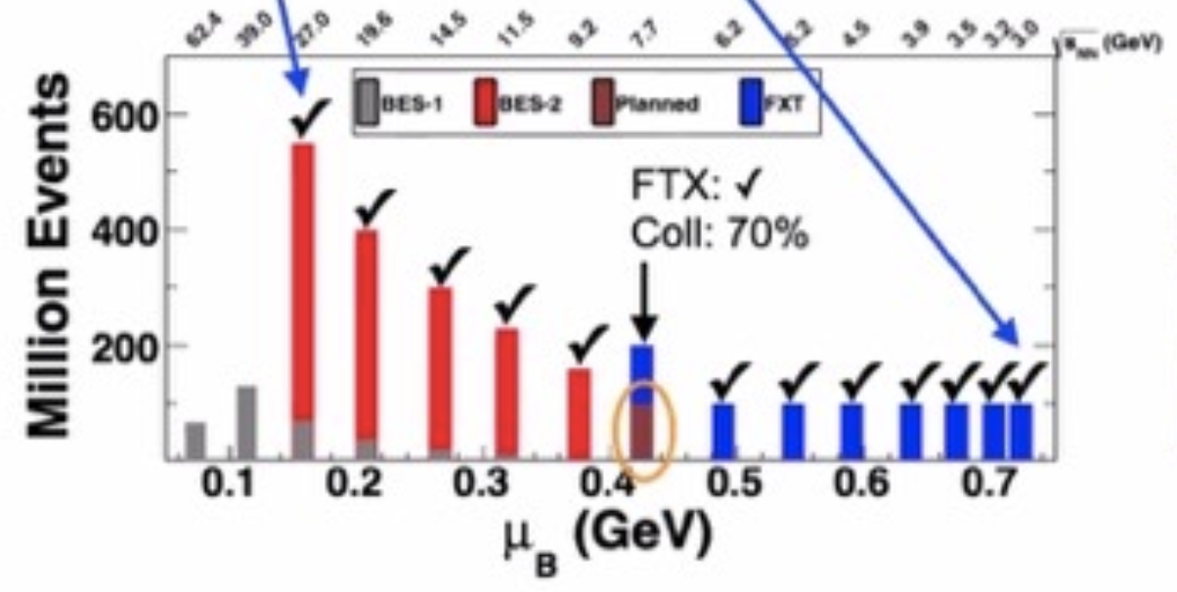
Open Questions
Is there a critical point in the QCD phase diagram?
What are the degrees of freedom in the vicinity of the phase transition?
Where is the transition line at high density?
What are the phases of QCD at high density?
Are we creating a thermal medium in experiments?
Run 2019:
Collider: √s_{NN}=14.6, 19.6, 200 GeV
Fixed target: √s_{NN}=3.2 GeV
Run 2020:
Collider: √s_{NN}=9.2, 11.5 GeV
Fixed target: √s_{NN}=3.5, 3.9, 4.5, 5.2,
6.2, 7.2, 7.7 GeV
Run 2021:
Collider: √s_{NN}=7.7 GeV
2/40

Slide 3
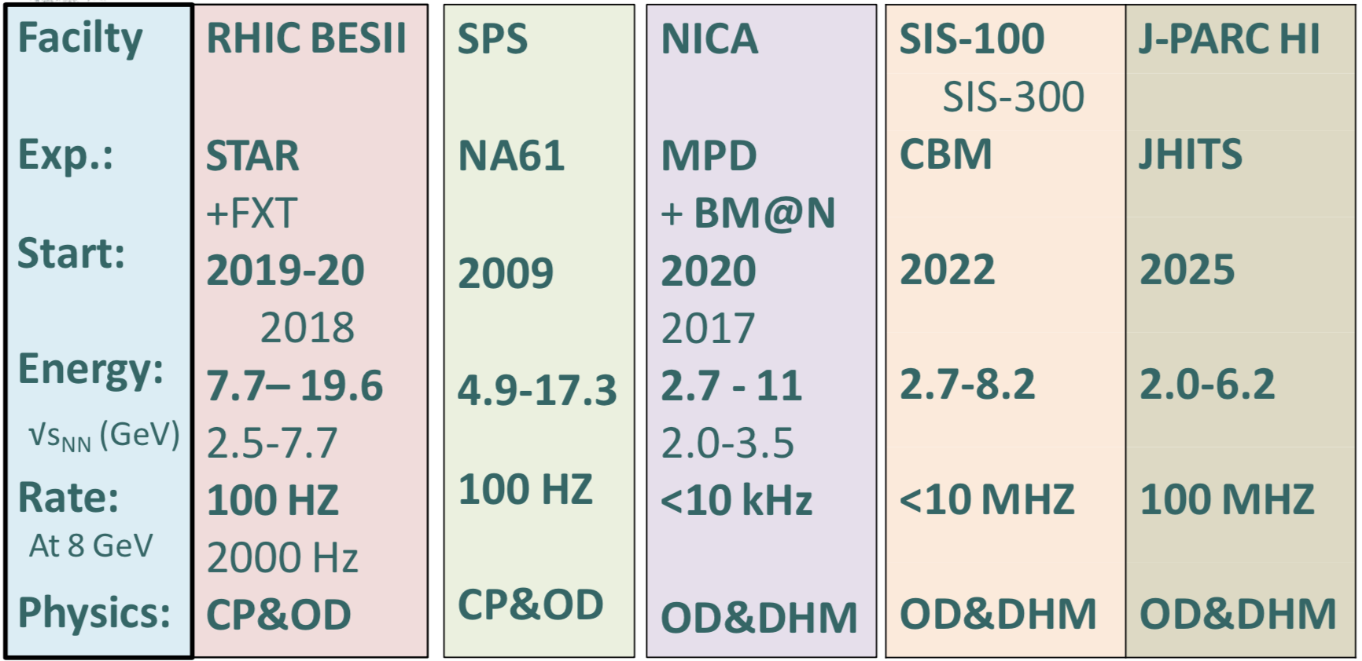
Comparison of the facilities
Compilation by D. Cebra
Collider
Fixed target
Fixed target
Lighter ion
collisions
Collider
Fixed target
Fixed target
Fixed target
CP=Critical Point OD= Onset of Deconfinement DHM=Dense Hadronic Matter
Claudia Ratti
3/40

Slide 4
How can lattice QCD support the experiments?
Equation of state
Needed for hydrodynamic description of the QGP
QCD phase diagram
Transition line at finite density
Constraints on the location of the critical point
Fluctuations of conserved charges
Can be simulated on the lattice and measured in experiments
Can give information on the evolution of heavy-ion collisions
Can give information on the critical point
Claudia Ratti
4/40

Slide 5
QCD Equation of state at finite density from the lattice
Claudia Ratti
5/40

Slide 6
QCD EoS at μ_{B}=0
WB: PLB (2014); HotQCD: PRD (2014)
WB: Nature (2016)
EoS for N_{f}=2+1 known in the continuum limit since 2013
Good agreement with the HRG model at low temperature
Charm quark relevant degree of freedom already at T~250 MeV
Claudia Ratti
6/40

Slide 7
Taylor expansion of EoS
Taylor expansion of the pressure:
Two ways of extracting the Taylor expansion coefficients:
Direct simulation
Simulations at imaginary μ_{B}
Two physics choices:
μ_{Β}≠0, μ_{S}=μ_{Q}=0
μ_{S} and μ_{Q} are functions of T and μ_{B} to match the experimental constraints:
<n_{S}>=0 <n_{Q}>=0.4<n_{B}>
Claudia Ratti
7/40

Slide 8
Pressure coefficients
Simulations at imaginary μ_{B}:
Continuum, O(10⁴) configurations, errors include systematics (WB: NPA (2017))
Strangeness neutrality
Results for χ_{n}^{B} =n!c_{n} at μ_{S}=μ_{Q}=0
Claudia Ratti
WB: JHEP(2018)
8/40

Slide 9
Pressure coefficients
Direct simulation:
O(10⁵) configurations (hotQCD: PRD (2017) and update 06/2018)
Strangeness neutrality
Results for χ_{n}^{B} =n!c_{n} at μ_{S}=μ_{Q}=0
Claudia Ratti
9/40

Slide 10
Range of validity of equation of state
Other expansion schemes have been
proposed recently
The construction of the EoS with the
critical point is based on the Taylor
expansion
WB: PRL 2021)
S. Mukherjee et al., 2021
Claudia Ratti
10/40

Slide 11
QCD Equation of state for μ_{B,} μ_{S,} μ_{Q} >0
J. Noronha-Hostler, C.R. et al., PRC (2019)
Lattice: WB, JHEP (2018)
Claudia Ratti
See also A. Monnai et al., 1902.05095
11/40

Slide 12
QCD Equation of state for μ_{B,} μ_{S,} μ_{Q} >0
J. Noronha-Hostler, C.R. et al., PRC (2019)
Lattice: WB, JHEP (2018)
Claudia Ratti
See also A. Monnai et al., 1902.05095
12/40

Slide 13
Introducing a 3D-Ising critical point
Implement the scaling behavior of the 3D Ising model EoS
Map the 3D Ising model phase diagram onto the QCD one
Estimate the contribution from the critical point
Reconstruct the full pressure over the whole phase diagram
Collaborators: P. Parotto, M. Bluhm, D. Mroczek, M. Nahrgang, J. Noronha-Hostler, K. Rajagopal,
T. Schaefer, M. Stephanov
Claudia Ratti
13/40

Slide 14
Implement the scaling EoS for 3D Ising
Claudia Ratti
14/40

Slide 15
Implement the scaling EoS for 3D Ising
Claudia Ratti
15/40

Slide 16
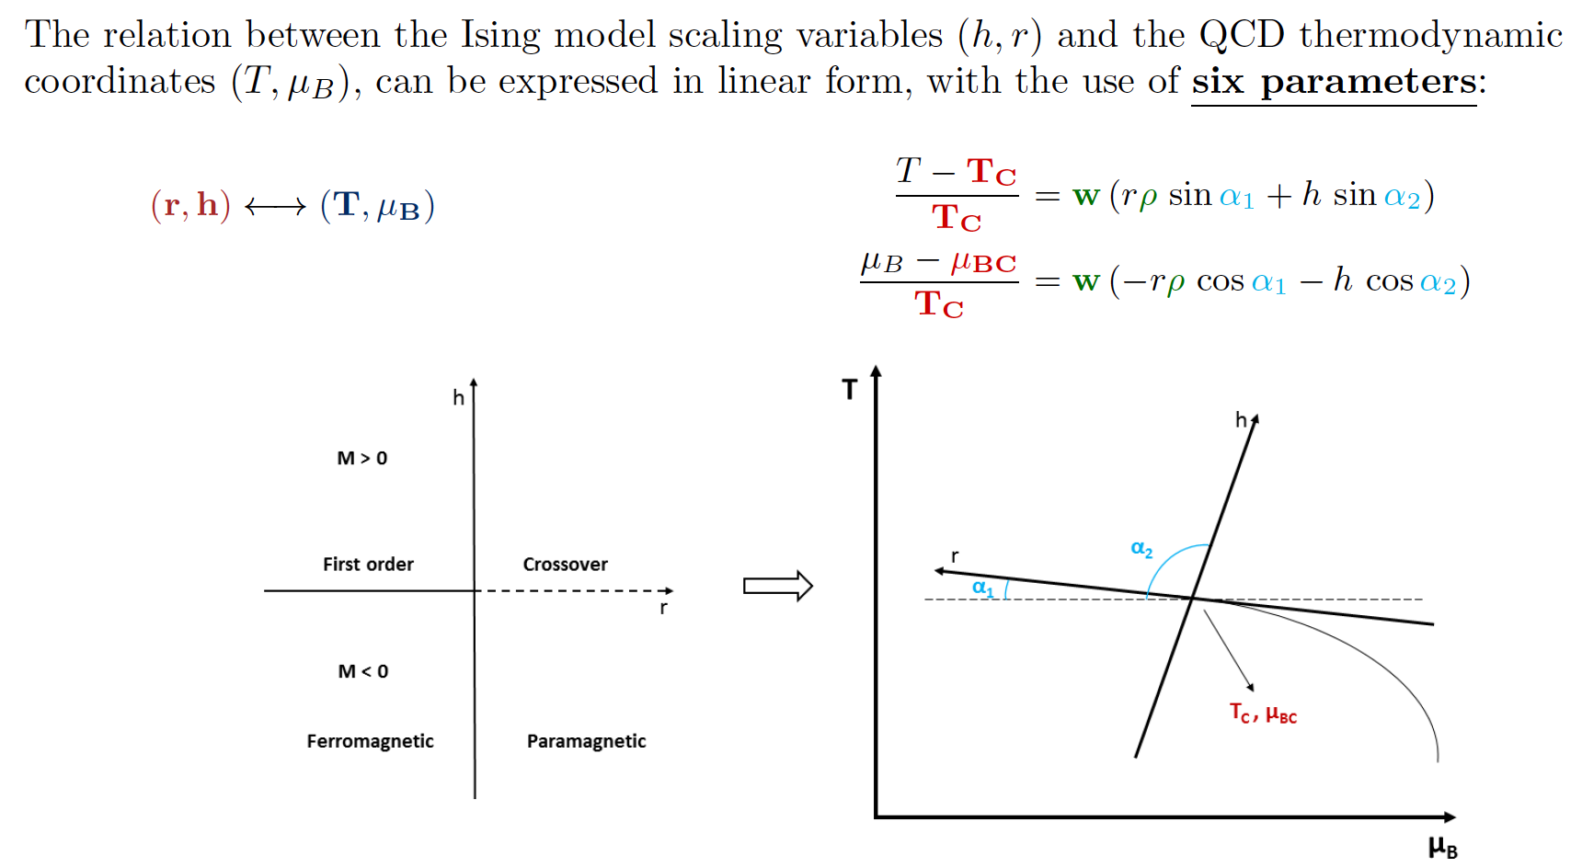
Map the phase diagram
Claudia Ratti
16/40

Slide 17
Map the phase diagram
Exploit the parametric nature of the EoS to constrain the values of the parameters:
Theoretical (a priori) arguments (i.e. require thermodynamic stability and causality)
Comparison (a posteriori) to future BES-II program experimental data
How is the choice of the parameters driven?
From Lattice QCD calculations: T_{C}<150 MeV, μ_{BC} >2T_{C}
place the critical point in the region of the phase diagram accessible to the BESII
we want to investigate the role of w and ρ
Claudia Ratti
17/40

Slide 18
Map the phase diagram
The number of free parameters is reduced:
Assume the shape of transition line is a parabola (good approximation at BES-like energies) → reduce to four parameters:
with the values T_{C}(μ_{B}=0)=155 MeV, κ=-0.0149.
For a chosen value of μ_{BC}, one gets
In the following:
Claudia Ratti
18/40

Slide 19
Critical pressure
Claudia Ratti
19/40

Slide 20
Expansion coefficients
Claudia Ratti
20/40

Slide 21
Expansion coefficients
Claudia Ratti
21/40

Slide 22
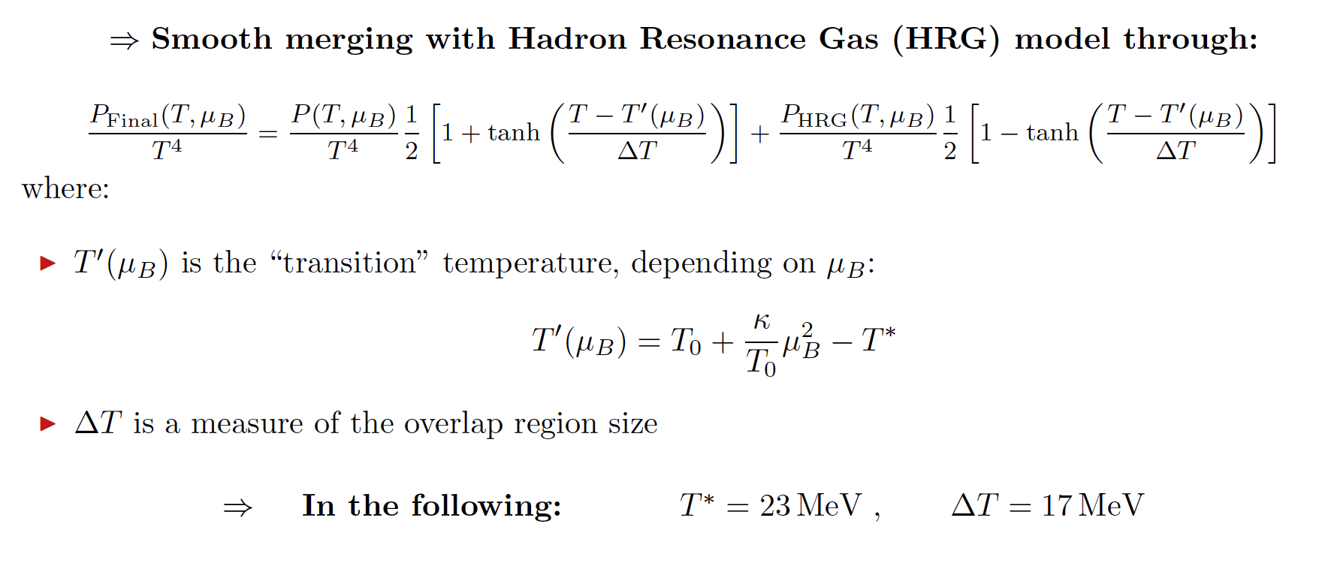
Merging with the HRG model at low T
Claudia Ratti
22/40

Slide 23
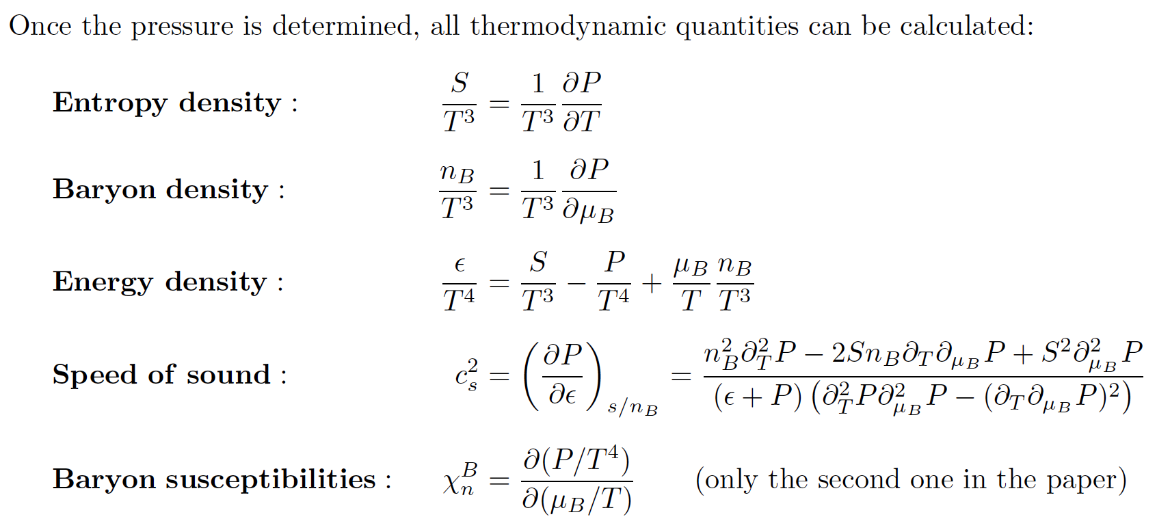
Final EoS: Thermodynamic quantities
Claudia Ratti
23/40

Slide 24
Final EoS: Pressure and Entropy Density
P. Parotto et al.,: PRC (2020)
Claudia Ratti
24/40

Slide 25
Final EoS: Baryon and Energy Density
P. Parotto et al.,: PRC (2020)
Claudia Ratti
25/40

Slide 26
Final EoS: Speed of sound and baryon number χ₂
P. Parotto et al.,: PRC (2020)
Claudia Ratti
26/40

Slide 27
Final EoS: isentropic trajectories
P. Parotto et al.,: PRC (2020)
Claudia Ratti
27/40

Slide 28
Final EoS: explore parameter space
Claudia Ratti
28/40

Slide 29
Behavior of the kurtosis
M. Stephanov, PRL (2011)
Motivation: predicted behavior of the kurtosis in the vicinity of the critical point:
This behavior was found considering the leading contribution to the kurtosis:
Claudia Ratti
29/40

Slide 30
Behavior of the kurtosis
P. Parotto, C. R. et al., PRC (2020)
We can now evaluate all contributions and see whether expected behavior still holds
The blue area corresponds to negative values
The blue area is pushed above the transition line
The dip is difficult to detect at the freeze-out
Claudia Ratti
30/40

Slide 31
Implications for the experimental measurement
P. Parotto, C. R. et al., PRC (2020)
Claudia Ratti
31/40

Slide 32
Strangeness-neutral EoS
Collaborators: Jamie Karthein, Angel Nava Acuna, Damien Price (UH), Paolo Parotto (University of Wuppertal), Debora Mroczek, Jaki Noronha-Hostler (UIUC)
New version of the code can be downloaded at:
https://bitbucket.org/bestcollaboration/eos_with_critical_point/src/master/
Claudia Ratti
32/40

Slide 33
New version
J. Karthein, C. R. et al., EPJPlus (2021)
Claudia Ratti
33/40

Slide 34
Taylor coefficients from lattice QCD
J. Karthein, C. R. et al., EPJPlus (2021)
Claudia Ratti
34/40

Slide 35
Lattice mode
J. Karthein, C. R. et al., EPJPlus (2021)
Claudia Ratti
35/40

Slide 36
Equation of state
J. Karthein, C. R. et al., EPJPlus (2021)
Claudia Ratti
36/40

Slide 37
Equation of state
J. Karthein, C. R. et al., EPJPlus (2021)
Claudia Ratti
37/40

Slide 38
Equation of state differences
J. Karthein, C. R. et al., EPJPlus (2021)
Claudia Ratti
38/40

Slide 39
Differences in isentropic trajectories
J. Karthein, C. R. et al., EPJPlus (2021)
Claudia Ratti
39/40

Slide 40
Conclusions
From lattice QCDTaylor expansionwe currently have the EoS for μ_{B}/T<2
We constructed a family of Equations of State containing a Critical Point in the 3D Ising model universality class to study its effect
The dip in the kurtosis is very difficult to observe at the chemical freeze-out
We recently extended the EoS to the case of strangeness neutrality
Claudia Ratti
40/40

