Slide 1
Machine Learning for High Energy Nuclear Physics
Long-Gang Pang (庞龙刚）
Central China Normal University
lgpang@mail.ccnu.edu.cn
The 17th RHIC-BES on-line seminar

Slide 2
What is machine learning
A collection of algorithms (PCA, SVM, Random Forest, Boosting Trees, Neural Network …) that let computer learn patterns from data by themselves.
Keywords: Data driven; Functional; Optimize; Software 2.0;
$Minimize loss\left[f\left(x, θ\right), y\right]→f$
Traditional
Machine learning
Input
Input
output
Program
computer
computer
Program
Output

Slide 3
Applications of machine learning

Slide 4
ML for Higgs Boson
In May 2014, ATLAS held Kaggle competition: Higgs Boson Machine Learning Challenge
Goal: distinguish Higgs signal from exotic background
The winner uses ensemble of neural networks
In this competition, TianQi Chen and Tong He developed XGBoost, which became the most popular ML tool on Kaggle!
Boosted trees and deep neural network are the most frequently used ML tools in HEP.
Higgs Boson Discovery with Boosted Trees. TQ Chen and T He, HEPML 2014

Slide 5
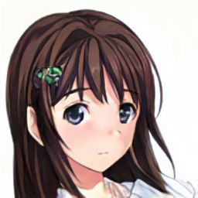
A single decision tree
Black Hair
Task: Asian girl?
Y
N
Black Eyes
Y
N
Score: 0.1
Score: 2
Score: 0.5
Splitting nodes are chosen to minimize the MSE, entropy or Gini factor.

Slide 6
Ensemble of trees: random forest (in parallel)
Tree 1
Tree 2
Tree 3
Black
Hair
Speak Chinese
Live in China
Score: 3
Score: 2
Score: 5
IsAsian( ) = 3 + 2 + 5
Low variance

Slide 7
Ensemble: boosted decision tree (in sequential)
Tree 1
Tree 2
Tree 3
Black
Hair
Speak Chinese
Live in China
Score: 2
Score: 3
Score: 5
Low bias.
Improve the tree by training residual of the previous tree.

Slide 8
$t\overline{t}H$ identification using boosted decision tree (BDT)
Motivation: the coupling between the heaviest SM particle top quark and Higgs is important for tree level top Yukawa coupling.
ATLAS use XGBoost to look for top associated Higgs.
Signal: $t\overline{t}H, H→γγ$
Noise: $t\overline{t}γγ,$continuous gamma and non $t\overline{t}H$ Higgs events.
ATLAS-CONF-2019-004

Slide 9
Higgs identification using deep learning
Signal
“Our analysis shows that recent advances in deep learning techniques may lift these limitations by automatically discovering powerful non-linear feature combinations and providing better discrimination power than current classifiers – even when aided by manually-constructed features.”
Background
P.Baldi,P.Sadowski,& D.Whiteson, Nature Commun.5, 4308 (2014)

Slide 10
What is deep neural network
DNN: artificial neural network with multiple hidden layers

Slide 11
How does deep neural network learn: back propagation

Slide 12
Convolution Network
1D convolution
Densely connected
Locally connected
Locally connected
and sharing weights

Slide 13
CNN for jet tagging

Slide 14
Point Cloud in momentum space

Slide 15
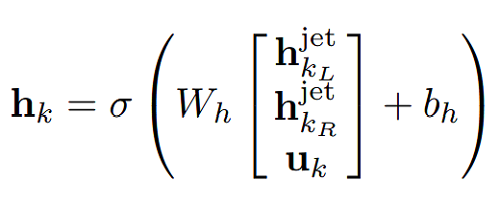
Recurrent and Recursive network for q/g jet tagging
Gluon Jet
Quark Jet
Recurrent Net
Recursive Net
[G. Louppe, K. Cho, C. Becot, K. Cranmer, arXiv: 1702.00748;
Taoli Cheng, Comput Softw Big Sci (2018) 2: 3

Slide 16
Permutation symmetry: Particle/Energy flow network
FCN, RNN, RcNN all break the permutation symmetry
JHEP 2018, 13, P.T. Komiske, E.M. Metodiev, and J. Thaler. 1810.00835 by Y.S. Lai

Slide 17
Dynamical Graph CNN – more local structure
Arxiv:1801.07829.

Slide 18
Jet tagging via ParticleNet
Edge Conv
Key Idea: kNN + Edge Conv + PointCloud Net
Better with PID
Jet Tagging via Particle Clouds, HuiLin Qu and Loukas Gouskos, 2020

Slide 19
ML for Heavy Ion Collisions
Many parameters contribute to the same observable
How to constrain one physical parameter?
Information survived?
Encoded in final state?
How to decode?

Slide 20
Bayesian analysis
Walk in parameter space of physical model.

Slide 21
Constrain QCD EoS
PRL114, 202301 Scott Pratt, Evan Sangaline, Paul Sorensen, and Hui Wang

Slide 22
Constrain shear and bulk viscosity
PRC 94.024907, J. E. Bernhard, J. Scott Moreland, S. A. Bass, J. Liu, U. Heinz

Slide 23
Constrain heavy quark diffusion coefficient
PRC. 97 (2018), 014907, Yingru Xu, J.E. Bernhard, S.A. Bass and M. Nahrgang and S.S. Cao

Slide 24
Constrain Jet energy loss distribution
PRL2019, Yayun He, L.G. Pang and X.N. Wang

Slide 25
CNN for QCD Phase transition: E-By-E classification
Nature Communications 2018, LG. Pang, K.Zhou, N.Su, H.Petersen, H. Stoecker, XN. Wang.

Slide 26
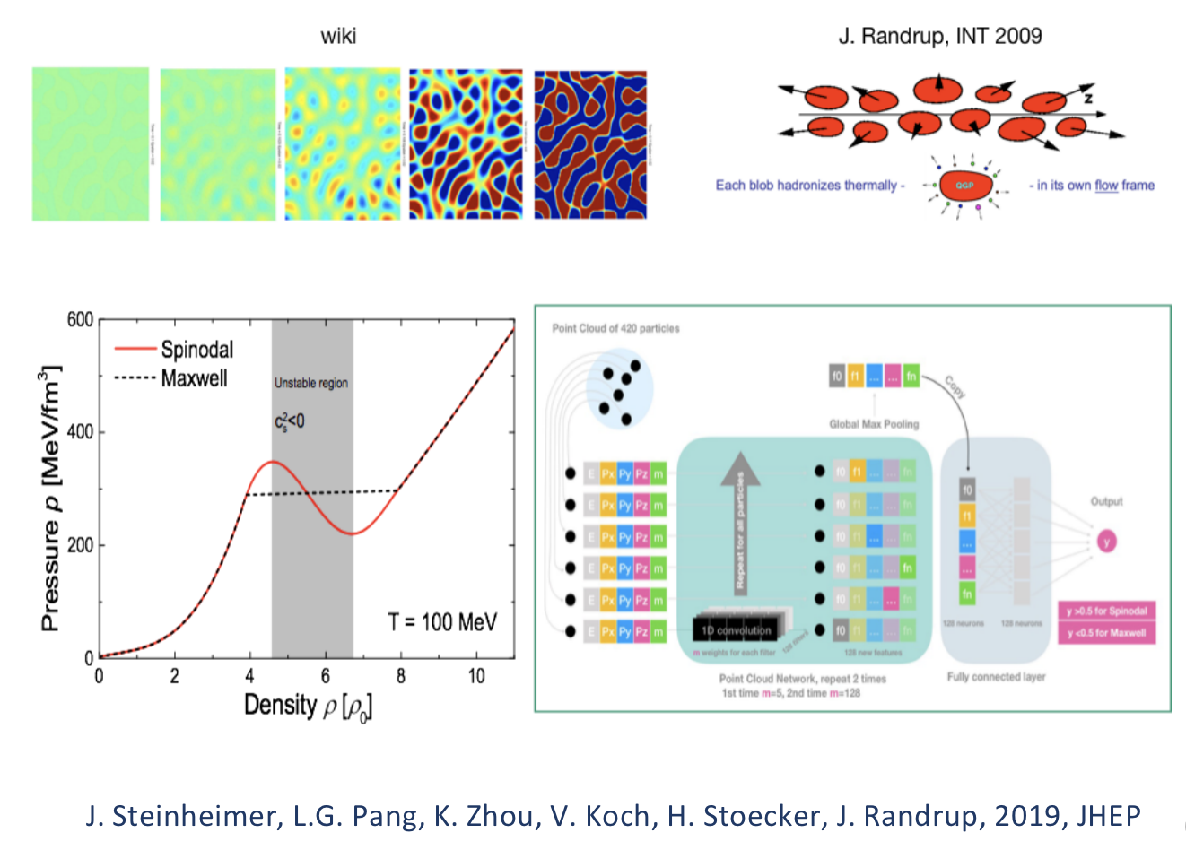
Point cloud network for QCD EoS

Slide 27
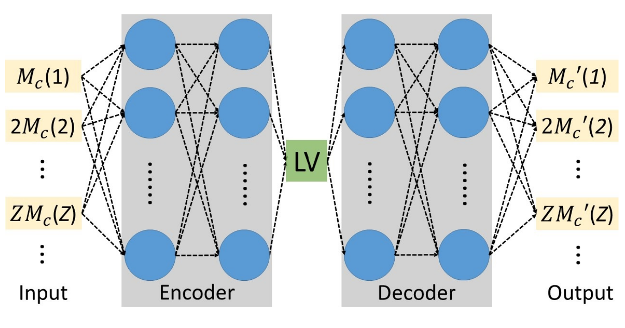
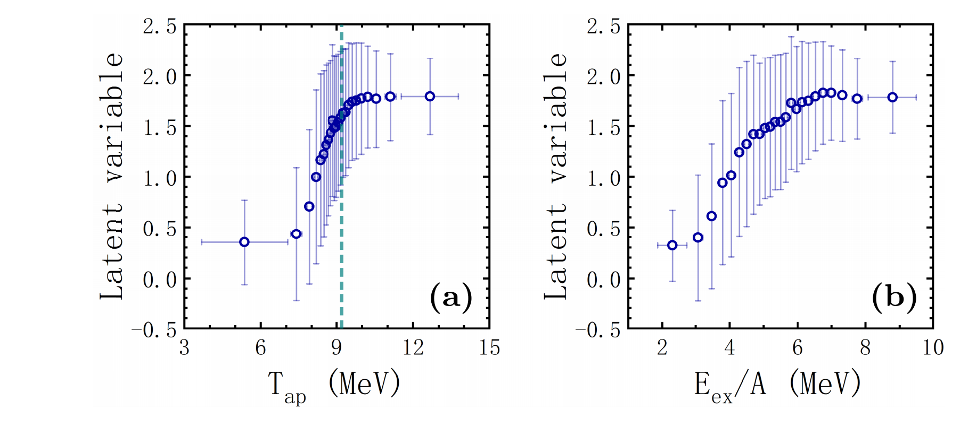
Nuclear Liquid Gas phase transition
Unsupervised Learning: Auto Encoder to reconstruct
the data using a bottle-neck network structure.
The learned Latent variable (LV) classify events with low
temperature from high temperature regions.

Slide 28
Stacked U-net for relativistic hydrodynamics
arXiv: 1801.03334; NPA2018, H.Huang, B.Xiao, H.Xiong, Z.Wu, Y. Mu and H.Song

Slide 29
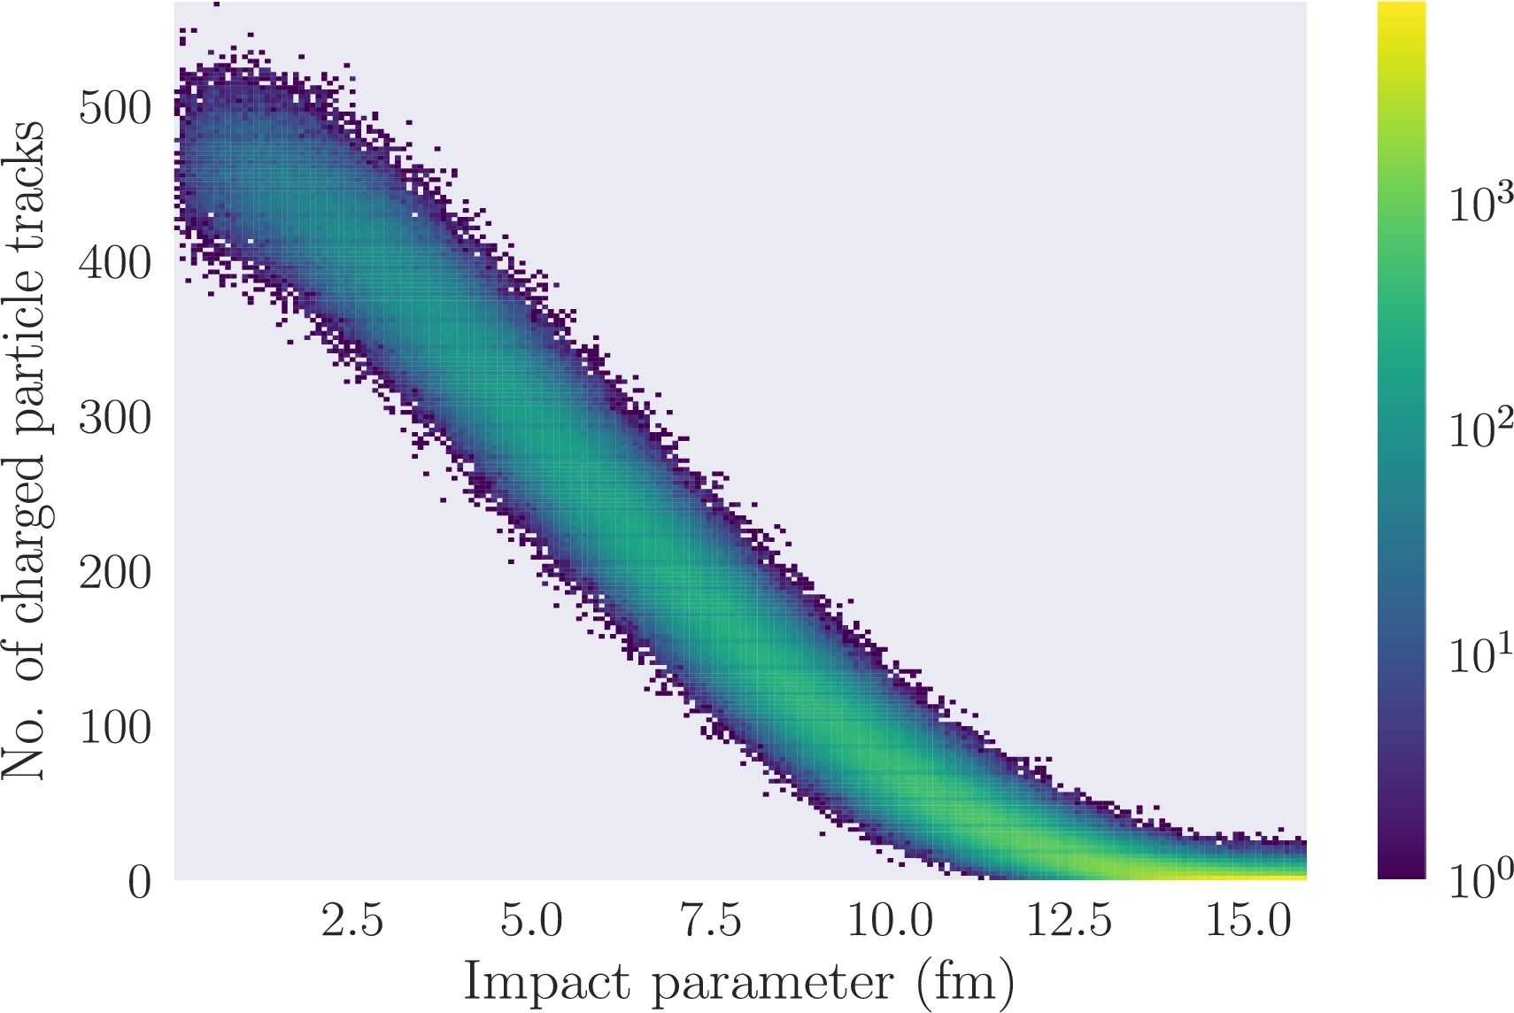
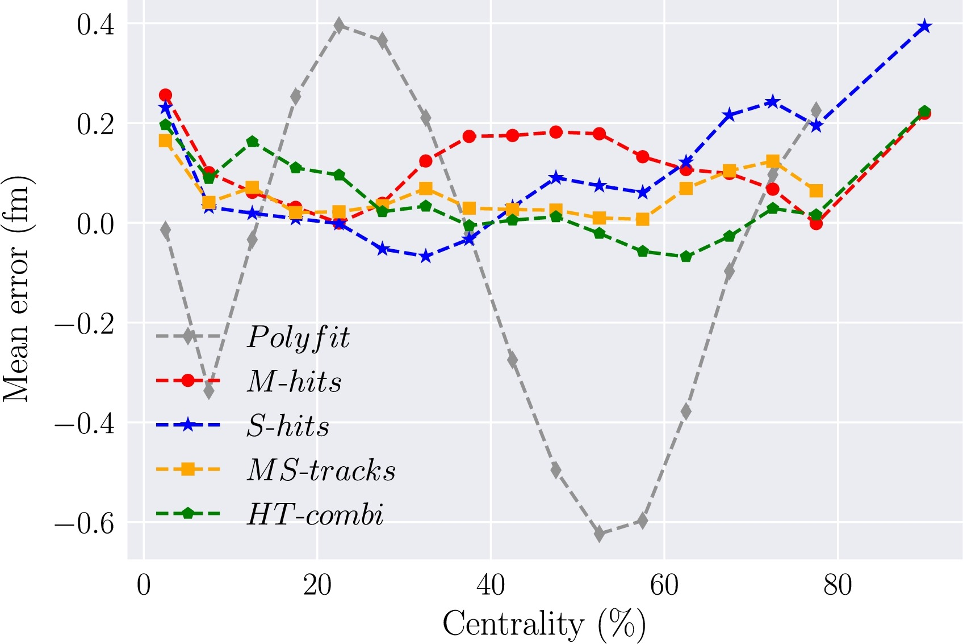
Point Cloud Net for impact parameter determination
See also: 2008.11540 by Fupeng Li, Yongjia Wang, Hongliang Lv, Pengcheng Li, Qingfeng Li, and Fanxin Liu

Slide 30
Uncertainty
K-fold Cross validation
Split data into K groups
Train with K-1 groups
Get K validation accuracy
The uncertainty is the standard deviation of the K models
Cons: training deep neural networks is computing intensive

Slide 31
Bayesian Neural Network

Slide 32
Monte Carlo dropout
Switch on dropout at testing stage to get an ensemble of networks.

Slide 33
Interpretable ML: global explanation
Global interpretation: staring with empty picture, visualize
what has been learned by each neuron using gradient ascent.

Slide 34
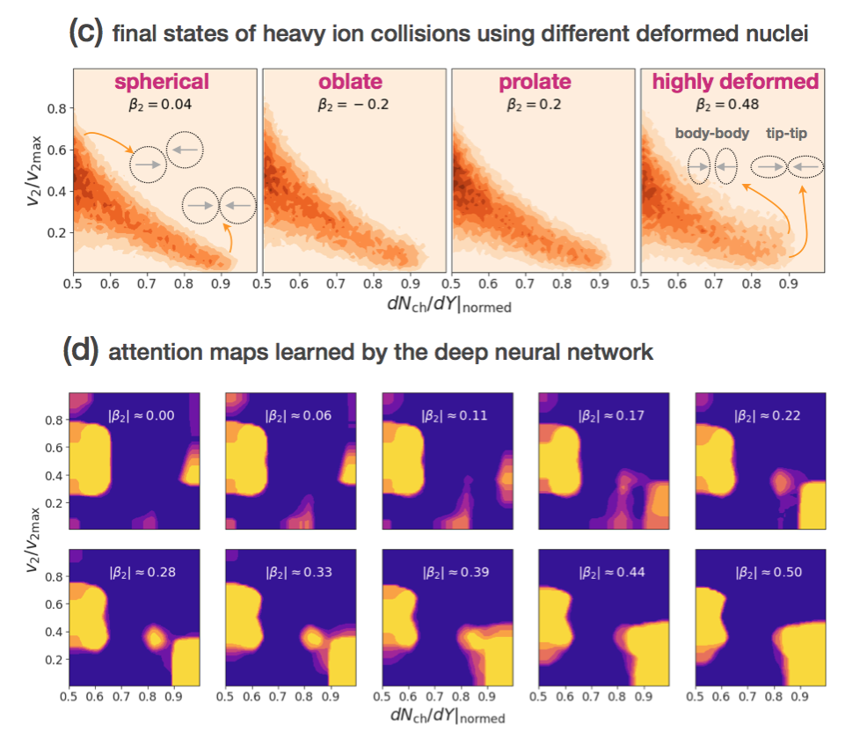
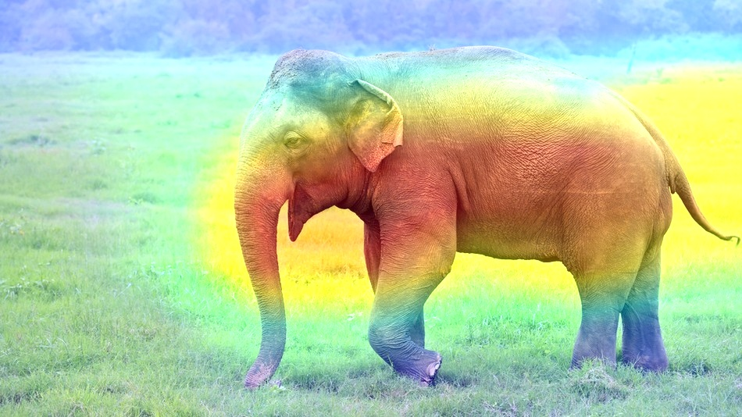
Interpretable ML: local explanation
LIME; Surrogate; Activation map; Layer-wise relevance propagation, attention
arXiv:1906.06429, L.-G. Pang, K. Zhou and X.-N. Wang

Slide 35
Summary
ML plays important role in HEP and HIC
ParticleNet/GCNN might be the way for particle cloud
What has not been mentioned
PCA
Attention network
Capsule network
BDT, GAN and Flow models for high dim numerical integration
Various applications in detector design, pileup mitigation and event(track) reconstruction
The topics are selected and biased by the limitation of personal knowledge

Slide 36
Backups

Slide 37
DeepJet to identify jets originating from b quarks
CMS-DP-2018-058
IHEP： DeepJet
DeepJet performs better than the previous widely used DeepCSV
DeepCSV: 4 hidden layer fully connected network, 100 neurons per layer

Slide 38
Graph CNN for boosted Higgs reconstruction
Reconstructed $m_{H}$ from GCN
is closer to 125 GeV
Fake signal
suppressed
$$p_{T}\left(H\right)>300 GeV$$
2003.11603, X. Ju et al.; 2010.05464, Jun Guo, Jinmian Li, and Tianjun Li;

Slide 39
Recurrent net for MRPC and RPC time resolution regression
Input: RPC waveforms (18 ns * 4 channels * 2)
Network structure:
3-layer LSTM (hidden size ~700)
3-layer MLP in series
1-dim output: ToF_predict
XiangYu Xie, USTC
Talk: 2020-11-07

Slide 40
Quantum Machine Learning
Huge Hilbert space
Before measuring, the states are in quantum parallel
Period of quantum interference can be measured
No classical correspondence for entanglements
Feynman: simulate one quantum system with another
Quantum Machine learning: the best of two worlds

Slide 41
Quantum Machine Learning: QSVM
Many quantum machine learning algorithms are inspired by variational quantum eigen solver.
S. L. Wu and C. Zhou (U. Wisconsin) 40th International Conference on High Energy Physics July 28, 2020

Slide 42
Quantum GAN
Generative Adversarial Network (GAN) is quite successful in image and video generation.
GAN is used as fast emulator of MC event generators (GEANT4).
Real Quantum Generator!

