Slide 1
核结构研究的RHF/RHFB理论
龙文辉
兰州大学核科学与技术学院

Slide 2
OUTLINE
Introduction: basic concept, frontiers, challenges
RHF/RHFB theories:
General formalism, with spherical and axial symmetries
Pseudo-spin symmetry: In-medium effects
Tensor force: Relativistic form, tenor effects
Magicities: New magicity in Calcium isotopes
Conclusions and perspectives

Slide 3
Introduction
Frontiers and challenges
Ingredients of a nuclear model
Brief introduction of RHF models

Slide 4
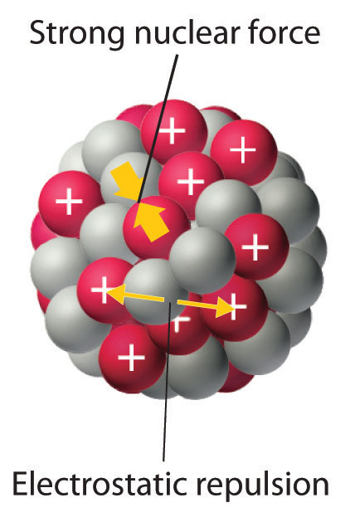
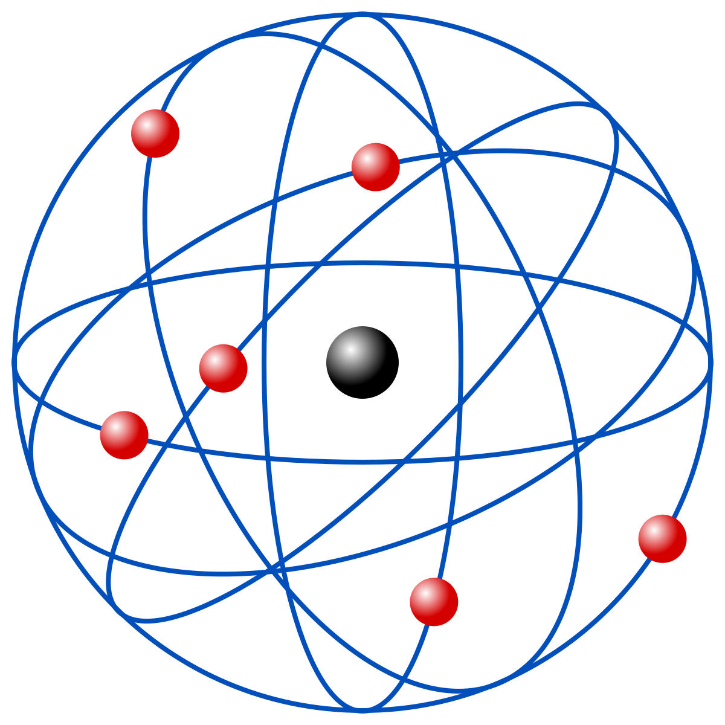
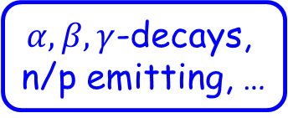

Knowledge about the nucleus
Microscopic quantum many-body self-bound system
10⁻¹⁵ m
Strong, weak, electro-magnetic interactions
${10}^{−10}$ m
More than 2000 nuclides have been discovered with precise mass data, less than 300 naturally exist on the earth.
Nuclides may decay, can be excited, have similar shell structure as atom
$α, β, γ$-decays,
n/p emitting, …
Rotation, vibration,
Spin-isospin ex., s.p. ex., …
Magicity, superfluid, …

Slide 5
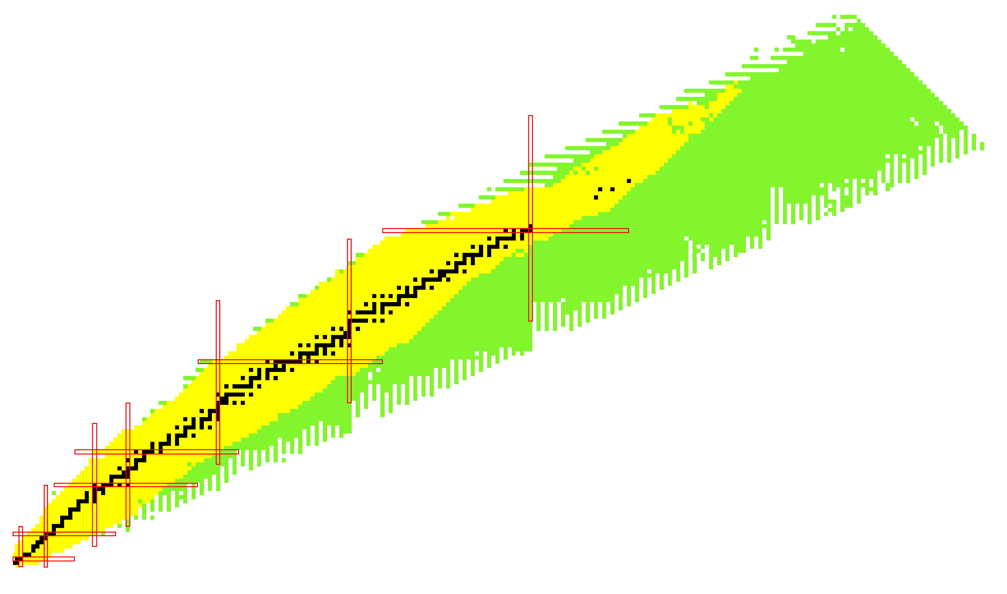
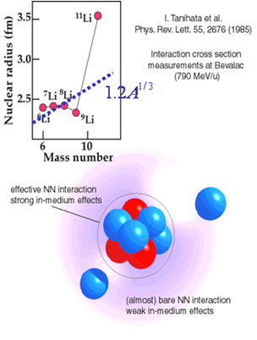
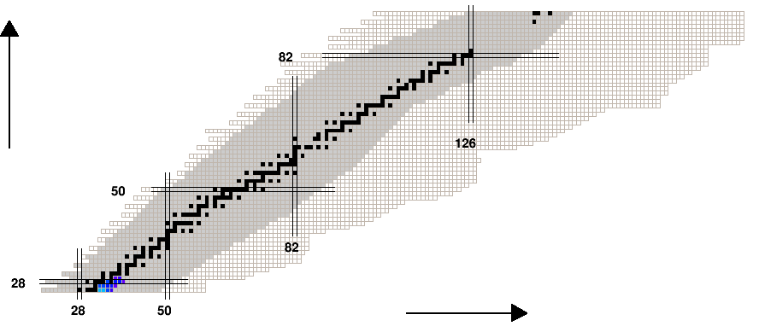
Unstable Nuclei: the Frontier
~270 stable nuclei ➔ several thousand unstable ones
Halo in ¹¹Li
Stable Nuclei
Unstable Nuclei
β-衰变
Many Unstable nuclei are involved!
中子俘获

Slide 6
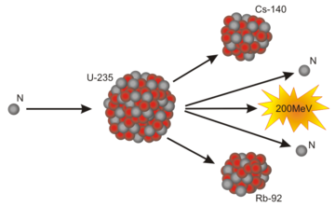
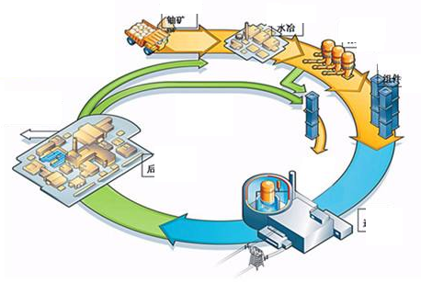
Unstable Nuclei: Applications
Nuclear energy from ²³⁵U
Long life-time radioactive nuclides remain
complicated Spent Fuel Reprocessing and Nuclear Waste Disposal
Closed Nuclear Fuel Cycle: Isotope transmutation ➔ Unstable nuclei
Reaction cross section
Decay properties
Structure, etc.
β-衰变
中子俘获
Most of the Unstable nuclei have not been synthesized yet

Slide 7
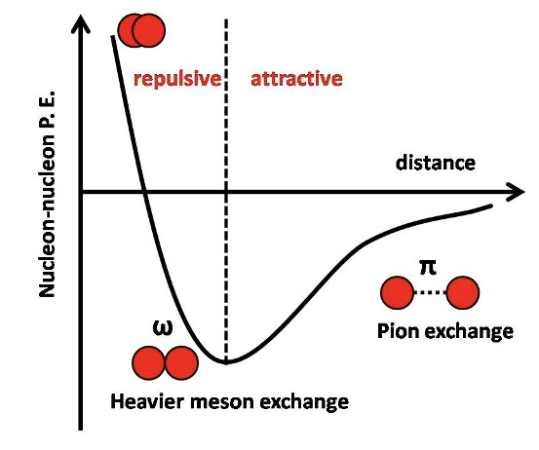
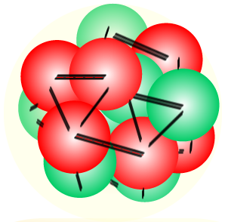
Nuclear Model
We can proudly say that we knew much about nuclides, while we have to admit that many things about nucleus we do not know.
Nuclear Many-body method
Nuclear Force
Nuclear Theoretical model

Slide 8

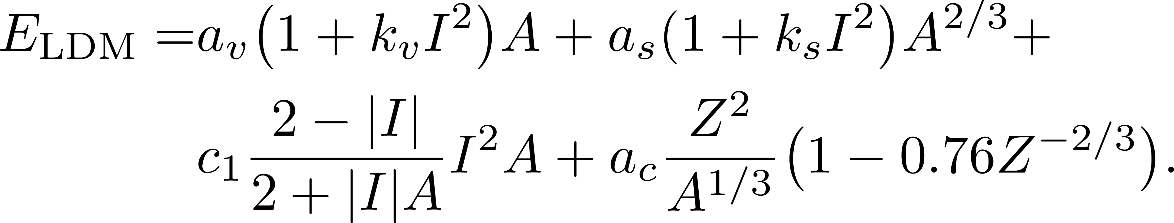
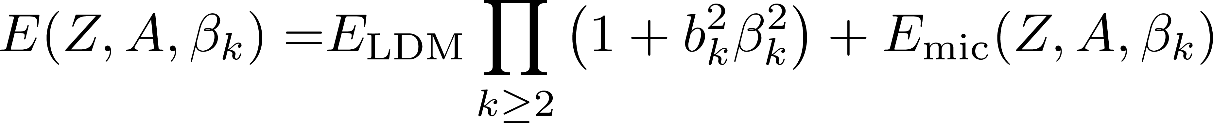
LDM for Nuclear Mass
Liquid droplet model (LDM):
Uniform charged droplet
Volume
Surface
Liquid droplet
Symmetry
Coulomb
Generalized macro-micro model
Shell corrections, etc.
Precision on describing nuclear mass can reach ~ 300 keV
N. Wang (Guangxi Normal Univ.)

Slide 9
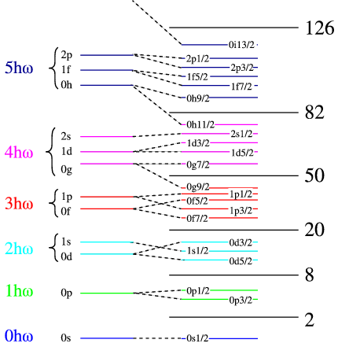
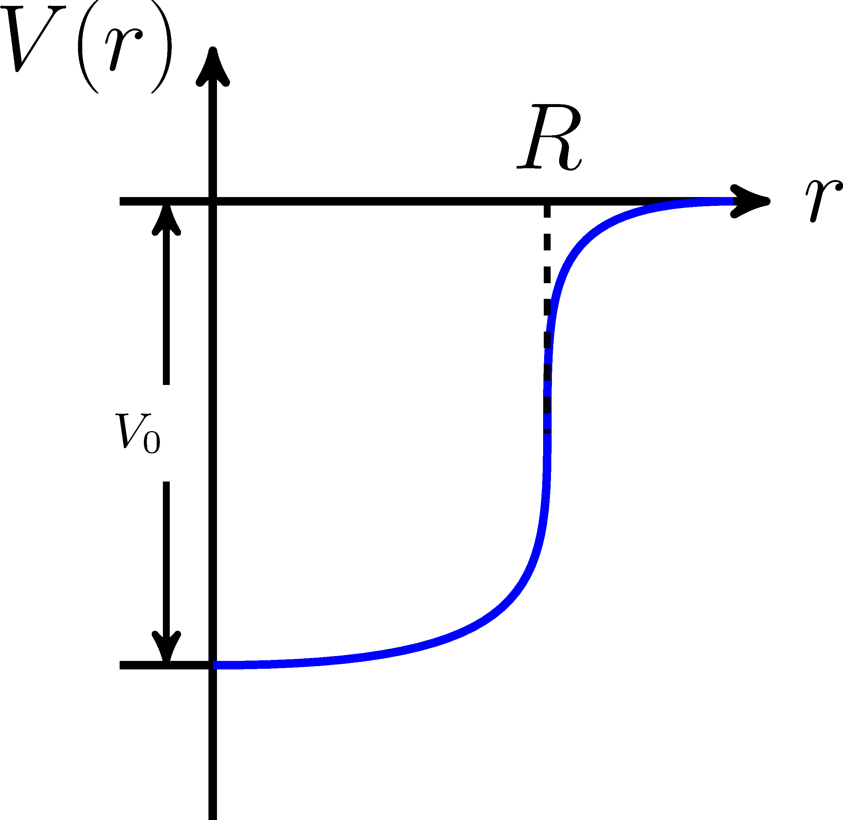
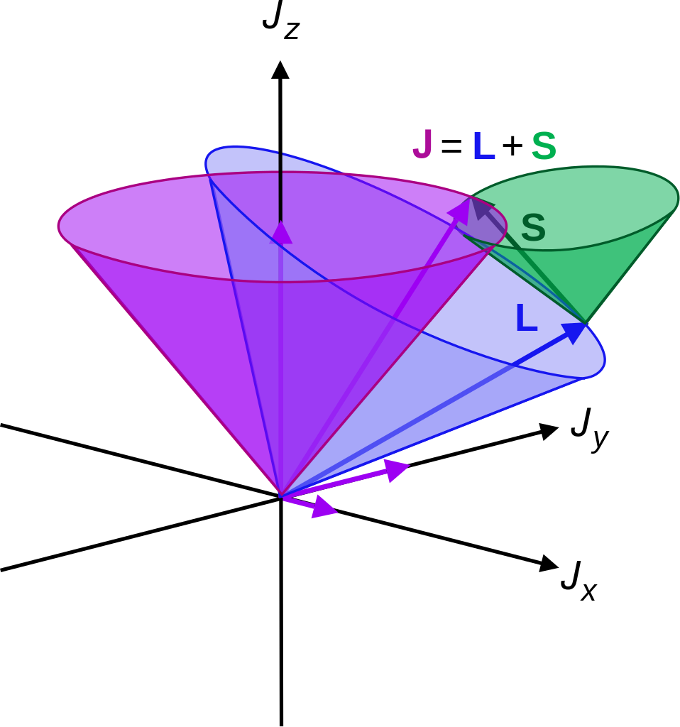
Shell model: single particle motion
Microscopic picture of nucleus
Nucleon moving independently in the mean field originated from the others.
Mean field potential
Spin-orbit coupling

Slide 10
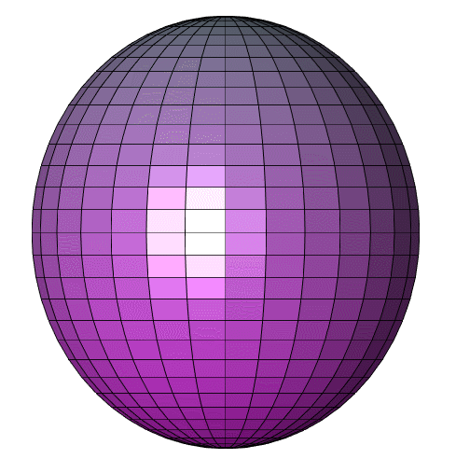
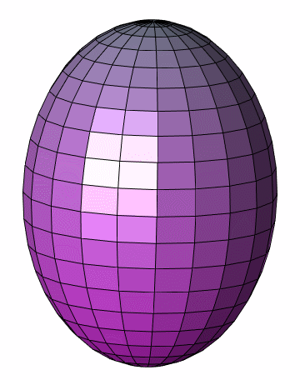

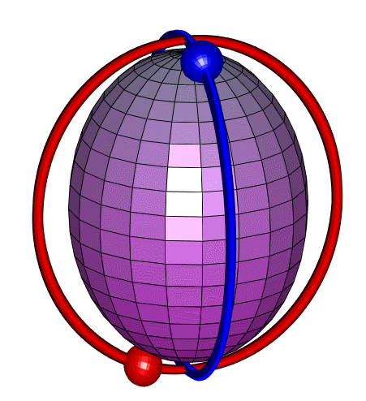
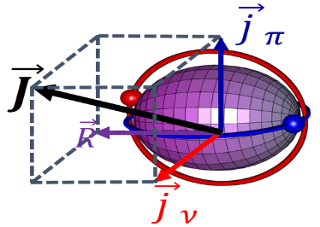
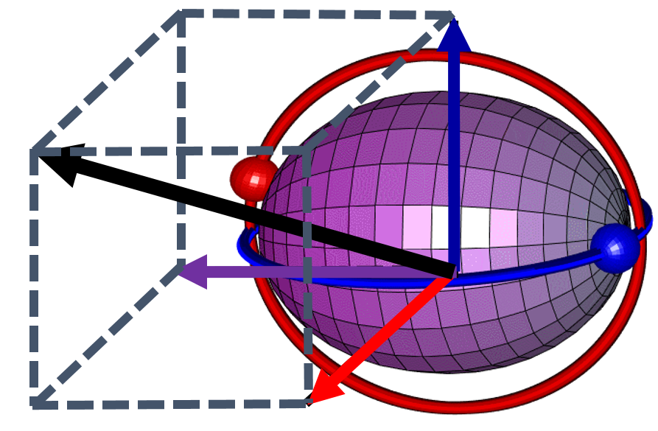


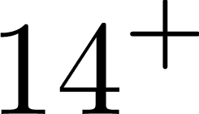


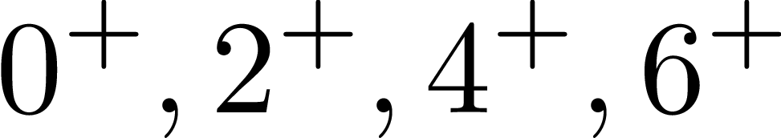
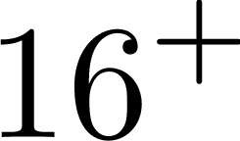








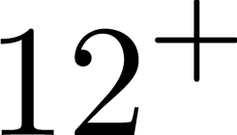
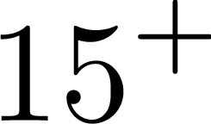

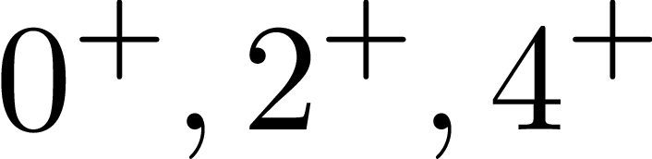

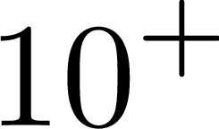
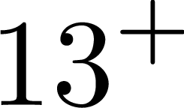

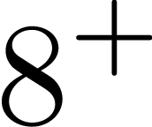

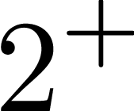
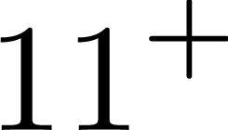
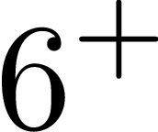
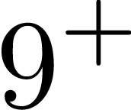
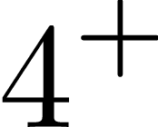
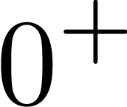
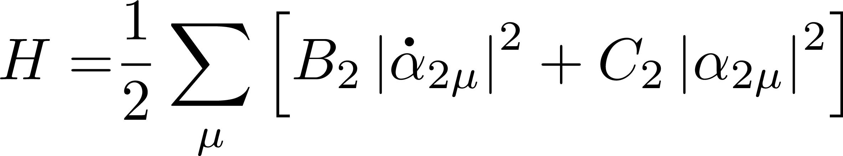
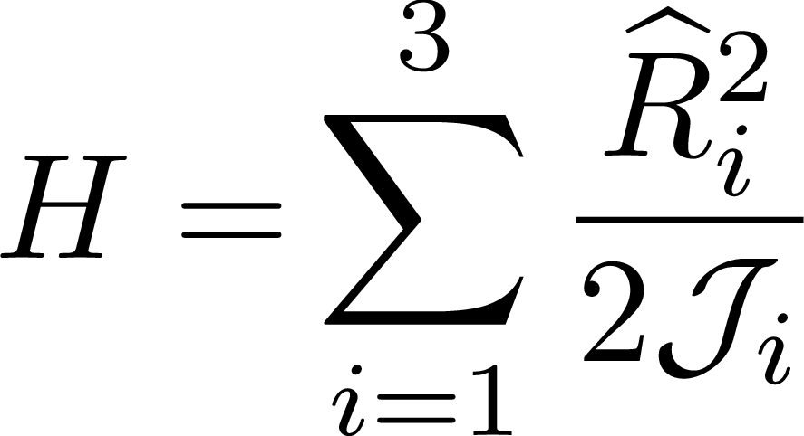
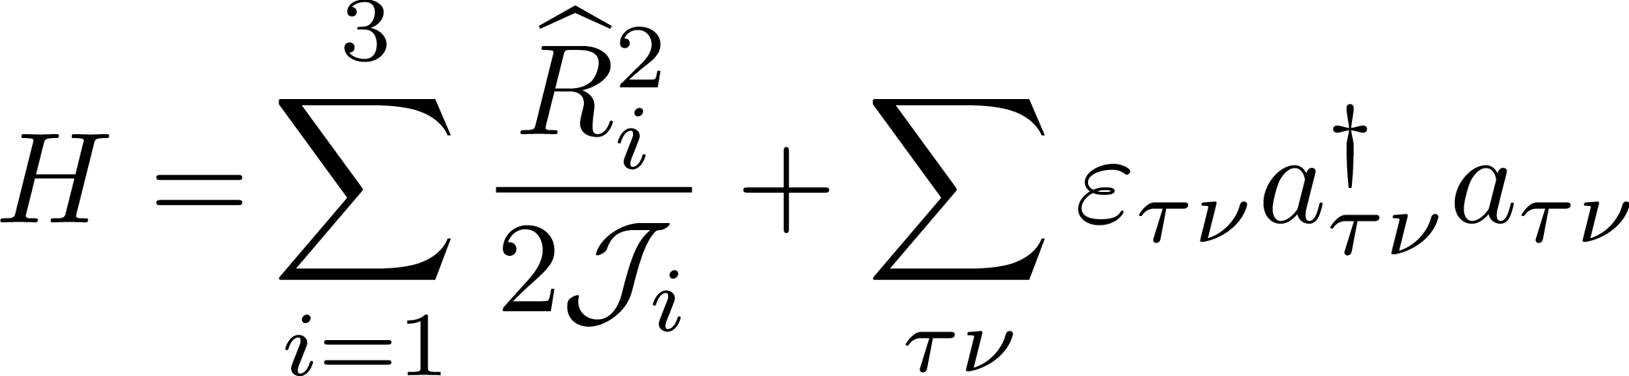
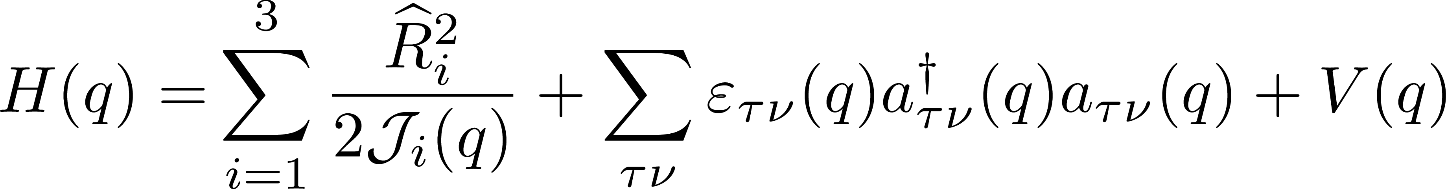
Collective model: rotation and vibration
vibration
Rotation
Chiral Rotation
Multi-Chiral Doublets
Bohr & B. Mottelson
Interpretation
Frauendorf & Meng
NPA 617, 131 (1997)
Meng, Peng, Zhang, Zhou
PRC 73, 037303 (2006)

Slide 11
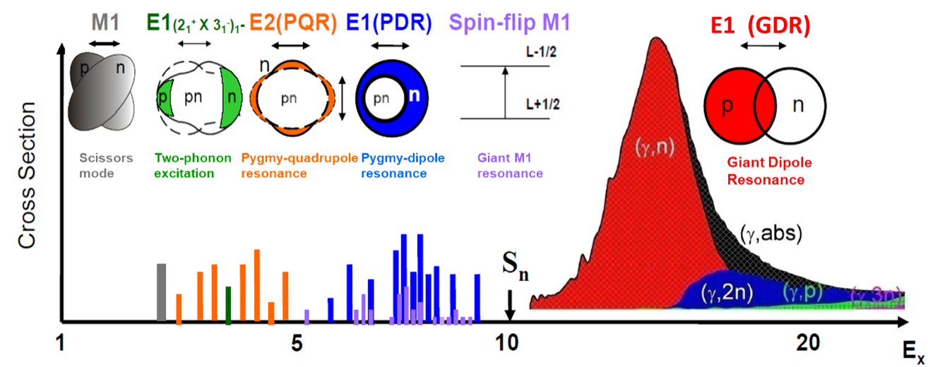

Resonances: beyond mean field effects
Beyond mean field effects are called:
time-dependent Hartree-Fock method, random phase approximation (RPA), particle vibration couplings (PVC), angular momentum projection, generate coordinate method (GCM), …

Slide 12
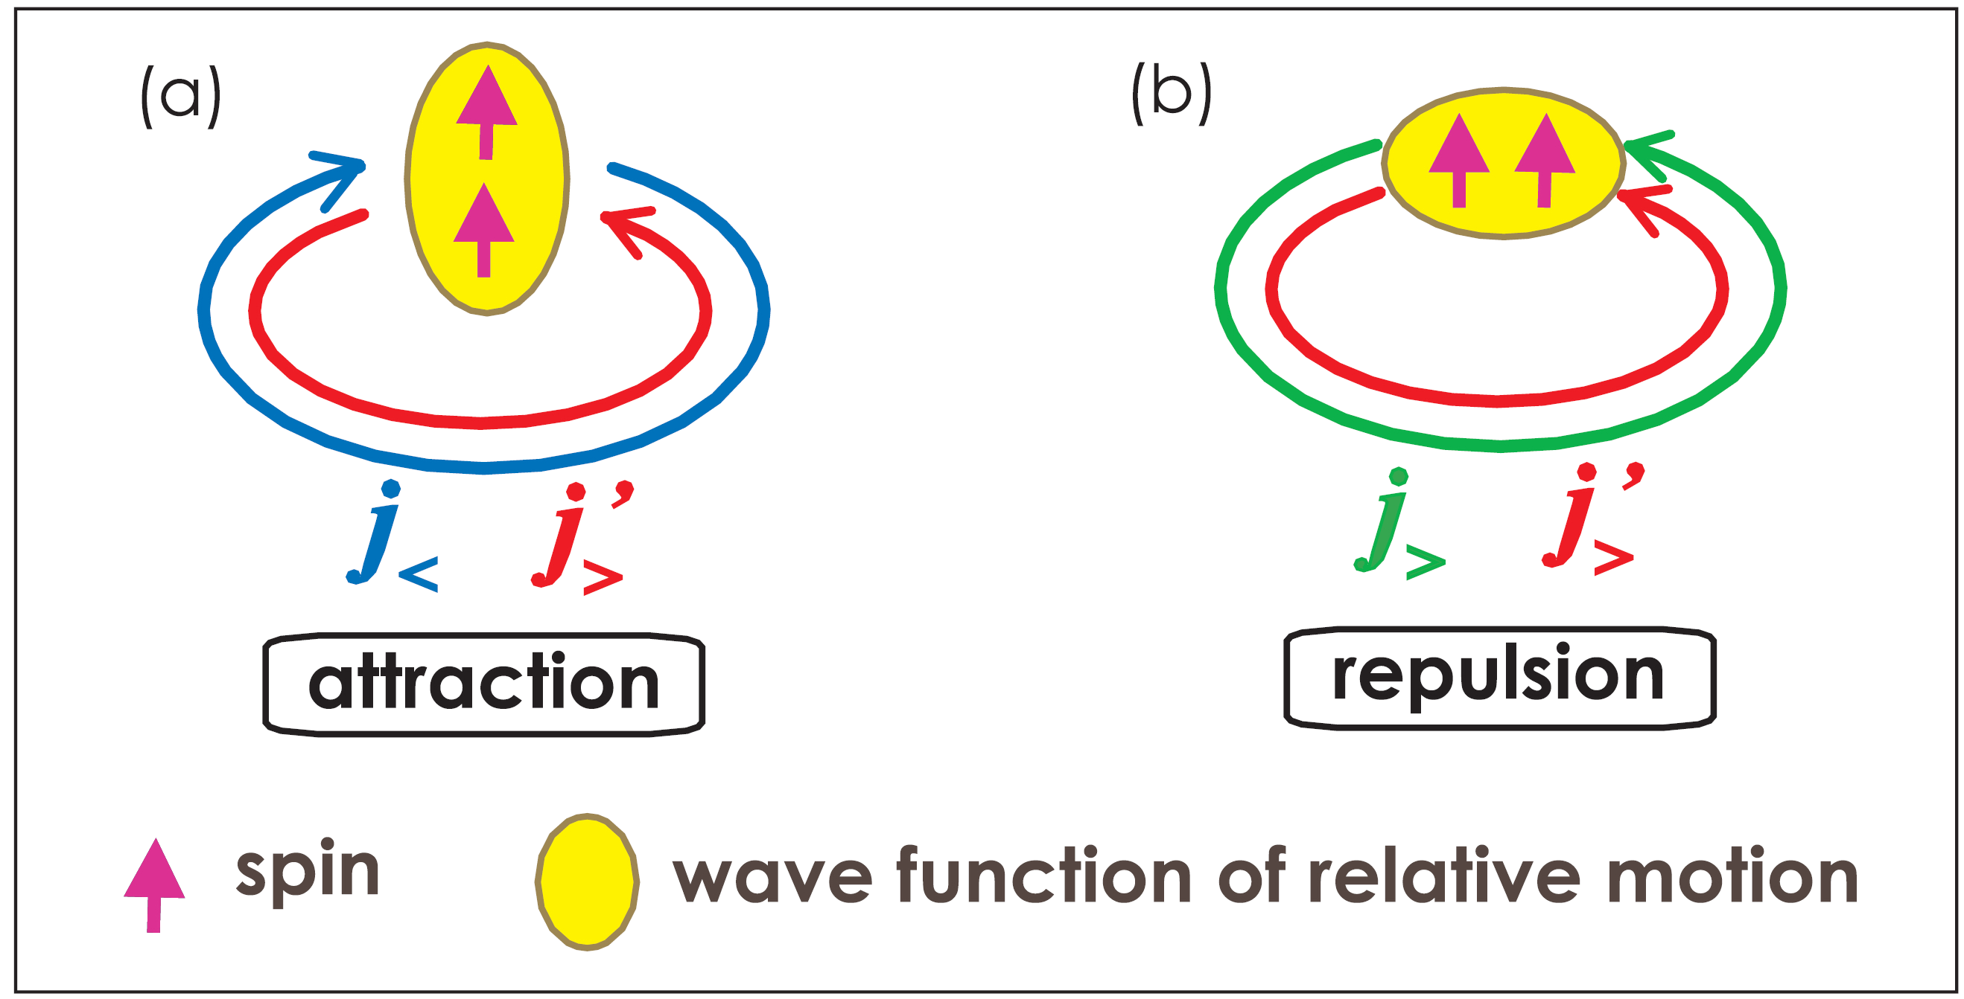
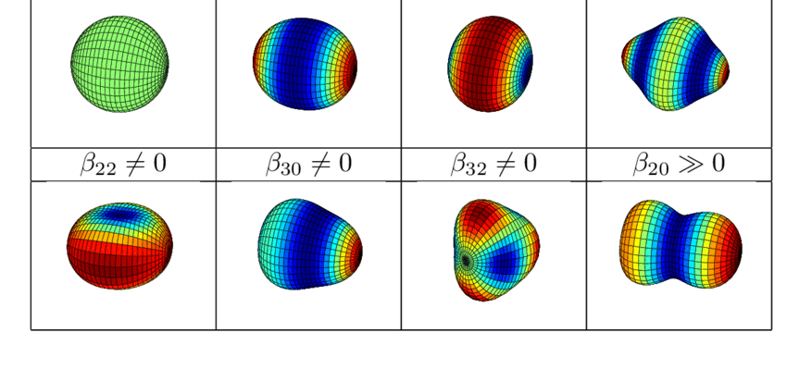
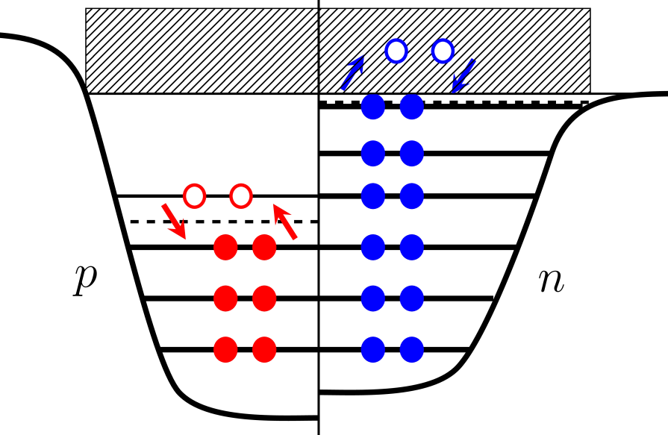

Challenges from unstable nuclei
Unstable nuclei
Tensor force
Deformation
Nuclear Many-body method
Nuclear Force
Nuclear Theoretical model
Continuum
Pairing Correlation
Axially deformed RHF/RHFB theories for unstable nuclei
Relativity, Hartree-Fock approach, Bogoliubov transformation, deformation

Slide 13
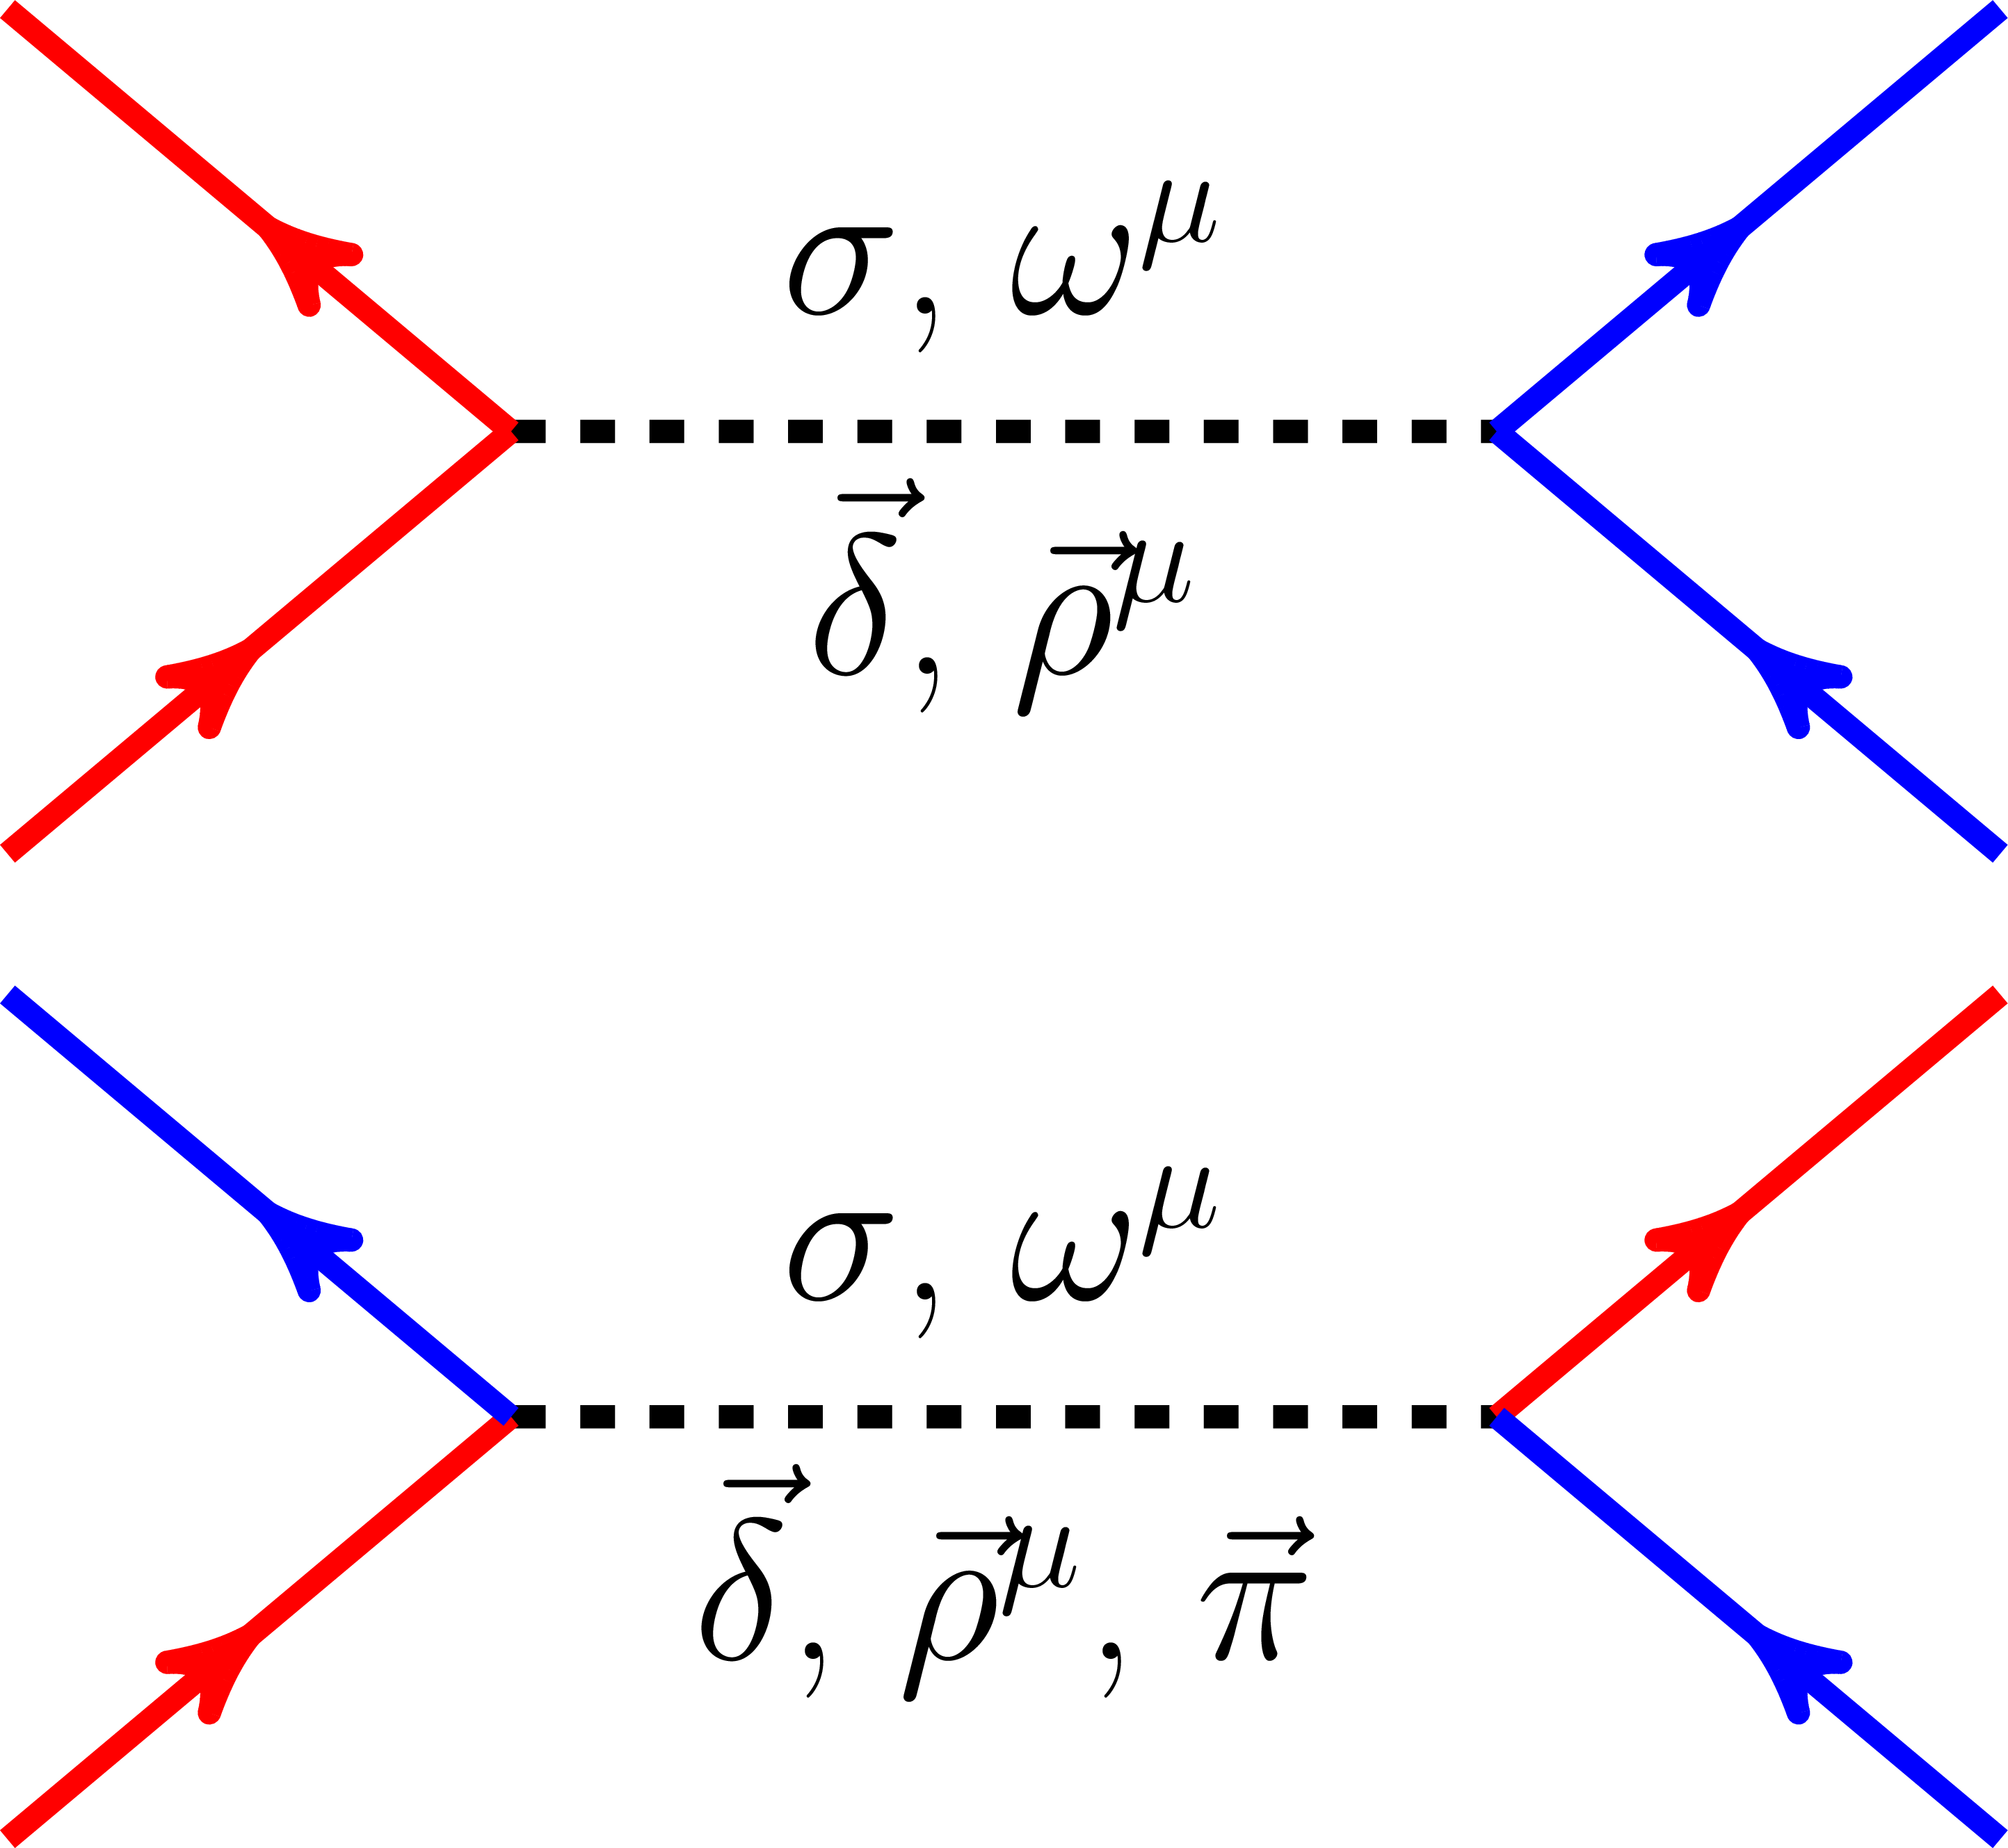
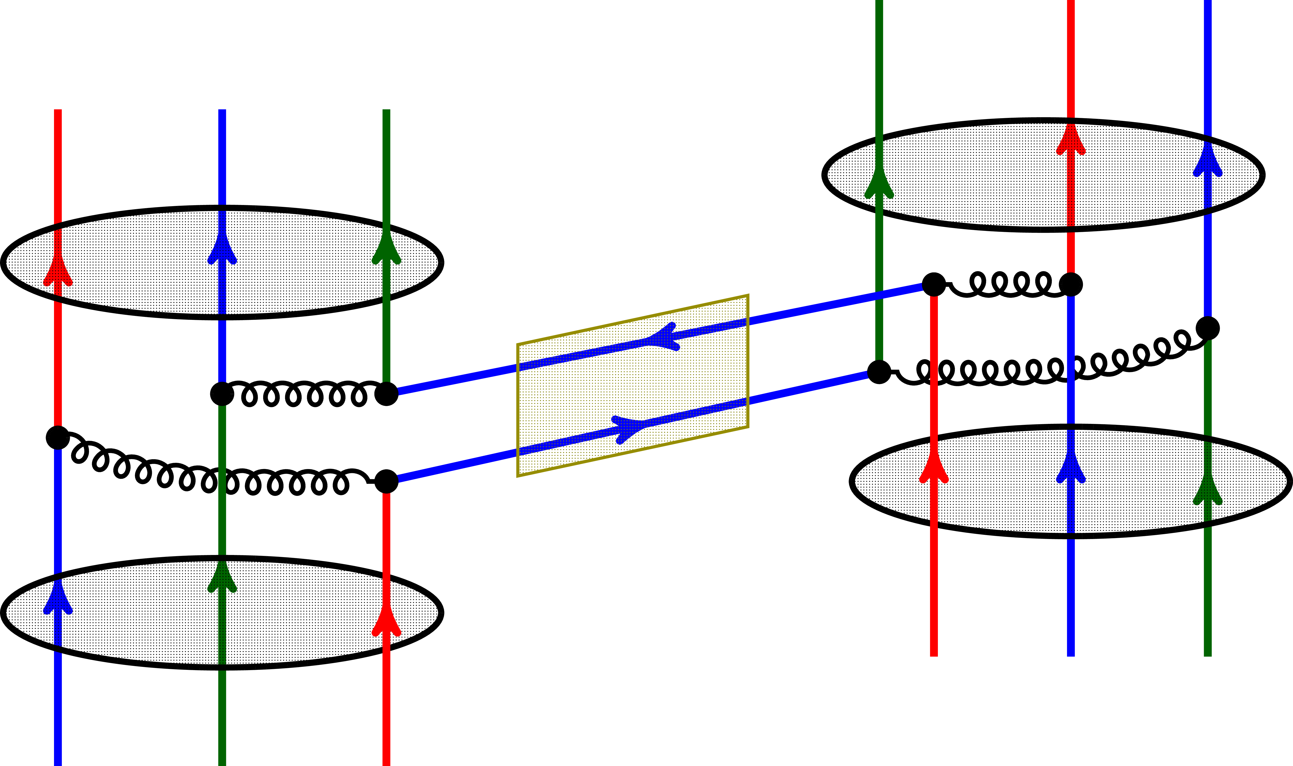
Why utilizing relativistic scheme?
Meson propagated nuclear force:
Hartree terms
基态
Fock terms
Yukawa (1935)
It is nature to express the meson-exchange picture of nuclear force
Degree of freedom associated with spin is naturally considered.
Nucleon is Dirac spinor field
Natural spin-orbit couplings
Origin of spin & pseudo-spin symmetry

Slide 14
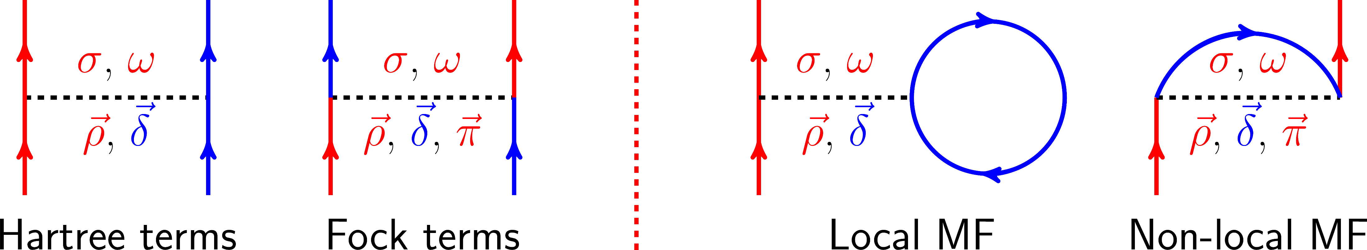
Relativistic Hartree-Fock approach
Relativistic mean field (RMF) model: Hartree terms only
Walecka(1974), Serot(1986), Reihard(1989), Ring(1996), Bender(2003), Meng(2006)……
  Natural spin-orbit couplings, saturation mechanism, simple, …
  Missing D.o.F related to tensor force, e.g., π-PV, ρ-T, …
Relativisitc Hartree-Fock (RHF) model: Fock terms are implemented
  Bouyssy (1987), Bernardos (1993), Shi (1995), Marcos (2004), Long (2004-2021), ……
  Maintain advantages of RMF model except simplicity, Tensor force, …
  Complicated non-local MF, not ab initial, …

Slide 15


Progress of RHF model
From stable to unstable nuclei
Nonlinear self-coupling of $σ$-meson (1993) and scalar field ($\overline{ψ}ψ$) (2004)
RHFB theory for unstable nuclei is implemented
Axially deformed RHF/RHFB theory
PRC 48, 2665 (1993); JPG 30, 703 (2004)
PRC 81, 024308 (2010)
PRC 101, 064302 (2020)
Model accuracy improved, while not comparable with RMF
Systematic applications were performed since then
Spherical DWS base is utilized
1993
2004
2010
2020-now
1987
1995
2006-2008
2011
First application
Density dependence considered
DDRHF model with PKOi (i=1, 2, 3)
Axially deformed RHFB with oscillator base
PRC 36, 380 (1987)
PRC 52, 144(1995)
Long (2006-2008)
PRC 83, 064323 (2011).
Poor accuracy
Rearrangement term was missing
Similar accuracy as RMF model
Not suitable for unstable nuclei
Improving model accuracy: modeling of in-medium effects
From spherical to deformed nuclei

Slide 16
Heart issues in RHF models
Nuclear in-medium interactions: non-perturbative nature
Density-dependent meson-nucleon couplings are more consistent with the model itself
RHF Lagrangians: PKO2 w/o pion, PKO1 and PKO3 with pion, PKA1 with pion and $ρ$-T
PLB 640, 150 (2006); EPL 82 (2008) 12001; PRC 76, 034314 (2007).
Unstable nuclei with spherical and ellipsoidal shapes
Axially deformed RHF/RHFB models are available recently
Long, Ring, Giai, Meng, PRC 81, 024308 (2010)
Geng, Xiang, Sun, Long, PRC 101, 064302 (2020).
Necessity of Fock terms in describing nuclear structure
Delicate equilibrium of nuclear in-medium interactions
PRC 100, 051301 (2019); CPC 44, 074107 (2020).
Self-consistent description of magicity
Tensor force
PLB 680, 428 (2009); PLB 788, 192 (2019); PLB 806, 135524 (2020)

Slide 17
RHF/RHFB theoretical platform
General formalism
RHF/RHFB models for spherical/ellipsoidal nuclei
Numerical Technology

Slide 18
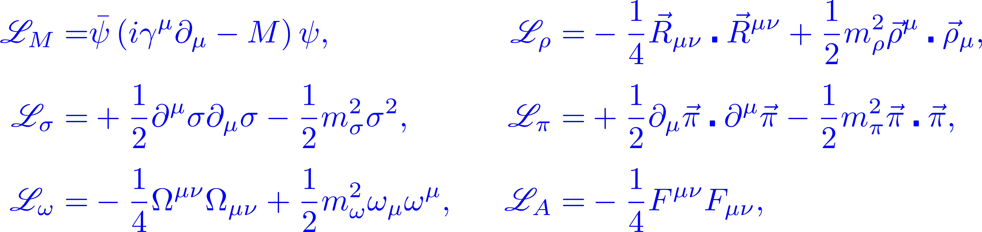
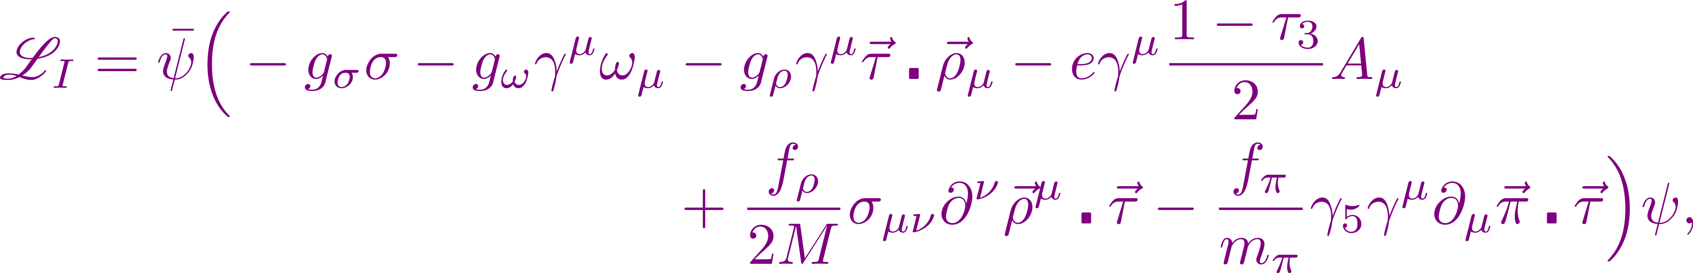
Lagrangian：degrees of freedom
Lagrangian density: nucleon ($ψ$), Mesons ($σ$, $ω_{μ}$, ${\vec{ρ}}_{μ}$, $\vec{π}$), Photon ($A_{μ}$)
Vector
Scalar
Tensor
Pseudo-vector

Slide 19
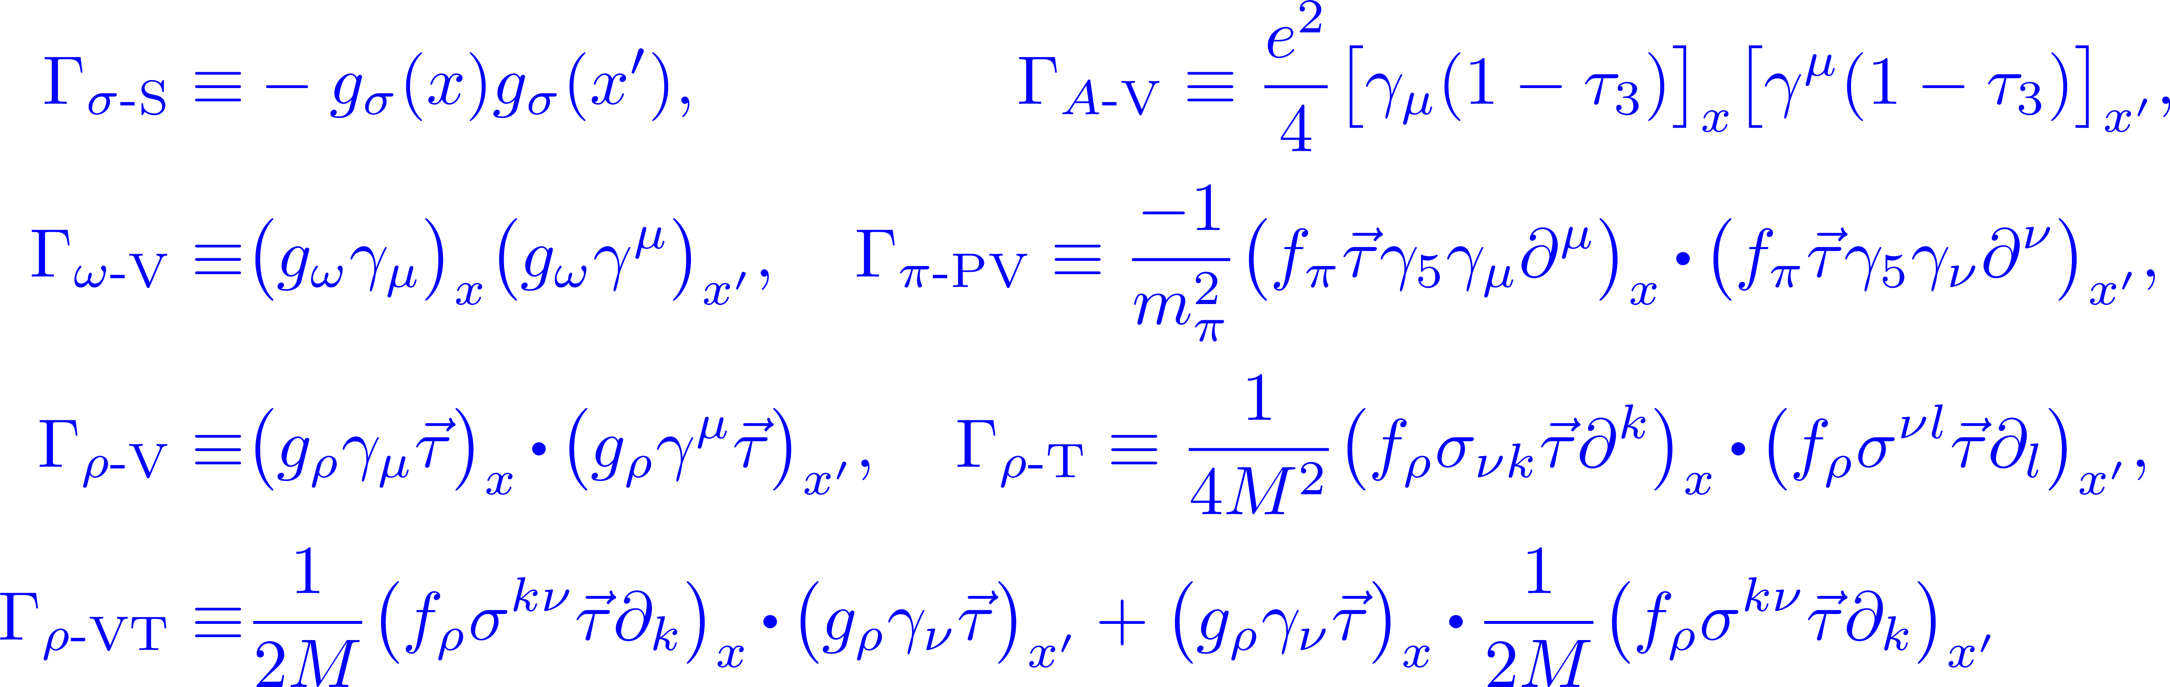
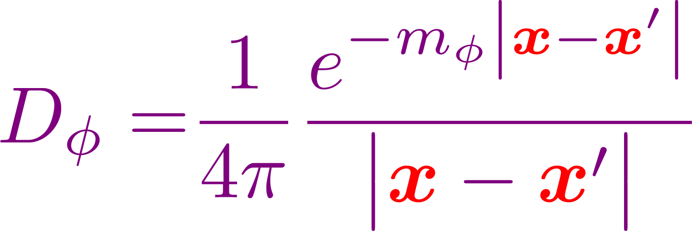


Hamiltonian
Hamiltonian:

Slide 20










Variational principle
Quantizing nucleon field: Dirac sea is neglected
Energy functional
Shell model
Hartree-Fock ground state
Hartree-Fock single-particle space
Integral-differential Dirac equations ⬅ Variation of $E$
➔
Kinetic energy term
Non-Local potential energy term
Local potential energy term

Slide 21




Effective Lagrangians
Modeling of nuclear in-medium effects
Rearrangement terms
Non-linear self-coupling of mesons
density-dependent coupling strength
Isoscalar
Constraint conditions
Isoscalar
RHF effective Lagrangians: nuclear in-medium interactions
PKO2
PKO1 & PKO3
PKA1

Slide 22







Geometric symmetry: Spherical
Spherical symmetry: good quantum numbers ($n, π, j, m$)
Orbital angular momentum $l$ is not a conserved quantity
$π$ represents parity
Expansion of the propagators: to avoid the singularity in propagators
Hartree
Selecting $\left(λμ\right)$ in $D_{φ}$
Fock

Slide 23




Localization of the integral terms
Integral-differential radial Dirac equation:
Equivalently, localize the integral terms
Similar for $X$ term
An equivalent differential Dirac equation is obtained, and such technical does not work in solving either the RHFB equation or partial differential one (considering deformation effects)

Slide 24







Geometric symmetry: Axial symmetry
Spinor in cylinder coordinate
$ν$: index of orbits in $πm$block
Using spherical Dirac Woods-Saxon (DWS) basis
Zhou, Meng, Ring, PRC 68, 034323 (2003)
Summation runs over both positive and negative states of the DWS basis.

Slide 25



Why choosing spherical DWS basis
DWS basis can provide appropriate asymptotic behavior of WF
方势阱
谐振子势
Woods-Saxon势
Appropriate asymptotic behaviors of wave functions are essential for the reliable description of weakly bound systems, such as unstable nuclei

Slide 26




Why choosing spherical DWS basis
DWS basis can provide appropriate asymptotic behavior of WF
Expansion of propagators: cylinder and spherical coordinates
Infinite summation over $λ$
In cylinder space, the decompositions of propagators lack operability

Slide 27




Eigenvalue equations with DWS base
Partial differential-integral Dirac equations ➔ Eigenvalue ones
Column matrix representation of the expansion
$a$ and $a′$ are the index of states in DWS base
PRC 101, 064302 (2020).

Slide 28





Configuration space
Expansion of density-dependent coupling strength
Truncations of spaces: DWS base, coupling strength, propagators
Specific nuclei: determine the truncations of $ν$ and $m$
DWS base: $n$ is truncated by a given energy cutoff
$κ_{max}$ depends on $m_{max}$
Coupling strength:
Propagator: automatically truncated by $κ_{max}$ and $λ_{p}^{max}$

Slide 29


Unstable nuclei: weakly bound mechnism
Continuum effects become essential for unstable nuclei
Continuum
Continuum
Stable nuclei
Unstable nuclei
Proton
Neutron
Proton
Neutron
Bogoliubov Scheme: Unified treatment of MF and pairing effects
Showing advantages in describing both unstable and superheavy nuclei

Slide 30



Bogoliubov Transformation
Bogoliubov transformation: from particle to quasi-particle
Bogoliubov ground state
Bogoliubov transformation: from particle to quasi-particle
Pairing force
Gogny D1S

Slide 31
Single-particle (s.p.) space
Arbitrary
s.p. Space
HF
s.p. Space
HFB
s.p. Space
Canonical
s.p. Space

Slide 32
Advantages of Bogoliubov Scheme
RHFB equation: $E$ is quasi-particle energy
If omitting the pairing potential, U and V components have opposite single-particle energies, which means one is bound and the other is unbound.
HF S.P. states
Bogoliubov quasi-particle states: V and U
Canonical S.P. states

Slide 33
Pseudo-spin symmetry (PSS)
Concept and open question
PSS restoration and the nature of nuclear force
Hints

Slide 34



Pseudo-spin symmetry (PSS)
PSS: near degeneracy of the orbits $\left(n,l,j=l+1/2\right)$ and $\left(n−1, l+2, j=l+3/2\right)$, which forms the PS doublet $\left(n^{′}, l^{′}, j=l′±1/2\right)$.
PSS is a relativistic symmetry:
$l′$ is nothing but the orbital angular momentum of the lower component of Dirac spinor.
Ginocchio (1997, 2005); Meng (1998); Liang, Meng, Zhou (2015).
PSS restoration reveals nuclear in-medium balance of attraction and repulsion, namely by $V\left(r\right)+S\left(r\right)$ in RMF.

Slide 35

Spurious shell closures
Conventional CDF suffered a lot from spurious shell closures $N/Z = 58 \& 92$, due to the PSS violation.
PKA1 that contains the ρ-tensor coupling cures the disease with enhanced spin-orbit couplings. PRC 76, 034314 (2007)

Slide 36

Remarks on degrees of freedom
dominant σ-S & ω-V
strong attraction & repulsion, respectively.
➔
RMF models
➔
Isovector ρ-V
weak Hartree terms
Isovector nature
RHF models
PKO2
PKO1, PKO3
Isovector channels
Largely enhanced by Fock terms.
➔
RHF models
PKA1
ρ-T presents rather strong attraction.
Binding energy of ²⁰⁸Pb given by PKA1: PRC 76, 034314 (2007).
PRC 100, 051301 (2019)

Slide 37



Pseudo-Spin Orbital splittings
RHF models: Fock terms
  PKO3: $σ$-S, $ω$-V, $ρ$-V, $π$-PV and $A$-V
  PKA$1:σ$-S, $ω$-V, $ρ$-V, $ρ$-VT, $ρ$-T, $π$-PV and $A$-V
RMF models: w/o Fock terms
  DD-ME2: density dependent RMF
  PK1 & NL3*: nonlinear self-couplings
$ΔE_{PSO}$ are overestimated notably, except PKA1 that well reproduces the data.
Systematical deviations are found between PKA1 and other models
PRC 100, 051301 (2019)

Slide 38




Systematics of ${ΔE}_{PSO}$in ²⁰⁸Pb
Dominant term
PKA1
${∆E}_{PSO}$ show distinct $l′$-dependence.
PSS is well restored at Fermi surface.
Other RHF/RMF models
Similar trends are obtained, while with paralleled $E_{kin.+ σ+ω}$.
PRC 100, 051301 (2019)

Slide 39


Modeling of in-medium balance
In general, the models provide similar binding energy for ²⁰⁸Pb
—similar equilibrium of nuclear dynamics—
RMF (DD-ME2) ➔ RHF (PKO3) ➔ RHF (PKA1)
In RMF, such equilibrium is maintained largely by $E_{kin+σ+ω}$, which dominates the PSS restoration in all selected models.
Isovector channels are enhanced by Fock terms, particularly by ρ-T coupling, which notably reduce the dominant isoscalar channels (σ-S & ω-V).
How does it change PSS restoration systematically?

Slide 40




Modeling of in-medium effects
Values & density dependence of $g_{σ}$ and $g_{ω}$ are reduced from DD-ME2 to PKO3, which are further reduced in PKA1.
DD-ME2 & PKO3
$g_{σ}\left(ρ_{b}\right)$ // $g_{ω}\left(ρ_{b}\right)$
Such situation is common for DDRMF and PKO series
PKA1
$g_{σ}\left(ρ_{b}\right)$ $g_{ω}\left(ρ_{b}\right)$
strong attractive potential from $ρ$-T coupling
//
PRC 100, 051301 (2019)

Slide 41





In-medium effects on ${ΔE}_{PSO}$
1.0$κ_{ρ}$: staring from PKA1, set ${\text{g}}_{σ}$ and ${\text{g}}_{ω}$ to share same density dependence as ${\text{g}}_{σ}$.
0.0$κ_{ρ}$: based on 1.0$κ_{ρ}$, ρ-T is switched off.
PRC 100, 051301 (2019)
PKA1 ➔ 1.0$κ_{ρ}$: washing out the $l′$-dependence of ${ΔE}_{PSO}$.
1.0$κ_{ρ}$➔ 0.0$κ_{ρ}$: Enhanced residual attraction from σ-S & ω-V enlarges ${ΔE}_{PSO}$.

Slide 42









Residual in-medium effects
Similar density dependent
Little in-medium effects carried by the balance of $σ$-S & $ω$-V couplings
PKA1: ➔ Residual in-medium effects.
With pseudo-orbit $l′$ increasing, nucleons are driven away from the center by centrifugal repulsion.
From the center to the edge, nucleon density varies from near saturated to zero values.
PRC 100, 051301 (2019).
s-orbit
Density $ρ_{b}$
Orbital angular momentum $l$ increasing
Residual in-medium effects are manifested as notable $l’$-dependence of ${∆E}_{PSO}$.

Slide 43




Remarks
The parametrizations $1.0κ_{ρ}$ & $0.0κ_{ρ}$ are not fully performed.
Parametrization $0.0κ_{ρ}$ shares the degrees of freedom as PKO3, also with roughly similar contributions $E_{kin+σ+ω}$ & $E_{ρ+π}$.
Full parametrization of the set $0.0κ_{ρ}$ ➔ PKO3, with similar conditions.
PRC 100, 051301 (2019).
Residual attraction for the values of ${ΔE}_{PSO}$
Residual in-medium effects for the $l’$-dependences of ${ΔE}_{PSO}$

Slide 44


Hints from PSS restorations

Slide 45
Nuclear Tensor force
Concept and picture
Relativistic representation of tensor force
Effects of tensor force in ellipsoidal nuclei

Slide 46
Tensor force
Tensor force is essential in giving ground state of Deuteron.
Tensor force plays an essential role in determining nuclear shell evolution.
T. Otsuka, T. Suzuki et al., PRL 95, 232502 (2005)
G. Colo, H. Sagawa, et al., PLB 646, 227-231 (2007)
C.L. Bai, H. Q. Zhang, H. Sagawa, et al., PRL 105 072501 (2010)
Tensor force was recognized to be carried by $π$-meson
Non-relativistic reduction
Tensor interaction

Slide 47

Tensor effects in nuclear shell evolution
Euro. Phys. Lett. 82, 12001 (2008)
Tensor force components carried by $π$-exchange potential play an essential role in the self-consistent description of nuclear shell evolution.
How about the other meson-nucleon coupling channels?

Slide 48
Spin dependence of Fock terms
Lower components of Dirac spinors are omitted
L.J. Jiang, S. Yang, B.Y. Sun, W.H. Long, and H.Q. Gu, PRC 91, 034326 (2015).

Slide 49


Relativistic representation of tensor force
Tensor force component in Fock diagram of $σ$-S coupling
Non-relativistic reduction
Relativistic formalism are proposed for other channels as well
L.J. Jiang, S. Yang, B.Y. Sun, W.H. Long, and H.Q. Gu, PRC 91, 034326 (2015).

Slide 50

Test of relativistic formalsim
Tensor force components are naturally introduced with Fock terms.
It is striking to see that Fock diagrams of isoscalar couplings show remarkable tensor effects
Unified treatments of central force, tensor force and spin-orbit coupling

Slide 51
Axially Deformed RHF Model
Unified treatment of the tensor force and deformation
Different systematics of shape evolution of S.P. orbits can be predicted by RHF models with the $π$-PV coupling
Spherical d_{5/2} orbit: following the nature of tensor force of the $j_{>}$ orbit
Deformed ${1/2}^{+}$ and ${3/2}^{+}$ orbits: the $d_{3/2}$ and/or $s_{1/2}$ components may contribute with the development of deformation
PRC 101, 064302 (2020).
From 《原子核物理》卢希庭等

Slide 52


Shape Evolution of s.p. Orbits
$$ν\left[m\right]π$$
ν: ordering
m: projection
π: parity
$$∆E=E_{2[1/2]+}{ − E}_{1[3/2]+}$$
PRC 101, 064302 (2020).

Slide 53



Effects of Pion Coupling
PRC 101, 064302 (2020).
$π$-PV ➔ More mixture of $j_{>}$ & $j_{<}$ components ➔ tensor effects emerge

Slide 54


Constraint calculations for ²⁰Ne
Role of pion meson：Tensor force

Slide 55
Magicity in Calcium isotopes
Motivation
Tensor force effects
Unified mechanism accounting for the occurrence of Magicity
Si-48: an atypical nucleus

Slide 56

New magicity N=32 & 34 in Calcium
Experimental evidence
D. Steppenbeck et al., Nature 502, 207(2013).
S. Michimasa et al., PRL 121, 022506 (2018).
Theoretical
Uncertainty

Slide 57

RHF-PKA1 reproduces magicity
J.J. Li, J. Margueron, LONG, N. Van Giai, PLB 753 (2016) 97–102.

Slide 58


Effects of tensor force components
Tensor force shows some effects in the occurrence of N=32 sub-shell, but not for the N=34 one.
PLB 753 (2016) 97–102.

Slide 59

Magic nature at N=32 and 34
Discrepancy is notable for PKO3 and DD-ME2
PKA1 reproduces the data, as well as systematics.
Unified mechanism?
PLB 806, 135524 (2020)
Exp.: Chinese Physics C 41 (2017); Phys. Rev. Lett. 121, 022506 (2018).

Slide 60


Mechanism of the magicity
Mean field potential
Coincidence
Density profiles
PLB 806, 135524 (2020)
N = 32 in ⁵²Ca ⬅ notable ${∆E}_{ν2p}$ ⬅ central-bumped density profiles
N = 34 in ⁵⁴Ca ⬅ reduced ${∆E}_{ν2p}$ & unchanged ${∆E}_{ν1f}$ ⬅ flat or even depressed central densities

Slide 61









Strong coupling of Dirac inversion partners
Spherical Dirac spinor: $l+l^{′}=2j$
Dirac inversion partners (DIPs):
$$l=0$$
$$l=1$$
G
F
G
F
Same 𝑗 but opposite parity
$$l′=1$$
$$l′=0$$
$$s_{1/2}$$
$$p_{1/2}$$
Strongly repulsive UL-terms: repulsive DIPs’ couplings, which reflect detailed information of nuclear force
PLB 806, 135524 (2020)

Slide 62




Sub-shell N=32 and semi-bubble
Exclude UL-terms felt by s-orbit from its DIP $ν2p_{1/2}$
DIPs $\left(s_{1/2}, p_{1/2}\right)$
Repulsive UL-terms Repulsive DIPs couplings
Neutron semi-bubble
Reduce $ΔE_{ν2p}$while unchanged $ΔE_{ν1f}$
PLB 806, 135524 (2020)

Slide 63



Evolution of ${ΔE}_{ν2p}$: magicity N = 32
DIPs：
PLB 806, 135524 (2020)
UL-terms of the couplings between s- and 2p-orbits dominant the evolution of ${ΔE}_{ν2p}$
⁴⁸S: last even isotone preserving the magicity N=32
⁵⁰Ar: the magicity N=32 have been confirmed experimentally
PRL 114, 252501 (2015)
PKA1 provides unified interpretation on both magicity N = 32 & 34.

Slide 64
Si-48: an atypical nucleus
Density profiles
s.p. spectra
PLB 788, 192 (2019)
Dual bubble-like structure, Double magicity, Drip line nucleus

Slide 65

Si-48: an atypical nucleus
Pairing gap
Specific heat
Reentrance of Pairing Correlation
PLB 788, 192 (2019)

Slide 66

Si-48: an atypical nucleus
PLB 788, 192 (2019)
Si-48: candidate with several novel structures which is quite rare in nuclear chart

Slide 67
Conclusions and Perspectives
RHF models for nuclear structures: current situation
Nuclear ground state and novel structure
Spherical nuclei | Spherical RHFB | Quadruple deformation | Axially deformed RHFB | Octuple deformation | Triaxiality
✔ | ✔ | ✔ | ✔ | planning | ✘
Nuclear excitation and decay
Spherical RHF(B)+(Q)RPA | Rotation and vibration | Deformed RPA | Spherical RPA+PVC | Angular Momentum projection | Deformed RPA+PVC
✔ | Planning | ✘ | Planning | Planning | ✘
Why we need Fock diagram: theoretical consistency
Optimal nuclear in-medium interactions
Tensor force
Connecting with ab-initio

Slide 68
Acknowledgements
Early stage of development of RHF model
J. Meng (PKU), N. Van Giai (Paris-sud U), H. Sagawa (Aizu), P. Ring (TUM)
Extensive development of RHF model
H.Z. Liang (Tokyo U), Z.M. Niu (Anhui U); B.Y. Sun (LZU), J.J. Li (SWU)
Axially deformed RHF/RHFB model
J. Geng (LZU), J. Xiang (Qiannan Normal U); B.Y. Sun (LZU)
Applications of RHF/RHFB model: tensor force, magicity, etc.
L.J. Jiang, L.J. Wang (SWU), X.L. Lu, S. Yang, J. Liu (LZU), X.D. Sun (LZU)
Z.H. Wang (LZU), Y.F. Niu (LZU)

Slide 69

Thank you for your attentions!

Slide 70



与中国物理学同行
SCI三刊入选“中国科技期刊卓越行动计划”
四刊发文量占国内物理学期刊的70%
发文类型：中文/英文 | 学术/科普 | 快讯/原始论文/综述
Notes:
四刊主办单位是中科院物理所和中国物理学会，总发文量占国内物理学期刊的70%，组成了国内综合影响力最大的物理学期刊方阵。CPL，CPB分别对标PRL和PRB，物理学报是我国唯一被SCI收录的综合物理学中文学术期刊，物理是国内权威的物理类中文科普期刊。

Slide 71
Progress of RMF models
Walecka ($σ$-$ω$) model: relativistic scalar and vector MF
Walecka, Ann. Phys. 83, 491 (1974); Serot & Walecka, Adv. Nucl. Phys. 16, 1 (1986).
Nuclear in-medium Interaction: non-perturbative nature
1. Non-linear self-couplings of $σ$- and $ω$-mesons
Boguta & Bodmer, NPA 292, 413 (1977); Sugahara & Toki, NPA 579, 557 (1994).
2. Density-dependent meson-nucleon couplings
Brockmann & Toki, PRL 68, 3408 (1992); Lenske & Fuchs, PLB 345, 355 (1995).
3. Zero-range approach: relativistic point-coupling model
Nikolaus, Hoch et al, PRC 46, 1757 (1992); Burvenich, Madland et al., PRC 65, 044308 (2002).
Relativistic continuum Hartree-Bogoliubov (RCHB) theory
J. Meng, NPA 635, 3 (1998); J. Meng et al, PPNP 57, 470 (2006).
Lulu Li, Jie Meng, Peter Ring, En-Guang Zhao, Shan-Gui Zhou, PRC 85, 024312 (2012).

Slide 72
Progress of RHF models
Several attempts of RHF approach in nuclear structure
A. Bouyssy, J.F. Mathiot, N. Van Giai, and S. Marcos, PRC 36, 380 (1987)
1. Nonlinear self-couplings of $σ$-meson and scalar field $\left(\overline{ψ}ψ\right)$
P. Bernardos, et al, PRC 48, 2665 (1993); S. Marcos, et al, JPG 30, 703 (2004)
2. Density-dependent meson-nucleon couplings w/o rearrangement terms
H.L. Shi, B.Q. Chen, and Z.Y. Ma, PRC52, 144(1995).
Density dependent RHF theory for nuclear structure
1. Precise RHF Lagrangians (PKO series, PKA1) as RMF were obtained.
PLB 640, 150 (2006); EPL 82 (2008) 12001; PRC 76, 034314 (2007).
2. Relativistic Hartree-Fock-Bogoliubov (RHFB) theory for unstable nuclei
W.H. Long, P. Ring, N. Van Giai, and J. Meng, PRC 81, 024308 (2010)
3. Axially deformed RHF/RHFB theory: very recently

