Slide 1
高能重离子碰撞输运模型及应用
马国亮
复旦大学
现代物理研究所

Slide 2
内容
背景介绍
模型介绍
软探针－集体流
手征反常探针－手征磁效应
硬探针－喷注
总结

Slide 3
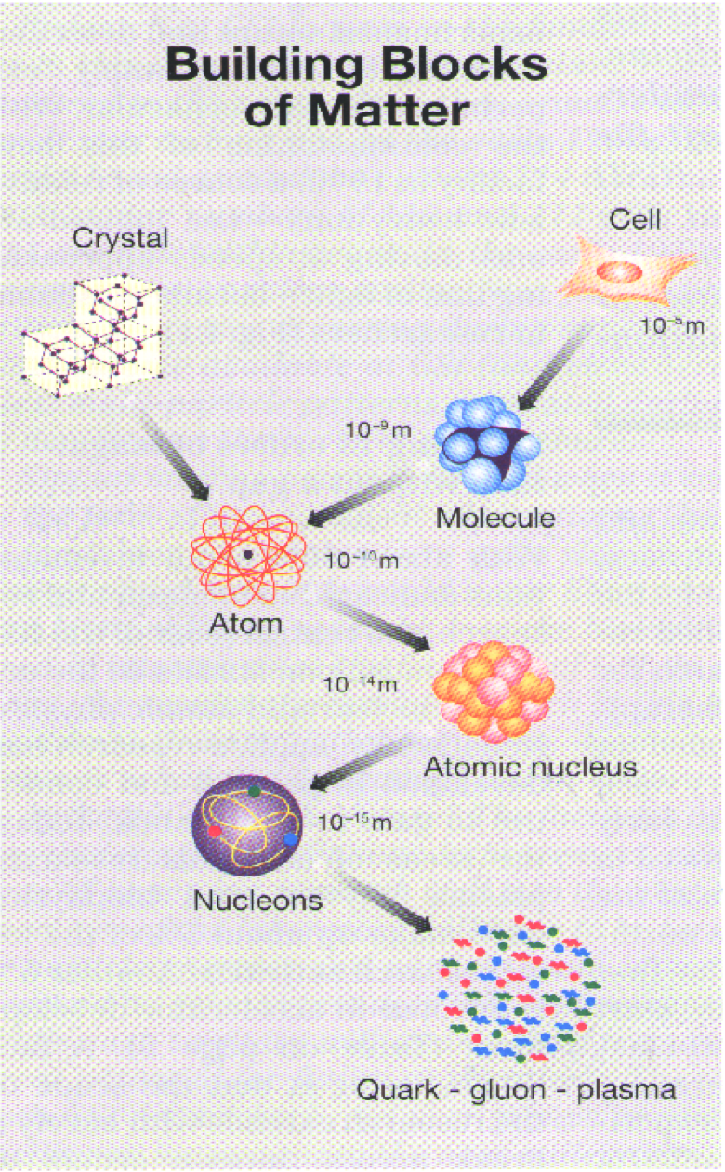
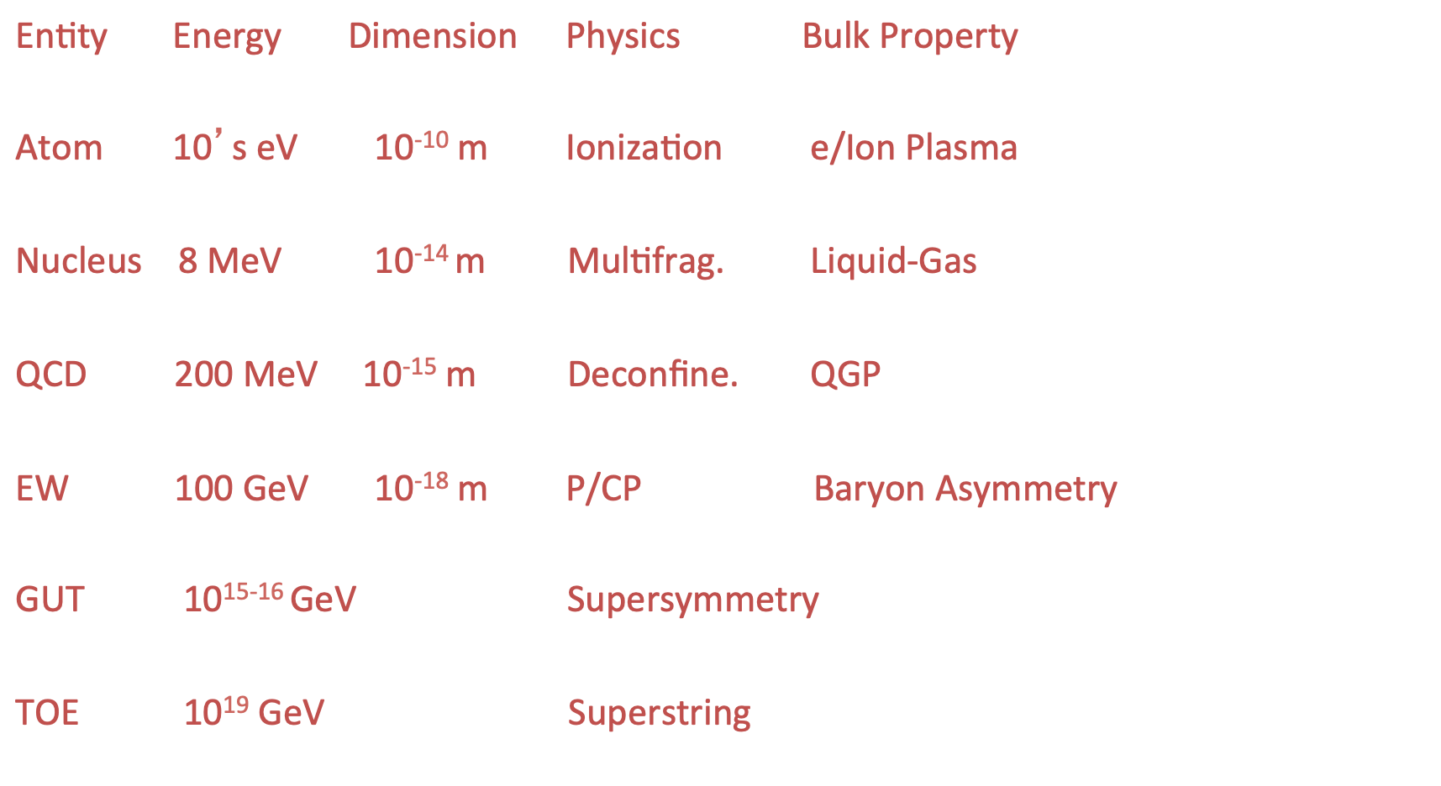
physics @ energy and length scales

Slide 4
Strong interaction

Slide 5
Quantum Chromodynamics (QCD)

Slide 6
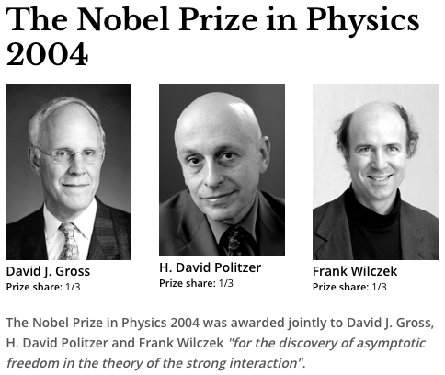
Asymptotic freedom
Asymptotic freedom

Slide 7
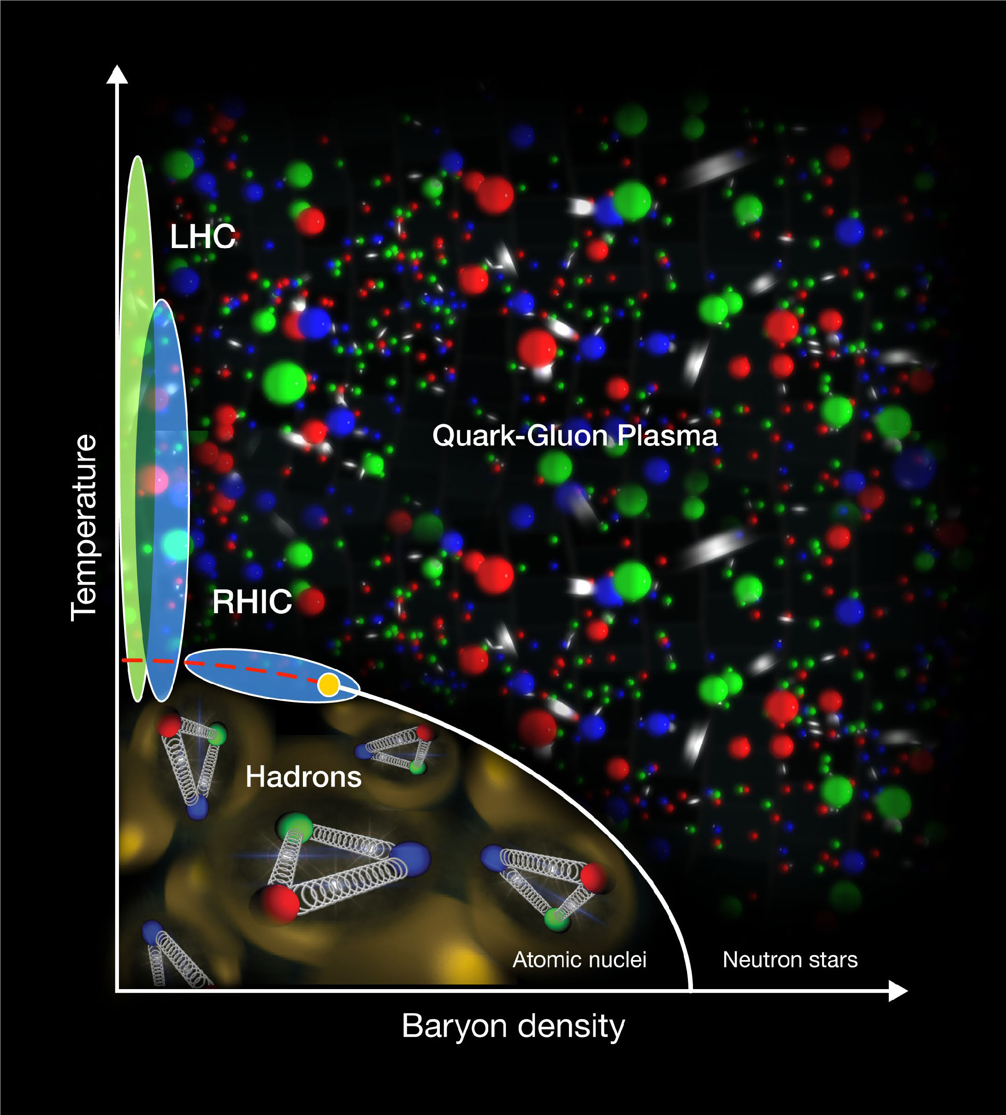
QCD deconfinement: quark gluon plasma
QCD物质相图

Slide 8
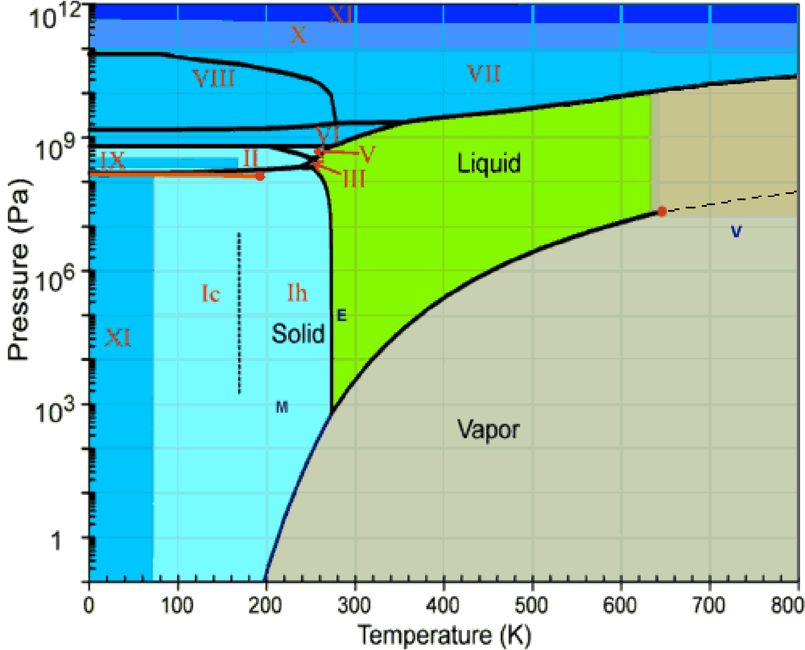
Phase diagram of matters
水相图
QCD物质相图
热力学关系：ε=Ts+𝛍n-P

Slide 9
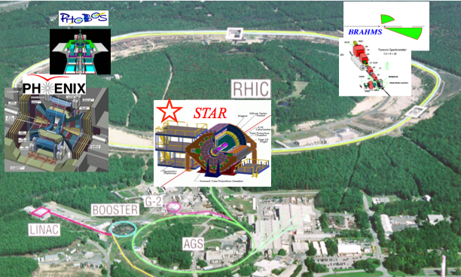
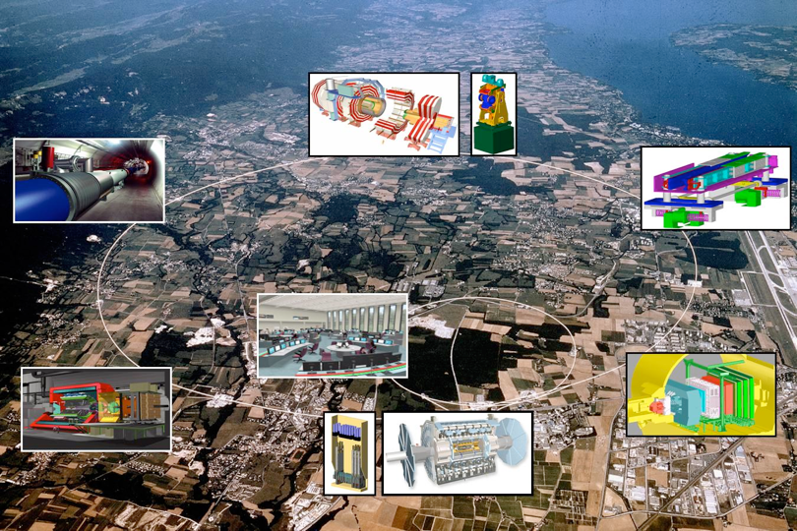
Experiment: relativistic heavy-ion collisions
Little bangs @ RHIC and LHC.
Au+Au at √sNN=200 GeV
Pb+Pb at √sNN=5.02 TeV

Slide 10
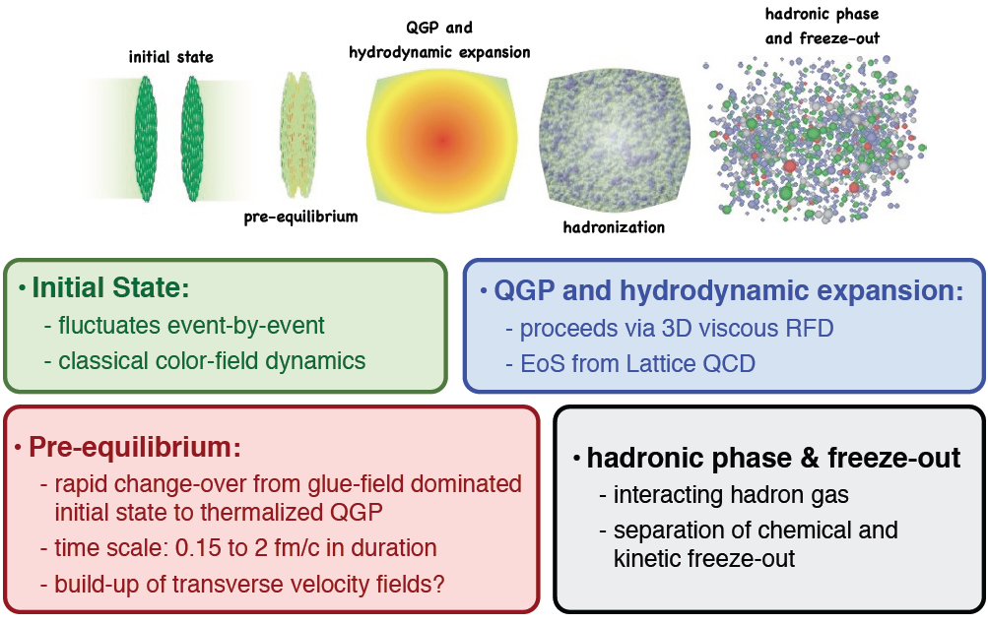
Stages of relativistic heavy-ion collisions

Slide 11
相对论重离子碰撞的模型
流体力学模型
统计热力学模型
输运模型
...

Slide 12
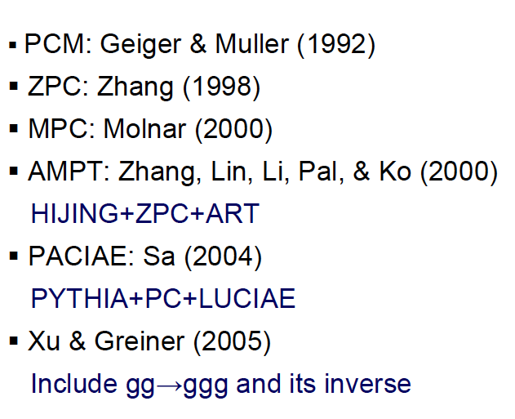
主要的部分子输运模型
BAMPS

Slide 13
为什么需要输运模型？

Slide 14
粒子相空间分布

Slide 15
粒子相空间分布的演化

Slide 16
玻尔兹曼方程

Slide 17
流体力学和输运模型
流体力学演化方程：
玻尔兹曼输运方程：
N

Slide 18
Structure of default AMPT model
Z. W. Lin, C. M. Ko et al. PRC 72, 064901 (2005)
A+B
HIJING (PDFs, nuclear shadowing):
minijet partons, excited strings, spectators
玻尔兹曼部分子输运
Less partonic interaction
Dominated by hadronic
interactions
(at very high densities)
ZPC (Zhang's Parton Cascade)
Partons freeze out
Hadronization (Lund String fragmentation)
玻尔兹曼强子输运
ART (A Relativistic Transport model for hadrons)
Hadrons freeze out (at a global cut-off time);
strong-decay all remaining resonances
Final particle spectra
马国亮/(复旦大学现代物理研究所)

Slide 19
Structure of string-melting AMPT model
Z. W. Lin, C. M. Ko et al. PRC 72, 064901 (2005)
A+B
HIJING (PDFs, nuclear shadowing):
minijet partons, excited strings, spectators
Melt to q & qbar via intermediate hadrons
Partonic
interactions
dominate.
Better describes flow & HBT,
but does not describe well
single particle spectra
玻尔兹曼部分子输运
ZPC (Zhang's Parton Cascade)
Partons freeze out
Hadronization (Quark Coalescence)
玻尔兹曼强子输运
ART (A Relativistic Transport model for hadrons)
Hadrons freeze out (at a global cut-off time);
strong-decay all remaining resonances
Final particle spectra
马国亮/(复旦大学现代物理研究所)

Slide 20
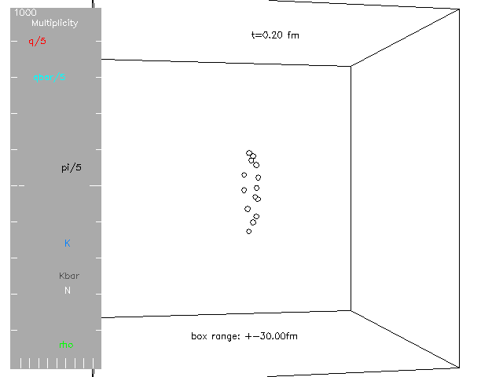
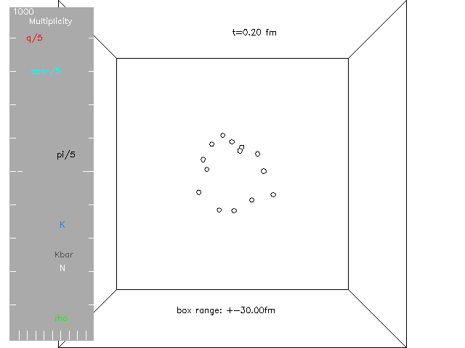
Time evolution of a central Au+Au collision from the AMPT model (string-melting version)
XOZ
XOY

Slide 21
Main Ingredients
HIJING soft strings + hard minijets
ZPC 2↔2 parton cascade:
gg↔gg, gg↔qqbar, gq↔gq, ...
Hadronization Lund string fragmentation
or
quark coalescence
ART hadron cascade including:
马国亮/(复旦大学现代物理研究所)

Slide 22
HIJING initial condition
马国亮/(复旦大学现代物理研究所)

Slide 23
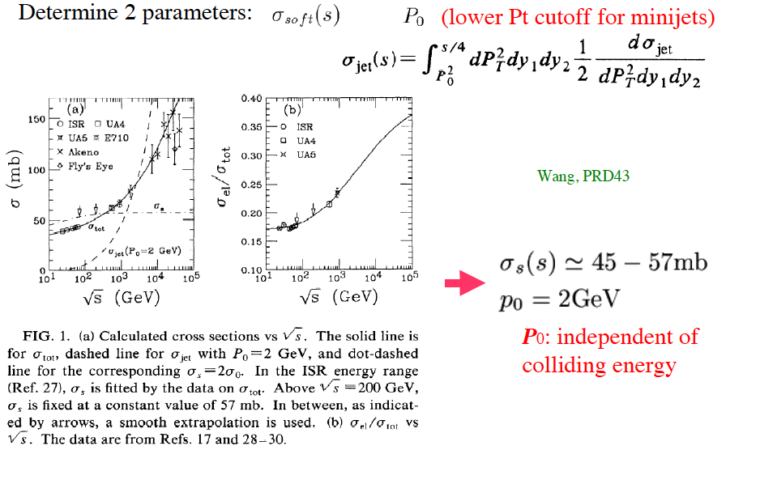
two key parameters of HIJING
马国亮/(复旦大学现代物理研究所)

Slide 24
Zhang’s parton cascade model
马国亮/(复旦大学现代物理研究所)

Slide 25
Zhang’s parton cascade model
Table 1
1 |  | 1 | 1932 | 10.0000 | 0 | 0 | 1 | 35 | 3 35
 | 1 | -3 |  | 0.189 -0.212 |  | -0.286 |  | 0.199 | -4.26E-01 | -4.56E-01 | -2.01E-02 | 6.63E-02
 | 2 | 2 |  | 0.797 -2.614 |  | -0.707 |  | 0.006 | -4.26E-01 | -4.56E-01 | -2.01E-02 | 6.63E-02
 | 3 | 2 |  | 0.337 -1.804 |  | -0.948 |  | 0.006 | -5.48E-01 | -2.48E+00 | -2.46E-02 | 6.68E-02
 | 4 | 1 | - | 0.015 0.073 |  | 0.006 |  | 0.010 | -5.48E-01 | -2.48E+00 | -2.46E-02 | 6.68E-02
 | 5 | 2 | - | 0.252 -1.209 |  | -0.318 |  | 0.006 | -5.48E-01 | -2.48E+00 | -2.46E-02 | 6.68E-02
Particle#
b(fm)
f(x,p,t) of initial partons
Particle ID
(PYTHIA)
momentum
mass
position & time
Table 1-1
1 |  | 1 | 1932 | 10.0000 | 0 | 0 | 1 | 35 | 3 35
 | 1 | -3 | - | 0.037 -0.171 |  | -0.029 |  | 0.199 | -3.91E-01 | -5.77E-01 | -2.06E-01 | 8.32E-01
 | 2 | 2 |  | 0.212 0.321 |  | -0.739 |  | 0.006 | -2.41E-01 | -8.82E-01 | -3.04E+00 | 3.79E+00
 | 3 | 2 |  | 0.435 -1.184 |  | -0.636 |  | 0.006 | -3.37E-01 | -3.6E+00 | -6.17E-01 | 1.36E+00
 | 4 | 1 |  | 0.099 0.052 |  | 0.102 |  | 0.010 | 1.19E+00 | -2.87E+00 | 5.99E-01 | 2.12E+00
 | 5 | 2 |  | 0.046 -1.033 |  | 0.071 |  | 0.006 | -7.07E-01 | -3.24E+00 | -2.26E-01 | 8.75E-01
f(x,p,t) of final partons
马国亮/(复旦大学现代物理研究所)

Slide 26
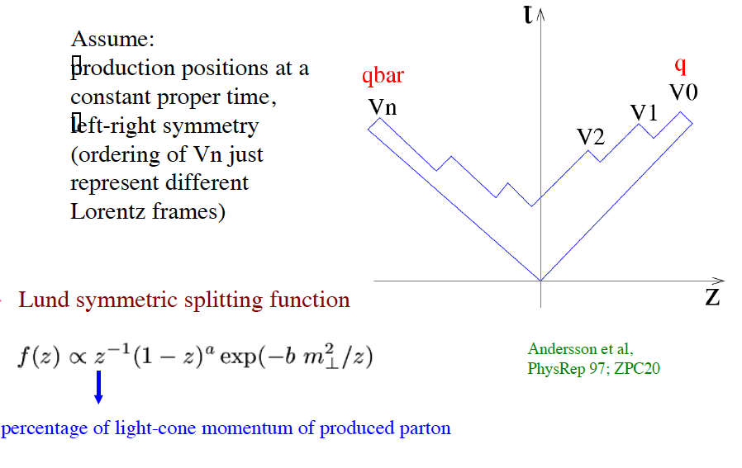
String fragmentation
string tension:
马国亮/(复旦大学现代物理研究所)

Slide 27
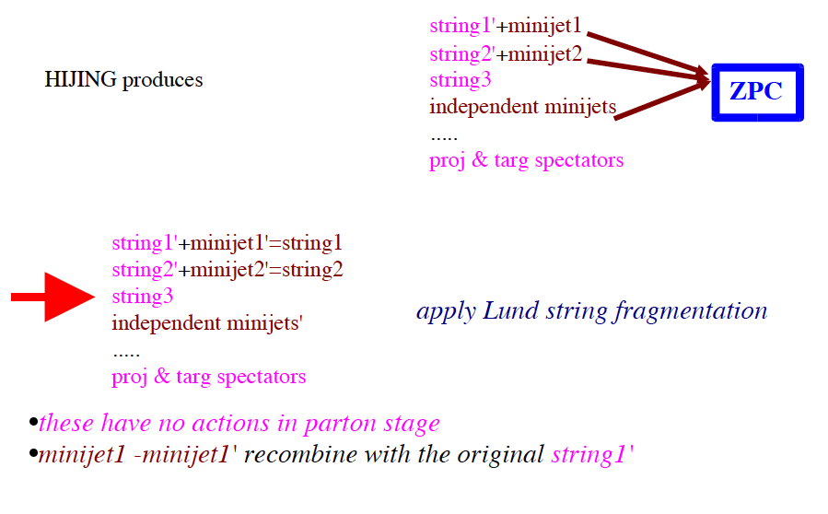
Fragmentation in default AMPT
马国亮/(复旦大学现代物理研究所)

Slide 28
String melting mechanism
马国亮/(复旦大学现代物理研究所)

Slide 29
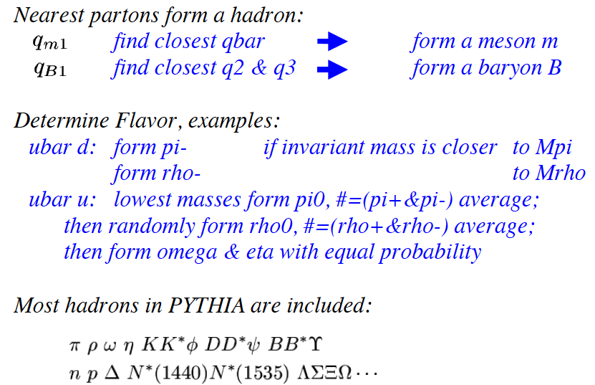
Coalescence in string-melting AMPT
马国亮/(复旦大学现代物理研究所)

Slide 30
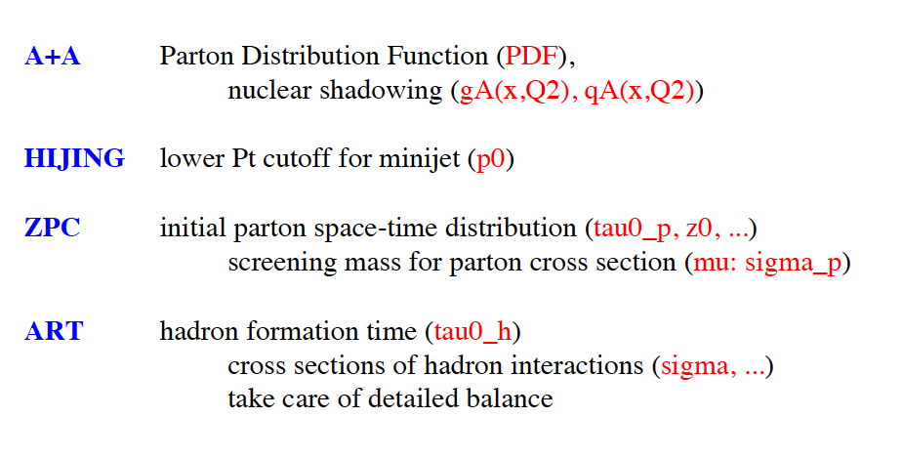
AMPT模型的关键参数

Slide 31
Parameters in input.ampt: New options in red
200. ! EFRM (sqrt(S_NN) in GeV) CMS ! FRAME A ! PROJ A ! TARG 197 ! IAP (projectile A number) 79 ! IZP (projectile Z number) 197 ! IAT (target A number) 79 ! IZT (target Z number) 2 ! NEVNT (total number of events) 0. ! BMIN (mininum impact parameter in fm) 13. ! BMAX (maximum impact parameter in fm, also see below) 1 ! ISOFT (D=1): select Default AMPT or String Melting(see below) 150 ! NTMAX: number of timesteps (D=150), see below 0.2 ! DT: timestep in fm (hadron cascade time= DT*NTMAX) (D=0.2) 2.2 ! PARJ(41): parameter a in Lund symmetric splitting function 0.5 ! PARJ(42): parameter b in Lund symmetric splitting function 1 ! (D=1,yes;0,no) flag for popcorn mechanism(netbaryon stopping) 1.0 ! PARJ(5) to control BMBbar vs BBbar in popcorn (D=1.0) 1 ! shadowing flag (Default=1,yes; 0,no) 0 ! quenching flag (D=0,no; 1,yes) 1.0 ! quenching parameter -dE/dx (GeV/fm) in case quenching flag=1 2.0 ! p0 cutoff in HIJING for minijet productions (D=2.0) 3.2264d0 ! parton screening mass in fm^(-1) (D=3.2264d0), see below 0 ! IZPC: (D=0 forward-angle parton scatterings; 100,isotropic) 0.47140452d0 ! alpha in parton cascade 1d6 ! dpcoal in GeV 1d6 ! drcoal in fm 0 ! ihjsed: take HIJING seed from below (D=0)or at runtime(11) 53153523 ! random seed for HIJING 8 ! random seed for parton cascade 0 ! flag for Ks0 weak decays (D=0,no; 1,yes) 1 ! flag for phi decays at end of hadron cascade (D=1,yes; 0,no) 0 ! optional OSCAR output (D=0,no; 1,yes; 2,initial parton info)
Initial Conditions/
HIJING
(e.g. turn on quenching to
mimic inelastic energy loss)
Hadron Cascade
(e.g. NTMAX=2 turns off
hadron cascade
but still has full parton
cascade & hadronization)
Parton Cascade
Hadronization
Output options
马国亮/(复旦大学现代物理研究所)

Slide 32
Output files
ampt.dat
Npart2
Event#
Particle#
b(fm)
Npart1
Test#
1 1 4218 8.0000 84 84 2 82 1 83 2112 0.000 0.000 99.996 0.940 6.00 -4.86 0.23 0.00 2112 0.000 0.000 99.996 0.940 6.78 3.61 0.21 0.00 2212 0.000 0.000 99.996 0.940 5.53 1.48 0.26 0.00 2212 0.000 0.000 -99.996 0.940 -9.31 -2.75 -0.16 0.00 111 0.071 -0.334 -0.376 0.135 1.81 -0.96 -1.18 7.00
Particle ID
(PYTHIA)
Final momentum
mass
Final position & time
(at kinetic freeze-out)
zpc.dat
Final momentum, position & time of all partons (at kinetic freeze-out)
马国亮/(复旦大学现代物理研究所)

Slide 33
软探针：集体流(flow)

Slide 34
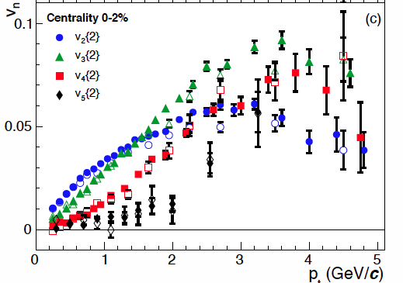
初始几何涨落⇒各种集体流
y
p_{y}
x
p_{x}
初态几何空间的涨落在末态相互作用下演化为各阶次的集体流。
几何空间的涨落⟺集体流
ALICE, PRL, 107, 032301 (2011)

Slide 35
flow and
ɸ
ɸ
ɸ
ɸ
ɸ
ɸ
Measuring flow vn is nothing but a Fourier analysis on exp. data.
ɸ=tan⁻¹(py/px); vn=an =<cosnɸ>
ɸ
ɸ
ɸ
ɸ
ɸ
ɸ

Slide 36
flow in each event
Event 1
Event 2
Event 3

Slide 37
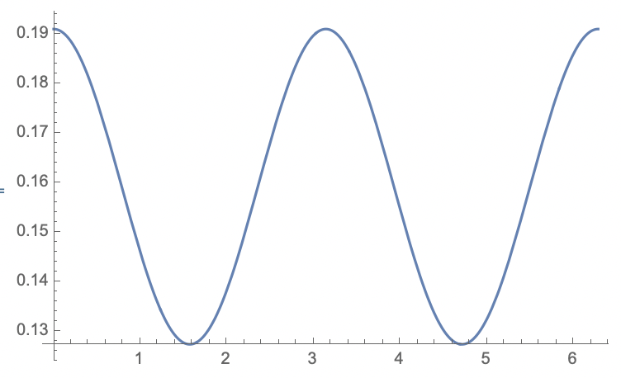
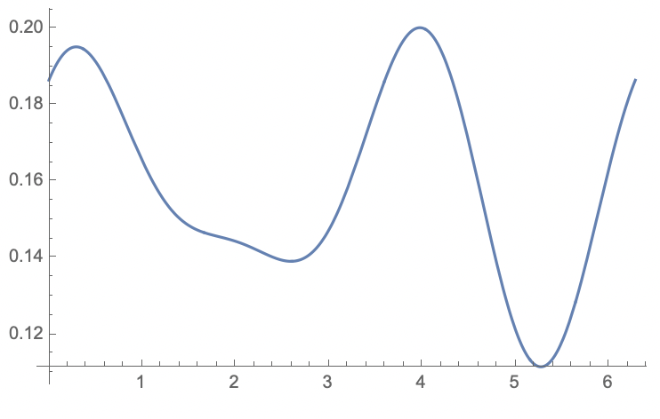
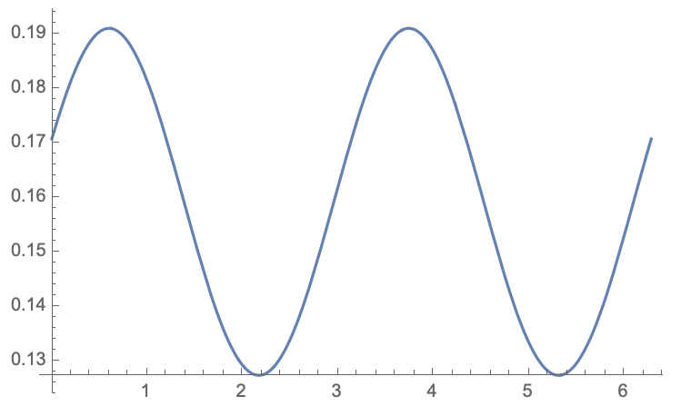
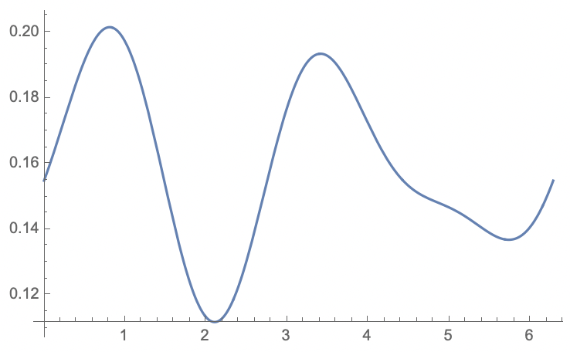
⓵v2=0.1,v3=0,𝚿2=0,𝚿3=0
③v2=0.1,v3=0.05,𝚿2=0.6,𝚿3=0
②v2=0.1,v3=0,𝚿2=0.6,𝚿3=0
④v2=0.1,v3=0.05,𝚿2=0.6,𝚿3=1.0

Slide 38
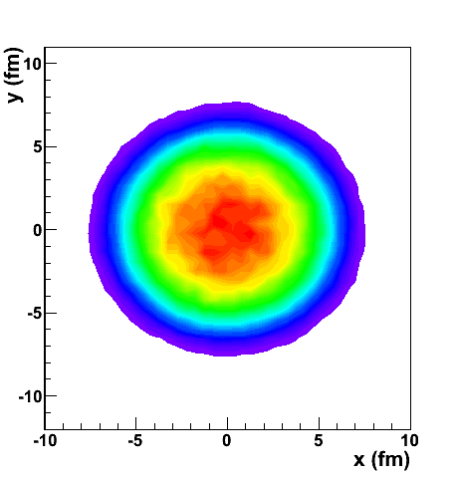
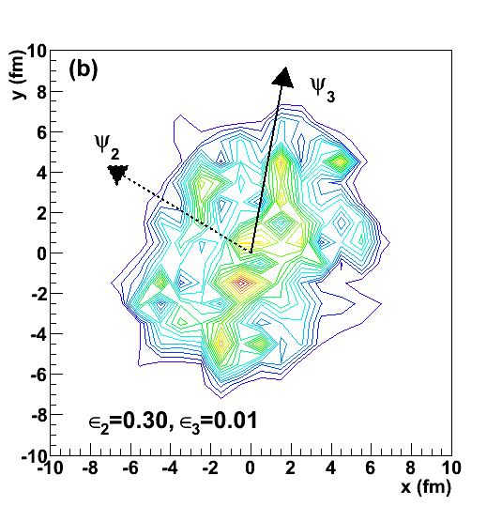
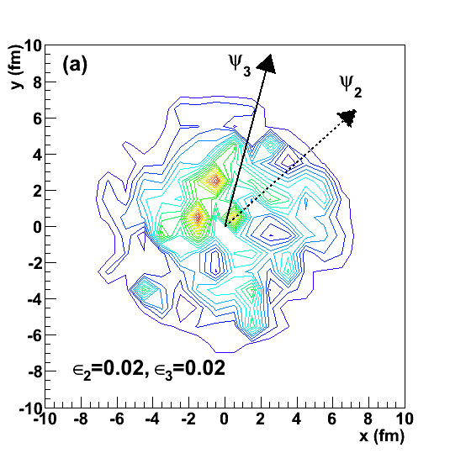
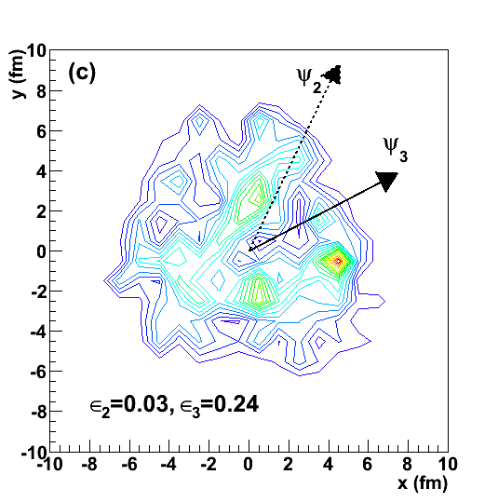
初始几何涨落
Ma et al. 2011
Au+Au 200 GeV (b=0 fm)
f(t=0,x,y)
+ event 2
event 1
=
+ event 3
最中心的碰撞（b=0）由于初态几何空间的涨落存在，所以也不总是圆形对称分布。
+...
AMPT events

Slide 39
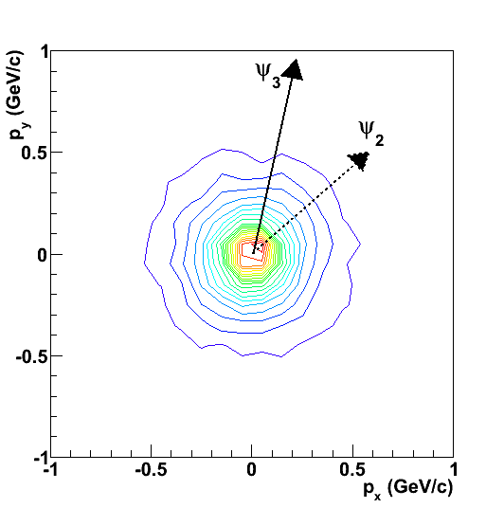
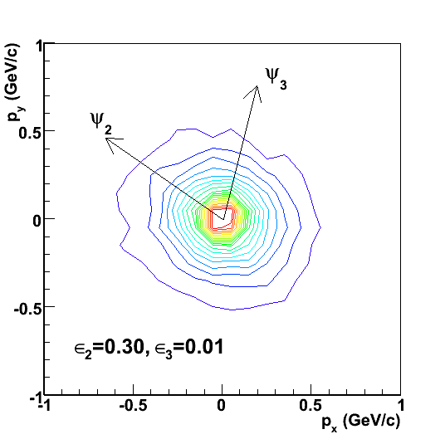
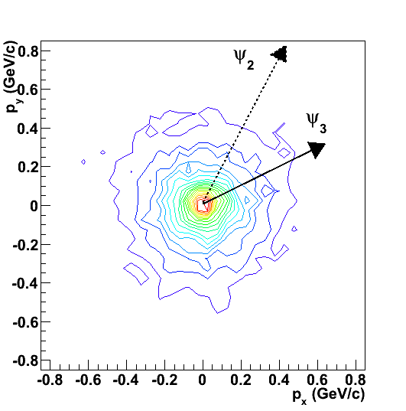
初始几何涨落⇒各种集体流
f(t=0,x,y)
(a)
(b)
(c)
initial spacial space
via parton cascade
via parton cascade
via parton cascade
(d)
(e)
(f)
f(t,px,py)
final momentum space
Au+Au 200 GeV (b=0 fm)
Au+Au 200 GeV (b=0 fm)
Au+Au 200 GeV (b=0 fm)
部分子相互作用将初始的几何不对称分布转化为末态动量空间的各种集体流。

Slide 40
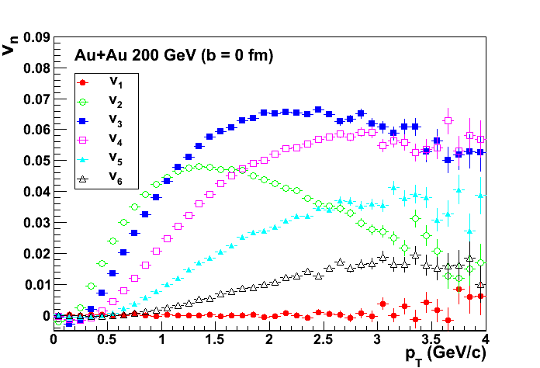
各种集体流
G. L. Ma and X.-N. Wang, PRL 106, 162301 (2011)
σ=10mb
n
v3
n
Note: ψn is the minor axis of initial geometry distribution.
v2
v4
v5
v6
v1
ALICE, PRL, 107, 032301 (2011)
我们在b=0的中心碰撞中给出各个阶次的集体流，和实验结果非常相似。

Slide 41
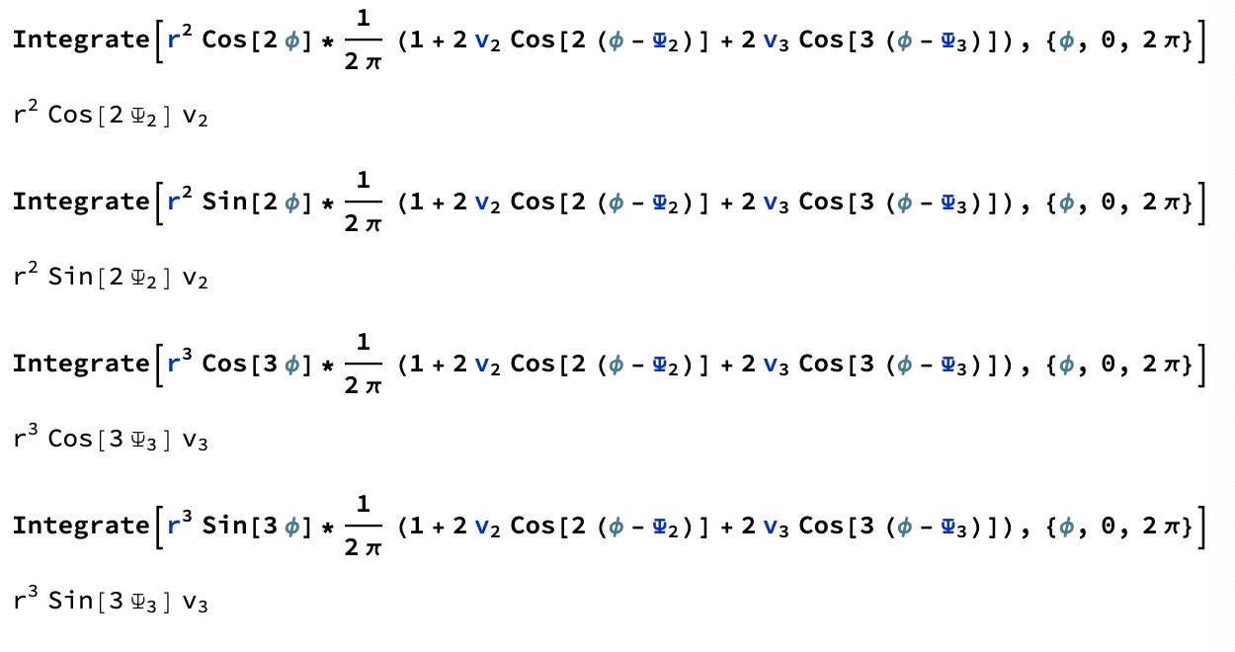
Understand 𝜀n and 𝜓n
=
=
=
=

Slide 42
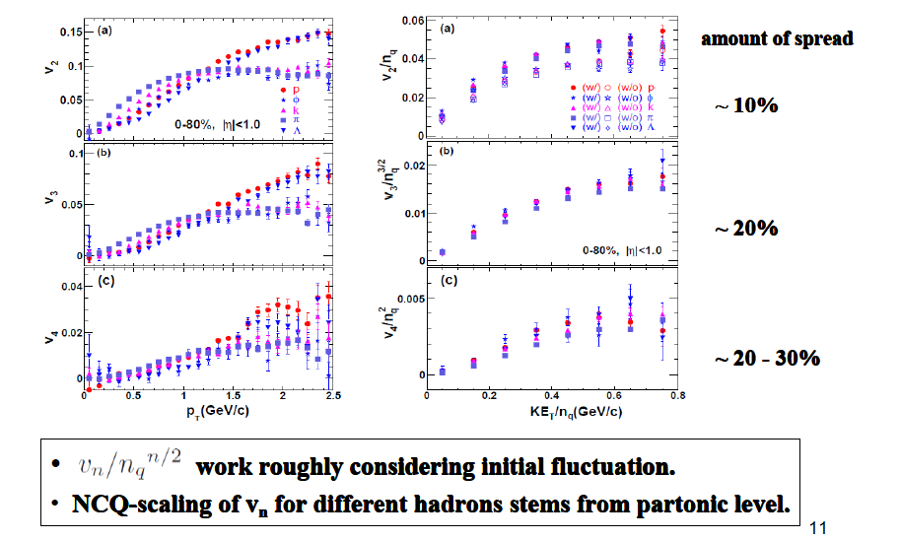
集体流的组分夸克标度
和夸克组合（ coalescence）模型强子化机制保持一致。

Slide 43
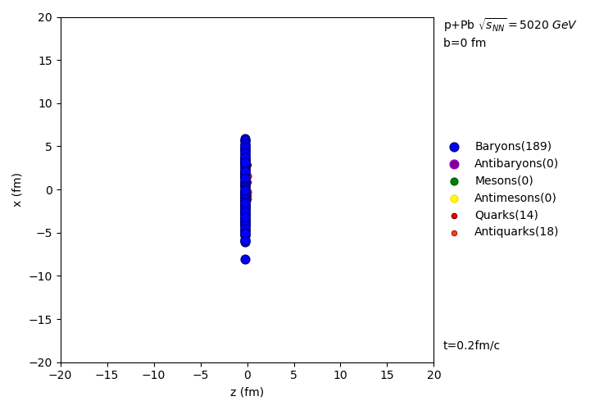
AMPT simulation on p+Pb collision

Slide 44
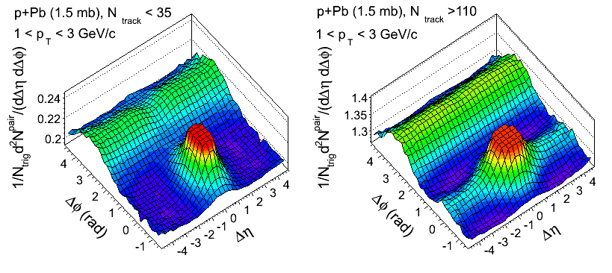
AMPT results on long-range correlation in p+Pb
G.-L. Ma and A. Bzdak, PLB 739, 209 (2014)
No long-range correlation in low-multiplicity p+Pb.
Clear long-range correlation in high-multiplicity p+Pb.

Slide 45
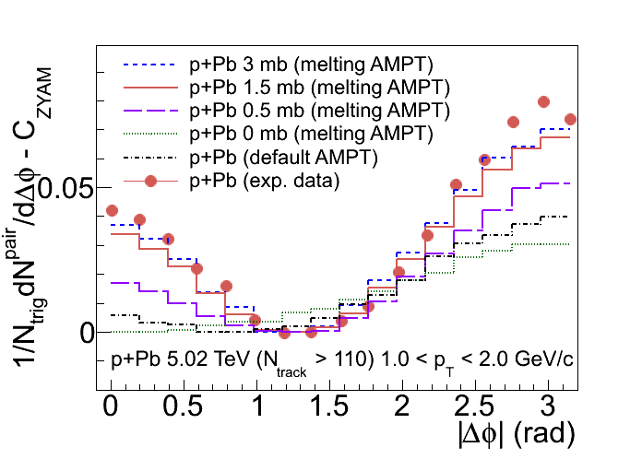
AMPT results on long-range correlation and vn
G.-L. Ma and A. Bzdak, Phys.Lett. B 739 (2014) 209.
A. Bzdak and G.-L. Ma, Phys.Rev.Lett. 113, (2014) 252301.
The two-particle correlation in p+Pb can be well described by σ=1.5-3 mb.
The signal strength increases with σ and vanishes for σ = 0 mb.=>Long-range correlation is produced by parton cascade.
For p+Pb, AMPT (σ=3 mb) reproduces the integrated two-particle v2 and v3.

Slide 46
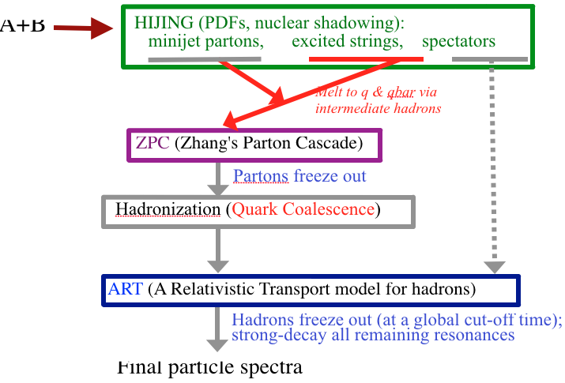
Studying flow` in small systems with AMPT model
Z.-W.Lin et al., Phys. Rev C 72, 064901 (2005)
flow`=flow(escape⊕hydro⊕CGC)⊕non-flow

Slide 47
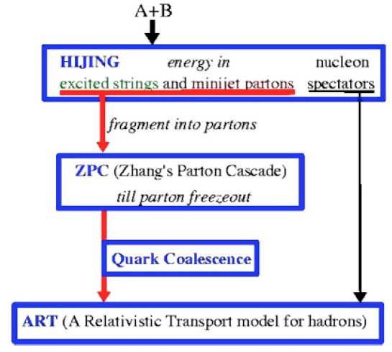
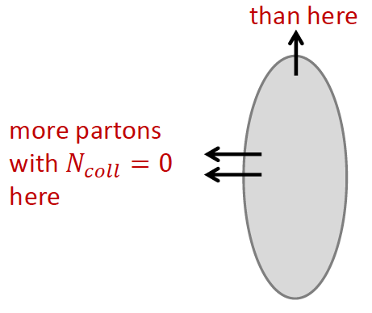
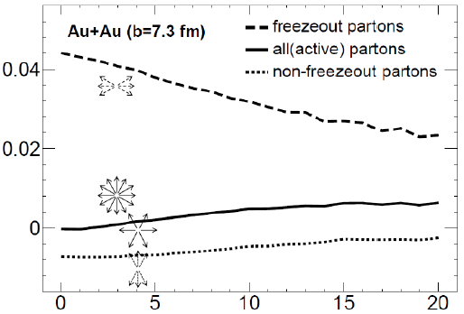
Escape-type small systems?
L. He, T. Edmonds, Zi-Wei Lin, F. Liu, D. Molnar, Fuqiang Wang, Phys.Lett. B753 (2016) 506.
larger probability for partons to escape along the short axis
Features:
All partons’ v2 increases with Ncoll
Freezeout partons’ v2 decreases with Ncoll.
Non-freezeout partons go from negative v2 to small v2 after collisions
The escape contribution to total v2 is large (~70%) in mid-central Au+Au; larger for d+Au (~90%)
parton v2
Number of parton collisions

Slide 48
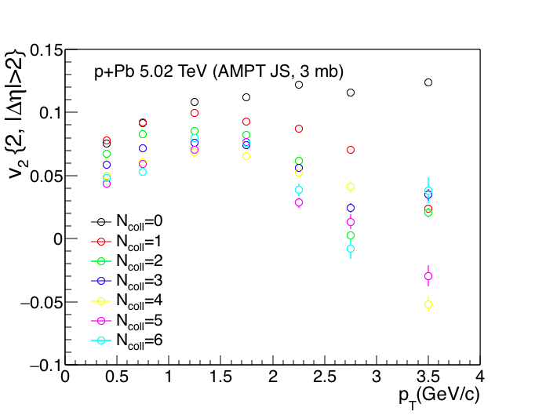
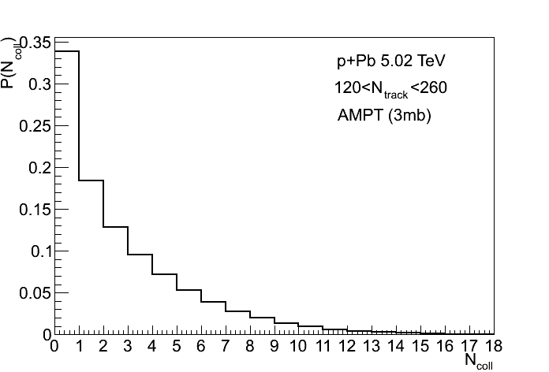
Final partons’ v2 with different Ncoll
Final freezeout partons
partons
=
Ncoll=0
+
Ncoll=1
+
Ncoll=2
+
Ncoll=3
+
Ncoll=4
+
Ncoll=5
+
Ncoll=6
+
...
Final partons’ v2 decreases with Ncoll.
Guo-Liang Ma, Adam Bzdak, Nucl. Phys. A 956 (2016) 745–748

Slide 49
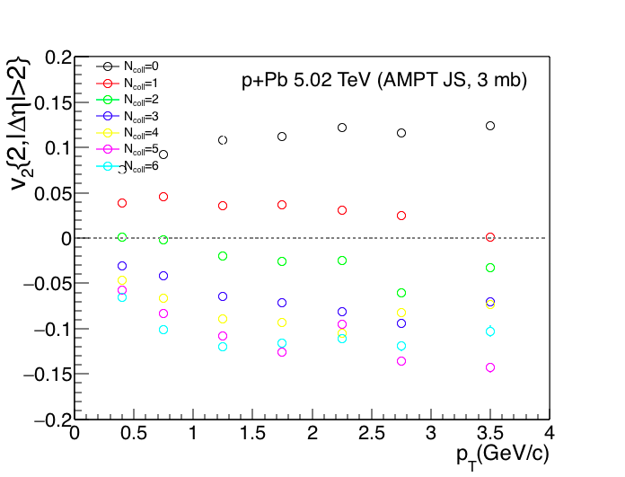
Initial partons’ v2 with different Ncoll
Initial partons
partons
=
Ncoll=0
+
Ncoll=1
+
Ncoll=2
+
Ncoll=3
+
Ncoll=4
+
Ncoll=5
+
Ncoll=6
+
...
In the initial state, v2 (small Ncoll)>0 and v2 (large Ncoll)<0 since the average v2 must be zero.
Guo-Liang Ma, Adam Bzdak, Nucl. Phys. A 956 (2016) 745–748

Slide 50
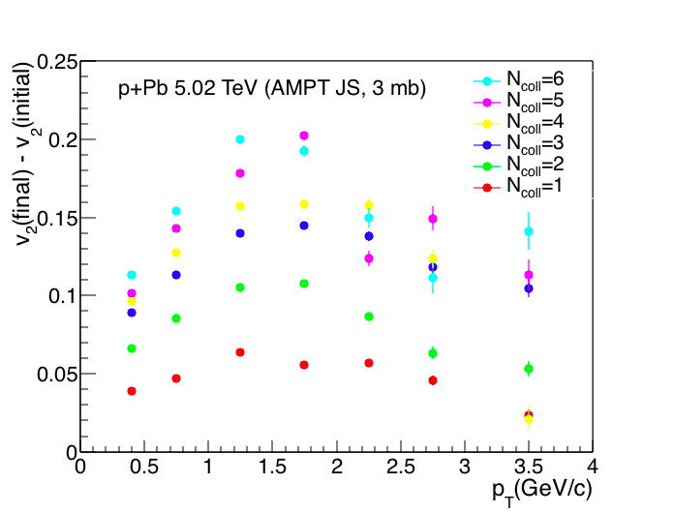
Partons’ Δv2 with different Ncoll
Guo-Liang Ma, Adam Bzdak, Nucl. Phys. A 956 (2016) 745.
More parton collisions generate larger Δv2. =>The escape mechanism needs collisions. What is limit?

Slide 51
Studying flow` in small systems with AMPT model
Z.-W.Lin et al., Phys. Rev C 72, 064901 (2005)
flow`=flow(escape⊕hydro⊕CGC)⊕non-flow

Slide 52
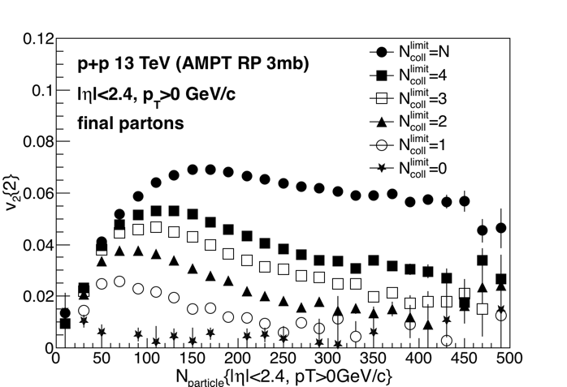
Final partons’ v2 for different Ncoll limits
Adam Bzdak and Guo-Liang Ma, in progress
For low-multiplicity p+p: v2 arises after the first collision, and then little changes by next collisions. =>Escape feature?
For high-multiplicity p+p: the establishment of v2 needs more collisions. The last collisions generate more v2. =>hydro-like feature?

Slide 53
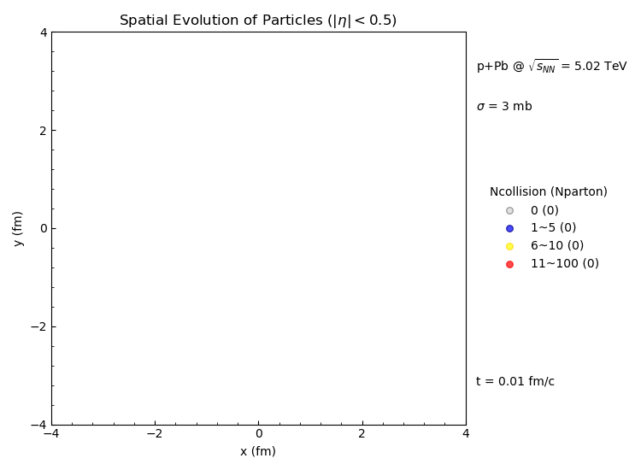
Parton collision history of p+Pb
Most of collisions happen within ~1fm/c in p+Pb=> a short-lived QGP =>?

Slide 54
Studying flow` in small systems with AMPT model
Z.-W.Lin et al., Phys. Rev C 72, 064901 (2005)
flow`=flow(escape⊕hydro⊕CGC)⊕non-flow

Slide 55
AMPT with introducing an initial ‘flow’
f(t=0,px,py,v2=0)
f(t=0,px,py,v2=0.1)
Initial flow v2=0.1
Initial flow v2=0
If an initial momentum anisotropy from CGC, how does the initial flow interplay with final flow? Can it survive?

Slide 56
AMPT results with different strengths of initial flow
Maowu Nie, Li Yi, Jiangyong Jia, Guoliang Ma,arXiv:1906.01422
0.09
0.08
Final
0.07
Initial v2
0.06
0.05
The existence of initial flow affects final flow measurement.
At small Nch, initial flow is basically dominant and easily survive.
At large Nch, final flow is dominant; initial flow but help increase final flow.

Slide 57
IP-GLASMA+BAMPS result on initial flow
M. Greif, C. Greiner, B. Schenke, S. Schlichting, Z. Xu,Phys.Rev. D96 (2017) no.9, 091504
With initial flow
W/O initial flow
AMPT results are consistent with IP-GLASMA+BAMPS results at low and high multiplicities

Slide 58
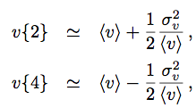
AMPT results on flow fluctuations with initial flow
Initial v2
The flow fluctuation can be strongly modified due to initial momentum anisotropy.

Slide 59
手征磁效应(CME)

Slide 60
B is large but short-lived in HIC

Slide 61
手征磁效应
the illustration is for just one kind of massless quarks with positive electric charge Q > 0 and for the case of μ₅ > 0.
Initial fluctuations of topological charge in QCD vacuum → P and CP odd metastable domains → Charge separation in the direction of magnetic field → CME indicates that parity can be locally violated in strong interactions.

Slide 62
CME exp. probe: charge azimuthal correlator
Non-flow/non-parity effects:
largely cancel out
Directed flow: vanishes
if measured in a symmetric rapidity range
P-even quantity:
still sensitive to charge separation
PRL 103, 251601 (2009)
Measuring CME is to measure a1² in fact, ɸ=tan⁻¹(py/px); a1 =<cosɸ>
The STAR data are consistent with the CME expectation. → dipole charge separation.

Slide 63
Constraint of CME from Δ𝛾 at RHIC
possible CME signal is (8±4±8)% of the inclusive Δγ;
Results indicate possible CME signal fraction is small in Δγ

Slide 64
Can CME survive from HIC?
dipole
final interaction
effects
STAR, PRL 103, 251601 (2009)
DE Kharzeev
It is important to investigate final interaction effects on the initial CME effect.

Slide 65
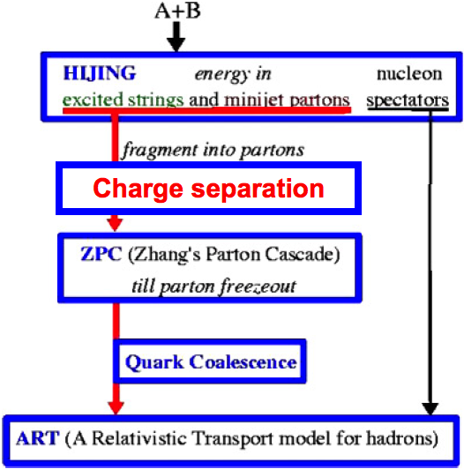
AMPT model with charge separation
(1) Introduction
G.-L. Ma, B. Zhang, PLB 700 (2011) 39
dipole
dipole charge separation
u
u
u
u
f%=(N⁺upward-N⁺downward)/(N⁺upward+N⁺downward)
We include initial dipole charge separation mechanism into AMPT model.
We switch the p_{y} values of a percentage of the downward moving u quarks with those of the upward moving u-bar quarks, and likewise for d-bar and d quarks, where the percentage is a relative ratio with respect to the total number of quarks.
We focus on final state effects on the charge separation, including parton cascade, hadronization, resonance decays after B and E vanish quickly.
⇀
⇀

Slide 66
The Background from original AMPT
The Background from original AMPT
Opp-charge and same-charge are consistent with zero initially.(◇)
being negative through parton cascae due to Flow+TMC.(◯)
Coalesce enhances same-charge and reduce opp-charge. (△)
Resonance decays reduce signal. (☐)

Slide 67
AMPT results on the CME obs. γ=<cos(φα+φβ)>
G.-L. Ma, B. Zhang, PLB 700 (2011) 39
Original AMPT (0%) underestimates exp. data, ~2/3.
10% initial charge separation can describe same-charge data.

Slide 68
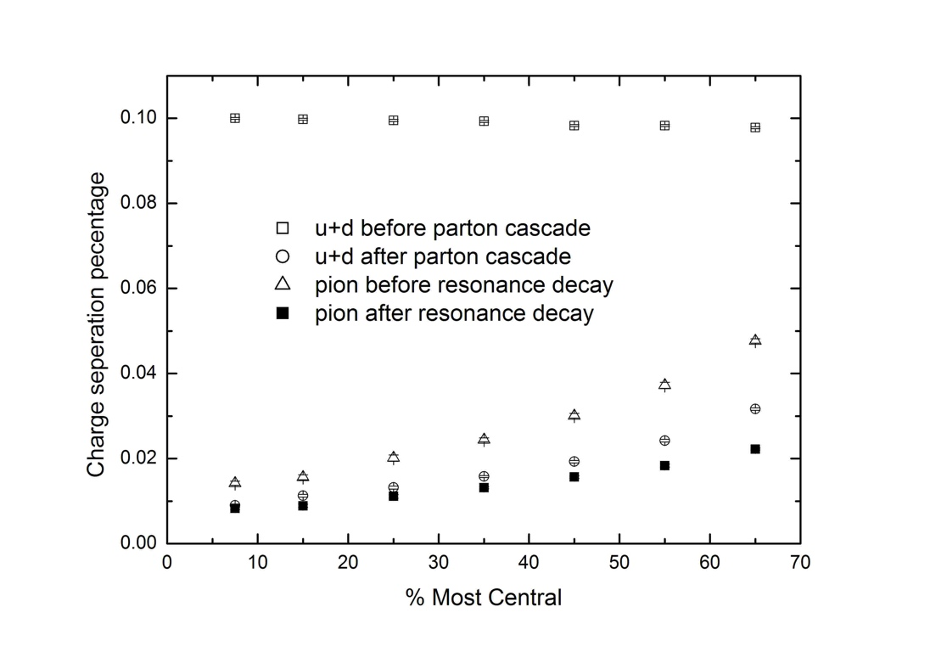
Final state effects on initial CME signal
Final state effects on initial CME signal
pion after hadronization
Parton cascade reduces charge separation significantly;
Coalescence recovers some charge separation in part;
Resonance decays reduce charge separation.
10% in the beginning →1-2% percentage at the end.
G.-L. Ma, B. Zhang, PLB 700 (2011) 39

Slide 69
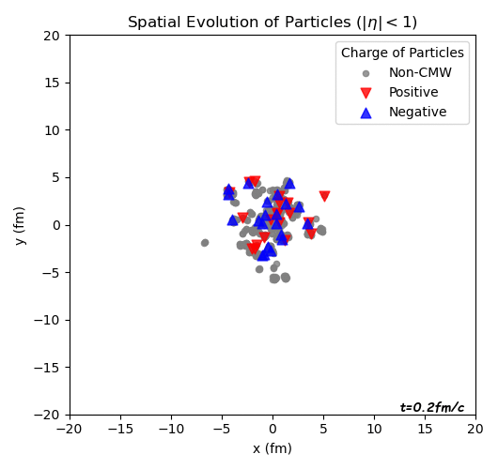
Parton cascade effect on the CME signal
Au+Au 200 GeV (b=8fm), AMPT+CME(10%)
f(t,x,y)
0 mb
f(t,x,y)
3 mb
J

Slide 70
Isobar collisions : a new probe to search for CME
钌+钌
锆+锆

Slide 71
Using Isobaric Collisions for CME Search
⎯ ⁹⁶40Zirconium vs ⁹⁶44Ruthenium
Isobars are atoms (nuclides) of different chemical elements that
have the same number of nucleons.
RHIC collides isobars (96Zr+96Zr and 96Ru+96Ru) at 200 GeV in Run-18 (2017-2018).

Slide 72
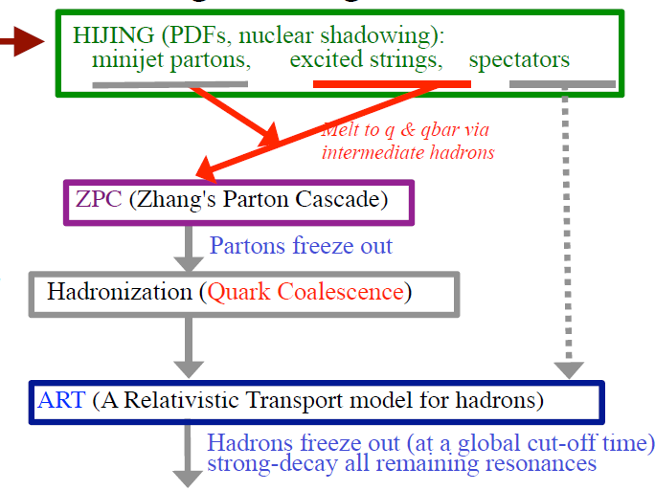
String-melting AMPT model
A+A
Final particle spectra

Slide 73
Geometry Configuration of Isobaric Collisions
Woods-Saxon form of spatial distribution of nucleons:
X. L. Zhao, G. L. Ma, Y. G. Ma, PRC 99, 034903 (2019)

Slide 74
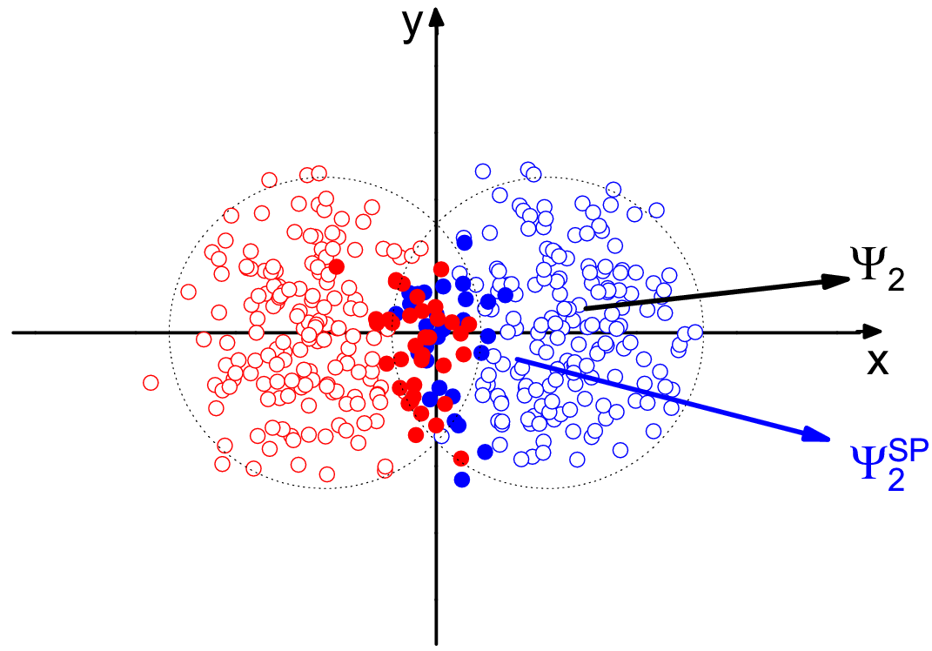
Calculation Method of Ѱ2 & Ѱ2^{SP}
In model,
X. L. Zhao, Y. G. Ma, G. L. Ma, PRC 97, 024910 (2018)
Sandeep Chatterjee et al, PRC 92, 011902(R) (2015)
Jie Zhao et al, arXiv:1807.05083; Hao-Jie Xu et al, arXiv:1710.07265; Sergei A. Voloshin, arXiv:1805.05300

Slide 75
Spatial Distributions of Electromagnetic Fields
From Lienard-Wiechert potential:

Slide 76
40-70%
|B|_{Ru} > |B|_{Zr}
For case 1, RR is about 4% - 6%.
For case 2, RR is about 4% - 12%.
Deformation info. causes difference

Slide 77
In mid-central collisions, RR are similar for case 1 and 2.
In peripheral collisions, RR are different.
A bad news for looking for CME!

Slide 78
contaminated by deformation

Slide 79
Ψ2^{SP} has stronger correlation with ΨB than Ψ2.
A good news for looking for CME!

Slide 80
CME observable Δ𝛾:
~15
~10
For case 1, RR is near 15%.
For case 2, RR increases from 0 to 15% from central to peripheral events.
Less contaminated by deformation
in peripheral events

Slide 81
X. L. Zhao, G. L. Ma, Y. G. Ma, PRC 99, 034903 (2019)

Slide 82
Isobaric collision transport simulations with CME
(1) Introduction
dipole charge separation
Two key facts:
Initialization of isobars
By-dependent CME percentage
u
u
u
u
f%=f%(By)

Slide 83
b-dependent B field
W.-T. Deng, X.-G. Huang, G.-L. Ma, G. Wang, Phys.Rev. C97 (2018), 044901
I use By(b) =A*b+B*b²+C*b³ to fit the calculated By(b).
<-eBy>(r=0, t=0)
We use Lienard-Wiechert potential to calculate b-dependent <By> .
<By>(Ru+Ru) is larger than <By>(Zr+Zr) by 10% at large b.

Slide 84
b-dependent initial charge sep. percent
Centrality cuts for Ru+Ru and Zr+Zr
Centrality | bmin (fm) | bmax (fm)
0-10% | 0 | 3.9
10-20% | 3.9 | 5.5
20-30% | 5.5 | 6.8
30-40% | 6.8 | 7.8
40-50% | 7.8 | 8.8
50-60% | 8.8 | 9.6
60-70% | 9.6 | 10.3
We apply f%=1146.1A^{-4/3}By(b) to introduce the initial charge separation into Ru+Ru and Zr+Zr.
f%=1146.1A^{-4/3}By(b)

Slide 85
AMPT (CME) results on γ=<cos(ϕa+ϕβ-2ѱ2)>
We see a reasonable magnitude ordering of | <cos(ϕa+ϕβ-2ѱ2)> |, i.e., Au+Au < Zr+Zr < Ru+Ru < Cu+Cu.

Slide 86
CME effect in isobar collisions
If w/o CME(solid symbol), the signals are almost same between Ru+Ru and Zr+Zr from the normal AMPT model.
If with CME (open symbol), the magnitudes of signals increase, the difference between Ru+Ru and Zr+Zr appears ~10%.

Slide 87
Final state effect in isobar collisions
initial state
(parton cascade, hadronization, resonance decays)
final state
Final state interactions reduce imported charge separations.
The relative ratio of charge separation percentage is kept, same as <By> ratio.
The CME signal difference can be observed even after strong final state interactions, if with enough statistics.
90-100%
90-100%
W.-T. Deng, X.-G. Huang, G.-L. Ma, G. Wang, Phys.Rev. C97 (2018), 044901

Slide 88
硬探针：“a粒子”
Probe
Target
Classic experiment: shoot a probe through medium to learn about the properties of the medium

Slide 89
Jet in vacuum

Slide 90
Jet in QGP
Jet quenching:
X.-N.Wang and M.Gyulassy, Phys.Rev.Lett.68,1480(1992)
The hard jet loses a significant amount of its energy via gluon radiation induced by multiple scattering.
Leading particle suppressed
leading
particle
hadrons
hadrons
q
q
PRL 96, 202301 (2006)
q
q
hadrons
hadrons
leading
particle suppressed
leading particle
N-N collision
A-A collision

Slide 91
Jet events in PbPb collisions at LHC
ATLAS
CMS

Slide 92
Jet reconstruction
Need rules to group the hadrons
A popular algorithm is anti-k_{T} algorithm Used in ALICE, ATLAS and CMS analyses
Radius parameter:
decide the resolution scale
Large radius parameter
Small radius parameter → jet spliting
Cacciari, Salam, Soyez, JHEP 0804 (2008) 063
ΔR = 0.2, 0.3, 0.4, 0.5 are used in LHC analyses

Slide 93
Summary of jet reconstruction
correction
Raw jet energy
Background subtraction
Jet energy correction
Jet energy
Remove underlying events contribution
MC Simulation PYTHIA

Slide 94
Dijet asymmetry
Periphreral events have an unmodified AJ
In pp, asymmetry arises from 3-jet events
Asymmetry much enhanced in central AA

Slide 95
AMPT model with a trigged dijet
=
+
Med.
Jet
(σ = 10 mb)
add a dijet with known
momentumand production point

Slide 96
Method and cuts
AMPT melting model: 10 mb and 0 mb (as a reference) for partonic interaction cross sections are chosen for Pb+Pb 2.76 TeV (0-100%).
direct photon,
pT^{Ɣ}>60 GeV/c ,|η^{Ɣ}|<1.44,
q
q
quark/gluon jet,
R=0.3, pT^{jet}>30 GeV/c and |η^{jet}|<1.6
Jet: anti-kt algorithm, R=0.3, pT^{jet}>30 GeV/c and |η^{jet}|<1.6 [Fastjet package, background subtraction, jet energy scale correction, jet efficiency correction]

Slide 97
Dijet asymmetry at LHC
双喷注不对称度演化函数
A large dijet asymmetry ($A_{J}$) is produced by strong interactions between jets and partonic matter.
The final $A_{J}$ is found to be driven by both initial $A_{J}$ and partonic jet energy loss.

Slide 98
Problem of jet as a trigger: surface bias
All hard collisions
Can happen in any place in the QGP
High p_{T} leading jet
Triggered sample
Selection on a high p_{T} leading jet (charged particle) may bias the position of the hard scattering in the QGP

Slide 99
How about correlate photons and jets?
Hadrons
photon+jet
Surface bias is removed!
Jet
Gluon
“quark-gluon
compton scattering”
Quark
pT^{photon} ~ pT^{Jet}
Photon

Slide 100
A golden probe: γ-jet (@ RHIC)
direct photon
q
q
quark/gluon jet
suppressed
PHENIX, PRL 109, 122302 (2012)
Hanzhong Zhang, Jeseph F.Owens,
EnkeWang & Xin-Nian Wang (2009)
thermal
Prompt γ has no energy loss and does not flow.
γ-hadron probes medium differently from dihadron.

Slide 101
γ-jet momentum imbalance @ LHC
arXiv: 1205.0206
Ɣ-jet momentum balance fraction:
xjƔ = pT^{Jet}/pT^{Ɣ}
PbPb
Vacuum (pp collision)
vs. QGP (PbPb collision)
PbPb
Quark/gluon jets lose about 15% of their initial energy.
20% of photons lose their jet partner.

Slide 102
γ-jet momentum imbalance simulation
ΔɸjƔ>7/8 π
G.-L. Ma, Phys. Lett. B 724 (2013) 278
xjƔ = pT^{Jet}/pT^{Ɣ}
Jet losses more energy by strong partonic interactions than by hadronic interactions.

Slide 103
When jet losses energy
before parton cascade
ET(GeV)
Δɸ
Δη
after parton cascade
ET(GeV)
Δɸ
Δη
xjƔ= pT^{jet,rec}/pT^{ɣ}
Jet losses its energy in parton cascade process.

Slide 104
Detail tomography of QGP
xjƔ is sensitive to the production information of γ-jet.
γ-hadron correlation with selected xjƔ is proposed as a good tool to do detail tomography of QGP.

Slide 105
Jet fragmentation function

Slide 106
Jet fragmentation function
Select Tracks in ΔR=0.3 cone p_{T}> 1 GeV/c

Slide 107
Decomposition of jet fragmentation function
Two components of jet hadronization from fragmentation and coalescence
Jet fragmentation functions for mesons and baryons are proposed as a good probe to study the competition.

Slide 108
Jet shape
G.L. Ma, PRC 89, 024902 (2014)
A dynamical evolution of jet shape modifications in A+A:
Parton cascade :Jet energy is redistributed towards larger radius.
Coalescence: weaken the jet modification (a qualitative feature).
Hadron rescatterings: futher modification by pushing the jet energy outwards further.

Slide 109
Leading vs subleading jet shapes
G.L. Ma, PRC 89, 024902 (2014)
Subleading jet has a larger medium modification than leading jet. This ordering is consistent with the new CMS measurement.
The jet shape slightly depends on the dijet asymmetry Aj, consistent with the new CMS data.

Slide 110
Jet transport in ZPC
段香盼 & 马国亮 in progress
a single event
Jet losses energy and excite surrounding medium by collisions.
Jet energy loss dE/dx, transport parameter q^, Mach Cone?

Slide 111
总结
相对论重离子碰撞研究的科学意义，已经取得了令人瞩目的重要结果
通过输运模型，结合不同的实验探针，来研究热密物质的不同性质
未来理论和实验结合，将进一步探索更多QCD物质神秘的性质

