Slide 1
超重核合成与性质的理论研究
原子核结构与中高能重离子碰撞交叉学科理论讲习班，2021.7.9 - 25,湖州师范学院
张鸿飞
兰州大学核科学与技术学院
2021.07.13

Slide 2
1. 超重核研究的意义及现状
2. 超重核的合成
3. 超重核的结构
4. 超重核的衰变
5. 总结和展望
报告内容

Slide 3
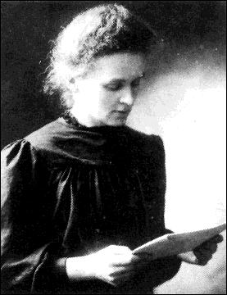
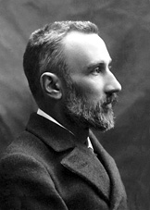

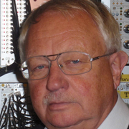

一、超重核研究的意义及现状
1、超重核合成与性质的研究是自然科学的重要课题之一
（1）超重核的合成是研究原子核电荷数和质量数上限的唯一途径，具有极大的技术难度，超重核素的合成已成为检验人们认识自然的能力和一个国家科技水平的重要标志。
Marie. Curie，
法国物理学家
（1867-1934），
波兰人，1903年获得诺贝尔物理学奖。发现84号元素钋(Po)和88号元素镭(Ra)
Pierre Curie
（1859-1906）
113 Nh (Nihonium)
115 Mc (Moscovium)
117 Ts (Tennessine)
118 Og (Oganesson)
西格·霍夫曼
森田浩介
Kosuke Morita
（1957- ）
Yuri Oganessian
（1933- ）
Sigurd Hofmann
（1944- ）
为了庆祝元素周期表诞生150周年，联合国宣布将2019年定为国际化学元素周期表年。

Slide 4
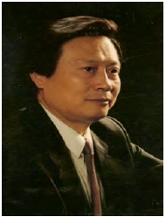
罗亦孝，科学通报，2016 年第 61 卷第 21 期：2326 ~ 2330
113, 115, 117 和118 号超重元素的探索和成功, 实现了原子核物理基于理论预言的实验探索最艰难的突破, 提供了存在超重稳定岛的确凿证据.被认为是过去30 年中原子核物理学基础研究前沿最重要的进展.

Slide 5
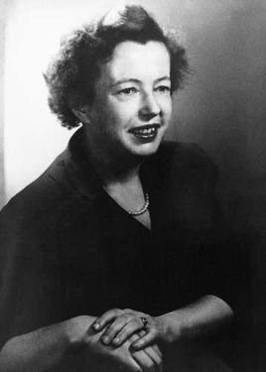
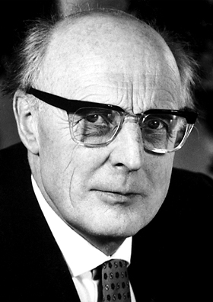
（2）超重核性质与合成的研究是对原子核理论模型的严格检验，对深入理解原子核内核子—核子相互作用及宇宙的组成都有十分重要的意义。
1963 年 12 月 10 日，德国科学家詹森、美国科学家梅耶因创立原子核结构的壳模型理论二获得了第六十三届诺贝尔奖 物理学奖 。
玛丽亚·格佩特-梅耶
J. Hans D.
Jensen – Facts
（1907-1973）
Maria Goeppert-Mayer
（1906-1972）

Slide 6
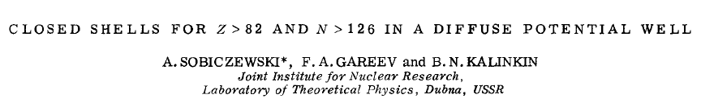
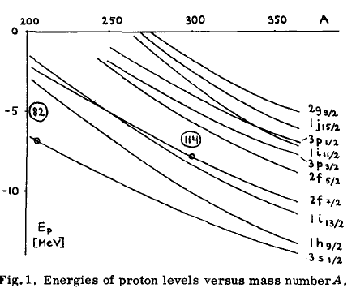
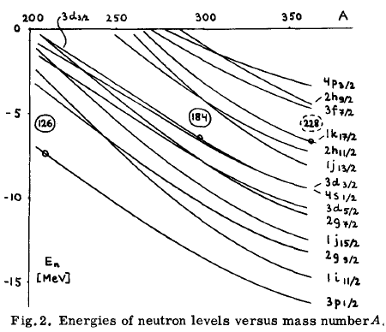
2、超重核稳定岛的理论探索
（1）首次理论预言超重双幻核Z=114，N=184
F. A, Gareev et al., Phys. Lett. 22, 500(1966)
A. SOBICZEWSKI*, F.A. GAREEV and B. N. KALINKINF, Phys. Lett. 22, 500(1966)

Slide 7
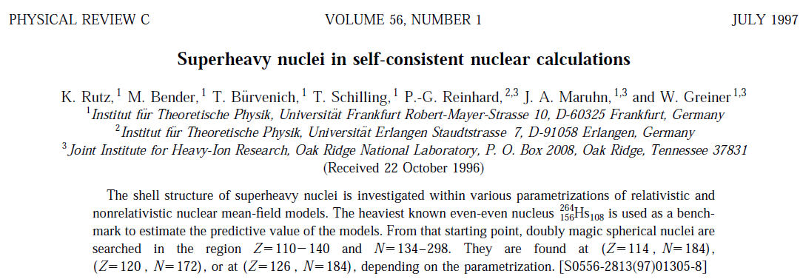
（2）理论工作继续寻找超重核区中子和质子幻数
(A) Frankurt, Germany
Possible double magic superheavy nuclei:
Z=114, N=184;
Z=120, N=172;
Z=126, N=184
PHYSICAL REVIEW C, VOLUME 60, 034304(1999)

Slide 8
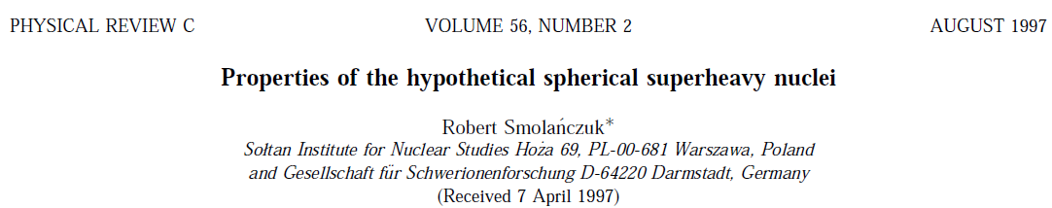
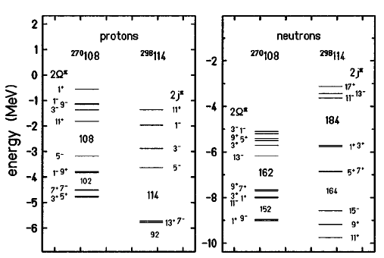
(B) Warszawa, Poland
The calculations are based on the macroscopic-microscopic model.

Slide 9
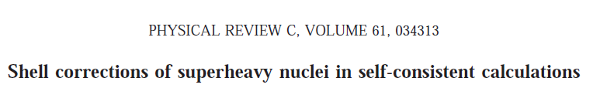
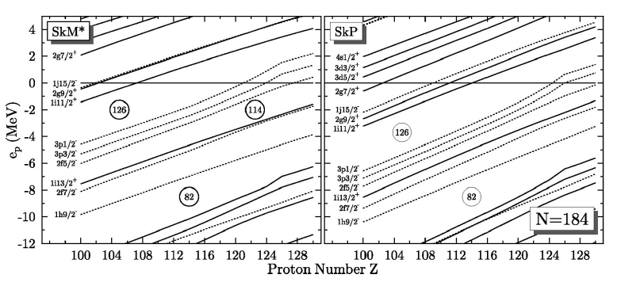
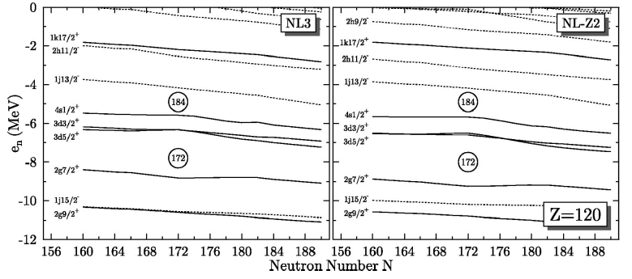
(C) Tennessee, USA, Hungary, Poland, Germany
Skyrme-Hartree-Fock:
Z=114 or 126, N=184
Relativistic mean-field :
Z=120, N=172

Slide 10
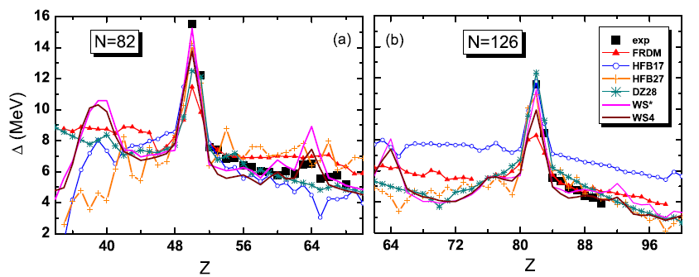
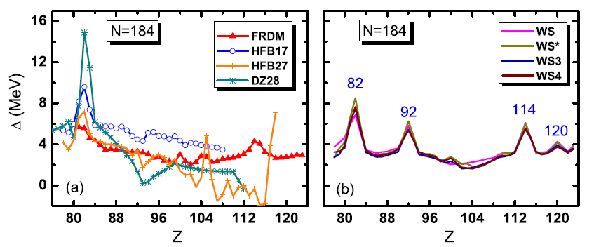
(D) Guanxi，China，
Qiuhong Mo， Min Liu，Ning Wang，PRC 90, 024320 (2014)
Pairing gap

Slide 11
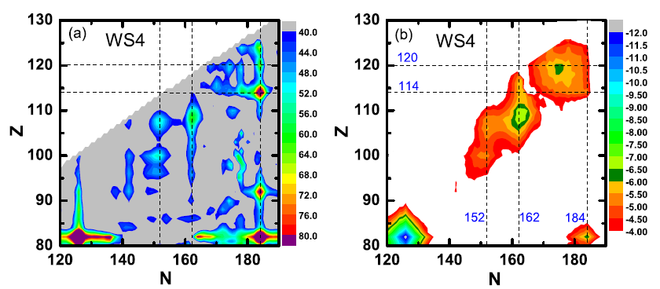
Shell correction energy
In addition to the shell closures at N = 184, Z = 114, the subshell closures at around N = 178,
Z = 120 could also play a role for the stability of superheavy nuclei.

Slide 12
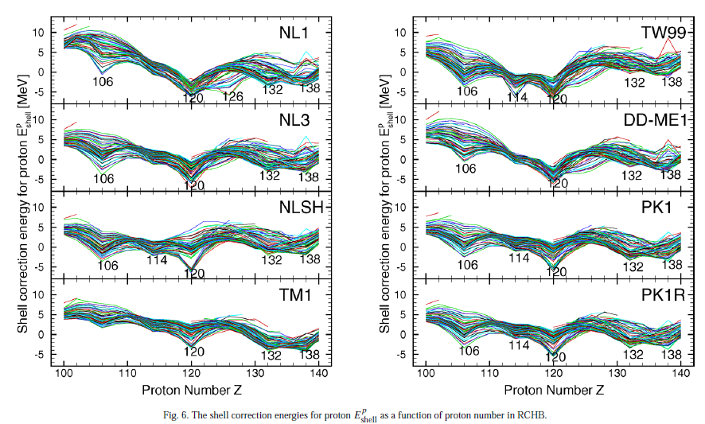
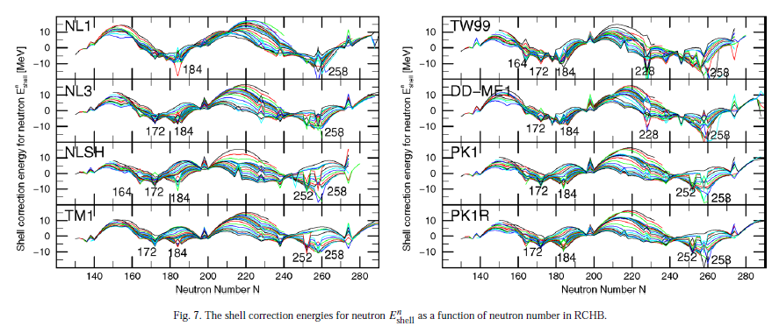
（E）Beijing , China
W. Zhang, J. Meng, S.Q. Zhang, L.S. Geng, H. Toki， Nuclear Physics A 753 (2005) 106–135

Slide 13
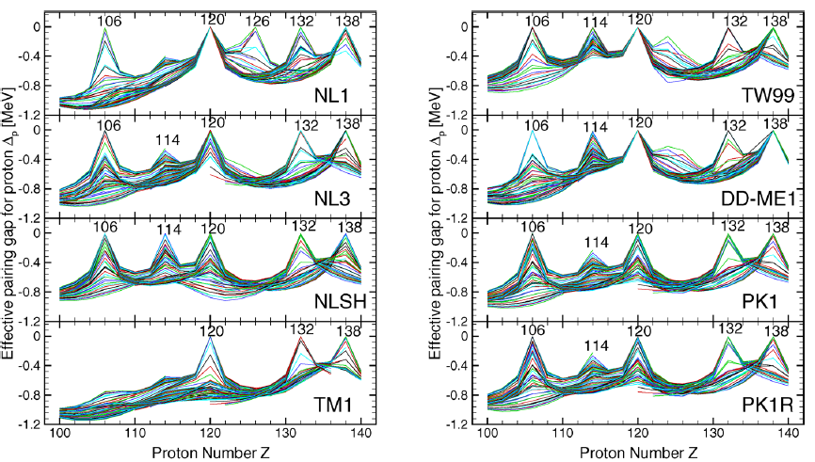

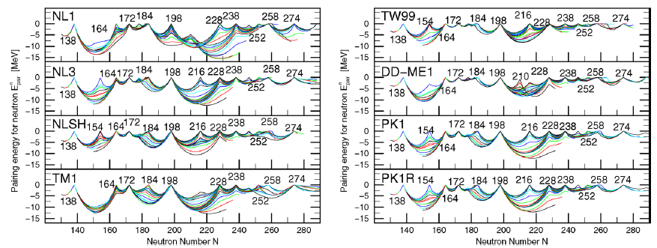
Z = 120, 132, and 138,
and N = 172, 184, 198,
228, 238, and 258 are
inferred to be magic
numbers
292120
would be doubly magic
nuclei with spherical
configuration.

Slide 14
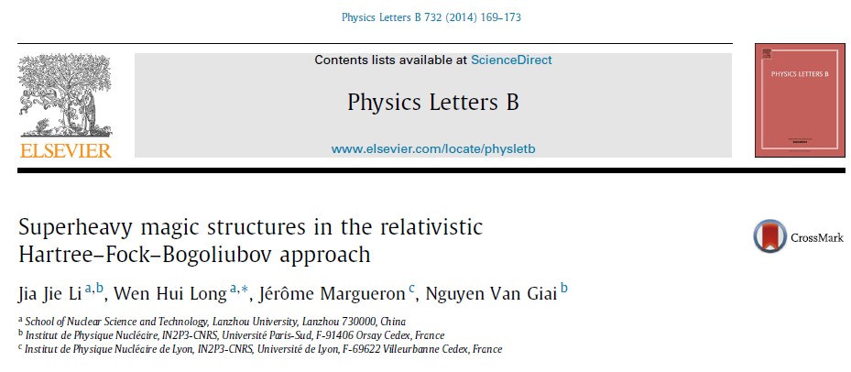
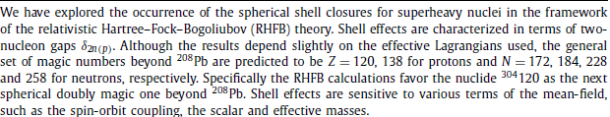
（F）Lanzhou , China

Slide 15
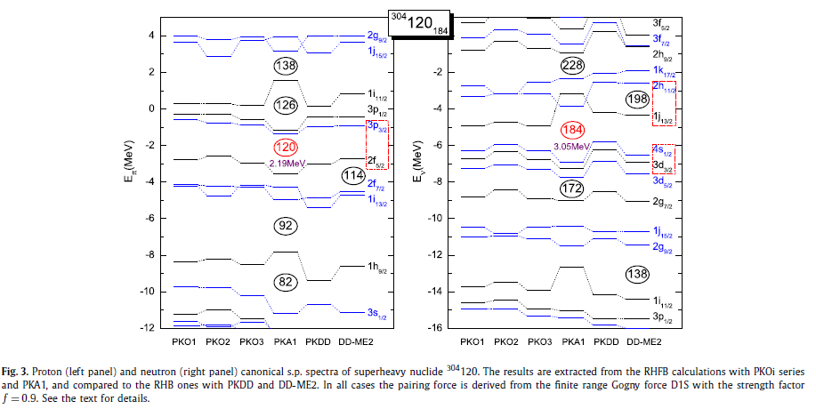

Slide 16
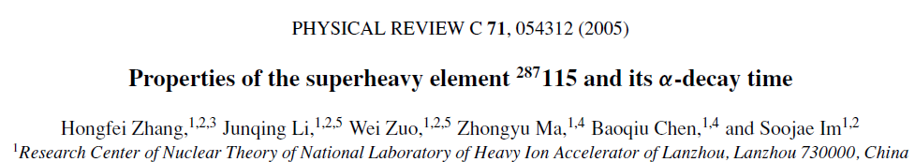
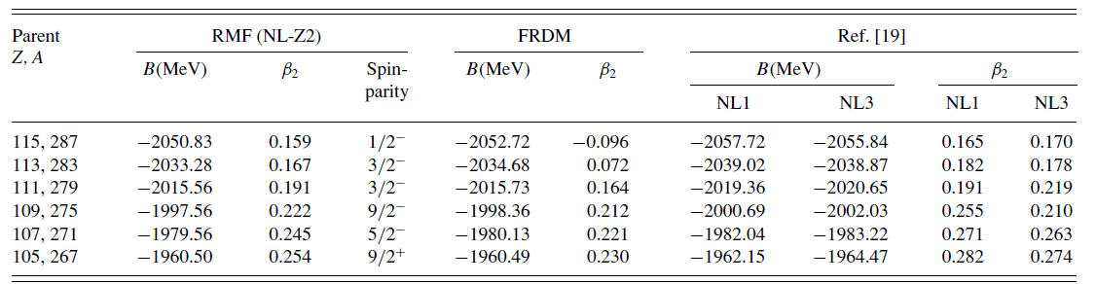
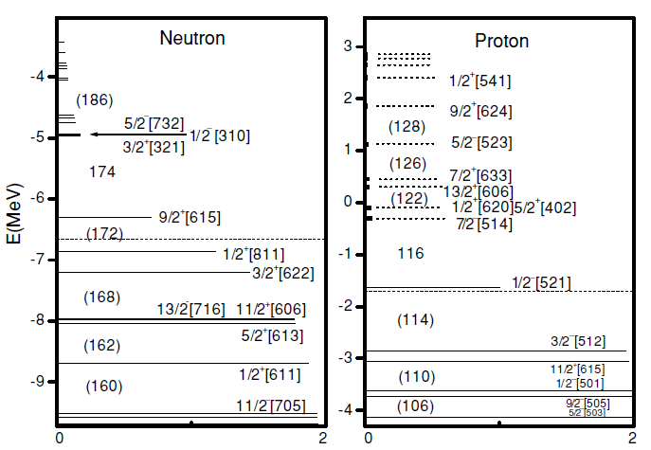

Slide 17
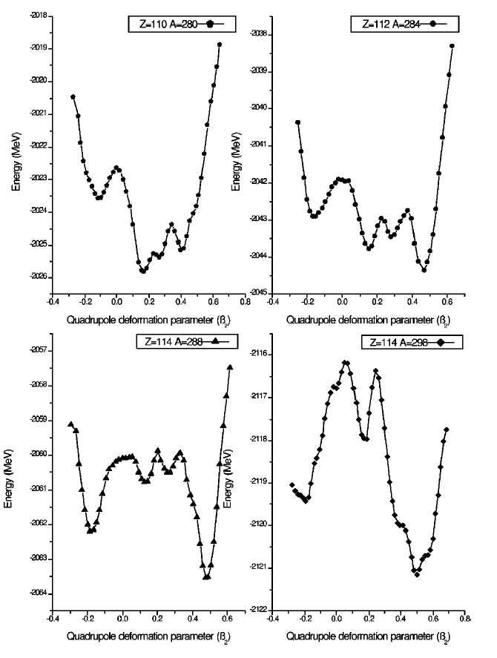

（3）对超重核性质的理论探索一直在进行……
(A) Shape coexistence in even-even superheavy nuclei
（形状共存）
relativistic mean-field theory
It reliably demonstrates that there is shape coexistence in superheavy nuclei. In some cases the configuration with superdeformation may be the ground state of superheavy nuclei near Z=114 and N=174.
Zhongzhou Ren, PRC, 65, 051304(R)(2002)

Slide 18
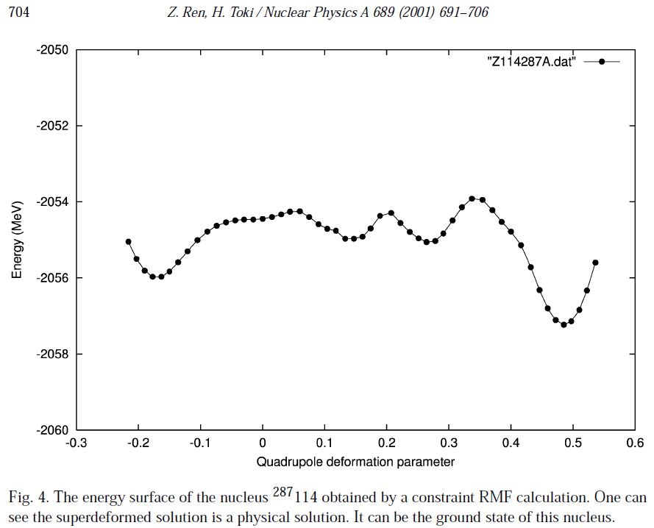
(B) Superdeformation of the superheavy nuclei (超形变）

Slide 19
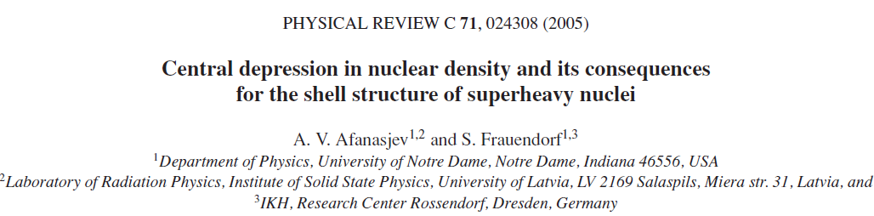
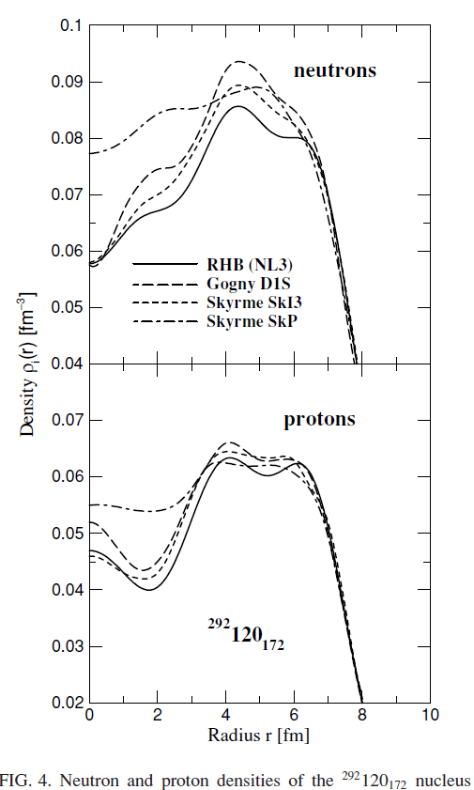
(C) Central density depression
中心密度压低

Slide 20
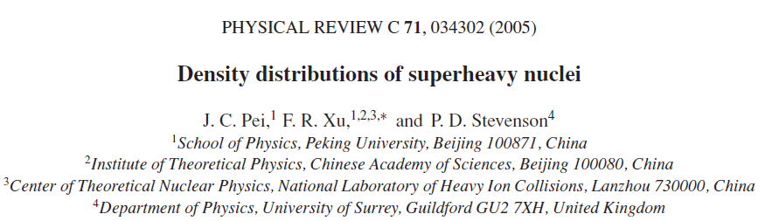
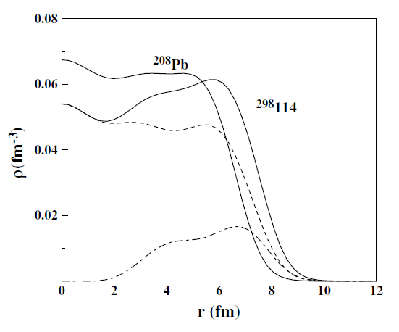
中心密度压低

Slide 21
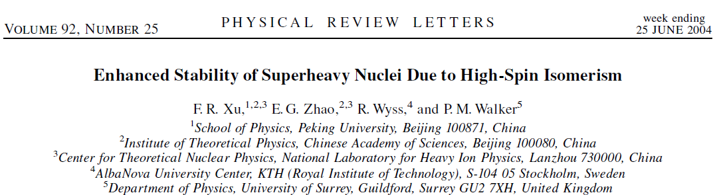
(D) Isomers in superheavy nuclei
同核异能态
In a quantal system, the ground state is usually more stable than the excited states. In contrast, in superheavy nuclei the multiquasiparticle excitations decrease the probability for both fission and decay, implying enhanced stability. Hence, the systematic occurrence of multiquasiparticle isomers may become crucial for future production and study of even heavier nuclei.
J. Dong et al. / Nuclear Physics A 832 (2010) 198–208
The long-lived isomers in superheavy nuclei region can be observed when the long-lived isomers decay to the isomeric states of the daughter nuclei

Slide 22
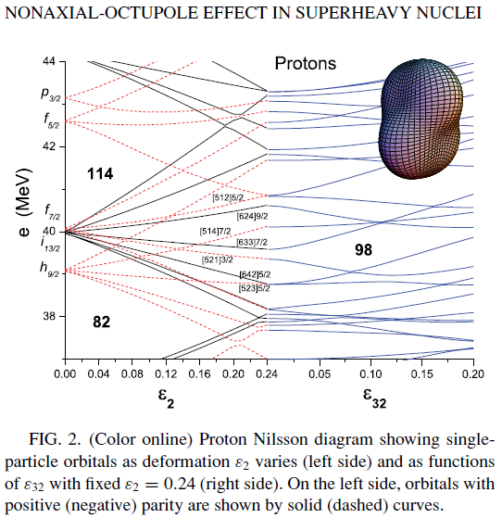
(E) Nonaxial-octupole effects in superheavy nuclei
非轴向八极形变效应
It is predicted that the strong
nonaxial-octupole effect may
persist up to the element 108.
The result thus represents the
first concrete example of
spontaneous breaking of both
axial and reflection symmetries
in the heaviest nuclear systems.
Y.-S. Chen, Yang Sun, and Zao-Chun Gao， PRC 77, 061305(R) (2008)

Slide 23
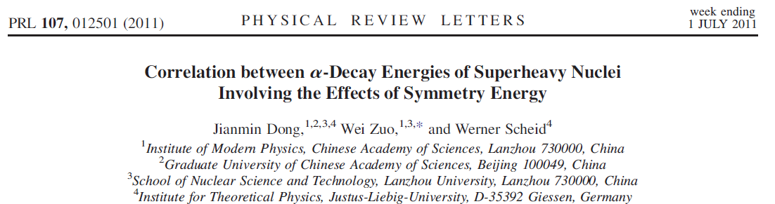
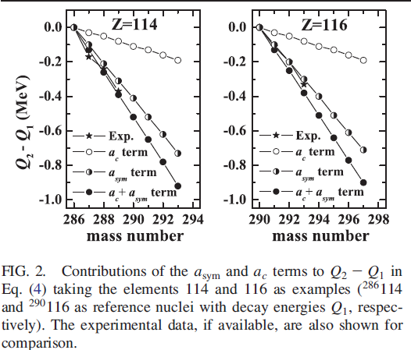


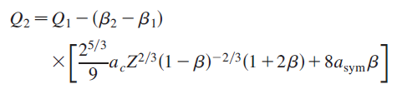
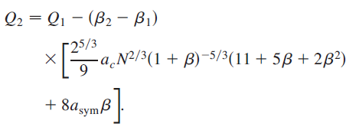
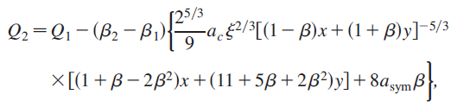
(F) Nuclear symmetry energy and the SHN
阿尔法衰变能与对称能的关系

Slide 24
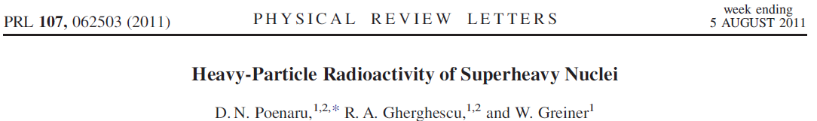
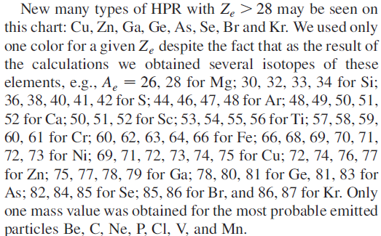
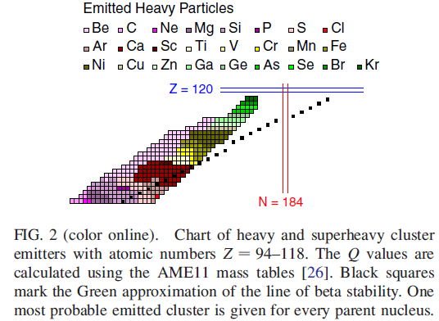
(G) Heavy-particle Radioactivity of Superheavy Nuclei
重粒子放射性

Slide 25
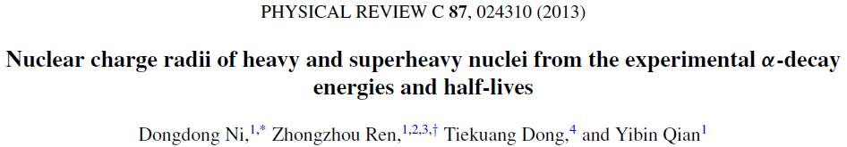
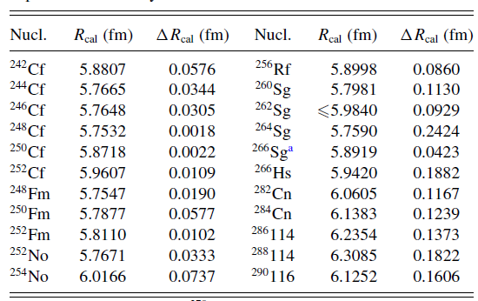
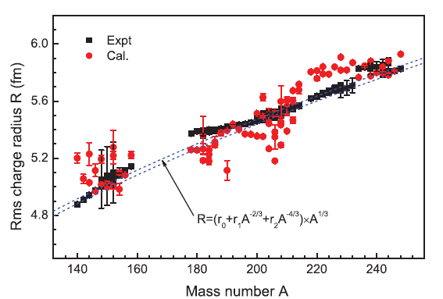
(H) Charge Radii of Superheavy Nuclei
电荷半径

Slide 26
(I) alpha-decay of Superheavy Nuclei
超重核的阿尔法衰变
南京大学 同济大学 | 兰州大学 兰州近物所 石家庄铁道大学 湖南师范大学 湖州师范学院 | 北京航空航天大学 | 南华大学 | 上海交通大学 | 广西师范大学 | 中科院理论所 | 中国原子能科学研究院
结团模型 质量公式 | 推广的液滴模型，质量公式 | 结团模型 |  | 质量公式 | 质量公式 | 半衰期
阿尔法衰变是超重核最重要的衰变模式，也是探测超重核最重要的手段。
国内外从事超重核阿尔法衰变研究的工作很多！

Slide 27
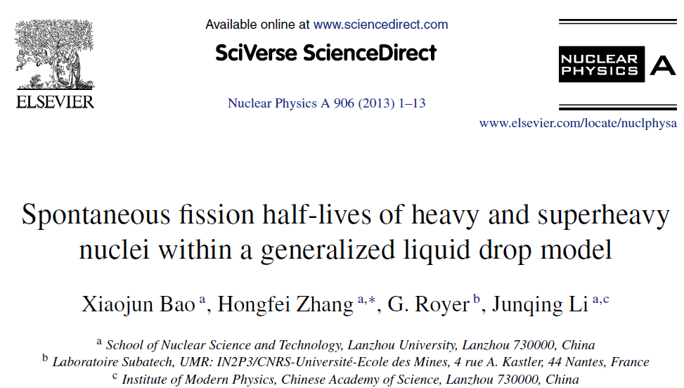
(J) Spontaneous fission of Superheavy Nuclei
超重核的自发裂变

Slide 28
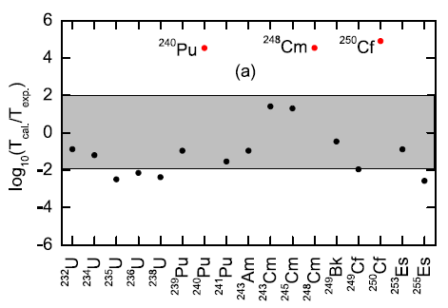
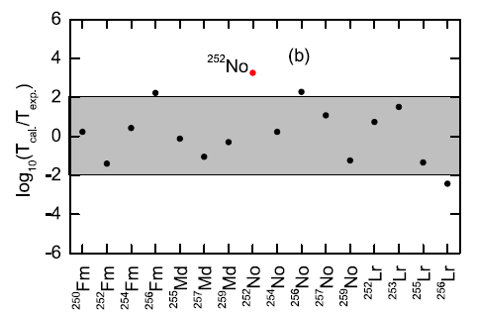


超重核自发裂变寿命

Slide 29



重核自发裂变位垒
Jie Zhao, Bing-Nan Lu , Tamara Niksik, Dario Vretenar, and Shan-Gui Zhou,
PRC 93, 044315 (2016)
PRC 89, 014323 (2014)

Slide 31



P. Moller, PRC 79, 064304 (2009)

Slide 32
(K) Ternary fission of superheavy elements
超重核的三分裂
PHYSICAL REVIEW C 93, 014601 (2016)
Ternary fission of superheavy nuclei is studied within the three-cluster model potential energy surfaces (PESs). Though the dominant decay mode of superheavy nuclei is α decay, the α-accompanied ternary breakup is found to be a nonfavorable one. Further, the prominent ternary combinations are found to be associated with the neutron magic number.

Slide 33
(L) Microscopic calculations of weak decays in superheavy nuclei
超重核的β衰变
P. Sarriguren，PHYSICAL REVIEW C 100, 014309 (2019)
The calculations correspond to six different choices for Qα values,which are labeled in the figure, and four different options for phenomenological formulas of Tα, labeled from 1 up to 4 in the x axis.
The results are compared with phenomenological α-decay half-lives, showing that the latter decay
mode is dominant in this mass region.

Slide 34


（4）近期超重核合成的理论研究（攻关如何合成Z=119、120！）
Effects of the entrance channel in the synthesis of superheavy element Z = 120
K. Nasirov, G. Mandaglio, G. Giardina, A. Sobiczewski, and A. I. Muminov，PRC 84, 044612 (2011)
The combined dinuclear system and advanced statistical models

Slide 35


dinuclear system

Slide 36


fusion-by-diffusion (FBD) model

Slide 37



Slide 38



Slide 39



Slide 40




Slide 41




dinuclear system

Slide 42
Investigations of the synthesis of the superheavy element Z = 122
PHYSICAL REVIEW C 98, 024308 (2018)

Slide 44



（5）超重核合成实验
（A) 中国兰州
甘再国
中科院近物所超重核研究组
GFSL
Gas-filled recoil separator in Lanzhou
HIRFL-CSR

Slide 45

CHIN. PHYS. LETT. Vol. 29, No. 1 (2012) 012502
²⁰⁸Pb(⁶⁴Ni, n)²⁷¹Ds (Z=110)
焦平面探测器
充气反冲谱仪
蒸发余核
靶
He
束流
PSD
Veto
已经合成Z=105、107、110号超重核
期望将来在HAIF上合成更多更重110号以上的超重核！

Slide 46

中科院B类先导专项-核物质相结构与重元素合成研究
建成超重研究专用重离子加速器，提供国际最高流强 5∼10pμA
合成铀附近新核素3-5个；研发丰中子超重核素产生、分离、鉴别关键技术
力争合成119或120号新元素、开启元素周期表第八周期
研究113号超重元素化学性质，检验元素周期律的外推性
来源于张志远

Slide 47

（B） 德国GSI
Separator for Heavy Ion Reaction Products (SHIP) at GSI
Eur. Phys. J. A (2016) 52: 278

Slide 48

德国重离子研究中心2010年2月19日宣布，经国际纯粹与应用化学联合会确认，由该中心人工合成的第112号化学元素从即日起获正式名称“Copernicium”，相应的元素符号为“Cn”。为纪念著名天文学家哥白尼 （Nicolaus Copernicus），德国重离子研究中心提出了上述命名建议。
S. Hofmann and G. Munzenberg:
Discovery of the heaviest elements
RMP 72 （2000）733
合成了Z=107到112号超重核

Slide 49


The latest superheavy nuclei
experiment.
[23] Yu. Ts. Oganessian et al.,
Phys. Rev. C 87, 054621 (2013).
[39] K.-H. Schmidt, C.-C. Sahm, K. Pielenz,
and H.-G. Clerc, Z. Phys. A 316, 19 (1984).

Slide 50


（C）美国Berkeley 国家实验室

Slide 51


Slide 52



Theoretical predictions from [17–19]
The observed alpha-decay Q values for the new isotopes were used to gain insight into the shell effects used in theoretical superheavy mass predictions.
[17] I. Muntian, Z. Patyk, and A. Sobiczewski, Acta Phys. Pol.
B 32, 691 (2001).
[18] I. Muntian et al., Acta Phys. Pol. B 34, 2073 (2003).
[19] I. Muntian, Z. Patyk, and A. Sobiczewski, Phys. At. Nucl.
66, 1015 (2003).

Slide 53


（D）日本RIKEN

Slide 54



Slide 55


（E）俄罗斯Dubna

Slide 56


俄罗斯Dubna

Slide 57


俄罗斯Dubna
Dubna合成了Z=107到118的超重核

Slide 58

期望Dubna超重核工厂建成后合成稳定岛中心区的超重核！

Slide 59

2、超重核的合成
双核模型（Dinuclear system）
蒸发剩余截面
俘获截面
熔合几率
存活几率

Slide 60

动力学形变对熔合几率和蒸发剩余截面的影响
X. J. Bao, Y. Gao, J. Q. Li , H. F. Zhang *，PRC 91, 011603(R) (2015)

Slide 61

X. J. Bao, Y. Gao, J. Q. Li , H. F. Zhang *，PHYSICAL REVIEW C 91, 011603(R) (2015)

Slide 62

The ERCS for producing element
119 and 120 are small but are still
within the achievement of the
current experimental equipment.
The maximum ERCS to produce
element 119 is one order of
magnitude larger than that to
produce element 120.
X. J. Bao, Y. Gao, J. Q. Li , H. F. Zhang *，PHYSICAL REVIEW C 91, 011603(R) (2015)

Slide 63
原子核性质对蒸发剩余截面的影响
趋势完全一致！
X. J. Bao,Y. Gao, J. Q. Li,
H. F. Zhang, PRC 92, 014601 (2015)

Slide 64


X. J. Bao,Y. Gao, J. Q. Li,
H. F. Zhang, PRC 92, 014601 (2015)

Slide 65





Slide 66



Slide 67


X. J. Bao,Y. Gao, J. Q. Li,
H. F. Zhang, PRC 92, 014601 (2015)
FRDM：50Ti+248Cf, ERC:0.186Pb
54Cr+248Cm, ERC:0.062Pb
KTUY：50Ti+249Cf, ERC:6.57Pb
54Cr+248Cm, ERC:11.3Pb

Slide 68
准裂变碎片总动能分布
S. Q. Guo, Y. Gao, J. Q. Li, H. F. Zhang，
PRC 96, 044622 (2017)

Slide 69
S. Q. Guo, Y. Gao, J. Q. Li,
H. F. Zhang，
PRC 96, 044622 (2017)

Slide 70
S. Q. Guo, Y. Gao, J. Q. Li, H. F. Zhang，PRC 96, 044622 (2017)

Slide 71
理论模型：相对论平均场
3 超重核的结构
（Prog. Part. Nucl. Phys., 1996, 37:193 )

Slide 72
Hongfei Zhang, Junqing Li, Wei Zuo, Zhongyu Ma, Baoqiu Chen, and Soojae Im, PRC 71, 054312 (2005)

Slide 73
Qi-Xin Yu, Jun-Qing Li, Hong-Fei Zhang Commun. Theor. Phys. 67 (2017) 83–89

Slide 74
推广的液滴模型
4 超重核的衰变
Like other liquid drop models, the macroscopic total energy includes the volume,
surface, Coulomb and rotating energies:
Two improvements of the conventional liquid drop model:
Quasi-molecular Deformation Mechanism.
The proximity energy.

Slide 76

(1) α decay

Slide 77


Slide 80


Slide 82

Preformation factor of Alpha particle
The decay constant of alpha emission is,
E is the energy of alpha particle, corrected for recoil.
M is the mass of alpha particle。
P₀ , the preformation factor can be extracted form
the experimental alpha decay half-live and

Slide 84


Slide 85


Slide 86


Continue the work on alpha decay,

Slide 87
The closed shell structures play the key role for the preformation of a alpha
preformation mechanism, and the more the nucleon number is close to the
magic numbers, the more the preformation of alpha cluster is difficult inside
the mother nucleus.

Slide 88



Slide 89

H. F. Zhang, Y. Gao, N. Wang, J. Q. Li, E. G. Zhao, and G. Royer，PRC 85, 014325 (2012)

Slide 90

H. F. Zhang, Y. Gao, N. Wang, J. Q. Li, E. G. Zhao, and G. Royer，PRC 85, 014325 (2012)

Slide 91

H. F. Zhang, Y. Gao, N. Wang, J. Q. Li, E. G. Zhao, and G. Royer，PRC 85, 014325 (2012)

Slide 92

(2) Cluster radioactivity
Cluster radioactivity (heavy-ion radioactivity) was first theoretically predicted in the beginning of the 1980s by Sandulescu, Poenaru, and Greiner [Sov. J. Part. Nucl. 11, 528 (1980)].
The cluster radioactivities from 224Ra and 223Ra
were predicted in the left text book, which
is published in 1981 (first edit).

Slide 93


The first observation was the detection of 14C emitted from 223Ra by Rose and Jones [Nature (London) 307, 245 (1984)].
$${}^{223}Ra C^{14} +{}^{209}Pb$$
Q is 32 MeV
Up to now, many cluster heavier than 14C radioactivities have been observed, such as 20O, 23F, 24-26Ne, 28-30Mg and 32Si, the decay parent nuclei are actinide elements: Fr, Ra, Ac, Pa, Th, U, Pu and other heavier nuclei.

Slide 94



Cluster preformation law was proposed in 1988.
R. Blendowske and H. Walliser,
Phys. Rev. Lett. 61, 1930 (1988).

Slide 95




The cluster preformation law was confirmed recently in the framework of GLDM.
H. F. Zhang, J. M. Dong, G. Royer, W. Zuo,
J. Q. Li, PRC 80, 037307 (2009).

Slide 96



H. F. Zhang, J. M. Dong, G. Royer, W. Zuo,
J. Q. Li, PRC 80, 037307 (2009).

Slide 97



Heavy-Particle radioactivity of superheavy nuclei

Slide 98


D. N. Poenaru, R. A. Gherghescu, W.Greiner，PRL 107, 062503 (2011)

Slide 99
Cluster preformation law
R. Blendowske and H. Walliser,
Phys. Rev. Lett. 61, 1930 (1988).

Slide 100




(a) Methods
R. Blendowske and H. Walliser,
Phys. Rev. Lett. 61, 1930 (1988).
When experimental half lives of the cluster radioactivity are not available, the following formula has been adopted to obtain the cluster radioactivity half life,
C. Qi, F. R. Xu, R. J. Liotta, and R. Wyss,
Phys. Rev. Lett. 103, 072501 (2009).

Slide 101

(b) Potential Barrier
K. Wei and H.F. Zhang, PHYSICAL REVIEW C 96, 021601(R) (2017)

Slide 102


(c) Preformation Factor and Cluster structure
K. Wei and H.F. Zhang,
submitted to PRC (2017)

Slide 103

(d) Preformation Factor and Daughter Nuclei
K. Wei and H.F. Zhang, PHYSICAL REVIEW C 96, 021601(R) (2017)

Slide 104




(e) Preformation Factor and Mother Nuclei
K. Wei and H.F. Zhang, PHYSICAL REVIEW C 96, 021601(R) (2017)

Slide 105
The cluster preformation factor has been extracted for heavy and superheavy nuclei by a preformed cluster model with the help of experimental.
The calculated results show that the preformation factor is nuclear structure dependent of the emitted cluster and mother nucleus.
The previous cluster preformation law breaks down when the mass number of the emitted cluster Ac > 28, and the new experiential cluster preformation formulae are proposed for heavy and superheavy nuclei
The main needs is experimental results of cluster radioactivity for superheavy nuclei
The microscopic calculation on preformation factor is necessary and timely.

Slide 106
(3) Spontaneous fission
Xiaojun Bao, Hongfei Zhang, G. Royer,
Junqing Li,NPA 906(2013)1

Slide 107
Xiaojun Bao, Hongfei Zhang, G. Royer,Junqing Li,NPA 906(2013)1

Slide 108
Xiaojun Bao, Hongfei Zhang, G. Royer,Junqing Li,NPA 906(2013)1

Slide 109







两边乘

Slide 110






Slide 111

5、总结和展望
（1）超重核的实验和理论研究取得了很大的进展，确定超重核稳定岛还有很
长的路要走！提出了挑战，同时也带来了机遇！
A、合成超重核的挑战 ----------- 蒸发剩余截面太小，已达到目前的实验极限。
带来的机遇 ---------- 探索新的合成机制。
吴老师在2012超重核合成与性质研讨会上提出！

Slide 112


揭示了U+U等重核大质量
转移反应对产生丰中子
超重核是非常有利的。
吴锡真，赵凯，李祝霞，
王宁，田俊龙，张英逊,
原子核物理评论, 30 （2013）221
About 60 unknown neutron-rich isotopes from elements Ra (Z = 88) to Db
(Z = 105) can be produced with the production cross sections above the lower bound of 10^−8 mb in this reaction.

Slide 113




Multinucleon transfer reactionsare a viable pathway to the production of new transuranium isotopes.

Slide 114


Dinuclear system model
The low-energy transfer reactions in the damped collisions of the actinide nuclei are a good mechanism for producing neutron-rich heavy isotopes, in which shell closure plays an important role in the estimation of the cross sections.

Slide 115
For the production of superheavy elements the
advantage of 238U projectiles would be the very
large mass transfer probability and the high neutron-to-proton ratio which makes it possible to reach neutron-rich areas in the “island of stability”.
PHYSICAL REVIEW LETTERS，48（1982）852
248Cm靶产生Fm元素的截面达到了约10mb，
比238U提高了3个量级。不难想象，通过这
样的多核子转移，合成超重核是可能的。
林承键《重离子核反应》P126
转移反应的理论工作：
time-dependent Hartree-Fock
PRC 100, 014612 (2019)
Production of light neutron-rich nuclei in multinucleon transfer reactions，Xiaojun Bao，NPA 986（2019）60.
Multinucleon transfer in the 136Xe+208Pb reaction，Cheng Li, Fan Zhang, Jingjing Li, Long Zhu, Junlong Tian, Ning Wang, Feng-Shou Zhang，PRC 93, 014618 (2016).

Slide 116

B、研究超重核结构的挑战 ----------- 存活时间太短，不宜直接研究其微观
结构等性质。
带来的机遇 ---------- 研究锕系及较轻超重核的结构性质以及微观结构随形
变的演化，得到可靠的自旋轨道耦合强度等信息，从而确定超重核的单粒
子能级。

Slide 117

由中子幻数N=126附近的能级结构，推测Z=126附近质子幻数

Slide 119

C、超重核衰变性质的挑战 ----------- 远离稳定核，直接外推理论模型得到
的结果，不确定性大。
带来的机遇 ---------- 建立与完善能精准预言衰变能及位垒等性质的理论模型。

Slide 120


Slide 121


Slide 122


Slide 123


Slide 124





Slide 125


改进算法1

Slide 126


Slide 127



改进算法2
J. Phys. G: Nucl. Part. Phys. 44 (2017) 045110

Slide 128
各种模型的结合能均方根偏差
Model FRDM GHFB SHFB RMF WS4 (+RBF) WS+BCS(+RBF) LD(+LMNN)
RMS(MeV) 0.57 0.798 0.581 1.1 0.298 (0.170) 0.496(0.323) 2.455(0.235)

Slide 129
谢谢！

