Slide 1
Electromagnetic field and anomalous transports
Xu-Guang Huang
（黄旭光）
Fudan University
July 20, 2021 @ Huzhou

Slide 2
Note: There are many related works on this topic so that I cannot quote them all in this lecture. So I will keep only a few references which are essential for the discussions. I am sorry for not reflecting other relevant works.
2

Slide 3
Electromagnetic fields in heavy-ion collisions

Slide 4
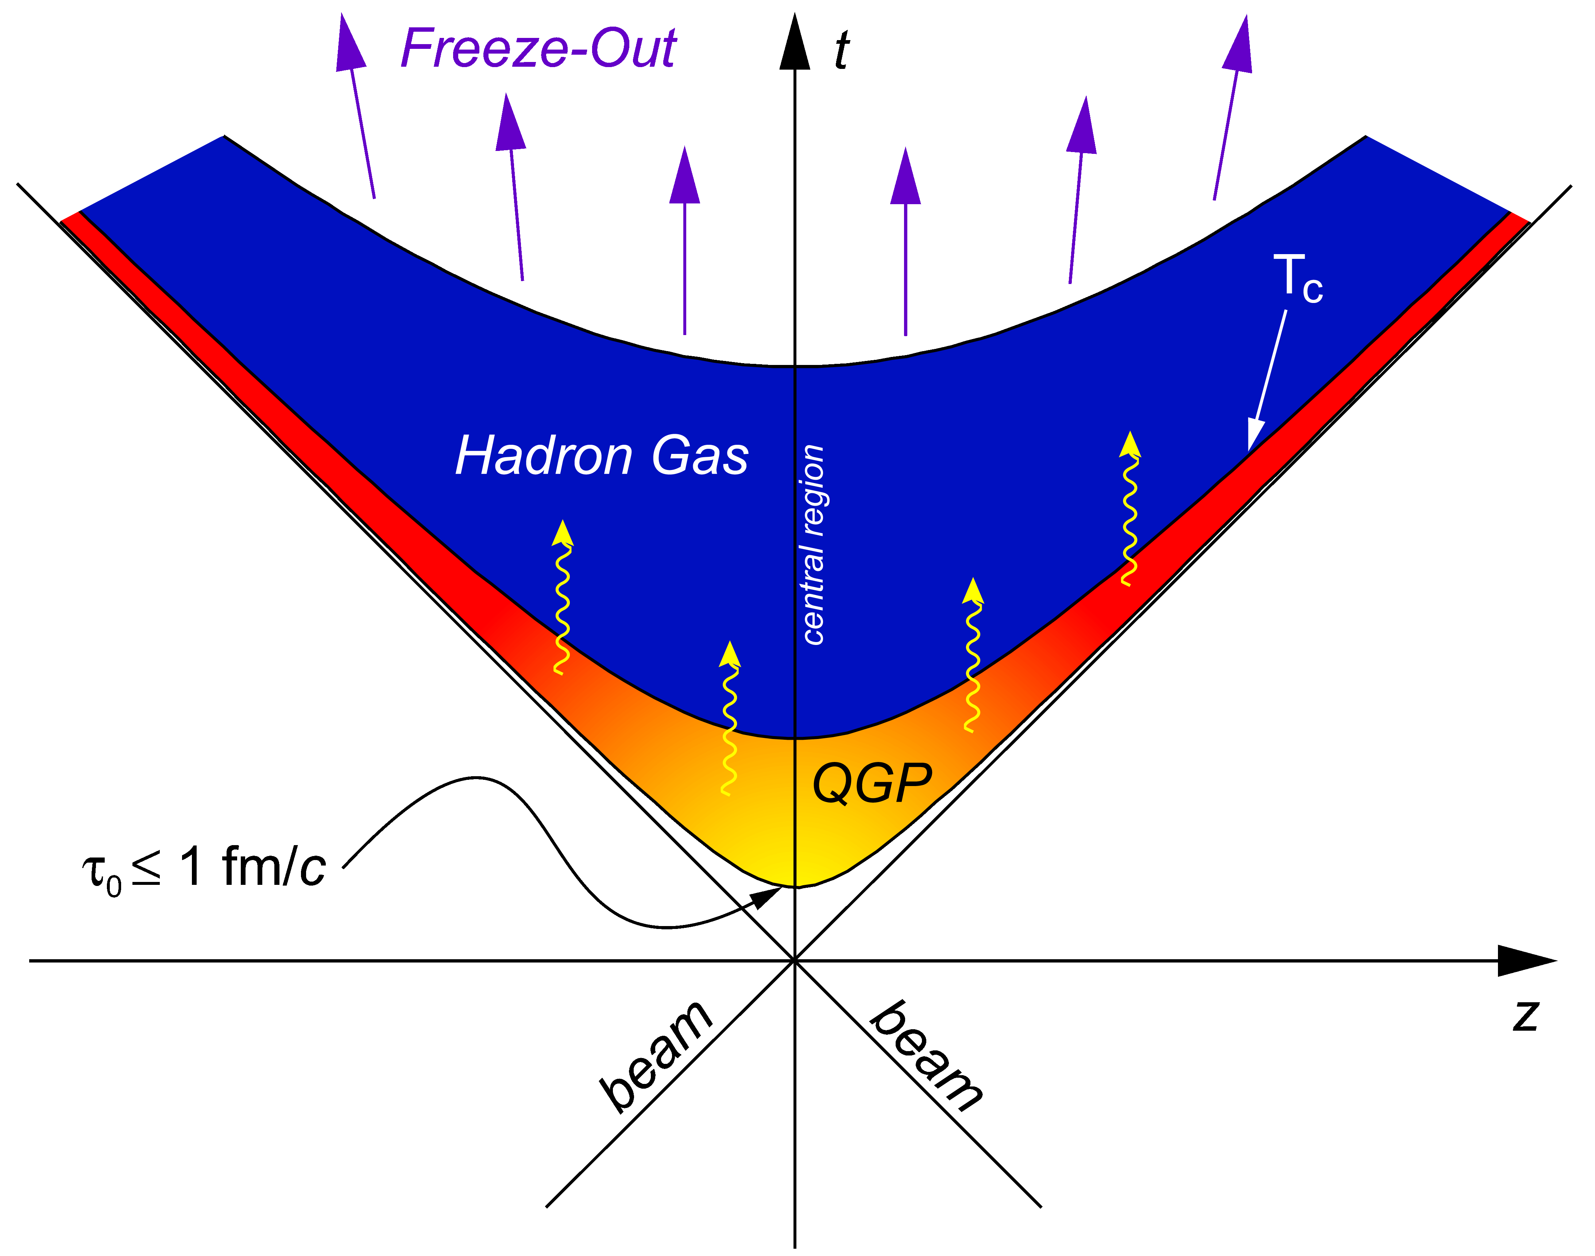
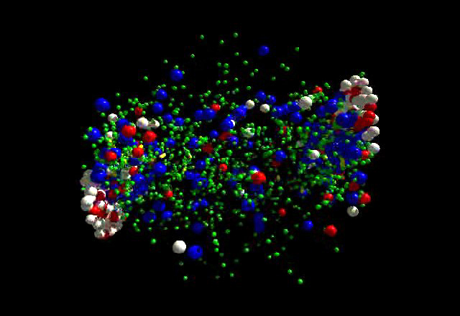
Time Scales of a Relativistic Heavy Ion Collisions
soft physics
regime
e.m. probes (l⁺l⁻, γ)
hard (high-p_{T}) probes
Chemical freezeout (T_{ch} ≤ T_{c}) : inelastic scattering stops
Kinetic freeze-out (T_{fo} ≤ T_{ch}): elastic scattering stops
4

Slide 5
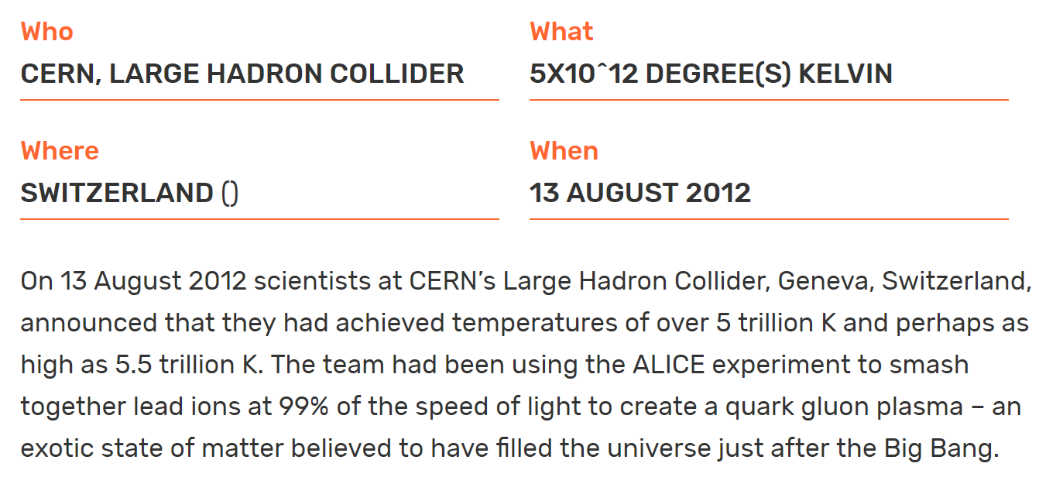
https://www.guinnessworldrecords.com/world-records/highest-man-made-temperature
5

Slide 6
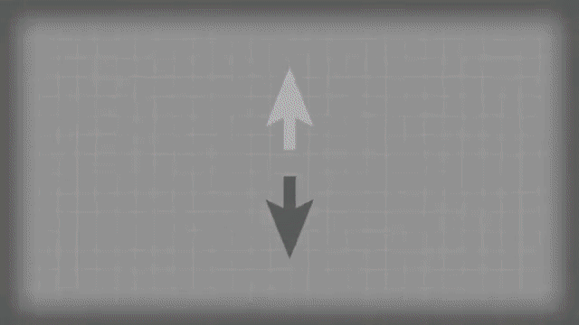
The strongest magnet!
Cartoon from BNL
6

Slide 7
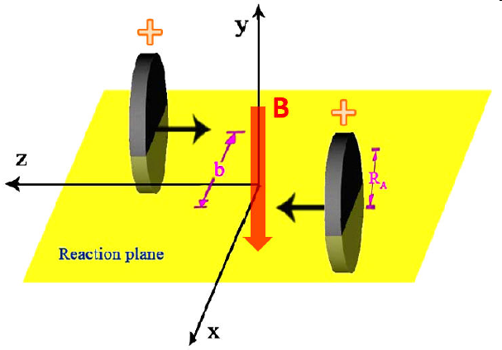
The strongest magnet!
7

Slide 8
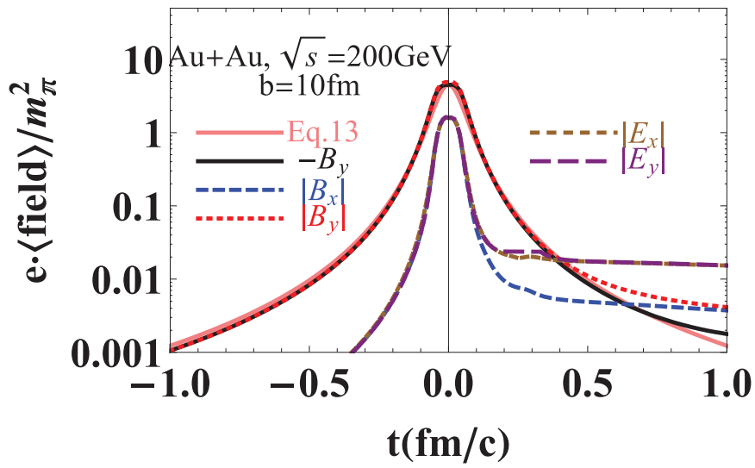
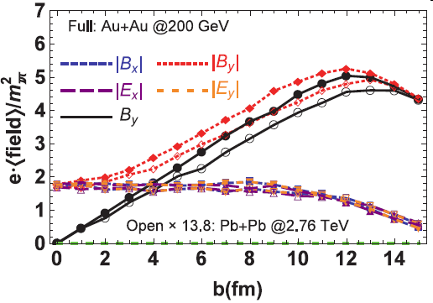
The strongest magnet!
arXiv:1201.5108
arXiv:1509.04073
Strongest B fields we have known in current universe: $eB\sim {10}^{18}$ G (RHIC)- ${10}^{20}$G (LHC)
8

Slide 9
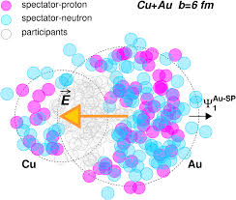
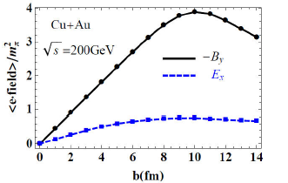
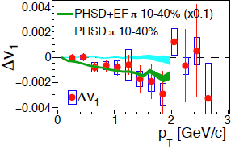
The strongest electric field!
arXiv:1411.2733
Charge dependence of v1
9

Slide 10
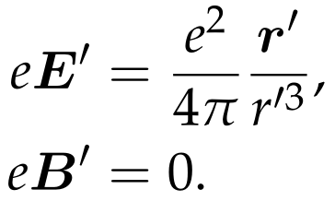
How to compute the EM fields?
Consider a moving point charge (for example, a proton):
$$e$$
In the rest frame (with a prime):
In the Lab frame:
Coordinate relation:
$$r$$
$$R=r−r_{p}$$
Lab frame
$$r_{p}$$
Charge at $t$
Rest frame at $t_{p}$
Retardation effect
10

Slide 11
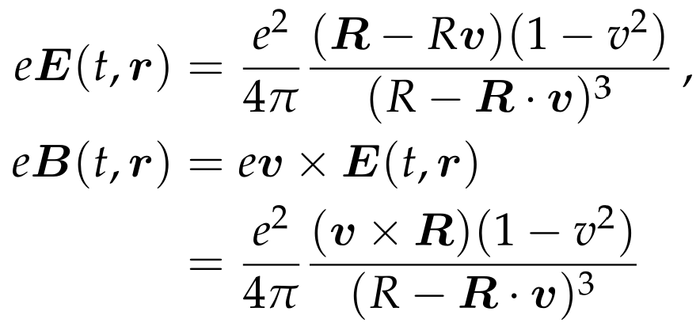
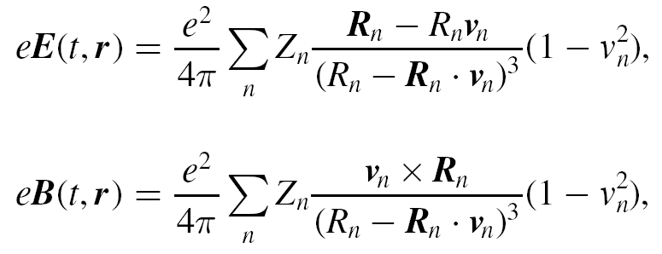
How to compute the EM fields?
Combine the equations above (Homework):
Extended to N particles (e.g., for Au, N=79):
$Z_{n},v_{n}=$ charge and velocity of the nth particle
This is the Lienard-Wiechert formula
11

Slide 12
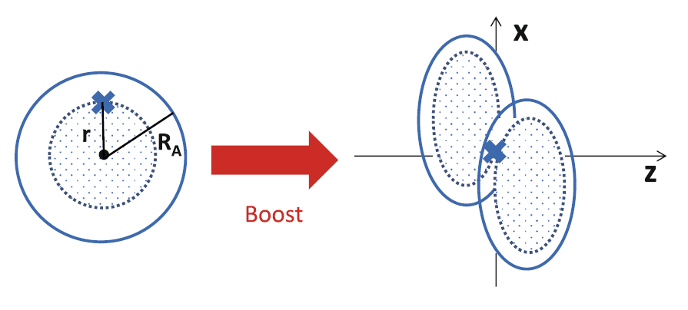
How to compute the EM fields?
From HIJING or AMPT or UrQMD or other event generators, applying these formulas give the EM fields shown before.
As an exercise, we consider continuous charge distribution as an approximation.
12

Slide 13
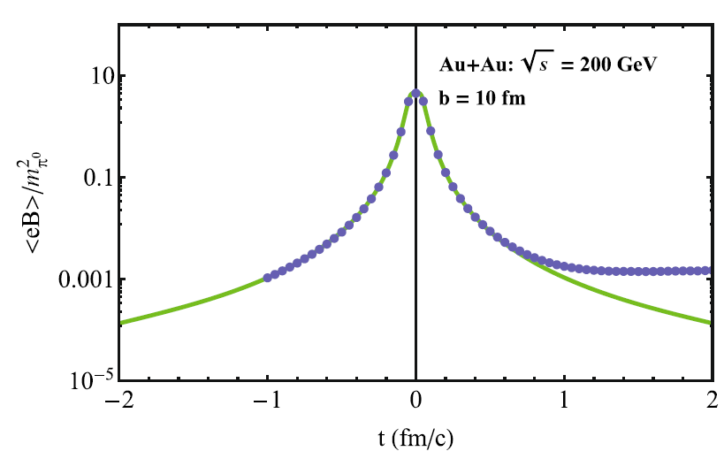
How to compute the EM fields?
Homework: using this continuous approximation, calculate the magnetic field at the center of the collision region in Au + Au collisions at 200 GeV.
Answer:
HIJING model
arXiv: 1609.00747
Continuous approximation
13

Slide 14
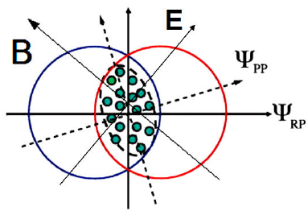
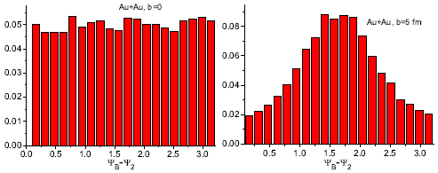
Some properties of EM field in HICs
Azimuthal fluctuation
arXiv: 1209.6594
Time evolution of the B field (vacuum)
Well fitted by
Life time of B field
arXiv:1509.04073
14

Slide 15
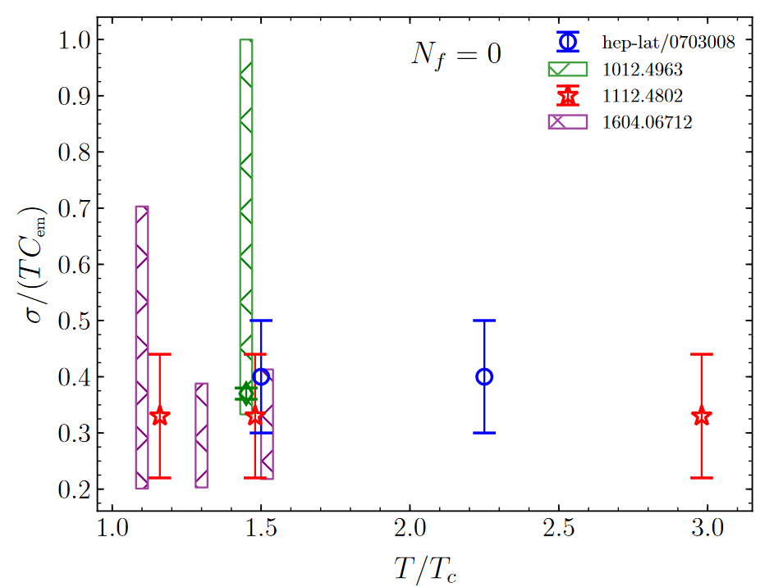
Some properties of EM field in HICs
Quark gluon plasma (QGP) is a very good conductor
Time evolution of the B field (conducting medium)
$$J$$
B
B
In vacuum: moving charges
In conductor: Faraday effect
15

Slide 16
Some properties of EM field in HICs
Time evolution of the B field (conducting medium): Solving the coupled Boltzmann and Maxwell equations
arXiv: 2104.00831
Initial condition for EM field: moving colliding nuclei in vacuum
Initial condition for q and g: CGC inspired distribution
Plus s, u channels
16

Slide 17
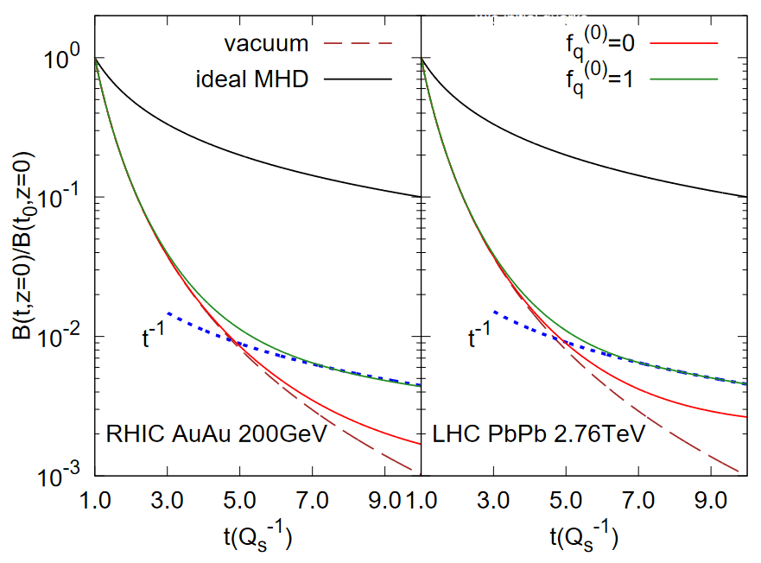
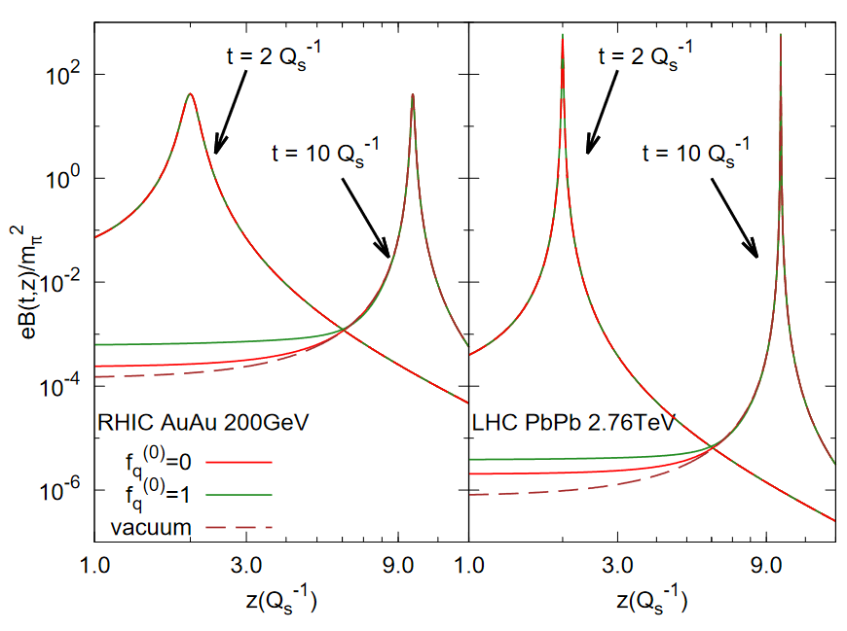
Some properties of EM field in HICs
Time evolution of the B field (conducting medium): Solving the coupled Boltzmann and Maxwell equations
arXiv: 2104.00831
After the kinetic evolution, the system is thermalized, and after that the time evolution can be obtained by solving relativistic magnetohydrodynamics.
Discussed in Shi Pu’s lecture.
But the full time evolution is still unknown.
17

Slide 18
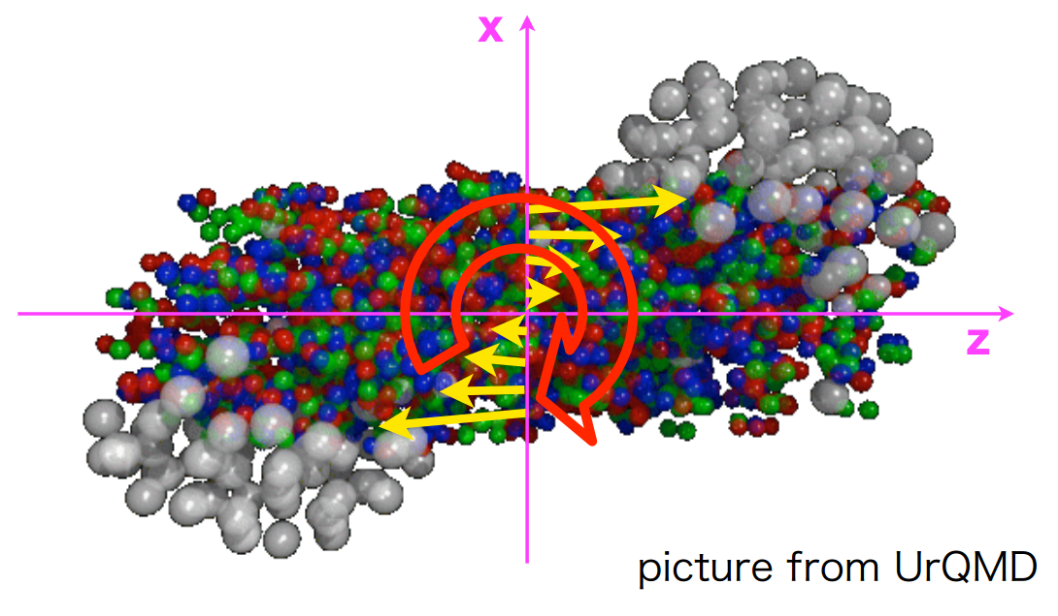
Angular momentum in HICs
$⨀$ y
$$P_{z}\sim \frac{A\sqrt{s}}{2}$$
+
$$J_{0}\sim \frac{Ab\sqrt{s}}{2}\sim {10}^{6}ℏ$$
Global angular momentum
(RHIC Au+Au 200 GeV, b=10 fm)
18

Slide 19
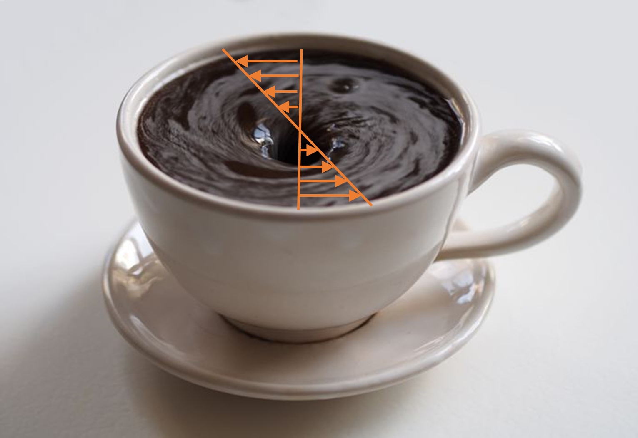
Fluid vorticity in HICs
Global angular momentum
Local fluid vorticity
$$ω=\frac{1}{2}∇×v$$
(Angular velocity of fluid cell)
Let us estimate the vorticity:
19

Slide 20
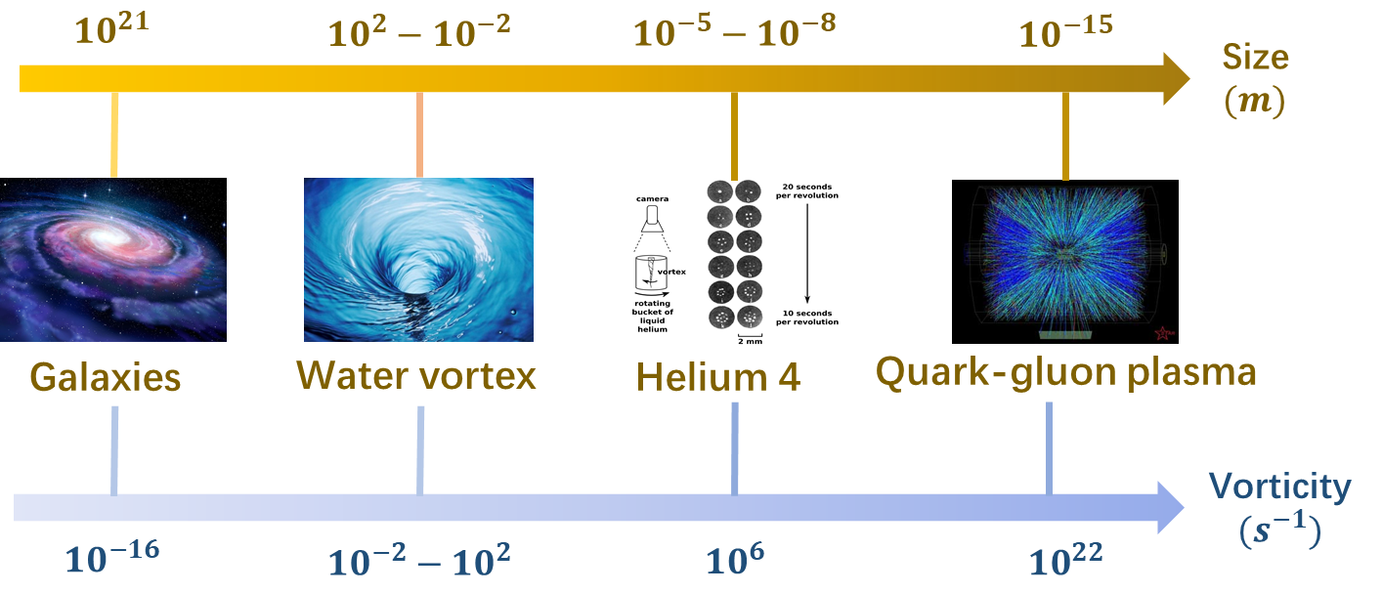
Fluid vorticity in HICs
Let us estimate the vorticity:
Consider Au+Au@200GeV, $T=300$MeV, system size 10 fm (Homework):
20

Slide 21
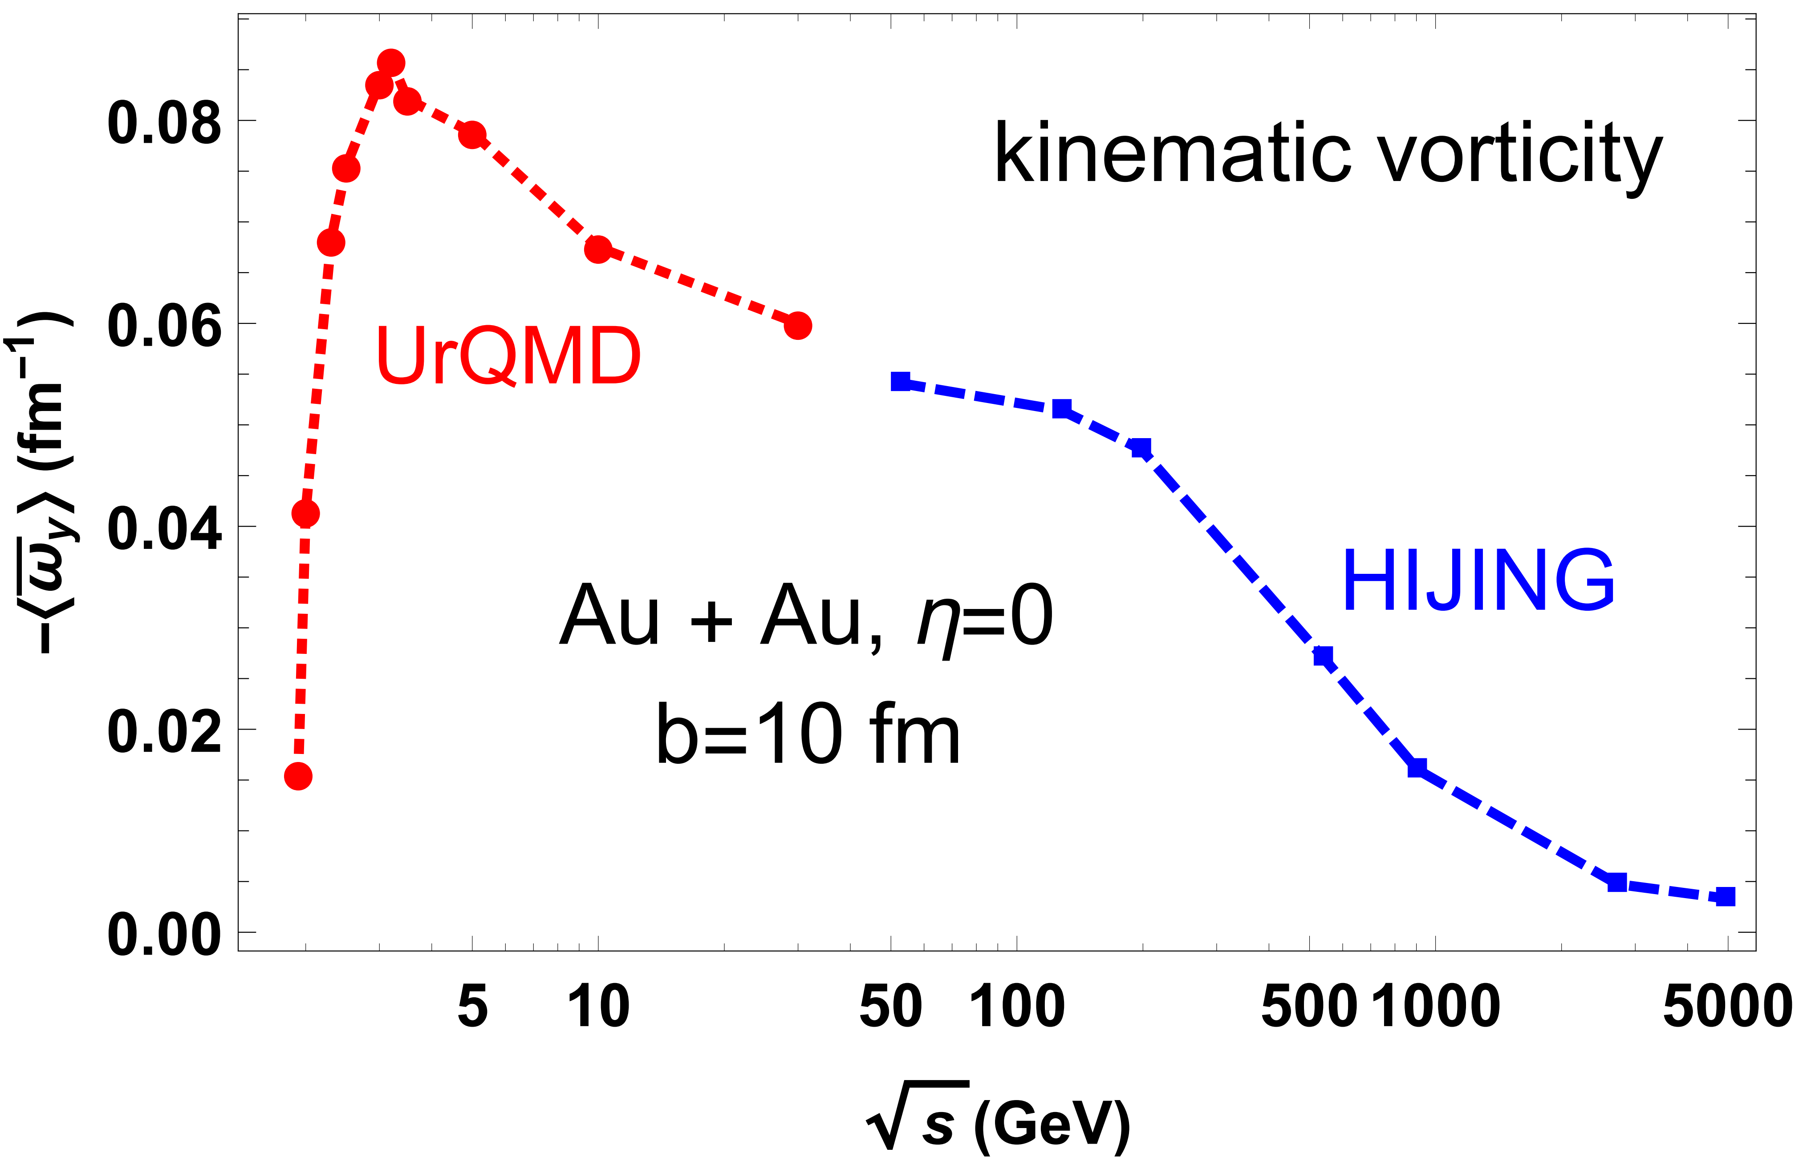
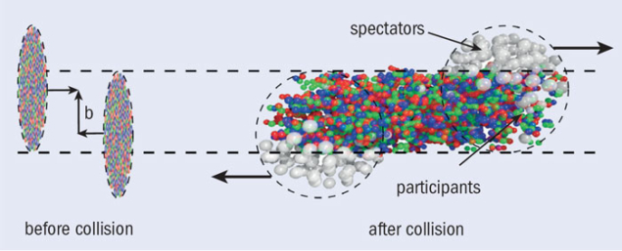
Fluid vorticity in HICs
More rigorous computation:
arXiv:1603.06117,
arXiv:2001.01371,
arXiv:2002.07549
Why decreasing with increasing energy?
21

Slide 22
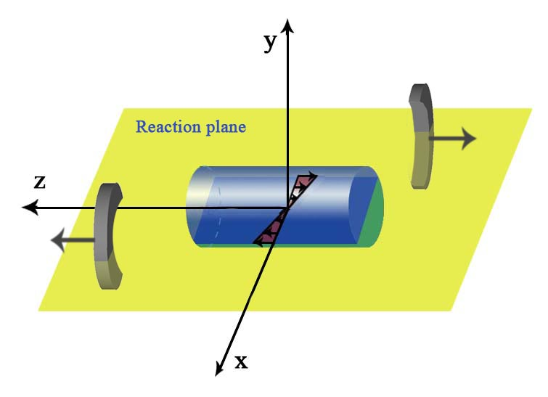
Heavy-ion collisions can generate
$$ω$$
Strongest EM fields
Largest local vorticity
What are the novel effects to the QGP?
Anomalous chiral transports
22

Slide 23
Chiral anomaly and anomalous transports

Slide 24
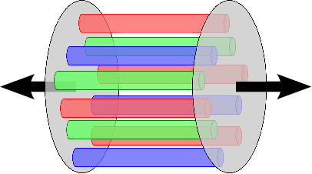
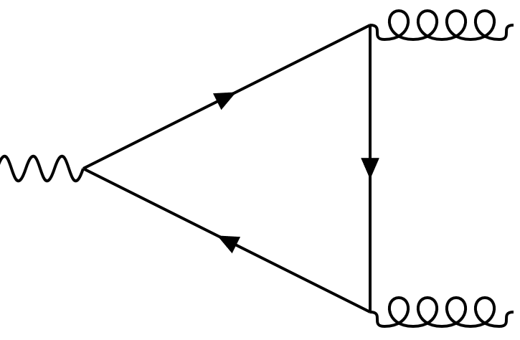
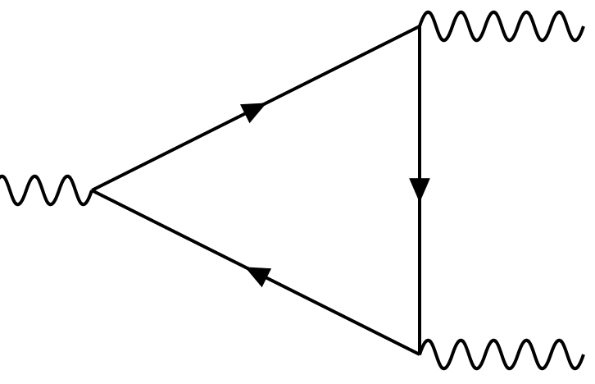
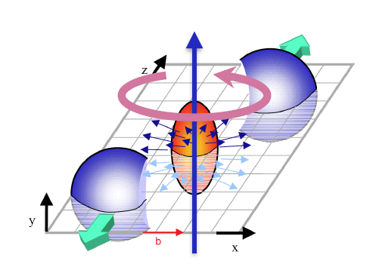
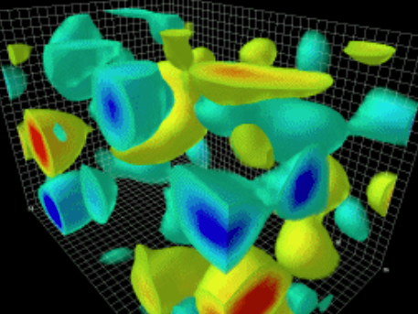
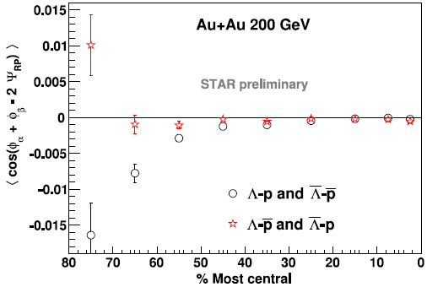
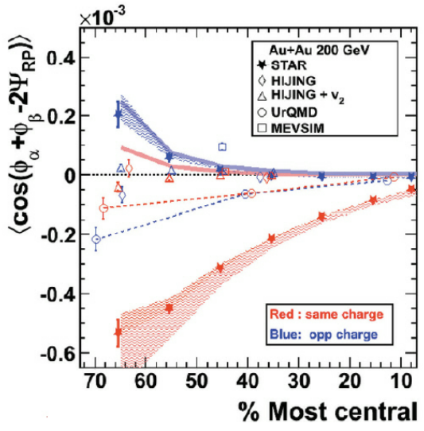
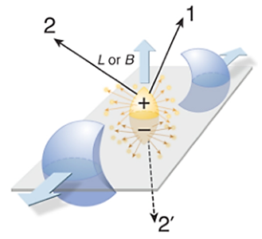
Probe QCD topological sector
QCD chiral anomaly
QED chiral anomaly
B,ω
$$μ_{A}$$
$$J_{V}$$
Chiral magnetic/ vortical effects
Initial state topological fluctuations
Observable: e.g. $γ$-correlator
(Voloshin 2004)
(STAR 2009, 2014)
24

Slide 25
QED vacuum
In 3+1 dimension, QED Hamiltonian
QED vacuum
Thus QED vacuum is described by pure gauge
Consider the Chern-Simons term (magnetic helicity) which counts the winding number of magnetic lines (and thus is topological)
It is zero in (3+1)-D QED vacuum. So QED vacuum is topologically trivial.
*Note: in (1+1)-D, QED vacuum is topologically nontrivial.
25

Slide 26
QCD vacuum
In 3+1 dimension, QCD Hamiltonian
QCD vacuum
Thus QCD vacuum is described by pure gauge
Consider the Chern-Simons term (the coupling constant is absorbed into gauge field)
$$N_{CS}=\frac{1}{24π^{2}}\int{ⅆ^{3}x}ε^{ⅈjk}tr\left[\left(U^{−1}∂_{i}U\right)\left(U^{−1}∂_{j}U\right)\left(U^{−1}∂_{k}U\right)\right], U∈SU(3)$$
It is non-zero! So in (3+1)-D QCD vacuum is topologically non-trivial!
*Homework: Show that N_CS is an integer and counting the winding number from S^3 to S^3
26

Slide 27
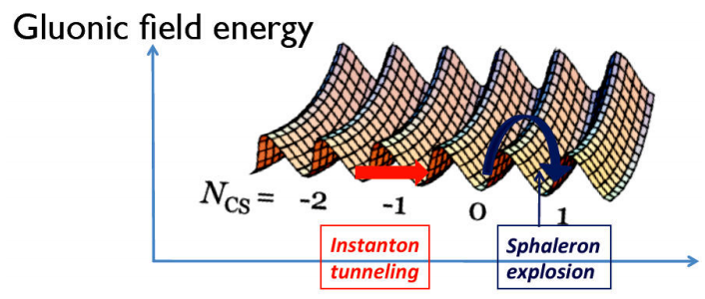
QCD vacuum
QCD topologically nontrivial vacuum: The theta vacuum
Transition between 2 vacua is topological (e.g., Instanton, sphaleron)
$$N_{CS}=\frac{1}{24π^{2}}\int{ⅆ^{3}x}ε^{ⅈjk}tr\left[\left(U^{−1}∂_{i}U\right)\left(U^{−1}∂_{j}U\right)\left(U^{−1}∂_{k}U\right)\right], U∈SU(3)$$
$$Q=\frac{1}{32π^{2}}\int{ⅆ^{4}x}G_{μν}^{a}{\tilde{G}}_{a}^{μν}=N_{CS}\left(t=∞\right)−N_{CS}(t=−∞)$$
27

Slide 28
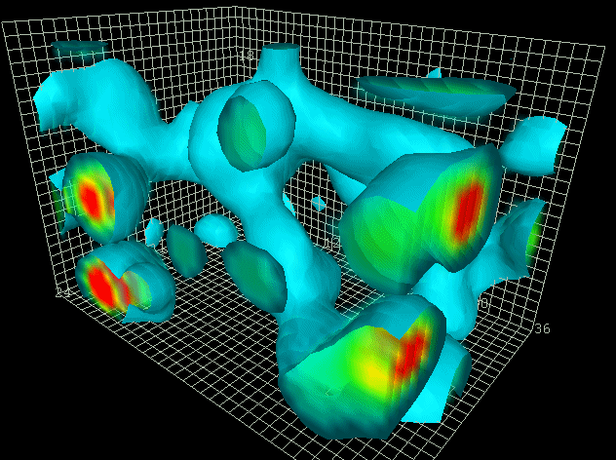
Topological fluctuation of QCD vacuum
Lecture 5: Quark-gluon plasma (2)
Derek Leinweber
28

Slide 29
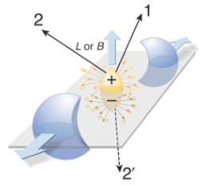
Anomalous transports in HICs
QCD triangle anomaly
$$μ_{A}$$
B,ω
$$J_{V}$$
CME/CVE
QED triangle anomaly
Initial state topological fluctuations
29

Slide 30
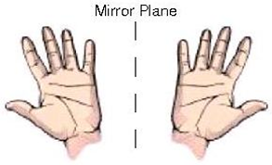
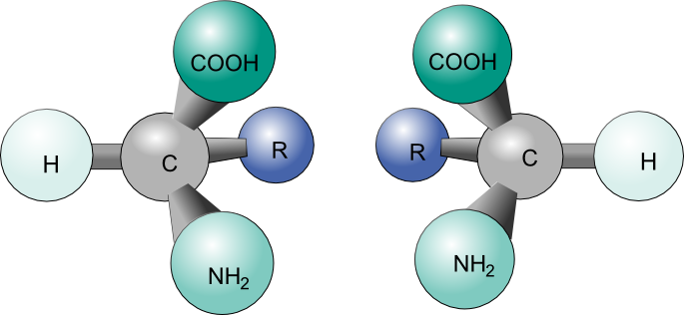
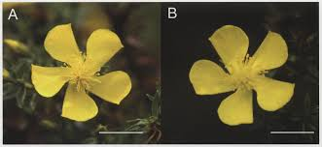
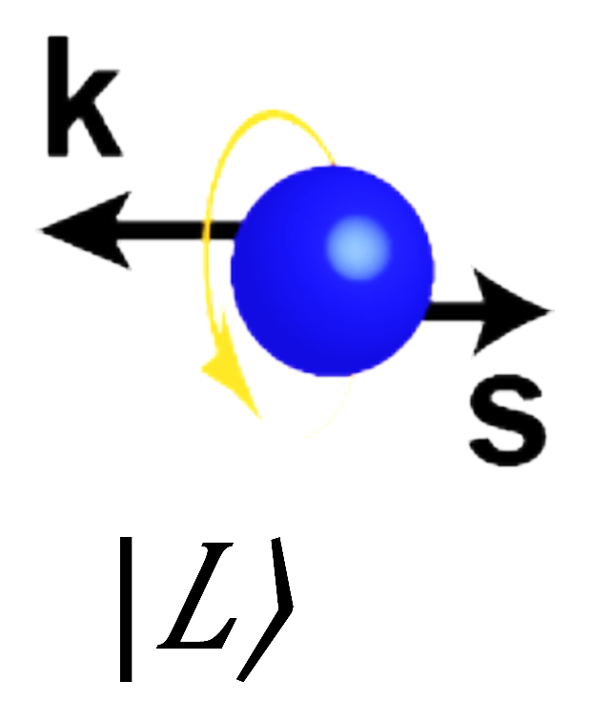
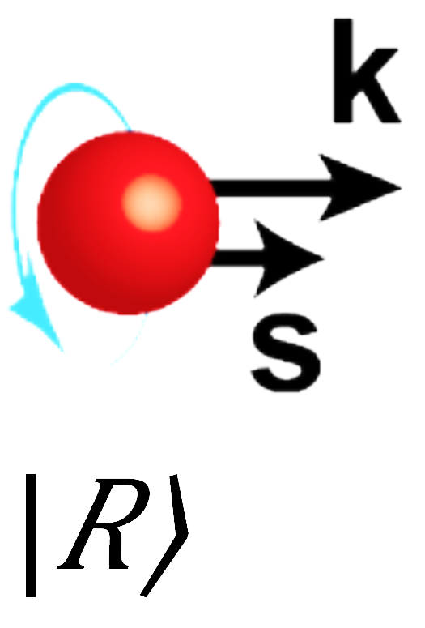
Chirality
A common concept
For massless fermions
$J_{L}^{μ}= {\overline{ψ}}_{L}γ^{μ}ψ_{L}$
$$J_{R}^{μ}={\overline{ψ}}_{R}γ^{μ}ψ_{R}$$
Classically
$${∂_{μ}J}_{V}^{μ}=0={∂_{μ}J}_{A}^{μ} with J_{V/A}^{μ}=J_{R}^{μ}±J_{L}^{μ}$$
30

Slide 31
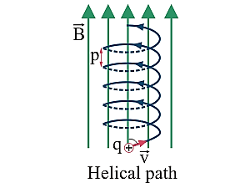
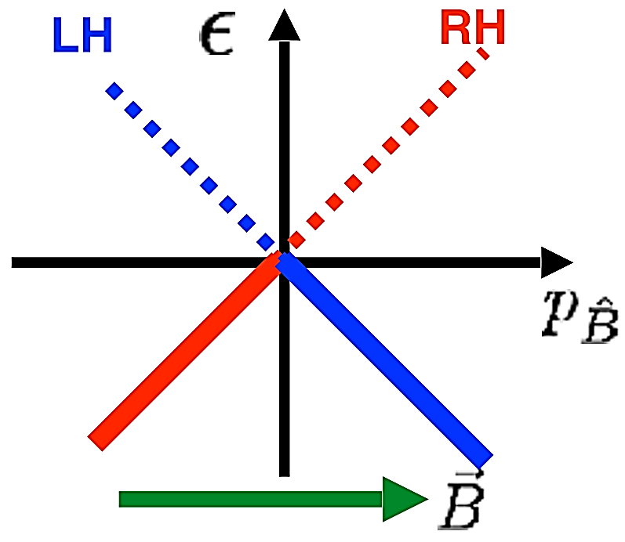
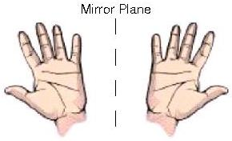
Chiral anomaly
Lowest Landau level of massless fermion in B
Two conserved currents with left- and right-chirality
$$n=0$$
$$p_{z}$$
$$E_{n}^{2}=p_{z}^{2}+2neB$$
$$B$$
$J_{R}^{μ}={\overline{ψ}}_{R}γ^{μ}ψ_{R}$ and $J_{L}^{μ}= {\overline{ψ}}_{L}γ^{μ}ψ_{L}$
Homework: Derive the Landau levels
31

Slide 32
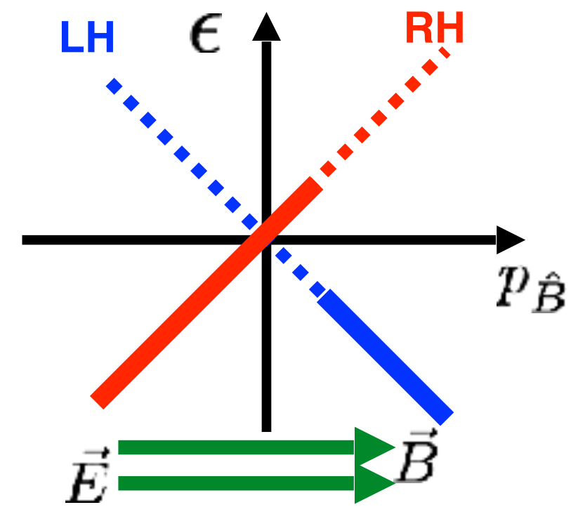
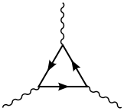
Chiral anomaly
Lowest Landau level of massless fermion
One conserved current
$J_{A}^{μ}=J_{R}^{μ}−J_{L}^{μ}=$ $\overline{ψ}γ^{μ}γ_{5}ψ$
is no longer conserved:
$N_{R/L}=V\frac{p_{F}^{R/L}}{2π}\frac{eB}{2π}$
${\frac{d}{dt}N}_{A}={\frac{d}{dt}(N}_{R}−N_{L})$
$=V\frac{{\dot{p}}_{F}^{R}−{\dot{p}}_{F}^{L}}{2π}\frac{eB}{2π}=V\frac{eE}{π}\frac{eB}{2π}$
${{ ∂}_{μ}J}_{A}^{μ}=\frac{e^{2}}{2π^{2}}E∙B$
$$p_{z}$$
$$B$$
$$E$$
$$J_{V}^{μ}=J_{R}^{μ}+J_{L}^{μ}=\overline{ψ}γ^{μ}ψ$$
Adler 1969, Bell and Jackiw 1969
32

Slide 33
Chiral anomaly
Triangle diagram coupled to EM field
Triangle diagram coupled to gluon field
Integrate over space and time from 0 to t
${{ ∂}_{μ}J}_{A}^{μ}=\frac{e^{2}}{2π^{2}}E∙B=\frac{e^{2}}{8π^{2}}{F_{μν}\tilde{F}}^{μν}$
${{ ∂}_{μ}J}_{A}^{μ}=\frac{g^{2}}{16π^{2}}{Tr[G_{μν}\tilde{G}}^{μν}]$
$$μ_{A}$$
33

Slide 34
Anomalous transports in HICs
QCD triangle anomaly
$$μ_{A}$$
B,ω
$$J_{V}$$
CME/CVE
QED triangle anomaly
Initial state topological fluctuations
34

Slide 35
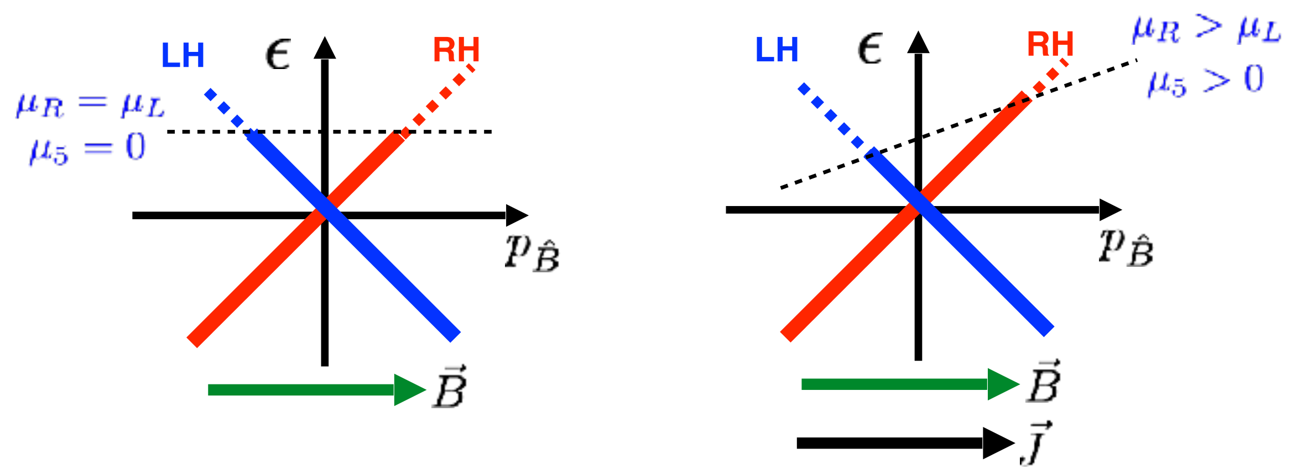
Chiral magnetic effect (CME)
Remove the E field
$$μ_{R}≠μ_{L}$$
$$μ_{R}=μ_{L}$$
$$μ_{A}≠0$$
$$μ_{A}=0$$
$$p_{z}$$
$$p_{z}$$
$$B$$
$$B$$
$$J_{V}$$
$$J_{V}=J_{R}+J_{L}=\frac{e^{2}B}{4π^{2}}\left(p_{F}^{R}−p_{F}^{L}\right)=\frac{e^{2}B}{2π^{2}}μ_{A}$$
CME current
Kharzeev et al 2004-2008,
Vilenkin 1980, ……
35

Slide 36
Chiral magnetic effect (CME)
CME: vector current induced by B in matter with $μ_{A}$
Macroscopic quantum phenomenon
P- and CP-odd transport
Time-reversal even, no dissipation
Fixed by anomaly coefficient, universal
$$J_{V}=\frac{e^{2}μ_{A}}{2π^{2}}B$$
V
To realize CME, we need: environmental parity violation ($μ_{A}$) and external magnetic field (B)
A
V
36

Slide 37
Chiral separation effect (CSE)
A dual effect to the CME: axial current induced by B in matter with $μ_{V}$
$$J_{V}$$
$$J_{A}$$
$$μ_{R}=μ_{L}$$
$$μ_{V}≠0$$
$$p_{z}$$
$$μ_{A}$$
$$μ_{V}$$
B
B
$$B$$
CME
CSE
$$J_{A}$$
$$J_{A}=J_{R}−J_{L}=\frac{e^{2}B}{4π^{2}}\left(p_{F}^{R}+p_{F}^{L}\right)=\frac{e^{2}B}{2π^{2}}μ_{V}$$
CSE current
Son and Zhitnitsky 2004 ……
37

Slide 38
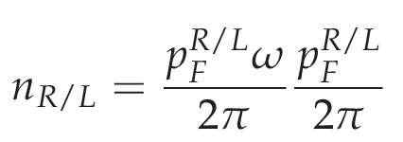
Chiral vortical effect (CVE)
Charged particle in magnetic field and in rotation
“Lowest Landau level” (omit centrifugal force $O(ω^{2})$)
In magnetic field, Lorentz force:
$$F=e(\dot{x}×B)$$
In rotating frame, Coriolis force:
$$F=2ε(\dot{x}×ω)+O(ω^{2})$$
Larmor theorem: $eB\sim 2εω$
$$J_{V}=\frac{eω}{4π^{2}}\left({{(p}_{F}^{R})}^{2}{{−(p}_{F}^{L})}^{2}\right)=\frac{eω}{π^{2}}μ_{V}μ_{A}$$
$$J_{A}=\frac{eω}{4π^{2}}\left({{(p}_{F}^{R})}^{2}{{+(p}_{F}^{L})}^{2}\right)=\frac{eω}{2π^{2}}(μ_{V}^{2}+μ_{A}^{2})$$
CVE currents
More rigorous calculation shows a ${(T}^{2}/6)eω$ term in $J_{A}$related to gravitational anomaly or global anomaly. (Landsteiner etal 2011, Glorioso etal 2017)
Erdmenger etal 2008, Banerjee etal 2008, Son and Surowka 2009 ……
38

Slide 39
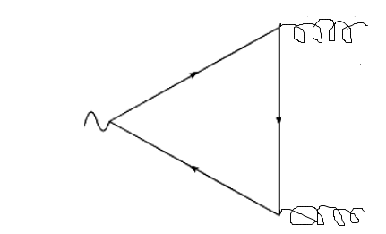
Chiral electric separation effect
Electric field induced anomalous transport
Chiral electric separation effect (CESE)
with
XGH and Liao 2013, Jiang, XGH, Liao 2015
Ma and XGH 2015
39

Slide 40
Collective modes: chiral magnetic waves
Consider CME and CSE in constant magnetic field
Consider the continuity equations
Consider small fluctuations of RH/LH densities
These are two wave equations describing two gapless collective modes (Chiral magnetic wave) with velocities
Kharzeev-Yee 2011
40

Slide 41
Collective modes: chiral vortical wave
The vortical analogue of chiral magnetic wave
$J_{A}$=$\frac{T^{2}}{6}+\frac{μ_{V}^{2}{+μ}_{A}^{2}}{2π^{2}}ω$, $J_{V}$=$\frac{1}{π^{2}}μ_{V}μ_{A}ω$,
$$μω$$
To reveal its dispersion we use continuity eq.
Substitute CVE currents. Obtain Burgers wave equation which is linearized to normal wave equation(Homework)
~ inverse baryon susceptiblity
CVW velocity
arXiv: 1504.03201
41

Slide 42
Collective modes: chiral electric wave
42

Slide 43
Table of anomalous chiral transports
 | $$E$$ | $$B$$ | $$ω$$
$$J_{V}$$ | $$σ$$ Ohm’s law | $$\frac{e^{2}}{2π^{2}}μ_{A}$$ Chiral magnetic effect | $$\frac{e}{π^{2}}μ_{V}μ_{A}$$ Vector chiral vortical effect
$$J_{A}$$ | $$∝\frac{μ_{V}μ_{A}}{T^{2}}σ$$ Chiral electric separation effect | $$\frac{e^{2}}{2π^{2}}μ_{V}$$ Chiral separation effect | e$(\frac{T^{2}}{6}+\frac{μ_{V}^{2}{+μ}_{A}^{2}}{2π^{2}})$ Axial chiral vortical effect
Wave mode | $$ε=α_{A}n_{A}\sqrt{2σ_{2}χ_{e}α_{V}α_{A}}k∙E$$ Chiral electric wave | $$ε=σ_{A}\sqrt{α_{V}α_{A}}k∙B$$ Chiral magnetic wave | $$ε=\frac{μ_{V}}{2π^{2}χ_{μ}}k∙ω$$ Chiral vortical wave
Reviews: Kharzeev, arXiv:1312.3348;
XGH, arXiv:1509.04073;
Kharzeev-Liao-Voloshin-Wang, arXiv:1511.04050 ;
Liu-XGH, arXiv:2003.12482;
… …
43

Slide 44
How to detect CME, CMW, etc?

Slide 45
Anomalous transports in HICs
QCD triangle anomaly
$$μ_{A}$$
B,ω
$$J_{V}$$
CME/CVE
QED triangle anomaly
Initial state topological fluctuations
45

Slide 46
Experimental test of CME
Event-by-event charge separation wrt. reaction plane
46

Slide 47
Experimental test of CME
Event-by-event charge separation wrt. reaction plane
STAR 2010
For more details: lecture by Qiye Shou
ALICE 2013
STAR 2014
47
47

Slide 48
Back-ground contributions to CME
Back-ground contributions to gamma correlator
Transverse momentum conservation(Pratt 2010; Liao, Bzdak,Koch 2011):
Charge blind
And
Can be subtracted in
48

Slide 49
Back-ground contributions to CME
Back-ground contributions to gamma correlator
Local charge conservation(Pratt, Schlichting 2011) or neutral resonance decay (Wang 2010) :
Main challenge: how to separate the background elliptic flow effects?
49

Slide 50
Experimental methods
Fix the flow, but vary the magnetic field: isobar collisions
+
-
-
+
+
+
+
+
-
+
Vs
-
+
+
+
-
-
+
+
+
-
-
+
-
-
+
+
+
+
+
+
+
+
+
+
+
+
+
+
-
-
At same energy, same centrality, they would have equal elliptic flow but 10% difference in magnetic field.
50

Slide 51
Isobar collisions
Deng, XGH, Ma, and Wang, 2016
Centrality 20-60%: sizable difference in B ($R_{B_{sq}}\sim 10−20\%$) but small difference in eccentricity ($R_{ε_{2}}<2\%$)
First run: 2018 @ RHIC has done!
Data is under analysis
51

Slide 52
52

Slide 53
CME on desktop
Chiral fermions in 3D semimetals
Li et al 2015, … …
53

Slide 54
CME on desktop
54

Slide 55
CME on desktop
Spin-orbit coupling (SOC) in cold atomic gases
A rotating Weyl SOC atomic gas will show CME:
The Weyl SOC may also be realized (Spielman 2012; Andersen etal 2013; … …)
Spielman et al 2011: Equal Rashba-Dresselhaus SOC Bose gas; MIT 2012, Shanxi U. 2012, for Fermi gas
arXiv: 1506.03590
55

Slide 56
Experimental test of CVE
Event-by-event baryon separation wrt. reaction plane
The vortical gamma correlator
STAR 2014
Positive opposite-sign correlation, negative same-sign correlation
Increase with centrality = vorticity increases with centrality
56

Slide 57
Experimental test of CMW
Phenomenology of CMW in heavy-ion collisions: Elliptic flow splitting of charged pions (Burnier, Kharzeev, Liao, Yee 2011)
Intuitive picture
STAR 2015
STAR 2015
57

Slide 58
Potential experimental test of CESE (1)
58

Slide 59
Potential experimental test of CESE (2)
59

Slide 60
Potential experimental test of CVW
Experimental implication: baryon charge quadrupole
More baryon charges at the tips of the fireball, more antibaryon charges at the center
arXiv: 1504.03201
Stronger in-plane radial expansion lets antibaryons get larger elliptic flow than baryons
60
60

Slide 61
Summary

Slide 62
Anomalous chiral transports
Universal phenomena that may happen across a very broad hierarchy of scales.
$${10}^{−10}K$$
$${1−10}^{2}K$$
$${10}^{10}K$$
$${10}^{12}K$$
Temperature
Cold atomic gases
Supernovae
Weyl/Dirac semimetals
Heavy-ion collisions
Electromagnetic force
Electroweak force
Strong force
62

Slide 63
Most ideal fluid
Strongest Magnetic field
Highest temperature
Most vortical fluid
Atomic physics
Condensed matter
Cosmology
Astrophysics
Fluid mechanics
63

