Slide 1
Study of Particle Detector by Simulation
- The DTOF in STCF Experiment
湖州暑期讲习班
Ming Shao
University of Science and Technology of China
State Key Laboratory of Particle Detection and Electronics
7月10-23日，湖州师范学院

Slide 2
Outline
Detector system in particle and nuclear physics: Simulation vs. experiment
The DTOF detector in STCF experiment
  Motivation
  Conceptual design
  Key parameters in study
  Performance expectation
Summary

Slide 3
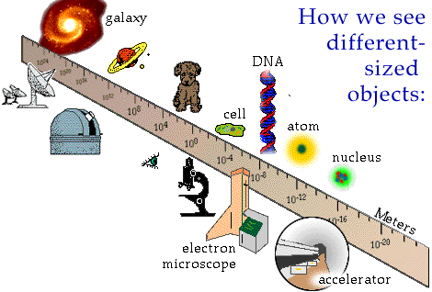
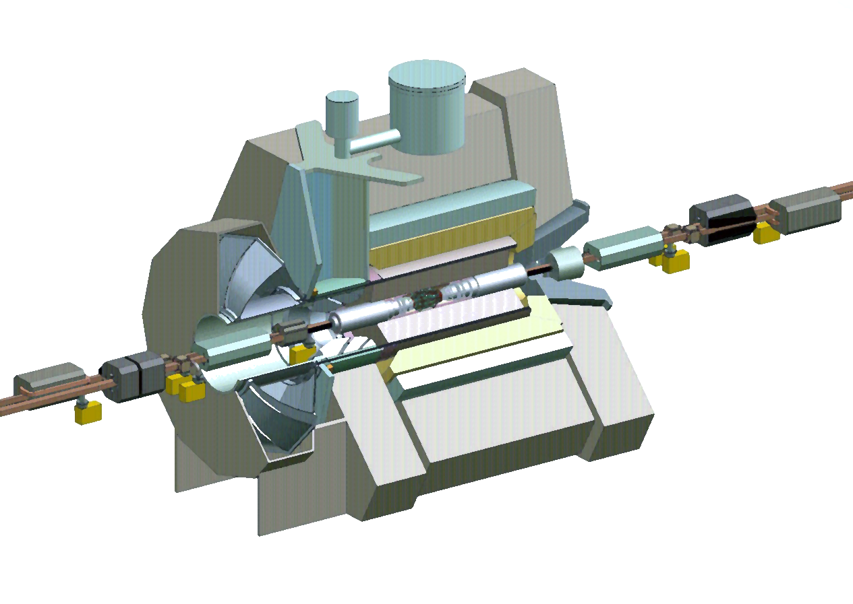
Tools vs. Objects of Study in Research
Instruments to ‘see’ objects
detector

Slide 4
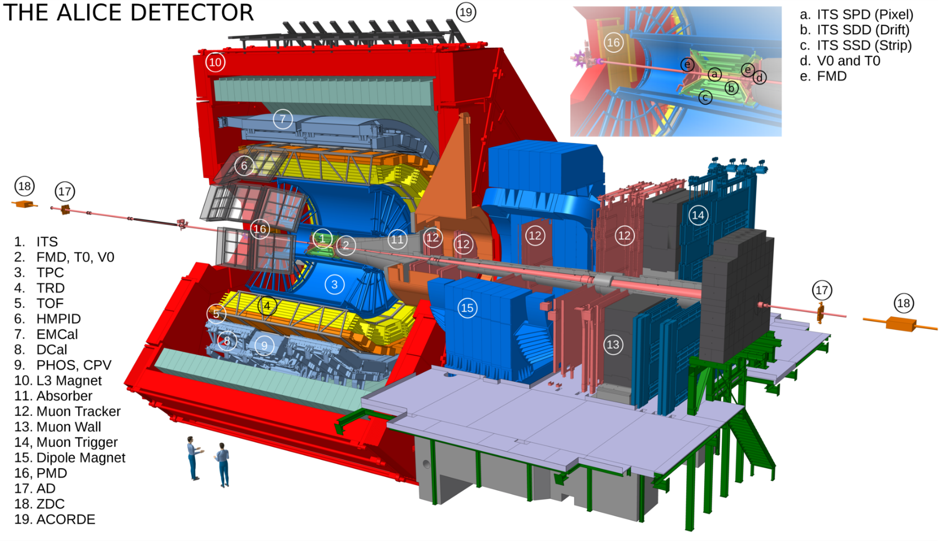
Detector System in High-Energy Physics Program
To measure the momentum, energy and type of final state particles in particle or nuclear collisions, by recording the spatial, time and energy information leaved in the detector system.
ALICE

Slide 5
Simulation vs. Experiment
Importance of simulation in high-energy physics experiment
  Physics simulation (benchmark channels)
  Design and Optimization of the Detector system
  Accelerator and detector physics
Physics (data) analysis
  Control of systematic errors
  Theoretical (model, event generator etc.)
  Experimental (detector, reconstruction etc.)
Physics Analysis
Experiment
Simulation
Theory

Slide 6
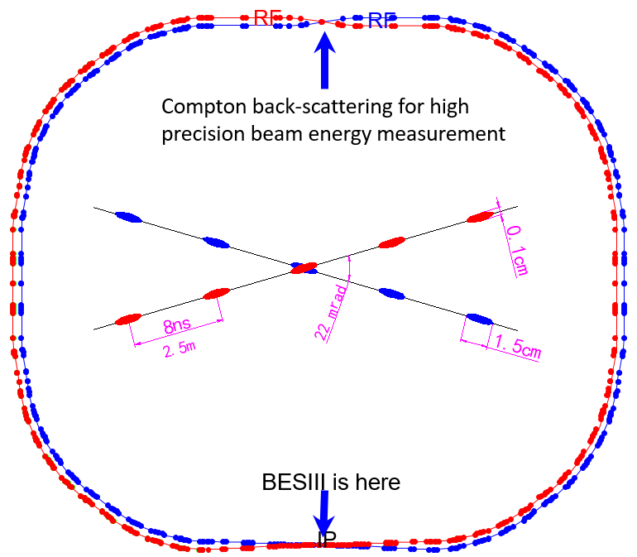
What Is Super Tau-Charm Facility (STCF)
Collision energy: 2-7 GeV
Luminosity: 1.0×1035 cm-2 s-1
Circumfluence: 600~800 m
Detector
LINAC: ~300 m
RF cavity
Current Beijing Electron-Positron Collider (BEPCII)：
Collision energy: 2-4.6 GeV
Luminosity: 1.0×10³³ cm⁻² s⁻¹
Circumfluence: ~240 m

Slide 7
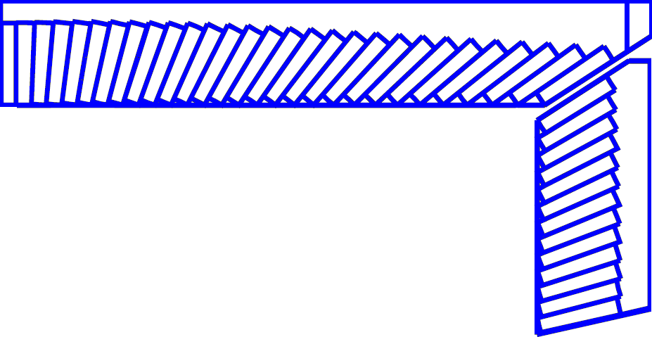
STCF Experiment
245 cm
Inner Tracker
~0.15%X₀ / layer
σ_{xy}~50-100 um
York/Muon Detector
185 cm
Main Tracker
σ_{xy}<~130 um
σ_{p}/p ~ 0.5% @ 1 GeV
dE/dx~6%
Super-conducting Magnet (1T)
135 cm
York/Muon Detector
Electro-magnetic Calorimeter
PID
π/K (K/p) 3-4σ separation
Momentum 2GeV/c
105 cm
Barrel PID
85 cm
20°
Endcap PID
EMC
Energy range: 0.02-3GeV
Resolution σ_{E} (%)@1GeV
barrel: 2.5%
endcap: 4%
Main Tracker
15 cm
Inner Tracker
10 cm
MUD
Low momentum ~0.5GeV
π suppression >30
3~6 cm
IP
120 cm
240 cm
300 cm
140 cm
190 cm

Slide 8
PID Requirements
Particle Identification (PID) of charged particles： π/K (K/p) 3-4σ separation, up to p= 2GeV/c

Slide 9
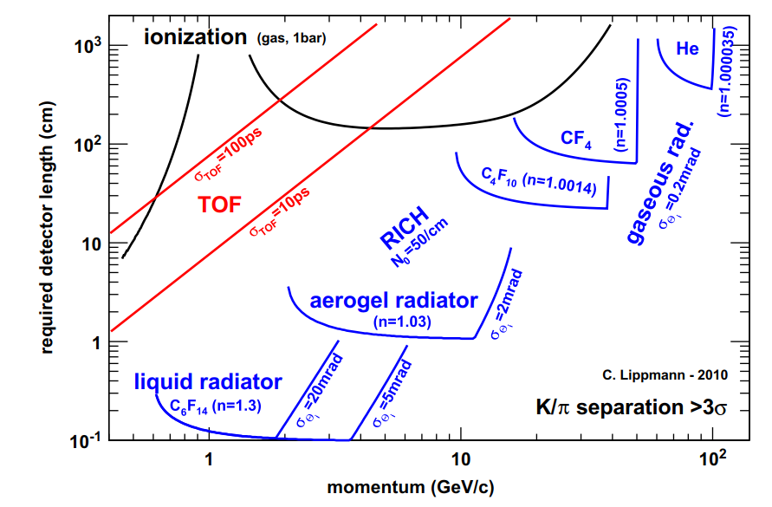
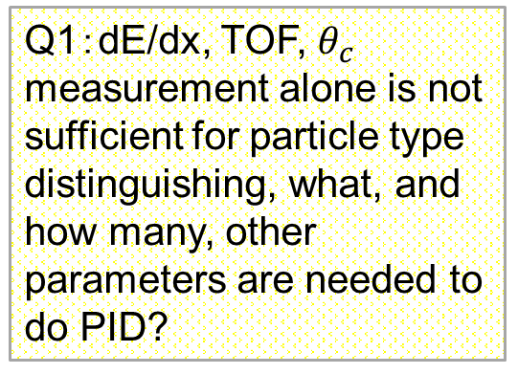
PID Technology for Charged Hadron
Nucl. Instr. & Meth. A 666 (2012), 148-172
Q1：dE/dx, TOF, $θ_{c}$ measurement alone is not sufficient for particle type distinguishing, what, and how many, other parameters are needed to do PID?
Options for STCF PID:
RICH (barrel),
DIRC or DIRC-like (endcap)

Slide 10
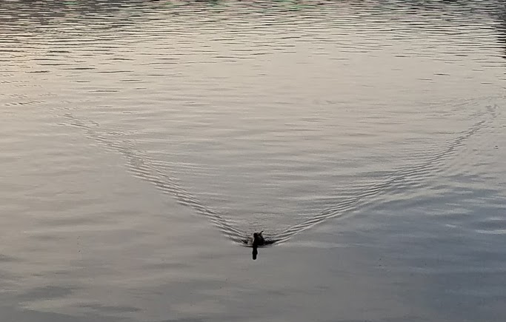

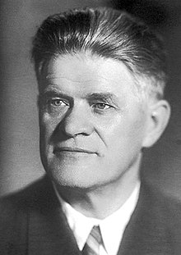
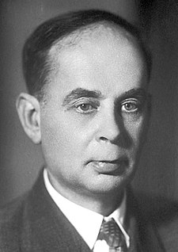
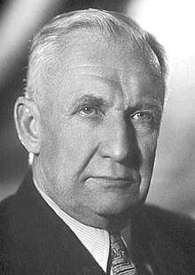


Cherenkov Radiation
Cherenkov radiation angle
$$\cos{θ_{c}=\frac{1}{βn(λ)}}$$
$$\frac{d^{2}N}{dxdλ}=\frac{2παz^{2}}{λ^{2}}\left(1−\frac{1}{β^{2}n^{2}\left(λ\right)}\right)$$

Slide 11
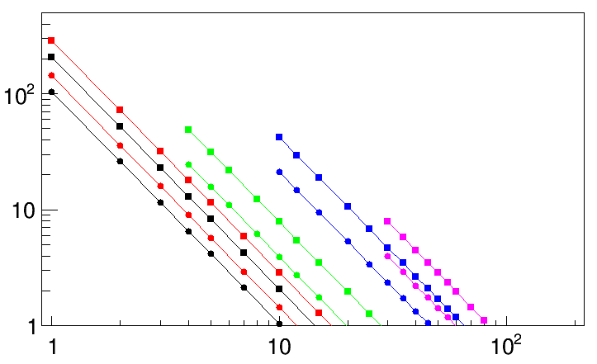
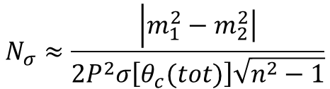
Cherenkov Detector Performance
$$N_{σ}≈\frac{\left|m_{1}^{2}\right.−\left.m_{2}^{2}\right|}{2P^{2}σ\left[θ_{c}(tot)\right]\sqrt{n^{2}−1}}$$
for particles well above threshold
0.5 mrad
Fused Silica
1 mrad
C₆F₁₄ (liquid)
Aerogel (1.04)
C₄F₁₀
Ns p/K separation
CF₄
3 s
B. N. Ratcliff, NIMA 502 (2003) 211-221
Particle momentum (GeV/c)

Slide 12
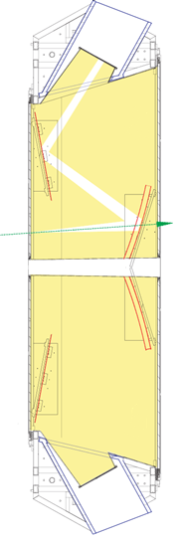
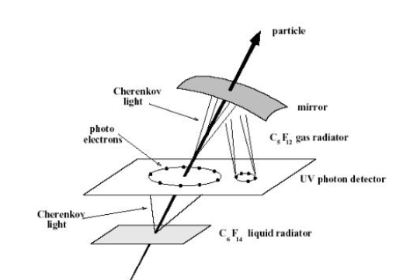
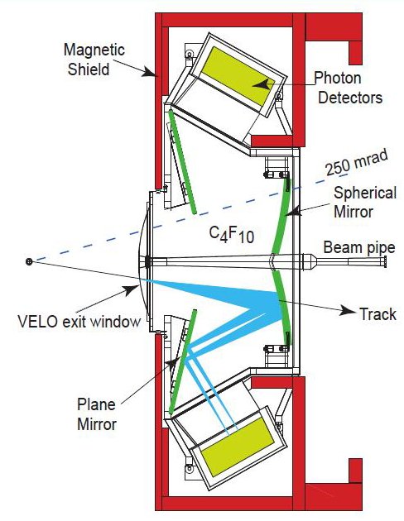
RICH – Ring Imaging Cherenkov Detector
RICH has been widely applied in high-energy physics or astrophysics experiments since 1990’s, providing PID over large kinematic coverage
~7 m
300 mrad
120 mrad
Spherical mirrors
Flat mirrors
CF₄ gas
RICH at SLD, DELPHI, 1994
RICH at LHCb

Slide 13
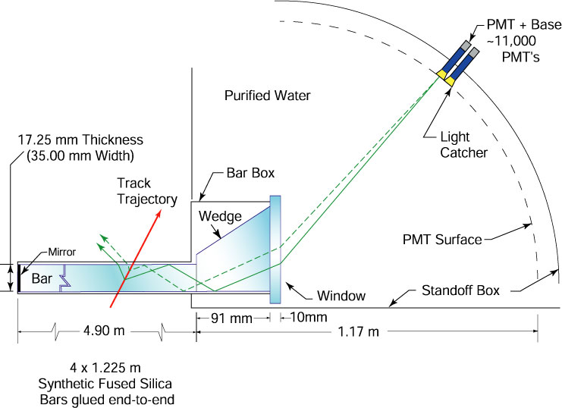
DIRC – Detection of Internal Reflected Cherenkov Light
DIRC at Babar
Started operation in 1999
p/K separation: 3s at 4 GeV/c
Single photon timing resolution: 1.7 ns
B.N. Ratcliff, SLAC-PUB-6047 (Jan. 1993);
P. Coyle et al., NIM A343 (1994) 292

Slide 14
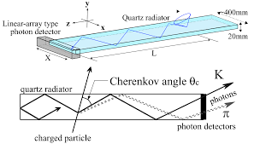
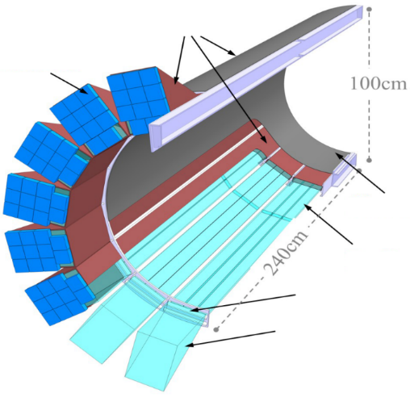
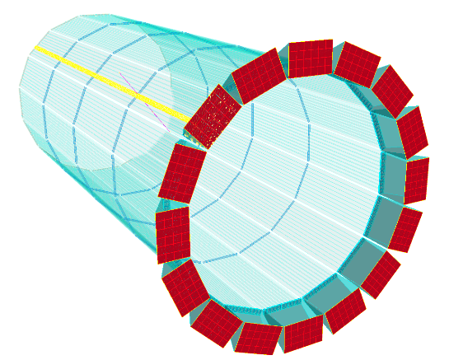
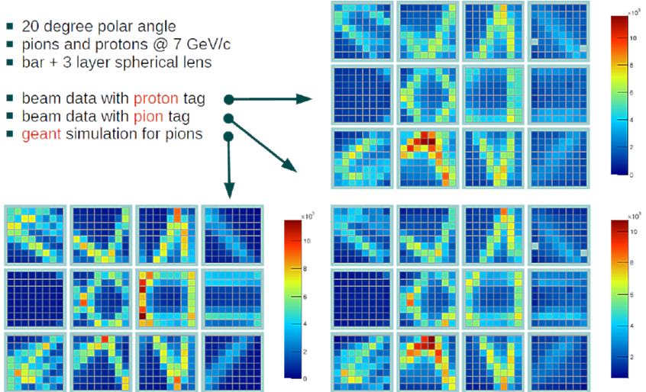
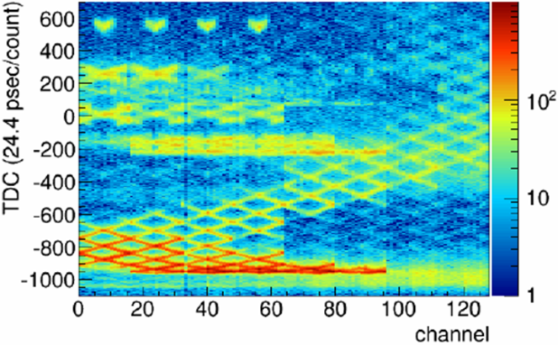
Development of DIRC Technique
DIRC structure is very compact and robust, yet with excellent PID capability (3σ π/K separation up to 4-6 GeV/c)
DIRC@PANDA
DIRC@EIC
Belle2-TOP

Slide 15
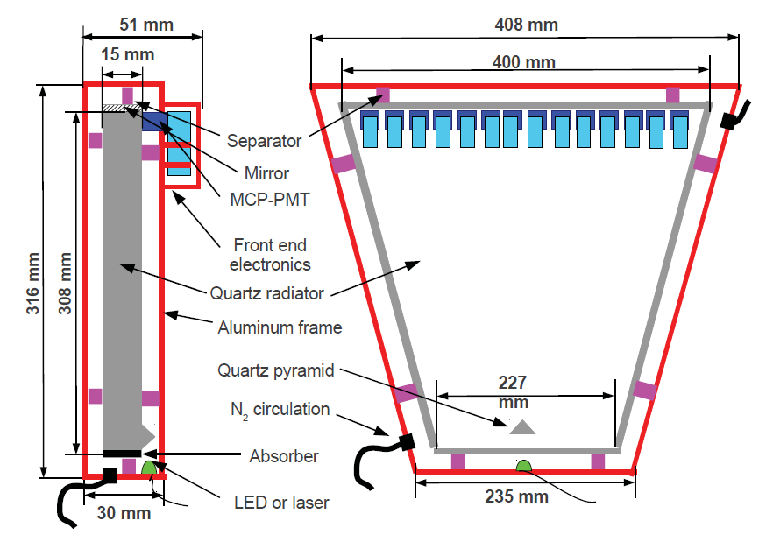
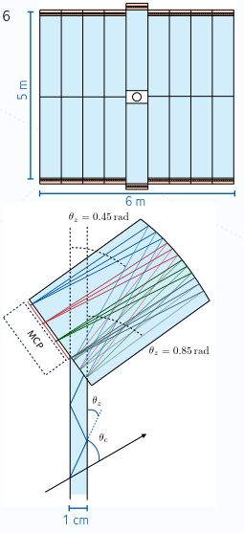
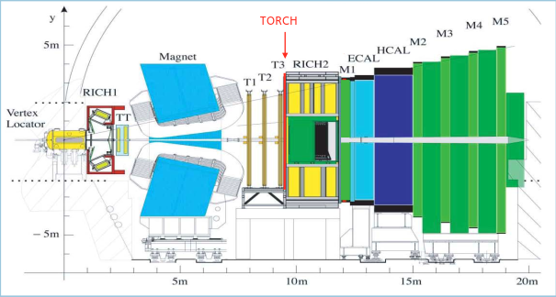
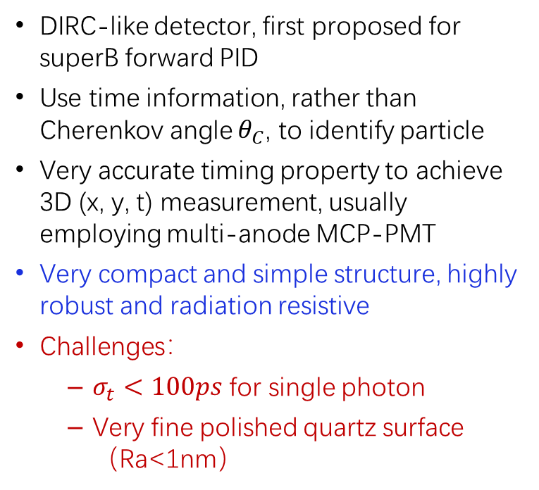
DIRC-like Timing Detector
DIRC-like detector, first proposed for superB forward PID
Use time information, rather than Cherenkov angle $θ_{C}$, to identify particle
Very accurate timing property to achieve 3D (x, y, t) measurement, usually employing multi-anode MCP-PMT
Very compact and simple structure, highly robust and radiation resistive
Challenges：
  $σ_{t}<100ps$ for single photon
  Very fine polished quartz surface（Ra<1nm）
FTOF at superB:
Forward Time-of-Flight
Overall time resolution <30ps
TOF detector considered for LHCb Upgrade II
PID in 2-10 GeV/c momentum range
Single photon σ_{t} ~ 70 ps, single track σ_{t} ~ 15 ps
Baseline technology for STCF endcap PID detector
TORCH at LHCb

Slide 16
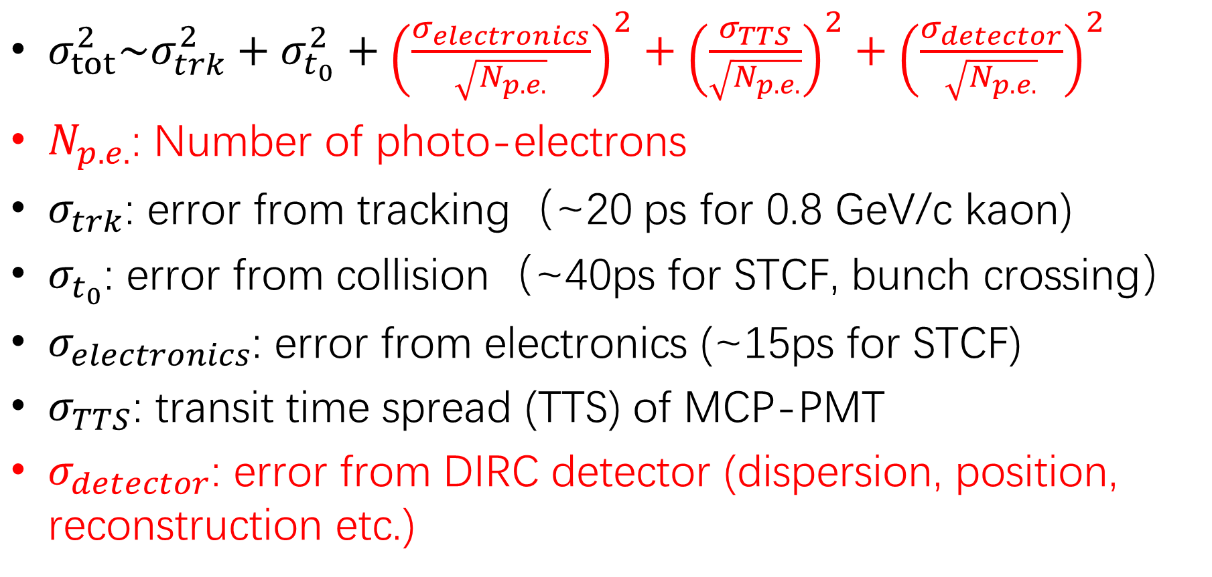
DIRC-like Detector Timing Error Sources
$σ_{tot}^{2}\sim σ_{trk}^{2}+σ_{t_{0}}^{2}+{\left(\frac{σ_{electronics}}{\sqrt{N_{p.e.}}}\right)}^{2}+{\left(\frac{σ_{TTS}}{\sqrt{N_{p.e.}}}\right)}^{2}+{\left(\frac{σ_{detector}}{\sqrt{N_{p.e.}}}\right)}^{2}$
$N_{p.e.}$: Number of photo-electrons
$σ_{trk}$: error from tracking（~20 ps for 0.8 GeV/c kaon)
$σ_{t_{0}}$: error from collision（~40ps for STCF, bunch crossing）
$σ_{electronics}$: error from electronics (~15ps for STCF)
$σ_{TTS}$: transit time spread (TTS) of MCP-PMT
$σ_{detector}$: error from DIRC detector (dispersion, position, reconstruction etc.)

Slide 17
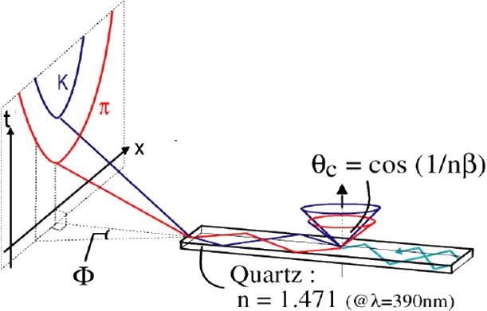
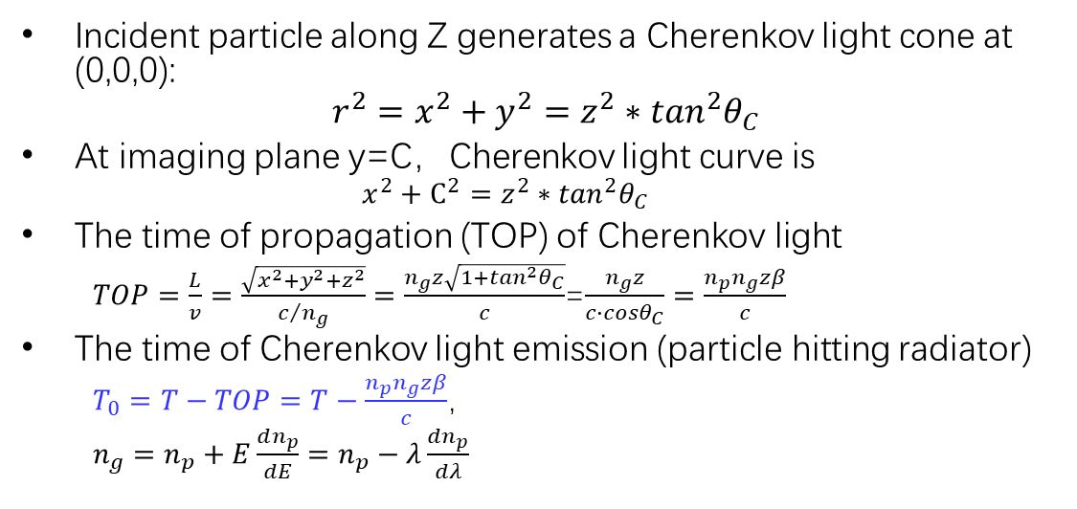
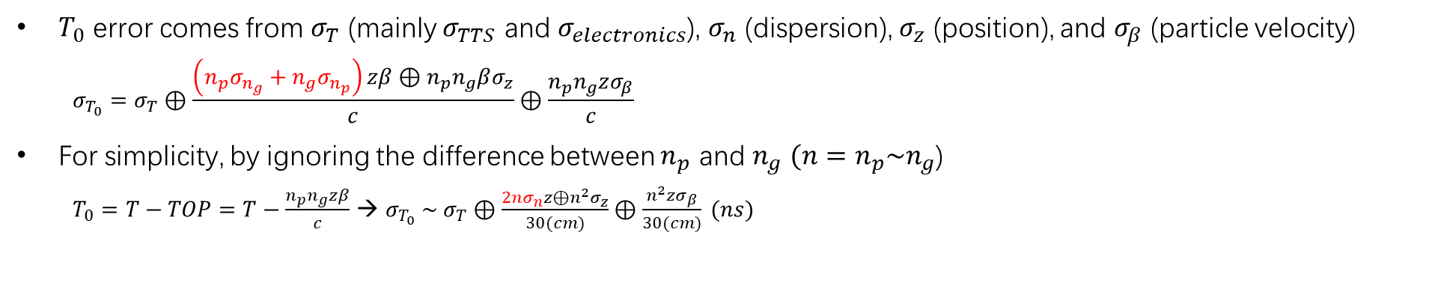
A Simple Example
Incident particle along Z generates a Cherenkov light cone at (0,0,0):
$$r^{2}=x^{2}+y^{2}=z^{2}∗\tan^{2}θ_{C}$$
At imaging plane y=C，Cherenkov light curve is
  $$x^{2}+C^{2}=z^{2}∗\tan^{2}θ_{C}$$
The time of propagation (TOP) of Cherenkov light
  $TOP=\frac{L}{v}=\frac{\sqrt{x^{2}+y^{2}+z^{2}}}{c/{n_{g}}}=\frac{n_{g}z\sqrt{1+\tan^{2}θ_{C}}}{c}$=$\frac{n_{g}z}{c∙cosθ_{C}}=\frac{n_{p}n_{g}zβ}{c}$
The time of Cherenkov light emission (particle hitting radiator)
  $T_{0}=T−TOP=T−\frac{n_{p}n_{g}zβ}{c}$，
  $n_{g}=n_{p}+E\frac{dn_{p}}{dE}=n_{p}−λ\frac{dn_{p}}{dλ}$
Z
Y
$T_{0}$ error comes from $σ_{T}$ (mainly $σ_{TTS}$ and $σ_{electronics}$), $σ_{n}$ (dispersion), $σ_{z}$ (position), and $σ_{β}$ (particle velocity)
  $$σ_{T_{0}}=σ_{T}⊕\frac{\left(n_{p}σ_{n_{g}}+n_{g}σ_{n_{p}}\right)zβ⊕n_{p}n_{g}βσ_{z}}{c}⊕\frac{n_{p}n_{g}zσ_{β}}{c}$$
For simplicity, by ignoring the difference between $n_{p}$ and $n_{g}$ $(n=n_{p}\sim n_{g}$)
  $T_{0}=T−TOP=T−\frac{n_{p}n_{g}zβ}{c}$ → $σ_{T_{0}} \sim σ_{T}⊕\frac{2nσ_{n}z⊕n^{2}σ_{z}}{30(cm)}⊕\frac{n^{2}zσ_{β}}{30(cm)} (ns)$

Slide 18

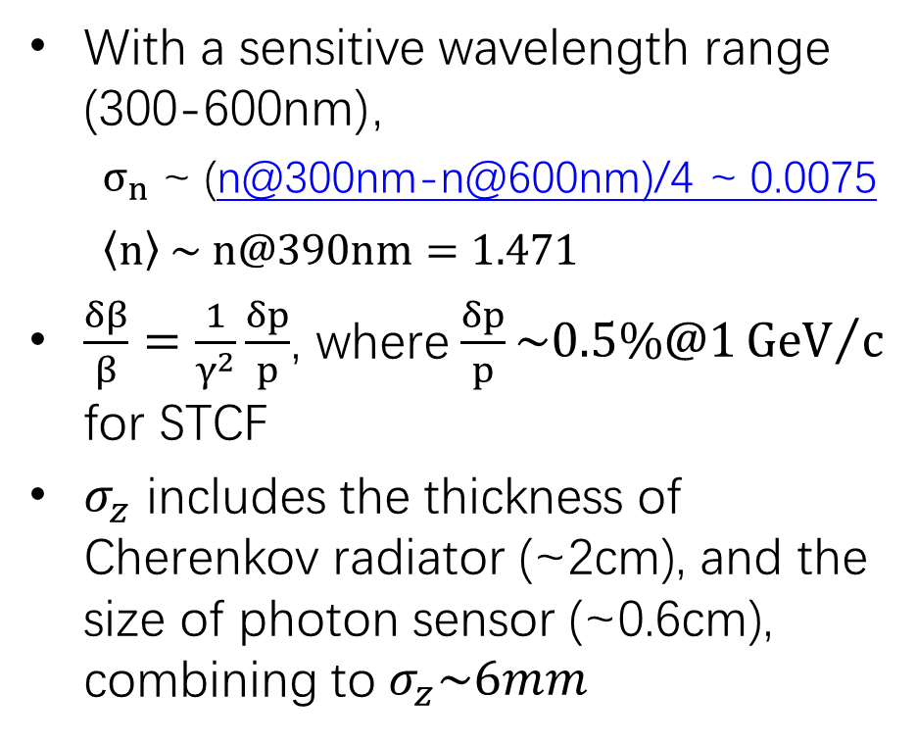


A Simple Example (cnt.)
With a sensitive wavelength range (300-600nm)，
  $σ_{n}$ ~ (n@300nm-n@600nm)/4 ~ 0.0075
  $$\left\langle n\right\rangle \sim n@390nm=1.471$$
$\frac{δβ}{β}=\frac{1}{γ^{2}}\frac{δp}{p}$, where$\frac{δp}{p}\sim 0.5\%@1{GeV}/c$ for STCF
$σ_{z}$ includes the thickness of Cherenkov radiator (~2cm), and the size of photon sensor (~0.6cm), combining to$σ_{z}\sim 6mm$
$$λ\sim 300nm$$
$$λ\sim 390nm$$
$$λ\sim 600nm$$

Slide 19
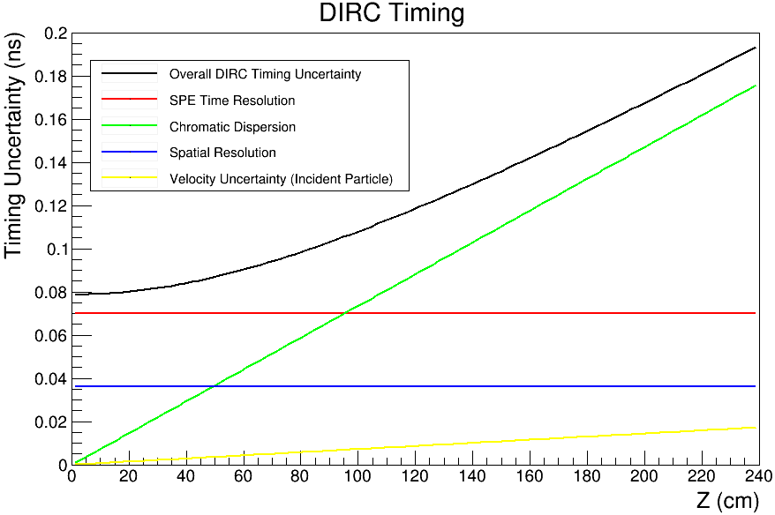

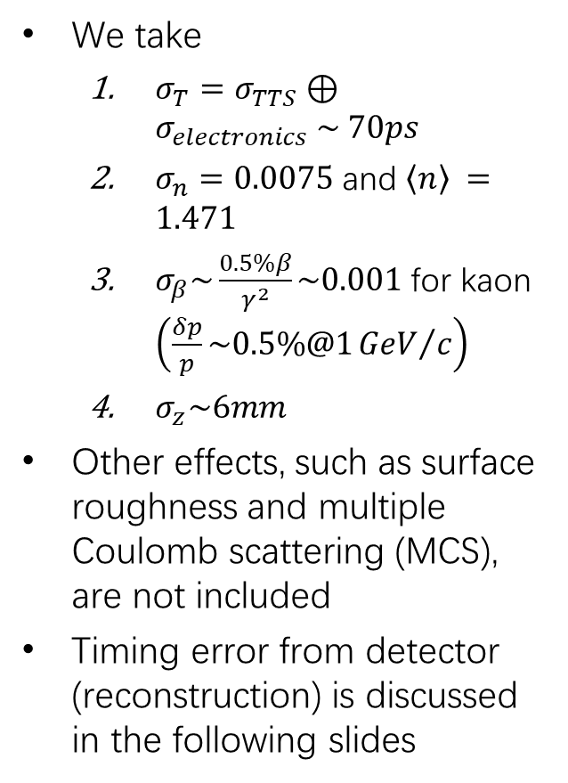



Result
We take
  $σ_{T}=σ_{TTS}⊕σ_{electronics} \sim 70ps$
  $σ_{n}=0.0075$ and $\left\langle n\right\rangle =1.471$
  $σ_{β}\sim \frac{0.5\%β}{γ^{2}}\sim 0.001$ for kaon $\left(\frac{δp}{p}\sim 0.5\%@1{GeV}/c\right)$
  $σ_{z}\sim 6mm$
Other effects, such as surface roughness and multiple Coulomb scattering (MCS), are not included
Timing error from detector (reconstruction) is discussed in the following slides
$σ_{n}=0.0075$
$$σ_{T}=70ps$$
$$σ_{z}\sim 6mm$$
$$σ_{β}\sim 0.001$$

Slide 20
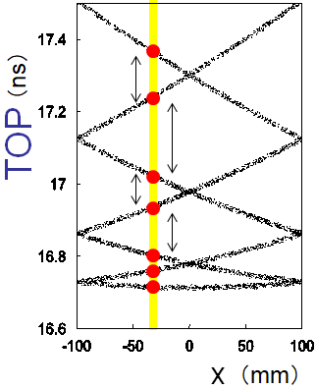
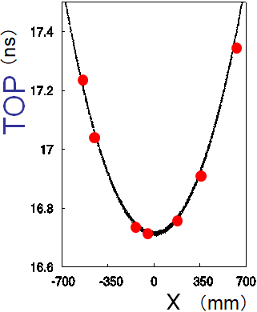
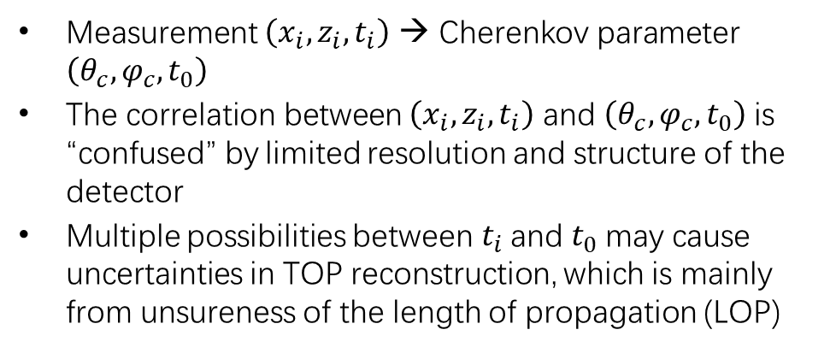

Reconstruction of Cherenkov Light Cone
Measurement $\left(x_{i},z_{i},t_{i}\right)$ → Cherenkov parameter $\left(θ_{c},φ_{c},t_{0}\right)$
The correlation between $\left(x_{i},z_{i},t_{i}\right)$ and $\left(θ_{c},φ_{c},t_{0}\right)$ is “confused” by limited resolution and structure of the detector
Multiple possibilities between $t_{i}$ and$t_{0}$ may cause uncertainties in TOP reconstruction, which is mainly from unsureness of the length of propagation (LOP)
BELLE-II TOP
PANDA barrel DIRC
Unfold
$$σ_{detector}$$

Slide 21

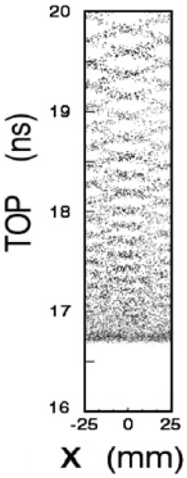
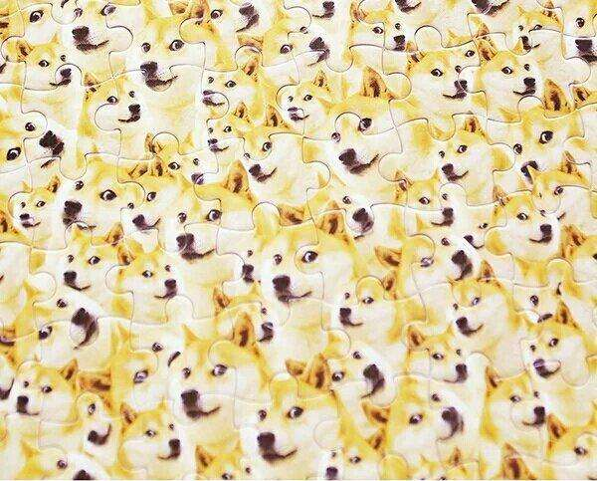


Reconstruction of Cherenkov Light Cone (cnt.)
Unfold
Unfold
$$σ_{detector}$$
$$σ_{detector}$$
Suppress “confusion” in reconstruction → improved timing
  Proper radiator size
  Excellent position and time resolution → 3D reconstruction
  Proper optics (focusing)
  Proper reconstruction algorithm
Q2：The first DIRC at Babar made use of quartz bars of small cross-section, why didn’t it suffer from “confusion” in reconstruction?

Slide 22
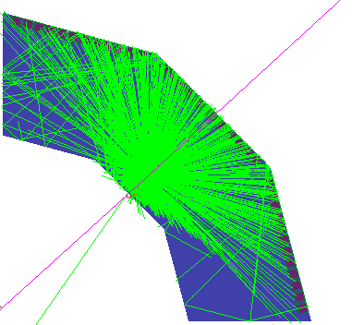
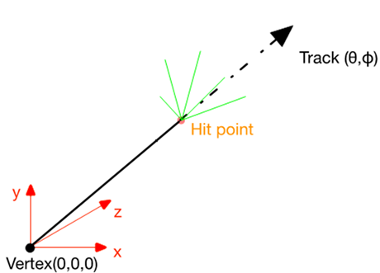
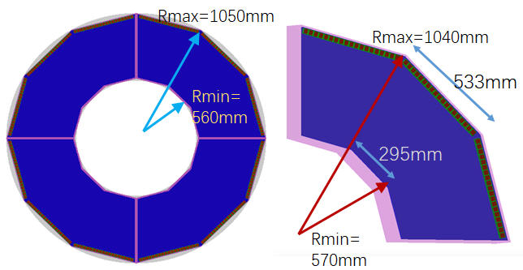
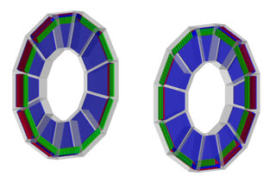
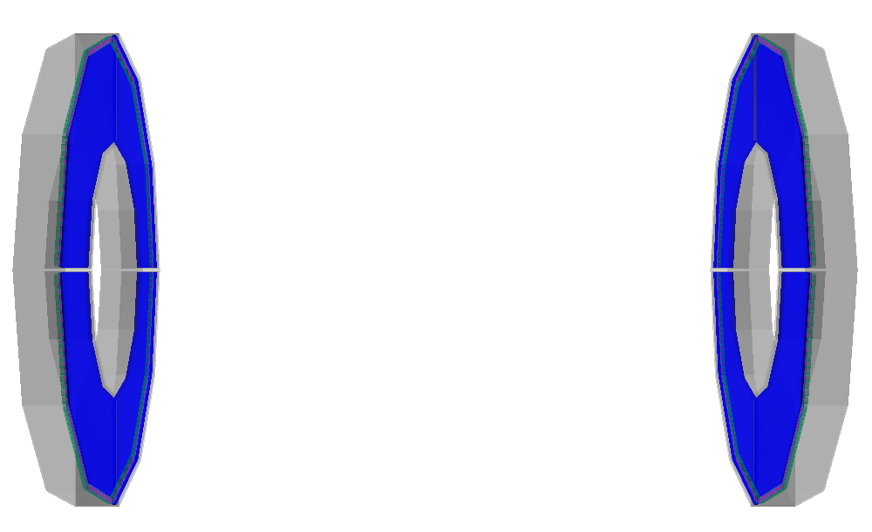
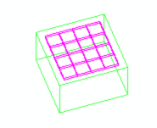
STCF-DTOF Design and Modelling in Geant4
DTOF: DIRC-like Time-of-Flight
FTOF at superB
DTOF v1
DTOF v2
Z = ±(1400 mm - 1600 mm)
R = 560 mm – 1050 mm
18×3×4(sectors)×2(endcaps)=672 MCP-PMTs
MCP-PMT:
  27.5mm*27.5mm*16.6mm
  4*4 multi-anode
  pixel size: 5.5mm*5.5mm
MCP-PMT

Slide 23
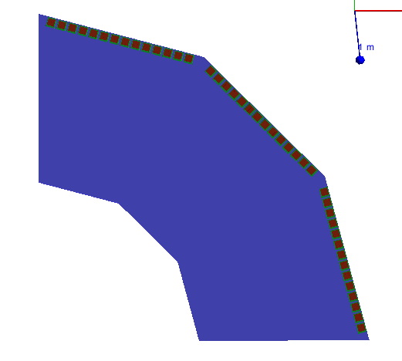

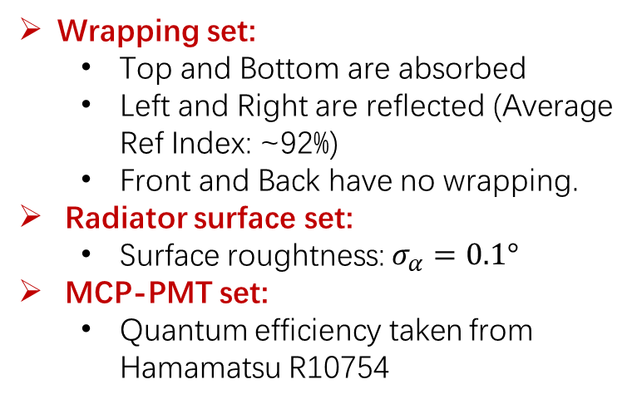
Simulation Parameter Setting
Optical parameters of fused silica
Top
Absorption length
Refractive index
Back
Front
Back
Left
Right
Bottom
Wrapping set:
  Top and Bottom are absorbed
  Left and Right are reflected (Average Ref Index: ~92%)
  Front and Back have no wrapping.
Radiator surface set:
  Surface roughtness: $σ_{α}=0.1°$
MCP-PMT set:
  Quantum efficiency taken from Hamamatsu R10754
Reflection coefficient between air and fused silica
Reflection coefficient of mirror
=1 – absorption coefficient
dielectric-metal = reflection ratio
dielectric-dielectric = reflection + refraction ratio

Slide 24
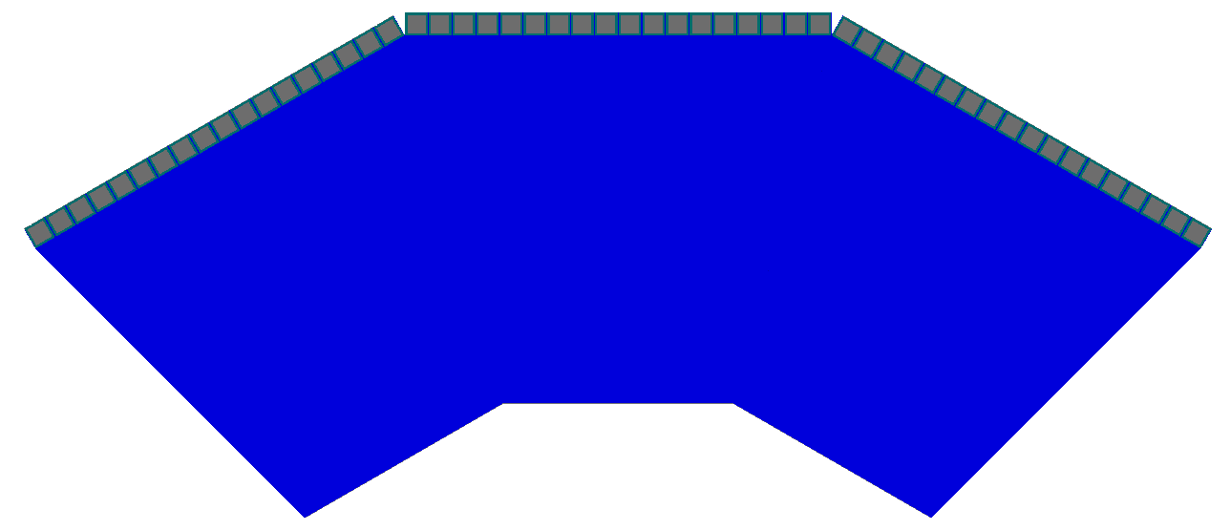
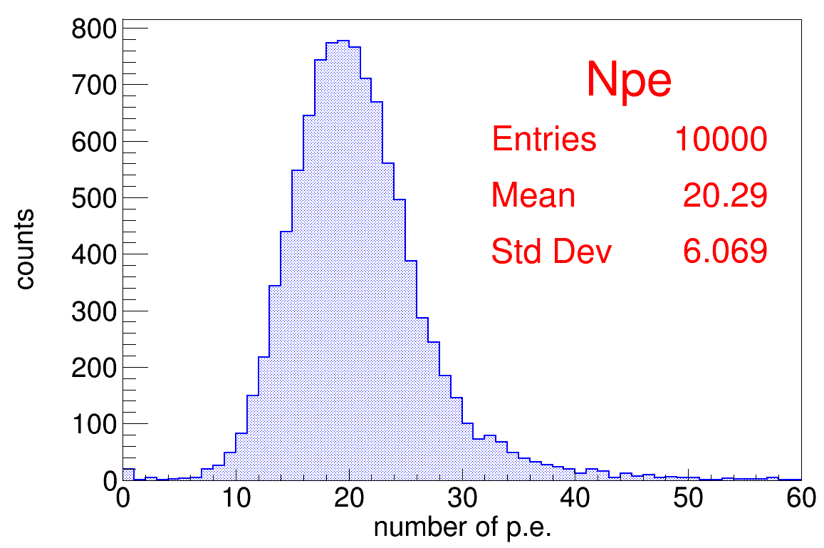
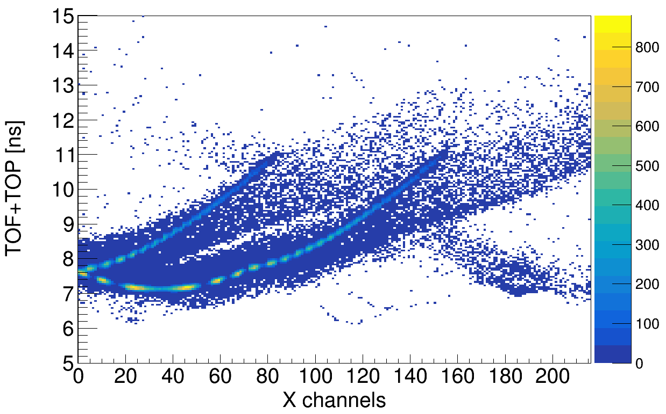
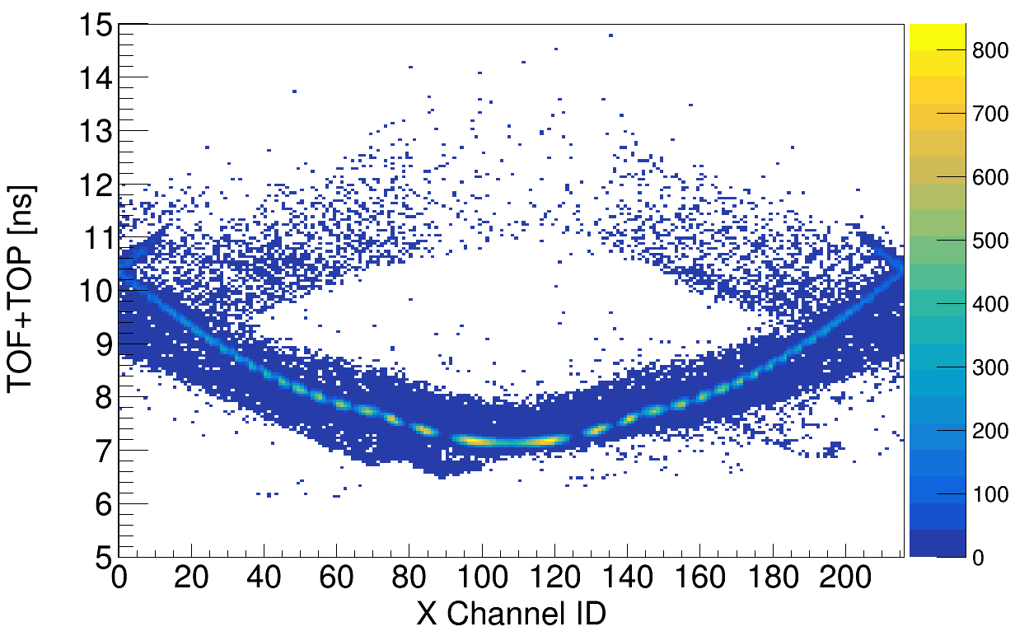
Simulated DTOF Hit Pattern

Slide 25









Simulated DTOF Performance
Total time resolution $σ_{tot}$:
$$σ_{tot}^{2}\sim σ^{2}\left(\frac{\sum{T_{i,cor}}+σ_{TTS}+σ_{ele}}{NPE}\right)+σ_{trk}^{2}+σ_{T0}^{2}$$
  $σ_{ele}=10ps$
  $σ_{TTS}=70ps$
  $σ_{trk}=10ps$
  $σ_{T0}=40ps$
K/pi separation ($σ$)
$$∆t=\frac{Lc}{2p^{2}}\left(m_{1}^{2}−m_{2}^{2}\right)$$
Separation power = $\frac{\left|∆t\right|}{σ}$

Slide 26

Expected PID with Different DTOF Time Resolution
The direction of track can affect both the number of photons and time resolution
The momentum of track only affects time resolution
Total time resolution always below 50 ps.
K/pi separation better than 3 sigma.

Slide 27

Reconstruction Algorithm
$cos\left(\overline{θ_{c}}\right)=\frac{1}{n_{p}β}=\frac{\vec{v_{t}}∙\vec{v_{p}}}{\left|\vec{v_{t}}\right|∙\left|\vec{v_{p}}\right|}$
  $\vec{v_{t}}=\left(a,b,c\right)，\left|\vec{v_{t}}\right|=1$
  $\vec{v_{p}}=\left(∆x,∆y,∆z\right)$
$σ_{∆x}=\frac{pitch X}{\sqrt{12}},σ_{∆y}=\frac{pitch Y}{\sqrt{12}}$
$LOP=H∙\sqrt{\frac{{∆x}^{2}+{∆y}^{2}+{∆z}^{2}}{{∆y}^{2}}}$
$TOF=T−TOP−T0=T−\frac{LOP∙\overline{n_{g}}}{c}−T0$
H
Y
Y
T
Z
X

Slide 28





Reconstruction Algorithm (cnt.)
$m_{c}=cos\left(\overline{θ_{c}}\right)=\frac{1}{n_{p}β}=\frac{\vec{v_{t}}∙\vec{v_{p}}}{\left|\vec{v_{t}}\right|∙\left|\vec{v_{p}}\right|}$，$\vec{v_{t}}=\left(a,b,c\right)$，$\vec{v_{p}}=\left(∆x,∆y,∆z\right)$
$\left({c^{2}−m}_{c}^{2}\right){∆z}^{2}+2c\left(a ∆x+b ∆y\right)∆z+{\left(a ∆x+b ∆y\right)}^{2}−m_{c}^{2}\left({∆x}^{2}+{∆y}^{2}\right)=0$
Solve: $∆z=\frac{−B±\sqrt{B^{2}−4AC}}{2A}$
  $A=\left({c^{2}−m}_{c}^{2}\right)$，$B=2c\left(a ∆x+b ∆y\right)$
  ${C=\left(a ∆x+b ∆y\right)}^{2}−m_{c}^{2}\left({∆x}^{2}+{∆y}^{2}\right)$
  $∆=B^{2}−4AC≥0 \& a ∆x+b ∆y+c ∆z>0$
  $∆z=min\left\{\left|{∆z}_{1}\right|,\left|{∆z}_{2}\right|\right\}$
Total reflection criteria: $\frac{{∆x}^{2}+{∆y}^{2}}{{∆x}^{2}+{∆y}^{2}+{∆z}^{2}}≥\frac{1}{n_{p}^{2}}$
$∆$x
$$∆y$$
$$θ_{c}$$
$$∆z$$
Y
Z
X

Slide 29



Reconstructed LOP

Slide 30



Reconstructed TOF
$$TOF=T−TOP−T0=T−\frac{LOP∙\overline{n_{g}}}{c}−T0$$

Slide 31




Another Incident Position

Slide 32



TOF Distribution of π/K
$$TOF=T−TOP−T0=T−\frac{LOP∙\overline{n_{g}}}{c}−T0$$

Slide 33

π/K separation
2
1
3
4
Q3： Why does the mean TOF with wrong hypothesis shift beneficially as in the figure, and what’s the relationship among peak 1 - 4?
peak2 and peak3：3.0σ
peak1 and peak3：4.1σ
peak2 and peak4：4.0σ

Slide 34


π/K separation
Likelihood method

Slide 35

π/K separation
In larger phase space
p = 2 GeV/c

Slide 36

K/p separation

Slide 37


π/e and π/μ separation
π/e
π/μ

Slide 38


Background at STCF
Dedicated background study in the framework of STCF software
Detailed simulation of machine and MDI design, background generation and beam transport
1➔RBB electron
2➔RBB photon
3➔Two photon
4➔Touschek
5➔Coloumbscattering
6➔Brems
7➔Total

Slide 39
Time Structure of Background
gamma
electron

Slide 40

Time Structure of Background (cnt.)
$$T=T_{01}+T_{02}+T_{flight}$$
$T_{01}$ = 0, 8, 16.. ns
$T_{02}$ = Uniform (-50ps, 50ps)
$T_{flight}$, time of flight
DTOF all sectors

Slide 41
DTOF Background Simulation
  Background hit number sampled by Poisson distribution, mean hits from STCF background simulation
  Particle parameters directly sampled from STCF background simulation, including particle type, position, momentum/energy
  Hit time sampled by Uniform distribution

Slide 42



DTOF Simulation with Background
θ=24°, φ=45°, p=2GeV, pion
Assume PMT gain~10⁶，10 years’ operation （50% duty time）
Background，12p.e. in 100ns ➔ 12C/cm² accumulated anode charge
Signal，22p.e.@400K ➔ 0.8C/cm² accumulated anode charge

Slide 43





Likelihood Method with Background
Contribution from Npe is included in the likelihood
$ℒ_{h}=p_{h}\left(N_{p.e.}\right)\prod_{i=0}^{N_{p.e.}}{f_{h}\left({TOF}_{i}\right)}$
$f_{h}\left(t\right)=\left\{\begin{aligned}gauss+0.05, signal and bkg \\ 0.05, bkg\end{aligned}\right.$
$p_{h}\left(N_{p.e.}\right)=crystalball$
$ℒ_{h}=\prod_{i=0}^{N_{p.e.}}{f_{h}\left({TOF}_{i}\right)}$
$f_{h}\left(t\right)=gauss+0.05$
TOF distribution, gaussian fit
Np.e. distribution (bkg), crystalball fit
Np.e. distribution (signal+bkg), crystalball fit

Slide 44



π/K Separation with Background
No background
Simulated background
Simulated background*3
Without background，4.30 σ
With background，4.27 σ
With 3-time background，4.26 σ
Conclusion: PID capability not affected by background hits

Slide 45




DTOF PID with Background
Bz = 1 T

Slide 46



Optimization of DTOF Shape
Design-A
4 sectors per disc
18×3 MCP-PMTs per sector
Design-B
12 sectors per disc
18 MCP-PMTs per sector
Design-C
24 sectors per disc
8 MCP-PMTs per sector

Slide 47
DTOF Design with Mirror
Design-α
No mirror, absorber
Design-β
Mirror on top surface
Design-γ
Mirror with 45°chamfer

Slide 48






Comparison – Different Shape
θ=24°, φ=45°, p=2GeV, pion
Aα15
Bα15
Cα15

Slide 49






Comparison – Different Shape (cnt.)
Aα15
Bα15
Cα15

Slide 50
Comparison – Different Shape (Summary)
Different design | Aα15 | Bα15 | Cα15
Sector number | 4 | 12 | 24
Sector angle | 90° | 30° | 15°
MCP-PMTs (per sector) | 18×3 | 18 | 8
Anode charge density | 11 C/cm² | 12 C/cm² | 13 C/cm²
Signal number of p.e. (θ=24°, φ=45°, p=2GeV, pion) | 22 | 22 | 17
φ=45°, p=2GeV/c |  | θ=24° | θ=27° | θ=30° | θ=33°
π/K PID | Aα15 | 4.29σ | 4.34σ | 4.30σ | 4.24σ
 | Bα15 | 4.20σ | 4.20σ | 4.23σ | 4.14σ
 | Cα15 | 3.77σ | 4.03σ | 4.16σ | 4.10σ

Slide 51




Comparison – Different Thickness
θ=24°, φ=45°, p=2GeV, pion
Aα10
Aα15
Aα20

Slide 52




Comparison – Different Thickness (cnt.)
Aα10
Aα15
Aα20

Slide 53
Comparison – Different Thickness (Summary)
Different design | Aα10 | Aα15 | Aα20
Quartz theckness | 10mm | 15mm | 20mm
Anode charge density | 9 C/cm² | 11 C/cm² | 12 C/cm²
θ=24°, φ=45°, p=2GeV
Signal number of p.e. (pion) | 15 | 22 | 26
π/K PID | 4.03σ | 4.29σ | 4.36σ

Slide 54




Comparison – Mirror
θ=24°, φ=45°, p=2GeV, pion
Aα15
Aβ15
Aγ15

Slide 55




Comparison – Mirror (cnt.)
Aα15
Aβ15
Aγ15

Slide 56
Comparison – Mirror (Summary)
Different design | Aα15 | Aβ15 | Aγ15
Mirror design | No mirror | 90° mirror | 45° mirror
Anode charge density | 11 C/cm² | 17 C/cm² | 22 C/cm²
θ=24°, φ=45°, p=2GeV
Signal number of p.e. (pion) | 22 | 33 | 39
π/K PID | 4.29σ | 4.32σ | 4.27σ
Q4： Why does the DTOF PID change little, even with much more Npe when including mirrors in the design?

Slide 57
Optimization of DTOF Geometry
Performance of DTOF with different configurations
Thickness of radiator
Shape of radiator
Configuration/Geometry ID | 0 | 1 | 2 | 3 | 4 | 5 | 6
Radiator shapes (sector number) | 4 | 12 | 24 | 4 | 4 | 4 | 4
Radiator thickness (mm) | 15 | 15 | 15 | 10 | 20 | 15 | 15
Outer side surface | A | A | A | A | A | M | 45° M
Inner side surface | A | A | A | A | A | A | A
Lateral side surface | M | M | M | M | M | M | M
Number of photoelectron for pions (except background) | 21.8 | 21.9 | 17.0 | 15.5 | 25.7 | 33.2 | 38.7
Accumulated charge density on MCP-PMT anode (C/cm²) | 10.8 | 10.5 | 9.6 | 8.8 | 11.8 | 17.0 | 25.6
π/K separation power | 4.17σ | 4.08σ | 3.66σ | 3.99σ | 4.27σ | 4.26σ | 4.19σ
Including of mirror
Optimized DTOF structure

Slide 58





Further Improvement?
Include position information in the likelihood
$ℒ_{h}=p_{h}\left(N_{p.e.}\right)\prod_{i=0}^{N_{p.e.}}{f_{h}\left({TOF}_{i}\right)}$
$f_{h}\left(t\right)=\left\{\begin{aligned}gaus+0.05, signal and bkg \\ 0.05, bkg\end{aligned}\right.$
$p_{h}\left(N_{p.e.}\right)=crystalball$
$ℒ_{h}=p_{h}\left(N_{p.e.}\right)\prod_{i=0}^{N_{p.e.}}{f_{h}\left(x_{i},t_{i}\right)}$
$f_{h}\left(x,t \right)=Hist2D+bkg$
$p_{h}\left(N_{p.e.}\right)=crystalball$
pion
pion
kaon
kaon

Slide 59


PID Capability with All Info. From DTOF
π/K separation
Imaging method
Timing method
x, t, Npe
t, Npe

Slide 60
Summary
We illustrate the design of the DTOF detector for the future STCF program. The simulation tool are extensively used to study various aspects of the DTOF:
  Key factors influencing the time resolution
  Detector geometry and optimization
  Background effect
  PID algorithm and expected performance
  And many more not introduced here …
Thank you !
References: A DIRC-like time-of-flight detector for the experiment at the Super Tau-Charm Facility, https://arxiv.org//abs/2104.05297; STCF Detector Conceptual Design Report, to be released soon.

Slide 61
BACKUP SLIDES

Slide 62

Beckmann-Spizzichino Reflection
能量反射公式：
  $\left\langle E_{2}E_{2}^{∗}\right\rangle =\left\langle {\left|E\right|}^{2}\right\rangle ={\left|E_{2ss}\right|}^{2}e^{−g}\left(ρ_{0}^{2}+\frac{πT^{2}D^{2}}{A}\sum_{m=1}^{∞}{\frac{g^{m}}{m!m}e^{−{v_{xy}^{2}T^{2}}/{4m}}}\right)\underset{→}{g≪1}{\left|E_{2ss}\right|}^{2}e^{−g}\left(ρ_{0}^{2}+\frac{πT^{2}D^{2}g}{A}e^{−{v_{xy}^{2}T^{2}}/4}\right)$
  $\left|E_{2ss}\right|$为纯镜面反射场强
  光波长λ，波数$k={2π}/λ$，入射角$θ_{i}$，出射角$\left(θ_{r},φ_{r}\right)$，表面粗糙度$σ_{h}$（h为表面轮廓高度），关联长度$T$，照射（矩形）表面积$A=4XY$
  $g={\left(2π\frac{σ_{h}}{λ}\left(cosθ_{i}+cosθ_{r}\right)\right)}^{2}$（从空气到介质）
  或${\left(2πn\frac{σ_{h}}{λ}\left(cosθ_{i}+cosθ_{r}\right)\right)}^{2}$（从介质到空气）
  $ρ_{0}=sinc\left(v_{x}X\right)sinc\left(v_{y}Y\right)$
  $D=\frac{1+cosθ_{i}cosθ_{r}−sinθ_{i}sinθ_{r}cosφ_{r}}{cosθ_{i}\left(cosθ_{i}+cosθ_{r}\right)}$
  $\left(v_{x},v_{y},v_{z}\right)=\left(k\left(sinθ_{i}−sinθ_{r}cosφ_{r}\right),ksinθ_{r}sinφ_{r},−k\left(cosθ_{i}+cosθ_{r}\right)\right)$
  $v_{xy}=\sqrt{v_{x}^{2}+v_{y}^{2}}$
Specular spike
Specular lobe
GEANT4 Optics

Slide 63



B-S Reflection (cnt.)
表面非常光滑时，能量反射由$镜面反射\sim {\left|E_{2ss}\right|}^{2}e^{−g}ρ_{0}^{2}$，$g={\left(2π\frac{σ_{h}}{λ}\left(cosθ_{i}+cosθ_{r}\right)\right)}^{2}$、$ρ_{0}=sinc\left(v_{x}X\right)sinc\left(v_{y}Y\right)$
其中$e^{−g}$代表光强的衰减$\frac{∆I}{I}=1−e^{−g}\sim g={\left(2πn\frac{σ_{h}}{λ}\left(cosθ_{i}+cosθ_{r}\right)\right)}^{2}$，为降低多次内表面反射导致的光衰减，要求$\frac{σ_{h}}{λ}$尽可能小
$ρ_{0}^{2}$代表反射光的角发散，$\left(v_{x},v_{y}\right)=\left(k\left(sinθ_{i}−sinθ_{r}cosφ_{r}\right),ksinθ_{r}sinφ_{r}\right)\sim \left(\frac{2π}{λ}cosθ_{i}∆θ,\frac{2π}{λ}sinθ_{i}∆φ\right)$，其中$∆θ=θ_{r}{−θ}_{i}$，$∆φ=φ_{r}{−φ}_{i}$，且$∆θ\sim ∆φ≪1$，因此$ρ_{0}^{2}={sinc}^{2}\left(\frac{2πX}{λ}cosθ_{i}∆θ\right){sinc}^{2}\left(\frac{2πY}{λ}sinθ_{i}∆φ\right)\sim {sinc}_{2D}^{2}\left(\frac{\sqrt{2}πd}{λ}∆θ,\frac{\sqrt{2}πd}{λ}∆φ\right)$，已假设$θ_{i}\sim \frac{π}{4}$，$X\sim Y\sim d$（d为石英厚度）
$d\sim 2cm$
$λ\sim 400nm$
$ρ_{0}^{2}$分布非常窄，可近似为δ函数
但sinc函数方差不收敛→小概率出现大角散射

Slide 64

Rayleigh scattering
For Rayleigh scattering (elastic scattering), the transmissivity T of a path of length L at wavelength λ is:
$T=e^{−\frac{L}{Λ_{0}}{\left(\frac{λ_{0}}{λ}\right)}^{4}}$，其中$Λ_{0}$是波长$λ_{0}$处的吸收长度
根据Babar的测量，$Λ_{0}=500±167m$@$λ_{0}=442nm$
对于数米长度的石英，因瑞利散射损失的光强~5%（对比：因表面粗糙度损失的光强~5-10%（$σ_{h}\sim 0.5nm$，200次反射）或~30% （$σ_{h}\sim 1nm$，200次反射） ）

Slide 65

Multiple Coulomb Scattering (MCS)
The incident charged particle suffers from MCS effect when passing the fused silica plate (~1cm), its velocity direction changes continuously – correspondingly the Cherenkov light emission direction also changes, following a Gaussian distribution with the standard deviation (σ) as
$θ_{0}=\frac{13.6MeV}{βcp}z\sqrt{\frac{x}{X_{0}}}\left[1+0.038ln\left(\frac{x}{X_{0}}\right)\right]$，其中$X_{0}$为辐射长度（对于熔融石英，该值为12.3cm）
$Ψ_{plane}=\frac{1}{\sqrt{3}}θ_{0}$
对低动量粒子影响较显著

Slide 66




聚焦型DIRC探测器
15 mm厚度石英板➔切伦科夫辐射体
光学聚焦设计：thickness=87mm，R=300mm
聚焦覆盖范围：12°-48°
DIRC有效覆盖区间：θ=21°-35°
DIRC死区范围：θ=35°-38°

Slide 67




模拟创建结果
θ = 24°，φ = 0°, p = 2GeV/c
σ = 6 mrad
σ = 2.9 mrad
σ = 4.2 mm
σ = 33 ps

Slide 68








粒子鉴别能力
For Np.e. = 32

Slide 69


Wider Momentum Range
θ = 24°，φ = 0°
For Np.e. = 32
利用切伦科夫角，可以实现p = 5 GeV下 3 σ 的π/K分辨能力

