Slide 1
湖州师院暑期学校 2021.07.23
原子核第一性原理 (ab initio) 计算
许甫荣
什么是核物理第一性原理计算
核力
核力重整化
“严格”的量子多体关联方法
核物理前沿：滴线区原子核
含“共振”与“连续谱”自由度的ab initio计算 (Gamow)
V. 总结

Slide 2
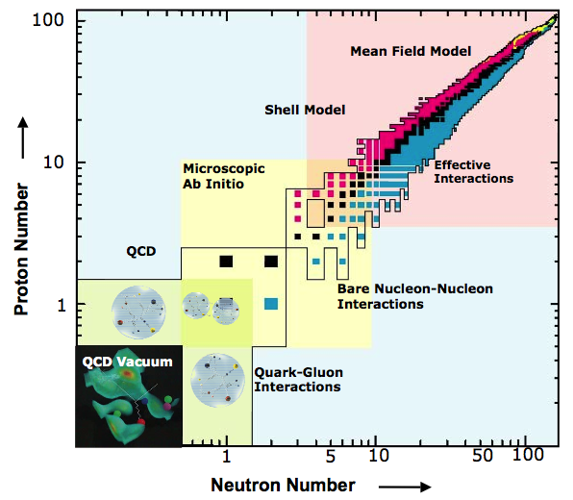
I. 第一性原理计算 （the first principles，ab initio)

Slide 3
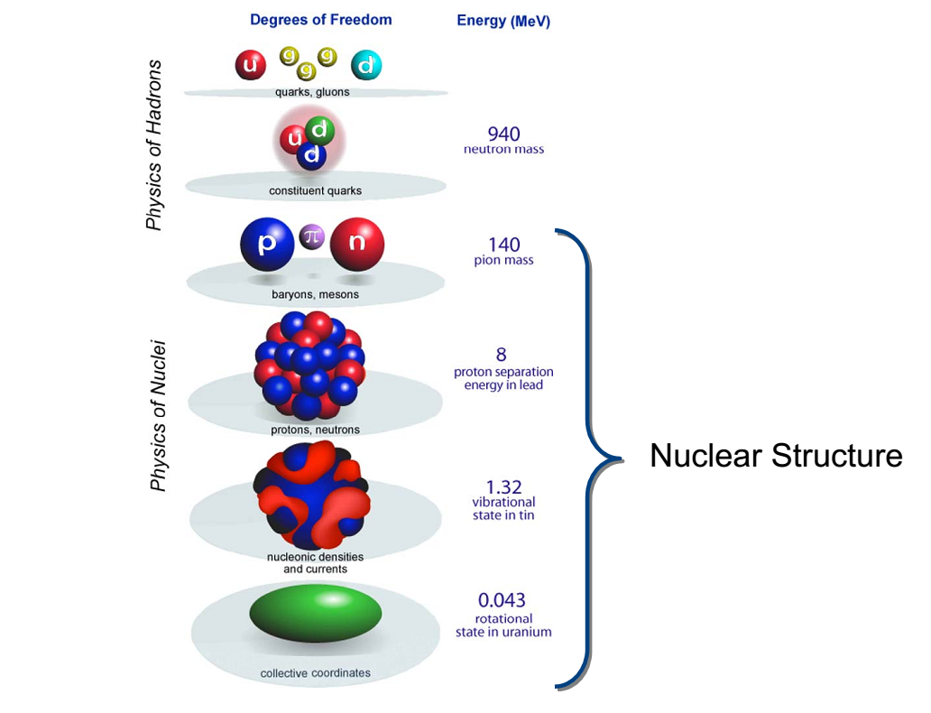

Slide 4
US Long Range Plan (2015-)
Areas of priority for US nuclear structure theory
1. Rigorous / ab initio theory for bound state systems:
1.a ab initio EFT-chiral etc. forces （核力）
1.b Rigorous theories for softening forces/speeding convergence (SRG etc) （软化）
1.c Powerful many-body methods: （多体方法）
-- "exact" few-body methods (Faddeev, hyperspherical harmonics, etc)
-- diffusion Monte Carlo
-- coupled cluster
-- selfconsistent Green's function methods
-- configuration interaction shell model
-- rigorous density functional theory for heavy nuclei
2. Rigorous/ ab initio theory for open systems (scattering + reactions)
……

Slide 5
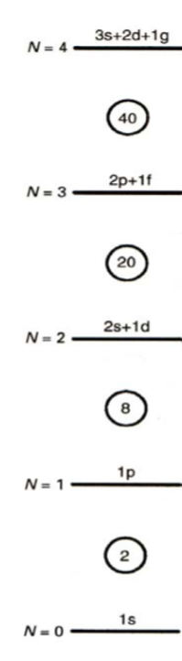
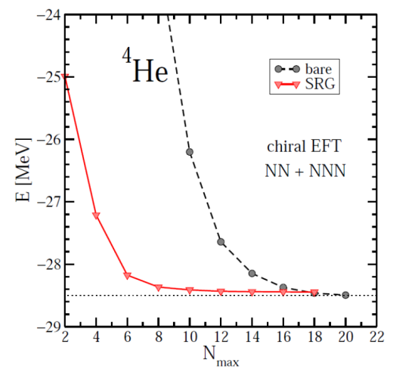
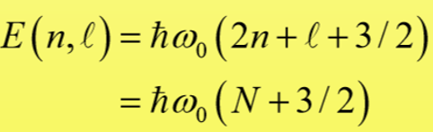
核理论的二个最基本问题：
Nuclear force（核力）
Many-body correlations（多体量子关联）
什么叫“核物理第一性原理计算 (ab initio, first principles)” ？
1）从 realistic nuclear forces出发
2) “严格”处理量子多体关联 (“严格”— 数值计算收敛)
真正意义上的ab initio计算应该是
从本世纪开始

Slide 6
Ab initio 计算三步曲
Realistic nuclear forces:
Chiral EFT (N³LO), CD Bonn, AV18 …
Renormalization to soften the force, to speed up convergence
V_{low-k ,} OLS, SRG, UCOM, (G-Matrix) …
Ab-initio many-body methods
No Core Shell Model (NCSM)
Coupled Cluster (CC)
In-medium Similarity Renormalization Group (IM-SRG)
Configuration interaction shell model
Selfconsistent Green’s Function
Diffusion Monte Carlo
Lattice Nuclear Chiral EFT
Many-Body Perturbation Theory (MBPT)
(Dirac-) Bruckner-Hartree-Fock

Slide 7
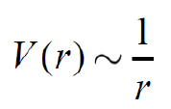
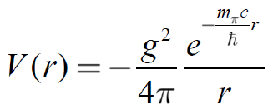

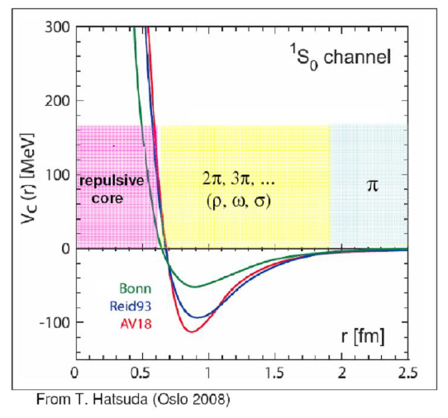
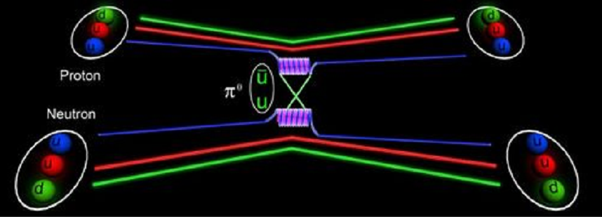
Yukawa nuclear force by π meson exchange
II. Realistic nuclear forces
Electromagnetic force has an infinite range!
(交换光子，m_{γ}=0)
交换π介子
Long-range attractive，no short-range repulsive

Slide 8

History, Phase I (The first pion period)
Chadwick (1932): Neutron
Heisenberg (1932): First Phenomenology (Isospin)
Yukawa (1935): Meson Hypothesis
1930’s
Discovery of the pion in cosmic ray (1947) and in the
Berkeley Cyclotron Lab (1948).
Nobelprize awarded to Yukawa (1949).
1940’s
Taketani, Nakamura, Sasaki (1951): 3 ranges.
One-Pion-Exchange (OPE): o.k.
Multi-pion exchanges: Problems!
Taketani, Machida, Onuma (1952);
Brueckner, Watson (1953).
1950’s
“Pion Theories”

Slide 9
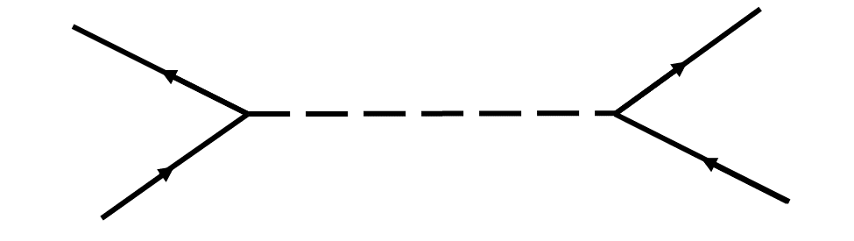
Phase II: The meson period
Many pions = multi-pion resonances:
One-Boson-Exchange Model
1960’s
Refined Meson Theories
Paris Potential (Lacombe et al., PRC 21, 861 (1980))
Bonn potential (Machleidt et al., Phys. Rep. 149, 1 (1987))
1970’s

Slide 10
Phase III: The QCD/EFT period
1970’s-1980’s
Nuclear physicists discover QCD:
Quark cluster models.
Nuclear physicists discover Effective Field Theory (EFT):
Weinberg (1990); Ordonez, Ray, van Kolck (1994/96).
Another “pion theory”; but now right: constrained by chiral symmetry
1990 –
today

Slide 11
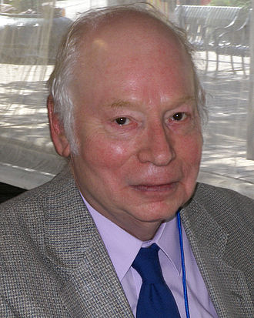
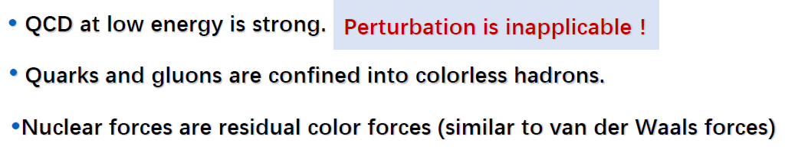
QCD=quarks + gluons (symmetries: spin, isospin, parity, chiral symmetry broken spontaneously)
核物理研究的梦想：从QCD出发
From QCD to nuclear physics via Chiral EFT
50s: multi-pion exchange 失败， Why?
因为当时还不知道“手征对称性”及“破缺”！写出的场论拉氏量不合适！
Weinberg (1990’s)
Chiral EFT=nucleon + pion (symmetries: spin, isospin, parity, chiral symmetry broken spontaneously)
At low energy, the effective degrees of freedom are nucleon and pion, rather than quark and gluon!
Notes:
Hamiltonian可能包含的对称性：I, T, parity? CP symmetry? In Chiral EFT （手征有效场理论），由于pion的质量不为零，所以手征对称性是破缺的,但是具有CP对称性？正像QCD中，由于u和d夸克的质量不为零，所以QCD强相互作用的手征对称性是破缺的，但具有CP对称性（CP=手征×宇称），弱相互作用又破坏CP对称性。
理论方法要好。
第二项公式的第一项是质心系动能，但（p_i-p_j)不是相对动量，如果两个物体质量相同，则相对动量是(p_i-p_j)/2，具体推导见笔记。

Slide 12
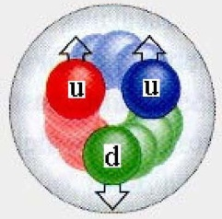



What is the nature of nuclear force?
Analogy
Van der Waals force
Nuclear force
-
+
-
+
The effective interaction between neutral atoms: the residual force of electromagnetic interaction outside atom.
Residual force of the QCD strong interaction outside the nucleon
Quarks and gluons are confined into colorless hadrons
From R. Machleidt

Slide 13
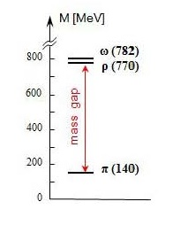
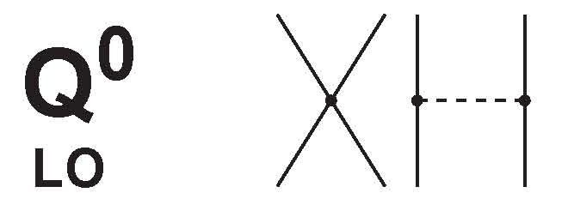
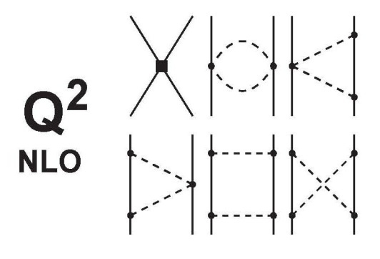

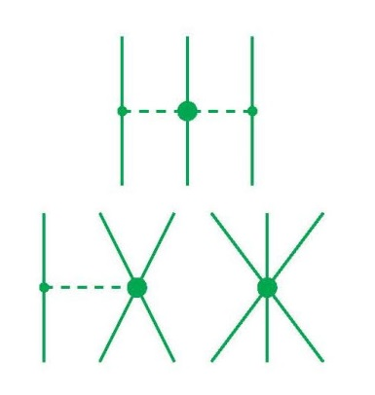
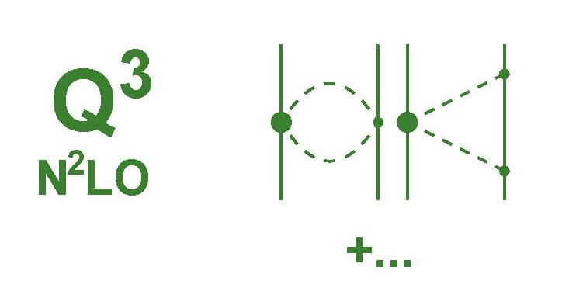
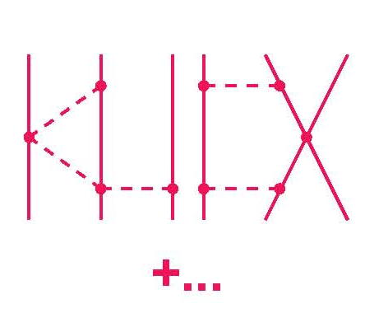
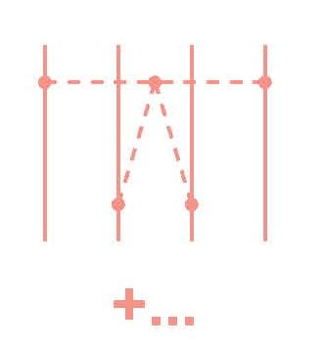
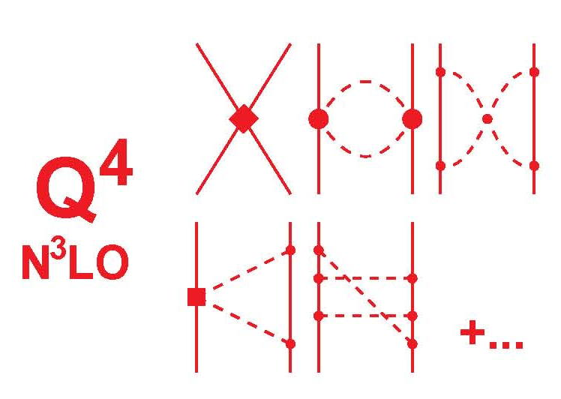
2N forces
3N forces
4N forces
Leading Order
Chiral EFT
2000年以后才开始EFT核物理计算
Next-to Leading Order
Advantages:
Gives hierarchy of nuclear force;
Naturally generates 3NF, 4NF…
Control the uncertainty of each hierarchy.
……
Power counting ：
Next-to-Next-to Leading Order
Next-to-Next-to-Next-to Leading Order

Slide 14
Main milestones for NN potential development in chiral perturbation theory (ChPT)
1994/96: v. Kolck and co-workers, first ChPT based NN potential at N2LO using cutoff regularization (r-space)
1994-1997:
- Robilotta and co-workers, 2-pi at N2LO
- 1997: Kaiser et al., 2-pi at N2LO
2000: Epelbaum et al. , NN potential in momentum space at N2LO
2003:
- Robilotta and co-workers 2-pi at N3LO
- Entem & Machleidt (“Idaho” group), first NN potential at N3LO
2005: Epelbaum et al. (“Bochum-Juelich” group), NN potential at N3LO

Slide 15

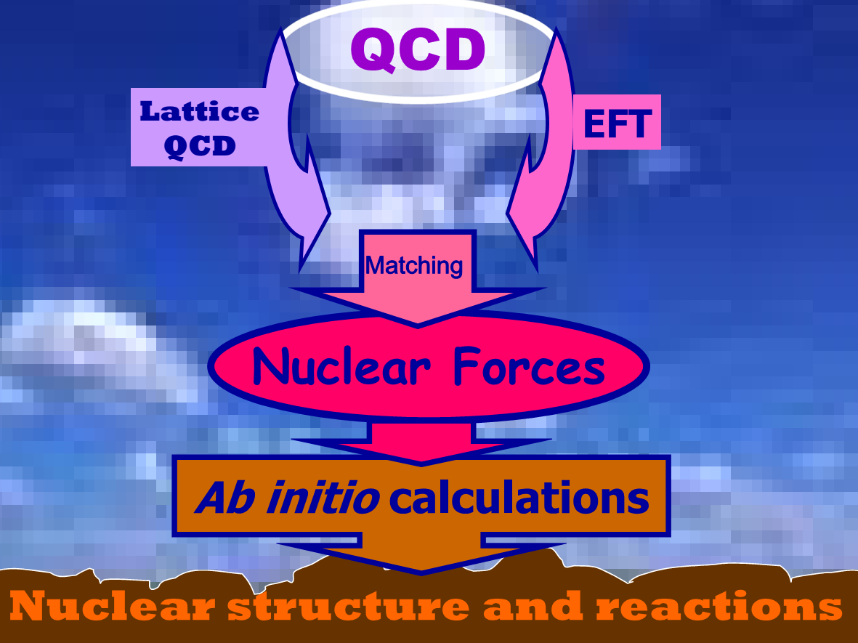
After 80 years of struggle, we have now a proper theory （ChPT) for nuclear force that is based upon the fundamental theory of strong interactions, QCD.
Machleidt
To develop a low-momentum expansion for chiral EFT (low energy) (Chiral perturbation theory, power counting).
Notes:
Hamiltonian可能包含的对称性：I, T, parity? CP symmetry? In Chiral EFT （手征有效场理论），由于pion的质量不为零，所以手征对称性是破缺的,但是具有CP对称性？正像QCD中，由于u和d夸克的质量不为零，所以QCD强相互作用的手征对称性是破缺的，但具有CP对称性（CP=手征(电荷？）×宇称），弱相互作用又破坏CP对称性。
理论方法要好。
第二项公式的第一项是质心系动能，但（p_i-p_j)不是相对动量，如果两个物体质量相同，则相对动量是(p_i-p_j)/2，具体推导见笔记。

Slide 16
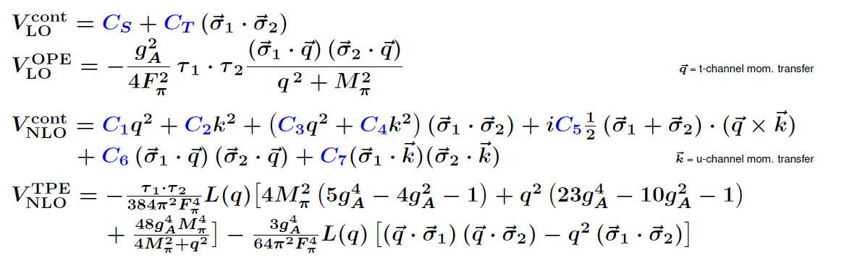

Slide 17
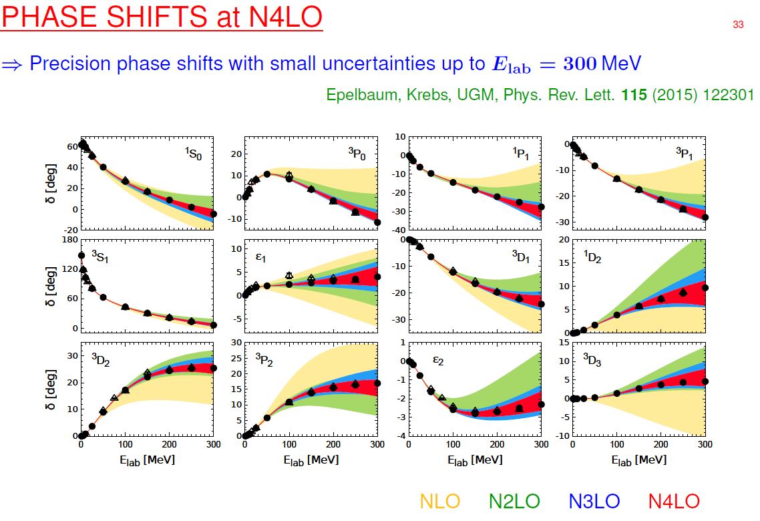
ChPT Lagrangian 的合理性
现实核力的最大特点：势参数由核子二体散射数据确定（和²H），而不是核结构实验数据！

Slide 18
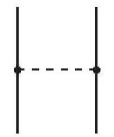
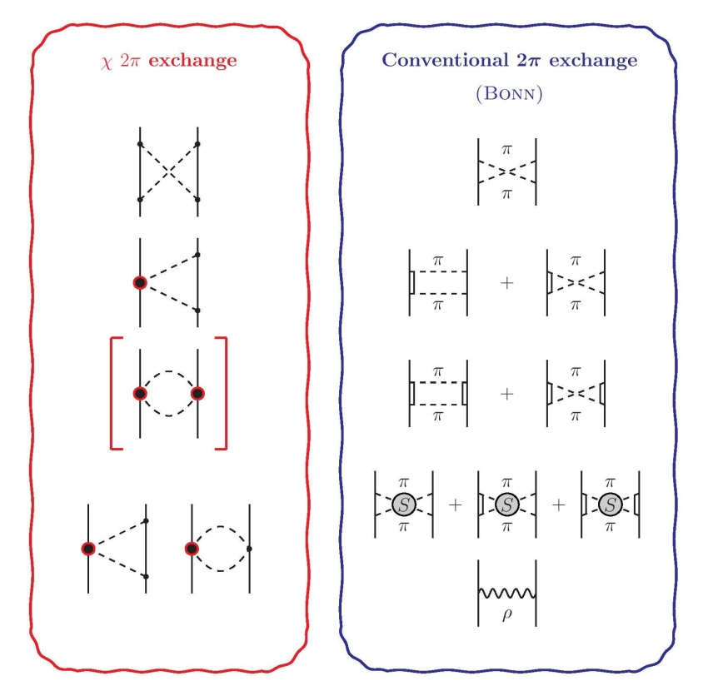

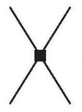

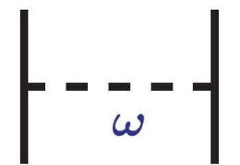
ChPT Conventional meson model
OPE
Chiral perturbation theory (ChPT) is an expansion in terms of small momenta.
TPE
Meson model is an expansion in terms of ranges (masses).
Short range

Slide 19
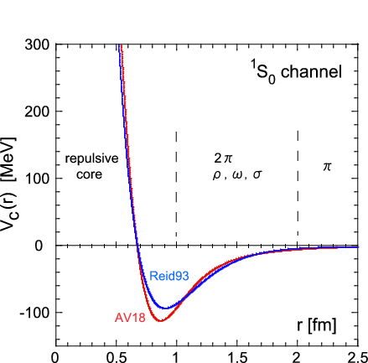
Realistic nuclear force
QCD!
Repusive core
OPEP
attraction
Reid93 is from
V.G.J.Stoks et al., PRC49, 2950 (1994).
AV16 is from
R.B.Wiringa et al., PRC51, 38 (1995).
quark-gluon structures
overlap
heavy mesons

Slide 20
Properties of the nuclear force
Finite range
Intermediate-range attraction
Short-range repulsion (“hard core”)
Spin-dependent non-central forces:
- Tensor force
- Spin-orbit force
Charge independence

Slide 21
高精度核力 (high-precision modern nuclear forces)
1980’s
Nijmegen: We need more precision!!!
“A χ²/dat of ≈ 2 is not good enough, it has to be 1.0”
1993: The high-precision Nijmegen phase shift analysis
1994-2001: High-precision NN potentials:
Nijmegen I, II, ’93, Reid93 (Stoks et al. 1994)
Argonne V18 (Wiringa et al, 1995)
CD-Bonn (Machleidt et al. 1996, 2001)
1990’s
- 2000’s

Slide 22

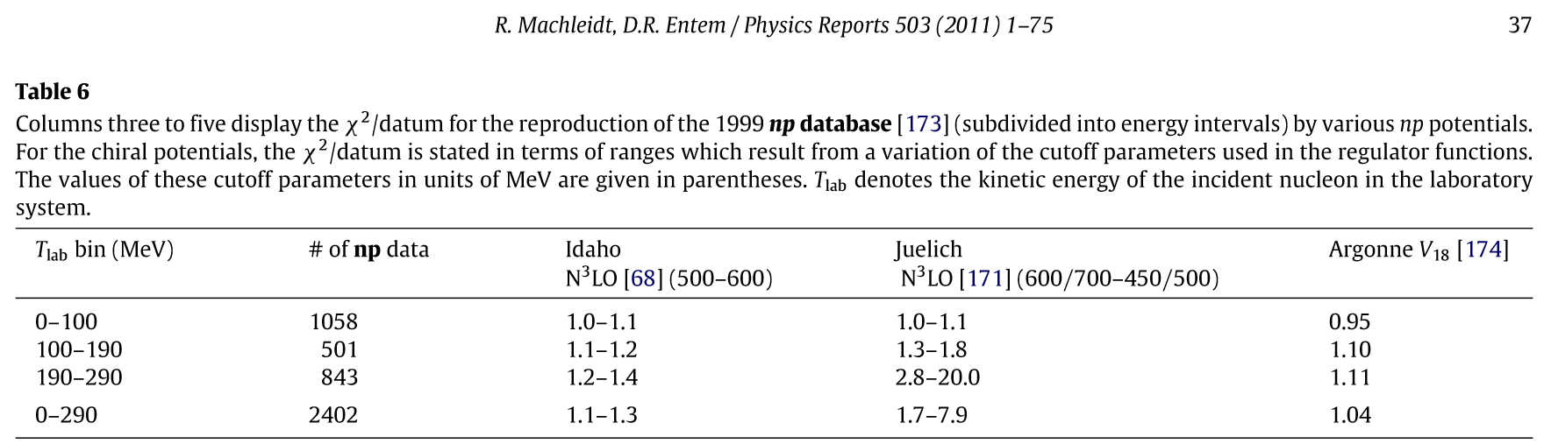
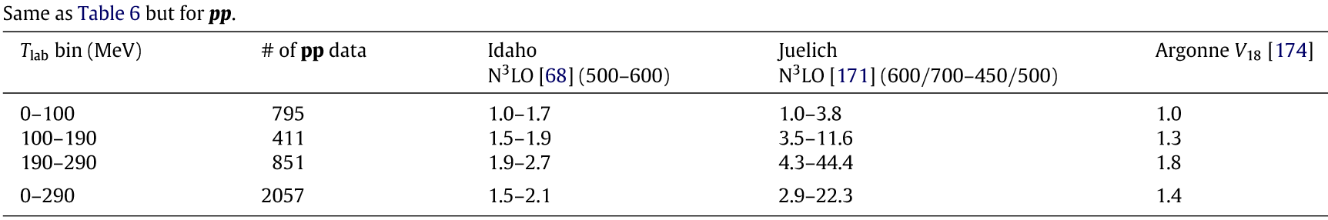
Modern high-precision realistic nuclear forces:
(about 6000 NN Data below 350 MeV)

Slide 23
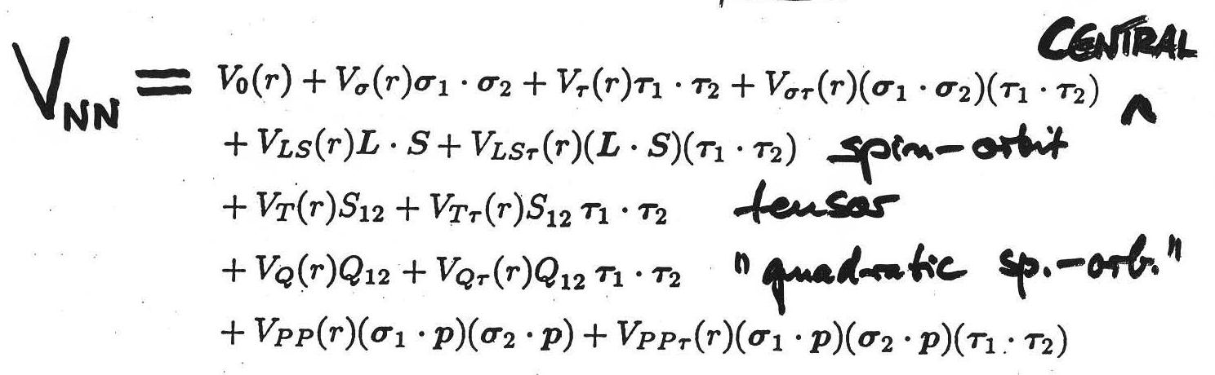
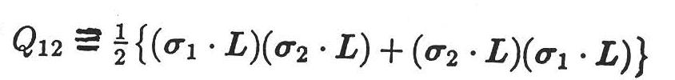
Most general two-body potential under those symmetries (Okubo and Marshak, Ann. Phys. 4, 166 (1958))
central
spin-orbit
tensor
quadratic spin-orbit
another tensor
Symmetries：
parity
spin
isospin
with

Slide 24
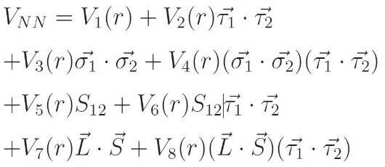

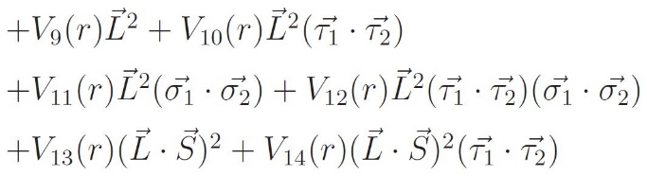
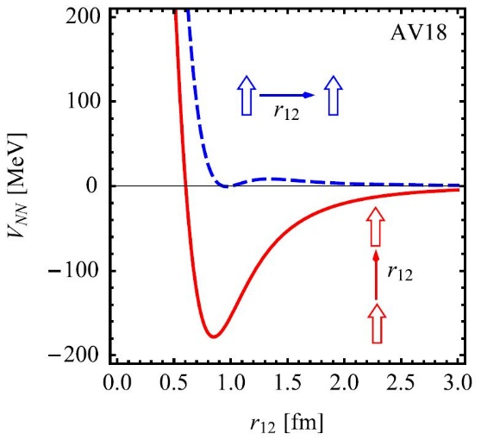
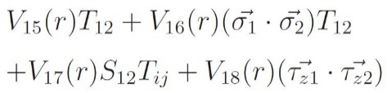
AV18

Slide 25
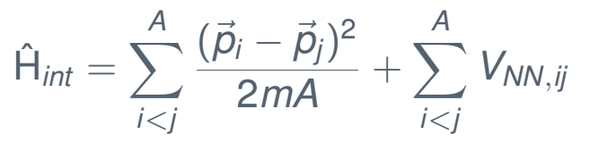
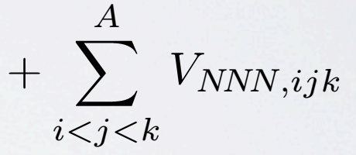
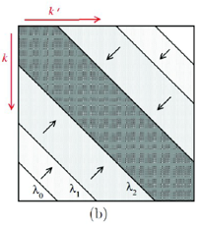
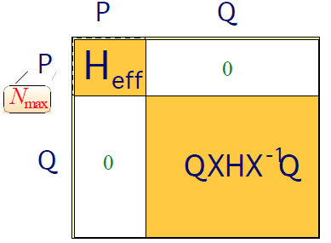
III. Renormalizations (softening) : G-matrix, V_{low k,} OLS, SRG, UCOM…
自由空间的核力软化，目的是加速数值“量子强关联多体系统”计算的收敛性
“无限”空间转化到有限空间，目的是缩小模型空间
SRG

Slide 26
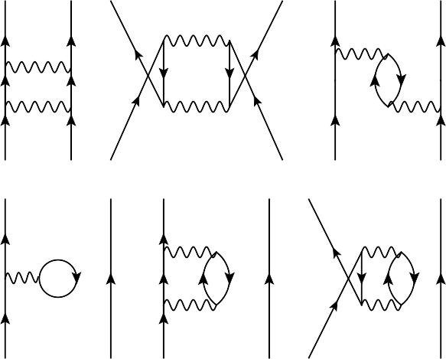
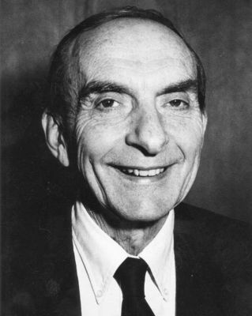
60年代以前，现实核力研究主要局限于核力本身的研究或用于一些少体问题研究，很难用于真正的核物理计算（计算核结构问题定量很差）
G.E. Brown (1926-2013, Nordita, Princeton, Stony Brook…)
60s-70s: 从现实核力出发计算核结构问题，G-matrix, Q-box, V_{low-k}
用于configuration-interaction shell model with an inert core，
核芯极化的重要性！
使得用现实核力计算原子核成为可能！
90s以后，高精度现实核力 + 超级计算机：No Core Shell Model (NCSM)等ab-initio方法……

Slide 27

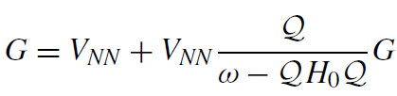
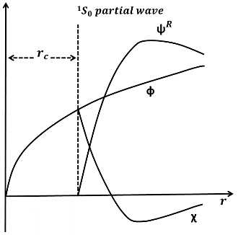
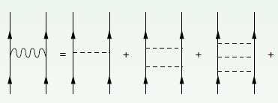
Renormalization schemes preserving all symmetries
Bare force
G-Matrix
Lee-Suzuki-Okamoto
renormalizes to the shell model basis chosen
Vlowk
scales to a lower cutoff momentum
Similarity renormalization group (SRG)
reduces off-shell couplings
Unitary Correlation Operator Method (UCOM)
reduces short range repulsion
重整化到模型空间
软化

Slide 28
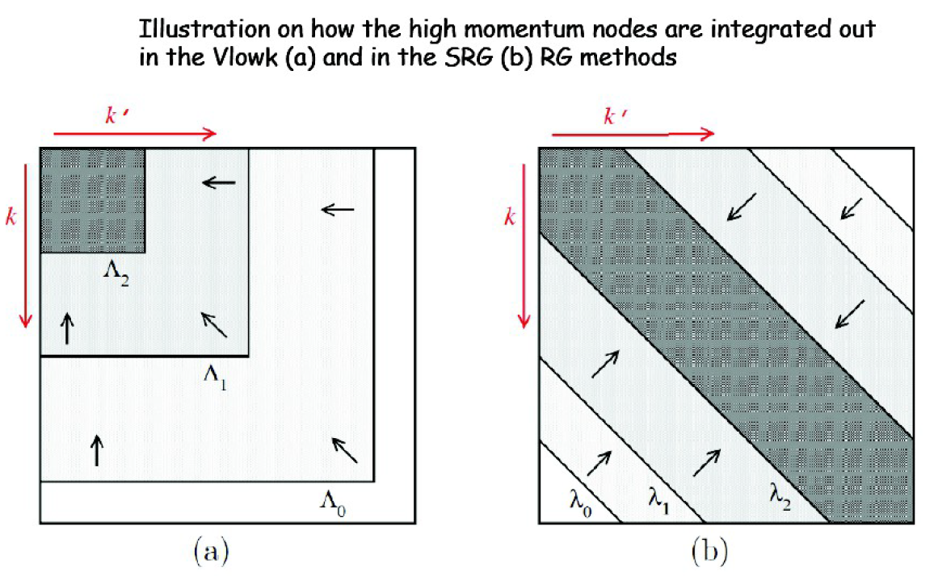
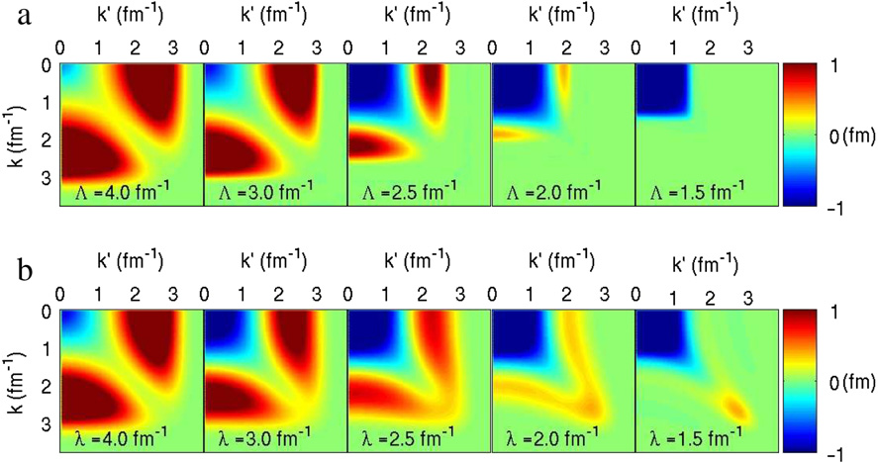
软化核力
SRG
V_{low-k}
V_{low-k}
SRG

Slide 29
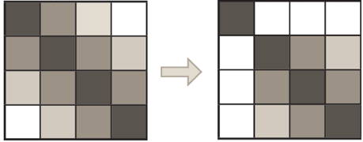


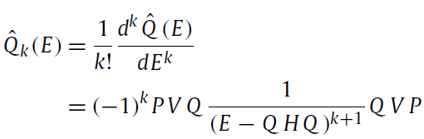
软化后，再脱耦到模型空间：我们用Q-box folded diagrams
2nd order perturbation
3rd order perturbation
Q-box folded diagrams
Q-box derivatives
这就是做ab initio壳模型计算的困难之一，用唯象核力计算不会碰到这个难点！

Slide 30


IV. 如何“严格”求解强关联量子多体体系？

Slide 31




Slide 32

Ab-initio many-body methods
No Core Shell Model (NCSM)
Coupled Cluster (CC)
In-medium Similarity Renormalization Group (IM-SRG)
Configuration interaction shell model
Selfconsistent Green’s Function
Diffusion Monte Carlo
Lattice Nuclear Chiral EFT
Many-Body Perturbation Theory (MBPT)
(Dirac-) Bruckner-Hartree-Fock

Slide 33






Gamow Shell Model （共振 + 连续谱）
Gamow IM-SRG （共振 + 连续谱）
Gamow Chiral EFT 三体力
形成了我们自己的特色
（创新）
1）第一性原理计算
2）滴线区弱束缚或不束缚核

Slide 34
背景 （前沿和困境）
当前核物理前沿：放射性核束物理（滴线区、弱束缚、不束缚、共振、连续….）
在建装置：FRIB, HIAF, FAIR …
运行装置： RIBF (RIKEN) , NSCL (MSU), HIRFL（兰州）, ISOLDE (CERN), ISAC (TRIUMF) …
通过下面数据体现“前沿性”(近2年)
RIBF (RIKEN) ：
2019: > 5 PRL (2 Editors’ Suggestion)（不完全统计）
2020：≈ 16 PRL (2 Editors’ Suggestion)
兰州装置：
2019: 1 PRL (Editors’ Suggestion)
2020：3 PRL （其中1篇北大叶组在兰州装置的工作）
2021：1 PRL (Featured in Physics, Editors’ Suggestion)
全球核结构与核反应 Nature和Nature physics的文章
2020：4 Nature，2 Nature physics
2021: 3 Nature, 2 Nature physics
2021: 2 Science

Slide 35




美国物理学会选出的“2019年物理学发生的十大事件”
4.
需要高精度测量（高灵敏度）
物理学家希望下一个元素的滴线不要再等上20年。下一代稀有同位素装置计划在两年内投入使用，可能会将滴线延伸至镁元素，即元素周期表中的第12号元素。

Slide 36


Slide 37
Element production

Slide 38


我们的特色：Resonance and continuum Gamow SM with realistic nuclear forces
Q
P
A time-dependent many-body problem
Core

Slide 39





$i\text{ℏ}\frac{∂}{∂t}ψ(r,$t)=[- $\frac{ℏ^{2}}{2m}∇^{2}$+V(r)]𝜓(𝒓,t) ; $\int{ψ(r,t)}$𝜓*(𝒓,t)=1
薛定谔方程
--TDSE
Discretizing the TDSE
定态
$ψ(r,t)$=$e^{−iEt/ℏ}φ_{E}\left(r\right)$
$[−\frac{ℏ^{2}}{2m}∇^{2}+$V(r)]$φ_{E}\left(r\right)$=E$φ_{E}\left(r\right)$
时间只是提供一个相因子
定态薛定谔方程
核结构理论：一般求解定态薛定谔方程本征值，核态的能量不变。求解相对简单！
但是，对于不束缚？如何考虑弱束缚的连续谱贡献？如何处理衰变问题？
这些都是含时问题！
Notes:
Discrete [[dɪ'skriːt]

Slide 40


Berggren 60年代 发展$了量子力学$
用定态方法求解含时问题
$ψ(r,t)$=$e^{−iEt/ℏ}φ_{E}\left(r\right)$
$[−\frac{ℏ^{2}}{2m}∇^{2}+$V(r)]$φ_{E}\left(r\right)$=E$φ_{E}\left(r\right)$
But E can be complex, and $\int{φ_{E}\left(r\right)φ_{E}\left(r\right)}$=1
$$本征值：E={ E}_{n}−i\frac{Γ_{n}}{2}$$
$ψ(r,t)$=$e^{−iEt/ℏ}φ_{E}\left(r\right)$=${e^{−iE_{n}t/ℏ}φ}_{E}\left(r\right)e^{−Γ_{n}t/2ℏ}$
T. Berggren, Nucl. Phys. A109 (1968) 265
（Berggren方法的一个关键）
核态有衰变寿命，decay width:
复空间求解量子力学问题要比实空间困难得多！
Notes:
conjugate ['kɒndʒʊgeɪt]

Slide 41
An extension of the standard Schrodinger equation
Physics Perspective:
Time-dependent Schrodinger eq.
Math Perspective:
Complex wave equation
  A is an anti-Hermitian (non-Hermitian) operator in a complex (rigged) Hilbert space
  Inner product in a complex Hilbert space
  H is a Hermitian operator in
  real-number Hilbert space
  is a complex wavefunction
  Normalization
has physical interpretation as a probability density

Slide 42








The Gamow (Berggren) basis
T. Berggren, Nucl. Phys. A109 (1968) 265
Single-particle basis in complex-k plane describe bound, resonance and scattering on equal footing.
The radial wave function
Outgoing solution at large distance
Asymptotically
Orthogonality and Completeness
Discretized
Notes:
orthogonality [,ɔːθɒɡə'nælətɪ]

Slide 43




Complex-momentum space: bound, resonance and continuum
Woods-Saxon in complex-k space
$\int{φ_{E}\left(r\right)φ_{E}\left(r\right)}$=1
复数

Slide 44





Nuclear shell model
（概念1932年由D. Ivanenko and E. Gapon提出，1949年主要由下面三人独立发展，Nobel prize 1963 ）
Eugene Paul Wigner
Maria Goeppert-Mayer
J. Hans D. Jensen
Spin-orbit coupling
幻数
单粒子壳层轨道实验可观测吗？
（定量）
Single-particle orbits (shell)
(configuration-mixing; configuration-interaction) shell model
1950年代开始，Igal Talmi et al.
Many-body nucleus
原子核性质实验可观测吗？（定量）

Slide 45



Gamow Shell Model 本身很新
下面二篇是最早的但基于“唯象相互作用”的 Gamow Shell Model (configuration mixing, many-body) (Berggren basis是for single particle)，主要是给出方法
1. Betan, Liotta, Sandulescu, Vertse, PRL 89, 042501 (2002) (⁸⁰Ni: 2 valence particles)
2. Michel, Nazarewicz, Płoszajczak, Bennaceur, PRL 89, 042502 (2002) (¹⁸O: 2 valence particles)
1. 我们发展了 ab initio Gamow Shell Model
构建一个ab initio的模型空间的相互作用是一个艰难而巨大的任务！
Interaction Gamow space
$V_{low k}$ or SRG
To remove hard core,
but still keep good descriptions of NN scattering phase shifts
Bare forces:
Strong repulsion，slow convergence
Q-box
Non-degenerate extended Kuo-Krenciglowa folded-diagram method (EKK) by Takayanagi, NPA 852, 61 (2011)

Slide 46
我们发展 Q-box folded diagram (MBPT) 到复动量空间（Berggren复空间）
2nd order perturbation
3rd order perturbation
Q-box folded diagrams
Q-box derivatives
这就是做ab initio壳模型计算的困难之一，用唯象核力计算不会碰到这个难点！

Slide 47

Model space
Q space
P space
……
g_{9/2} …
Continuum
Continuum
1p_{1/2}, 2p_{1/2}…
P is the model space
Q is the excluded space
(including the core)
f_{5/2} …
d_{3/2} continuum
1p_{3/2}, 2p_{3/2}…
The Berggren space must be nondegenerate
f_{7/2}…
1d_{3/2}, 2d_{3/2} …
0d_{3/2}
0d_{3/2}
1s_{1/2}
1s_{1/2}
0d_{5/2}
0d_{5/2}
Bound
0p_{1/2}
0p_{3/2}
2
Q-box folded diagrams in complex-k basis
0s_{1/2}

Slide 48




the two-body density operator for two nucleons in (a, b) and (c, d ) with the coupled angular momentum J and isospin T ; is the creation or annihilation of two nucleons.
TBMEs: (用Q-box folded diagrams建立)
复空间H对角化 本征值(复数)：实部 (resonance energy) + 虚部 (decay width)

Slide 49



2017年
2020年

Slide 50



高精度计算

Slide 51



Ca同位素链非常特殊！链非常长，二个双幻核 ^{40,48}Ca
连续谱效应很关键！
L. Coraggio et al., PRC 80, 044311 (2009), PRC 89, 024319 (2014): CD Bonn, MBPT
J.D. Holt et al., PRC 90, 024312 (2014): N3LO(NN)+N2LO(NNN), MBPT
H. Hergert et al., PRC 90, 041302(R) (2014): N3LO(NN)+N2LO(NNN), IM-SRG
G. Hagen et al., PRL 109, 032502 (2012): NN+3NF_{eff} , CC-continuum (closed shell ±1 or 2 particles)
Mean-field calculations for ground states
C.Forssen et al., Phys. Scr. T 152, 014022 (2013)

Slide 52



Slide 53



Slide 54



1) High-precision CD-Bonn potential
2) Q-box folded diagrams
3) Gamow shell model
Odd-A滴线
高精度计算
Weakly unbound
Even 滴线

Slide 55



Core Gamow Shell Model (CGSM) with V_{low k} CD Bonn for calcium isotopes
J. G. Li, B. S. Hu , Q. Wu, Y. Gao, S. J. Dai, and F. R. Xu，PRC 102, 034302 (2020)

Slide 56



⁶He halo
density
⁶He correlated density distribution
0⁺
⁶He halo
GSM计算

Slide 57


R. Lazauskas, E. Hiyama, J. Carbonell,
PLB 791, 335 (2019).
对这些量子体系的计算必须：
1）ab initio
2) 含共振与连续谱
3）高精度
Li, Michel, Zuo, Xu, “Resonances of A = 4 T = 1 isospin triplet states within the ab initio no-core Gamow shell model”

Slide 58




Ab initio (Chiral EFT) calculations of Trineutron and Tetraneutron systems

Slide 59



IM-SRG
本身很新
Tsukiyama, Bogner, Schwenk, PRL106, 222502 (2011).
Hergert, Bogner, Morris, Schwenk, Tsukiyama, Physics Reports 621, 165 (2016)
2. 我们发展了ab initio Gamow IM-SRG （复空间）
Complex-momentum Berggren space ab initio Gamow IM-SRG

Slide 60









Real-energy IM-SRG:
Complex-energy Gamow IM-SRG:
Continuous similarity transformation
Flow equation
Directly gives g.s. energies for close-shell nuclei.
For open shell or excited states, we use the Equation of Motion (EOM)
Gamow IM-SRG + EOM :
Gamow IM-SRG decouples the space from the closed-shell HF Fermi;
Use EOM to calculate excited states
White generator η(s) is used
H. Hergert, S. Bogner, T. Morris, A. Schwenk, K. Tsukiyama, Physics Reports 621 (2016) 165.
Notes:
Conjugate ['kɒndʒʊgeɪt]

Slide 61

Hu, Wu, Sun, Xu, PRC 99, 061302(R) (2019)

Slide 62



3. 我们把 Chiral EFT 三体力发展到复空间 Gamow 3NF
Chiral EFT 3NF 本身很新:
E. Epelbaum et al., PRC 66, 064001 (2002);
P. Navratil et al., PRL 99, 042501(2007)
直到现在，国际上拥有EFT 3NF的组还很少！
Phenomenological 3NFs:
- Urbana (1995)
- Tucson-Melbourne (1975-1999)
- Illinois (2001-2010)
- CD-Bonn + Δ (Deltuva, Sauer, 2003)
Δ-resonance (m ~1232MeV, t ~10⁻²⁴ s)
isobar degrees of freedom贡献很小，在Lagranian中可以不考虑
(m_{n}=939.6 MeV; m_{p}=938.3 MeV)

Slide 63
2N forces
3N forces
4N forces
Leading Order
Chiral EFT
2000年以后才开始EFT核物理计算
Next-to Leading Order
Power counting ：
Next-to-Next-to Leading Order
Next-to-Next-to-Next-to Leading Order

Slide 64



三体力：NNLO(NNN)
EFT 3NF at N²LO level

Slide 65

To reduce the calculation task, in many-body calculations, the normal-ordered 3NF is used usually.

Slide 66

Residual 3NF

Slide 67






合作实数空间 EFT 3NF
我们组发展复数空间Gamow EFT 3NF

Slide 68



GSM with ¹⁶O core: N³LO(NN) + N²LO(NNN)
Ma, Xu, Coraggio, Hu, Li, Fukui, Angelis, N.Itaco, Gargano, PLB 802, 135257 (2020)
[3] Otsuka, Suzuki, Holt, Schwenk, Akaishi, PRL 105 (2010) 032501.
[31] Hagen, Hjorth-Jensen, Jansen, Machleidt, Papenbrock, PRL108 (2012) 242501.
N³LO(NN): Entem and Machleidt, PRC 66, 014002 (2002).
N²LO(NNN): c_{D}=-1, c_{E}=-0.34, Navrátil, Gueorguiev, Vary, Ormand, A. Nogga, PRL 99, 042501 (2007).

Slide 69



Both 3NF and continuum play important roles in describing Borromean and halo
N³LO(2NF) + N²LO(3NF)
GSM with the core ¹⁴O
valence particles: 2p + 1n
two-proton halo
two-nucleon correlation density

Slide 70





无中微子双β衰变（0νββ）
Neutrino is its own antiparticle?
(Majorana Fermion)
¹³⁶Xe → ¹³⁶Ba + 2e⁻ (+ ? )
（利用精确的能量守恒关系）
预言衰变寿命：
phase-space factor (or kinematic factor);
nuclear matrix element
（核物理第一性原理计算，非常依赖于母核、子核波函数）
物理可观测量:
Free space effective space, 利用场论重整化方法(Goldstone diagrams)

Slide 71
2020年
Y.Z. Ma, F.R. Xu* et al., PLB 802, 135257 (2020)
Y.Z. Ma, F.R. Xu* et al., PLB 808, 135673 (2020)
B.S. Hu, Q.Wu, J.G. Li, Y.Z. Ma, Z.H. Sun, N. Michel, F.R. Xu*, PLB 802, 135206 (2020)
B. S. Hu , Q. Wu, Q. Yuan, Y. Z. Ma, X. Q. Yan, and F. R. Xu*, PRC 101, 044309 (2020)
J.G. Li, B.S. Hu, Q. Wu, Y. Gao, S.J. Dai, and F. R. Xu*, PRC 102, 034302 (2020)
2021年
J.G. Li, N. Michel, W. Zuo, and F.R. Xu*, PRC 103, 034305 (2021)
B. Dai, B. S. Hu, Y. Z. Ma, J. G. Li, S. M. Wang, C. W. Johnson, and F. R. Xu*, PRC 103, 064327 (2021)
J.G. Li, N. Michel, W. Zuo, and F.R. Xu*, PRC 103, 064324 (2021)
J.G. Li, N. Michel, W. Zuo, and F.R. Xu*, PRC (accepted)
……

Slide 72

VI. 总结
核物理正在追求第一性原理计算（我们发展了Gamow ab initio）
滴线区是低能核物理实验和理论的研究重点和前沿，
共振态、连续谱影响 Gamow复数量子力学
Berggren complex space
我们组的工作：
复动量空间：Ab initio Gamow Shell Model with the complex full Q-box folded diagrams;
复动量空间：Ab initio Gamow IM-SRG
复动量空间：Gamow N²LO 3NF

Slide 73


湖州 2021.07.23
PKU：孙中浩、胡柏山、吴强、马远卓、李健国、张爽、袁琪 … （按入学时间）
IMP: Nicolas Michel, Wei Zuo （many-body)
INFN (Italy): Coraggio, Fukui, Angelis, Itaco (实空间 EFT 3NF )
73

