Slide 1
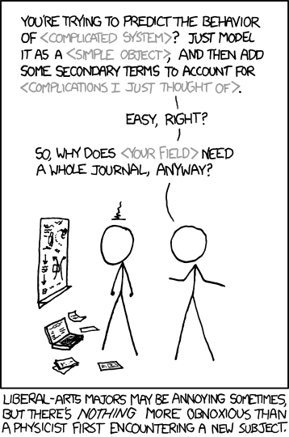
Hadronic Physics, Detectors, & Accelerators Lecture 1: Building Blocks of Matter
Douglas W. Higinbotham
Jefferson Lab
Thank you to Rolf Ent and Richard Miller for providing me with their slides from a 7 July 2022 lecture on this same topic.
Animations of the proton developed in collaboration with Christopher Boebel, Joseph McMaster and James LaPlante: https://www.youtube.com/watch?v=G-9I0buDi4s
Cartoon from XKCD https://xkcd.com/793/

Slide 2
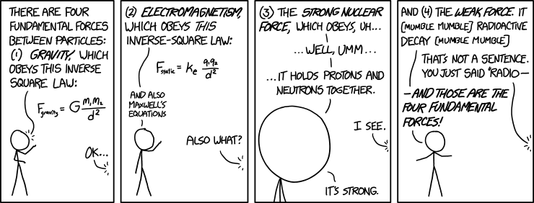
Topics of my five lectures
Lecture 1: Building Blocks of Matter
Lecture 2: Proton Radius Puzzle
Lecture 3: Short-Range Correlations & the EMC Effect
Lecture 4: Particle Detectors
Lecture 5: Accelerators with a focus on JLab & RHIC/EIC
https://xkcd.com/1489/

Slide 3
3000 years ago, what did the great philosophers think were the building blocks of matter?

Slide 4
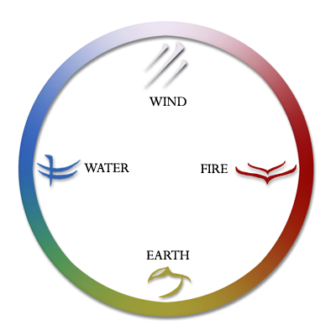
The Five Elements (Aristotle ~300BC )
And the Aether, the divine substance that makes up the heavenly spheres and heavens.
(i.e. the stars and planets, which Aristotle could see easier then we can in Boston )

Slide 5
In the late 1800’s, what did the great scientists think were the building blocks of matter?

Slide 6
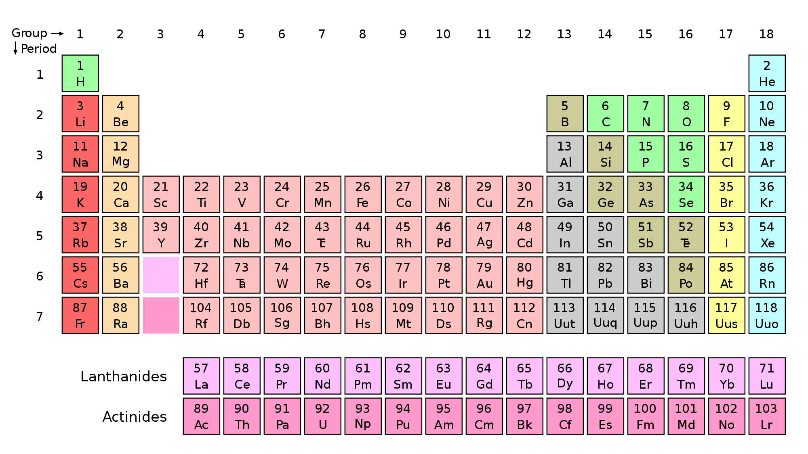
Periodic Table (Mendeleev 1868)

Slide 7
But this is getting really complicated…
We started with five building blocks
Earth
Wind
Fire
Water
Aether
Now I have learn the an entire periodic table?!
Why someday it might bite us, science often looks for simpler solutions, so as things get complicated, we often search for simpler solutions.

Slide 8
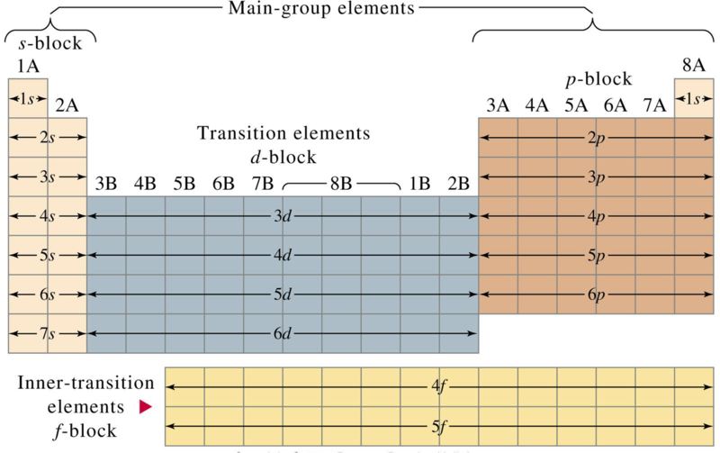
Quantum Mechanical Table
Charles Janet 1927

Slide 9
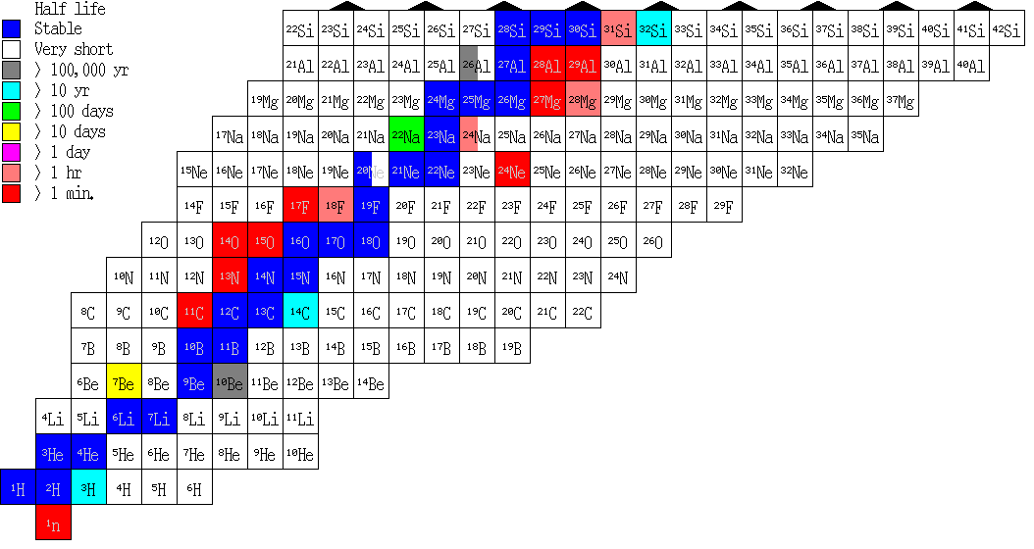
Chart of the Nuclides
Elements on the periodic table can have different numbers of neutrons.
Protons
Neutrons
Electrons

Slide 10
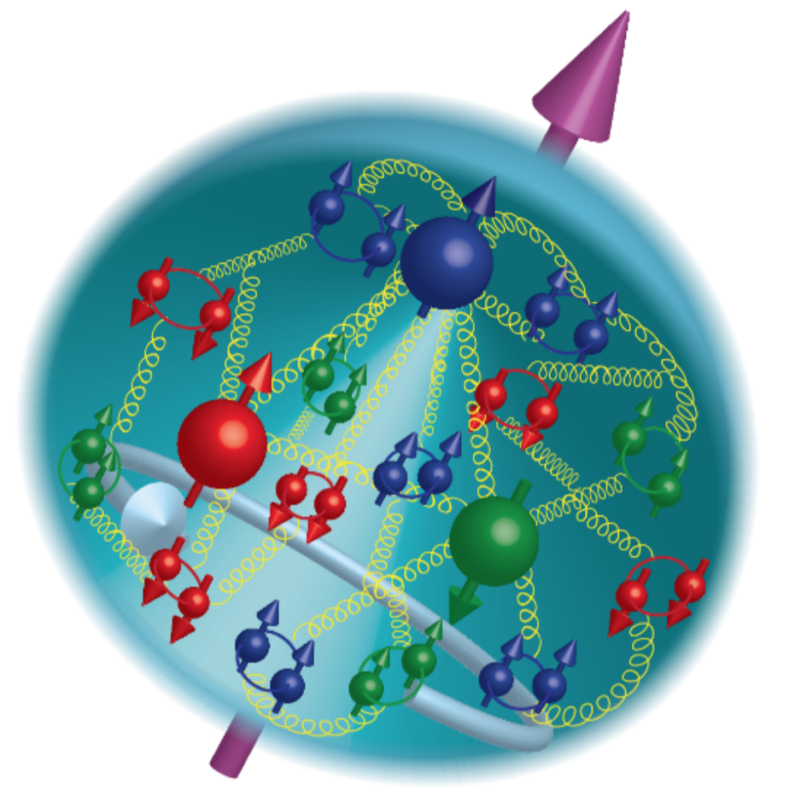
21st Century View of the Fundamental Structure of the Proton
Elastic electron scattering determines charge and magnetism of nucleon
Approx. sphere with <r> ≈ 0.84 Fermi ( next talk )
The proton contains quarks,
as well as dynamically
generated
quark-antiquark pairs
and gluons.
The proton spin
and mass have large
contributions from
the quark-gluon
dynamics.

Slide 11
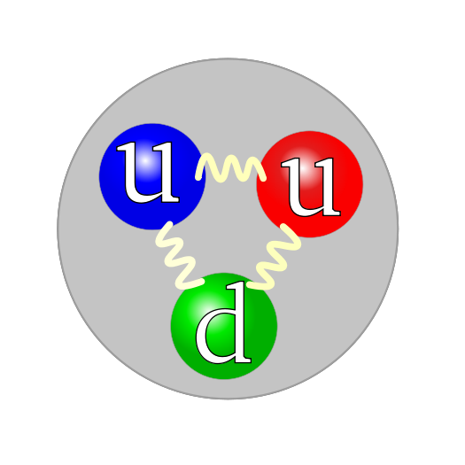
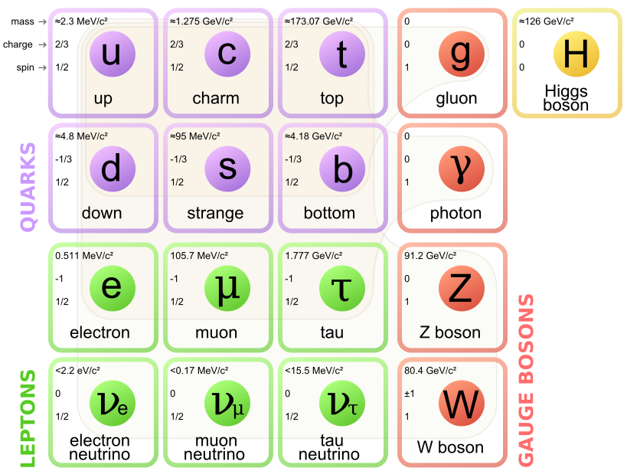
The 21st Century Building Blocks
Proton

Slide 12
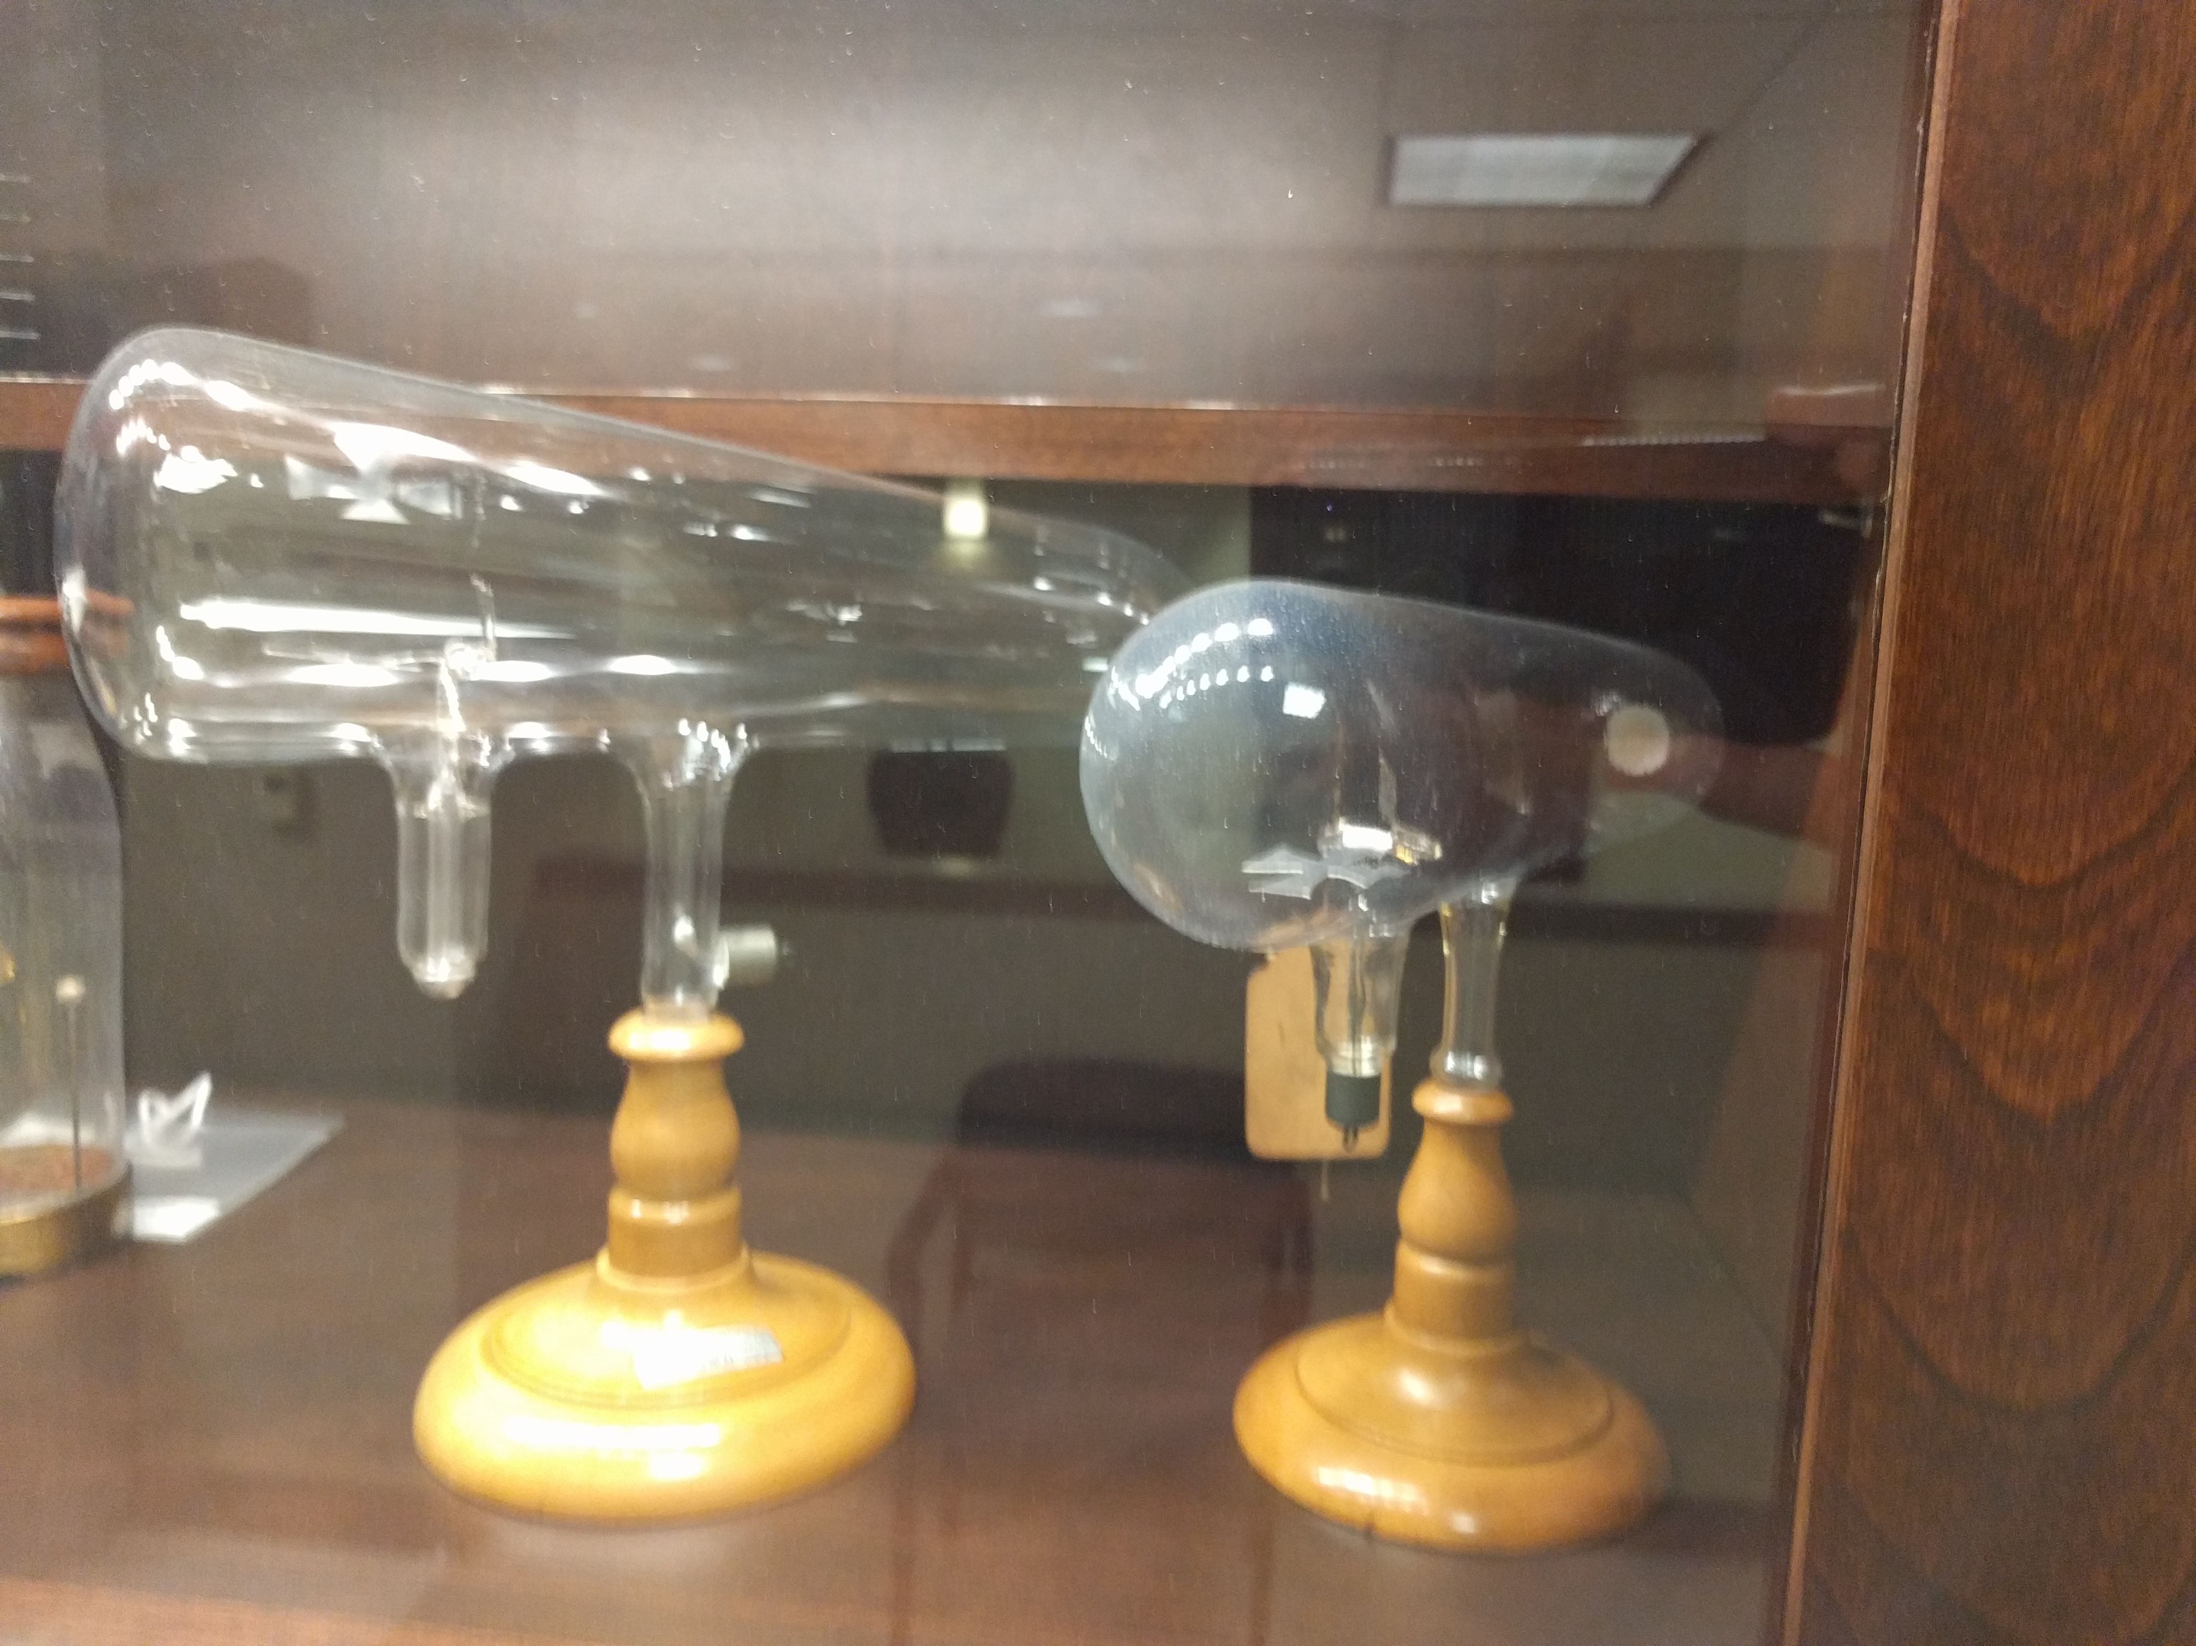
But you cannot see any of this!!
Photo taken at the Physics Department at Duquesne University
Does anyone know what these are and what they used to be commonly used for?

Slide 13
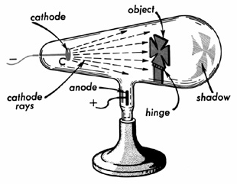
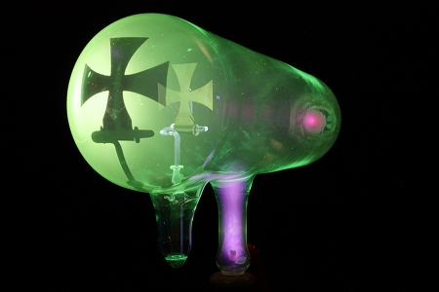
Cathode Ray Tube
Wilhelm Röntgen received the first Nobel prize for physics in 1901 “in recognition of the
extraordinary services he has rendered by the discovery of the remarkable rays subsequently
named after him".

Slide 14
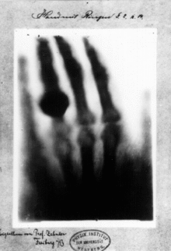
The First X-Ray of a Human
(i.e. Röntgen discovered what we now call X-rays)

Slide 15
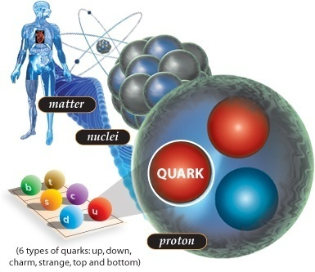
Cool Facts about QCD and Nuclei
Did you know that … ?
If an atom was the size of a football field, the (atomic) nucleus would be about the size of the umpire.
Despite its tiny size, the nucleus accounts for 99.9% of an atom’s mass.
Protons and neutrons swirl in a heavy atomic nucleus with speeds of up to some ¾ of c. More commonly, their speed is some ¼ the speed of light. The reason is because they are “strong-forced” to reside in a small space.
Quarks (and gluons) are “confined” to the even smaller space inside protons and neutrons. Because of this, they swirl around with the speed of light.

Slide 16
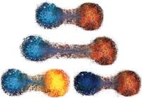
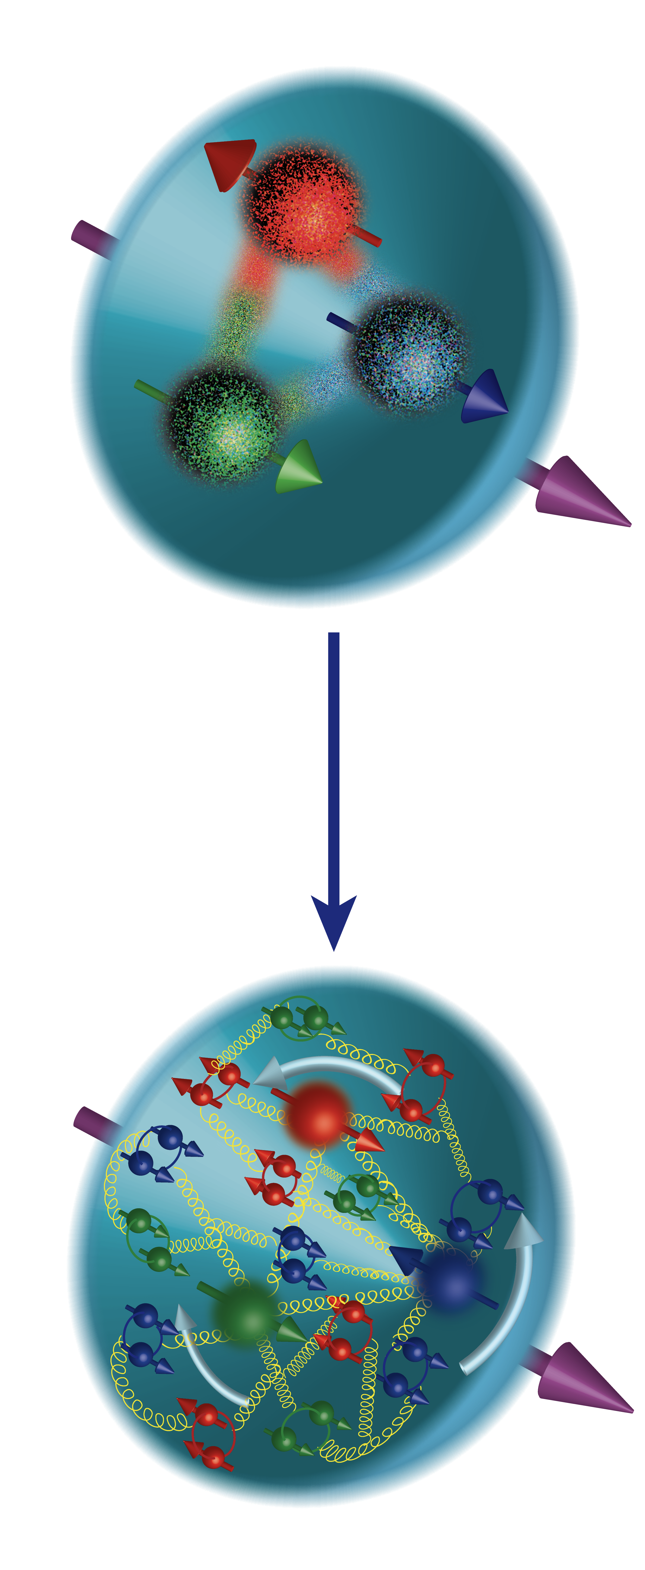
Cool Facts about QCD and Nuclei
The strong force is so strong, that you can never find one quark alone (this is called “confinement”).
When pried even a little apart, quarks experience ten tons of force pulling them together again.
Quarks and gluons jiggle around at nearly light-speed, and extra gluons and quark/anti-quark pairs pop into existence one moment to disappear the next.
This flurry of activity, fueled by the energy of the gluons, generates nearly all the mass of protons and neutrons, and thus ultimately of all the matter we see.
Even the QCD “vacuum” is not truly empty. Long-distance gluonic fluctuations are an integral part. Quarks have small mass themselves, but attain an effective larger mass due to the fact that they attract these gluonic fluctuations around them.
Nuclear physicists are trying to answer how basic properties like mass, shape, and spin come about from the flood of gluons, quark/anti-quark pairs (the “sea”), and a few ever-present quarks.

Slide 17
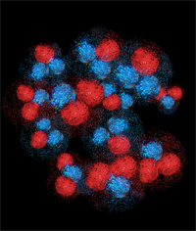
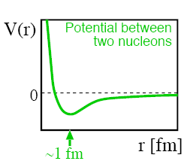
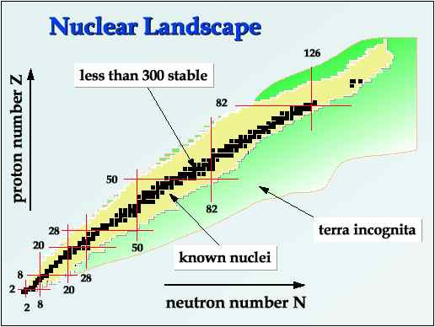
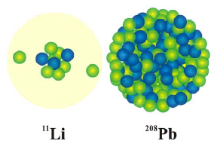
Cool Facts about QCD and Nuclei
A small fraction of the force between quarks and gluons “leaks out” of protons and neutrons, and binds them together to form tiny nuclei. The long-range part of this process can be well described as if protons and neutrons exchange pions.
Nuclear physicists are only now starting to understand how this “leakage” occurs, and how it results in the impressive variety of nuclei found in nature.
A nucleus consisting of some 100 protons and 150 neutrons can be the same size as one with 3 protons and 8 neutrons.
Despite the variety of nuclei found in nature, we believe we miss quite some more. These are necessary to explain the origin of nuclei and the abundance of elements found in the cosmos.

Slide 18
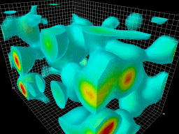
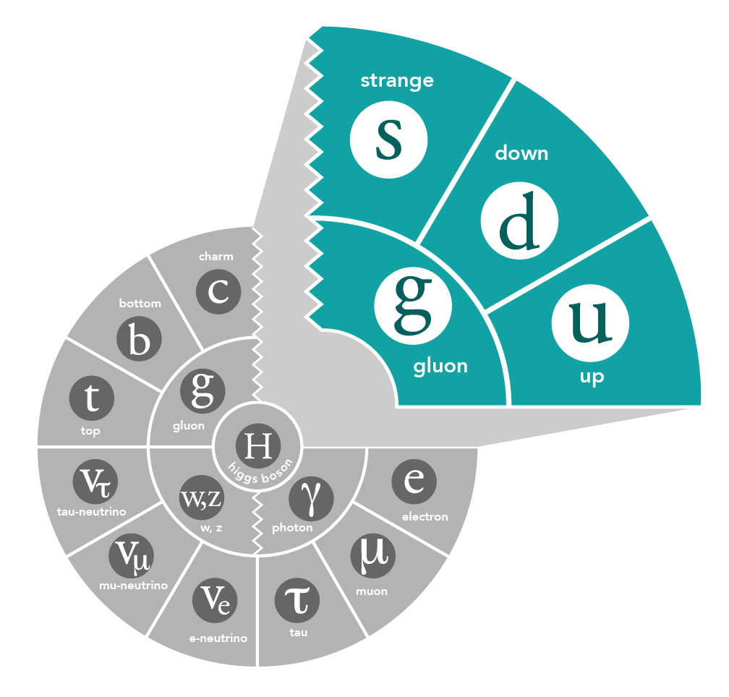
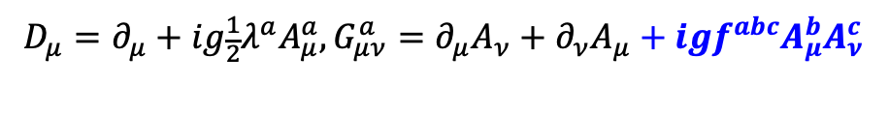
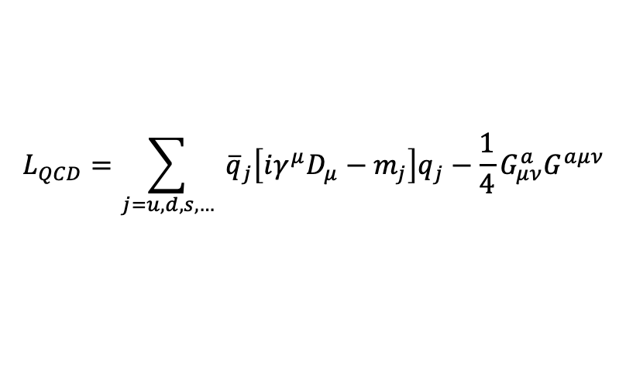
Gluons and QCD
QCD is the fundamental theory that describes structure and interactions in nuclear matter.
Without gluons there are no protons, no neutrons, and no atomic nuclei
Gluons dominate the structure of the QCD vacuum
$$L_{QCD}=\sum_{j=u,d,s,…}{ {\overline{q}}_{j}\left[iγ^{μ}D_{μ}−m_{j}\right]q_{j}−\frac{1}{4}G_{μν}^{a}G^{aμν}}$$
$$D_{μ}=∂_{μ}+ig\frac{1}{2}λ^{a}A_{μ}^{a}, G_{μν}^{a}=∂_{μ}A_{ν}+∂_{ν}A_{μ}+igf^{abc}A_{μ}^{b}A_{ν}^{c}$$
Facts:
Unique aspect of QCD is the self interaction of the gluons
The essential features of QCD - asymptotic freedom and (the emergent features) dynamical chiral symmetry breaking and color confinement - are all driven by gluons!
Mass from massless gluons and nearly massless quarks
Most of the mass of the visible universe emerges from quark-gluon interactions
The Higgs mechanism has almost no role here
Emergent mass of the visible universe

Slide 19
Electron Scattering Kinematics
k’ = (Ε’,k’)
Virtual photon → off-mass shell
q_{μ}q^{μ} = ν² – q² ≠ 0
k = (Ε,k)
Θ
Define two invariants:
Q² = -q_{μ}q^{μ} = -(k_{μ} – k_{μ}’)(k^{μ}-k’^{μ})
= -2m_{e}² + 2k_{μ}k’^{μ}
(m_{e} ~ 0) = 2k_{μ}k’^{μ}
(LAB) = 2(EE’ – k.k’)
= 2EE’(1-cos(Θ))
= 4EE’sin²(Θ/2)
only assumption: neglecting m_{e}²!!
2) 2Mν = 2p_{μ}q^{μ} = Q² + W² – M²
q = (ν,q)
Undetected final state X
p = (Μ,0)
p’ = (sqrt(p’² + M’²),p’)
Elastic scattering
→ W² = M² → Q² = 2M(E-E’)
(→ p’² = M’² = W²) !!

Slide 20
Use electron scattering as high-resolution microscope to peer into matter
Extracting the (e,e’) cross section
N_{N} (cm⁻²)
e'
N_{e}
e
(ΔΩ_{e}, Δp_{e})
Scattering probability or cross section

Slide 21
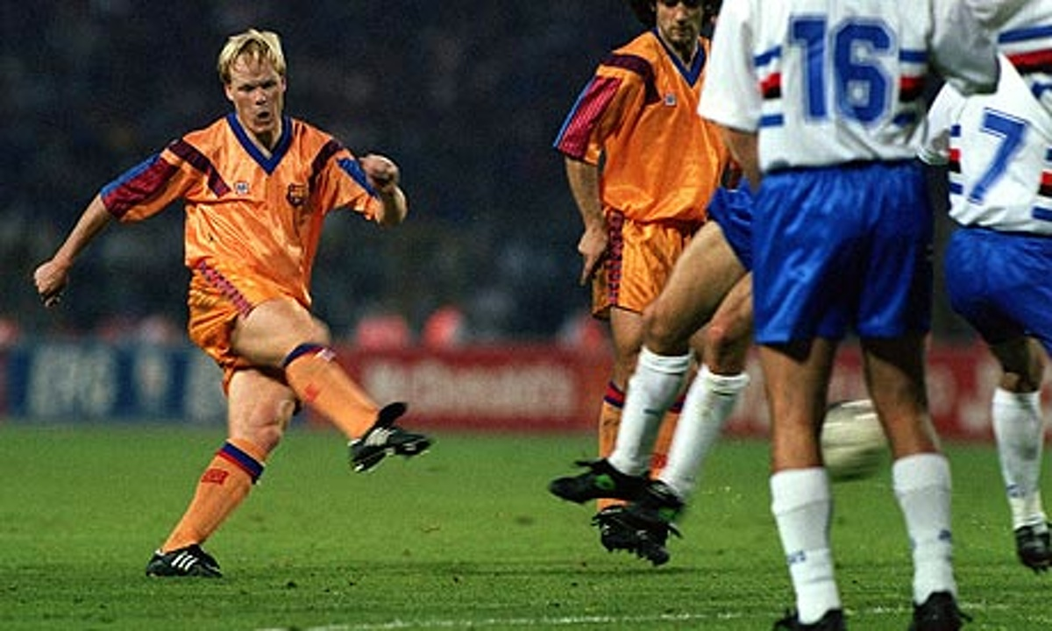


Elastic Scattering (nucleons stay together)
https://www.youtube.com/watch?v=tMkElwkZPyI

Slide 22
Quasi-Elastic Scattering (knock nucleon out)
https://www.youtube.com/watch?v=tMkElwkZPyI

Slide 23
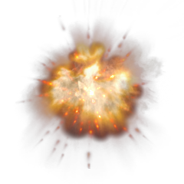
Deep Inelastic Scattering (probing partons)
https://www.youtube.com/watch?v=tMkElwkZPyI

Slide 24
Electron Scattering at Fixed Q²
Quark (fictitious)
Elastic
ν
Proton
Elastic
Δ
Deep Inelastic
N*
ν

Slide 25
Electron Scattering at Fixed Q²
Elastic
Nucleus
Deep Inelastic
Δ
Quasielastic
N*
ν
Proton
Elastic
Δ
Deep Inelastic
N*
ν

Slide 26
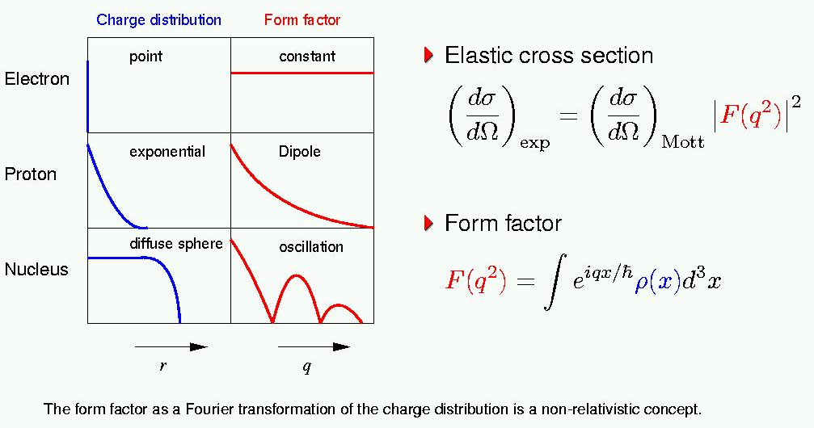
Electron-Charge Scattering
Form Factors characterize internal structure of particles

Slide 27
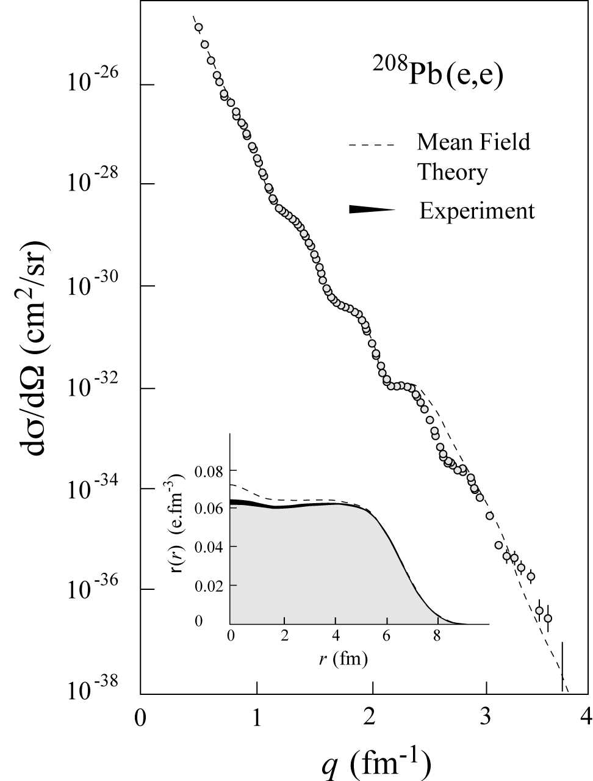
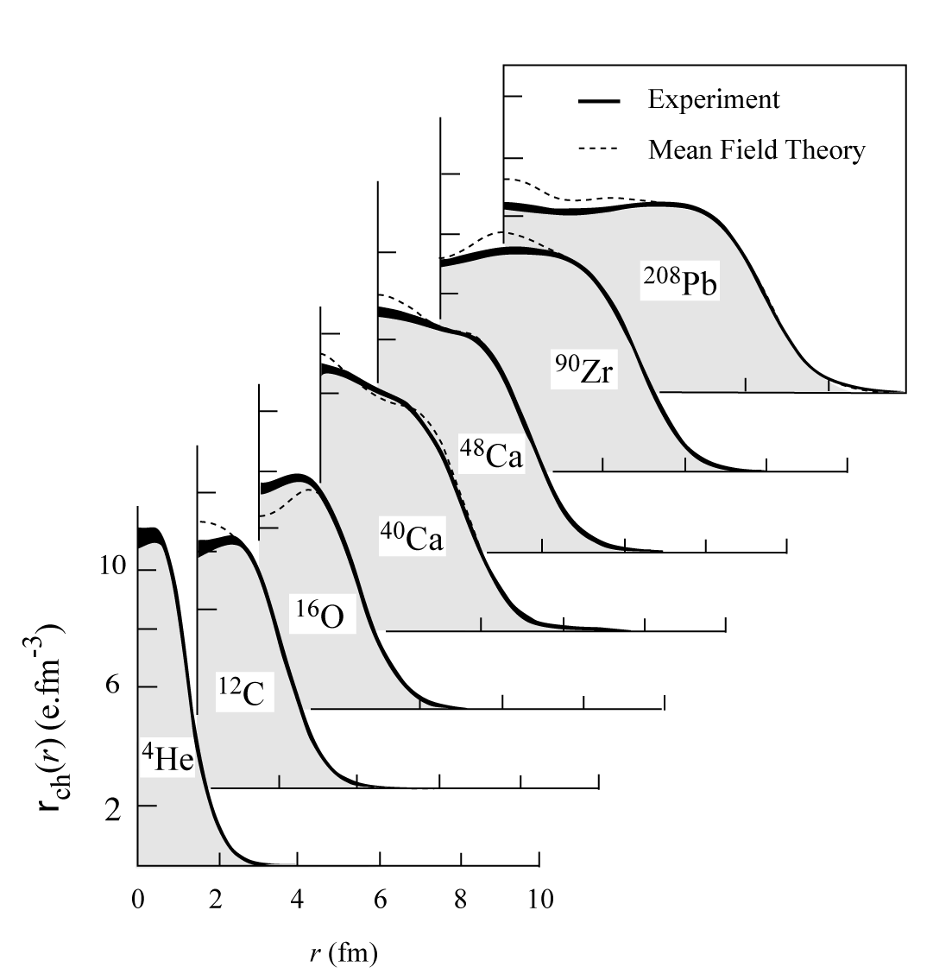
History: Charge Distributions
In ‘70s large data set was acquired on elastic electron scattering (mainly from Saclay & NIKKHEF) over large Q²-range and for variety of nuclei
“Model-independent” analysis provided accurate results on charge distribution well described by mean-field calculations.

Slide 28
Cross section for elastic Electron Proton Scattering
Recoil factor for scattering from proton with mass
Mott Cross Section for scattering from pointlike particle
Formula for scattering from a spin-1/2 particle.

Slide 29
Elastic Scattering from a Proton at Rest
(m,0)
(ω,q)
Before
p
(ω+m, q)
After
p
Proton is on-shell ⇒
(ω + m)² − q² = m²
ω² + 2mω + m² − q² = m²
ω = Q² ⁄ 2m

Slide 30
Elastic Scattering from a Moving Proton
(E,p)
(ω,q)
Before
p
After
p
(ω+E, q+p)
(ω + E)² – (q+p)² = m²
ω² + 2Eω + E² − q² −2p•q − p² = m²
Q² = 2Eω −2p•q
ω (E/m) = (Q² ⁄ 2m) + p•q ⁄ m

Slide 31
Quasielastic Scattering
For E ≈ m:
ω ≈ (Q² ⁄ 2m) + p•q ⁄ m
If we “quasielastically” scatter from nucleons within nucleus:
Expect peak at: ω ≈ (Q² ⁄ 2m)
Broadened by Fermi motion

Slide 32
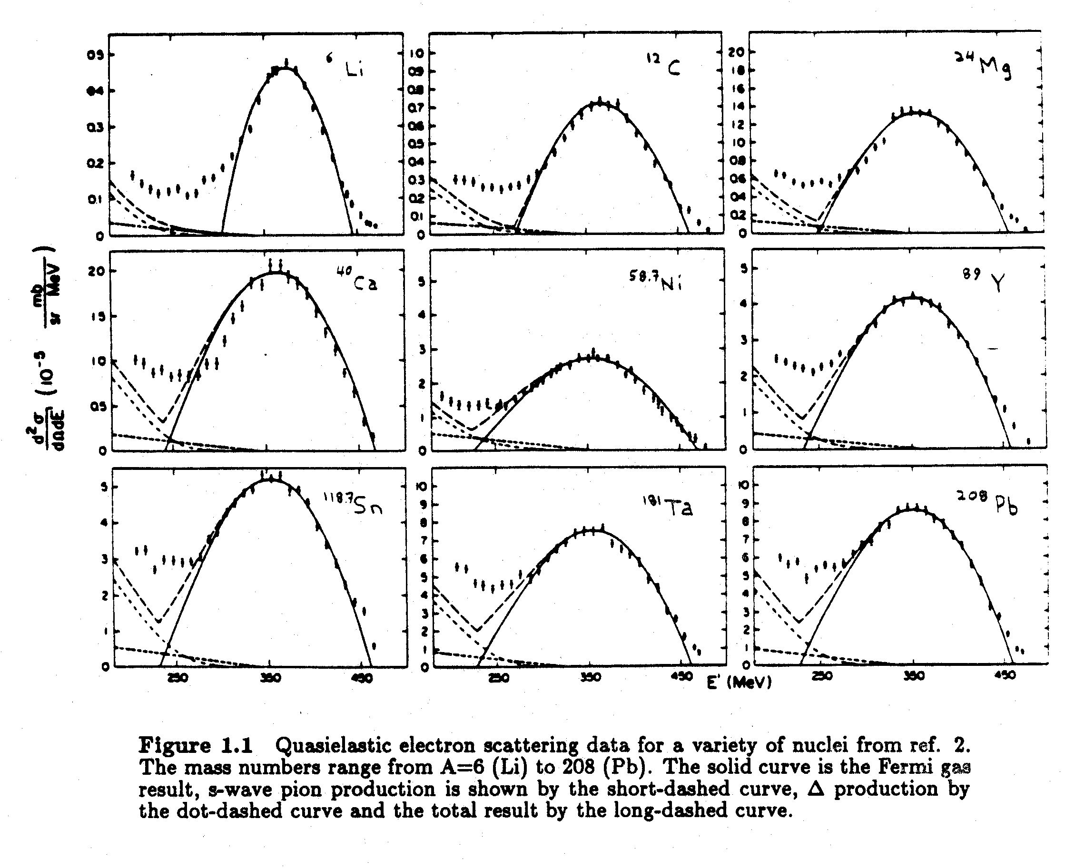
Quasi-elastic Electron Scattering
⁶Li
¹²C
²⁴Mg
⁴⁰Ca
⁵⁸Ni
⁸⁹Y
¹¹⁸Sn
¹⁸¹Ta
²⁰⁸Pb
R.R. Whitney et al., Phys. Rev. C 9, 2230 (1974).

Slide 33
Knock a Proton out of a Nucleus
A(e,e'p)B
p
scattering plane
e'
θ_{pq}
reaction plane
e
(ω,q)
p_{A–1}
φ_{x}
“out-of-plane” angle
Neglecting m_{e}: Q² ≡ – q_{μ}q ^{μ} = q² –ω ² = 4ee' sin²θ/2
Known: e and A + Detect: e’ and p → Infer:
Missing momentum: p_{m} = q – p = p_{A–1}
Missing mass: ε_{m} = ω –T_{p} – T_{A–1}

Slide 34
A(e,e’p)B (or in general any (e,e’h) reaction)
Extracting the (e,e’p) cross section
N_{N} (cm⁻²)
e'
N_{e}
e
(ΔΩ_{e}, Δp_{e})
(ΔΩ_{p}, Δp_{p})
p

Slide 35

Plane Wave Impulse Approximation (PWIA)
spectator
A–1
e'
p
p₀
A-1
q
p₀
e
A
q – p = p_{A-1}= p_{m}= – p₀

Slide 36
The Spectral Function
In nonrelativistic PWIA:
Not an observable!
e-p cross section
nuclear spectral function
For bound state of recoil system:
proton momentum distribution

Slide 37
The Spectral Function, cont’d.
ε_{m} = missing energy
Note: S is not an observable!

Slide 38
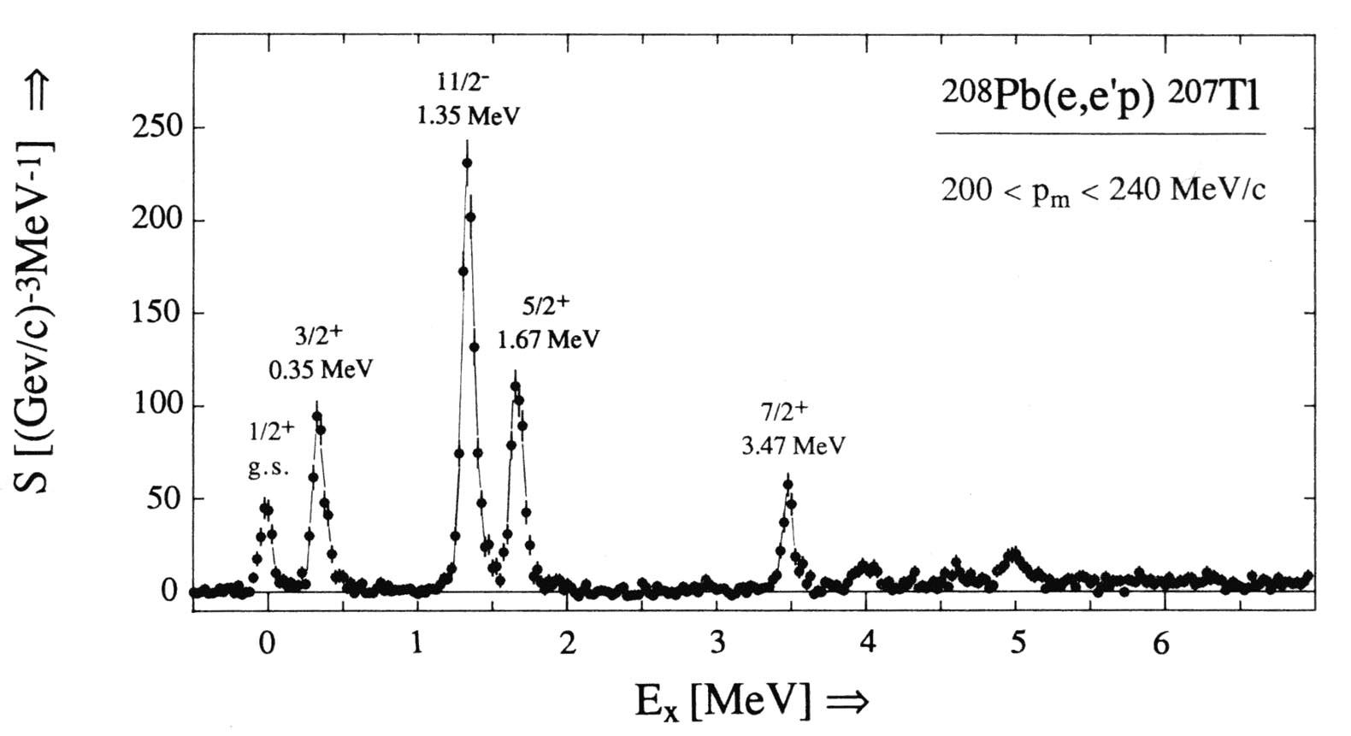
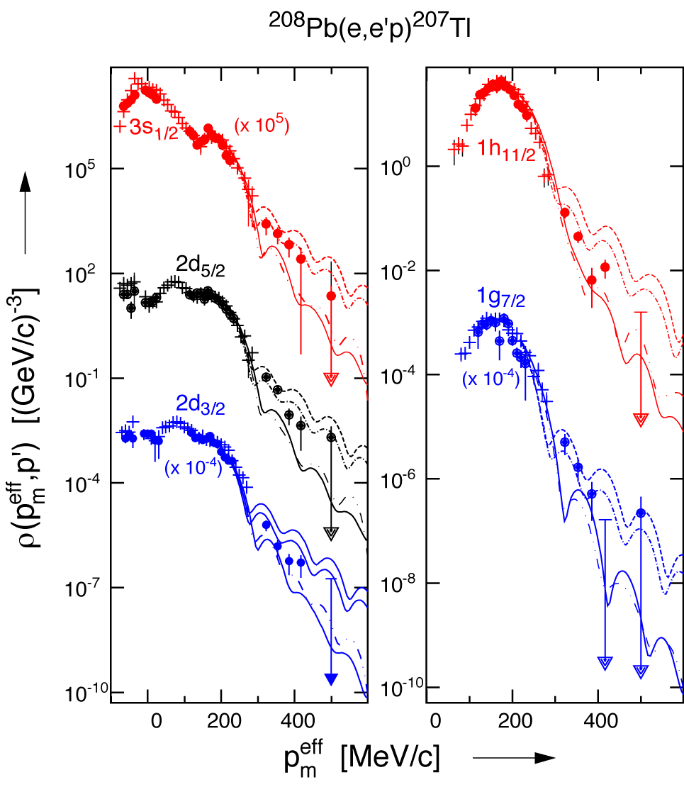
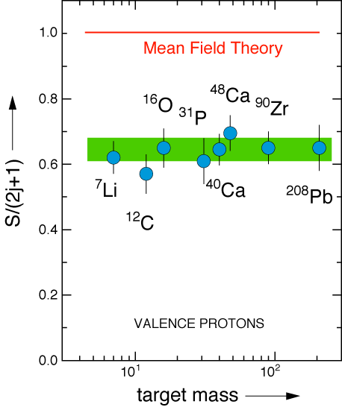
Visualizing the Shell Model
ν
in binding
in momentum
IMPORTANT
PUZZLE
PIECE !!
Missing 20+% in the integral??

Slide 39
Where does the “missing” strength go?
One possibility is a single recoil takes most of the missing strength.
Detected
populates high ε_{m}
recoils

Slide 40
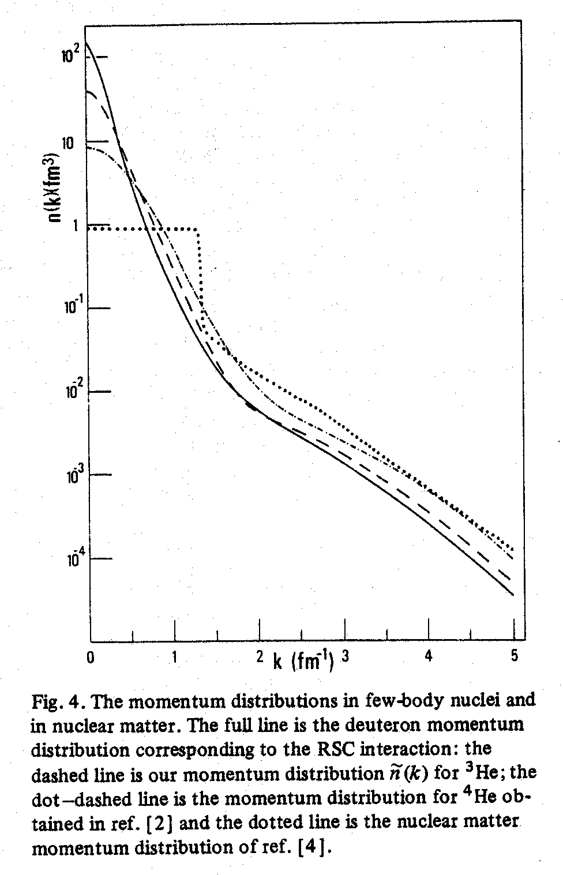
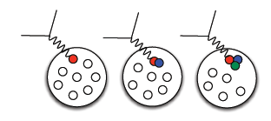
Proton Momenta in the nucleus
Similar shapes for few-body nuclei and nuclear matter at high k (=p_{m}).
Nuclear Matter
MORE
DETAILS
TOMORROW
Short-range repulsive core gives rise to high proton momenta
β = 0.75
p
n
²H
³He
⁴He
0 200 400 600 800 1000
p (MeV/c)

Slide 41
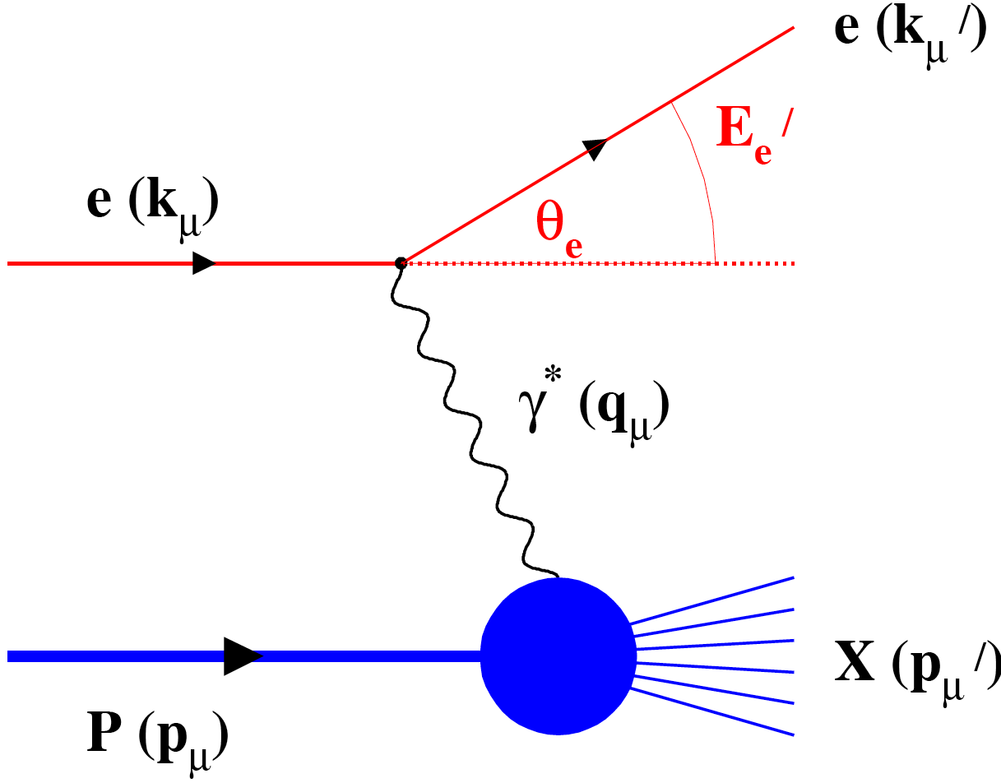
Deep Inelastic Scattering
Inclusive events: e+p/A → e’+X
Detect only the scattered lepton in the detector
Semi-Inclusive events: e+p/A → e’+h(π,K,p,jet)+X
Detect the scattered lepton in coincidence with identified hadrons/jets in the detector
Exclusive events: e+p/A → e’+ p’/A’+ h(π,K,p,jet)
Detect every things including scattered proton/nucleus (or its fragments)

Slide 42
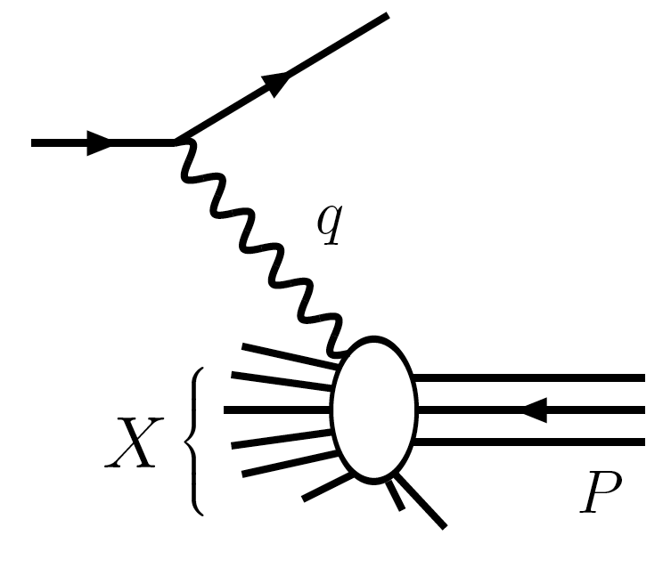
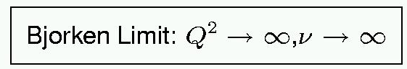
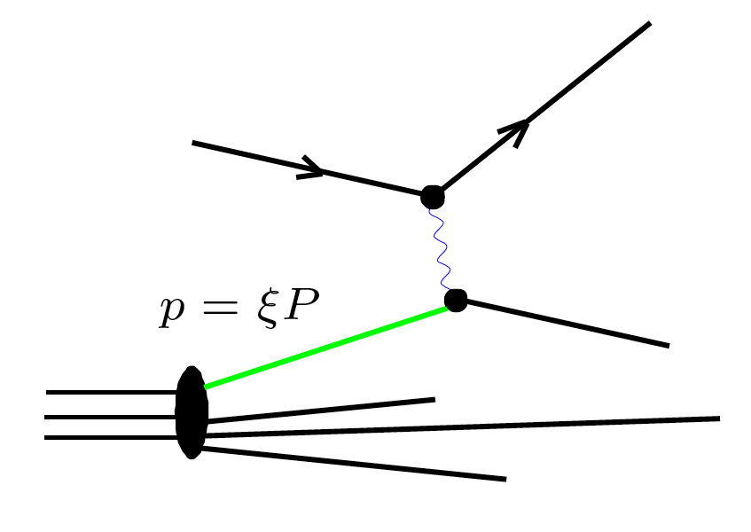



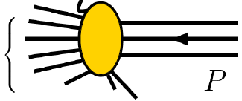






Deep Inelastic Scattering (DIS) and the Parton Model
Deep Inelastic Scattering – knock a nucleon apart
(Infinite Momentum Frame)
Parton Model : Feynman; Bjorken, Paschos
(x = momentum
fraction)
→ access through Structure Functions F₂ to Parton Distribution Functions
Empirically, DIS region is where logarithmic scaling is observed
Q² > 1 GeV², W² > 4 GeV²

Slide 43
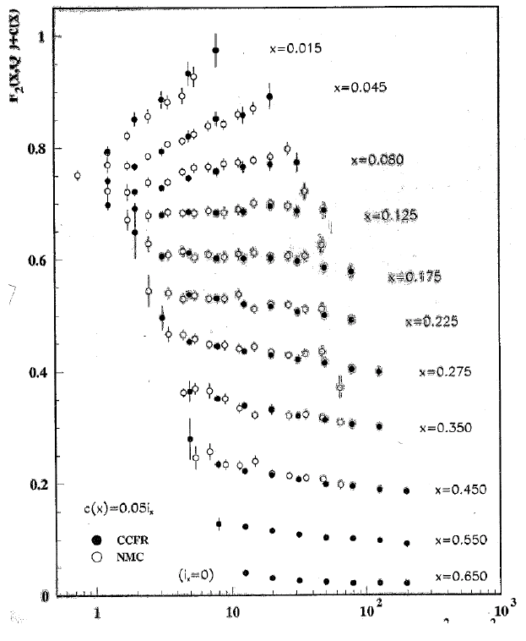
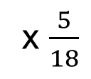
Structure Function by Different DIS Probes
F₂^{μD}
μ DIS
ν DIS
(-)
x $\frac{5}{18}$
F₂^{νN}
F₂(x,Q²) + c(x)
The Classic Example
Extending the scaling found by the venerable SLAC (electron scattering) experiment.
Confirming the basis of the Quark-Parton Model: the expected 5/18 charge weighting works well.
Logarithmic Scaling Violations as anticipated from a renormalizable field theory (QCD) are clearly shown, with both muon and neutrino probes.
Q² (GeV²)

Slide 44
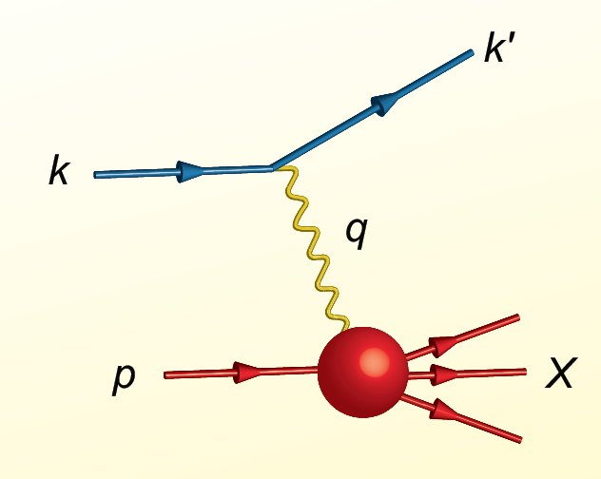
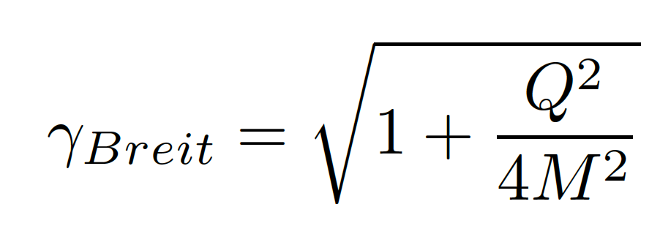
Proton Viewed in High Energy Electron Scattering: 1 Longitudinal Dimension
Viewed from boosted frame,
length contracted by
Internal motion of the proton’s constituents is slowed down by time dilation – the instantaneous charge distribution of the proton is seen.
In boosted frame x is understood as the longitudinal momentum fraction
valence quarks: 0.1 < x < 1
sea quarks: x < 0.1
Lorentz Invariants
E²_{CM} = (p+k)²
Q² = -(k-k’)²
x = Q²/(2p•q)
J. Bjorken, SLAC-PUB-0571
March 1969

Slide 45
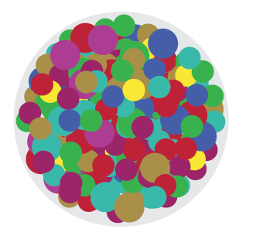
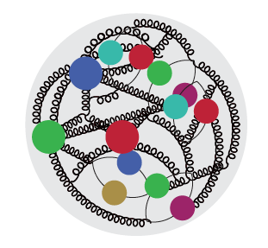
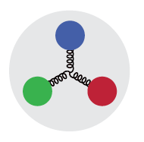

High Energy Electron Scattering
Snapshots where 0 < x < 1 is the shutter exposure time
x ≈ 10⁻⁴
Probe non-linear dynamics
short exposure time
x ≈ 10⁻²
Probe rad. dominated
medium exposure time
x ≈ 0.3
Probe valence quarks
long exposure time
R. Milner

Slide 46
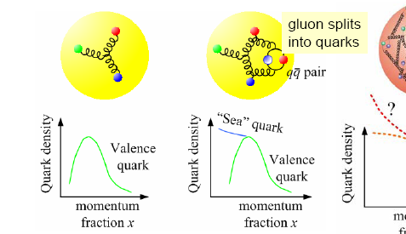
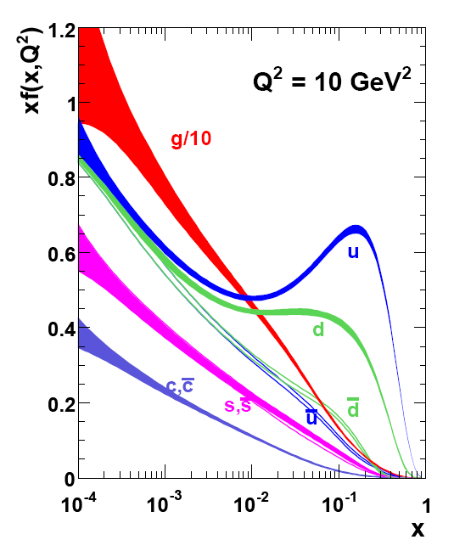
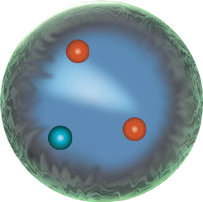
Parton Distribution Functions (PDF)
PDF q(x): probability that a quark (or gluon) has fraction x of proton’s momentum
proton: uud + uū + dđ + …

Slide 47

A Gluon PDF Surprise – 1990-2007
HERA collider at DESY (Germany)
Gives tremendous reach in measurements of F₂ structure functions. Result: the gluons completely dominate low x.

Slide 48

1 Longitudinal Momentum Distributions
1/Q ~ spatial resolution
EMC Effect:
Nucleons are modified
In The Nuclear Medium!
g – gluons
S – quark sea
u, d – up, down
valence quarks
R. Yoshida
C. Gwenlan

Slide 49



QCD
Asymptotic Freedom
Confinement
Small Distance
High Energy
Large Distance
Low Energy
no signature of gluons yet
Perturbative QCD
Strong QCD
High Energy Scattering
Hadron Spectrum
Gluon Jets
Observed

Slide 50

The low- and high-energy side of nuclei
The Low Energy View of Nuclear Matter
nucleus = protons + neutrons
nucleon ↔ quark model
(valence) quark model ↔ QCD
The High Energy View of Nuclear Matter
The visible Universe is generated by quarks, but dominated by gluons!
But what influence does this have on hadron structure?
Reduced by a
factor 20
50

Slide 51

Proton Viewed in High Energy Electron Scattering: One Longitudinal Dimension
How would a 3D artistic impression look like?
See 18 min. long Visualizing the Proton video:
https://www.youtube.com/watch?v=G-9I0buDi4s

Slide 52
Extension to Proton 3D Distributions

Slide 53


Towards 3D Structure of Nucleons and Nuclei
s=xyQ², s=4E_{e}E_{p}
s: center-of-mass energy squared
x: the fraction of the nucleon’s momentum carried by the struck quark (0 < x < 1)
Q²: resolution power
y: inelasticity
need energy range to unambiguously resolve partons over wide range in x and Q² → versatile center-of-mass energy energy √s: 20 – 140 GeV
need to resolve parton quantities (k_{t}, b_{t}) of order a few hundred MeV in the proton → high luminosity needed: 10³³-10³⁴ (and high polarization needed)
k_{T}, b_{T} (~100 MeV)
Proton and Ion Beam ~100 GeV

Slide 54




Paving the Road to Nuclear Femtography
CLAS12 at Jefferson Lab:
Workhorse for 3D imaging program of nuclear femtography in the region where the valence quark structure of nucleons prevails.
Simplest process: e + p → e’ + p + γ (DVCS)
DVCS
e
e
BH
p
p
Sangbaek Lee (MIT) – PhD thesis (2022)
54

Slide 55





Developing The Science Case for the Electron-Ion
Collider
2002
2007
2009
2010
Gluons and the Quark Sea at High Energies
2012
2013
Major Nuclear Physics Facilities for the Next Decade
2015
2018
NSAC
National Academy of Science Report:
AN ASSESSMENT OF U.S.-BASED
ELECTRON-ION COLLIDER SCIENCE
“An EIC can uniquely address three profound questions about nucleons—neutrons and protons—and how they are assembled to form the nuclei of atoms:
• How does the mass of the nucleon arise?
• How does the spin of the nucleon arise?
• What are the emergent properties of dense systems of gluons?”
March 14, 2013

