Slide 1
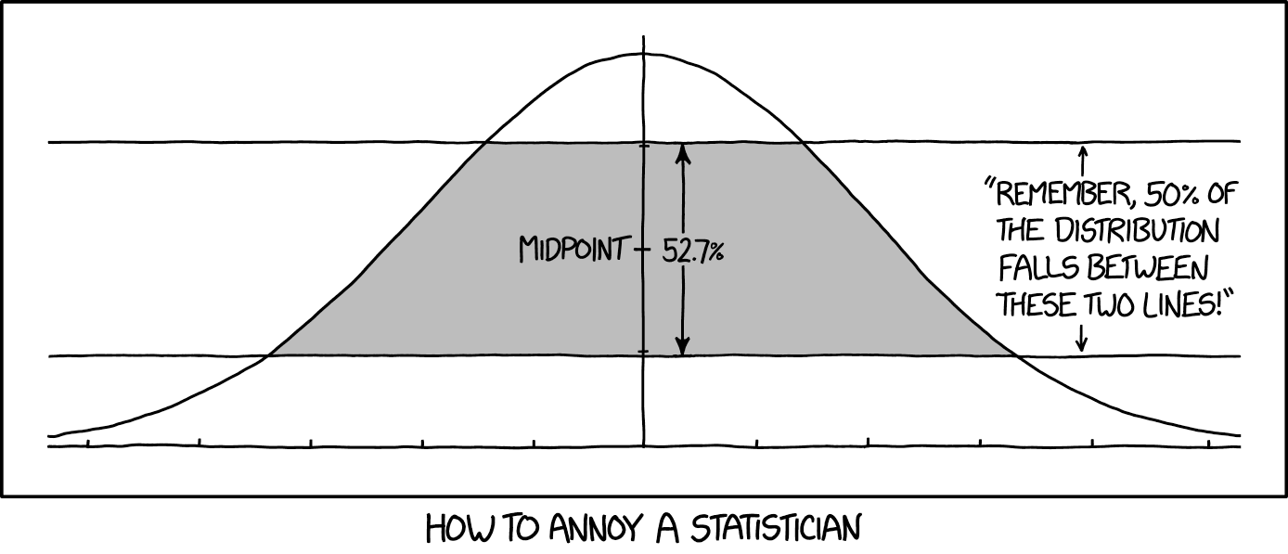
Hadronic Physics, Detectors, & Accelerators Lecture 2: Proton Radius Puzzle
Douglas W. Higinbotham
Jefferson Lab
Image from XKCD https://xkcd.com/2118/

Slide 2
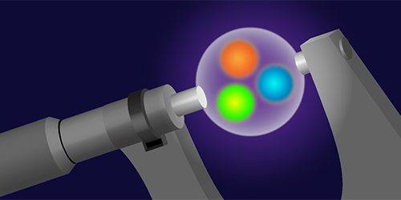
A Puzzle Caused By Tenacious Graduate Students
Randolf Pohl, Aldo Antognini, et al., Nature 466 (2010) 213–216.
The signal was nearly not found as they had been scanning frequencies assuming a large radius.
Figure by APS/Alan Stonebraker
1

Slide 3
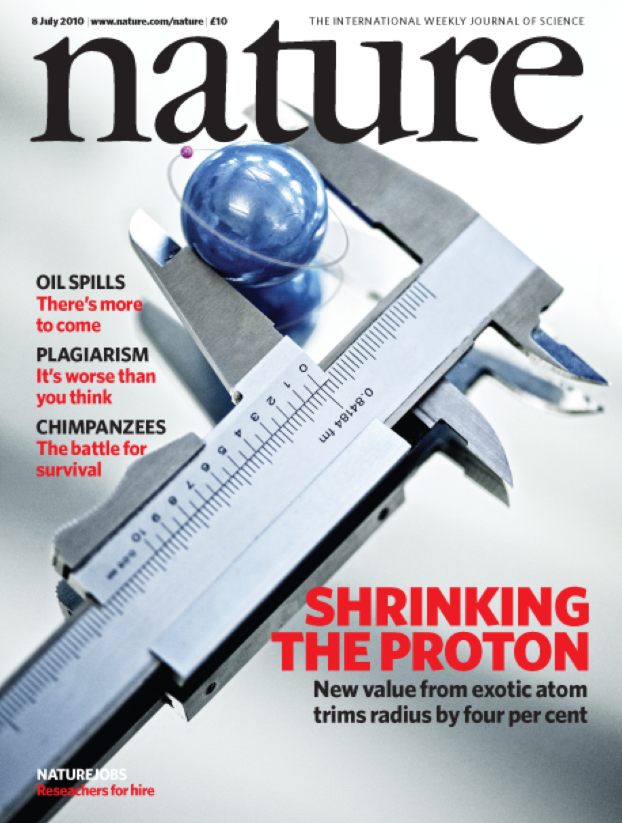
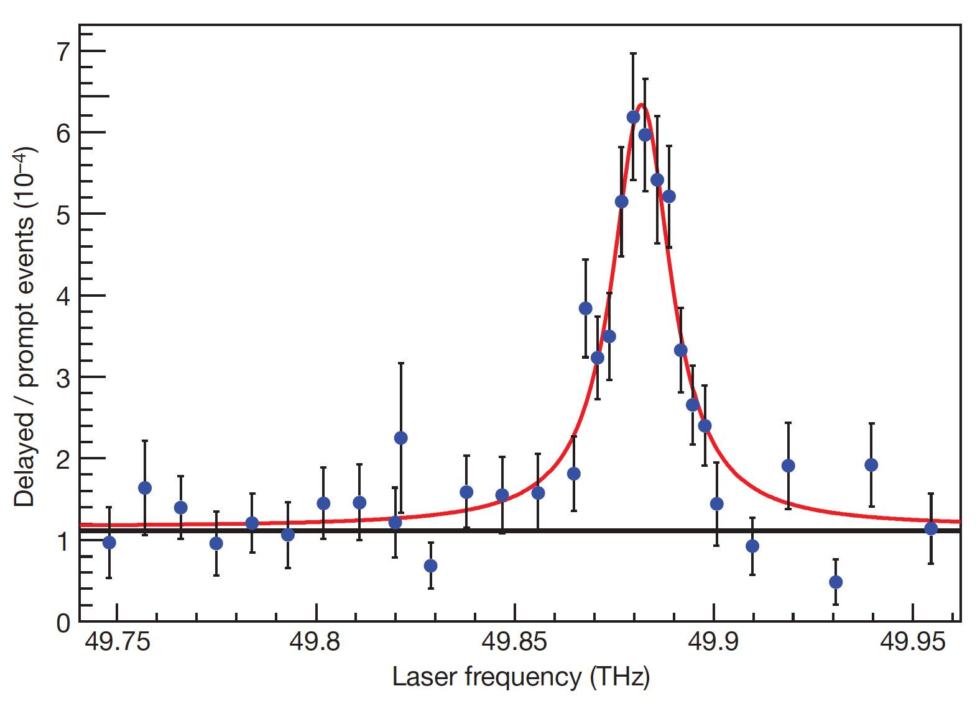
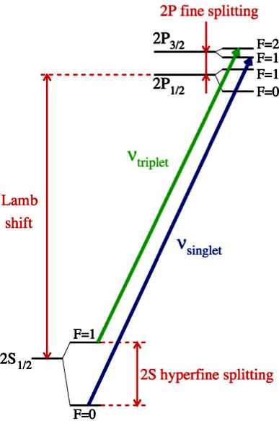
Muonic Hydrogen Data
High precision results from Muonic Lamb shift data give a proton radius of 0.84 fm.
This result contradicts many other extractions which have determined the proton radius to be ~0.88 fm.
E_{2p} – E_{2s} = 209.98 – 5.2262 r_{p}² + 0.0347 r_{p}³ meV
2

Slide 4

Back in 2011 MANY Possible Explanations
eH theory wrong ?
μH experiment wrong ?
Lamb shift difference of
310 ± 2 μeV
Beyond Standard Model
eH experiment
+ ep scattering wrong ?
- R∞
- 2γ corrections
- low-Q² extrapolation
μH theory wrong ?
- 2γ corrections
- missing QED or EW corrections
- soft hadronic corrections
3

Slide 5
How do we typically do electron scattering measurements?
Beam of electrons from an accelerator (E)
Place target material in the beam
Foils are easy, nearly point (typically thin) targets and thickness is easy to determine
Cryo-targets are challenging (e.g. boiling effects, energy loss)
Since target thickness cannot be exactly determined, floating normalizations are often used.
For elastic hydrogen measure scattered electron (E’) and/or proton.
Over determined reaction
Spectrometers are typically used
Magnetic fields, wire-chambers, reconstructed tracks, sieve data, etc.
Electron Beam
➔

Slide 6
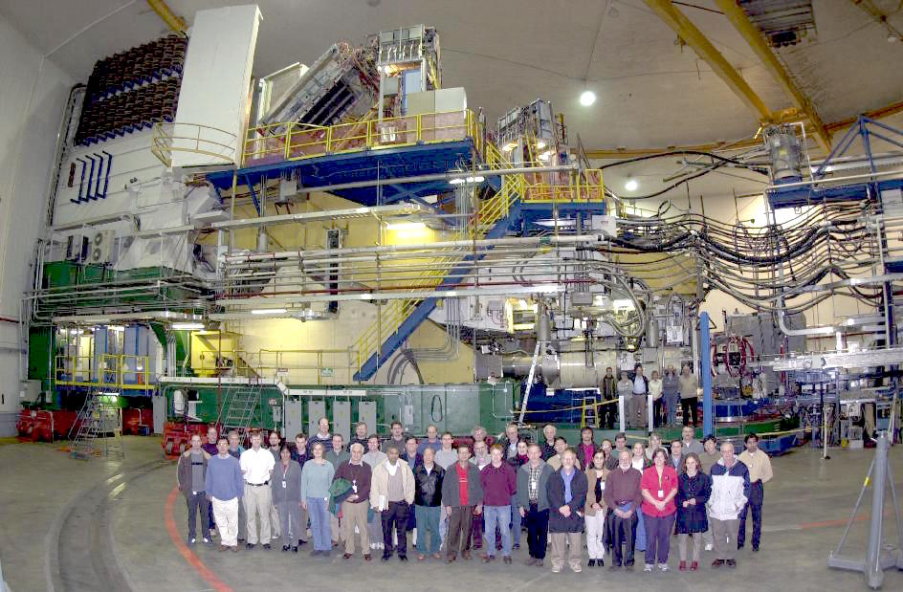
Jefferson Lab Hall A High Resolution Spectrometer
5

Slide 7
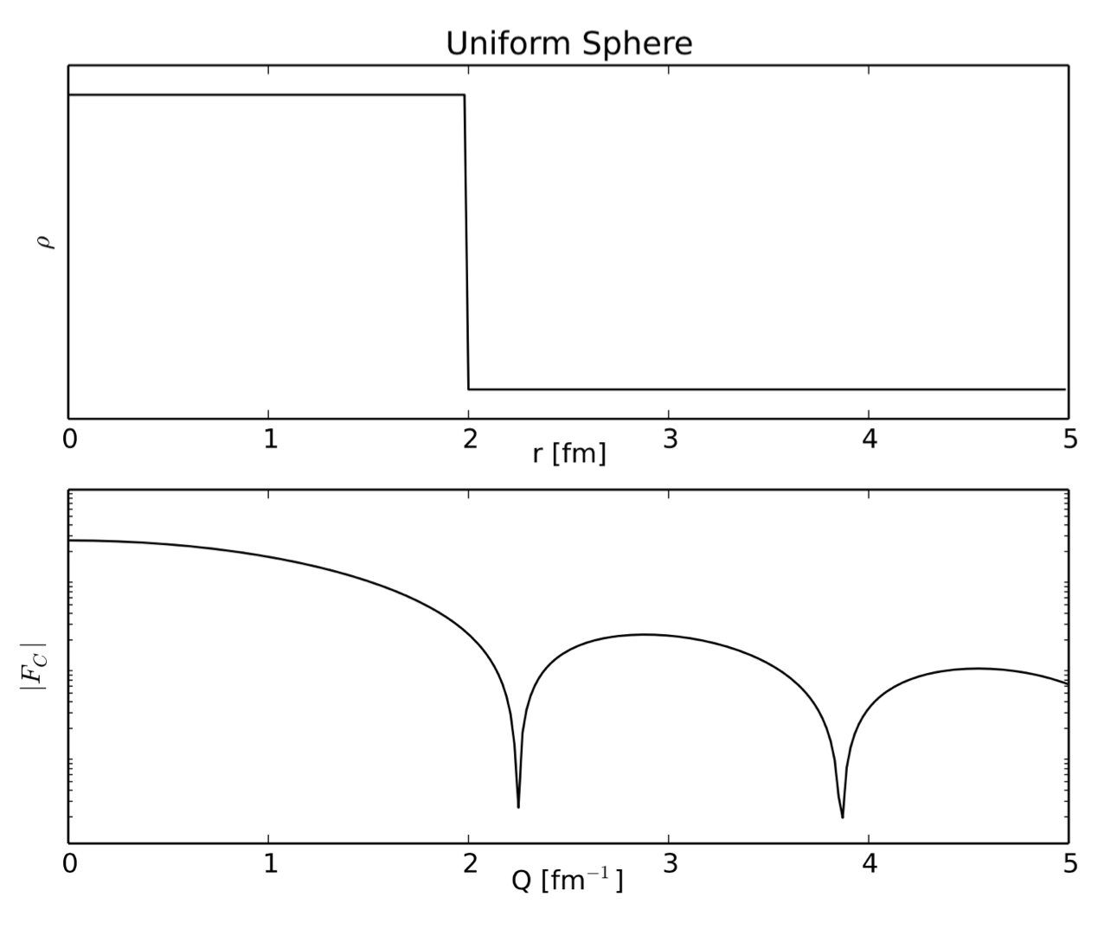
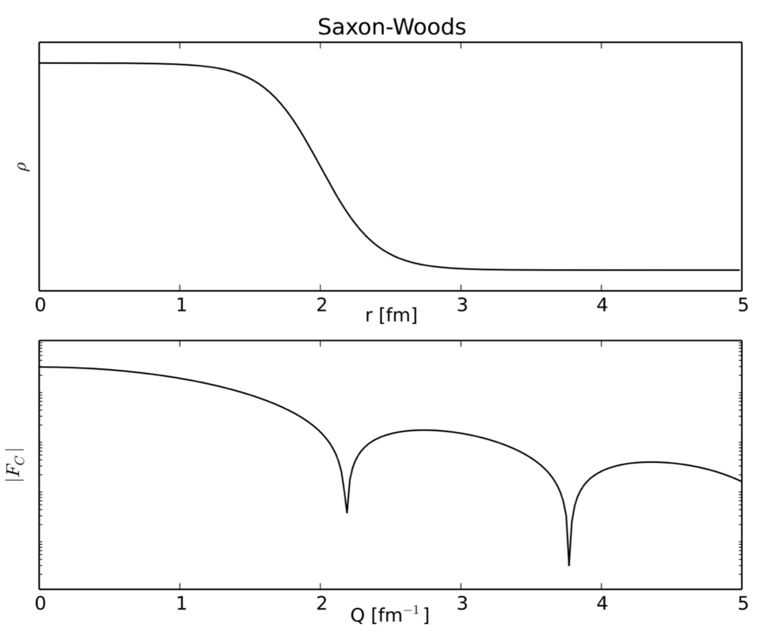
Electron Scattering Charge Radii from Nuclei
Fourier Transformation of Ideal Charge Distributions.
Example Plots Made By R. Evan McClellan (Jefferson Lab Postdoc)
e.g. for Carbon: Stanford high Q² data from I. Sick and J.S. McCarthy, Nucl. Phys. A150 (1970) 631.
National Bureau of Standards low Q² data from L. Cardman et. al., Phys. Lett. B91 (1980) 203.
6

Slide 8
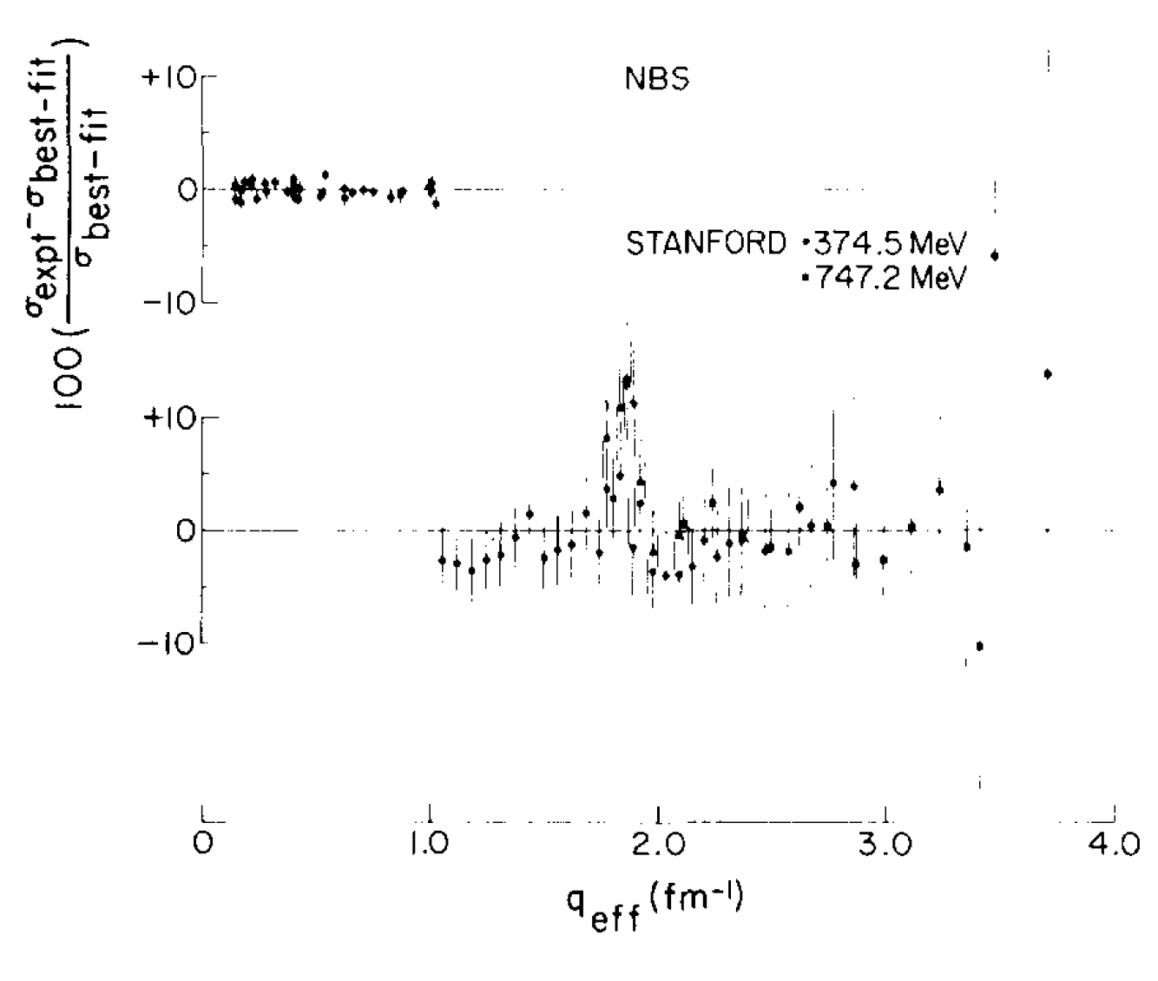
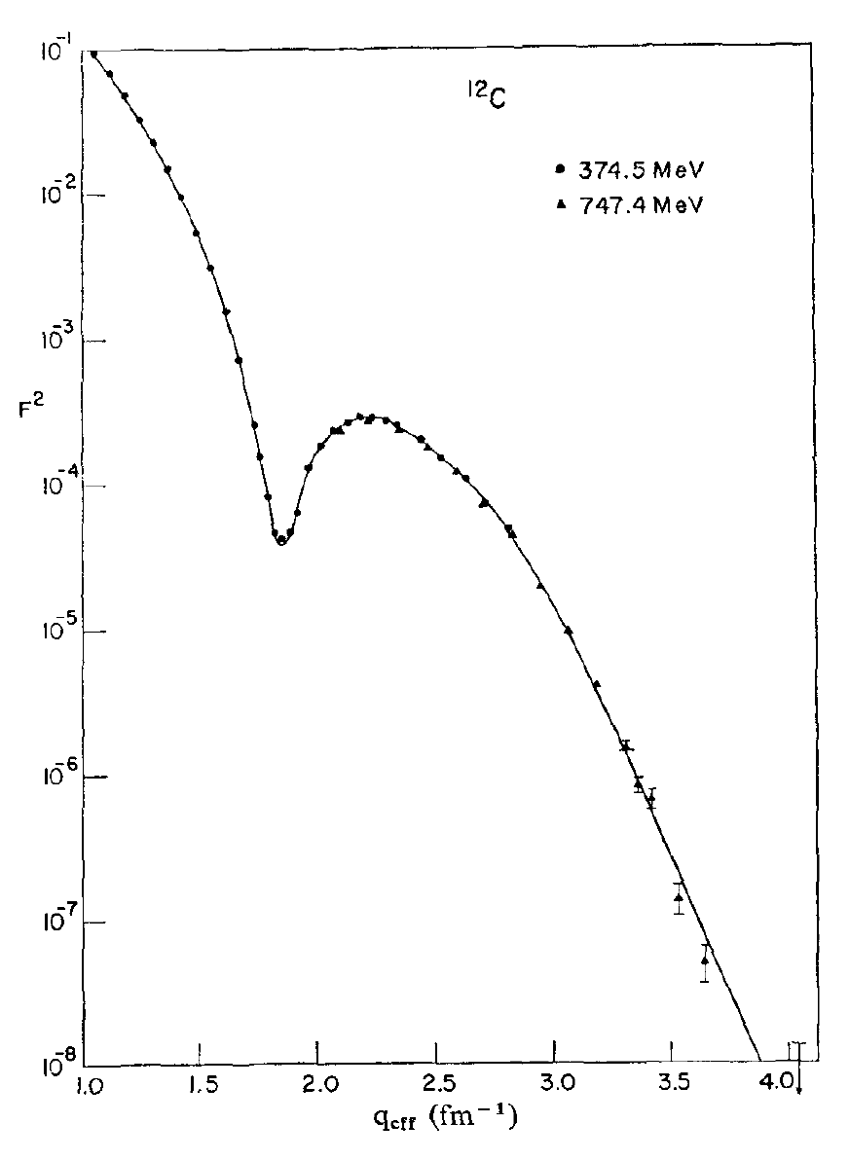
Determining the Charge Radius of Carbon
Stanford high Q² data from I. Sick and J.S. McCarthy, Nucl. Phys. A150 (1970) 631.
National Bureau of Standards (NBS) low Q² data from L. Cardman et. al., Phys. Lett. B91 (1980) 203.
See the L. Cardman’s paper for details of the carbon radius ( 2.46 fm ) analysis.
7

Slide 9
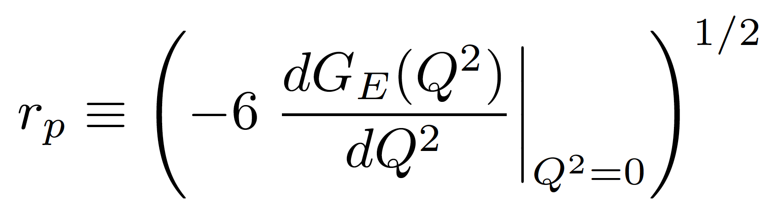
Charge Radius of the Proton
Proton G_{E} has no measured minima and it is too light for the Fourier transformation to work in a model independent way.
Thus for the proton we make use of the fact that as Q² goes to zero the charge radius is proportional to the slope of G_{E}
This definition of r_{P} has been shown to be consistent with the radius extracted from the muonic hydrogen data.
M. I. Eides, H. Grotch and V. A. Shelyuto, Phys. Rept.342 (2001) 63. http://doi.org/10.1016/S0370-1573(00)00077-6
Gerald A. Miller, Phys. Rev. C 99 (2019) 035202. https://doi.org/10.1103/PhysRevC.99.035202
For electron scattering this will be an extrapolation problem.
8

Slide 10
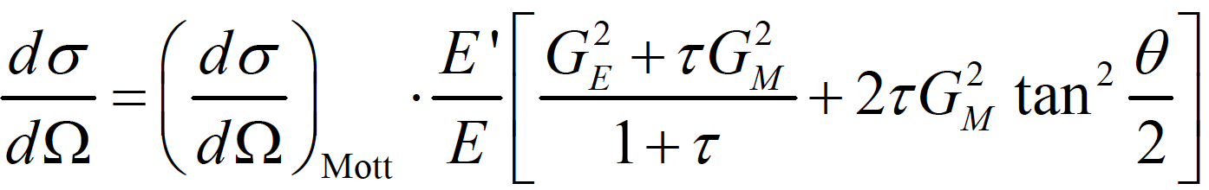
Elastic Electron Scattering from Spin-1/2 Particles
From relativistic quantum mechanics one can derive the formula for electron-proton
scattering where one has assumed the exchange of a single virtual photon.
where G_{E} and G_{M} form factors take into account the finite size of the proton.
G_{E} = G_{E}(Q²), G_{M} = G_{M} (Q²); G_{E}(0)=1, G_{M}(0) = μ_{p}
Q² = 4 E E’ sin²(θ/2) and τ = Q² /4m_{p}²
Elastic cross sections at small angles and small Q²’s are dominated by G_{E} ( JLab PRad Hall B )
Elastic cross sections at large angles and large Q²’s are dominated by G_{M} ( JLab GMP Hall A )
For moderate Q^{2’}s one can separate G_{E} and G_{M} with the Rosenbluth technique (same Q² different E,θ).
9

Slide 11
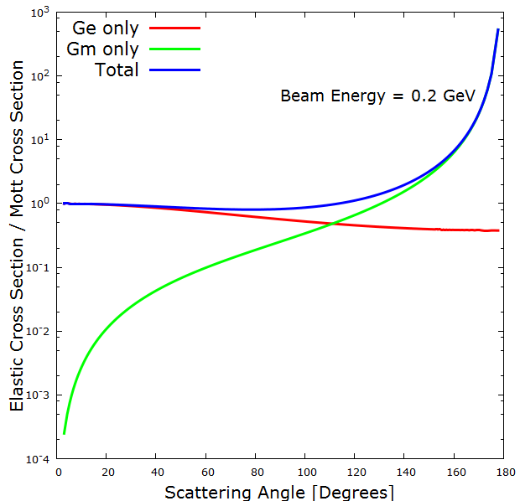
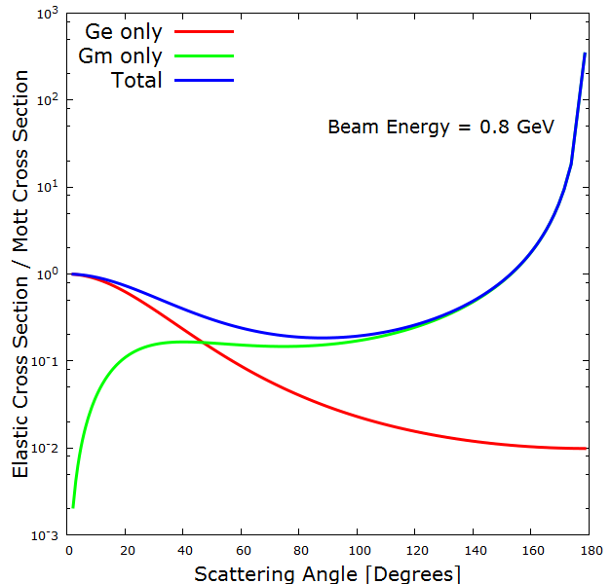
G_{E} and G_{M} Contributions To The Cross Section
Plots by Ethan Buck (Jefferson Lab SULI Student and W&M undergraduate)
Experiments like PRad (Hall B) go to small angle to maximize G_{E} and minimize G_{M} contribution..
Global fits, like typically done with the Mainz 2010 data, need several normalization, G_{E} and G_{M}

Slide 12
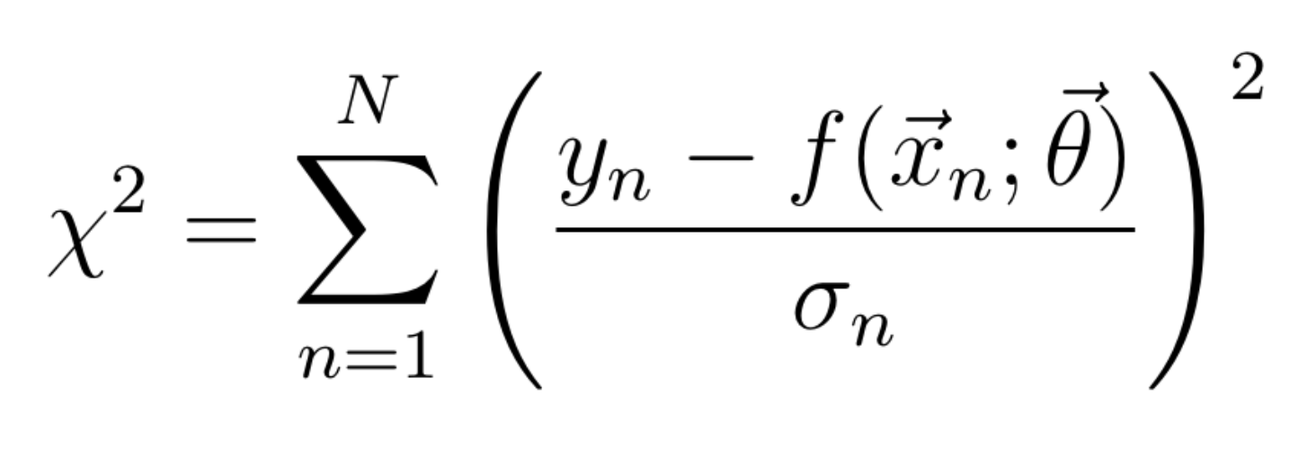
What’s a nuclear physicist need to know about fitting?!
Where you have data y with uncertainness 𝛔_{n} at different values of x_{n} fit to a function f with parameters 𝛳.
Just fit until you get total χ² divided by number of degrees of freedom < 1 and your good!
And knowledgeable physicists love to add terms to 𝛳 and make fun of those who have less terms then them)
What could possibly go wrong?!
What if the weights (sigma’s) are underestimated or overestimated?
What if I have the wrong model?
What if the data aren’t normally distributed?
What if average reduced χ² is good, but one over-fits one area and under-fits another?
What are the number of degrees of freedom in a non-linear model? (see https://arxiv.org/abs/1012.3754 )
These are all non-trivial questions and just getting a reduced χ² ~ 1 does not mean you have a good result!

Slide 13
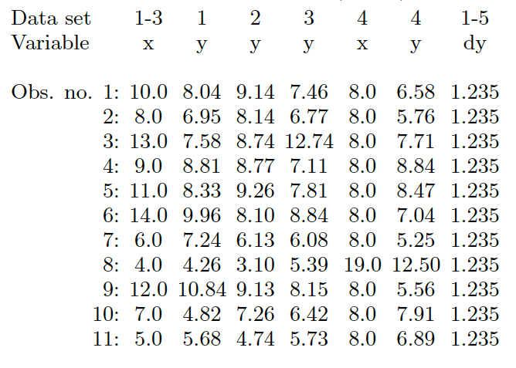
Anscombe's Quartet
F. J. Anscombe, The American Statistician 27 (1973) 17 plus I have added dy terms.

Slide 14
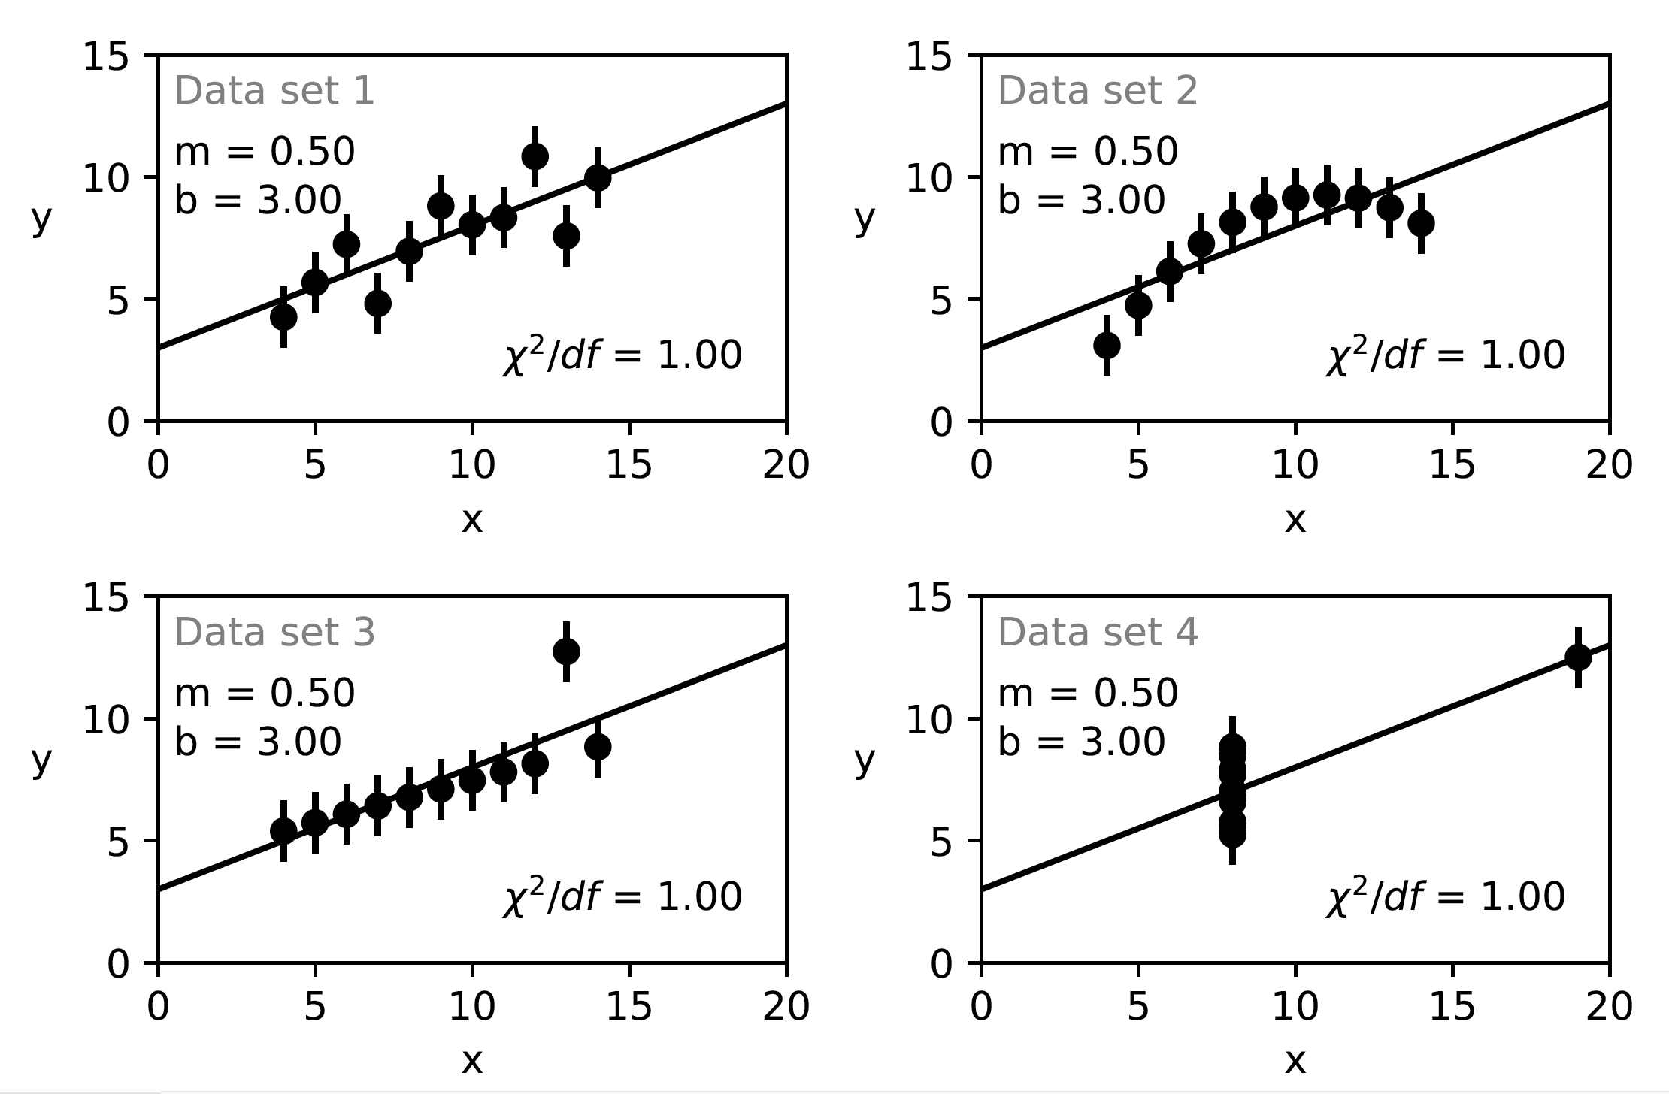
When fit with a linear function, Slope, Intercept, 𝝌², etc. are all the same.
NOTE: Standard error assumes that the data are normally disturbed about the fit function.
Details in appendix of https://doi.org/10.1103/PhysRevC.102.015205 and https://arxiv.org/abs/1812.05706

Slide 15
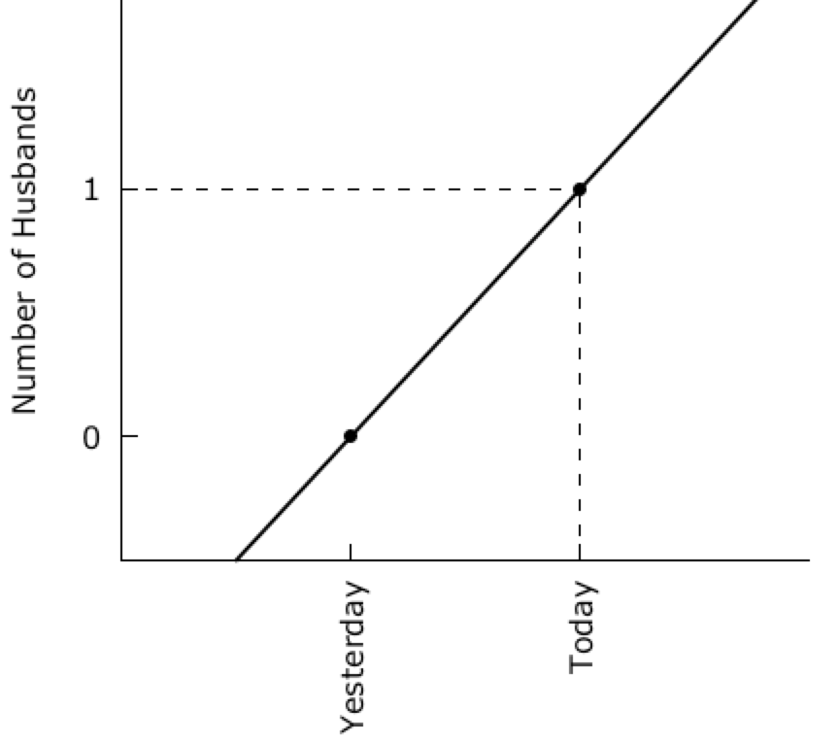
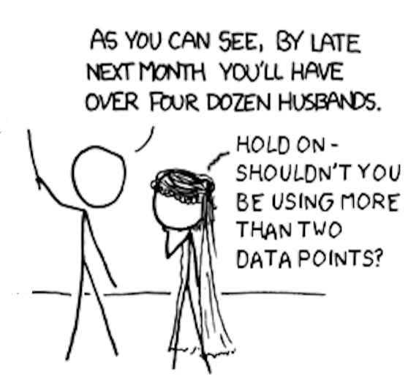
“My Hobby: Extrapolating” from XKCD

Slide 16
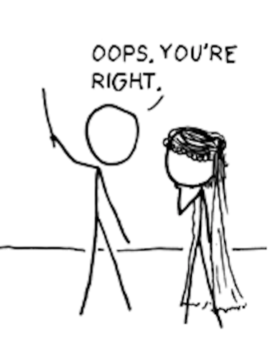
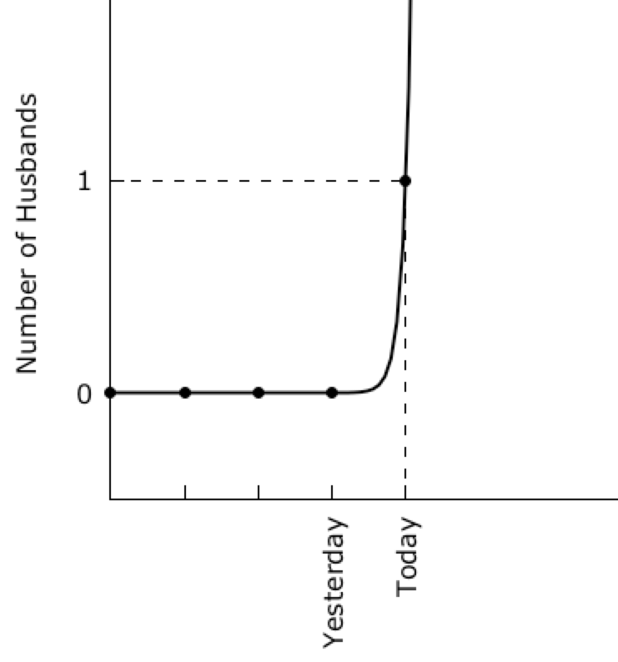
“My Hobby: Extrapolating” from XKCD
#
# gnuplot overfitting of xkcd Husband Data
# modified from https://xkcd.com/605/
# by
# Douglas W. Higinbotham
#
set terminal wxt enhanced font "verdana,12" size 900,450
set nokey
set xtic rotate 90
set ytic 0,1,1
set border 3
set xtics nomirror
set ytics nomirror
set multiplot layout 1,2
set ylabel "Number of Husbands"
f(x)=f0+f1*x
g(x)=g0*exp(g1*x)
fit f(x) '1.dat' using 1:3 via f0,f1
fit g(x) '2.dat' using 1:3 via g0,g1
set arrow from 0,1 to 2,1 nohead dashtype 7 lc 'black'
set arrow from 2,-0.5 to 2,1 nohead dashtype 7 lc 'black'
set xrange [0:3]
set yrange [-0.5:2]
plot '1.dat' using 1:3:xtic(2) lt 7 lc 'black' ,f(x) lw 2 lc 'black'
unset arrow
set xrange [-2:6]
set arrow from -2,1 to 2,1 nohead dashtype 7 lc 'black'
set arrow from 2,-0.5 to 2,1 nohead dashtype 7 lc 'black'
plot '2.dat' using 1:3:xtic(2) lt 7 lc 'black' ,g(x) lw 2 lc 'black'
unset multiplot
pause -1

Slide 17
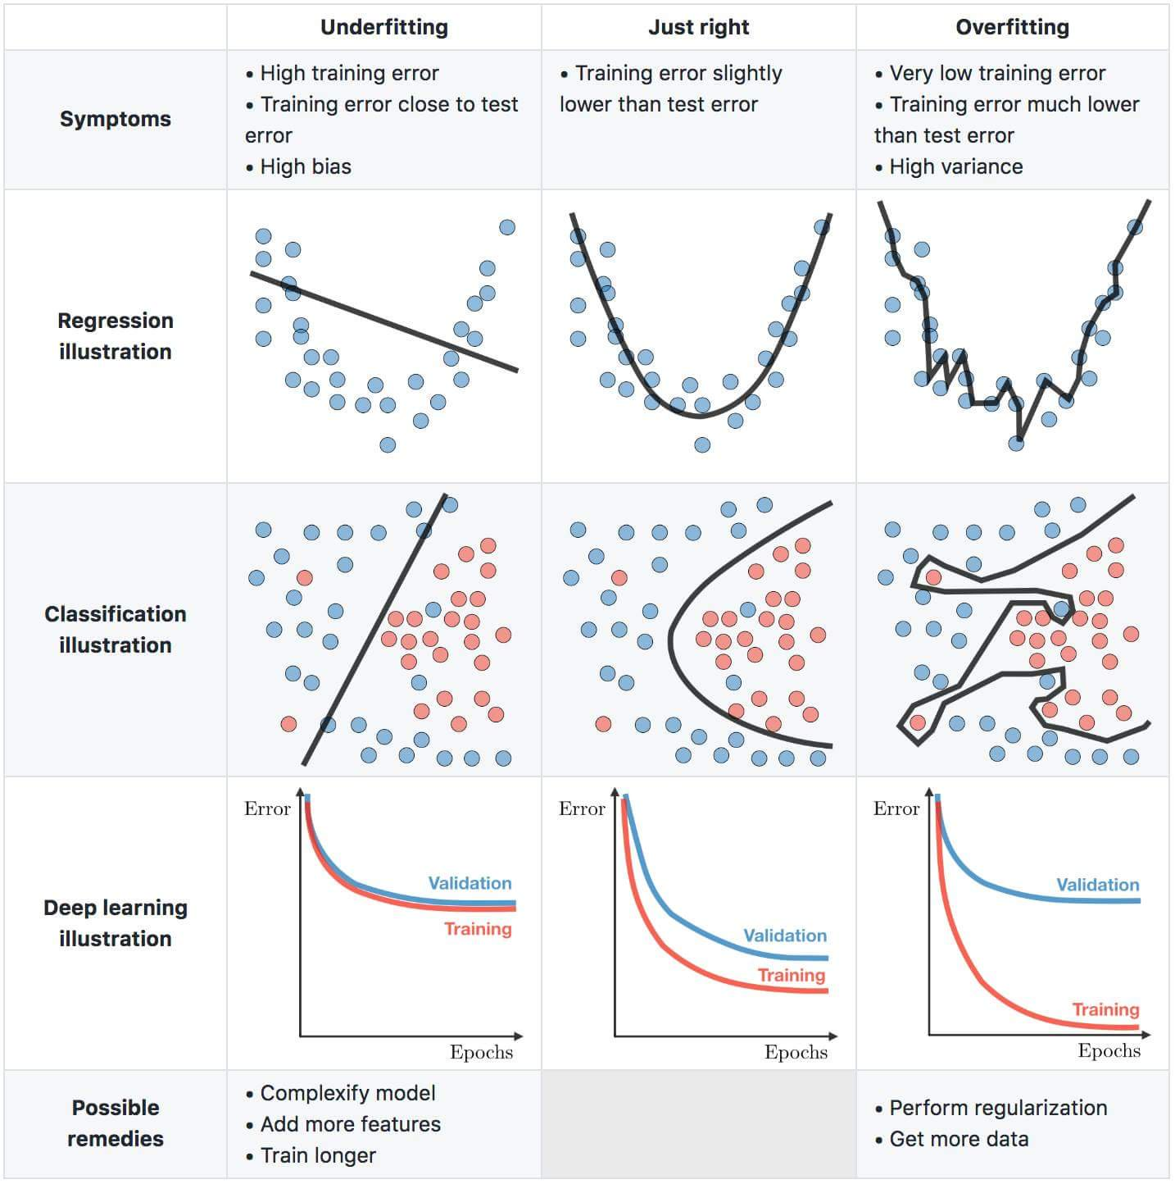

Slide 18
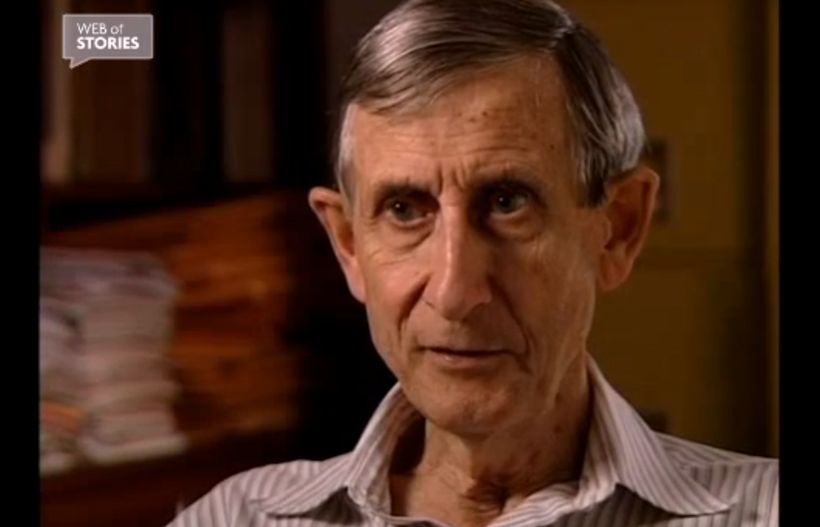
Fermi’s Rejection of Dyson’s Work
https://www.webofstories.com/people/freeman.dyson/94?o=SH
Also written as a Nature article: https://www.nature.com/articles/427297a
“Johnny van Neumann used to say with four free parameters I can fit an elephant and with a fifth makes it’s trunk wiggle.” - Fermi

Slide 19

The Five Parameter Elephant
“Drawing an elephant with four complex parameters”
by Jurgen Mayer, Khaled Khairy, and Jonathon Howard, Am. J. Phys. 78 (2010) 648.
https://www.johndcook.com/blog/2011/06/21/how-to-fit-an-elephant/

Slide 20
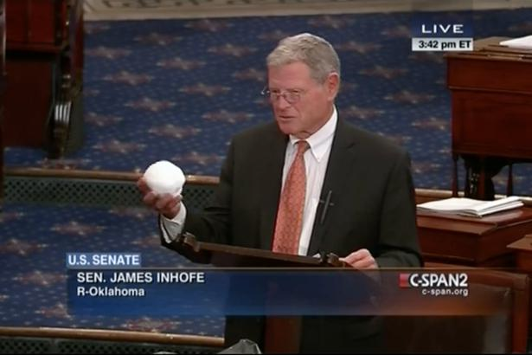
Warning: Danger of Confirmation Bias
In psychology and cognitive science, confirmation bias is a tendency to search for or interpret information in a way that confirms one's preconceptions, leading t statistical errors.
https://www.youtube.com/watch?v=3E0a_60PMR8
Though not only do people tend to search out information consistent with their beliefs, but we instinctively and unconsciously tend to protect those beliefs when confronted with information that conflicts with them. It’s an instinctive defense mechanism that kicks in when someone presents information – even statistically sound research or data – that disputes your position.

Slide 21
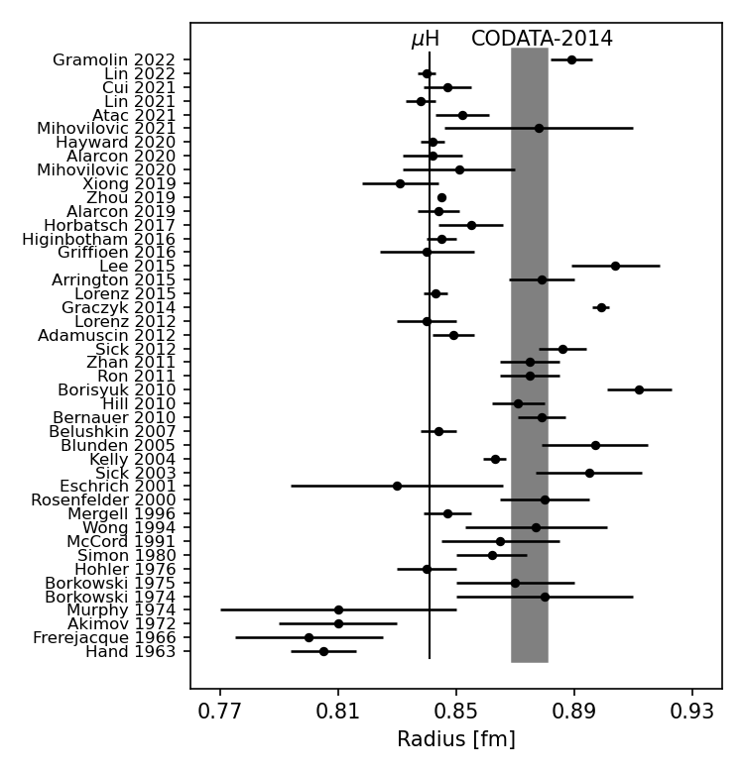
Radii from Electron Scattering Is A Story Of Many Results With Almost As Many Methods
Gramolin 2022: https://doi.org/10.1103/PhysRevD.105.054004
Lin 2022: https://doi.org/10.1103/PhysRevLett.128.052002
Cui 2021: https://doi.org/10.1103/PhysRevLett.127.092001
Lin 2021: https://doi.org/10.1016/j.physletb.2021.136254
Atac 2021: https://doi.org/10.1140/epja/s10050-021-00389-9
Mihovilovic 2021: https://doi.org/10.1140/epja/s10050-021-00414-x
Hayward 2020: https://doi.org/10.1016/j.nuclphysa.2020.121767
Alarcon 2020: https://doi.org/10.1103/PhysRevC.102.035203
Xiong 2019: https://doi.org/10.1038/s41586-019-1721-2
Zhou 2019: https://doi.org/10.1103/PhysRevC.99.055202
Alarcon 2019: https://doi.org/10.1103/PhysRevC.99.044303
Horbatsch 2017: https://doi.org/10.1103/PhysRevC.95.035203
Higinbotham 2016: https://doi.org/10.1103/PhysRevC.93.055207
Griffioen 2016: https://doi.org/10.1103/PhysRevC.93.065207
Lee 2015: https://doi.org/10.1103/PhysRevD.92.013013
Arrington 2015: https://doi.org/10.1063/1.4921430
Lorenz 2015: https://doi.org/10.1103/PhysRevD.91.014023
Graczky 2014: https://doi.org/10.1103/PhysRevC.90.054334
Lorenz 2012: https://doi.org/10.1140/epja/i2012-12151-1
Adamuscin 2012: https://doi.org/10.1016/j.ppnp.2012.01.014
Sick 2012: https://doi.org/10.1016/j.ppnp.2012.01.013
Zhan 2011: https://doi.org/10.1016/j.physletb.2011.10.002
Ron 2011: https://doi.org/10.1103/PhysRevC.84.055204
Borisyuk 2010: https://doi.org/10.1016/j.nuclphysa.2010.05.054
Hill 2010: https://doi.org/10.1103/PhysRevD.82.113005
Bernauer 2010: https://doi.org/10.1103/PhysRevLett.105.242001
Belushkin 2007: https://doi.org/10.1103/PhysRevC.75.035202
Blunden 2005: https://doi.org/10.1103/PhysRevC.72.057601
Kelly 2004: https://doi.org/10.1103/PhysRevC.70.068202
Sick 2003: https://doi.org/10.1016/j.physletb.2003.09.092
Eschrich 2001: https://doi.org/10.1016/S0370-2693(01)01285-0
Rosenfelder 2000: https://doi.org/10.1016/S0370-2693(00)00316-6
Mergell 1996: https://doi.org/10.1016/0375-9474(95)00339-8
Wong 1994: https://doi.org/10.1142/S0218301394000255
McCord 1991: https://doi.org/10.1016/0168-583X(91)96079-Z
Simon 1980: https://doi.org/10.1016/0375-9474(80)90104-9
Hohler 1976: https://doi.org/10.1016/0550-3213(76)90449-1
Borkowski 1975: https://doi.org/10.1007/BF01409496
Borkowski 1974: https://doi.org/10.1016/0550-3213(75)90514-3
Murphy 1974: https://doi.org/10.1103/PhysRevC.9.2125
Akimov 1972: http://www.jetp.ac.ru/cgi-bin/dn/e_035_04_0651.pdf
Frerejacque 1966: https://doi.org/10.1103/PhysRev.141.1308
Hand 1963: https://doi.org/10.1103/RevModPhys.35.335

Slide 22
Types of Scientific Papers https://xkcd.com/2456/

Slide 23
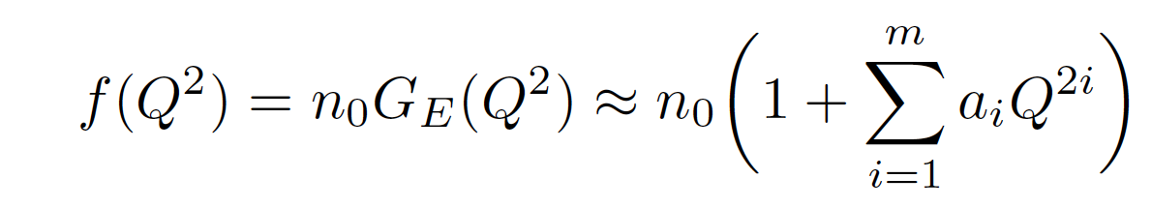
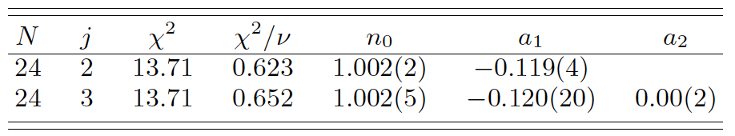
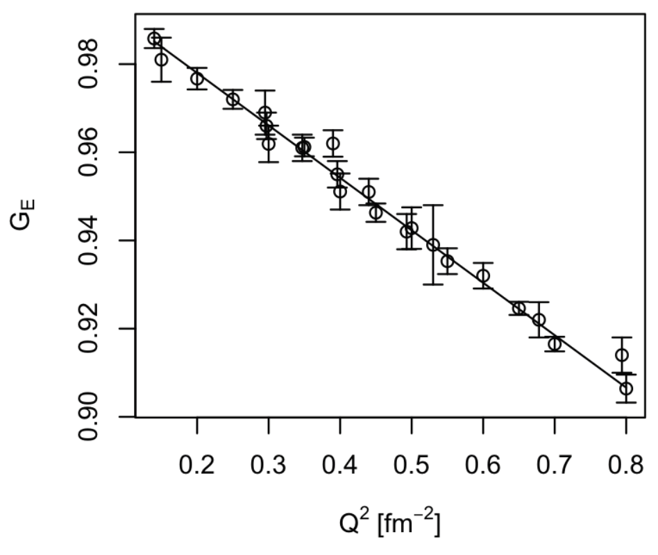
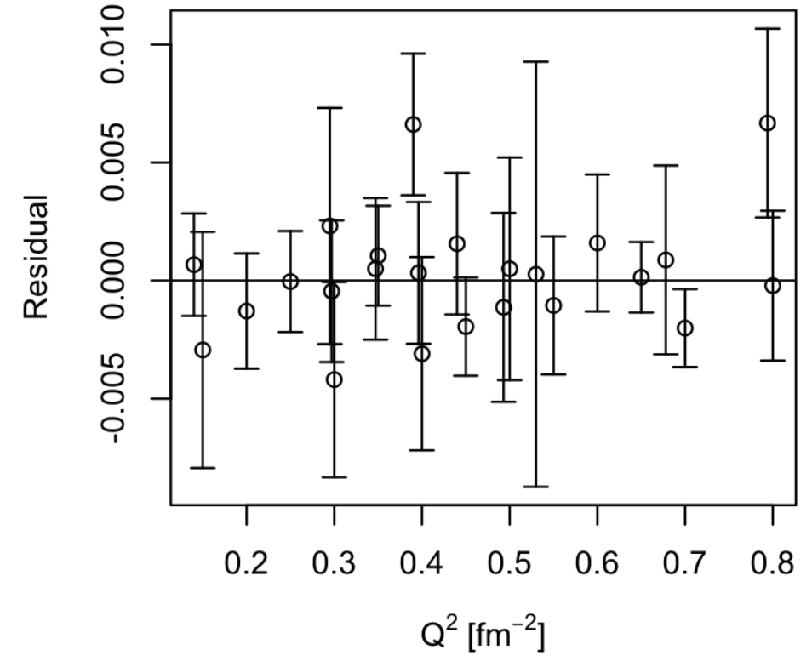
Simple Real World Example (where the high school intern didn’t get the expected result)
Using the data from G. G. Simon, C. Schmitt, F. Borkowski, and V. H. Walther, Nucl. Phys. A333 (1980) 381 and
J. J. Murphy, Y. M. Shin, and D. M. Skopik, Phys. Rev. C9 (1974) 2125.
Textbook test, an F-test, rejects fitting with the more complex j=3 (j=m+1) function, that does NOT mean a₂ = 0.
Pohl et.al’s 0.84 fm radius would predict an a₁ value of - 0.1176 since radius = sqrt(-6a₁)
Analysis done with very talented high school intern: https://doi.org/10.1103/PhysRevC.93.055207

Slide 24
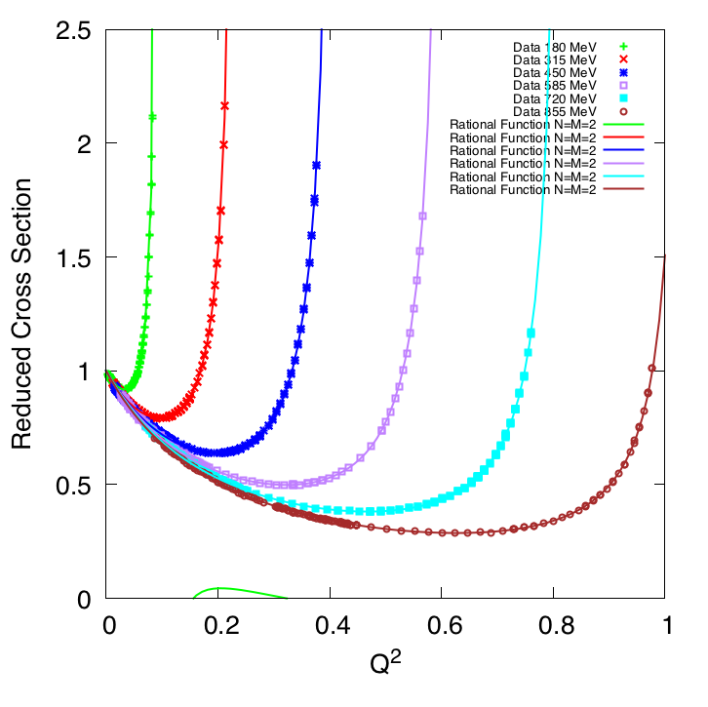
Mainz 2014 1422 Data Points Plotted vs Q²
Absolutely beautiful data!
Elastic Cross Section / Mott Cross Section
1 fm⁻²
[ GeV/c² ]
25.7 fm⁻²
NOTE: Q² = Q²(E,theta) has a kinematic max., Q²_{max}(E,180º), which these rational function fits nicely reproduce.

Slide 25
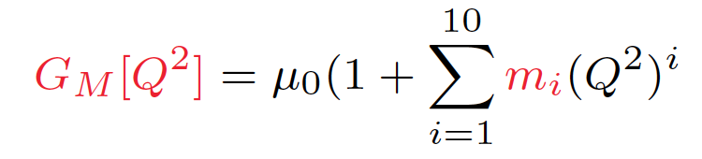
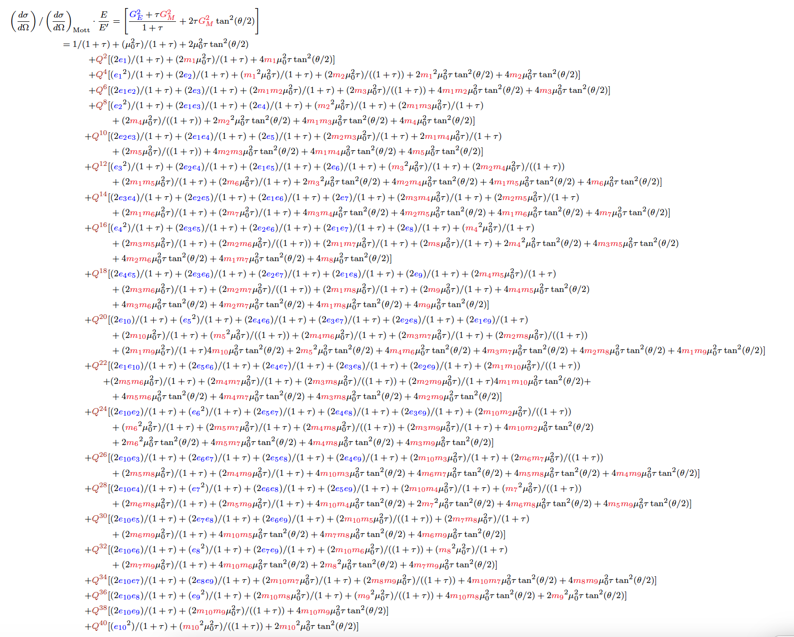
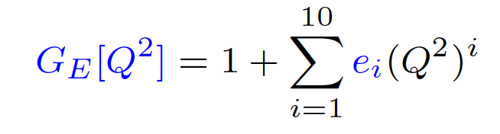
The Mainz 2014 0.88 fm Proton Radius Comes From A 51 Parameter Regression
plus 31 floating normalizations

Slide 26
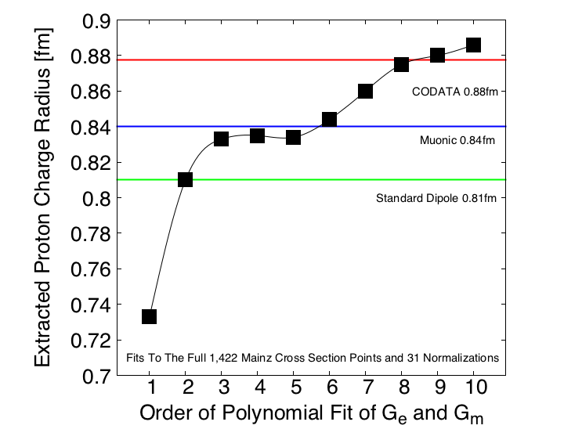
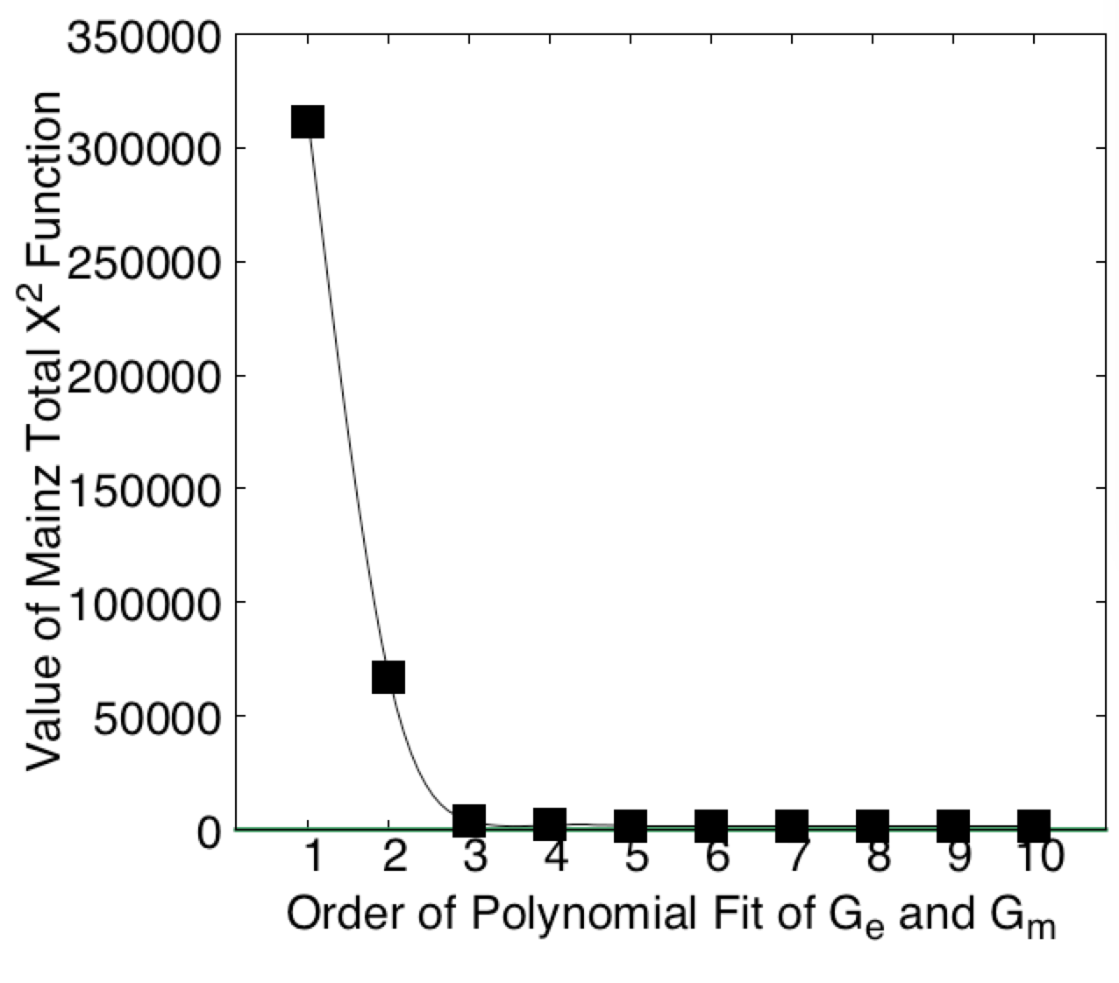
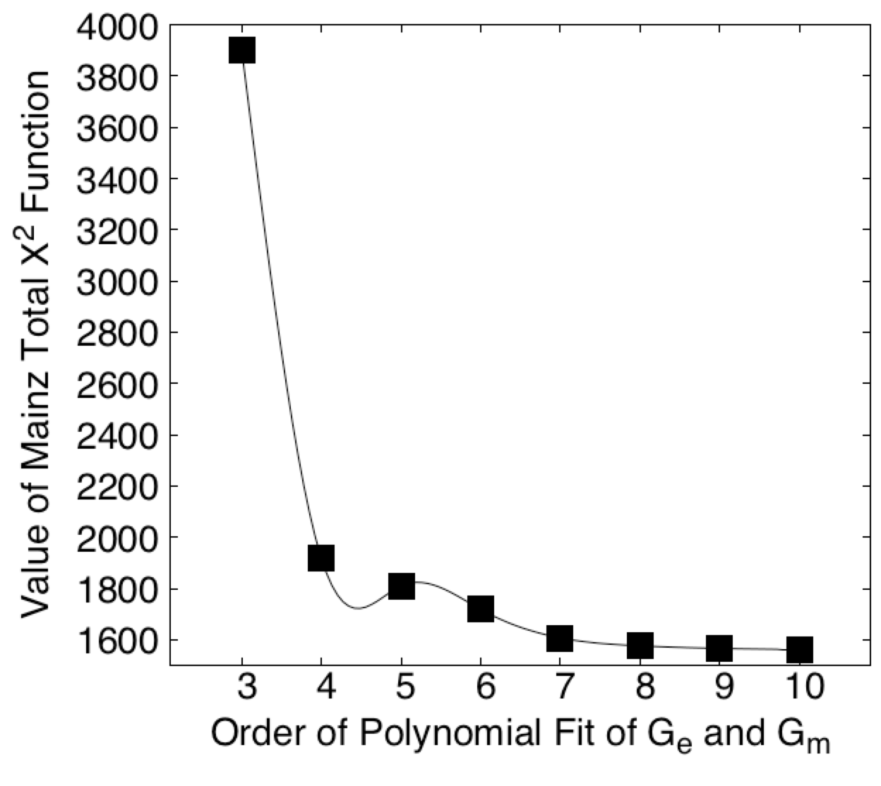
Proton Radius vs. Order of Polynomial Fits
Fits to the full 1422 points of the Mainz 2014 Data Using A Python Regression Code That Reproduces The PRC Results
Fits all include the Mainz’s 31 normalization parameters.
Even with 51 parameters (x2 10 & 31 norms) reduced chi2 never gets to unity.
If uncertainty estimates are increased by 0.001, then 4th order reduced chi2 less then unity.
( see the Dos and don’ts of chi-square - http://arxiv.org/abs/1012.3754 )

Slide 27
Checking of Hand et al.’s 1963 Proton Charge Radius Result (Just using the data and Hand’s procedure, no changes!)
M. Mihoviloivic, DH, M. Bevc, and S. Sirca, https://doi.org/10.3389/fphy.2020.00036
The Hand et al. result is often quoted and its radius value is used in standard dipole, there was likely a sign error in there work.

Slide 28
Is There Some Way To Avoid The Extrapolations?!
Recent Global Fit
Z. Ye et al., Phys. Lett. B 777 (2018) 8.
Used world data
Fixed the Radius to the current CODATA value
Recent Theory Work
Jose Alarcon and Christian Weiss, Phys. Lett. B 784 (2018) 373-377
Dispersively Improved Chiral Effective Theory
Proper analytic behavior of the Form Factors
Work was Expanded In Radius (i.e. the radius is there unknown parameter.

Slide 29
The Goldilocks Method
Take the global fit of Zhihong Ye and fix the radius to different values
Values 0.80 to 0.90 fm (completely did the regression for each radius)
Different radii slight change the normalization (i.e. floating normalizations)
z-expansion
world data
Ask Alarcon & Weiss to fix the radius to different values in their model.
Generate many different curves for different radii
Each curves has all the proper physical properties.
Compare
Is there a curve where the global fit and the theory agree? (i.e. are just right)
If so, what is the radius of that curve?

Slide 30
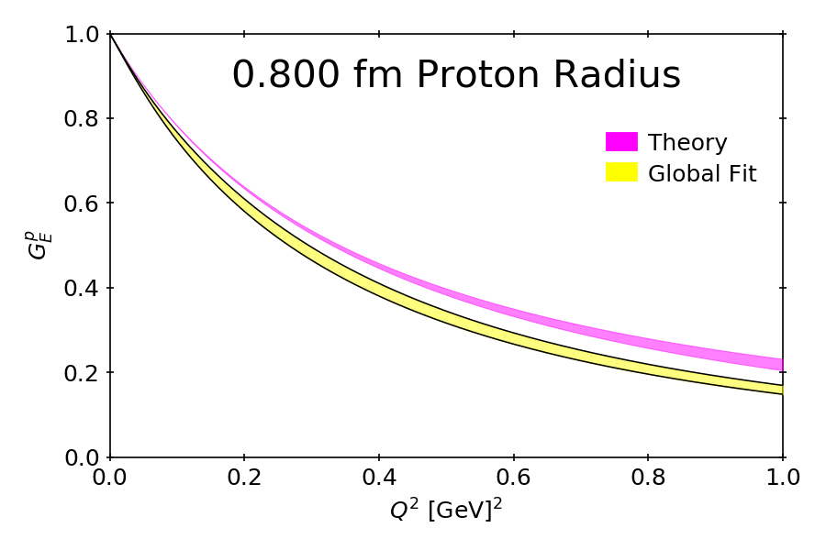

Slide 31
J. M. Alarcón, DWH, C. Weiss, and Zhihong Ye, Phys. Rev. C 99 (2019) 044303 an open access paper thanks to SCOAP
30

Slide 32
Comparison to Mainz Analysis

Slide 33
Apply DI𝜒XEFT To Full Mainz Data Set
Simply Replacing The Polynomial Fit Functions With The Model Removes 18 Regression Parameters
Fits done with both Bernauer’s original binning and the rebinned version of Lee, Arrington, and Hill, Phys. Rev. D 92 (2015) 013013
For original Mainz data set:
R_{E} = 0.842(2) fm, R_{M}=0.850(1)
reduced chi2 of 1.43
For rebinned Mainz data set:
R_{E} = 0.841(3) fm, R_{M}= 0.849(1)
reduced chi2 of 1.00
https://doi.org/10.1103/PhysRevC.102.035203, https://arxiv.org/abs/2002.05167

Slide 34
“There must be some way out of here Said the joker to the thief There's too much confusion I can't get no relief” – Bob Dylan

Slide 35
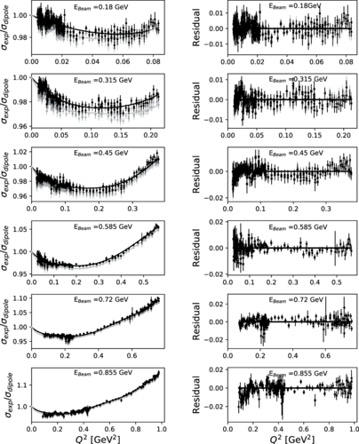
How Analytic Choices Can Affect the Extraction of Electromagnetic Form Factors from Elastic Electron Scattering Cross Section Data
https://doi.org/10.1103/PhysRevC.102.015205
https://arxiv.org/abs/1902.08185
Paper explicitly shows the difference between a descriptive model
of the data vs. a predictive model. Also how analytic choices
can strongly effect the interpretation of the data.
The paper shows that with all other things fixed, simply changing
from an unbounded polynomial fit to one where the polynomial
parameters are forced to alternate sign, you can get from the large radius to the small when fitting full Mainz data set.
The alternating sign is what one would expect from the theoretic models such as the dispersively improved chiral effective theory.

Slide 36
Oddly Enough, The Way Out May Lie With G_{M}^{P}
Full fit to the Mainz data: 1422 points, 31 normalizations and 11th order polynomials with the mean values shown
The bounded fit approximates a completely monotone function by alternating signs of terms while the unbounded does not.
Notice how the bounded fit is smoother then the unbound, but unbounded will always give the lower chi2.
Scott Barcus, DH, Randall E. McClellan, https://doi.org/10.1103/PhysRevC.102.015205

Slide 37
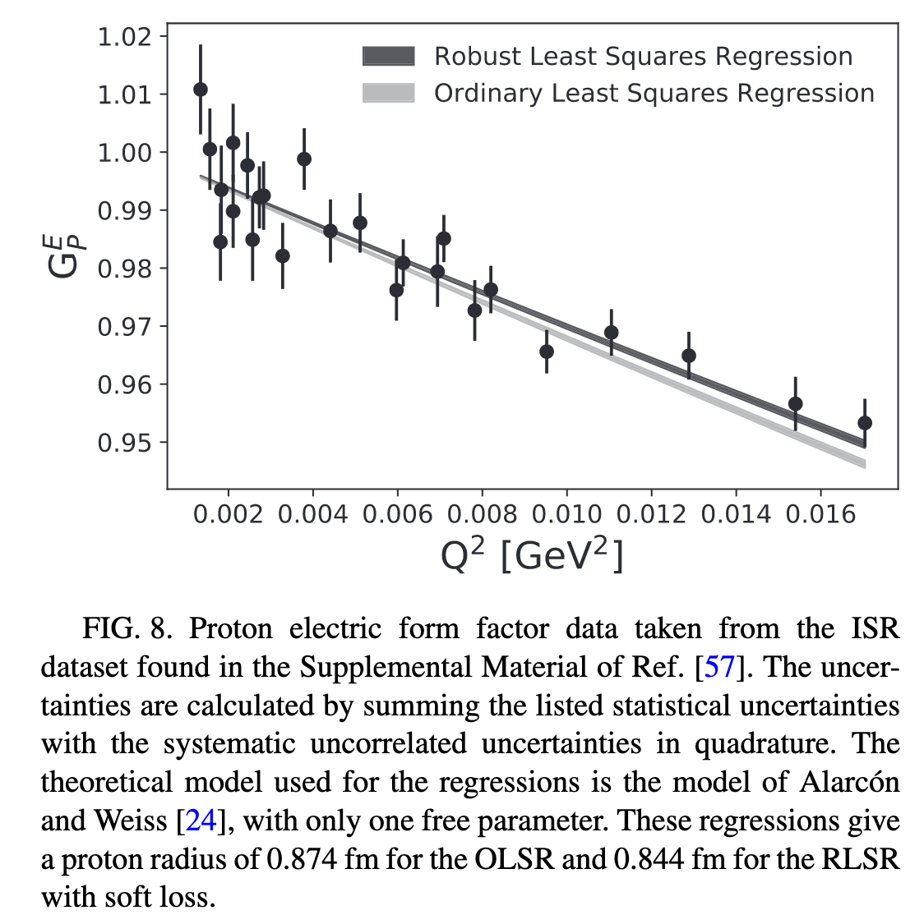
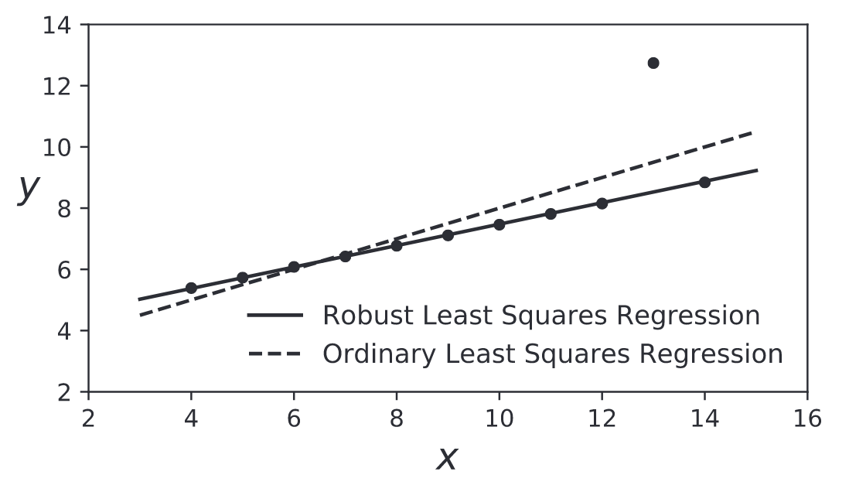
Robust Regressions https://doi.org/10.1103/PhysRevC.102.015205
Ordinary Least Squares Regressions are easily “pulled” by a single point.
Robust regressions tend to follow the global trends.

Slide 38
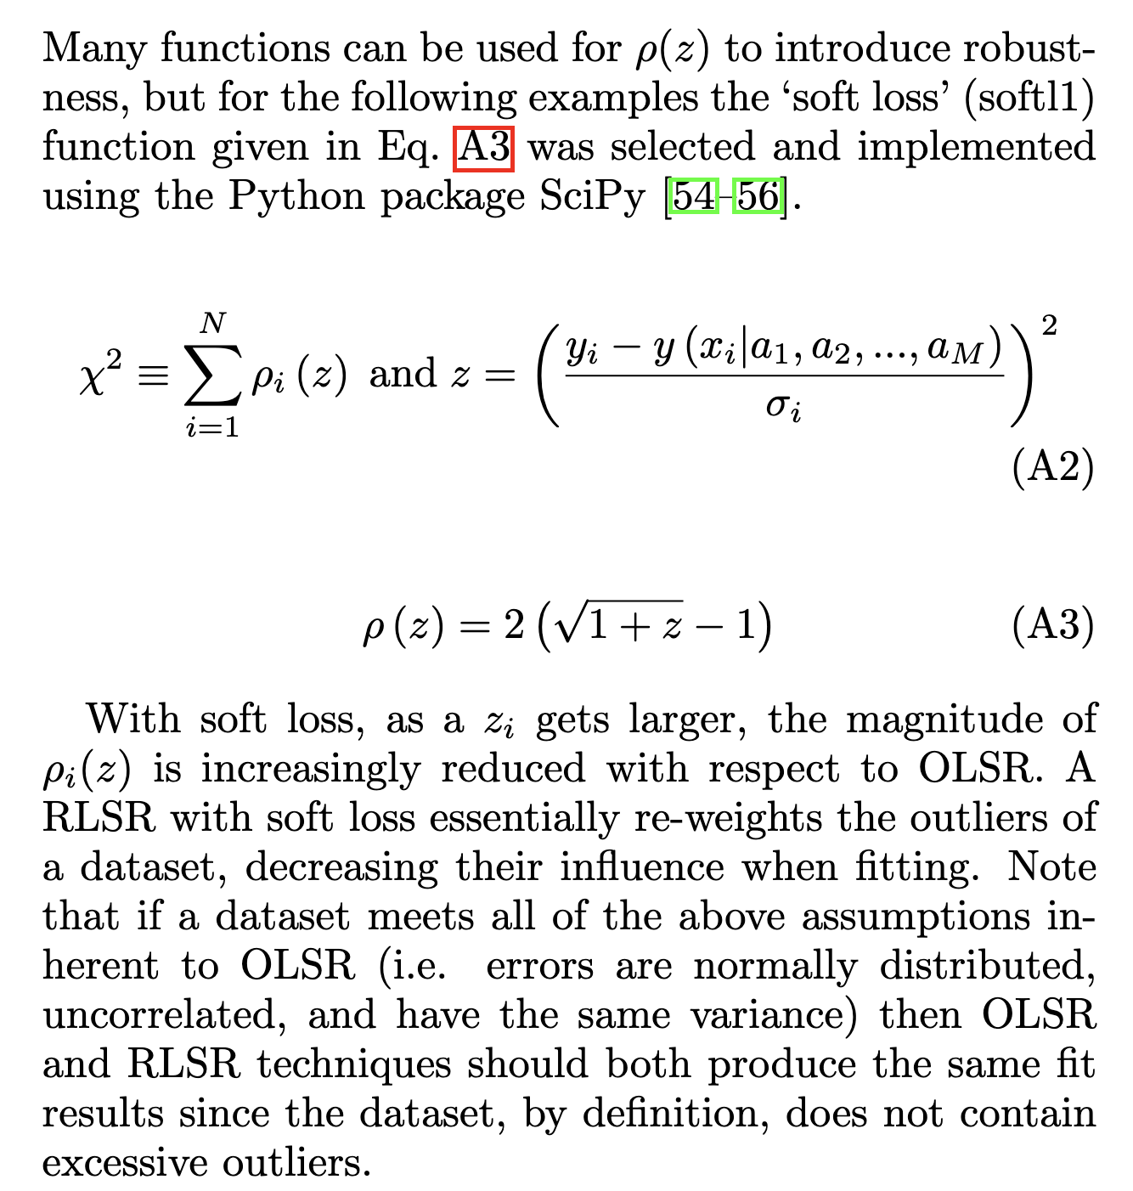
https://doi.org/10.1103/PhysRevC.102.015205

Slide 39
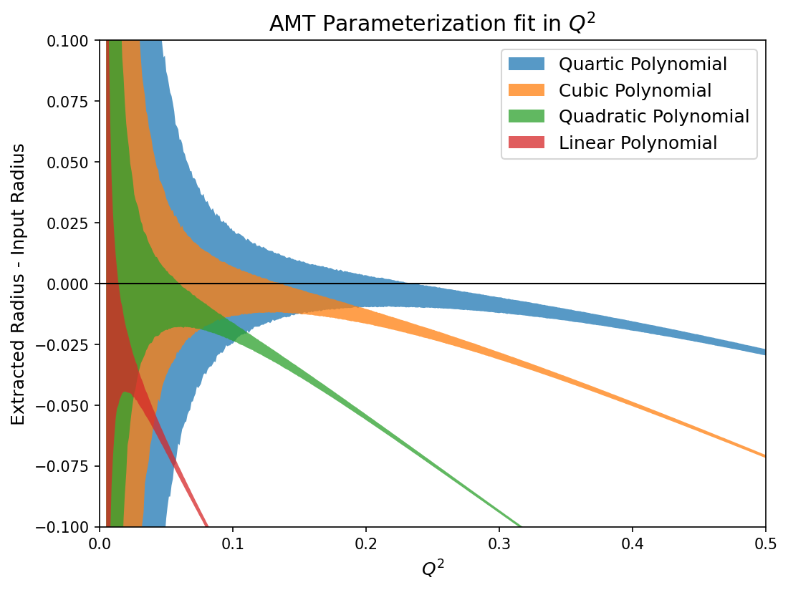
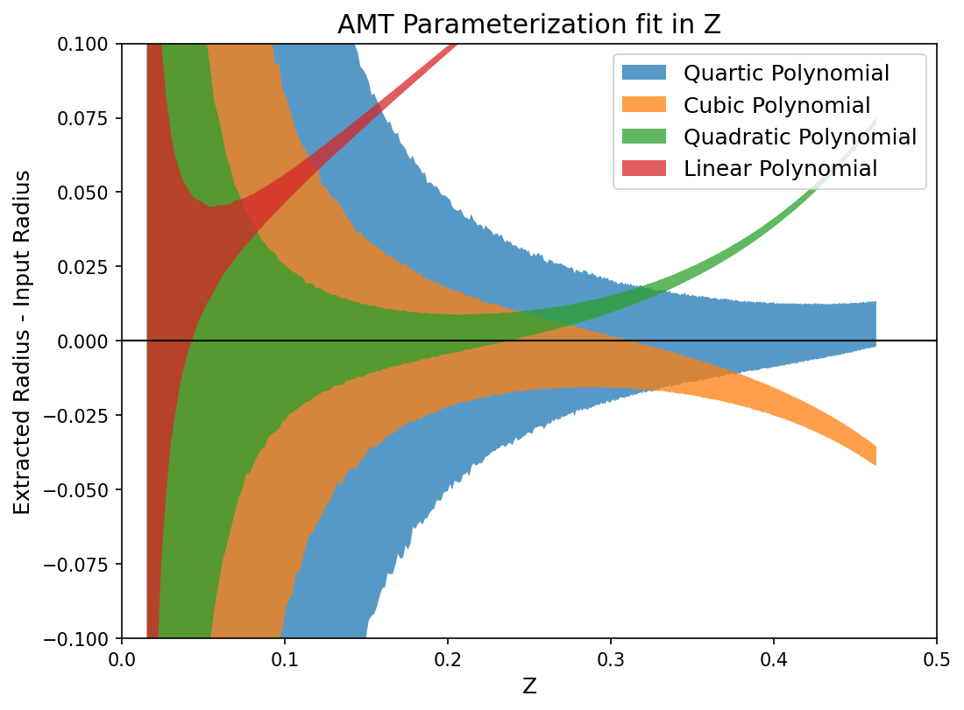
Q² vs. Z polynomial regressions Thanks to Tyler Hague for providing his preliminarily results.
Following the example problem in Kraus et al., https://journals.aps.org/prc/abstract/10.1103/PhysRevC.90.045206
Radius Fit – Radius Actual
Radius Fit – Radius Actual
Q²
Z
These are both unbounded regressions and next step will be to do both as bounded regressions.

Slide 40
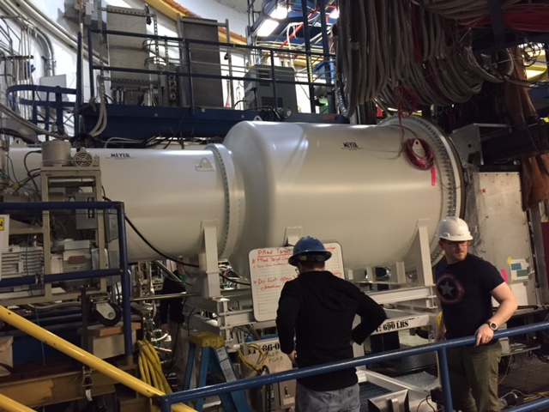
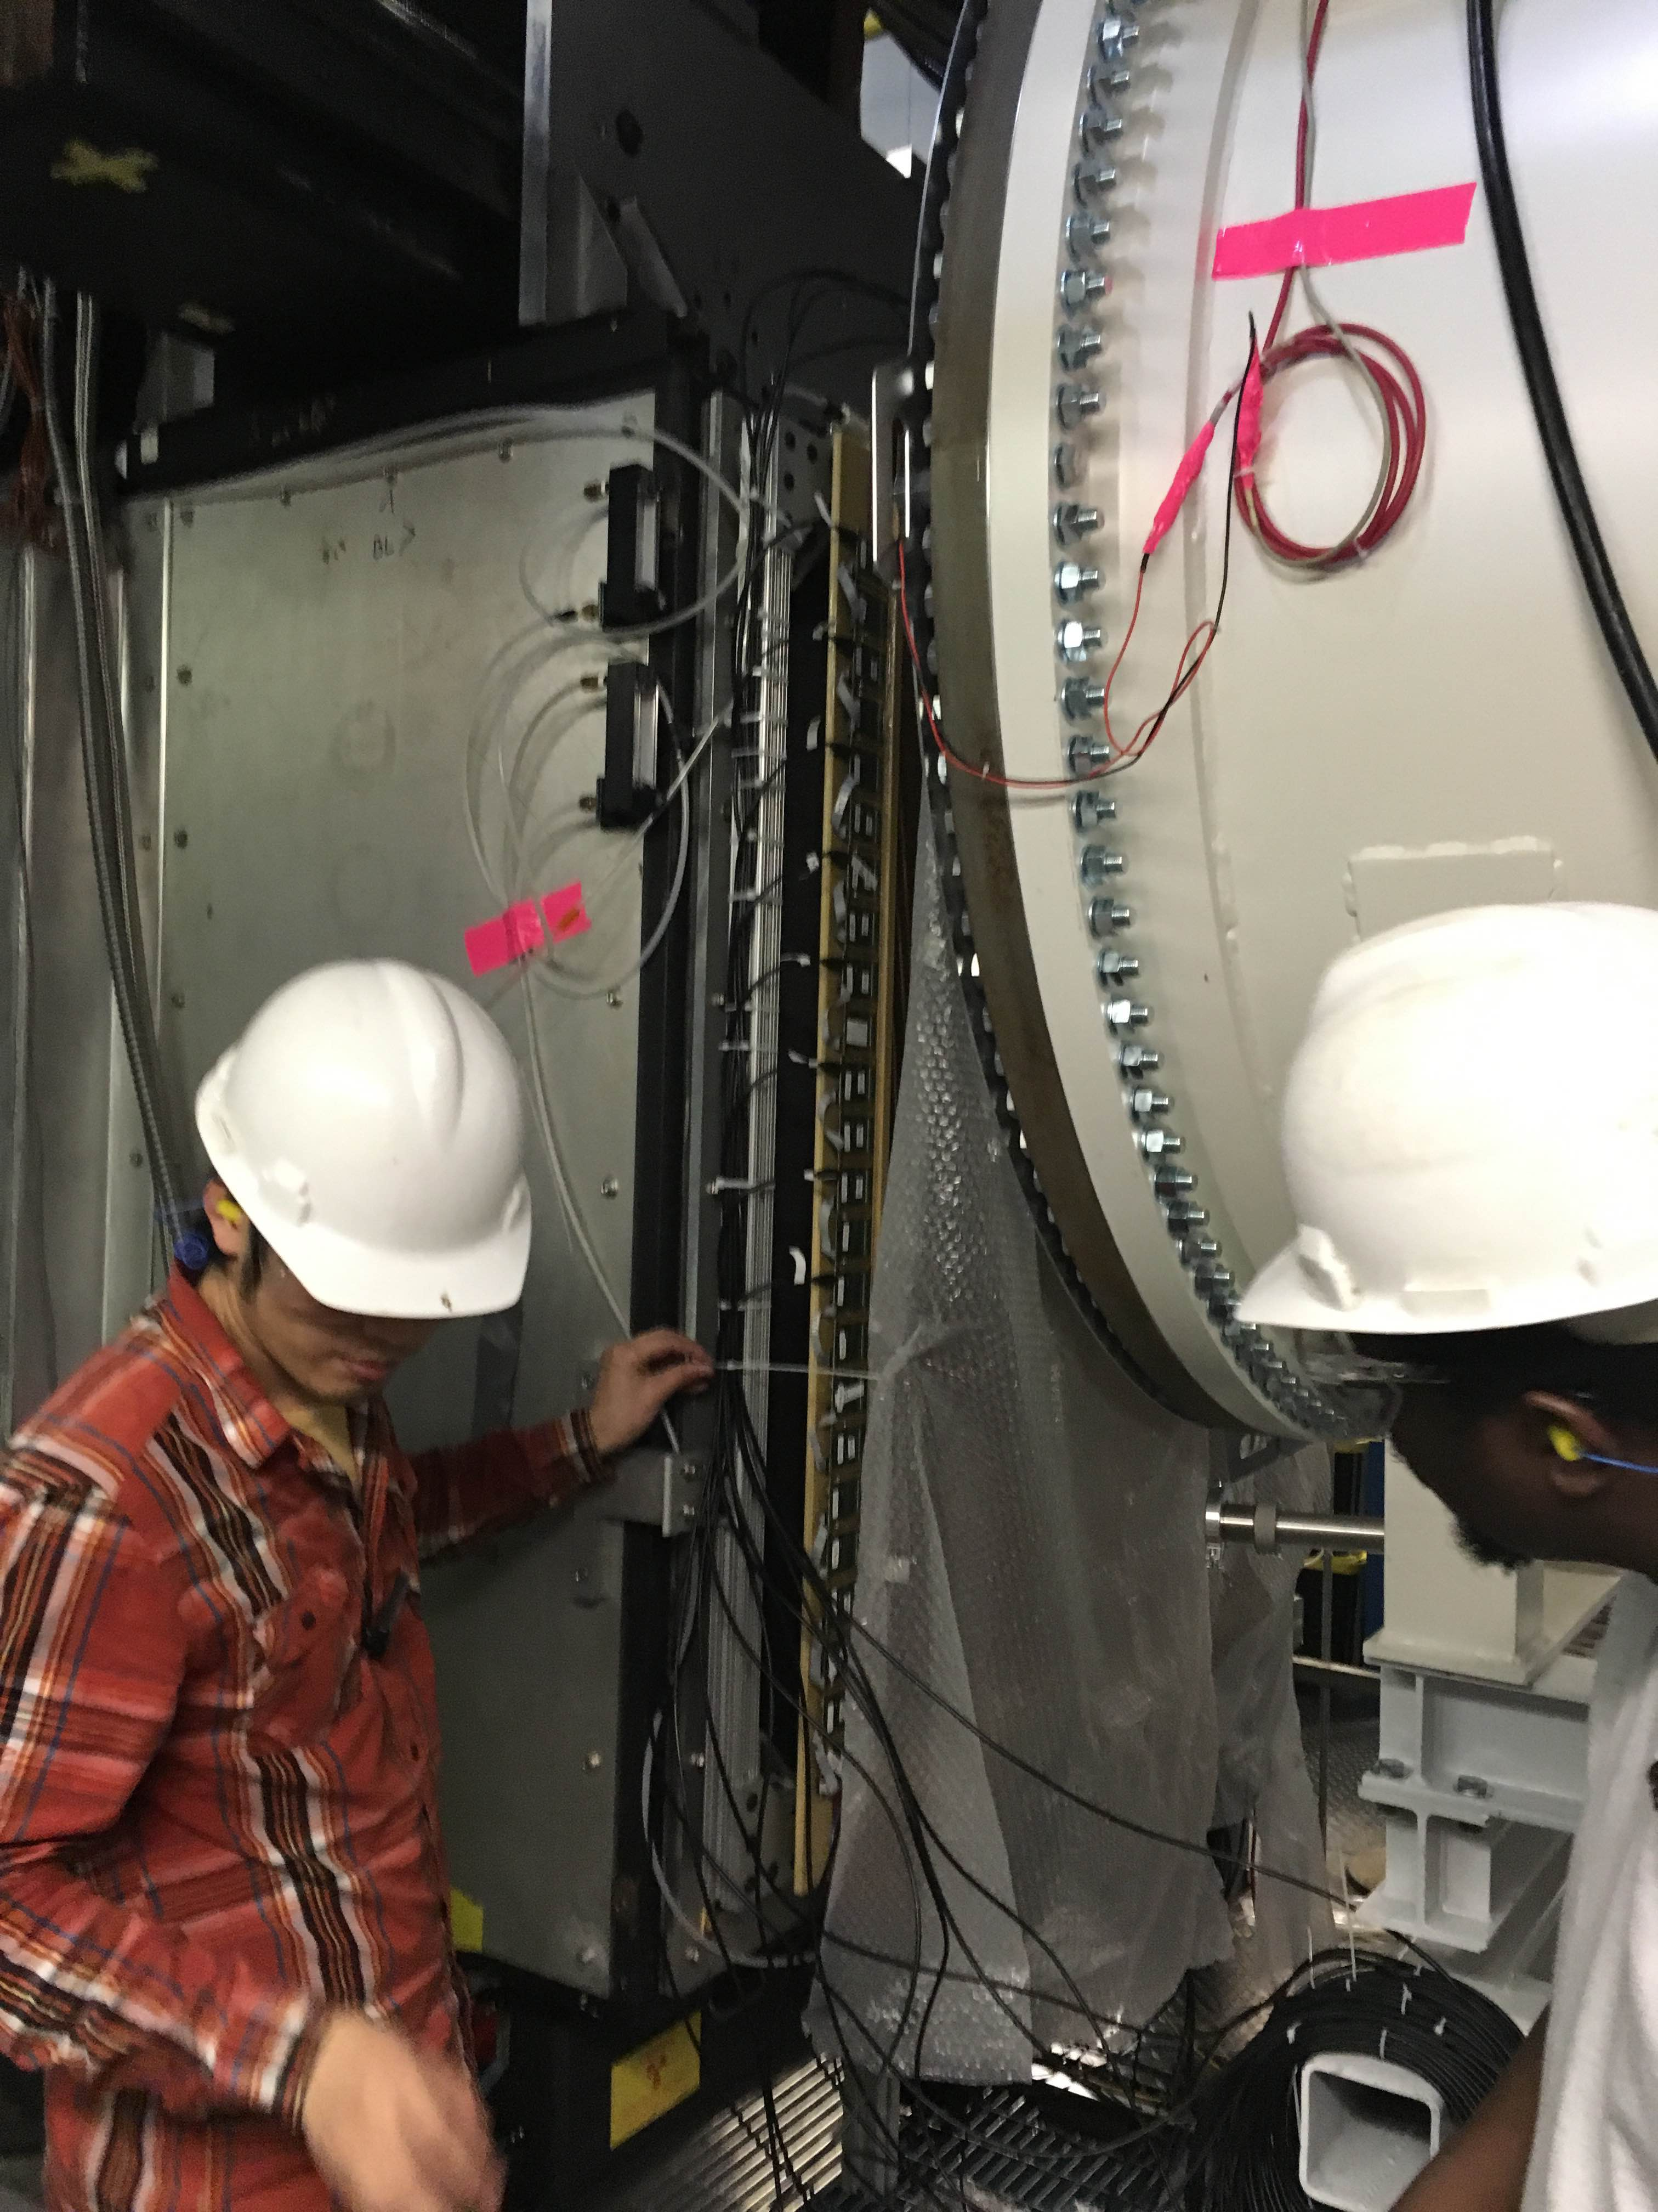
PRad: Hall B Proton Radius Experiment
Small angle and small Q² to minimize the effects of G_{M} and provide best measurement of G_{E}
Gas Target (the proton) and GEM Detectors (scattering angles) & CEBAF (the beam energy)
The Collaboration & Jefferson Lab staff did an
amazing job getting this experiment ready and was the first completed experiment for the upgraded CEBAF accelerator.
39

Slide 41
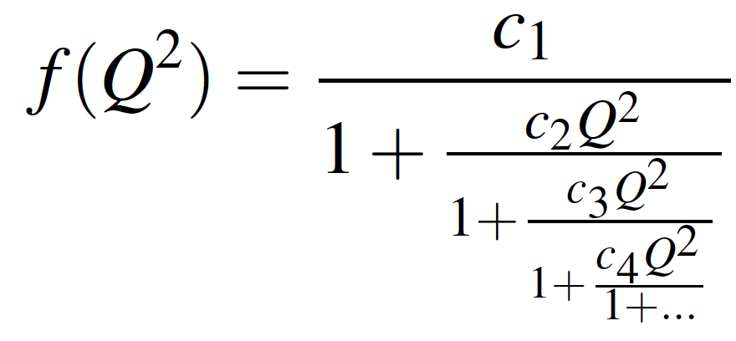
Padé Approximant & Continued Fractions
Pade’ Approximant
Continued Fraction
When it exists, the Pade’ approximant (N,M) of a
Tayler series is unique.
a₀ + a₁ x¹ + a₂ x² … + a^{M} * x^{M}
1 + b₁ x¹ + b₂ x² ... + b^{N} * x^{N}
f(x) =
In our case we want f(x) = n₀ G_{E}(Q²), so
1 + a₁ Q₂ + a₂ Q⁴ … + a^{M*2} * Q^{M*2}
1 + b₁ Q₂ + b₂ Q⁴ ... + b^{N*2} * x^{N*2}
f(x) = n₀
( Henri Padé ~ 1860 )
( Ancient Greeks )
Further reading: Extrapolation algorithms and Padé approximations: a historical survey
C. Brezinski, Applied Numerical Mathematics 20 (1996) 299.

Slide 42
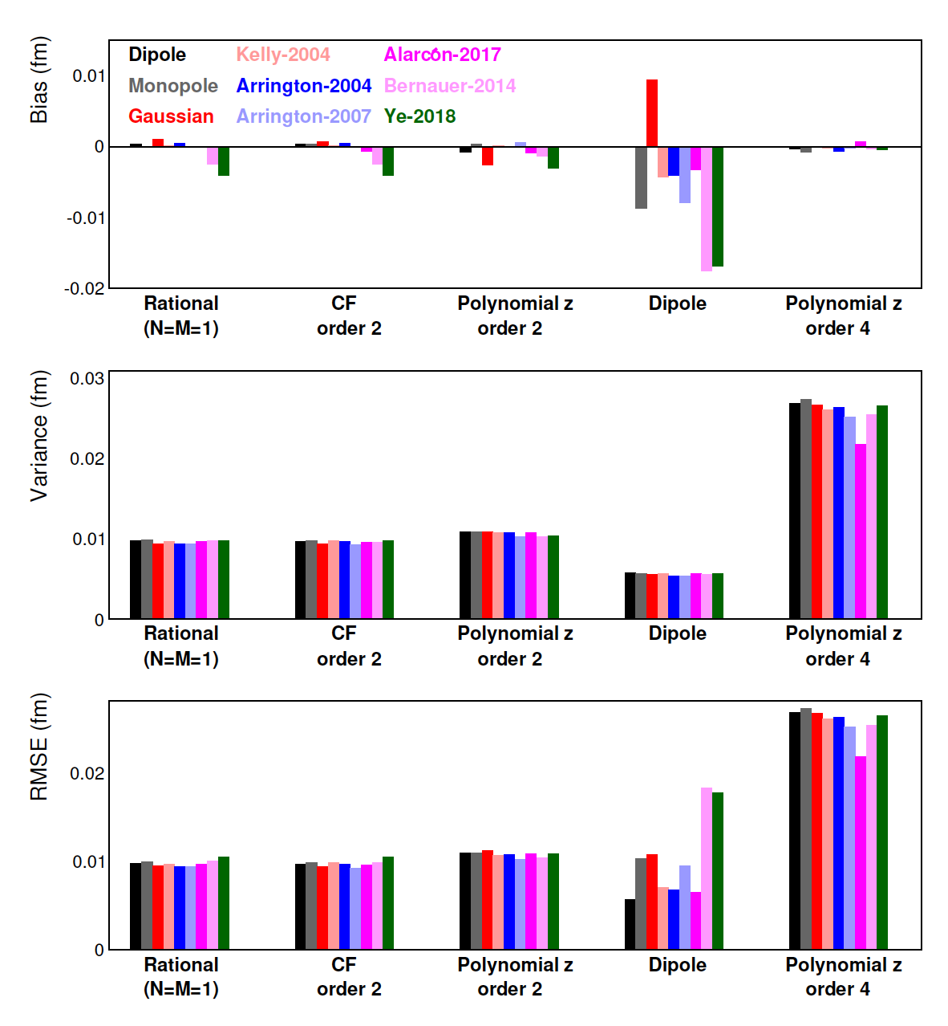
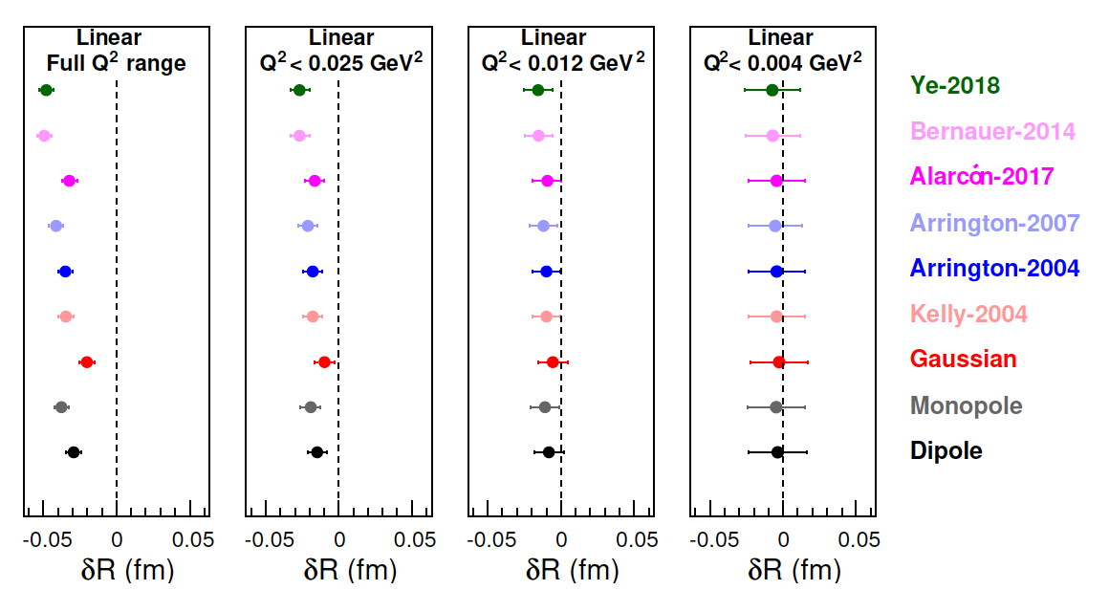
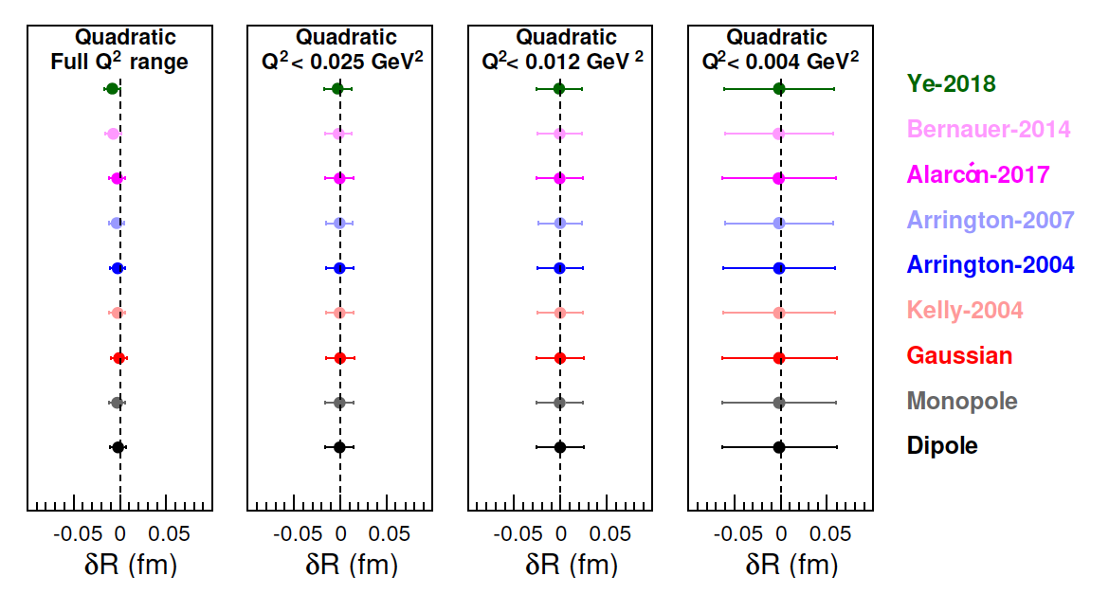
Model Selection For PRad BEFORE Seeing The Data
Z. Yan, DH, et al., Phys. Rev. C 98 (2018) 025204; https://doi.org/10.1103/PhysRevC.98.025204
Shown are a subset of the result of fitting the full range.
Linear and Quadratic fits for different ranges.

Slide 43
Blind Validation Test by Theorist Jerry Miller
Two sets of Faux G_{E} Were Set
Used the binning and uncertainties of the PRad Experiment
Able To Correctly Tell His Input Radius Using The Robust Functions
Caveat that the electromagnetic form factors are reasonably well behaved.
This really is an important test, yet to this day, PRAD is the only group that has taken Jerry up on this blind challenge!

Slide 44
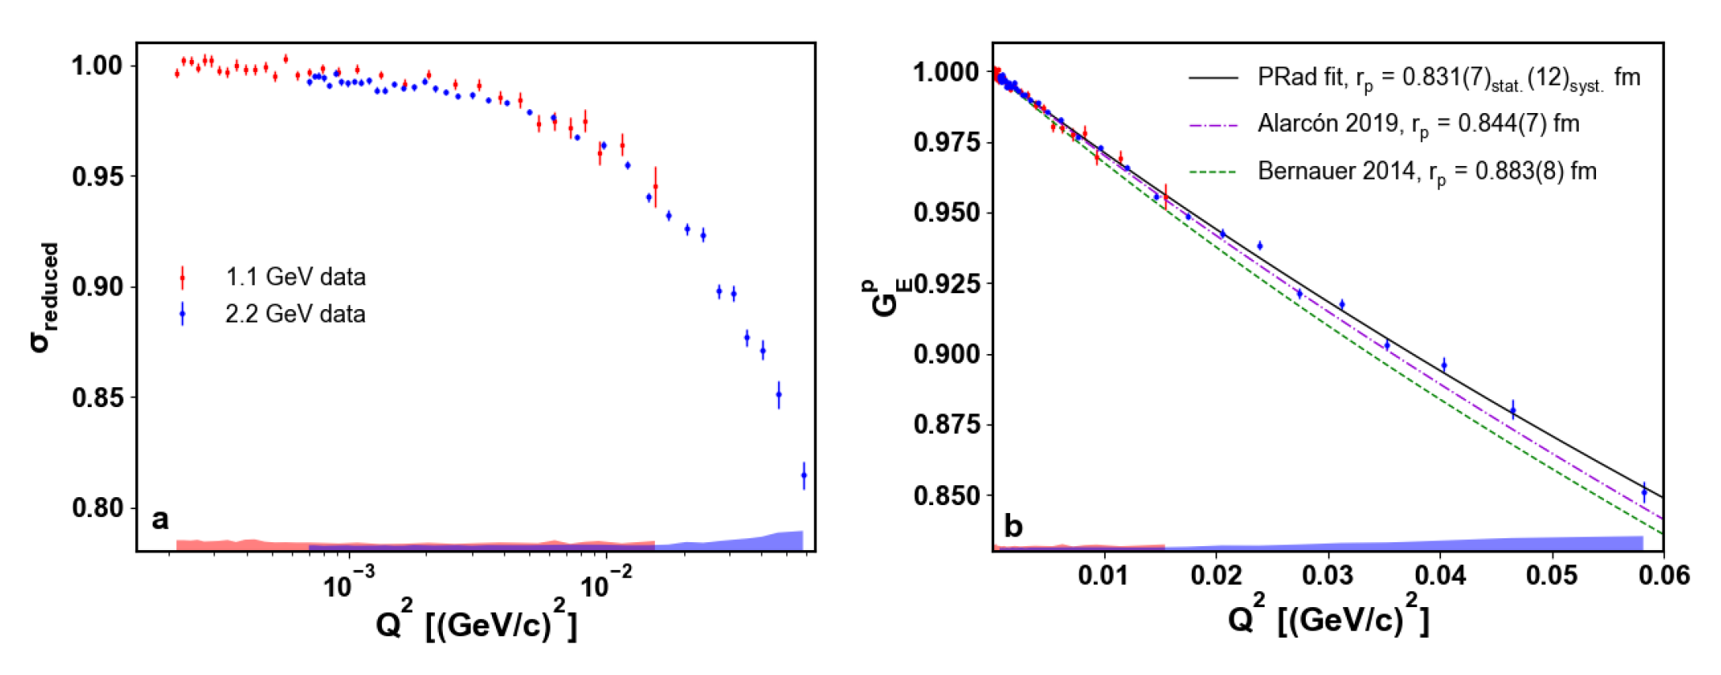
PRad Data and Extracted Proton Radius
W. Xiong et al., Nature 575 (2019) 147–150. https://doi.org/10.1038/s41586-019-1721-2

Slide 45



Next Generation Atomic Hydrogen Lamb Data
Blue band (CODATA-2014) is basically a simple average of the results.
6 September 2019:
N. Bezginov et al., Science 365 (2019) 1007-1012
Extracted proton radius of 0.833(10) fm (BLINDED ANALYSIS)
Photos from results first new atomic results at Trento proton radius workshop: Science 358 (2017) 79 of 0.833(9) fm.
And to keep life interesting, there is also a measurement reported in PRL 120 (2018) 183001 that gets 0.877(13) fm.
Neither of these two other measurements were done with a blind analysis.
44

Slide 46
Which Brings Us To New Recommended Values
CODATA 2014
Proton Radius 0.8751(61) fm
Rydberg Constant 10 973 731.568 508(65)m−1
CODATA 2018
Proton Radius 0.8414(19)fm
Rydberg Constant 10 973 731.568 160(21) m-1
Particle Data Book has also changed its recommend value to the 0.84 fm.

Slide 47
Summary and Outlook
A lot of effort has gone into understanding the proton radius puzzle
MANY re-analysis of old and new scattering data
PRad (no spectrometer) proton radius 0.831(7) fm
New Atomic Lamb shift results mostly consistent with small radius
2020 blinded analysis from Candana was consistent http://doi.org/10.1126/science.aau7807
2017 CRÈME result also consistent with smaller value http://doi.org/10.1126/science.aah6677
But 2018 French result still gives previous value https://doi.org/10.1103/PhysRevLett.120.183001
MUSE, New Mainz A1 Data, MESA, Compass, PRAD-II and more still to come
Dispersively Improved Chiral Effective Field Theory (conventional nuclear physics) is consistent with a smaller radius.
Now it is your turn!! https://wiki.jlab.org/pcrewiki/index.php/PRad_Results

Slide 48
https://xkcd.com/2048
And just for fitting fun!
https://twitter.com/dwhiginbotham/status/1043837703991832577
and the source code: http://doi.org/10.5281/zenodo.1436555

Slide 49
Further Reading & Source For Python & R Software
To Explain or Predict? ( Descriptive, Predictive and Explanatory Modeling )
https://projecteuclid.org/euclid.ss/1294167961
The Interpretation of Errors – Fredrick James (most of you use MINUIT, so please read!)
http://seal.cern.ch/documents/minuit/mnerror.pdf
Data Analysis Textbooks
Data Reduction and Error Analysis – Philip Bevington
Statistical Methods in Experimental Physics – Fredrick James
Computation Methods in Physics – Simon Širca
Probability for Physicists – Simon Širca (https://www.springer.com/us/book/9783319316093)
Anaconda Open Source Software (https://www.anaconda.com/download)
And one of my favorites: https://en.wikipedia.org/wiki/How_to_Lie_with_Statistics
This book shows you the lies
Though it is old, you can see example after example that is discussed in this book on social media sites today!

Slide 50


