Slide 1
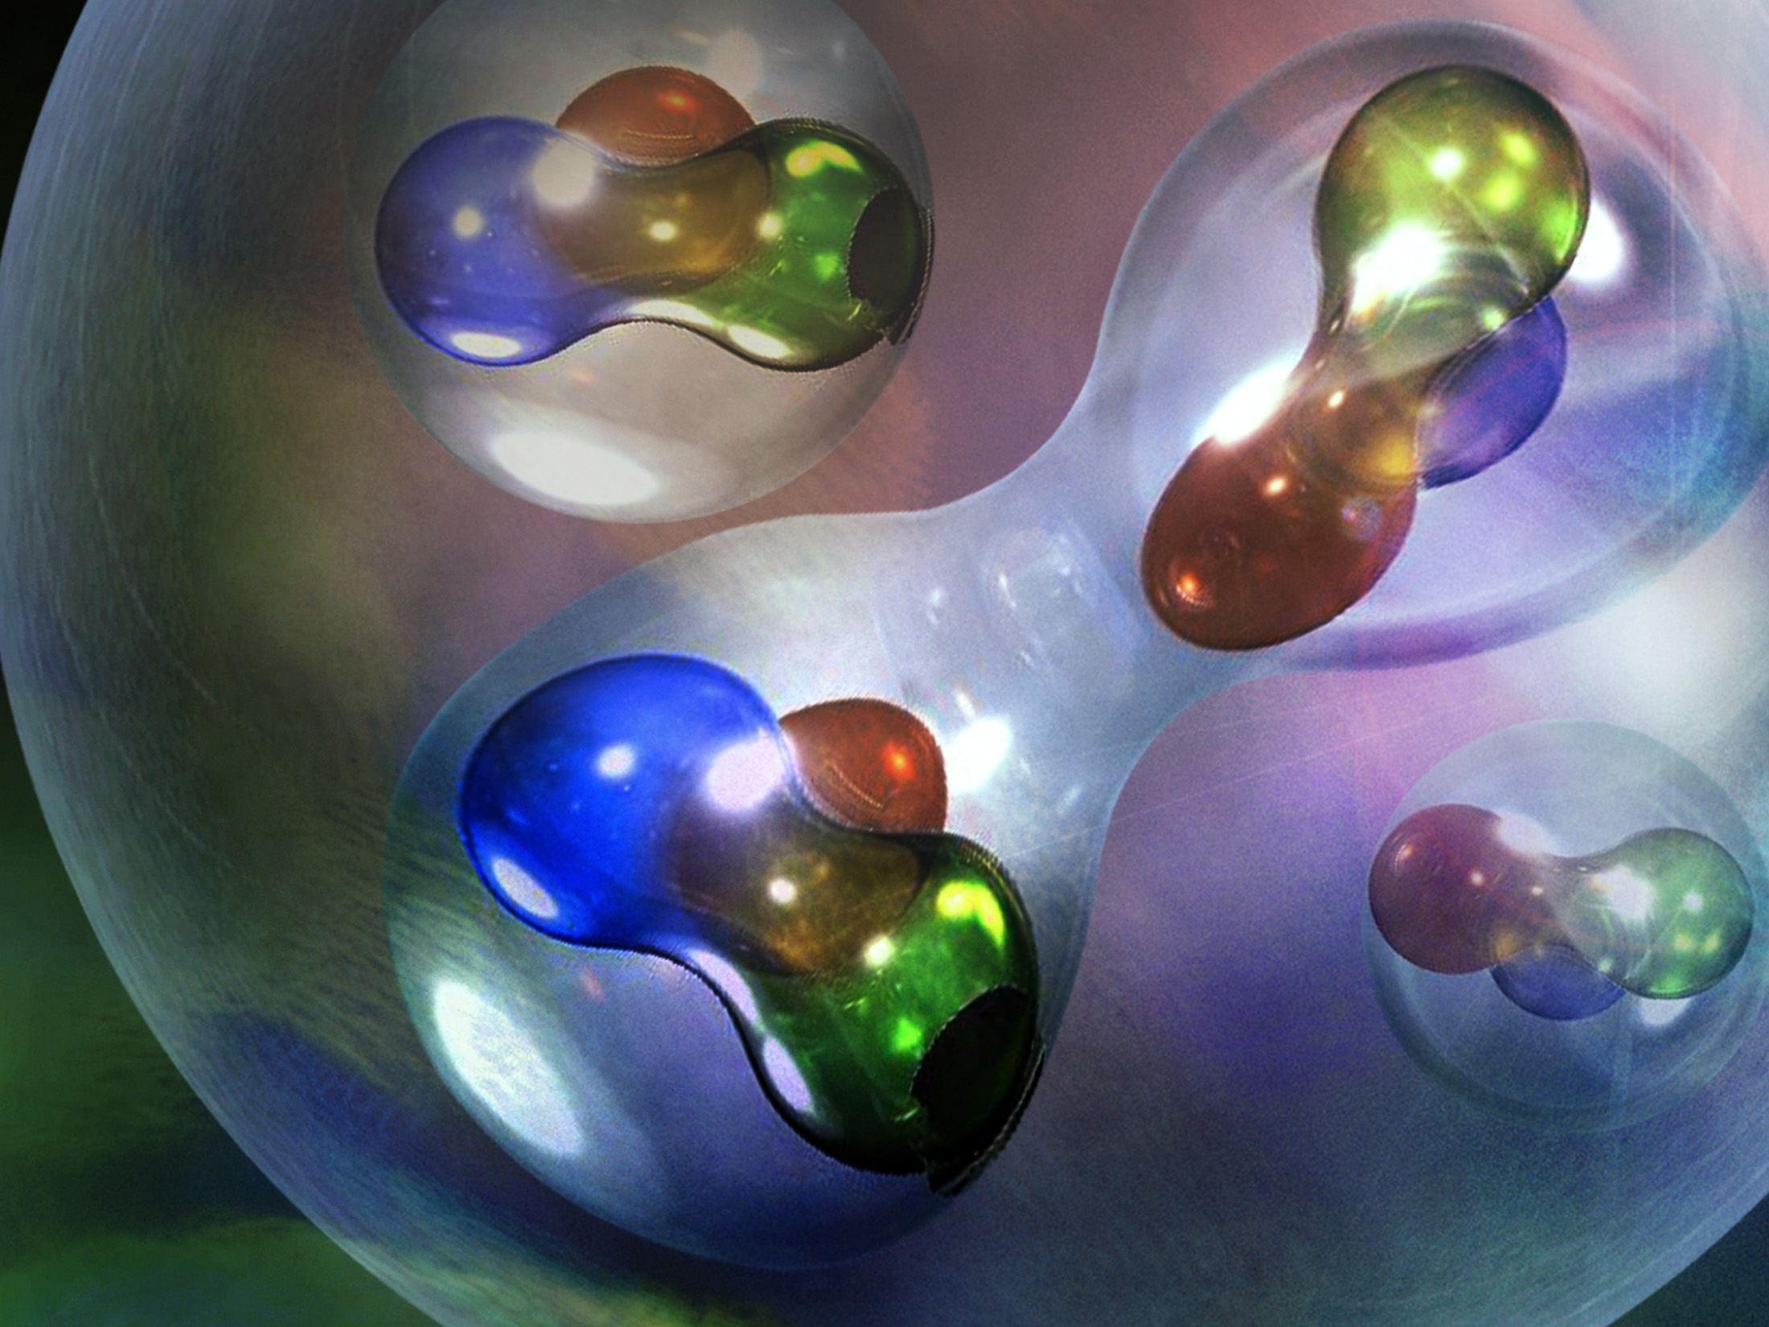
Hadronic Physics, Detectors & Accelerators
Lecture 3: The EMC Effect and Short-Range Correlations
by
Douglas W. Higinbotham

Slide 2
Follow-up Material From Yesterday’s Discussions
1

Slide 3
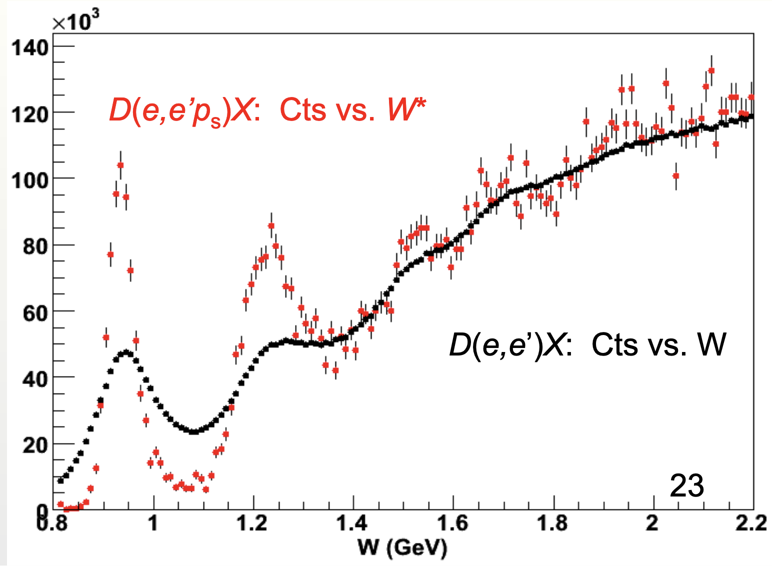
Real Electron Scattering Data
Data from the BONUS Experiment in CLAS / Hall B at Jefferson Lab
2

Slide 4
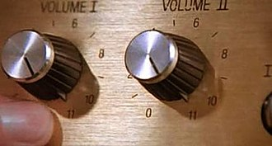
Going to Eleven
https://en.wikipedia.org/wiki/Up_to_eleven
https://www.youtube.com/watch?v=KOO5S4vxi0o
3

Slide 5
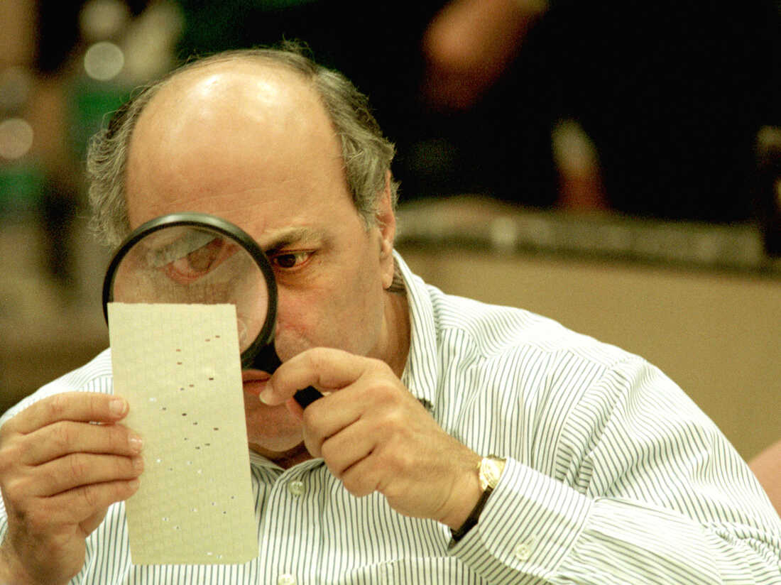
Florida Election Recount of 2000
https://www.npr.org/2018/11/12/666812854/the-florida-recount-of-2000-a-nightmare-that-goes-on-haunting

Slide 6
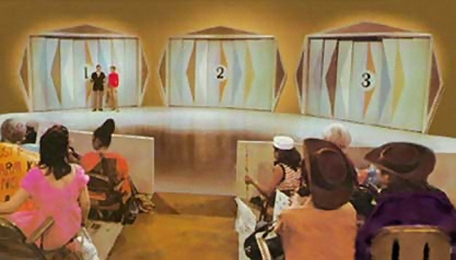
Let’s Make A Deal
Behind Two of the Doors Are Goats …
Behind One of the Doors Is A Fabulous Prize!

Slide 7
Monty Hall Problem
Door #1
Door #2
Door #3

Slide 8

Monty Hall Problem
Door #1
Door #2
Door #3
Right
Wrong

Slide 9
Monty Hall Problem
Door #1
Door #2
Door #3
Right
Wrong

Slide 10
Monty Hall Problem
Door #1
Door #2
Door #3

Slide 11
Probability Says Switch
Your human reaction is to stay with your original choice.
I setup the problem before I even arrived today (i.e. you have 1/3 chance to pick correctly at the start)
My opening a door is NOT random, so the remaining door has a 2/3 chance to be the winner!
If you are still not convinced trying reading https://en.wikipedia.org/wiki/Monty_Hall_problem
The is actually a great problem to set up as a Monte Carlo simulation.
10

Slide 12
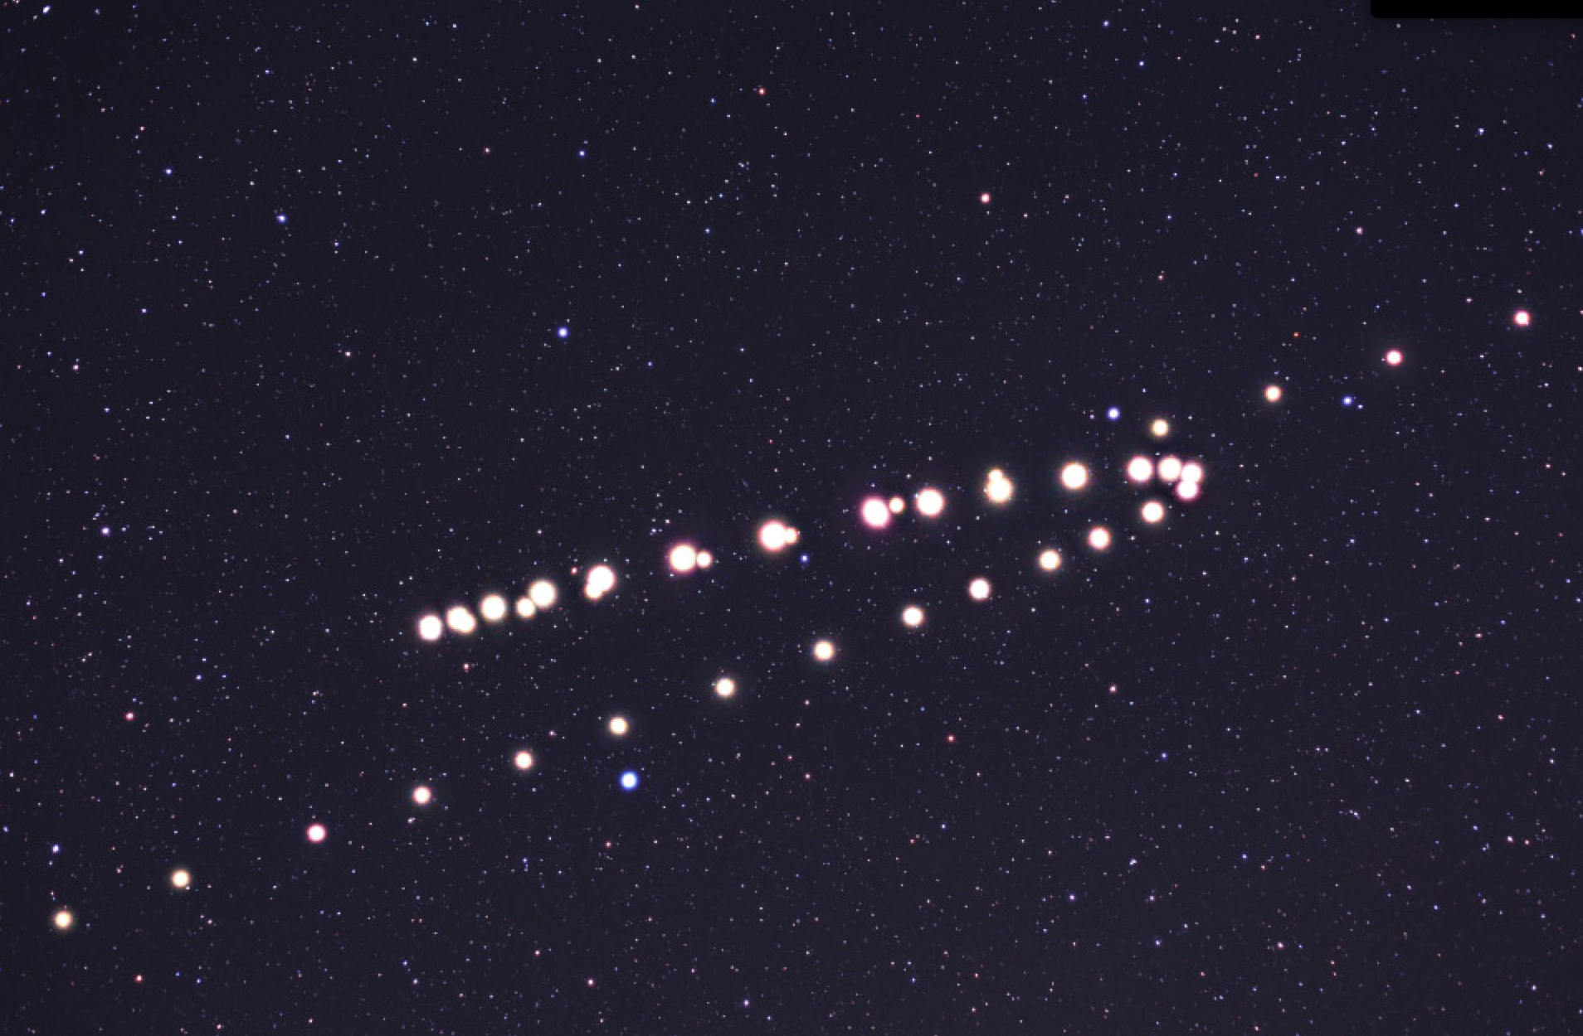
Retrograde Motion of Mars As Seen From Earth
11

Slide 13
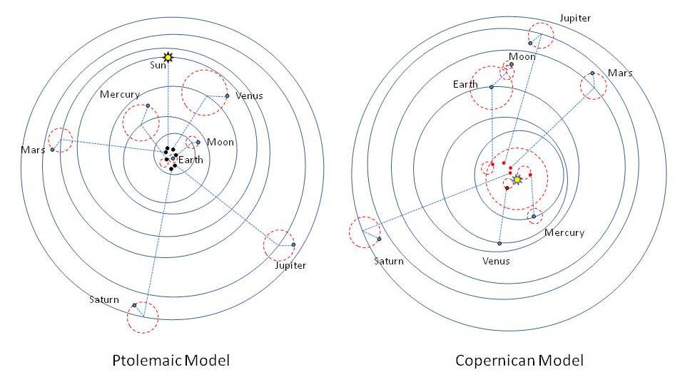
Earth vs. Sun Centered Models
12

Slide 14
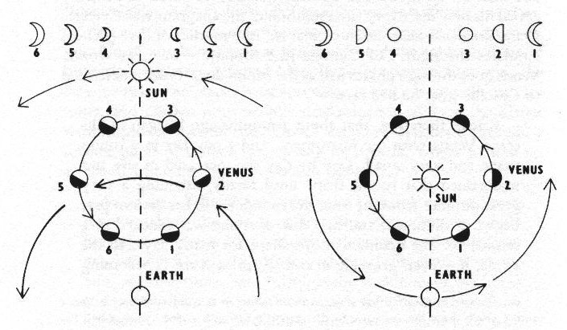
Phases & Elliptical Orbits
At first, with orbits as perfect circles, Ptolemaic models were better at predicting the orbits of the planets then Copernican models.
It was the phases of the Venus (Galileo 1610) along with the elliptical orbits of Kepler (1609) [ fitting the “naked eye” data of Brahe (1574) ] that proved to be the downfall of the Ptolemaic model.
Illustration based on work of Galileo Galilei in Sidereus Nuncius (Starry Messenger) 1610.
13

Slide 15
Occam's Razor
William Occam (1287 – 1347)
One can always explain failing explanations with an ad hoc hypothesis, thus in Science, simpler theories are preferable to more complex ones. (e.g. the Sun centered vs. Earth centered)
Layman’s version of Occam’s Razor is “the simplest explanation is usually the correct one”
In statistical versions of Occam's Razor, one uses a rigorous formulation instead of a philosophical argument. In particular, one must provide a specific definition of simple:
F test, Akaike information criterion, Bayesian information criterion, etc.
In statistical modeling of data too simple is under-fitting and too complicated is over-fitting.
14

Slide 16
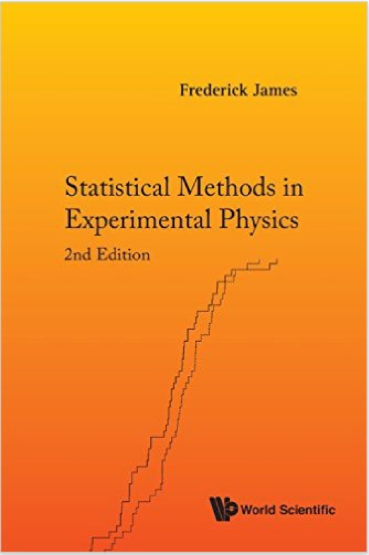
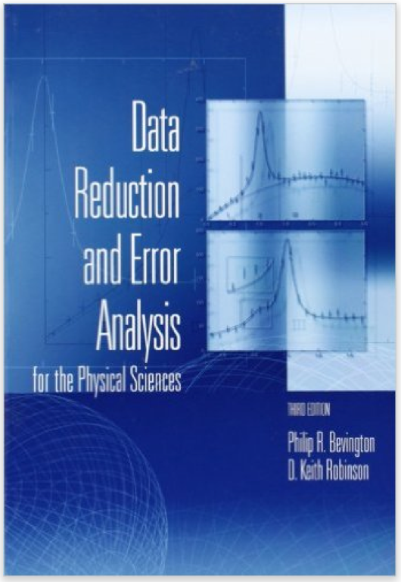
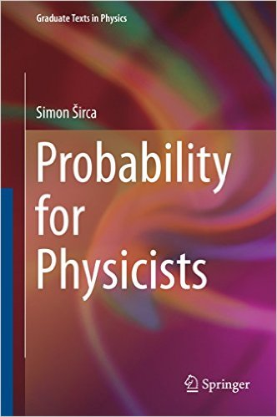
Some suggested books on data analysis.
15

Slide 17
Now Back To The Focus of Today’s Lecture
16

Slide 18
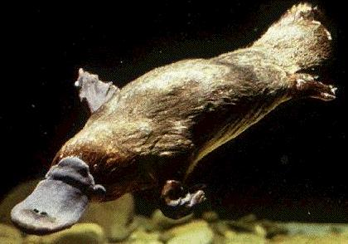
“When the explorer returned from Australia, the good people of England, having seen all the animals in the world, demanded to know if it was a duck or a beaver. They were asking the wrong question!” – Rolf G. Winter, Introduction to Quantum Physics
17

Slide 19
Electron Scattering Kinematics
p
scattering plane
e'
θ_{pq}
reaction plane
e
(ω,q)
p_{A–1}
φ_{x}
“out-of-plane” angle
Energy transfer: ω = e – e’
Four-momentum transfer: Q² ≡ – q_{μ}q ^{μ} = q² –ω ²
Missing momentum: p_{m} = q – p = p_{A–1}
Bjorken x: x_{B} = Q²/2mω (just kinematics!)
18

Slide 20
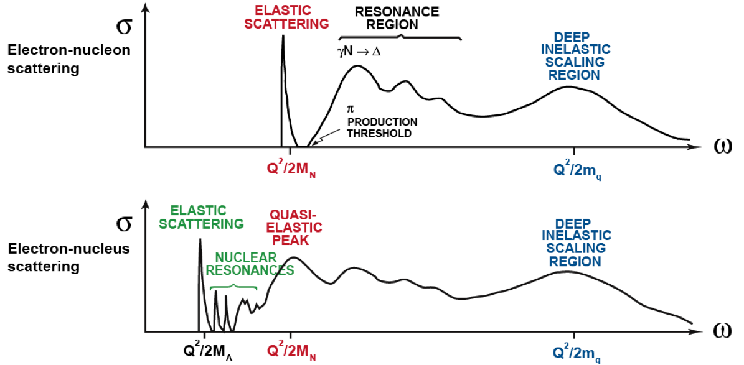
Electron Scattering from Nucleons in the Nucleus
EMC Effect Region
x_{B} = Q²/2mω
x_{B} > 1
x_{B} = 1
x_{B} < 1
19

Slide 21
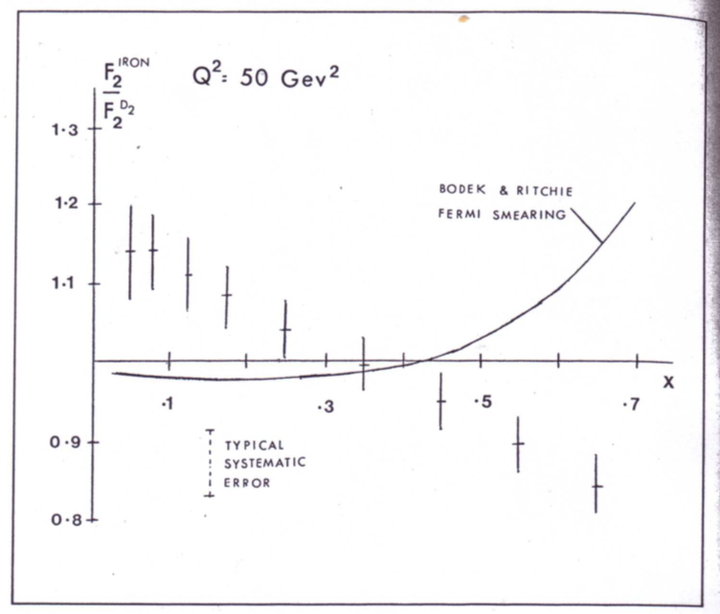
What is the EMC effect?
CERN Courier, Nov. 1982 (shown) and then J.J. Aubert et al.,Phys. Lett. B 123 (1983) 275.
20

Slide 22
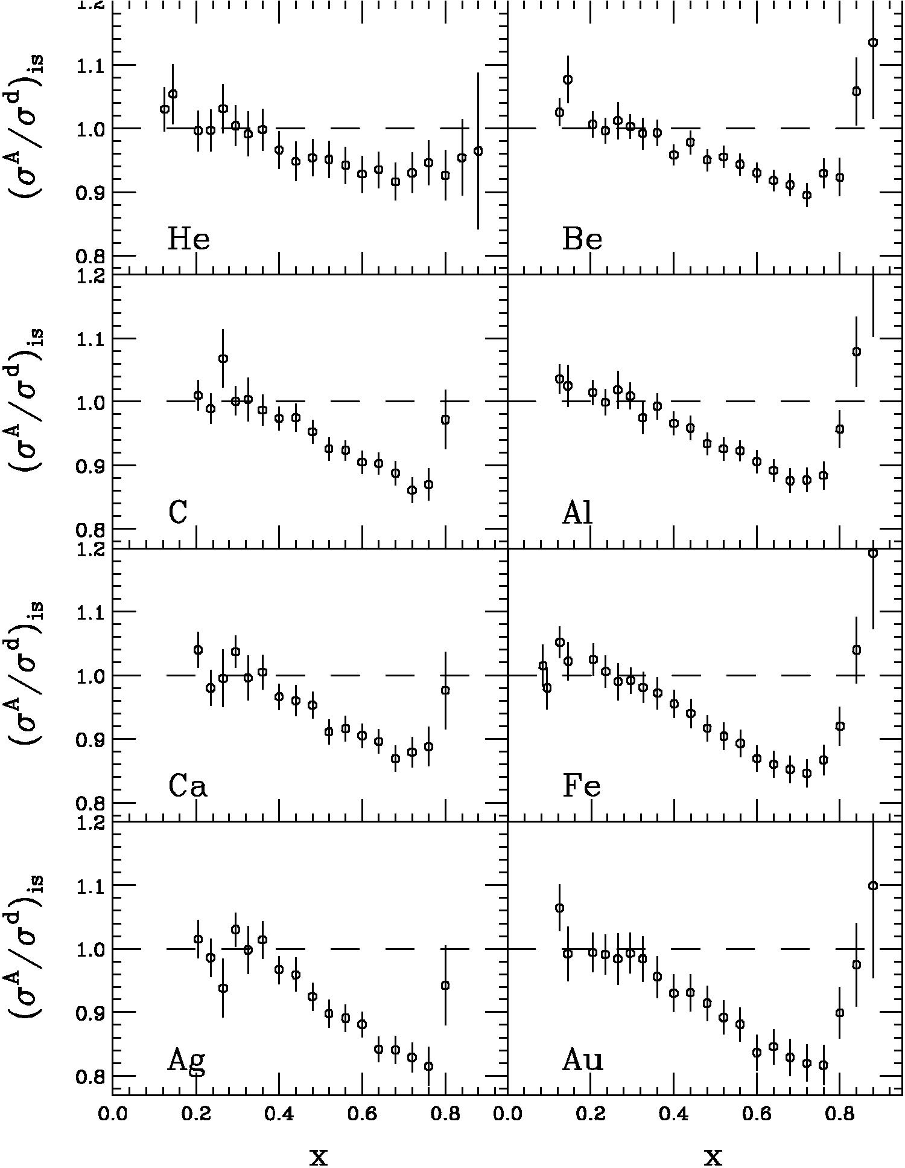
Effect Reproduced Many Times
EMC effect is simply the fact the ratio of DIS cross sections is not one
J.J. Aubert et al. PLB 123 (1983) 275.
Simple Parton Counting Expects One
MANY Explanations
SLAC E139
J. Gomez et al., PRD 49 (1994) 4348.
Precise large-x data
Nuclei from A=4 to 197
Conclusions from SLAC data
Q²-independent
Universal x-dependence (shape)
Magnitude varies with A
Average Nuclear Density Effect
21

Slide 23
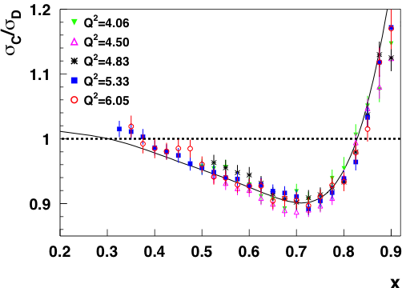
New Jefferson Lab EMC Effect Data
J. Seely et al., Phys, Rev. Lett. 103 (2009) 202301.
22

Slide 24
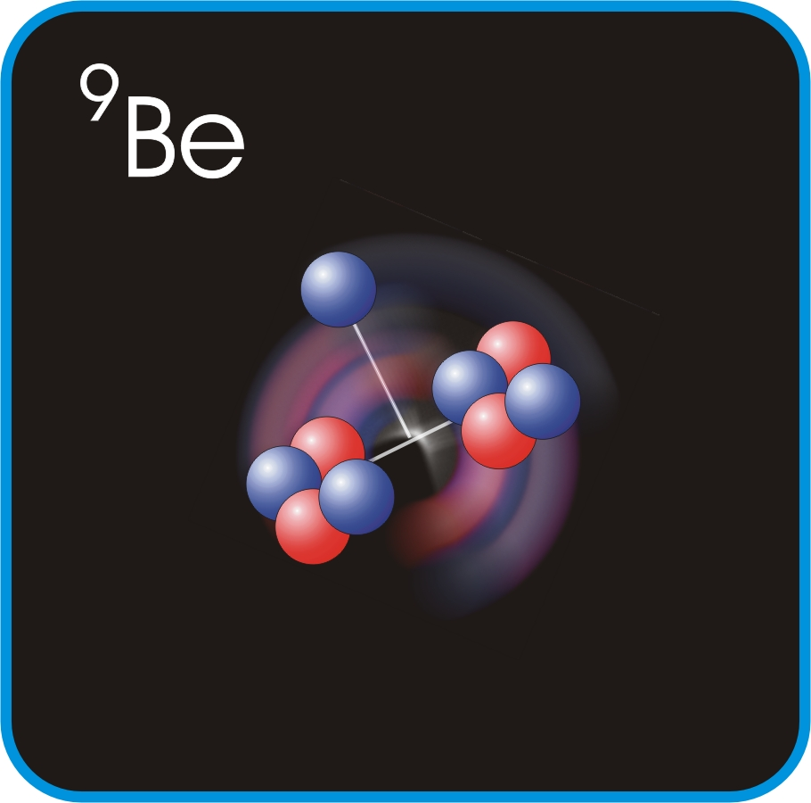
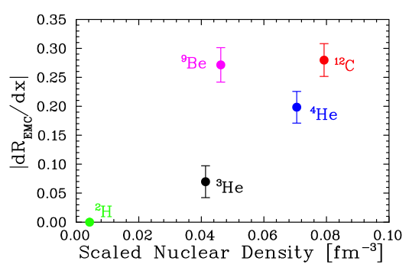
New Jefferson Lab EMC Effect Data
J. Seely et al., Phys, Rev. Lett. 103 (2009) 202301.
Plot shows slope of ratio σA/σD at EMC region.
EMC effect correlated with local density not average density.
23

Slide 25
If the EMC effect is a local density effect, then it seems reasonable to look for connections to other local density effects.
24

Slide 26
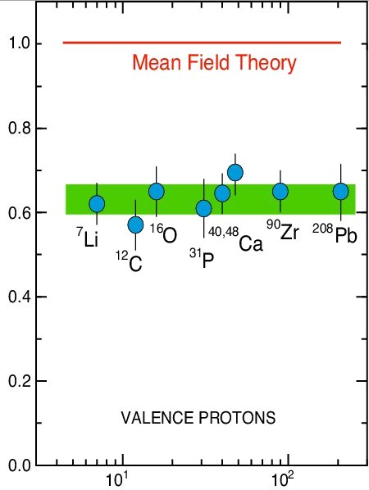
Classic (e,e’p) Results
L. Lapikas, Nucl. Phys. A553 (1993) 297.
Independent-Particle Shell-Model
is based upon the assumption that
each nucleon moves independently
in an average potential (mean field)
induced by the surrounding nucleons
SPECTROSCOPIC STRENGTH
The (e,e'p) data for knockout of valence and deeply bound orbits in nuclei gives spectroscopic factors that are 60 – 70% of the mean field prediction.
Solution: Correlations Between Nucleons
Target Mass
25

Slide 27
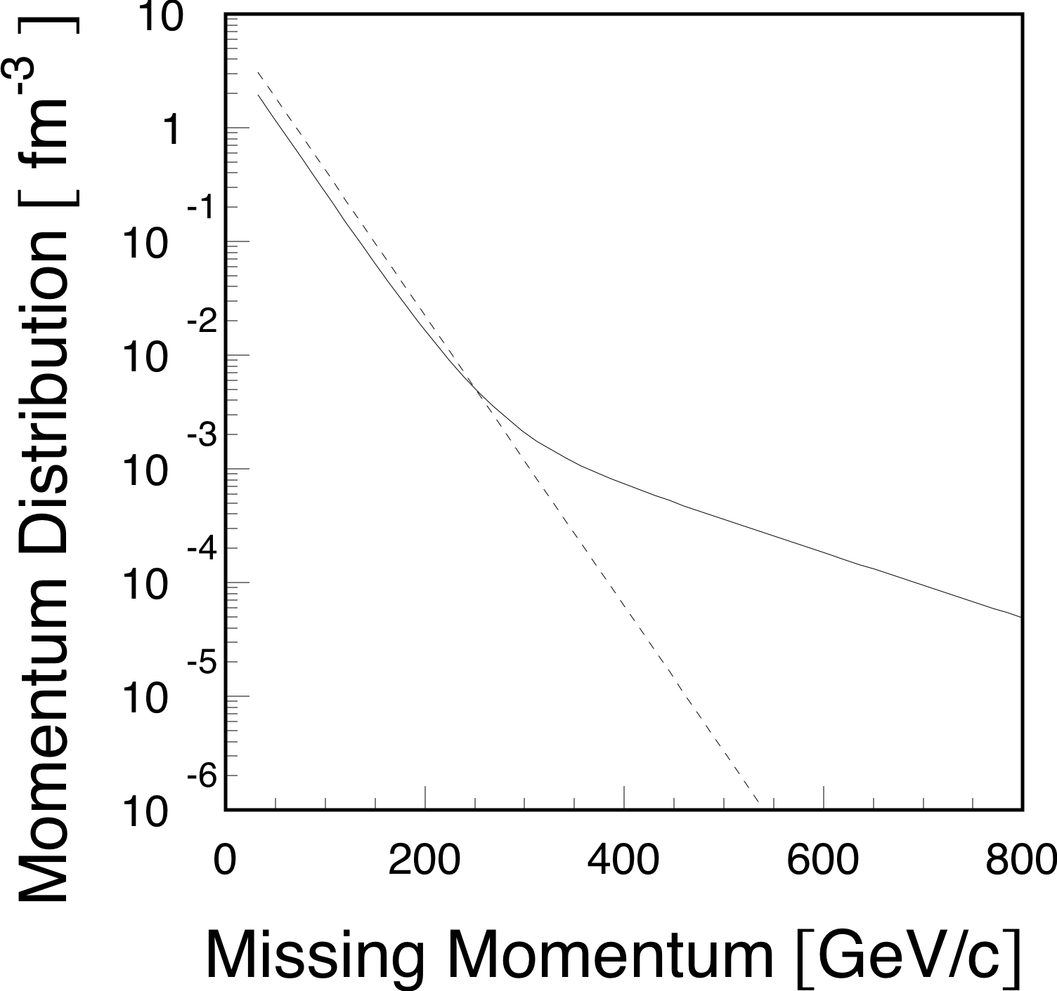
A Toy Model Momentum Distribution
By Uncertainty Principle High Momentum Region Dominated by Short Distance Phenomena
26
26

Slide 28
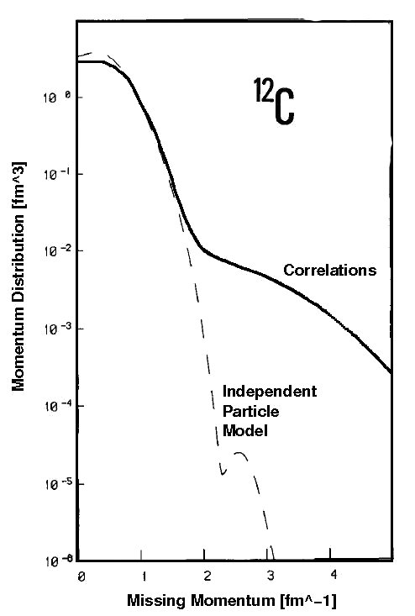
Realistic Momentum Distribution
Benhar et al., Phys. Lett. B 177 (1986) 135.
27

Slide 29
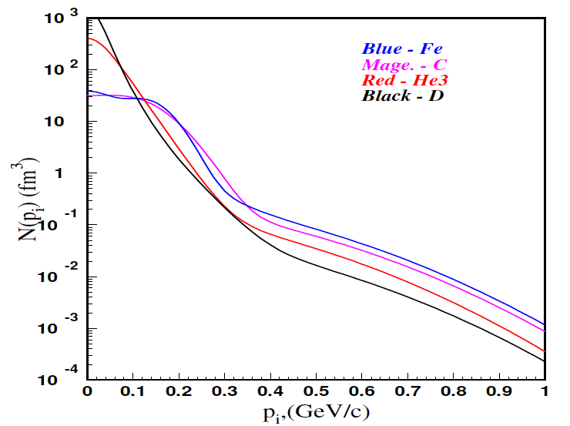
Momentum Distributions
C. Ciofi degli Att and S. Simula, Phys. Rev. C 53 (1996) 1689.
At high initial momentums n_{A}(p) = N * n_{D}(p)
28

Slide 30
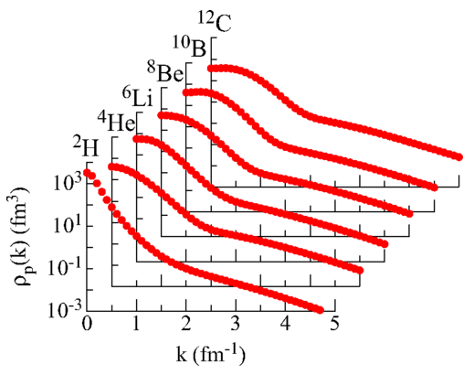
Modern AV18 and Urbana-X Results
R. Wiringa, R. Schiavilla, S. Pieper, and J. Carlson, Phys. Rev. C89 (2014) 024305.
29

Slide 31
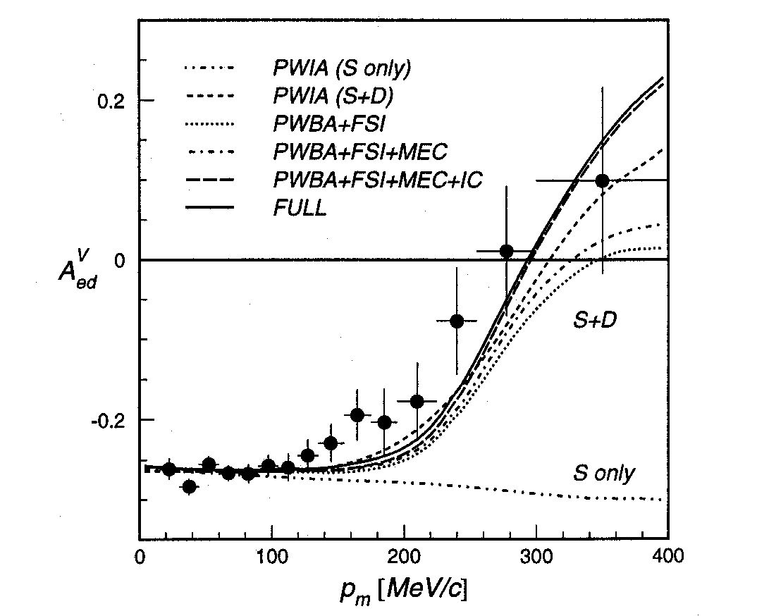
Deuteron Asymmetry Data
I. Passchier et al., Phys. Rev. Lett. 88 (2002)102302.
Q² = 0.2 GeV/c
x_{B} = 1
30

Slide 32
Nuclear Scaling Plateaus from CLAS
K. Sh. Egiyan et al., Phys. Rev. C 68 (2003) 014313.
Originally done with SLAC data by Frankfurt et al., Phys. Rev. C 48 (1993) 2451.
31

Slide 33
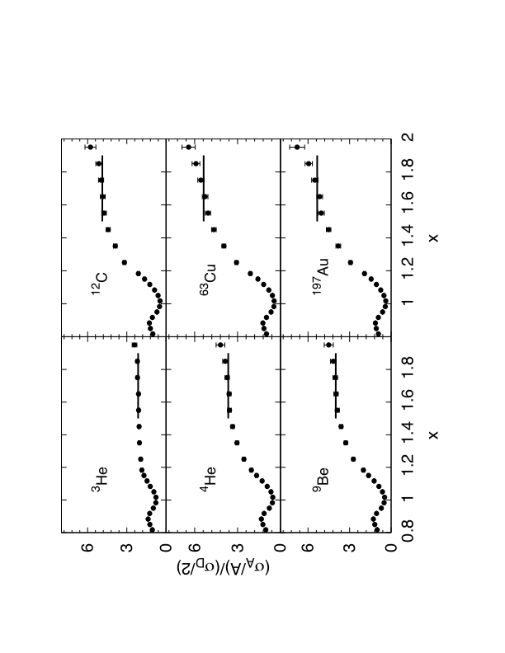
New Results From JLab Hall-C
N. Fomin et al., Phys. Rev. Lett. 108 (2012) 092502.
32

Slide 34
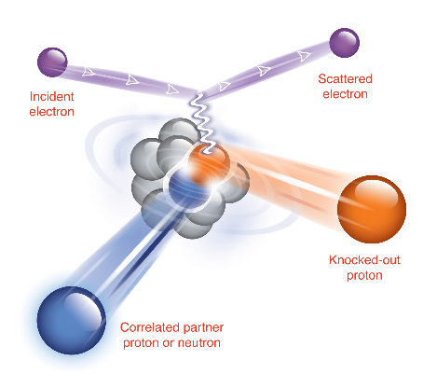
Coincidence (e,e’pN) Measurement
To study nucleon pairs and the fraction that contribute to momentum tail.
x > 1 , Q² = 1.5 [GeV/c]² and missing momentum of 500 MeV/c
33

Slide 35
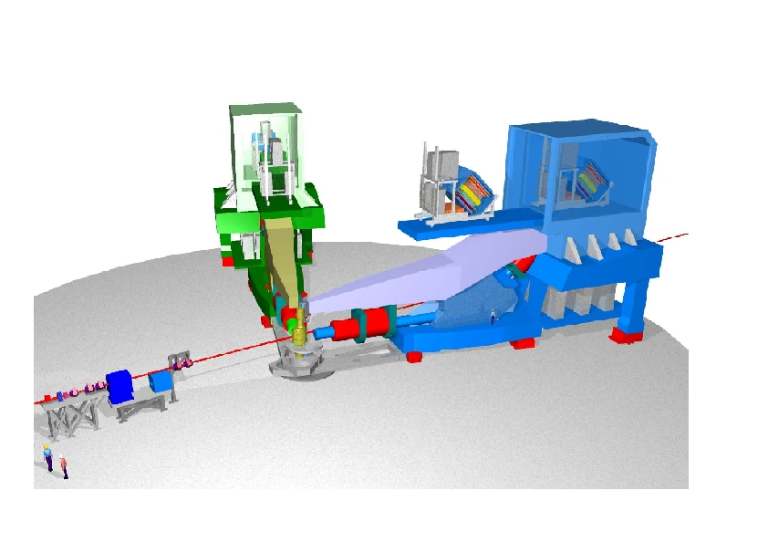
Jefferson Lab’s Hall A
34

Slide 36
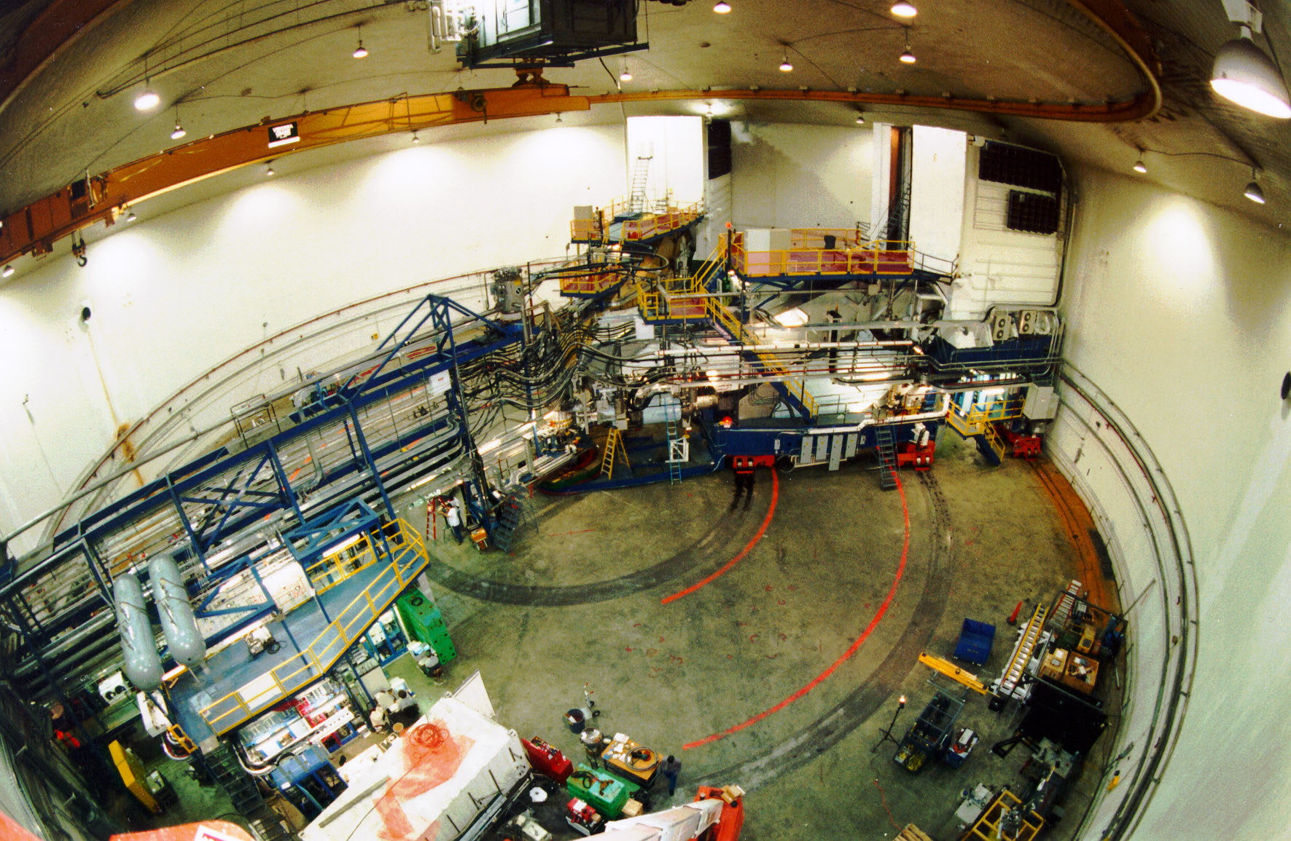
Jefferson Lab’s Hall A
35

Slide 37
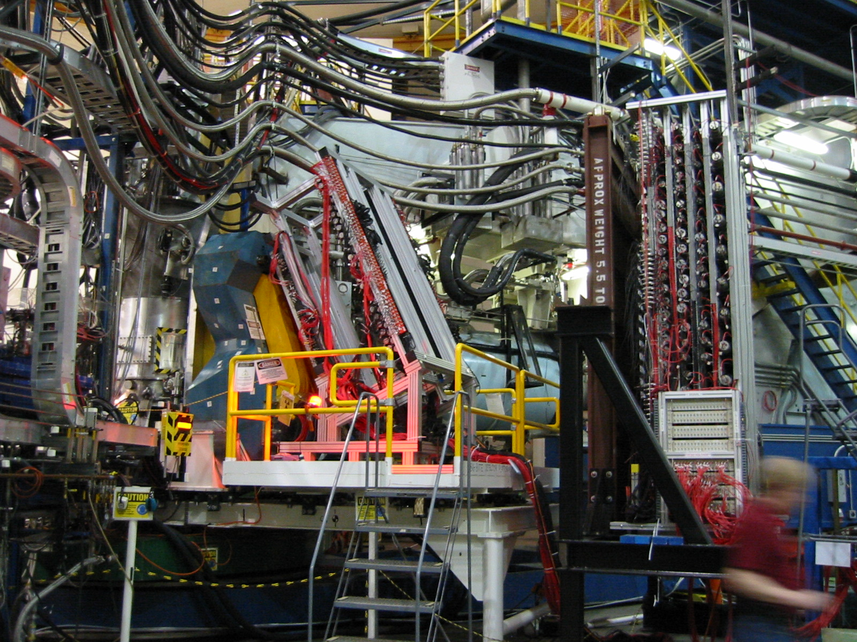
Acceptance matched np detectors.
36

Slide 38
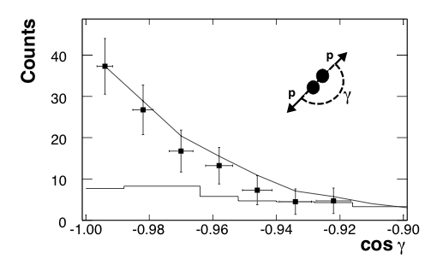
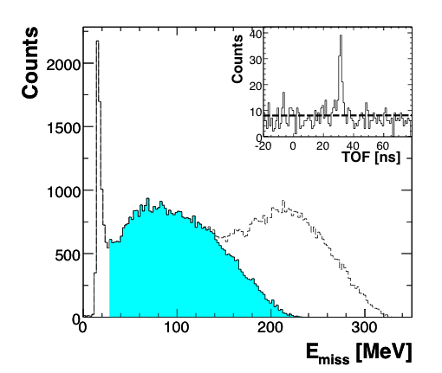
(e,e’p) & (e,e’pp) Data
R. Shneor et al., Phys. Rev. Lett. 99 (2007) 072501.
(e,e’pp)
(e,e’p)
Strong back-to-back correlation!
¹²C(e,e’p)
Quasi-Elastic Shaded In Blue
Resonance Even at x_{B}>1
37

Slide 39
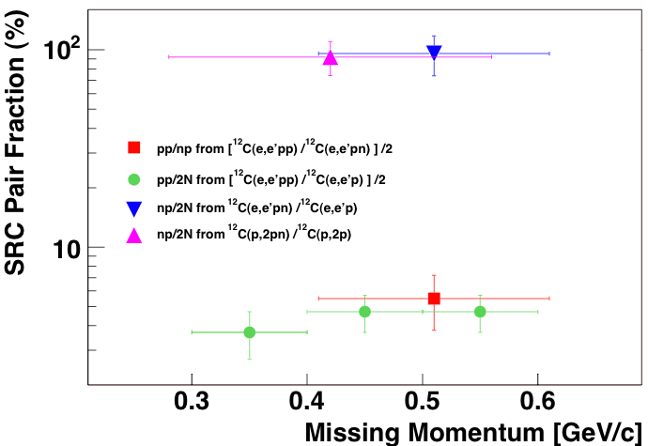
High p_{m} (e,e’p) events have recoiling neutrons.
R. Subedi et al., Science 320 (2008) 1476.
38

Slide 40
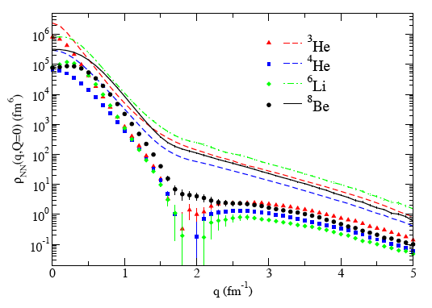
Importance of Correlations
np
pp
R. Schiavilla et al., Phys. Rev. Lett. 98 (2007) 132501.
M. Sargsian et al., Phys. Rev. C (2005) 044615.
M. Alvioli et al., Phys. Rev. Lett. 100 (2008) 162503.
39

Slide 41
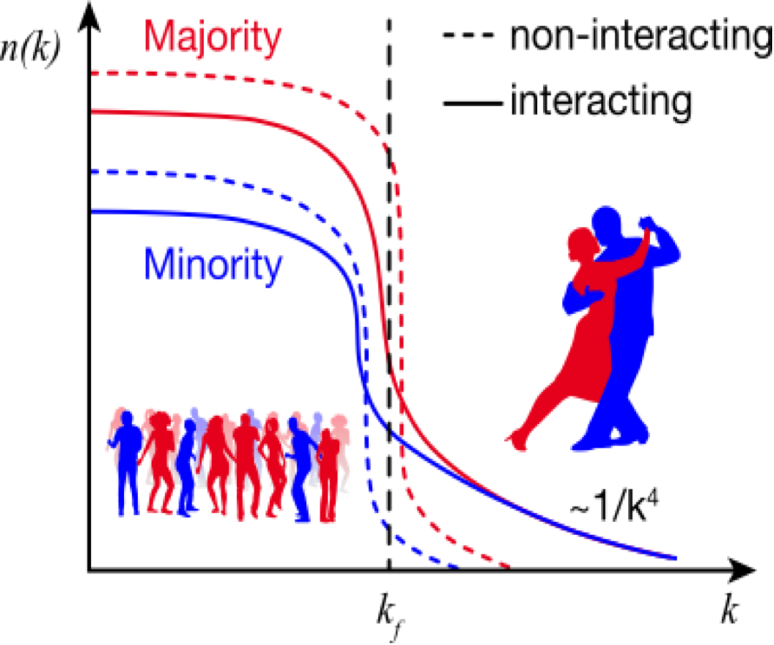
Minority vs. Majority Momentum Distribution
40

Slide 42
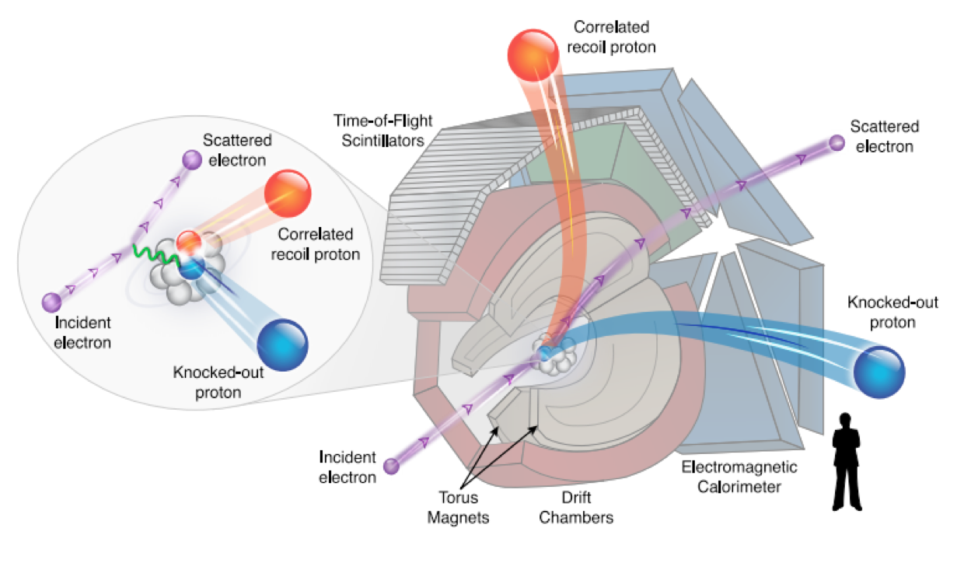
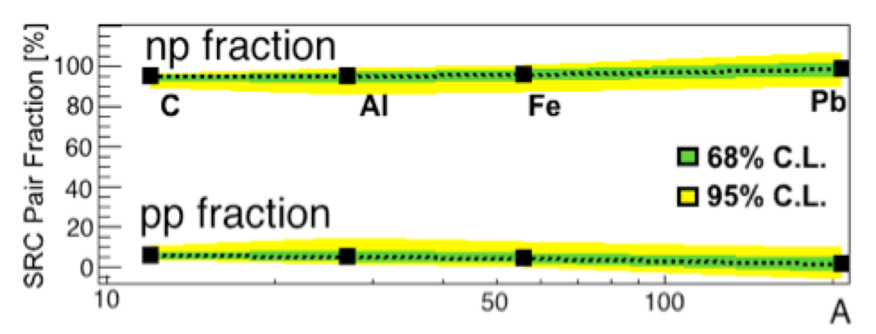
High momentum np pair dominance
https://www.science.org/doi/10.1126/science.1256785
41

Slide 43
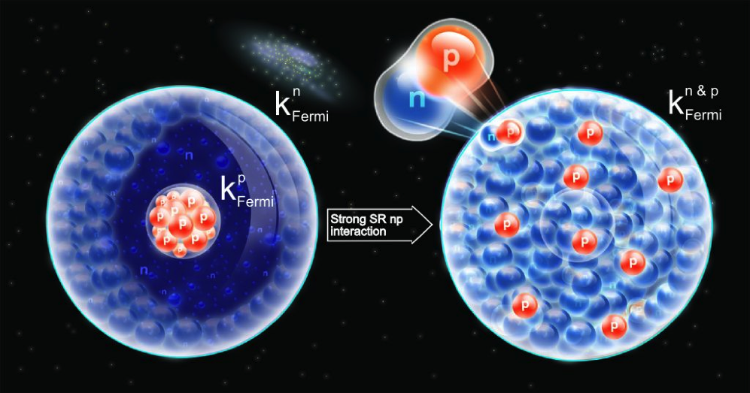
Changing Picture Of Nuclear Matter
Image from CERN Courier 49N1 (2009) 22-24.
42

Slide 44
What is the value of the cross section ratio of ³He(e,e’p)/³H(e,e’p) ?
43

Slide 45
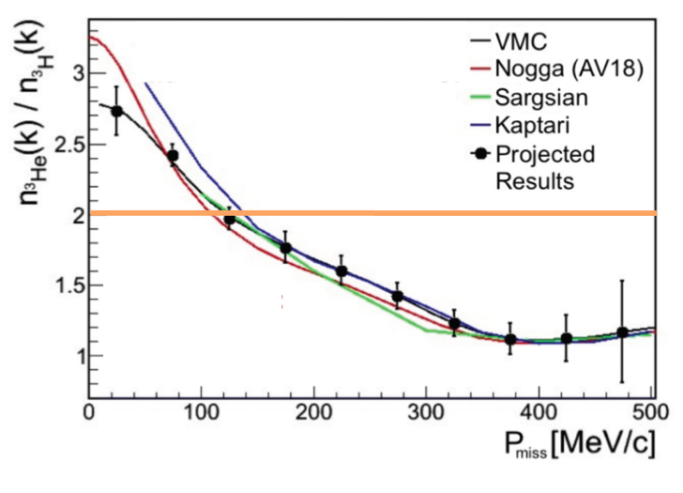
³He(e,e’p)/³H(e,e’p) Is Two… Isn’t It?!
E12-14-011: Proton and Neutron Momentum Distributions in A = 3 Asymmetric Nuclei
44

Slide 46
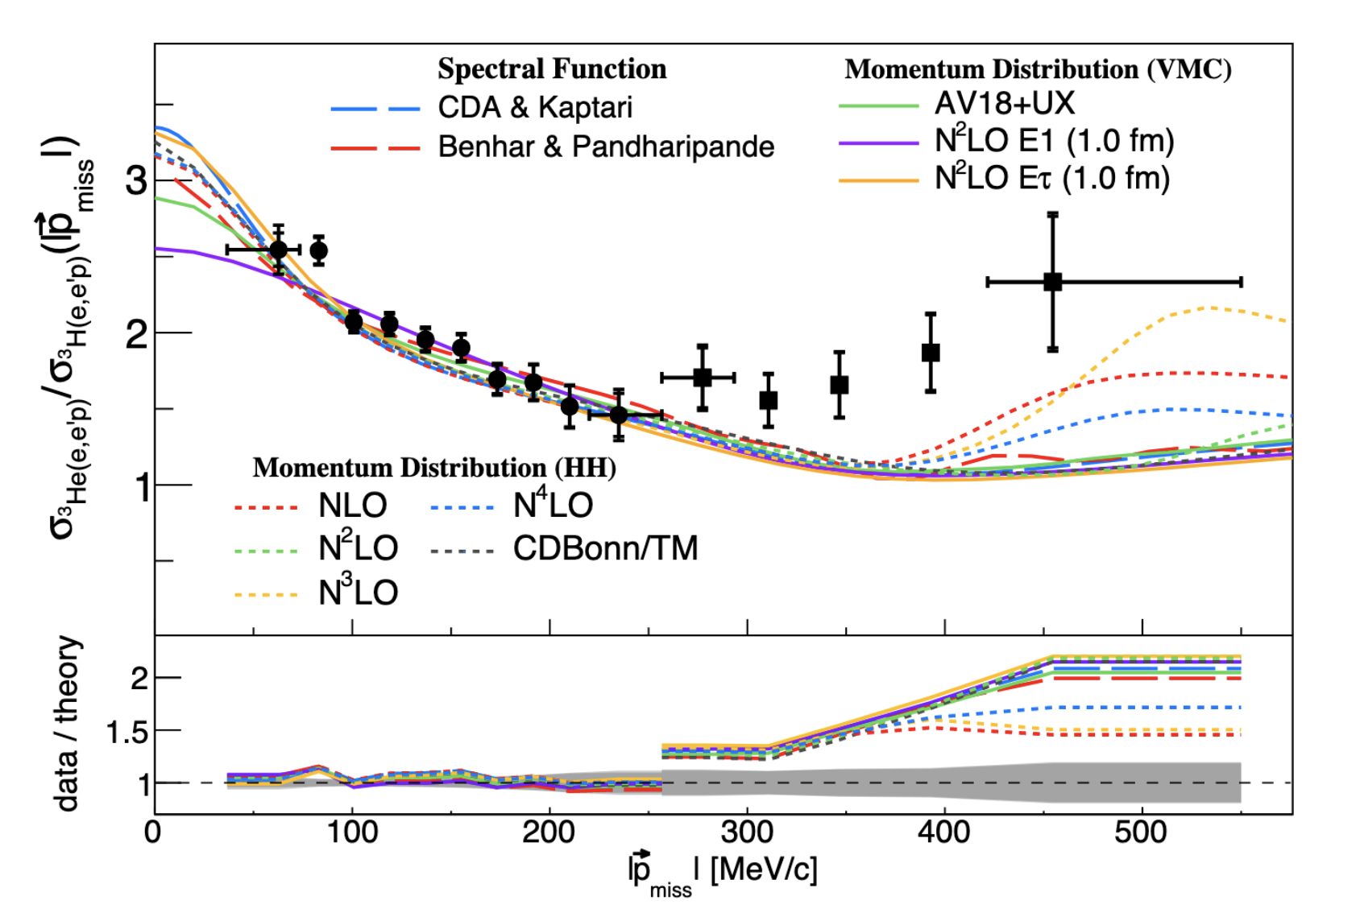
And what Nature has to say….
45

Slide 47
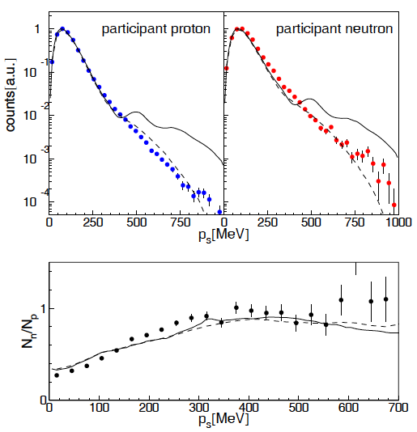
Real Photon 3He Data from Mainz A2
L. Witthauser et al., Eur. Phys. J. A 49 (2013) 154.
Solid Curve Momentum Distribution
Dashed Curve Monte Carlo Averaged
46

Slide 48
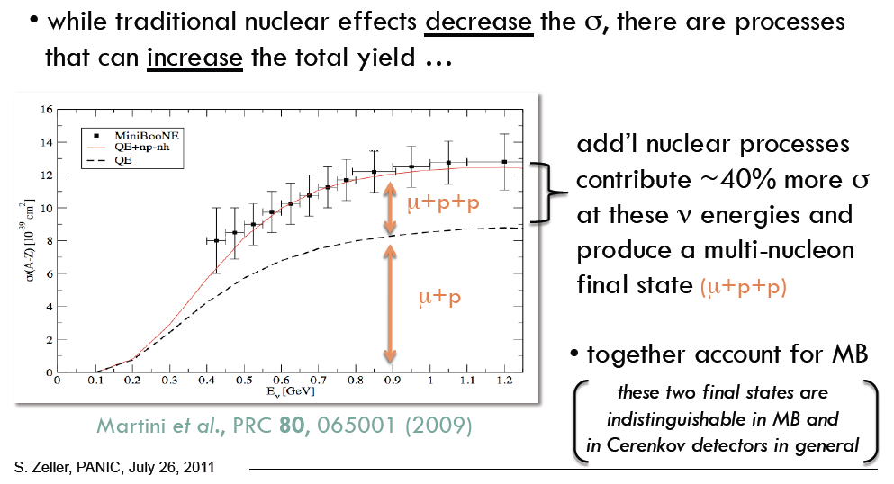
Modern Neutrino Example
Correlations Effecting The Result of Neutrino Scattering Data
47

Slide 49


So How Can These “Nuclear” Results Relate To The “Deep Inelastic” EMC Effect Results?!
48

Slide 50
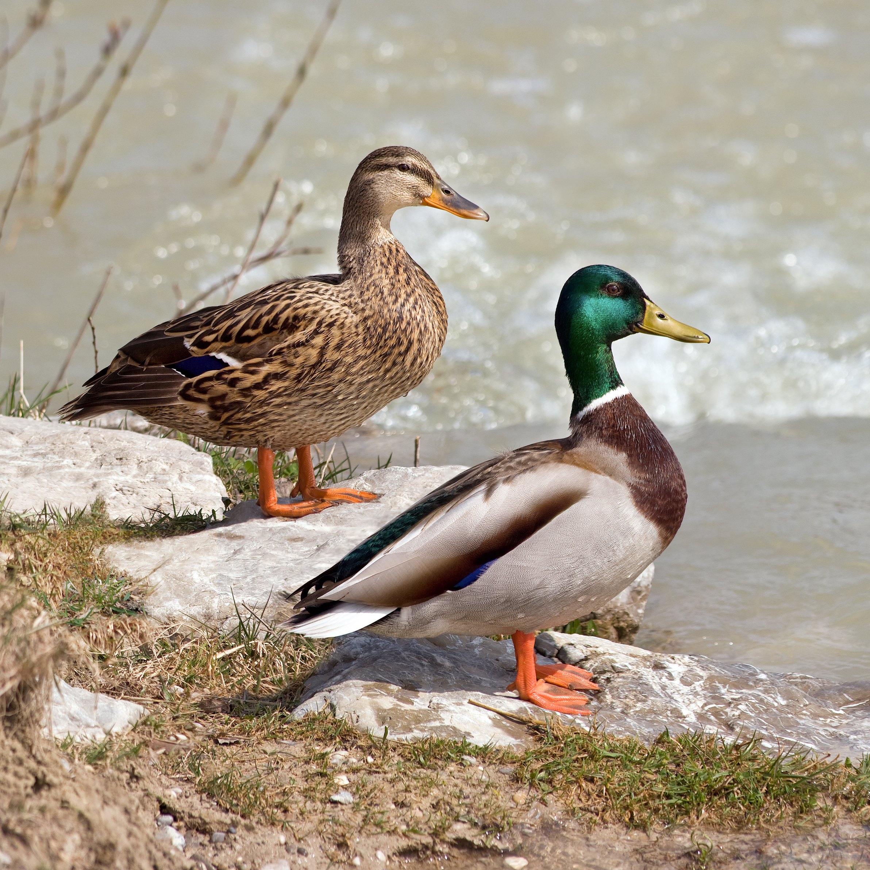

So How Can These “Nuclear” Results Relate To The “Deep Inelastic” EMC Effect Results?!
49

Slide 51
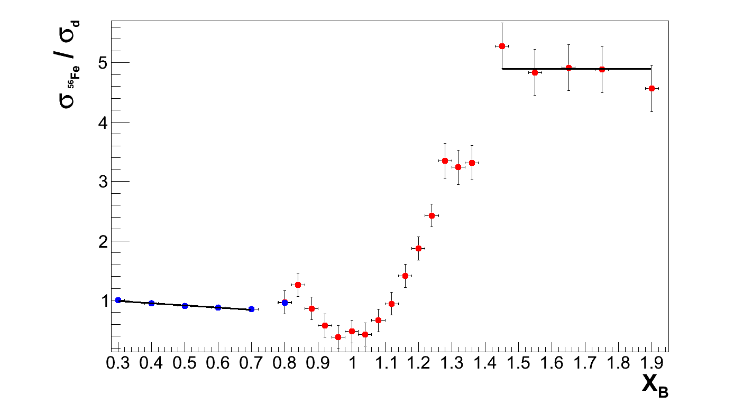
Holistic View of the EMC & SRC Data
D. H. et al., arXiv:1003.4497
Q² = 2.5 [GeV/c]²
SRC Plateau
EMC Slope
Scaling plateaus are likely due to proton-nucleon local density correlations
So could the EMC slopes (x_{B}<0.7) and SRC plateaus (x_{B}>1.5) correlated?!
50

Slide 52
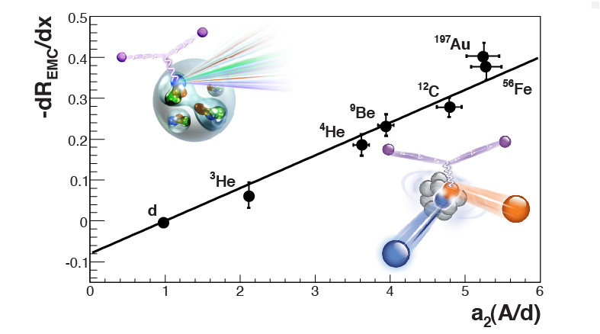
SRC and EMC Correlation
L. Weinstein et al., Phys. Rev. Lett. 106 (2011) 052301.
51

Slide 53
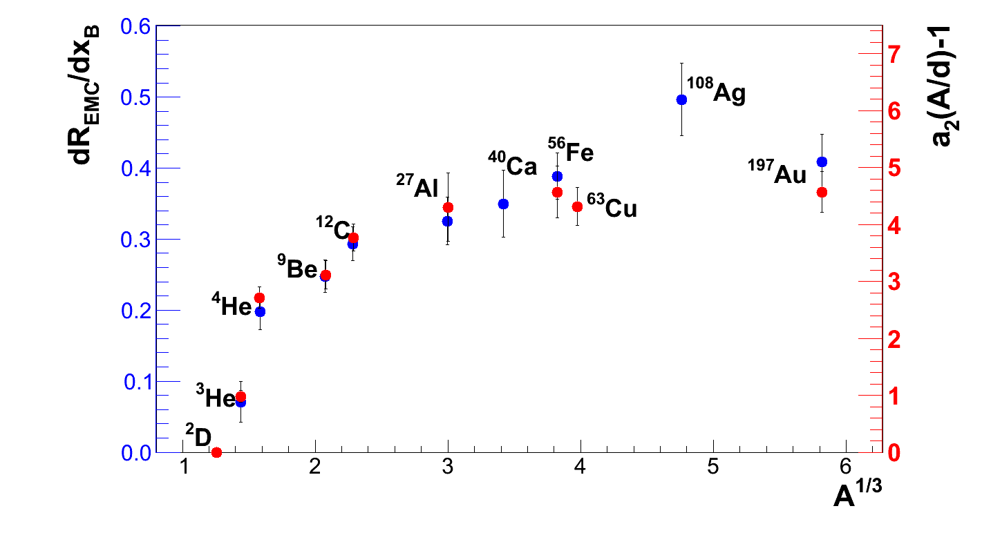
EMC Slopes & SRC Plateaus
52

Slide 54


53

Slide 55
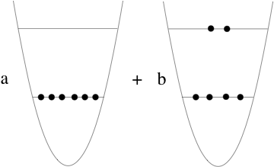
Quark State of Overlapping Nucleons
Deuteron Has Quadripole Moment In All Frames Of Reference!
l=1
l =0
l =0
54

Slide 56
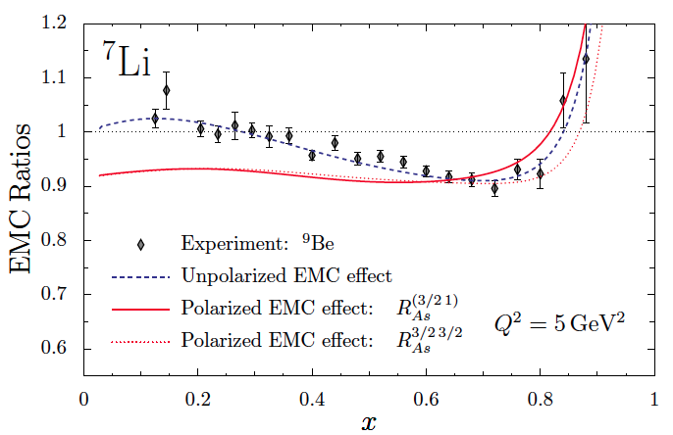
Polarized EMC Effect
I. C. Cloet, W. Bentz and A. W. Thomas, Phys.Lett.B 642 (2006) 210-217.
55

Slide 57
Polarized EMC = Every Model Cannot
E12-14-001: The EMC Effect in Spin Structure Functions
Δσ Ratio
A|| Ratio
56

Slide 58
Summary
Reviewed the Deep Inelastic Scattering EMC Puzzle and the new data that points to it being a local density (high momentum) effect.
x_{B}>1 nuclear scaling plateaus have been shown to also be a high momentum effect due to short-range correlations (SRC) between mainly protons and neutrons in the nucleus
Data shows EMC and SRC effects to be strongly correlated.
Open Questions
What exactly is the high momentum tail?
Is it hadronic, partonic , or some combination both?!
Can we use this correlation to make even more insights?!
Many New Nuclear Structure Experiments at 12GeV Jefferson Lab, including ³H & ³He, ⁷Li, ⁴⁰Ar (proposed by neutrino community), ⁴⁰Ca, ⁴⁸Ca, and ²⁰⁸Pb and will also be done with the future EIC.
57

Slide 59
So the good physicists finally agreed, the nucleus isn’t just a collections of protons and a neutrons, but something unique with a physics richness all its own.
58

