Slide 1


相对论重离子碰撞中的轻核产生与QCD相图
Lie-Wen Chen (陈列文)
School of Physics and Astronomy, Shanghai Jiao Tong University, China
(lwchen@sjtu.edu.cn)
QCD Phase Diagram and Critical Endpoint (CEP)
Baryon density fluctuation and coalescence production of light nuclei in HIC
p,d,t yields as a probe of CEP and 1st Order Phase Transition
Summary and Outlook
QCD物理研讨会暨基金委重大项目“量子色动力学的相结构和新颖拓扑效应研究”年度学术交流会，青岛，2022年7月29-31日

Slide 2
Outline
QCD Phase Diagram and Critical Endpoint (CEP)
Baryon density fluctuation and coalescence production of light nuclei in HIC
p,d,t yields as a probe of CEP and 1st Order Phase Transition
Summary and Outlook

Slide 3

QCD Phase Diagram
Holy Grail
of
Nuclear
Physics
“All science is either physics or stamp collecting.” --- Ernest Rutherford
“The Way Forward – Closing Remarks at Quark Matter 2017”, W.A. Zajc, [arXiv:1707.01993]
p. 1

Slide 4
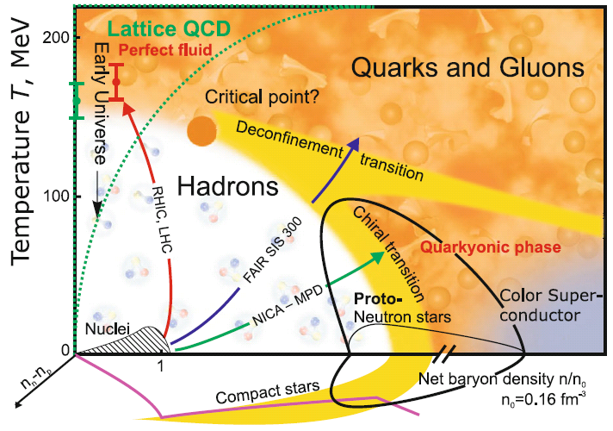
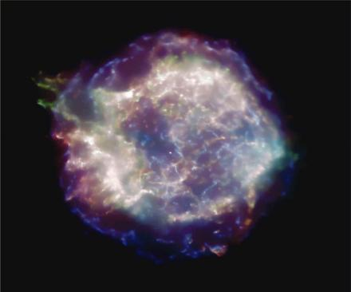
QCD Phase Diagram
V.E. Fortov, Extreme States of Matter – on Earth and in the Cosmos, Springer-Verlag, 2011
Probing QCD phase diagram in Nuclei and Heavy Ion Collisions in terrestrial labs
and in NS Merger, SN, and Nstar in heaven?
Nuclei
HIC
SN
NStar
NS Merger
Small baryon chemical potential:
Smooth Crossover Transition
Large baryon chemical potential:
First-order Phase Transition
QCD Critical Endpoint (CEP):
where the first-order phase transition ends
NS Mergers/NStar/CCSNe:
Ideal and unique site to probe QCD phase diagram at low T and high densities (and large isospin )!
p. 2

Slide 5
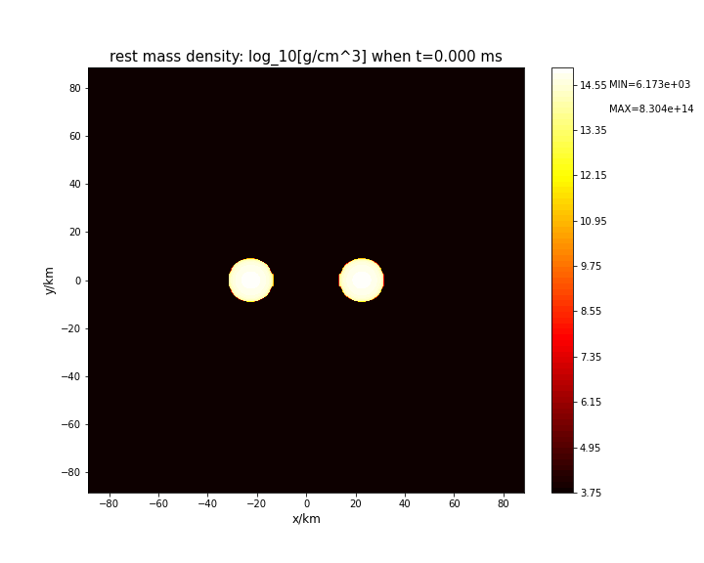
n_{B} and T in binary neutron star merger
Merging neutron stars
Two inspiralling neutron stars
Single mass
Tidal deformation
Matter density evolution of BNS mergers with equal mass 1.364M⊙
by Bai-Min Bai (白济民)
Inspiral Chirp signal
NS oscillation/BH formation
The baryon density in binary neutron star merger could reach more than ~15ρ₀ and the temperature could reach ~50 MeV but with large isospin density!
LIGO/Virgo/KAGRA: From 2023 (O4), one GW event/1~2 days！
Elias R. Most et al., PRL122, 061101 (2019); Andreas Bauswein et al., PRL122, 061102 (2019)
The high density Esym of nuclear/quark matter is particularly important for NS mergers!
p. 3

Slide 6
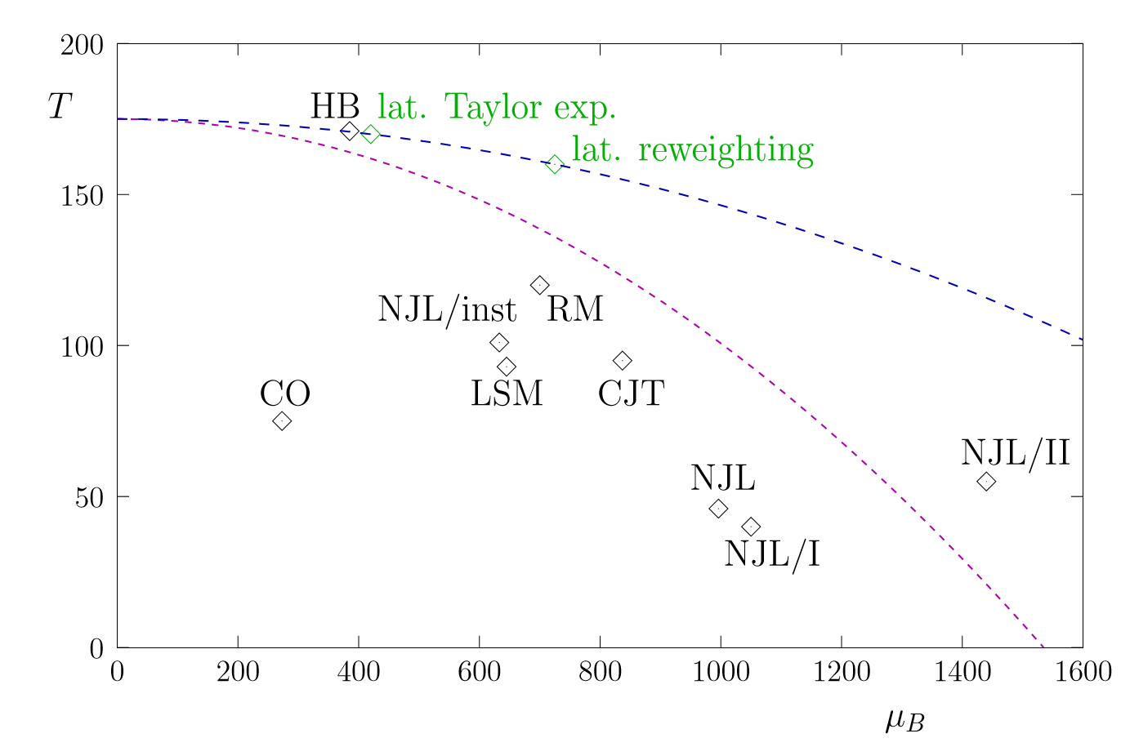
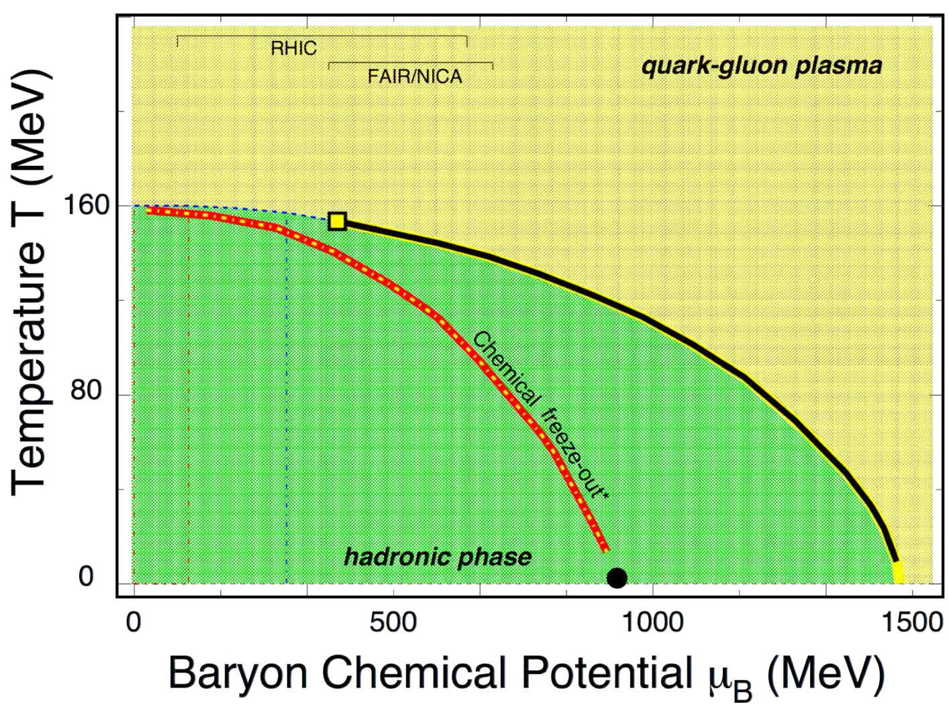
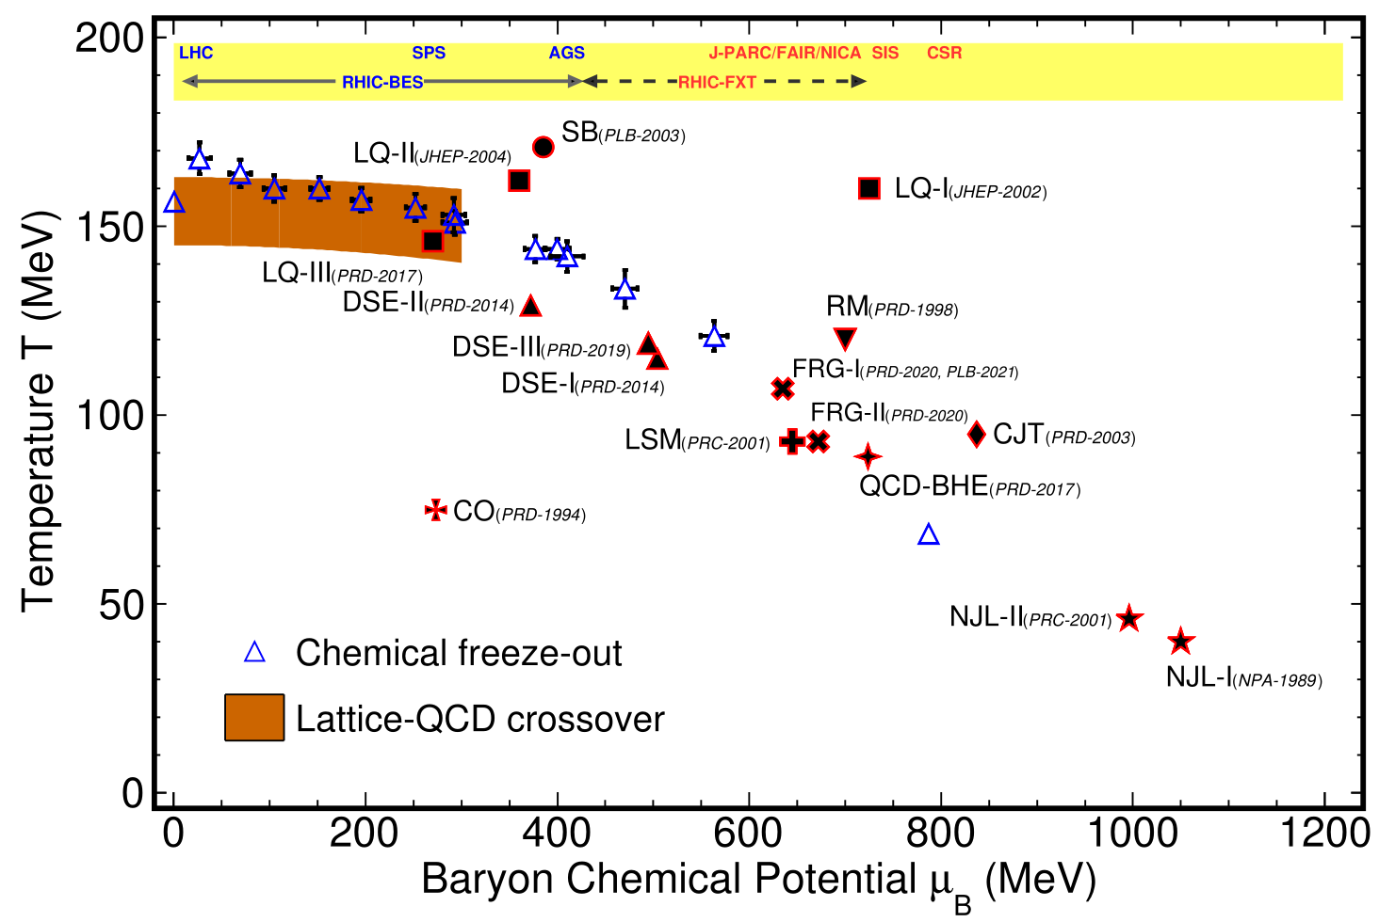
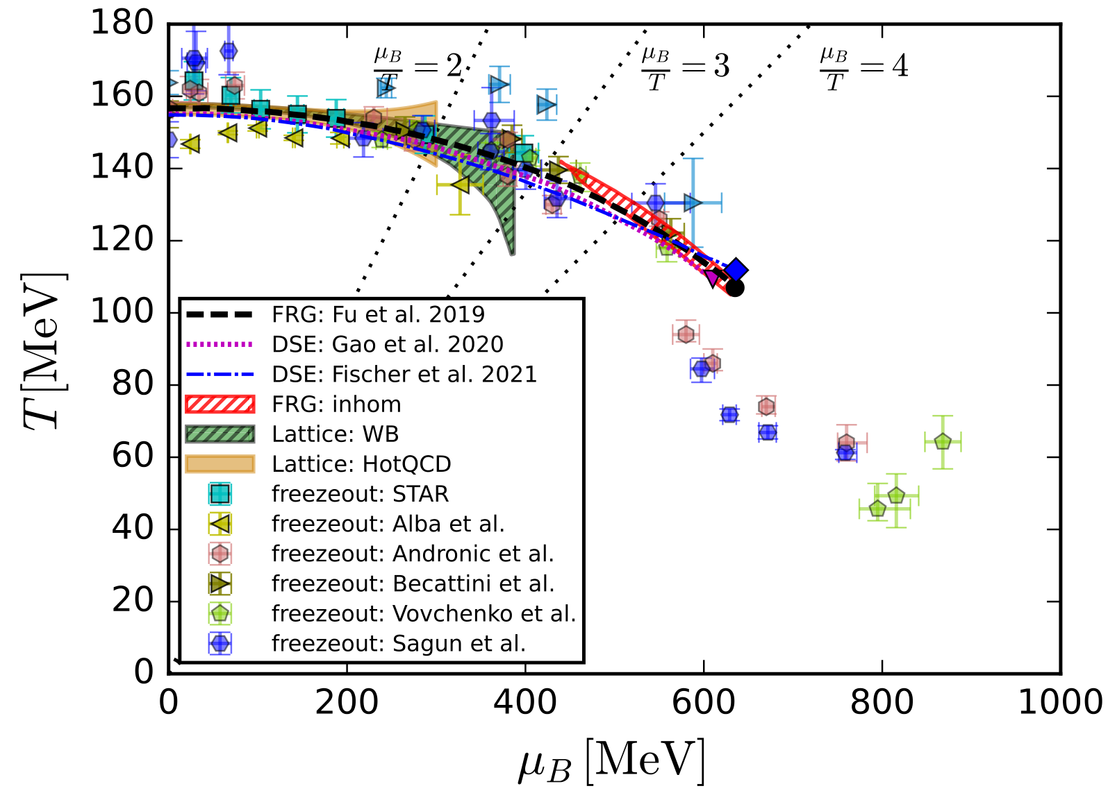
CEP from Lattice and effective field theories
M.A. Stephanov,
IJMPA20, 4387 (2005)
(Theory Review)
X.F. Luo and N. Xu, NST28, 112 (2017) (Exp. Review)
A. Pandav, D. Mallick, B. Mohanty,
2203.07817 (PPNP, 2022)
(Exp. Review)
W. J. Fu,
2205.00468
(Theory Review)
p. 4

Slide 7
Outline
QCD Phase Diagram and Critical Endpoint (CEP)
Baryon density fluctuation and coalescence production of light nuclei in HIC
p,d,t yields as a probe of CEP and 1st Order Phase Transition
Summary and Outlook

Slide 8
Basic idea
Baryon density fluctuation vs light nuclei production
Baryon density fluctuation
is closely related to
the correlation between nucleons.
The correlation between nucleons determines
the production of light nuclei
Baryon density fluctuation in vicinity of first-order phase transition/CEP
could be deciphered from
the production of light nuclei
p. 5

Slide 9
Cluster Production: Coalescence?
Coalescence model provides a useful approach to describe light cluster production in HIC
Coalescence model provides a useful tool to describe light
nuclei production in HIC
Coalescence model also provides a useful tool to describe
hadron production from partonic matter (hadronization)
……
Butler, Pearson, Sato, Yazaki, Gyulassy, Frankel, Remler, Dove, Scheibl, Heinz, Schnedermann, Mattiello, Nagle, Polleri, …
Biro, Zimanyi, Levai, Csizmadia, Hwa, Yang, Ko, Lin , Greco, Chen, Fries, Muller, Nonaka, Bass, Voloshin, Molnar, Xie, Shao, …
p. 6

Slide 10
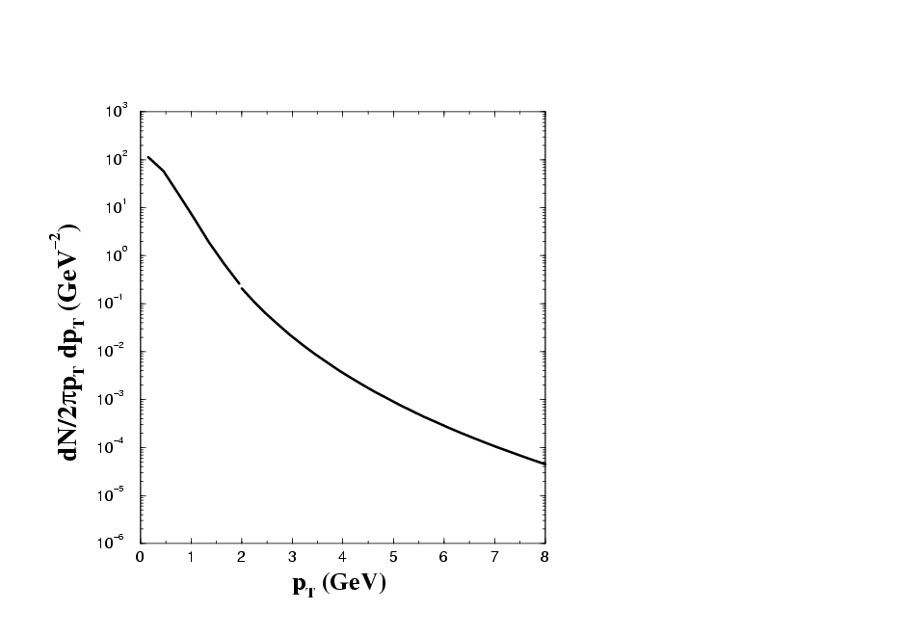
Parton coalescence mechanism at RHIC
Lin/Ko
PRL89, 202302 (2002);
S.A. Voloshin,
NPA715, 379(2003);
Greco/Ko/Levai,
PRL90, 202302 (2003);
Fries/Muller/Nonaka/Bass
PRL90, 202303 (2003);
Hwa/Yang
PRC67, 034902 (2003); 064902 (2003);
Molnar/Voloshin
PRL91, 092301 (2003)
1. Naïve QC
2. Schematic QC
3. Dynamical QC
……
coalescence
B M
fragmentation
p. 7

Slide 11
Deuteron production in HIC
The correlation between neutron and proton with small relative momentum
and deuteron formation both appear due to the final state interaction
(S. Mrowczynsky, PLB248 (1990), P. Danielewicz et al., PLB274 (1992))
The n-p pair in a scattering state with small relative momentum and
deuteron (n-p pair in a bound state) should provide the same space-time
information about the size of an emission source
Using stiff symmetry energy will produce more deuterons than using
soft symmetry energy?
Similarly to the n-p correlation function (HBT), deuteron yield in HIC’s induced by neutron-rich nuclei is also a sensitive probe of the nuclear symmetry energy!!!
n-p HBT: Chen/Greco/Ko/Li, PRL90, 162701(2003); PRC68, 014605 (2003)
Deuteron: Chen/Ko/Li, PRC68, 017601 (2003); NPA729, 809 (2003)
p. 8

Slide 12
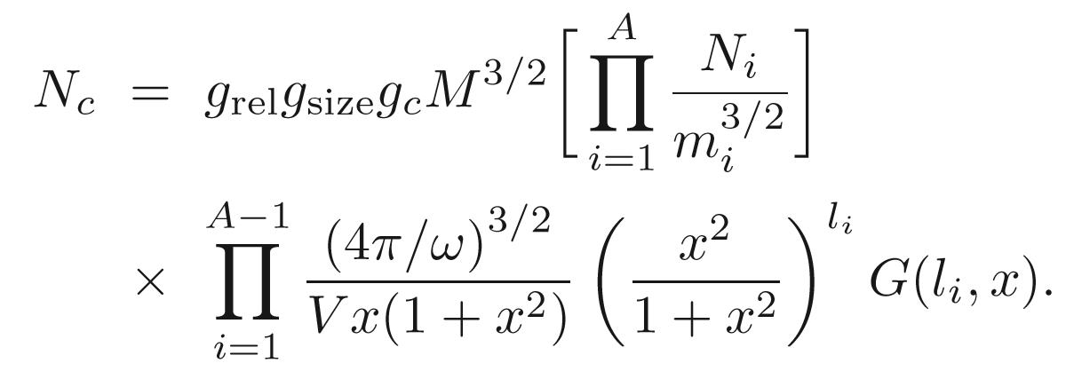
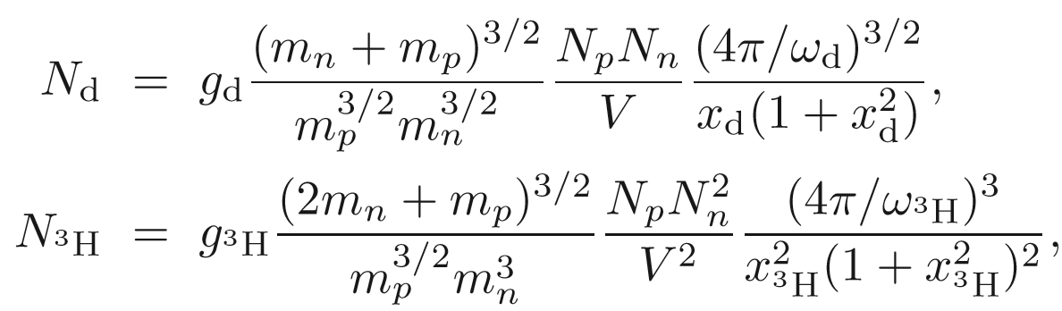
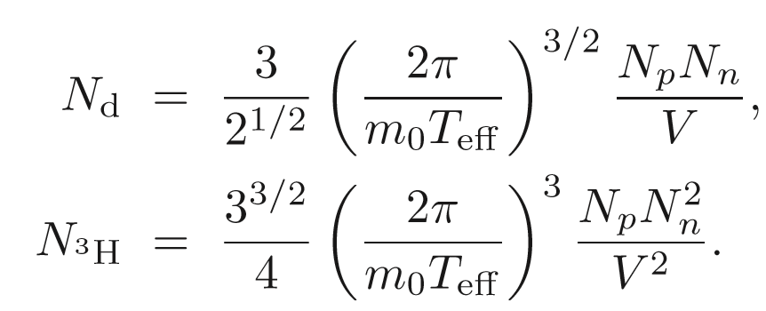
Analytical Coalescence Formula
Analytical coalescence formula: COAL-SH (ShangHai)
K. J. Sun(孙开佳)/LWC, PRC95, 044905 (2017)
(Open source on github: https://github.com/kaijiasun/ExoticCoalescence)
COAL-SH:
COAL-Ex +
Longitudinal dimension
+ rel. corrections
+ finite size corrections
K. J. Sun(孙开佳)/LWC,
PRC95, 044905 (2017)
COAL-Ex
(ExHIC Collaboration)
S. Cho et al.,
PRL106, 212001 (2011)
PRC84, 064910 (2011)
p. 9

Slide 13
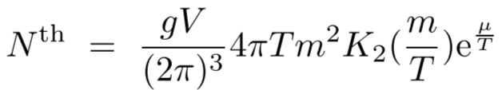
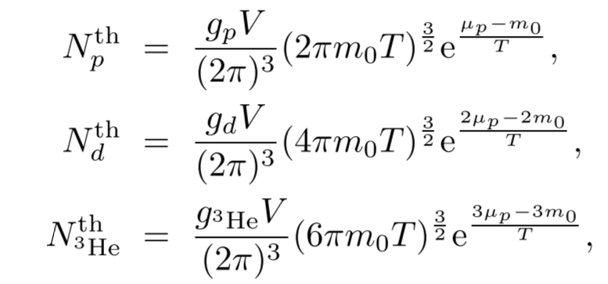
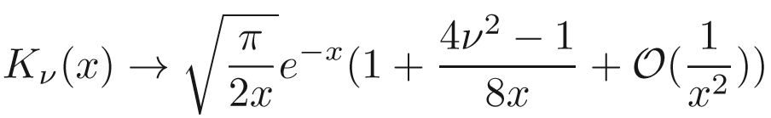
Cluster Yields w/o density fluctuation
The above equations are consistent with conventional thermal model:
K₂ is the modified Bessel function
K. J. Sun, LWC, C.M. Ko, and Z. Xu, PLB774, 103 (2017) [arXiv:1702.07620 (2017)]
p. 10

Slide 14
Cluster Yields with density fluctuation
Density fluctuation over space:
Neutron:
Proton:
d yield ~ Cnp
³H yield ~ the relative den. Fluc. +Cnp!
n and p density correlation function:
n relative density fluctuation:
Isospin relative density fluctuation:
K. J. Sun, LWC, C.M. Ko, J. Pu, and Z. Xu,
PLB781, 499(2018) [arXiv:1801.09382]
p. 11

Slide 15
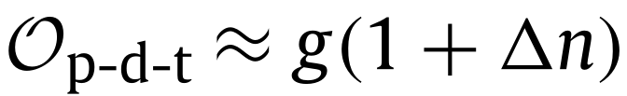
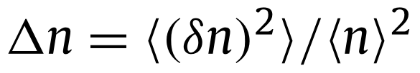

Cluster Yields with density fluctuation
K. J. Sun, LWC, C.M. Ko, J. Pu, and Z. Xu, PLB781, 499(2018) [arXiv:1801.09382]
Assuming is much less than 1 leads to very simple relation:
p. 12

Slide 16
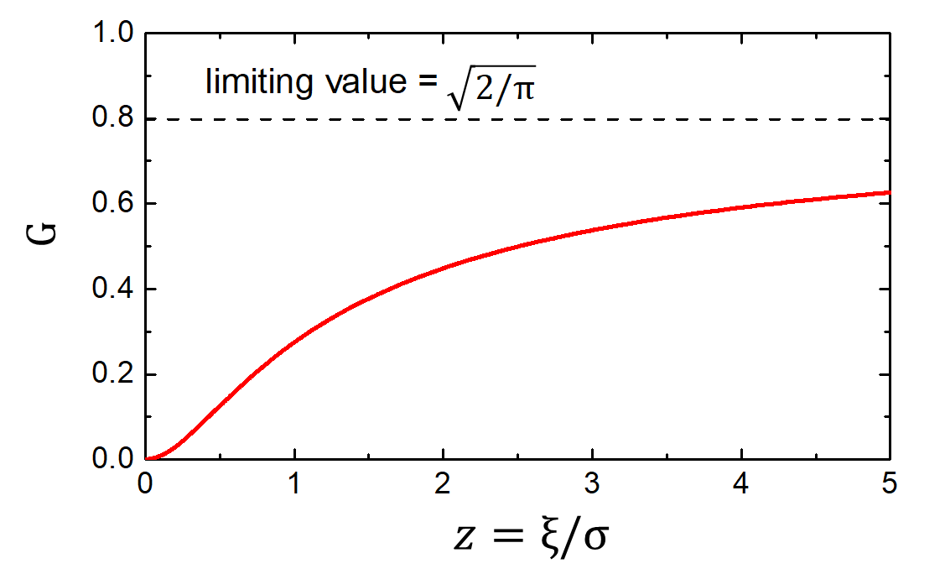
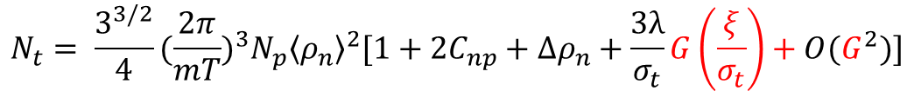

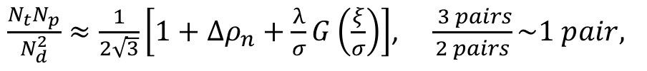


Cluster Yields with density fluctuation correlation length
K. J. Sun, C.M. Ko, and F. Li, PLB816, 136258(2021) [arXiv:2008.0225]
$C_{2}\left(x_{1}−x_{2}\right)≈λ〈ρ_{n}〉〈ρ_{p}〉\frac{e^{−\left|x_{1}−x_{2}\right|/ξ}}{{\left|x_{1}−x_{2}\right|}^{1+η}} (singular part only)$
$$with ξ being the density−density correlation length$$
$$0<〈δN^{2}〉\sim ∫dxC_{2}\left(x\right)\sim λξ^{2}→λ>0$$
$$N_{d}= \frac{3}{\sqrt{2}}{(\frac{2π}{mT})}^{\frac{3}{2}}N_{p}〈ρ_{n}〉[1+C_{np}+\frac{λ}{σ_{d}}G(\frac{ξ}{σ_{d}})]$$
$$N_{t}= \frac{3^{3/2}}{4}{(\frac{2π}{mT})}^{3}N_{p}{〈ρ_{n}〉}^{2}[1+{2C}_{np}+∆ρ_{n}+\frac{3λ}{σ_{t}}G\left(\frac{ξ}{σ_{t}}\right)+O(G^{2})]$$
Pre-factors are thermal yields w/o density fluc./corr.
Ratio:
$\frac{N_{t}N_{p}}{N_{d}^{2}}≈\frac{1}{2\sqrt{3}}\left[1+∆ρ_{n}+\frac{λ}{σ}G\left(\frac{ξ}{σ}\right)\right]$, $\frac{ 3 pairs}{2 pairs}\sim 1 pair,$
$σ≈2$ fm
p. 13

Slide 17
Outline
QCD Phase Diagram and Critical Endpoint (CEP)
Baryon density fluctuation and coalescence production of light nuclei in HIC
p,d,t yields as a probe of CEP and 1st Order Phase Transition
Summary and Outlook

Slide 18
Peak structure and CEP
K. Huang, Intro. Stat. Phys (p.58)
Liquid
Gas
Fluc.
Corr. Func.
Corr. Length
Critical point: Largest density fluctuation (e.g., critical
opalescence,《相变和临界现象》-于渌，郝柏林
First-order phase transition: Large density fluctuations due to spinodal instability (but take time to build) Steinheimer/Randrup/Koch(12,14); Herold et al.(14); Li/Ko (16)
K. J. Sun, LWC, C.M. Ko, J. Pu, and Z. Xu,
PLB781, 499(2018) [arXiv:1801.09382]
p. 14

Slide 19
Circumstantial evidence of peak structure?
From NA49 Collaboration
T. Anticic et al. (NA49 Collaboration),
Phys. Rev. C 94, 044906 (2016).
For Δρ_{n}:
A peak is observed at 8.8 GeV;
There is another possible peak below 6.3 GeV
K. J. Sun, LWC, C.M. Ko, J. Pu, and Z. Xu, PLB781, 499(2018) [arXiv:1801.09382]
p. 15

Slide 20
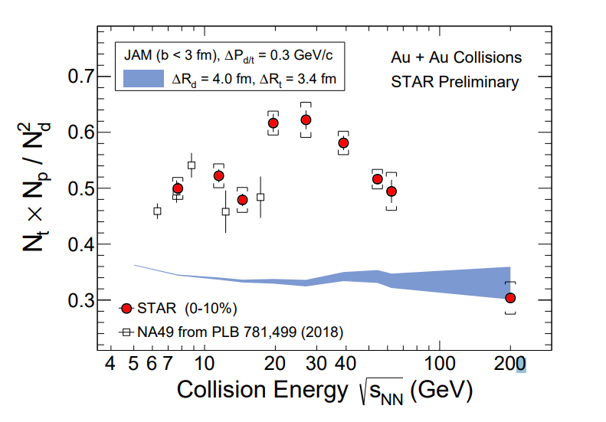
Energy dependence of $tp/d^{2}$ w/o 1st-order PT
Model calculations without the inclusion of a first-order
or second-order phase transition, e.g., JAM+COAL,
AMPT+COAL, MUSIC+COAL, UrQMD+COAL, and
SHM, all give monotonic or flat energy dependence
Data is preliminary and weak-decay correction
is important
Dingwei Zhang(CCNU)for STAR Collaboration, QM2019
W. Zhao et al., arXiv:2009. 06959(2020)
D. Zhang (STAR), arXiv:2002.10677(2020)
H. Liu et al., Phys. Lett. B805, 135452 (2020)
V.Vovchenko et al., arXiv:2004.04411(2020)
K. J. Sun and C. M. Ko, arXiv:2005.00182(2020)
p. 16

Slide 21
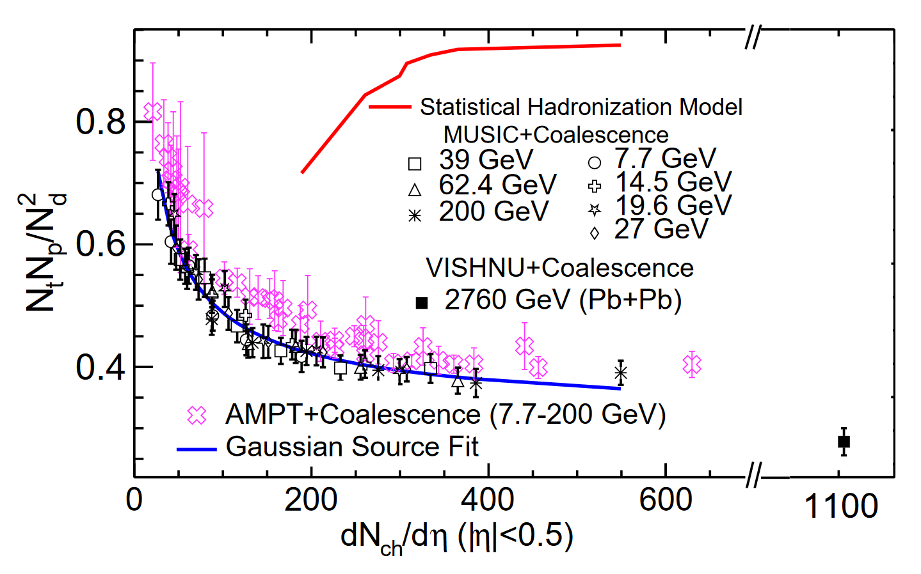
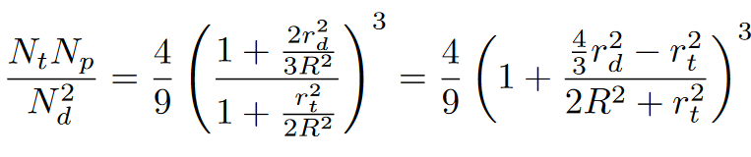
Centrality dependence of $tp/d^{2}$ w/o 1st-order PT
This ratio increases in peripheral collisions due to the effects of finite nuclei sizes
Gaussian source:
W.B. Zhao, K. J. Sun, C. M. Ko, and X. F. Luo, PLB820 (2021) 136571
S. Wu, K. Murase, S. Tang, and H. Song, arXiv:2205. 14302(2022)
p. 17

Slide 22
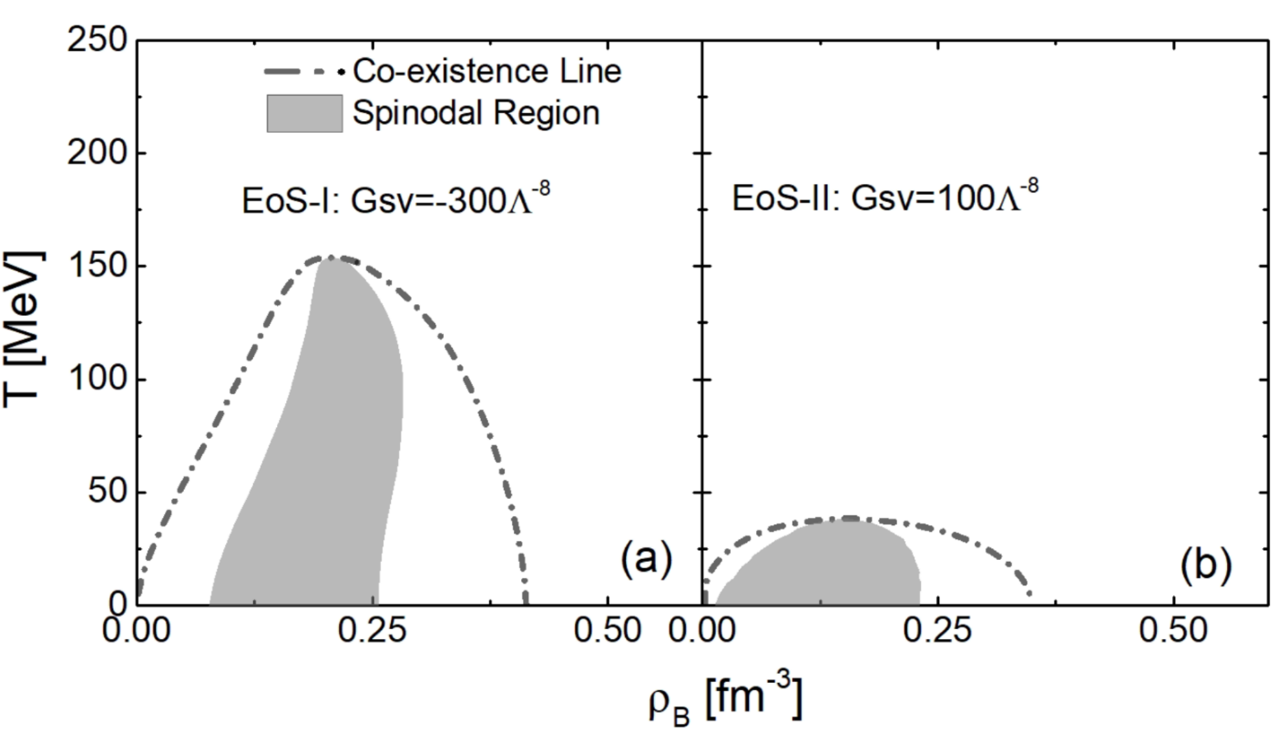
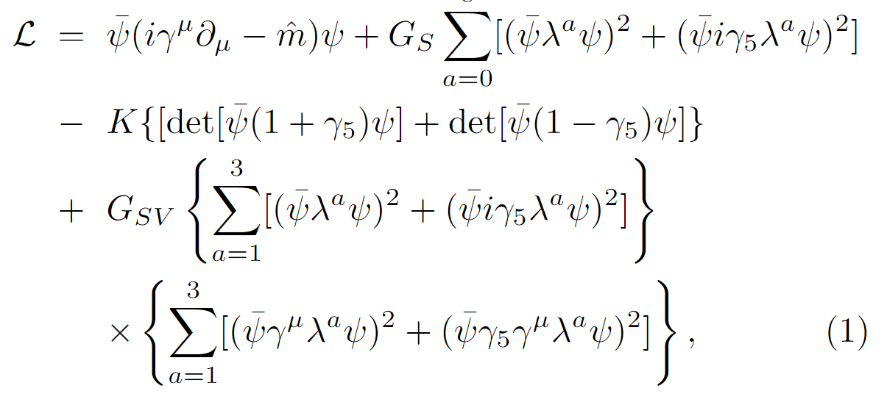
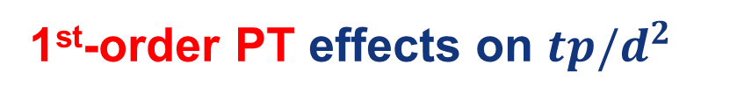
1st-order PT effects on $tp/d^{2}$
The eNJL provides a flexible equation of state (EoS) . The critical temperature can be easily changed by
varying the strength of the scalar-vector interaction without affecting the vacuum properties.
Lagrangian density for eNJL:
K. J. Sun, C. M. Ko, S. Cao, and F. Li., Phys. Rev. D 103, 014006 (2021)
p. 18

Slide 23
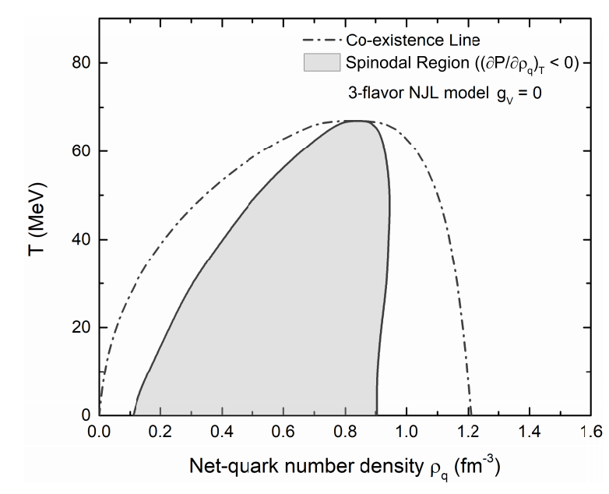
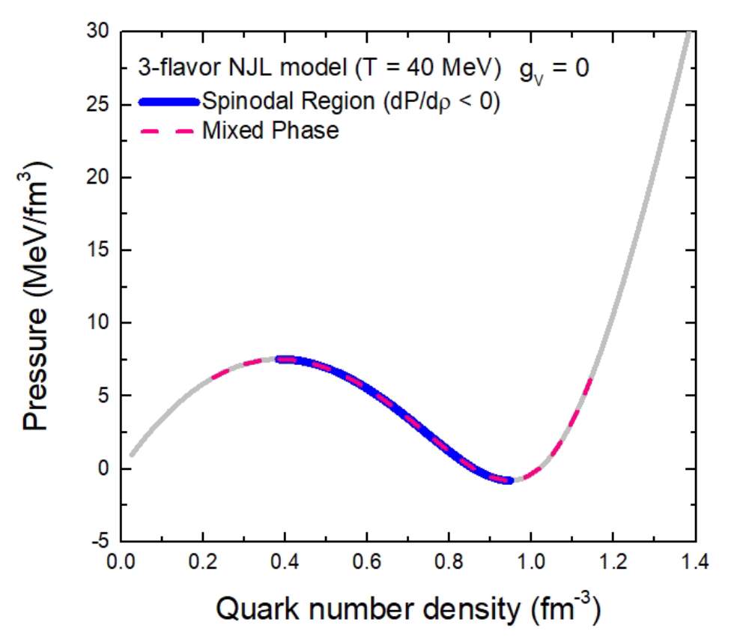
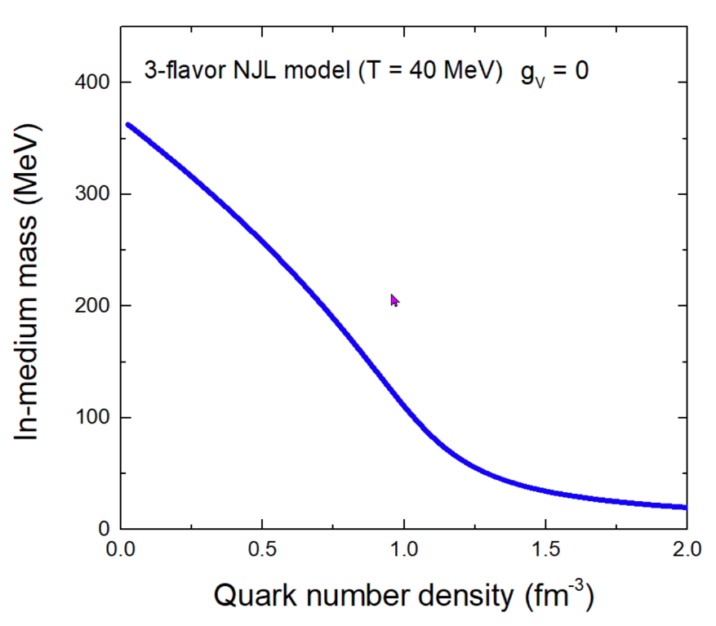
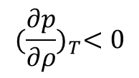

1st-order PT effects on $tp/d^{2}$
Spinodal instability
$${(\frac{∂p}{∂ρ})}_{T}<0$$
$$G_{SV}=0$$
Spinodal instability
First-Order Chiral PT
K. J. Sun, C. M. Ko, S. Cao, and F. Li., Phys. Rev. D 103, 014006 (2021)
p. 19

Slide 24
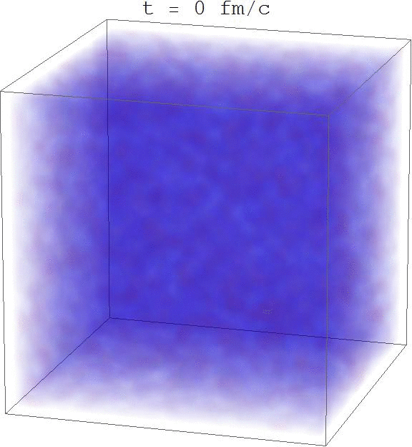
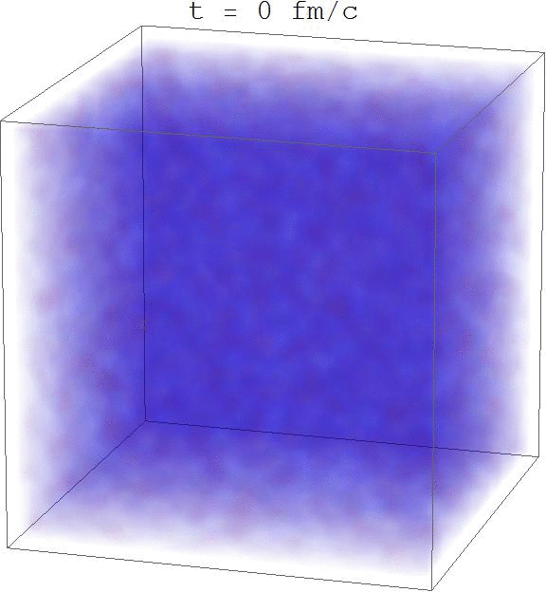
First-order phase transition and baryon density fluctuation
Transport Model + NJL
With first-order phase transition
No first-order phase transition
Taken from Feng Li(李峰)’s talk at Shanghai, 01/2017
F. Li and C.M. Ko, Phys. Rev. C 93, 035205 (2016).
p. 20

Slide 25
1st-order PT effects on $tp/d^{2}$
Dynamical Transport model
Initialization
K. J. Sun, W. H. Zhou, LWC, C. M. Ko, F. Li, and R. Wang, and J. Xu, arXiv:2205.11010(2022
Parton evolution
Mean field (eNJL) + scattering
Exhibits dynamical
chiral phase transition
Hadronization: Quark coalescence
ART(A Relativistic Transport model for hadrons)
Nucleon coalescence
Light nuclei
p. 21

Slide 26
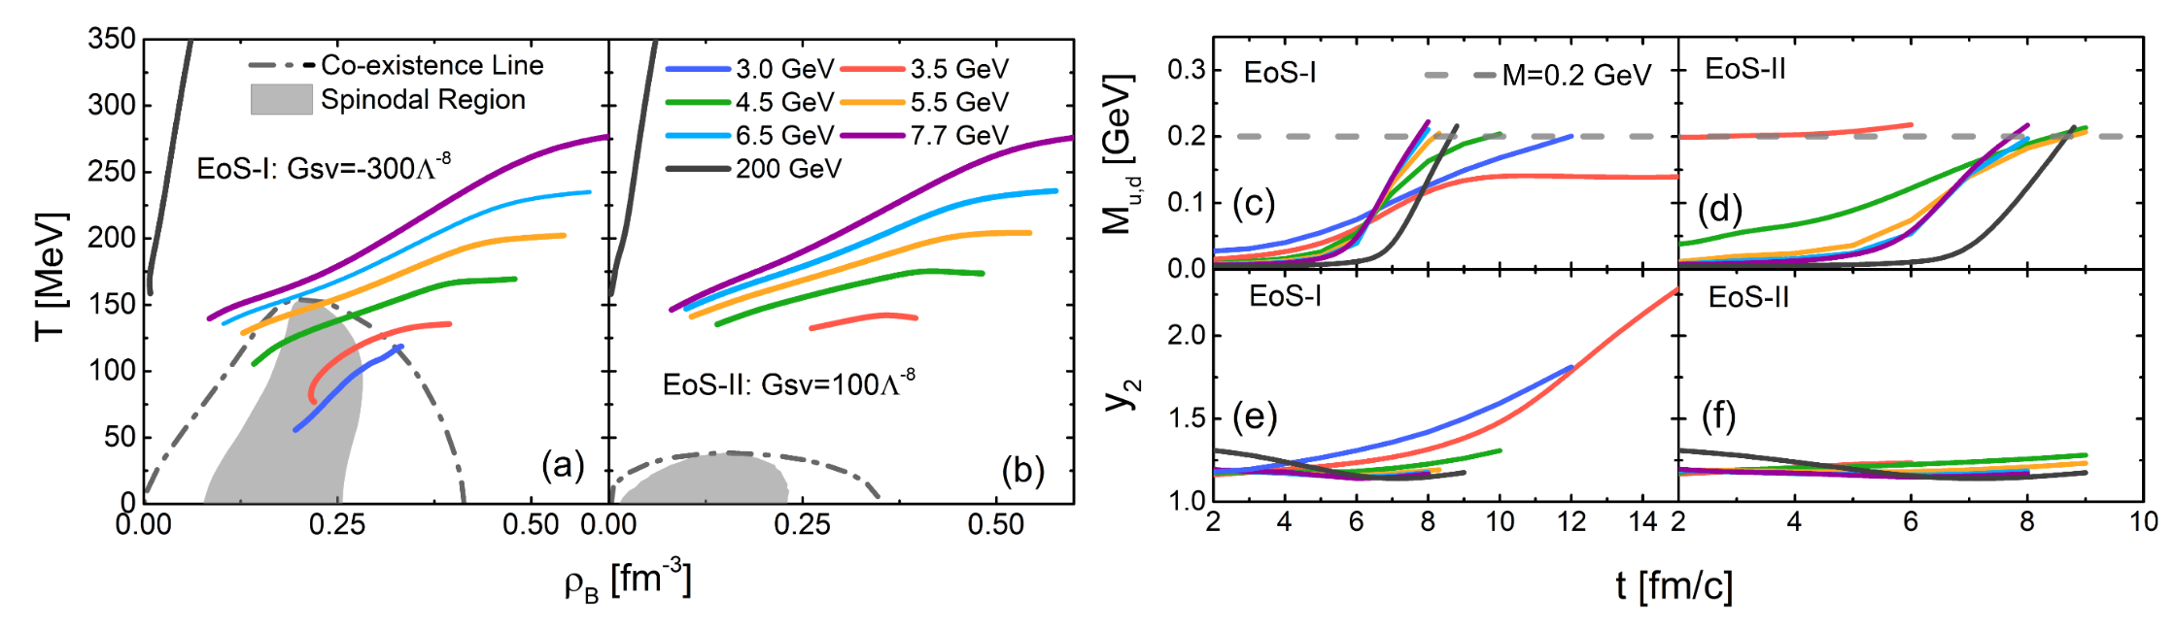
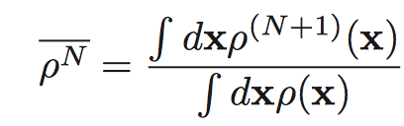
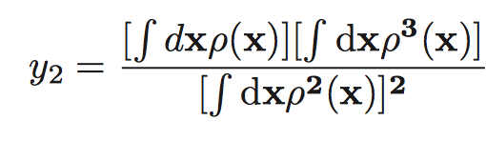
1st-order PT effects on $tp/d^{2}$
Trajectories in the phase diagram
K. J. Sun, W. H. Zhou, LWC, C. M. Ko, F. Li, and R. Wang, and J. Xu, arXiv:2205.11010(2022
p. 22

Slide 27
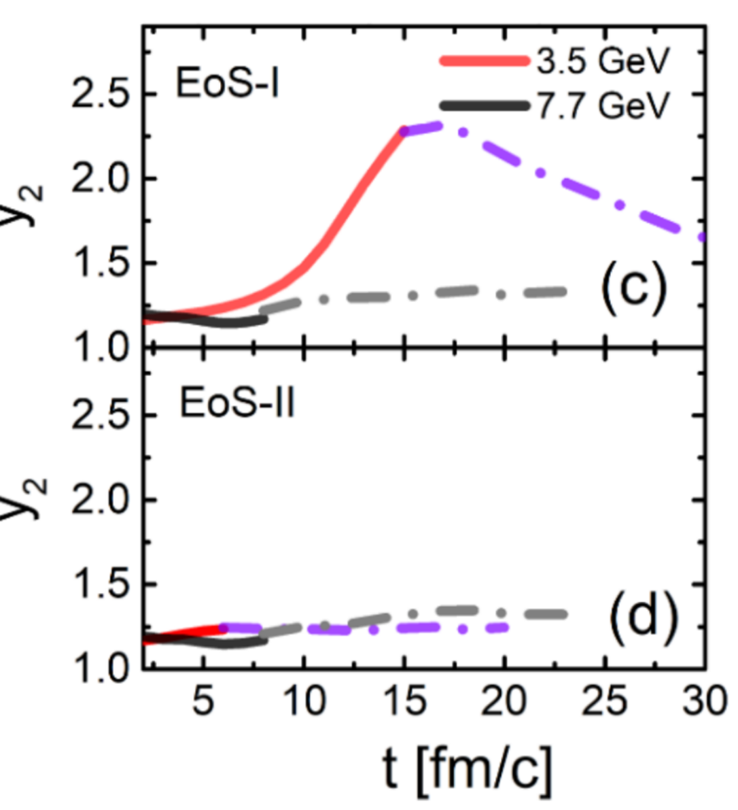


1st-order PT effects on $tp/d^{2}$
Survival of density fluctuation in expanding fireball
Density moment:
If the expansion is self-similar or scale invariant
then $y_{2}\left(t\right)=y_{2}\left(t_{h}\right)$, i.e., remains a constant
‘Memory effects’: Large density inhomogeneity survives to kinetic freezeout
p. 23

Slide 28
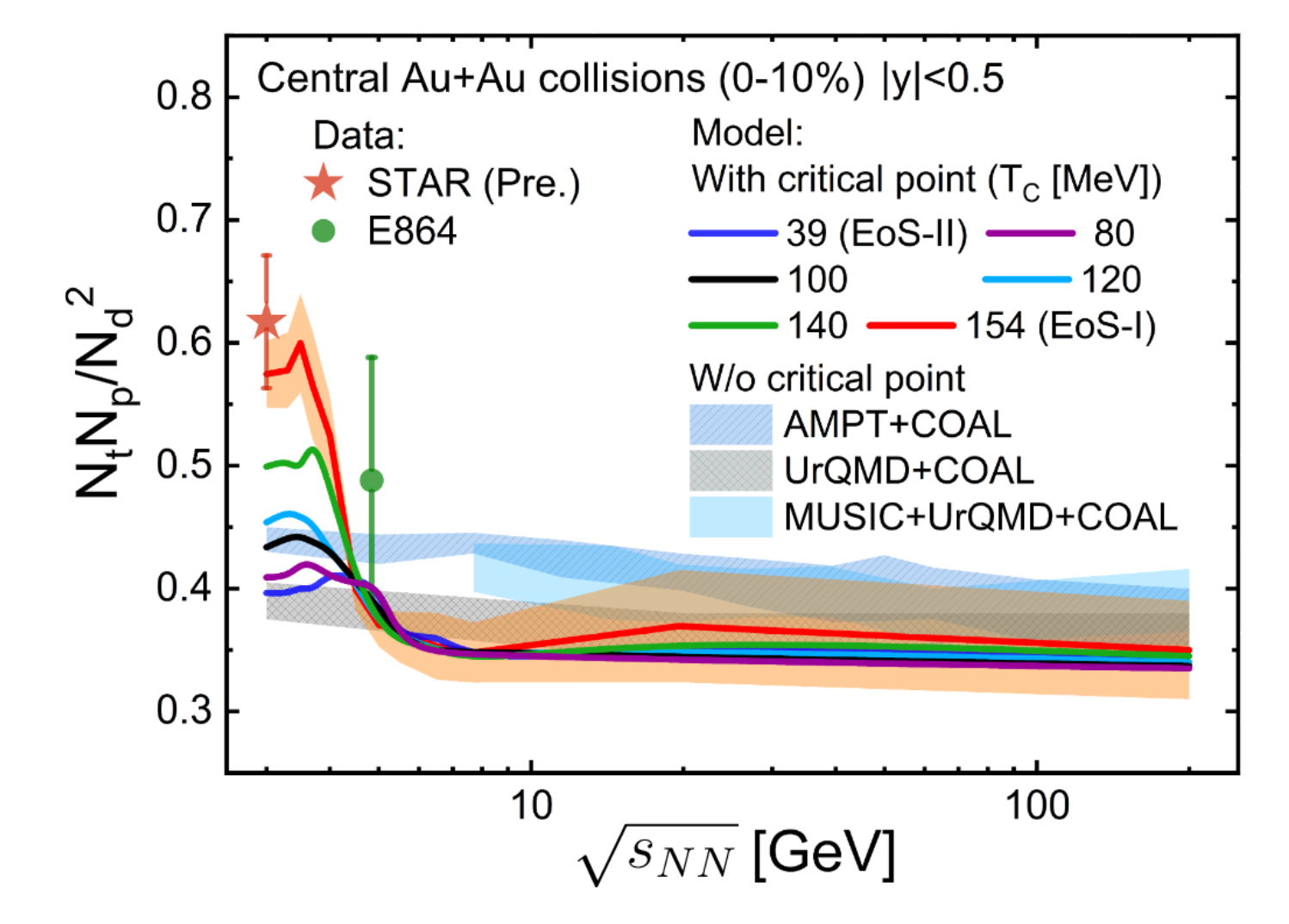
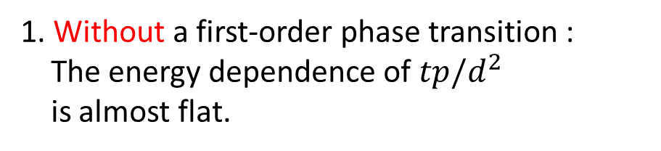
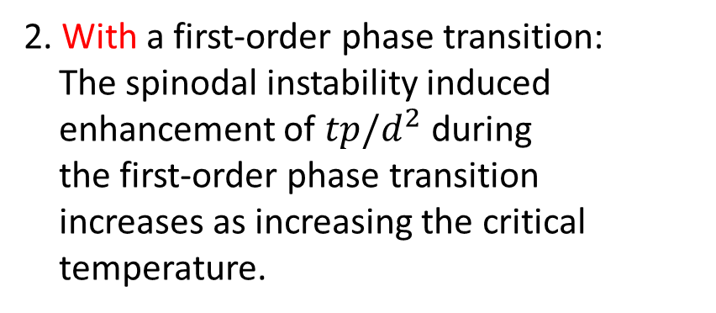
Energy dependence of $tp/d^{2}$ with 1st-order PT
K. J. Sun, W. H. Zhou, LWC, C. M. Ko, F. Li, and R. Wang, and J. Xu, arXiv:2205.11010(2022
1. Without a first-order phase transition :
The energy dependence of $tp/d^{2}$
is almost flat.
2. With a first-order phase transition:
The spinodal instability induced
enhancement of $tp/d^{2}$ during
the first-order phase transition
increases as increasing the critical
temperature.
Data:
Hui Liu (STAR), QM2022
T. A. Armstrong et al. (E864), PRC 61, 064908 (2000).
p. 24

Slide 29
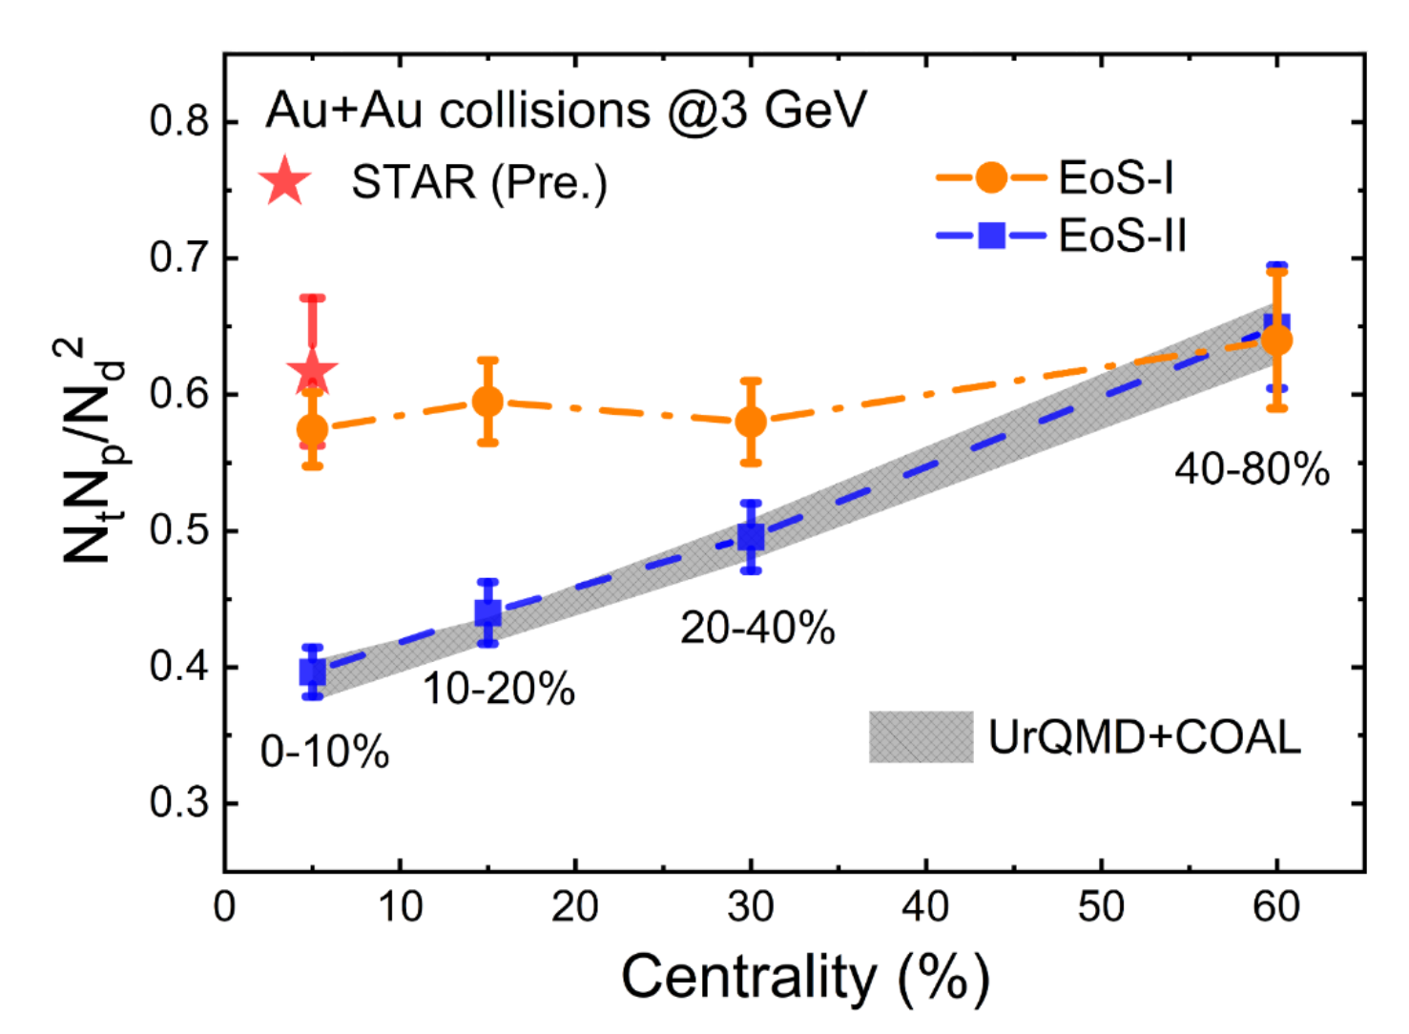
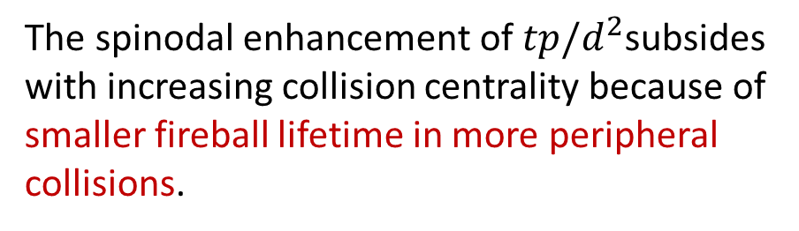
Centrality dependence of $tp/d^{2}$ with 1st-order PT
K. J. Sun, W. H. Zhou, LWC, C. M. Ko, F. Li, and R. Wang, and J. Xu, arXiv:2205.11010(2022
The spinodal enhancement of $tp/d^{2}$subsides with increasing collision centrality because of
smaller fireball lifetime in more peripheral collisions.
The slope with EoS-I is 5 times smaller
p. 25

Slide 30
Outline
QCD Phase Diagram and Critical Endpoint (CEP)
Baryon density fluctuation and coalescence production of light nuclei in HIC
p,d,t yields as a probe of CEP and 1st Order Phase Transition
Summary and Outlook

Slide 31
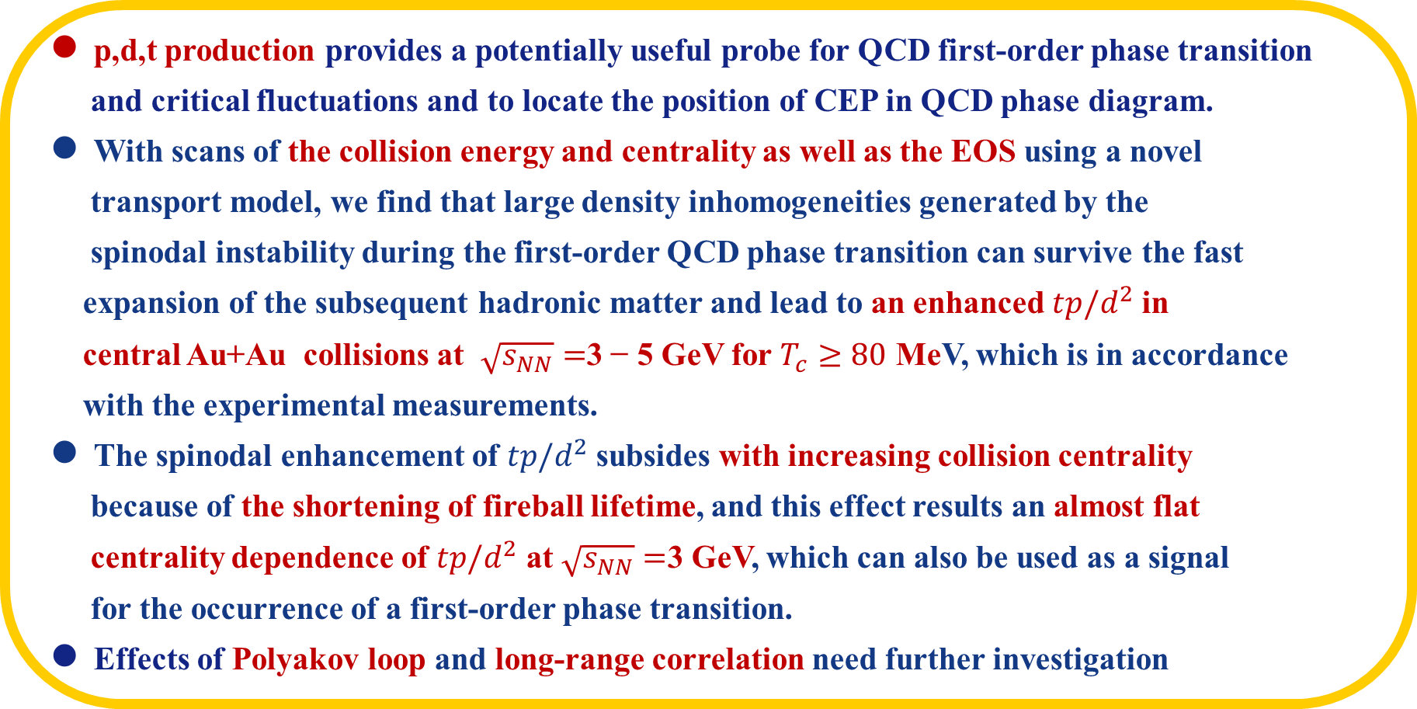
Summary and Outlook
p,d,t production provides a potentially useful probe for QCD first-order phase transition
and critical fluctuations and to locate the position of CEP in QCD phase diagram.
With scans of the collision energy and centrality as well as the EOS using a novel
transport model, we find that large density inhomogeneities generated by the
spinodal instability during the first-order QCD phase transition can survive the fast
expansion of the subsequent hadronic matter and lead to an enhanced $tp/d^{2}$ in
central Au+Au collisions at $\sqrt{s_{NN}}=$3 − 5 GeV for $T_{c}≥80$ MeV, which is in accordance
with the experimental measurements.
The spinodal enhancement of $tp/d^{2}$subsides with increasing collision centrality
because of the shortening of fireball lifetime, and this effect results an almost flat
centrality dependence of $tp/d^{2}$ at $\sqrt{s_{NN}}=$3 GeV, which can also be used as a signal
for the occurrence of a first-order phase transition.
Effects of Polyakov loop and long-range correlation need further investigation
p. 26

Slide 32
谢 谢！
Thanks!

