Slide 1
Charge fluctuations in strong magnetic fields:
New opportunities
Heng-Tong Ding (丁亨通)
Central China Normal University (华中师大)
HTD, S.-T. Li, Q. Shi, X.-D. Wang, arXiv: 2104.06843, Eur.Phys.J.A 57 (2021) 6
HTD, S.-T. Li, A. Tomiya, X.-D. Wang and Y. Zhang, Phys.Rev.D 126 (2021) 082001
HTD, S.-T. Li, J.-H. Liu, X.-D. Wang, Phys.Rev.D 105 (2022) 3, 034514
QCD物理研讨会暨基金委重大项目
“量子色动力学的相结构和新颖拓扑效应研究”年度学术交流会
29-31 July, 2022@即墨

Slide 2
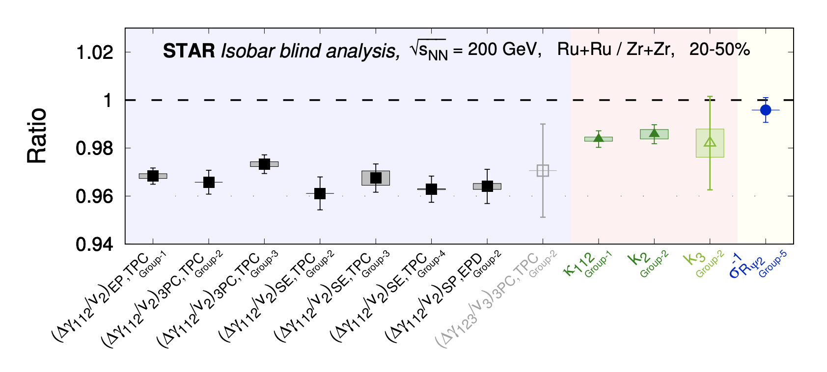
Search for the Chiral Magnetic Effect with Isobar Collisions
STAR collaboration, Phys.Rev.C 105 (2022) 1, 014901

Slide 3
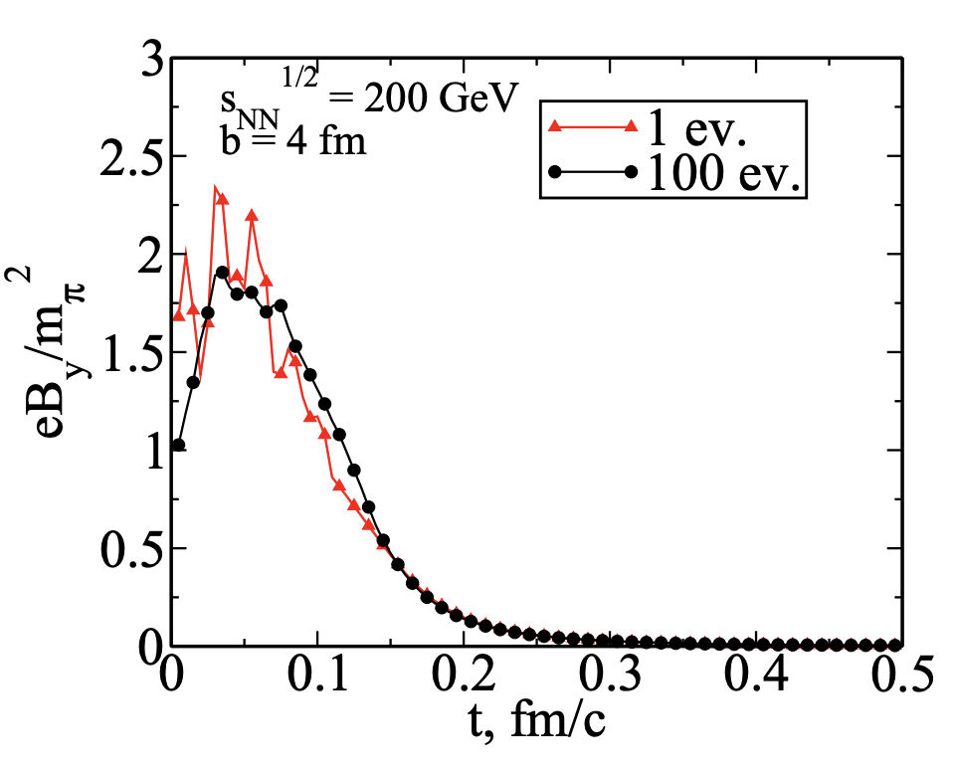
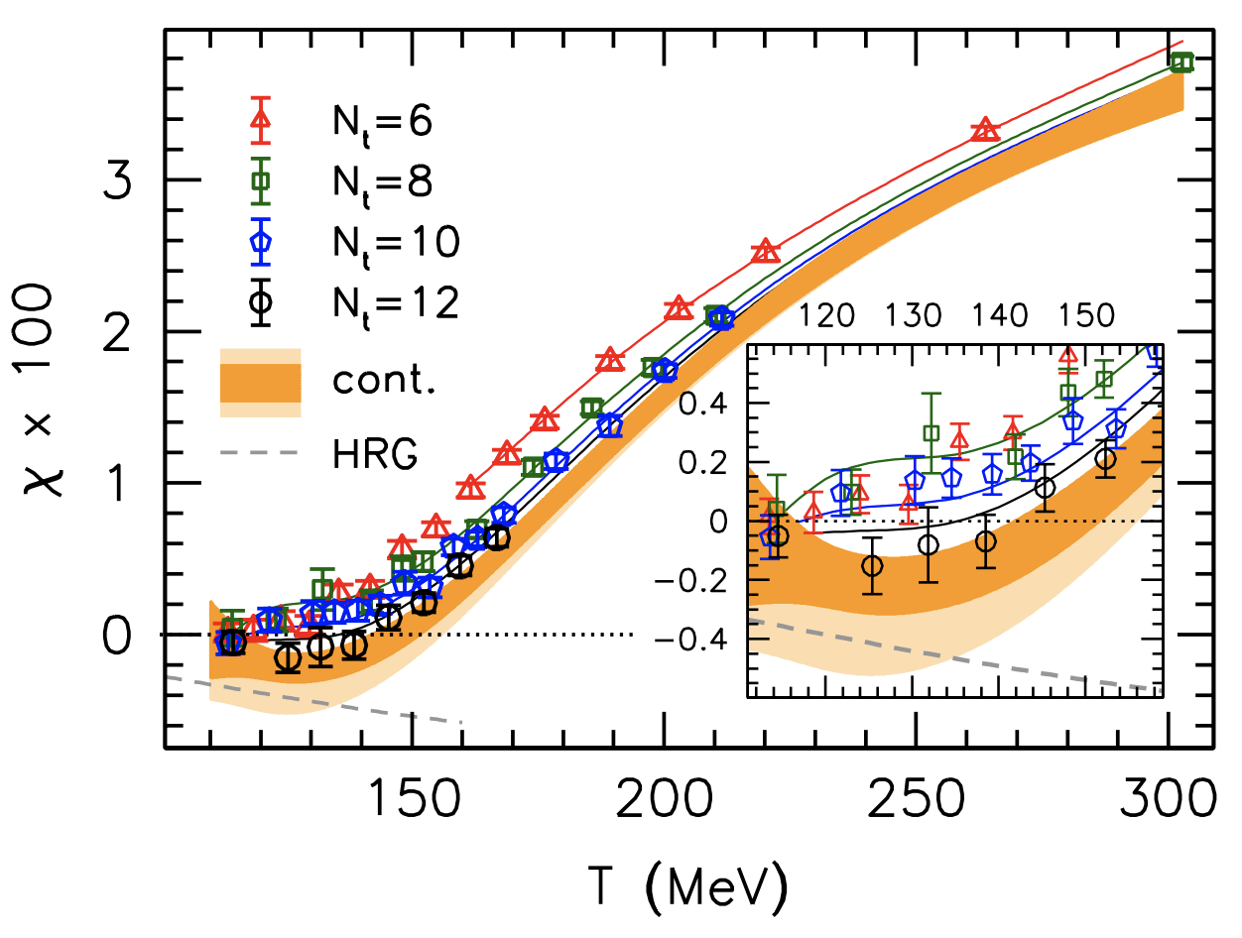
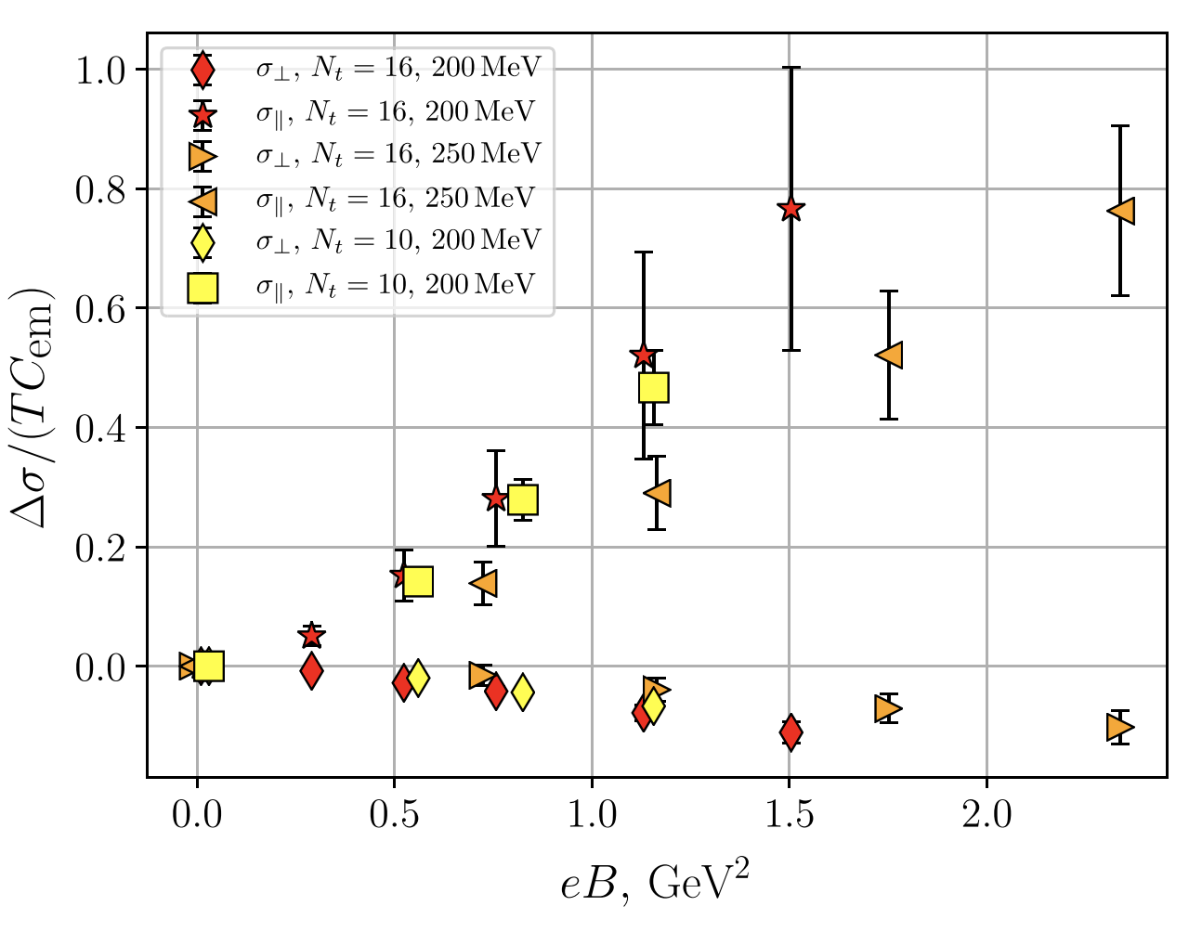
Magnetic field created in the early stage of HIC
LQCD results on
difference to electromagnetic conductivity at eB=0
LQCD results on
Magnetic susceptibility
Skokov, Illarionov and Toneev, IJMPA 24 (2009) 5925
Bali, Endrodi, Piemonte, JHEP 07 (2020) 183
Astrakhantsev et al., PRD 102 (2020) 054516
RHIC:
T> 155 MeV: Paramagnetic
T<155 MeV: Diamagnetic
Parallel: $↑$
Transverse: $↓$
t=0:
eB $↑$
LHC:

Slide 4
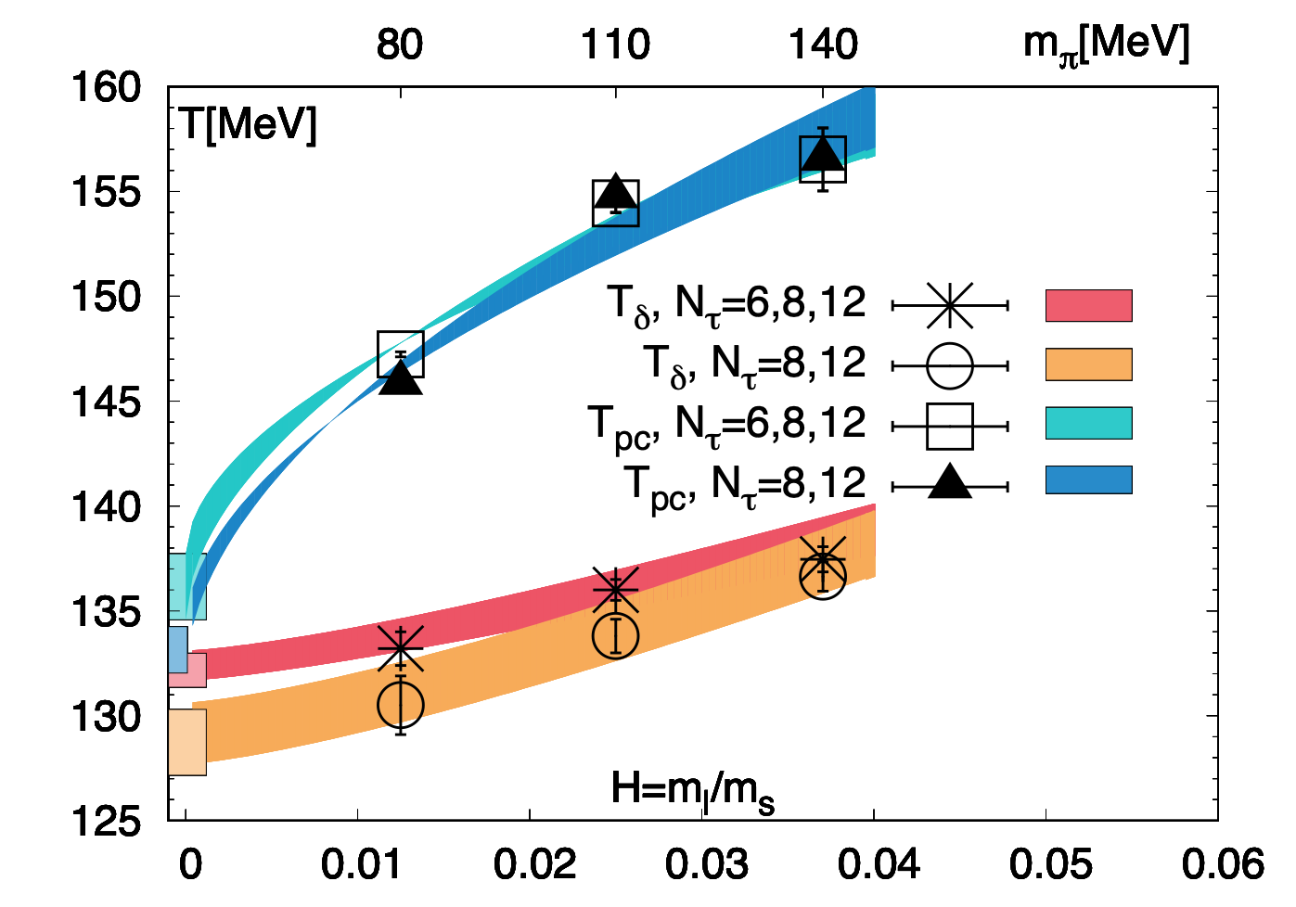
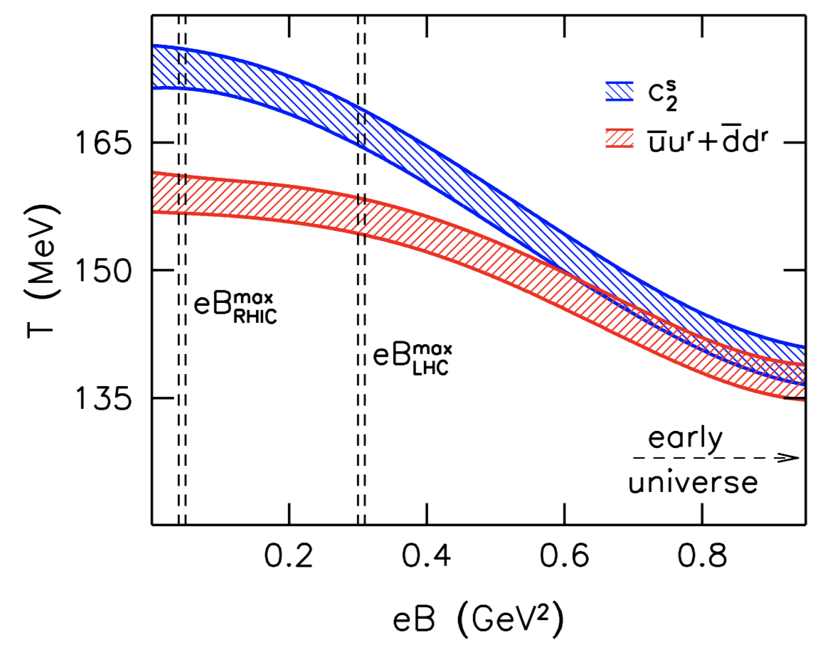
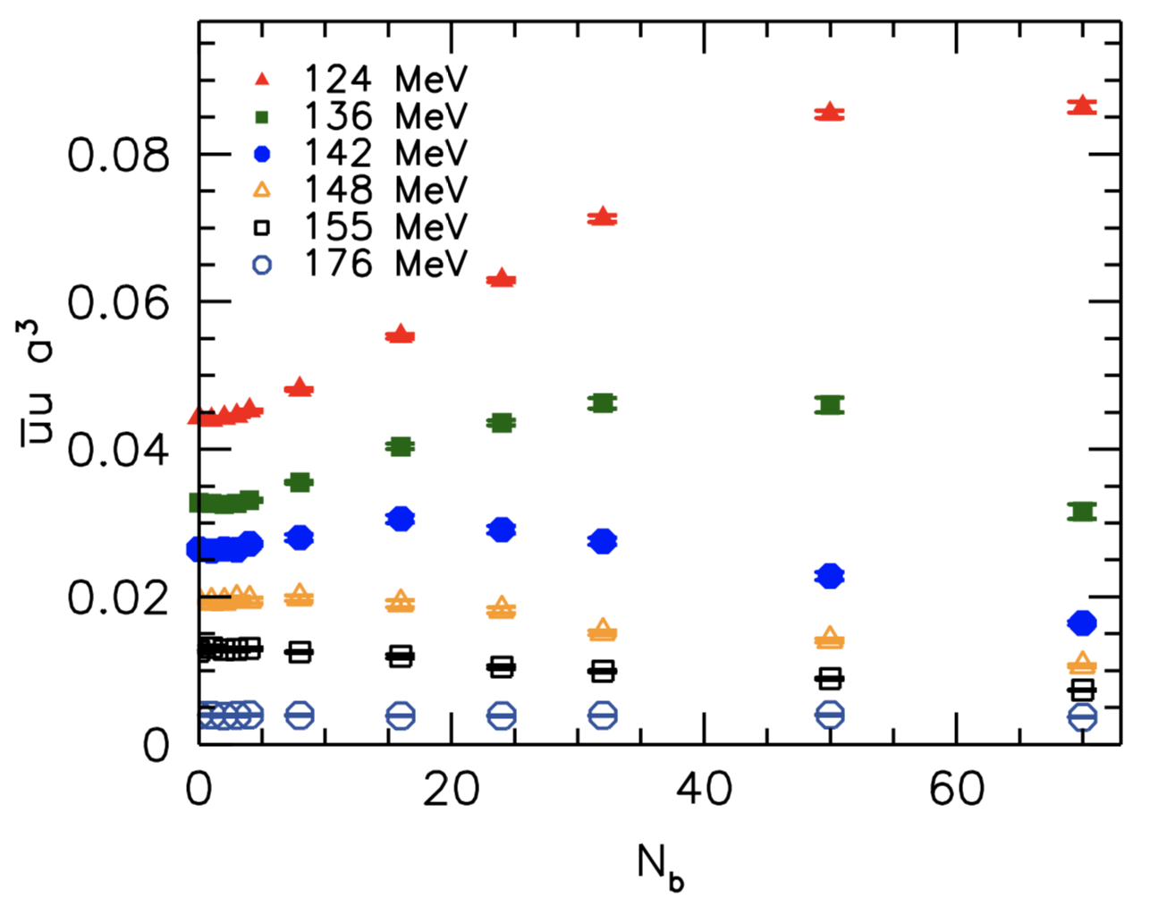
Inverse magnetic catalyses and Tpc
Continuum extrapolated lattice QCD results with physical pion mass
Bali et al., JHEP02(2012)044
Inverse magnetic catalysis (IMC)
eB↑ Tpc↓
eB=0, Nf=2+1 QCD
See recent reviews e.g.
Gaoqing Cao, arXiv:2103.00456
Andersen et al., Rev. Mod. Phys. 88(2016)02001
HTD, P. Hegde, O. Kaczmarek et al.[HotQCD],
Phys. Rev. Lett. 123 (2019) 062002
Reduction of Tpc always associated with IMC?
Role of hadrons?
HTD, arXiv:2002.11957

Slide 5
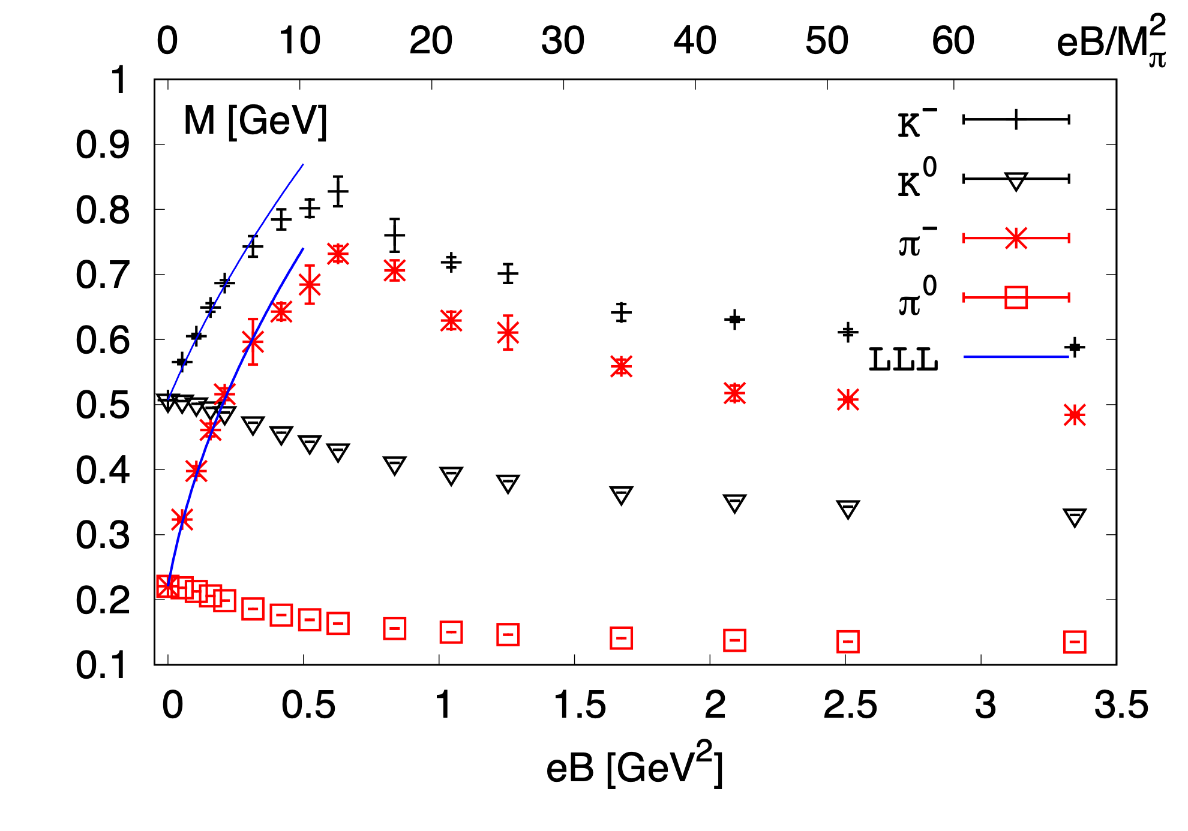
Masses of $π^{0,±}$ and $K^{0,±}$ and energy density
Nf=2+1 QCD, $M_{π}(eB=0)≈220MeV$,
${32}^{3}×96$ lattices with $a^{−1}≈1.7GeV$ and HISQ action
Energy density in Hadron resonance gas model
T=0
HTD, S.-T. Li, A. Tomiya, X.-D. Wang, Y. Zhang, PRD 126 (2021) 082001
See quenched LQCD results in Bali et al., PRD 97 (2018) 034505, Luschevskaya et al., NPB 898 (2015) 627
HTD, S.-T. Li, Q. Shi, A. Tomiya, X.-D. Wang, Y. Zhang, arXiv: 2011.04870

Slide 6
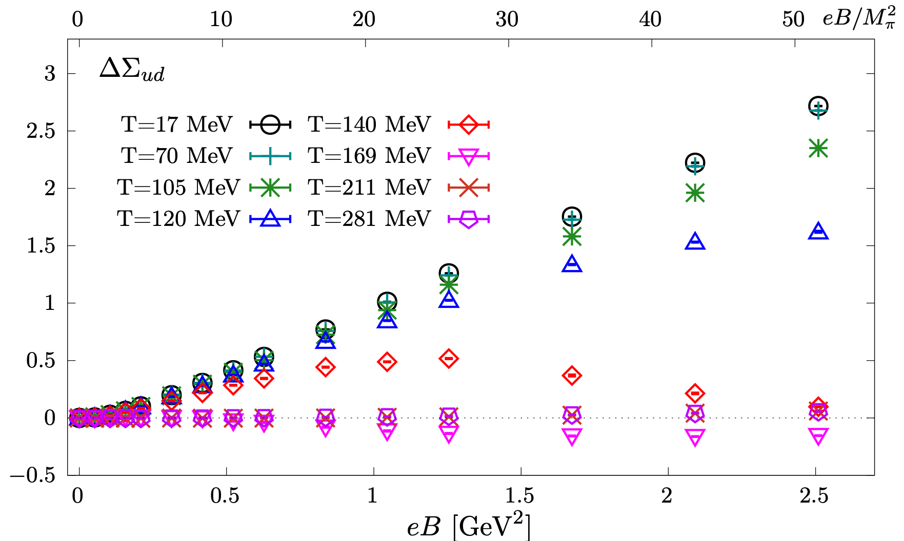
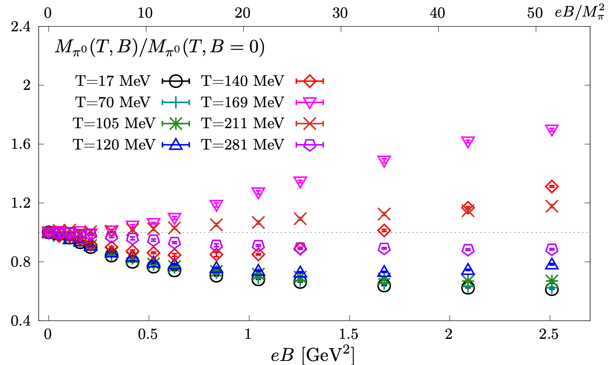
(inverse) magnetic catalysis $⟺$ hadron screening masses
Ward Identity:
HTD, S.-T. Li, J.-H. Liu, X.-D. Wang,
Phys.Rev.D 105 (2022) 3, 034514
,
$M_{π^{0}}$: Screening mass of $π^{0}$
Complex non-monotonous behavior consistent with chiral condensates

Slide 7
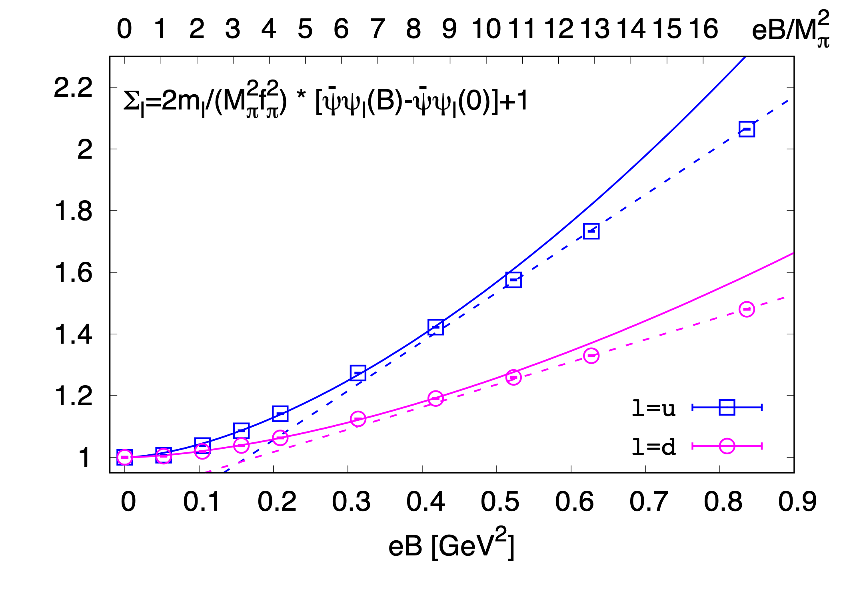
Isospin symmetry breaking at eB≠0 manifested
in chiral condensates
Not accessible in HIC experiments
HTD, S.-T. Li, A. Tomiya, X.-D. Wang and Y. Zhang, PRD 126 (2021) 082001
See also in reviews e.g. M. D’Elia, Lect.NotesPhys.871(2013)181

Slide 8
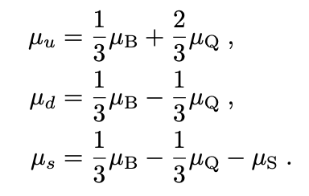
Fluctuations of net baryon number, electric charge and strangeness
Taylor expansion of the QCD pressure:
Allton et al., Phys.Rev. D66 (2002) 074507
Gavai & Gupta et al., Phys.Rev. D68 (2003) 034506
Taylor expansion coefficients at μ=0 are computable in LQCD
See recent reviews:
LQCD: HTD, F. Karsch, S. Mukherjee, Int. J. Mod. Phys. E 24 (2015) no.10, 1530007
Exp.: X.-F. Luo & N. Xu, Nucl. Sci. Tech. 28 (2017) 112
At eB=/=0 a lot more need to be explored
HRG: G. Kadam et al., JPG 47 (2020) 125106, Ferreira et al., PRD 98(2018)034003,
Fukushima and Hidaka, PRL117 (2016)102301
Bhattacharyya et al., EPL115(2016)62003
PNJL: W.-J. Fu, Phys. Rev. D 88 (2013) 014009

Slide 9
2nd order fluctuations of net baryon number, electric charge and strangeness
Nf=2+1 QCD, $M_{π}(eB=0)≈220MeV$, with $a^{−1}≈1.7GeV$ and HISQ action, fixed $a$ approach ($T=a^{−1}$/$N_{τ}$)
$$eB=\frac{6π}{N_{x}N_{y}}N_{b}a^{−2}$$
HTD, S.-T. Li, Q. Shi and X.-D. Wang, 2104.06843
Peak locations shift to lower T in stronger eB
Consistent with the reduction of Tpc in a stronger magnetic field
Signal for a critical end point in the T-eB plane of QCD phase diagram?

Slide 10
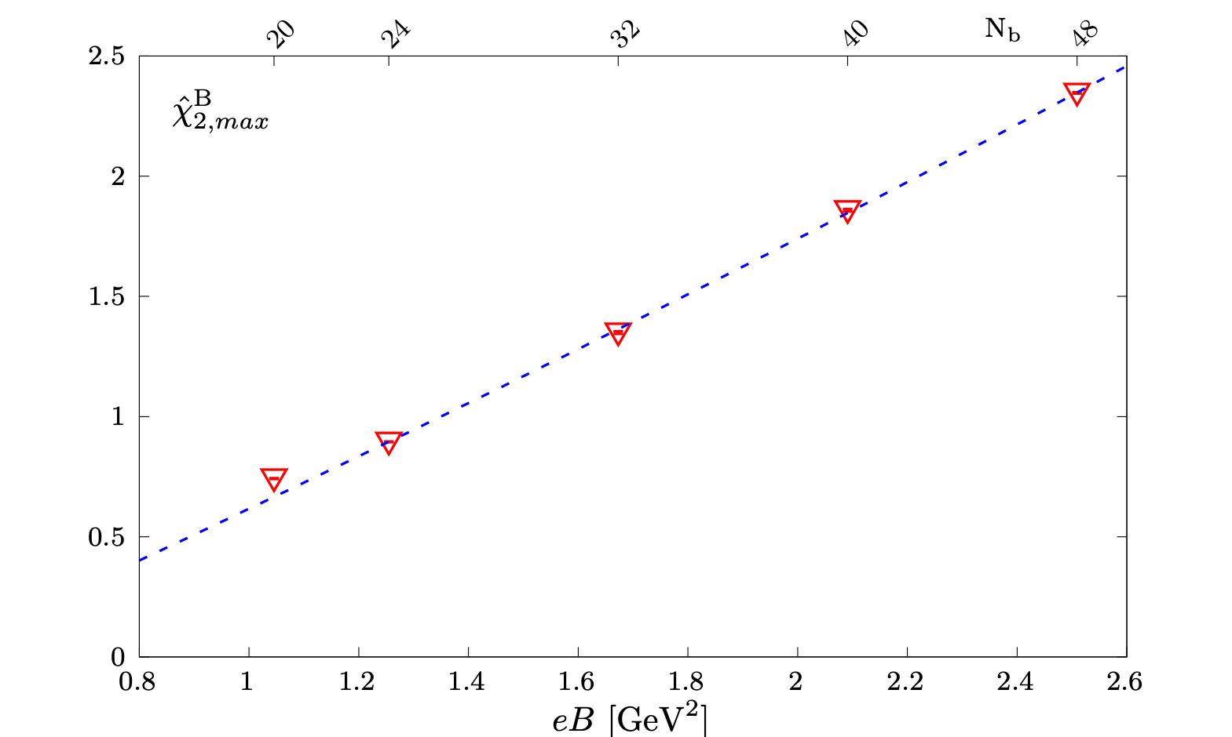
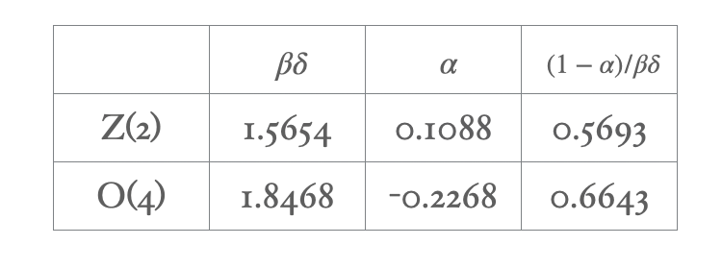
A rough estimate of a CEP in T-eB plane
Consistent with
$eB_{c}∈(4−9){GeV}^{2}$
Preliminary
$$eB_{c}≈7{GeV}^{2}$$
D’ Elia et al., Phys.Rev.D 105 (2022) 034511
At eB=0:
$$χ_{2,max}^{B}=b(eB_{c}−eB)^{(1−α)/βδ}+d$$
$$χ_{n}^{B}∝(−2κ_{q})^{n/2}h^{(2−α−n/2)/βδ}f_{f}^{(n/2)}(z)$$
Friman et al., Eur. Phys. J. C 71(2011)1694

Slide 11
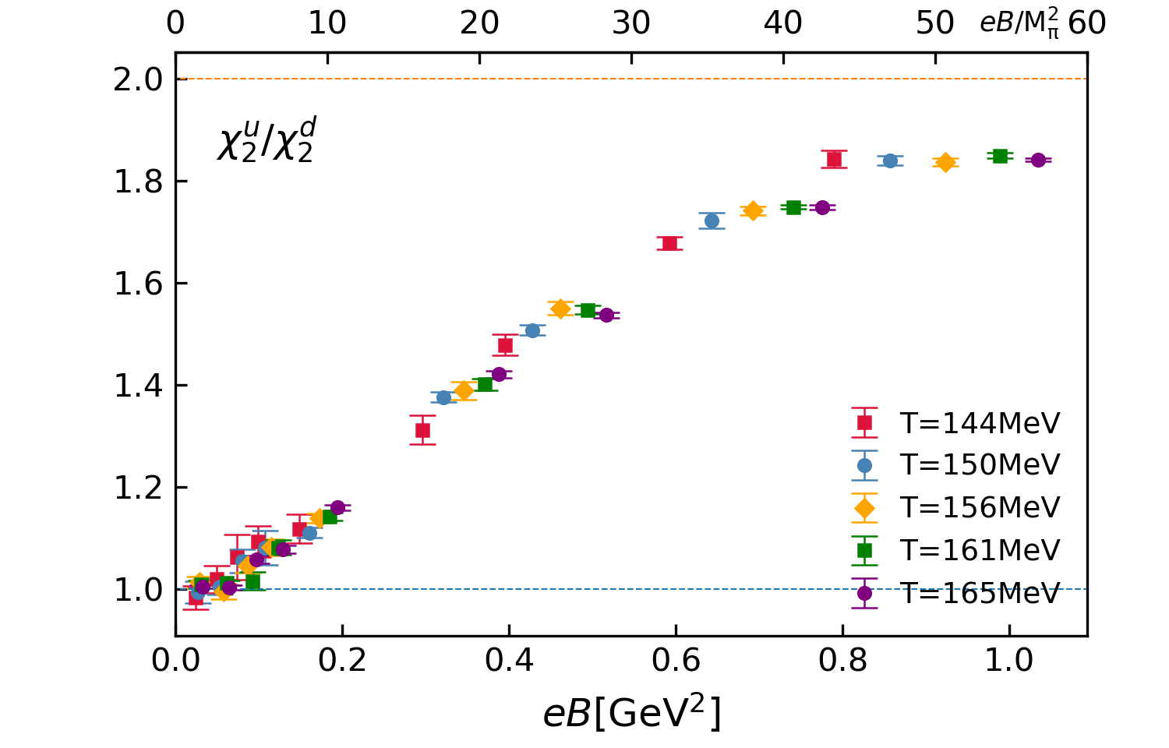
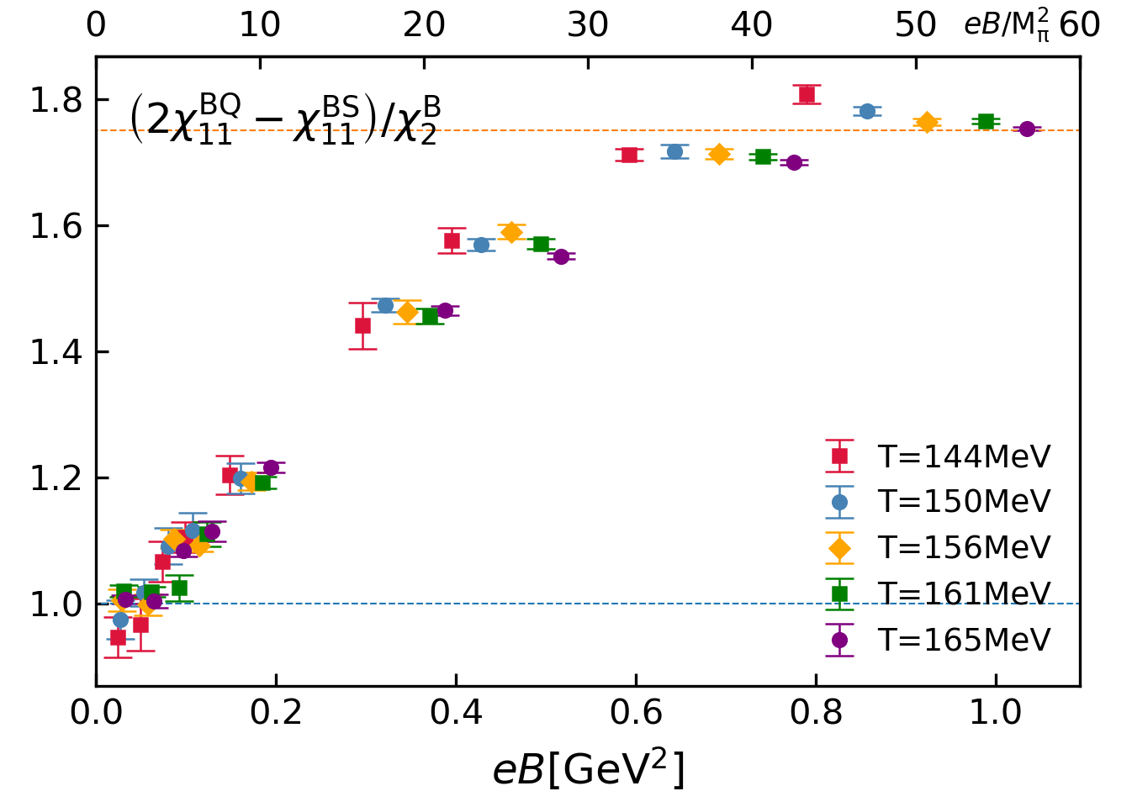
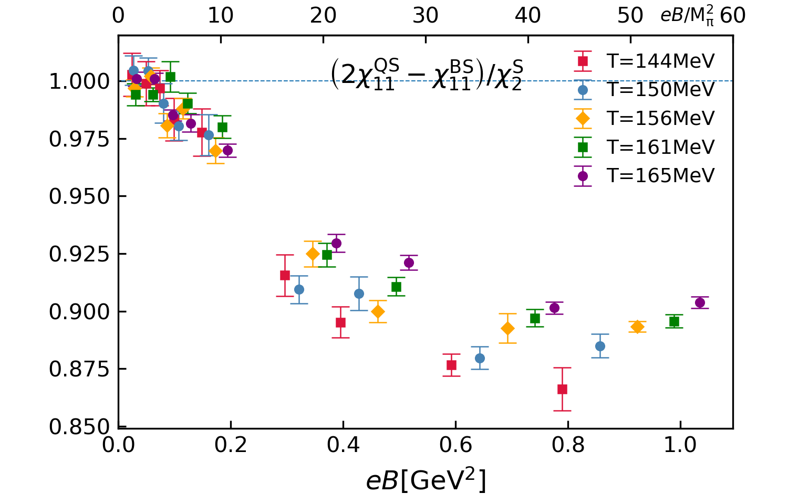
Isospin symmetry breaking at nonzero eB with physical pion mass
Nf=2+1 QCD, $M_{π}(eB=0)≈135MeV$, $T_{pc}(eB=0)≈157MeV$, ${32}^{3}×8$ lattices with HISQ action
free case
free case
Isospin symmetric
& free case
Isospin symmetric case
Isospin symmetric case
Jun-Hong Liu, QM2022, HTD, Sheng-Tai Li, Jun-Hong Liu, Xiao-Dan Wang, work in progress
At eB=0:
$$χ_{2}^{u}/χ_{2}^{d}=1,$$
$$2χ_{11}^{BQ}−χ_{11}^{BS}=χ_{2}^{B},$$
$$2χ_{11}^{QS}−χ_{11}^{BS}=χ_{2}^{S}$$

Slide 12
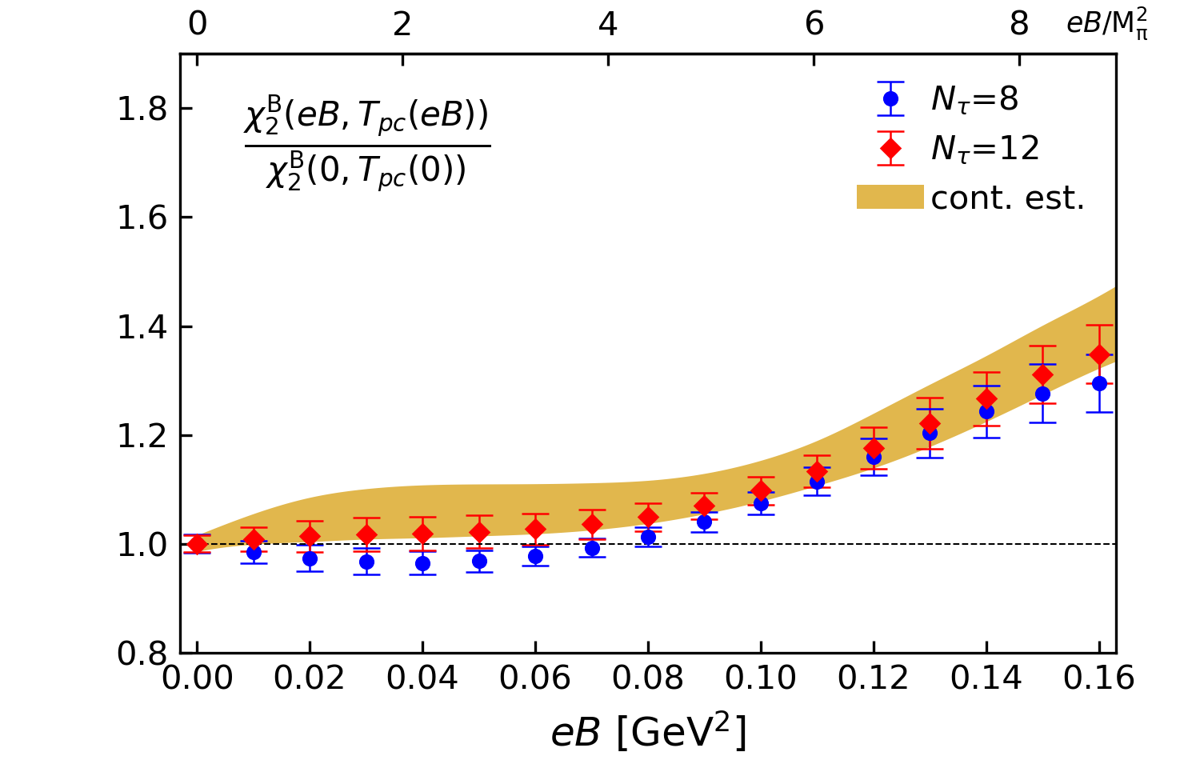
Ratio X(eB)/X(eB=0) for 2nd order diagonal fluctuations
Nf=2+1 QCD, $M_{π}(eB=0)≈135MeV$, $T_{pc}(eB=0)≈157MeV$, ${32}^{3}×8$ and ${48}^{3}×12$ lattices with HISQ action
X(eB)/X(eB=0) : Rcp like observable
At $eB≃M_{π}^{2}$: deviation from unity is mild
At $eB≃8M_{π}^{2}$: ~1.3
Note: $T_{pc}(eB≃8M_{π}^{2})/T_{pc}(eB=0)∼99\%$
Jun-Hong Liu, QM2022
Central Collisions
Peripheral Collisions
HTD, Sheng-Tai Li, Jun-Hong Liu, Xiao-Dan Wang,
work in progress

Slide 13
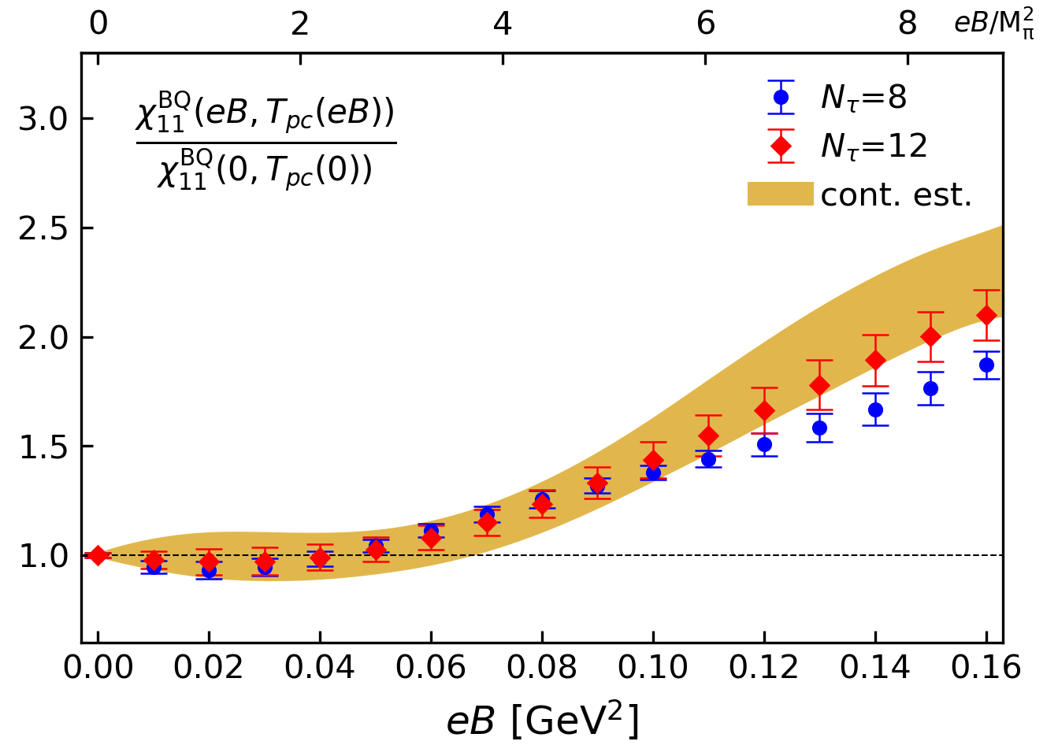
Ratio X(eB)/X(eB=0) for 2nd order off-diagonal fluctuations
Nf=2+1 QCD, $M_{π}(eB=0)≈135MeV$, $T_{pc}(eB=0)≈157MeV$, ${32}^{3}×8$ and ${48}^{3}×12$ lattices with HISQ action
X(eB)/X(eB=0) : Rcp like observable
At $eB≃M_{π}^{2}$: deviation from unity is mild
At $eB≃8M_{π}^{2}$: ~2 !
Note: $T_{pc}(eB≃10M_{π}^{2})/T_{pc}(eB=0)∼99\%$
Central Collisions
Smaller eB
Peripheral Collisions
Larger eB

Slide 14
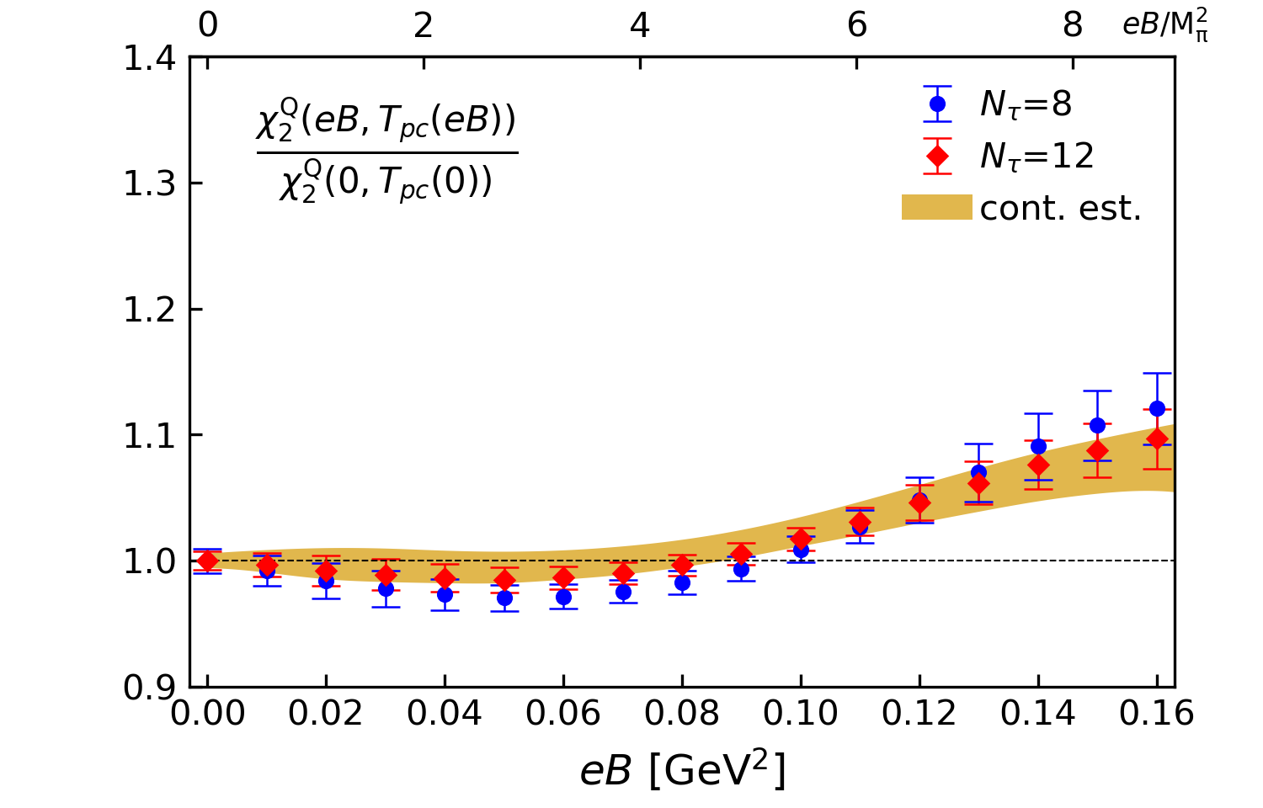
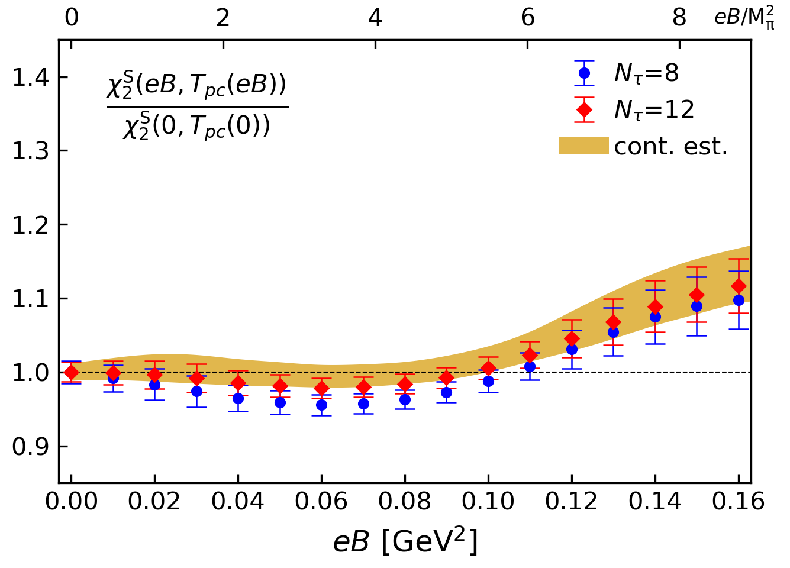
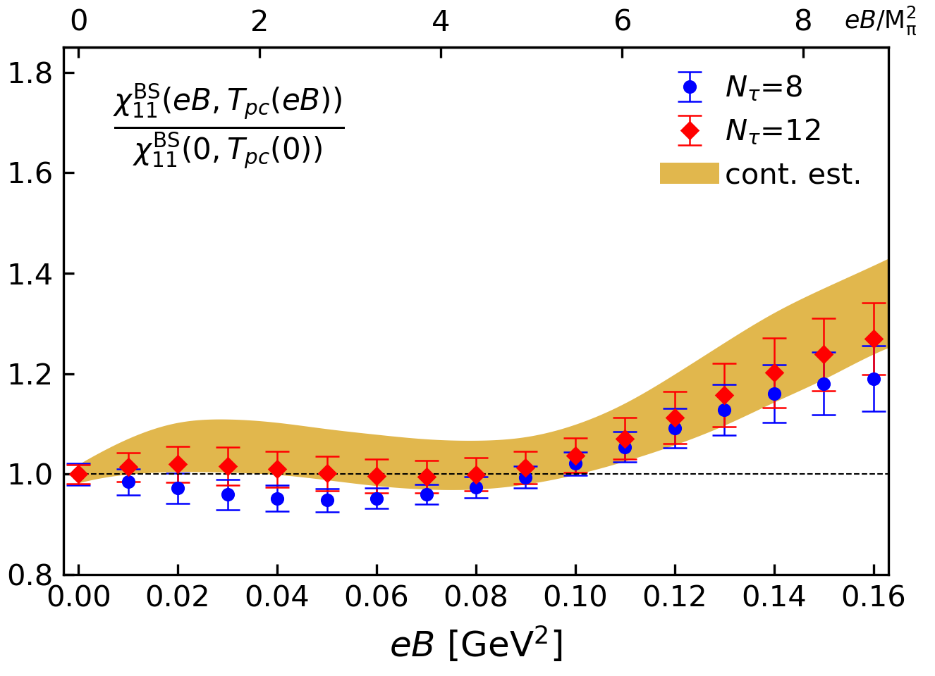
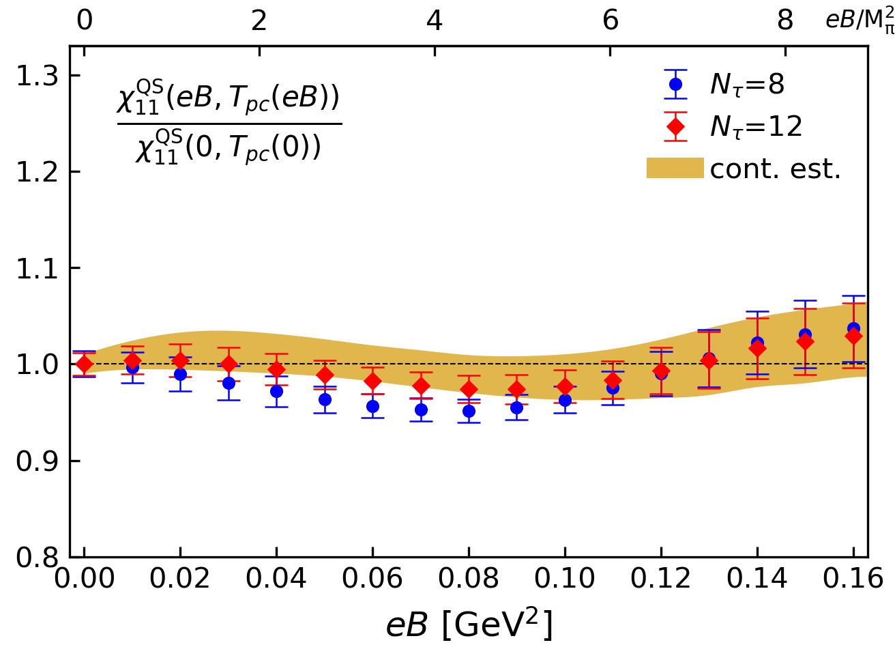
At $eB≃8M_{π}^{2}$:
$χ_{2}^{Q}/χ_{2}^{Q}(eB=0)$ ~ 1.15
$χ_{2}^{S}/χ_{2}^{S}(eB=0)$ ~ 1.15
$χ_{11}^{BS}/χ_{11}^{BS}(eB=0)$ ~ 1.2
$χ_{2}^{QS}/χ_{2}^{QS}(eB=0)$ ~ 1.06
Jun-Hong Liu, QM2022

Slide 15
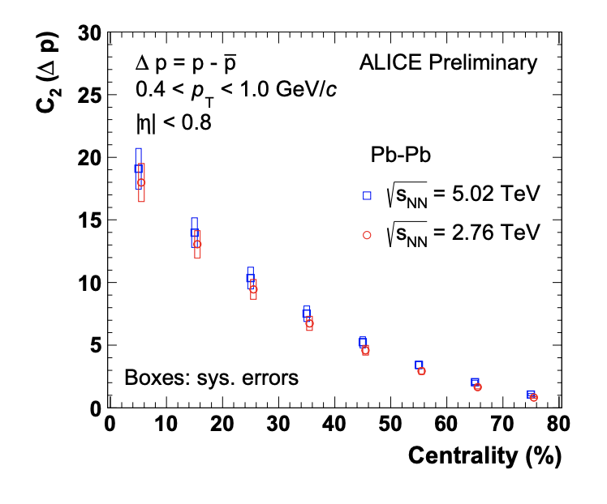
Lattice QCD meets experiment
Lattice QCD
Proxy of
$$χ_{2}^{B}$$
$$C_{2}=VT^{3}χ_{2}^{B}$$
Volume!
$$M_{π}(eB=0)≈135MeV$$
$T_{pc}(eB=0)≈157MeV$ on Nt=8 lattices
Smaller eB
Larger eB
ALICE: Nucl.Phys.A 982 (2019) 851

Slide 16
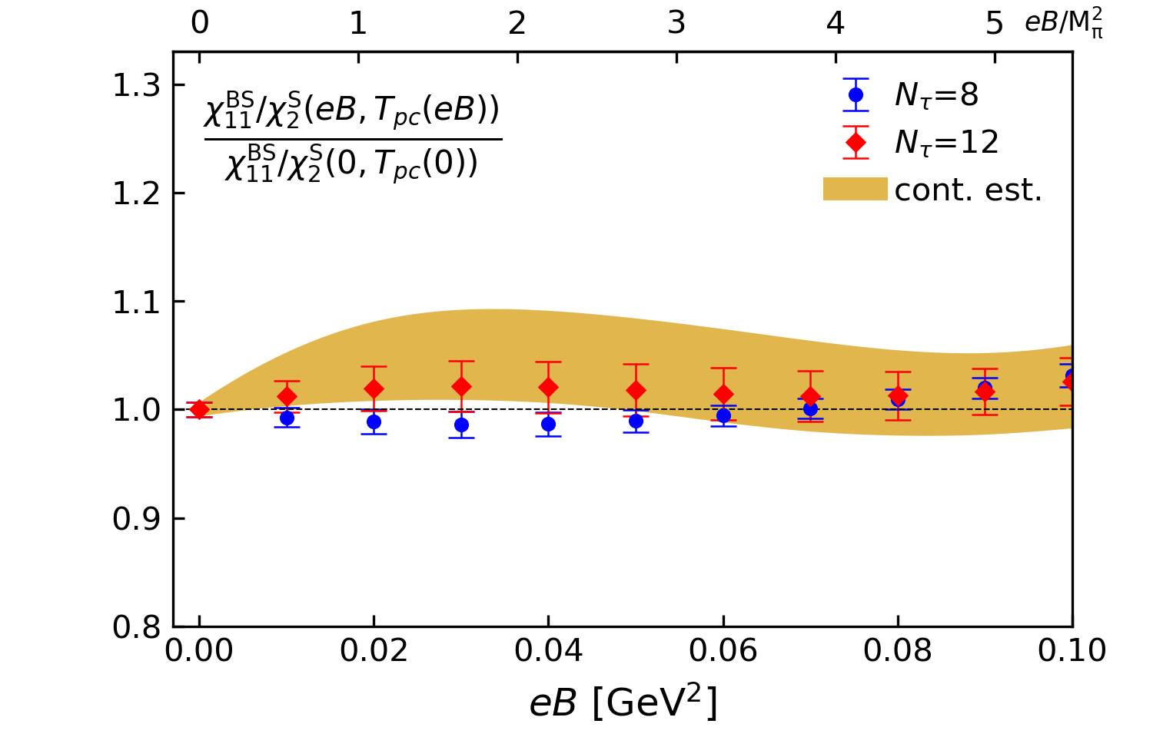
Lattice QCD meets experiment
Lattice QCD
Proxy of
$${χ_{11}^{BS}}/{χ_{2}^{S}}$$
0
200
$$⟨N_{part}⟩$$
Larger eB
Smaller eB
$$M_{π}(eB=0)≈135MeV$$
$T_{pc}(eB=0)≈157MeV$
STAR, Phys.Rev.C 100 (2019) 1, 014902

Slide 17
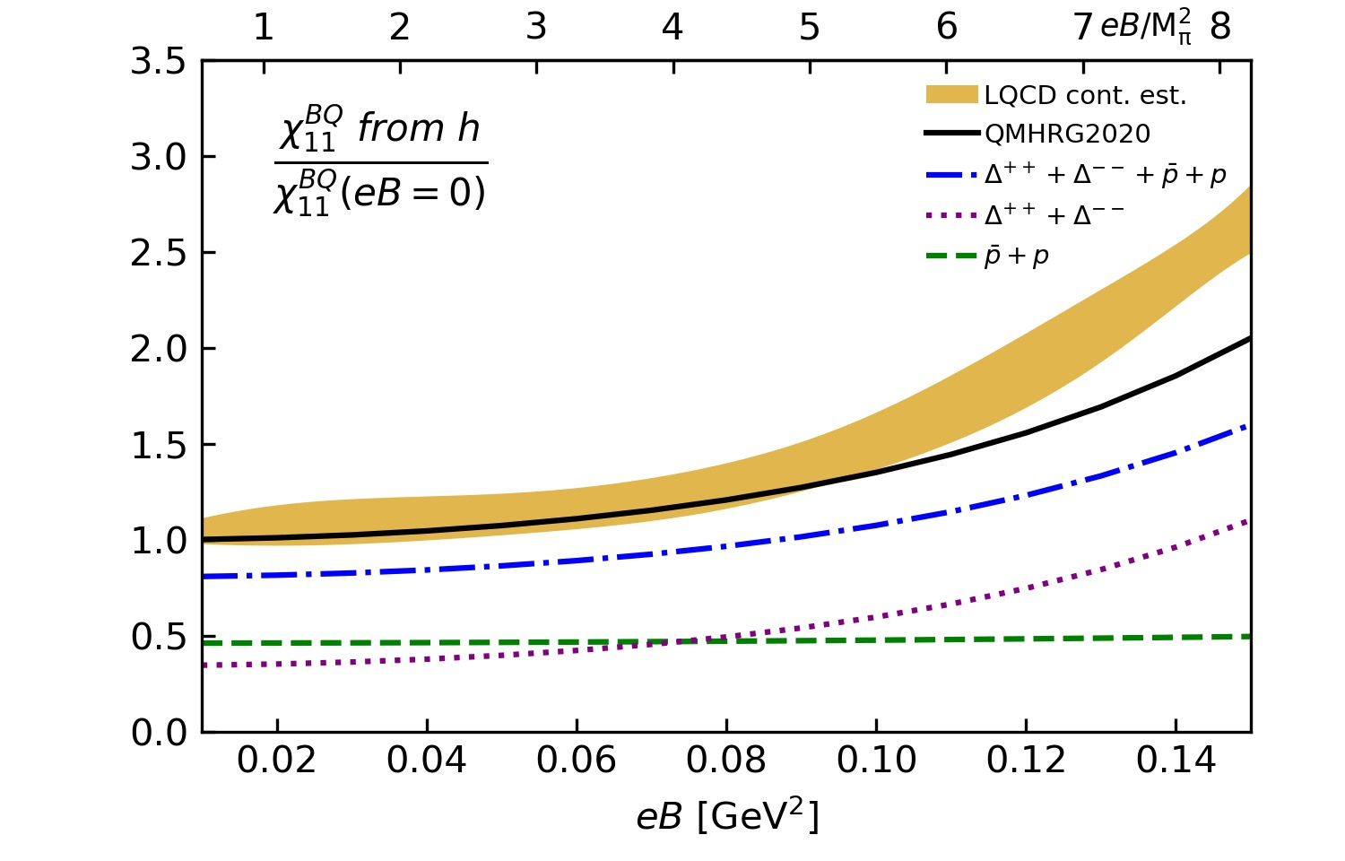
Breakdown the contributions to $χ_{BQ}^{11}$
Most of the eB-dependences comes from
Delta baryons
T=145 MeV
Delta baryons: not-measurable in HIC experiments
Breakdown the contribution of Delta baryons through their decays!
Work in progress…
HTD, Sheng-Tai Li, Jun-Hong Liu, Xiao-Dan Wang, work in progress

Slide 18
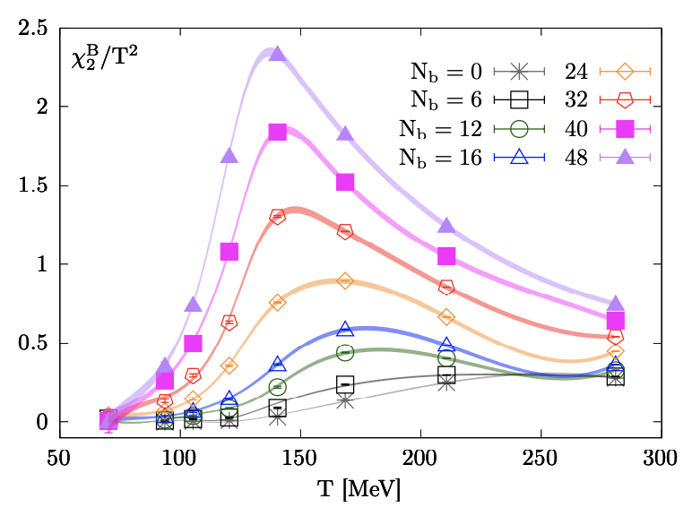
Summary & Outlook
The 2nd order fluctuations and correlations of B,Q & S are strongly affected by eB
Could be useful to 1) detect the existence of a magnetic field in HIC; 2) analogy to study the QCD critical end point in the $T−μ_{B}$ plane
Construct suitable proxies for the fluctuations via HRG
HTD, S.-T. Li, J.-H. Liu, X.-D. Wang in preparation

Slide 19
Backup

Slide 20
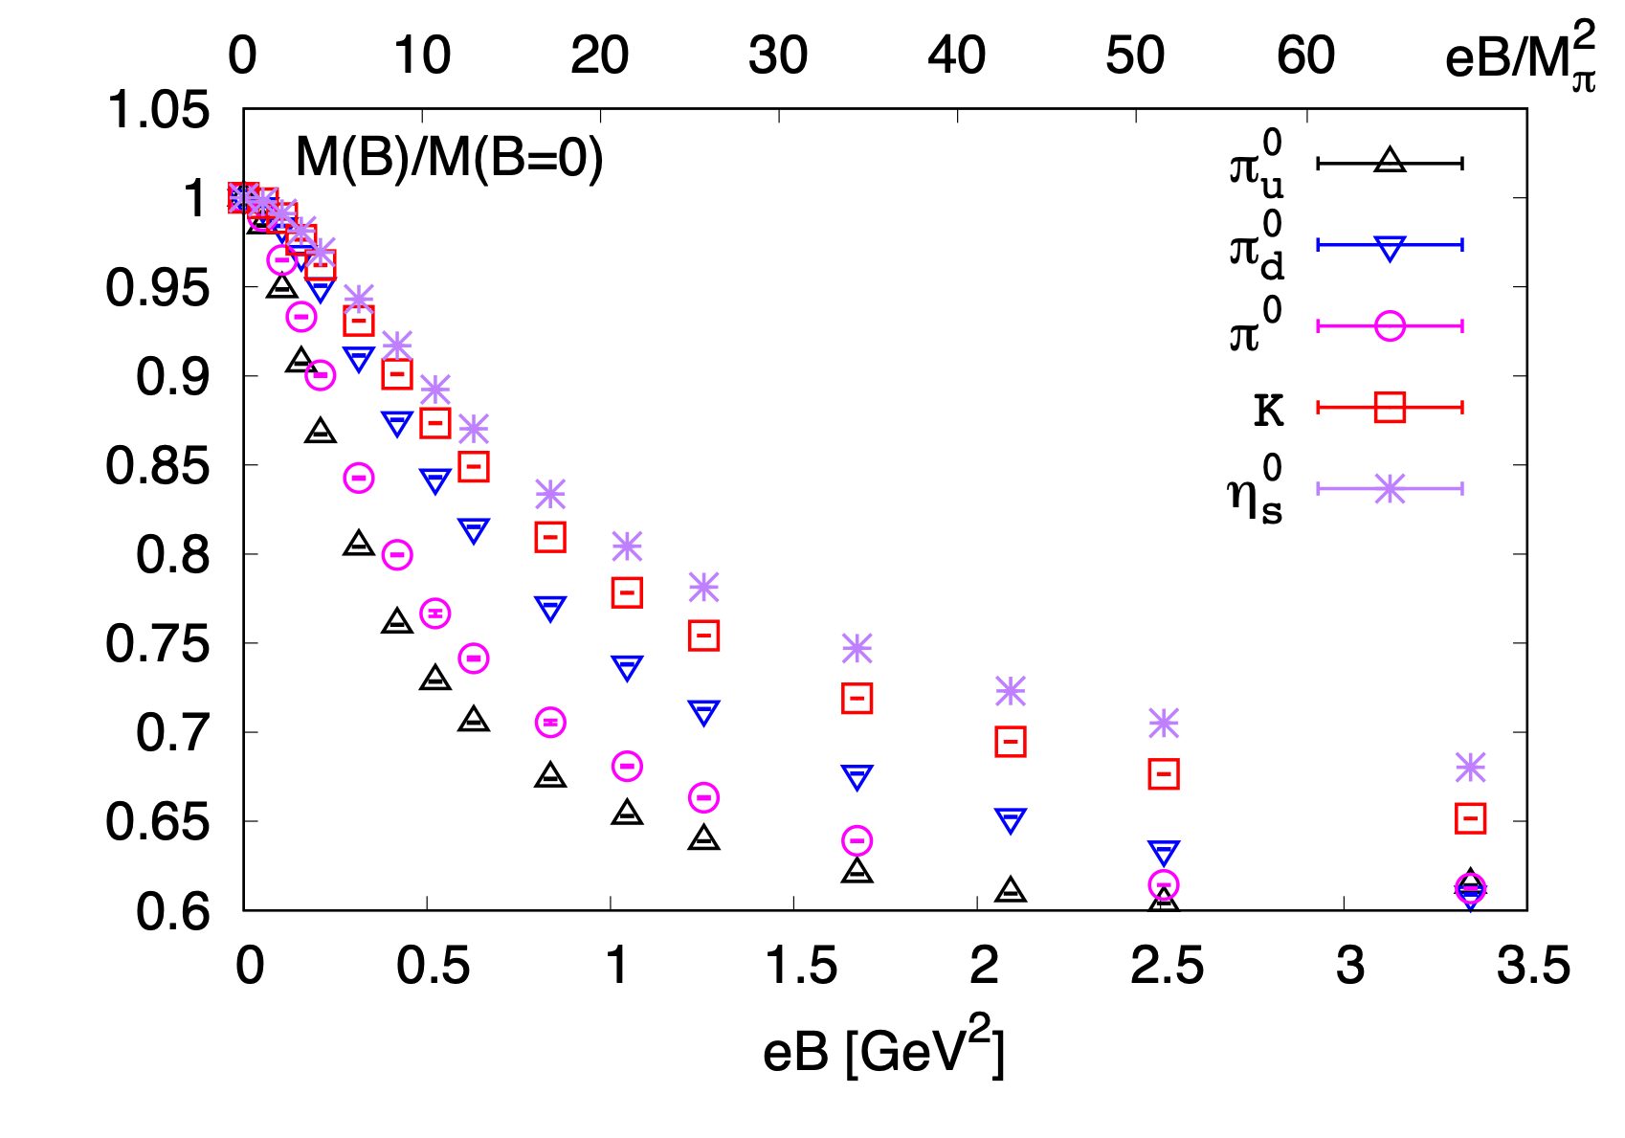
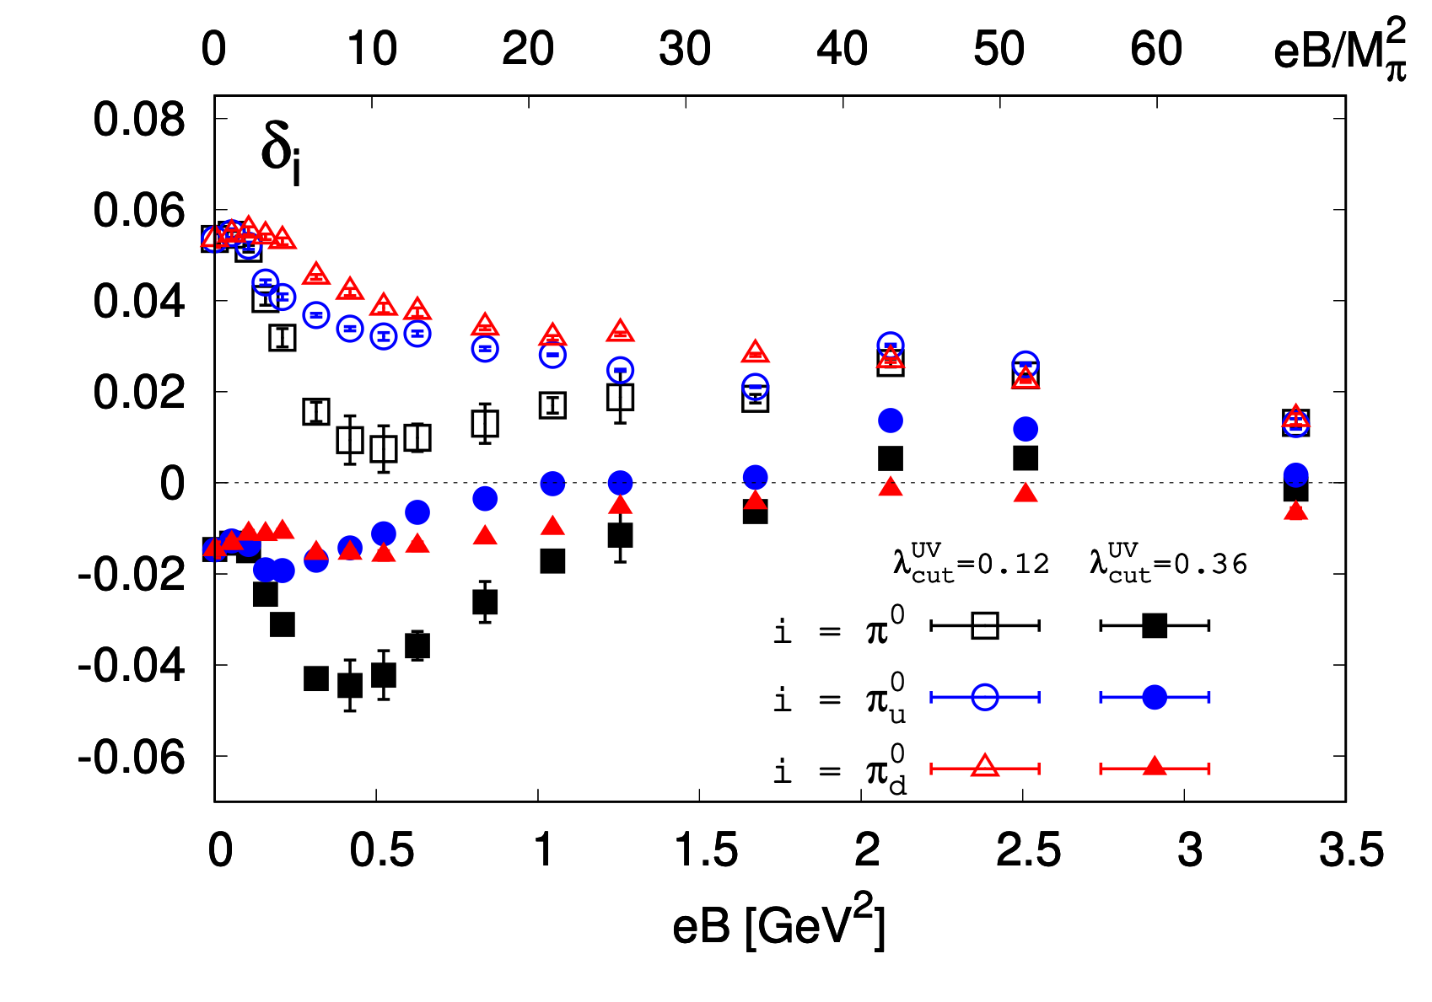
Neutral pion mass & Gell-Mann-Oakes-Renner relation
with $eB≠0$
Nf=2+1 QCD, $M_{π}(eB=0)≈220MeV$, on ${32}^{3}×96$ lattices with $a^{−1}≈1.7{GeV}^{−1}$ and HISQ action at T=0
correction to the GMOR relation
HTD, S.-T. Li, A. Tomiya, X.-D. Wang, Y. Zhang, PRD 126 (2021) 082001
neutral pion remains as a Goldstone boson with eB up to ~3.5 GeV²
Tpc decreases with eB regardless of (inverse) magnetic catalysis

Slide 21
Comparison to HRG and idea gas limit
Nf=2+1 QCD, $M_{π}(eB=0)≈220MeV$, with $a^{−1}≈1.7GeV$ and HISQ action, fixed $a$ approach ($T=a^{−1}$/$N_{τ}$)
Low T: Kaons dominated
Pions dominated
Baryons dominated
HTD, S.-T. Li, Q. Shi and X.-D. Wang, 2104.06843

Slide 22
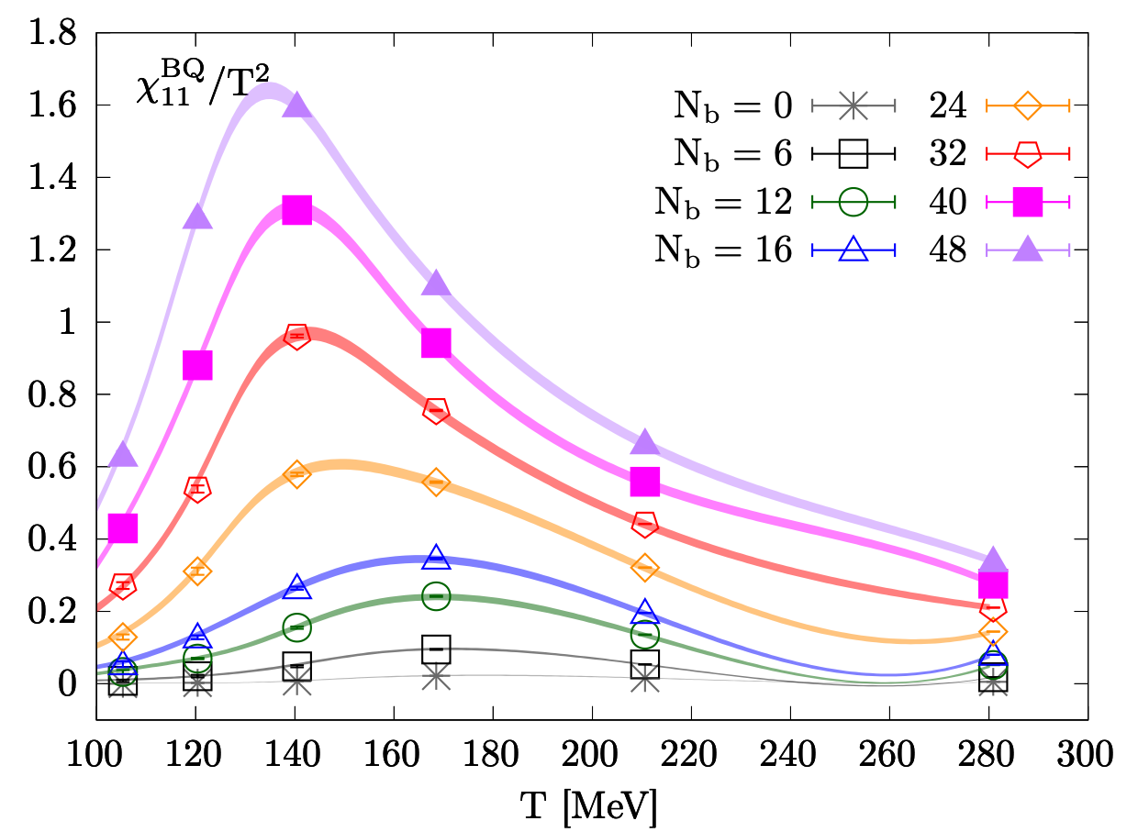
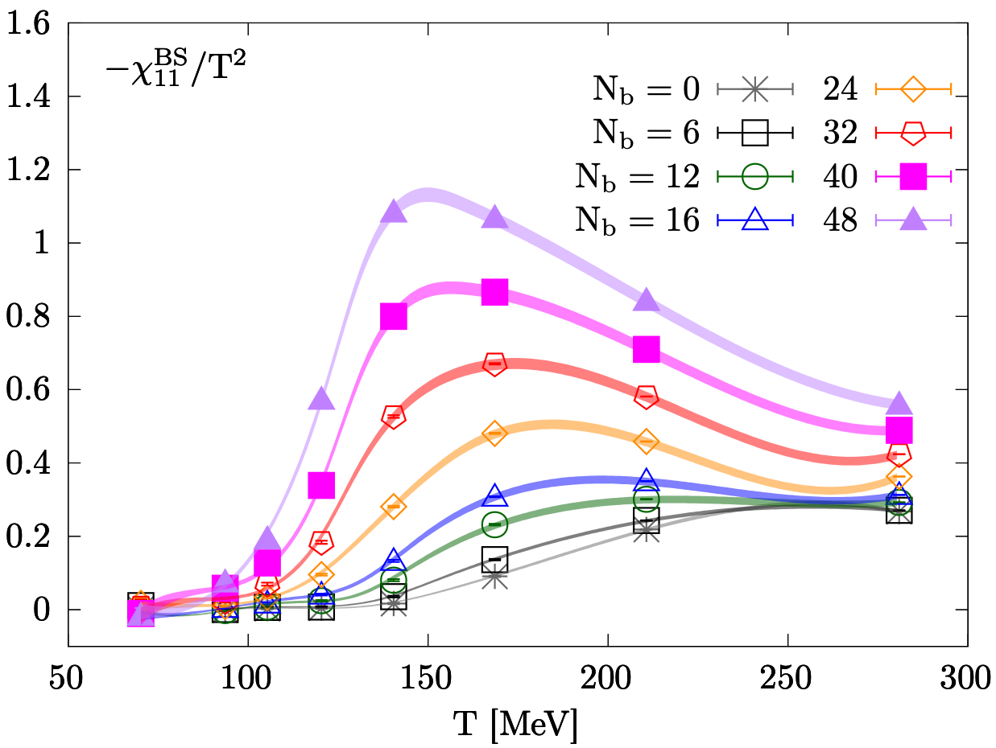
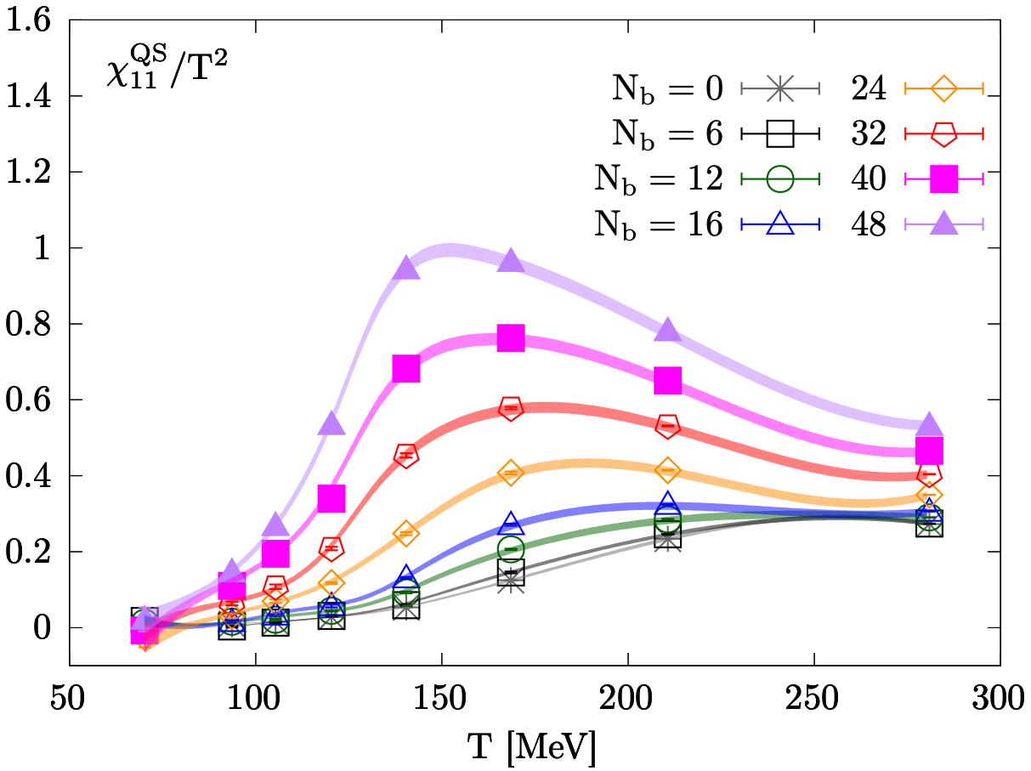
2nd order correlations of net baryon number, electric charge and strangeness
Nf=2+1 QCD, $M_{π}(eB=0)≈220MeV$, with $a^{−1}≈1.7GeV$ and HISQ action, fixed $a$ approach ($T=a^{−1}$/$N_{τ}$)
$$eB=\frac{6π}{N_{x}N_{y}}N_{b}a^{−2}$$
HTD, S.-T. Li, Q. Shi and X.-D. Wang, 2104.06843
Similar to the 2nd order diagonal fluctuations
Signal for a critical end point in the T-eB plane of QCD phase diagram?

Slide 23
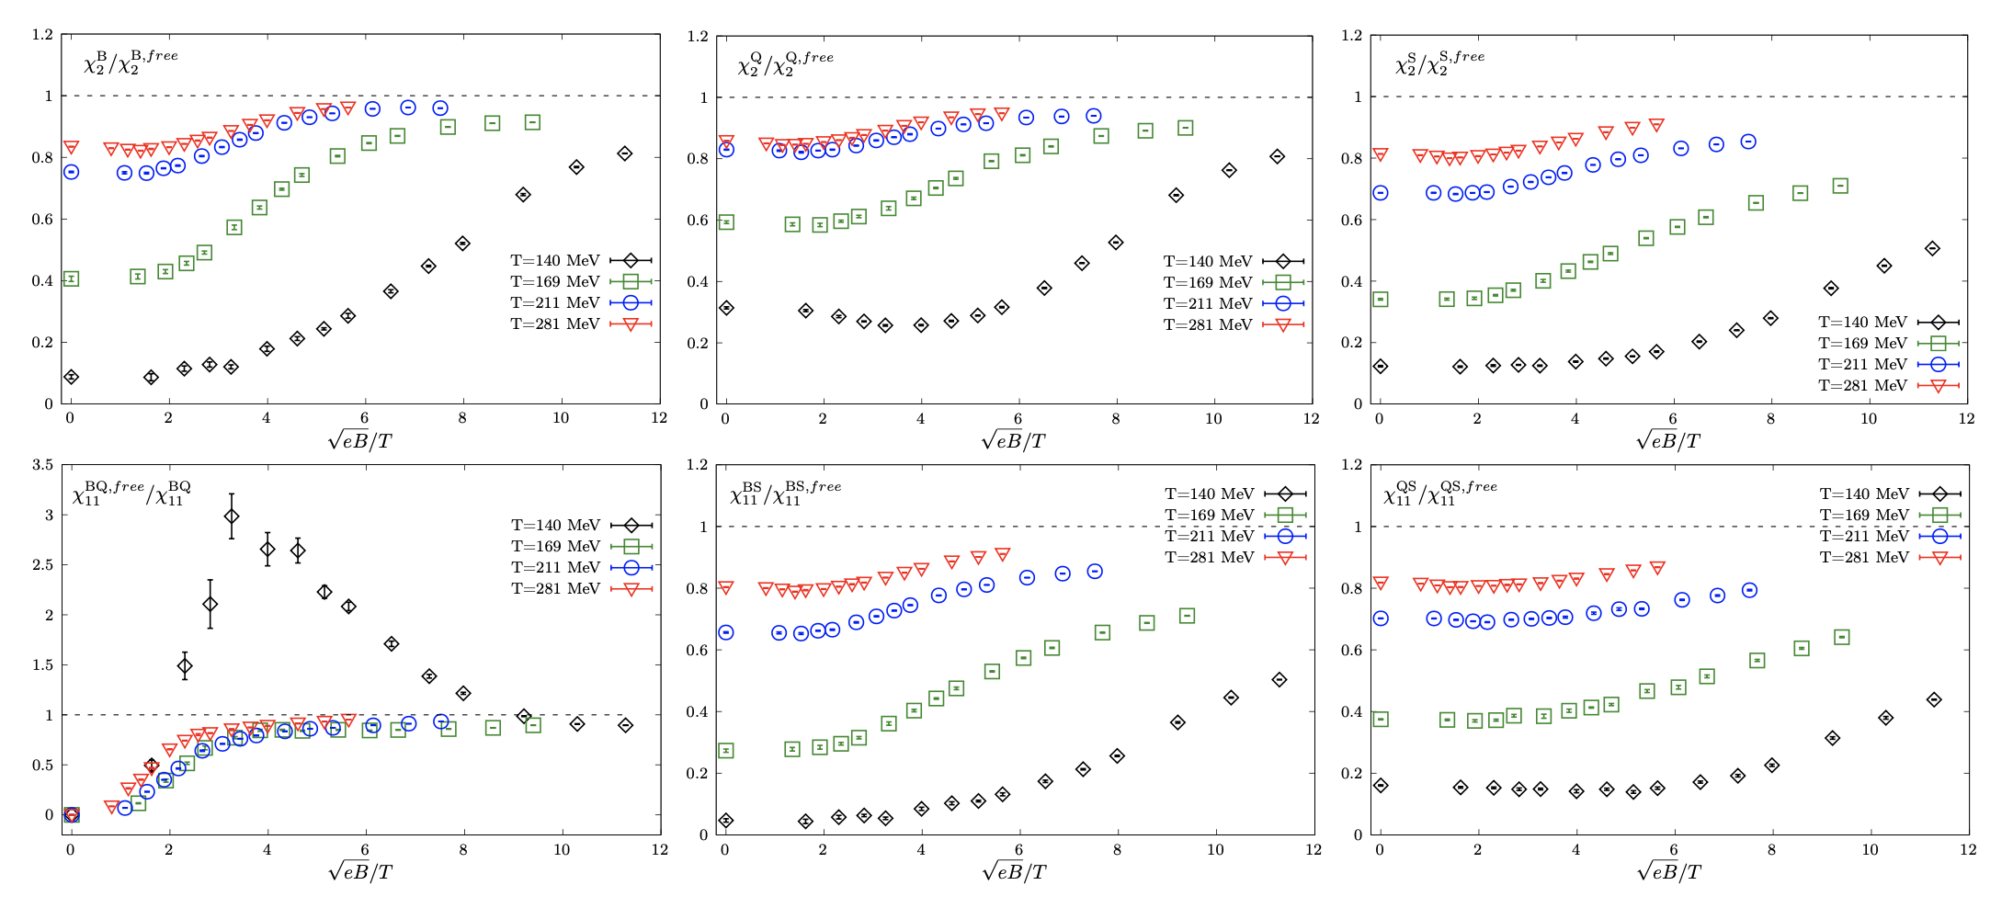
Comparison to the ideal gas limit
Nf=2+1 QCD, $M_{π}(eB=0)≈220MeV$, with $a^{−1}≈1.7GeV$ and HISQ action, fixed $a$ approach ($T=a^{−1}$/$N_{τ}$)
HTD, S.-T. Li, Q. Shi and X.-D. Wang, 2104.06843

Slide 24
High T: Ideal gas limit
At eB=0:
Kapusta & Gale, Finite-temperature field theory: Principles and applications
At eB=/=0:
HTD, S.-T. Li, Q. Shi and X.-D. Wang, 2104.06843
$K_{1}$: first-order modified Bessel function of the second kind

Slide 25
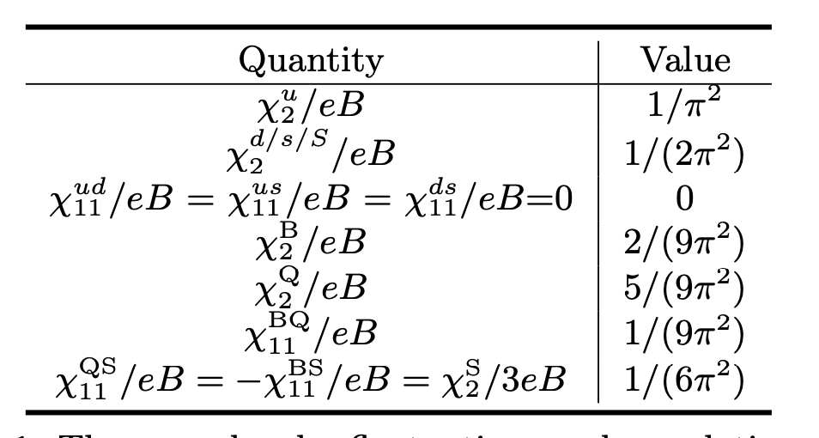
High T: Ideal gas limit
Holds at both eB=0 and eB=/=0 with T→∞

Slide 26
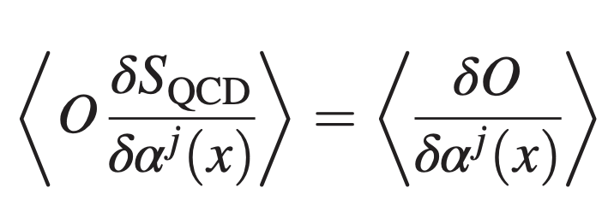
Chiral condensates v.s. screening masses of neutral PS mesons
Ward Identity:
At nonzero magnetic field:
Consider $𝒪$ as a pseudoscalar operator,
and integrate the WI over space-time:
HTD et al.,
PRD 2022,2021
See also cases at eB=0,
Kilcup and Sharpe,
NPB 1987
Hadron susceptibility:
Integral of spatial correlation function
Screening mass $M_{H}$:

Slide 27
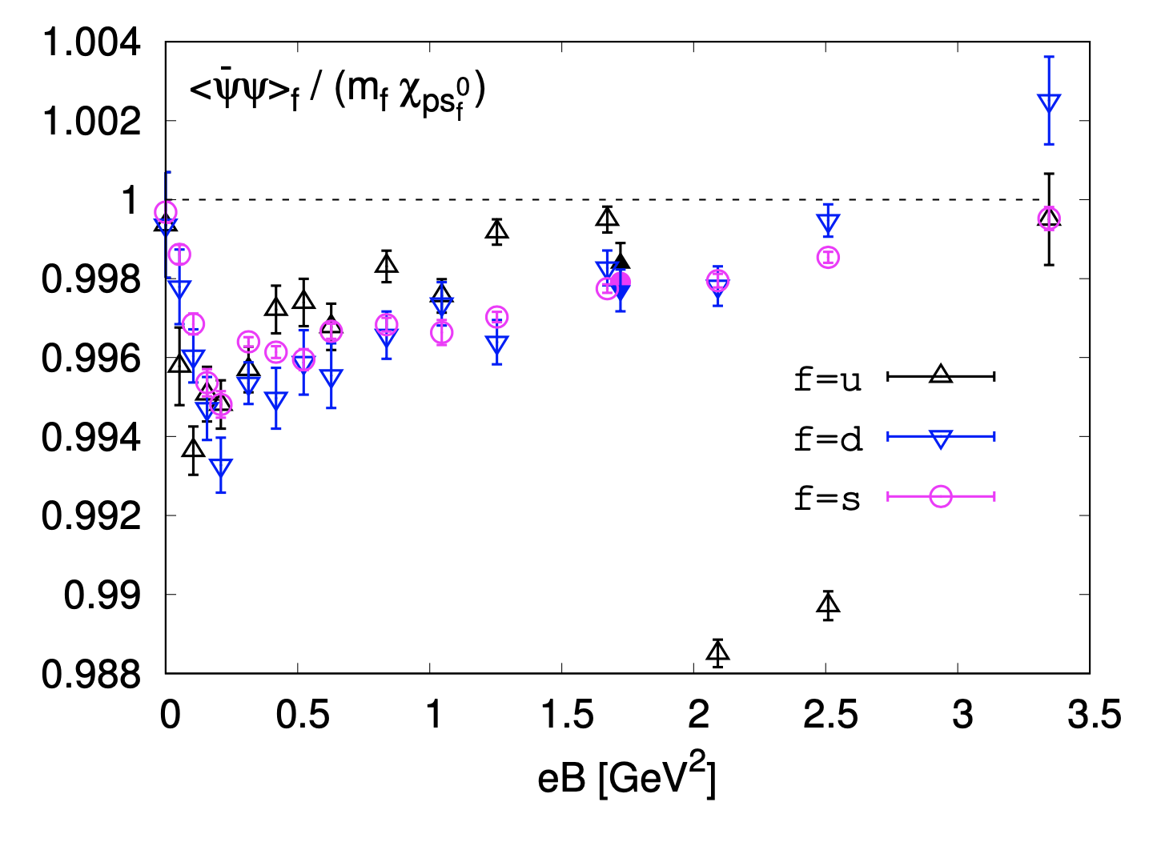
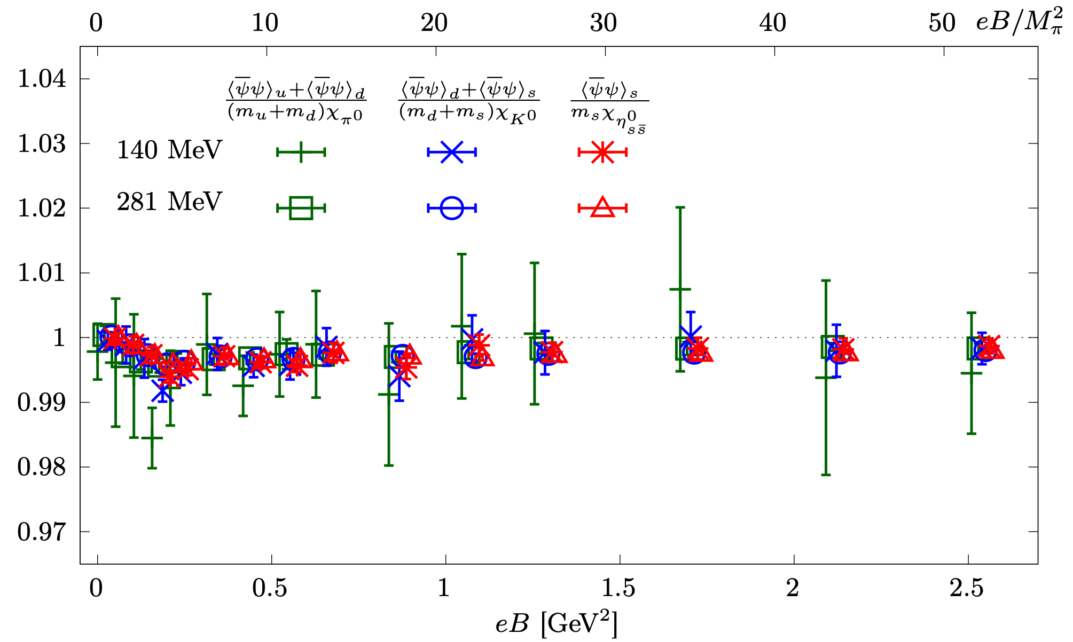
Numerical demonstration of the integrated Ward Identities
T=17 MeV
HTD, S.-T. Li, A. Tomiya, X.-D. Wang, Y. Zhang, Phys.Rev.D 104 (2021) 1, 014505
HTD, S.-T. Li, J.-H. Liu, X.-D. Wang, Phys.Rev.D 105 (2022) 3, 034514

Slide 28
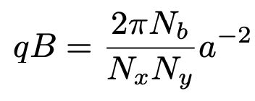
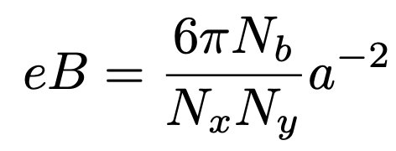
Lattice QCD in strong magnetic fields
No sign problem
B pointing to the z direction & Gauge link multiplied by a U(1) factor
M. D’Elia, S. Mukherjee, F. Sanfilippo,
Phys.Rev.D 82 (2010) 051501,
G. Bali et al., JHEP02(2012)044,
…
Quantization of the magnetic field
qu=2/3e, qd=-1/3e, qs=-1/3e
$a^{−1}$: inverse lattice spacing
$N_{b}$: magnetic flux
$N_{x},N_{y},N_{z}$: number of lattice points in x,y,z directions

Slide 29
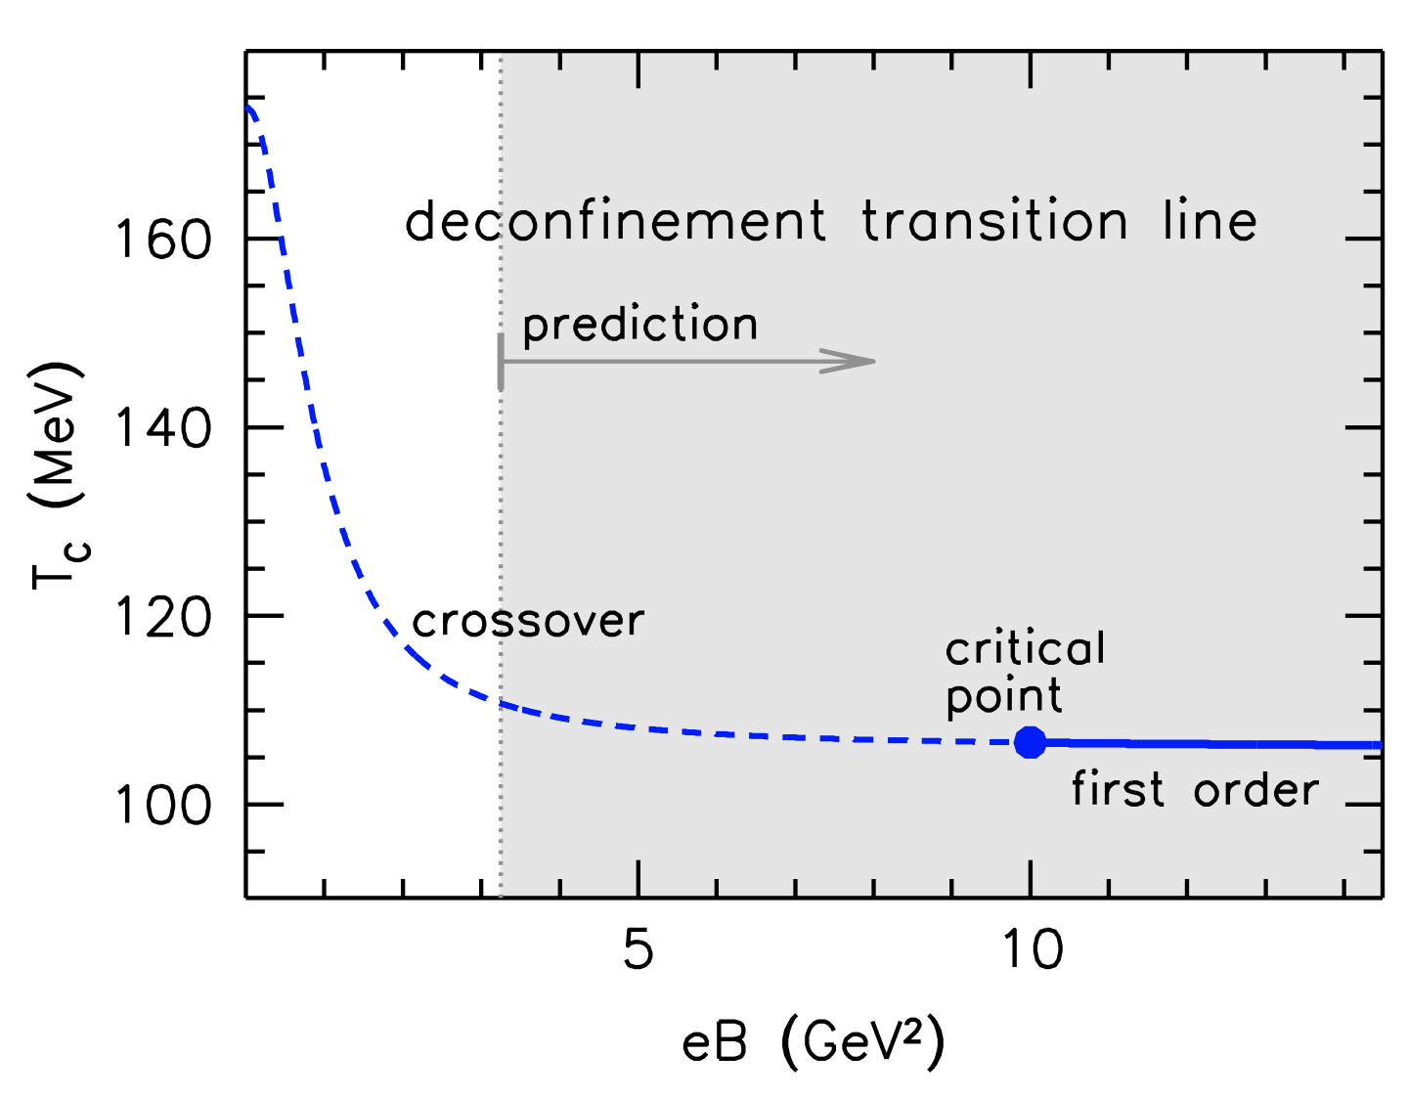
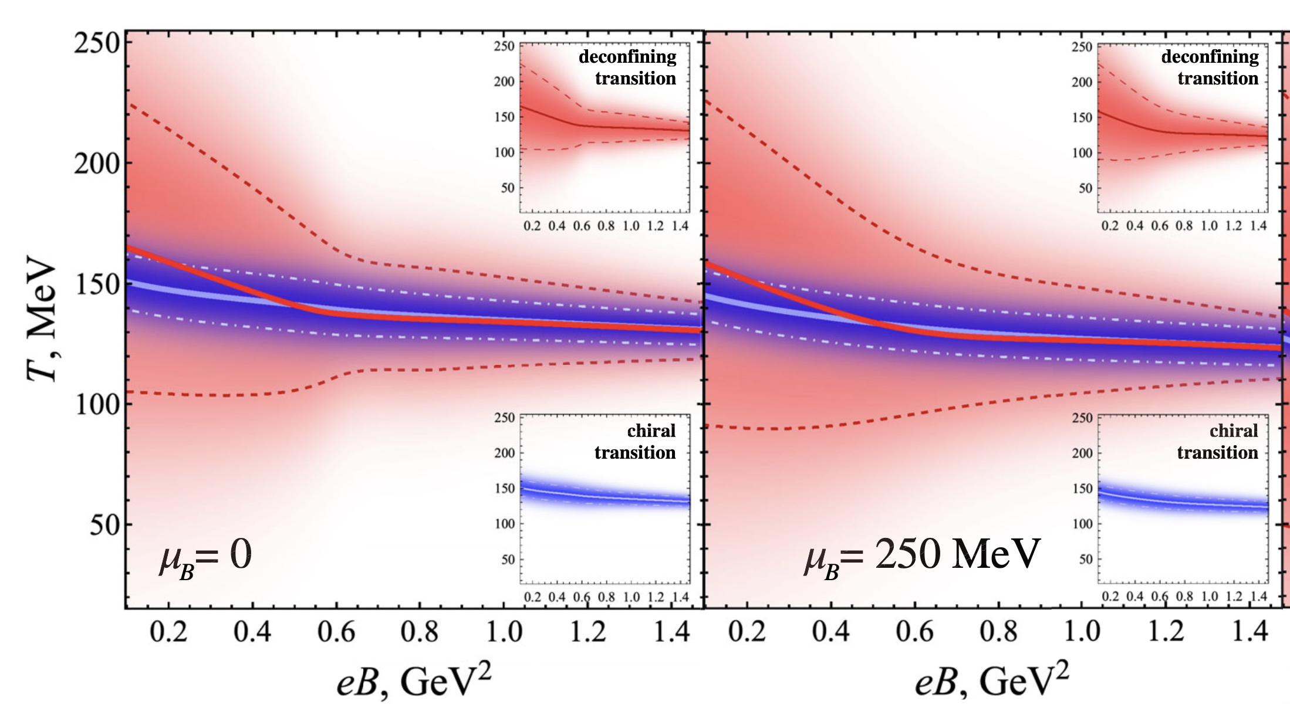
eB induced effects:
Chiral magnetic effects, QCD critical end point…
T-eB plane
Transition at nonzero eB and $μ_{B}$
3
165 $M_{π}^{2}$
549 $M_{π}^{2}$
G. Endrodi, JHEP 1507(2015) 173
V. Braguta et al., Phys.Rev.D 100 (2019) 114503

