Slide 1

Helicity Polarization in Relativistic Heavy Ion Collisions
1. JHG PRD104 (2021) , arXiv:105.08293
2. C. Yi, S. Pu, JHG, D.L. Yang PRC 105 (2022), arXiv: 2112.15531
高建华
山东大学（威海）
QCD物理研讨会暨基金委重大项目年度学术交流会, 2022/07/29

Slide 2
Outline
Introduction
Global/local spin polarization in relativistic heavy ion collisions
Helicity polarization in relativistic heavy ion collisions
Summary

Slide 3
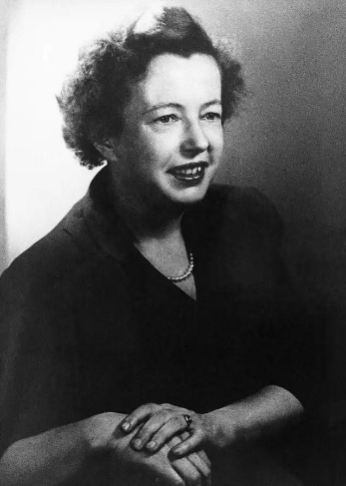
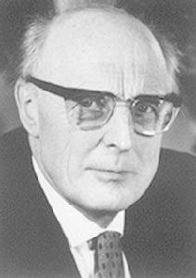
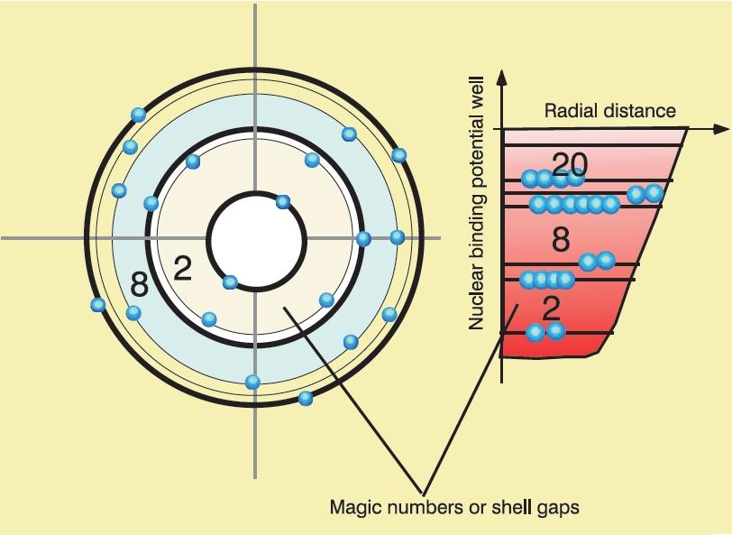
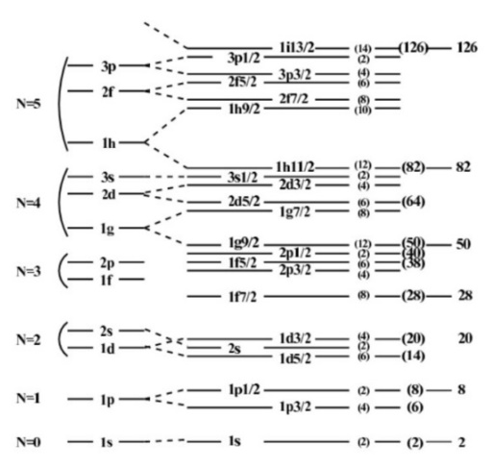


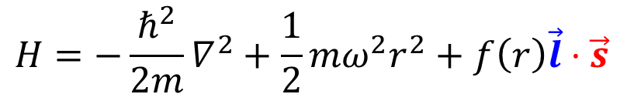

Nuclear shell model
M. G. Mayer
J. H. D. Jensen
1963
Spin-orbital interaction
$$\vec{l}$$
$$\vec{s}$$
$$H=−\frac{ℏ^{2}}{2m}∇^{2}+\frac{1}{2}mω^{2}r^{2}+f\left(r\right)\vec{l}⋅\vec{s}$$

Slide 4
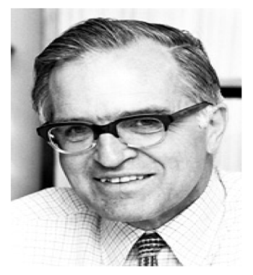

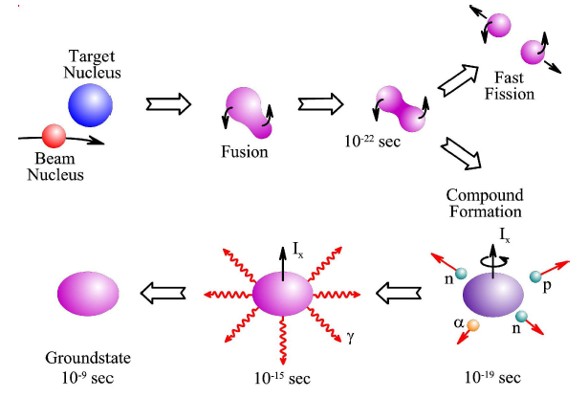


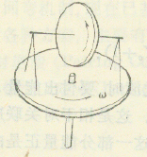
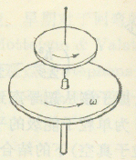

Collective rotation at low energy
Heavy ion fusion evaporation reaction
A. N. Bohr
B. R. Mottelson
High spin state
L. J. Rainwater
1975
Angular-momentum alignment:
$$H_{ω}=H_{0}−\vec{ω}⋅\vec{j}$$
F.S.Stephens Rev.Mod.Phys.1975

Slide 5
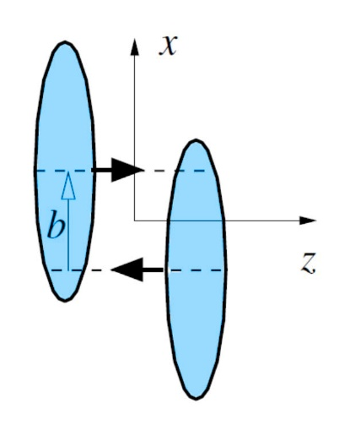
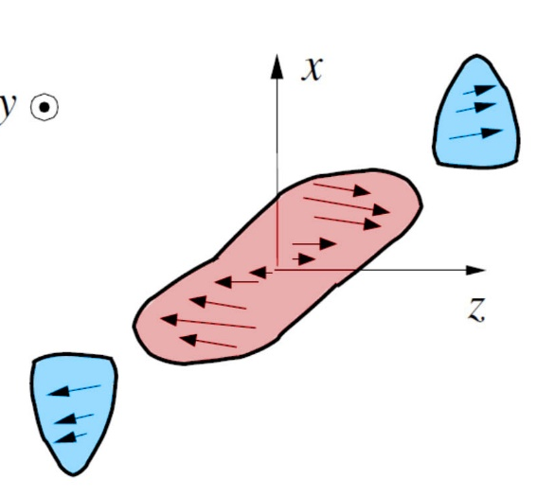
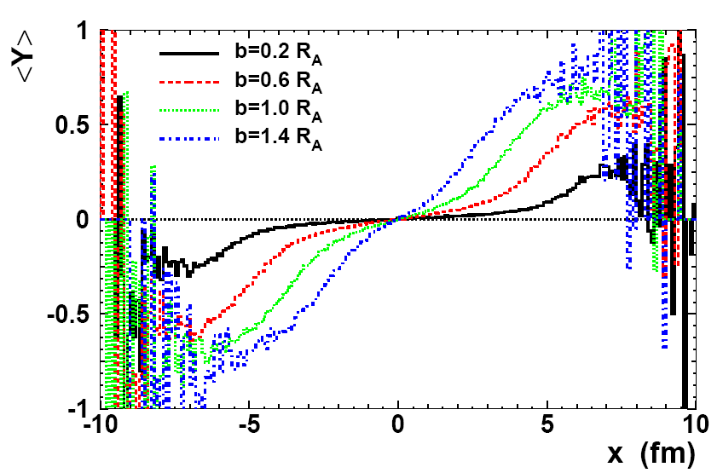



Global and local o.a.m. in relativistic heavy ion collisions
Local o.a.m
Spin polarization
?
$$Δp_{z}$$
$$Δx$$
$$\vec{l}⋅\vec{s}$$
Liang-Wang PRL 2005
Landau fireball model
Bjorken senario
Vorticity
JHG-Chen-Deng-Liang-Wang-Wang PRC 2008

Slide 6
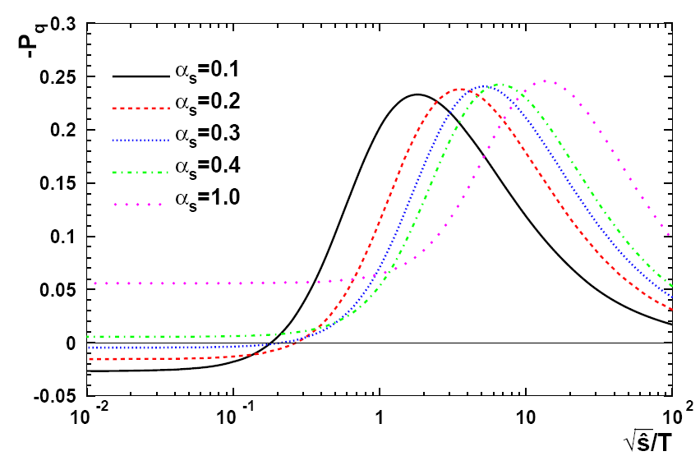
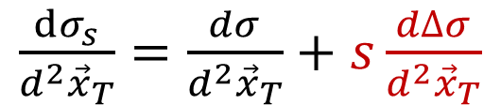


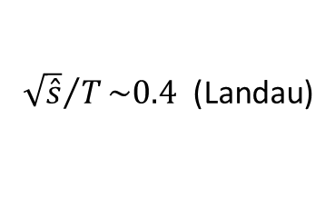


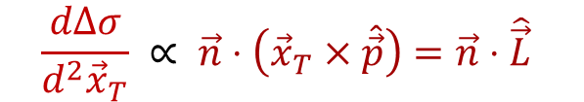

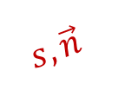
Polarization after single scattering
Single scattering at fixed impact parameter
JHG-Chen-Deng-Liang-Wang-Wang PRC 2008
$$s,\vec{n}$$
1
unpolarized
$$\vec{p}$$
$${\vec{x}}_{T}$$
2
unpolarized
Liang-Wang PRL 2005
$\frac{dσ_{s}}{d^{2}{\vec{x}}_{T}}=$ $\frac{dσ}{d^{2}{\vec{x}}_{T}}+s\frac{dΔσ}{d^{2}{\vec{x}}_{T}}$
$$\frac{dΔσ}{d^{2}{\vec{x}}_{T}} ∝ \vec{n}⋅\left({\vec{x}}_{T}×\hat{\vec{p}}\right)=\vec{n}⋅\hat{\vec{L}}$$
$T:$ Temperature of QGP
$\sqrt{\hat{s}}:$ CM energy of qq
200GeV:
${\sqrt{\hat{s}}}/T\sim 0.4$ (Landau)
$\sim 0.0025$ (Bjorken)
Intuitive method displaying how o.a.m leads to spin polarization

Slide 7
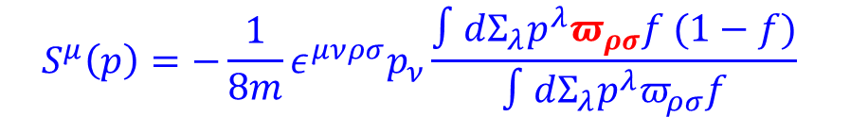
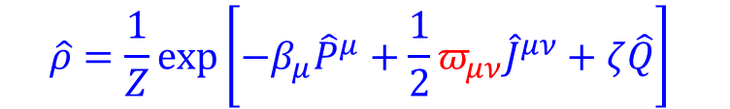




Polarization in equilibrium
Density operator at global equilibrium with given $J^{μν}$
$$\hat{ρ}=\frac{1}{Z}exp\left[−β_{μ}{\hat{P}}^{μ}+\frac{1}{2}π_{μν}{\hat{J}}^{μν}+ζ\hat{Q}\right]$$
Thermal vorticity: $π_{μν}=−\frac{1}{2}\left(∂_{μ}β_{ν}−∂_{ν}β_{μ}\right)$,
$$β_{μ}=u_{μ}/T$$
Becattini-Chandra-Del Zanna-Grossi Annals Phys. 2013
Spin polarization vector in phase space for spin ½ particles
$$S^{μ}\left(x,p\right)=−\frac{1}{8m}\left(1−f\right)ε^{μνρσ}p_{ν}π_{ρσ}$$
$f:$Fermi-Dirac distribution
Also: Fang-Pang-Wang-Wang PRC 2016
Spin polarization vector at freezeout hypersurface in heavy ion collisions:
$$S^{μ}\left(p\right)=−\frac{1}{8m}ε^{μνρσ}p_{ν}\frac{∫dΣ_{λ}p^{λ}π_{ρσ}f (1−f)}{∫dΣ_{λ}p^{λ}π_{ρσ}f}$$

Slide 8

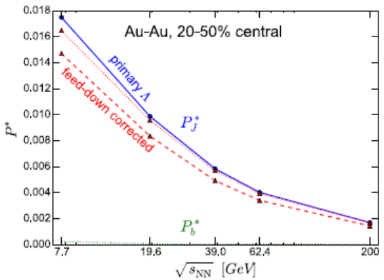
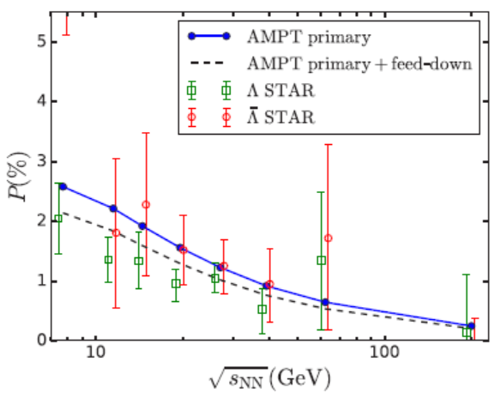
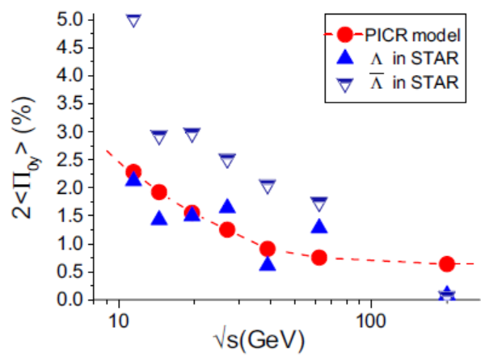
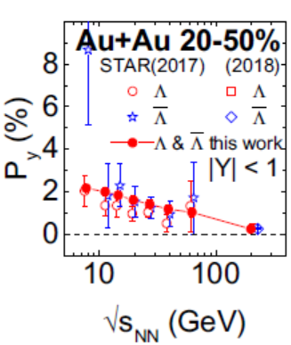
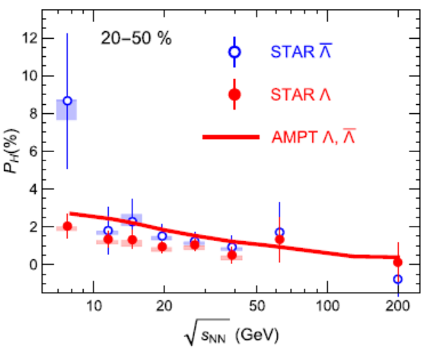
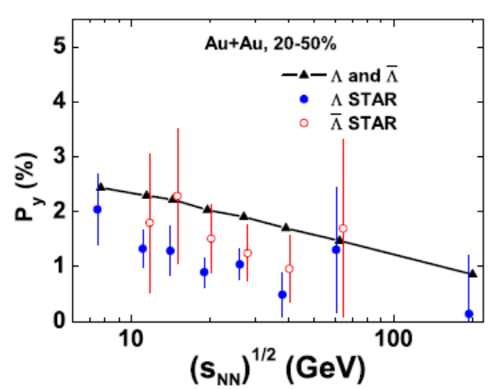
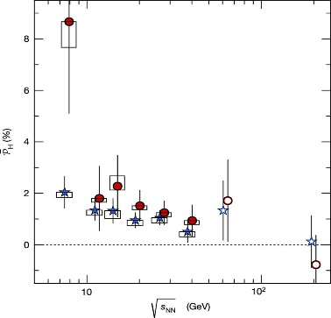

Global polarization in heavy ion collisions
Karpenko-Becattini EPJC 2017
Xie-Wang-Csernai PRC 2017
Li-Pang-Wang-Xia PRC 2017
Sun-Ko PRC 2019
Shi-Li-Liao PLB 2019
Wei-Deng-Huang PRC 2019
$$\sqrt{s_{NN}}(GeV)$$
Quantitatively consistent !

Slide 9
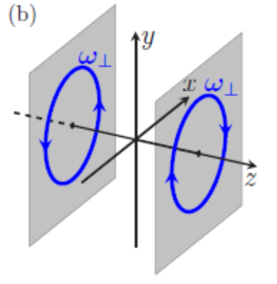
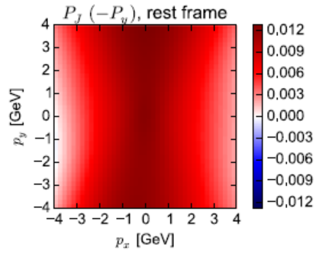
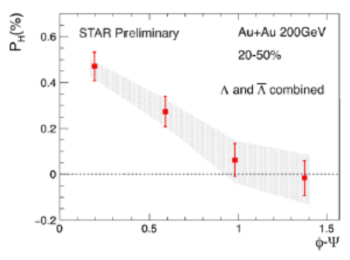

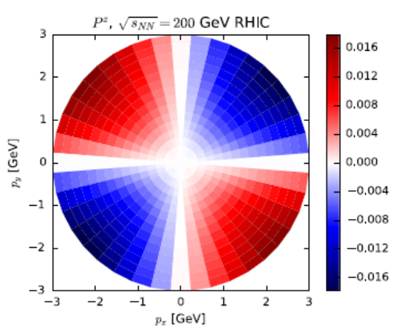
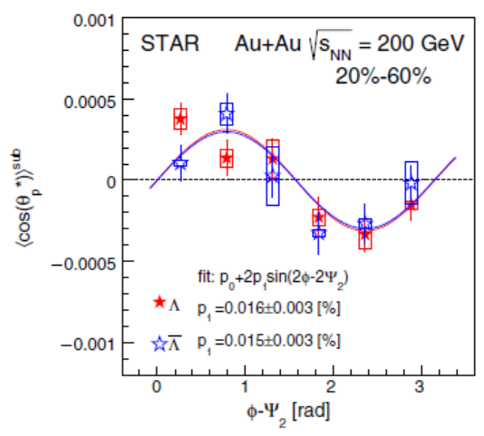





Local polarization in heavy ion collisions
Transverse
vorticity
$$⇒$$
$$⇎$$
Xia-Li-Tang-Wang PRC 2018
Becattini-Karpenko PRL 2018
y
Longitudinal
vorticity
⊙
⊕
$$ω_{z}$$
$$⇒$$
$$⇎$$
⊕
⊙
x
Qualitatively inconsistent!
Feed down effects can not solve it: Xia-Li-Huang-Huang PRC 2019; Becattini-Cao-Speranza EPJC2019

Slide 10
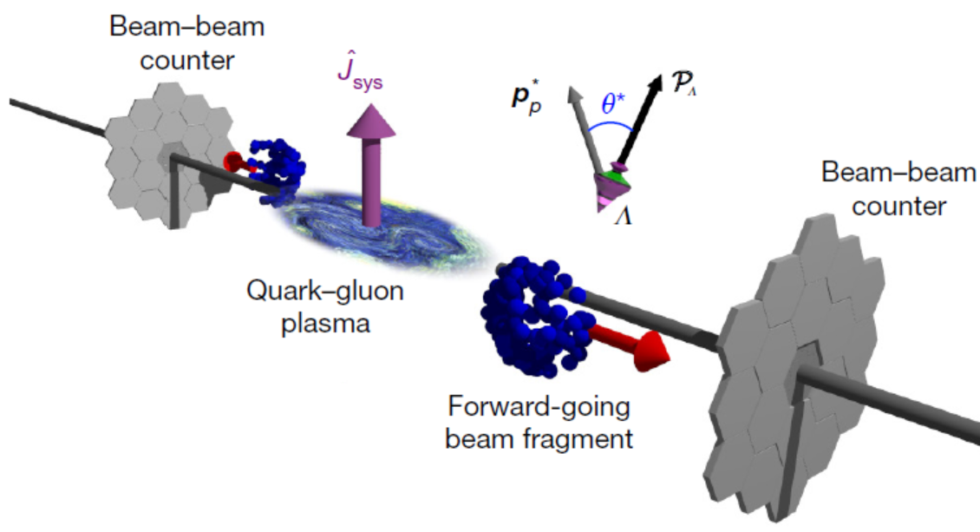


Helicity polarization in Heavy ion collisions
Out-plane direction polarization (transverse polarization)
Polarization along the particle’s momentum
$$\vec{p}$$
Helicity polarization
JHG PRD 2021
$$Λ$$
STAR Nature 2017
Beam direction polarization (longitudinal polarization)
Jacob-Rafelski PLB 1987; Ambrus-Chernodub 1912.11034 , EPJC 2022,; Ambrus JHEP 2020;
Finch-Murray PRC 2017; Becattini-Buzzegoli-Palermo-Prokhorov PLB 2021 ……

Slide 11





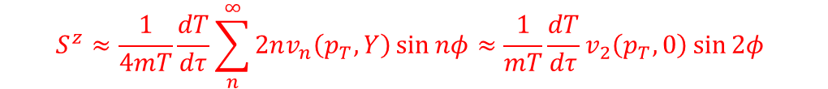
Helicity polarization from vorticity
Helicity polarization from vorticity tensor:
$$S^{μ}\left(p\right)=−\frac{1}{8m}ε^{μνρσ}p_{ν}\frac{∫dΣ_{λ}p^{λ}π_{ρσ}n_{F}(1−n_{F})}{∫dΣ_{λ}p^{λ}π_{ρσ}n_{F}}$$
$$S^{h}\left(p\right)≡\hat{\vec{p}}⋅\vec{S}=\frac{1}{8m}\frac{\int{dΣ_{λ}p^{λ} \hat{\vec{p}}⋅\left(\vec{∇}×β\vec{u}\right)f\left(1−f\right)}}{\int{dΣ_{λ}p^{λ} f}}$$
Helicity polarization detects $\vec{∇}×β\vec{u}$: spatial thermal vorticity in lab frame!
Ideal fluid with temperature vorticity and $T=T(τ)$:
$$Ω_{μν}=∂_{μ}\left(Tu_{ν}\right)−∂_{ν}\left(Tu_{μ}\right)=0$$
$$S^{μ}≈\frac{1}{4mT}\frac{dT/dτ}{\int{dΣ_{λ}p^{λ} f}}p_{ν}∂_{σ}^{p}\int{dΣ_{λ}p^{λ} f}(ε^{μν0σ}\cosh{η}−ε^{μν3σ}\sinh{η})$$
Becattini-Karpenko PRL 2018
$$S^{z}$$
$$S^{h}$$
At central rapidity region:
$$S^{z}≈\frac{1}{4mT}\frac{dT}{dτ}\sum_{n}^{∞}{2nv_{n}\left(p_{T},Y\right)\sin{nφ}}≈\frac{1}{mT}\frac{dT}{dτ}v_{2}\left(p_{T},0\right)\sin{2φ}$$
$$S^{h}=YS^{z}$$
Leading contribution is Y odd !
We should detect it with $Y>0$or $Y<0$ separately :
Yi-Pu-JHG-Yang PRC 2022
JHG PRD 2021

Slide 12


Helicity polarization from vorticity
$$P_{H}≈\frac{ΔY^{3}}{3}\frac{dT}{dτ}\frac{∂v_{1}\left(p_{T},Y\right)}{∂Y} {\left.​\right|}_{Y=0}sin φ$$
: next leading contribution
$$Y∈(−ΔY,ΔY)$$
Yi-Pu-JHG-Yang PRC 2022

Slide 13


Helicity polarization from shear tensor and acceleration
$${Δ^{μα}Δ^{νβ}(∂}_{α}u_{β}+∂_{β}u_{α}−\frac{1}{3}Δ_{αβ}∂⋅u)$$
$$u⋅∂u_{α}−\frac{1}{T}∂_{α}T$$
Yi-Pu-JHG-Yang PRC 2022
Thermal vorticity dominates over other contributions

Slide 14

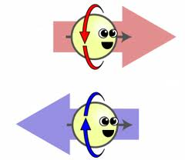


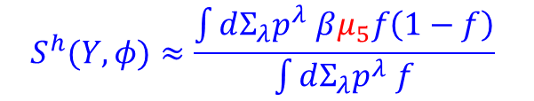
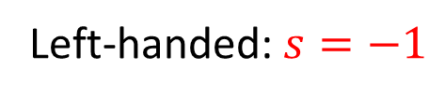
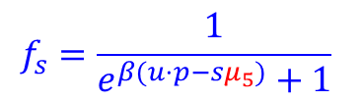
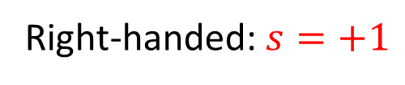
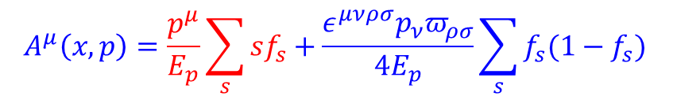
Helicity polarization from helicity charge
Helicity
Chirality
Right-handed:$s=+1$
Left-handed:$s=−1$
Spin polarization vector can be represented by axial Wigner function:
$$A^{μ}\left(x,p\right)=\frac{p^{μ}}{E_{p}}\sum_{s}{sf_{s}}+\frac{ε^{μνρσ}p_{ν}π_{ρσ}}{4E_{p}}\sum_{s}{f_{s}(1−f_{s})}$$
$$f_{s}=\frac{1}{e^{β(u⋅p−sμ_{5})}+1}$$
$μ_{5}$: helicity or axial charge chemical potential describing imbalance between right-handed and left-handed
$$S^{h}(Y,φ)≈\frac{\int{dΣ_{λ}p^{λ} βμ_{5}f\left(1−f\right)}}{\int{dΣ_{λ}p^{λ} f}}$$
$S^{y}(Y,φ)=\frac{\sin{φ}}{\cosh{Y}}S^{h}(Y,φ)$
$S^{z}(Y,φ)=\frac{\sinh{Y}}{\cosh{Y}}S^{h}(Y,φ)$
How the helicity charge can be generated?

Slide 15
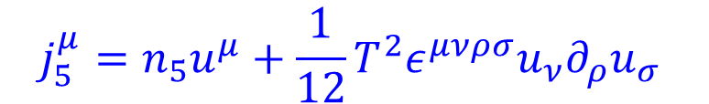
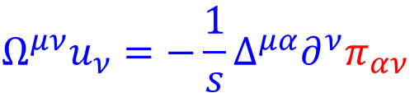


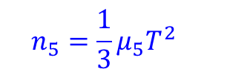

Helicity redistribution from relativistic hydrodynamics
Relativistic uncharged hydrodynamics :
temperature vorticity
$$∂_{μ}T^{μν}=0$$
$$Ω^{μν}u_{ν}=−{\frac{1}{s}Δ}^{μα}∂^{ν}π_{αν}$$
$$T^{μν}=\left(ε+P\right)u^{μ}u^{ν}−Pg^{μν}+π^{μν}$$
entropy density
The evolution of axial charge in the background of relativistic hydrodynamics :
$$j_{5}^{μ}=n_{5}u^{μ}+\frac{1}{12}T^{2}ε^{μνρσ}u_{ν}∂_{ρ}u_{σ}$$
$$n_{5}=\frac{1}{3}μ_{5}T^{2}$$
$$∂_{μ}j_{5}^{μ}=0$$
Chiral anomaly from T vorticity:
$$∂_{μ}(n_{5}u^{μ})=−\frac{1}{24}Ω_{μν}{\tilde{Ω}}^{μν}$$
$$∂_{μ}\left(n_{5}u^{μ}\right)=−\frac{1}{6s}{\tilde{Ω}}_{μρ} u^{ρ}∂_{ν}π^{μν}=\frac{1}{6s}{\tilde{Ω}}_{μρ} u^{ρ}Δ_{νλ}(∂^{λ}π^{μν}−π^{μν}∂^{λ}\ln{T})$$
Helicity redistribution from zero only happens in viscous hydrodynamics!

Slide 16
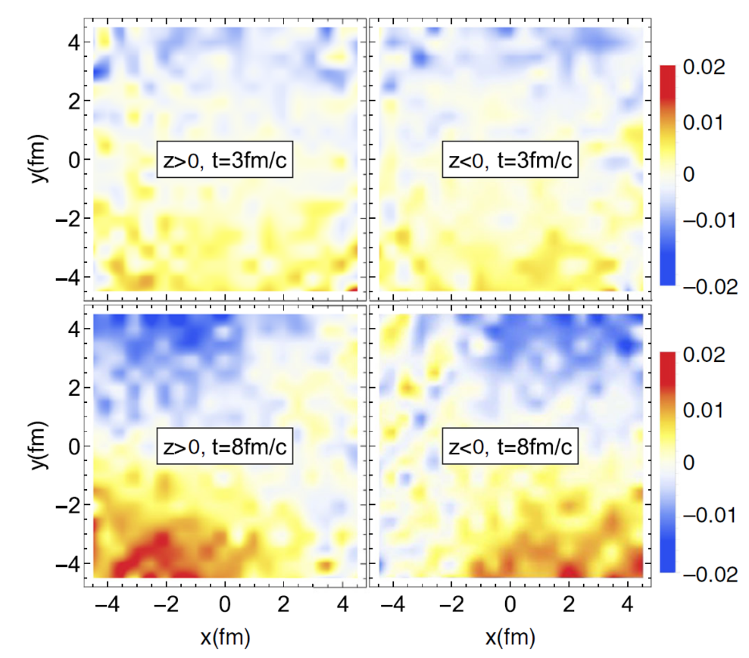
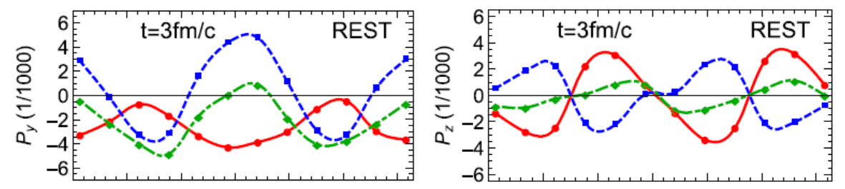
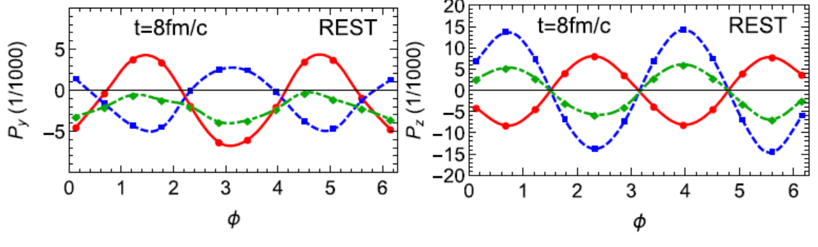
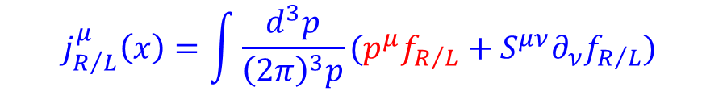
Helicity redistribution from chiral kinetic equation
Helicity charge redistribution
$$j_{R/L}^{μ}\left(x\right)=\int{\frac{d^{3}p}{{\left(2π\right)}^{3}p}}(p^{μ}f_{R/L}+S^{μν}∂_{ν}f_{R/L})$$
Liu-Sun-Ko PRL 2020
Local polarization: vorticity tensor + shear tensor + helicity redistribution, ….

Slide 17
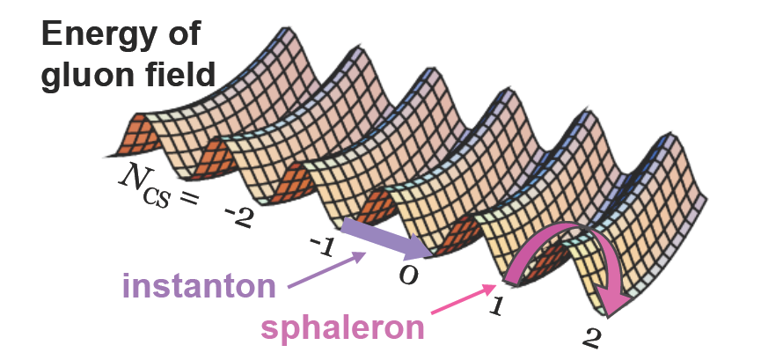
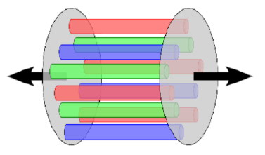
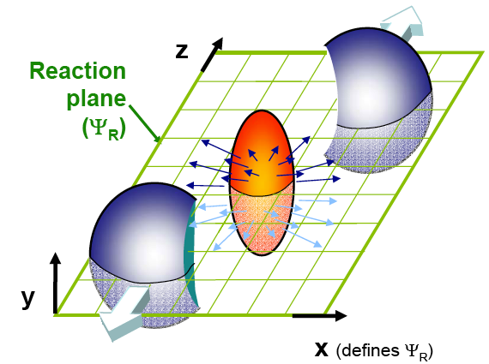
Event-by-event net helicity charge
Event-by-event net helicity charge can be induced:
QCD sphaleron transitions
Classical color longitudinal field
local parity violation
McLerran-Mottola-Shaposhnikov PRD 1991 … …
Kharzeev-Krasmitz-Venugopalan PLB 2002 … …
Chiral magnetic effect

Slide 18









Initial net helicity charge
Detect net helicity charge by correlation of two hyperons?
$$H_{1}$$
Hyperon 1:
$$\frac{dN_{1}}{d\cos{θ_{1}^{∗}}}=\frac{1}{2}(1+α_{H_{1}}P_{H_{1}}\cos{θ_{1}^{∗}})$$
$$θ^{∗}$$
P
Hyperon 2:
$$\frac{dN_{2}}{d\cos{θ_{2}^{∗}}}=\frac{1}{2}(1+α_{H_{2}}P_{H_{2}}\cos{θ_{2}^{∗}})$$
H
Helicity polarization correlation:
$$C_{H_{1}H_{2}}=\left\langle \frac{dN_{1}}{d\cos{θ_{1}^{∗}}}\frac{dN_{2}}{d\cos{θ_{2}^{∗}}}\cos{θ_{1}^{∗}}\cos{θ_{2}^{∗}}\right\rangle =\frac{1}{4}α_{H_{1}}α_{H_{2}}P_{H_{1}}P_{H_{2}}$$
$$H_{2}$$
The same hyperons:
$$C_{HH}=\frac{1}{4}α_{H}^{2}P_{H}^{2}$$
Hyperon and antihyperon:
$$C_{H \overline{H}}=−\frac{1}{4}α_{H}^{2}P_{H}^{2}$$
($P_{H}=P_{\overline{H}}$)
$C_{H_{1}H_{2}}$: no need for determining reaction plane and external magnetic field, can exist in central HIC.
Other work on helicity correlation: Becattini-Buzzegoli-Palermo PLB 2021

Slide 19
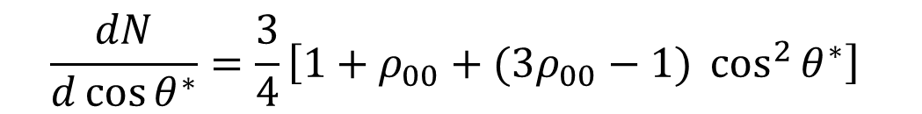




Spin alignment of vector mesons
$$\frac{dN}{d\cos{θ^{∗}}}=\frac{3}{4}\left[1+ρ_{00}+(3ρ_{00}−1) \cos^{2}{θ^{∗}}\right]$$
M
$$θ^{∗}$$
Spin alignment:
$$ρ_{00}≠\frac{1}{3}$$
$$Δ=ρ_{00}−\frac{1}{3}≠0$$
Liang-Wang PLB 2005
Helicity charge lead to spin alignment along $x$, $y$, $z$ axis:
V
$$ρ_{00}^{x}=\frac{1}{3}−\frac{1}{2}Δ\left(1−3\sin^{2}{θ}\cos^{2}{φ}\right), ρ_{00}^{y}=\frac{1}{3}−\frac{1}{2}Δ\left(1−3\sin^{2}{θ}\sin^{2}{φ}\right), ρ_{00}^{z}=\frac{1}{3}+\frac{1}{2}Δ\left(2−3\sin^{2}{θ}\right)$$
$ρ_{00}^{x}+ρ_{00}^{y}+ρ_{00}^{z}=$1
$$\hat{p}=(\sin{θ}\cos{φ},\sin{θ}\sin{φ},\cos{θ})$$
The averaged $ρ_{00}^{x}$, $ρ_{00}^{y}$, $ρ_{00}^{z}$ at $Y=0$ are given by:
JHG PRD 2021
$${\overline{ρ}}_{00}^{x}=\frac{1}{3}+\frac{1}{4}Δ+\frac{3}{4}v_{2}Δ, {\overline{ρ}}_{00}^{y}=\frac{1}{3}+\frac{1}{4}Δ−\frac{3}{4}v_{2}Δ, {\overline{ρ}}_{00}^{z}=\frac{1}{3}−\frac{1}{2}Δ$$

Slide 20






Spin alignment of vector mesons
Recombination:
$$P_{hyperon} ∝\left\langle P_{q}\right\rangle$$
$$Δ=ρ_{00}−\frac{1}{3}∝\left\langle P_{q}^{2}\right\rangle$$
$$not {\left\langle P_{q}\right\rangle }^{2}$$
JHG PRD 2021
Sheng-Oliva-Wang PRD 2020； Sheng-Wang-Wang PRD 2020
Xia-Li-Huang-Huang PLB 2021
Local fluctuation in one event + event-by-event fluctuation
$$\left\langle ω^{2}\right\rangle ≫{\left\langle ω\right\rangle }^{2}$$
$$\left\langle P_{q}^{2}\right\rangle ≫{\left\langle P_{q}\right\rangle }^{2}$$
$C_{H_{1}H_{2}}$measures global helicity charge in heavy ion collisions
$Δ$measures local helicity charge and fluctuation in heavy ion collisions!

Slide 21
Summary
Helicity polarization detects spatial vorticity and helicity charge.
Helicity polarization gets dominant contribution from thermal vorticity.
Helicity correlation of hyperons detects local parity violation.
Helicity alignment detects local helicity polarization.
Thanks for your attention !

