Slide 1
RHIC-STAR实验 光致产生过程的研究进展
杨 驰
山东大学
QCD物理研讨会暨重大项目学术交流会
2022年7月29-31日，青岛

Slide 2
Outline
Introduction
Polarized photon-photon fusions
Polarized photon-nuclear interactions
Summary

Slide 3
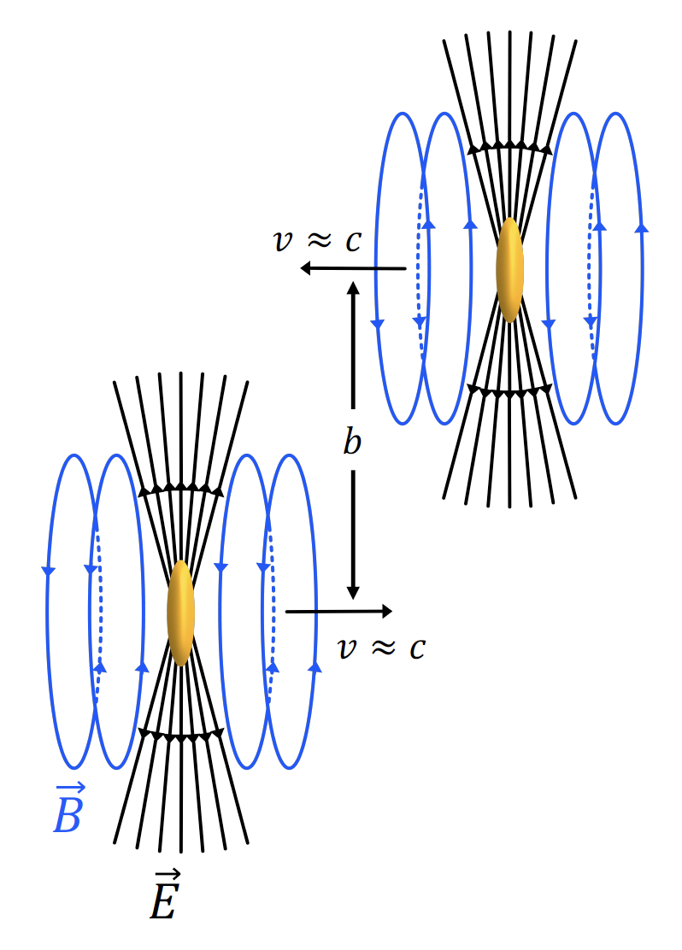
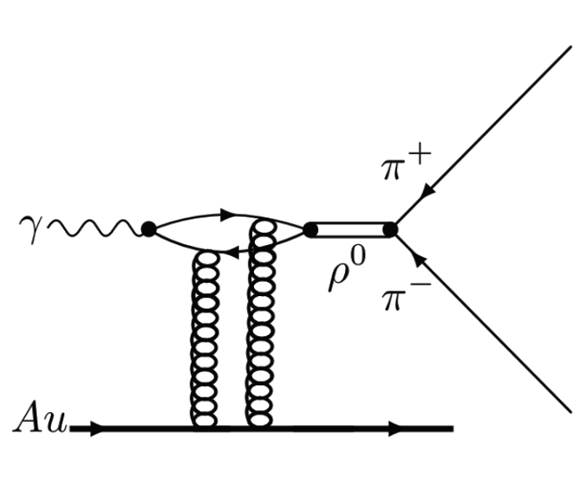
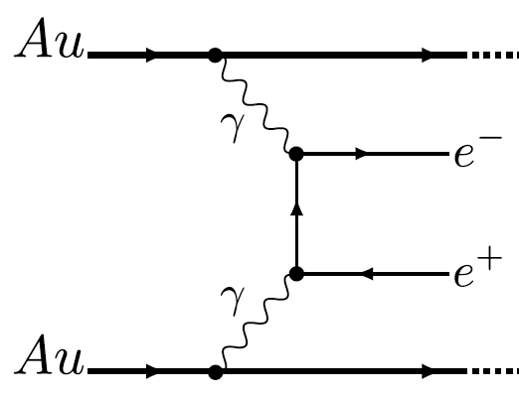
Photon-induced Processes in HICs
EM fields is highly compressed in HICs
Equivalent to quasi-real photons moving alone the beam direction
These photons may then interact with the other nucleus/photons
$$γγ→l^{+}l^{−}$$
$$γℙ→J/ψ{\left(ρ^{0}\right)→l}^{+}l^{−}(π^{+}π^{−})$$

Slide 4
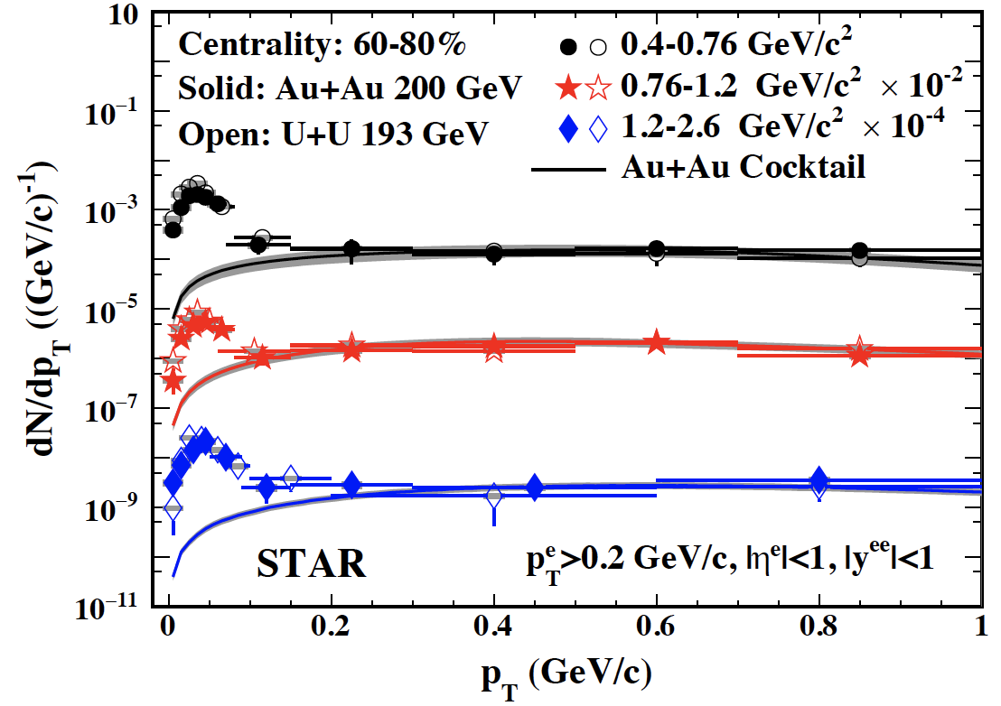
Reminder: Photon-induced e⁺e⁻ in Au+Au and U+U
Phys. Rev. Lett. 121, 132301 (2018)
$$γγ→e^{+}e^{−}$$
Significant enhancement
Excesses concentrate below p_{T} ≈ 0.15 GeV/c
Coherent photon-photon interactions in HHICs

Slide 5
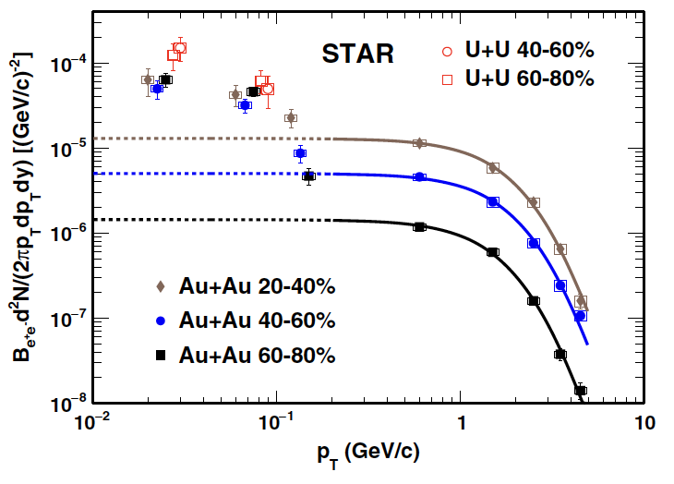
Reminder: Photon-induced J/psi in Au+Au and U+U
Phys. Rev. Lett. 123, 132302 (2019)
$$γℙ→J/ψ{→e}^{+}e^{−}$$
Significant enhancement
Excesses concentrate below p_{T} ≈ 0.15 GeV/c
Coherent photon-nucleon interactions in HHICs

Slide 6
Affected by Strong Magnetic Field？
$\left\langle p_{T}^{2}\right\rangle$ higher than QED expectation

Slide 7
In UPC
We Proceed as We Planned
Provide baseline
Exclusive and clean dielectron detection
Individual e should be preferentially aligned longitudinally
Azimuthal angle between the e⁺e⁻ pair momentum and the individual e momenta should display modulations
In HHIC
Study extreme magnetic field and potential medium effect
A+A centralities and different species (A+B, STAR isobaric data)
Kinematics WRT B-field (reaction plane), mass, p_{T}, longitudinal alignment
From Chi’s ISMD2019 talk

Slide 8
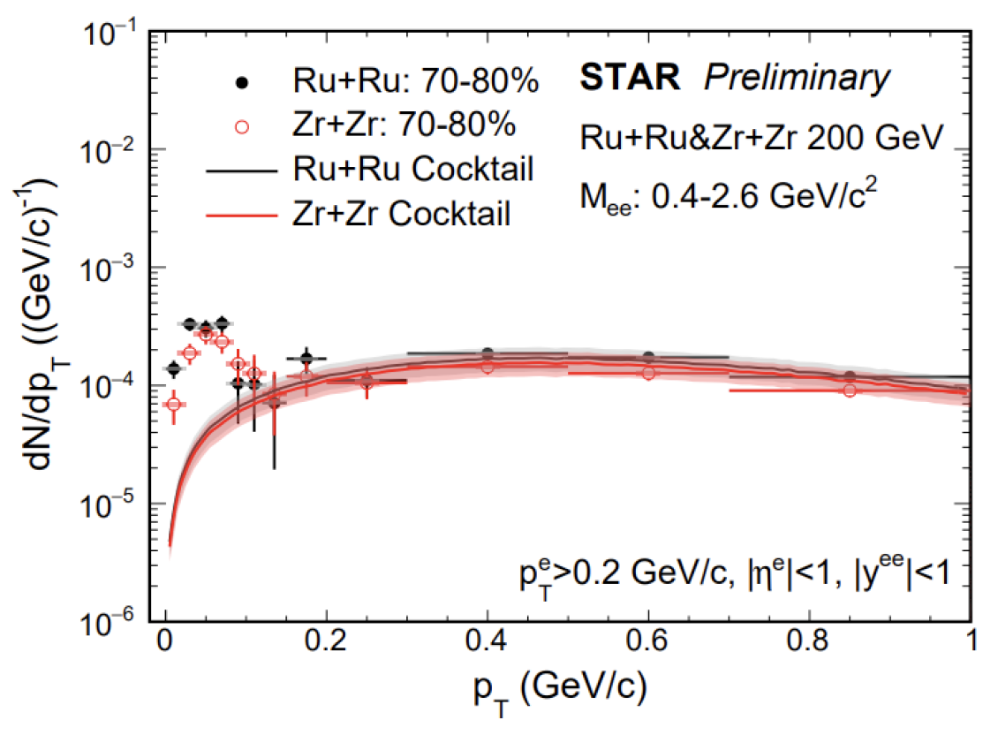
Photon-induced e⁺e⁻ in Ru+Ru and Zr+Zr
$$γγ→e^{+}e^{−}$$
Significant enhancement
Excesses concentrate below p_{T} ≈ 0.15 GeV/c
Similar to the structures in Au+Au and U+U

Slide 9
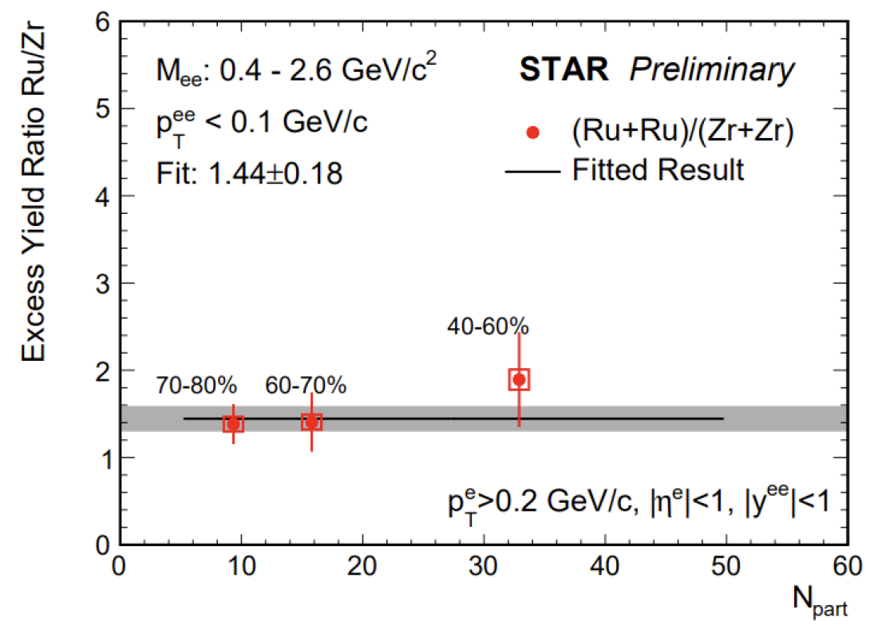
Photon-induced e⁺e⁻ in Ru+Ru and Zr+Zr
EPA-QED: W. Zha et al, Phys. Lett. B 789 (2019) 238-242
About 2.4𝜎 higher than unity
The ratio of excess yield at low-p_{T} is consistent with Z⁴ scaling
The initial EM fields seem to be different

Slide 10
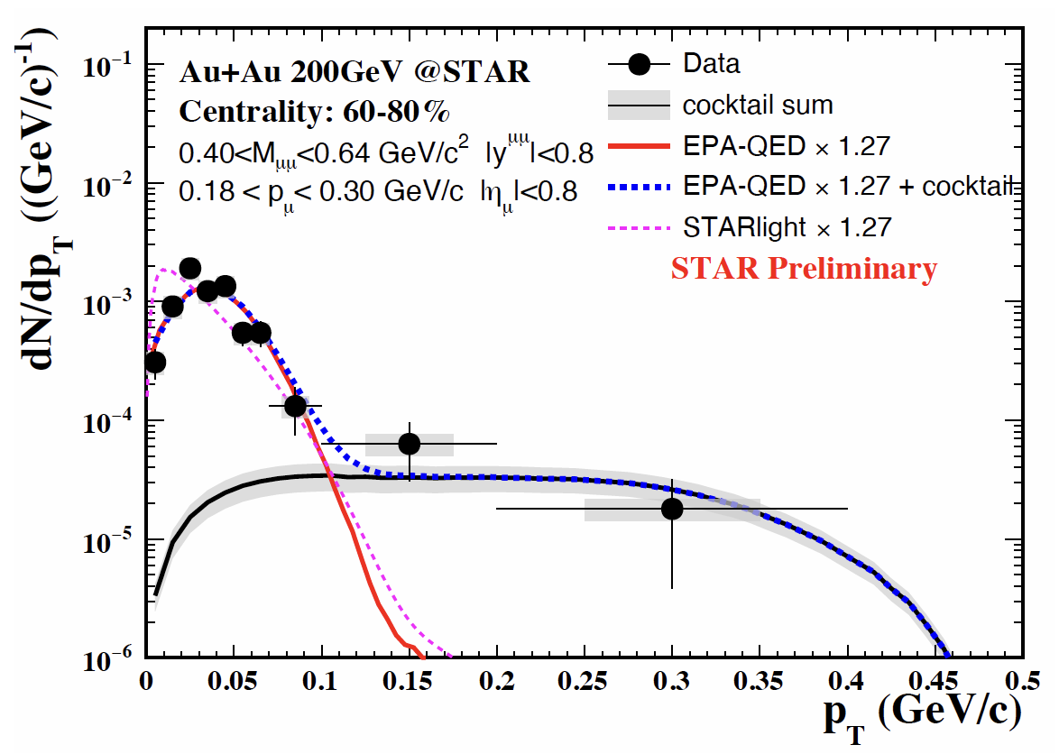
Photon-induced 𝛍⁺𝛍⁻ in Au+Au and U+U
Photon-induced 𝛍⁺𝛍⁻ pairs observed
Mass shapes are different due to the STAR acceptance

Slide 11
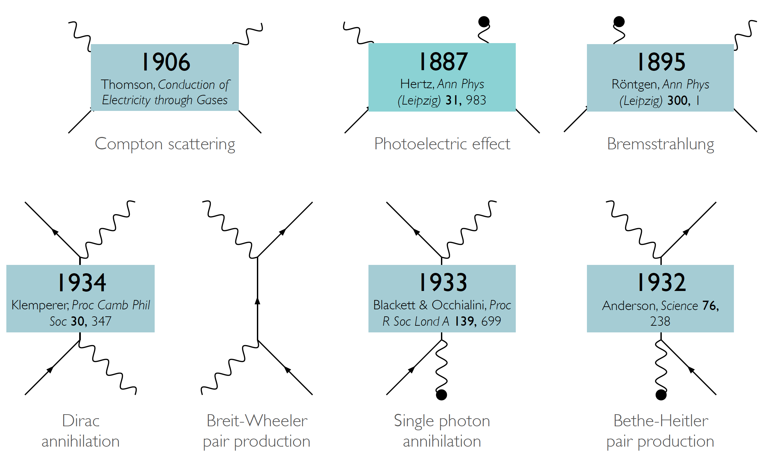
Fundamental Interactions: Light & Matter
Plots from O. Pike
Phys. Rev. 46, 1087 (1934)
Breit-Wheeler process as baseline

Slide 12
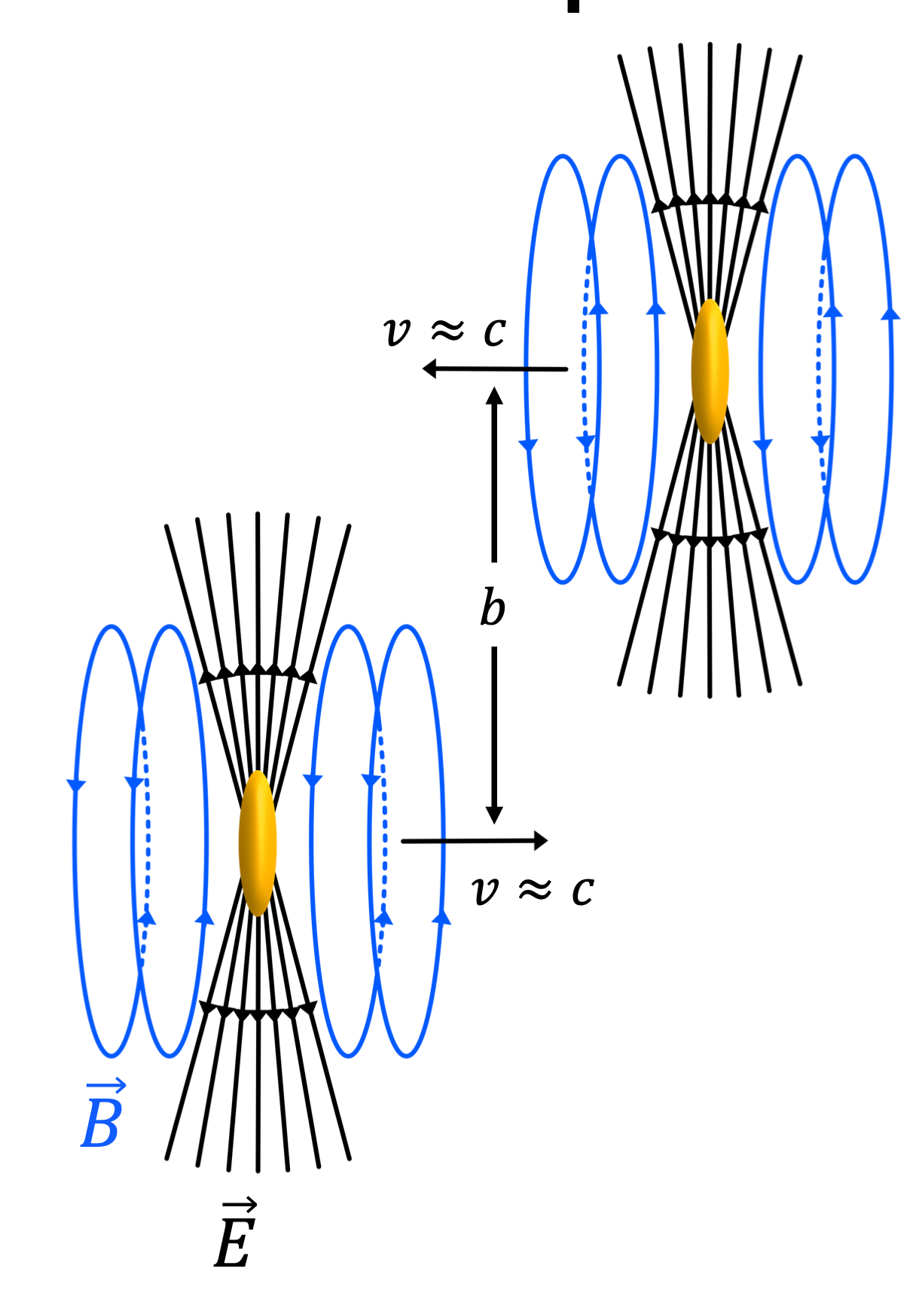
Ultra-Peripheral Collisions Provide Opportunities
Main challenges in detection:
Peak of the same order of that in Compton scattering and Dirac annihilation.
Center-of-mass energy > 2m_{e}
High photon density need.
Test QED under extreme conditions
b>2R_{A}
UPC of heavy ions solve the central challenges:
Highly Lorentz contracted EM field, quantized as a flux of quasi-real photons
|B|~10¹⁴⁻¹⁶T
High photon density: Z𝛂～1
Z⁴~40,000,000 times higher yield than collisions of single charged particle pairs
Clean background, no hadronic collisions

Slide 13
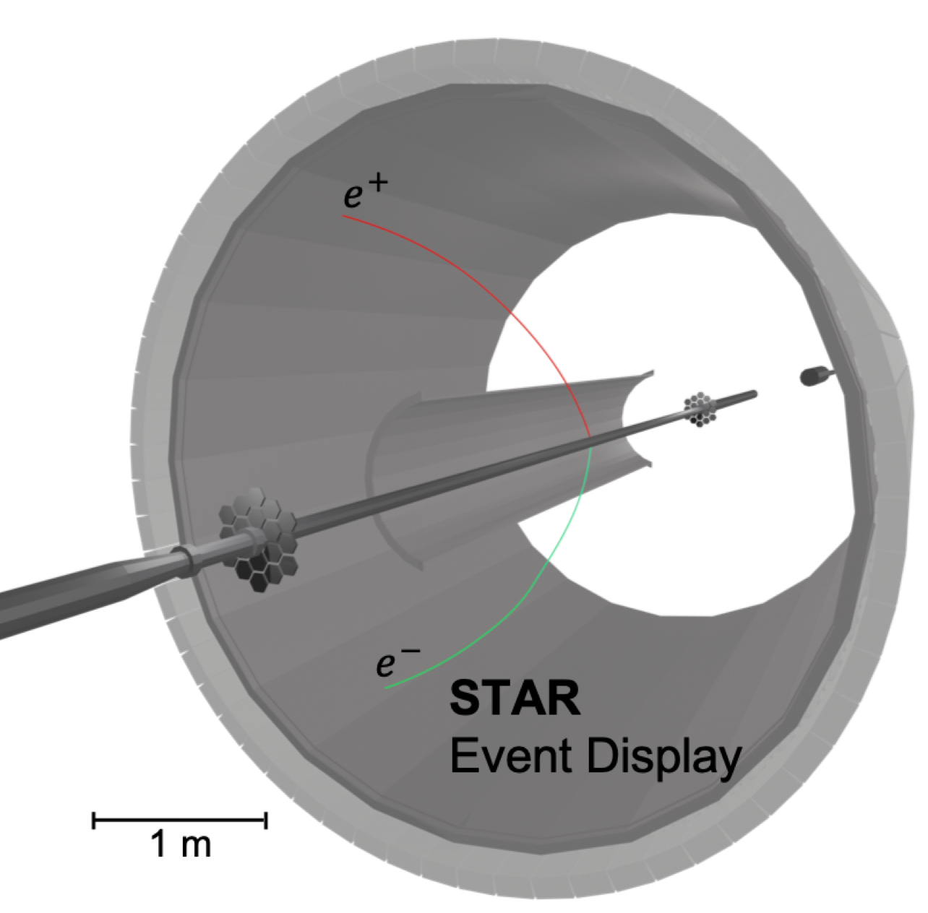
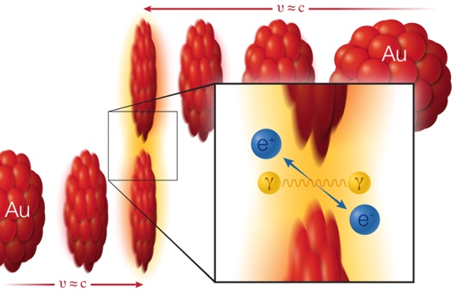
Search for Breit-Wheeler Process at RHIC-STAR
Phys. Rev. Lett. 127, 052302 (2021)
1. Observe 6085 exclusive e⁺e⁻ pairs from data collected in 2010 at STAR.
2. No vector meson contribution visible
3. Energy spectrum
4. Photon transverse polarization & spatial distribution

Slide 14
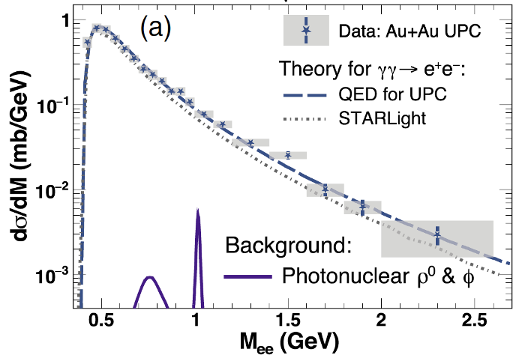
Cross-Section in STAR Acceptance
Phys. Rev. Lett. 127, 052302 (2021)
No vector meson production
Pure QED 2->2 scattering
S.R. Klein, et.al, Compt.Phys. Commun.212, 258 (2017)
W.Zha, et.al, Phys.Lett.B 800, 135089 (2020)
C.Li, et.al, Phys.Rev. D 101, 034015 (2020)
STARLight: 0.22mb
Generalized EPA: 0.26mb
QED: 0.26mb
𝝈($γγ→e^{+}e^{−}$) in STAR Acceptance:
0.261 ± 0.004(stat.) ± 0.013(sys.) ± 0.034(scale) mb
Measured cross-section consist with various theory calculations within ± 1𝝈

Slide 15
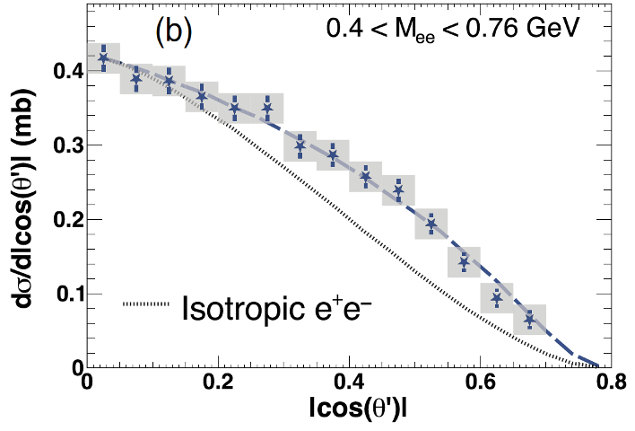
Polar Angle and Transverse Momentum Distribution
Phys. Rev. Lett. 127, 052302 (2021)
𝜃’: angle of the e⁺ momentum w.r.t the beam axis in the pair rest frame
Exhibits an enhancement toward a small polar angle
Highly virtual photon interactions should have an isotropic distribution
Peak at very low p_{T}
Impact parameter dependence
$γγ→e^{+}e^{−}$: Individual e⁺/e⁻ preferentially aligned along beam direction
S. Brodsky, T. Kinoshita and H. Terazawa, Phys. Rev. D 4, 1532 (1971)

Slide 16
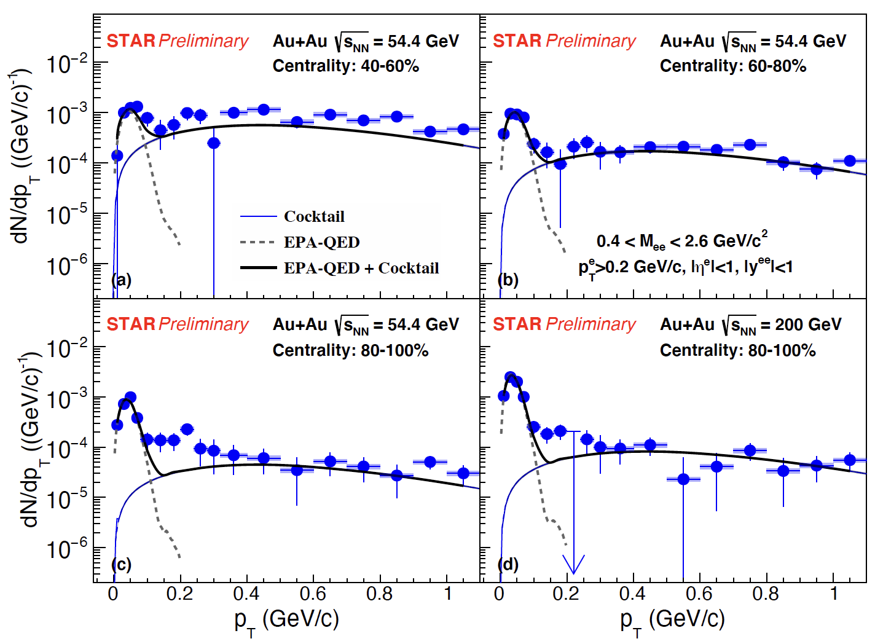
Photon-induced e⁺e⁻ in STAR BES-II
$$γγ→e^{+}e^{−}$$

Slide 17
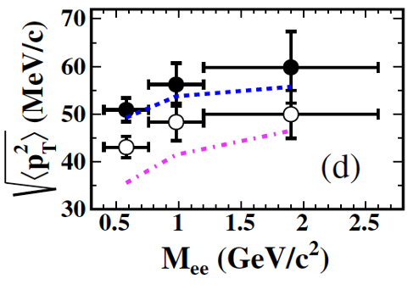
Energy and Centrality Dependence of $\sqrt{\left\langle p_{T}^{2}\right\rangle }$
$\left\langle p_{T}^{2}\right\rangle$ sensitive to 𝑝_{T} broadening
Decreases from semi-peripheral to peripheral collisions
Initial state effect: Impact parameter dependence
Energy dependence (3.7𝝈 compared to 200 GeV QED)
And/or final state effect (1.8𝝈)?

Slide 18
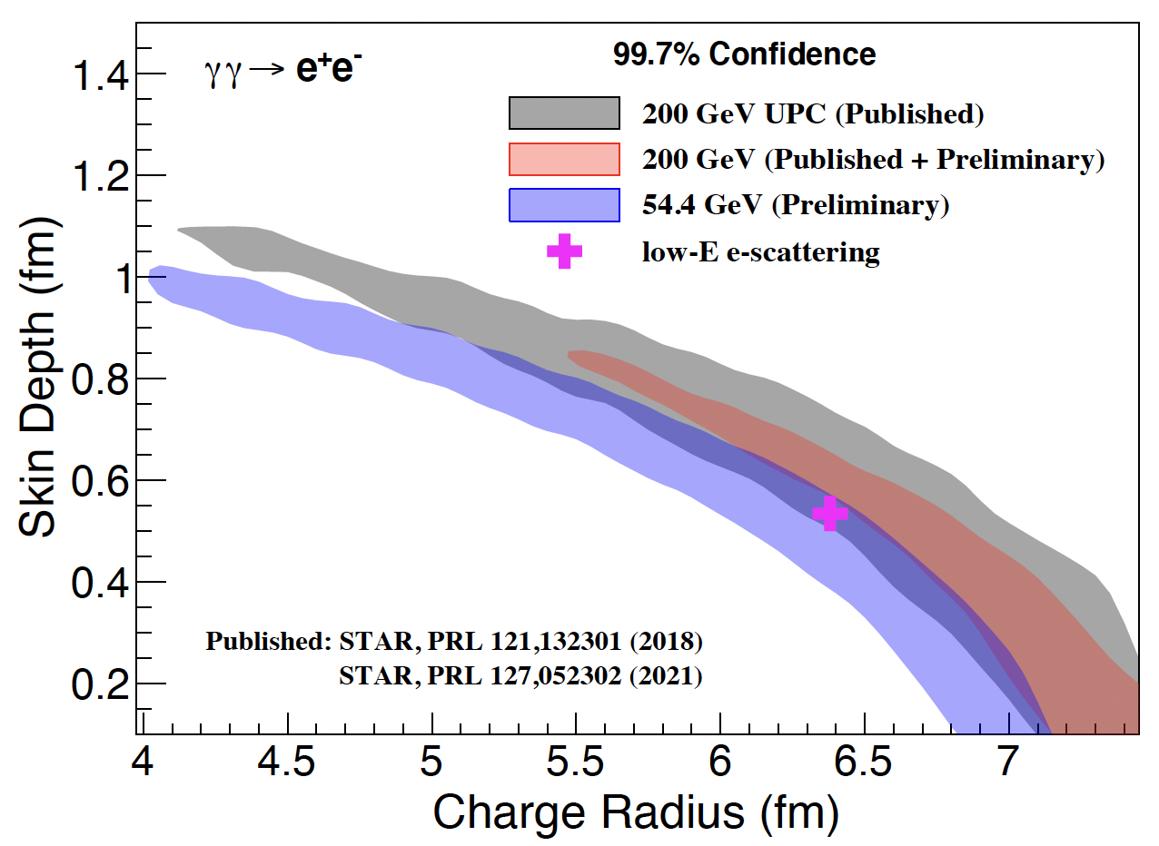
Application to Nuclear Charge Radius Measurements
X. Wang, QM2022 talk
arXiv:2207.05595
200 GeV vs 54.4 GeV:
energy dependence of charge distribution？
Low-energy scattering vs RHIC (3𝜎 difference):
energy dependence of charge distribution and/or final state effect？
Low energy scattering: R=6.38 fm, d=0.535 fm
R. C. Barrett and D. F. Jackson, Nuclear Sizes and Structure (Oxford University Press, 1977)

Slide 19
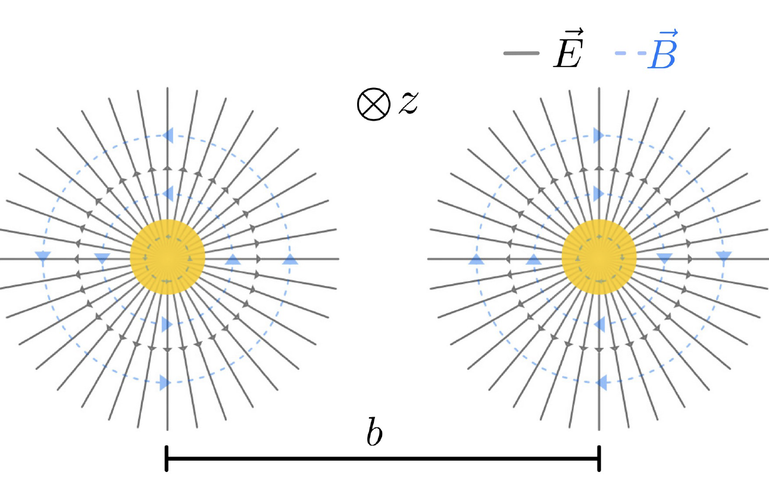
Linearly Polarized Photon in Photon-induced Process
Quasi-real photons should be linearly polarized in the transverse plane

Slide 20
Polarized Photon-Photon Collisions
Gluons are highly linearly polarized.
Metz & 周剑, 2011
CGC is highly linearly polarized state.
The same analysis applies to the QED case.

Slide 21
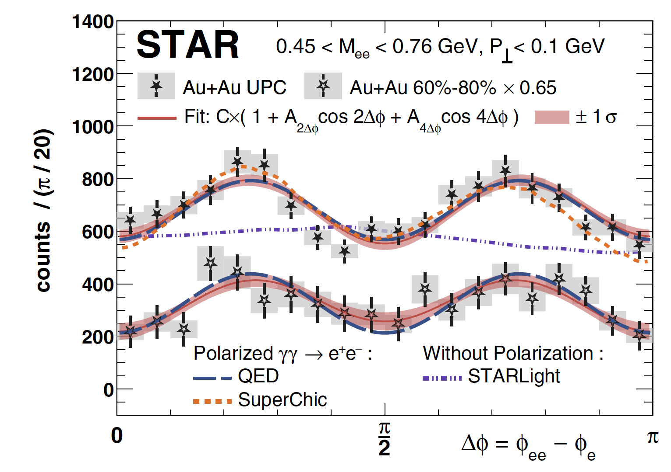
Azimuthal Modulations Predicted for Real Photon
Idea generated from a local discussion at SDU between experiment group and theory group.
Phys.Rev. Lett. 127, 052302 (2021)
Phys.Lett. B 795, 576 (2019)
Phys.Rev. D 101, 034015 (2020)
周剑
周雅瑾
李聪
Results at STAR are well consistent with the theory prediction.

Slide 22
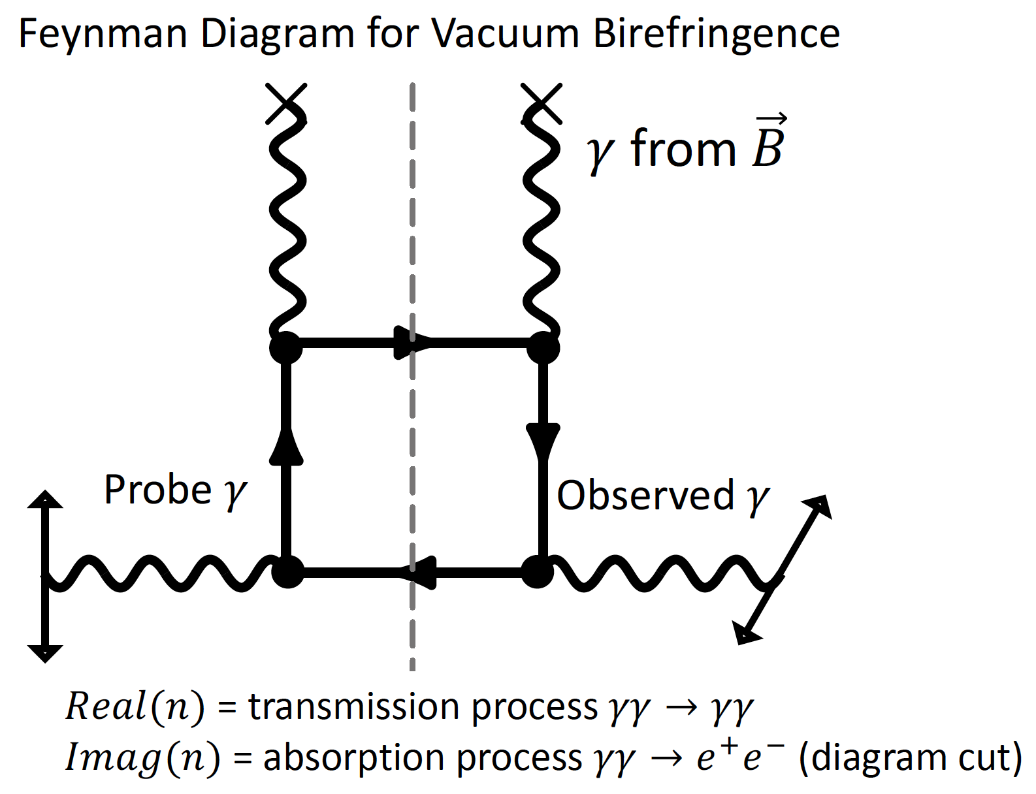
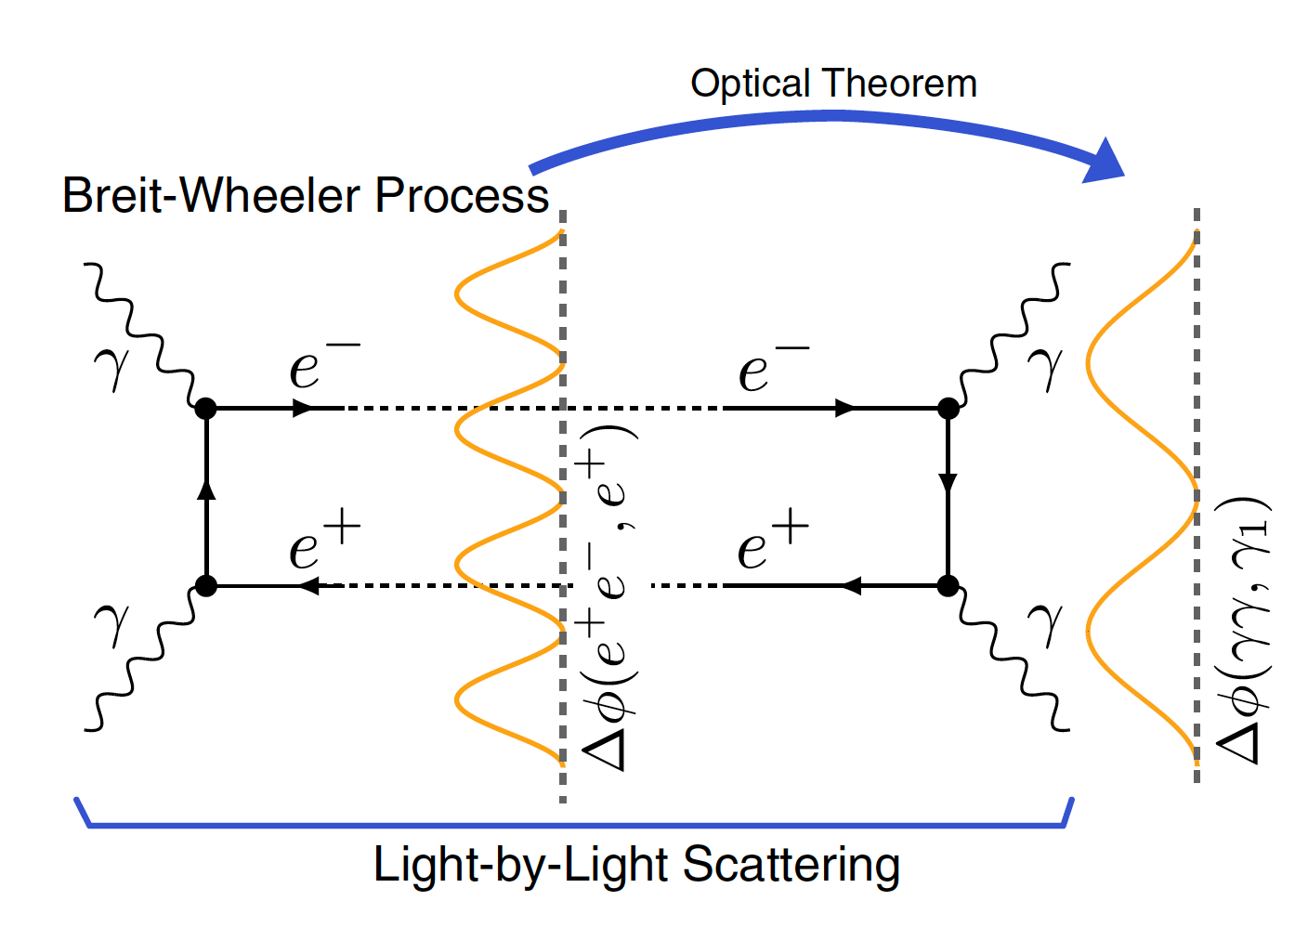
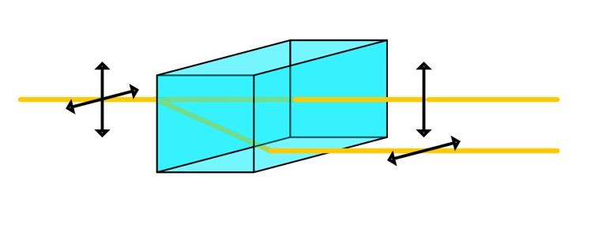
Link to Vacuum Birefringence
W. Heisenberg and H. Euler, Z. Phys. 98, 714 (1936)
Vacuum birefringence:
predicted in 1936 by Heisenberg & Euler.
EM field polarizes the vacuum in the absence of a medium.
QED vacuum + Extreme Magnetic field
Linearly polarized (vertical)
Linearly polarized (horizontal)
Maybe more closely related to the vacuum dichroism?
K. Hattori, H. Taya, and S. Yoshida, JHEP 01,93 (2021)

Slide 23
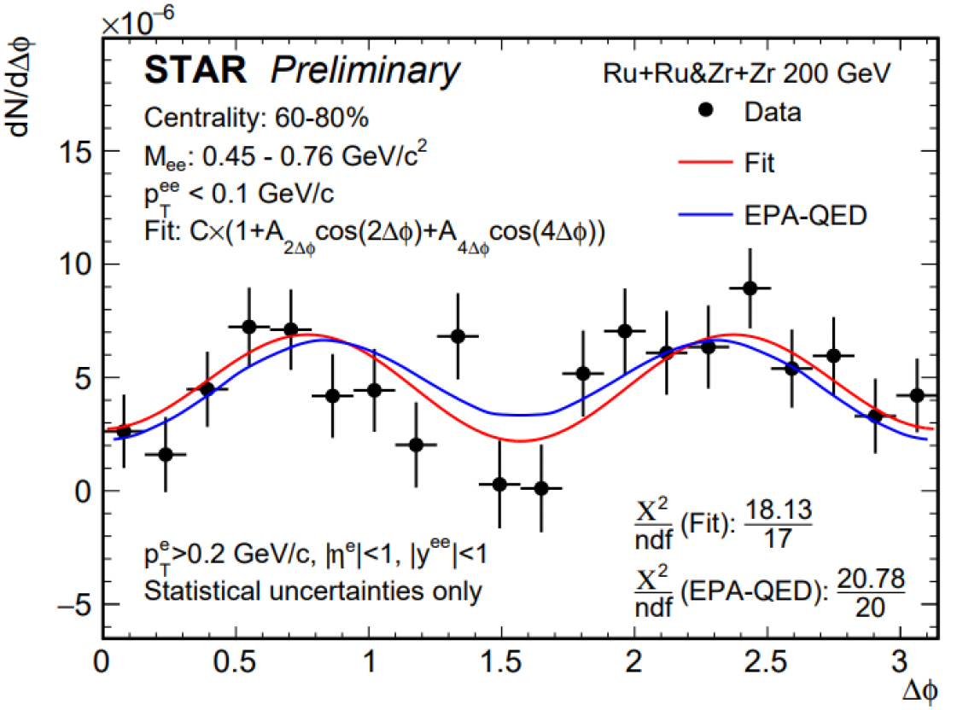
$\cos{(4∆φ})$ Modulation
 | UPC | 80-100% | 60-80% | 40-60%
200 GeV Au+Au | 6.7$σ$ | 3.7$σ$ | 4.5$σ$
200 GeV isobar |  |  | 3.6$σ$
54.4 GeV Au+Au |  | 1.5$σ$ | 2.1$σ$ | 1.6$σ$

Slide 24
Photon-nuclear Interactions
Have been studied for decades
Well known process for probing the hadronic structure
Polarized Photon-nucleon Interactions
Theoretical calculations indicate that the quantum interference effect is sensitive to:
Nuclear Geometry (gluon distribution)
Impact Parameter (detailed spatial distribution)
Access through measurement of Δ𝜙 distribution, like the Breit-Wheeler process

Slide 25
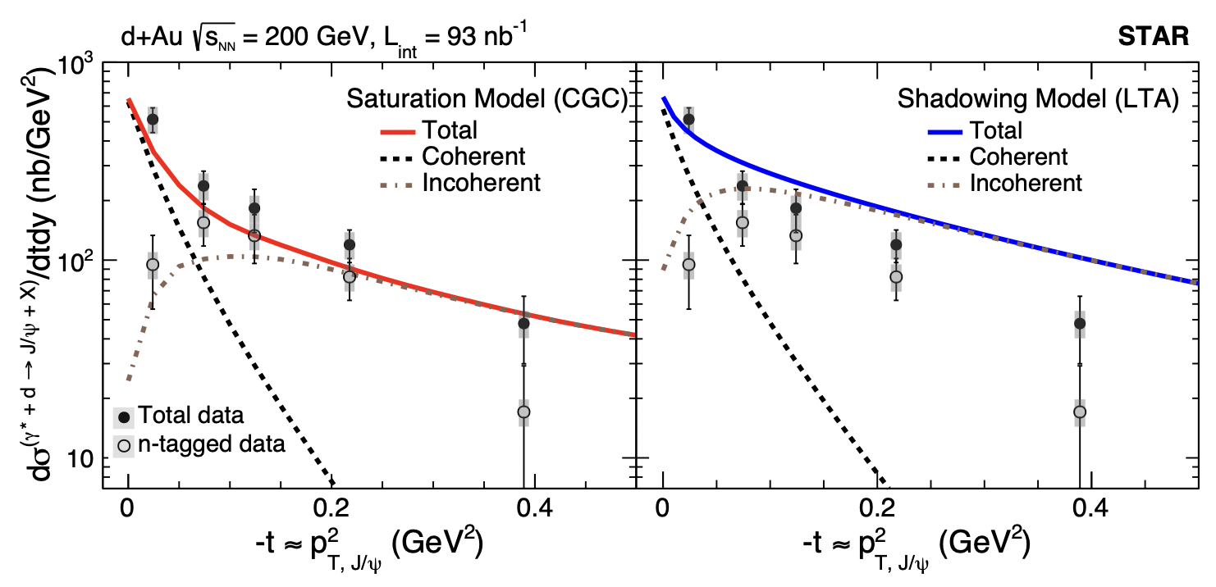
J/psi in d+Au
Probing the gluonic structure of the deuteron
Experimental baseline for a high precision measurement of diffractive J/ψ production at EIC
Phys. Rev. Lett. 128，122303 (2022)

Slide 26
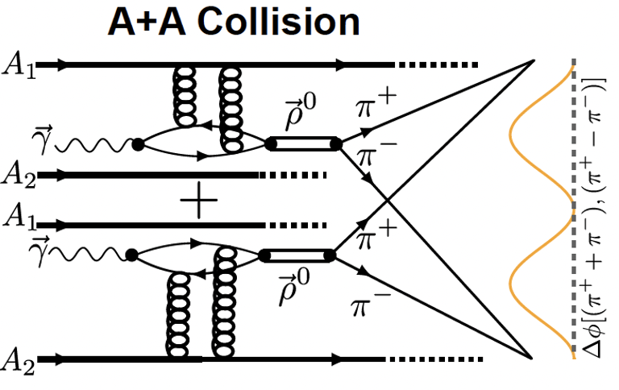
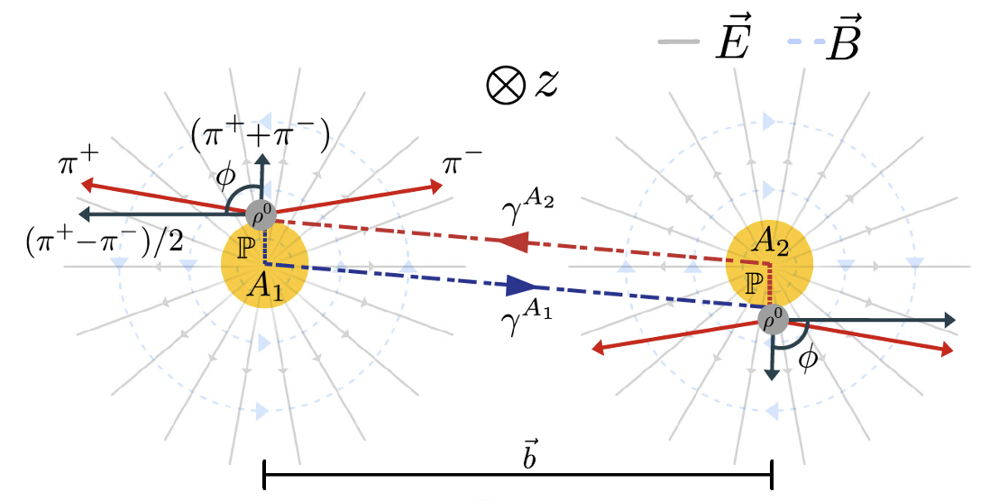
Photo-production of Polarized Photons
arXiv:2204.01625
Modulation due to quantum interference of amplitudes
Expect$\cos{(2∆φ})$ modulation in the final state
邢宏喜、周剑、周雅瑾等 J. High Energ. Phys. 10, 64 (2020)

Slide 27
R_{A} = 6.9 fm
a = 0.64 fm
Modulation due to quantum interference of amplitudes
Expect$\cos{(2∆φ})$ modulation in the final state
邢宏喜、周剑、周雅瑾等 J. High Energ. Phys. 10, 64 (2020)

Slide 28
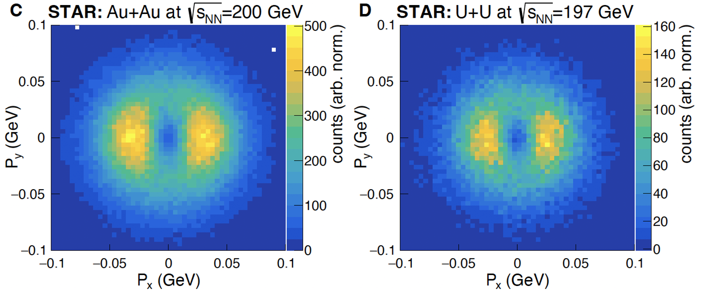
Interference Pattern Disappears in 𝑃y Direction
arXiv:2204.01625

Slide 29
$\cos{(2∆φ})$ Modulation
No structures in p+Au
Interference pattern changed when nucleon radius change
Precious enough to tomograph the nuclear

Slide 30
|t| Distribution
Coherent + Incoherent
$φ=0$, R = 7.90 fm
$φ=π/2$, R = 7.09 fm

Slide 31
Extract the Nuclear Radius and Probe Neutron Skin
After correct for the finite size of rho wavefunction and depolarization
arXiv:2204.01625
Finite size of wavefunction:
J. R. Forshaw, R. Sandapen, JHEP 11, 037 (2010)
R_{p}:
Q. Shou, et al., Phys. Lett. B 749, 215 (2015)
H. De Vries, C. W. De Jager, C. De Vries, At. Data Nucl. Data Tables 36, 495 (1987)

Slide 32
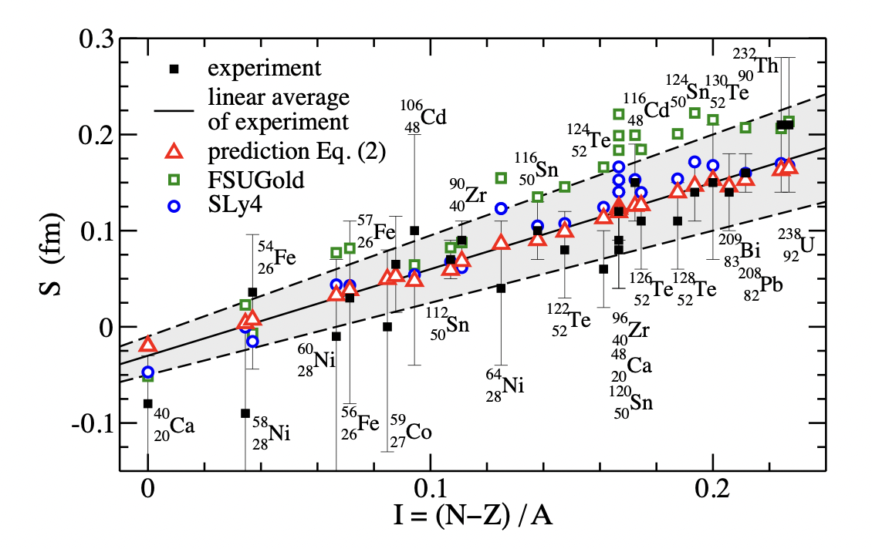
Extract the Nuclear Radius and Probe Neutron Skin
M. Centelles, X. Roca-Maza, X. Vi˜nas, M. Warda
Phys. Rev. Lett. 102, 122502 (2009).
arXiv:2204.01625
STAR: S_{197Au} =0.17+/-0.03+/-0.08 fm S_{238U}=0.44+/-0.05+/-0.08 fm

Slide 33
Summary
Polarized photon-photon fusions : good probes of magnetic field
Measure Breit-Wheeler process
Constrain nuclear charge radius when compared to QED
cos(𝟒∆𝝓) modulation: link to vacuum birefringence effect
Indicate EM fields are different in isobaric collisions
Observed in non-UPCs: probes of final state effect
Polarized photon-nuclear interactions: good probes of gluon distribution
2D tomograph technique: interference pattern observed
Constrain nuclear radius
cos(2∆𝝓) modulation: help to measure the “true” nuclear radius

Slide 34
感谢各位专家的批评指正！

