Slide 1
手征磁效应的输运理论研究
马国亮
（复旦大学）

Slide 2
Outline
Introduction
Methods to simulate CME
AMPT simulation on CME
Summary

Slide 3
Chiral Magnetic Effect (CME)
Initial fluctuations of topological charge in QCD vacuum → P and CP odd metastable domains → Charge separation in the direction of magnetic field

Slide 4
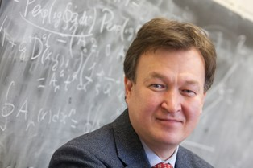
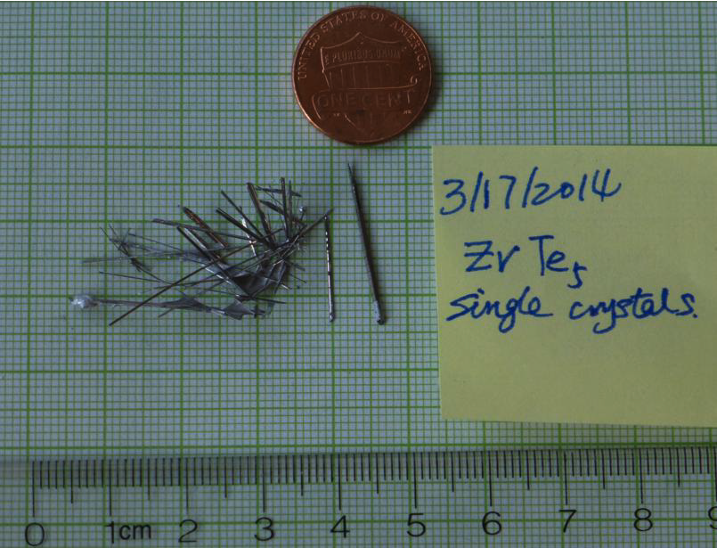
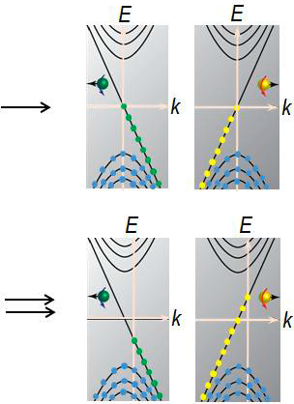
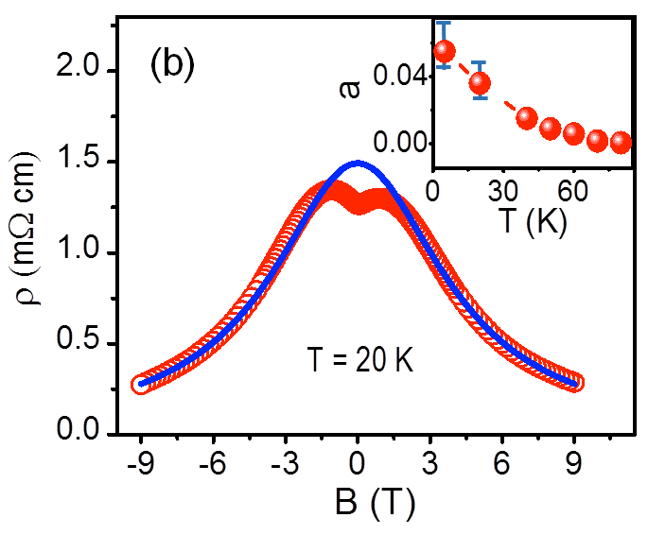
B≠0
E=0
B||E
When the electric field and magnetic field are parallel, the conductivity of CME can meet the expected B^2 dependence.
B≠0
E≠0
CME found in condensed matter,
a very important potential application prospect
Quasiparticles
in 3D Dirac semimetals

Slide 5
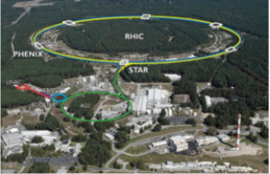
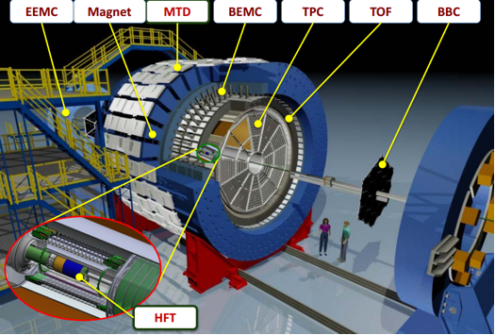
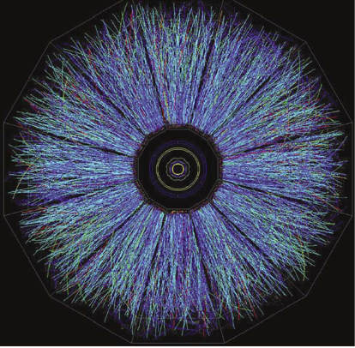
Heavy-ion collision experiment
Relativistic Heavy Ion Collider (RHIC)
&& Large Hadron Collider (LHC)
Solenoidal Tracker at RHIC (STAR)

Slide 6
CME probe: charge azimuthal correlation 𝛾
𝛾=
Non-flow/non-parity effects:
largely cancel out
Directed flow: vanishes
if measured in a symmetric rapidity range
P-even quantity:
still sensitive to charge separation
PRL 103, 251601 (2009)
RHIC data are consistent with the CME expectation that charges could be distributed asymmetrically w.r.t reaction plane, i.e. dipole charge separation.

Slide 7
CME in large vs small systems

Slide 8
Comparing Δ𝛾 in pPb vs PbPb at LHC

Slide 9
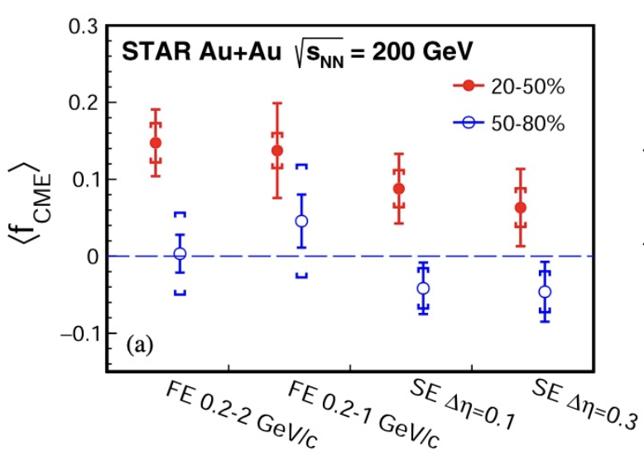
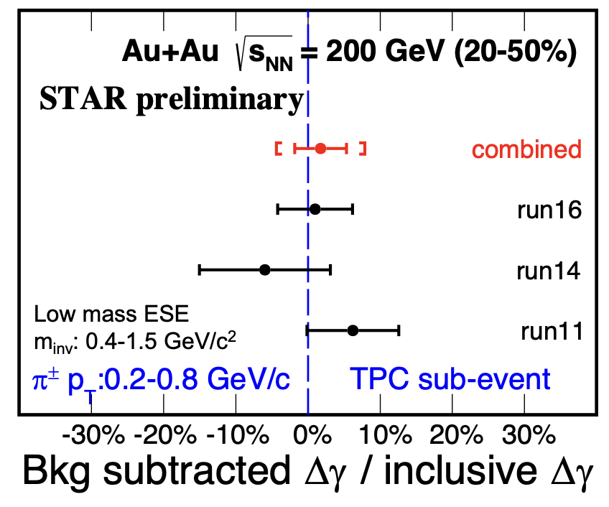
CME constraint in Δ𝛾 for Au+Au 200GeV from STAR
不变质量背景扣除法
双平面组合提取法
STAR collaboration, arXiv:2006.05035
The possible CME signal ~5-10% of the early Δγ measurements, with 1-2σ significance.
non-flow may still be present.

Slide 10
Isobar collision experiment
Wei-Tian Deng, Xu-Guang Huang, Guo-Liang Ma, Gang Wang,
Phys. Rev. C 94 (R), 041901 (2016)
400 million simulation events at 2/3 background scale, relative difference between two isobar collisions reaches 5%, and the significance is 5σ.
Blind analysis:
In 2018, STAR collected isobar data (1.8B Ru+Ru && 2.0B Zr+Zr), looking for the CME expectation.
Five teams conducted blind analysis.
CME expectation:
10

Slide 11
First isobar results from STAR experiment
CME expectation:
Five analysis teams show a good agreement: "The ratios are generally less than 1, and no obvious CME signal is found"
Need to better understand the baseline? set a new baseline?
11

Slide 12
Understand background difference in isobar collisions
STAR, Phys.Rev.C 105 (2022) 1, 014901
Difference in multiplicity distribution, <Nch> and v2 between two isobar systems.
Related to the nuclear deformation/structure?
Other cases?
12

Slide 13
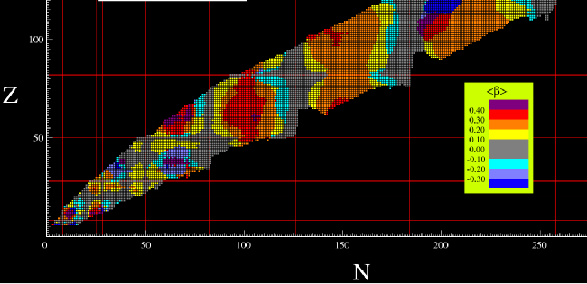
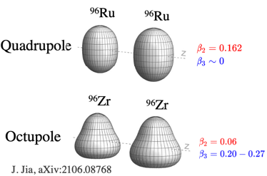
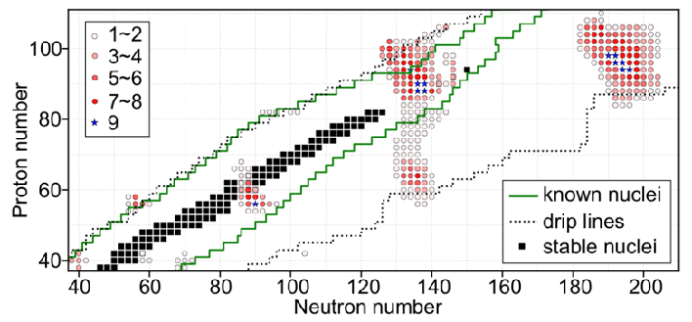
Nuclear structure in relativistic heavy-ion collisions
β2-landscape
1.1
1.0
β3-landscape
0.9
STAR, Phys.Rev.C 105 (2022) 1, 014901
H. Li et al., Phys.Rev.C 98 (2018) 5, 054907
H. J. Xu, Phys.Lett.B 819 (2021) 136453
J. Jia, arXiv:2109.00604
J. Jia, Phys.Rev.C 105, 014905 (2022)
C. Zhang and J. Jia, Phys.Rev.Lett. 128 (2022), 022301
G. Giacalone et al., Phys.Rev.Lett. 127 (2021), 242301
J. Jia and C. Zhang, arXiv:2111.15559
The ratios between isobar systems is sensitive to nuclear deformation/structure!
Open a window to see nuclear structure
13

Slide 14
Can CME survive from final state interactions?
dipole
final state
interaction
effects
STAR, PRL 103, 251601 (2009)
DE Kharzeev
To know if CME can survive from FSI, it’s important to simulate the evolution of CME in heavy-ion collisions.
How to simulate the evolution of CME?

Slide 15
Hydrodynamics and transport model
流体力学演化方程：
玻尔兹曼输运方程：
N

Slide 16
Relativistic QKT, Gao & Liang, PRD 100, 056021 (2019)
QCD物理研讨会暨基金委重大项目2022年度学术交流会，7月29-31日，青岛
马国亮 (复旦大学)

Slide 17
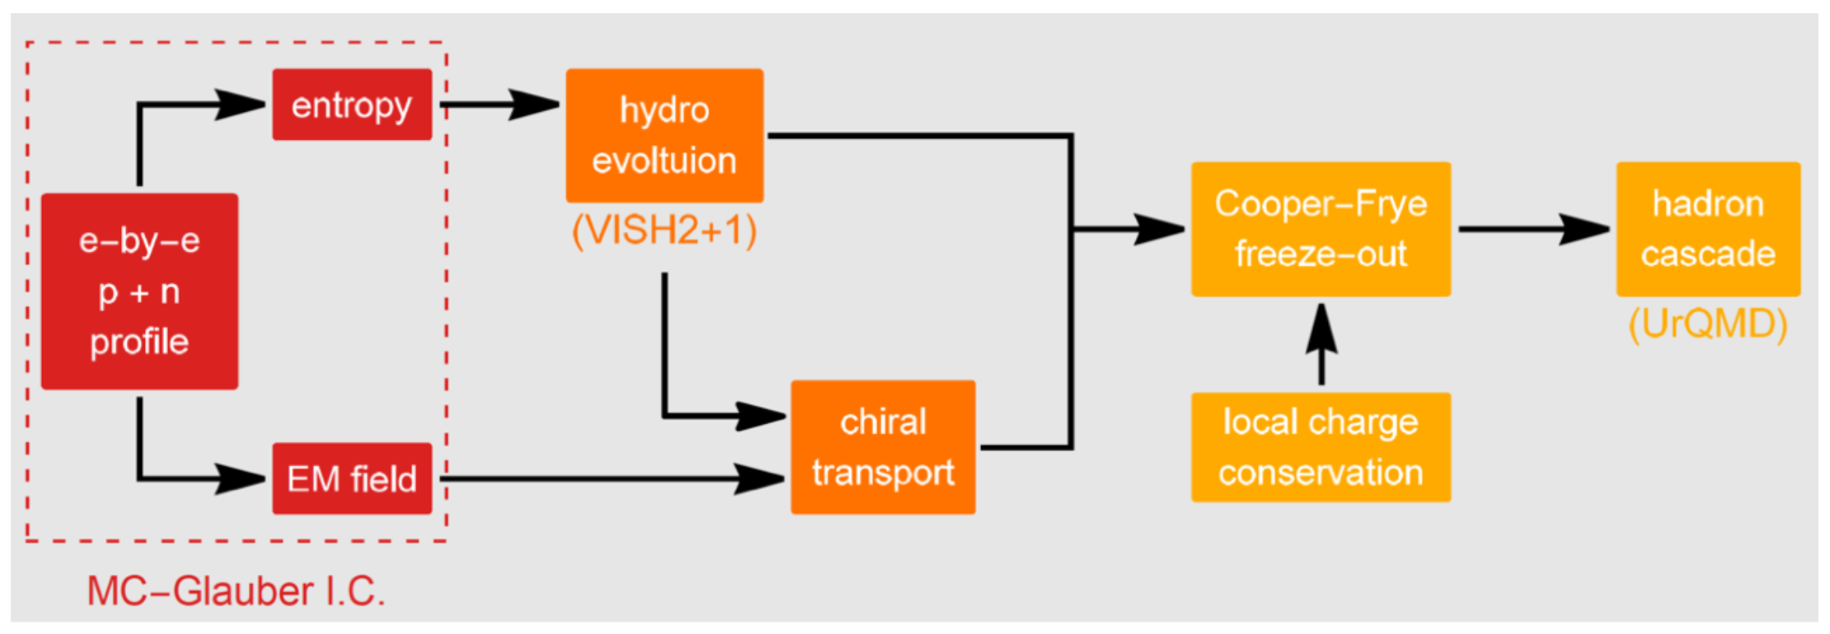
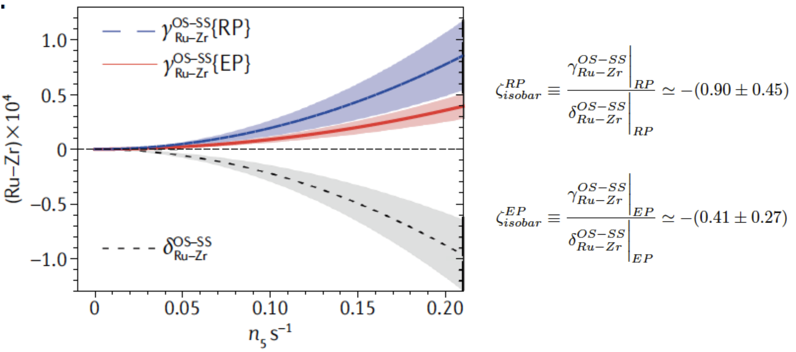
EBE-AVFD: event-by-event anomalous- viscous fluid dynamics
施苏哲, Hui Zhang, 侯德富, and 廖劲峰, PRL 125, 242301 (2020)
Predict CME signal and universal ratios:
QCD物理研讨会暨基金委重大项目2022年度学术交流会，7月29-31日，青岛
马国亮 (复旦大学)

Slide 18
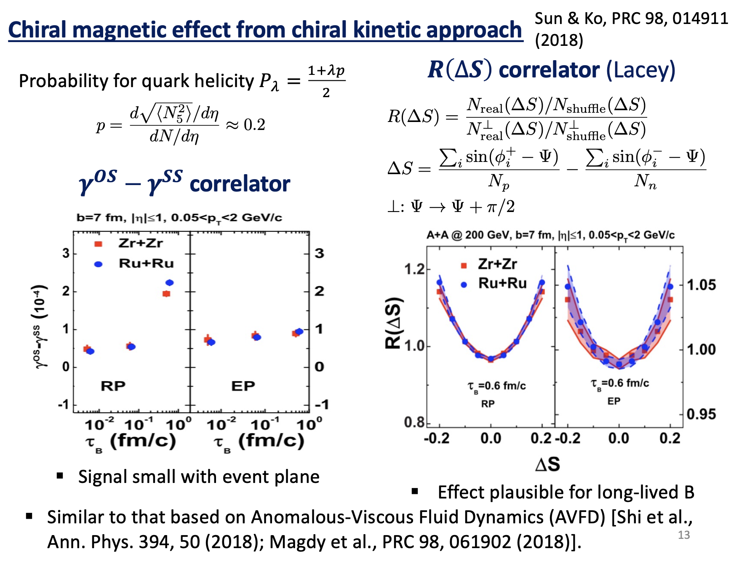
孙艺锋&&柯治明
QCD物理研讨会暨基金委重大项目2022年度学术交流会，7月29-31日，青岛
马国亮 (复旦大学)

Slide 19
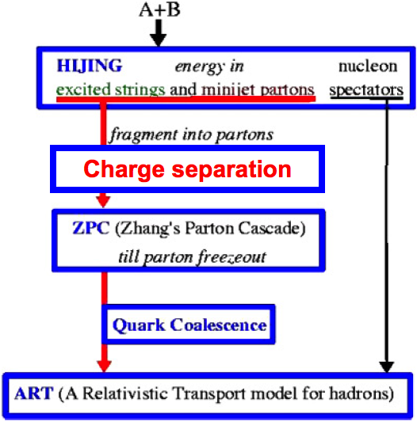
AMPT model with CME-type charge separation
(1) Introduction
G.-L. Ma, B. Zhang, PLB 700 (2011) 39
dipole
dipole charge separation
u
u
u
u
f%=(N⁺upward-N⁺downward)/(N⁺upward+N⁺downward)
To include initial dipole charge separation (CME) into AMPT model,
We switch p_{y} of f% of the downward moving u quarks with those of the upward moving u-bar quarks, and likewise for d-bar and d quarks.
We focus on FSI effects on the charge separation, including parton cascade, hadronization, resonance decays after B and E vanish quickly.
⇀
⇀

Slide 20
AMPT results on the CME obs. γ=<cos(φα+φβ)>
G.-L. Ma, B. Zhang, PLB 700 (2011) 39
Original AMPT (f=0%,◇) underestimates exp. data. ~2/3.
Non-linear sensitivity of the CME observable 𝛾
AMPT+CME (f=10%,☐) can describe same-charge data.

Slide 21
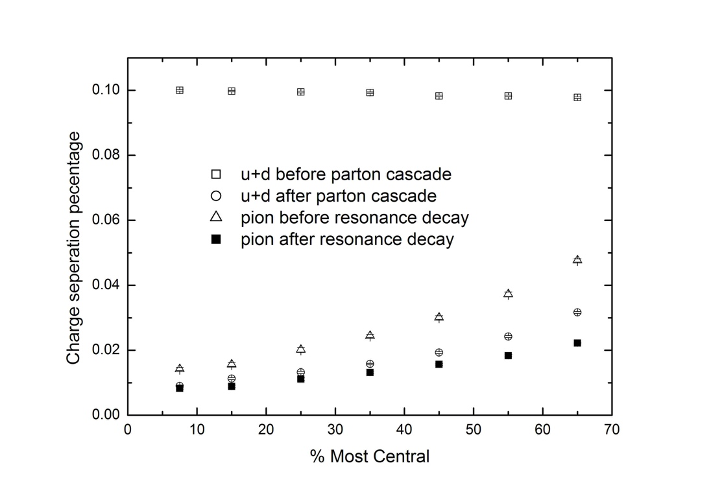
Final state effects on charge separation
Stage evolution of CME signal in AMPT
I
II
III
IV
pion after hadronization
I
IV
III
II
II
III
IV
I
Parton cascade reduces charge separation significantly; Coalescence enhances some charge separation; Resonance decays reduce charge separation.
FSI effect: 10% in the beginning →1-2% percentage at the end.

Slide 22
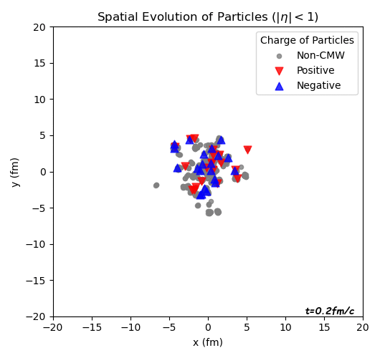
Parton cascade effect on the CME signal
Au+Au 200 GeV (b=8fm), AMPT+CME(10%)
0 mb
3 mb
Non-CME
Non-CME
Negative (CME)
Negative (CME)
(CME)
Positive (CME)
Positive (CME)
J

Slide 23
Isobar collisions : a promising way to see CME
钌+钌
锆+锆

Slide 24
Simulating CME in isobar collisions using AMPT
(1) Introduction
Initialization of isobar
dipole charge separation
CME
f=(N⁺upward-N⁺downward)/(N⁺upward+N⁺downward)

Slide 25
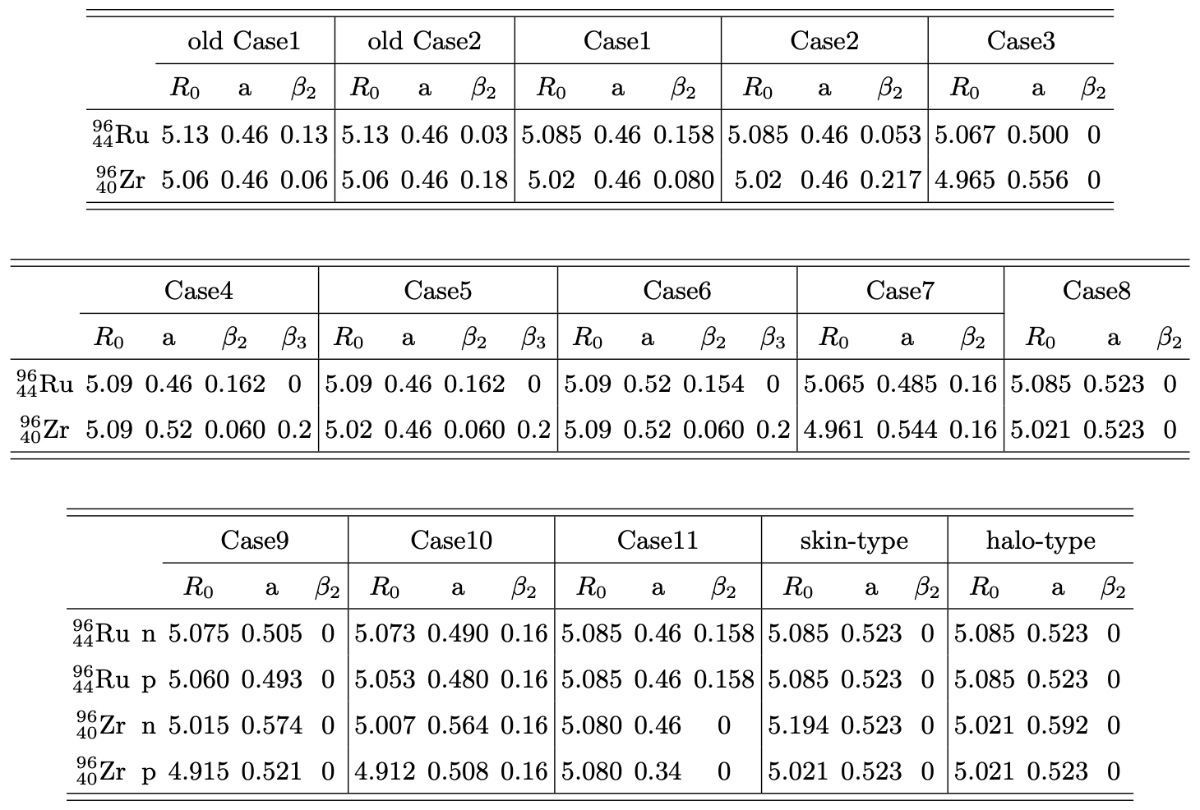
Geometry initialization of isobar nuclei
Woods-Saxon form of spatial distribution of nucleons:
dipole charge separation
Which one is good among 15 cases?
Our criterion is the ratios in final state:
Mult. dist. ratio
<Nch> ratio vs centrality
v2 ratio vs centrality
1 M events for each case are used to test if it can pass the criterion test.

Slide 26
Good geometry configurations of isobar nuclei
Woods-Saxon form of spatial distribution of nucleons:

Slide 27
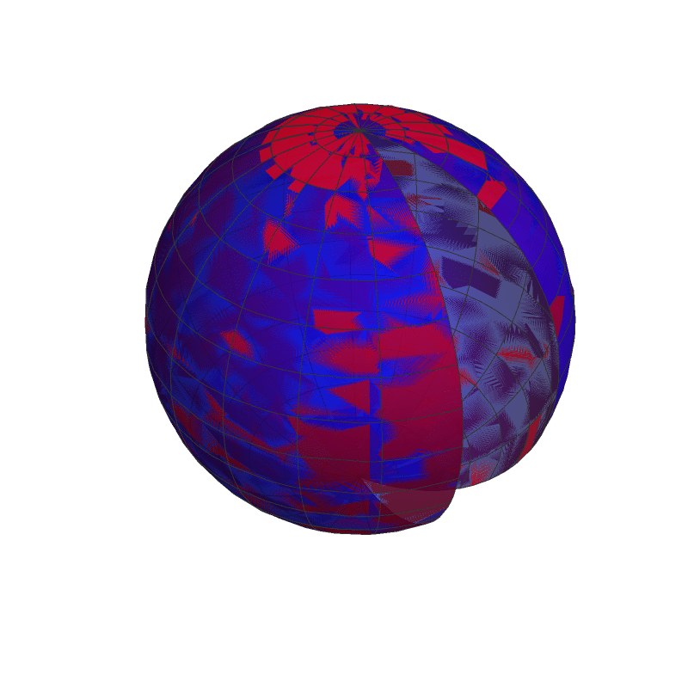
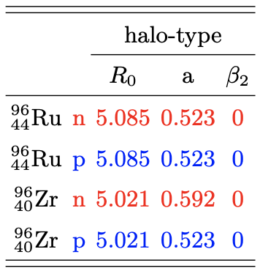
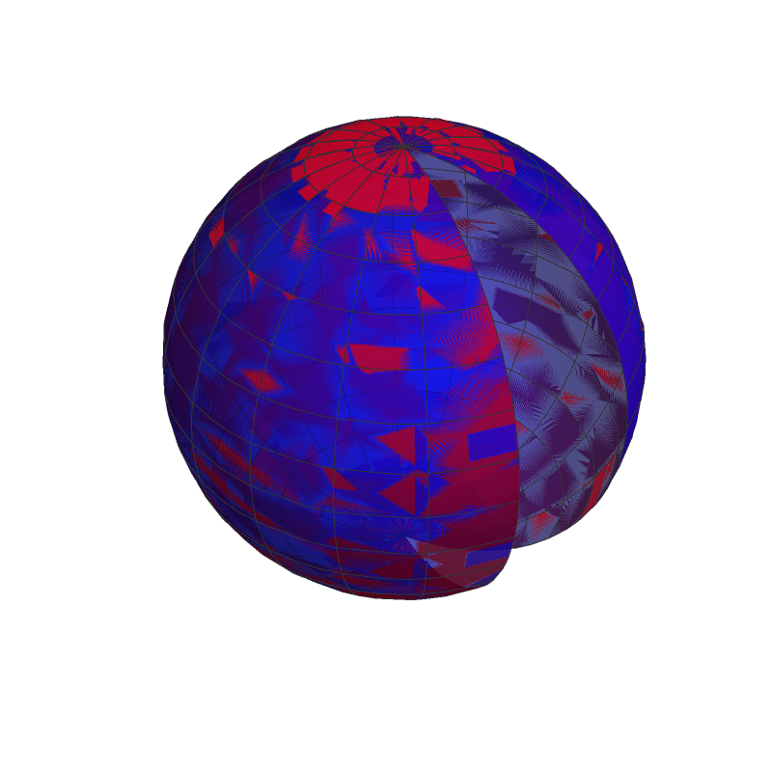
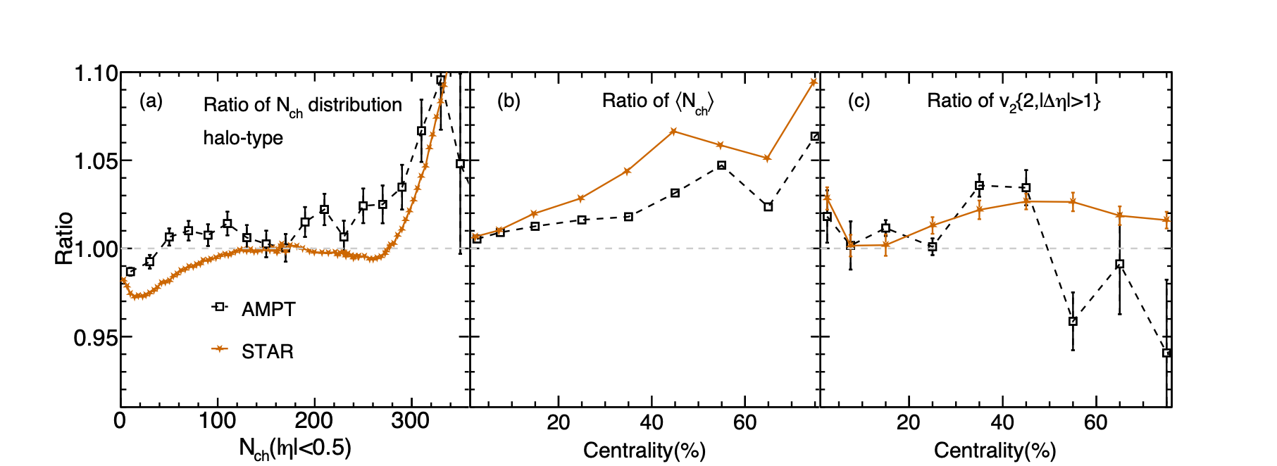
Halo-type
Ru
Ru
Solid: Ru+Ru, Dash: Zr+Zr
Red: neutron, Blue: proton
Zr
Zr
+
+
徐浩洁, H. Li, X. Wang, C. Shen and F. Wang, Phys. Lett. B 819, 136453 (2021)
Ru+Ru/Zr+Zr

Slide 28
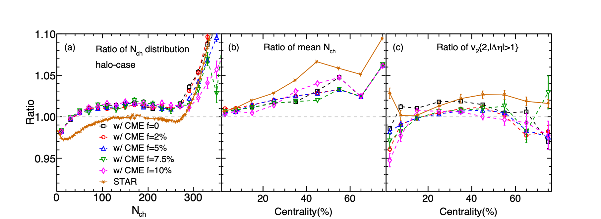
Can CME affect the ratios?
Ru
Ru
Solid: Ru+Ru, Dash: Zr+Zr
Red: neutron, Blue: proton
Zr
Zr
+
+
徐浩洁, H. Li, X. Wang, C. Shen and F. Wang, Phys. Lett. B 819, 136453 (2021)
f for Ru+Ru
Ru+Ru/Zr+Zr

Slide 29
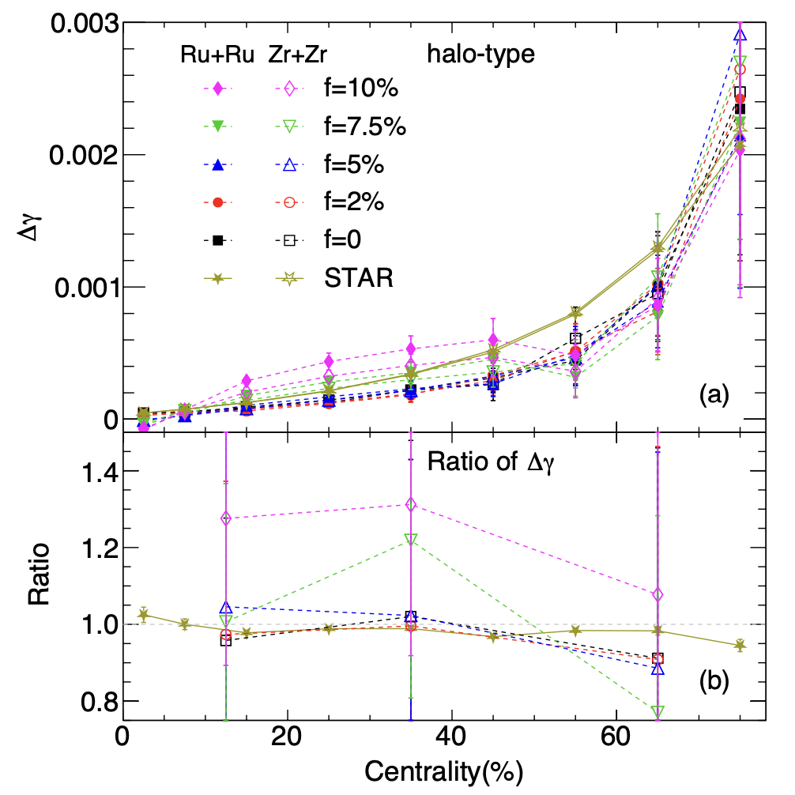
The CME observable Δ𝛾 in isobar collisions
赵新丽 && 马国亮, arXiv: 2203.15214
Δ𝛾 (Exp.) =Δ𝛾 (f=0%) ≈ Δ𝛾 (f=2%) ≈Δ𝛾 (f=5%) < Δ𝛾 (f=7.5%) < Δ𝛾 (f=10%)
Due to the non-linear sensitivity of the CME observable Δ𝛾?

Slide 30
Summary
dipole
AVFD, CKE and AMPT etc are applied to simulate CME.
Final state interactions significantly reduce the CME signal.
Non-linear sensitivity of the CME observables due to FSI.
The CME observable Δ𝛾 ratio may not response to the CME if the signal strength f<5%.

Slide 31
Backup

Slide 32
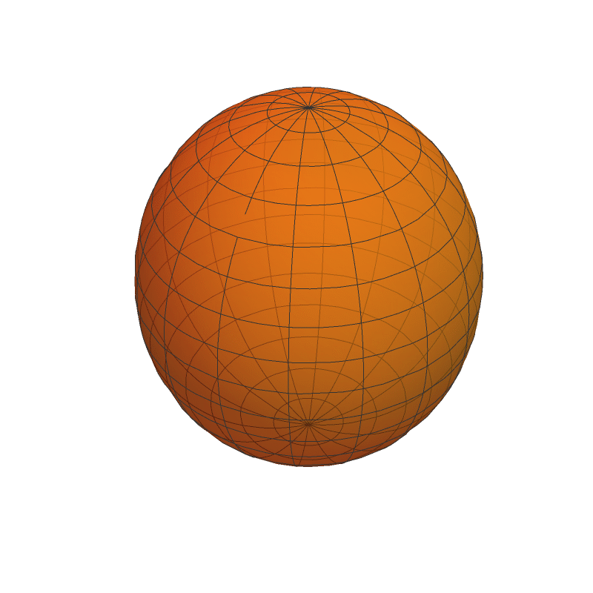
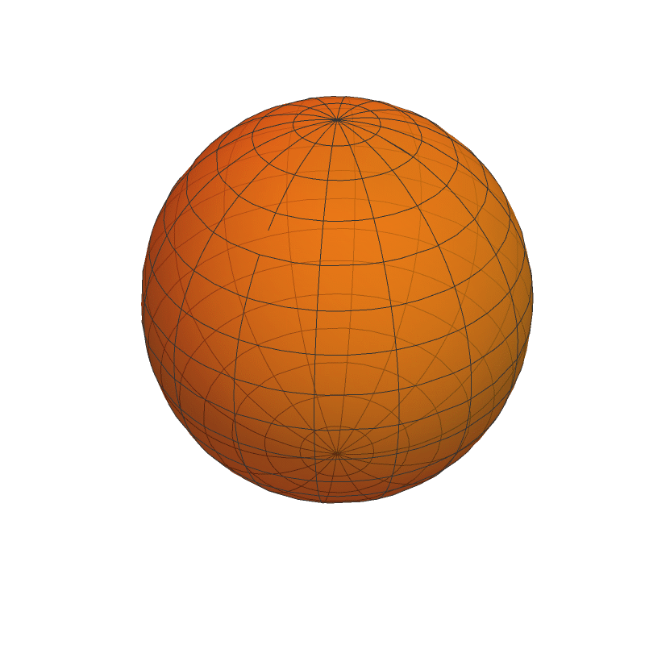
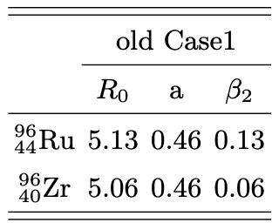
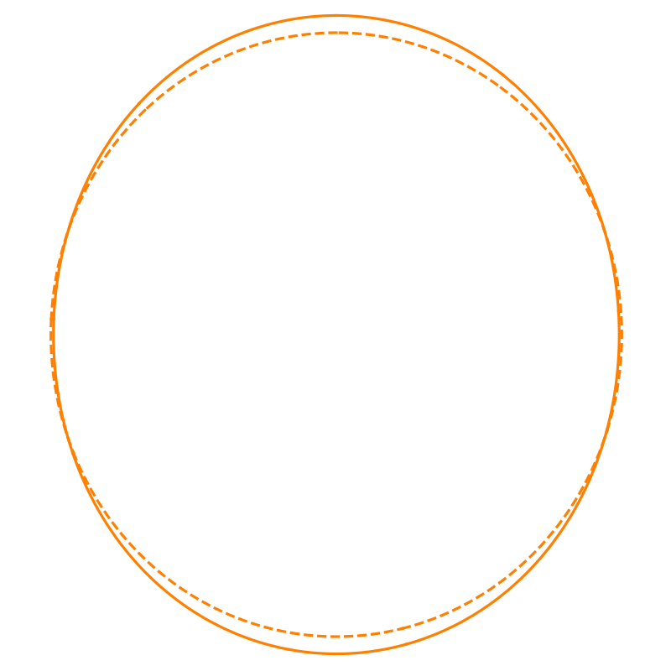
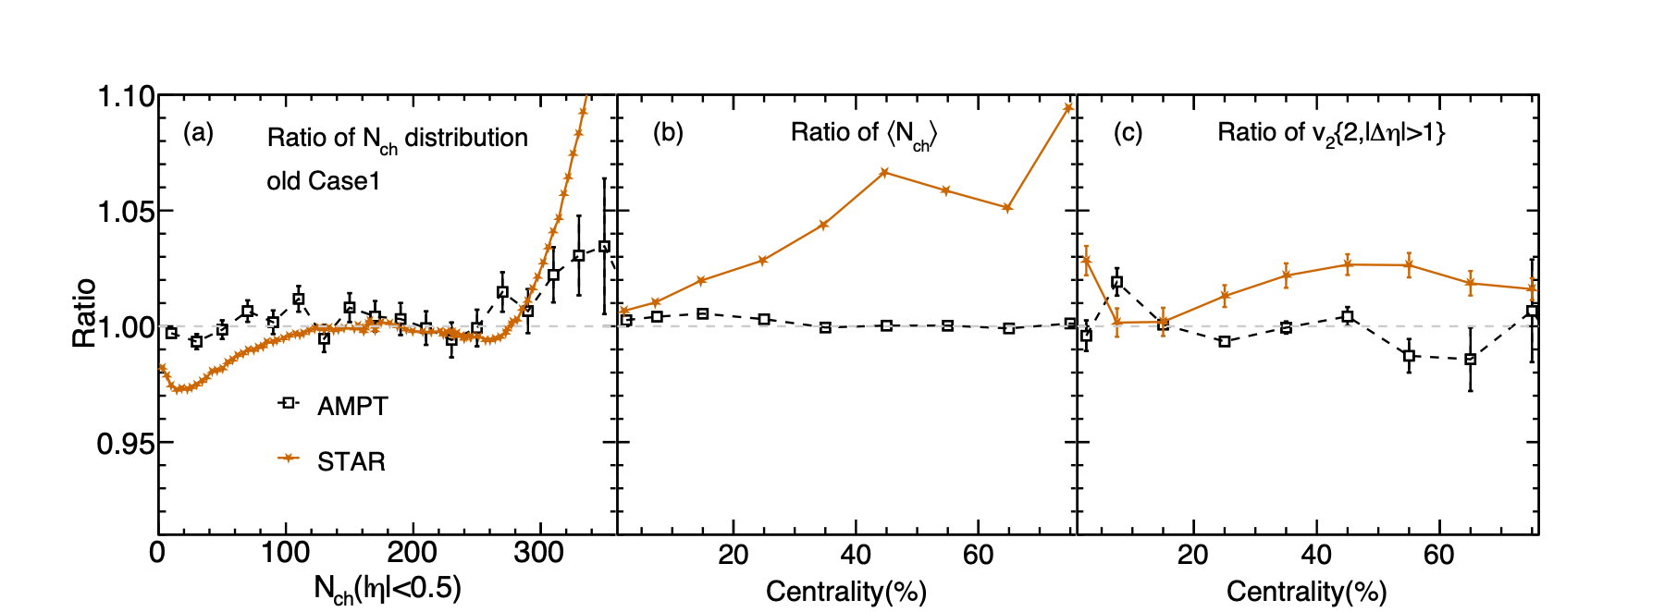
Old Case1
Ru
Ru
Solid: Ru+Ru, Dash: Zr+Zr
Zr
Zr
+
+
X. L. Zhao, G. L. Ma and Y. G. Ma, Phys. Rev. C 99, no.3, 034903 (2019).
Ru+Ru/Zr+Zr

Slide 33
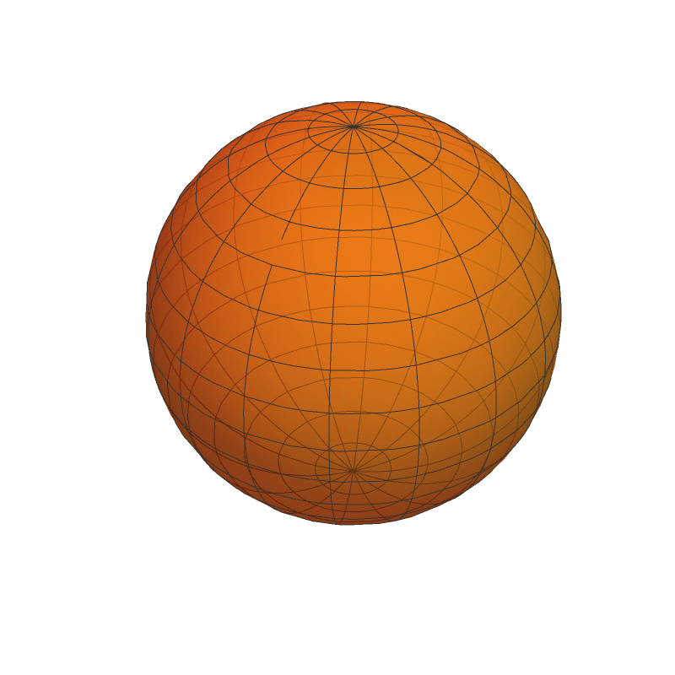
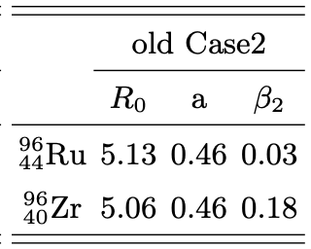
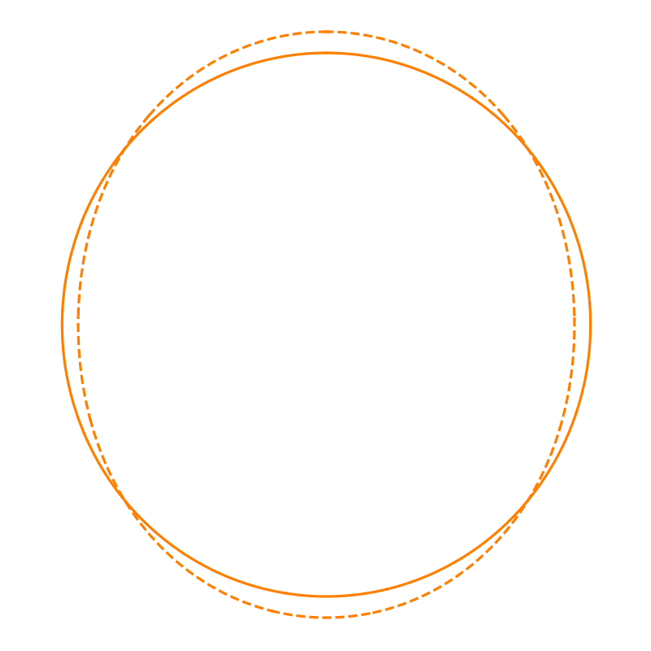
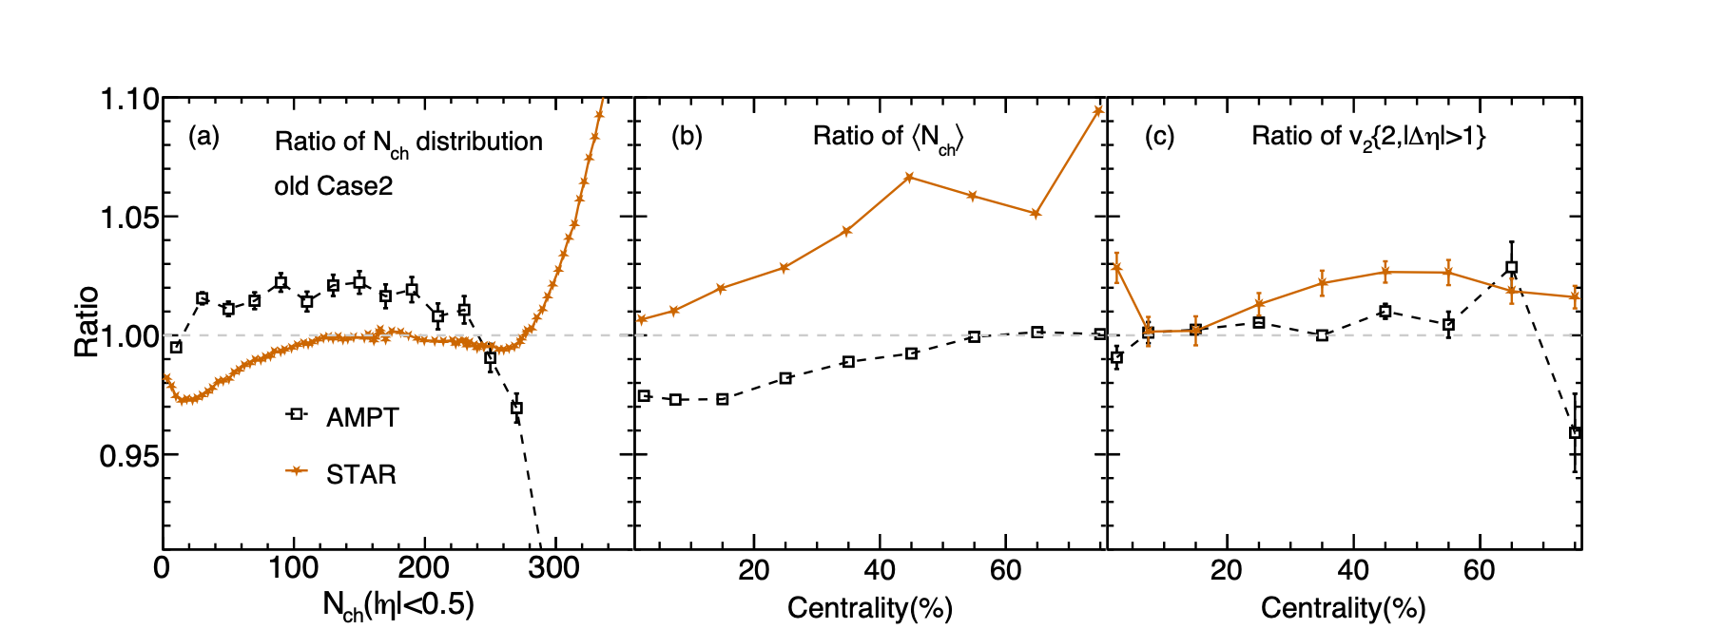
Old Case2
Ru
Ru
Solid: Ru+Ru, Dash: Zr+Zr
Zr
Zr
+
+
X. L. Zhao, G. L. Ma and Y. G. Ma, Phys. Rev. C 99, no.3, 034903 (2019).
Ru+Ru/Zr+Zr

Slide 34
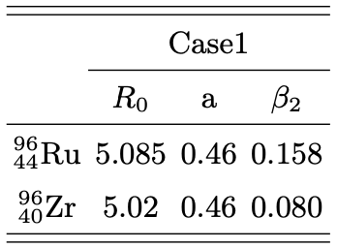
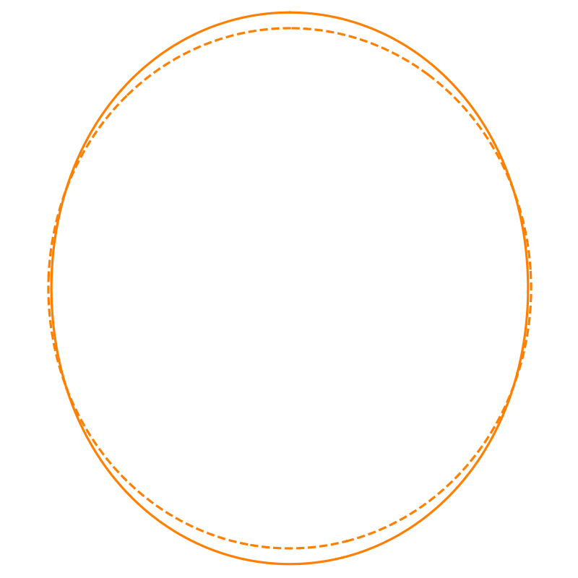
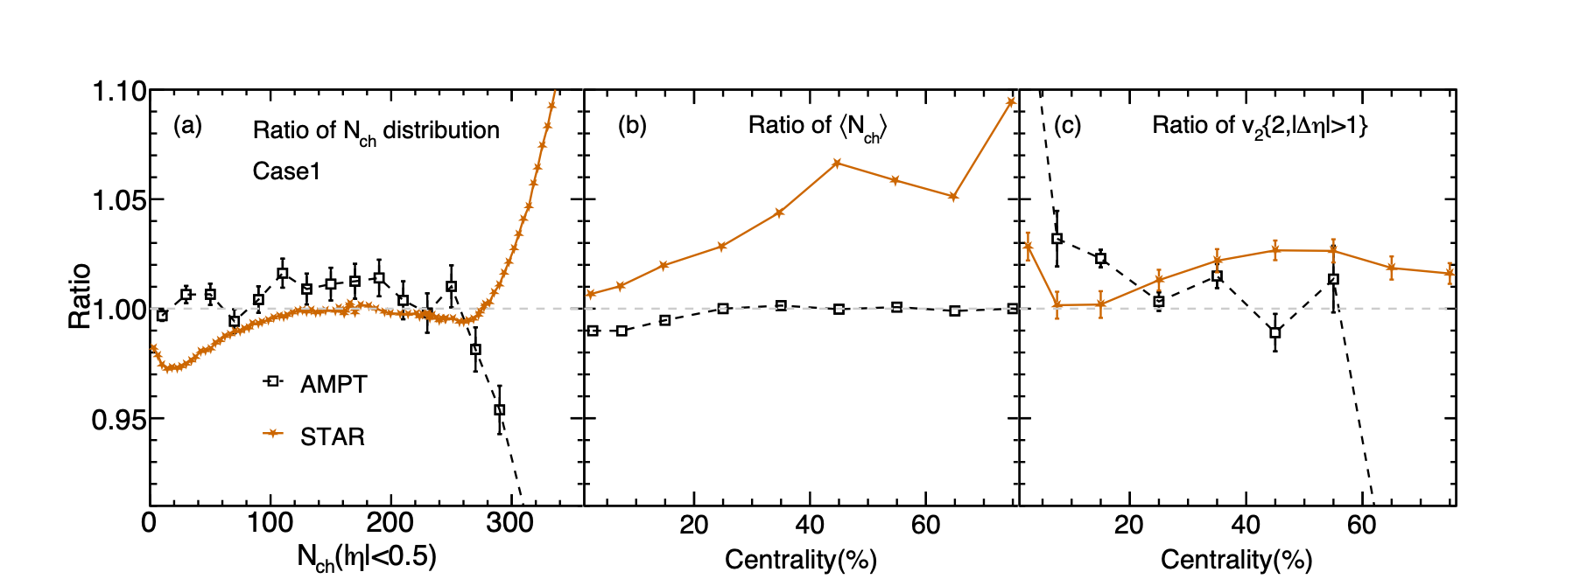
Case1
Ru
Ru
Solid: Ru+Ru, Dash: Zr+Zr
Zr
Zr
+
+
W. T. Deng, X. G. Huang, G. L. Ma and G. Wang, Phys. Rev. C 94, 041901 (2016).
G. Fricke, C. Bernhardt, K. Heilig, L. A. Schaller, L. Schellenberg, E. B. Shera and C. W. de Jager, Atom. Data Nucl. Data Tabl. 60, 177-285 (1995).
S. Raman, C. W. G. Nestor, Jr and P. Tikkanen, Atom. Data Nucl. Data Tabl. 78, 1-128 (2001).
M. Abdallah et al. [STAR], Phys.Rev.C 105 (2022) 1, 014901
Ru+Ru/Zr+Zr

Slide 35
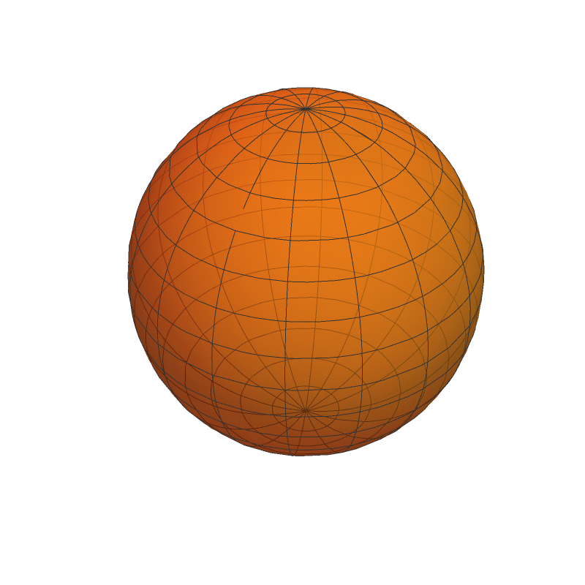
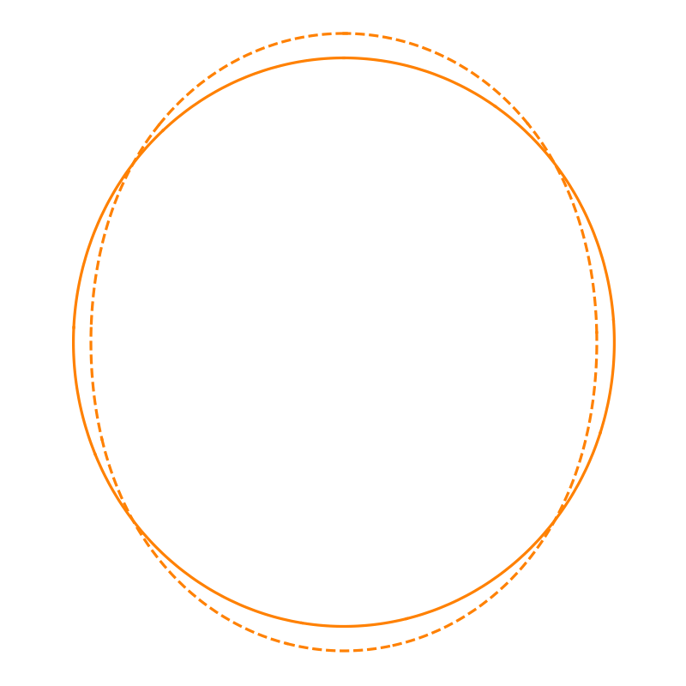
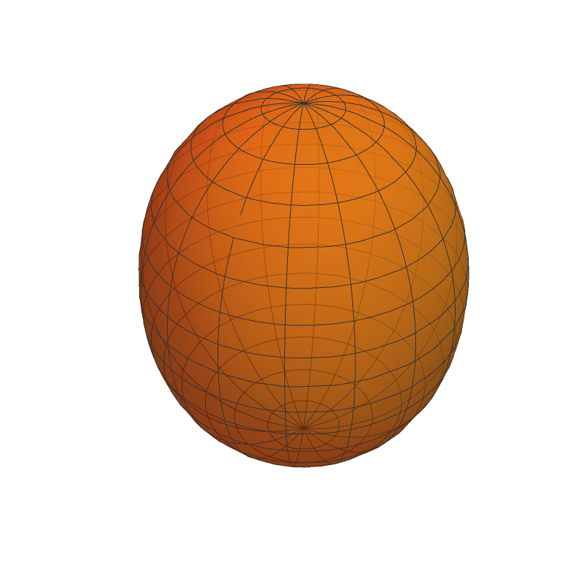
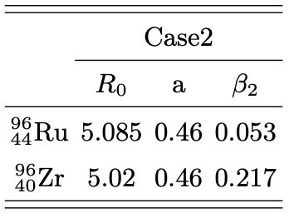
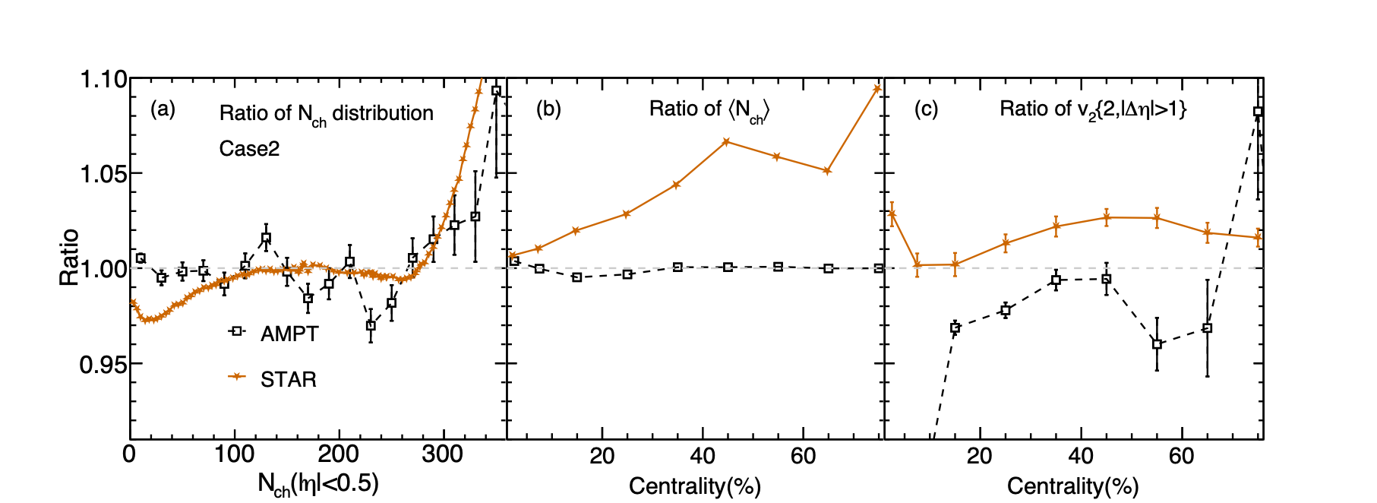
Case2
Ru
Ru
Solid: Ru+Ru, Dash: Zr+Zr
Zr
Zr
+
+
W. T. Deng, X. G. Huang, G. L. Ma and G. Wang, Phys. Rev. C 94, 041901 (2016).
G. Fricke, C. Bernhardt, K. Heilig, L. A. Schaller, L. Schellenberg, E. B. Shera and C. W. de Jager, Atom. Data Nucl. Data Tabl. 60, 177-285 (1995).
P. Moller, J. R. Nix, W. D. Myers and W. J. Swiatecki, Atom. Data Nucl. Data Tabl. 59, 185-381 (1995).
M. Abdallah et al. [STAR], Phys.Rev.C 105 (2022) 1, 014901
Ru+Ru/Zr+Zr

Slide 36
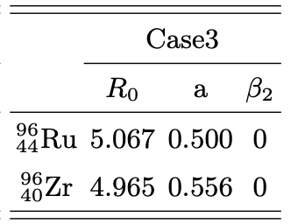
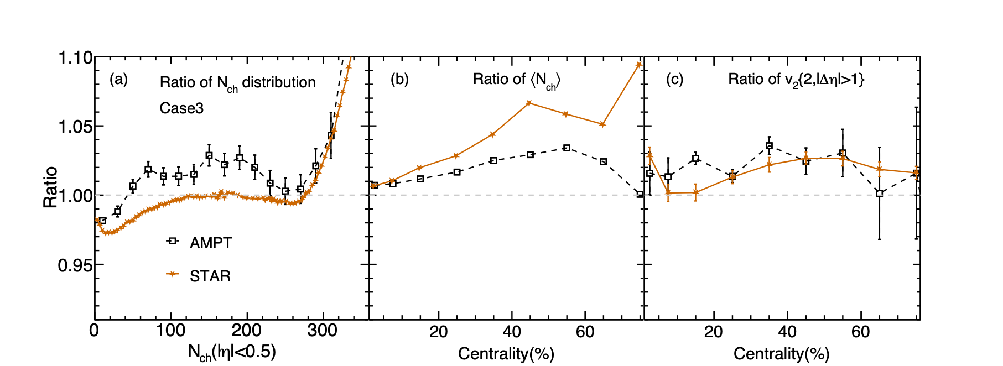
Case3
Ru
Ru
Solid: Ru+Ru, Dash: Zr+Zr
Zr
Zr
+
+
M. Abdallah et al. [STAR], Phys.Rev.C 105 (2022) 1, 014901
H. j. Xu, H. Li, X. Wang, C. Shen and F. Wang, Phys. Lett. B 819, 136453 (2021).
Ru+Ru/Zr+Zr

Slide 37
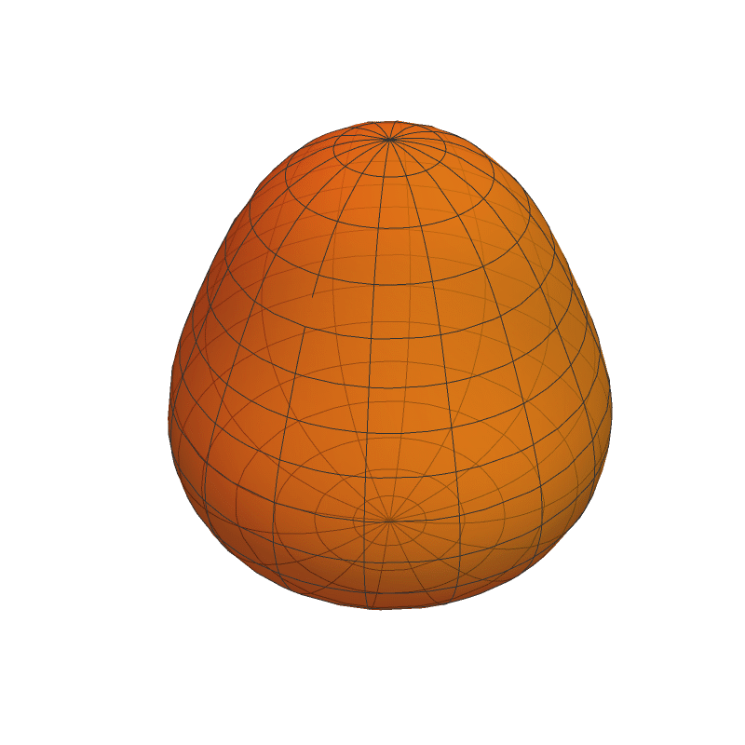
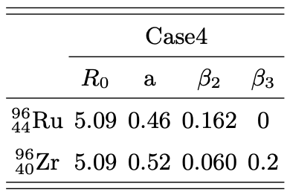
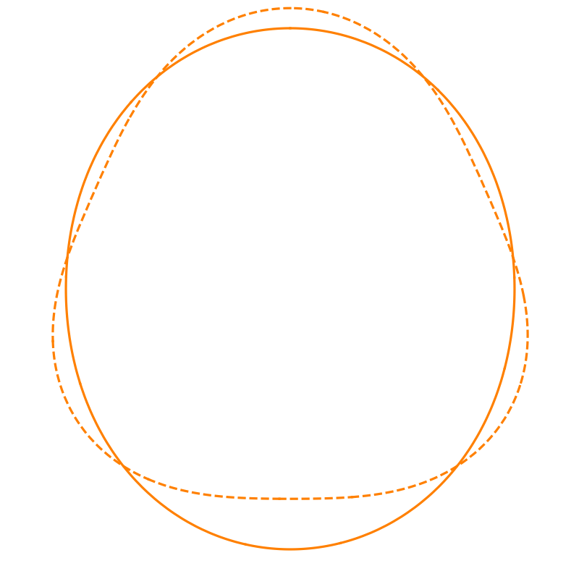
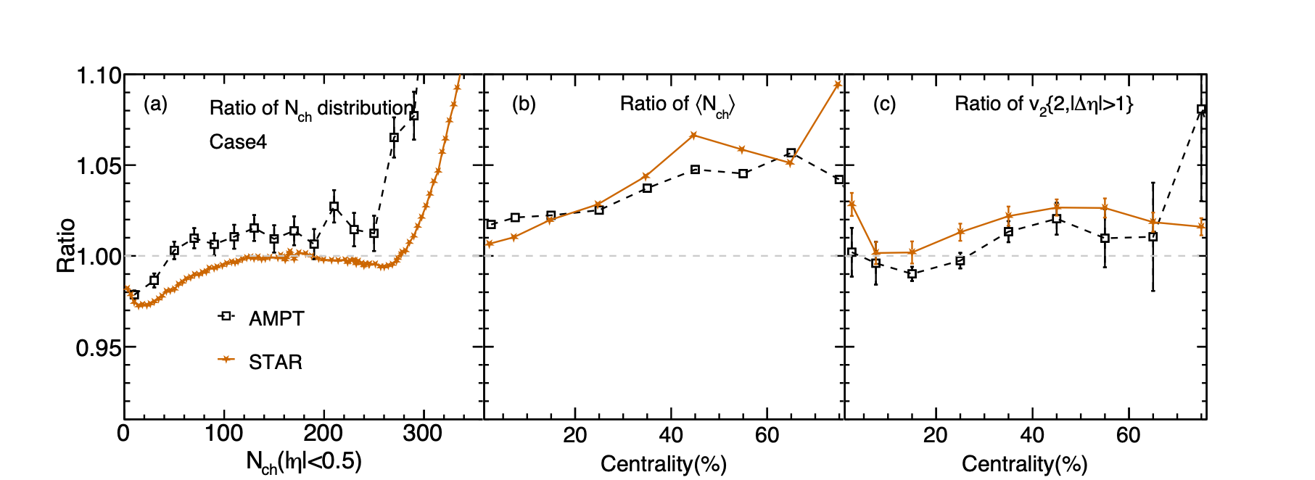
Case4
Ru
Ru
Solid: Ru+Ru, Dash: Zr+Zr
Zr
Zr
+
+
J. Jia and C. J. Zhang, arXiv:2111.15559.
Ru+Ru/Zr+Zr

Slide 38
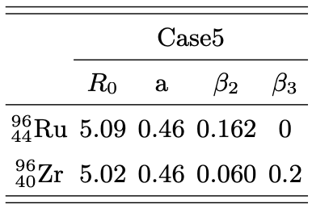
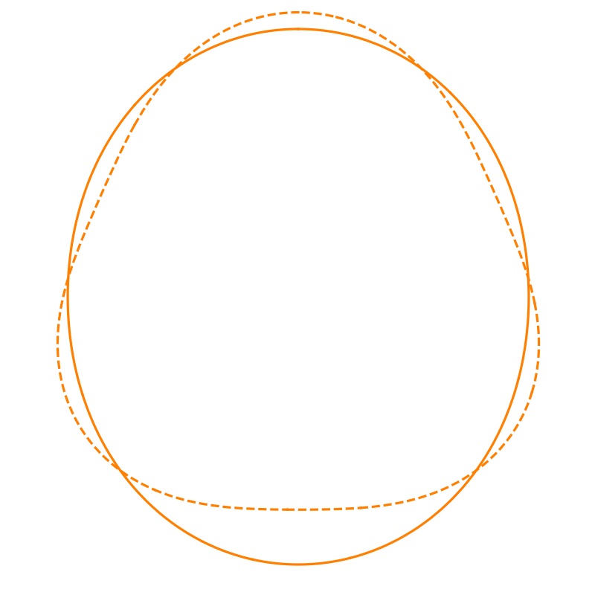
Case5
Ru
Ru
Solid: Ru+Ru, Dash: Zr+Zr
Zr
Zr
+
+
J. Jia and C. J. Zhang, arXiv:2111.15559.
Ru+Ru/Zr+Zr

Slide 39
Case6
Ru
Ru
Solid: Ru+Ru, Dash: Zr+Zr
Zr
Zr
+
+
C. Zhang and J. Jia, Phys.Rev.Lett. 128 (2022) 2, 022301
B. Pritychenko, M. Birch, B. Singh and M. Horoi, Atom. Data Nucl. Data Tabl. 107, 1 (2016)
Ru+Ru/Zr+Zr

Slide 40
Case7
Ru
Ru
Solid: Ru+Ru, Dash: Zr+Zr
Zr
Zr
+
+
H. j. Xu, H. Li, X. Wang, C. Shen and F. Wang, Phys. Lett. B 819, 136453 (2021).
Ru+Ru/Zr+Zr

Slide 41
Case8
Ru
Ru
Solid: Ru+Ru, Dash: Zr+Zr
Zr
Zr
+
+
H. j. Xu, H. Li, X. Wang, C. Shen and F. Wang, Phys. Lett. B 819, 136453 (2021).
Ru+Ru/Zr+Zr

Slide 42
Case9
Ru
Ru
Solid: Ru+Ru, Dash: Zr+Zr
Red: neutron, Blue: proton
Zr
Zr
+
+
H. j. Xu, H. Li, X. Wang, C. Shen and F. Wang, Phys. Lett. B 819, 136453 (2021).
Ru+Ru/Zr+Zr

Slide 43
Case10
Ru
Ru
Solid: Ru+Ru, Dash: Zr+Zr
Red: neutron, Blue: proton
Zr
Zr
+
+
H. j. Xu, H. Li, X. Wang, C. Shen and F. Wang, Phys. Lett. B 819, 136453 (2021).
Ru+Ru/Zr+Zr

Slide 44
Case11
Ru
Ru
Solid: Ru+Ru, Dash: Zr+Zr
Red: neutron, Blue: proton
Zr
Zr
+
+
J. Hammelmann, A. Soto-Ontoso, M. Alvioli, H. Elfner and M. Strikman, Phys. Rev. C 101, no.6, 061901 (2020)
Ru+Ru/Zr+Zr

Slide 45
Skin-type
Ru
Ru
Solid: Ru+Ru, Dash: Zr+Zr
Red: neutron, Blue: proton
Zr
Zr
+
+
H. j. Xu, H. Li, X. Wang, C. Shen and F. Wang, Phys. Lett. B 819, 136453 (2021).
Ru+Ru/Zr+Zr

Slide 46
Halo-type
Ru
Ru
Solid: Ru+Ru, Dash: Zr+Zr
Red: neutron, Blue: proton
Zr
Zr
+
+
H. j. Xu, H. Li, X. Wang, C. Shen and F. Wang, Phys. Lett. B 819, 136453 (2021)
Ru+Ru/Zr+Zr

Slide 47
重离子碰撞如何研究核结构？
贾江涌
原子核尺寸
原子核形状
47

Slide 48
同质异位素碰撞如何研究核结构
48

Slide 49
集体流观测量比值
Isobar碰撞系统间的vn比值对末态相互作用不敏感，直接反映初态信息
49

Slide 50
<pT>观测量比值
Isobar碰撞系统间的<pT>比值反映出原子核的对称能信息
50

Slide 51
CME观测量比值
X. L. Zhao and 马国亮, arXiv: 2203.15214
Δ𝛾 (f=0%) ≈ Δ𝛾 (f=2%) ≈Δ𝛾 (f=5%) < Δ𝛾 (f=7.5%) < Δ𝛾 (f=10%)
Isobar碰撞系统间的Δ𝛾比值反映出初态CME信息

