Slide 1
EIC Project Status and Next Steps Jim Yeck, EIC Project Director
September 16, 2020

Slide 2
EIC Planning Context
Performance and Scope
Full-energy, full-luminosity accelerator (NSAC and NAS recommended)
One interaction region with allowance for a second
One detector
Schedule
Completion in ~10-15 years
Cost
CD-0 approved with a range of $1.6B-$2.6B

Slide 3
Recent History
Event | Date
Mission Need Statement Approved | January 22, 2019
Independent Cost Review (DOE Order 413.3b) | July 2019
DOE Independent Electron Ion Collider Site Assessment | October 8-9, 2019
CD-0 Approved | December 19, 2019
DOE Site Selection Announced | January 9, 2020
FY2020 Budget Includes EIC TEC and OPC Funding | 1st Quarter FY2020
BNL TJNAF Partnership Agreement Approved | May 2020
DOE OPA CD-1 Review Target Date | January 26-28, 2021
CD-1 Approval Target Date | 2nd Quarter of FY2021

Slide 4
Scope – Detectors Definition

Slide 5
Reference Funding Profile
CD-1: March 2021
CD-2: September 2022
CD-3: September 2023
CD-4a: September 2030
CD-4: June 2032
Staged CD-4
Operations Start - CD-4a
Install full RF Power - CD-4
$100M from New York State toward infrastructure

Slide 6
Progress on Organization
BNL/TJNAF Partnership
BNL and JLAB partnering agreement signed
EIC Council established (BNL and TJNAF Directors) with a charter based on experience from recent projects including the LCLS-II and Exascale projects – 1st meeting on June 25, 2020
Executive Management Team established
BNL and TJNAF worked together to clarify mandates and membership for the advisory committees (project, machine, and detector)
Machine Advisory Committee Meeting – August 26, 2020
Project Advisory Committee Meeting – August 27, 2020
Detector Advisory Committee Meeting – September 28-29, 2020
Preparing for a Comprehensive Conceptual Design Review
Jim Yeck and Allison Lung organizing the review in early November 2020
Co-chaired by Sarah Cousineau, ORNL, and Mark Reichanadter, SLAC retired

Slide 7
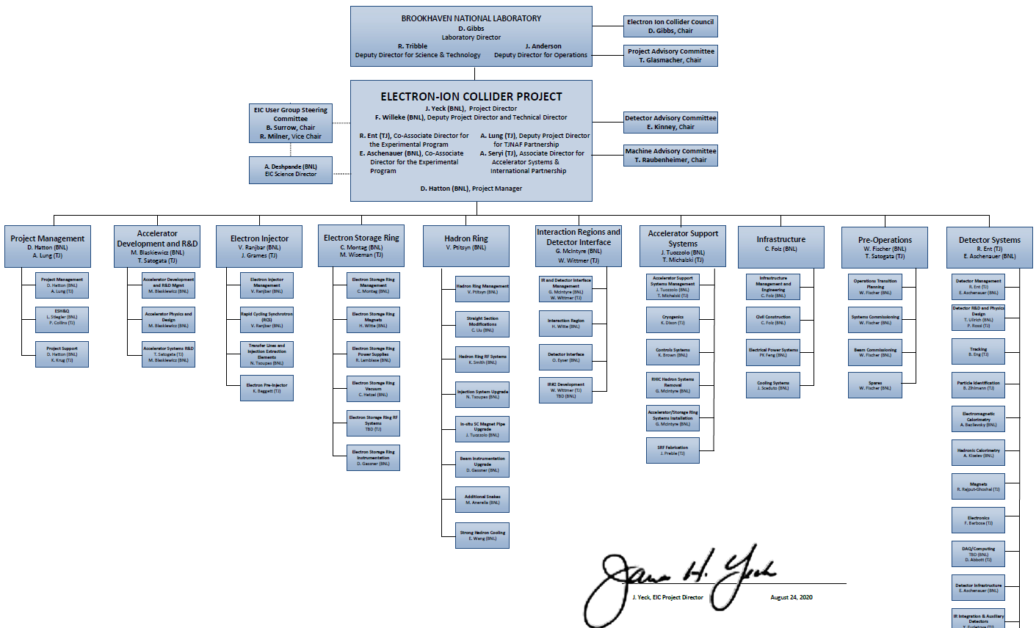
EIC Project Organization
7
7

Slide 8
EIC Partnership Goals
Prospects for significant international and domestic partners considered in planning the project
Promoting a culture of interdisciplinary and multi-institutional collaboration for both the accelerator and experimental program
Bi-lateral meetings with potential partners underway to discuss opportunities in the accelerator and experimental areas
Accelerator Partnership Activities
Workshop planned for October 7-9 – Promoting Collaboration on the Electron-Ion Collider
Possible contributions to the EIC accelerator could include the full range of accelerator design and hardware
Detector Partnership Activities
Call for Expressions of Interest (EoI) for potential cooperation on EIC experimental equipment was released in May: https://www.bnl.gov/eic/EOI.php.
DOE Office of Nuclear Physics organizing regular meetings with international funding agencies

Slide 9
EIC Bilateral Discussions
September 2020
SLAC – EIC: 9/30
ORNL – EIC: 9/18
TRIUMF – EIC: 9/17
CERN – EIC: 9/14
DESY – EIC: 9/14
ANL – EIC: 9/8
LBNL – EIC: 9/2
June – August 2020
CERN FCC – EIC: 7/6
INF Krakow – EIC: 7/2
ANL – EIC: 7/1
CEA-Saclay – EIC: 6/16

Slide 10
Experimental Program Preparations
EIC Community’s Yellow Report Initiative (Kickoff in December 2019, site)
Four workshops planned to advance the state and detail of the documented physics studies and detector concepts in preparation for the realization of the EIC.
BNL and TJNAF Jointly Leading Process for Defining Detector(s)
Call for “Potential Cooperation on the EIC Experimental Program” published in May
Includes two questionnaires, FAQ, and input received
Expressions of Interest (EOIs) due November 1, 2020
Following the EOI Response Deadline
Status report at 4th Yellow Report meeting in November
Responses evaluated and Call for Proposal(s) finalized
Assessment by Members of the Users Group and Project Management with advice from Detector Advisory Committee (DAC)
Call for Detector Proposal(s) in March 2021
EIC EOI Site: https://www.bnl.gov/eic/EOI.php

Slide 11
2nd Detector and IR Planning
EIC will be capable of supporting a science program that includes two detectors and two interaction regions
EIC project planning includes ensuring the viability of a 2nd Interaction Region (IR) and detector
EIC project budgets support construction of one IR and one detector
Stakeholders agree that a 2nd IR and detector within the same timeline as the EIC project is desirable and routes to making this possible as a separate project will be explored
Discussion and dedicated session(s) on the 2nd IR during Yellow Report Meeting in November 2020
Topical week-long workshop on 2nd IR concepts in February 2021

Slide 12
Detector Advisory Committee (DAC)
First DAC Meeting is scheduled for September 28-29, 2020
DAC draft charter and agenda in discussion
DAC members:
Edward Kinney, CHAIR (University of Colorado)
Etiennette Auffray (CERN)
Peter Krizan (University of Ljubjana)
Ana Ameila Machado (University of Campinas)
Greg Rakness (Fermilab)
Werner Riegler (CERN)
Ewa Rondio (National Centre for Nuclear Research)
Heidi Schellman (Oregeon State University)
Brigette Vachon (McGill Univeristy)
Andrew White (University of Texas at Arlington)
Chi Yang (Shandong University)
Glenn Young (BNL)
Ex-officio members: Chair and Vice-chair of EICUGM Steering Committee
Ex-officio members: Chair and Coordinator of Generic EIC Detector R&D program

Slide 13
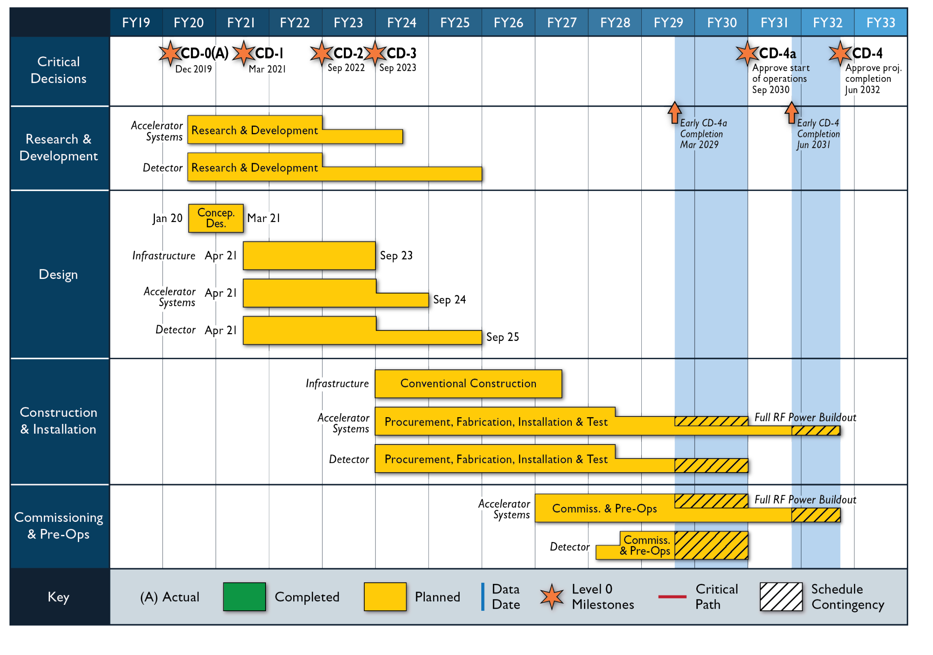
Schedule

Slide 14
Timeline to CD-1
EIC Program Steering Group Meeting May 7, 2020
Partnership Agreement Signed May 7, 2020
Call for EoI for Contributions to Detectors May 29, 2020
EIC Director’s Council Meeting June 25, 2020
Preliminary drafts/full outline of CDR due June 30, 2020
Draft CD-1 documents complete June 30, 2020
A/E Services Contract awarded July 3, 2020
Analysis of Alternatives Team report due July 15, 2020
Deadlines for drafts of new CDR material July 31, 2020
Freeze Design updates for Draft CDR July 31, 2020
Risk Workshop July 31-August 6, 2020

Slide 15
Timeline to CD-1
Freeze data for DOE Mini Review August 1, 2020
Independent Review of AoA Week of August 10, 2020
CD-1 Documents complete for review August 15, 2020
AoA Final Report complete August 25, 2020
Mini MAC (Machine Advisory Com.) Mtg August 26, 2020
Post Material for DOE Status Review August 26, 2020
Project Advisory Committee Meeting August 27, 2020
Draft CDR complete September 1, 2020
DOE OPA Status Review September 9-10, 2020
Cost Estimate “Scrubbing” Week of September 14, 2020

Slide 16
DOE Review
September 9-11, 2020
20 External Reviewers, plus Observers
Results
Closeout Slides provided to EIC (53 slides)
DOE CD-1 review scheduled for January 26-28, 2021 as originally planned
Numerous constructive recommendations as is typical for these types of reviews
Also constructive advice in the written comments and the discussions throughout the review
EIC Team did a great job presenting documentation and plans!

Slide 17
Review Committee Participants
Kurt Fisher, DOE/SC, Chairperson

Slide 18
Charge Questions
Accelerator Conceptual Design: Is the present stage of the accelerator conceptual design sufficiently advanced to reach the technical maturity expected by the pre-CD-1 review planned for January of 2021? Is the overall concept technically sound and likely to meet the project’s technical performance requirements? Is there an accelerator research and development (R&D) plan that adequately supports the design effort and mitigates the technical risks?
Experimental Program: Is the plan for defining the experimental program appropriate? Is there a detector R&D plan in place that will appropriately address the highest technical risks? Is the reference detector design sufficient to allow confidence in the detector cost estimate?
Conceptual Design Report (CDR): Is the CDR on track for timely completion for CD-1?
Project Scope: Is the project’s scope sufficiently defined to support the preliminary cost and schedule estimates?
Cost and Schedule: Are the cost and schedule estimates credible and realistic for this stage of the project? Do they include adequate scope, cost, and schedule contingency that are based on a project-wide risk analysis?
Partnerships: Is the proposed distribution of scope between the EIC partners adequately understood for this stage of the project? Does the project have an appropriately defined framework to plan for the formalization of contributions from DOE and non-DOE partners?
Environment, Safety, and Health (ES&H): Is ES&H being properly addressed given the project’s current stage of development?
Management: Is the project being properly managed at this stage? Has the management team made adequate progress on the prerequisite requirements for CD-1 approval and is there a sound plan for their completion? Will the project be ready for the pre-CD-1 review in January of 2021?

Slide 19
2.2 Detectors R. Kruecken, TRIUMF / A. Lankford, UCI / M. Stancari, FNAL/ Subcommittee 2
Experimental Program:
Is the plan for defining the experimental program appropriate?
Yes, the experimental program is well defined, and a reference detector concept has been defined that is able to deliver the full science program.
Is there a detector R&D plan in place that will appropriately address the highest technical risks
Not yet. An explicit R&D plan is under development. OPC activities address high technical risks.
Is the reference detector design sufficient to allow confidence in the detector cost estimate?
Mostly. The reference detector design is an adequate basis for a reliable cost estimate. More work is required on the cost estimate.
Conceptual Design Report (CDR):
Is the CDR on track for timely completion for CD-1?
Yes. The Yellow Report will further inform the CDR.

Slide 20
CD-1 Review Final Preparations
Detector Advisory Committee Meeting | September 28-29, 2020
Accelerator Collaboration Workshop | October 7-9, 2020
EOIs for Experimental Equipment Due | November 1, 2020
Conceptual Design Review | November 16-18, 2020
Project Advisory Committee Meeting | November 19, 2020
NEPA Process Complete | November 30, 2020
CD-1 Director’s Review | December 8-10, 2020
Conceptual Design Report Complete | January 12, 2021
DOE CD-1 Review | January 26-28, 2021

Slide 21
Post CD-1 Timeline
Start Preliminary Design | April 1, 2021
Focused Technical Reviews | Spring 2021
DOE Status Review | July 2021
DOE Status Review | December 2021
Start Earned Value Tracking | March 2022
CD-2 Director’s Review | March 2022
DOE CD-2 Review (Baseline) | March 2022
Goal for CD-2 Approval | September 2022
Goal for CD-3 Approval | July 2023

Slide 22
Timeline Post CD-1
Start Preliminary Design April 1, 2021
Focused Technical Reviews Spring 2021
OPA Status Review July 2021
OPA Status Review December 2021
Start using EVMS as practice prior to CD-1 March 2022
CD-2 Director’s Review March 2022
OPA CD-2 Review June 2022
Goal for CD-2 Approval September 2022
Goal for CD-3 Approval July 2023

Slide 23
EIC Challenges and Opportunities
Affordability – EIC is very large project for DOE Office of Nuclear Physics (NP) and Office of Science (SC)
Requires reprioritization of RHIC operations funding to EIC and new funding
Significant ramp up of project funding (annual doubling) starting in FY2021 is required to maintain timeline for Critical Decisions
Most cost-effective project follows closely to a technically driven schedule
Partner Engagement – Expectations and Implementation
International and domestic engagement highly desirable and widely expected
In-kind contributions to the accelerator and experiment(s) will be pursued
Potential partners must be engaged now given the EIC technically driven schedule

Slide 24
EIC Challenges and Opportunities
JLAB Partnership – Non-traditional, breaking new ground
EIC Executive Management Team (Level 1) and JLAB personnel in Level 2 management roles establish JLAB as a full intellectual partner in the leadership of the project.
BNL and JLab jointly hosting the EIC experiments.
JLab responsibilities for project scope need to be further clarified
COVID-19 Impacts – Immediate and long-term implications
Current EIC activities are primarily planning and design work carried out remotely
There are impacts on efficiency and R&D work, however we remain confident about the path to CD-1
Indirect impacts will likely to be more significant, including aligning with RHIC operations plans, uncertain fiscal context, design efficiency, R&D efficiency

Slide 25
Summary
Overall Project Delivery Plans Rapidly Maturing
Strong foundation in place: pre-conceptual design, cost and schedule
Pursuing broad collaboration around the EIC
BNL and JLAB leadership and the entire EIC Project Team committed to delivering the EIC project as cost effectively as possible and with the engagement of partners
Project planning has matured to level required for DOE CD-1, with a clear timeline of activities to be completed prior to DOE OPA CD-1 review
Schedule aligned with reasonable annual funding projections
DOE review and approval process established: CD-1 approval in March 2021
Experimental Program Planning
BNL and TJNAF jointly leading the process for defining detector(s)
Community engagement and timeline for the Yellow Book, Call for Expressions of Interest, Call for Proposals, etc. is extremely important
BNL and TJNAF jointly serve as the “host” lab for the international user community - EIC Call for Expressions of Interest (EoI) released: https://www.bnl.gov/eic/EOI.php.
Detector(s) plans will align with project CD-4 schedule and transition to operations

