Slide 1
System Integration Issues for the Electron Ion Collider
Interfaces / Interferences / Interactions
Walt Akers, Systems Engineer
Thomas Jefferson National Accelerator Facility

Slide 2
System Integration: A Common Frame of Reference
General Definition:
the composition of a capability by assembling elements in a way that allows them to work together to achieve an intended purpose [MITRE].
Practical Definition:
coordinating the interfaces, interferences, and interactions between sub-systems and their environment to achieve operability.

Slide 3
System Integration: Practical Issues
Interfaces:
the connections and conduits (input/output) between a sub-system and other entities.
Interferences:
the limiting factors within the assembled system (and its environment) that constrain the sub-systems.
Interactions:
emergent conditions that arise from the operation (or coexistence) of multiple sub-systems in the operating environment.

Slide 4
Common Vectors of System Integration
Structural Dimensions
Door Sizes
Floor Loading
Crane Capacity
Dimensions and Configuration of Sub-Systems
Space Allocations within the System
Sub-System Mobility and Handling Systems
Installable Infrastructure, Resources and Amenities
SPACE
Electrical Service Size
Budgeted Power Limits
Transformer/Conductor Capacity
Generator Capacity
Internal Distribution
Power Transformation
Power Isolation and Source Selection
POWER
Frontier of Capability/Control
Cooling Tower Capacity
Cryogenic Capacity
Process Water/Low Conductivity Water Capacity
Allocations and Allowances for Shared Resources
Internal Distribution
Flow Management and Governance
Direct Expansion Systems / Independent Chillers
COOLING
External Data Storage Capacity
Bandwidth/Throughput
Global Latency
Cable Distribution
Signal Concentration / Data Reduction
Local Caching
SIGNAL

Slide 5
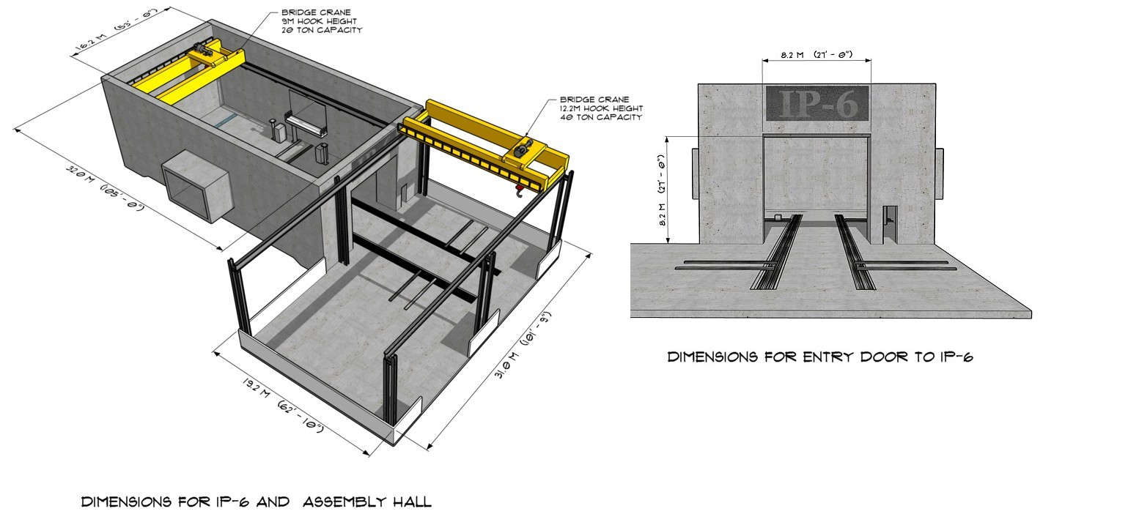
Space Limitations and Interferences for IP-6
Assembly approach is governed by the size and crane capacity of the IP-6 assembly area.
Final size of the detector assembly is limited by the dimensions of the IP-6 door.

Slide 6
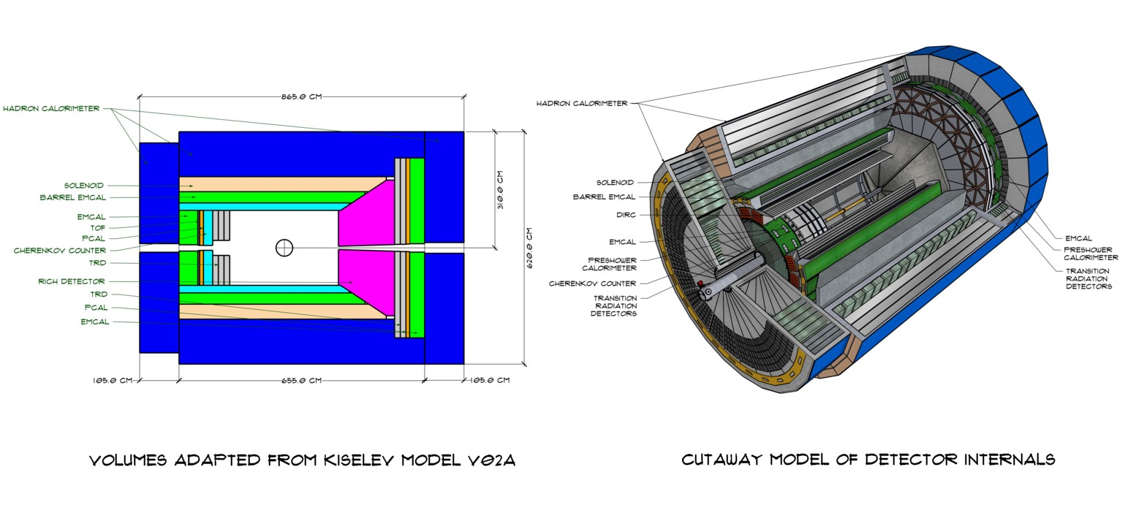
Interfaces & Interferences Within the Detector
Kiselev model shows the total space available for each detector and it’s supporting infrastructure.
Integrated sub-detector design must include space and pathways for power, cooling and signal interfaces.
Heat rejection for each system must be designed to minimize impacts to adjacent sub-detectors and components.

Slide 7
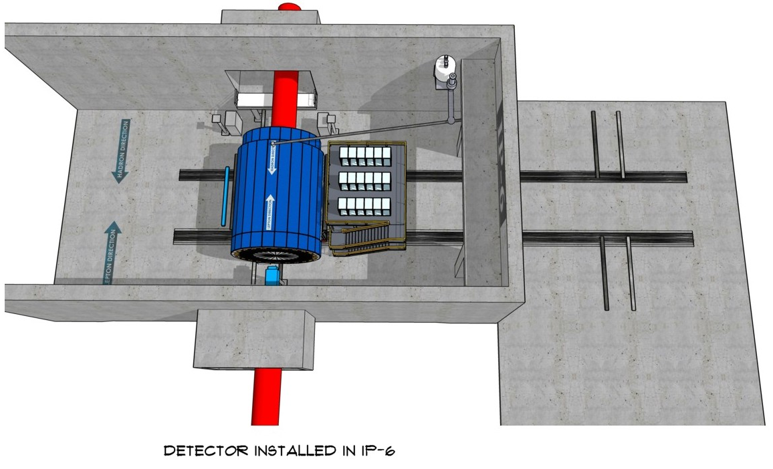
Placement of Detector Inside IP-6
A flexible cryogenic line attaches the detector system to the cryo-can, allowing it to be moved without being disconnected.
The detector systems in the experimental hall are positioned tightly between the accelerator magnets and IR infrastructure.
The space in the experimental hall is inadequate to perform any significant maintenance or installation functions.
ANY SIGNIFICANT MAINTENANCE MUST BE PERFORMED IN THE ASSEMBLY AREA.

Slide 8
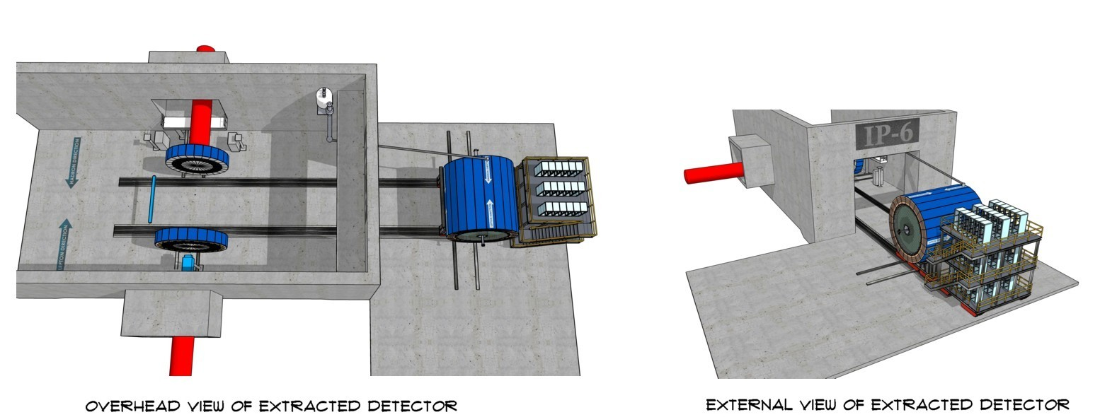
Detector Extracted to IP-6 Assembly Area
Hadron calorimeter end caps are separated from the detector assembly before it is removed.
The central detector and electronics carriage are rolled into the assembly area for installation and maintenance.
The flexible cryogenic line remains connected to the detector assembly, allowing it to remain cold for extended maintenance periods.

Slide 9
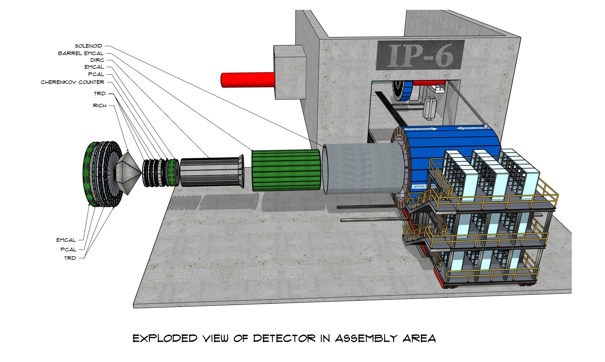
Detector Components “Unpacked”
The assembly area has sufficient space to ‘unpack’ the detector sub-systems on the left side.
Space on the right side is very limited and will only allow the removal of small components.
Several sub-systems (EMCAL, PCAL, TRDs) in the current design can only be removed on the left side.
Two large roll up doors are located in the assembly area, allowing components to be extracted and immediately removed if necessary.

Slide 10
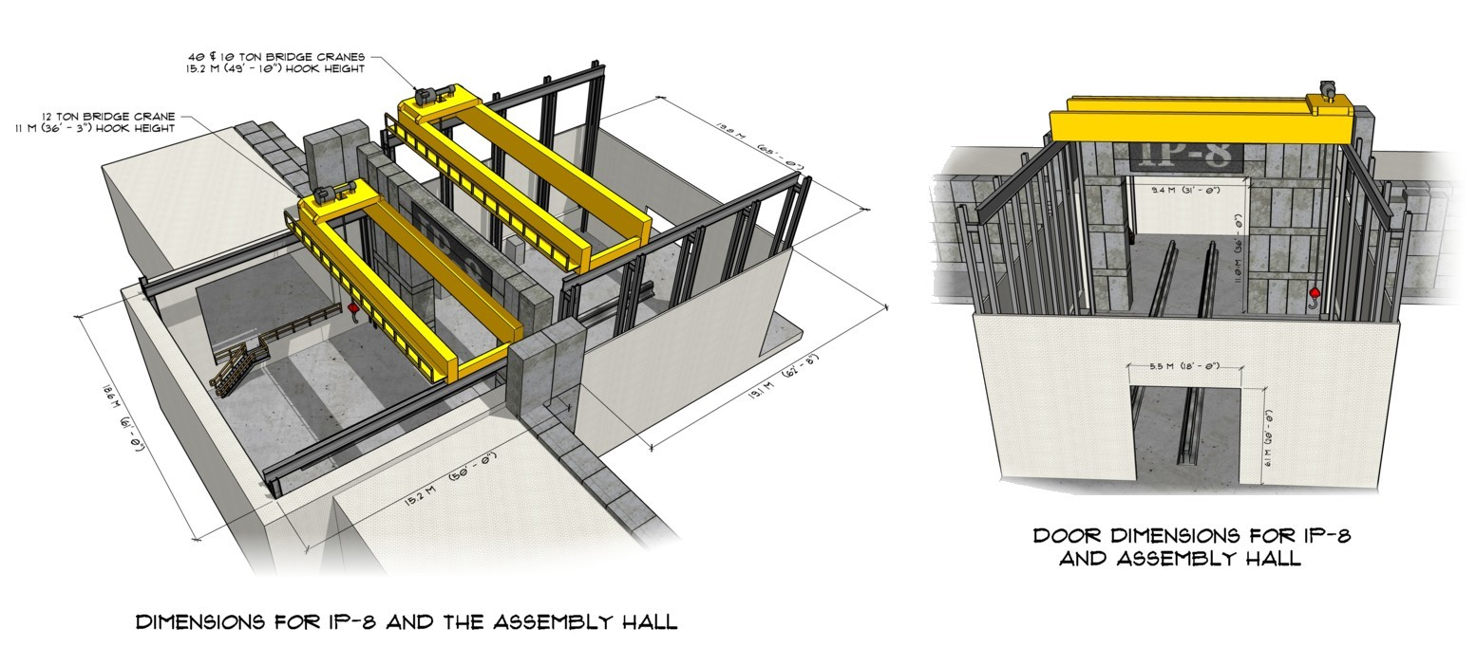
Space Limitations and Interferences for IP-8
The experimental hall in IP-8 is larger than IP-6, however detector access is still limited by the accelerator systems.
The assembly area for IP-8 is significantly smaller than that of IP-6.
Disassembly of the detector and removal of sub-systems in the IP-8 assembly area will require special considerations.

Slide 11
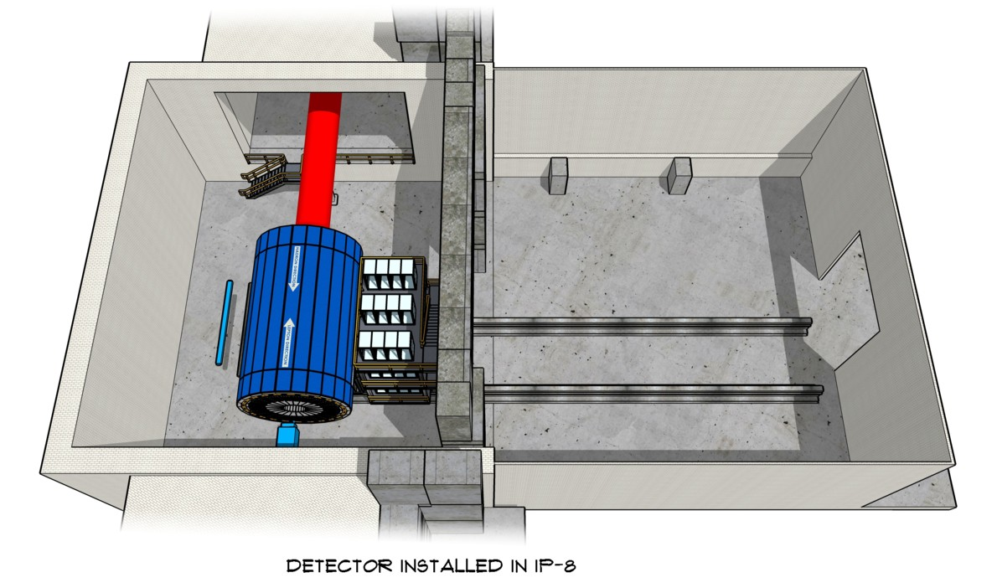
Placement of Detector Inside IP-8
This detector model shows the existing Babar/SPHENIX detector, coupled with two hadron calorimeter end caps.
The electronics carriage is shortened to fit inside the experimental hall when the door shielding is in place.
A flexibly connected cryogenic line (not shown) will be installed to allow this detector to be removed without disconnecting.
As with IP-6, the positioning of the accelerator systems around the detector will prevent detector maintenance in the experimental hall.

Slide 12
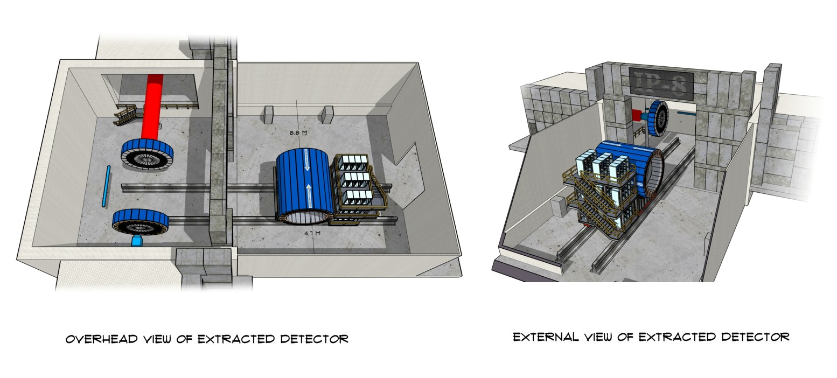
Detector Extracted to IP-8 Assembly Area
Hadron calorimeter end caps are separated from the detector assembly before it is removed.
The central detector and electronics carriage are rolled into the assembly area for installation and maintenance.
Major sub-systems can only be removed on the right side of the detector – and space is VERY limited.

Slide 13
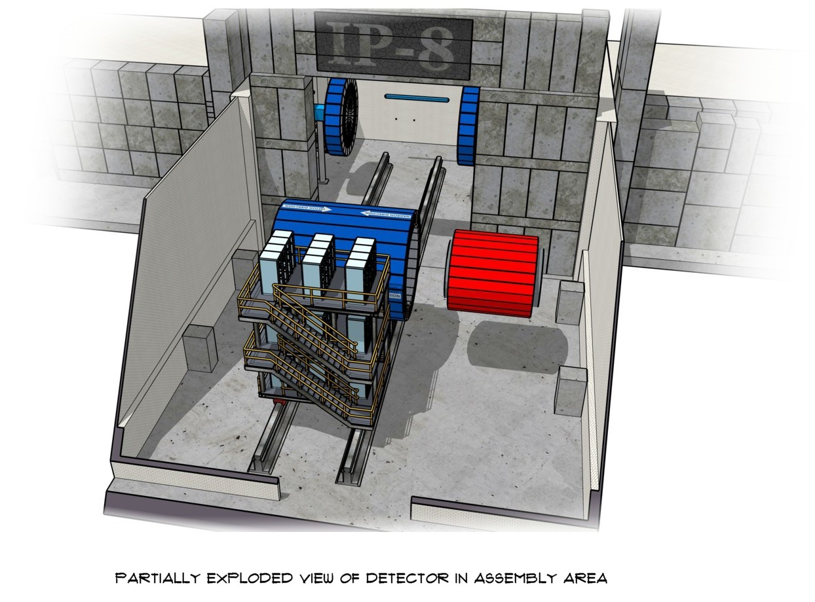
Detector Components “Unpacked?”
This model represents the components that are currently part of the Babar/SPHENX installation in IP-8.
Space on the left side is VERY limited and will only allow the removal of small components.
Space on the right side is tight, and will require significant planning to coordinate installation/removal of components.
Removal through the roll-up door may be obstructed when the detector is outside the hall.

Slide 14
Upcoming Work
Identify External Resource Limits
Further identify and document the limitations for space, power, cooling and signal resources.
Create a Preliminary Resource Budget
Identify the resource limits (space, power, cooling & signal) for each sub-system so owners can incorporate them into their designs.
Refine Models
Continue to refine the system models to better identify the structural supports between the subsystems and how power, cooling and signal services will be distributed.
Integrate with Accelerator Systems
Interfaces with the accelerator systems/IR must be identified and documented.

