Slide 1
Material Budget
Leo, Matt, Jin
Material in the EIC detector packages can be broken down into four main categories:
The detector itself (for Si tracking this is staves and discs, each has a radiation length incorporated into the existing simulations that includes the sensor and local support, powering, etc.).
The support structures. These include both the materials (other than incorporated into the detector itself) needed to form a detector package and the supports and transport mechanics to position and hold the detector package in position with the required stability.
The service connections (power, readout, cooling, gas lines, environmental monitor, detector safety system, etc.) needed to service the detector package.
The beam pipe and associated accelerator interaction point materials. (may include the main detector magnet) – This is under development by the machine group.
These quantities are what we wish to understand for the baseline detector systems.
This information would then be used in the simulations to determine the effects of these loads on the physics.

Slide 2
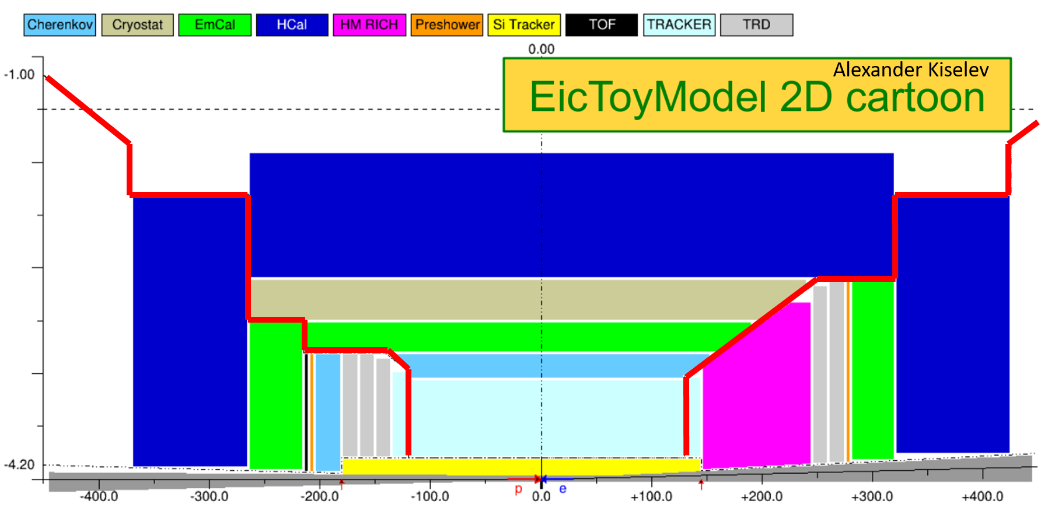
A reminder of detector layout and services routings
General Routing of services. Internal routing of detector package services are up to the detector designer.
Patch panel cables/services to outside of detector will generally be routed along the shown paths.
Alexander K. requested services and support estimates from all sub-detector groups in the document “Sub-detector system specifications.pdf”

Slide 3
What is the status?
Si Tracking detectors:
Comments:
The largest (by far) component of material in the full detector volume for the silicon tracking detectors is the power and signaling cables with the power cables dominating the load.
This is based on a powering and RDO architecture similar to the one used in the ALICE ITS. We use this as a baseline for comparisons.
We have identified options for targeted R&D to reduce both power and RDO services are available, see https://www.jlab.org/indico/event/400/contribution/18/material/slides/0.pdf and https://www.jlab.org/indico/event/400/contribution/17/material/slides/0.pptx.
We anticipate that after the initial projections are included in a full detector simulation, we will need targeted R&D to reduce the services loads.
Status:
(Detectors) We have detector models that correspond to the radiation lengths and volumes that can be reasonably expected for proposed candidate technologies (ITS3, 180 nm fallback). These exist as baseline configurations for the hybrid (Si + gas) and (soon) for the all-Si tracking version.
(Support Structure) We have projections for the support structures in a simplified layout. These estimates can be found at https://indico.bnl.gov/event/8231/contributions/37955/attachments/28329/43586/2020_05_15_EIC_Si_material_projections.pptx. These estimates and not yet fully propagated into the simulation models.

Slide 4
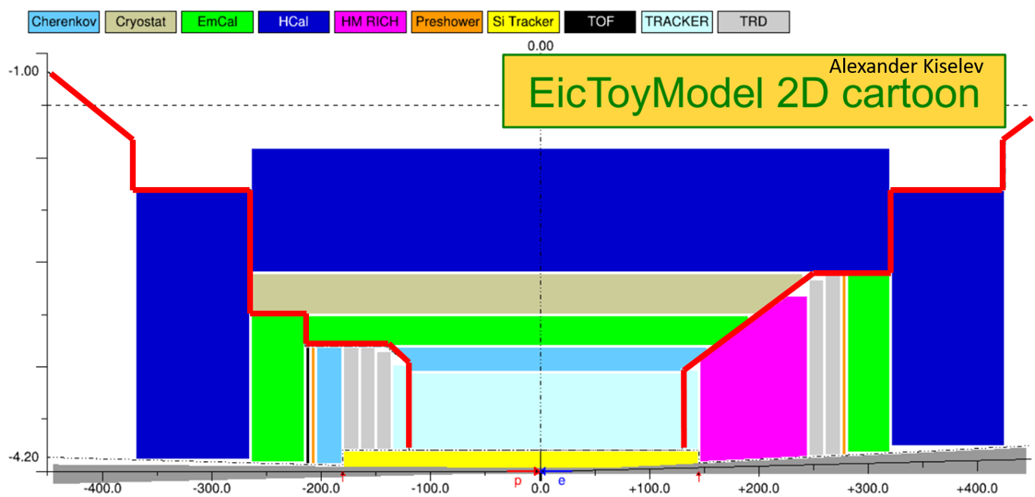
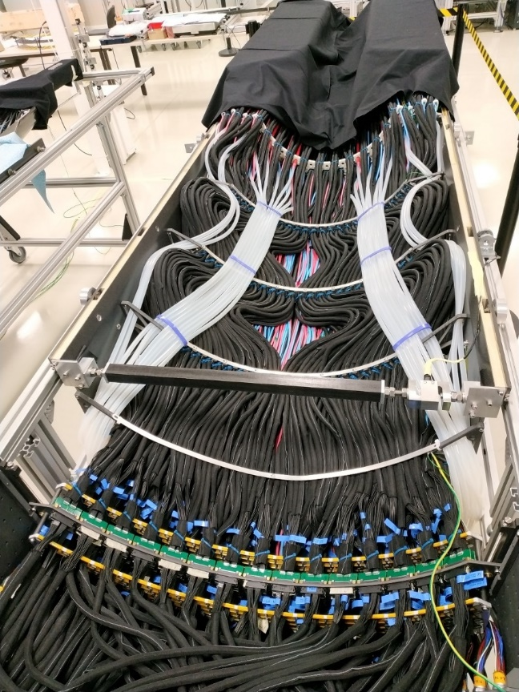
What is the status?
(Services) – We have a reasonable set of services extrapolations for the proposed candidate sensors based on an ITS like architecture and on a reduced X/X0 ITS like architecture with aluminum conductor power cables. These estimates are available at – https://indico.bnl.gov/event/8231/contributions/37955/attachments/28329/43586/2020_05_15_EIC_Si_material_projections.pptx. These estimates and not yet fully propagated into the simulation models.
ALICE ITS services for half-barrel
Patch panels and services from tracking detectors run in the acceptance of the outer detectors.

Slide 5
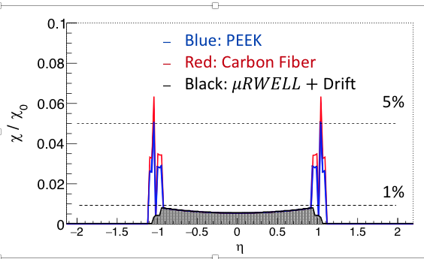
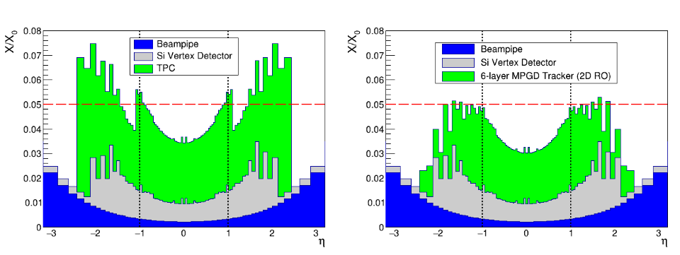
What is the status?
Gas tracking detectors
Comments: Central detector configurations could be used with either MPGD technology (Micromegas or Micro-RWell)
Status:
(Central MPGD Detectors) Two MPGD implementations for the central region.
Micromegas cylindrical tracking layers (6 layers) serving as an alternative to TPC or silicon barrel options. https://indico.bnl.gov/event/7909/contributions/40878/attachments/30147/47096/EIC_MM_tracker_simulation_weekly_27082020-2.pdf
Micro-RWell cylindrical MPGD layers used for fast tracking information and seed particle identification via precise track point and direction for particles impacting PID detector. https://indico.bnl.gov/event/8231/contributions/37817/attachments/28279/43480/EIC_YR-Tracking_-_PID_-_Calorimetry_session_Pavia_21.5.2020_final.pdf
(Support Structure) Estimates of material from readout layer, gas window, and detector gas volume support frame materials are taken into account. Still need to include detector assembly support materials.
Matt
(Services) Gas lines (most likely 4mm OD with 0.5 mm wall thickness), 18 AWG HV cable for power, and 28-32 AWG flat micro-coax cable for signal. Not implemented yet.
Micro-RWells (r = 79.5 and 90 cm)
TPC
Micromegas
M. Posik, Temple University
Qinhua Huang, CEA Saclay

Slide 6
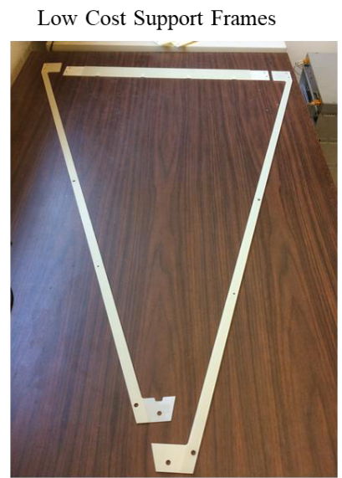
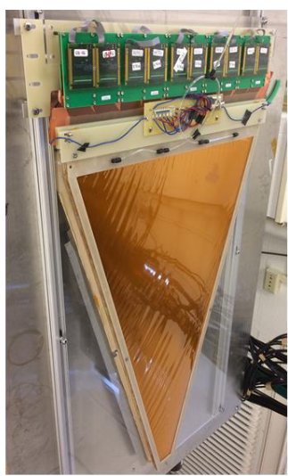
What is the status?
Matt
Gas tracking detectors
Comments:
End cap tracking system is not yet designed and numbers are derived from similar systems (pRad, Super BigBite, etc.)
Multiple MPGD technologies can be used (GEMs, Micromegas, and Micro-RWells)
Status:
(Endcap MPGD Detectors) The end cap tracking system is still being implemented. It will most likely consist of 12 trapezoidal modules. Exact material budget (active area and support frames) depends on MPGD technology. We expect a low radiation length ~0.3-0.6% in the active area (depending on MPGD technology).
(Support Structure) End cap MPGD layers will likely be supported by a carbon fiber wagon wheel.
(Services) Gas lines (most likely 4mm OD with 0.5 mm wall thickness), 18 AWG HV cable for power, and 28-32 AWG flat micro-coax cable for signal will be located at outer radius of end cap disk.
Kondo Gnanvo, UVa

Slide 7
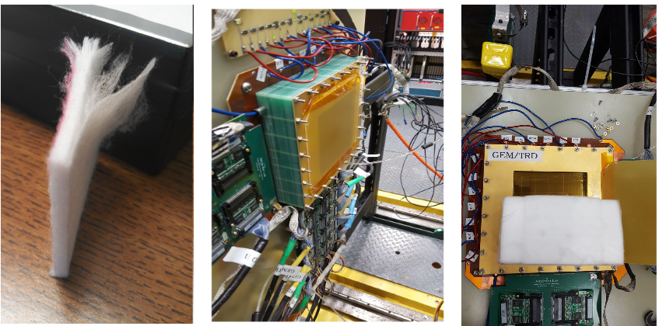
What is the status?
Matt
Gas tracking detectors
Status:
(Hadron MPGD-TRD Detector) Provides precision tracking and e/pi discrimination in the hadron end cap. Current prototype is based on triple-GEM plus readout.
Radiation Length (X/X₀) of a Single module
Xe gas (2 cm): ~0.1%
Triple-GEM+ Readout active area: (~0.7%), could go down to ~0.4%
Radiator fleece (10 cm): ~1.5%
eRD22 GEM-TRD Prototype

Slide 8
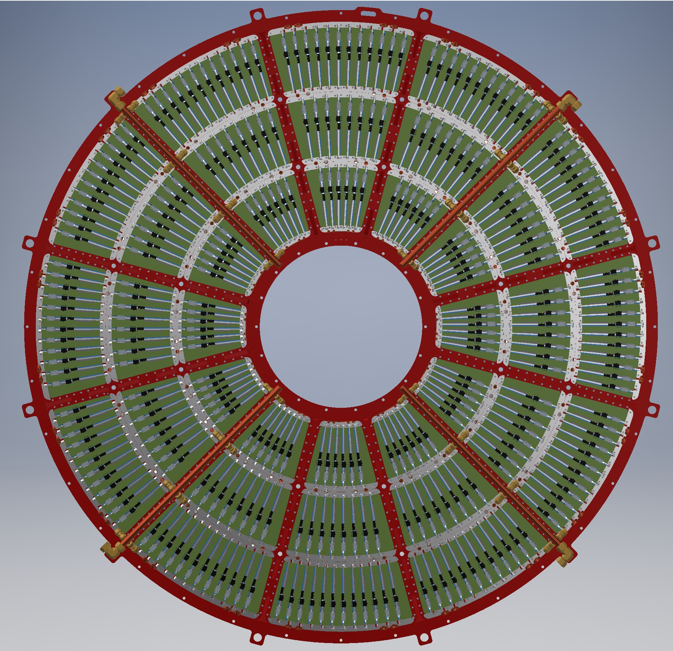
TPC
What is the status?
Jin
sPHENIX TPC end-cap in an EIC configuration
TPC provide thin-material tracking in the active region
E.g. sPHENIX TPC ~3% X₀ in the mid-rapidity with mature design (post CD3), under construction
Material in the TPC end-cap can be significant (support, readout, and cooling)
Although end-cap thickness not a spec. for sPHENIX TPC, significant efforts are made to reduce the material effects in the forward direction
Strong structure needed to survive magnet quenches, but aligned major masses (support beams in wagon wheel) to the inactive areas between GEM modules.
Integrate readout board mechanical support and cooling
Considerations to lighten the TPC end-cap masses
Kondo Gnanvo: single side readout, larger GEM module, charge spreader to reduce readout density
Low mass region (4xGEMs + readout pad PCB)
Electronics
Al cooling-support block
Al mechanical structural support (wagon wheel)

Slide 9
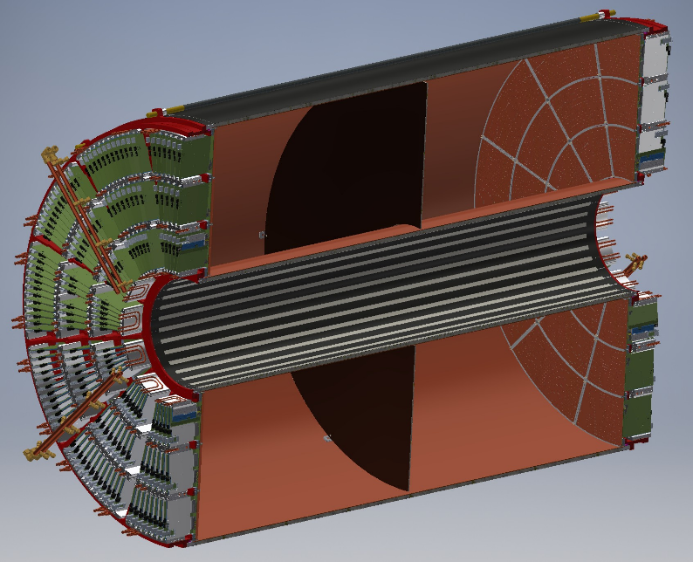
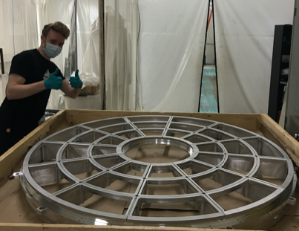
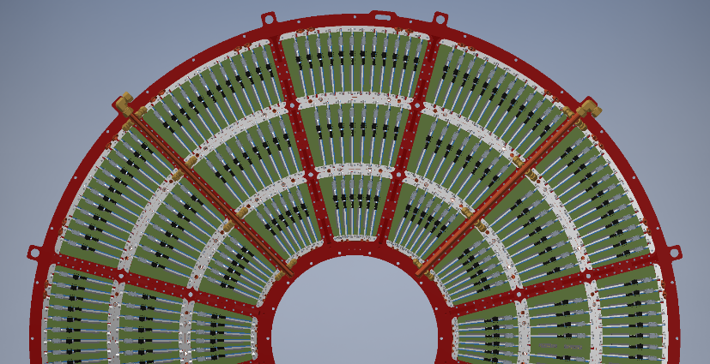
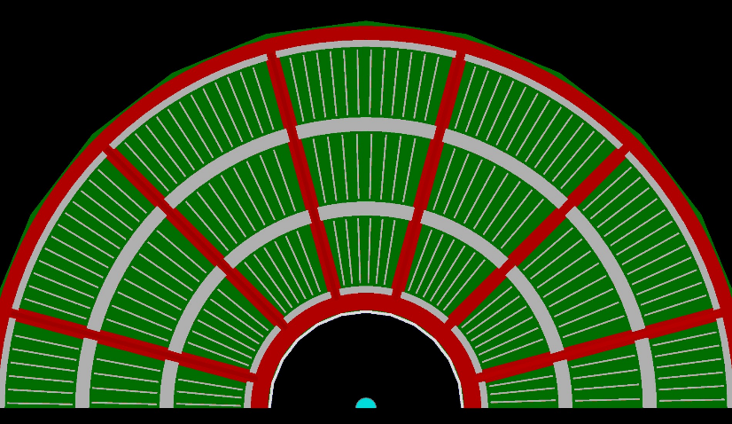
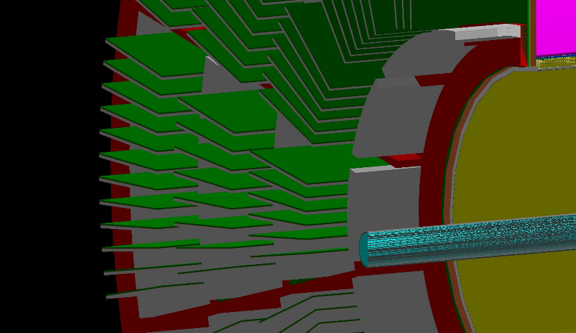
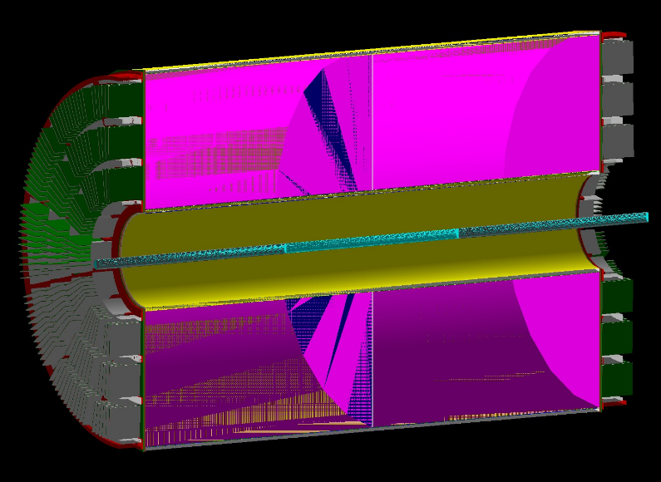
TPC endcap in Geant4 simulation
What is the status?
Jin
Geant4 simulation via Fun4All : https://github.com/sPHENIX-Collaboration/coresoftware/pull/915
CAD: TPC
StonyBrook Univ TPC wagonwheel
CAD:endcap
Fun4All-G4
Fun4All-G4
Fun4All-G4

Slide 10
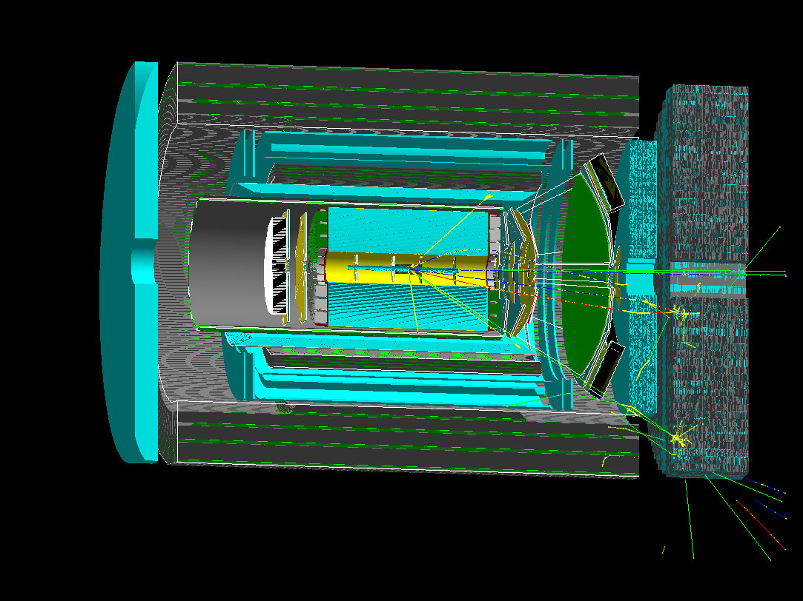
The detector model used in this material scan
What is the status?
Jin
Geant4-Material scan in simulation in Fun4All
2014 concept: arXiv:1402.1209 [nucl-ex], 2018 update: sPH-cQCD-2018-001
Scanning material for the tracker+PID core only Reproduce: https://github.com/blackcathj/macros/tree/display-EIC-BeamPipe-TPCEndCap-materialscan/macros/g4simulations
DIS e x p @ 18x275 GeV/c, 25mrad crossing, x~0.5, Q^2 ~ 5000 (GeV/c)^2, horizontal cut away

Slide 11
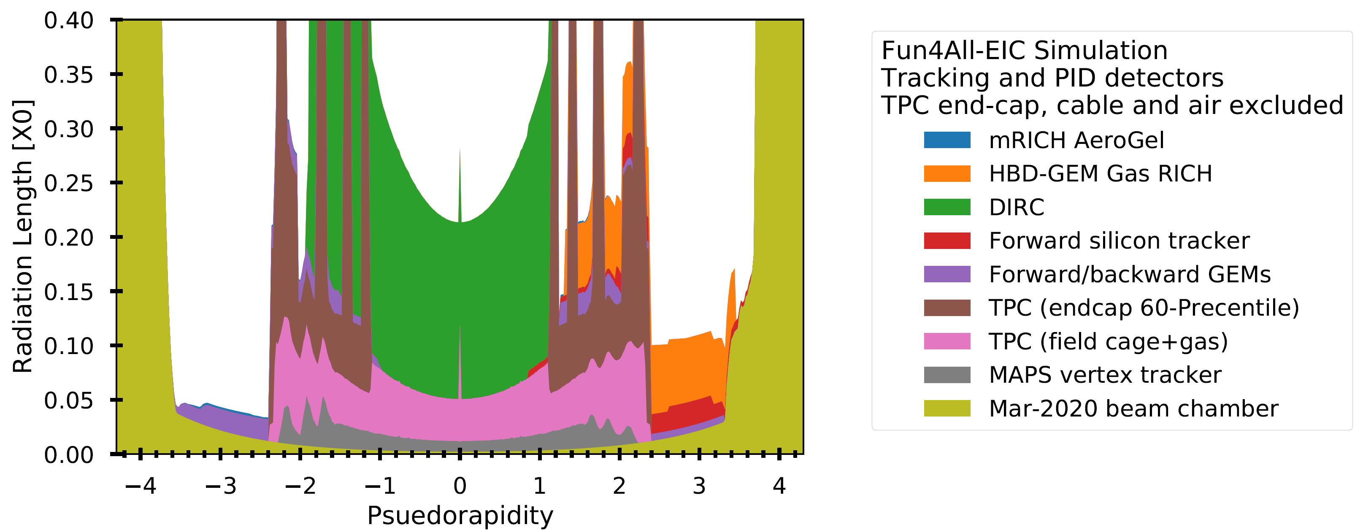
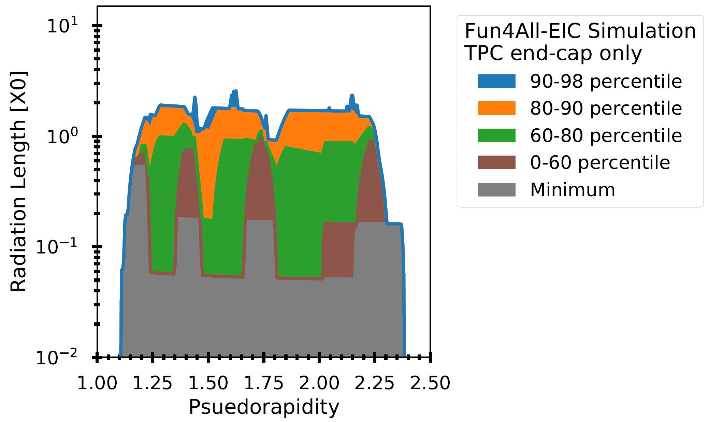
Material in the tracker+PID core
What is the status?
Jin
TPC end-cap, modeled after a mature design (sPHENIX), can be a significant material contributor / aperture limitation
Discussions on-going to optimize the TPC end-cap masses for EIC
Simulation study on impact to integrated tracking-PID-calorimetry performance welcomed
Other caveats:
mRICH support-readout not included, active components only
Off-active area cabling not included (see earlier part of the talk/Leo). Air disabled (0.3% X0 per meter ~ Be beam pipe)

Slide 12
Beam pipe
What is the status?
Jin
Many model right now assume Be beam pipe, possibly with cooling
1st YR workshop EIC beam pipe: 30mil/760µm Be pipe, 0.22% X0 ~= 1st layer silicon
Experience from electron collider support heavy-z coating to mitigate synchrotron background in the active detector region.
Quantified by detector SynRad+Geant4 simulation [see next talk M. Stutzman]
2-µm Au inner coating (0.06% X0) reduces the synchrotron photon hit to vertex tracker by four orders of magnitudes
Although machine and beam chamber design still on going, suggest include the added heavy-Z coating into the detector simulation

Slide 13
Comments and next steps
Most inner sub-detectors have a good estimate of the material in the detector itself (sensing medium, immediate support, etc.) and this understanding is propagated into their simulation models.
The status for the supports (what is needed to form a detector package and what is needed to hold that package in place) is mixed. For the sub-systems that have developed concepts, these are being passed to Alexander.
The status of the services estimates is also mixed. The inclusion of patch panels and nominal adherence to the defined service routing paths should be part of this.
Reasonable distributions and definitions (not detailed models, just approximations) of this material need to be in place to assess the effect on the ability to carry out the physics measurements of interest.
This process is underway by sub-detectors defining their estimated loads and by Alexander integrating this information.
It may be useful to better define the process where we add these mocked up loads to the simulations and examine the effects.
At least in the case of the silicon tracking, this exploration will likely lead to needing to begin targeted R&D to reduce the services load. Some ideas are already being explored to accomplish this (serial powering, DC-DC converters, fiber based RDO from staves/discs, etc.)

Slide 14
Backup

Slide 15
Detector model used in this study
2014 concept: arXiv:1402.1209 [nucl-ex], 2018 update: sPH-cQCD-2018-001

Slide 16
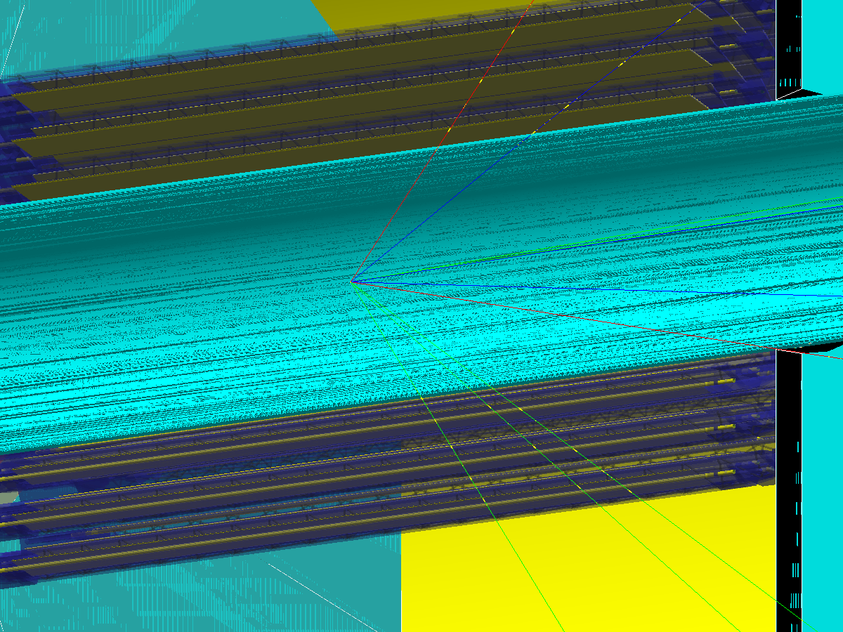
The detector model in this scan
Geant4-Material scan in simulation in Fun4All
2014 concept: arXiv:1402.1209 [nucl-ex], 2018 update: sPH-cQCD-2018-001
https://github.com/eic/Singularity
Be beam pipe
←Collision point
3-layer ALPIDE pixel tracker
DIS e x p @ 18x275 GeV/c, 25mrad crossing, x~0.5, Q^2 ~ 5000 (GeV/c)^2, horizontal cut away

Slide 17
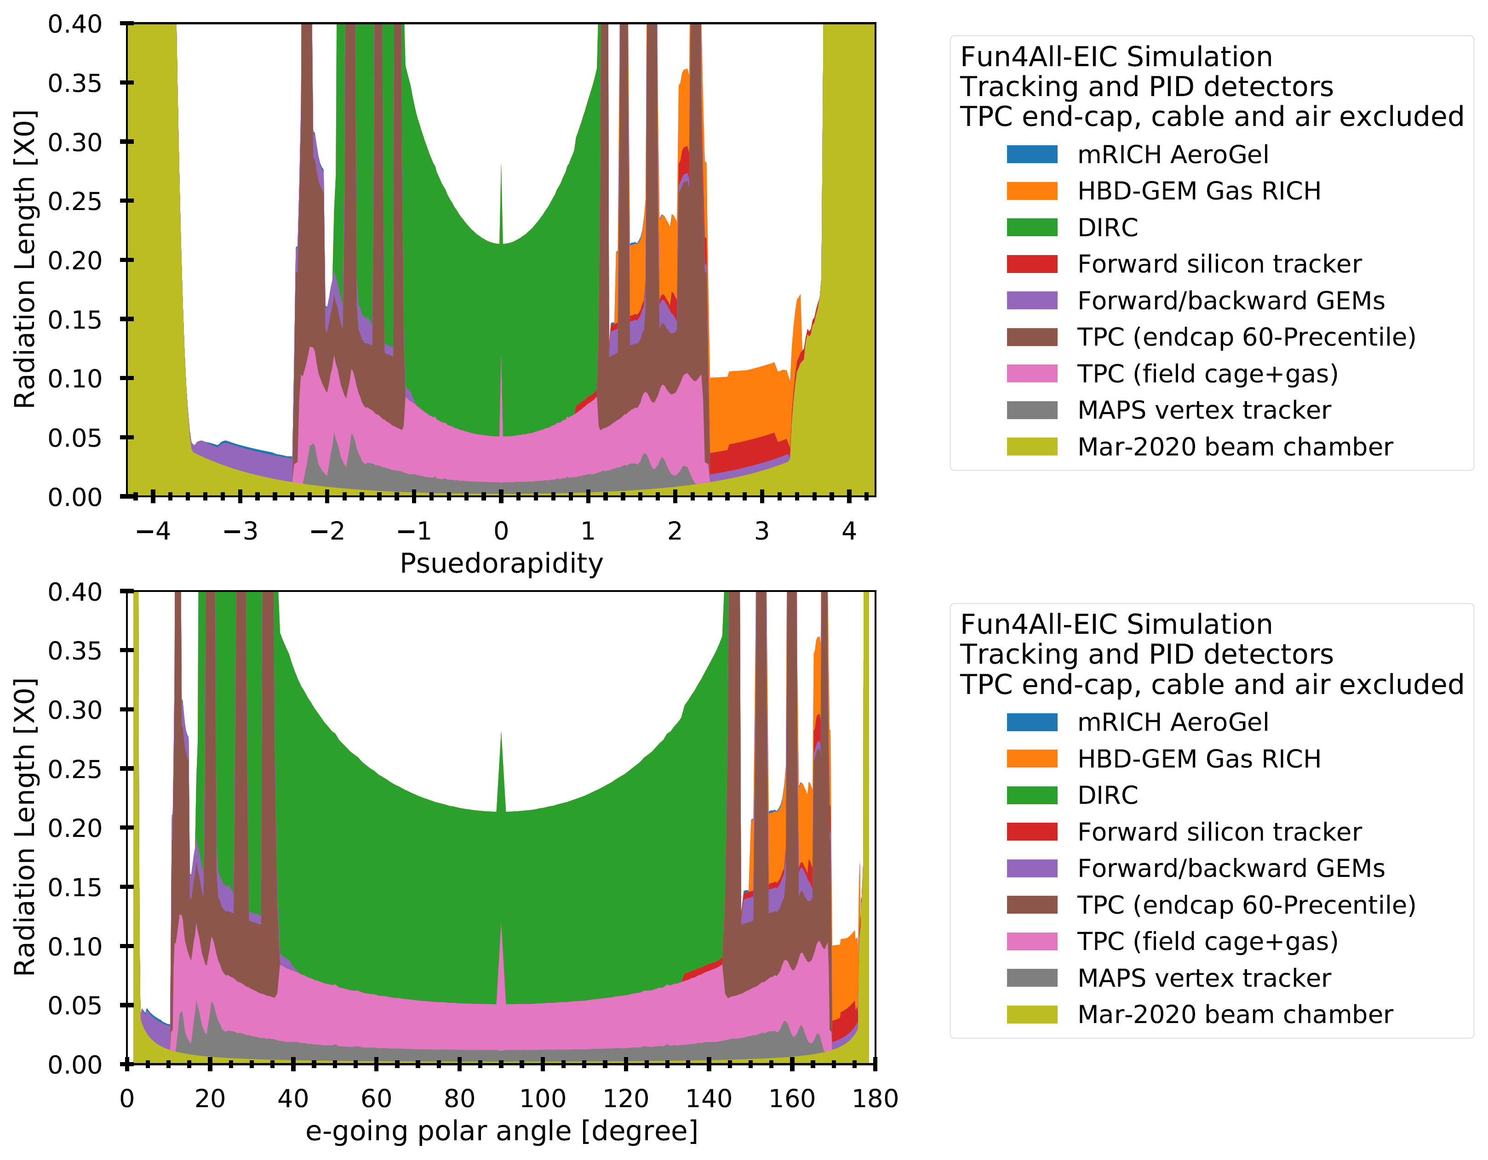
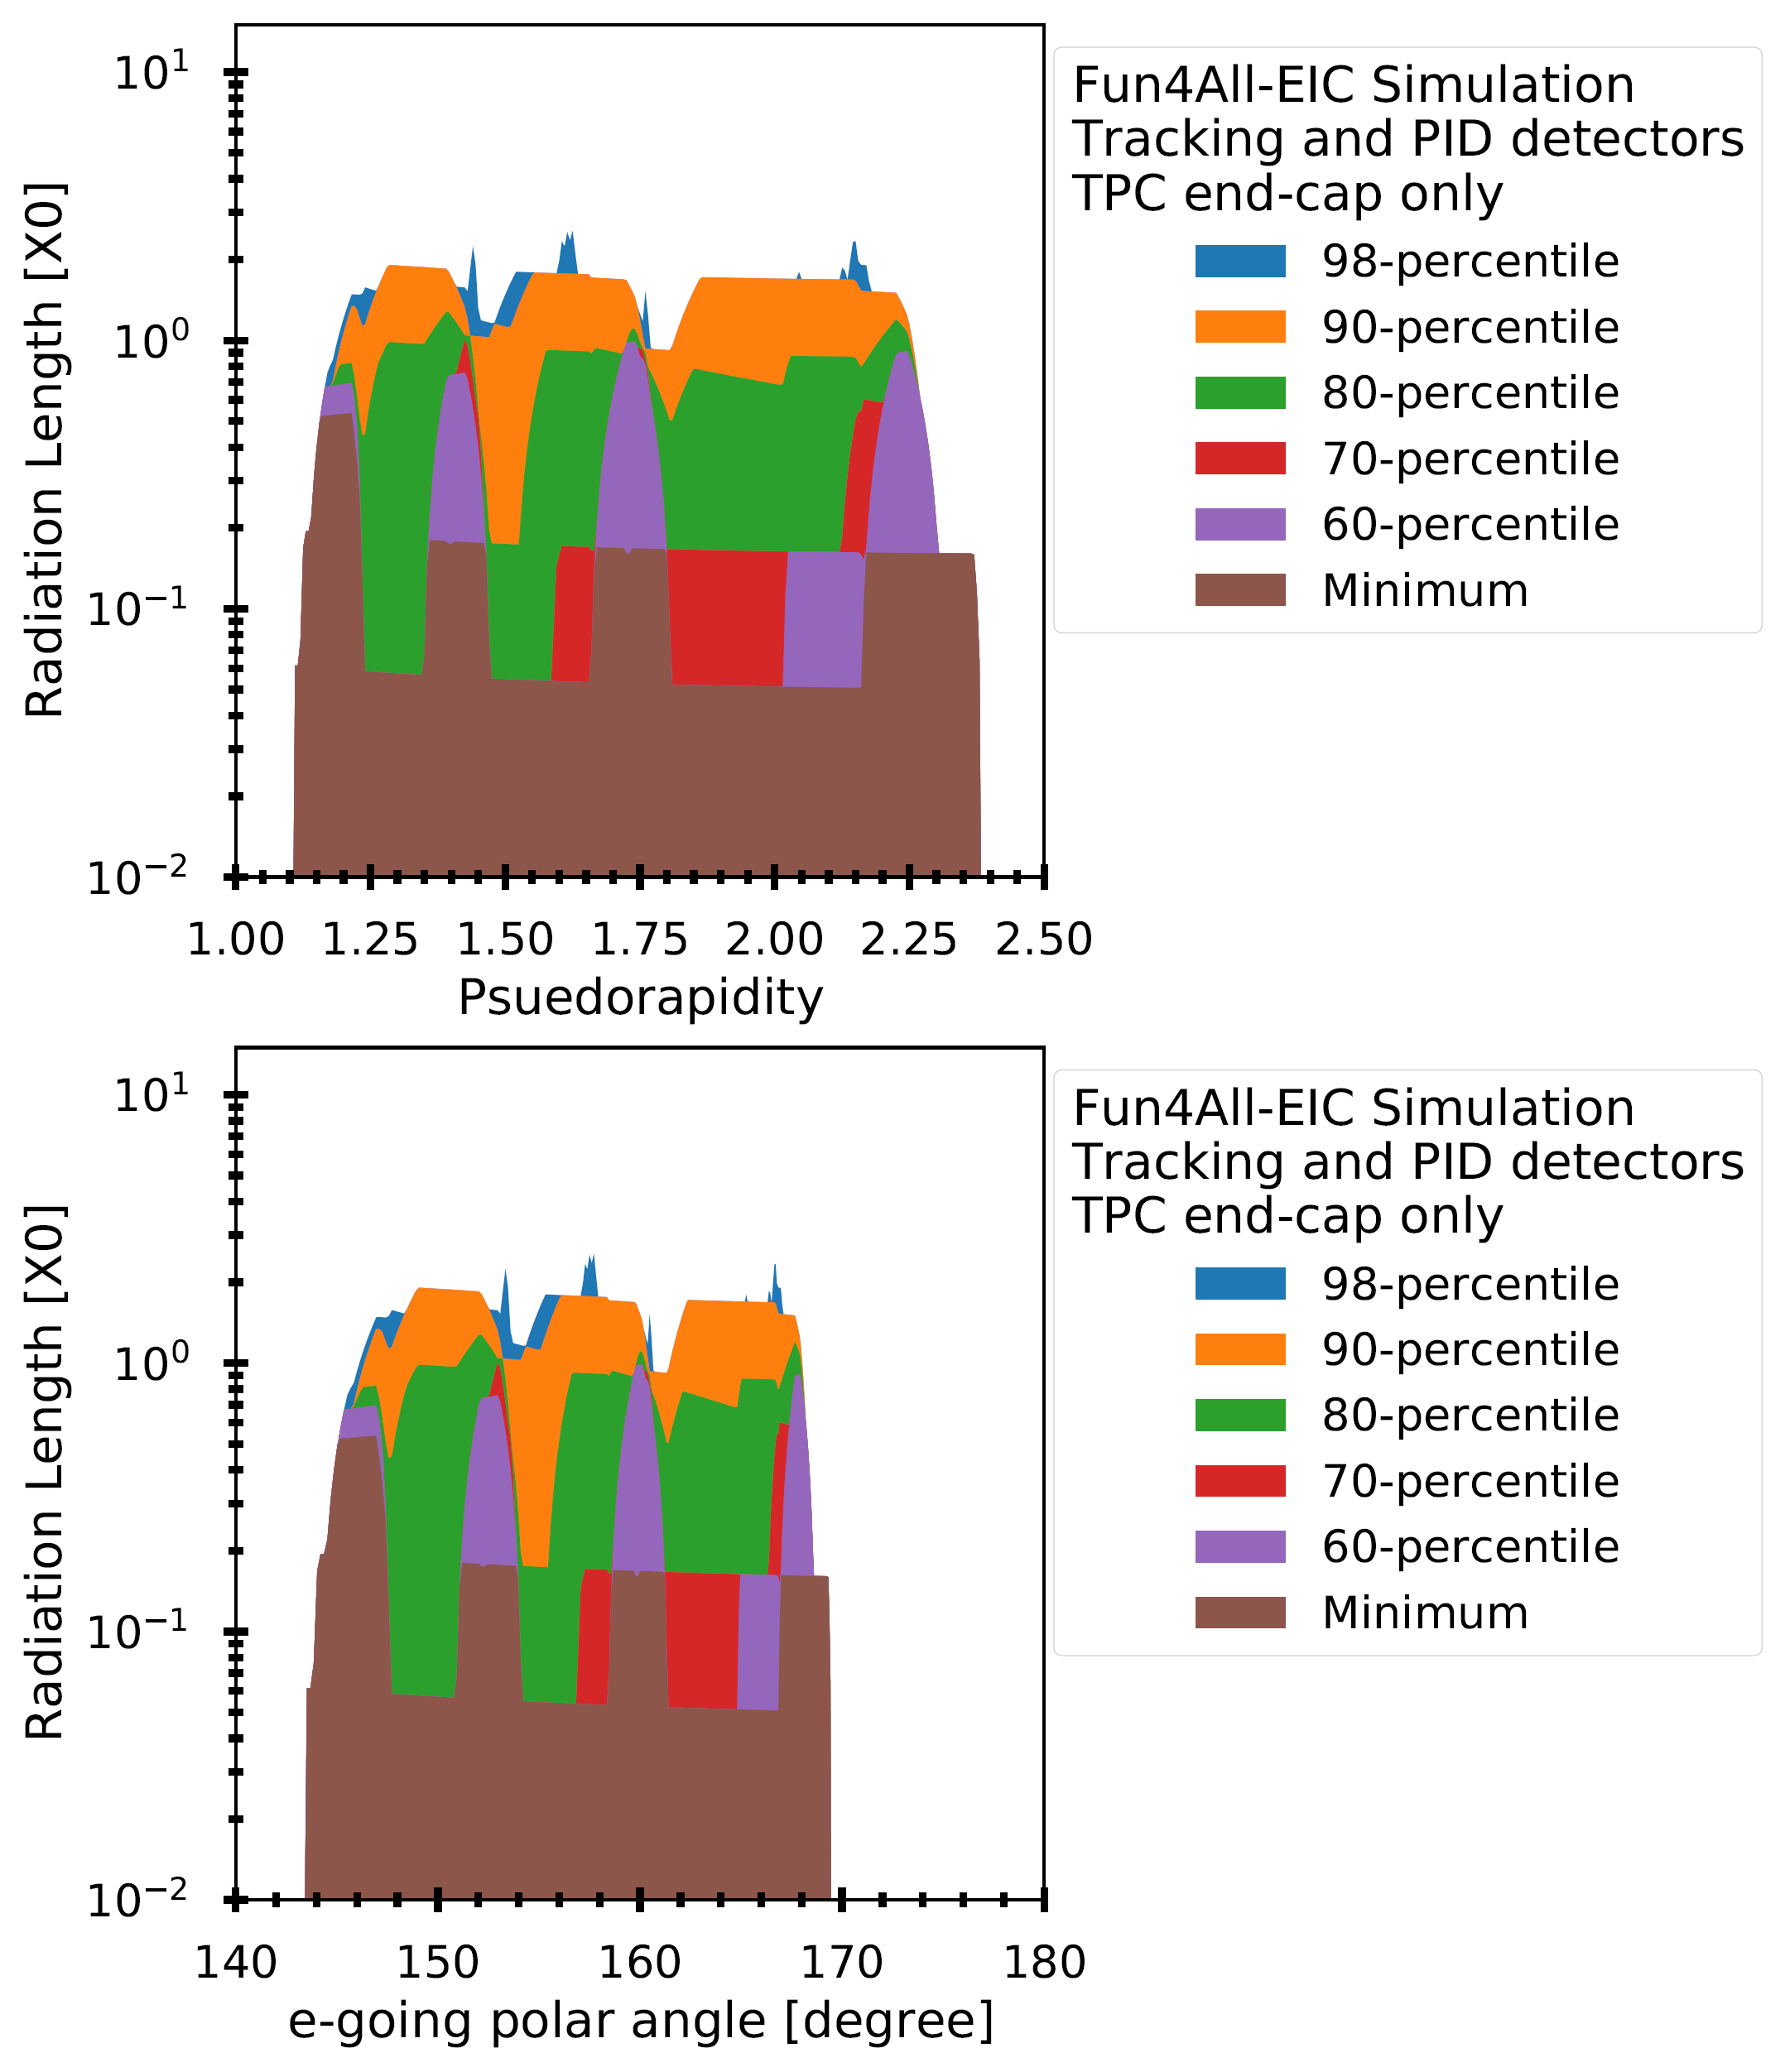
Angle-psuedorapidity translations

Slide 18
Services – what can we expect for EIC tracking Si?
We can use ITS as a baseline for services estimates
The expected surface area of an EIC tracking detector is similar to the ALICE ITS at ~10 m^2.
The largest component by far that will need to be routed inside the main EIC detector will be power and data cabling (see Alberto’s talk for other possible powering options).
The data cabling will likely remain similar of similar footprint. Targeted R&D can possibly improve this.
If we use water cooling, we can likely reduce the number and size of cooling lines since a new sensor power dissipation will likely be less.
Using what we know of the service needs for the existing ITS we can project and estimate what would be needed for a detector composed of similar ALPIDE like sensors.
We can then scale to what might be needed for a tracking detector based on new technology (such as ITS3 like sensors with half of the power dissipation) and using aluminum conductors for power/return wiring to reduce overall radiation length.
This exercise has been done for the volume and radiation length of the expected services to be used in the simulation efforts for the yellow report effort.

Slide 19
Services – what can we expect for EIC tracking Si?
stave
Volume and radiation length estimates for ITS3 like sensor based EIC tracking detector
 | Stave X/X0 | Stave transition (per 100 cm^2 of Si surface) | Services (per 100 cm^2 of Si surface) | Patch panel (per 100 cm^2 of Si surface)
ITS3 like vertexing | ~0.1% | 6.66 cm^3 of material with X/X0 of 0.031 per traversed cm | 2.96 cm^2 cross section with X/X0 of 0.002 per traversed cm | 4.32 cm x 1cm x 1 cm with 0.03423 X/X0 per traversed cm
ITS3 like barrel (up to 1.5m length) | 0.55 % | 4.286 cm^3 of material with X/X0 of 0.0306 per traversed cm | 1.905 cm^2 cross section with X/X0 of 0.002 per traversed cm | 2.778cm x 1cm x 1 cm with 0.03423 X/X0 per traversed cm
ITS3 like disc (up to 60 cm diameter) | 0.24% | 6.66 cm^3 of material with X/X0 of 0.031 per traversed cm | 2.96 cm^2 cross section with X/X0 of 0.002 per traversed cm | 4.321 cm x 1cm x 1 cm with 0.03423 X/X0 per traversed cm
Stave
transition
services
Patch panel
https://indico.bnl.gov/event/7449/contributions/36038/attachments/27241/41529/2020_03_20_EIC_Si_services_parametrization_for_sim.pptx
https://indico.bnl.gov/event/8231/contributions/37955/attachments/28329/43586/2020_05_15_EIC_Si_material_projections.pptx

Slide 20
Additional infrastructure
Detector Safety System:
Interlocked PT100 temperature sensors on the output tubes of the stave cooling water for each stave.
Environmental Monitoring system
Temperature
Humidity
Leak detection (if not using sub-atmospheric cooling pressure)
Grounding
Infrastructure (detector support structures, services supports, etc.) must be grounded.
Isolation between instrumentation grounds and other ground.
Inner detector temperature and humidity stabilization
The inner detector area needs to be controlled usually with conditioned air. This is particularly important with an outer TPC. This system needs to be integrated into the design
All of these (and usually more) will need to be integrated into the detector packages and some into the places between detector packages.
The loads for these in EIC will likely be very similar to the ALICE ITS.

Slide 21
Way Forward
The proposed EIC detector design is a quite compact detector with a lot of silicon tracking surface area.
The services routing areas are somewhat limited.
As the full detector simulations develop, we can begin to understand the effects of the mass of the services on the physics performance, this will likely instigate targeted R&D into reducing these services.
The service loads for the power supply/return of the tracking detector are likely to be similar in scale to the ALICE ITS if we use the same architecture. It is worth using directed R&D to explore DC-DC converters or serial powering to reduce this load (see Alberto’s talk)
Similarly, the service loads for the data/configuration cabling could possibly be reduced by using targeted R&D on fiber optic systems.
The environmental monitoring, interlocks, grounding arrangements, etc. could be improved, but likely only moderately.
Cooling lines could be removed if we could used a forced air cooling system. This is feasible for a ~20 mW/cm^2 dissipation. But this requires ducting and space and generates it’s own set of issues. Options for air cooling should be considered.

