Slide 1
Overleaf for the EIC YR
We will be using Overleaf for the EIC-YR
We are using the BNL professional license
PWG and DWG Convenors will have edit permission for the integrated document
The structure of the document is based on the draft EIC YR outline (which has been discussed previously)
http://www.eicug.org/web/sites/default/files/YRs_Outline_v6_draft.pdf
Copies of the template will be made for each subgroup and hosted at BNL; subgroup conveners will have edit permissions.
Elke has set up the template based on the CDR
View only version of integrated document:
https://www.overleaf.com/read/bbdqsmspmjdp

Slide 2
preamble_black_report.tex
This is the heart of the format, which all sections will use.
It includes definitions for frequently used units, kinematic variables, particles, energies, colliding systems, etc. E.g
\newcommand{\gev}{\operatorname{GeV}}
\newcommand{\pT}{\mbox{$p_T$}}
\newcommand{\ep}{\textit{e}+\textit{p}}
USE THEM

Slide 3
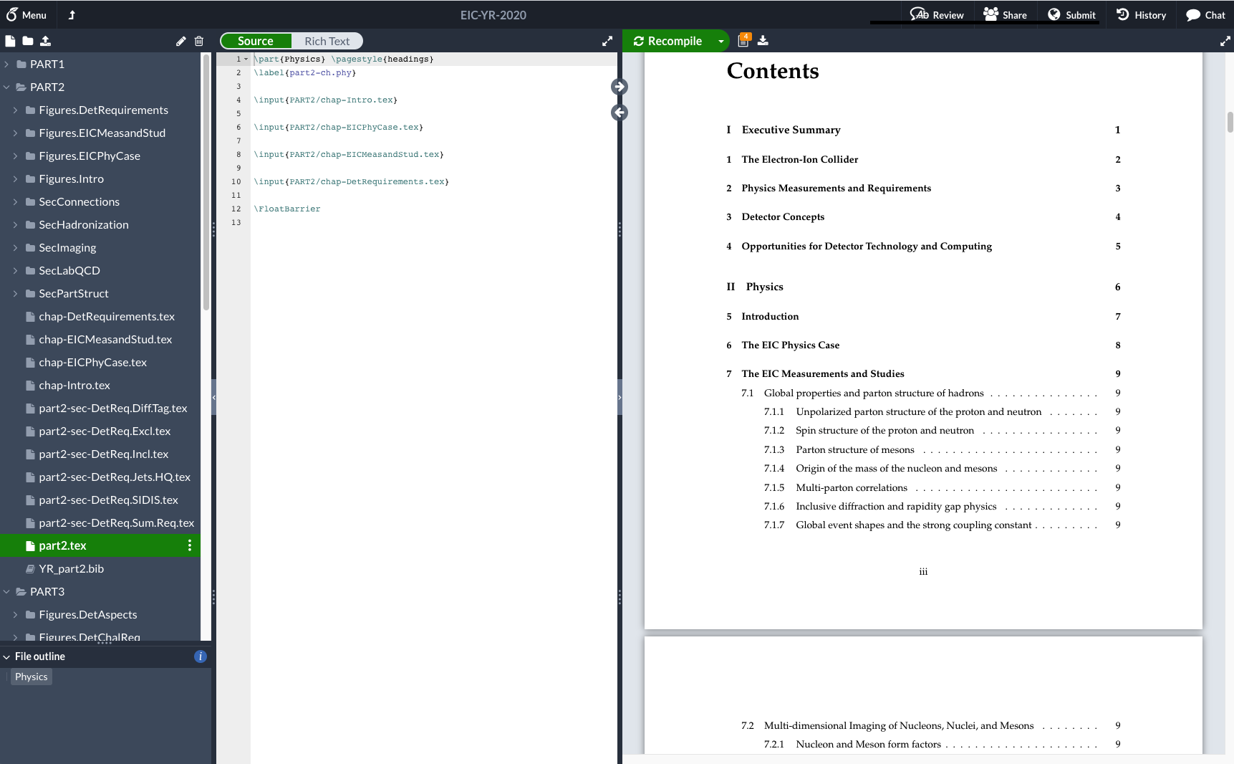
File Structure follows outline

Slide 4
Notes
Use common definitions
Do not deviate from labeling conventions for sections, figures, and citations.
Use Bibtex (and only Bibtex)
use INSPIRE standard where possible. (Search the publication on https://inspirehep.net, then click on "cite")

Slide 5
Timeline and Contacts
Contacts:
PWG Representative: Adrian Dumitru
DWG Representative: Ken Barish
Plan to finalize format over next few days
Make copies for subgroups early next week
Send info to working group convenors early next week.

Slide 6
Discussion
The floor is open …

