Slide 1
Detector Testing For The EIC
Opportunities for doing detector tests at Jefferson Lab.
Douglas W. Higinbotham

Slide 2
Many Experts & Opportunities For Detector Testing
Tom Hemmick (Stonybrook/BNL) long history of doing testing at:
Fermilab Test Beam Facility
SLAC End Station A
Old test beam line at BNL
And even Hall A @ Jefferson Lab
Barbara Jacak (LBNL):
Heavy ion beams at the 88” cyclotron
Presented at the recent Silicon Vertex Tracking meeting: https://www.jlab.org/indico/event/400/contribution/25/material/slides/0.pdf
Many many more!
Tom and I will be organizing a small workshop for approx. the middle next year (i.e. when we can meeting in person again) to both discuss detailed detector testing needs as well as allow in-depth discussion of various facilities to meet those needs. I hope is to have this workshop at Jefferson Lab in person so we can tour the new 10 MeV test area and the experimental halls.

Slide 3
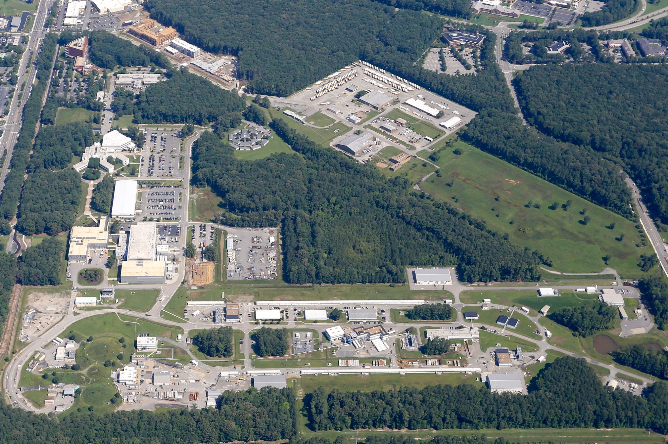
Thomas Jefferson National Accelerator Facility
The 12GeV CEBAF can deliver different passes and difference currents to exp. areas.
https://www.jlab.org/physics/experiments/schedule
3

Slide 4
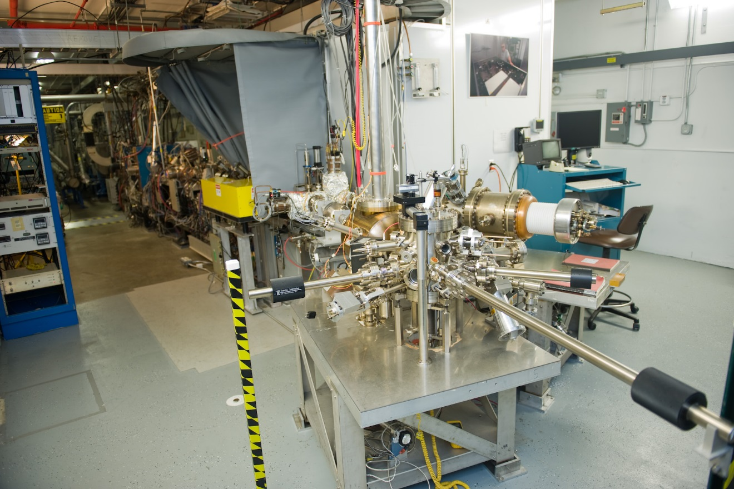
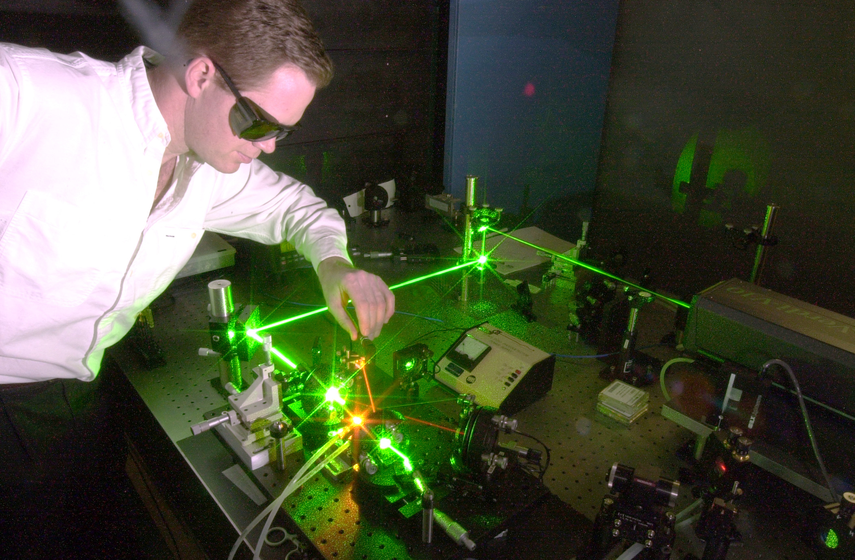
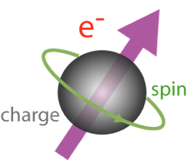
Injector: Photoelectric Effect
By using polarized laser light and special photocathode materials, we can make electrons whose spin is all in the same direction.
4

Slide 5
Thomas Jefferson National Accelerator Facility
The 12GeV CEBAF can deliver different passes and difference currents to exp. areas.
https://www.jlab.org/physics/experiments/schedule
5

Slide 6
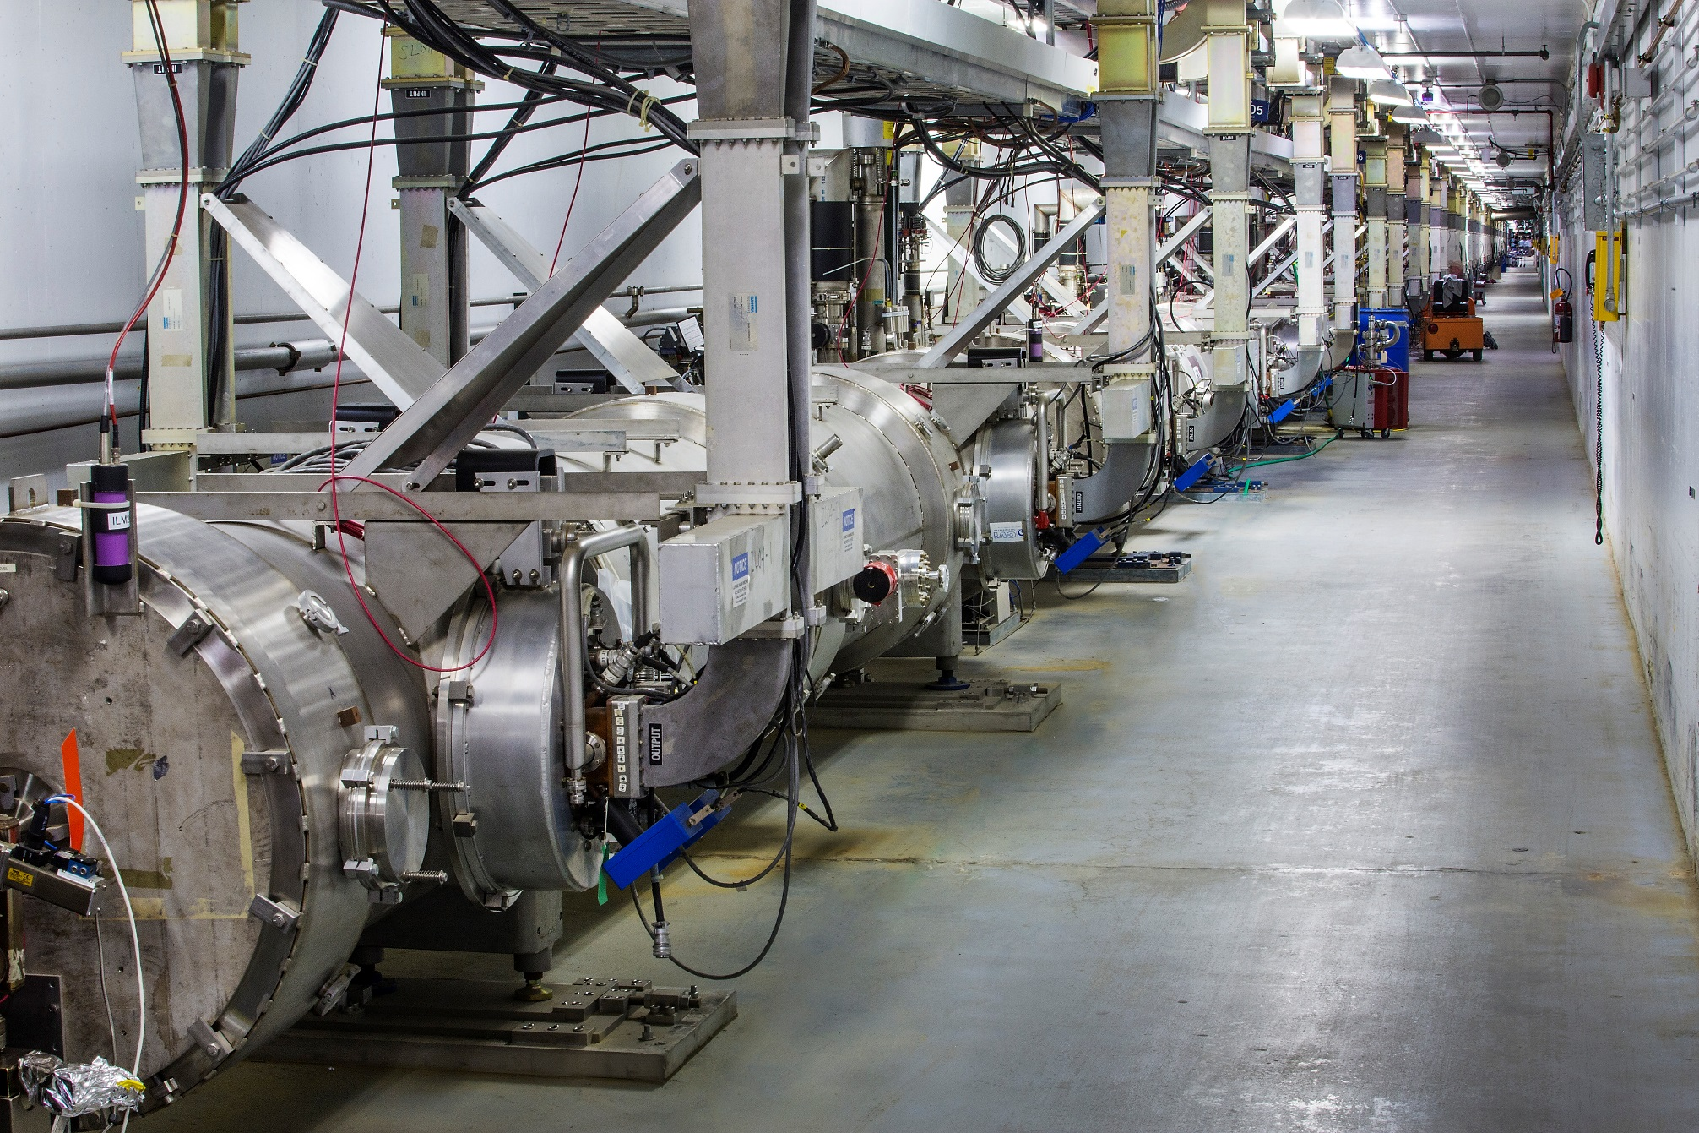
Two Linear Accelerators
The PMT cable tied to the front of the cryo-module is part of the machine protection system.
Each linear accelerators provide can provide up to ~1.1 GeV per pass.
6

Slide 7
Thomas Jefferson National Accelerator Facility
The 12GeV CEBAF can deliver different passes and difference currents to exp. areas.
https://www.jlab.org/physics/experiments/schedule
7

Slide 8
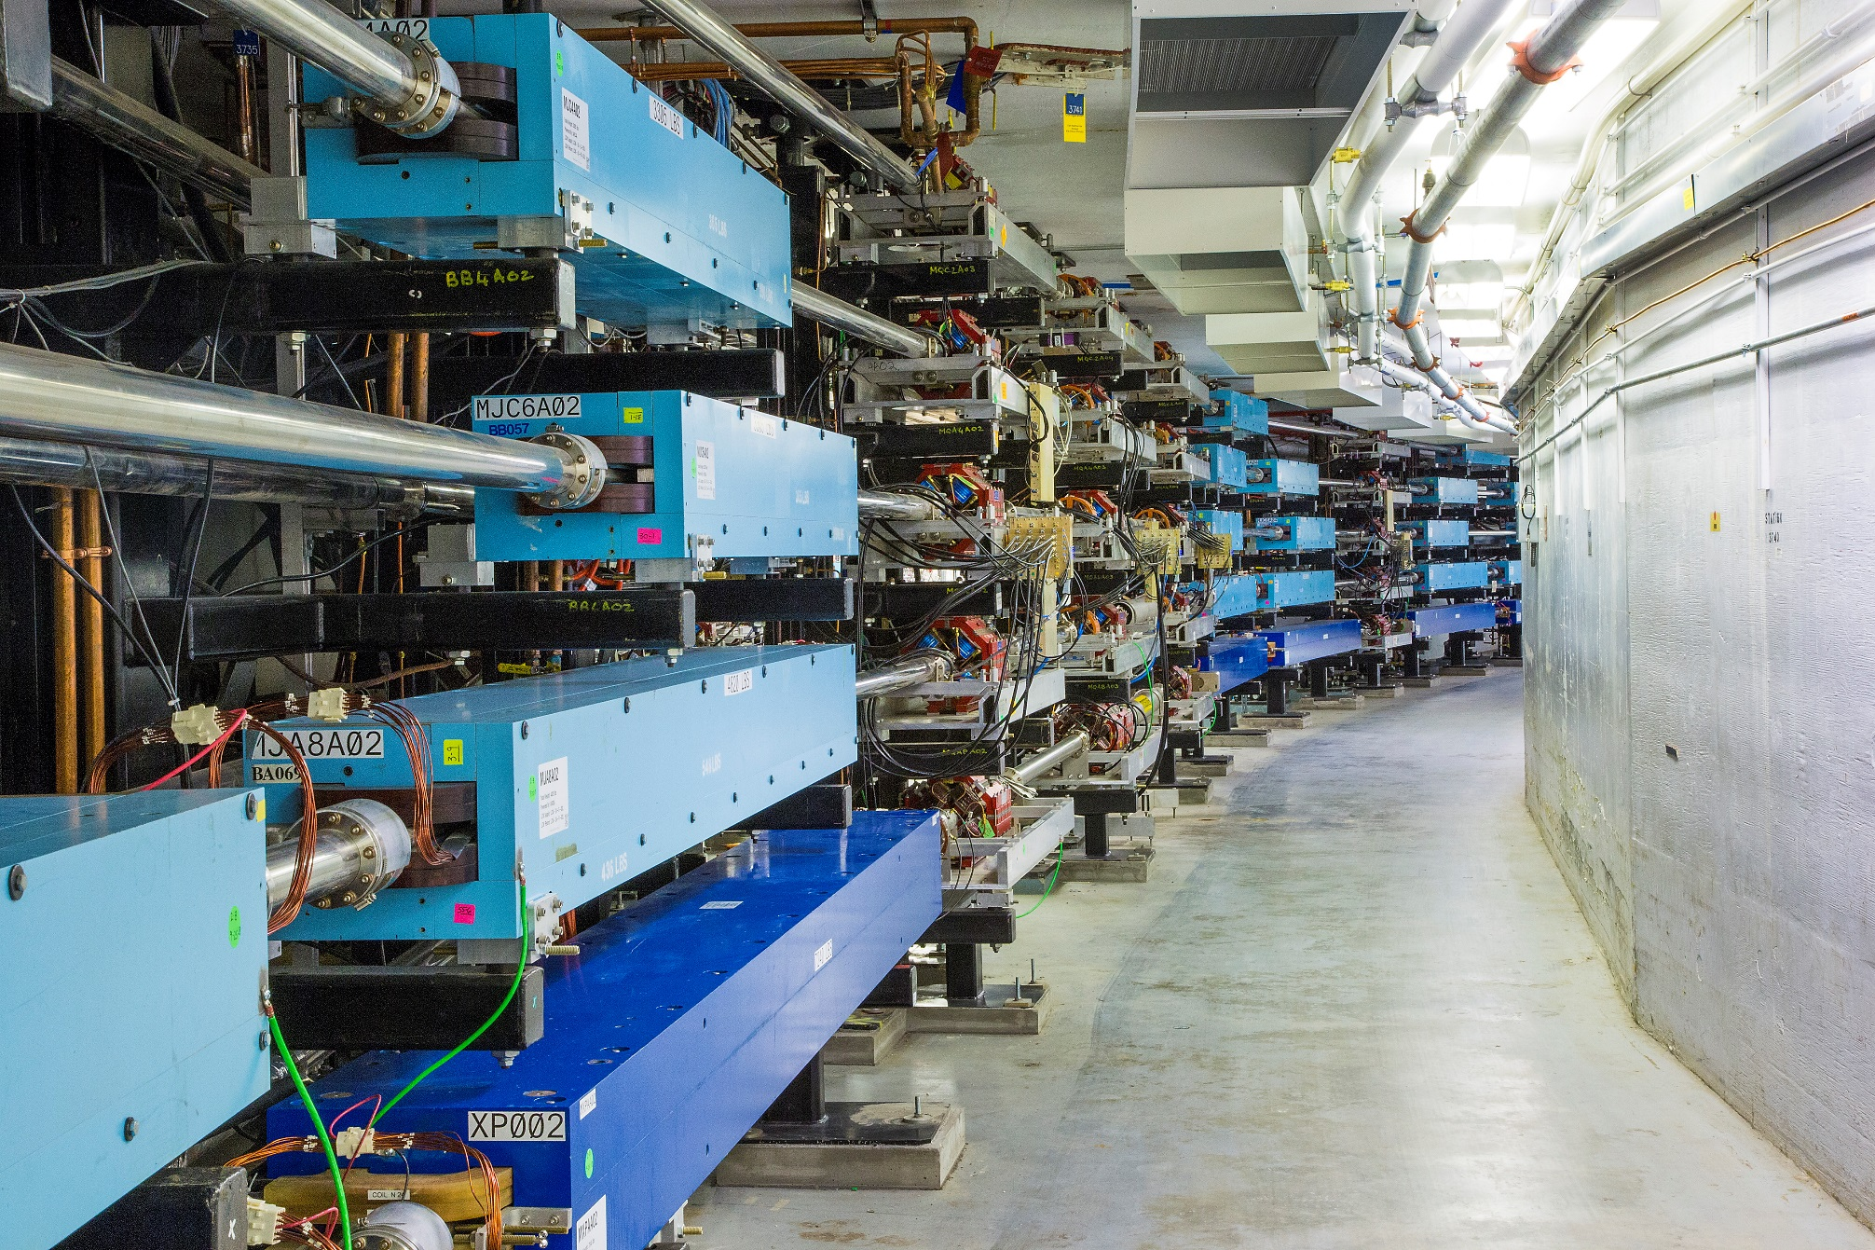
Race Track Design
Experimental Hall A, B, C can get up to 5th pass beam (~11 GeV) while Hall D gets 12 GeV.
All four halls can be run at once and with different combinations of currents and energies.
8

Slide 9
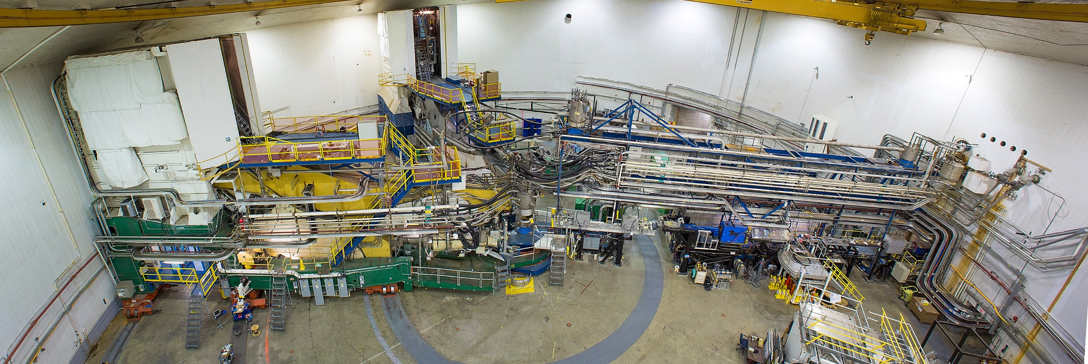
Jefferson Lab’s Experimental Hall A
Note the flexible cryo-lines that allow the HRS to rotate while SC magnets are cold.
High luminosity hall, >1E10³⁸ cm⁻² s⁻¹ with a high power dump (1MW)
Patch panel cables at the center of the hall have cables running to a small dedicated area on the 2nd floor of the counting house for easy monitoring of test setups.
Access during running is very limited, still many opportunities for parasitic testing.

Slide 10
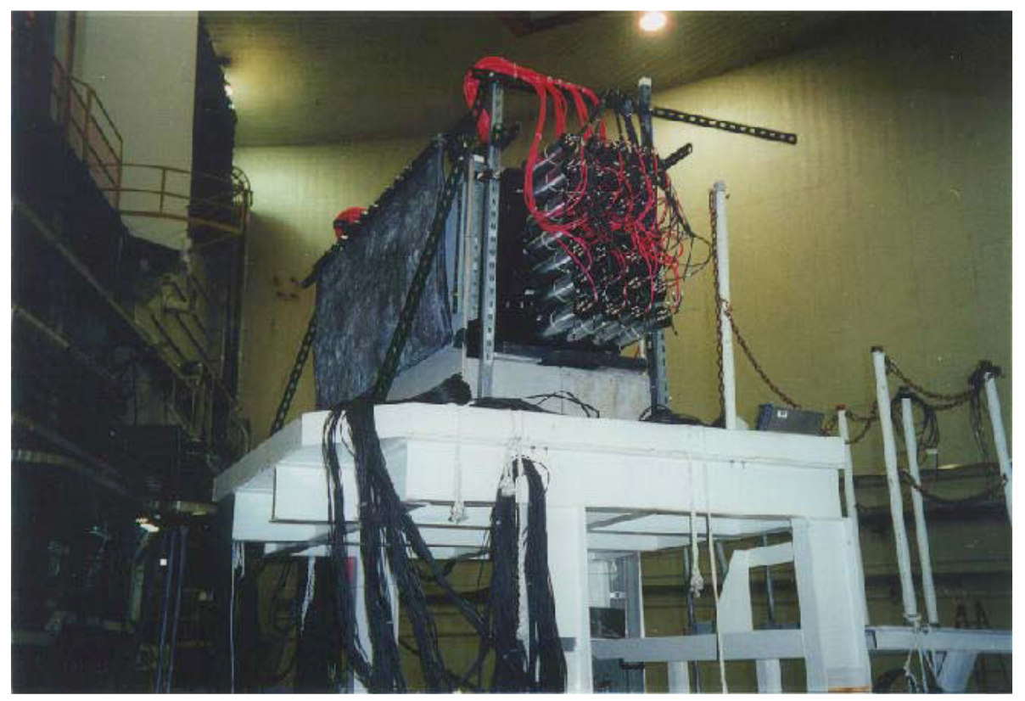
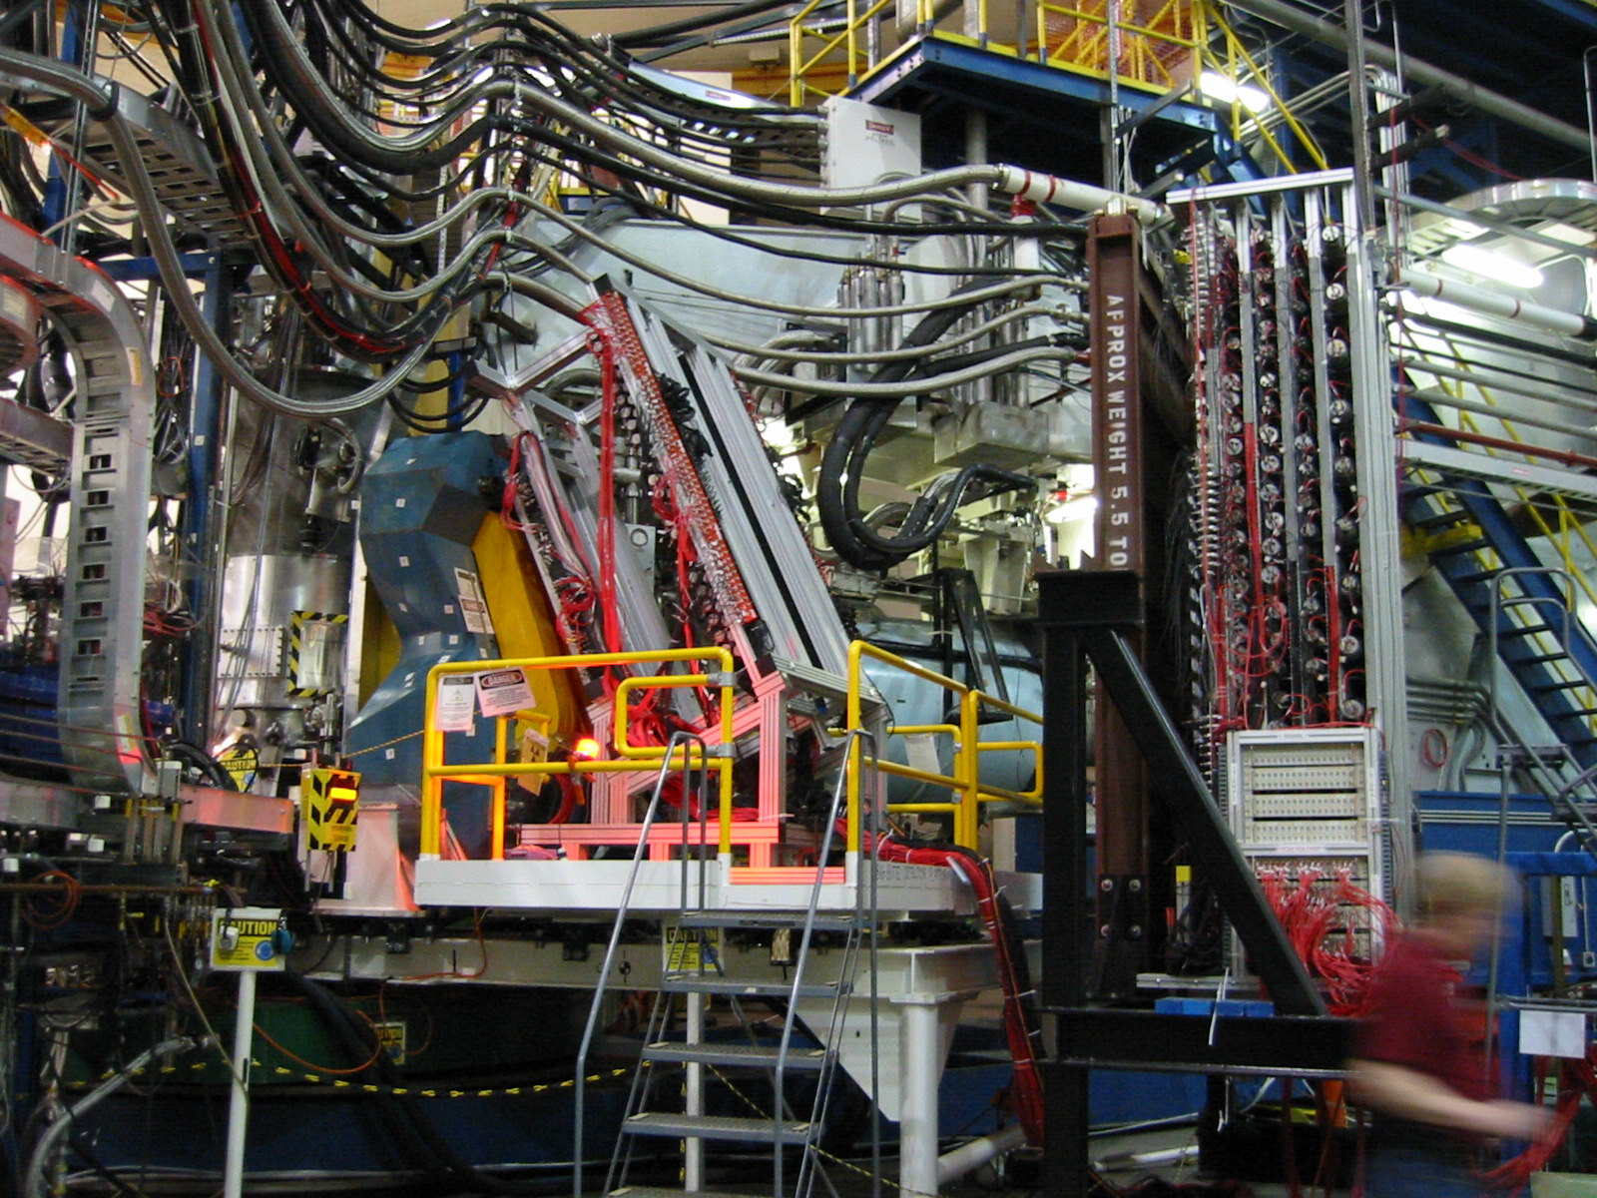
Neutron Detector Tests In Experimental Hall A
January 2020: Can you actually run an open geometry neutron detector in Hall A at a luminosity of 1E10³⁸ cm⁻² s⁻¹ ?!
We did a parasitic measurement with the ³He(e,e’p) experiment E89-044 and demonstrate we could indeed see triple events.
Ran the full SRC ¹²C(e,e’pn) experiment Dec. 2004 to April 2005
Resulted in Jefferson Lab’s first article in the journal Science.
https://science.sciencemag.org/content/320/5882/1476.abstract

Slide 11
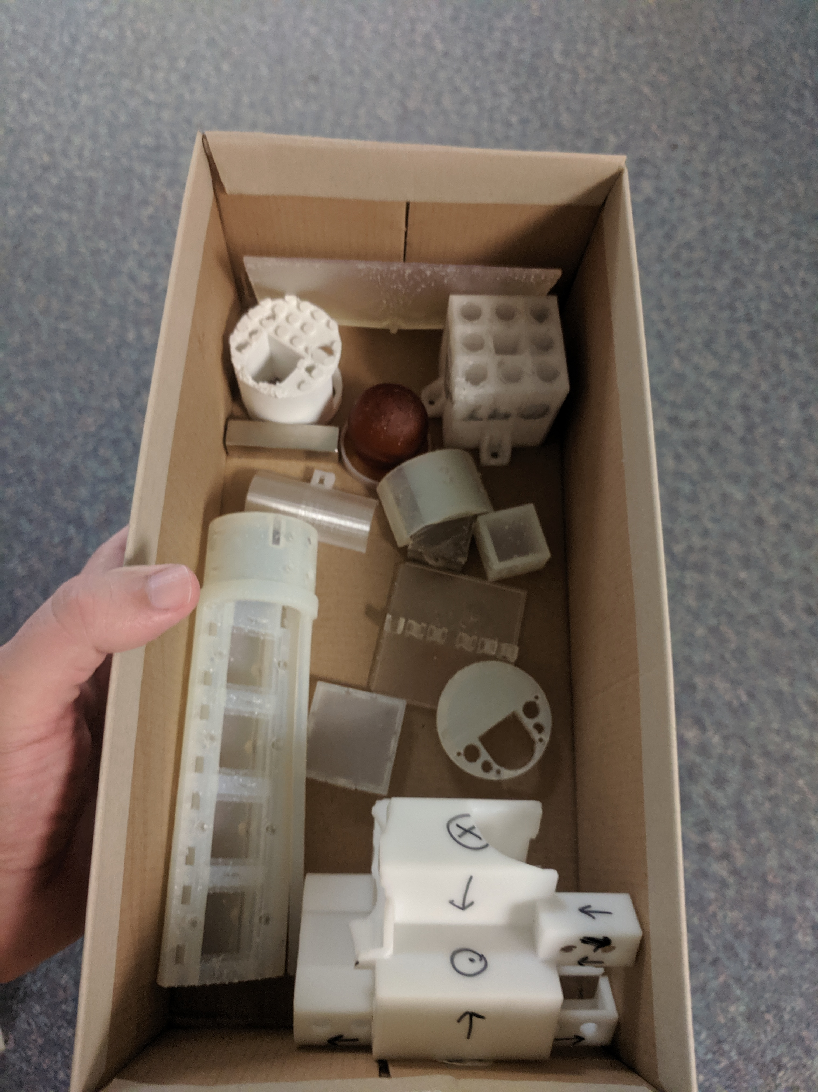
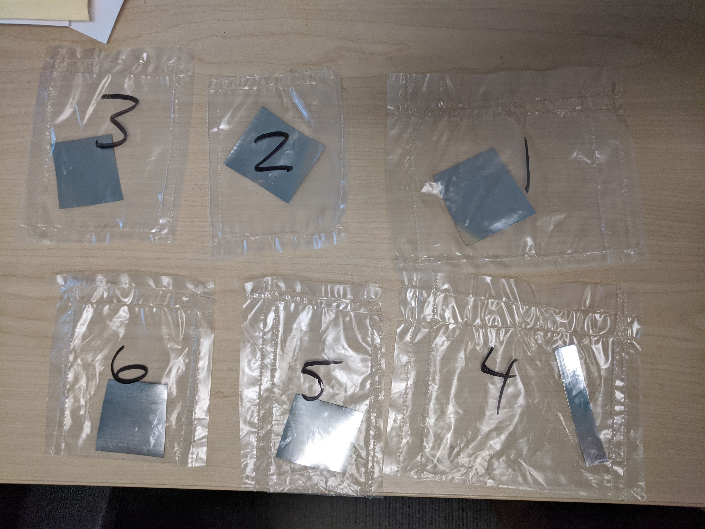
Materials Testing In High Radiation Environment
0.1 MRad dose to 3D printed plastics & alloy foils
Done in close collaboration with JLab radiation control group
Foils just placed on HRS near
target by RadCon.
Access and RadCon support is limited.

Slide 12
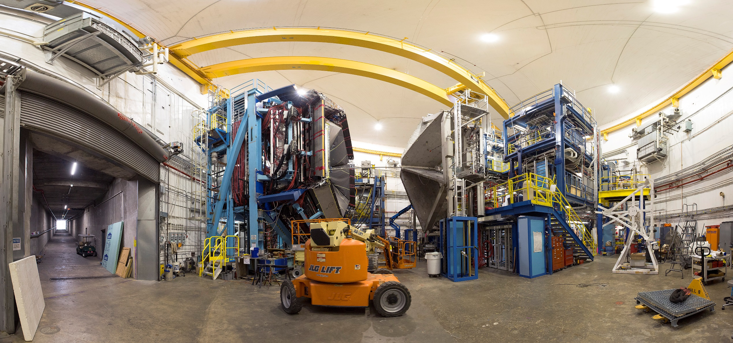
Jefferson Lab’s Experimental Hall B
Lower luminosity, ~1E10³⁵ with a low power dump, but many areas can used for testing.
https://www.eiccenter.org/content/detector-testing-capabilities-hall-b

Slide 13
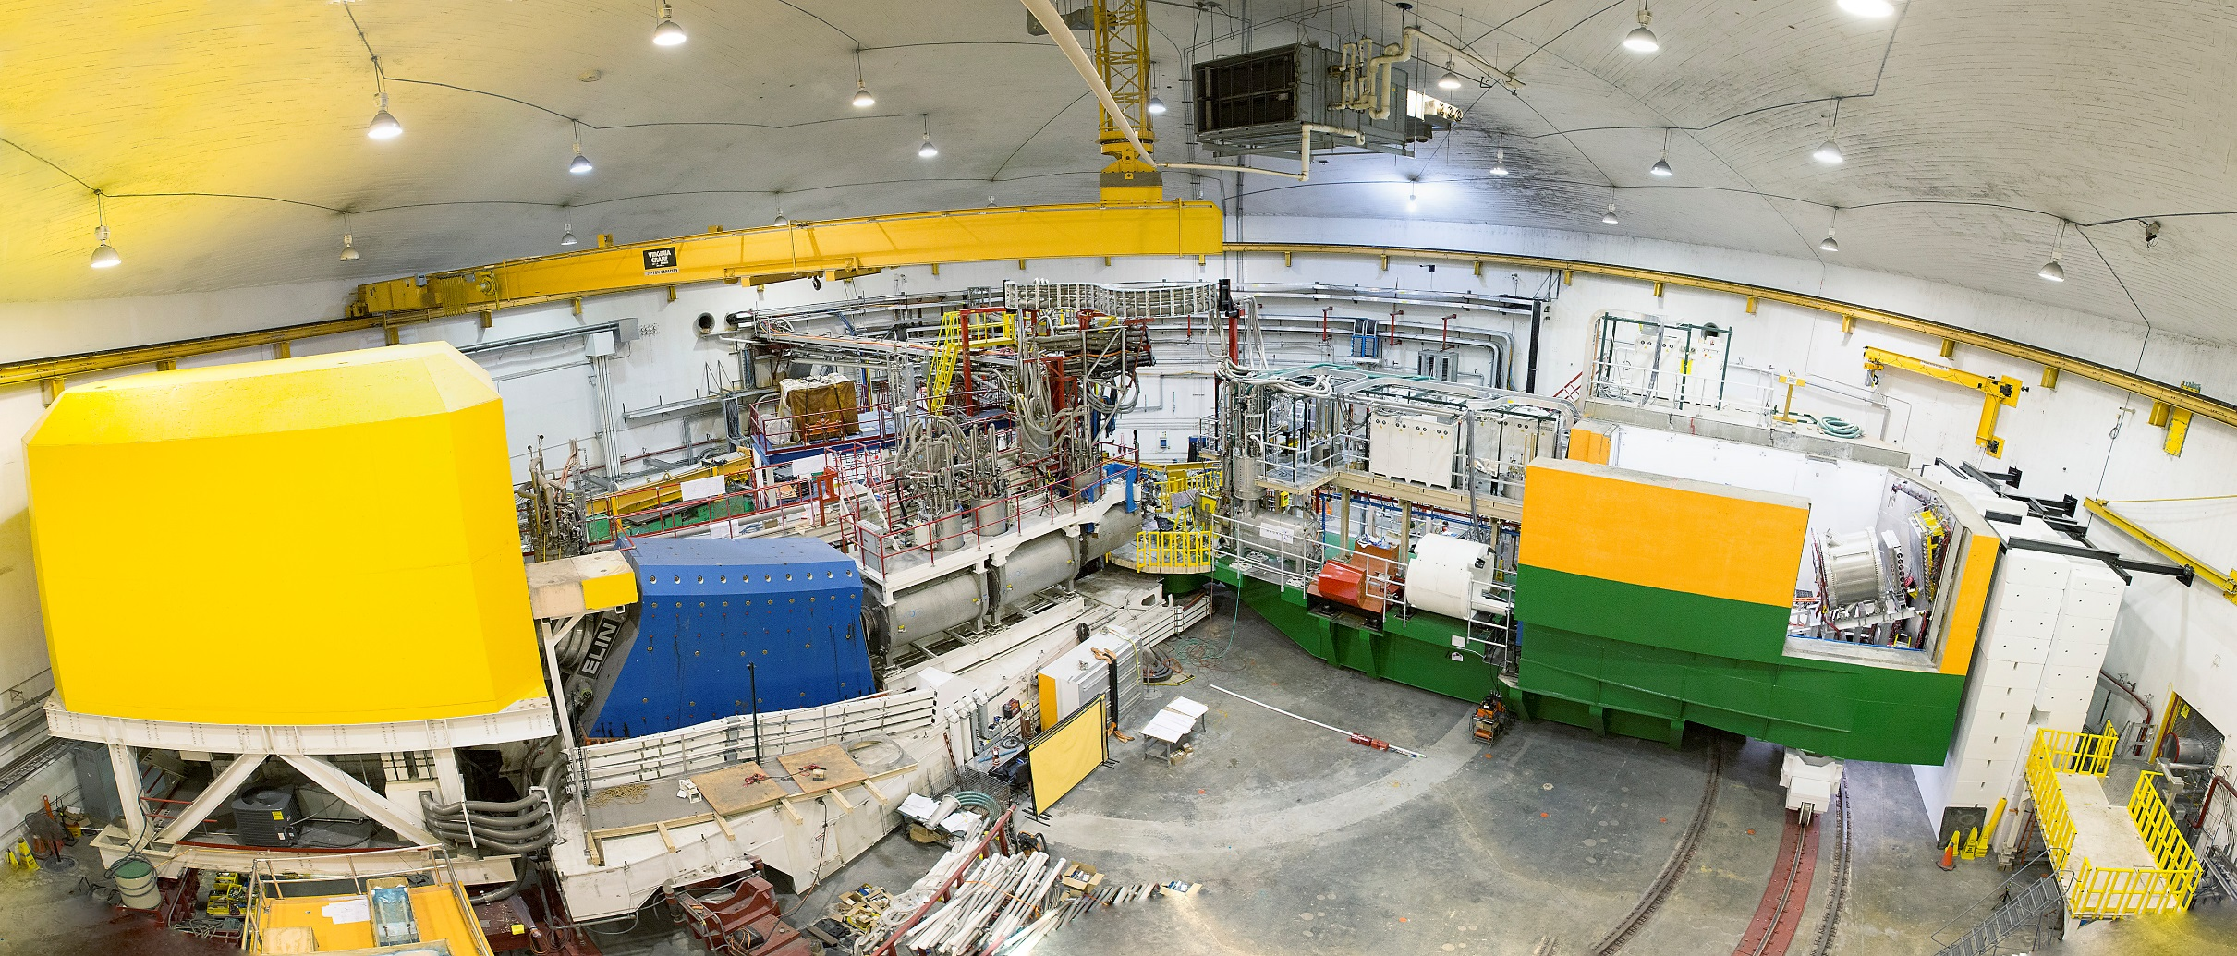
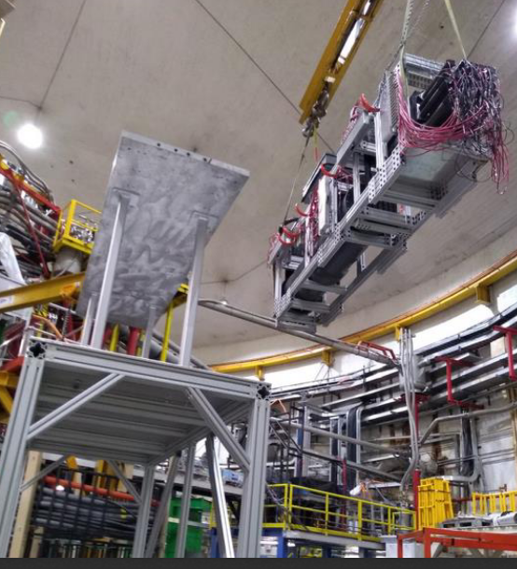
Jefferson Lab’s Experimental Hall C
High luminosity, ~1E10³⁸ , with a high power dump (1MW).
Right now we are testing a Cherenkov photo-type for
SoLID during the current A1n/d2n experiment.

Slide 14
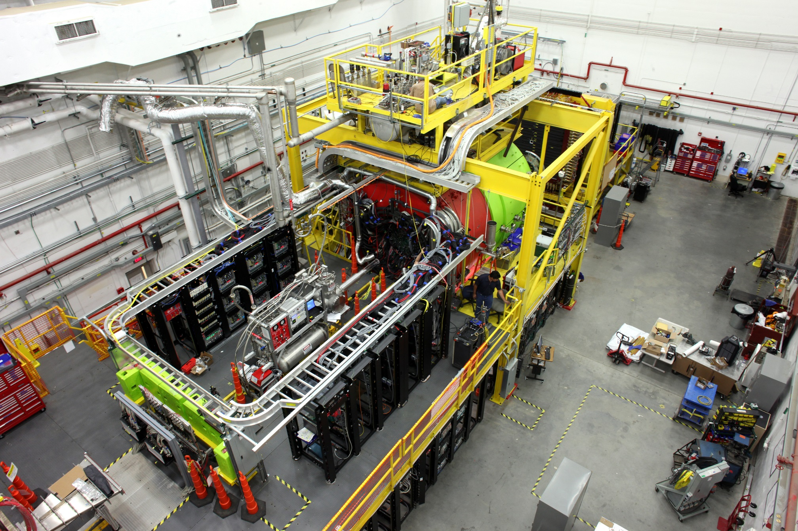
Jefferson Lab’s Experimental Hall D
Real photos into the hall, but also a tagger vault with 11 GeV electrons on a radiator.
Location of eRD22 tests of the GEM based transition radiation detector/tracker.

Slide 15
NEW Upgraded Injector Test Facility (UITF)
200 keV @ 100 uA readily available
10 MeV @ 100 uA available but requires liquid helium for SC RF.
First test in this area will be of the HD-ice target for Hall B
It is foreseen that this area will be used for dedicating testing.
Rapid access and many areas for testing.
Large items can be craned into area, but requires removing roof.
( panoramic photo of a long narrow room with a larger test area at end of the beamline )

Slide 16
Summary
Jefferson Lab has a long history of its users setting up small to medium sized parasitic tests in the experimental halls to ensure successful experiments.
Presently Four Parasitic Testing Areas On Site
High Luminosity Tests: Hall A and Hall C
Low Luminosity Tests: Hall B and Hall D
Presently One Area For Dedicated Testing
10 MeV Upgraded Injector Test Facility
For the EIC, the JLab EIC center will coordinate between outside groups and the experimental areas to facilitate testing.
Testing will require approval by hall leader and work coordinator as well as appropriate training and safety documentation.
More details at: https://www.eiccenter.org/detector-testing
Please feel free to email me with questions: doug@jlab.org
Looking forward to IRL workshop on detector testing next year!

