Slide 1
Next Steps in Planning for the experimental equipment
E.C. Aschenauer (BNL)
R. Ent (JLAB)
Co-Associate Directors for the Experimental Program
EIC-UG 4th YR Meeting
Electron Ion Collider

Slide 2
Expression of Interest
Information of the call is online
since end of May 2020 https://www.bnl.gov/eic/EOI.php
Deadline for EOI: November 1st 2020
What comes after:
Status report at 4th Yellow Report meeting at UCB/LBL Nov. 19-21 2020
Assess EoI and inform Call for Detector Proposal(s) < February 2021
Evaluation by a team composed from:
Project management team
Members of the User Group, working with EICUG SC on how to do this
Advise from Detector Advisory Committee
Remember:
The EIC is capable of supporting a science program that includes two detectors and two interaction regions
but Project has only funding for one full IR and one Detector, with for the latter $200M on project and an assumed $100M (US accounting) in kind.
this general-purpose detector must deliver on the promised EIC science.

Slide 3
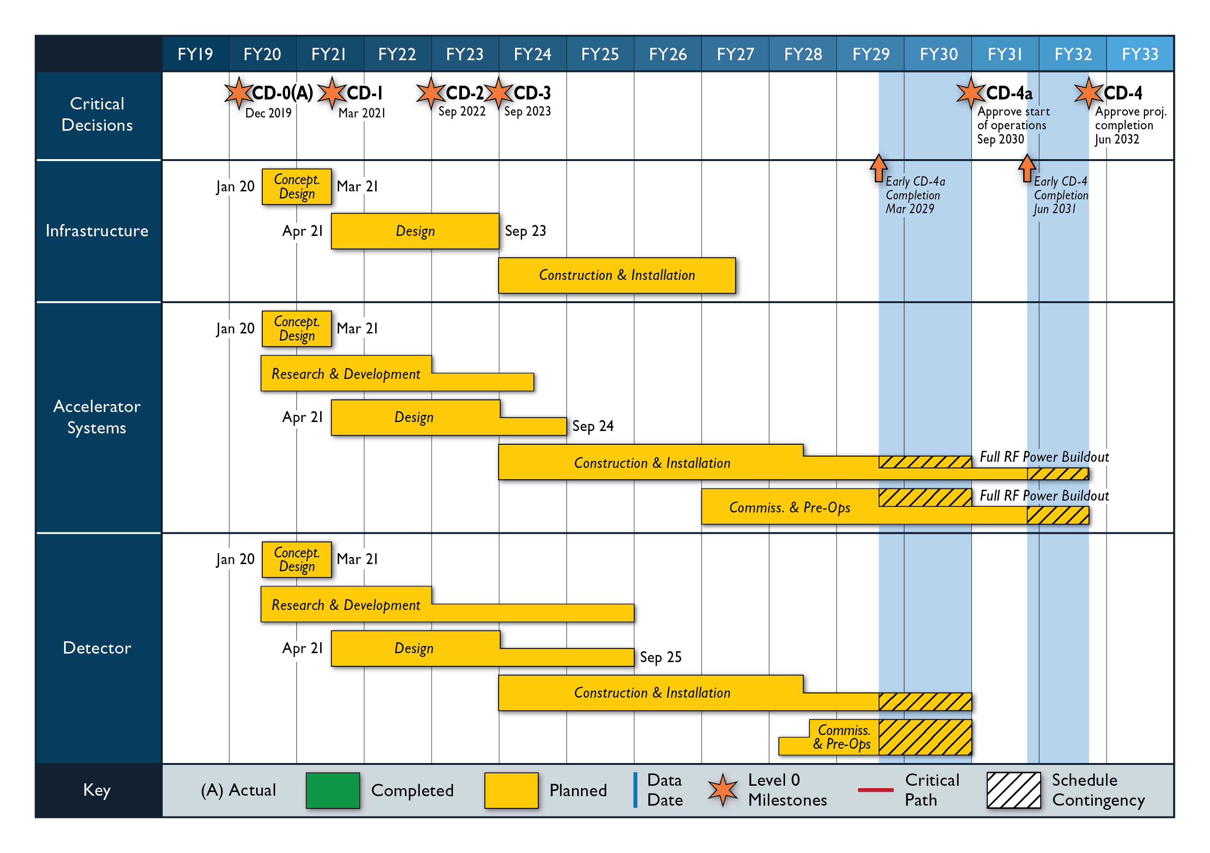
Timeline beyond Expression of Interest
March 2021:
Issue Call for Detector
Proposals
September 2021:
Deadline for Proposals
December 2021:
Selection of Detector(s)
Timeline driven by CD
schedule
have one detector
constructed by CD-4 (and ready by CD-4a for early ops)

Slide 4
Evaluation of Detector Proposals
Currently collecting information from different facilities on what procedure they followed
CERN (LHC), RHIC, Tevatron, DESY, …..
take from every model the best
Evaluation criteria
Design must be able to do the EIC science
Detector must be buildable in the EIC Project timeline
Detector technologies must have reasonable risk
……………..
Evaluation Committee
committee will likely be as follows
JLab and BNL Management
the EIC Project
Advise from Independent Science and Detector experts → equivalent to members on a PAC/DAC
members of the EICUG → working with EICUG SC on how to do this
Will give regular updates to EICUG and ask for input
following the approach for the EoI

Slide 5
Further detector (and IR!) planning
The EIC is capable of supporting a science program that includes two detectors and two interaction regions.
Dedicated Meetings: Dedicated session(s) on 2nd IR during YR Meeting November 2020
Topical week-long workshop on 2nd IR concepts early February 2021
Ground rules:
• A deliverable of the EIC is the possibility for a 2nd Interaction Region (IR) and detector.
• Present EIC plans and budgets support only one IR and detector.
• All stakeholders agree that a second IR and detector within the same timeline is desirable. Routes to make this possible are being explored.
• The topic of the second detector is investigated by the US/DOE and EIC project in cooperation with the EICUG and may be handled as a separate project.
Ansatz:
Goals and schedule are driven by keeping open a possibility of a 2nd IR from day-one, and how it can be integrated into the EIC Project. If the realization of a 2nd IR would shift to a later time, a time-line to account for this would need to be developed. At this moment it seems the best strategy is to assume realization of the 2nd IR, be it significantly different or similar to the 1st IR, consistent with the EIC project schedule and to revisit the situation in a year from now.

Slide 6
 | Activity Name | 2019 | 2020 | 2021 | 2022 | 2023 | 2024 | 2025 | 2026 | 2027 | 2028 | 2029 | 2030 | 2031 | 2032
 | CD-0 Mission Need
 | CD-1 Preliminary Baseline
 | CD-2 Performance Baseline
 | CD-3 Construction Start
 | CD-4A Initial Operations
 | CD-4 Project Complete
 | Physics/Detector book 1
 | Call for Detectors/ Collaboration Formation
 | Design of Detectors
 | Down-select to Two Full-Size Detectors
 | Detector/IR TDRs, Detector/IR construction
 | Expressions of Interest for Detectors
 | 2nd IR workshop
 | 2nd IR conceptual design
 | 2nd IR engineering & design
 | 2nd IR construction & installation
DOE Driven
EICUG Driven
DRAFT
2nd IR Driven

Slide 7
2nd IR Flowchart
11/20 Call for Expression of Interest
02/21 EICUG 2nd IR workshop
Sufficient interest to decide on 2nd detector and IR?
YES
Discuss with DOE/NP how to do 2nd detector and 2nd IR scope
NO
06/21 Survey international engagement in EIC Accelerator & 2nd IR design
Sufficient interest to request integration of 2nd IR?
YES
Discuss with DOE/NP possibility of integration of 2nd IR scope in EIC TPC
NO
Sufficient interest to continue 2nd IR design?
YES
Continue conceptual design of 2nd IR
NO
Complete engineering design of 2nd IR
2nd IR at CD-4B timescale is not within the range of EIC possibilities
06/24 Sufficient non-DOE interest in 2nd IR?
YES
Discuss with DOE/NP how to do 2nd IR scope
NO

Slide 8
Next Steps for Detectors (and IRs)
The DOE-NP supported EIC Project includes one detector and one IR
The DOE and the EIC Project need to mitigate risk such that EIC is a successful project and, once completed, is ready to do the NSAC/NAS Report science.
Based on the technical-driven EIC schedule and the EIC risk assessment, the starting point for the included EIC project detector is in IP6.
The included detector is ~70% scope as carried by the US-DOE EIC Project and ~30% international or in-kind scope.
The EoI call is crucial - we rely on the EICUG community for a successful EIC (1st) detector!
Ultimately, the EIC community will be very influential in determining the trajectory of both detectors and interaction regions. Again, the call for expression of interest is a crucial step to get guidance on the possibility of two EIC detectors.
A second detector without a second IR does not help…

Slide 9
Next Steps for Detectors (and IRs)
Many bi-lateral meetings with potential partners underway to discuss opportunities in accelerator and experimental areas
Accelerator Partnership Activities: Workshop planned for October 7-9 – Promoting Collaboration on the Electron-Ion Collider
Possible contributions to the EIC accelerator could include the full range of accelerator design and hardware
We do have a little more time for a 2nd EIC detector and IR – we drafted a first flowchart on what a timeline could be to be ready by CD-4 (not CD-4a as required for the detector in the project)

Slide 10
Governance Structure
Started discussion on “Management Approach to Detectors” with DOE/NP since May 2020, first by canvassing existing models (CERN, DESY, DUNE, KEK).
Defined EIC overarching guidelines
The EIC is a US-based Project
The EIC is at the technological and scientific forefront and is of international interest
With two possible detectors, we should treat both experimental collaborations equal
We should be welcoming and inclusive to new interested partners
Defined EIC principles and an initial EIC model
US pays for all costs to run the accelerator which sets weeks of operations & schedule
DOE and non-DOE participation in the governance (financing and oversight) of the experimental program including construction, maintenance and operations (M&O), and distributed software and computing.
The US convenes an international governing body for the oversight
The governing body meets once per year
US partially pays for detector M&O and computing costs, as follows:
M&O for incremental detector systems or detector upgrades to be supported by DOE and non-DOE, discussed at annual governing body meetings
Common Fund pays M&O for experimental equipment operations.
DOE and non-DOE support for distributed software and computing.

Slide 11
Governance Structure – Agency Oversight
The governing body meets annually for at least one day and hears the following presentations:
DOE/NP introduction
Financial oversight presentation, includes overview of use and need for shared M&O support (new detector subsystems, common fund, distributed computing)
EIC presentations
In Project phase: EIC presentations on project performance and management view (EIC team including BNL and JLab Lab managers)
in Operations phase: EIC presentations on accelerator performance and management view (BNL directorate including JLab Lab manager)
Spokesperson of the scientific collaboration(s) presentations
In Project phase: collaboration status and status to provide scope to project
In Operations phase: status and science operations strategy
Project Manager/Technical Coordinator presentations
In Project phase: Project Manager presentation(s) to discuss status of key topics
In Operations phase: Technical Coordinator presentation(s) (to discuss possible upgrades, reliability, etc)
DAC/PAC Chair presentations
In Project phase: DAC chair presentation on the recommendations and evaluation of detector design and construction progress
in Operations phase: PAC chair presentation on the recommendations and evaluation of the science program
Much of the afternoon is discussion

Slide 13
Questions received from EICUG SC
Naming: EIC project scope detector = IR1 detector, in contrast to the IR2 detector. (1) When will IR1 and IR2 be defined? It seems from the discussion on Wednesday afternoon that IR1 would be an IR region for high-luminosity operation at high CME, whereas IR2 is for an IR region for high-luminosity operation at lower CME. (2) Will the open call for detector proposals in March 2021 concern only the IR1 detector? Will the open call be restricted to accept only a fixed, pre-defined number of proposals? (3) If the open call also includes an IR2 detector, will the open call be restricted to accept only a fixed, pre-defined number of proposals? (4) Who, i.e., which committee, will review detector proposals for an IR1 detector? How is the down-select process going to be organized following the review process? (5) Assuming there is an open call for an IR2 detector, who, i.e., which committee, will review detector proposals for an IR2 detector? How is the down-select process going to be organized following the review process? (6) What strategy does the EIC project team have in mind to engage the EICUG through the Steering Committee in assembling the detector review committee(s) and in general concerning timelines and procedures impacting the EICUG

Slide 14
(1) When will IR1 and IR2 be defined? It seems from the discussion on Wednesday afternoon that IR1 would be an IR region for high-luminosity operation at high CME, whereas IR2 is for an IR region for high-luminosity operation at lower CME.
The DOE and the EIC Project need to mitigate risk such that EIC is a successful project and, once completed, is ready to do the NSAC/NAS Report science.
Based on the technical-driven EIC schedule and the EIC risk assessment, the starting point for the included EIC project detector is in IP6.
So IR1 = IP6, and has to deliver on the promised NSAC/NAS EIC science.
However, we need to ensure with TWO DETECTORS that both are treated equally, and that BOTH detectors/IRs can do our desired EIC science, and together can do more (= be complementary). We urge the EIC User Community to think about this as one entity and not segregate.

Slide 15
(2) Will the open call for detector proposals in March 2021 concern only the IR1 detector? Will the open call be restricted to accept only a fixed, pre-defined number of proposals?
This depends on the response to the call for EoI, and also on the success of the ongoing Accelerator Partnership Activities as a 2nd detector without a 2nd IR does not help.
The open call for detector proposals must always involve the IR1 detector, as we need to ensure EIC is a successful project and, once completed, is ready to do the NSAC/NAS Report science.
Our hope is that the signs for non-DOE engagement are sufficiently positive that we can do the call for two general-purpose EIC detectors.
The open call will not be restricted.
Our sincere hope is that the EICUG together converges on two excellent complementary EIC detectors to help all our EIC community science case and interest.

Slide 16
(3) If the open call also includes an IR2 detector, will the open call be restricted to accept only a fixed, pre-defined number of proposals?
See the answer on the previous question.
Our hope (wishful thinking?) is that we as community can gather enough positive signs that there is sufficient interest to fold into the March 2021 call directly two detectors.
But pending the assessment of the EoI and the Accelerator Partnership Activities, it may be that we need to do the call in two stages. If there is a call in two stages, the EoI will give important information what steps are needed to realize a 2nd detector
We drafted a possible timeline/flowchart, and will work with the EICUG to refine.
IF a separate second call is required:
The open call will not be restricted. We will ask for a general-purpose EIC detector that remains compatible with operationality over the full energy range (but can have different emphasis).

Slide 17
(4) Who, i.e., which committee, will review detector proposals for an IR1 detector? How is the down-select process going to be organized following the review process?
We will give regular updates to EICUG SC and ask for input → current thinking
Who:
JLab and BNL Management
the EIC Project
Advise from Independent Science and Detector experts → equivalent to members on a PAC/DAC
members of the EICUG → working with EICUG SC on how to do this
How:
Currently collecting information from different facilities on what procedure they followed
CERN (LHC), RHIC, Tevatron, DESY, …..
take from every model the best
Evaluation criteria
Design must be able to do the EIC science
Detector must be buildable in the EIC Project timeline
Detector technologies must have reasonable risk
…
Committee will conduct a transparent open review validating the proposals against pre-defined criteria in the call

Slide 18
(5) Assuming there is an open call for an IR2 detector, who, i.e., which committee, will review detector proposals for an IR2 detector? How is the down-select process going to be organized following the review process?
See the answers to Q2-Q4. The current plan is exactly the same process.

Slide 19
(6) What strategy does the EIC project team have in mind to engage the EICUG through the Steering Committee in assembling the detector review committee(s) and in general concerning timelines and procedures impacting the EICUG
After clarification, what was meant is:
(6) What would be the EICUG (SC)’s role and involvement in the planning and execution of milestones on the detector front ? That includes evaluation of EoI , evaluation of future detector proposals and possible down selects.
We plan to do exactly the same and work through our meetings with the EICUG SC to engage some of (or a representation of) them in these processes. E.g., the EICUG was mentioned already as part of the evaluation committee for the EoI and Detector Call.
Note that we also presented a plan of members of the EIC user community can be integrated in the EIC detector project(s) as point of contacts, owners, or even cost account managers at various levels for individual subsystems (see slides 12-14 in J. Yeck’s talk @ Miami meeting -https://indico.bnl.gov/event/7352/timetable/).

Slide 21
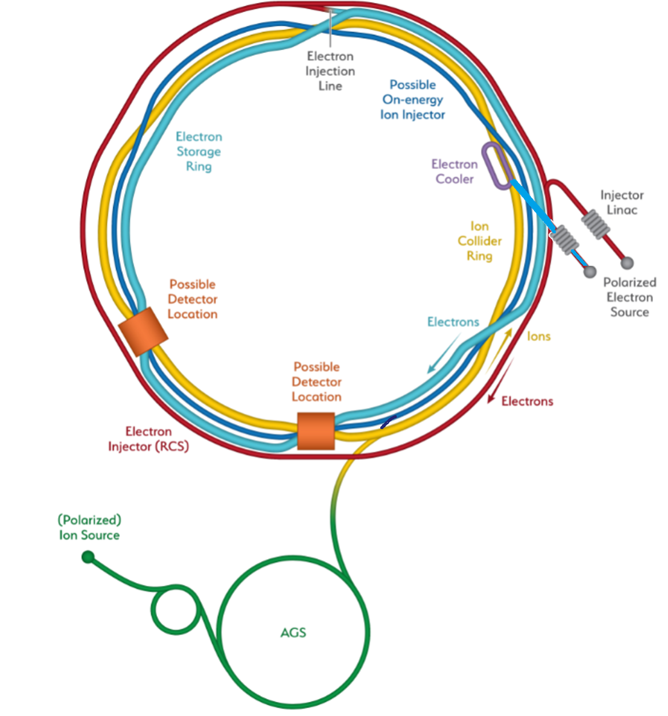
Detector Location Assumption
Two assumed detectors and Interaction Regions – IP6 and IP8
Assumption: based on technical-driven EIC schedule and present risk assessment, IP6 is “default” EIC detector location.
Existing IP6 and IP8 Hall, doors, and situation are different which can lead to complications to use or reuse equipment.
Hadron Storage Ring
Electron Storage Ring
Electron Injector Synchrotron
Possible on-energy Hadron
injector ring
Hadron injector complex

