Slide 1
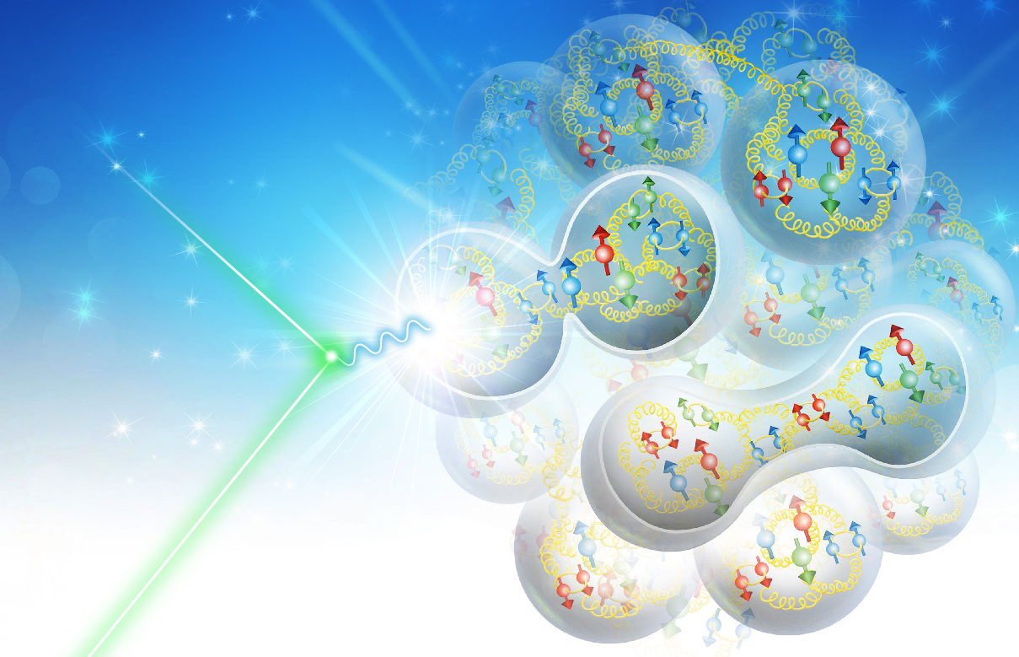
Optimization of a 2nd IR
V.S. Morozov, JLab
on behalf of the 2nd IR design task force
3rd EIC Yellow Report Workshop at CUA September 16, 2020

Slide 2
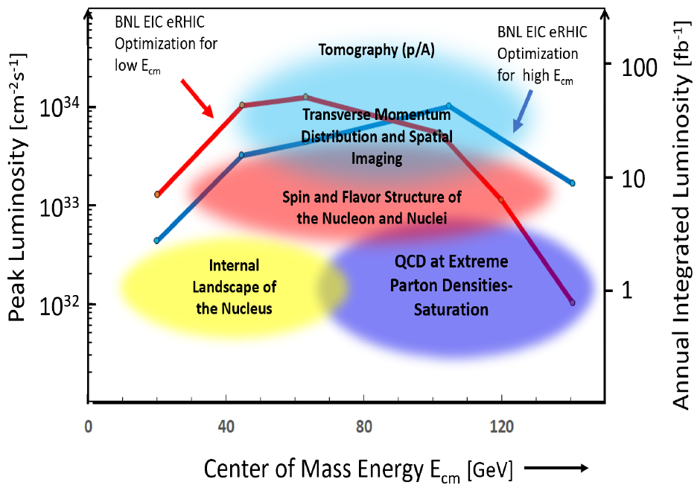
EIC 2nd IR
2nd IR of the EIC
Off project
Potentially more freedom to explore different design choices
Opportunities for international collaboration
Possibility of the 2nd IR is one of the EIC design requirements
Interest and support of the nuclear physics community
High-level requirements
High luminosity at a low CM energy of ~60 GeV
Detector acceptance satisfying physics requirements (what matters most for the machine design is the forward acceptance requirements)
Compatibility with running in parallel with the baseline detector

Slide 3
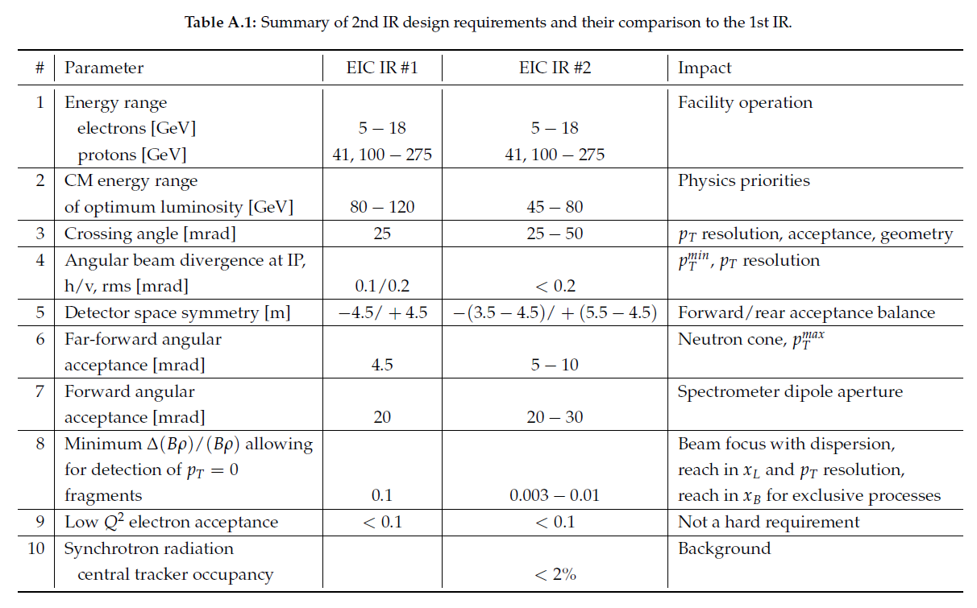
EIC IR Design Requirements
E.-C. Aschenauer and R. Ent

Slide 4
Crossing Angle and $p_{T}$ Resolution
Crab tilt smears the beam size at IP
$p_{T}^{IP}$ from position measurement at a Roman pot
$$p_{T}^{IP}=p\frac{x^{RP}}{\sqrt{β^{RP}β^{IP}}\sin{ΔΨ}}−\underset{Uncertainty}{\underbrace{p\frac{1}{β^{IP}}\frac{\cos{ΔΨ}}{\sin{ΔΨ}}x^{IP}}}$$
If also measure $p_{T}^{RP}$ $p_{T}^{IP}=\frac{p x^{RP}+β^{RP}\operatorname{atan}{ΔΨ}p_{T}^{RP}}{\cos^{2}{ΔΨ}+\sqrt{β^{RP}β^{IP}}\sin{ΔΨ}}$
$β^{RP}$ and $ΔΨ$ are known functions of $z_{RP}$ and $p$
Can we eliminate uncertainty using $ΔΨ=π/2$? Is precise timing needed then?
Optical analogy

Slide 5
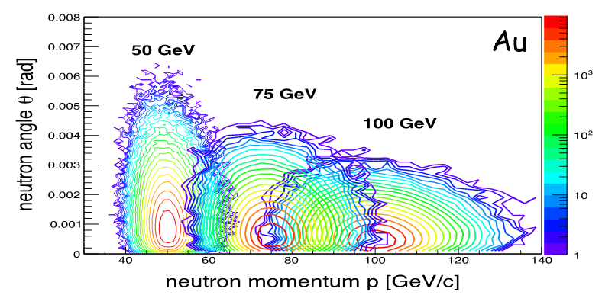
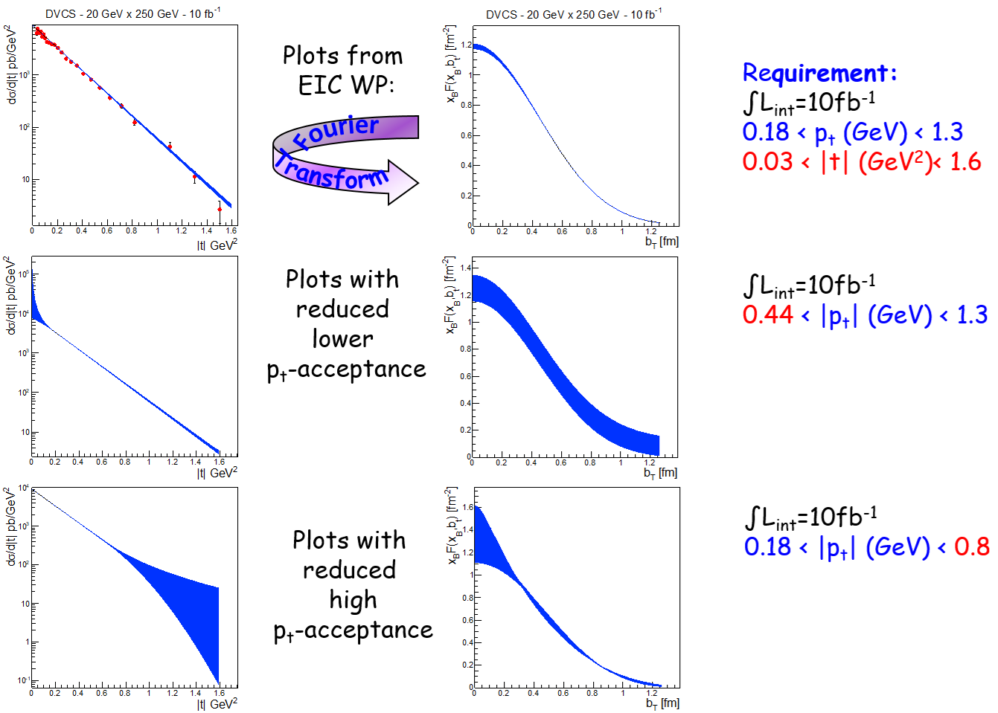
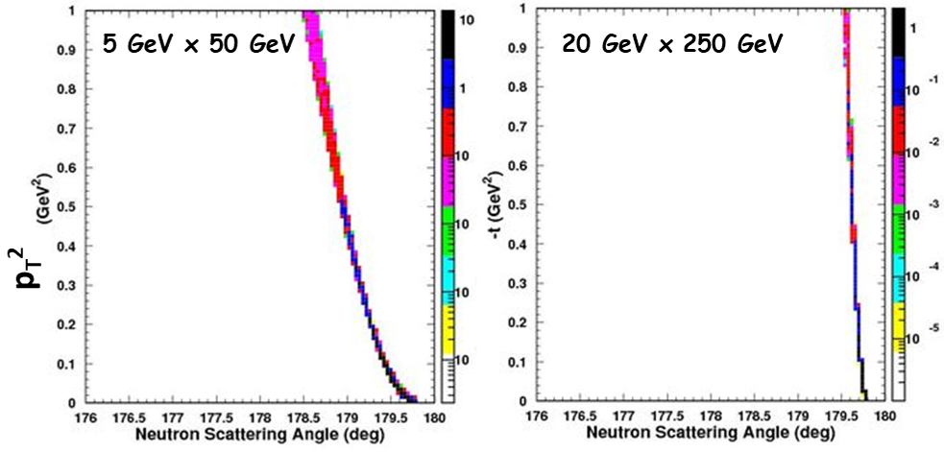
Far-Forward Angular Acceptance
Determined by apertures of the forward ion quads
Neutron cone and $p_{T}^{max}$ ⇒ $θ\sim 10$ mrad
Measurement
Physics Observable

Slide 6
Acceptance as Function of $x_{L}$ and $p_{T}$
$$p_{⊥}$$
without forward spectrometry
$p_{T}$ acceptance at $x_{L}=1$
$$p_{T}^{min}>10 p_{0} θ_{IP}=10 p_{0} \sqrt{\frac{ε}{β^{∗}}}$$
$x_{L}$ acceptance at $p_{T}=0$
Requires dispersion $D$
$$1−x_{L}>10\frac{σ}{D}=10\frac{\sqrt{βε+D^{2}σ_{δ}^{2}}}{D}$$
Secondary focus allows for
$$\left|Dσ_{δ}\right|≫\sqrt{βε}$$
Therefore, one can approach the fundamental limit
$$x_{L}<1−10σ_{δ}$$
200 MeV/c
0 MeV/c
0
1
$$x_{L}$$
with forward spectrometry
but no secondary focus
$$p_{⊥}$$
200 MeV/c
0 MeV/c
0
0.9
1
$$x_{L}$$
with forward spectrometry
and secondary focus
$$p_{⊥}$$
200 MeV/c
0 MeV/c
0
0.99
1
$$x_{L}$$

Slide 7
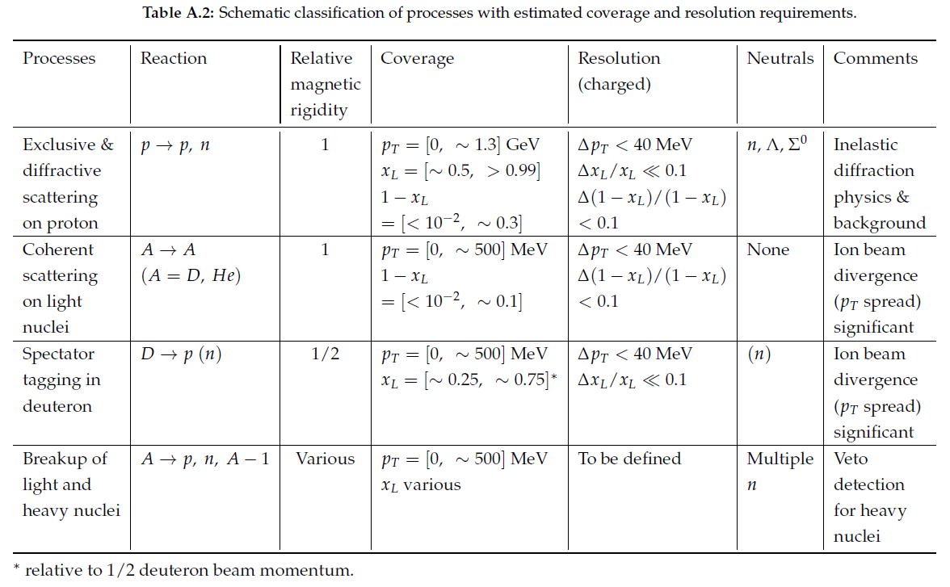
Physics Drivers for Low $(1−x_{L})$ at Small $p_{T}$

Slide 8
Geometric and Machine Constraints
Consistency with existing infrastructure: experimental hall and tunnel size
Integrate necessary components: spin rotators, crab cavities, ZDC, luminosity monitor, Roman pots, low-$Q^{2}$ tagger, etc.
Geometric and optical match to the rest of the collider rings
All beams transport over full energy range
Magnet aperture-edge fields < 4.6 T
Sufficient DA and momentum acceptance
Total beam-beam < 0.03 (p), 0.1 (e)
Beam aperture $>10σ$ (p); $>15σ_{x}/20σ_{y}$ H/V (e)
Dispersion and dispersion slope constraints at crab cavities

Slide 9
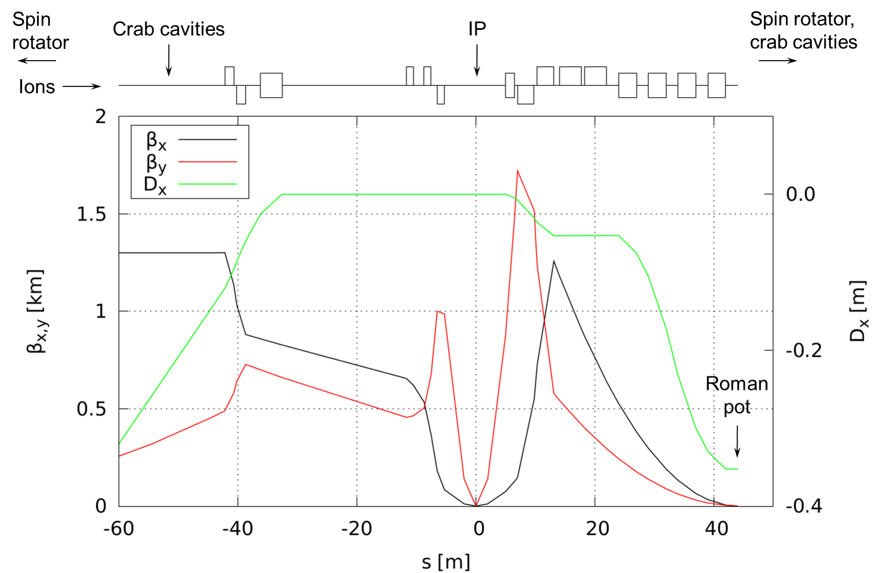
Ion 2nd IR Optics up to 120 GeV
Quadrupole lengths optimized to provide 10 mrad polar angle acceptance with aperture-edge fields below 4.6 T
Use constraints on $β_{x}^{max}=1.2$ km and $β_{y}^{max}=2$ km as in the 1st IR
Upstream section is based on the 1st IR
Doublet optics with reversible polarity of the second quad depending on the energy
Secondary focus with $\left(1−x_{L}\right)>7⋅{10}^{−3}$ acceptance
Chromatic contribution: ${ξ_{x}}/{ξ_{y}}={−30}/{−55}$

Slide 10
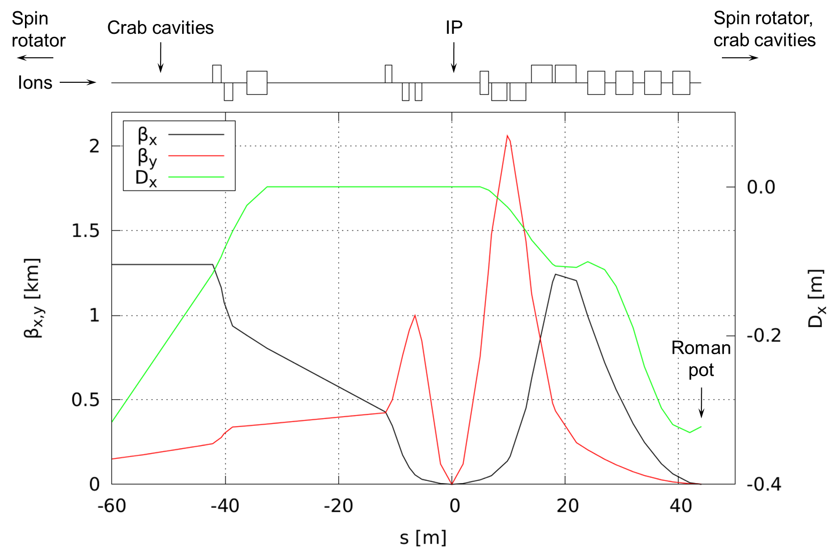
Ion 2nd IR Optics from 120 to 275 GeV
All aperture-edge fields below 4.6 T
Chromatic contribution: ${ξ_{x}}/{ξ_{y}}=−24/−45$

Slide 11
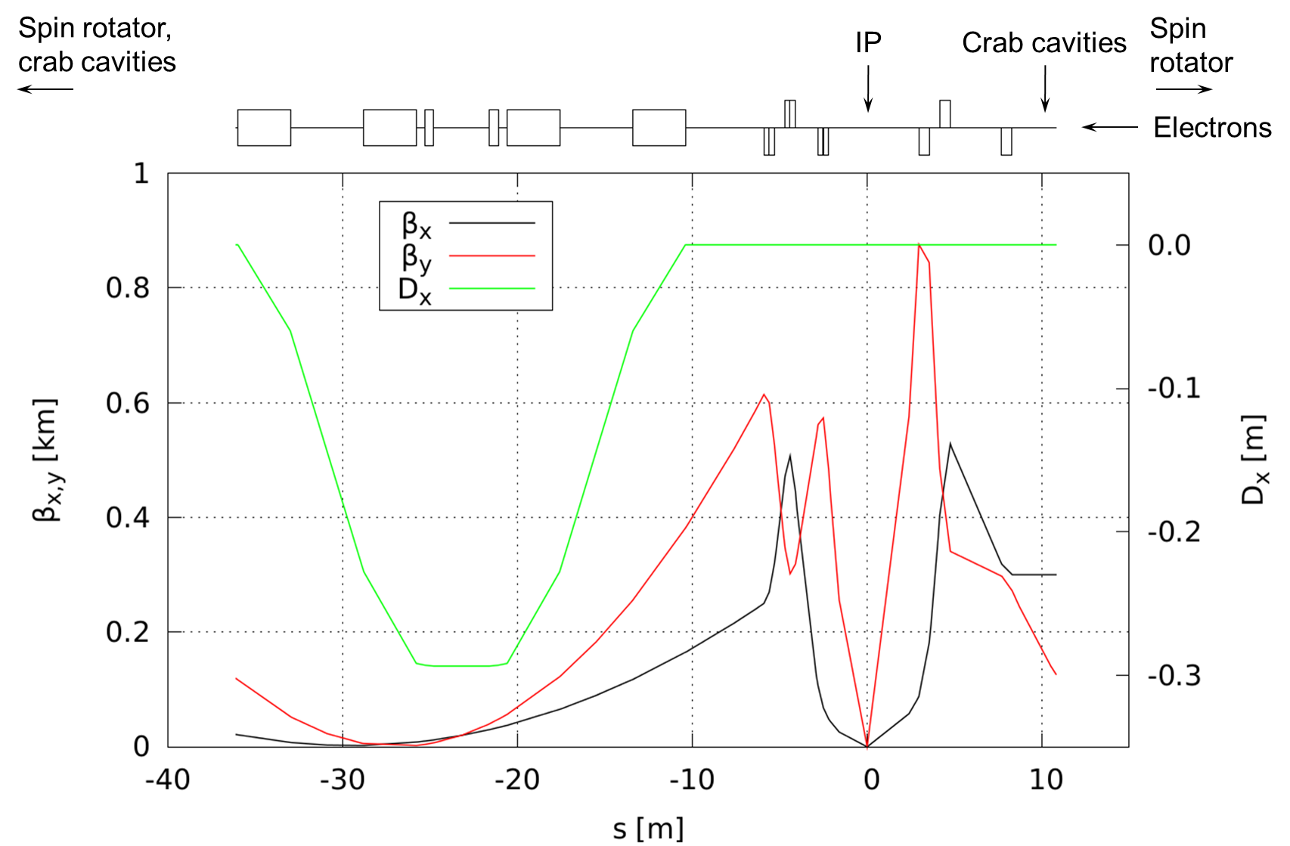
Electron 2nd IR Optics
Reduced spacing between the electron IR quads
Chromatic contribution: ${ξ_{x}}/{ξ_{y}}=−28/−64$
Synchrotron radiation background:
Consider more aggressive collimation on the upstream electron side to allow for smaller apertures and closer placement of the downstream electron IR quads
Use 1st IR SR simulation results and work with the synchrotron background study group to validate the design: Charles Hyde, Latifa Elouadrhiri, Yulia Furletova, Marcy Stutzman

Slide 12
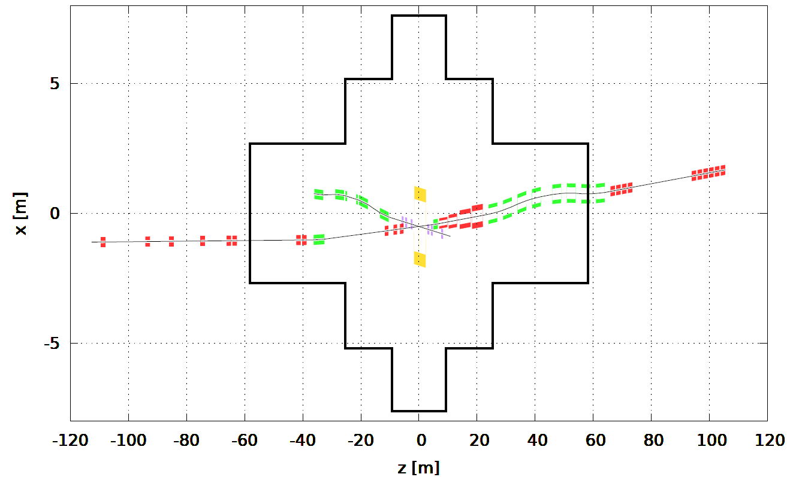
Footprint
Adjustment of the 2nd IR footprint to match the existing infrastructure and integrate the necessary detector and machine components
Hadron ring: Rear side: based on the 1st IR design Forward side: secondary focus, spectrometer dipoles, ZDC, crab cavities
Electron ring: Forward (upstream electron) and Rear (downstream electron) sides: integration of spin rotators, crab cavities, luminosity monitor, and low-$Q^{2}$ tagger

Slide 13
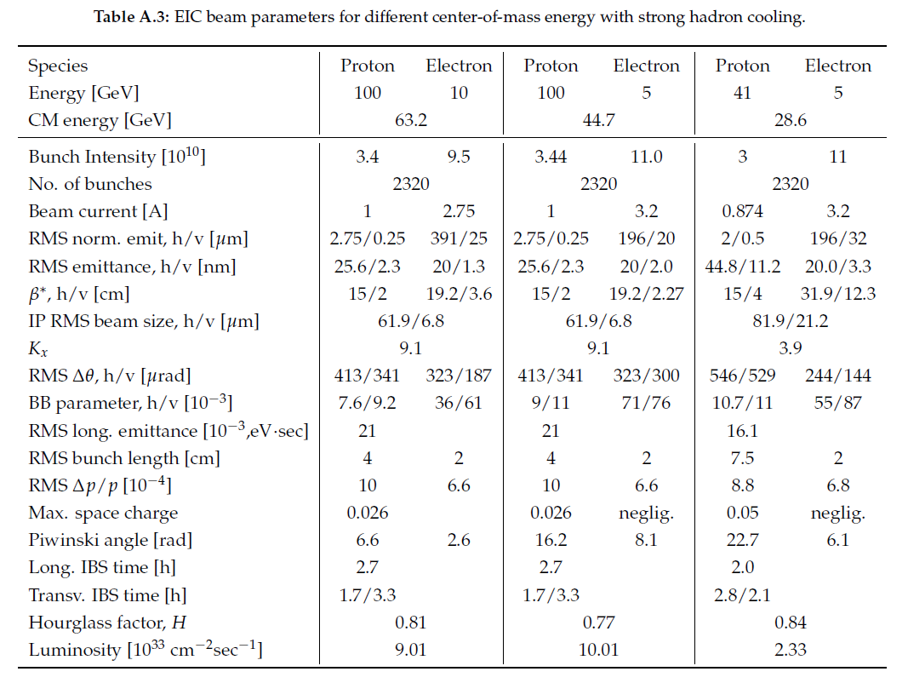
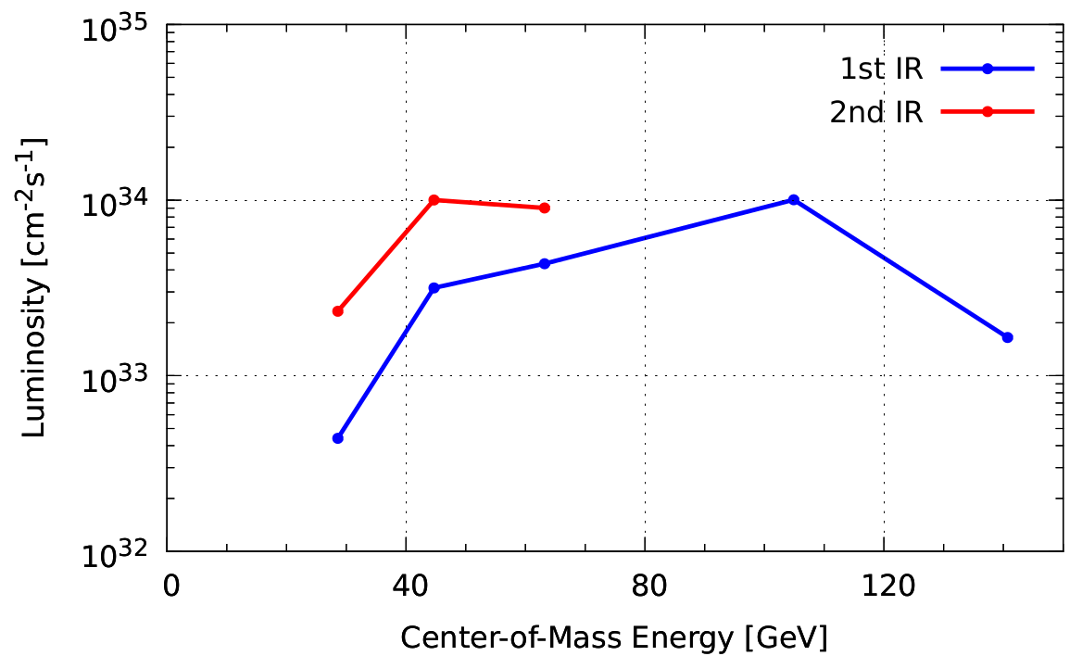
Design Optimization
Y. Zhang
Grid search and optimization in the luminosity/ detector acceptance/ beam parameter phase space
Each iteration involves
Lattice design update
Luminosity estimate
Acceptance simulation
Would like to streamline the process as much as possible
IRs optimized individually

Slide 14
Simultaneous Operation of Two IRs
Limit on the total beam-beam tune shift may result in luminosity sharing
$ξ^{p}≲0.015−0.03$
$ξ^{e}≲0.1$
Additional chromatic contribution of 2nd IR: chromaticity compensation, momentum acceptance and dynamics aperture
Local compensation scheme
Mutual compensation of the nonlinear effects of the two IRs
Doubling the bunch numbers
Larger number of parasitic collisions and their increased contribution to the total beam-beam tune shift
More challenging polarimetry due to shorter bunch spacing
Faster kicker for bunch swap in the electron collider ring
Impedance and instabilities may need to be re-evaluated due to the change of the beam spectrum
Additional machine components
IR magnets
Spin rotators
Crab cavities

Slide 15
Beam-Beam Tune Shift
Incoherent focusing of one beam by the other
Characterized by betatron tune shift of on-axis particle
Tune shifts
$$Δν_{x}^{e/p}(d)=\frac{N_{p/e}r_{e/p}β_{x}^{e/p}}{4πγ_{e/p}{\left(σ_{x}^{p/e}\right)}^{2}}\int_{0}^{1}{\frac{\exp{[−{{\left(d^{p/e}\right)}^{2}υ}/2]}\left(1−{\left(d^{p/e}\right)}^{2}υ\right)dv}{\sqrt{υ\left[{\left(r^{p/e}\right)}^{2}−1\right]+1}}}$$
$$Δν_{y}^{e/p}(d)=\frac{N_{p/e}r_{e/p}β_{y}^{e/p}}{4πγ_{e/p}{\left(σ_{y}^{p/e}\right)}^{2}}\int_{0}^{1}{\frac{\exp{[−{{\left(d^{p/e}\right)}^{2}υ}/2]}f^{p/e}dv}{\sqrt{υ\left[{\left(r^{p/e}\right)}^{2}−1\right]+1}}}$$
where
$$d^{p/e}\left(z\right)≡\frac{D\left(z\right)}{σ^{p/e}\left(z\right)}=\frac{zθ}{\sqrt{{\left(σ_{x}^{∗p/e}\right)}^{2}\left(1+{\left(\frac{z}{β_{x}^{∗p/e}}\right)}^{2}\right) }}≈\frac{θ}{σ_{x^{′}}^{p/e}}$$
$$r^{p/e}≡\frac{σ_{y}^{p/e}}{σ_{x}^{p/e}}$$
$$f^{p/e}≡\frac{{\left(r^{p/e}\right)}^{2}}{υ\left[{\left(r^{p/e}\right)}^{2}−1\right]+1}$$

Slide 16
Total Beam-Beam Tune Shift
The main and parasitic collisions occur at the $z$ locations give by
$$z_{n}=n\frac{λ}{2}$$
where $n$ is from $−Int\left({ΔL}/λ\right)$ to $Int\left({ΔL}/λ\right)$ and
$$d_{n}^{p/e}=\frac{nλθ}{2σ_{x}^{p/e}\left(z_{n}\right)}$$
The total beam-beam tune shift
$$Δν_{x}^{e/p}=\sum_{n=−Int\left({ΔL}/λ\right)}^{Int\left({ΔL}/λ\right)}{Δν_{x}^{e/p}(d_{n})}$$
$$Δν_{y}^{e/p}=\sum_{n=−Int\left({ΔL}/λ\right)}^{Int\left({ΔL}/λ\right)}{Δν_{y}^{e/p}(d_{n})}$$

Slide 17
Beam-Beam Tune Shift and Luminosity Sharing
Scaling of beam-beam tune shift limited luminosity $L∝\frac{\max{\{ξ_{x},ξ_{y}\}}}{ξ_{max}}$ where $ξ<ξ_{max}∼0.03\left(p\right), 0.1(e)$ is the beam-beam tune shift of the beam-beam limited beam
When not limited by beam-beam, can potentially have a greater combined luminosity than with a single IR.
To keep the luminosity constant, 1st IR parameters with the doubled bunch numbers scaled as $β→β/2$, $σ→σ/\sqrt{2}$
$p×e$ energy configuration $$[GeV×GeV]$$ | 1st IR |  | 1st IR |  | 2nd IR
 | 1160 bunches |  | 2320 bunches |  | 2320 bunches
 | $$ξ_{x/y}^{p}$$ | $$ξ_{x/y}^{e}$$ | $$ξ_{x/y}^{p}$$ | $$ξ_{x/y}^{e}$$ | $$ξ_{x/y}^{p}$$ | $$ξ_{x/y}^{e}$$
$$275×10$$ | 0.014 / 0.0073 | 0.073 / 0.1 | 0.0069 / 0.0037 | 0.036 / 0.05
$$100×10$$ | 0.01 / 0.009 | 0.075 / 0.058 | 0.005 / 0.0045 | 0.038 / 0.029 | 0.00768 / 0.00932 | 0.0352 / 0.0601
$$100×5$$ | 0.015 / 0.0099 | 0.1 / 0.067 | 0.0074 / 0.0049 | 0.051 / 0.034 | 0.00889 / 0.0108 | 0.0711 / 0.0766
$$41×5$$ | 0.015 / 0.0087 | 0.052 / 0.041 | 0.0075 / 0.0043 | 0.026 / 0.021 | 0.0109 / 0.0113 | 0.0519 / 0.0774

Slide 18
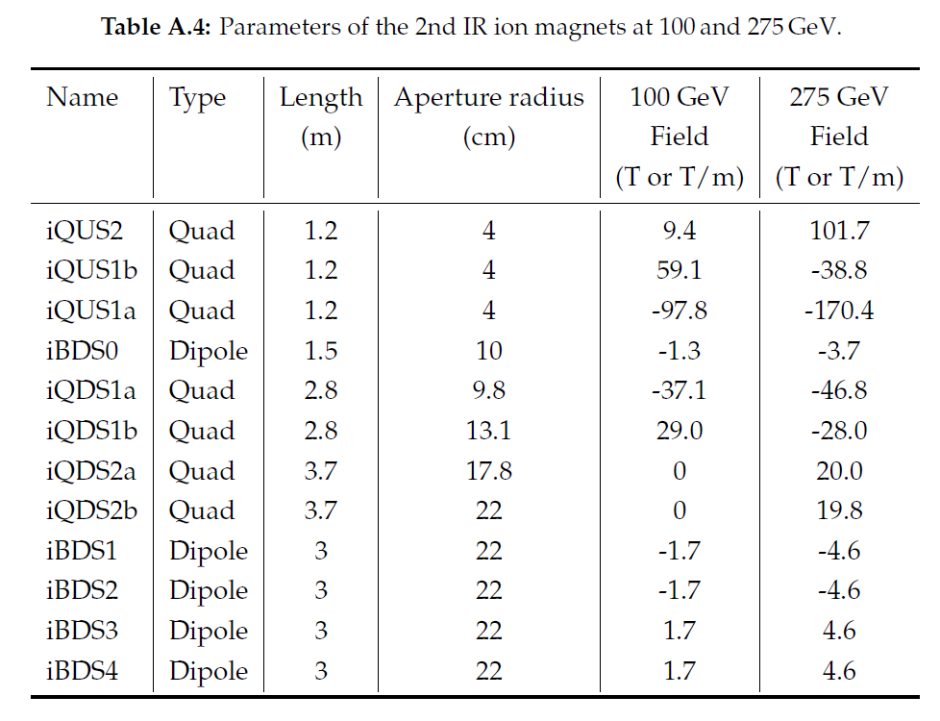
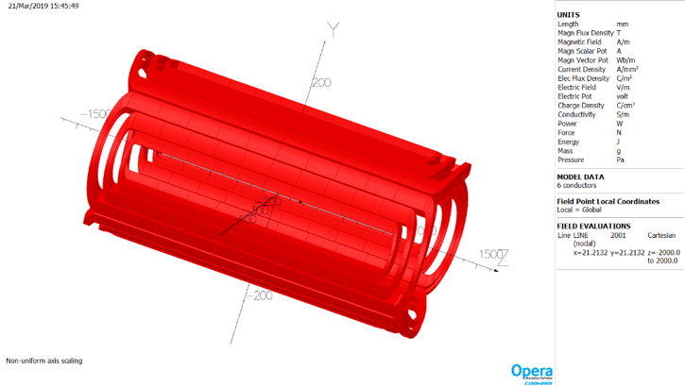
Engineering Feasibility
Engineering feasibility of the most challenging magnets
Largest-aperture forward ion quad
Forward spectrometer dipole

Slide 19
Ongoing and Future Work
Extension of the electron and ion beam lines
Geometric and optical matching of the IR
Integration of the machine and detector components
Design optimization in terms of luminosity/ acceptance/ beam parameters
Simulation of detector acceptance
Evaluation of engineering feasibility of key IR elements
Chromaticity compensation and non-linear dynamics studies

