Slide 1
Complementary Detectors at EIC
E.C. Aschenauer (BNL)
P.R. Newman (Birmingham)

Slide 2
We want it all
high Luminosity
at full acceptance
But there are some boundary conditions
accelerator
experiment

Slide 3
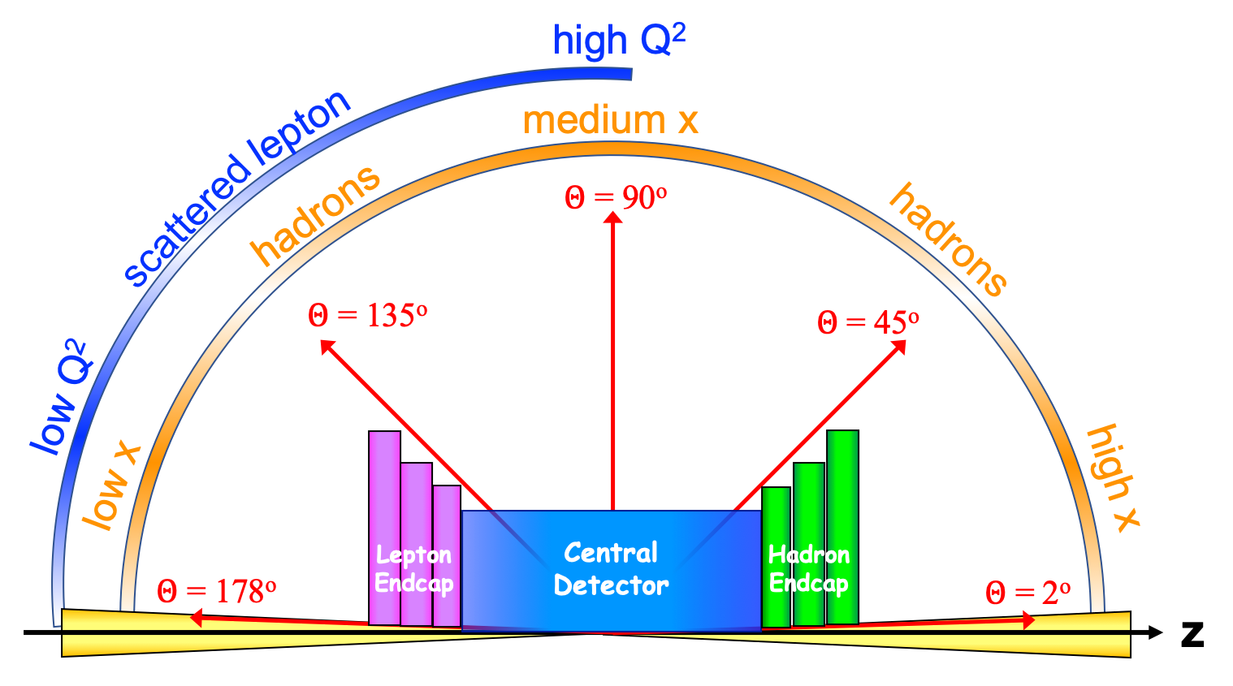
A high level view
Experimental Equipment fully integrated in IR spans +/-30 m
length of Central Detector impacts luminosity
Distance 1st focusing quad to IP
p/ion beam
e beam
far-backward
e-detection
e final-focus quads
“Central detector”, includes e-endcap, central, and p/ion endcap detectors
forward dipole
incl. h-detection
Ion final-focus quads
forward dipole
far-forward h detection
far-forward
h-detection
Low-Q²
spectroscopy
Inclusive Structure Functions, TMDs, heavy flavors and jets, electrons for GPDs
GPDs/DVCS, tagging, diffraction
high/medium t
Baryon decay
π/K structure
evaporated n
GPDs/DVCS, tagging, diffraction
lowest-t

Slide 4
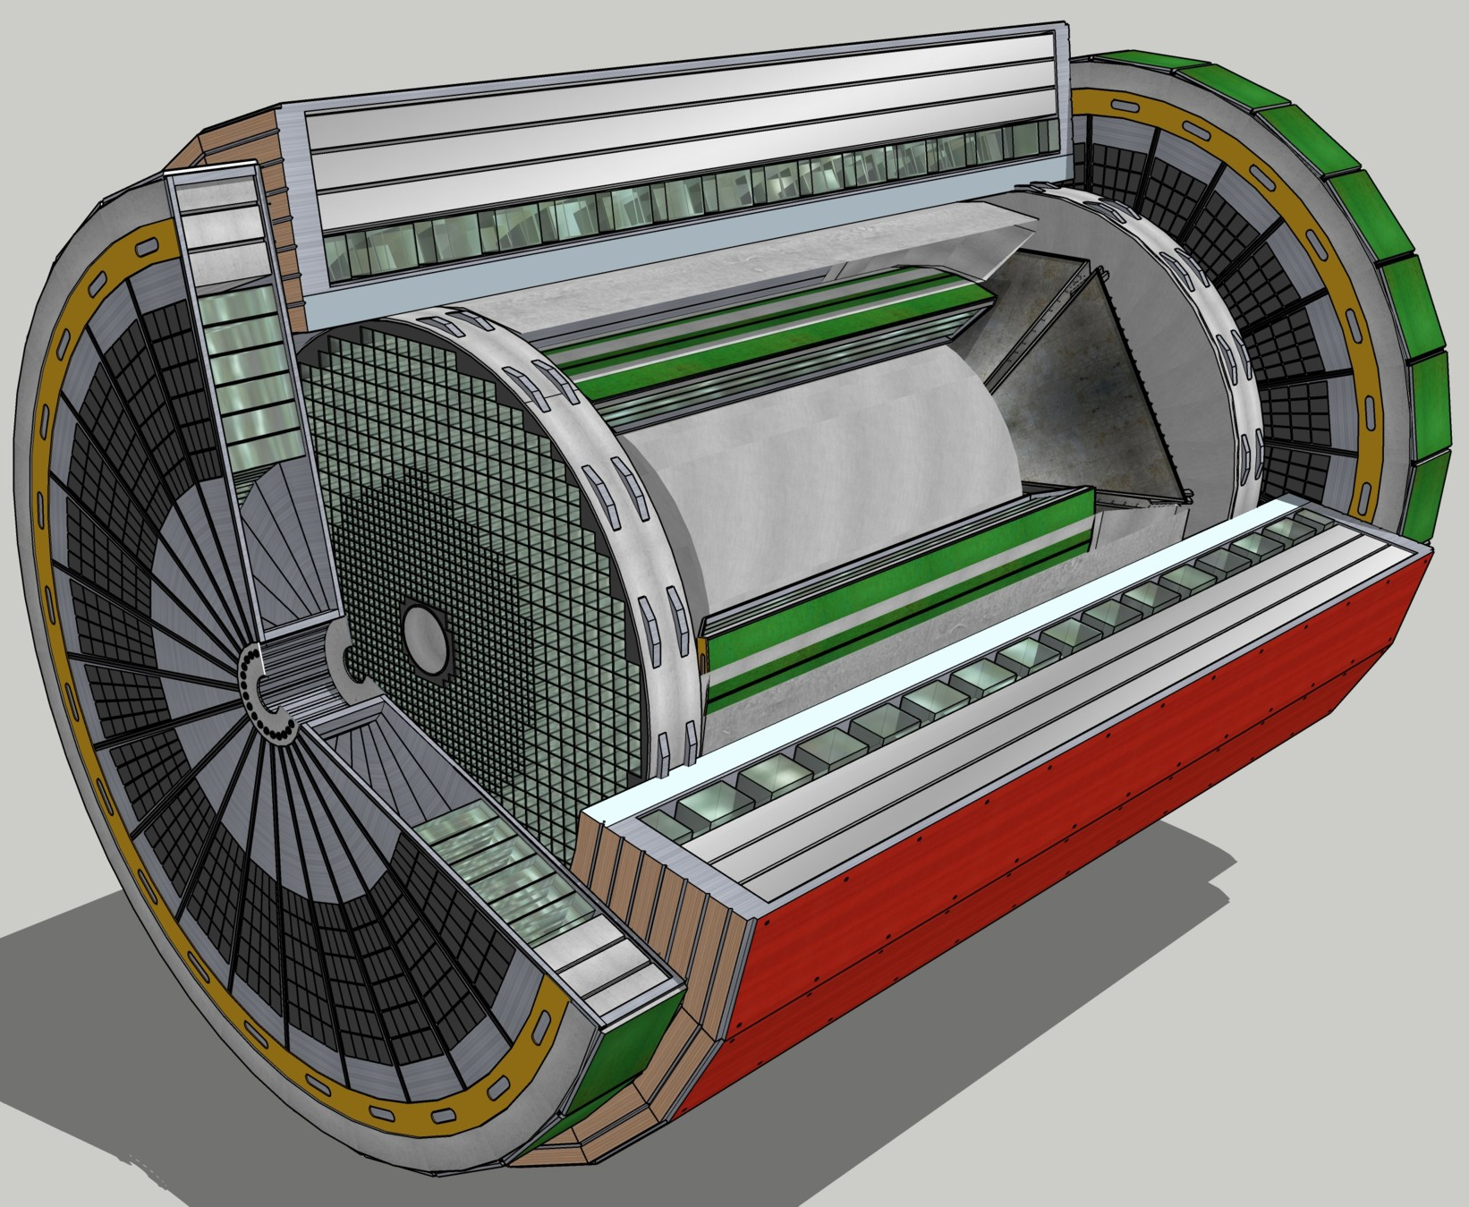
General Purpose Detector
High level detector requirements:
Large rapidity (-4 < η < 4) coverage; and far beyond in especially far-forward detector regions
High precision low mass tracking
small (μ-vertex) and large radius (gaseous-based) tracking
Electromagnetic and Hadronic Calorimetry
equal coverage of tracking and EM-calorimetry
High performance PID to separate π, K, p on track level
also need good e/p separation for electron-scattering
Large acceptance for diffraction, tagging, neutrons from nuclear breakup: critical for physics program
Many ancillary detector integrated in the beam line: low-Q² tagger, Roman Pots, Zero-Degree Calorimeter, ….
High control of systematics
luminosity monitors, electron & hadron Polarimetry
Advantage:
one device for all physics, better background rejection and systematic control
More challenging to design
Lifetime = Facility lifetime
To date no argument has been presented to change
this overall concept

Slide 5
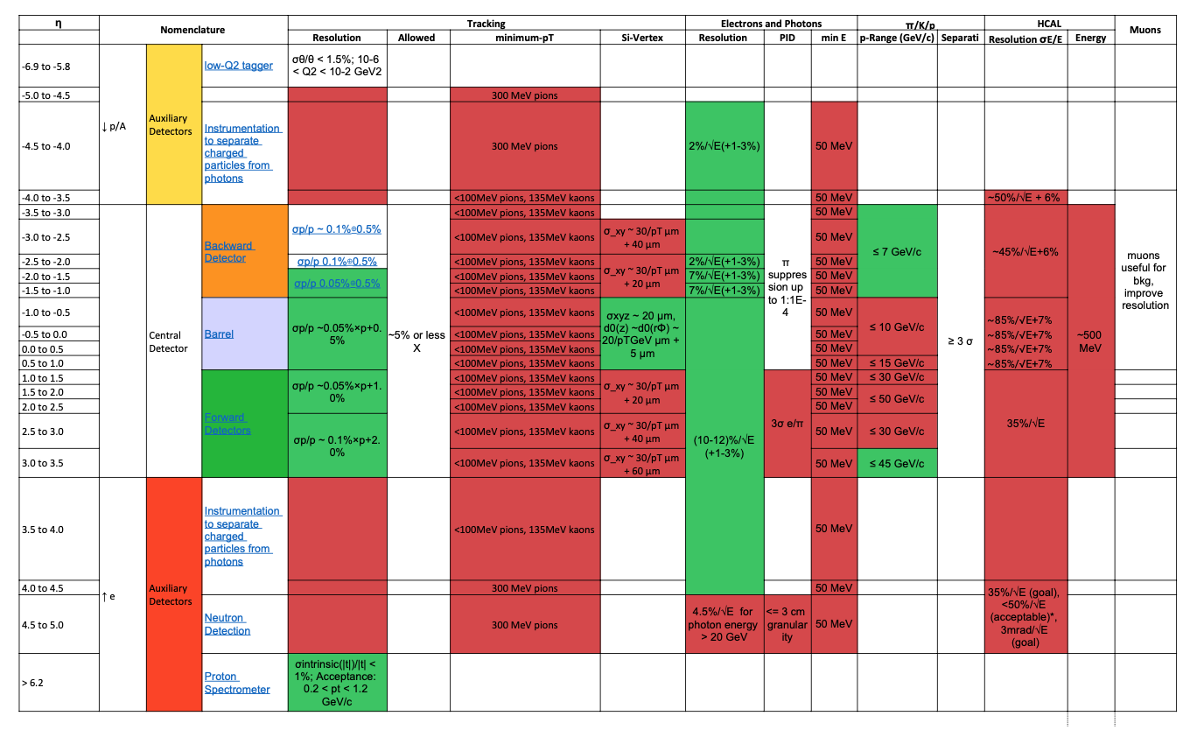
Detector Requirements from Physics

Slide 6
What is important to define Complementarity
Different CMS energies, luminosities can place emphasis on complementary kinematic regions (possible staging?) …
most physics topics require a wide range in (x,Q²)
→ need to run at different √s
→ Vary x-Q² / η correlation for SiDIS, HF, exclusives …
Some topics (eg far forward) may require dedicated set-up of detector or interaction region
synchrotron radiation fan and crossing angle define acceptance
solenoid aligned with lepton beam
asymmetric acceptance in central detector in hadron beam direction
gaps between different detectors along beamlines can be optimized differently in both IRs
Other possible key parameters:
Material budgets
Solenoid / forward magnetic field strength
Space for detector (minimum: +/-4.5m longitudinally)
Beamline instrumentation vs. IR design
Technology readiness

Slide 7
Complementarity Group Meetings - Progress so far
Separate meetings held to focus on needs of each Physics Working Group in turn and on implementation plans with most Detector Working Groups (Far-forward still to be done).
Very positive engagement (thanks) with lots of ideas
No strong arguments made for a dedicated second detector → aim for 2 GPDs
Opportunities to optimize to different physics aims by having different solenoid field strengths + maybe different emphasis on precision tracking v PID etc
Main source of complementarity likely to lie in different technology choices. Details so far not very clear
Next steps require more detailed simulations, including multiple detector components and the interfaces and interactions between them.

Slide 8
Till Today Defined Complementarity
Solenoid field
→ High field for precise measurement of high p_{T} charged particles (scattered electron, leading particles in SiDIS …)
Lower field for acceptance of lower p_{T} charged particles (spectroscopy, some charm decays …)
Complementary Technologies
→ muon detection – Question is tracking + ECAL- HCAL response enough
To get two detectors complementary in technology
but with equal performance one needs to optimize
the full detector and not only push individual subdetectors performances

Slide 9
Additional Science Opportunities
Integrate fixed target into collider:
done at LHC (ALICE and LHCb) and STAR@RHIC
for EIC on can do
ep/A fixed target --> access to high x
pp/A important to test universality for TMDs, GPDs, ……

Slide 10
Complementarity Matrix
For YR – write up
Collect information neatly via a ‘Physics Topic’ v ‘Detector Component’ matrix
Each element clickable to add content (could leads to a page with list of files / links)
→ complementarity ideas (see list of questions asked to Working Groups)
→ problems arising from baseline design
→ …
May need more rows, subdividing some of the PWGs (eg for SIDIS)
ECA and PRN populate based on material from Complementarity meetings so far
Invite others to add material during / after CUA meeting

Slide 12
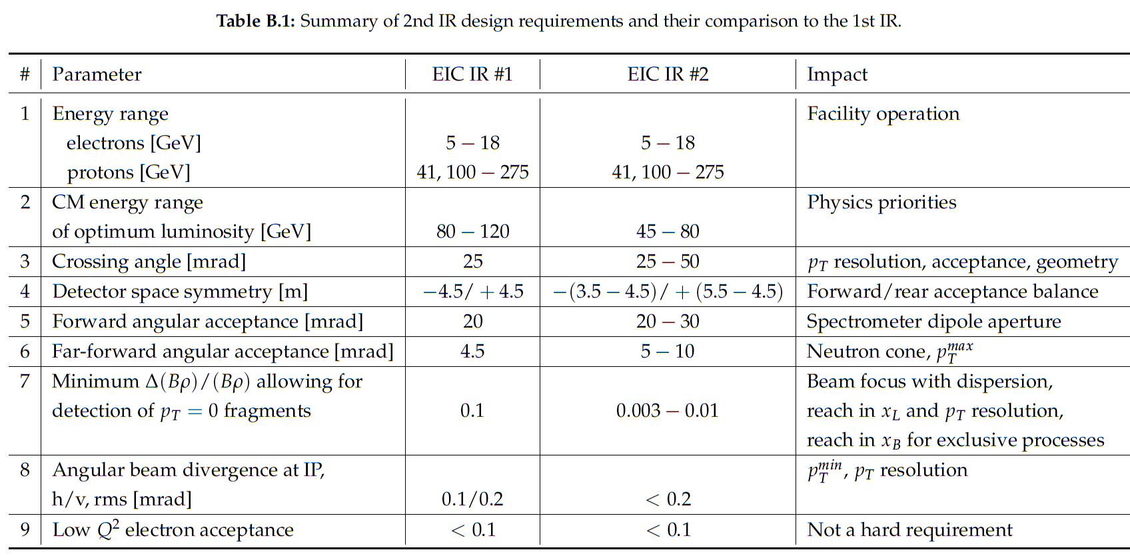
Boundary Conditions
Interaction Region:
All beams transport over full energy range
Magnet aperture-edge fields < 4.6 T
Detune low-beta or do not run for E_{p}>~180 GeV
Sufficient DA and momentum aperture
Total beam-beam < 0.03 (p), 0.1 (e)
Beam aperture >10σ (p); >15σ_{x}/20σ_{x} H/V (e)
Electron aperture accommodates non-Gaussian tails
Dispersion and dispersion’ constraints at crab cavities

Slide 13
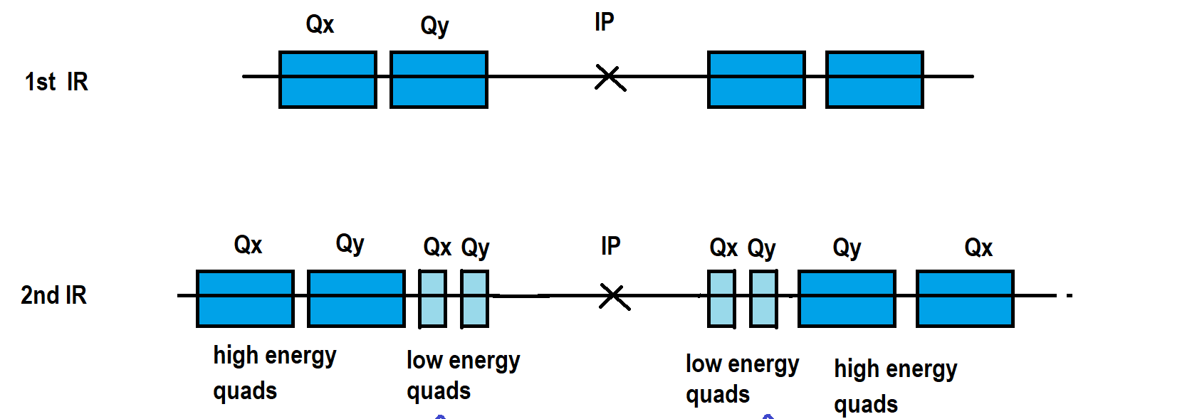
Luminosity vs. Detector Space
$$L= \frac{{h∙f}_{rev}∙{n·n}_{b}∙N_{e}/n∙N_{p}/n}{4π∙\frac{σ_{x}σ_{y}}{n}}$$
Luminosity:
but reduce emittances by factor n ( note n_{b} is original number of bunches, new is n·n_{b}), which requires much stronger cooling τ_{cool} ➔ τ_{cool} / 2,4, …
The original luminosity is then recovered
Luminosity can now be increased by squeezing the betas by a factor 2 which is possible since the envelope in the final focus quadrupoles has shrunk by a factor of √2 in x and y
One is left to deal with the enhanced IR chromaticity which went up by a factor of 2 which reduces the dynamic aperture by a factor ~2
How to reduce IR chromaticity?
Increase crossing angle to get final focus quadrupoles closer to IP
θ_{cross} ➔θ_{cross} x 2
→ Impact on detector: asymmetric material budget in outgoing hadron beam direction
asymmetric and reduced acceptance for high η hadrons
Electrons: final focus quadrupoles in the detector
Hadrons:
$$\hat{β }∝{L^{∗2}}/{β^{∗}}$$
L*
Detector Size directly coupled to Luminosity

