Slide 1
Jets and Heavy Flavor WG Meeting
August 3, 2020
A few announcements
Talk by Dillon Fitzgerald, University of Michigan with an update on charm jet substructure studies for the EIC
2. Talk by Xuan Li, LANL with an update on heavy flavor reconstruction with the latest FST design
3. Talk by Jae Nam, Temple U on charm in charge current DIS

Slide 2
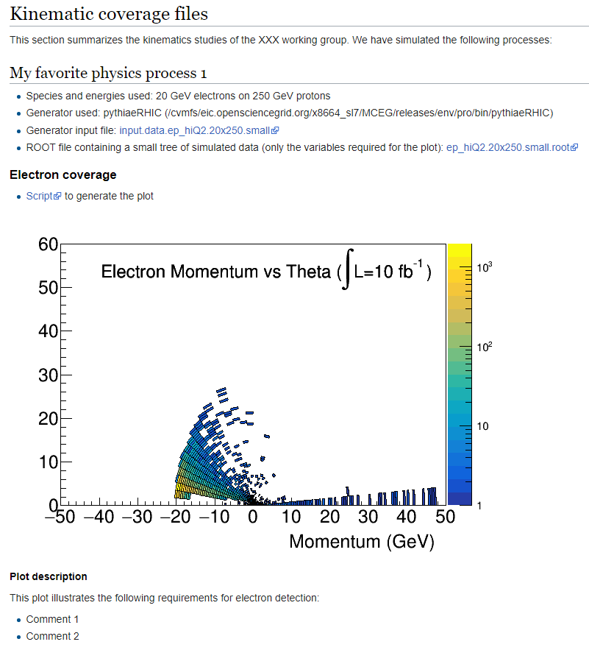
Post Pavia Activities
For kinematic maps
provide
Wiki-page template at:
https://wiki.bnl.gov/eicug/index.php/Yellow_Report_Physics_Common#Kinematic_coverage_files
Species and energies used
Generator used
(location if available)
Generator input file
ROOT file with tree to produce plots
Scripts to produce kinematic plots
There is still time to include them

Slide 3
Detector requirements
Deadline to give detector requirements is end of August so that DWG can take it into account
Provide studies and detector requirements and briefly mention the physics of the channel
Explain the requirements – is the measurement possible or not at all? What will happen if one varies detector parameters
If you have used Detector Matrix values specify that and clarify of you have made any other assumptions
If detector matrix parameters are sufficient state that, if not – what is needed for your channel
Send the documents with writup and supporting figures to us. We can put them on the Wiki page and send them to the PWG conveners
Even if you get results later than the end of August they will still be useful. The Yellow Report is not the last word on physics or detector technology

Slide 4
Snowmass 2021
This Tuesday, there will be an online meeting
https://indico.fnal.gov/event/44510/ on Aug. 4 2:30-4:30PM EDT
to explore physics opportunities at the Electron Ion Collider (EIC), co-organized by the Snowmass 2021 Energy Frontier Topical Groups 05, 06, and 07.
The meeting will include community contribution talks and a panel on Snowmass Letters of Interest (LoIs) dedicated to the following topics:
Electroweak and Beyond the Standard Model studies at the EIC
Proton tomography at the EIC for HEP applications
Jets at the EIC
Heavy flavors at the EIC
Gluon saturation at the EIC
Huey-Wen, Christophe, Pavel, Yen-Jie, Swagato
Conveners of the Snowmass EF06 and EF07 Topical Groups

Slide 5
Heavy flavors at the EIC
Xin Dong, Stephen Sekula, Ivan Vitev
The aim of this meeting is to coordinate submission of a Letters of Interests (LoI) related to EIC. LoIs are informal documents, maximum of 2 pages, intended to inform the Snowmass conveners regarding the communities interest in specific study topics. One of the EIC-related topics of interest for EF06 and EF07 is: Heavy flavors at EIC
Given your interest and expertise in this topic we kindly request you to coordinate the process of an LoI submission on the above topic by liaising with the EIC User Group.
Thank you very much!
Sawgato
Expect to get more information tomorrow
Haven’t discussed yet. We (I) expect to cover the heavy flavor topics discussed in the group

