Slide 1
Thoughts on EIC detector
installation and maintenance
Walt Akers, Yulia Furletova and Alexander Kiselev
YR Integration WG meeting August 12, 2020

Slide 2
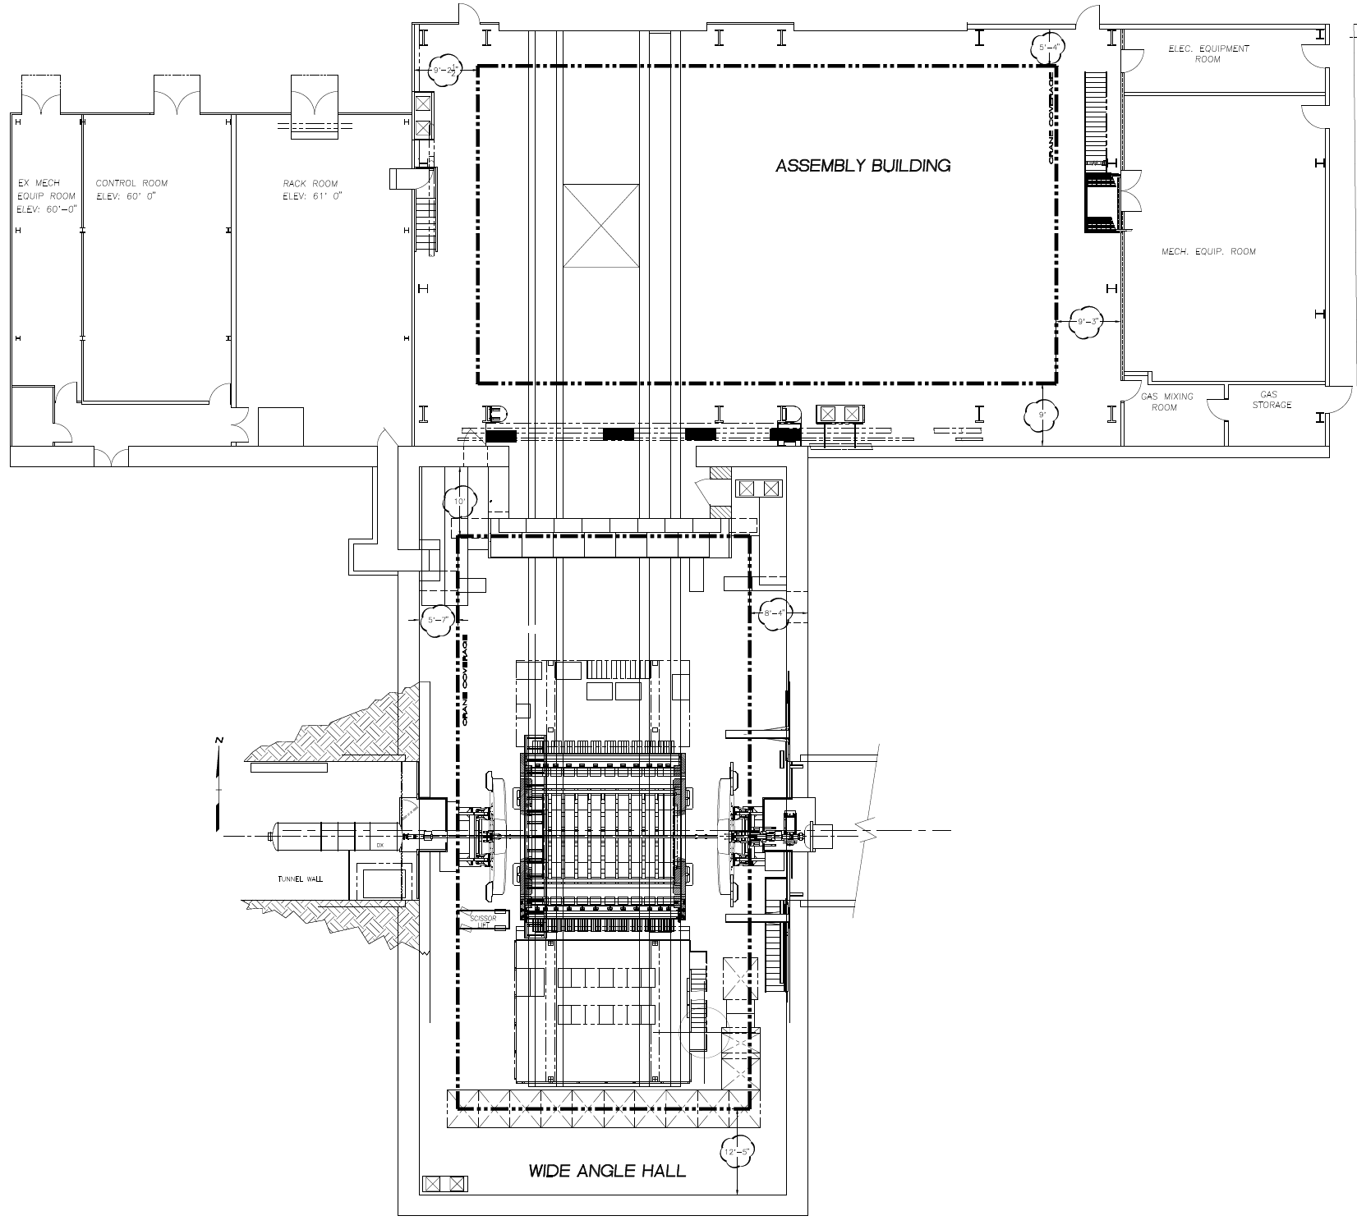
RHIC IP6 Hall (STAR): the default option
Barely enough space along the beam line
Small door
Hall length | ~3200 cm
Hall width | ~1615 cm
Door width | 823 cm
Door height | 762 cm
STAR detector in
the beam position

Slide 3
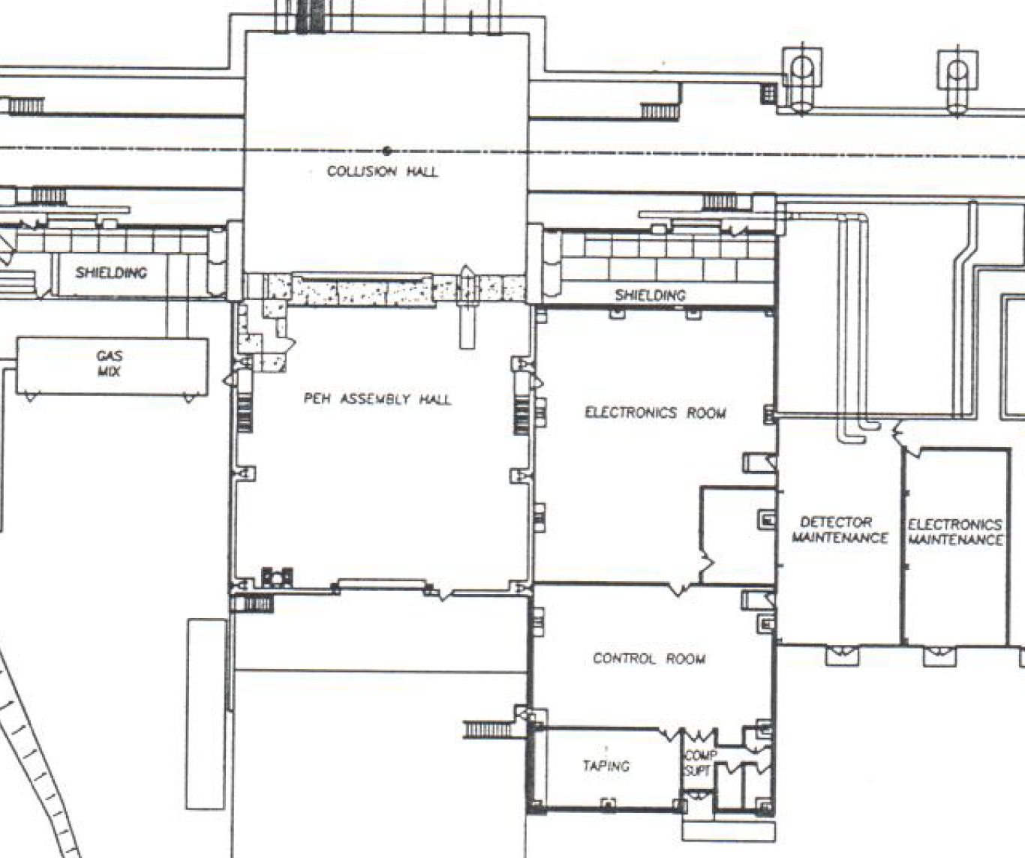
RHIC IP8 Hall (PHENIX): the “2-d IR” option
sPHENIX in IP8 doorway
Hall length | ~1740 cm
Hall width | ~1860 cm
Door width | 927 cm
Door height | 1017 cm
Very small exp. hall
Large doorway

Slide 4
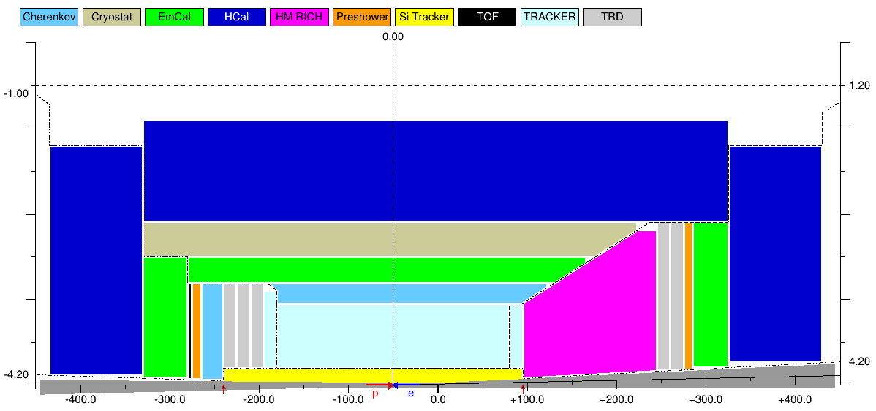
Detector Model
Take all the available space along the beam line (~9 m) …
… preferably with a ~0.5 m IP shift towards the e-endcap
Naturally split into a central (barrel) part and a pair of endcaps

Slide 5
Detector assembly / installation considerations
Exp. halls are small -> assemble outside; central detector sequence:
Barrel yoke (HCal) & the cryostat
Barrel PID & the central volume tracker
Central piece of the beam pipe & the silicon tracker
Endcap tracker and PID detectors; crystal EmCal
Doorways are narrow (and beam pipe access is tough)
Endcaps are separate pieces, on their own Hilman rollers, …
… rolled in separately (and most likely split into halves)
IP6 doorway height is small
Almost certainly need to consider a non-trivial cryocan configuration …
… and lower the whole barrel detector down to pass through the door
This design needs to be changed!

Slide 6
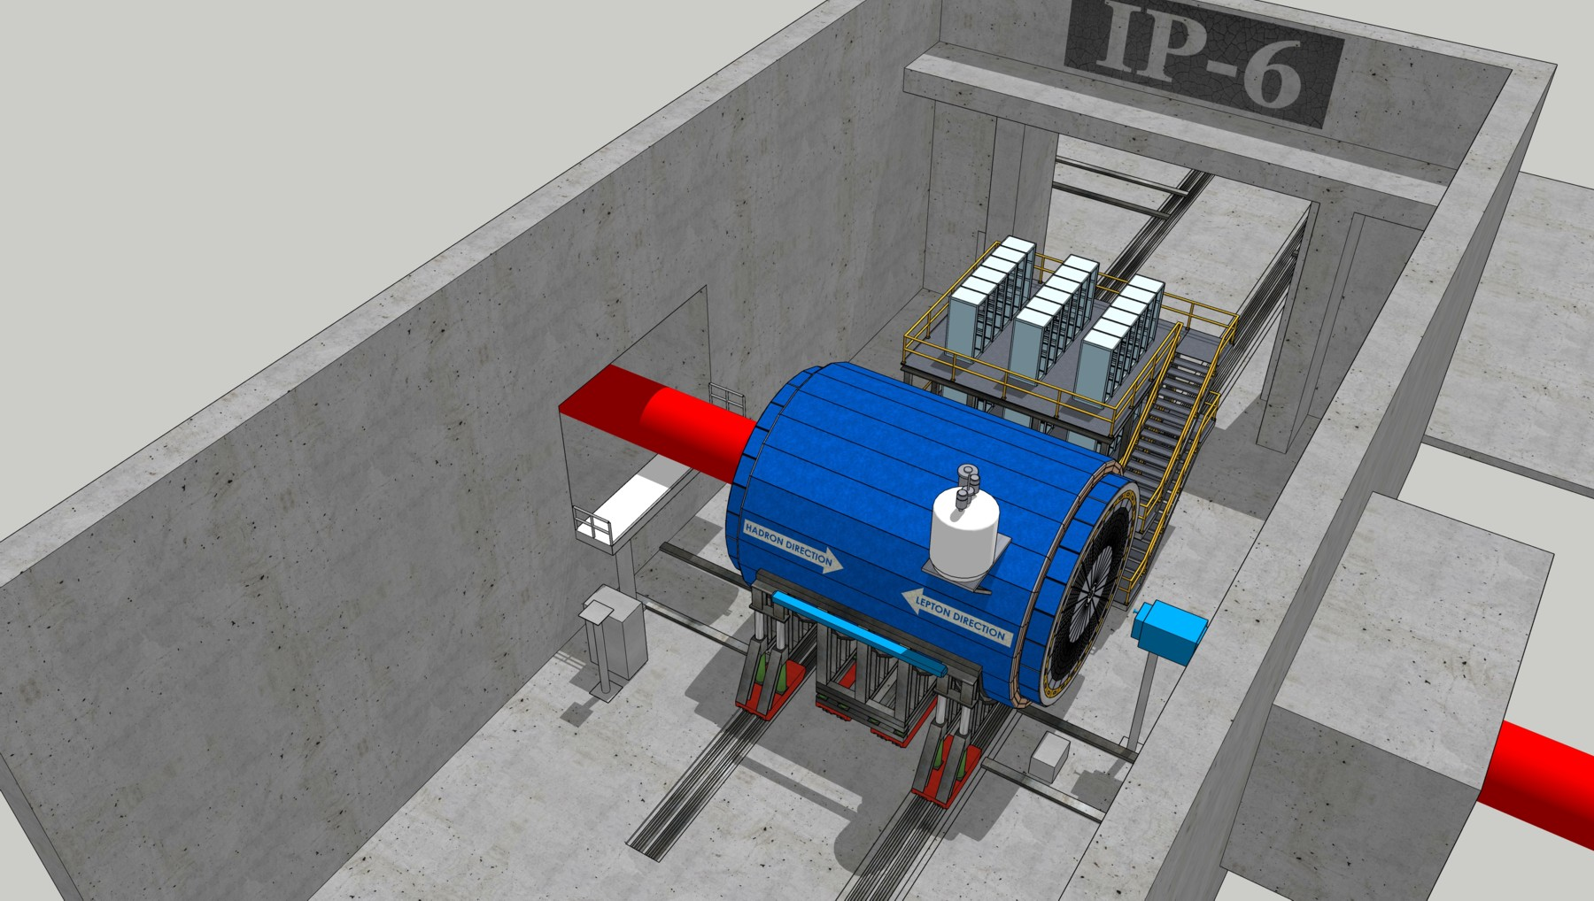
IP6: detector in the beam position

Slide 7
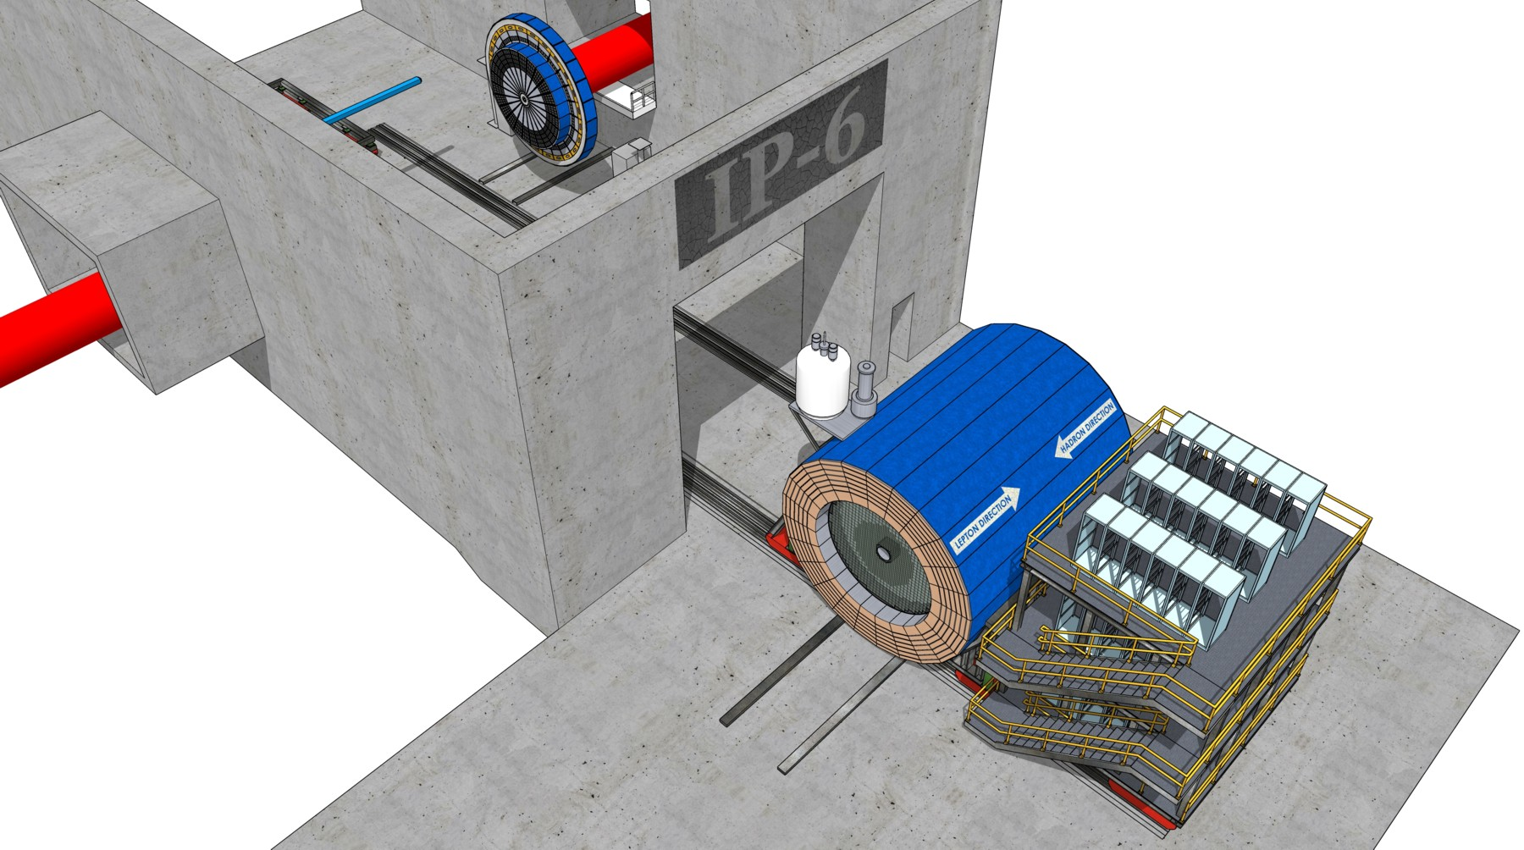
IP6: detector in the assembly hall

Slide 8
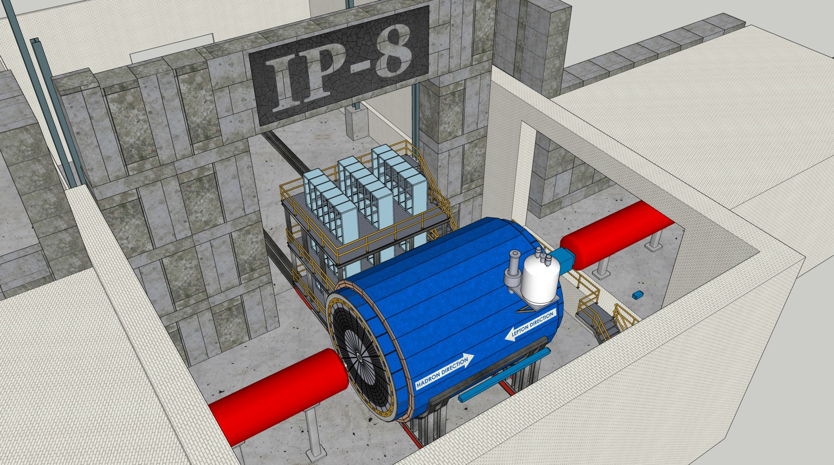
IP8: detector in the beam position
The electronics trailer next to the detector does not really fit into the exp. hall

Slide 9
Maintenance modes & access options
Short access (hours) – no major disassembly actions
Electronics trailer
HCal frontend electronics
Cryocan
“Monthly” access (days) – endcaps rolled out in halves
EmCal frontend electronics
B0 magnet detectors (silicon tracker and EmCal)
Outer part of the central detector (planar trackers, perhaps the gaseous RICH electronics, perhaps DIRC electronics – if installed)
Regular maintenance (months) – detector moved to the assembly hall
The only option to access the central tracker …
… and the forward / vertex / backward silicon trackers

Slide 10
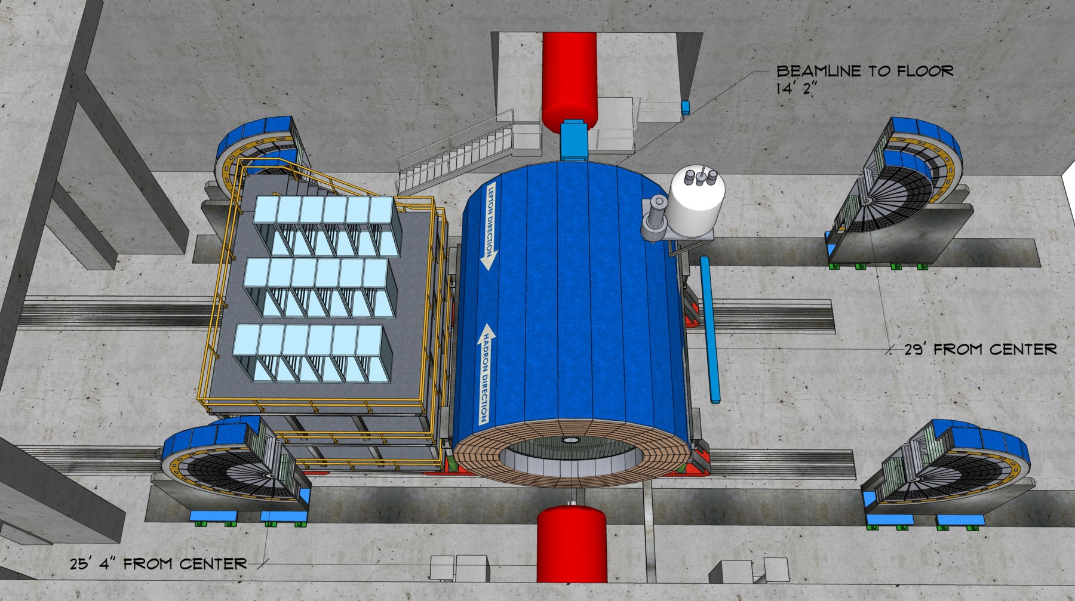
IP6: detector in the “monthly” maintenance mode

Slide 11
Movie time ☺

