Slide 1

Kolja Kauder
Using Eic-Smear 1.1.0
with Forward Detectors
New!
Exclusive Reactions Meeting
August 14, 2020

Slide 2
How to obtain
Included in all the packaged distributions (Singularity, ESCalate, …).
E.g., in singularity or directly on RCF, all you need is:
setenv EIC_LEVEL dev
source /cvmfs/eic.opensciencegrid.org/x8664_sl7/MCEG/releases/etc/eic_cshrc.csh
# or for bash
export EIC_LEVEL=dev
source /cvmfs/eic.opensciencegrid.org/x8664_sl7/MCEG/releases/etc/eic_bash.sh
Install locally from github: eic-smear, eicsmeardetectors
  A local version of the detectors makes sense if you want to modify them yourself
  eic-smear installs easily – however most generators are more finicky, you may want to use a container for those anyway

Slide 3
Accepted Generators
HERA era generators
BeAGLE
HepMC2 or HepMC3 data
(tested for PYTHIA8)
all of the above, gzipped
(factor ~6 compression)
PYTHIA6
DPMJet
PEPSI
gmc_trans
Djangoh
Milou
Rapgap
BeAGLE
Any HepMC
Example:
https://gitlab.com/eic/mceg
$ pythiaeRHIC < input.data.ep_noradcor.20x250.eic > log.txt
obtain input card from expert / PWG consensus
logfile needed for x-section information (use a better name…)

Slide 4
Interactive Use
Load the first library in ROOT
$ root -l
root [0] gSystem->Load("libeicsmear")
root [1] .L SmearMatrixDetector_0_1_FF.cxx
root [2] auto d = BuildMatrixDetector_0_1_FF(275)
root [3] SmearTree (d, "pythia.root")
Or load all at once with a second library, with a convenience function
root [2] gSystem->Load("libeicsmeardetectors")
root [3] SmearTree (BuildByName("matrixff",275), "pythia.root")
Or load libs and display information with the new executable eic-smear
$ eic-smear
Using eic-smear version: 1.1.0
Using these eic-smear libraries :
/Users/kkauder/software/lib/libeicsmear.dylib
/Users/kkauder/software/lib/libeicsmeardetectors.dylib
eic-smear [0] SmearTree (BuildByName("matrixff",275), "pythia.root")

Slide 5
Transformation
First, transform generator files with BuildTree
$ eic-smear
eic-smear [0] BuildTree("pythia.txt",".", -1, "log.txt")
eic-smear [1] BuildTree("beagle_eD.txt")
eic-smear [3] BuildTree("dis_hepmc2.dat")
eic-smear [4] BuildTree("nc_hepmc3.dat.gz")
This will create homogenous ROOT trees from all the different MCEGs
If a log file is provided (or guessed correctly), cross section information is added
  not needed for HepMC
The input filename should contain the generator name – this is how BuildTree guesses the type
  "hepmc" is enough, the version is determined automatically

Slide 6
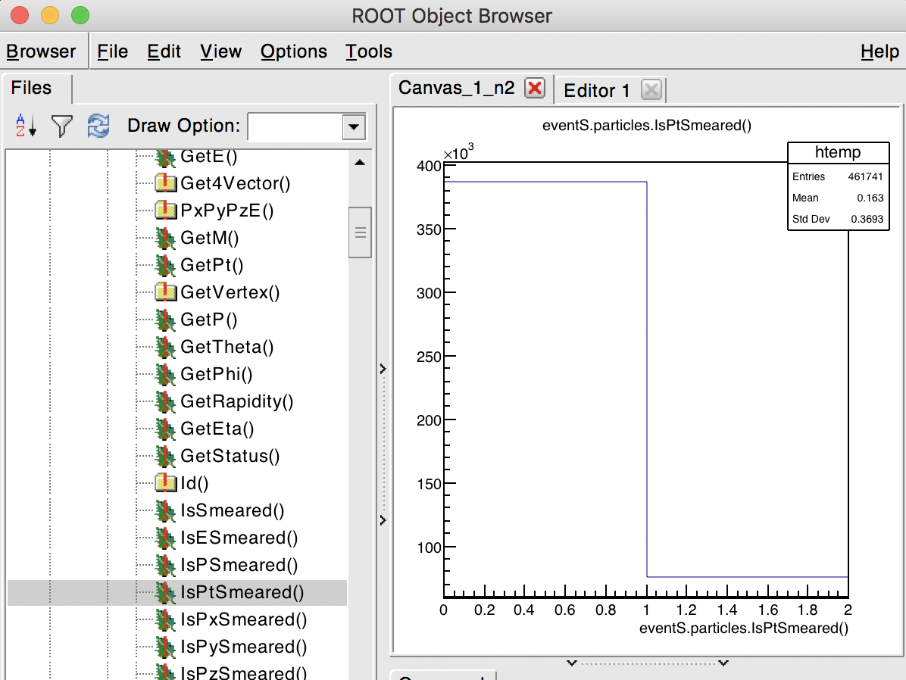
Smearing
Smeared with SmearTree
eic-smear [0] .L SmearMatrixDetector.cxx
eic-smear [1] auto d = BuildMatrixDetector_0_1_FF(275)
# OR
eic-smear [0] auto d = BuildByName("matrix");
# Either way
eic-smear [] SmearTree (d, "pythia.root", "smeared.root")
Load!
eic-smear [0] TFile s ("smeared.root")
eic-smear [1] new TBrowser
Smeared property is stored if final and in acceptance
0 can mean smeared to 0 or not measured – check flags

Slide 7
Changing or adding to the scripts
Install your own version, instructions at eicsmeardetectors
copy or modify – add to eicsmeardetectors.hh and BuildByName.cxx
make again!
Important: Add the path which contains your libeicsmeardetectors to the front of LD_LIBRARY_PATH (or DYLD_LIBRARY_PATH on a Mac)
bash $ export LD_LIBRARY_PATH=my/path:$LD_LIBRARY_PATH
macbash $ export DYLD_LIBRARY_PATH=my/path:$DYLD_LIBRARY_PATH
tcsh $ setenv LD_LIBRARY_PATH my/path:$LD_LIBRARY_PATH
eic-smear will show that you're doing it right
$ eic-smear
/Users/kkauder/software/lib/libeicsmear.dylib
/Users/kkauder/eicdev/eicsmeardetectors/build/libeicsmeardetectors.dylib

Slide 8
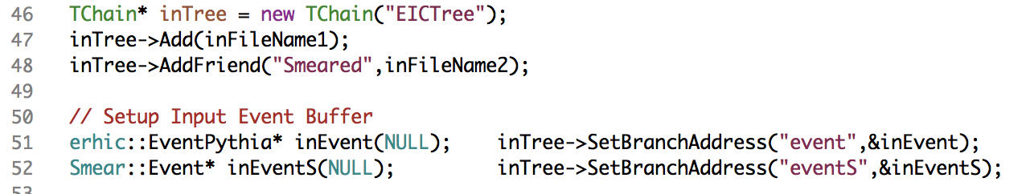
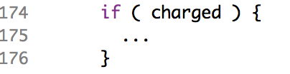
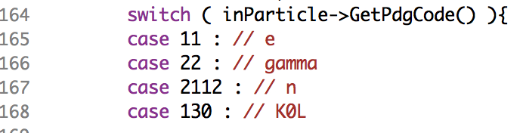
Analysis
Befriend and get matched branches
Particle Loop
Some additions at analysis level:
Tracking efficiency
Assign π mass to EMCal "hits"
Add convenience functions?

Slide 9
Compilation
$ g++ `root-config --cflags` \
`root-config --libs` \
-I<…>/include -L<…>/lib -leicsmear -leicsmeardetectors
Examples:
test/qaplots.cxx in eicsmeardetectors is written to demonstrate how to match and analyze
  also can be used as a demonstration of cmake
https://github.com/eic/eicsmear-jetexample is an example using just a plain makefile, no cmake needed.

Slide 10
Resources
All hosted at github.com/eic
Use issue tracker for bugs & requests!
Slack channel: eicug.slack.com/#software-support
Mailing list: eic-bnl-soft-l@lists.bnl.gov
Contact: kkauder@bnl.gov
Online users’ guide:
wiki.bnl.gov/eic/index.php/Eic-smear
Class documentation (temporary location):
www4.rcf.bnl.gov/~eickolja/

Slide 11
BACKUP

Slide 12
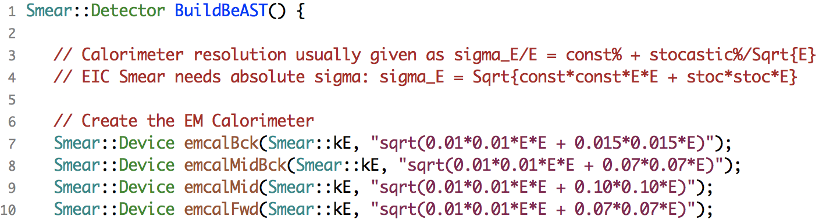
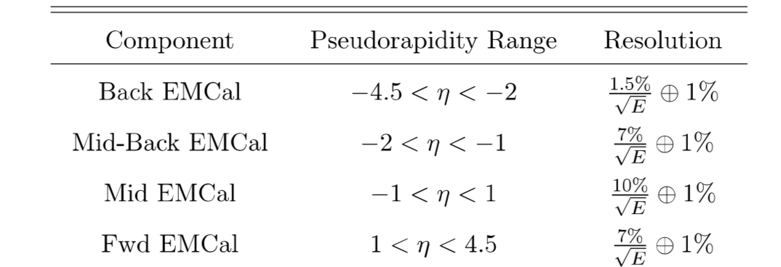
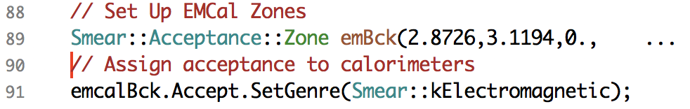
In Practice
BeAST Calo parameters
from eRHIC design study
Function returning a Smear::Detector
Acceptance (in θ)
Genre selects set of PIDs
→ can be customized
… same for HCal

Slide 13
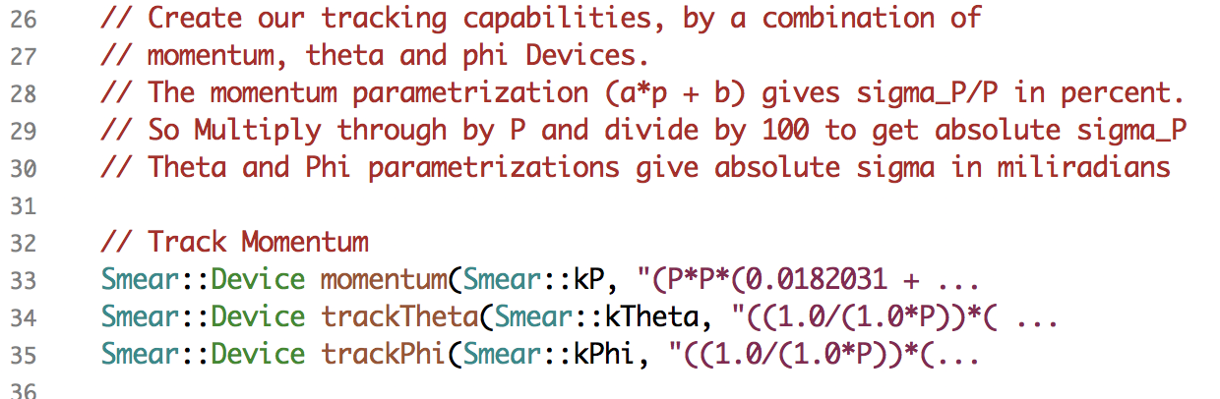
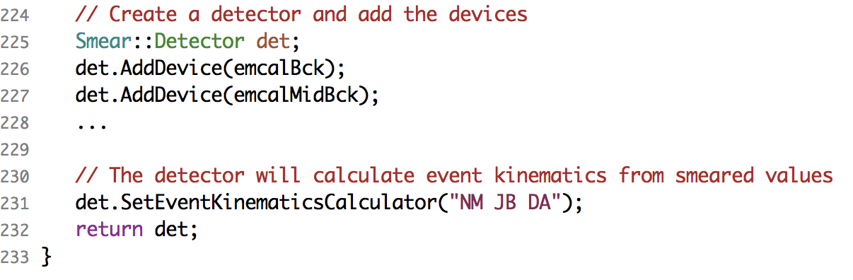
Example Continued
Tracking follows similar TFormula's.
Assemble devices
Kinematics options

