Slide 1
Jets and Heavy Flavor WG Meeting
August 17, 2020
Moving forward – focus on the detector requirements and YR writeup
1. Discussion of requirements by Osborn, Li, Arratia, Dong
2. Further discussion and input from the group
3. A few announcements

Slide 2
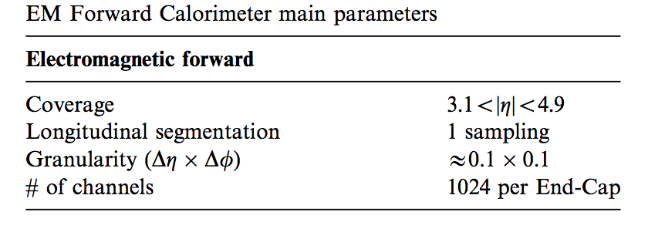
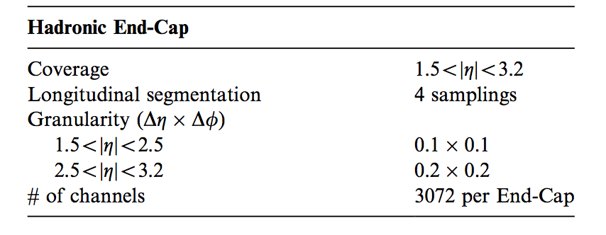
Calorimeter
ATLAS
$34\%/√E$ (GeV)
$56\%/√E$ (GeV)
$80\%/√E$ (GeV)
One module

Slide 3
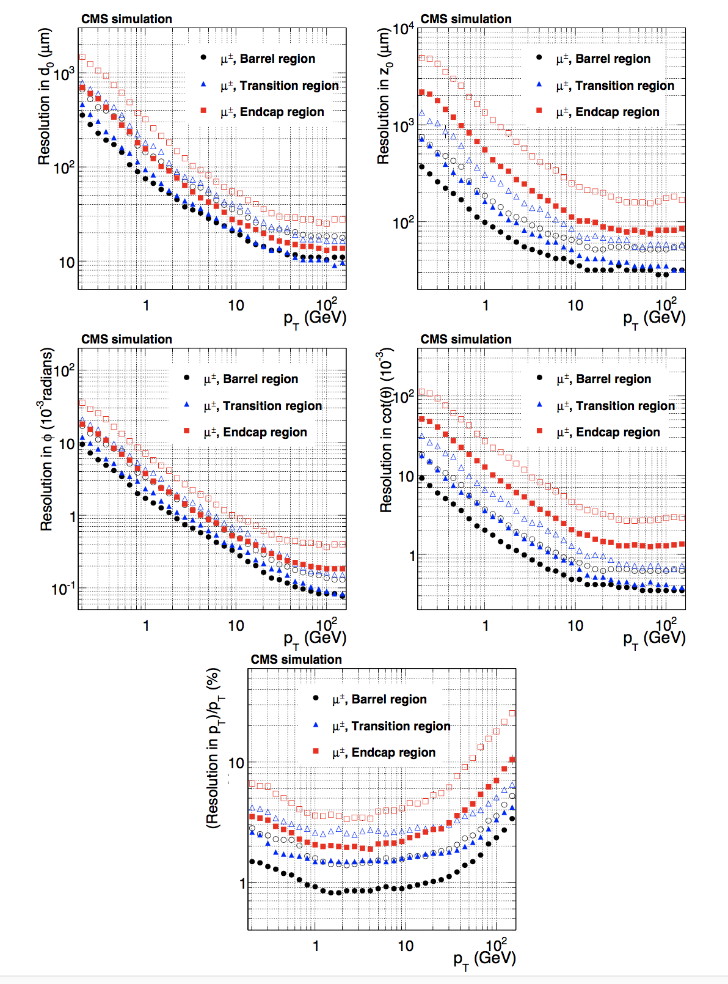
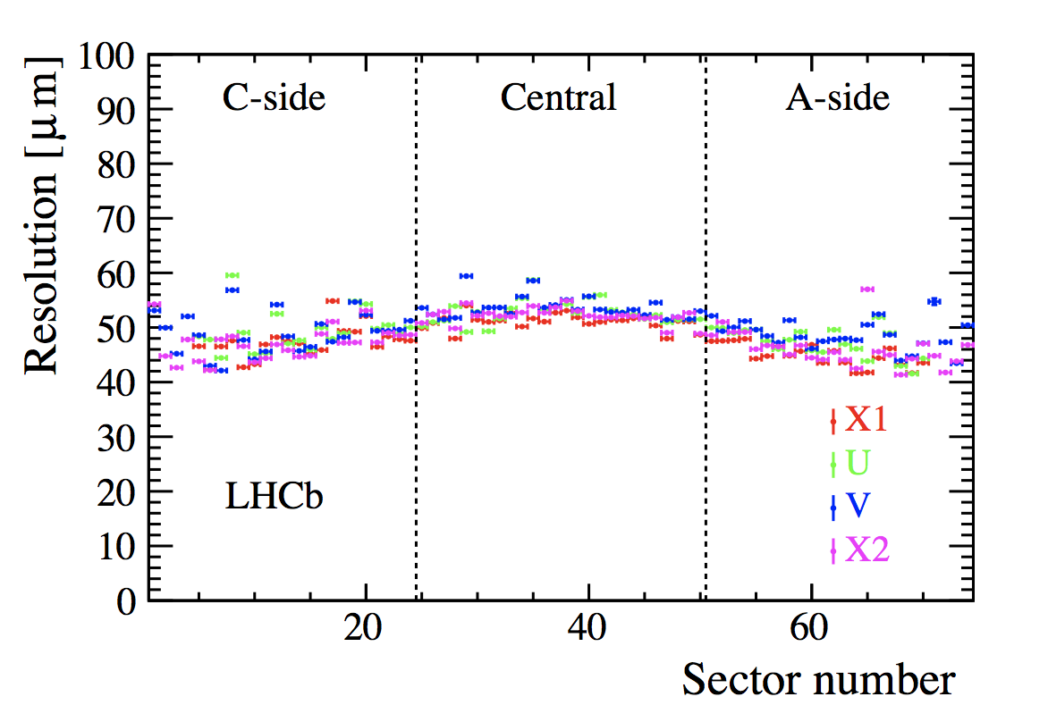
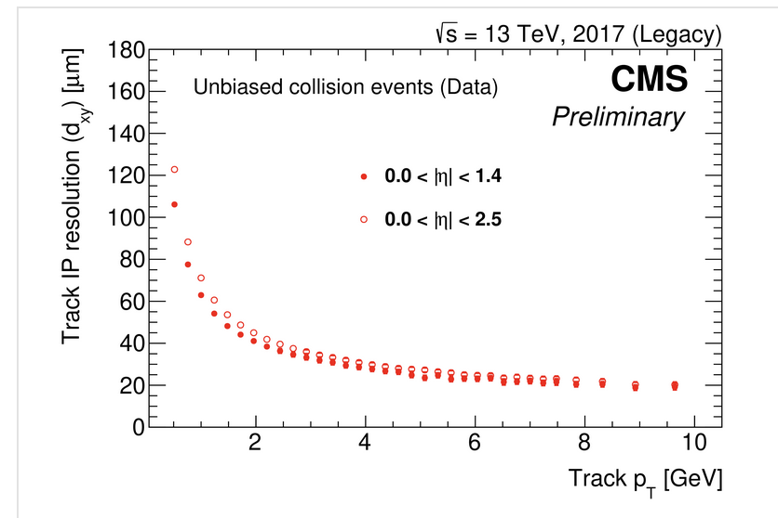
Tracker
Primary vertex LHCb
Tracker CMS

Slide 4
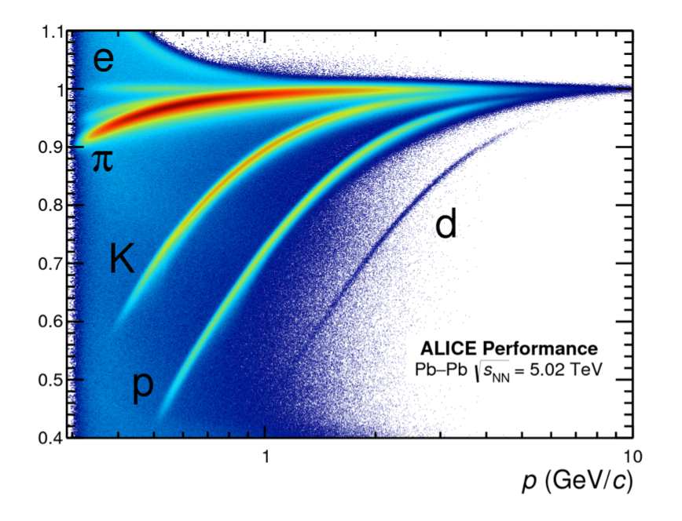
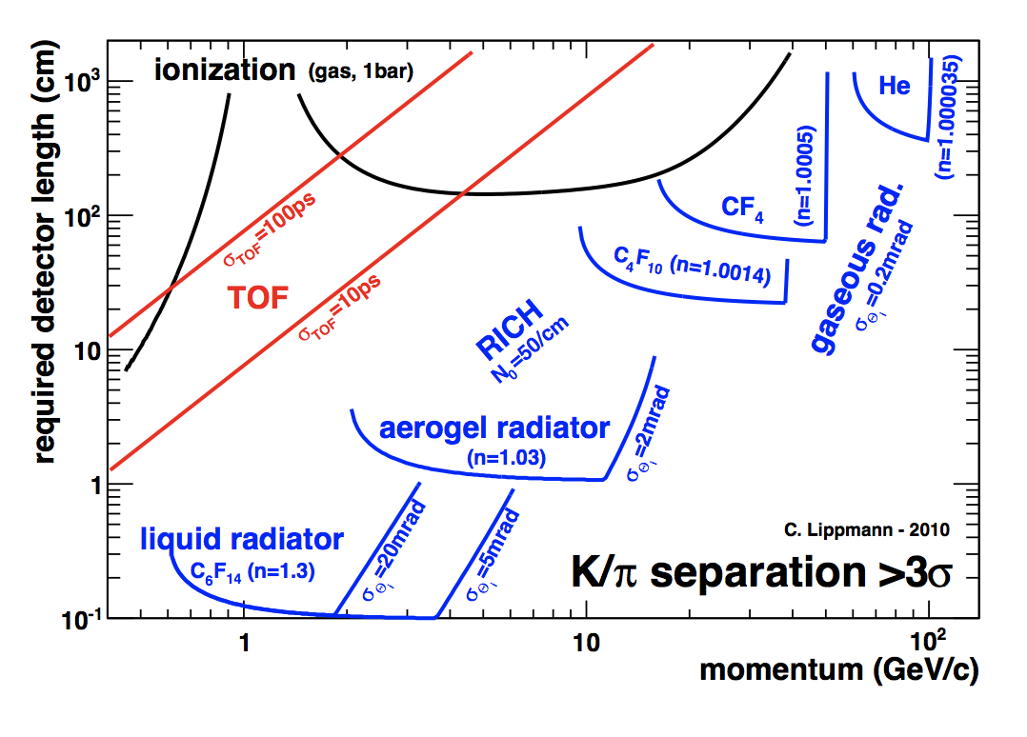
PID
ALICE TOF
Tracker CMS

Slide 5
Detector requirements
If you have a requirement
How does it compare to existing detectors
Explain the requirements – is the measurement possible or not at all? What will happen if one varies detector parameters
Is it a requirement or it will lead to improvement – better statistics.

Slide 6
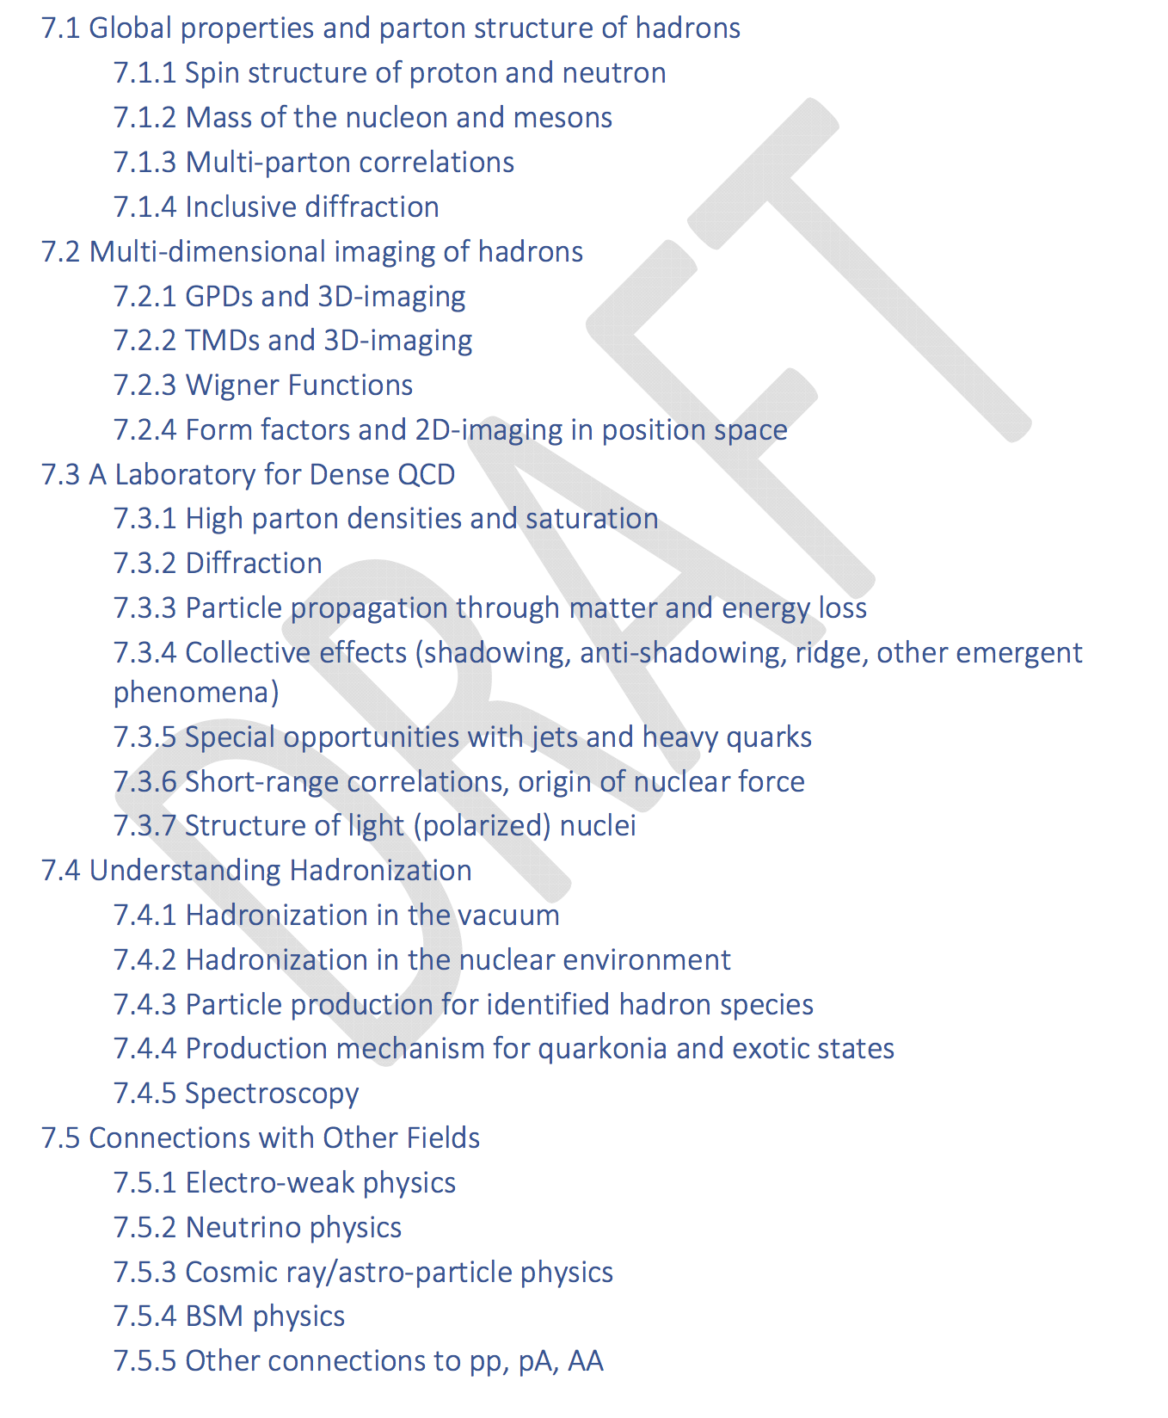
YR Outline
Outline exists on the YR website
Specifically, for Sec. 7 we solicit feedback on the following questions:
Do you have comments on the naming of the sections and/or subsections?
List the subsections for which your WG will have contributions.
Is there a need to add more subsections?

Slide 7
Snowmass 2021
Google doc
https://docs.google.com/document/d/1LAYICzGNUFLzwKTN4llo8-E5oe8rfKwwDBP-JwmvTno/edit#heading=h.no8ocmk6elgx
To explore physics opportunities at the Electron Ion Collider (EIC), co-organized by the Snowmass 2021 Energy Frontier Topical Groups 05, 06, and 07.
Electroweak and Beyond the Standard Model studies at the EIC
Proton tomography at the EIC for HEP applications
Jets at the EIC
Heavy flavors at the EIC
Gluon saturation at the EIC
Huey-Wen, Christophe, Pavel, Yen-Jie, Swagato
Conveners of the Snowmass EF06 and EF07 Topical Groups

