Slide 1
PID Bi-weekly Intro
TK Hemmick P Rossi

Slide 2
Evolving Requests for Deliverables from PID
Talk today by Miguel Arratia (coming up next).
Talk on Monday from Ralf Seidl (Semi-Inclusive PWG)
Request for input from Complementarity Group.
Request for input from Integration Group.
Briefly Summarized Here

Slide 3
How Requirements Determined:
Yields @ 10 fb⁻¹: 1 < Q² < 10
High $\sqrt{s}$
Low $\sqrt{s}$
Yield plots vs:
Beam Energy ($\sqrt{s}$)
Event Kine (Q²)
FWD PID tough when:
Large $\sqrt{s}$
High Q²
Notes:
Q² > 1000 = Low Stats
Yields @ 10 fb⁻¹: 100 < Q² < 1000
High $\sqrt{s}$
Low $\sqrt{s}$

Slide 4
SIDIS Request Update (R Seidl)

Slide 5
Key Questions from Complementarity Group
What is your current baseline thinking?
How might a second detector differ in technology choices and what (dis)advantages might that bring in terms of kinematic coverage, resolution on reconstructed variables, radiation hardness, dominating systematics etc?
Are there wider implications for other parts of the detector (e.g. due to material budgets)?
Would the complementary designs naturally be associated with different choices of solenoid field, center of mass energy, luminosity or beam polarization?
Are there any limitations in the performance of your sub detector technologies for very small bunch spacing < 9ns
Are there any rate limitations?
Is +/- 4.5 m enough longitudinal space to fit the detector
Are there any issues we should be aware of in terms of cost, technology readiness, or time required to construct the detector?
Might it be possible to combine more than one function into your detector(s)?
Do your detector technologies have any impact on the design of the interaction region?
What studies need to be done (or have been done already) to make fully quantitative statements?

Slide 6
Key Questions from Integration Group
Cabling
Services
Anticipated patch panel location, and splitting “philosophy”
Suggested detector segmentation
Support structure
Mounting (insertion) scheme and interface
Alignment scheme and associated requirements (marks visibility, etc.)
Weight per unit
Unit dimensions, driven by technology (e.g. EmCal tower length, GEM module thickness), preferably broken down into active, frame, readout, integrated support parts
Maintenance scheme, access needs
Power line requirements (UPS, clean, utility, other)
Cooling scheme and requirements (if applicable): air/gas, CW, LCW
Ambient temperature requirements
Anything on vibration tolerance, frequency spectrum, etc?

Slide 7
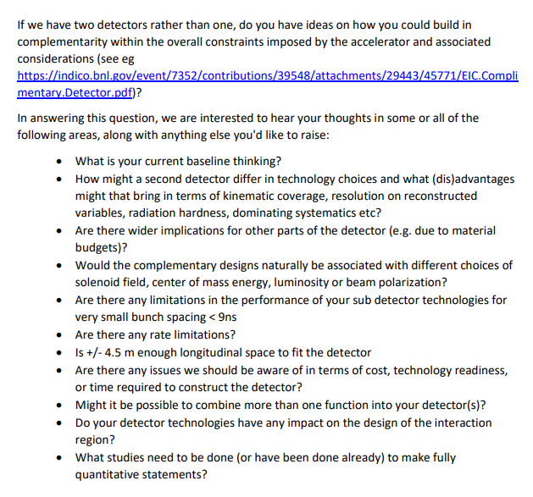
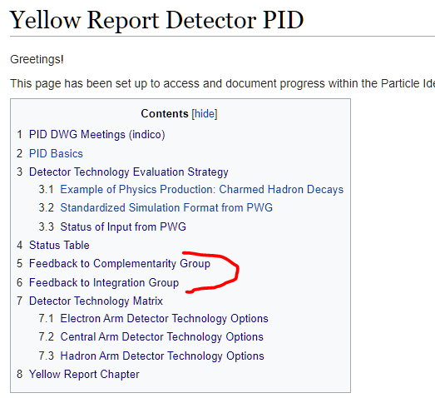
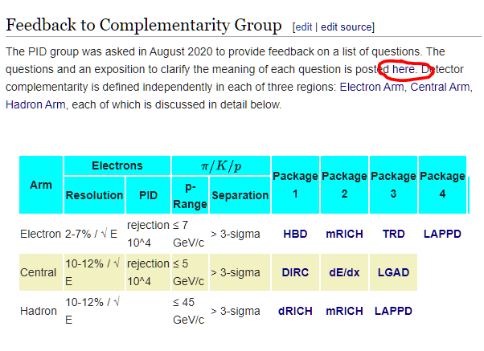
Feedback Mechanism: PID Wiki
Edit the Source.
Replace EVERY line:
An answer
An excuse
N/A
Due dates:
Complementarity on Tuesday
Integration on Friday

Slide 8
Plans for feedback
Wednesday Complementarity Meeting next week:
Present status of wiki exercise.
Your input by noon Tuesday.
Out slides as quickly as we can.
Next Integration Meeting:
Present status of wiki exercise.
Your input by noon Tuesday.
Out slides as quickly as we can.

