Slide 1

Kolja Kauder
Recent and upcoming
Changes to Eic-Smear
Now with Forward Detectors and more PID
BNL EIC Group Meeting
August 20, 2020

Slide 2
0. Location
setenv EIC_LEVEL dev
source /cvmfs/eic.opensciencegrid.org/x8664_sl7/MCEG/releases/etc/eic_cshrc.csh
# or for bash
export EIC_LEVEL=dev
source /cvmfs/eic.opensciencegrid.org/x8664_sl7/MCEG/releases/etc/eic_bash.sh
Moved from afs to cvmfs - identically the same as in Singularity
  … and would like to archive and retire afs!
Can still install locally from github: eic-smear, eicsmeardetectors
  Test files and examples now in the separate detector package
  A local version of the detectors makes sense if you want to modify them yourself
EIC2020b == dev now also includes PYTHIA8.3 and soon(?) HERWIG
https://github.com/kkauder/P8hepmc

Slide 3
1. Accepted generators
HERA era generators
BeAGLE
HepMC2 or HepMC3 data
(tested for PYTHIA8)
all of the above, gzipped
(factor ~6 compression)
PYTHIA6
DPMJet
PEPSI
gmc_trans
Djangoh
Milou
Rapgap
BeAGLE
Any HepMC
Generator example:
https://gitlab.com/eic/mceg
$ pythiaeRHIC < ep_hiQ2.20x250.small.txt.gz > log.txt
obtain input card from expert / PWG consensus
logfile needed for x-section information – not for HepMC

Slide 4
2. Interactive use
Automatic loading of libraries and version information now with a nifty new wrapper eic-smear
$ eic-smear
Using eic-smear version: 1.1.1
Using these eic-smear libraries :
/Users/kkauder/software/lib/libeicsmear.dylib
/Users/kkauder/software/lib/libeicsmeardetectors.dylib
eic-smear [0] BuildTree("pythia.txt",".", -1, "log.txt")
Load as usual, or with a convenient shortcut function
eic-smear [1] .L SmearMatrixDetector_0_1.cxx
eic-smear [2] auto d = BuildMatrixDetector_0_1();
# or
eic-smear [1] auto d = BuildByName("matrix")
All in one directly from the shell:
$ echo 'SmearTree(BuildByName("matrix"), "pythia.root")' | eic-smear

Slide 5
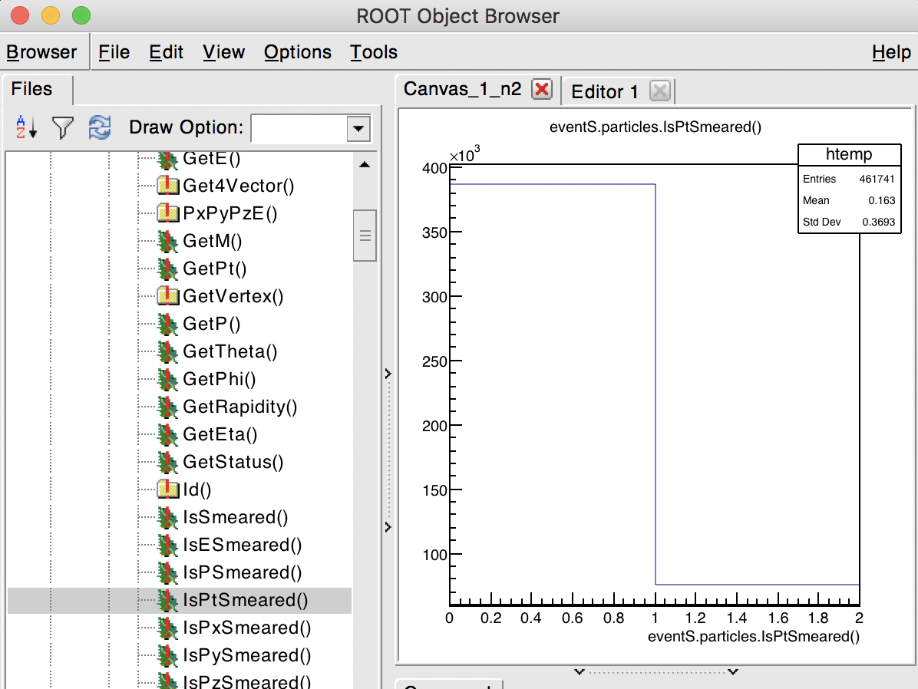
3. New flags - no more if(p!=0)
eic-smear [0] TFile s ("smeared.root")
eic-smear [1] new TBrowser
Smeared property is stored if final and in acceptance
0 can mean smeared to 0 or not measured – check flags

Slide 6
4. Changing or adding to the scripts
Install your own version, instructions at eicsmeardetectors
copy or modify – add to eicsmeardetectors.hh
  optional: BuildByName.cxx and cint/LinkDef.h
make again!
Important: Add the path which contains your libeicsmeardetectors to the front of LD_LIBRARY_PATH (or DYLD_LIBRARY_PATH on a Mac)
bash $ export LD_LIBRARY_PATH=my/path:$LD_LIBRARY_PATH
macbash $ export DYLD_LIBRARY_PATH=my/path:$DYLD_LIBRARY_PATH
tcsh $ setenv LD_LIBRARY_PATH my/path:$LD_LIBRARY_PATH
eic-smear will show that you're doing it right
$ eic-smear
/Users/kkauder/software/lib/libeicsmear.dylib
/Users/kkauder/eicdev/eicsmeardetectors/build/libeicsmeardetectors.dylib

Slide 7
5. Consistency
Now enforced:
Any measured particle must have zero or exactly three momentum components
If only E is measured (no tracker), still require phi, theta
No acceptance clashes allowed – we use the flags to check for double-smearing
For older scripts, can turn this off: det.SetLegacyMode();
  But one shouldn't use those anymore – update if needed
With that, we can turn back on p_{T}, p_{z},… smearing
→ JLEIC and Far Forward detectors are now included

Slide 8
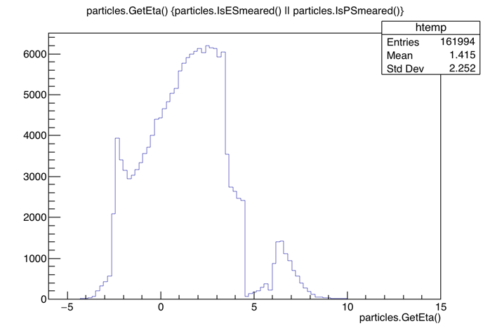
6. Far forward support
In SmearMatrixDetector_0_1_FF.cxx, added (rough) parameterization and acceptance from https://wiki.bnl.gov/eicug/index.php/Yellow_Report_Detector_Forward-IR
Alex is better suited to speak to the consistency checks ☺, but we can run it right now and look together at the output
$ echo 'SmearTree(BuildByName("matrixff",275), "ep_hiQ2.20x250.small.root")' | eic-smear
$ eic-smear ep_hiQ2.20x250.small.smear.root
eic-smear [] Smeared->Draw("particles.GetEta()", "particles.IsESmeared() || particles.IsPSmeared()")

Slide 9
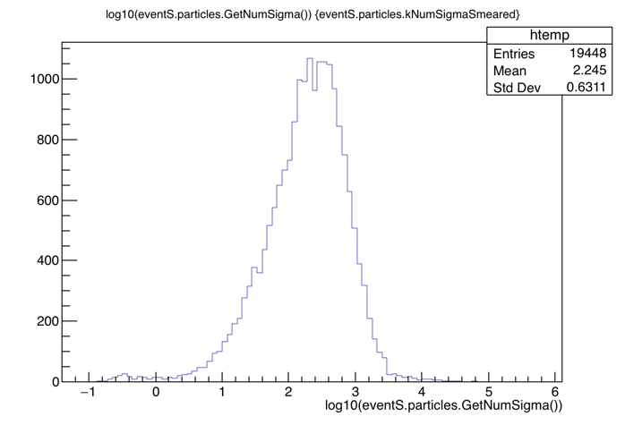
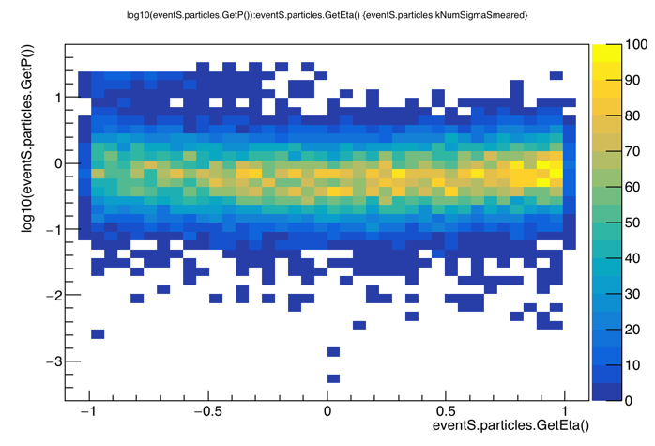
7. Support for TOFs and RICHes
Added new NumSigmaPid class to eic-smar, based on https://gitlab.com/preghenella/pid
In SmearMatrixDetector_0_1_TOF.cxx, added tofBarrel
This is a "technology preview", still qa'ing, improving, talking with PID group
Some questions:
Interface isn't completely identical in the repo
Currently using truth P. I believe I should be using smeared P? What about eta? How does this interact with acceptance, shouldn't that method select on truth and then the smearing be done on smeared values?
How does the smearer actually use the truth PID?
Side note: Another group is working on matrix PID

Slide 10
Soon: Granularity
Hoped for this to be "8. Granularity" – just a few more hours…
Idea: Rectangular tile centered on the truth and smearing uniformly
  Is that sound? Some mock Gaussian smearing is actually mathematically harder and doesn't seem all that physical to me
Discussion item:
What to do when Calo and Tracker deliver phi, theta? Currently only one is assumed, and when available the tracker is used.
Could keep separate CalPhi, CalEta fields? But where does that end?

Slide 11
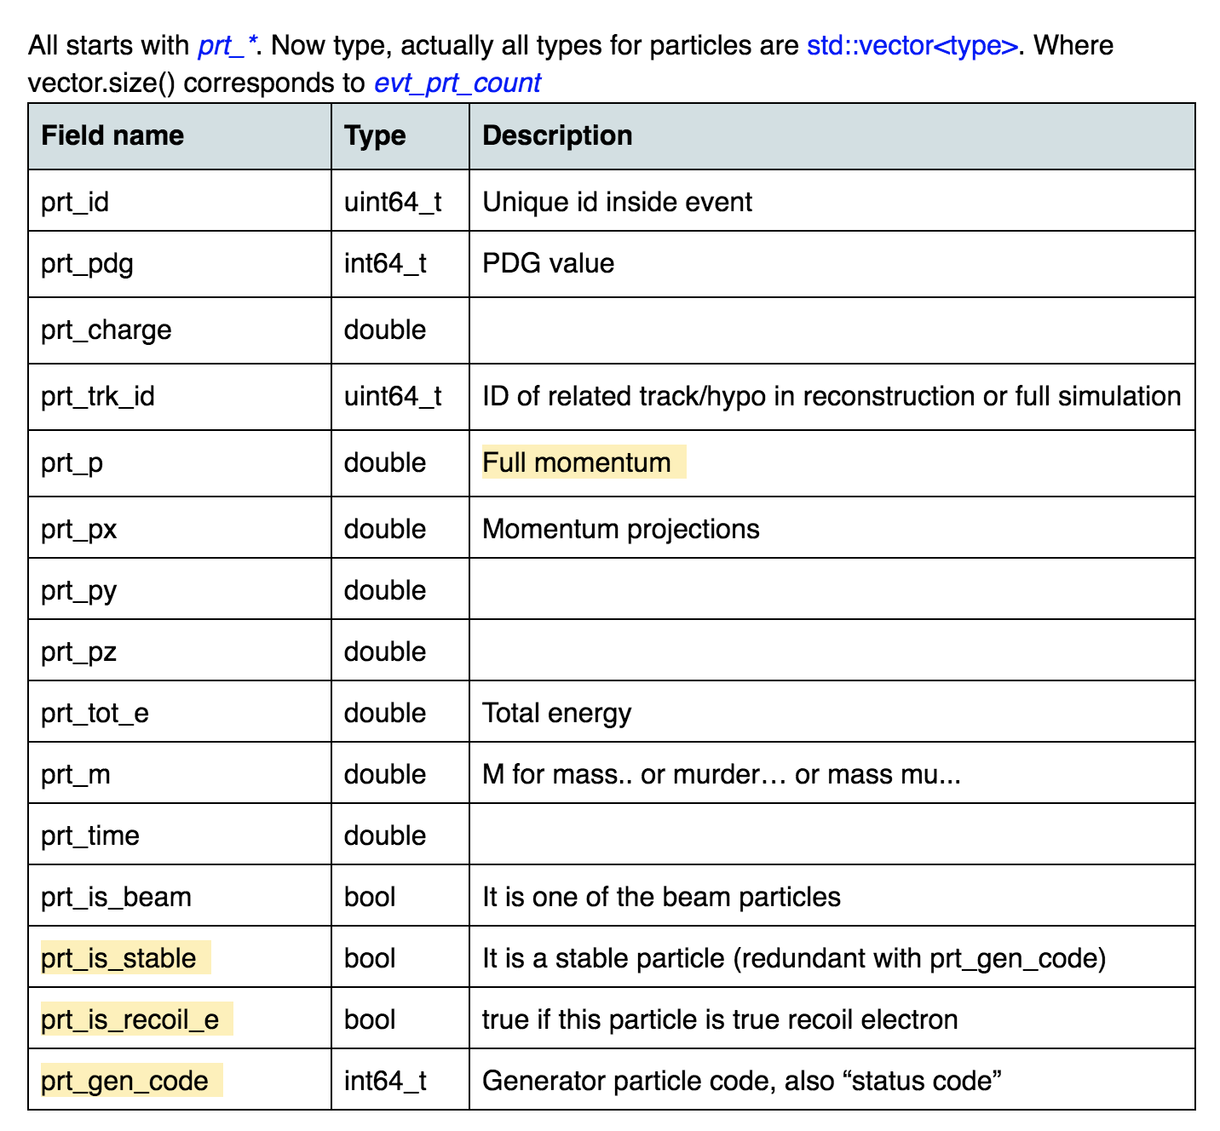
Soon: Common output format
This will be additional to the existing one! Aim is to unify frameworks, QA, …
and eic-smear is the natural starting point
Consensus is flat Plain Old Data (Zeus experience)
A 13+ page google doc discussion exists,
covering such riveting issues as use of NaN,
virtues and vices of TLorentzVector,
RDataFrames, and the still open question of
meta data
In the process of being written up
- meanwhile I have enough to start
implementing it in parallel
Very valuable for validation

Slide 12
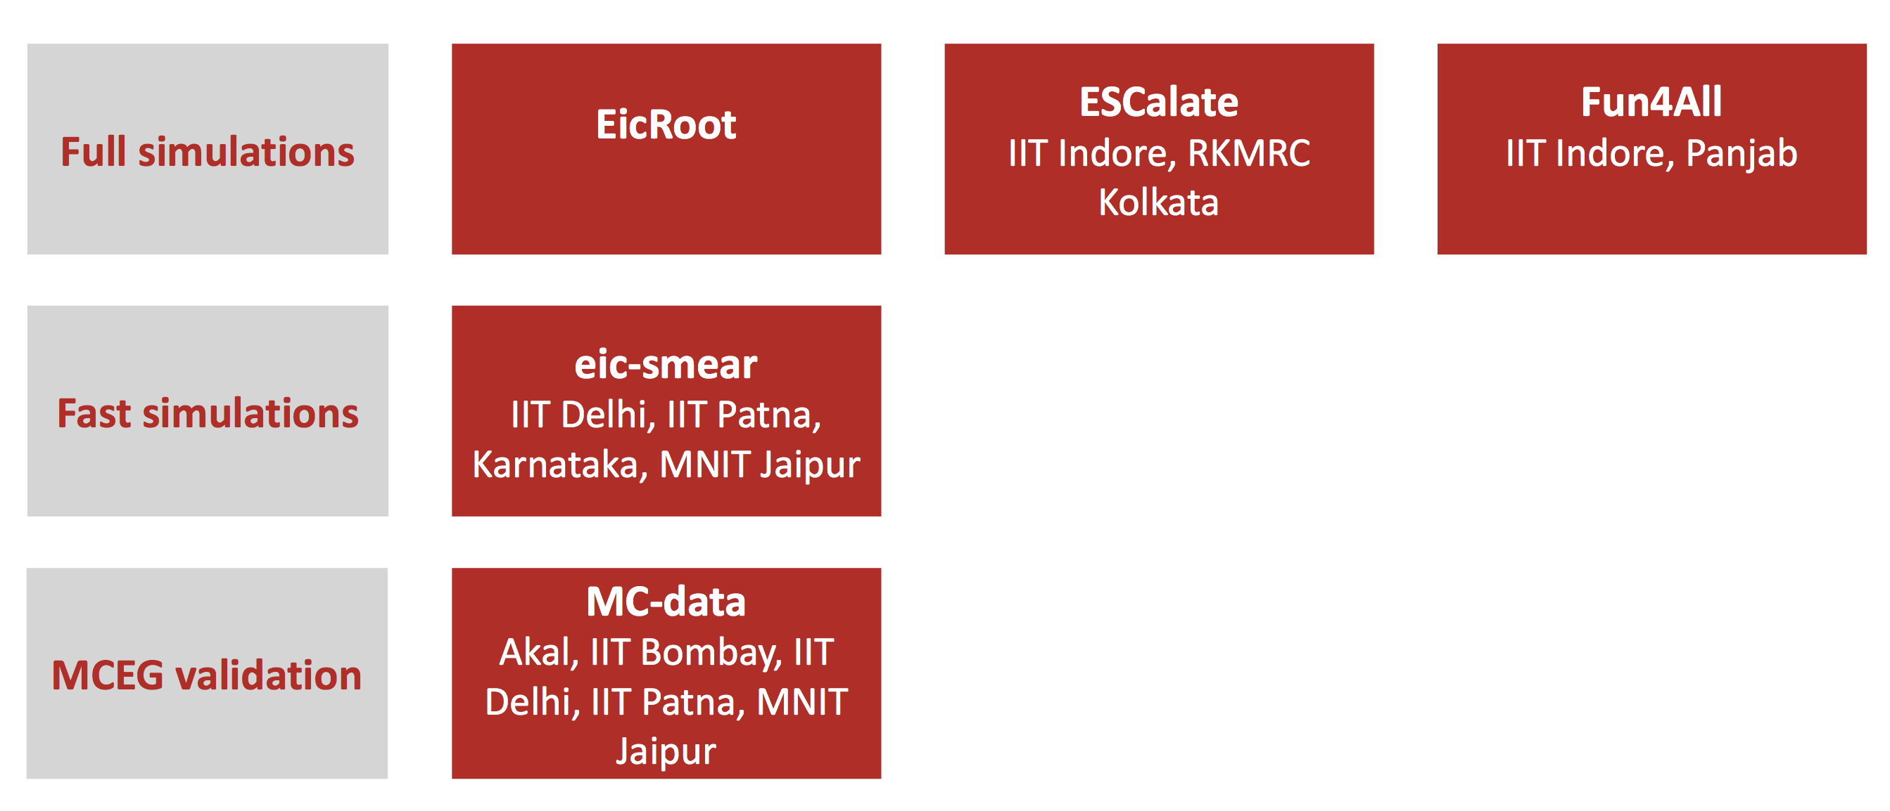
Soon: Validation efforts
Abhay was called upon to search for a helper for eic-smear validation – and delivered eight groups from India with 28+ people joining the last meeting
→ many unforeseen opportunities! And a challenge to keep everyone busy ☺
My tentative eic-smear plan:
Automated tests. For the more computationally minded
P{hysics, people, and coordination: establish concise suite of plots with working groups and the other "rectangles"
Geant vs fast simulation. Could even lead to new and better parameterizations
PID-focused combination of 2-3

Slide 13
Resources
All hosted at github.com/eic
Use issue tracker for bugs & requests!
Slack channel: eicug.slack.com/#software-support
Mailing list: eicug-software@eicug.org, eic-bnl-soft-l@lists.bnl.gov
Contact: kkauder@bnl.gov
Online users’ guide:
wiki.bnl.gov/eic/index.php/Eic-smear
Class documentation (temporary location):
www4.rcf.bnl.gov/~eickolja/

Slide 14
BACKUP

Slide 15
Compilation
$ g++ `root-config --cflags` \
`root-config --libs` \
-I<…>/include -L<…>/lib -leicsmear -leicsmeardetectors
Examples:
test/qaplots.cxx in eicsmeardetectors is written to demonstrate how to match and analyze
  also can be used as a demonstration of cmake
https://github.com/eic/eicsmear-jetexample is an example using just a plain makefile, no cmake needed.

