Slide 1
Detector Requirements from Diffractive and Tagging Working Group
Anna Stasto, Douglas Higinbotham, Or Hen
Spencer Klein, and Wim Cosyn

Slide 2
Vector Meson Production
Contact: Spencer Klein, Sam Heppelmann
Detection of 300 MeV pions from rho decay at pseudo-rapidity |eta|= 5
Resolution requirement on separation of three Upsilon states slides. Handbook resolutions ok.
Phi production requires detection of 135 MeV Kaons at mid rapidity.
Soft photons:
Detection of photons with ~50MeV for nuclear breakup (Far forward) slides, study is still in progress. Also of order 50 MeV proton detector for radiative decays in spectroscopy in the central region [needs detailed study, ballpark number for now]
It is clear that this will be challenging.

Slide 3
Detailed Studies of Meson Structure Functions Provided Requirements for four far forward detector regions.
Contact: Tanja Horn
https://indico.bnl.gov/event/9275/contributions/40865/attachments/30149/47098/Lambda_Aug27.pdf
Hcal: Resolution: 35%/√E (goal), <50%/√E (acceptable)*, 3mrad/√E (goal)
Hadron endcap calorimeter: Good resolution for x-resolution (large-x processes) also 35%/√E

Slide 5
Several other groups also checked performance of far forward region seeing reasonable results though with some holes in the acceptances..
Diffractive Deuteron Breakup (Z. “Kong” Tu)
https://arxiv.org/abs/2005.14706
Deuteron Quasi-Elastic Breakup (A. Jentsch)
https://wiki.bnl.gov/eicug/index.php/Yellow_Report_Physics_Diffractive_Reactions_-_Tagging#Deuteron_Spectator_Tagging_.28Diffractive_and_QE_processes.29
Medium & Heavy Nuclei QE & SRC Breakup (F. Hauenstein)
https://indico.bnl.gov/event/9067/contributions/40133/attachments/29733/46372/Hauenstein_taggedWG_072920.pdf
Elastic Scattering of Hydrogen and Deuterium (B. Schmookler)
https://wiki.bnl.gov/eicug/index.php/Yellow_Report_Physics_Diffractive_Reactions_-_Tagging#Elastic_ep_scattering

Slide 6
³He(e,e’(tagged pp))X Simulations
Contact: Dien Nugyen
Simulations using a modified CLAS12 generator as well as BeAGLE completed just before the Aug. 31 deadline
By tagging both protons, ³He could be used for a Bonus like measurement off a virtual free neutron (e.g. for F2n, GEN, etc.)
Preliminary results show it is very hard to detector two low momentum protons in the far forward region of the 1st IR
This might be an interesting reaction for tuning the properties of the 2nd IR to make it complimentary to the 1st.
Preliminary results do show that for larger initial-state pp momentums (a pp-SRC pair) the proton can be detected.
Simulations have been provided to Alex Jentsch for further study.

Slide 7
Preliminary Results That Still Need Further Study
Coherent 4He scattering
Contact: Mark Strikman
x_Pomeron < 0.01 (scattered ⁴He up to 99% beam momentum)
t-range from as small as possible (with good resolution) up to 0.6 GeV²
pT from 0 to 700 MeV.
Still needs detailed studies
Inclusive diffraction
Contact: Wojtek Slominski
forthcoming (studies well underway, results expected within a week)
Diffractive Jets
Distinguishing diffractive jets from non-diffractive ones requires good charged and neutral coverage over the whole rapidity range with as few holes as possible.
Detailed studies still needed

Slide 8
Acknowledgement
Many thanks for Yulia Furletova & Dmitry Romanov for studies with g4e and Alexander Jentsch for studies with EICROOT for all their help with simulations studies.
Further Details on the Diffractive and Tagging Wiki Page:
https://wiki.bnl.gov/eicug/index.php/Yellow_Report_Physics_Diffractive_Reactions_-_Tagging#Meson_Structure

Slide 9
Backup Slides

Slide 10
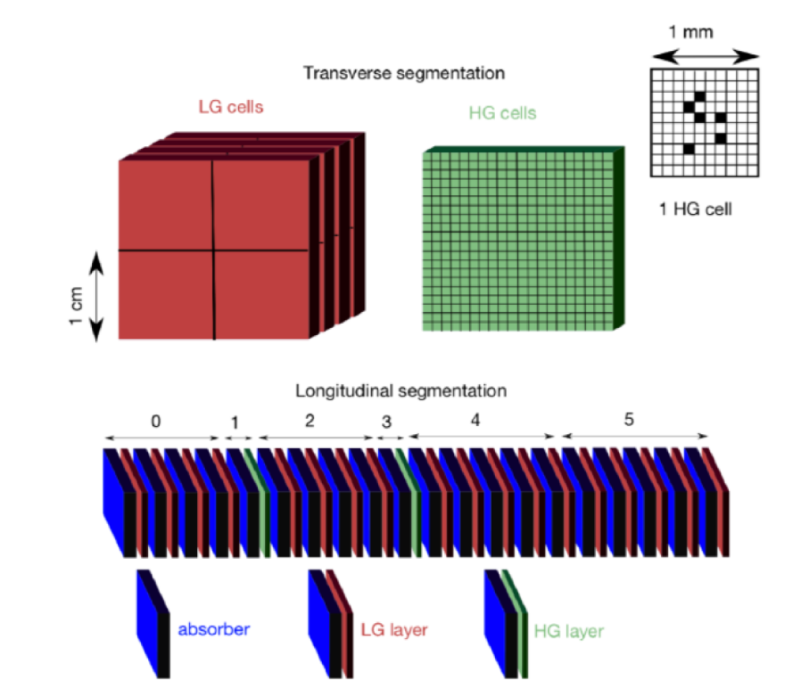
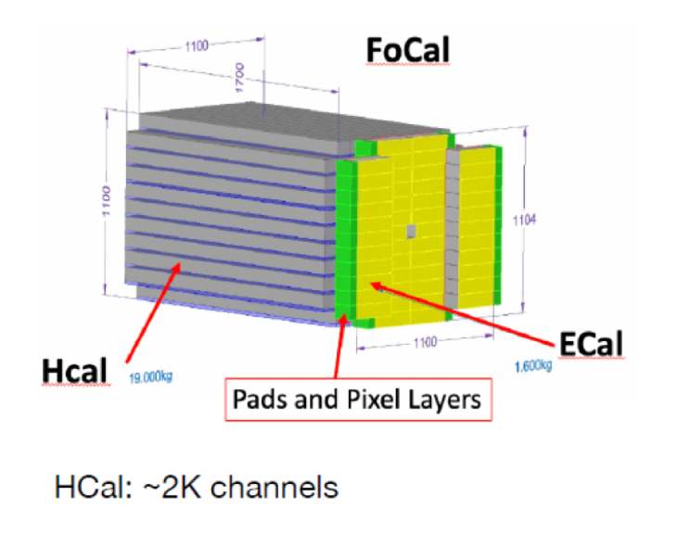
Zero Degree Calorimeter (ZDC) Concept
Contact: Y. Goto

