Slide 1
The CERN Neutrino Platform
20th October2014
Marzio Nessi, CERN & University of Geneva

Slide 2
CERN Neutrino Platform
CERN Neutrino Platform
Investigate new programs (mu storage ring, betabeams ?, …)
Logistics +
Test Beams Infrastructure (EHN1 ext)
Neutrino detectors R&D :
prototypes, components, final assemblies
Design and eventually implement a Neutrino Beam
EU participation in a High Intensity Facility & SBL
(detectors, beam, infrastr.)
PHYSICS (Short and Long Baselines)

Slide 3
Projects presently under consideration
WA104 ICARUS detector overhauling
WA105 construction and test of 2 large prototypes/demonstrators
WA104 NESSiE R&D and test of a new generation of muon spectrometers
Baby MIND : demonstrator and test of a new muon tracking detector (LBNO, ND-HKK?)
LBNF test of a TPC module
ArgonCube : prototypes of a new generation of highly modular TPCs
HKK : R&D and test of detector components (EU)
Construction and test of a new magnetized TPC (future ND ?)
Generic cryogenics support to various detectors (new cryo group at CERN)
Participation in the design and construction of LAR1-ND cryostat and cryo plant

Slide 4
A few examples !!

Slide 5
WA104 : ICARUS detector overhauling ICARUS Collaboration with INFN and CERN help
Move the detector from the GS Laboratory to CERN (2014)
Prepare at CERN all the necessary infrastructure (clean rooms, cryogenics, …)
Reshape the detector with new components
Construct a new generation of cryostats
Reshape, maintain and modernize the cryo plant
Reassemble the 2 T300 detectors inside their cryostats
Construct a new outer vessel
Make it ready for shipment to FNAL

Slide 6
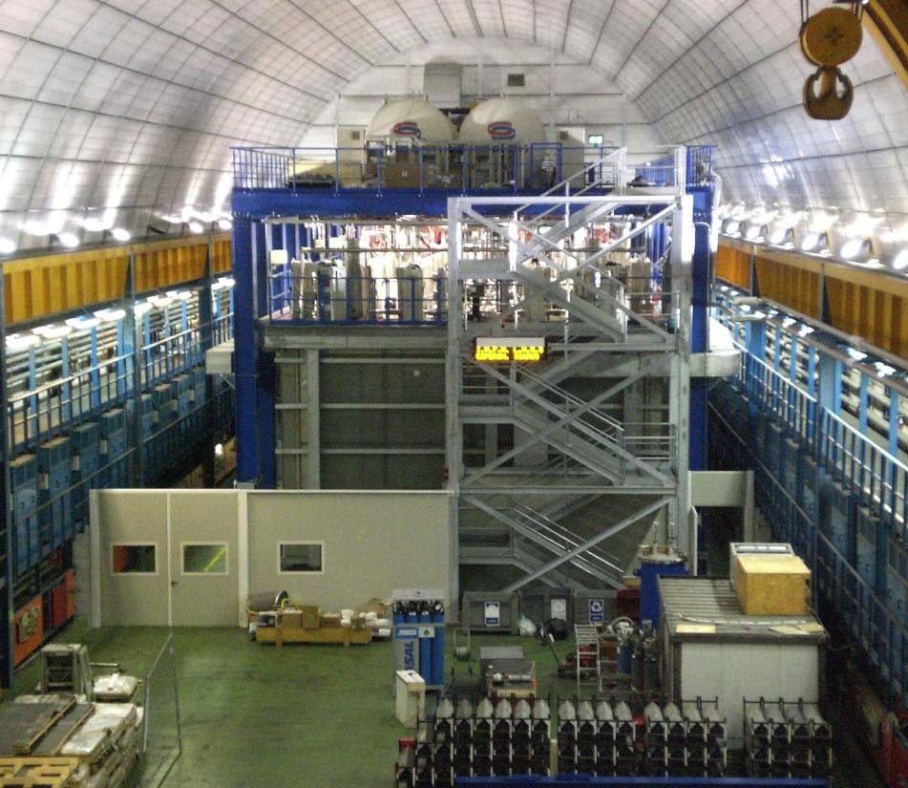
ICARUS Detector at Gran Sasso being dismantled and moved to CERN

Slide 7
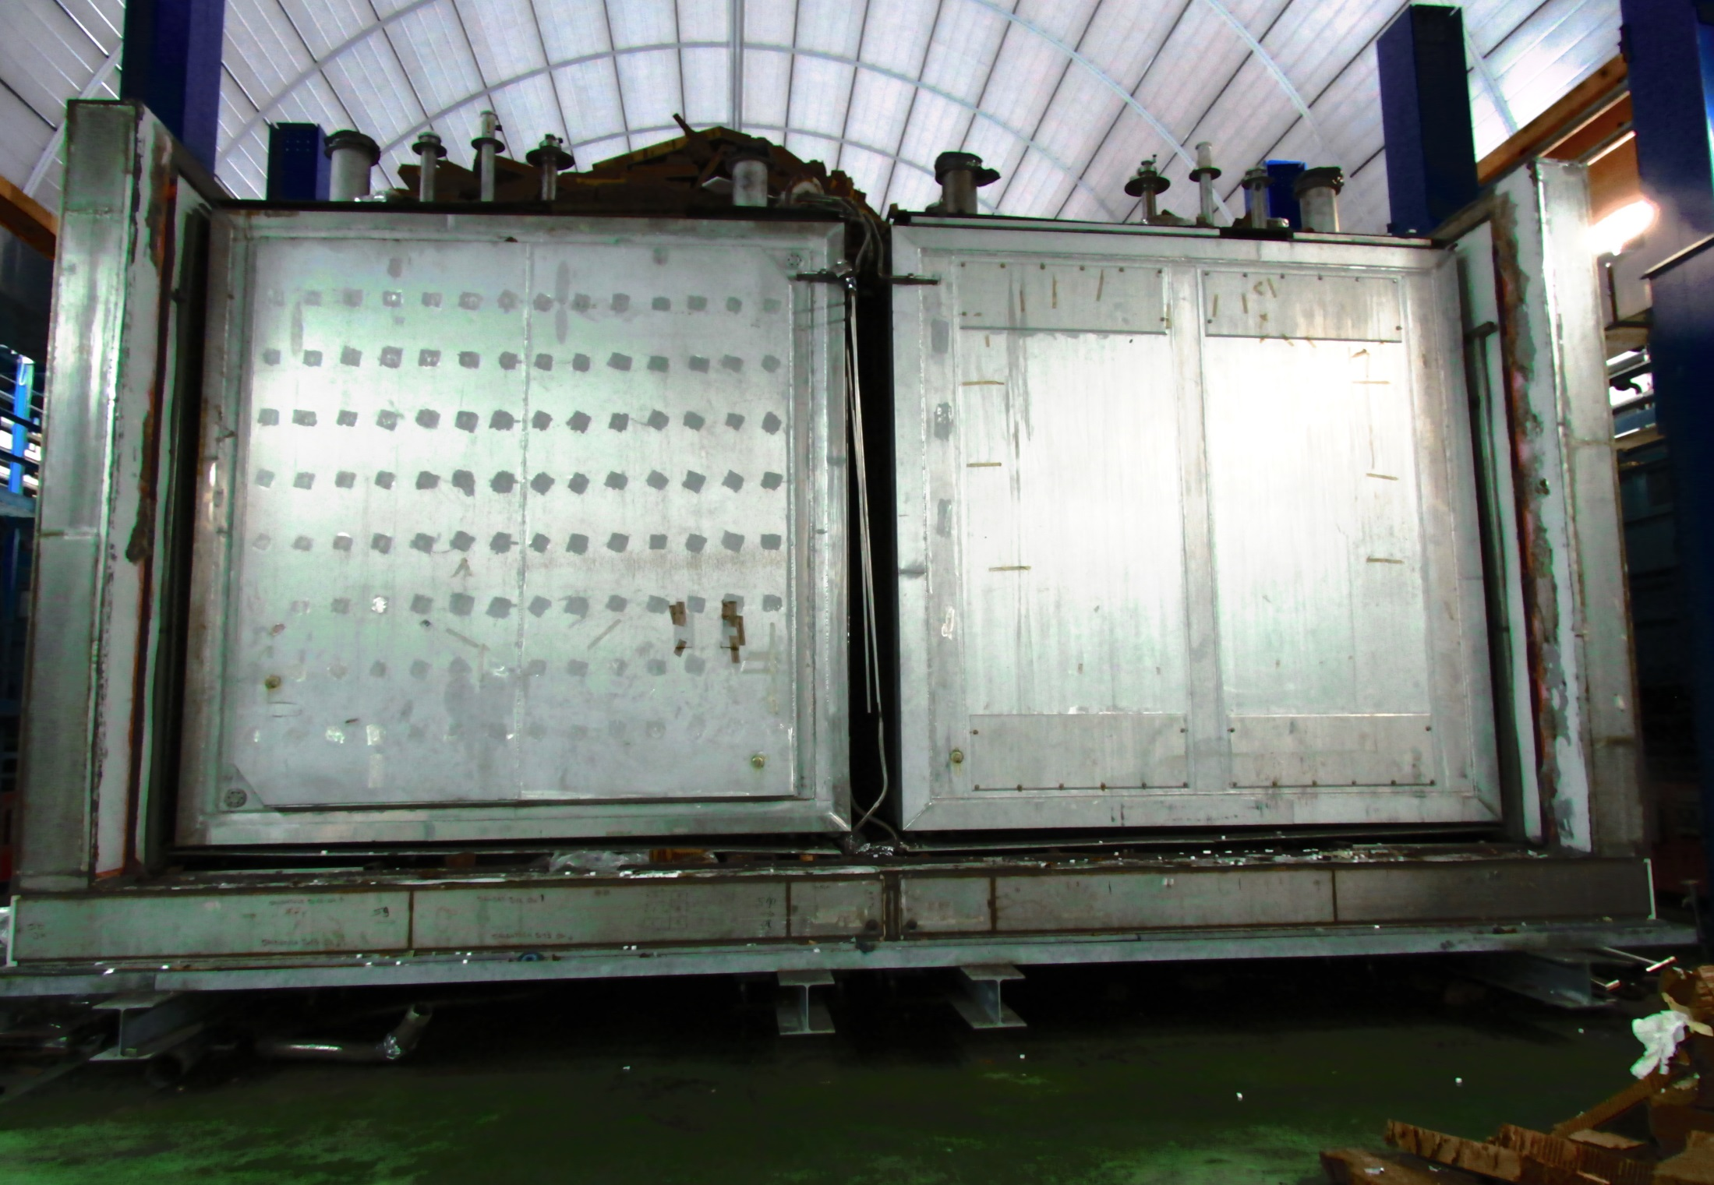
From 19 September

Slide 8
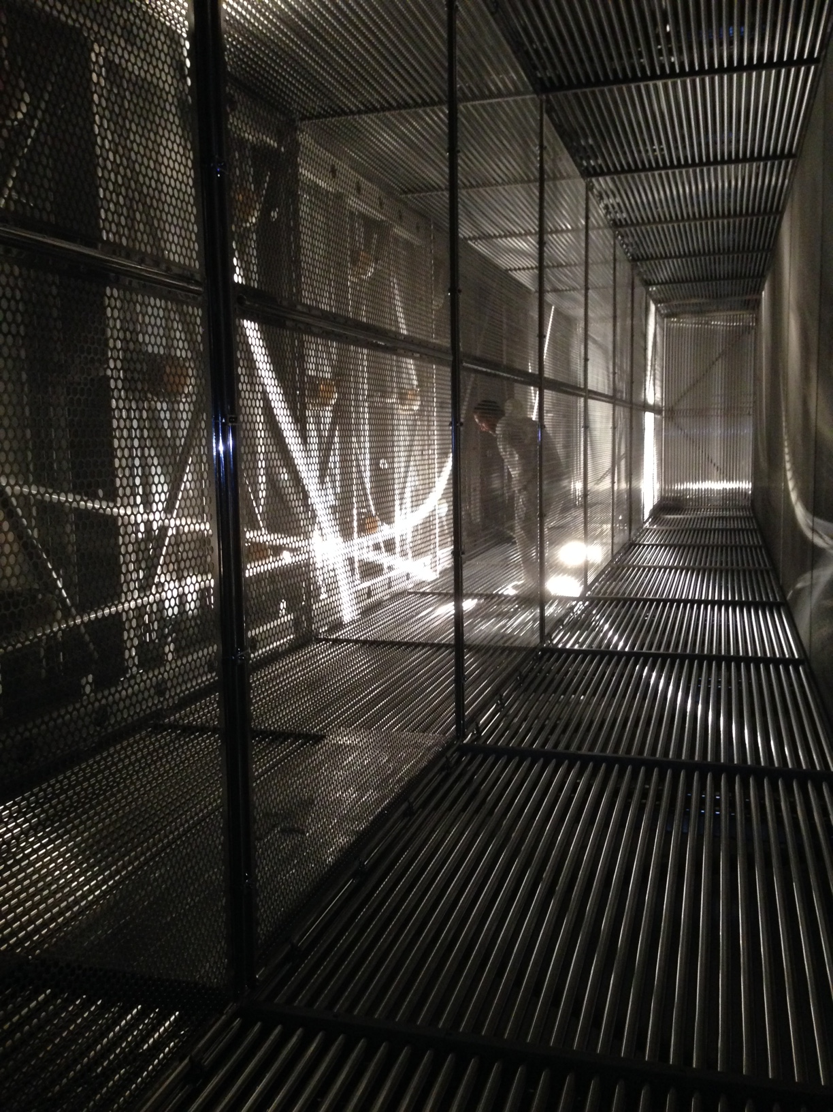
ICARUS Detector at Gran Sasso being dismantled and moved to CERN

Slide 9
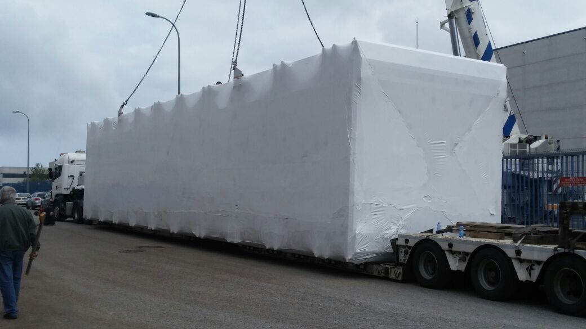
Ready to start

Slide 10
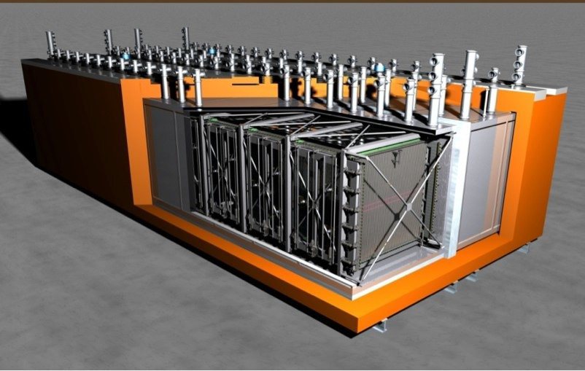
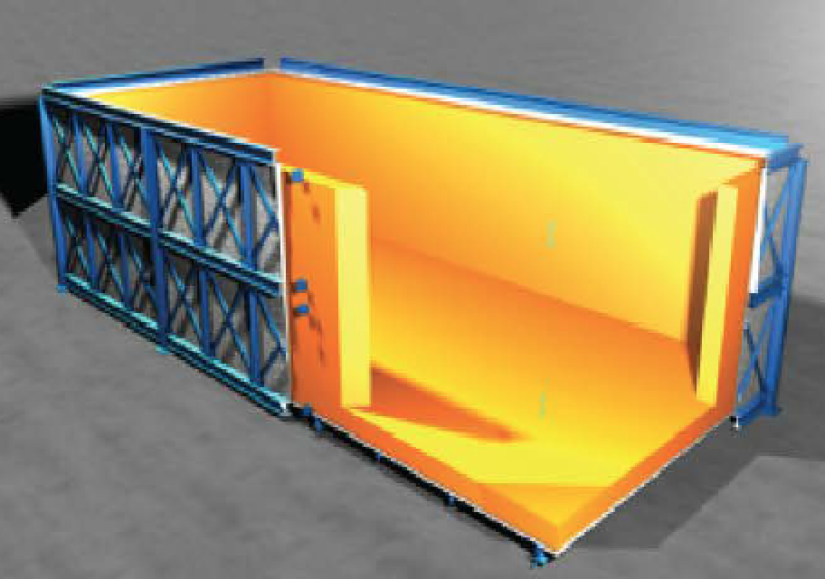
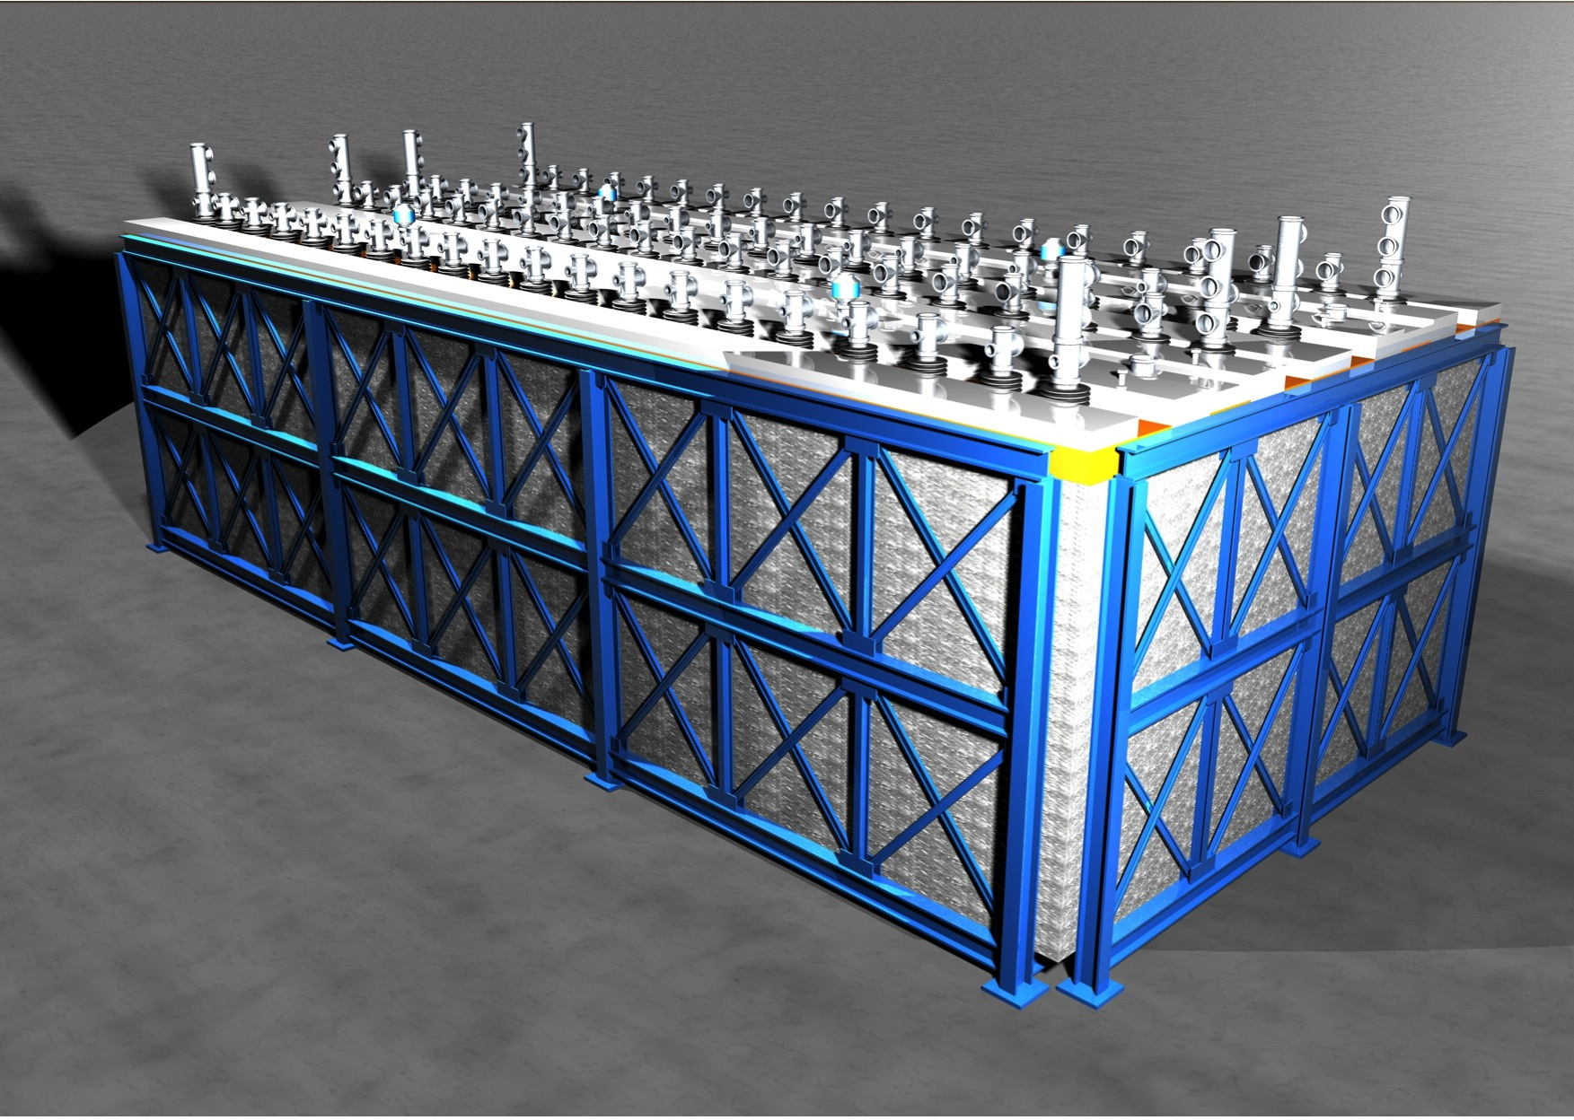
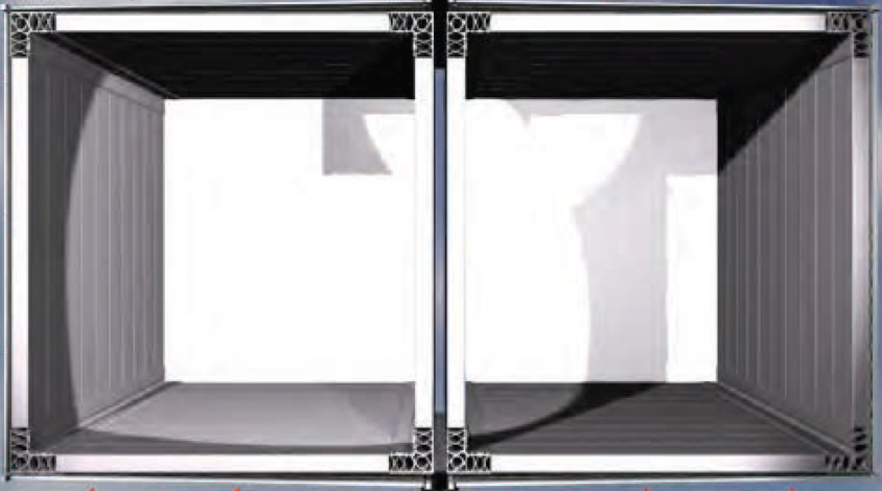
ICARUS detector overhauling

Slide 11
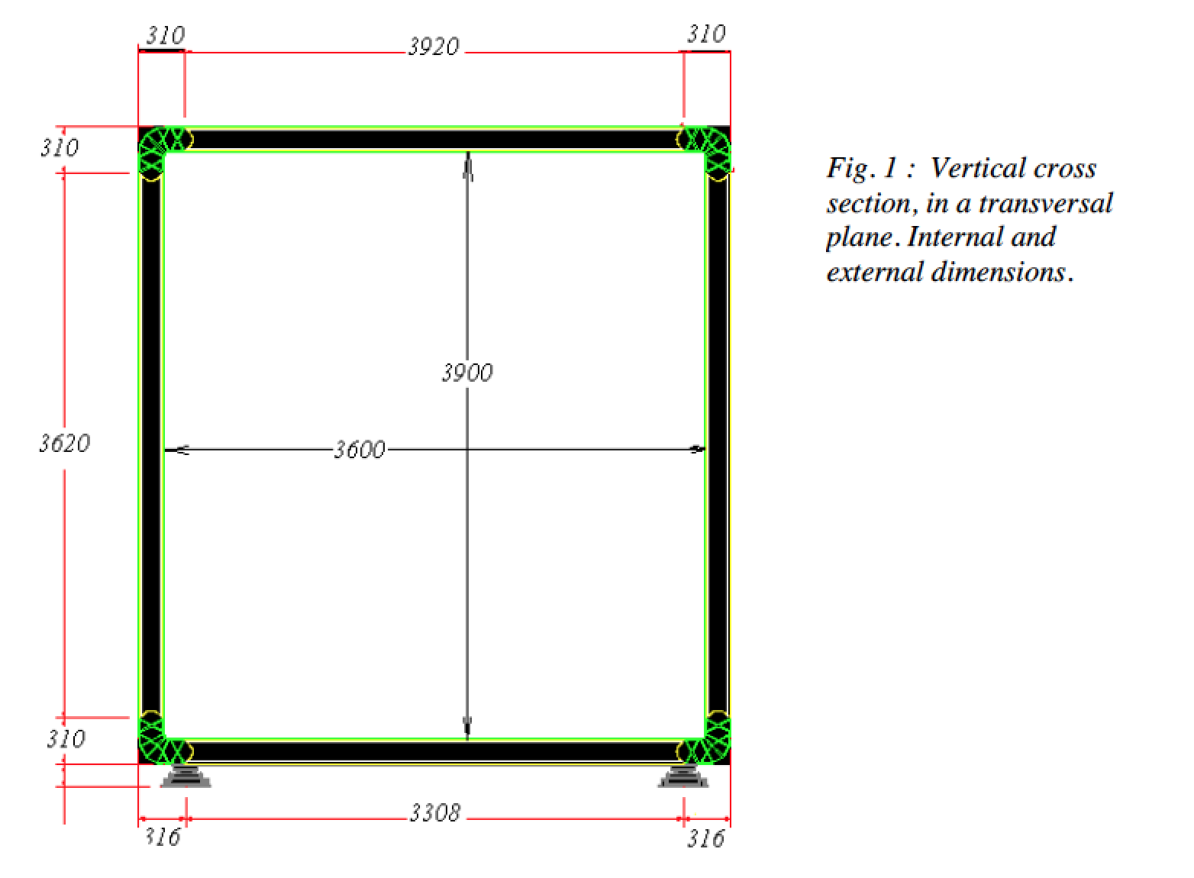
To be constructed : two cold vessels with these dimensions

Slide 12
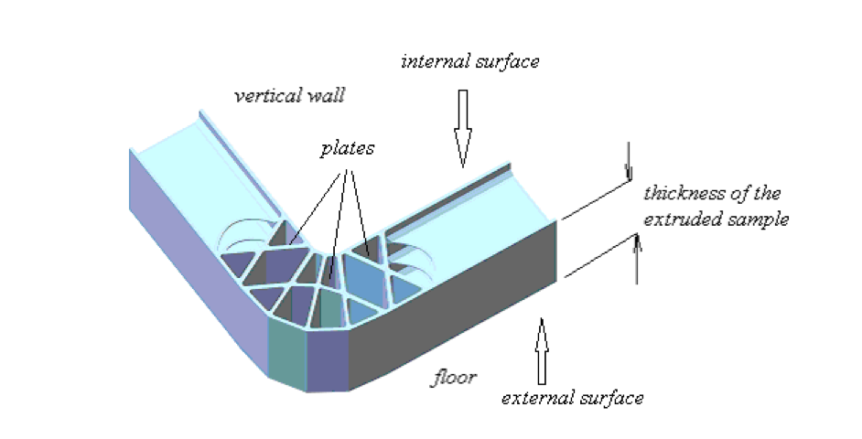
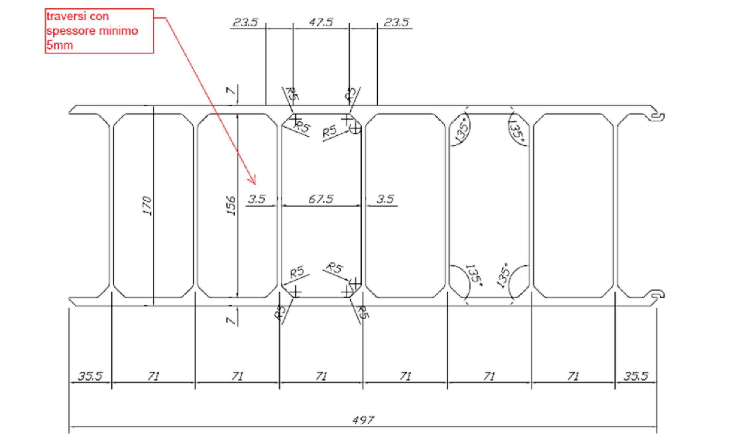

Slide 13
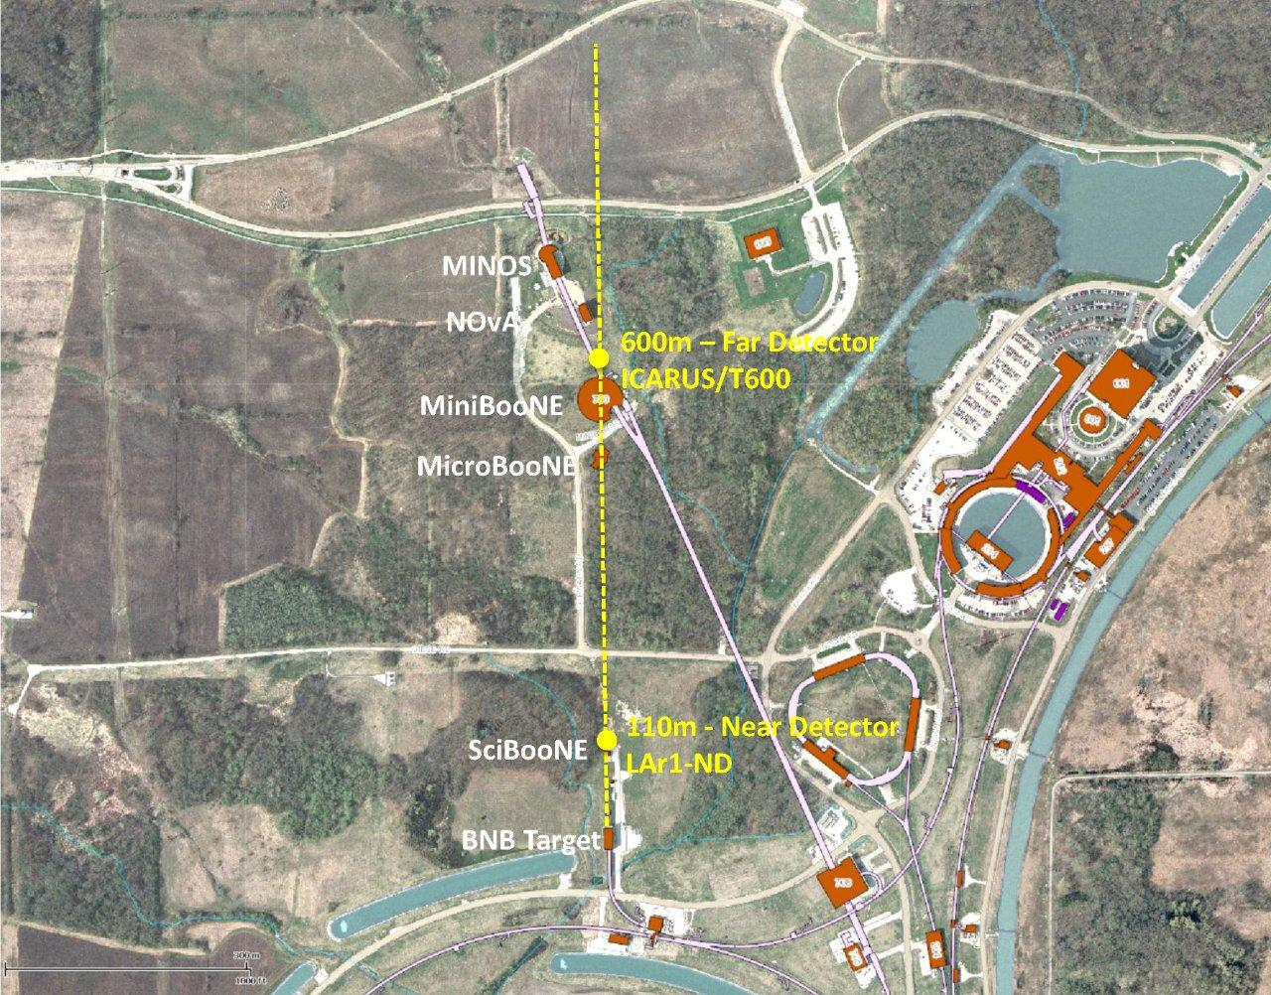
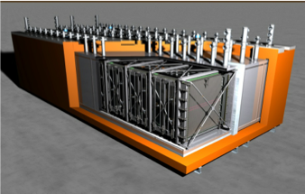
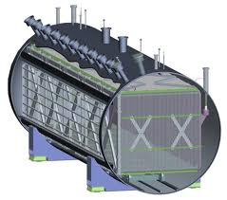
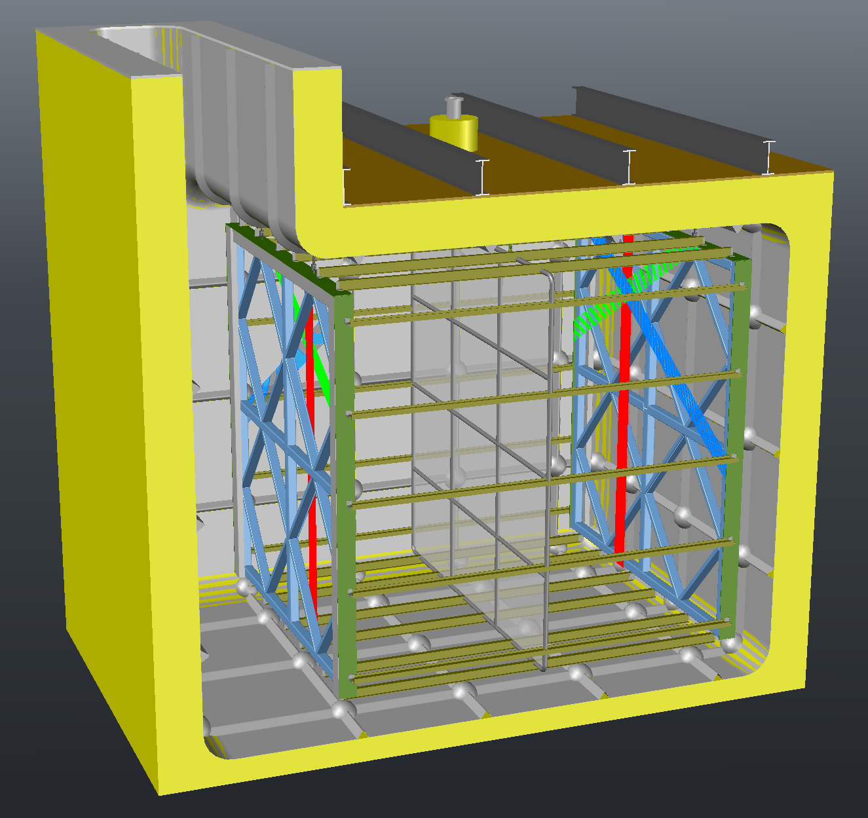
SBL at the FNAL ~ 0.8 GeV ν Booster Beam
 | LAr | Mass
 | Total | Active
LAr1-ND | 180t | 82t
MicroBooNE | 170t | 89t
T600 | 760t | 476t
ICARUS T600
NuMi Line
MicroBooNE
LAr1-ND

Slide 14
WA105 : LAGUNA detector Demonstrator LAGUNA Collaboration with CERN help
Prepare at CERN all the necessary infrastructure (clean rooms, cryogenics, …)
Construct a new generation of cryostats based on membrane technology
Provide all the necessary cryogenics
Construct and test 2 prototypes of a 2-phases LAr TPC
3 x1 x 1 m³
6 x 6 x 6 m³
Charged beam tests at the SPS with full readout capabilities

Slide 15
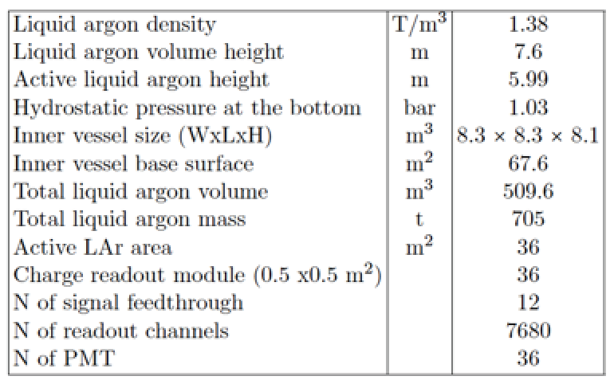
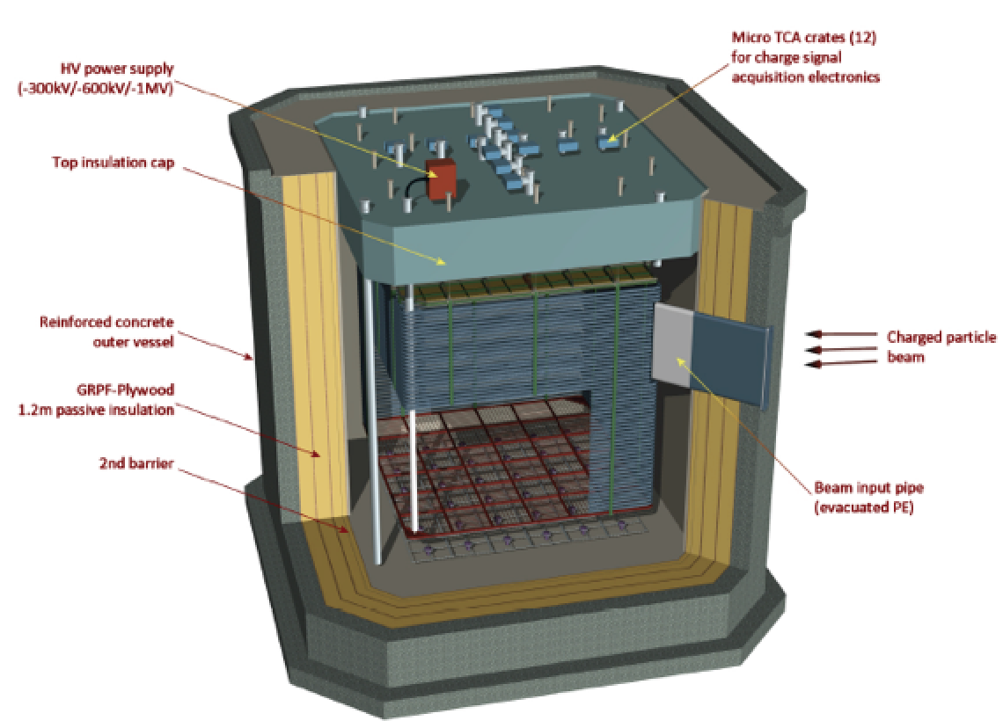
The WA105 - LBNO-Demo Detector
External dimensions: 12.5(w)Å~12.5(l)Å~11.2(h) m

Slide 16
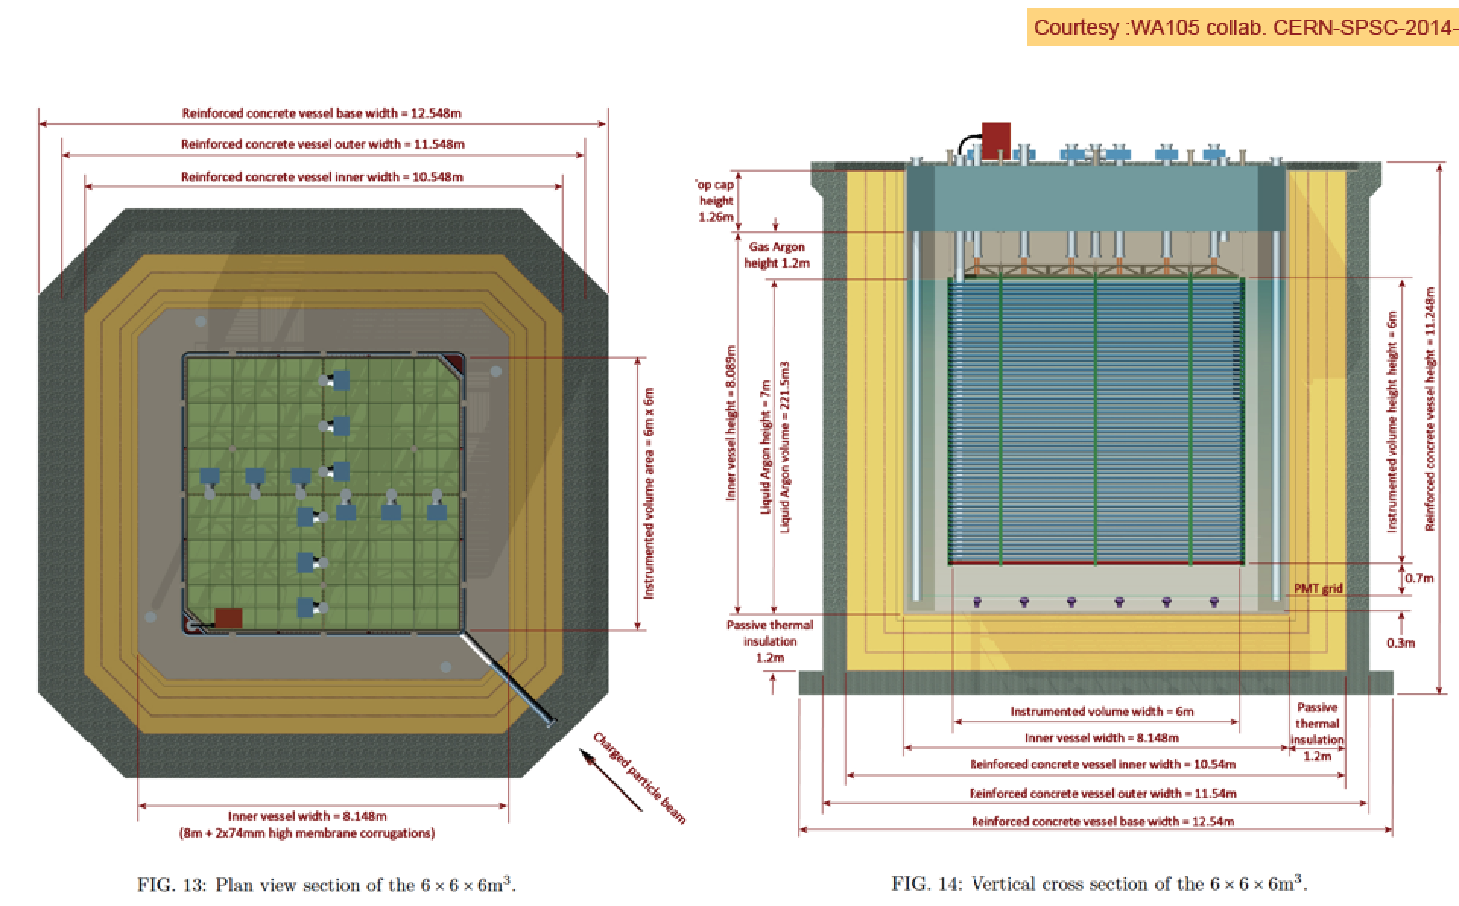
The WA105 - LBNO-Demo Detector

Slide 17
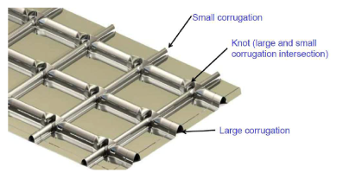
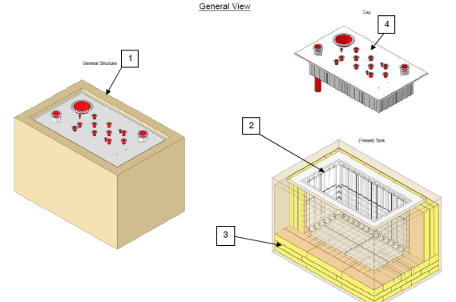
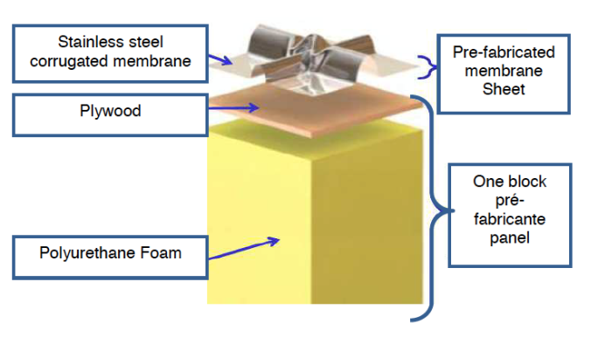
First membrane cryostat under construction (ready in spring 2015, 17 m³ LAr)

Slide 18
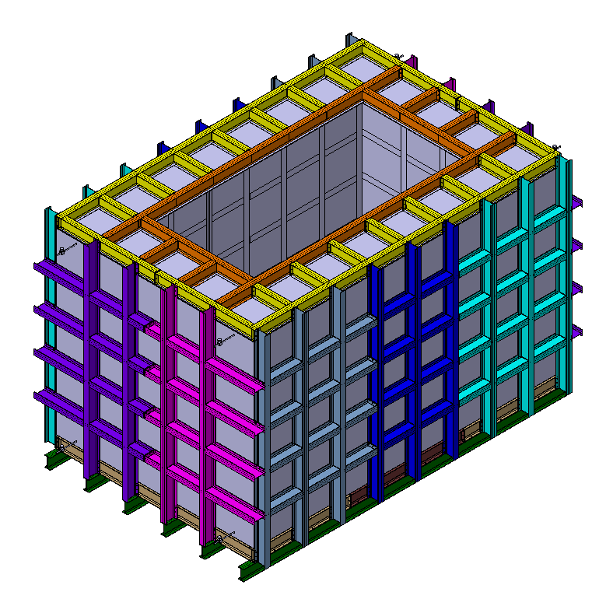
The outer structure
Overview
Steel profiles (IPE240)
bolted and welded together
Internal dimensions (now confirmed):
6’812mm x 4’412mm x 4’002mm (L x W x H)
Weight:
12T (confirmed)

Slide 19
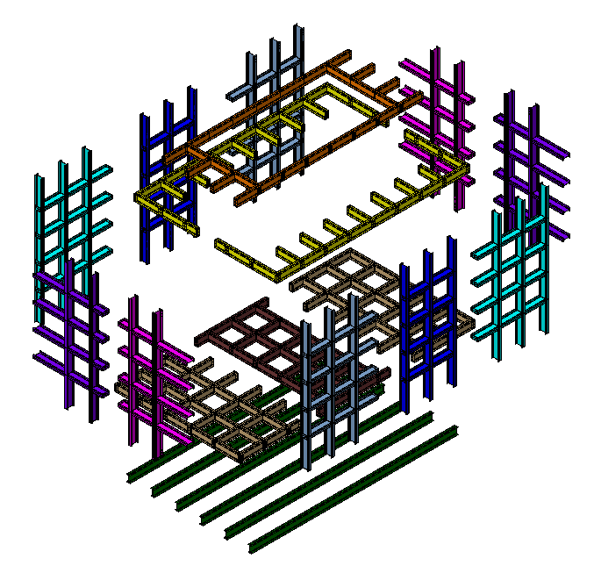
Transportation
Divided in 18 pieces:
Weight: 1 – 1.5 T each
Sizes: 4.5m x 2.5m
Standard trucks:
Probably two
10T each
2m height each

Slide 20
WA104 : Magnetized Muon Spectrometer NESSiE Collaboration with CERN help
Prepare at CERN all the necessary infrastructure (space, logistics)
R&D on a warm air core magnet
R&D on a cold air core magnet
Construct and test prototypes of a possible muon spectrometer
Charged beam tests at the SPS with full readout capabilities

Slide 21
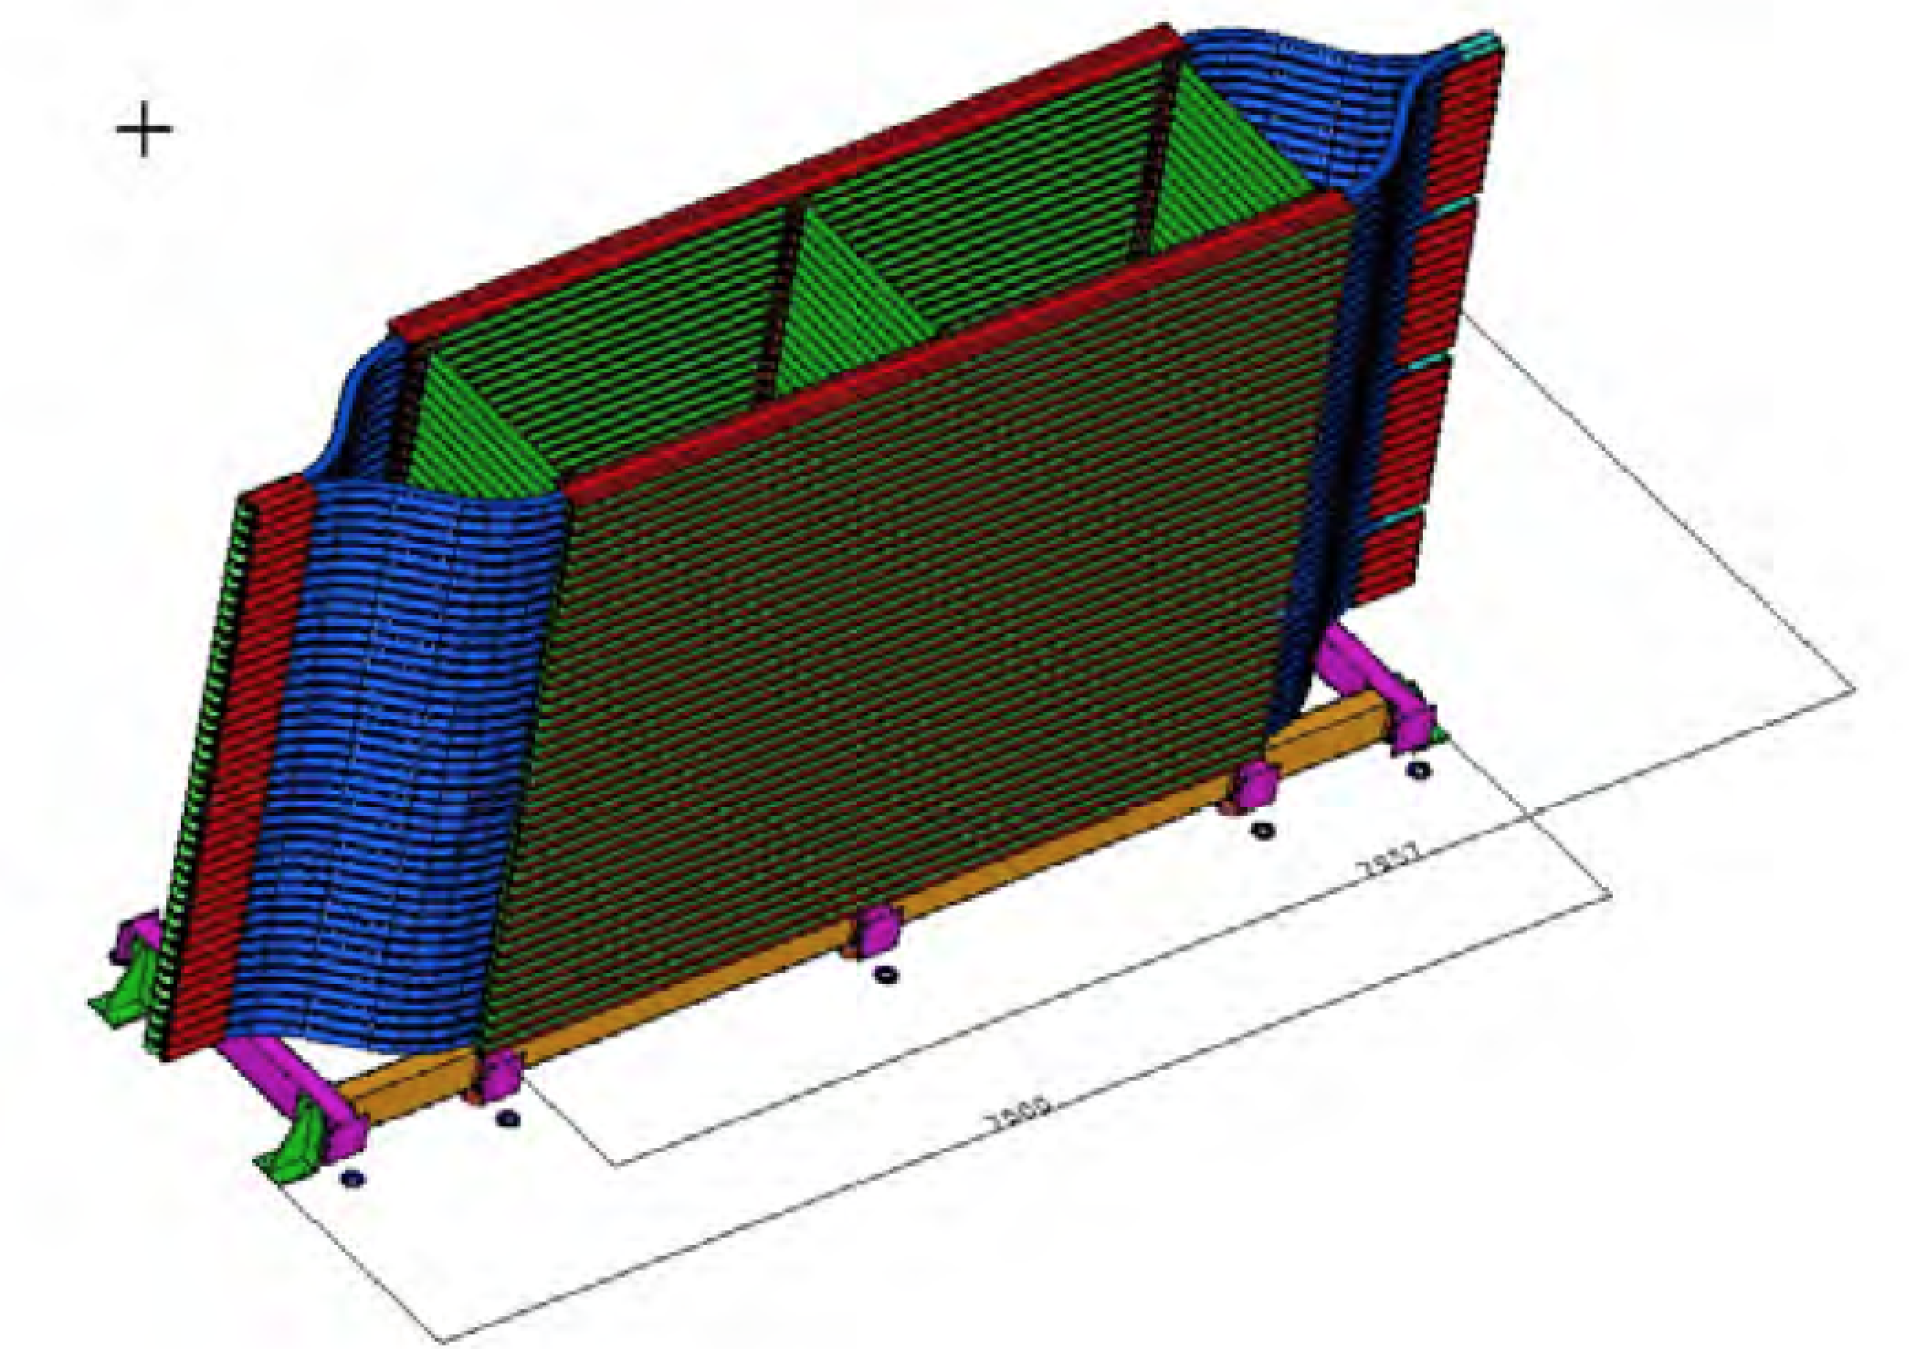
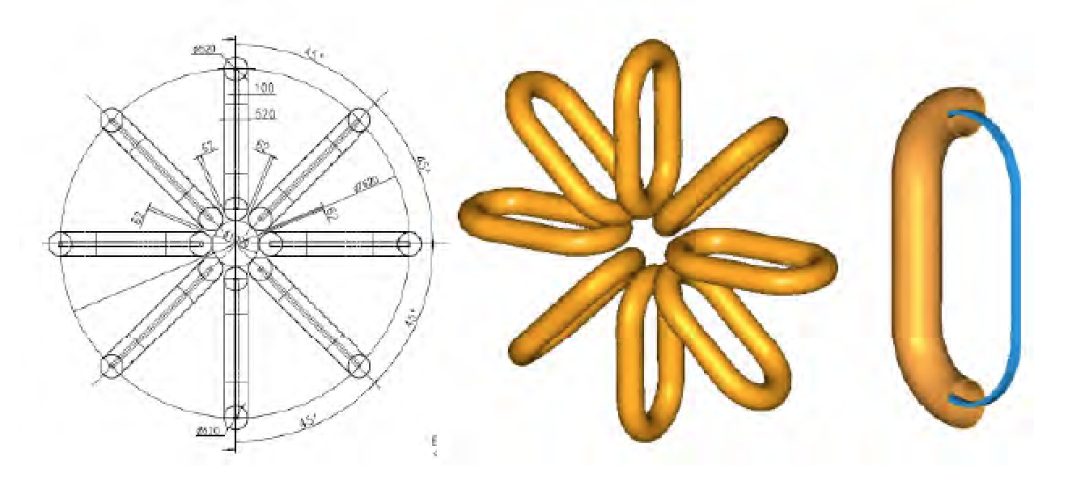
Air core magnets R&D
Warm
Superconducting

Slide 22
LBNF : Test of a large TPC module LBNF Collaboration with CERN help
Prepare at CERN all the necessary infrastructure (space, logistics)
Prepare a large cryostat for receiving this detector (new cap)
Bring to CERN components assembled in the UK and USA
Prepare/adapt the necessary cryogenics
Charged beam tests at the SPS with full readout capabilities

Slide 23
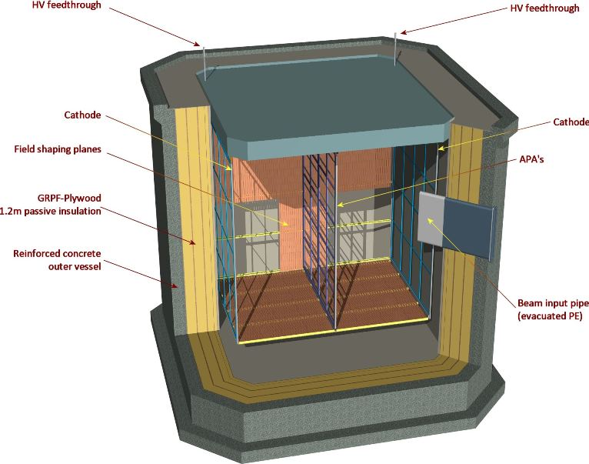

Slide 24
CERN support groups
a detector mechanical engineering team (3 eng. already involved)
a new Lar cryo group : 3 staff engineers + 3 Project associates eng. in rotation. The support of the CERN cryolab infrastructure ( cryo tecs and frames contracts)
a team of technicians
an electrical engineer
a controls group
a (Si)PM characterization lab
a simulation group for beam issues
safety and environment experts
secondary beam experts (from CNGS + new people)
access to many CERN technology groups (EL, power, CV, material, ….)
a new physics team

Slide 25
EHN1 extension as a new test area

Slide 26
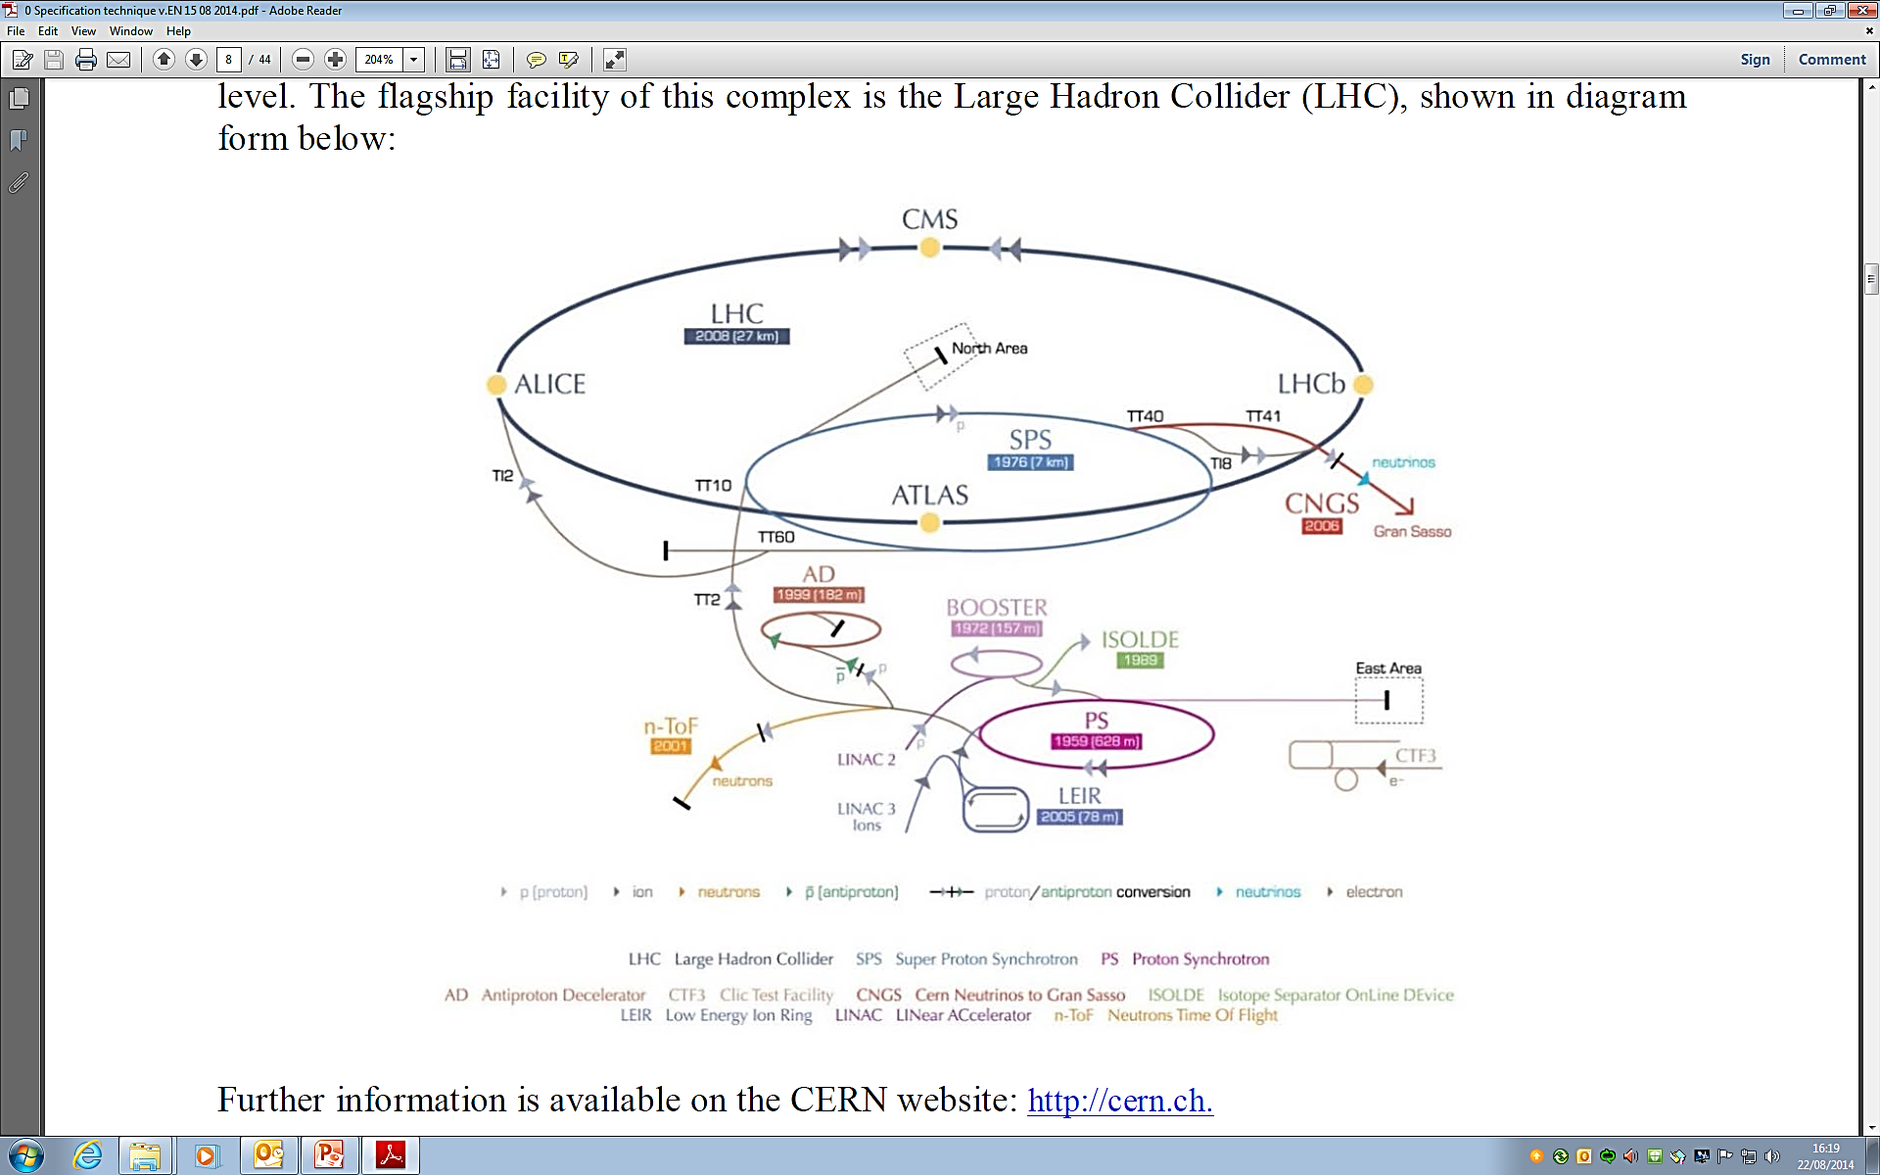
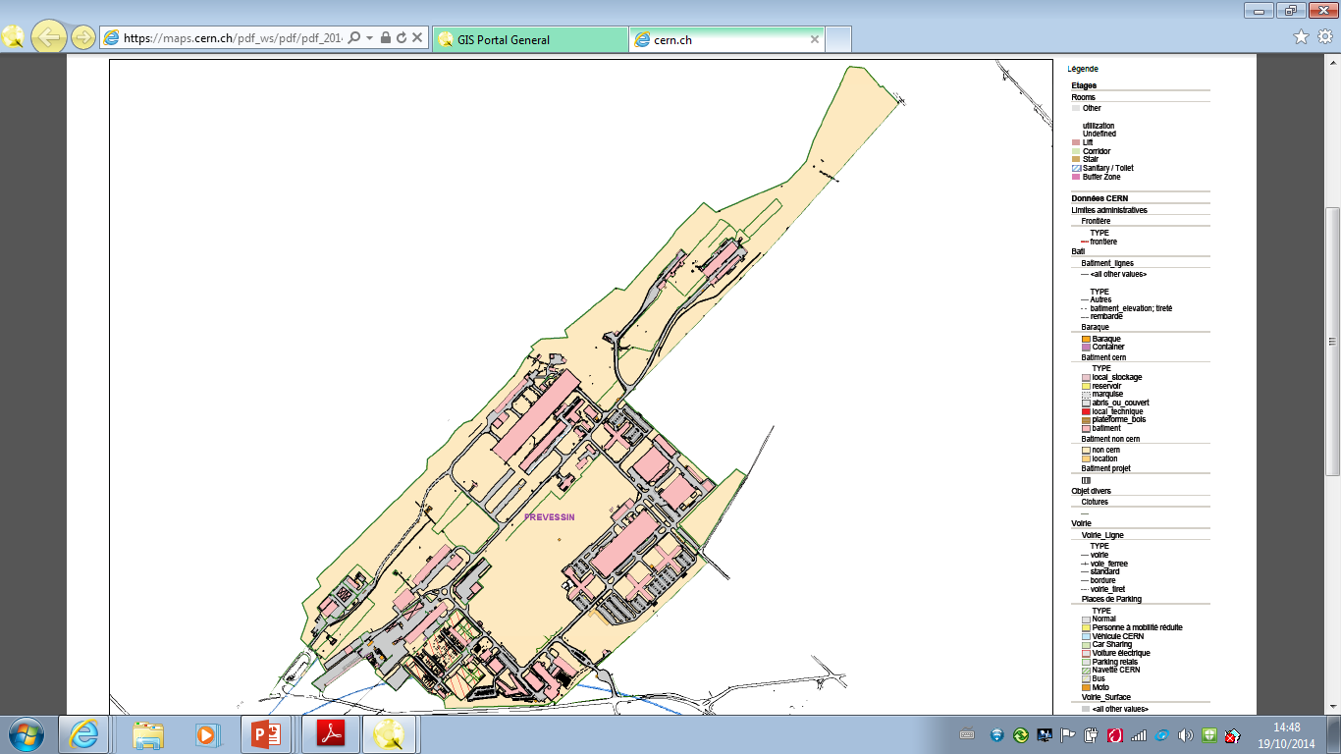
CENF – Civil Engineering Extension B887
-Prevessin site complex-
-EHN1 Extension Area-
CERN Prototype Meeting – M.Nessi
N.Lopez, M.Manfredi (GS-SE)

Slide 27
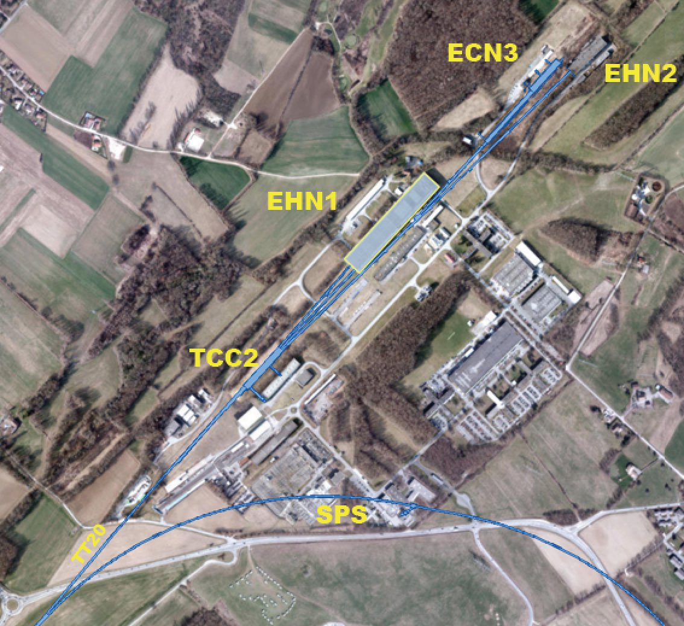
The Experimental Hall North 1 - EHN1

Slide 28
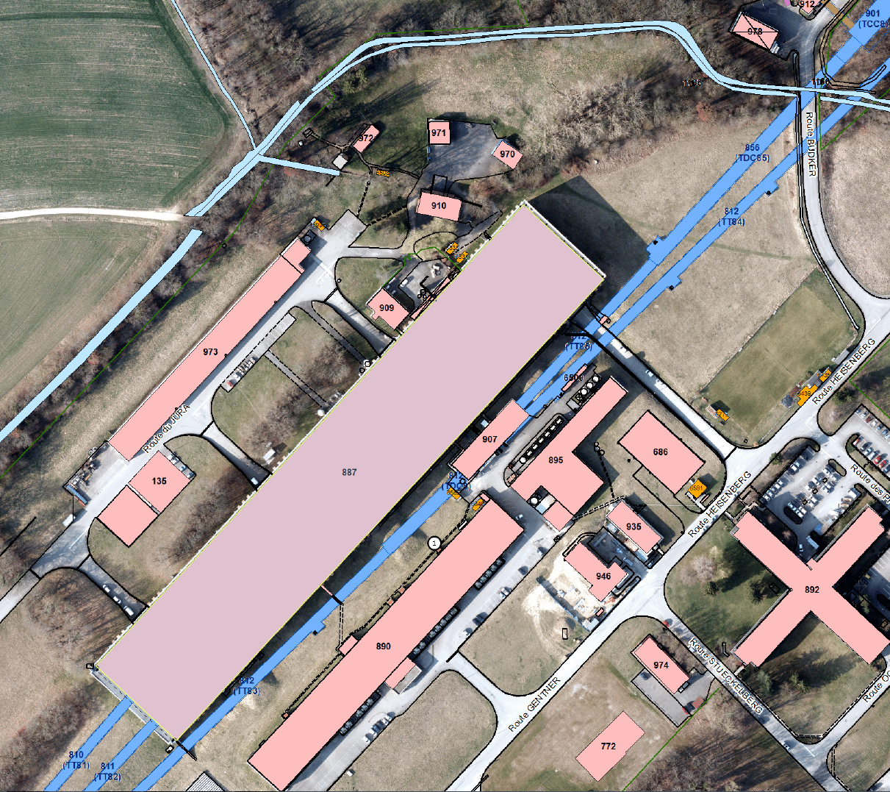
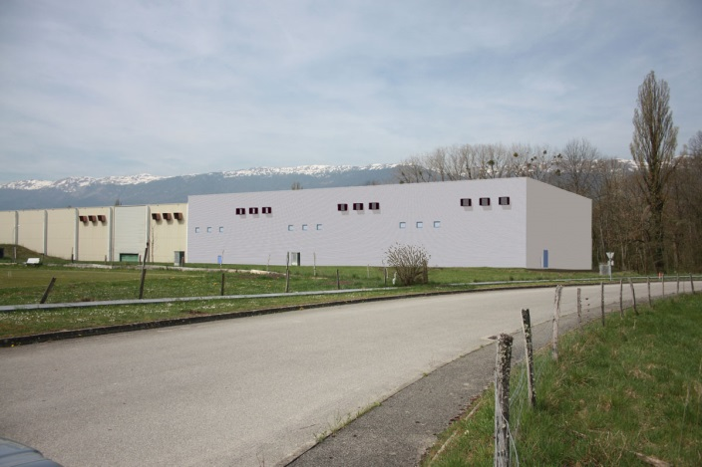
CENF – Civil Engineering Extension B887
Technical Aspect: Location
The EHN1 is a large industrial building situated on french territory, in Prévessin. The building has to be extended for the new generation of experiments on the neutrinos.
Site Installation Area
Tunnel TDC85
Extension
The Extension will extend northwards from the building for about 70 m in the direction of the beams.
Experimental Hall B.887 (EHN1)
CERN Prototype Meeting – M.Nessi
N.Lopez, M.Manfredi (GS-SE)

Slide 29
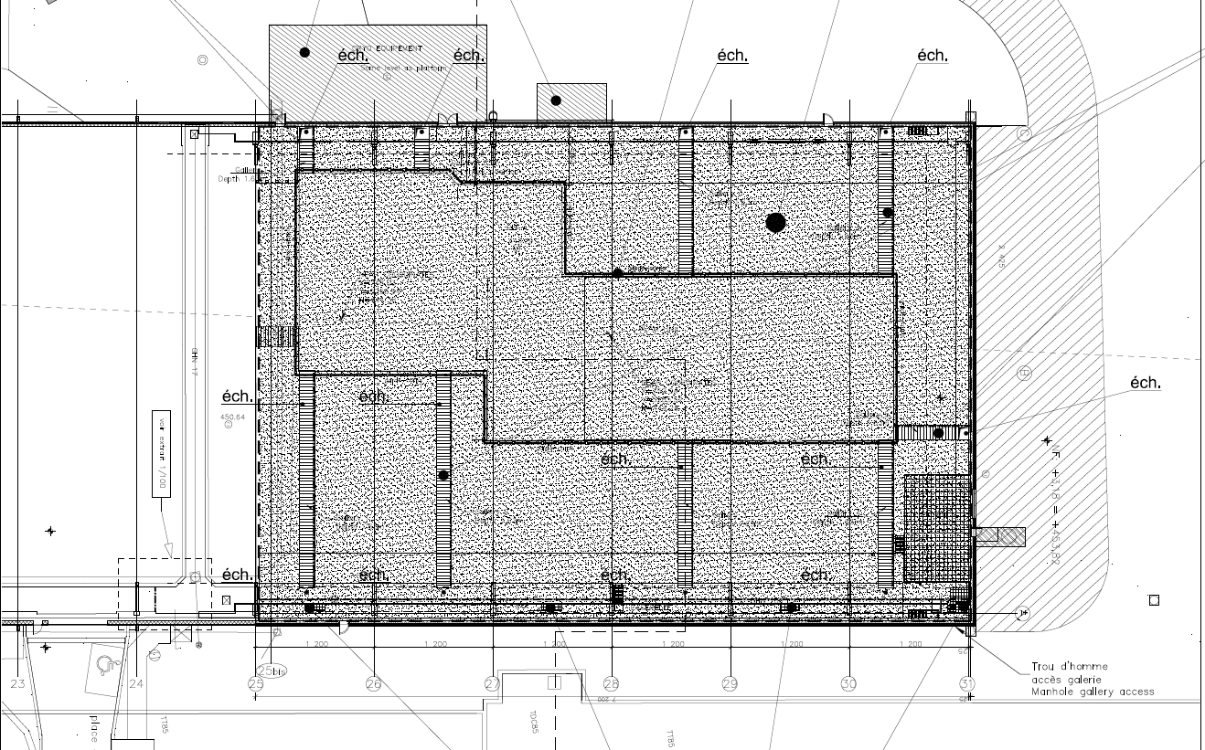
CENF – Civil Engineering Extension B887
Technical Aspect: General info
The Extension's dimensions are 72 m long by 50 m wide and 20 m high.
72.0
The extension includes two large pits of 7.35m and 9.0m deep.
20.0
PIT A:
7.35m deep
The top metallic structure is similar to the existing building, allowing for an easy continuation of the overhead crane and services.
PIT B:
9.0m deep
16.5
50.0
19.0
41.0
The technical gallery will be prolonged. Swallow service trenches will provide the access from the sidewalls to the pits.
Extension
CERN Prototype Meeting – M.Nessi
N.Lopez, M.Manfredi (GS-SE)

Slide 30
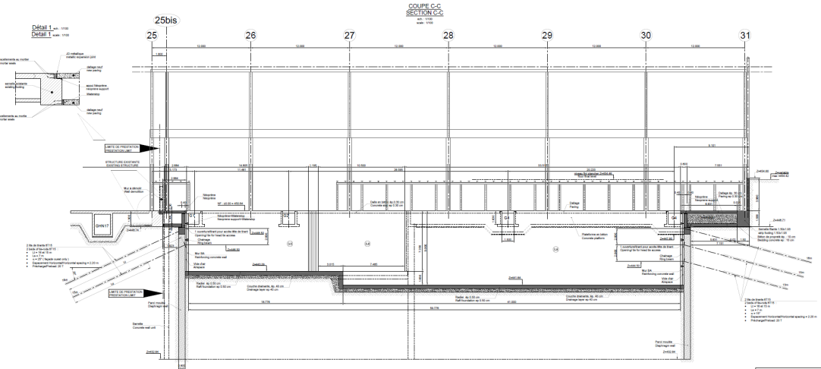
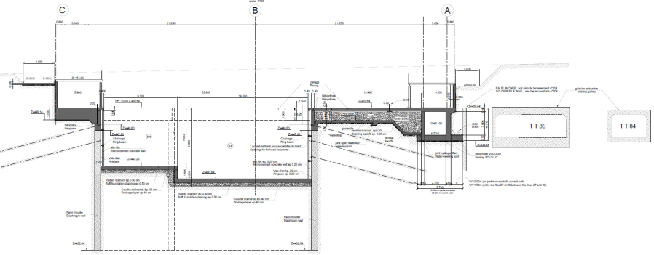
CENF – Civil Engineering Extension B887
Technical Aspect: Civil Engineering main activities (1/2)
B
-Construction sheet piles (or Reduce Cost Alternative Option)
-Construction diaphragm wall and final tie beams
-Construction of reinforced concrete structure (raft foundations, slabs, walls, etc.)
-Demolition of the existing gable retaining wall
Plan view
A
A
B
Section A-A
Section B-B
CERN Prototype Meeting – M.Nessi
N.Lopez, M.Manfredi (GS-SE)

Slide 31
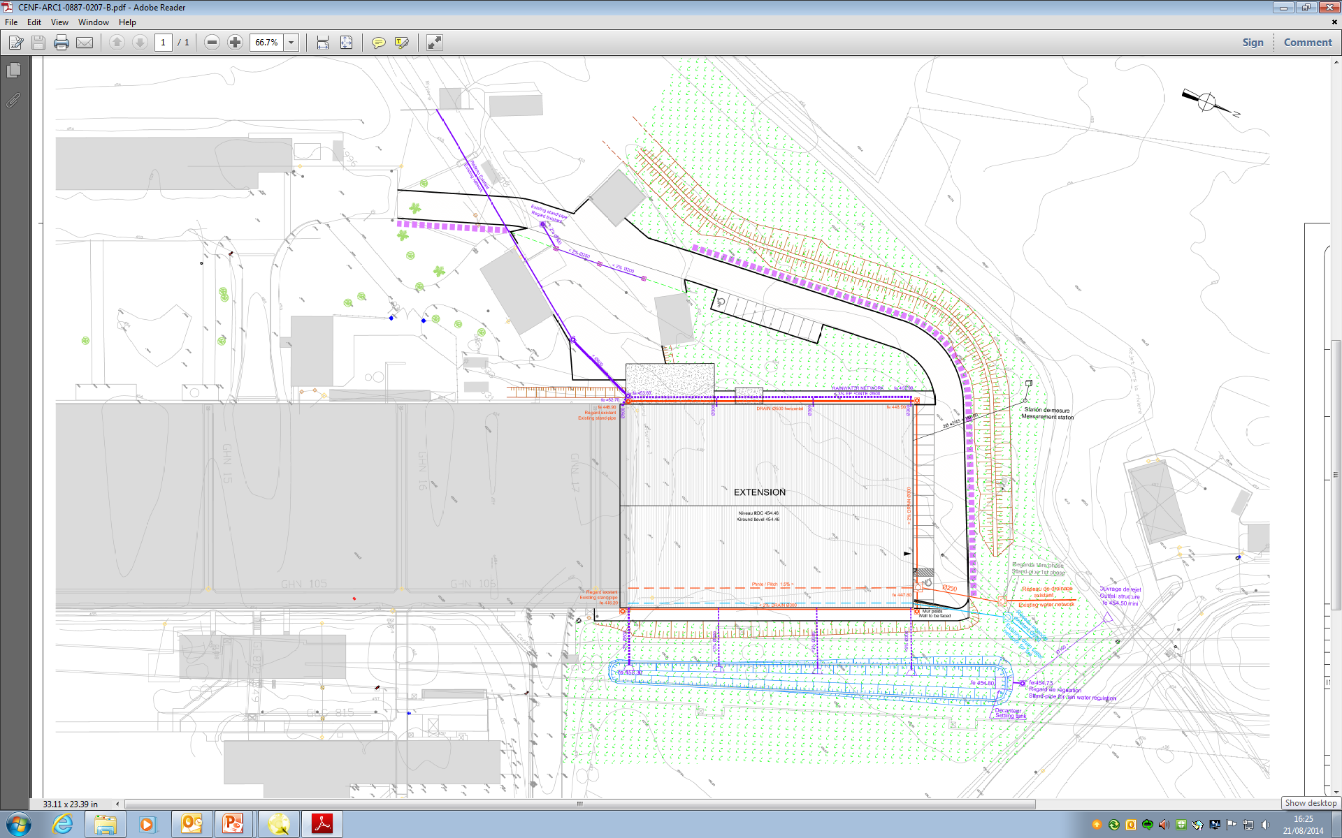
CENF – Civil Engineering Extension B887
Technical Aspect: Civil Engineering main activities (2/2)
The works to be carried out will include:
-General worksite installation
-Rerouting and cutting existing underground networks
-Mass and ditch earthworks
-Drawdown of the water table
-Road works, car parks and landscaping.
-Rainwater treatment structures (worksite and definitive)
Notes:
Particular attention should be kept to the extracted cut material within 5.50m of distance from the TDC85
Radiological Protection: People allow to enter the technical gallery or inside the existing building 887 should equipped (passive/operational dosimeter) and accredited by CERN. No special measure need to be planned to work outside
CERN Prototype Meeting – M.Nessi
N.Lopez, M.Manfredi (GS-SE)

Slide 32
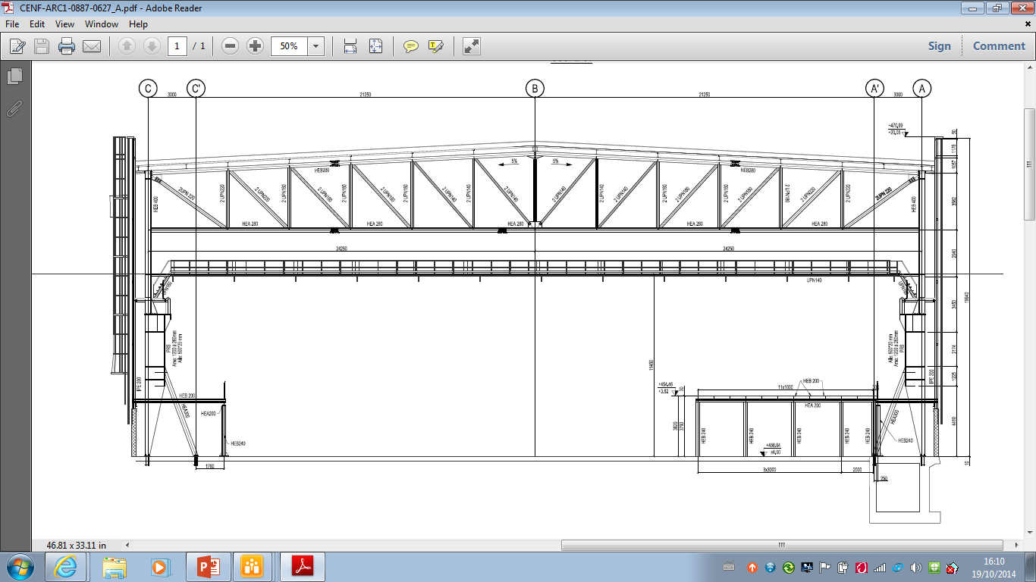
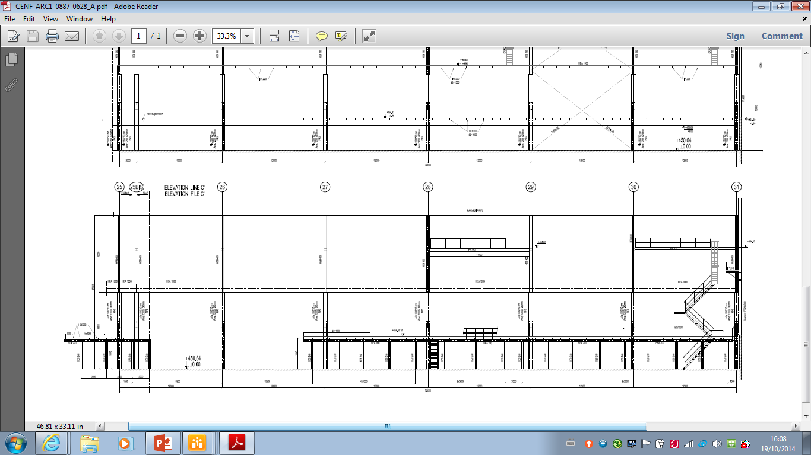
CENF – Civil Engineering Extension B887
Technical Aspect: Structural steel main activities (1/2)
-Structural steelwork and associated components (Main and Secondary structures, Internal structures, Travelling crane structures)
-Metalwork: guardrails, stairs, ladders, doors
-Removal of the north gable of the existing building (not before the extension is water-tight and air-tight)
CERN Prototype Meeting – M.Nessi
N.Lopez, M.Manfredi (GS-SE)

Slide 33
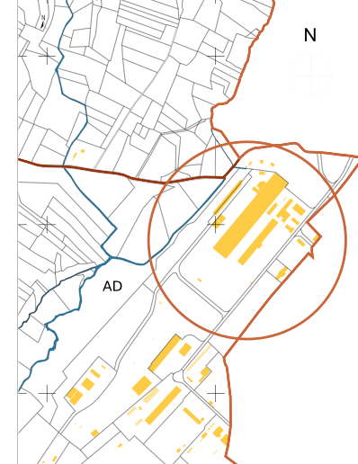
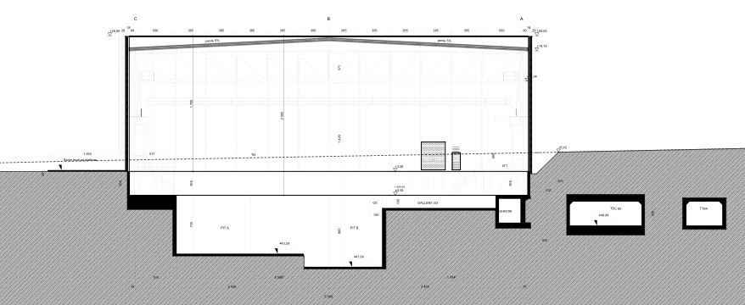
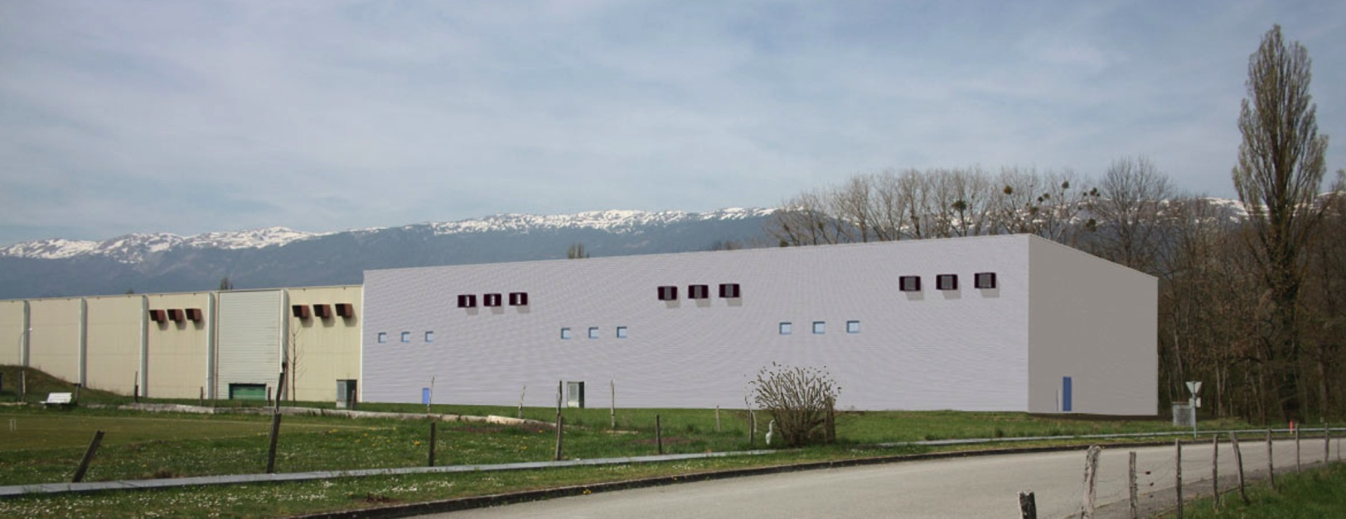
Nord Area EHN1 extension
Ready for beams in 2017

Slide 34
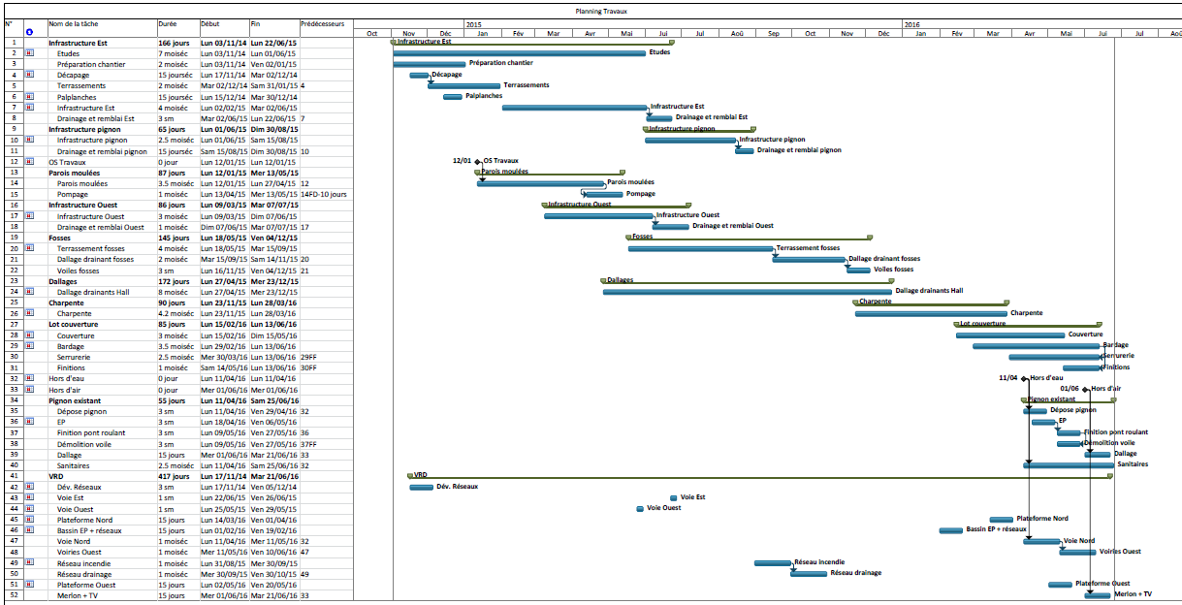
Schedule
Anticipated start of the works (if possible) + 18 months
Source : ARCADIS → to be updated after tendering procedures

Slide 35
Civil engineering CERN team
Luigi Scibile (group leader)
Matasha Lopez (project leader)
Martin Manfredi (CE engineer)
new CERN CE engineer to follow the construction on side to be appointed
firm ARCADIS as responsible for design and construction follow up (contract running)
Consortium of firms selected for the construction, Contract still in 2014 after CERN Finance Committee approval

Slide 36
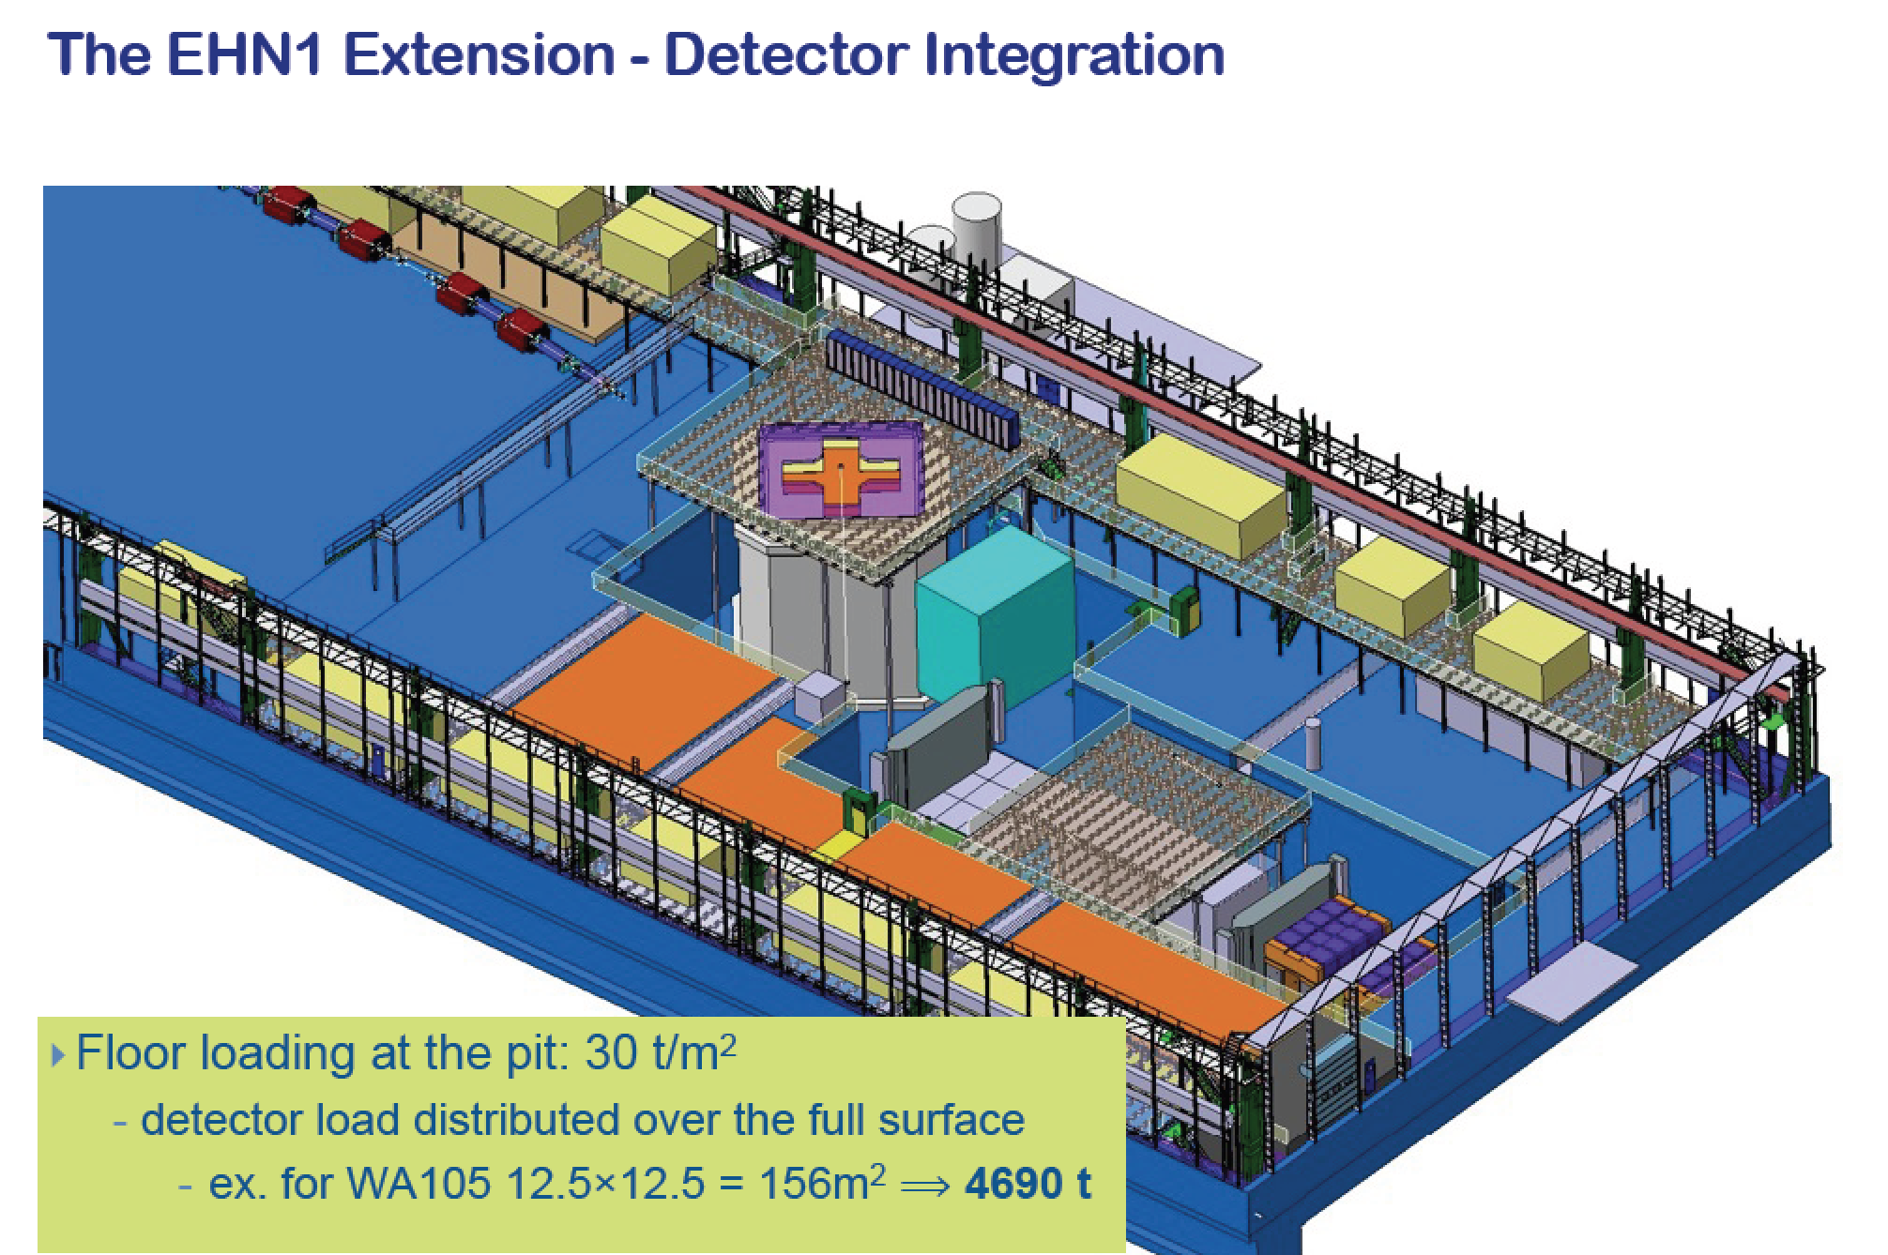

Slide 37
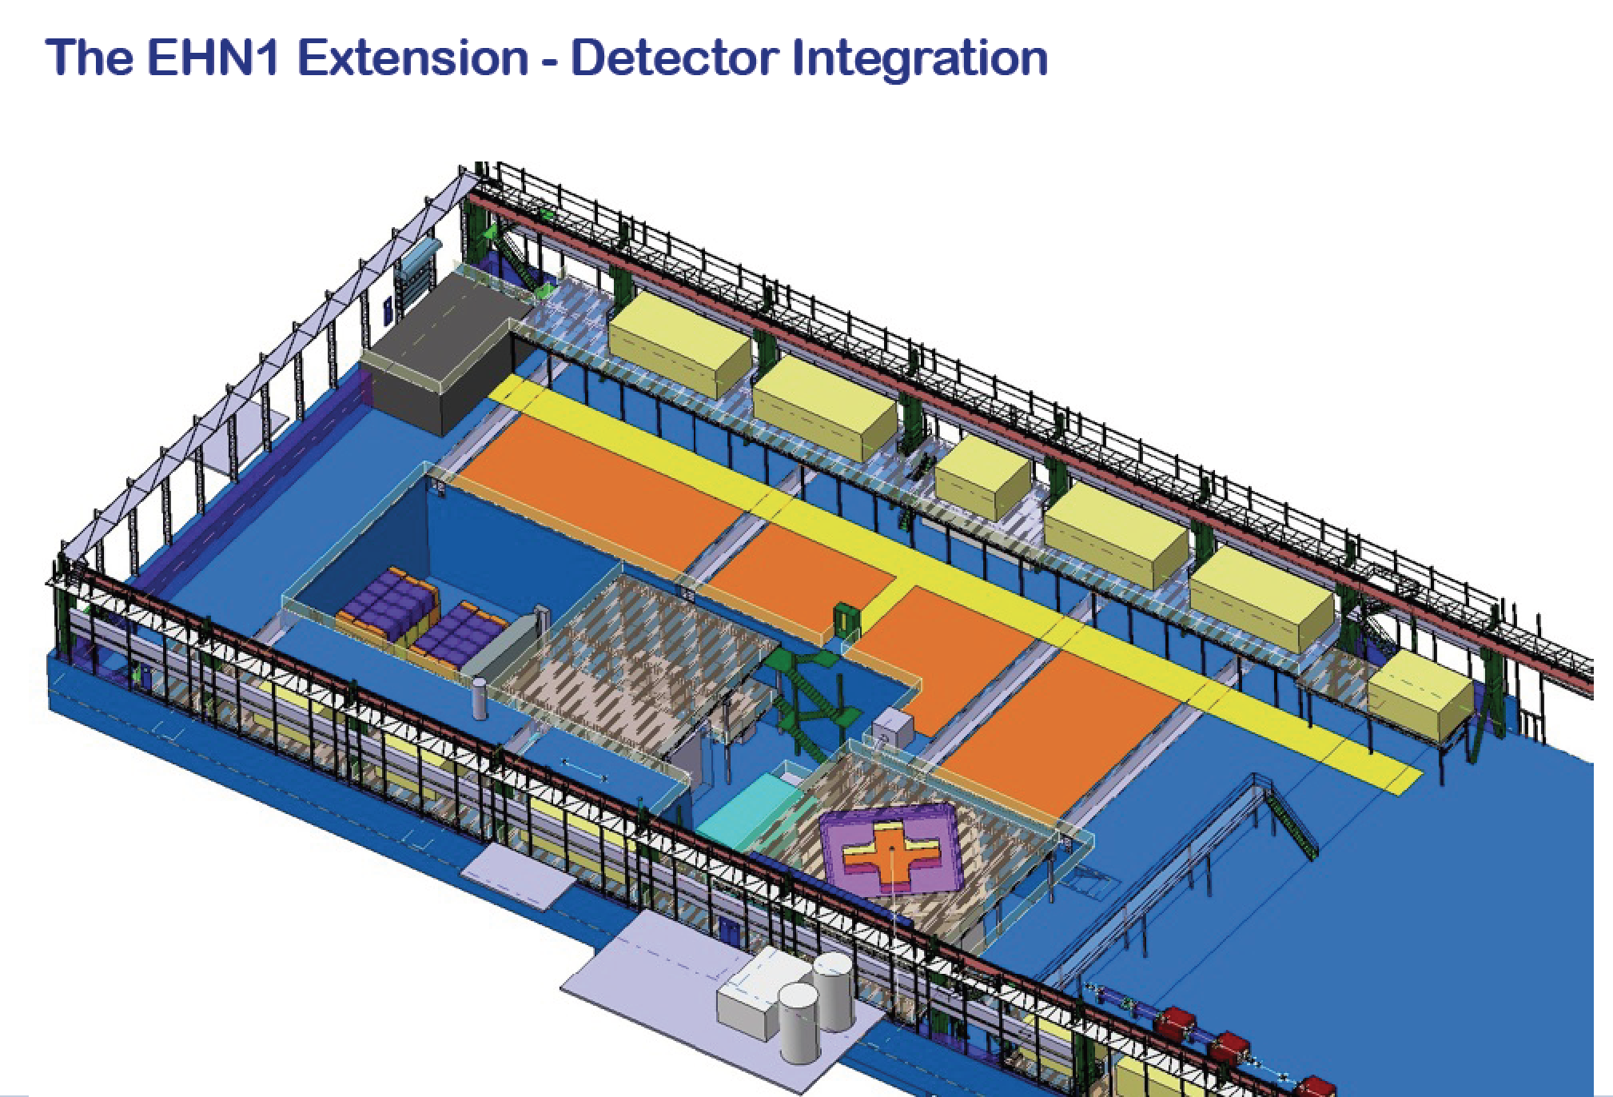

Slide 38
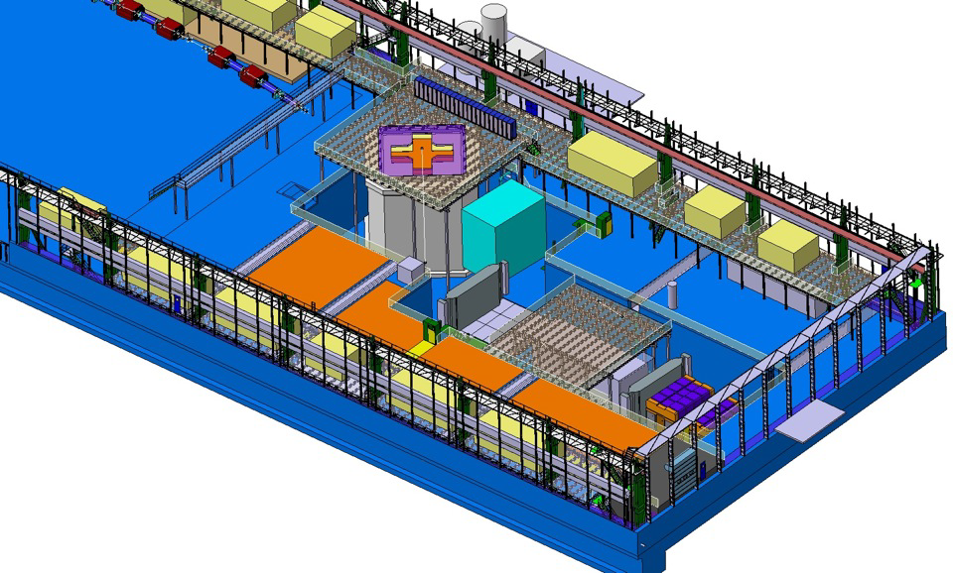
Neutrino extension

Slide 39
Neutrino extension
Integration of services and experimental groups steered by one of the support group (leader I. Efthimiopoulos)

Slide 40
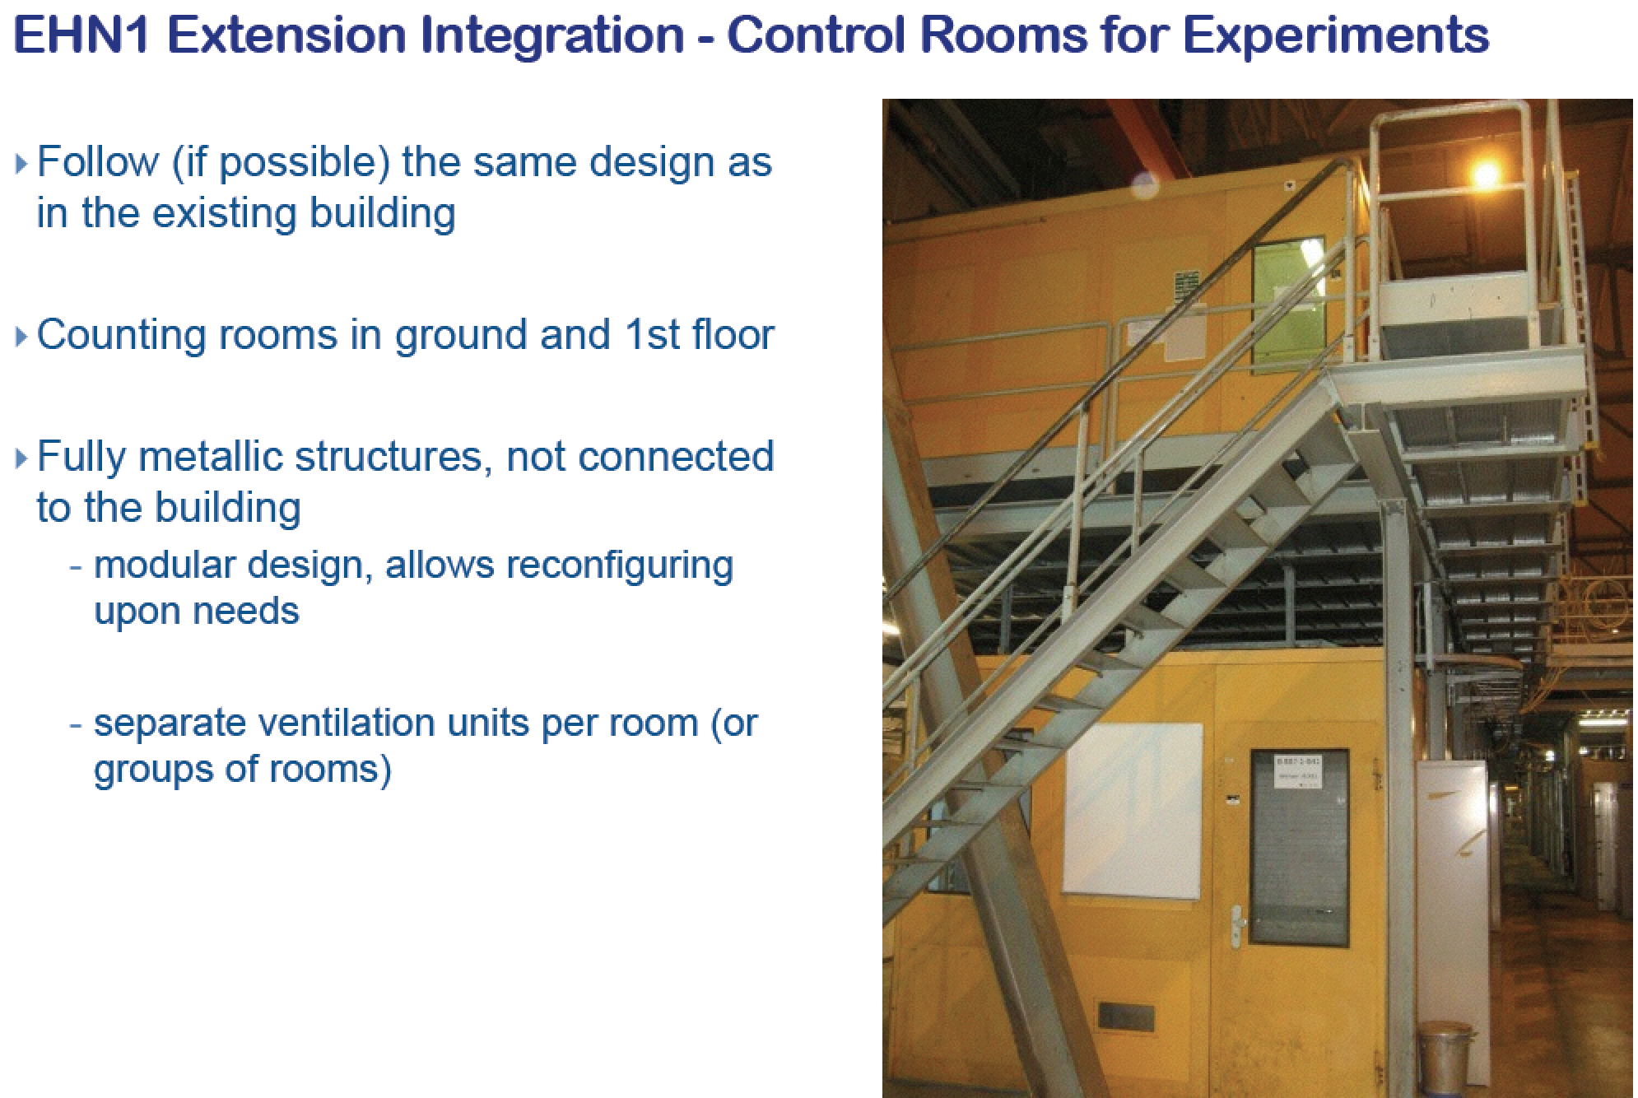

Slide 42
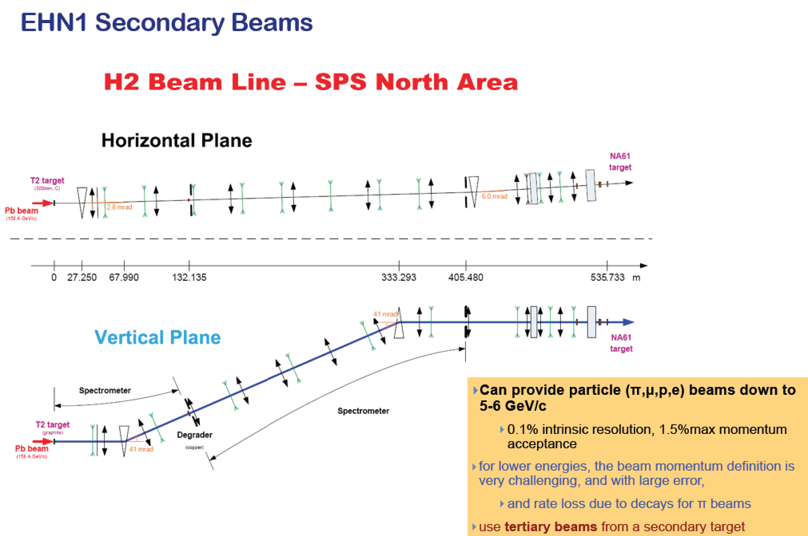

Slide 43
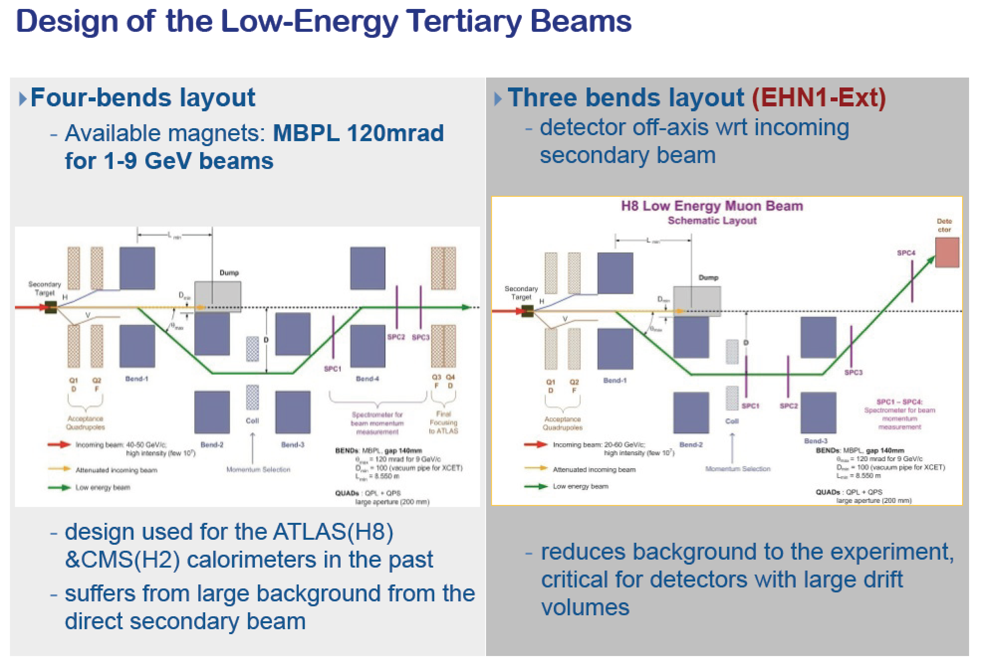

Slide 44
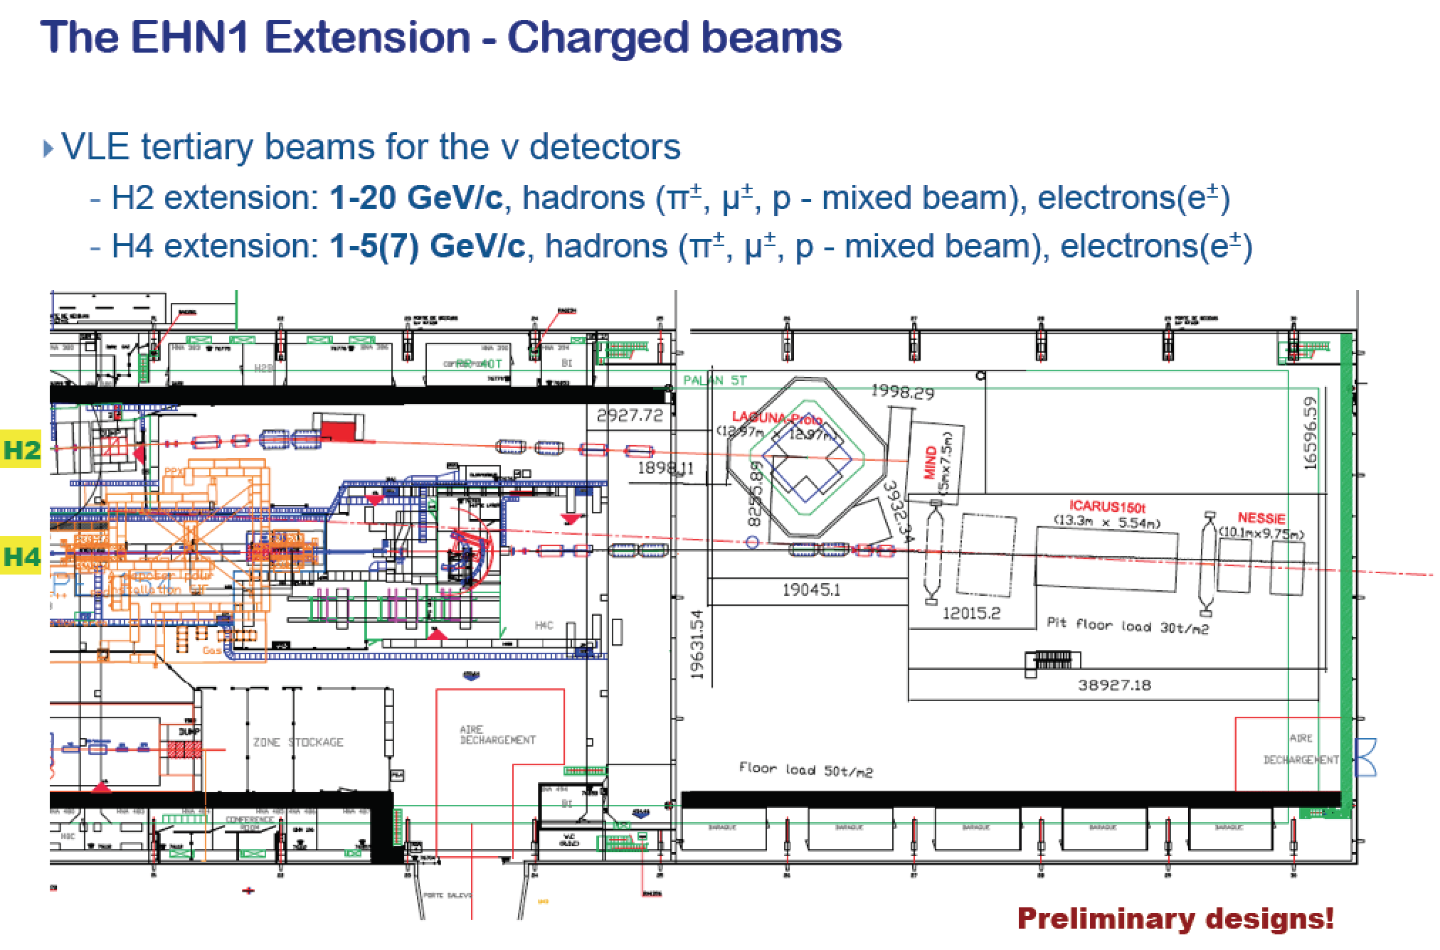

Slide 45
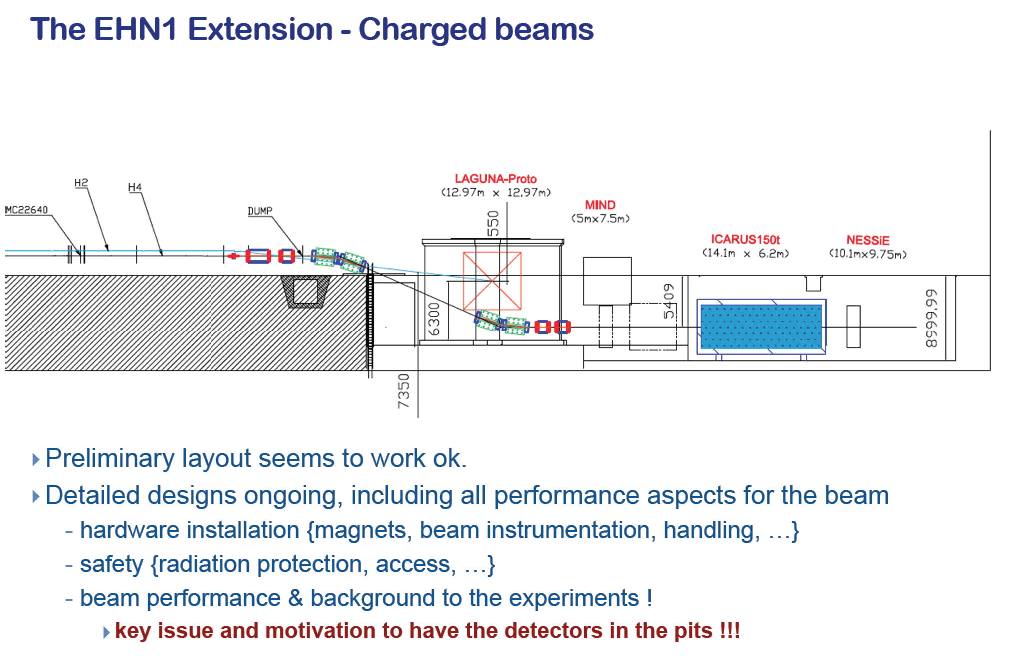

Slide 46
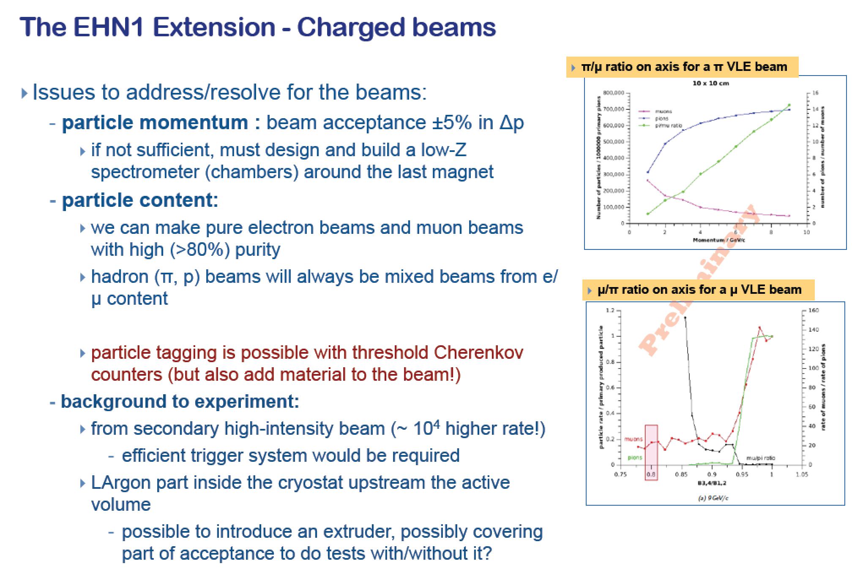

Slide 47

Integration team

Slide 48
How to get in ?

Slide 49

MOU frame
How to get in?
Present to the CERN SPSC a LOI or an expression of interest
When approved we prepare together an MOU (addendum) which defines all responsibilities and resources needed
Then a CERN experiment is created (WA104, WA105, …), with all priviledges and requirements
https://edms.cern.ch/document/1353815

Slide 50



Several MOUs are being prepared for signature

Slide 51
Summary
CERN is providing the community with a Neutrino Platform to develop detectors, beams and components
A new test area is under preparation
CERN provides the community with technical support, logistics and expertise
Any type of application is welcome
Platform organized via an MOU system

