Slide 1

Towards a Future Long-Baseline Neutrino Experiment
Bob Wilson
Colorado State University
CERN Prototype/Beam Test Meeting
CERN, 20 October 2014

Slide 2
Outline
Worldwide development
European Strategy/US P5
Fermilab International Facility Host
Post P5 Actions
Current status and goals

Slide 3

Worldwide Development
Regional development for > 10 years
  NNN conference series since 1999
  LAGUNA/LBNO Design Studies – final report Aug. 2014
  DUSEL -> LBNE – CDR and DOE “CD-1” approval Jan. 2013
  (Hyper-Kamiokande – small matter effect)
Technology
  Water, Liquid, Scintillator, Liquid Argon
  Liquid Argon TPC convergence for long baseline

Slide 4
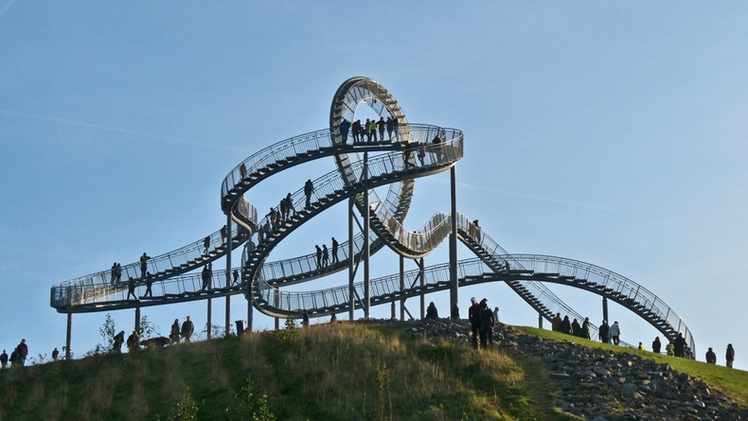
European Strategy/US P5
European Strategy for Particle Physics (May 2013)
  CERN should develop a neutrino programme to pave the way for a substantial European role in future long-baseline experiments. Europe should explore the possibility of major participation in leading long-baseline neutrino projects in the US and Japan.
Particle Physics Project Prioritization Panel (May 2014)
  Recommendation 13: Form a new international collaboration to design and execute a highly capable Long-Baseline Neutrino Facility (LBNF) hosted by the U.S. To proceed, a project plan and identified resources must exist to meet the minimum requirements in the text. LBNF is the highest-priority large project in its timeframe.

Slide 5

Fermilab LBNF Host
Fermilab is organizing to host an international facility to support a long-baseline neutrino experiment
Major lab focus on PIP-II (Proton Improvement Plan) leading to mega-watt class source for neutrinos
Committed to building infrastructure for far/near sites
Discussing with DOE, CERN, non-US funding agencies how to “internationalize” the lab
  e.g. Working Group on Int’l Project Management for LBNF
New Neutrino Division (led by Gina Rameika)
Fermilab director Nigel Lockyer taking a direct role in the reformulation process

Slide 6
Rapid Post-P5 Action
International Meeting for Large Neutrino Infrastructures, Paris, June 2014
  Agencies reps. issue supportive statement
Neutrino Summit 2014, Fermilab, July 2014
  Invited list of PIs spanning world accel. nu community
Interim International Executive Board, Sept 2014
  “In principle” interest in a Fermilab-hosted facility + agencies
  Develop a “Letter of Interest (LOI)” that would have broad acceptance
Geotechnical Working Meeting at SURF, Oct 2014
  Participation by iIEB reps. from LBNO and LBNE

Slide 7
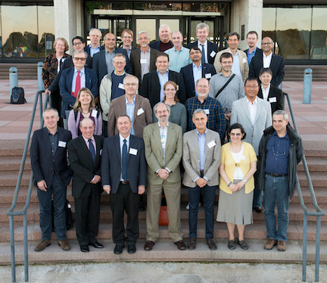
iIEB – Sept 2014
Representatives from:
HyperK, LBNE, LBNO, T2K, ICARUS, other nu expts.
DOE, Fermilab, CERN, STFC, INFN, National Labs, Universities
Brazil, Canada, France, India, Italy, Japan, Russia, Spain, Switzerland, US, UK,

Slide 8
Status and Goals
iIEB meeting – this afternoon
  Report from visit to Sanford Lab
  Discussion of the draft LOI
  Possibility of all-PI meeting(s) in December
Goals
  Form new collaboration; submit LOI with broad community support to January 2015 meeting of Fermilab Program Advisory Committee (PAC); dissolve LBNE, LBNO, iIEB
  “Proposal” by summer 2015 PAC
  Conceptual Design Report ~fall 2015

Slide 9
(E)LBNF R&D Coordination Goal
Concept for future management/funding structure
  Separation of infrastructure (accelerator complex, near/far sites incl. cryosystems) from detectors – like CERN/LHC
  Collaboration Proposes: Experimental program at Fermilab-hosted Long-Baseline Neutrino Facility
Worldwide Coordination/Participation in both Facility and Experimental Program
New collaboration coordination
  LBNE CERN beam test and WA105
  Other related LAr R&D and experiments

Slide 10
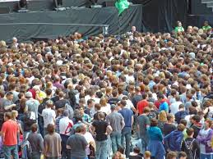
Path Forward

