Slide 1
Plans for the
Experimental Program
E.C. Aschenauer
Co-Associate Director for the Experimental Program
August 20, 2020
Electron Ion Collider

Slide 2
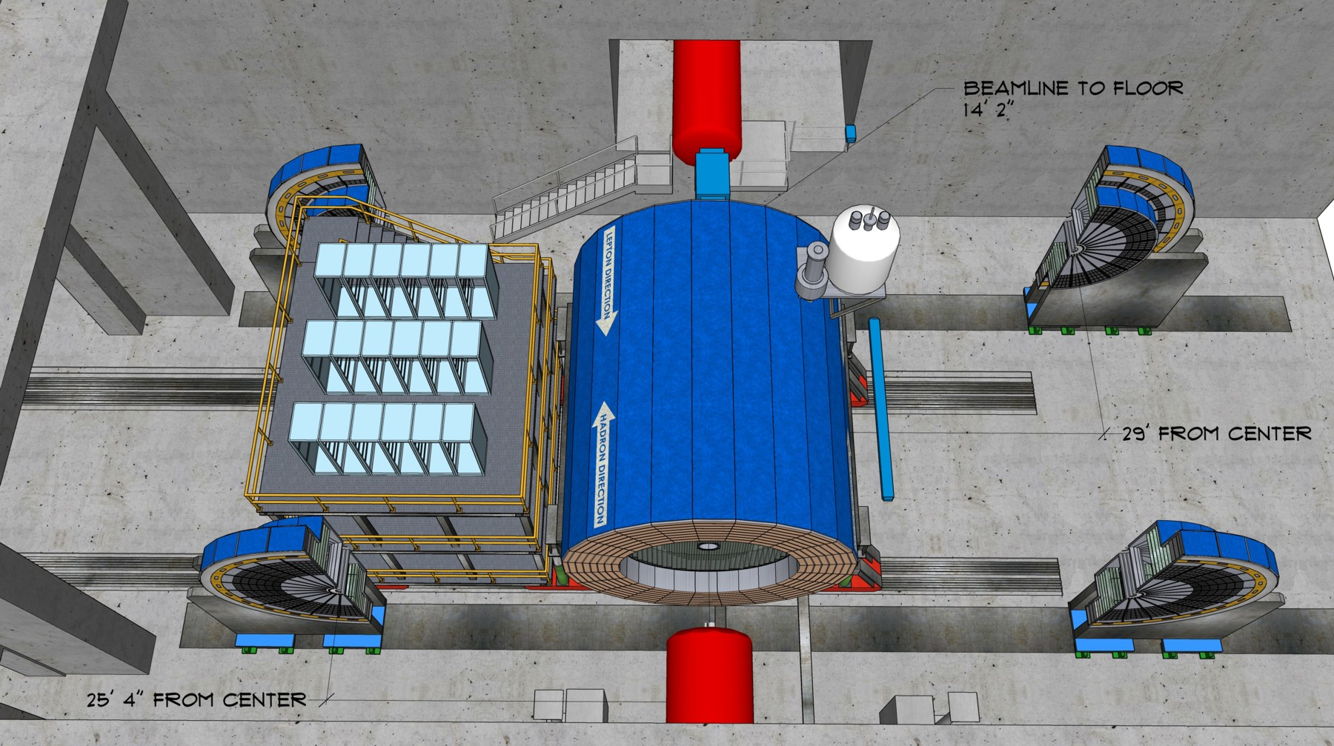
EIC Experimental Equipment
Any general purpose EIC Detector is complex
Overall detector requirements:
Large rapidity (-4 < η < 4) coverage; and far
beyond in especially far-forward detector regions
High precision low mass tracking
  small (μ-vertex) and large radius
  (gaseous-based) tracking
Electromagnetic and Hadronic Calorimetry
  equal coverage of tracking and EM-calorimetry
High performance PID to separate π, K, p on track level
  also need good e/π separation for electron-scattering
Large acceptance for diffraction, tagging, neutrons from nuclear breakup: critical for physics program
  Many ancillary detector integrated in the beam line: low-Q² tagger, Roman Pots, Zero-Degree Calorimeter, ….
High control of systematics
  luminosity monitors, electron & hadron Polarimetry
Integration into Interaction Region is critical

Slide 3
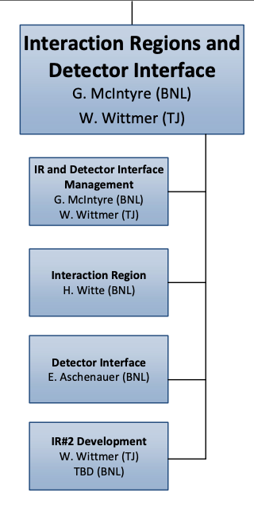
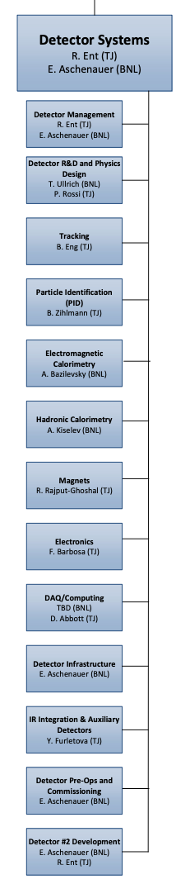
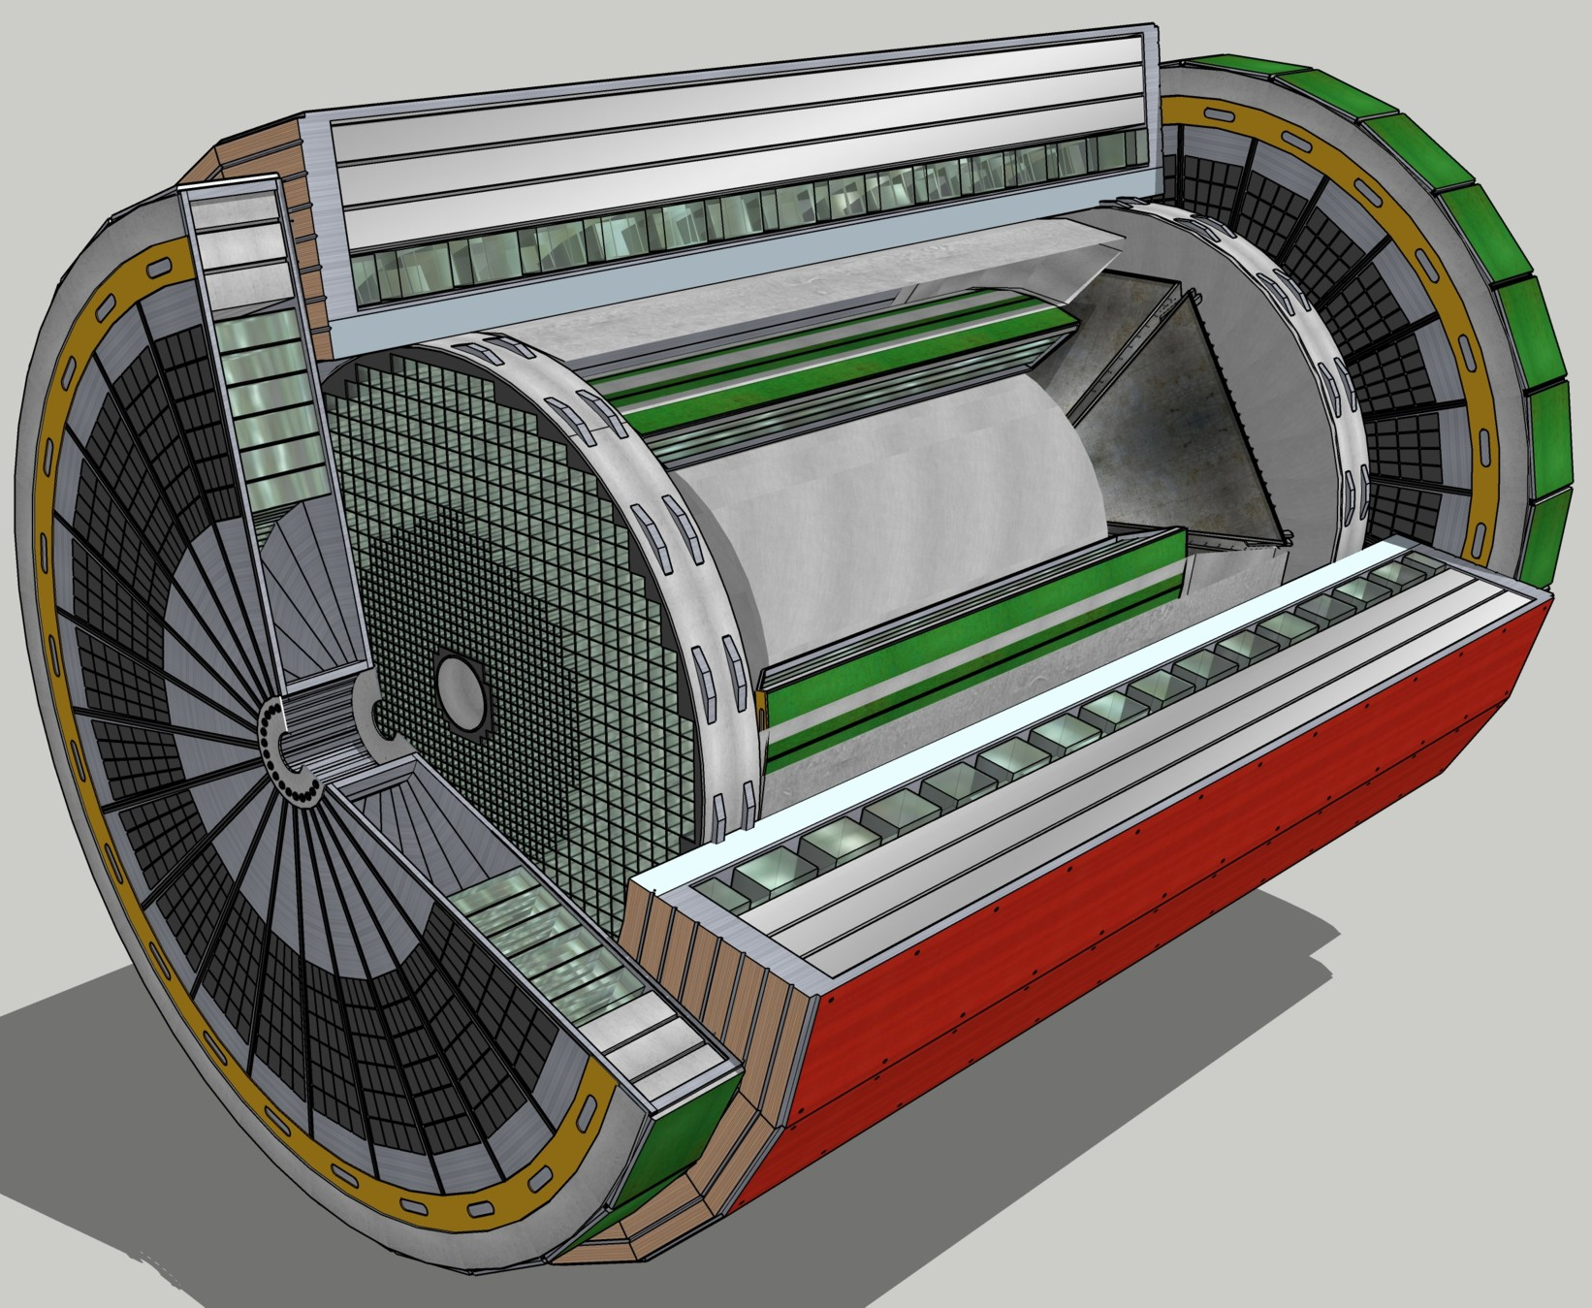
EIC Experimental Equipment
(L3) Detector Subsystems
EM Calorimetry
Hadronic Calorimetry
Particle Id. Detectors
Tracking Detectors
(L3) electron and hadron polarimetry and luminosity detector live here, under accelerator scope.
(L3) Detector #2 Development
and IR #2 Development
These have no formal scope within the project but are included to ensure we keep them in mind as possibility.

Slide 4
Detector Planning
The DOE-NP supported EIC Project includes one detector and one Interaction Region in the reference costing. Reference cost is the BNL estimate prepared for the DOE CD-0 Independent Cost Review (ICR).
    See various talks at the 1st Yellow Report Workshop at Temple University (https://indico.bnl.gov/event/7449/timetable/#20200319)
  Comprehensive general-purpose detector: rough costs (US project accounting) = ~$300M
  This assumed in-kind contributions (non-DOE or reused equipment) of order $100M
  Costs for one Interaction Region included in accelerator scope (US accounting) = ~$200M
  (Conversion of direct costs to US project accounting is a bit more than a factor of two)
The EIC is capable of supporting a science program that includes two detectors and two interaction regions.
  See the Yellow Report Initiative as spearheaded by the EIC User Group (http://www.eicug.org/web/content/yellow-report-initiative)
  2nd IR & Detector (direct costs only) :
  Experimental equipment; $150M and IR: $100M
  of course one would have to pay for the labor (normally assumed 1:1 to hardware costs)

Slide 5

Expression of Interest
Dear prospective Electron-Ion Collider users,
Brookhaven National Laboratory (BNL), in association with Thomas Jefferson National
Accelerator Facility (TJNAF), would like to invite interested groups to submit an Expression
of Interest (EOI) for their potential cooperation on the experimental equipment in support
of a broad and successful science program at the Electron-Ion Collider (EIC).
We encourage interested groups to work together within their country, their geographical
region, or as a general consortium, to submit such EOIs.
This call focuses on all detector components to facilitate the diverse EIC science program,
including those integrated in the interaction region.
Please visit https://www.bnl.gov/eic/EOI.php to see further details about this call and how
to submit an Expression of Interest.
Best regards,
Elke Aschenauer and Rolf Ent for the EIC Project Team
The received input will be made public here: https://indico.bnl.gov/event/8552/

Slide 6
EoI Preamble
Who issues the call:
The EIC Project (BNL together with JLab)
What is the goal:
Gauging the interest of national and
international groups/consortia in cooperation
to the EIC exp. equipment
Why now:
Information is needed to inform the project
on the scope of the experimental equipment
for the EIC program and the call for Proposals
What we need to know:
who wants to contribute
what do you want to contribute
what are your assumptions
Should Brookhaven National Lab and/or Jefferson Lab submit?
Both BNL and TJNAF have a vested interest in the scientific outcome of the EIC and plan to cooperate under a partnership agreement. As such, BNL in association with TJNAF will first and foremost act as host for the EIC Project, and both actively work together towards the timely and successful completion of the EIC Project, its experimental equipment, and the implementation of the EIC experimental program. Therefore, individual EOIs from BNL and TJNAF should instead detail the resources and expertise available to the EIC project. However, it is expected that BNL and/or TJNAF may join other institutions and/or consortia in their EOIs

Slide 7
Expression of Interest
Information of the call is online since end of May 2020
  https://www.bnl.gov/eic/EOI.php
  EoI Call
  2 Questionnaires
  FAQ: https://www.bnl.gov/eic/EOI-FAQ.php
  Received Input: https://indico.bnl.gov/event/8552/
  Call has been advertised worldwide
Deadline for EOI for potential cooperation to EIC Detectors November 1st 2020
What comes after:
Status report at 4th Yellow Report meeting at UCB/LBL Nov. 19-21 2020
Evaluate EoI and inform Call for Detector Proposal(s) < February 2021
  Evaluation by a team composed from:
    Project management team
    Members of the User Group
    Advise from Detector Advisory Committee

Slide 8
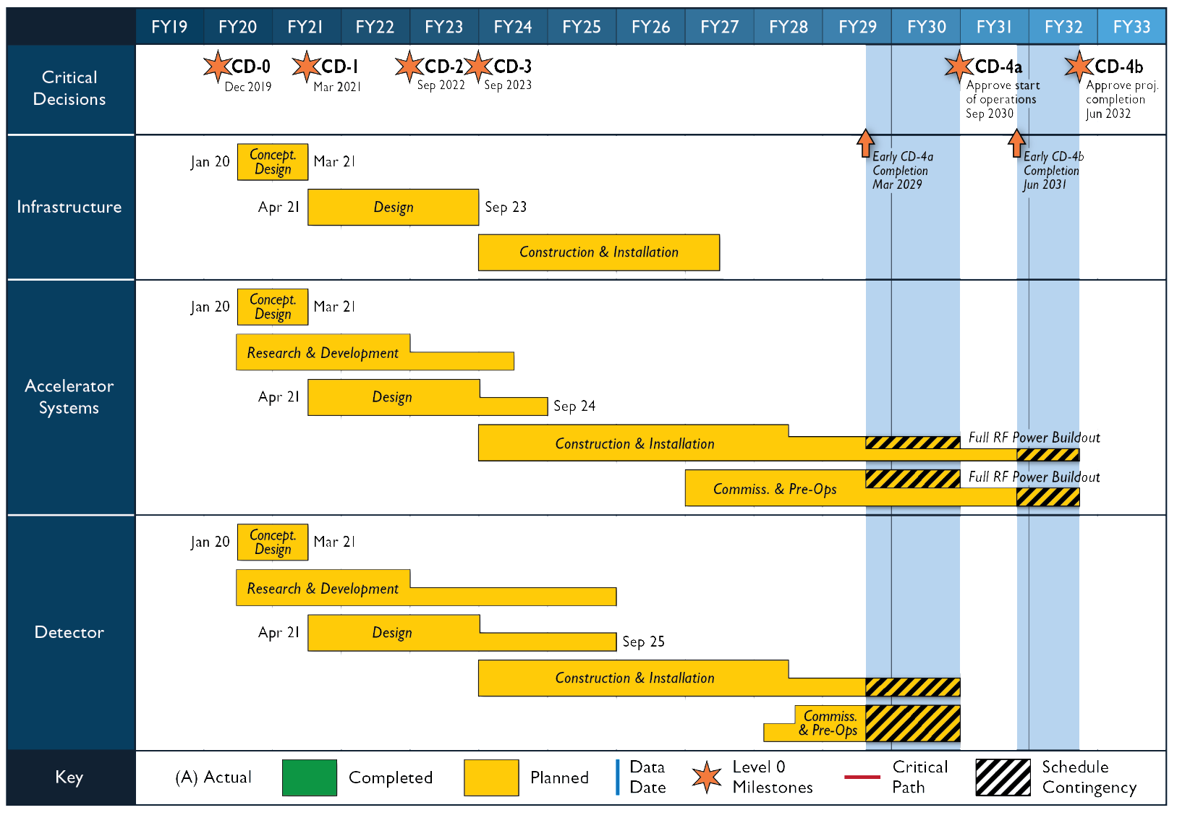
Timeline beyond Expression of Interest
March 2021:
Issue Call for Detector
Proposals
September 2021:
Deadline for Proposals
December 2021:
Selection of Detector(s)
Evaluation Committee:
Project management team
Lab management
Members of the User Group
Advise from DAC

Slide 9

Expression of Interest Timeline
(non-binding) Expressions of Interest (EoI) to get guidance on detector scope
Introduce concept and timeline for Call for Expressions of Interest March 2020
(introduce notion for Expressions of Interest for contribution to EIC
detectors in plenary talks at 1stYellow Report (remote) meeting at Temple)
Discussion Call for EoI for potential cooperation to EIC Detectors
initial discussion session at Remote EICUGM April 23 2020
final discussion at 2nd Yellow Report meeting at Pavia May 20 2020
Call for EoI for potential cooperation to EIC Detectors May 31 2020
(issue call after folding in feedback of EICUG)
Deadline EoI for potential cooperation to EIC Detectors November 1 2020
Status report at 4th (final) Yellow Report meeting at UCB/LBL November 19-21 2020
(Request for discussion session at 4th Yellow Report meeting
on 2nd IR ideas based on YR and Accelerator Task Force status)
Evaluate EoI and inform Call for Detector Proposal(s) February 2021
(complete after assumed January 2021 Yellow Report
completion, EoI can give guidance on detector scope)

Slide 10
Timeline beyond Expression of Interest
Assumption: CD-1 aligned with accelerator timeline
Goal: CD-2 & CD-3 also aligned!
  Request Topical week-long workshop on 2nd IR early February 2021 (accelerator discussion and science discussion on 2nd IR goal and needs
  such that we can potentially integrate in Call for Detector Proposals)
Form EIC Collaboration(s)
  Issue Call for Detector Proposals March 2021
  (consistent with EICUGM assumptions of early 2021)
  Deadline for Proposals September 2021
  (roughly in phase with projected CD-1 date)
  Detector Advisory Committee Meeting November 2021
    (to guide work in TEC phase)
  Selection of Detector(s) December 2021
  (one or two, pending Expression of Interest response)
  CD-2 September 2022
  CD-3 September 2023
  (CD-2 and CD-3 dates assumed for planning purposes)
Note: time to complete >80% of the full engineering & design for detector at CD-3 is tight, so we need to keep the YR efforts in motion for completion in January

Slide 11
Potential EoIs
one EoI describing BNLs unique facilities (IO, CFN, HEP……) → upper management
Several groups already show interest for collaboration to form consortia
  Polarimetry both hadron (BNL leading) and lepton (BNL collaborating)
    technical very challenging
  very forward detectors along outgoing lepton beam (BNL collaborating)
    calorimetry combined with Si-tracking will be key
  very forward detectors along outgoing hadron beam (BNL leading)
    silicon tracking high resolution and high timing
  Streaming DAQ (BNL+JLAB+……)
  electromagnetic and hadronic Calorimetry in hadron endcap combined with a ToF-preshower-tracker (BNL leading)
    also addressed in current strategy document
  MAPS tracker (BNL-IO partner of existing consortium)
  Software consortium (BNL is partnering)
  and …………
how to integrate operational experience, i.e TPC, integration, ….. into the EoI

Slide 12


Slide 13
Further detector (and IR!) planning
The EIC is capable of supporting a science program that includes two detectors and two interaction regions.
Dedicated Meetings: Dedicated session(s) on 2nd IR during YR Meeting November 2020
Topical week-long workshop on 2nd IR concepts early February 2021
Ground rules:
  • A deliverable of the EIC is the possibility for a 2nd Interaction Region (IR) and detector.
  • Present EIC plans and budgets support only one IR and detector.
  • All stakeholders agree that a second IR and detector within the same timeline is desirable. Routes to make this possible are being explored.
  • The topic of the second detector is investigated by the US/DOE and EIC project in cooperation with the EICUG and may be handled as a separate project.
Ansatz:
Goals and schedule are driven by keeping open a possibility of a 2nd IR from day-one, and how it can be integrated into the EIC Project. If the realization of a 2nd IR would shift to a later time, a time-line to account for this would need to be developed. At this moment it seems the best strategy is to assume realization of the 2nd IR, be it significantly different or similar to the 1st IR, consistent with the EIC project schedule and to revisit the situation in a year from now.

Slide 14
Detector 1 and 2 View
(L2) Detectors
Rolf Ent
Elke Aschenauer
(L3) Detector Management
CAM: BNL & TJ
(L3) Detector R&D
CAM: BNL & TJ
Possible Detector 2 – may be separate project
Detector 1
Detector Subsystems
(L3) EM Calorimetry – CAM: BNL
(L3) Hadronic Calorimetry – CAM: BNL
(L3) Particle Id. Detectors – CAM: TJ
(L3) Tracking Detectors – CAM: TJ
Detector 2 Management
Detector Subsystems
EM Calorimetry
Hadronic Calorimetry
Particle Id. Detectors
Tracking Detectors
(L3) Magnet
CAM: TJ
(L3) Electronics
CAM: TJ
Magnets
(L3) DAQ/Computing
CAM: BNL & TJ
Electronics
(L3) Detector Infrastructure
CAM: BNL
DAQ/Computing
(L3) IR Integration + anc. detectors
CAM: TJ
Detector Infrastructure
(L3) Detector Pre-Ops
CAM: BNL
IR Integration + ancillary detectors
(L3) Detector 2 Development
Elke Aschenauer
Rolf Ent
(L3) Detector 2 Development
Elke Aschenauer
Rolf Ent

Slide 15
Collaboration View
(L2) Detectors
Rolf Ent
Elke Aschenauer
Present thinking
Detector 1:
Fold in users/collaborators as
L3/L4 point of contacts?
L3/L4/L5 owners?
L4/L5 CAMs?
Example for EM calorimetry:
(L4) Forward EM calorimetry
  (L5) will e.g. be readout, blocks/crystals, integration/cooling, etc.
(L4) Central EM calorimetry
(L4) Backward EM calorimetry
Detector 2:
If a standalone project, this will/can have a separate management structure, users/collaborators can be owners and can be CAMs.
(L3) Detector Management
CAM: BNL & TJ
(L3) Detector R&D
CAM: BNL & TJ
Possible Detector 2 – may be separate project
Detector 1
Detector Subsystems
(L3) EM Calorimetry – CAM: BNL
(L3) Hadronic Calorimetry – CAM: BNL
(L3) Particle Id. Detectors – CAM: TJ
(L3) Tracking Detectors – CAM: TJ
Detector 2 Management
Detector Subsystems
EM Calorimetry
Hadronic Calorimetry
Particle Id. Detectors
Tracking Detectors
(L3) Magnet
CAM: TJ
(L3) Electronics
CAM: TJ
Magnets
(L3) DAQ/Computing
CAM: BNL & TJ
Electronics
(L3) Detector Infrastructure
CAM: BNL
DAQ/Computing
(L3) IR Integration + anc. detectors
CAM: TJ
Detector Infrastructure
(L3) Detector Pre-Ops
CAM: BNL
IR Integration + ancillary detectors
(L3) Detector 2 Development
Elke Aschenauer
Rolf Ent

Slide 16
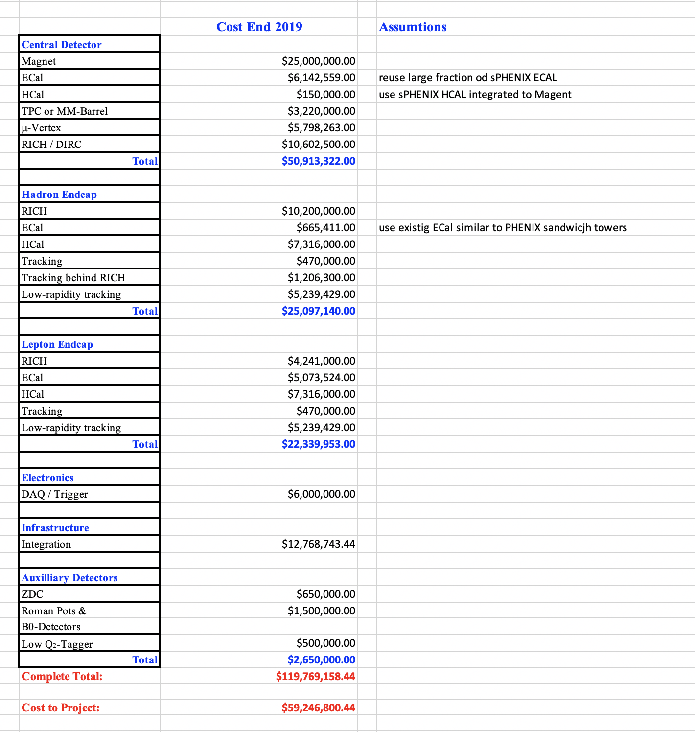
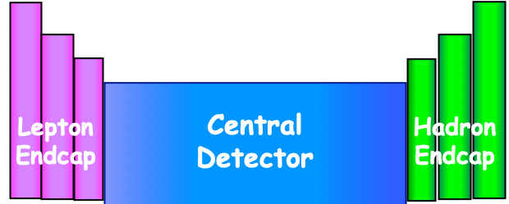
6.10 - EIC Detector Cost
Estimated 315 FTEs
over a period of 9 years
amounts to $88 M using BNL
labor bands
Costbook assumptions:
reuse existing equipment:
ECal towers in Hadron Arm
HCal towers in Central Det.
Some ECal towers in Central Det.
Existing Solenoid
Further in-kind contributions:
in the order of $35M

Slide 17
Detector Advisory Committee (DAC)
International Committee being assembled now
  Committee composition: geographically (USA: 5, Europe: 4, Asia: 1 Canada: 1, South America: 1 ) and gender diverse (5 females, 7 males)
12 members, as follows
  EIC science and general: (2) E. Kinney (Chair), Ewa Rondio
  Global integration (1): W. Riegler
  Detector integration (1): G. Rakness
  Particle identification (2): P. Krizian, A.A. Machado
  Computing (1): H. Schellman
  Electronics (1): B. Vachon
  Calorimetry (2): G. Young, E. Auffray (TBC)
  Tracking (2): A. White, Ch. Yang
Ex-officio: Chair and Vice-chair of EICUGM Steering Committee
Ex-officio: Chair and coordinator of generic EIC detector R&D program
First meeting is planned for early October 2020. The goal for that initial meeting is to bring the DAC up to speed and prepare them for upcoming charges, e.g., related to input on the evaluation of the EoI.

Slide 18
Detector R&D White Paper
This came about as a response an action item from this meeting to think of how to manage R&D.
Submitted to DOE ONP an detector R&D white paper. It contains a three-tiered system for Detector R&D
  Project R&D – Intended to reduce project risk and meet the cost and schedule milestones for the EIC detector.
  Generic EIC-related R&D – A continuation of the successful program started in 2011. More generic R&D which might influence improvements in performance of the first EIC detector and the second EIC detector.
  General Overall Nuclear Physics Detector R&D - Improves nuclear physics detection techniques over a large range in energies from sub-MeV scale to several tens of GeV, and would impact the longer-term vision for Nuclear Physics.
DOE ONP expressed support for the Detector R&D white paper and planning, although there remain uncertainties how to fully realize this financially.
For planning, EIC assumes a hybrid detector R&D program of Project R&D and generic EIC-related detector R&D.

Slide 19

Governance Structure
Started discussion on “Management Approach to Detectors” with DOE/NP since May 2020, first by canvassing existing models (CERN, DESY, DUNE, KEK).
Defined EIC overarching guidelines
  The EIC is a US-based Project
  The EIC is at the technological and scientific forefront and is of international interest
  With two possible detectors, we should treat both experimental collaborations equal
  We should be welcoming and inclusive to new interested partners
Defined EIC principles and an initial EIC model
  US pays for all costs to run the accelerator which sets weeks of operations & schedule
  DOE and non-DOE participation in the governance (financing and oversight) of the experimental program including construction, maintenance and operations (M&O), and distributed software and computing.
    The US convenes an international governing body for the oversight
    The governing body meets once per year
  US partially pays for detector M&O and computing costs, as follows:
    M&O for incremental detector systems or detector upgrades to be supported by DOE and non-DOE, discussed at annual governing body meetings
    Common Fund pays M&O for detectors dependent on weeks of beam operations.
    DOE and non-DOE support for distributed software and computing.

Slide 20

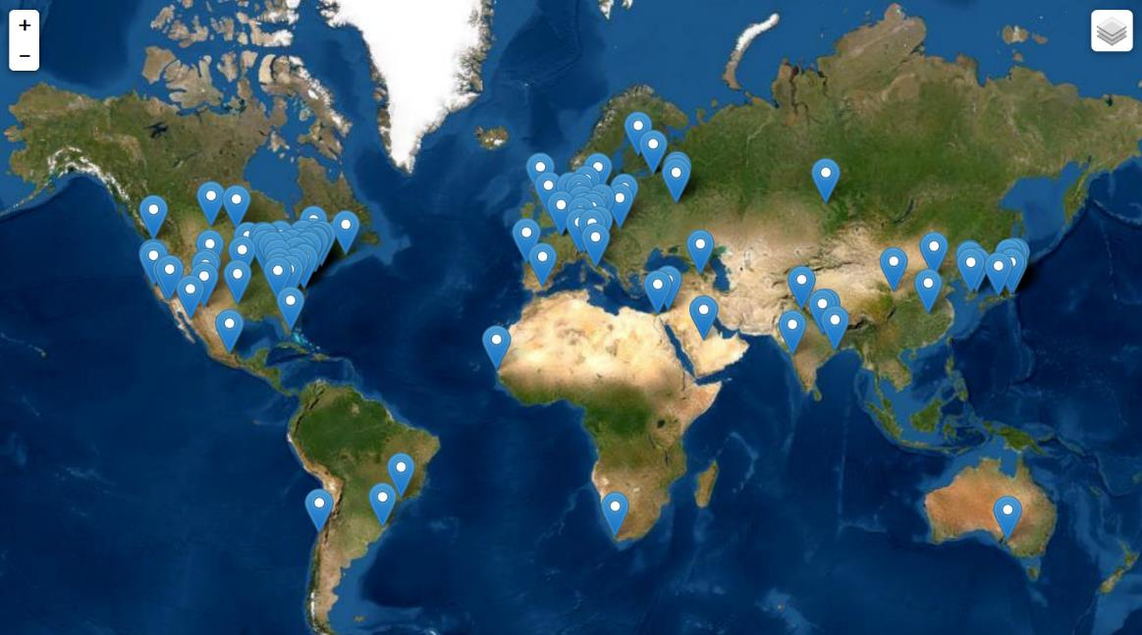
Worldwide Interest in EIC Physics
The EIC Users Group: EICUG.ORG
Formed 2016: 1131 collaborators, 32 countries, 238 institutions as of August 18, 2020
Map of institution’s locations
Annual EICUG meeting
2016 UC Berkeley, CA
2016 Argonne, IL
2017 Trieste, Italy
2018 Washington, DC
2019 Paris, France
2020 Miami, FL
2021 Warsaw, Poland

